Slide 1
Enlightenment and the American Revolution

Slide 2
Definitions
Philosophe:
Member of a group of Enlightenment thinkers who tried to apply the methods of science to the improvement of society
Natural Law:
Rule or law that governs human nature
Natural Right:
Right that belongs to all humans from birth
Enlightenment:
Revolution in thinking. Through the use of reason, people and governments could solve every social, political and economic problem.

Slide 3
The Philosophes
Denis Diderot – put together a collection of the writings of the major philosophes. Was an intellectual “best seller.”
Montesquieu – Described the “perfect” government. Power provided evenly over three branches of government - SEPARATION OF POWERS
a. Legislative – Made laws (Congress)
b. Executive – Administered laws (President, army, etc.)
c. Judicial – Interpreted and applied laws.
(Supreme Court and lesser courts.)
Montesquieu believed each branch should be subject to checks and balances.

Slide 4
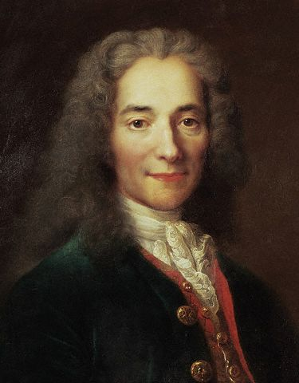
Philosophes, cont.
Voltaire – Used public opinion to fight injustice. “I do not agree with a word you say, but I will fight to the death for your right to say it.” Believed the perfect government needed freedom of speech and of religion.

Slide 5
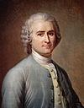
Philosophes, cont.
Rousseau – Wrote the “Social Contract.” Believed that people were born good, but corrupted by the environment, bad government, and laws. He believed the best government used POPULAR SOVEREIGNTY or a vote by all of the people.

Slide 6
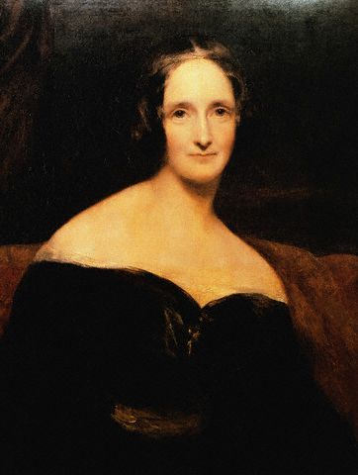
Women and the Enlightenment
“Free and equal” did not apply to women
Mary Wollstonecraft – 1792 – argued in “A Vindication of the Rights of Woman,” that a woman should be able to decide what was in her own best interest – not her husband or father.

Slide 7
Growth of Constitutional Government
Define “constitutional government”
Government whose power is defined and limited by law.
British Constitution = Magna Carta, English Bill of Rights, all Acts of Parliament and unwritten traditions that protect citizens’ rights.
British government not totally democratic.
Oligarchy
Government in which the ruling power belongs to a few people.

Slide 8
Causes of the American Revolution
The 13 English Colonies | Growing Discontent | Early Clashes

Slide 9
Causes of the American Revolution
The 13 English Colonies | Growing Discontent | Early Clashes
Part of British global trade Mercantilist policies Navigation Acts: regulated colonial trade Colonists felt entitled to the rights of English citizens

Slide 10
Causes of the American Revolution
The 13 English Colonies | Growing Discontent | Early Clashes
Part of British global trade Mercantilist policies Navigation Acts: regulated colonial trade Colonists felt entitled to the rights of English citizens | French and Indian War drained British treasury. Britain passed and enforced new tax law on the colonists “No taxation without representation.”

Slide 11
Causes of the American Revolution
The 13 English Colonies | Growing Discontent | Early Clashes
Part of British global trade Mercantilist policies Navigation Acts: regulated colonial trade Colonists felt entitled to the rights of English citizens | French and Indian War drained British treasury. Britain passed and enforced new tax law on the colonists “No taxation without representation.” | Boston Massacre Boston Tea Party Punitive laws passed by British to punish colonists Continental Congress with representatives from all 13 colonies

Slide 12
Underlying Causes of the American Revolution
Growing sense of colonial military security
Distance between the government and the governed
Misunderstandings
Horrible misjudgments by British government
Longstanding resentments of mercantilist policy
The “American Character”

Slide 13
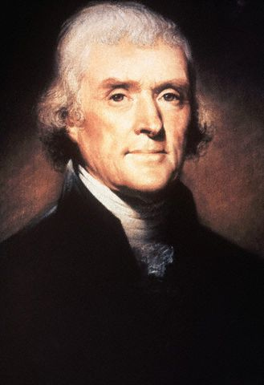
Declaration of Independence
Drafted by Thomas Jefferson
People had the right to “alter or abolish unjust governments.”
Popular sovereignty
All government power comes from the people
King had trampled the peoples’ natural rights.
Colonists now had the right to rebel

Slide 14
The Articles of Confederation
Loose association of states
Unicameral Congress; no executive or judicial branches
Could make money, treaties with Indians
Can establish treaties, post office, and currency
Equal representation - each state one vote
Many weaknesses

Slide 15
The Constitution
Used ideas of Locke, Montesquieu, Rousseau and Voltaire
Created a Federal Republic
Government in which power is divided between the national, or federal government, and the states
Separation of powers
Bill of Rights added later.
Federalist Papers – Writing campaign to convince American citizens to ratify the new Constitution
First President: George Washington.

Slide 16
Separation
Of Powers
Gov’t’s power
comes
from the people
People have natural
rights to life,
liberty and property
Checks
& Balances
Enlightenment Ideas
Checks &
Balances
US Constitution
Guaranteed
Individual Rights
Gov’t’s
authority
comes from people
Separation of
three
branches
of gov’t

