Slide 1
© Morgan AP Teaching
Period 2: 1648 CE – 1815 CE
Enlightened Absolutists

Slide 2
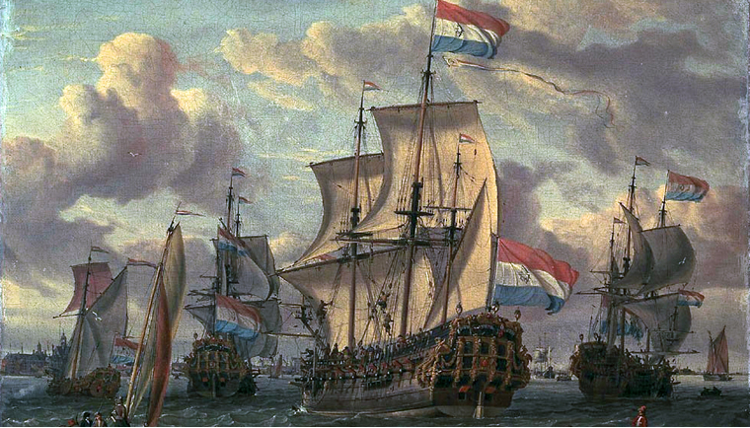
© Morgan AP Teaching
Westernization
With the Spanish, French, Portuguese, Dutch, and English thriving in
Western Europe, many of the Europeans further east began to
take notice
In Central and Eastern Europe, Prussia, Austria, and Russia would
all attempt to become more ‘Western,’ with varying amounts of success
The leaders of these countries would all try different methods and reforms to bring the nobles and finances under their control
At the time, to become more western meant four things:
To make their governments more centralized
To adopt Western economics (commercialization instead of serfdom/peasant agr)
To improve their military structure and technology
To adopt Western culture and ideas, if possible

Slide 3
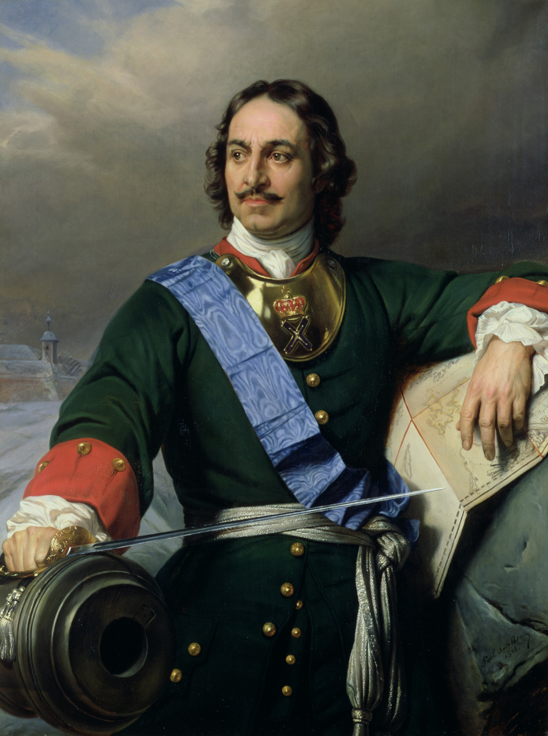
© Morgan AP Teaching
Peter the Great of Russia (1682-1725)
Peter the Great of Russia also followed a western model of reform, however, he rejected Enlightenment ideals in favor of complete control
Much like Louis XIV, Peter the Great had all of the nobles moved to him (this time by force), and forced them to be a part of his government
He reformed his military under the model of the Prussians, using nobles as officers, and vastly expanded Russian territory to the East and against Poland
He also attempted to mimic Louis XIV by building an entire City (St. Petersburg) and the lavish Winter Palace for himself like Louis XIV
Additionally, he used his conquest to open up ports in an attempt to open up trade and commercialization like the West
Lastly, he also established the Russian Academy of Sciences in 1725, meant to expand Russian knowledge and adopt Western science

Slide 4
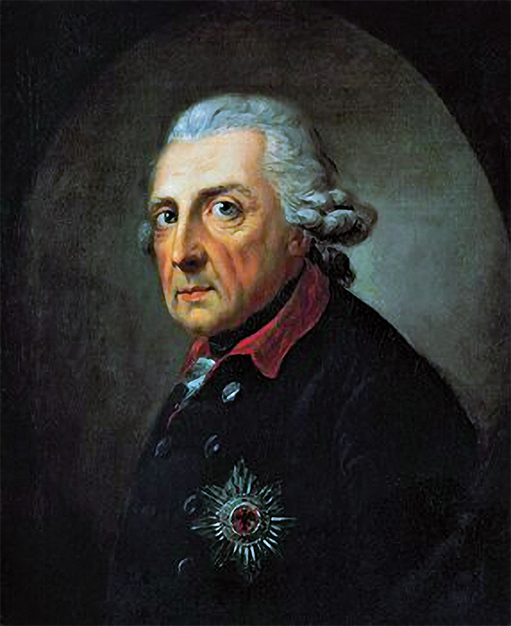
© Morgan AP Teaching
Frederick II of Prussia (1740-1786)
Of the four, Prussia was certainly the most successful at Westernizing under the ‘enlightened monarch’ Frederick the Great
Frederick was an educated individual who read Western literature and was fond of the ideals of the Enlightenment on government and religion
Frederick II believed that while a monarch should have complete control, he should use that power to protect and serve his people (consent of the governed)
Under Frederick I of Prussia, Prussia Westernized in the following ways:
Nobles were used in the central bureaucracy, and able to keep their nobles rights
The military was reformed under the model of the French with appointed officers
He initiated religious toleration in Prussia

Slide 5
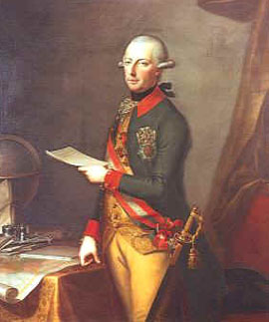
© Morgan AP Teaching
Joseph II (1765-1790)
Another enlightened monarch, Joseph II of Austria, also attempted to westernize, but focused instead on changing laws and education after his mother, Maria Theresa
Maria had tried but failed to centralize the nobles (mostly in Hungary) who refused to cooperate vs. the Ottoman Empire without maintaining their traditional local power
So instead, her son Joseph II made many Enlightenment-inspired changes to the HRE:
He initiated religious toleration in Austria
He started compulsory education for elementary boys
He freed the serfs as peasants had been in the West (didn’t last)
He also reformed the legal system to respect individual rights
Despite failing to reform Austria, Austrian power grew substantially thanks to the conquests of Poland and the Ottoman Empire in South/Eastern Europe

Slide 6
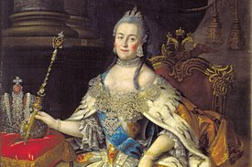
© Morgan AP Teaching
Catherine the Great (1762-1796)
Peter’s successor Catherine the Great continued to bring about reforms
She enhanced education in Russia, and started state school
for women
She patronized Enlightenment art and writers
She began to remove the Eastern Orthodox Church from the
Russian state (sold lands)
Non-Western Aspects
Gave nobles more freedom, and required less gov. participation
She did, however, reinforce serfdom, and made the Russian economy dependent on it
Lastly, she continued to expand Russia to the East, and vs. the decaying Ottoman Empire and Poland

