Slide 1
England The Victorian Era

Slide 2
Britain: 1850-1870s
The most prosperous period in British history.
Unprecedented economic growth.
Heyday of free trade.
New fields of expansion → shipbuilding from wood to iron.
By 1870, Britain’s carrying trade enjoyed a virtual monopoly.
Br. engineers were building RRs all over the world.
Br.’s foreign holdings nearly doubled.
BUT, Britain’s prosperity didn’t do away with political discontent

Slide 3
The “Victorian Compromise”
Both Tories and Whigs had considered the 1832 Reform Bill as the FINAL political reform.
Therefore, the aims of the two political parties seemed indistinguishable.
But, by the 1860s, the middle class and working class had grown → they wanted the franchise expanded!
This era saw the realignment of political parties in the House of Commons:
Tory Party → Conservative Party under Benjamin Disraeli.
Whig Party → Liberal Party under William Gladstone.

Slide 4
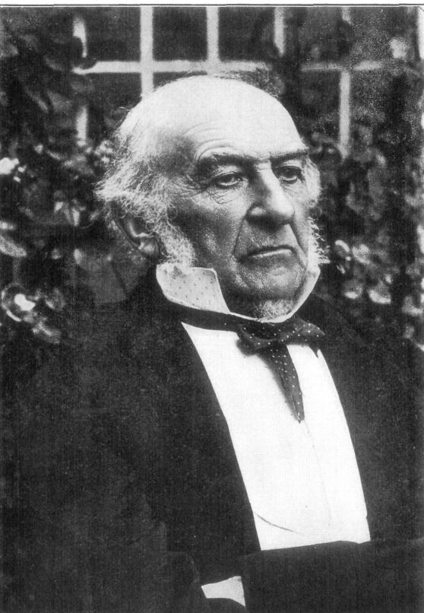
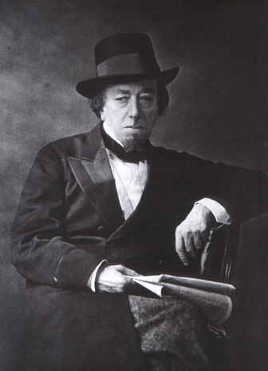
The Two “Great Men”
Benjamin Disraeli, Conservative Prime Minister
1868
1874-1880
William Gladstone, Liberal Prime Minister
1868-1874
1880-1885
1886
1892-1894

Slide 5
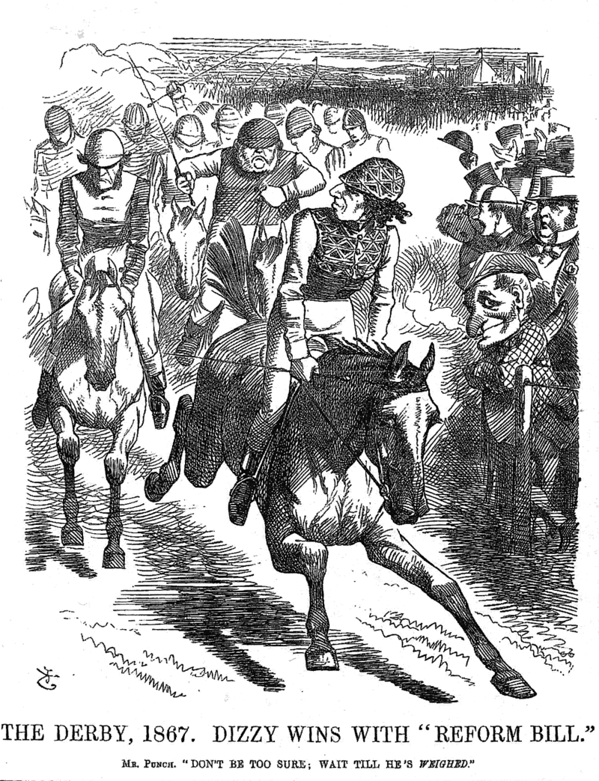
The 2nd Reform Bill - 1867
In 1866, Gladstone introduced a moderate reform bill that was defeated by the Conservatives.
A more radical reform bill was introduced by Disraeli in 1867, passed largely with some Liberal support.

Slide 6
The 2nd Reform Bill - 1867
Disraeli’s Goals:
Give the Conservative Party control over the reform process.
Labor would be grateful and vote Conservative.
Components of the Bill:
Extended the franchise by 938,427 → an increase of 88%.
Vote given to male householders and male lodgers paying at least £10 for room.
Eliminated rotten boroughs with fewer than 10,000 inhabitants.
Extra representation in Parliament to larger cities like Liverpool & Manchester.
This ended the “Victorian Compromise.”

Slide 7
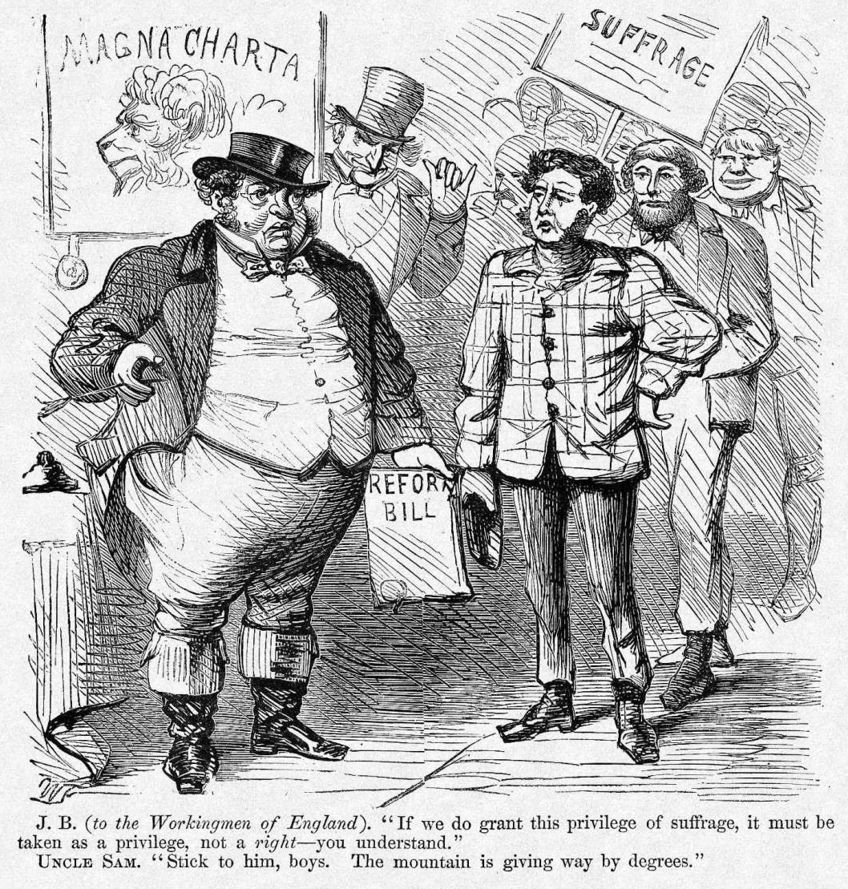
The 2nd Reform Bill - 1867

Slide 8
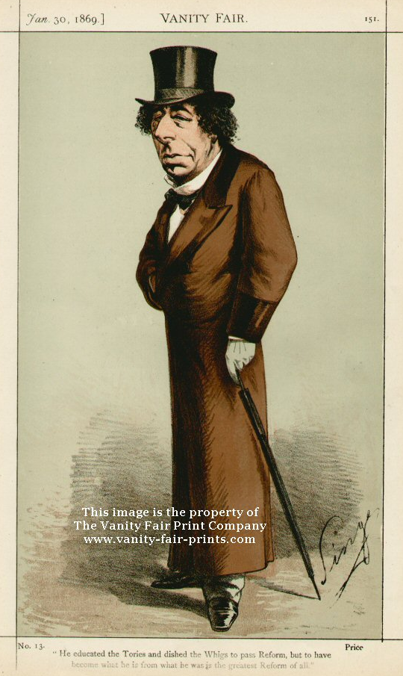
Benjamin Disraeli (1804-1881)
A dandy and a romance novelist.
A brilliant debater.
Baptized by his father into the Anglican Church.
BUT, he was the first & only Prime Minister of Jewish parentage.
A strong imperialist.
“Greater England” foreign policy.
Respected by Queen Victoria.

Slide 9
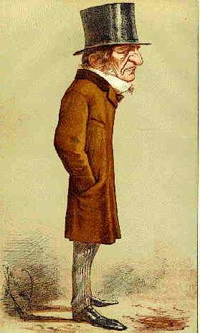
William Gladstone (1809-1898)
An active legislator and reformer.
Known for his populist speeches.
Could be preachy.
Queen Victoria couldn’t stand him.
Tried to deal with the “Irish Question.”
Supported a “Little England” foreign policy.

Slide 10
Gladstone’s 1st Ministry
Goals: [“Gladstonianism”]
Decrease public spending.
Reform laws that prevented people from acting freely to improve themselves.
He’s against privilege & supports a meritocracy.
Protect democracy through education.
Promote peace abroad to help reduce spending and taxation, and to help enhance trade.
Low tariffs.
All political questions are moral questions!

Slide 11
Gladstone’s 1st Ministry
Accomplishments:
1868: Army reform → peacetime flogging was illegal.
1869: Disestablishment Act → Irish Catholics did not have to pay taxes to support the Anglican Church in Ireland.
1870: Education Act → elementary education made available to Welsh & English children between 5-13 years.
1870: Irish Land Act → curtailed absentee Protestant landowners from evicting their Irish Catholic tenants without compensation.
1871: University Test Act → non-Anglicans could attend Br. universities.

Slide 12
Gladstone’s 1st Ministry
Accomplishments (con’t.):
1872: Ballot Act → secret ballot for local and general elections.
1872: The settlement of the CSS Alabama claims [from the American Civil War] in America’s favor.
1873: Legislation was passed that restructured the High Courts.
Civil service exams introduced for many government positions.

Slide 13
Disraeli’s 2nd Ministry
Accomplishments:
Domestic Policy
1875: Artisans Dwelling Act → govt. would define minimum housing standards.
1875: Public Health Act → govt. to create a modern sewer system in the big cities & establish a sanitary code.
1875: Pure Food & Drug Act.
1875: Climbing Boys Act → licenses only given to adult chimney sweeps.
1875: Conspiracy & Protection of Property Act → allowed peaceful picketing.

Slide 14
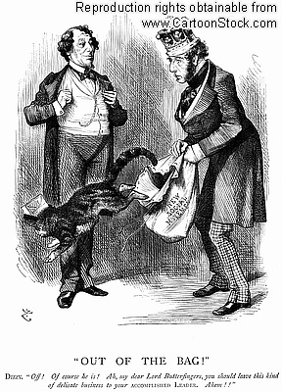
Disraeli’s 2nd Ministry
Accomplishments:
Domestic Policy
1876: Education Act
1878: Employers & Workmen Act → allowed workers to sue employers in civil courts if they broke legal contracts.

Slide 15
Gladstone’s 2nd Ministry
Accomplishments:
Domestic Policy
1884 Reform Bill
Extended the franchise to agricultural laborers.
Gave the counties the same franchise as the boroughs.
Added 6,000,000 to the total number who could vote in parliamentary elections.
1885: Redistribution of Seats Act → changes M.P. seats in Commons to reflect new demographic changes.

Slide 16
Gladstone’s Last Ministries
3rd Ministry: 1886
First introduced an Irish Home Rule Bill.
This issue split the Liberal Party.
Gladstone lost his position in a few months.
4th Ministry: 1892-1894
1893: Reintroduced a Home Rule Bill.
Provided for an Irish Parliament.
Did NOT offer Ireland independence!
Passed by the Commons, but rejected in the House of Lords.

Slide 17
Home Rule for Ireland??
Gladstone debates Home Rule in Commons.

Slide 18
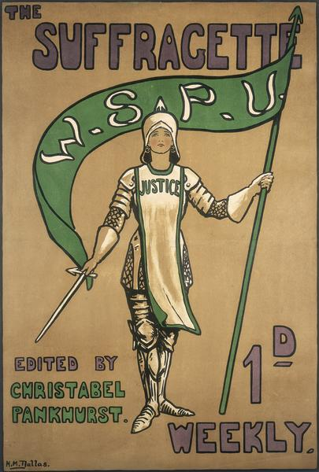
Women’s Social & Political Union [W.S.P.U.]

Slide 19
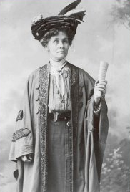
Emmeline Pankhurst
1858-1928.
Her husband & children were all involved in the suffrage movement.
They became militants & were arrested and imprisoned.
1917: She and her daughter, Christabel, formed the Women’s Party in 1917:
Equal pay for equal work.
Equal marriage & divorce laws.
Equality of rights & opportunities in public service.
A national system of maternity benefits.

Slide 20
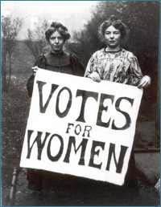
Representation of the People Act (1918)
Women over 30 got the right to vote.
All men gained suffrage.
Property qualifications were completely eliminated!
Reform Act of 1928
Women over 21 years of age gained the right to vote at last!

Slide 21
Victorian England:
Foreign Policy

Slide 22
The Foreign Policy Debate
“Little England” Policy
“Big England” Policy
Gladstone.
Liberal Party.
England must invest in her own people at home.
Try negotiations, rather than costly military solutions.
Disraeli
Conservative Party
England must be the greatest colonial power.
Spend £ on supporting the empire.

Slide 23
Victorian England:
Foreign Policy Issues

Slide 24
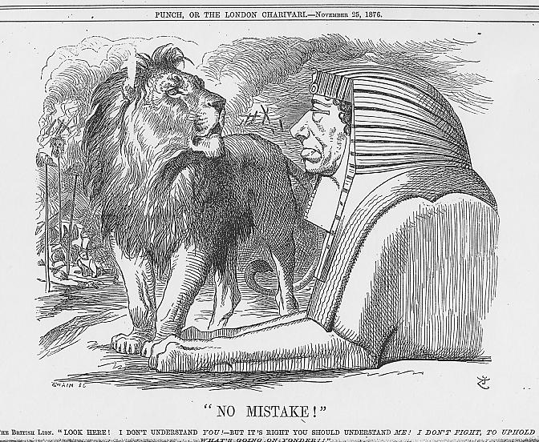
1. “Scramble for Africa”
1869: Disraeli pushed for the completion of the Suez Canal.

Slide 25
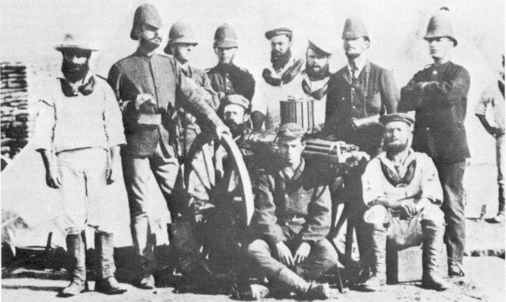
1. “Scramble for Africa”
Gladstone opposed the “Mad Scramble.”
1880-1881: First Boer War in South Africa [Gladstone].

Slide 26
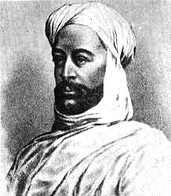
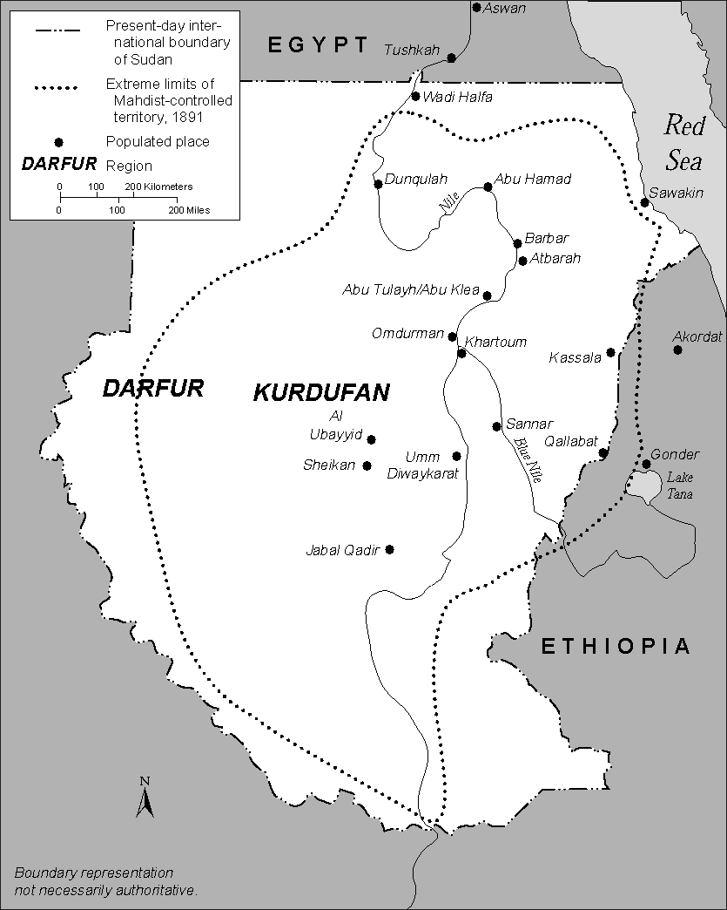
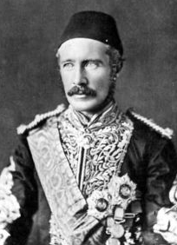
1. “Scramble for Africa”
1884-1885: Mahdi uprising in the Sudan [Gladstone].
Muhammad Ahmad “al-Mahdi”
Charles Gordon “Pasha”

Slide 27
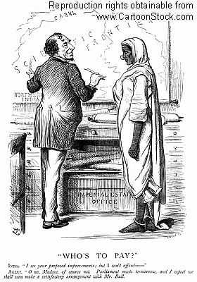
2. Middle East
1878-1880: Second Anglo-Afghan War

Slide 28
Congress of Berlin (1878)
Purpose → Great Powers & Ottomans met to settle issues from the Russo-Turkish War.
Disraeli represented England.
Notes:
The Congress of Berlin (13 June – 13 July 1878) was a meeting of the representatives of the Great Powers of the time (Russia, Great Britain, France, Austria-Hungary, Italy, Germany and the Ottoman Empire) and four Balkan states (Greece, Serbia, Romania and Montenegro), aiming at determining the territories of the states in the Balkan peninsula following the Russo-Turkish War of 1877–78. The Congress came to an end with the signing of the Treaty of Berlin, which replaced the preliminary Treaty of San Stefano signed three months earlier between Russia and the Ottoman Empire.

Slide 29
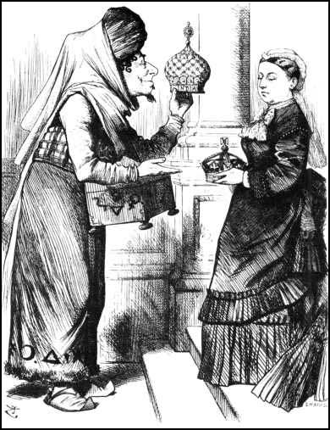
3. India: The British Raj
The new “Empress of India” receiving the “Jewel in the Crown” of her Empire.

Slide 30
Britain Is Everywhere!
Notes:
This political cartoon represents Britain as an octopus, with its arms on many different countries and regions, such as India, Canada, Egypt, and Boersland. The artist makes the face on John Bull represent Britain as greedy and selfish. John Bull is a national personification of the United Kingdom in general and England in particular, especially in political cartoons and similar graphic works. He is usually depicted as a stout, middle-aged, country dwelling, jolly, matter-of-fact man. Boersland - South Africa

Slide 31
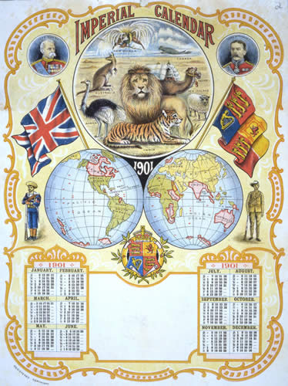
The Sun Never Sets on the British Empire

Slide 32
England’s Economic Decline? (1870s-1914)
Germany & the U. S. became England’s chief economic rivals.
Influx of cheap agricultural products from overseas caused a rapid decline in British farming.
Germany & U. S. overtake Britain in basic iron & steel production.
England’s share of world trade fell from 23% in 1876 to 15% in 1913.
British science & technological education lagged behind Germany.
England is slow to modernize her aging industrial infrastructure.
England clings to free trade while everyone else is erecting tariff walls.

Slide 33
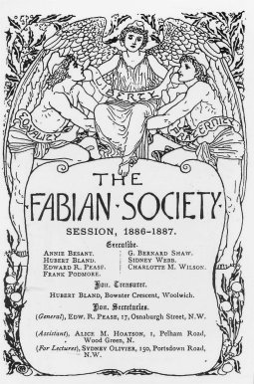
Fabianism
A British socialist intellectual movement founded in the mid-1880s.
Purpose → advance socialism by working through the political system, not through revolution.
Laid the foundations for the British Labour Party.
Famous Fabian Society members:
George Bernard Shaw.
H. G. Wells.
Sidney & Beatrice Webb.
Emmeline Pankhurst.
Bertram Russell.
John Maynard Keynes.

Slide 34
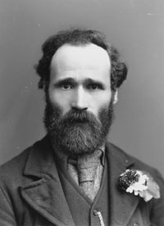
The British Labour Party
Founded in 1900 by the Scotsman, Keir Hardie.
The growth of labor unions gave voice to socialism in Britain.
By 1906, it won 26 seats in Commons.
Had to form a political coalition with the Liberal Party.
By the 1920s, Labour would replace the Liberals as on of the two major British political parties.

Slide 35
The Beginnings of the “Welfare State”?
Labour’s Political Agenda:
Gradual socialization of key industries & utilities.
Workman’s Compensation Act.
State employment bureaus.
Minimum wage set.
Aid to dependent children & the elderly.
Old age pension to all over 70.
National Insurance Act.
How to pay for all of this??

Slide 36
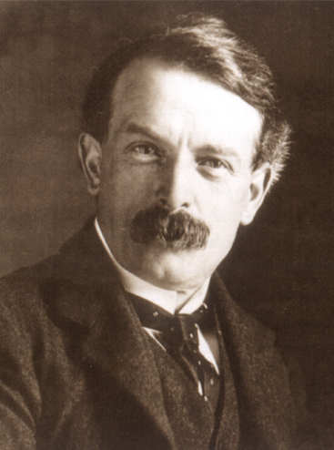
The “People’s Budget”
The Liberals dominated government from 1906 to 1924.
The Liberal Chancellor of the Exchequer, David Lloyd George, presented a “People’s Budget” in 1911.
Increase income taxes for those in the higher brackets.
Raise the inheritance tax.
The House of Lords rejected this budget.

Slide 37
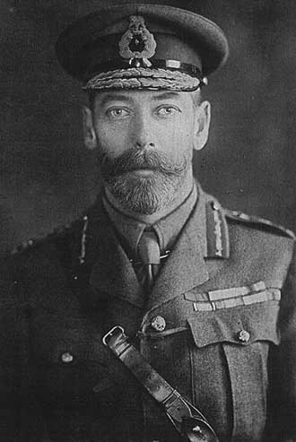
The Parliament Act of 1911
A political crisis.
WHY? → Lords had traditionally approved all revenue bills passed by the Commons in the past.
By threatening to create enough new Liberal peers to control that chamber, King George V forced the House of Lords to pass this bill
Also known as the 4th Reform Bill.
Provisions:
Lords could not defeat a bill passed three times by Commons.
Lords can’t hold up revenue bills for more than one month.
Members of Commons would be paid a salary.

