Slide 1
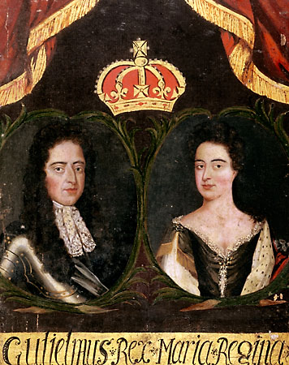
England’s Glorious Revolution
How did England become a constitutional monarchy?
William of Orange
Mary II

Slide 2
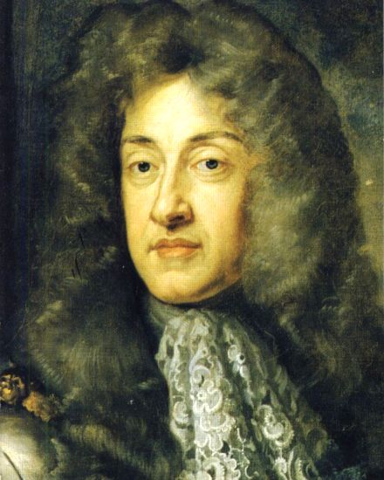
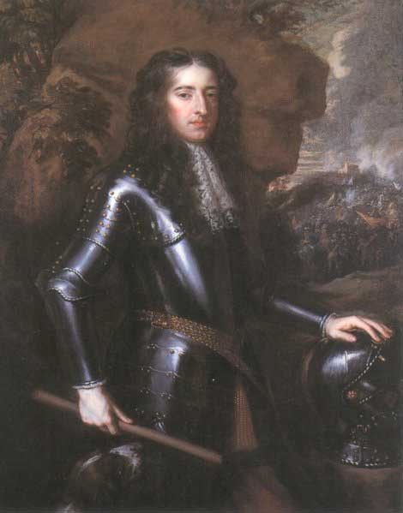
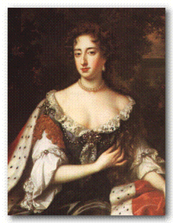
The Glorious Revolution
After Charles II dies, his brother James II becomes king
James had a daughter Mary II, who was Protestant
James II began offending many English citizens by displaying Catholic symbols and promoting Catholics in Govt.
When Parliament protested, he dismissed Parliament
James II
• Members of Parliament approached Mary & her husband about overthrowing her father
• William agreed and led his army into London
Instead of fighting, James II fled for France
William & Mary
• The “bloodless” overthrow of James II is called the Glorious Revolution

Slide 3
The Constitutional Monarchy
William & Mary promised to make Parliament an equal partner
Parliament drafted the English Bill of Rights, which did the following:
1) Monarch cannot suspend Parliament
2) Monarch can’t tax without Parliament’s consent
3) Monarch cannot interfere with free speech
4) No penalties for people who have grievances against the monarch
William & Mary agreed to these and other limits to their power
As a result England became a Constitutional Monarchy
Overtime, the Parliament & Monarchs did disagree
So a cabinet system was put into place as a link between the monarch and the Parliament
The leader of the cabinet & parliament is the Prime Minister

