Slide 1
The Directory
The End is the Beginning
Notes:
Special Fonts:
Biblo Display
Black Chancery
DavysOtherWingdings
Edwardian Script ITC

Slide 2
The “Thermidorian Reaction”
Curtailed the power of the Committee for Public Safety.
Closed the Jacobin Clubs.
Churches were reopened.
1795 → freedom of worship
Economic restrictions were lifted in favor of laissez-faire policies.
August, 1795 → a new Constitution is written
more conservative republicanism.

Slide 3
Characteristics of the Directory
The Law of 22 Prairial was revoked.
People involved in the original Terror were now attacked → “White” Terror
Inflation continues.
Rule by rich bourgeois liberals.
Self-indulgence → frivolous culture; salons return; wild fashions.
Political corruption.
Revival of Catholicism.

Slide 4
The Government Structure of the New Directory
5-man executive committee or oligarchy [to avoid a dictatorship].
Tried to avoid the dangers of a one-house legislature.
Council of 500 → initiates legislation.
Council of Elders [250 members] → married or widowed males over 40 years of age.
They accepted or rejected the legislation.
Both houses elected by electors who owned or rented property worth 100-200 days’ labor [limited to 30,000 voters].
The electors were elected by all males over 21 who were taxpayers.

Slide 5
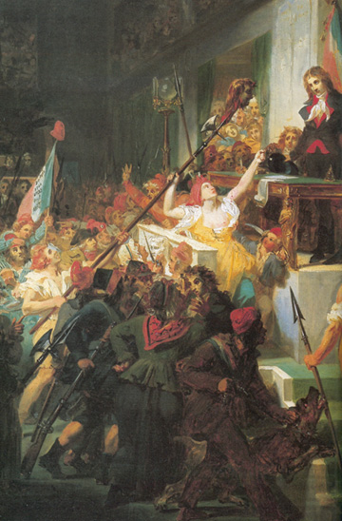
Political Instability: 1795-1796
April, 1795 → Inflation; bread riots.
May 20, 1795 → Revolt of Prairial [Year III]
October, 1795 :
Vendée and Brittany revolted.
Military suppressed them.

Slide 6
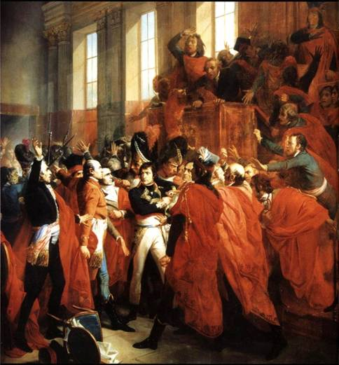
18 Brumaire (Nov. 9, 1799)
Coup d’état by Napoleon.
Approved by a plebiscite in December.
Abbe Sieyès: Confidence from below; authority from above.

Slide 7
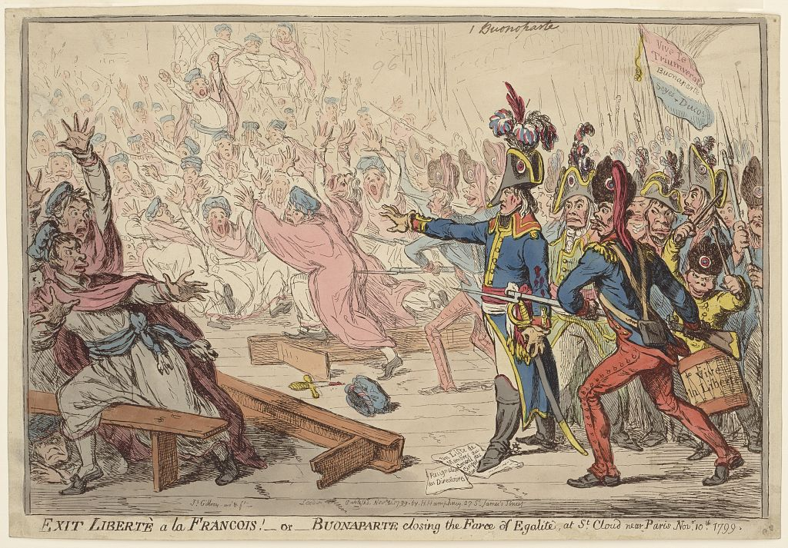
A British Cartoon about Napoleon’s Coup in 1799

