Slide 1
Industrial Revolution Philosophers
New economic ideas.

Slide 2
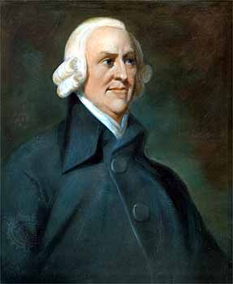
Laissez – Faire Economics
Laissez – faire means letting the owners of businesses set working conditions without interference from the government.
This idea originally came from the Enlightenment, but Adam Smith built on the idea.
Smith believed that government regulations, like taxes interfered with the production of wealth.

Slide 3
Malthus, Ricardo, and Capitalism!
Thomas Malthus and David Ricardo agreed with Smith’s ideas.
They took Smith’s ideas further which led to modern day capitalism a system in which money is invested in business ventures with the goal of making a profit.

Slide 4
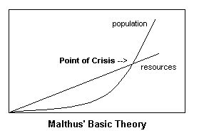
Malthus Further
Malthus argued that population tended to increase more than food supply. This would lead to a group of poor people, who would remain poor.
Without wars and epidemics to kill off people the population would jump rapidly, creating a bigger gap between the rich and the poor.
The poor people would continually get poorer and more miserable.

Slide 5
Ricardo Further
Like Malthus, Ricardo believed there would always be a permanent underclass of poor people.
Ricardo argued in a market (capitalist) system there are many workers, and lots of resources, that means labor and resources will be cheap.
Ricardo said as the population increased the wages would be forced down, since there are more workers. This means the poor would keep getting poorer.

Slide 6
Ricardo’s Theory

Slide 7
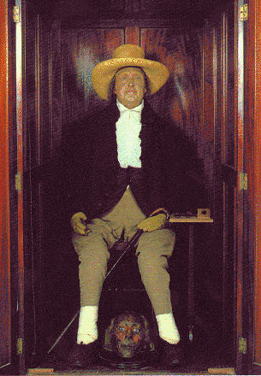
Utilitarianism
Jeremy Bentham introduced the idea of utilitarianism which said people should judge businesses, workers, and actions by their utility (usefulness).
He thought the goal of the government was to do what is best for the greatest number of people.
Many Utilitarians wanted reforms to the legal system and schools.

Slide 8
Utopian Ideas
Robert Owen was a factory owner who was shocked by the horrible conditions.
He improved working conditions for his employees such as not allowing children under 10 to work, and providing free schooling.
Owen came to the US to spread his ideas. Although his factory in the US wasn’t successful his ideas did spread.

Slide 9
Socialism
French reformers wanted to balance the effects of industrialization with socialism in which the factors of production are owned by the public and operate for the welfare of all.
What that means is the government owns the resources that businesses needed for industrialization.

Slide 10
Socialism Further
The basic belief behind socialism was that the government should actively plan the economy rather than letting the market determine what will happen.
Socialists believed if the government controlled and regulated resources, factories, and other key industries that poverty could be abolished, and equality would be promoted.
Socialists had a positive view of people and the future.

Slide 11
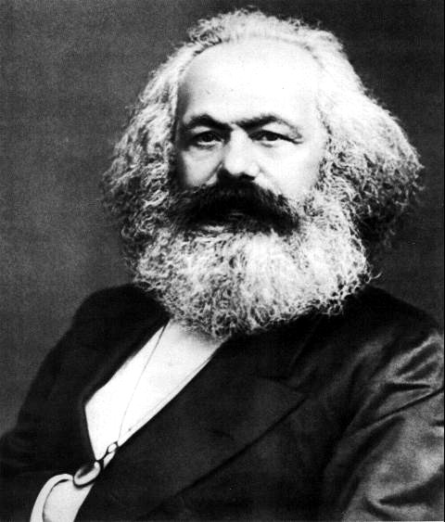
Communism
Karl Marx believed that communism a form of complete socialism in which all means of production (land, mines, factories, railroads, and businesses) would be owned by the people/government.
Under communism there would be no private property and everything is shared.

Slide 12
Communism Further
Marx believed economics to be the cause of every problem in society.
Marx believed there were two types of people: bourgeoisie or the proletariat.
In his book The Communist Manifesto Marx said the bourgeoisie were the people that had everything they needed and held down the proletariat who were the have-nots. The wealthy controlled the means of production and help the poor down.
Marx believed the capitalist system produced by the Industrial Revolution would eventually destroy itself and communism would spread.
Marx’s ideas inspired many attempted revolutions throughout Europe in 1848 – 1849 that were put down by European leaders.
Despite these failures Marx’s idea continued to spread . . .

Slide 13
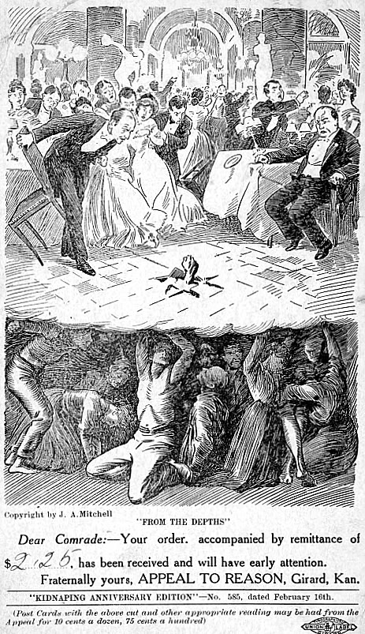

Slide 14
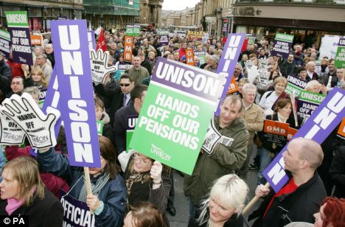
Rise of Unions
Workers joined unions or voluntary trade associations to make reforms.
Unions used collective bargaining and strikes to accomplish their goals.

