Slide 1
Economics of the
Industrial Revolution

Slide 2
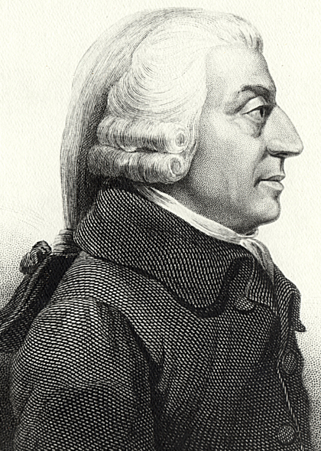
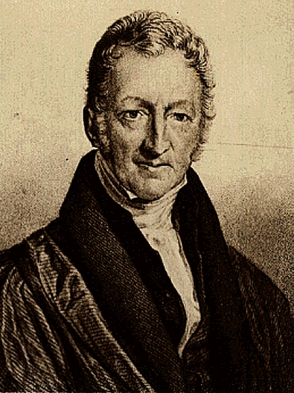
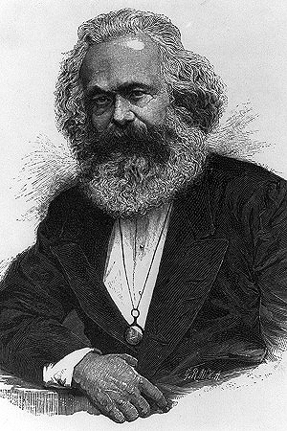
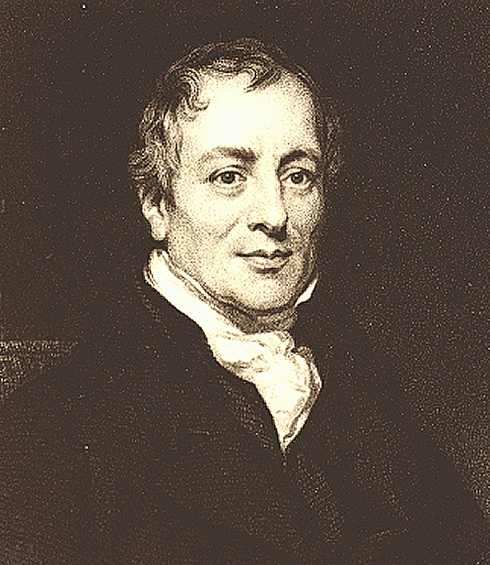
What We Will
Learn Today:
Who was Adam Smith, and what is laissez faire?
Who was Malthus, and what was his view on population growth?
What is Ricardo’s “iron law of wages?”
What is socialism, and how does it differ from Marx’s communism?
Smith
Malthus
Marx
Ricardo

Slide 3
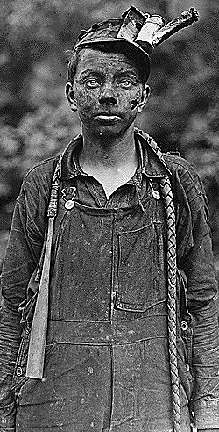
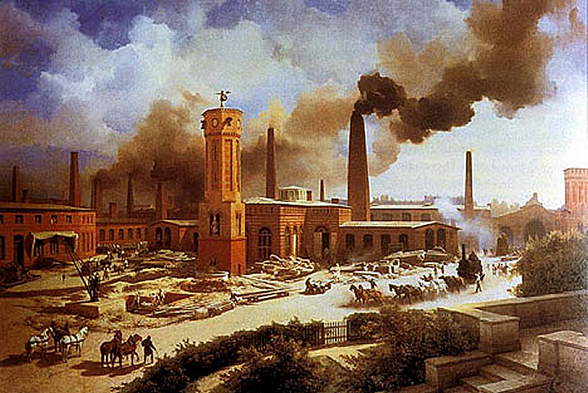
The problems caused by the Industrial Revolution caused many to look for solutions. While some believed the market would eventually fix the problems, others believed there should be a change in government.

Slide 4
Laissez-Faire Economics
Adam Smith
In his book The Wealth of Nations, British economist Adam Smith promoted “laissez faire” capitalism, which became the leading economic system during the Industrial Revolution.
Capitalism – economic system in which the means of production are privately owned and operated for profit.
Laissez Faire (hands off) – policy allowing businesses to operate with little or no government interference.
Smith

Slide 5
Private Ownership
Profit Motive
Capitalism
Free Enterprise
Market Economy
Competition

Slide 6
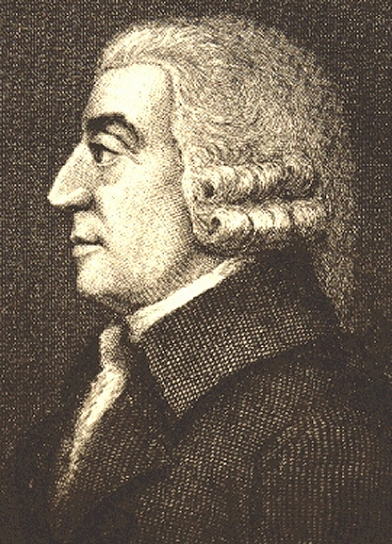
Laissez-Faire Economics
Adam Smith
Smith argued that the free market forces of supply and demand would produce more goods at lower prices, and encourage capitalists to invest their money in new ideas.
Smith claimed that the “invisible hand” of capitalism led individuals who worked for their own good to actually promote the good of the entire community.
Adam Smith is known as the father of economics.
Smith

Slide 7
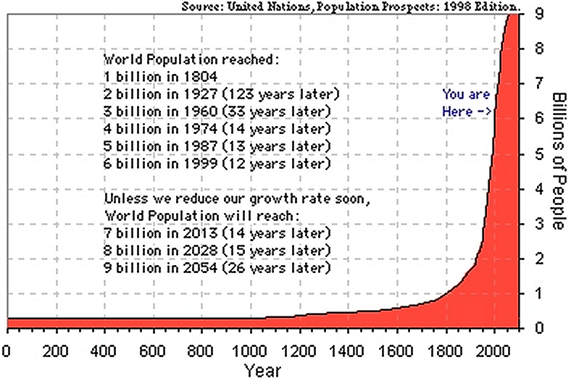
Laissez-Faire Economics
Thomas Malthus
In his 1798 Essay on the Principle of Population, Malthus predicted that population growth would outpace food supply.
Malthus

Slide 8
Laissez-Faire Economics
Thomas Malthus
Malthus warned that the poor would suffer from starvation, and the only option was for people to have fewer children.
Malthus

Slide 9
Laissez-Faire Economics
Thomas Malthus
Malthus’ predictions did not come true because food supply grew even faster than population.
Malthus

Slide 10
Laissez-Faire Economics
David Ricardo
British economist David Ricardo agreed with Malthus that the poor were having too many children.
Ricardo’s “iron law of wages” stated that population and wages are connected and go through a cycle:
When wages are high families have more children
When wages are low families have less children
Ricardo

Slide 11
David Ricardo’s Iron Law of Wages
High Wages →
Workers have more Children
Shortage of Workers → Higher Wages
Surplus of Workers → Lower Wages
Lower Wages →
Workers have fewer Children

Slide 12
Laissez-Faire Economics
David Ricardo
Like Malthus, Ricardo believed that laissez faire was the best cure for poverty, and not business regulation or government intervention.
Ricardo advised families to be hard workers, thrifty, and have a small family.
Ricardo

Slide 13
The Birth of Socialism

Slide 14
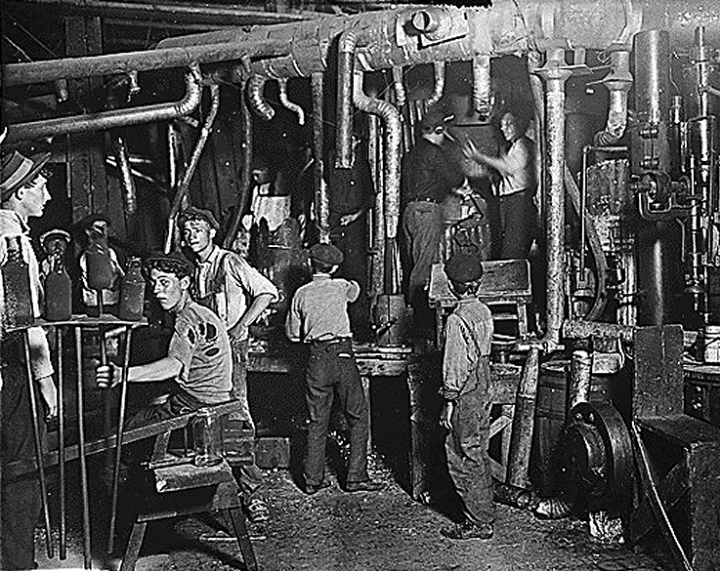
The Birth of Socialism
Socialism – system in which the people as a whole rather than private individuals own all property and operate all businesses.
Socialists claimed that industrial capitalism had created a large gap between the rich and poor.
Socialists cared less about individual ownership rights, and more about the interests of society.

Slide 15
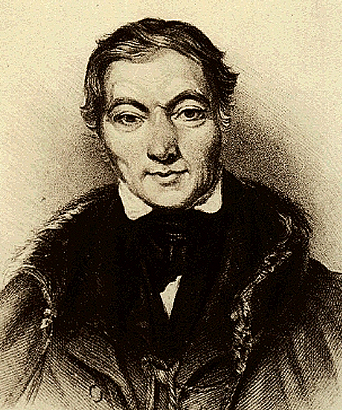
The Birth of Socialism
Utopian Socialism
Utopians socialists sought to create self-sufficient communities where all property and work would be shared, wealth would be equal, and fighting would end.
In Scotland, Robert Owen set up a Utopian factory community when he supplied good housing, education, and fair wages.
Owen

Slide 16
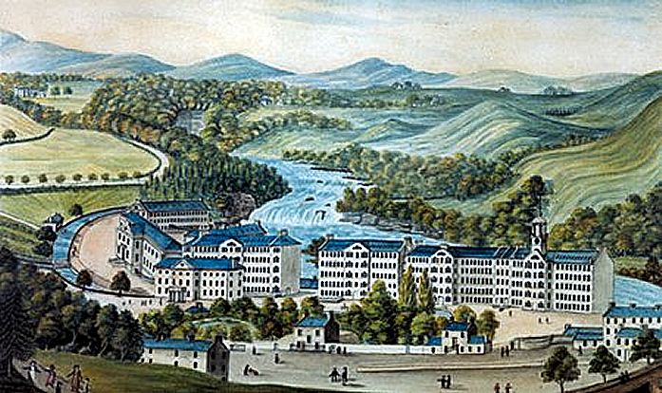
New Lanark, Scotland

Slide 17
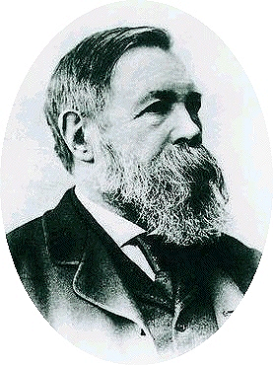
Marxist Socialism
Karl Marx
German philosopher Karl Marx promoted “scientific socialism,” which he claimed to be more realistic than utopian socialism.
In 1848, Marx teamed up with fellow German economist Friedrich Engels and published The Communist Manifesto.
Engels
Marx

Slide 18
Marxist Socialism
Communism
Communism – a form of socialism that sees class struggle between employers and employees as inevitable.
Marx

Slide 19
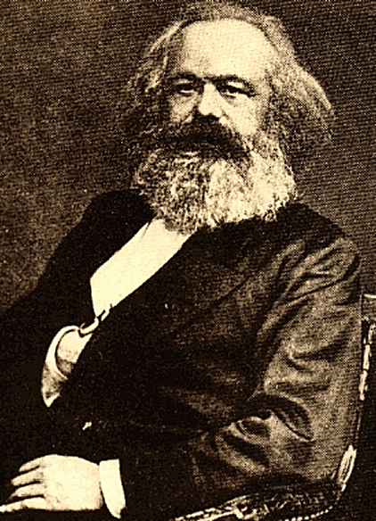
Marxist Socialism
Communism
In The Communist Manifesto Marx argued the following points:
History was a class struggle between the bourgeoisie (wealthy capitalists), and the proletariat (working class).
In order to make profits, the bourgeoisie exploited the proletariat.
Capitalism created prosperity for a few and poverty for many.

Slide 20
Marxist Socialism
Communism
In The Communist Manifesto Marx argued the following points:
The proletariat would eventually revolt and overthrow the capitalist system, creating their own society.
The proletariat society would take control of the means of production and establish a classless communist society where wealth and power would be shared.
With communism, all the evils of the industrial revolution would end.

Slide 21
Marx’s Industrial Age Social Pyramid
Bourgeoisie
(capitalists,
the “haves,”
the oppressors)
Proletariat
(workers, the “have-nots,” the oppressed)

Slide 22
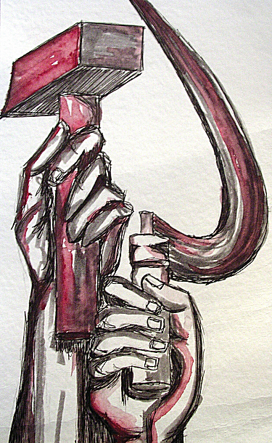
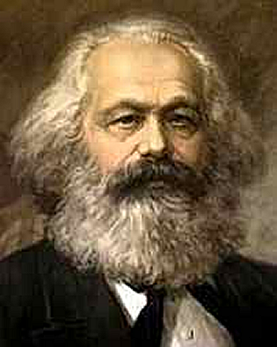
Marxist Socialism
Communism
Marx called for an international struggle to bring down capitalism, which he hated. His slogan was “workers of the world unite!”
Socialist political parties formed in Western Europe, but by 1900 the standard of living for the working class improved, and communism lost popularity.

Slide 23
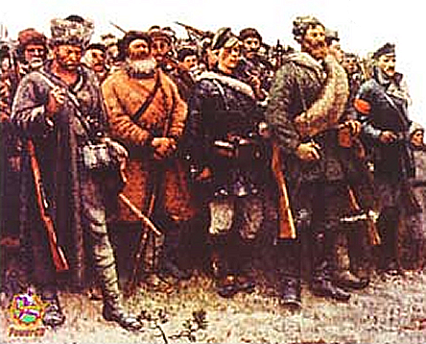
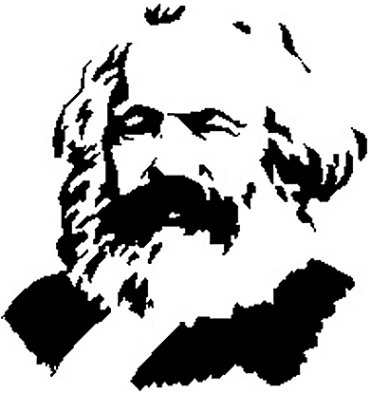
Marxist Socialism
However, in 1917 revolutionaries toppled Czar Nicholas II in Russia and set up the first communist state.
Communism
By 1900 most people still felt stronger ties to their nationality and county rather than their economic class, and there was no worldwide communist revolution.

Slide 24
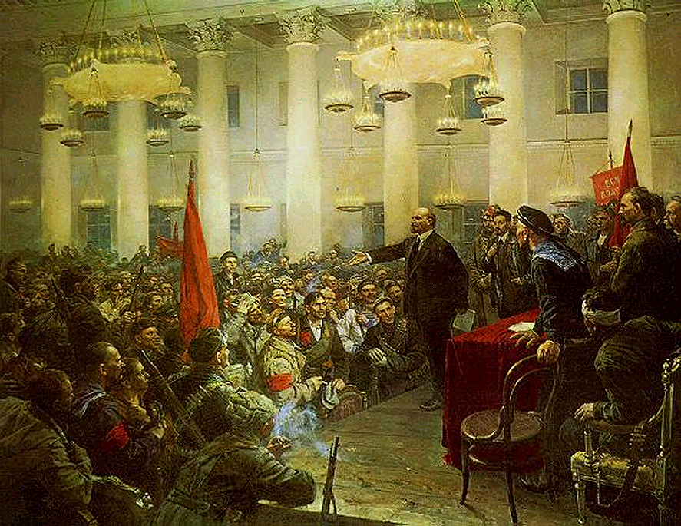
Lenin leads the
Revolution in Russia

