Slide 1
© Morgan AP Teaching
Period 1: 1450 CE -1648 CE
Early-Modern Society

Slide 2
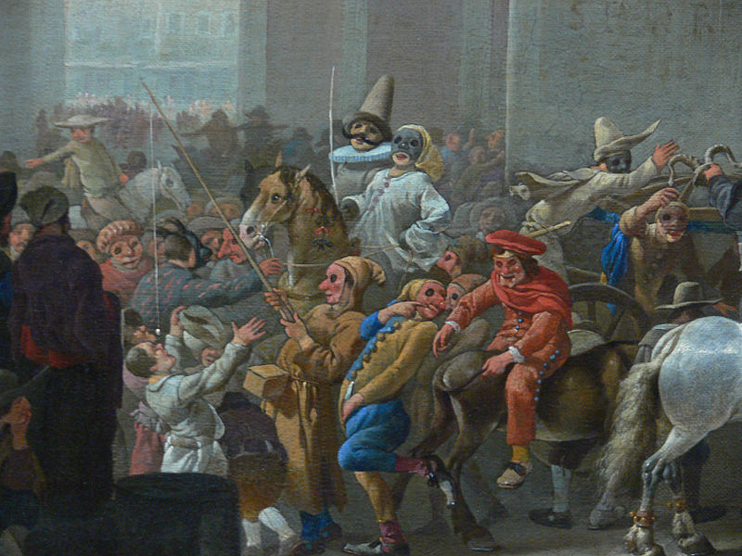
© Morgan AP Teaching
Public and Social Life
While governments and economies had all begun to
change quite drastically, the way people relaxed,
celebrated, and spent their free time remained largely
the same
Leisure activities were still tied directly the Church
and agricultural cycle, and still reflected the
persistence of magic and folklore
All Saint’s Day, Christmas, Easter, etc.
Events such as Carnival (social reversal), and religious festivals revolving around harvest dominated popular life
Additionally, large groups formed to watch blood sports (animals fighting): bull-baiting, bear-baiting, etc.

Slide 3
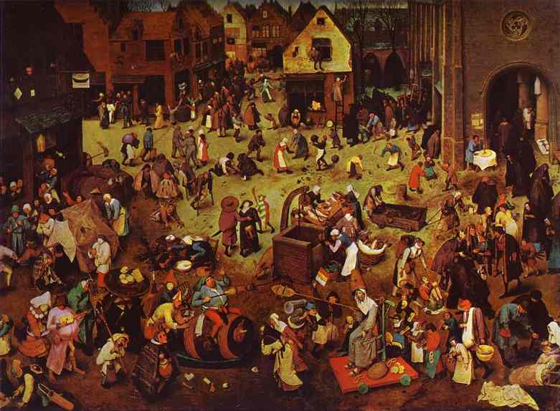
St. Gregor’s Day Festival

Slide 4
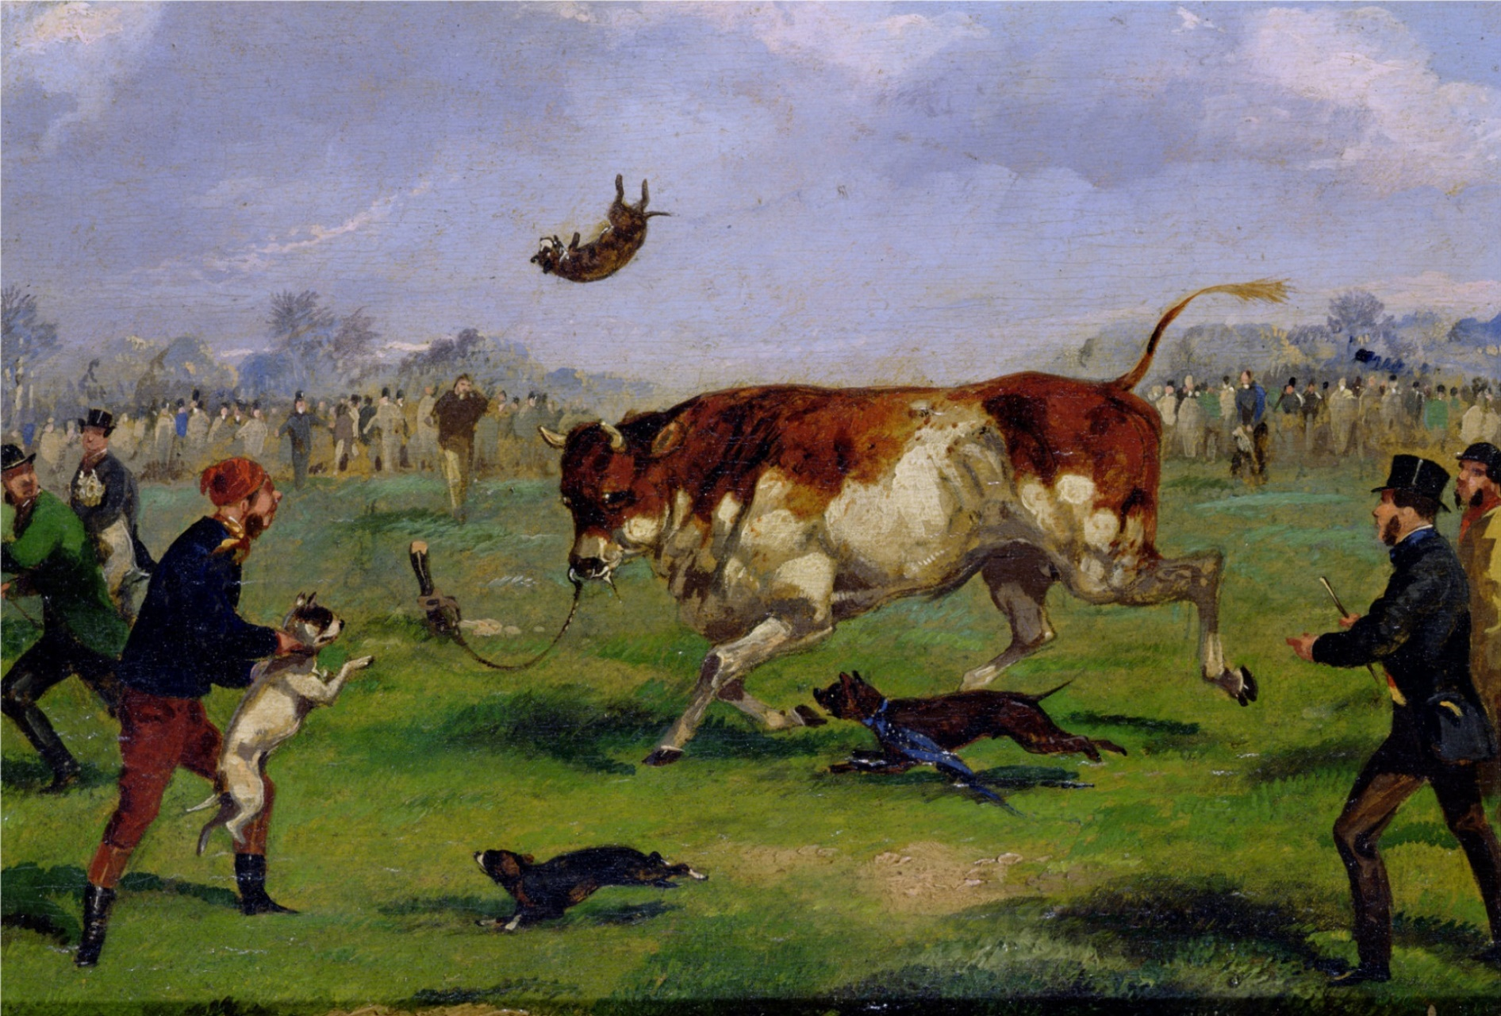
Bull Baiting

Slide 5
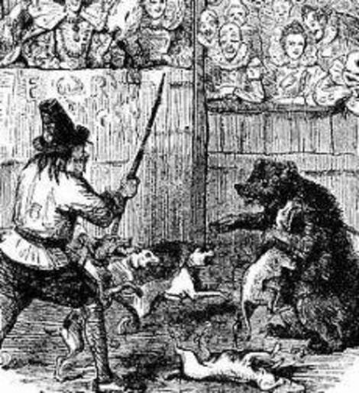
Bear Baiting

Slide 6
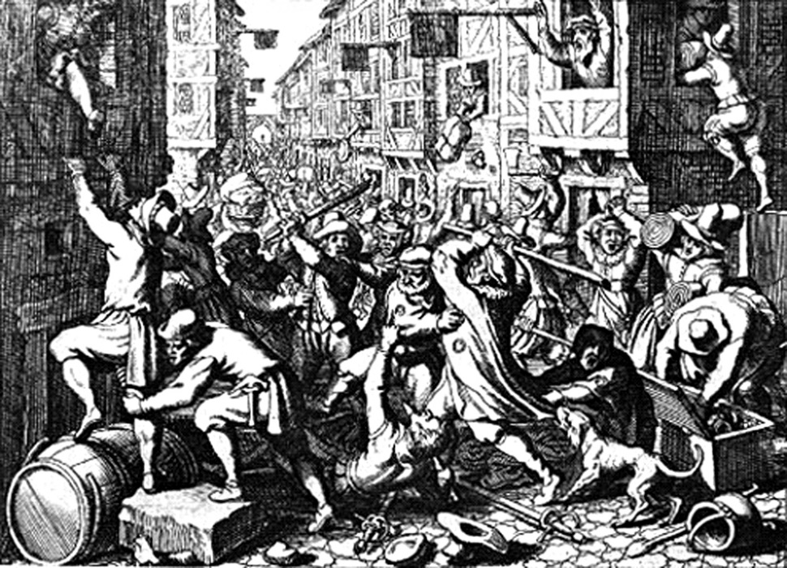
© Morgan AP Teaching
City Life
As large amounts of people began urbanizing due to enclosure
movements, cities and authorities were largely unprepared to
handle the new, massive crowds
While cities offered construction work for men, as food
processors and innkeepers, most people were unemployed
and extremely poor
Crime and disease ran rampant in cities, and a lack of sanitation made life miserable for citizens
With the Church largely gone or irrelevant in Protestant Europe, cities and governments were forced to enforce stricter laws on begging and prostitution and form secular local authorities
Regardless, following the Enclosure Movement, cities overflowed as craft guilds and merchant elites strained private resources to govern and maintain order

Slide 7
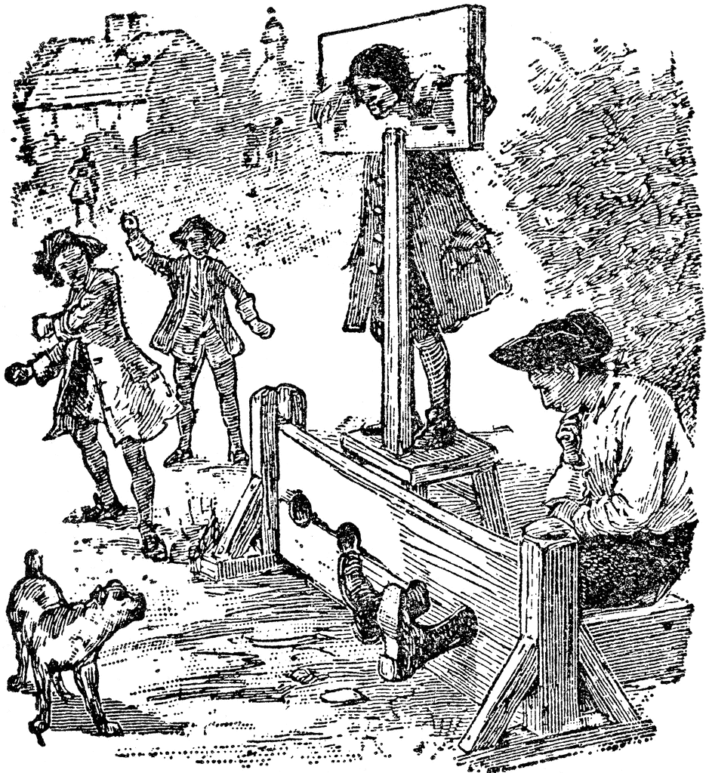
© Morgan AP Teaching
Secular Governments
While the Church was largely uninvolved with crimes or punishments, the old medieval punishments were still used by secular authorities
Punishment remained a public spectacle: stocks, branding, whipping, and torture
Secular authorities, mostly in Catholic states, also maintained religious laws and book bans
Many, like Philip II, continued to use the Inquisition to convert or execute ‘heretics’
Despite this continuation, many Protestant areas began to to ban Carnival as an immoral practice

Slide 8
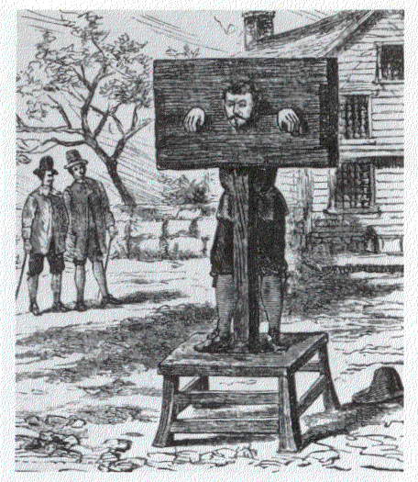

Slide 9
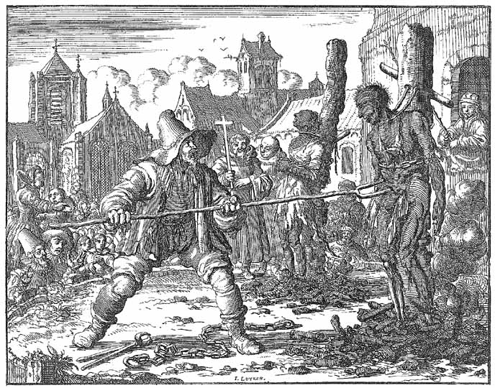

Slide 10
© Morgan AP Teaching
Old Beliefs and Witch Hunts
While the Scientific Revolution had brought new ideas
and techniques for solving the world’s mysteries,
old beliefs in magic and folk still persisted
People still believed in witchcraft, curses, blessings,
potions, magic, and were extremely superstitious
The believed sickness and plague were either
curses, hexes, or punishment for bad behavior or sin
In fact, despite a growing scientific community, witch
hunts and killings peaked in the late 1500s and early 1600s
Lastly, people also still believed actions such as volcanoes or comets in the sky were consequences of bad behavior or omens of bad things to come

Slide 11
© Morgan AP Teaching
Livelihood
During the 16th and 17th centuries most Europeans
obtained livelihood from peasant agriculture, paying
rent and taxes to their lords
Most farms at the time relied heavily on manual labor
and used the three-crop farming rotation, leaving
1/3 of the soil unused
Unfortunately for peasants, increases in population during the 16th century meant prices rose higher than wages
This caused peasant families to be poorer and reduced their standards of living

Slide 12
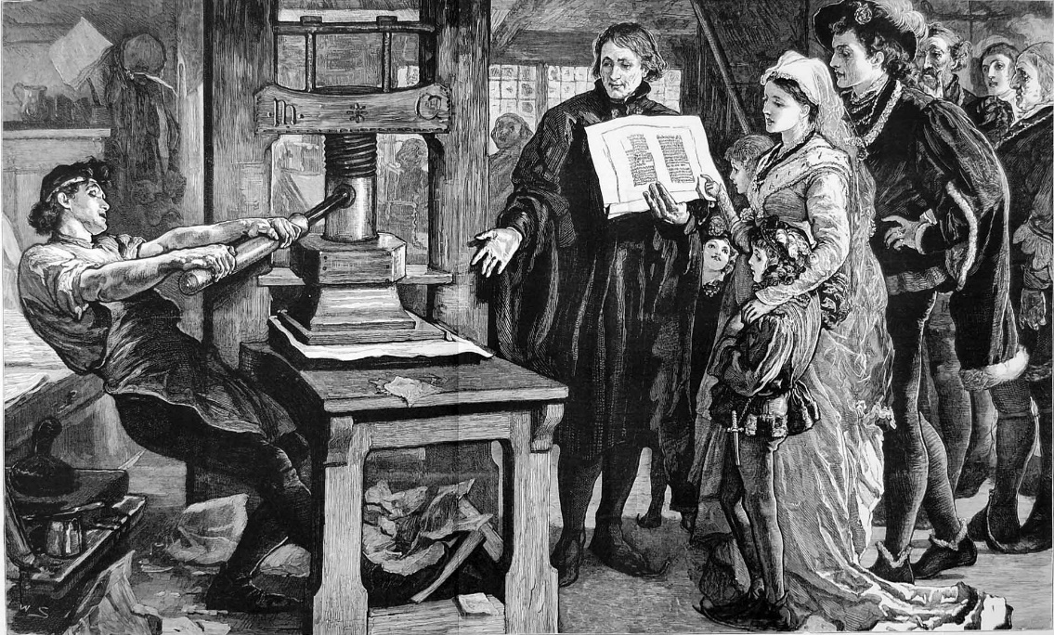
© Morgan AP Teaching
Marriage and Literacy
While these economic conditions lowered standards of
living, they were raised again by the 16th century
(post-Price Revolution)
Additionally, advances in education and harsh economic
pressures delayed marriages, resulting in smaller families
This left fewer people around to use the money supply, and actually raised living standards, especially after the Thirty Years War
While the printing press helped spread literature, the vast majority of Europeans were still uneducated, illiterate peasants
However, the printing press did play a pivotal role in establishing vernacular languages such as English (Shakespeare), German, Italian, and French

Slide 13
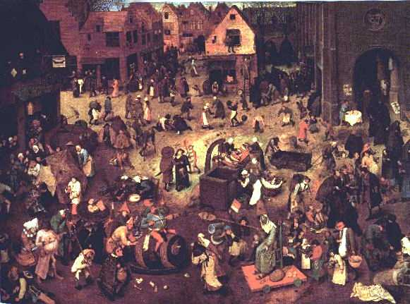
© Morgan AP Teaching
Families
Much like Paleolithic societies, peasant families worked in an
egalitarian manner
While men did more strength-oriented labor, women worked
often with the men in agriculture doing separate but
complementary tasks
Families worked and lived in units, enjoyed time
together & living in small, well-known local communities
The role of women did remain subordinate as the husband had total legal control
Additionally, while women could inherit businesses/land, they could not expand either or train their own employees

Slide 14
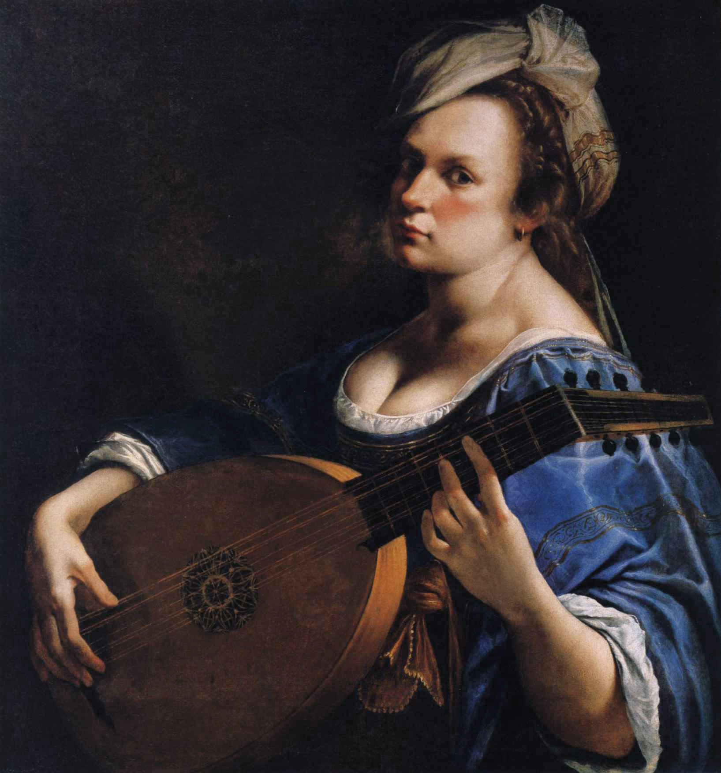
Women
© Morgan AP Teaching
While women remained subordinate to men in Early Modern Europe, the Reformations and the Renaissance raised debate about female education known as La Querelle Des Femmes in French
La Querelle Des Femmes was a broad debate from the 1400s to the 1700s in Europe regarding the nature of women, their capabilities, and whether they should be permitted to study, write, or govern in the same manner as men
Some women, such as writer Christine de Pizan, women were as intelligent as men were, they were, however, not afforded the same education
Additionally, some Protestants, mostly those deemed ‘radical’, believed women could play a more active role as a pastor or preacher
Protestant women also played a major part in the Reformation by offering funds to Protestant writers and princes who fought to defend Protestantism
Lastly, women had an impact on the arts as well, such as the famous Baroque painter (Artemisia Gentileschi)

