Slide 1
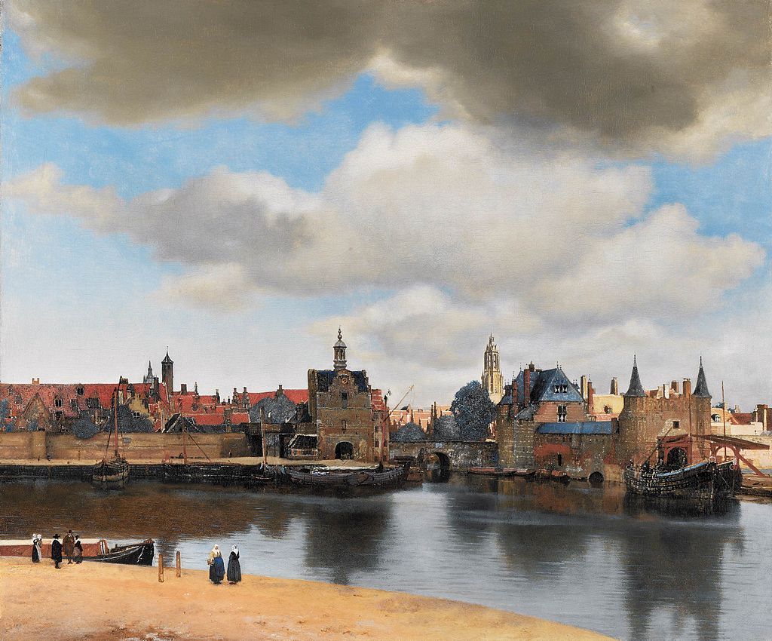
Dutch Golden Age Painting

Slide 2
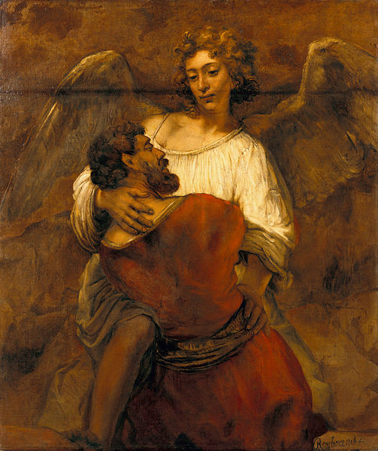
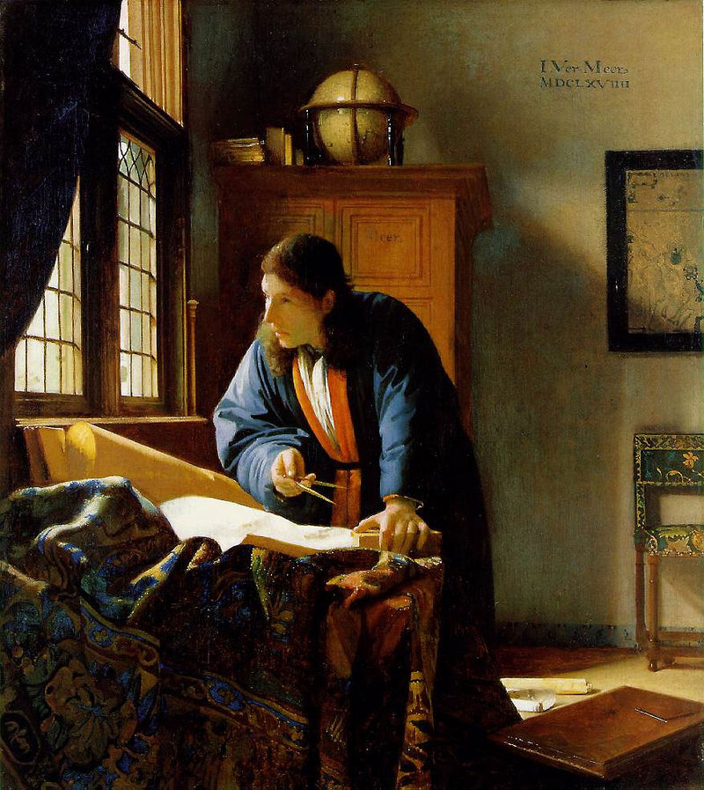
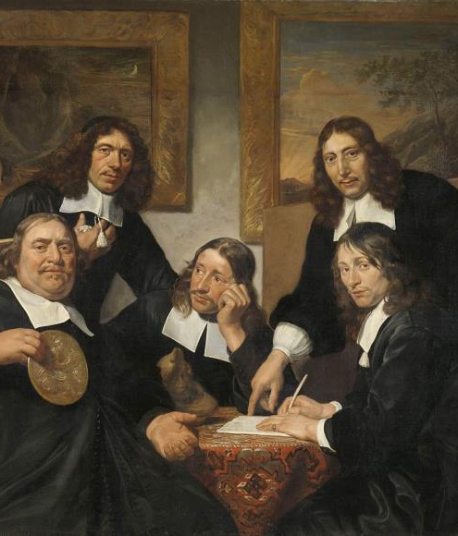
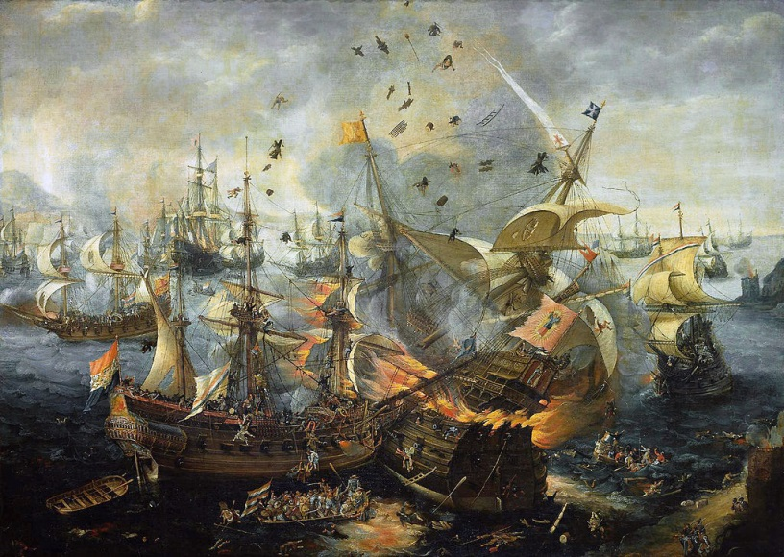
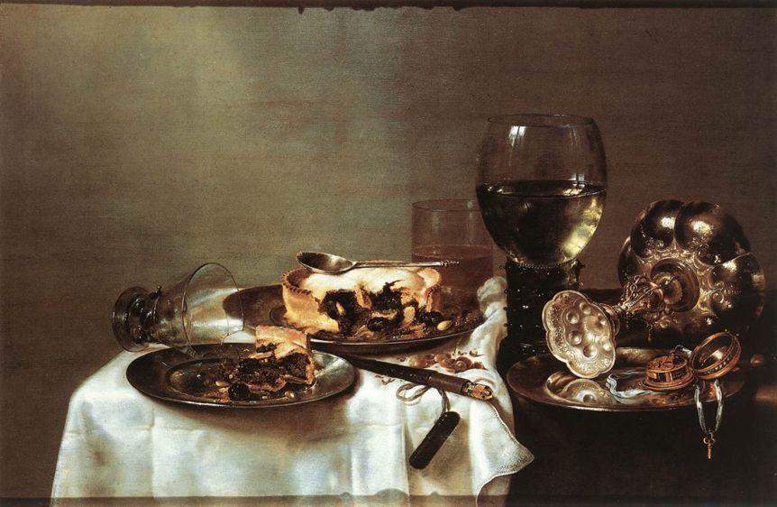
Dutch Golden Age Painting
Historical
Landscapes & Cityscapes
Genre Painting
Portraits
Maritime Scenes
Still Lifes

Slide 3
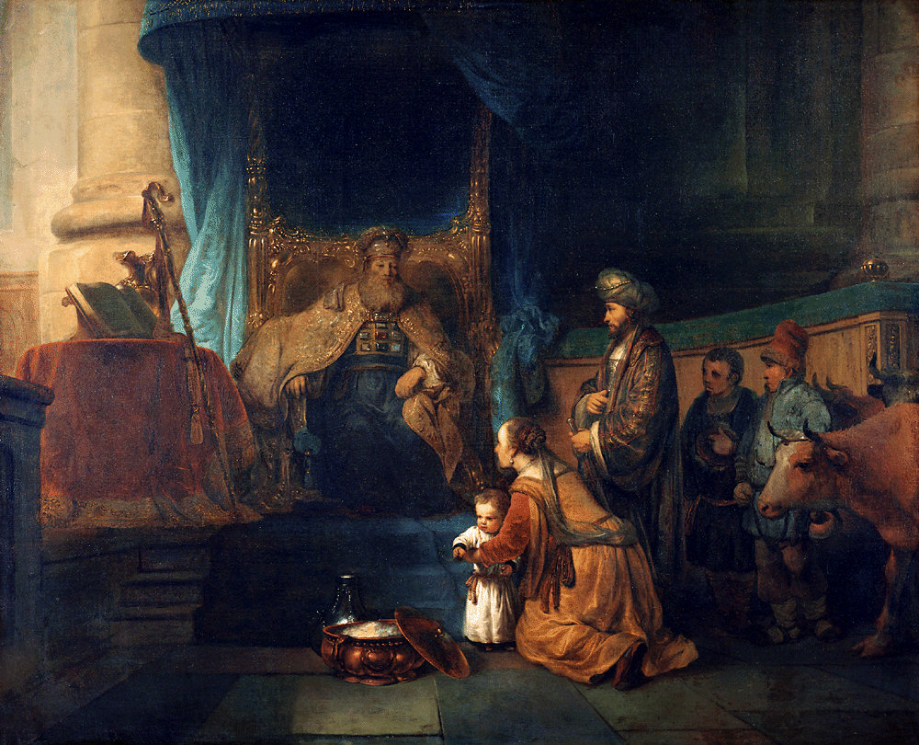
Historical Painting
Most Prestigious
Historical
Mythological
Biblical
Most Famous Artist(s):
Rembrandt & Pupils
Gerbrand van den Eeckhout, Hannah Presenting Her Son Samuel to the Priest Eli (1665)

Slide 4
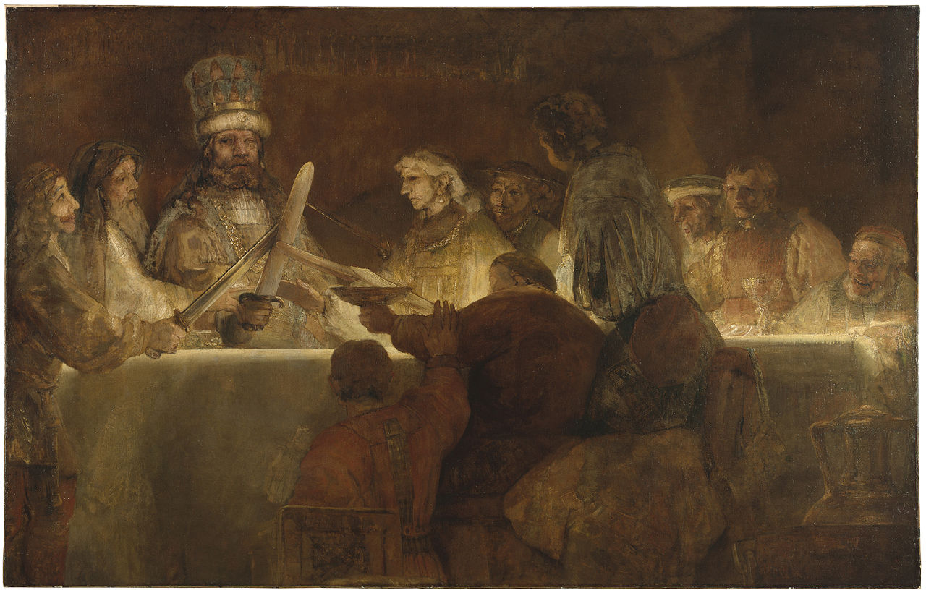
Rembrandt van Rijn, The Conspiracy of Claudius Civilis (1662)

Slide 5
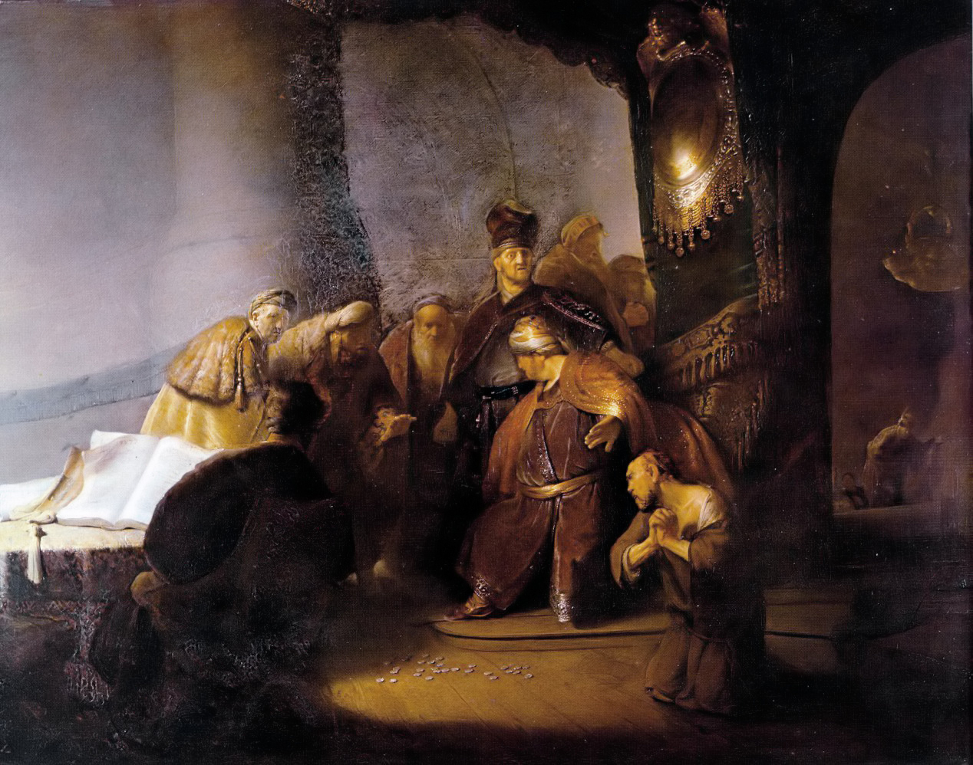
Rembrandt van Rijn, Judas Returning Thirty Silver Pieces (1629)

Slide 6
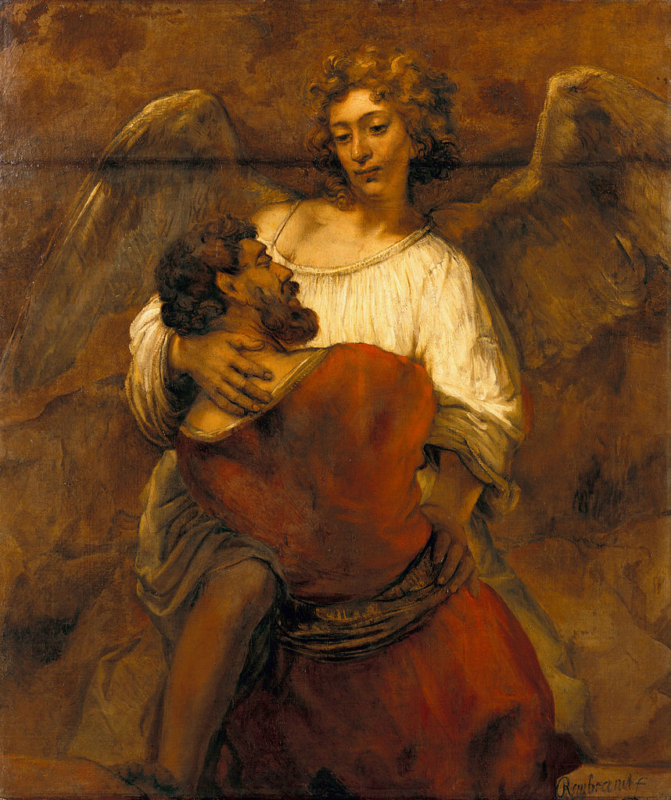
Rembrandt van Rijn, Jacob Wrestling with the Angel (c. 1659)

Slide 7
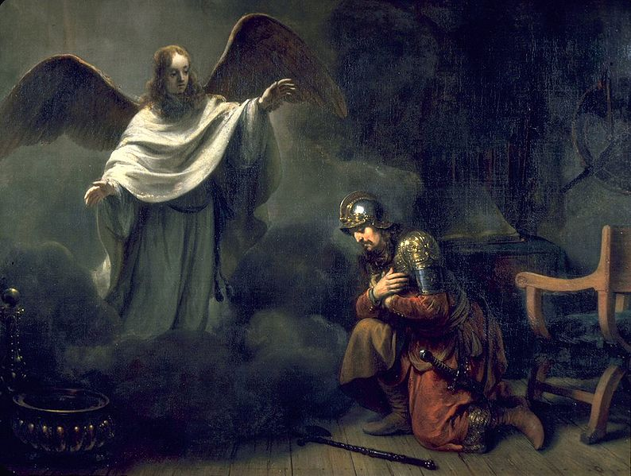
Gerbrand van den Eeckhout, An Angel Appears to the Roman Centurion Cornelius (1664)

Slide 8
Gerbrand van den Eeckhout, Hannah Presenting Her Son Samuel to the Priest Eli (1665)

Slide 9
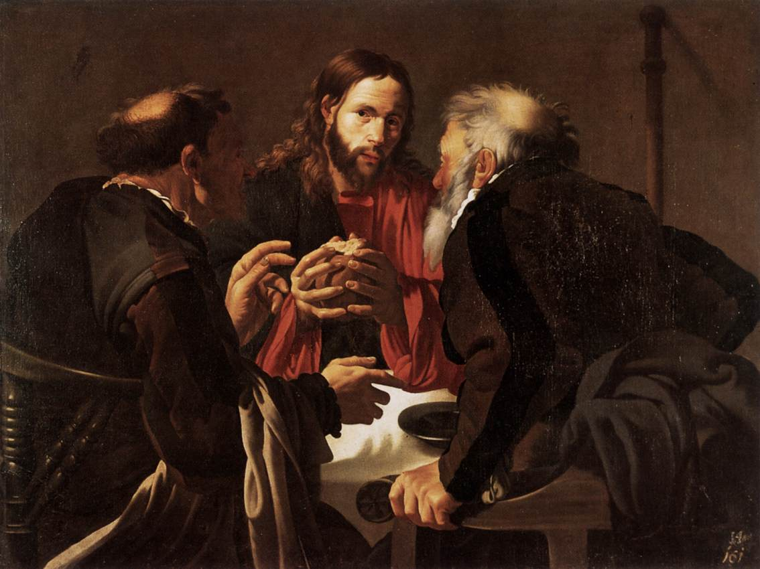
Hendrick Jansz ter Brugghen,The Supper at Emmaus (1621)
Utrecht Caravaggism

Slide 10
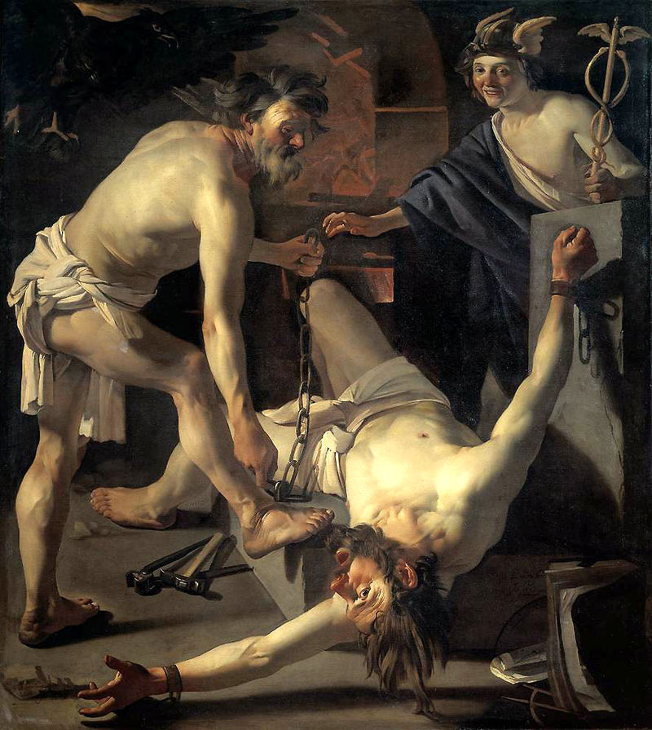
Dirck van Baburen, Prometheus Being Chained by Vulcan (1623)

Slide 11
Landscapes & Cityscapes
Dutch artists were known for their realistic depictions from the ground level.
Most Famous Artist(s):
Jacob van Ruisdael
Johannes Lingelbach , The Stadhuis under construction, (1656)

Slide 12
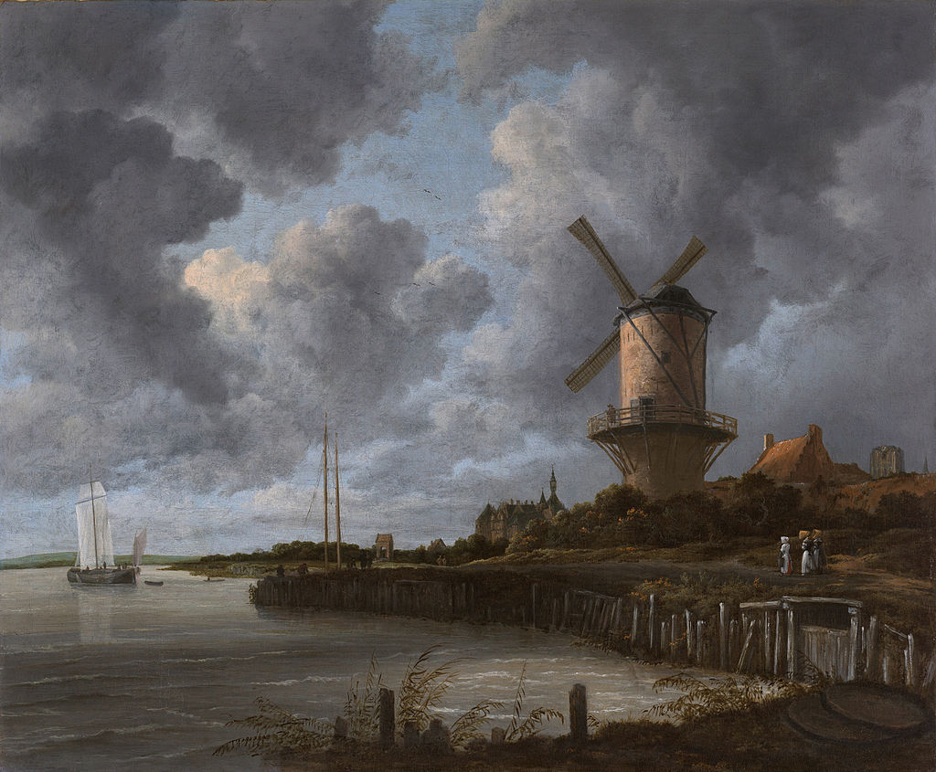
Jacob van Ruisdael, The Windmill at Wijk (1670)

Slide 13
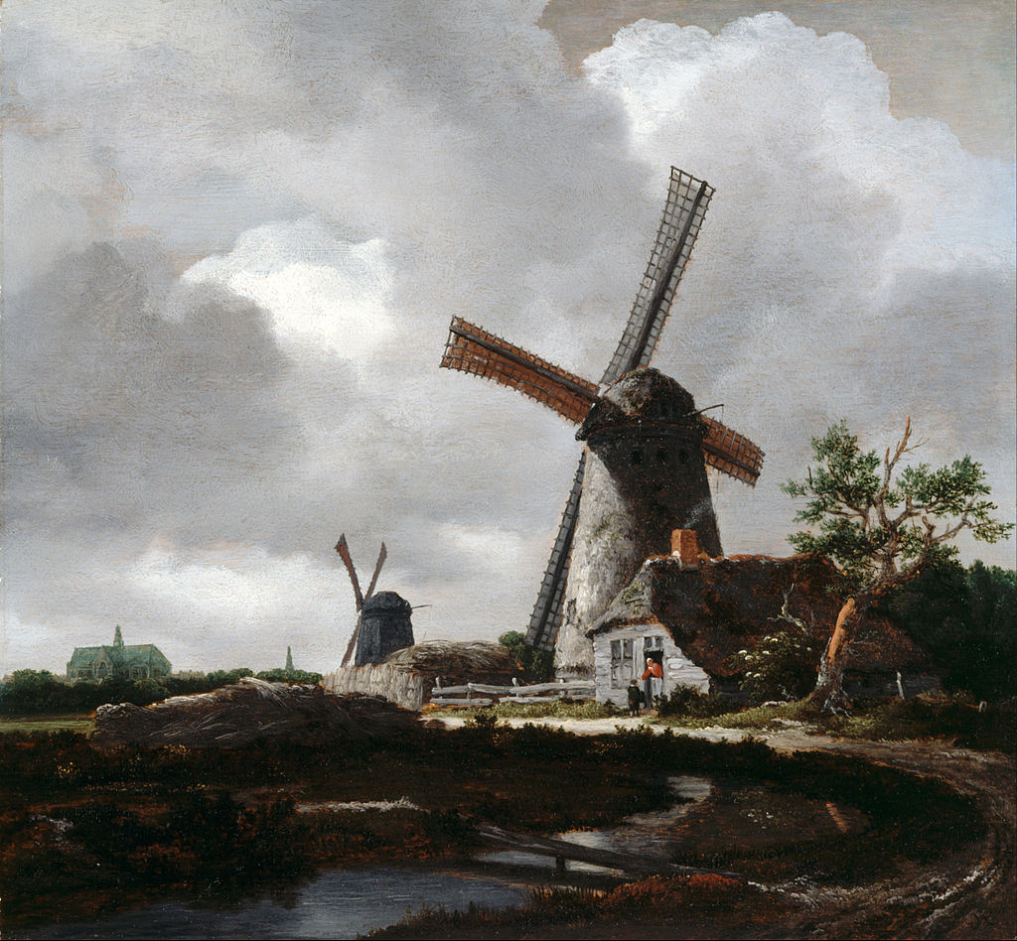
Jacob van Ruisdael, Landscape with Windmills near Haarlem (1651)

Slide 14
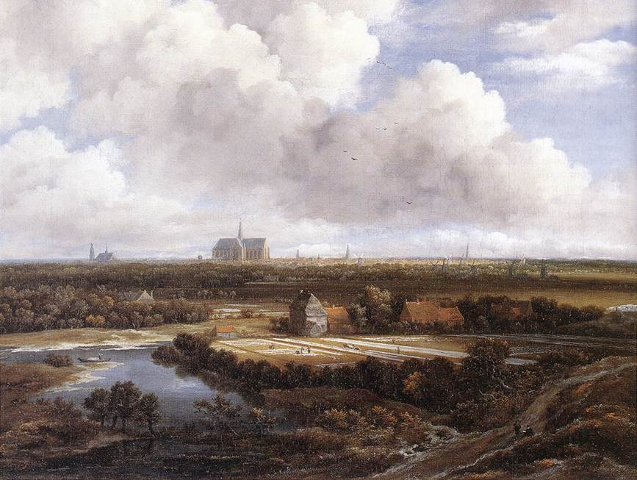
Jacob van Ruisdael, View of Haarlem with Bleaching Fields (c. 1665)

Slide 15
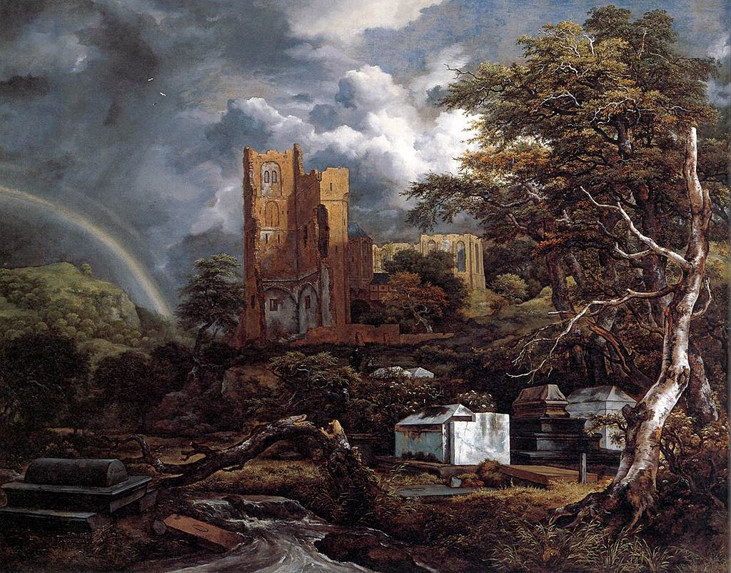
Jacob van Ruisdael, The Jewish Cemetery (1650s)

Slide 16
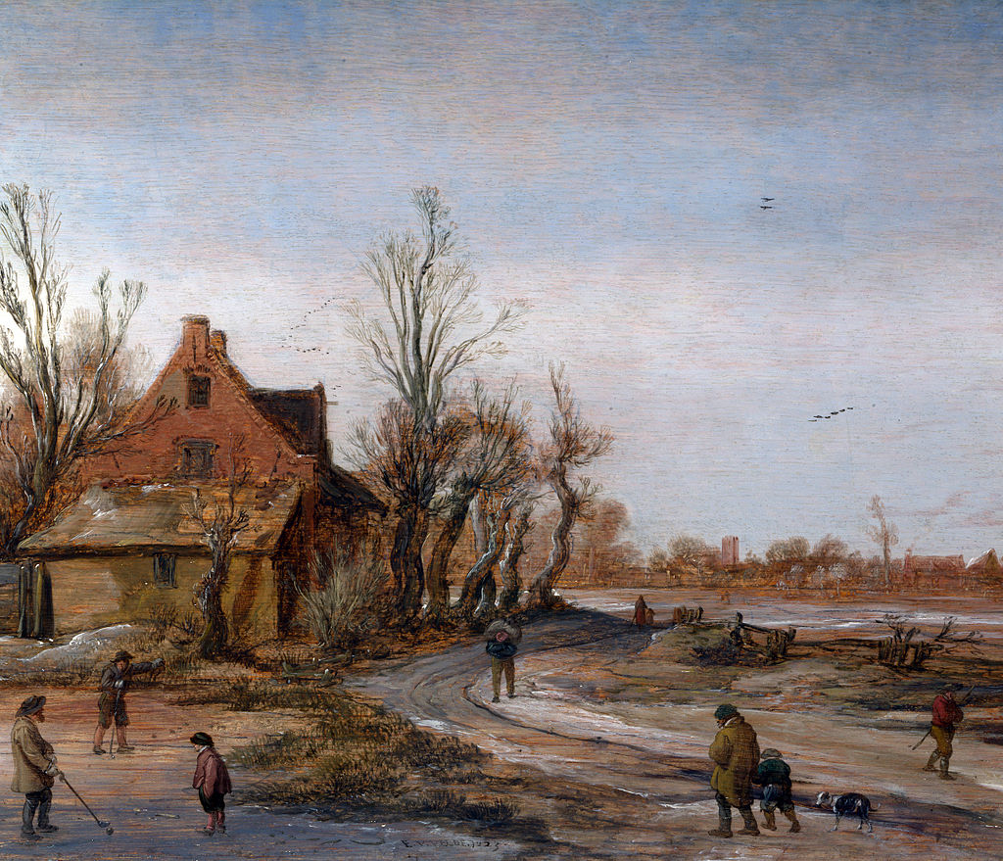
Esaias van de Velde, Winter Landscape (1623)

Slide 17
Johannes Lingelbach, The Stadhuis Under Construction, (1656)

Slide 18
Johannes Vermeer, View of Delft (1660–61)

Slide 19
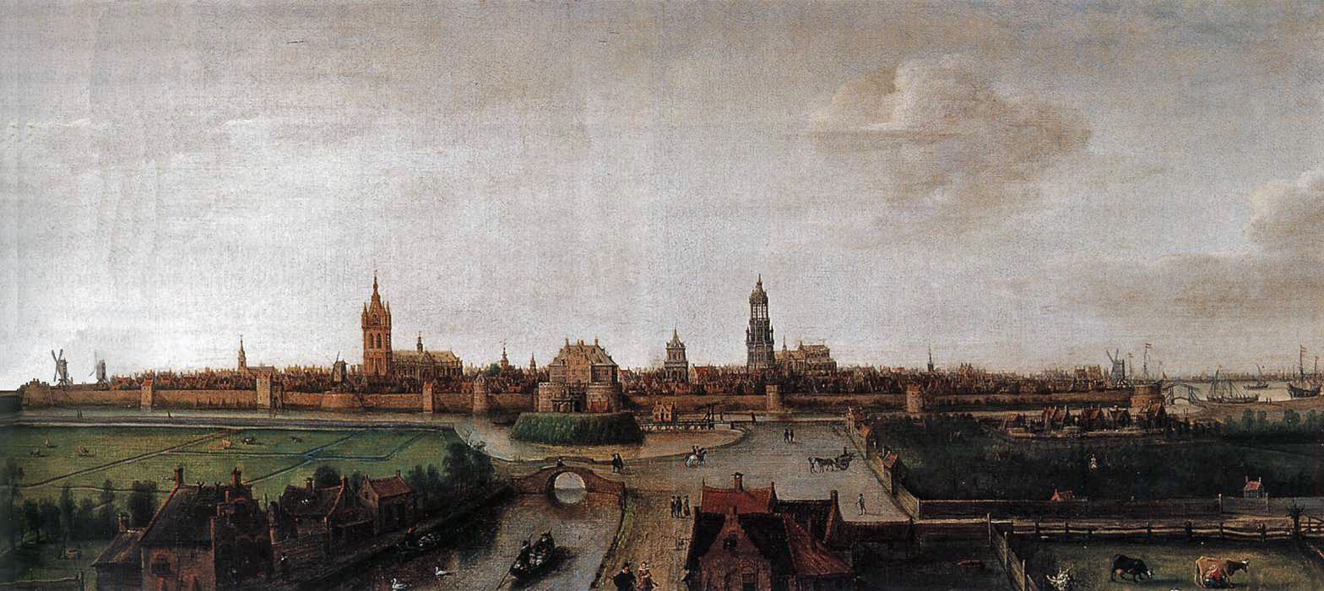
Hendrick Cornelisz Vroom, View of Delft Seen from the West one of the earliest cityscapes in the Netherlands, and the earliest of Delft

Slide 20
Genre Painting
Scenes from Everyday Life
Most Famous Artist(s):
Johannes Vermeer
Johannes Vermeer, The Geographer (1669)

Slide 21
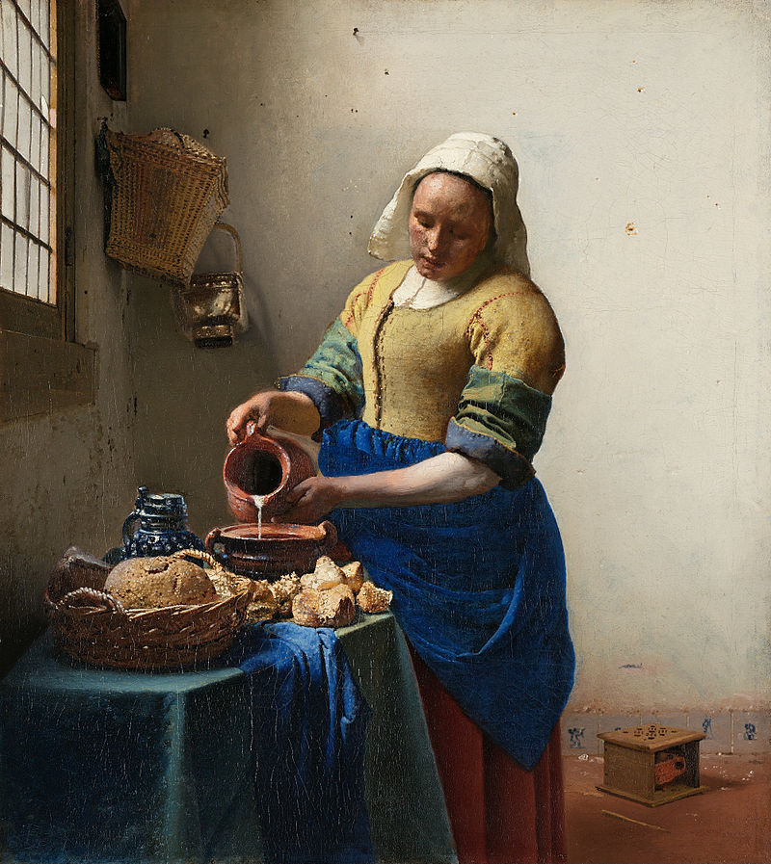
Johannes Vermeer The Milkmaid (1658–1660)

Slide 22
Johannes Vermeer The Geographer (1669)

Slide 23
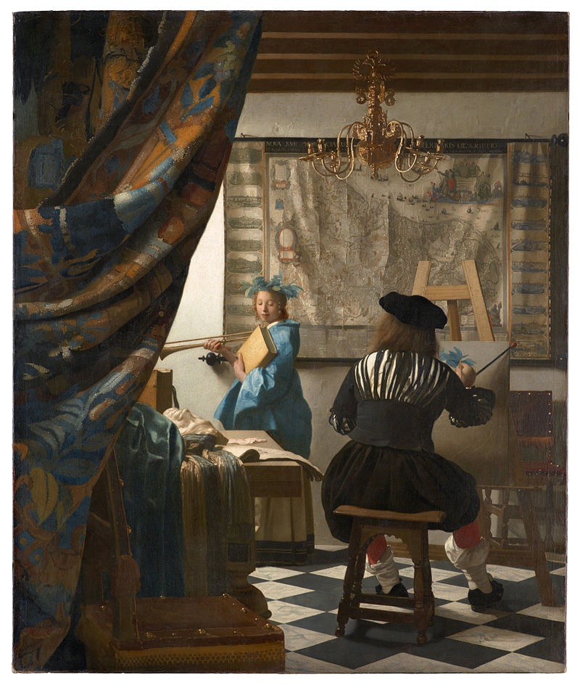
Johannes Vermeer, Art of Painting (c. 1666-68)

Slide 24
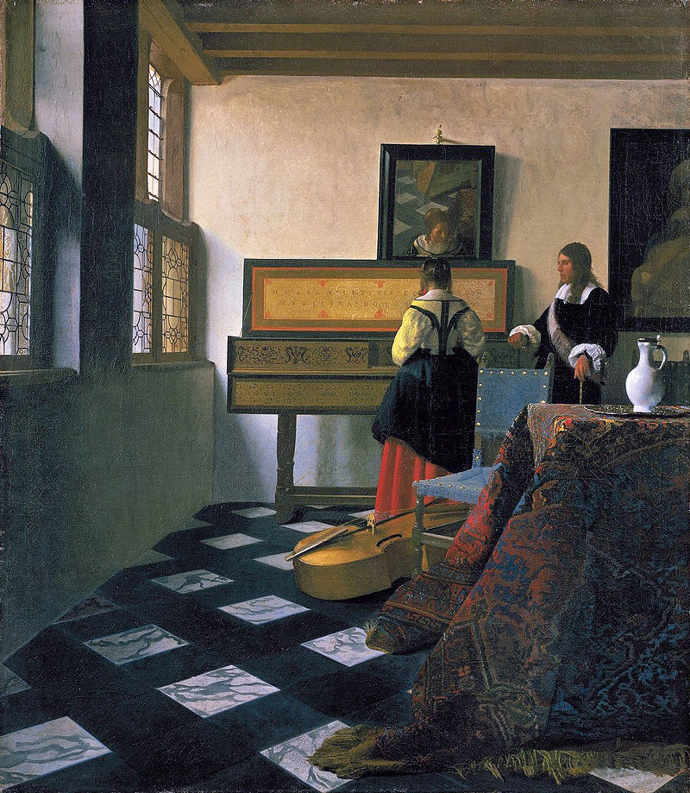
Johannes Vermeer The Music Lesson (c. 1662–65)

Slide 25
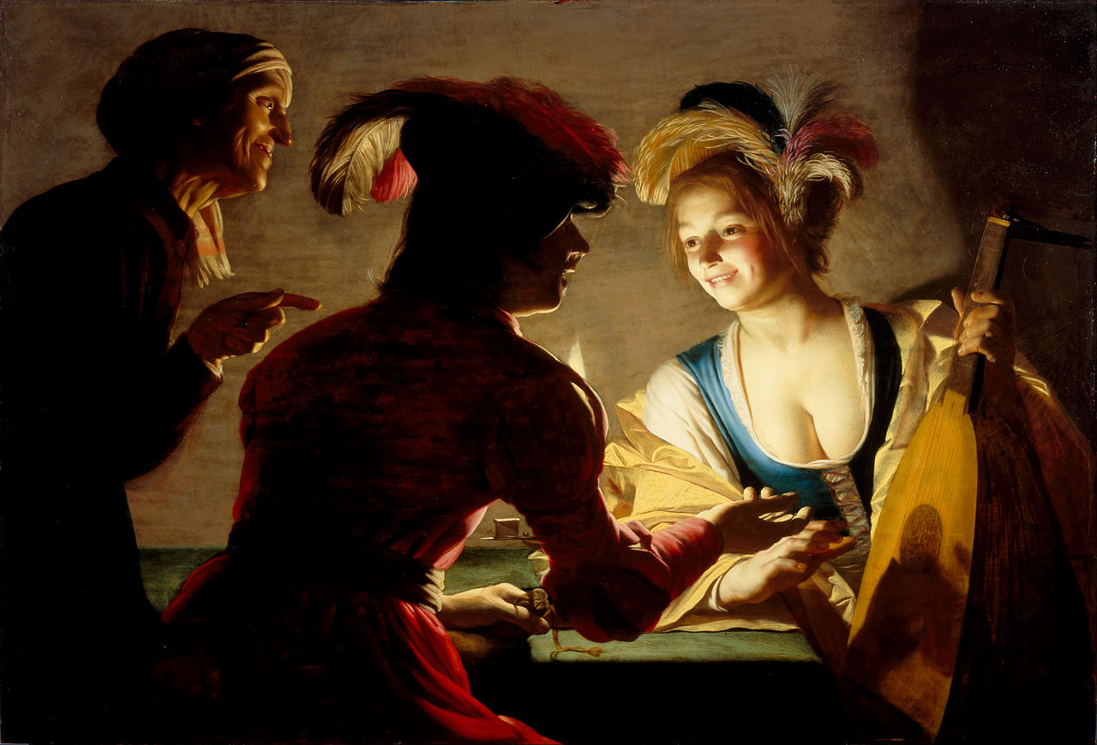
Gerard van Honthorst, The Matchmaker
Utrecht Caravaggism

Slide 26
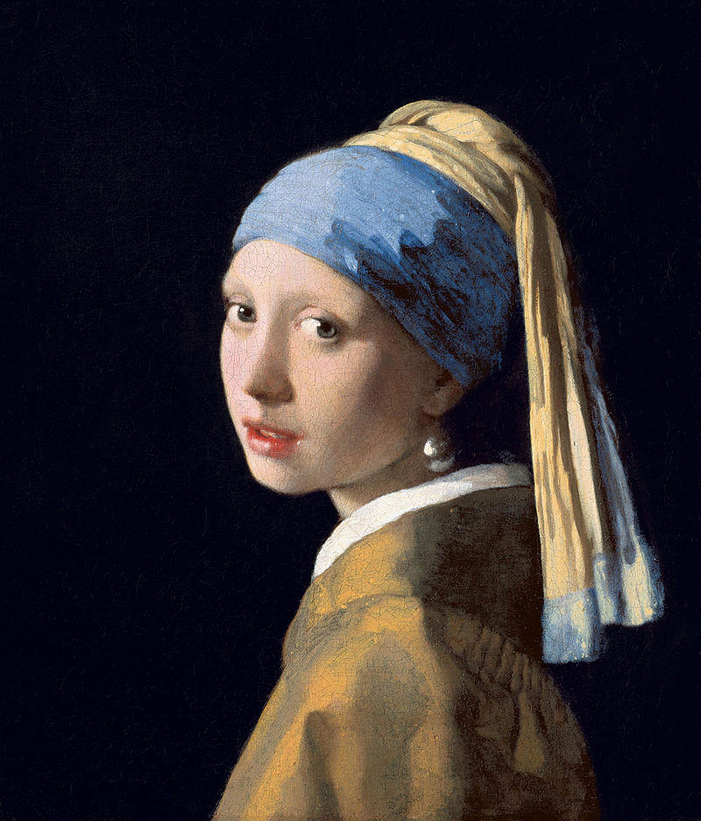
Johannes Vermeer, Girl with a Pearl Earring (1665)

Slide 27
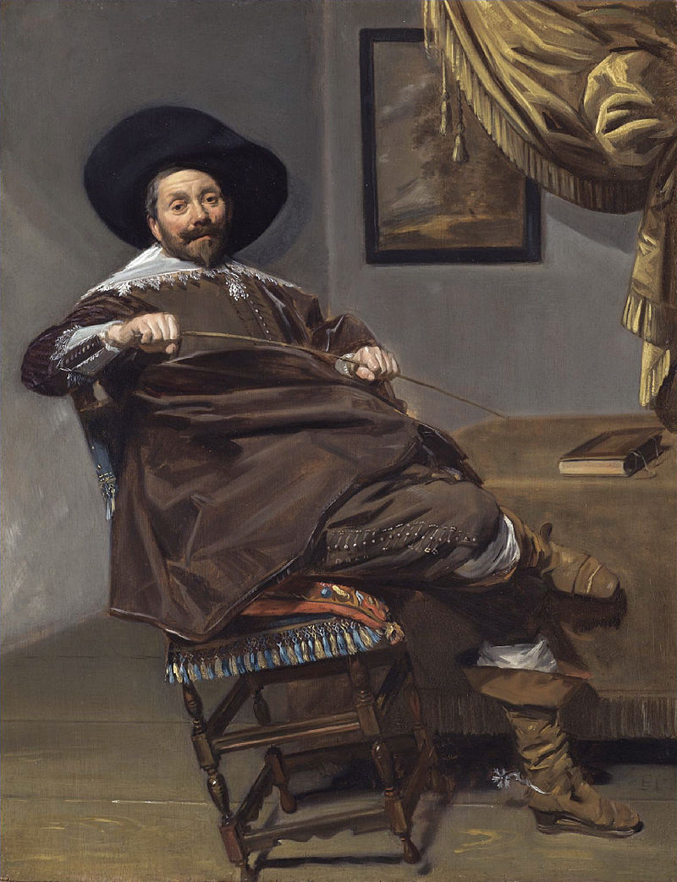
Portraits
The Dutch merchant class was more willing to spend money on portraits than their social equivalents in other countries.
Frans Hals, Willem Heythuijsen (1634)

Slide 28
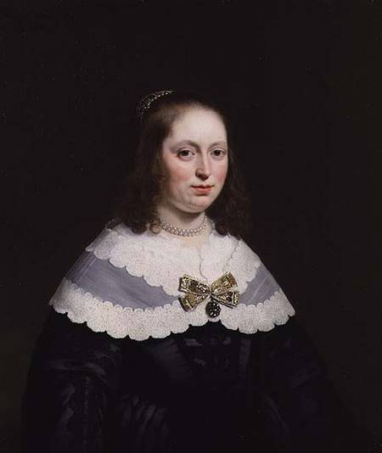
Bartholomeus van der Helst, Sophia Trip (1645)
The subject was a member of one of the wealthiest families in Holland.
(Calvinist Simplicity)

Slide 29
Frans Hals, Willem Heythuijsen (1634)

Slide 30
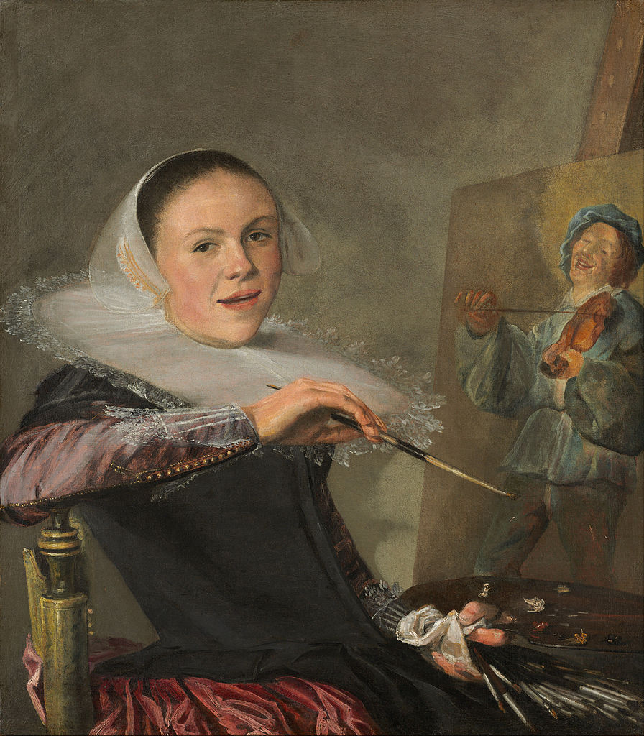
Judith Leyster Self-portrait at 20 (1630)
Leyster was the second woman to join the Haarlem Painters Guild.

Slide 31
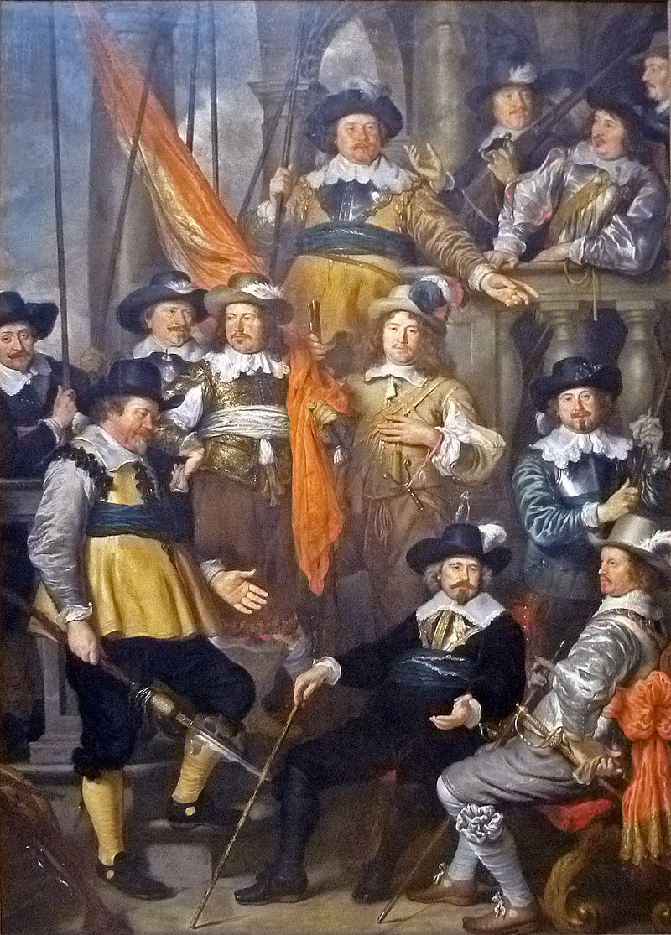
Group Selfies
Govert Teuniszoon Flinck, Militia Company of District XVIII under the Command of Captain Albert Bas (1645)

Slide 32
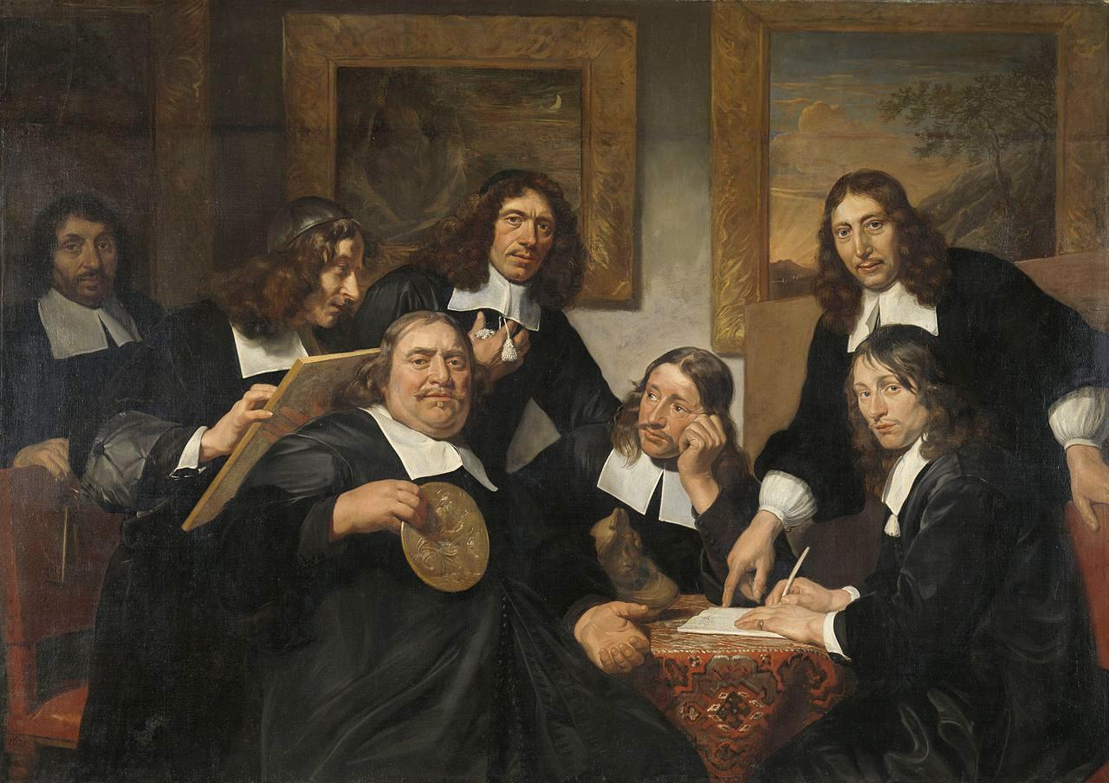
Jan de Bray (second from left), The Haarlem Painter's Guild (1675)

Slide 33
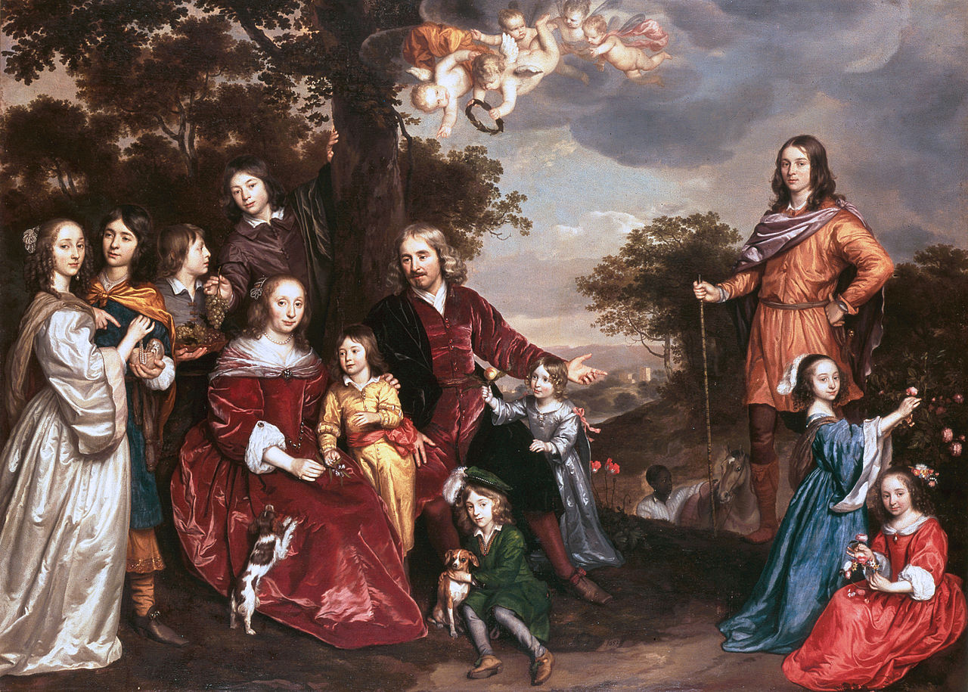
Jan Mijtens, family portrait (1652)

Slide 34
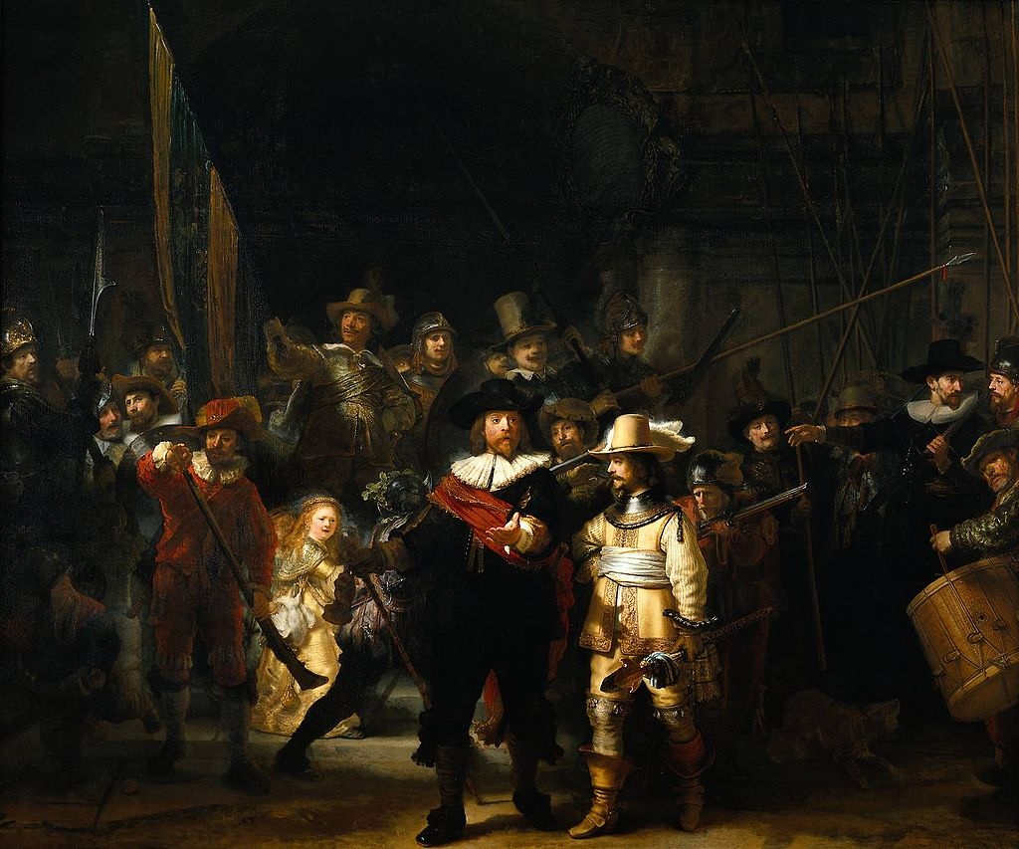
Rembrandt van Rijn, The Night Watch (1642)

Slide 35
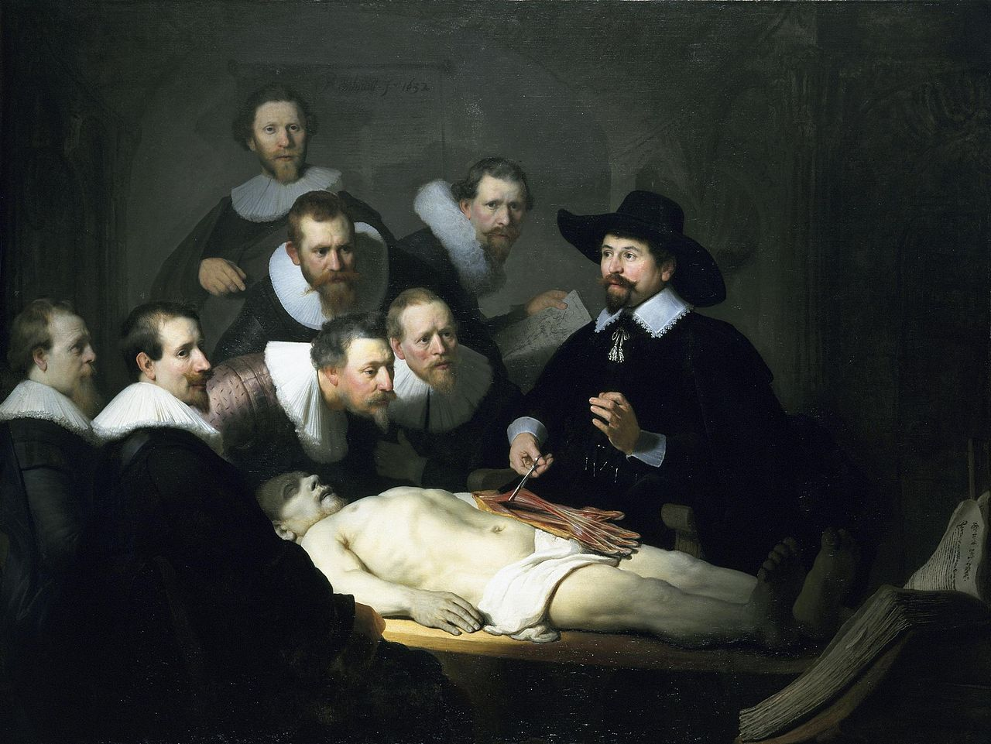
Rembrandt van Rijn, The Anatomy Lesson of Dr. Nicolaes Tulp (1632)

Slide 36
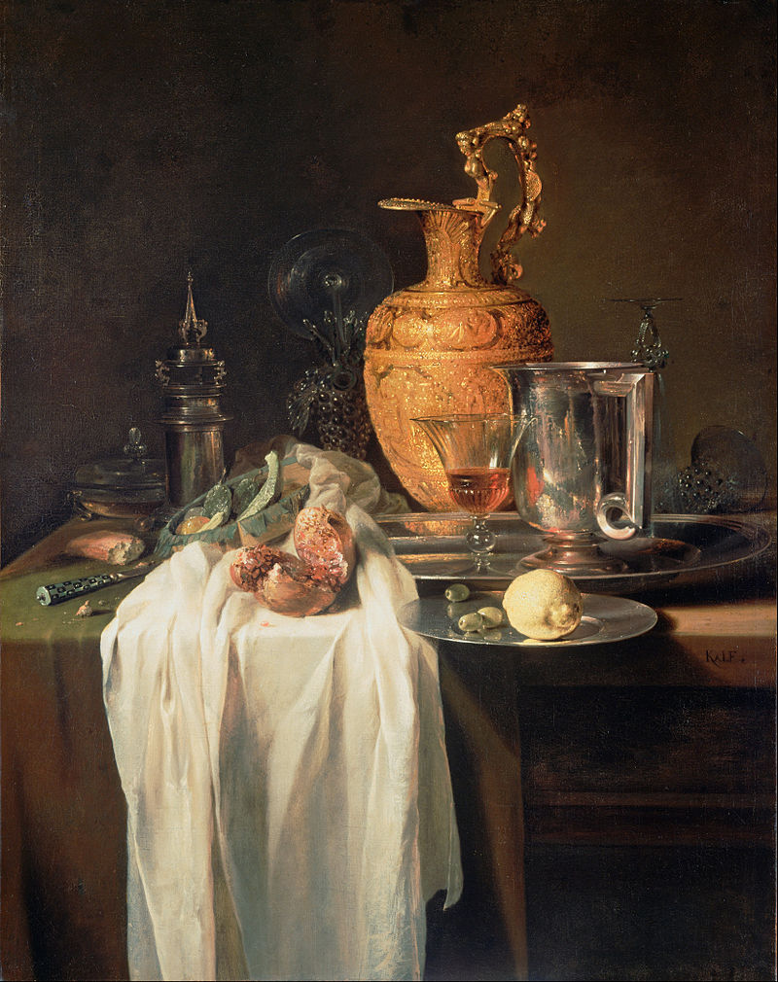
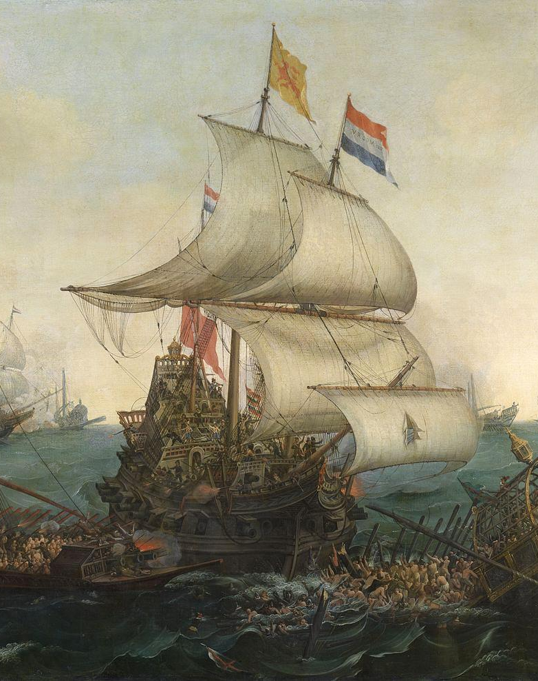
Maritime Painting
Showcased the Glory of the Dutch Navy
Most Famous Artist(s):
Hendrick Cornelisz Vroom
Hendrick Cornelisz Vroom, Dutch Ships Ramming Spanish Galleys off the Flemish Coast in October 1602 (1617)

Slide 37
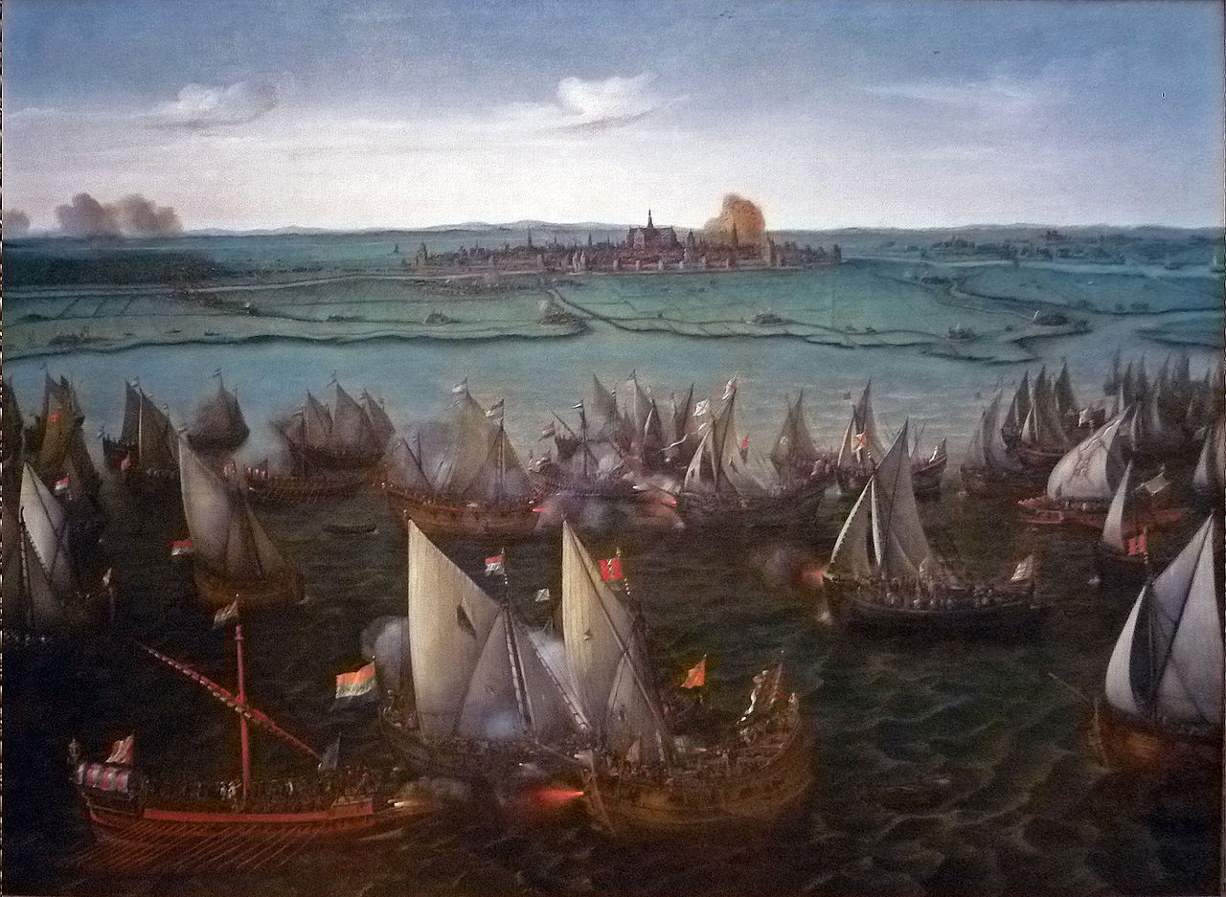
Hendrick Cornelisz Vroom, Battle in 1573 between Dutch and Spanish ships on the Haarlemmermeer

Slide 38
NOTE HIGHER ANGLE IN EARLY WORKS LIKE THIS
(Replaced by lower, more realistic angle in later works)
Hendrick Cornelisz Vroom, Battle in 1573 between Dutch and Spanish ships on the Haarlemmermeer

Slide 39
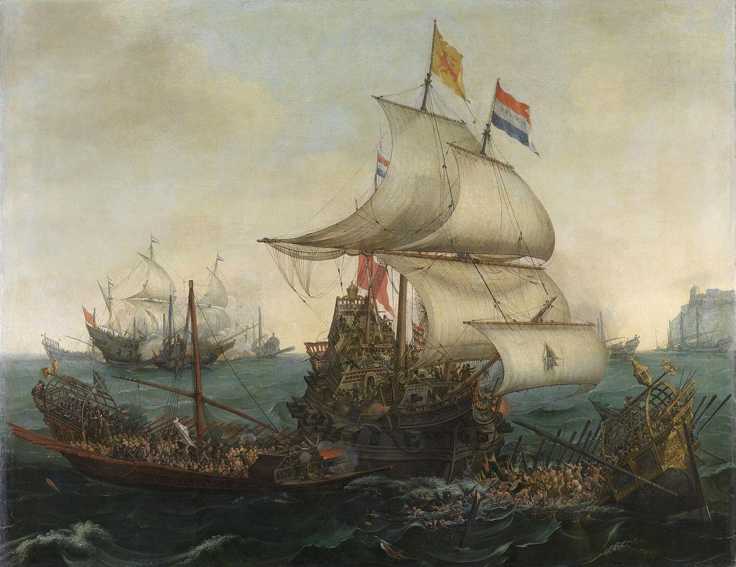
Hendrick Cornelisz Vroom, Dutch Ships Ramming Spanish Galleys off the Flemish Coast in October 1602 (1617)

Slide 40
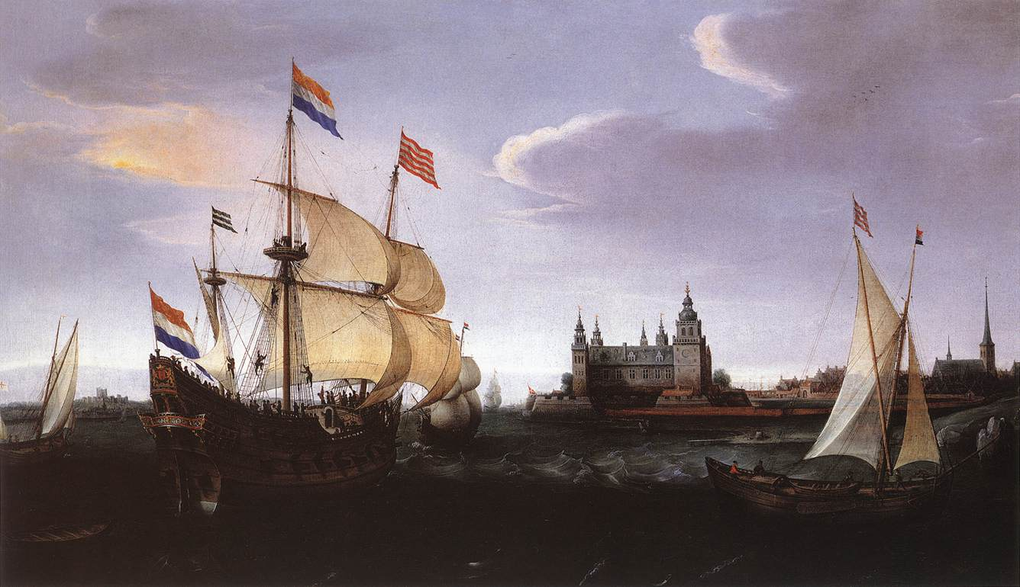
Hendrick Cornelisz Vroom, Arrival of a Dutch Three master at Kronborg Castle, Helsingør

Slide 41
Cornelis Claesz van Wieringen, The explosion of the Spanish flagship during the Battle of Gibraltar, 25 April 1607 (1621) www.rijksmuseum.nl

Slide 42
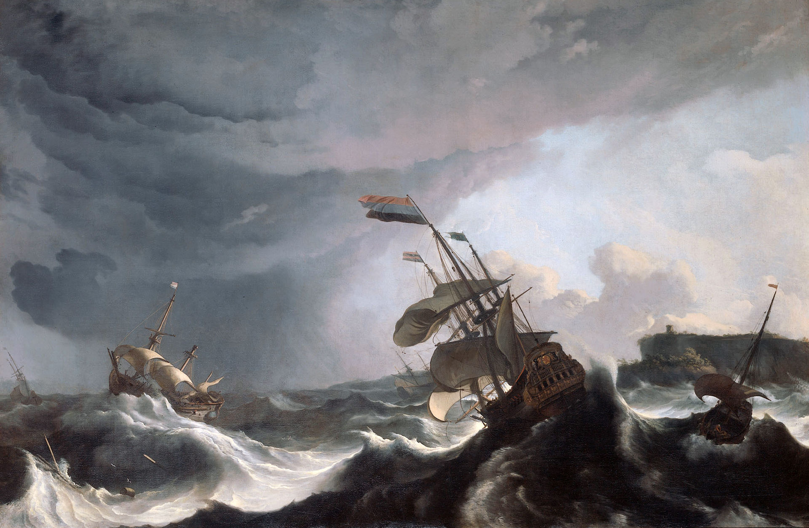
Ludolf Bakhuizen, Dutch warships in trouble off Gibraltar, a real incident of 1690

Slide 43
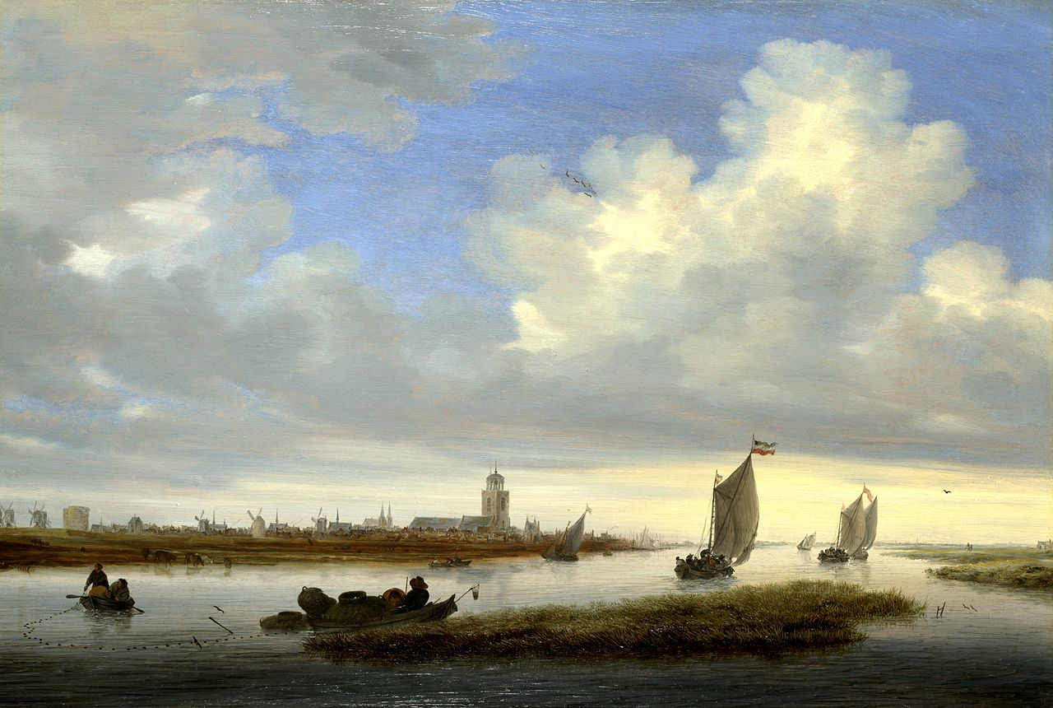
Salomon van Ruysdael, View of Deventer Seen from the North-West (1657)

Slide 44
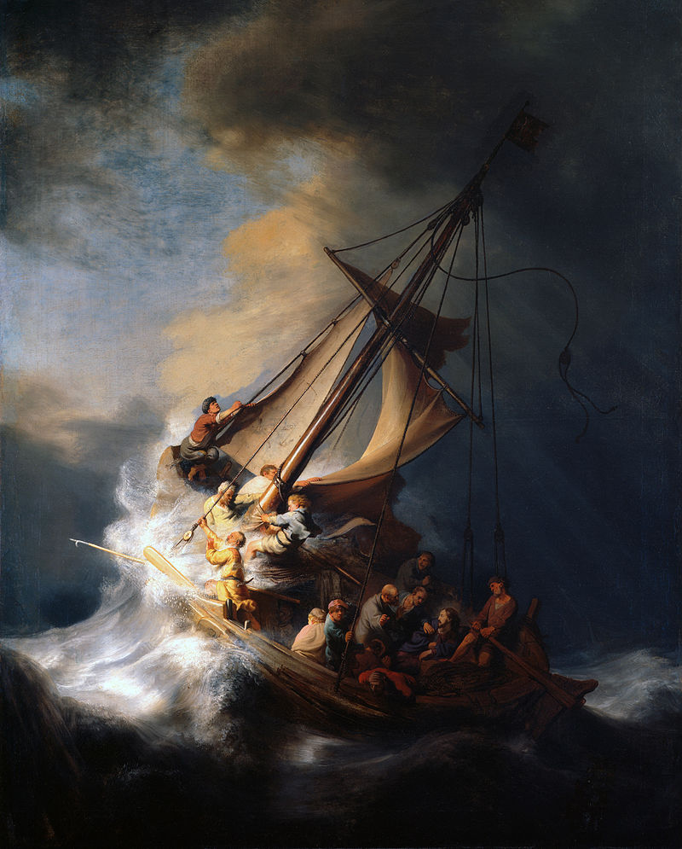
Rembrandt van Rijn. The Storm on the Sea of Galilee, 1633.
The painting is still missing after the robbery from the Isabella Stewart Gardner Museum in 1990.

Slide 45
Still Life Painting
Paintings of Inanimate Objects
Willem Kalf (1619–1693)

Slide 46
Willem Claeszoon Heda, Breakfast Table with Blackberry Pie (1631)
Heda was famous for his depiction of reflective surfaces.

Slide 47
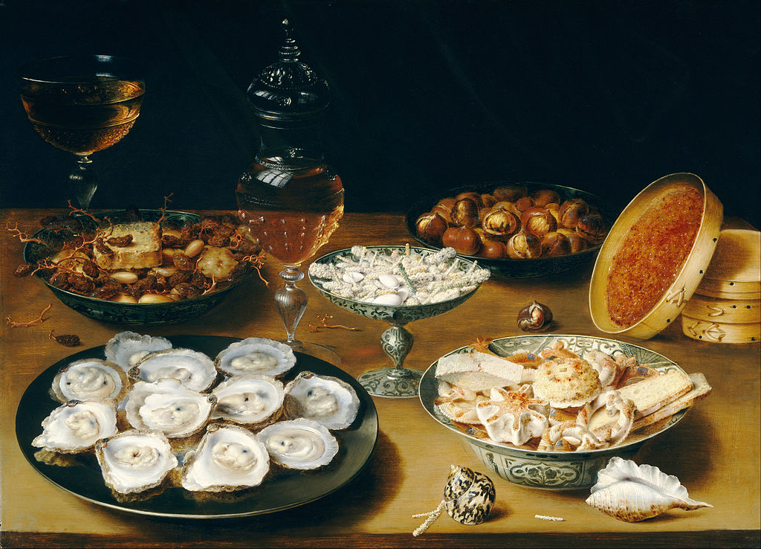
Osias Beert the Elder, Dishes with Oysters, Fruit, Candy and Wine, c. 1620/1625

Slide 48
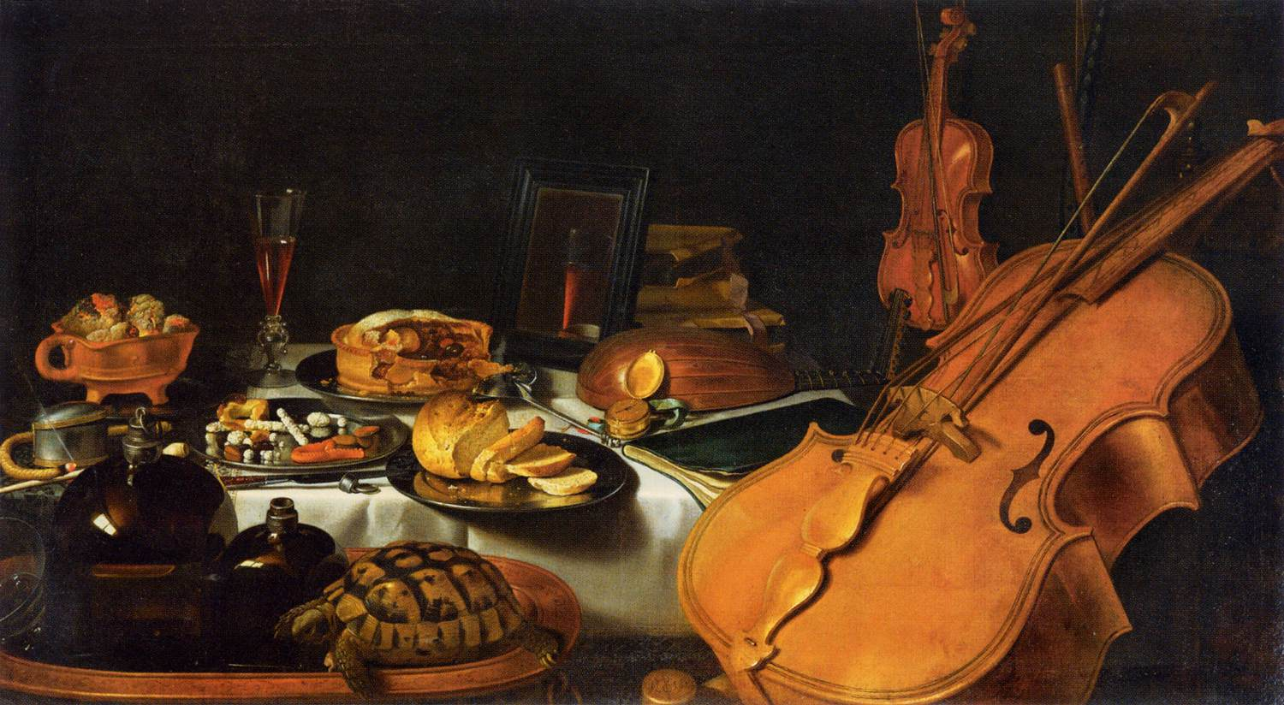
Pieter Claesz (1597–1660), Still life with Musical Instruments (1623)

Slide 49
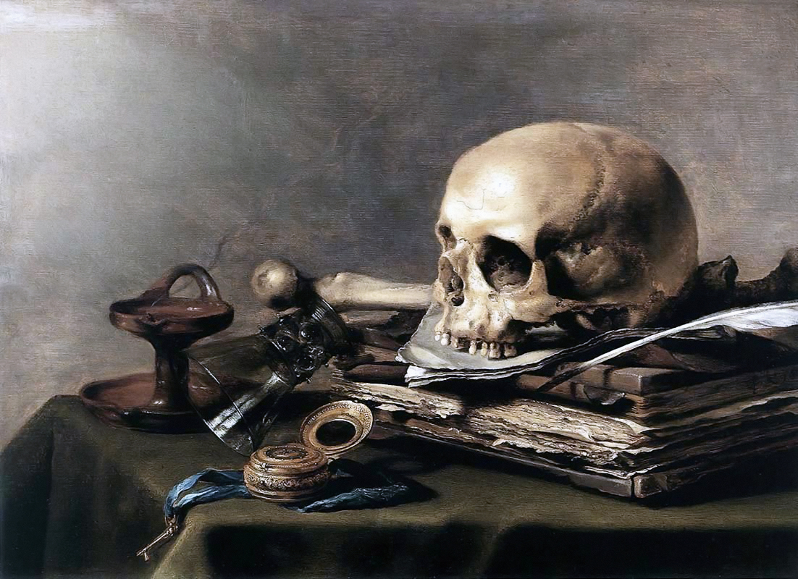
Pieter Claesz, Vanitas (1630)

