Slide 1
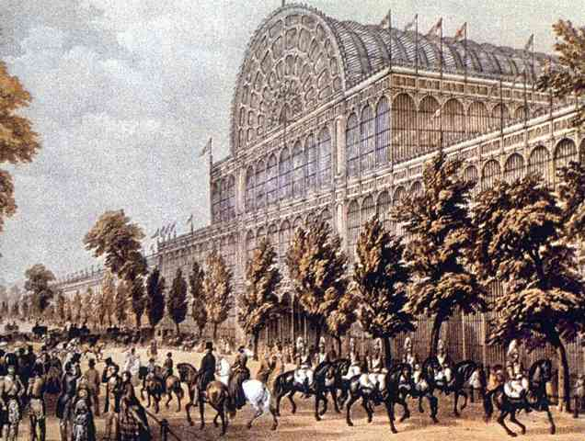
Crystal Palace Exhibition: 1851
Exhibitions of the new industrial utopia.

Slide 2
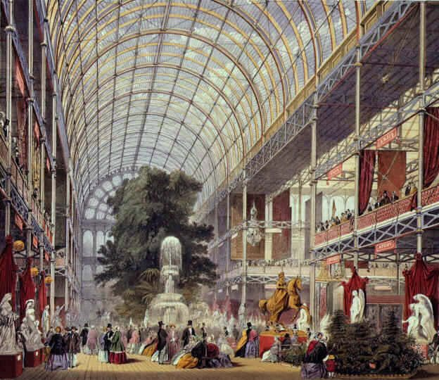
Crystal Palace: Interior Exhibits

Slide 3
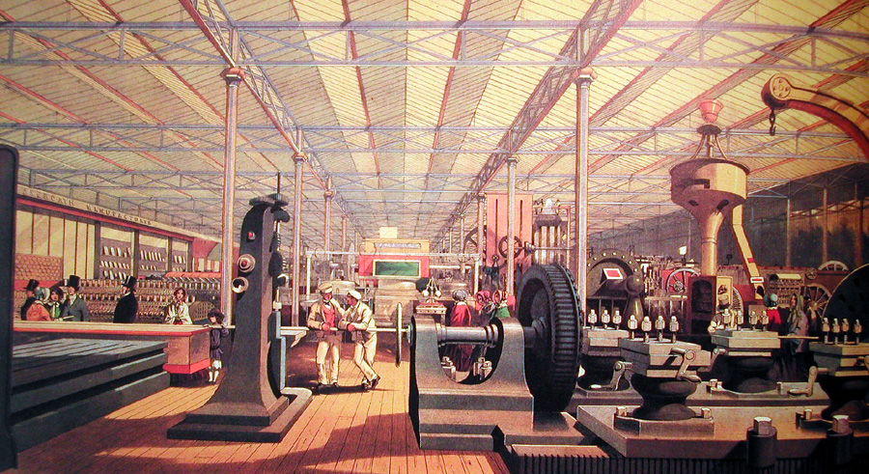
Crystal Palace: British Ingenuity on Display

Slide 4
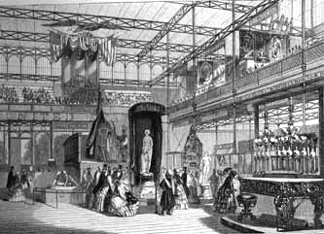
Crystal Palace: American Pavilion

Slide 5
The "Haves":
Bourgeois Life
Thrived on the
Luxuries of the
Industrial Revolution

Slide 6
19^{c} Bourgeoisie: The Industrial Nouveau Riche

Slide 7
Criticism of the New Bourgeoisie

Slide 8
Stereotype of the Factory Owner

Slide 9
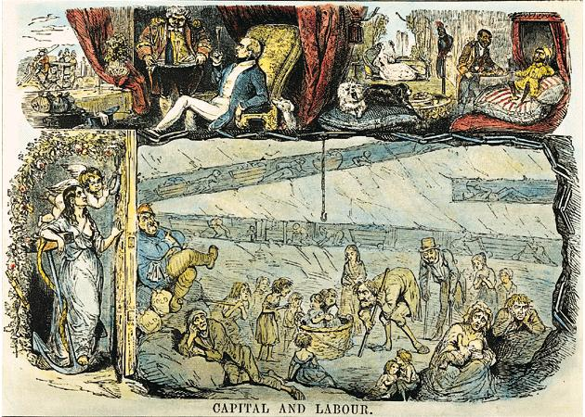
“Upstairs”/“Downstairs” Life

Slide 10
The "Have-Nots":
The Poor,
The Over-Worked,
& the Destitute

Slide 11
Factory Wages in Lancashire, 1830
Age of Worker | Male Wages | Female Wages
under 11 | 2s 3d. | 2s. 4d.
11 - 16 | 4s. 1d. | 4s. 3d.
17 - 21 | 10s. 2d. | 7s. 3d.
22 - 26 | 17s. 2d. | 8s. 5d.
27 - 31 | 20s. 4d. | 8s. 7d.
32 - 36 | 22s. 8d. | 8s. 9d.
37 - 41 | 21s. 7d. | 9s. 8d.
42 - 46 | 20s. 3d. | 9s. 3d.
47 - 51 | 16s. 7d. | 8s. 10d.
52 - 56 | 16s. 4d. | 8s. 4d.
57 - 61 | 13s. 6d. | 6s. 4d.

Slide 12
Industrial Staffordshire

Slide 13
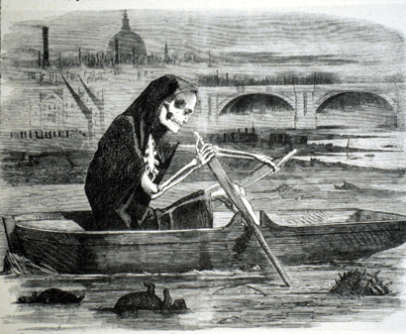
Problems of Polution
The Silent Highwayman - 1858

Slide 14
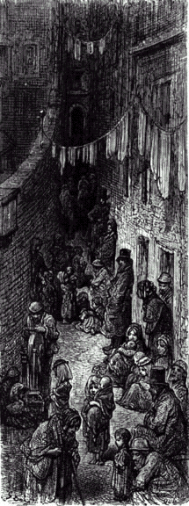
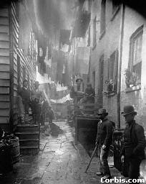
The New Industrial City

Slide 15
Early-19c London by Gustave Dore

Slide 16
Worker Housing in Manchester

Slide 17
Factory Workers at Home

Slide 18
Workers Housing in Newcastle Today

Slide 19
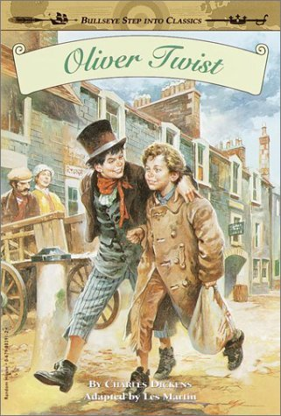
The Life of the New Urban Poor: A Dickensian Nightmare!

Slide 20
Private Charities: Soup Kitchens

Slide 21
Private Charities: The “Lady Bountifuls”

Slide 22
Protests / Reformers

Slide 23
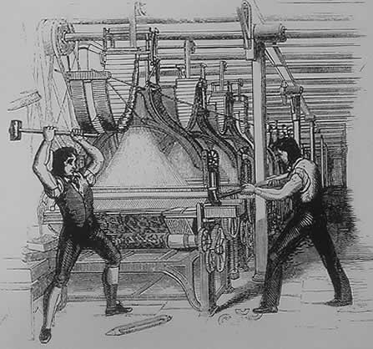
The Luddites: 1811-1816
Attacks on the “frames” [power looms].
Ned Ludd [a mythical figure supposed to live in Sherwood Forest]

Slide 24
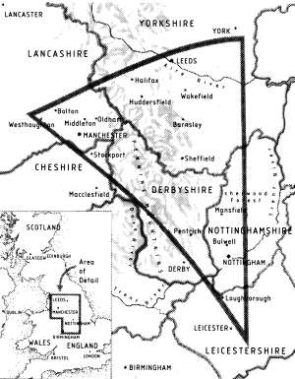
The Luddite Triangle

Slide 25
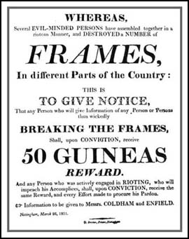
The Luddites

Slide 26
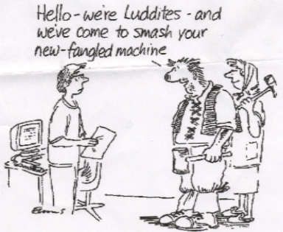
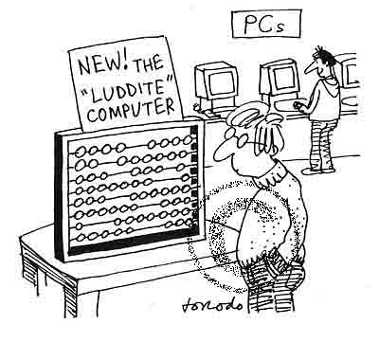
The Neo-Luddites Today

Slide 27
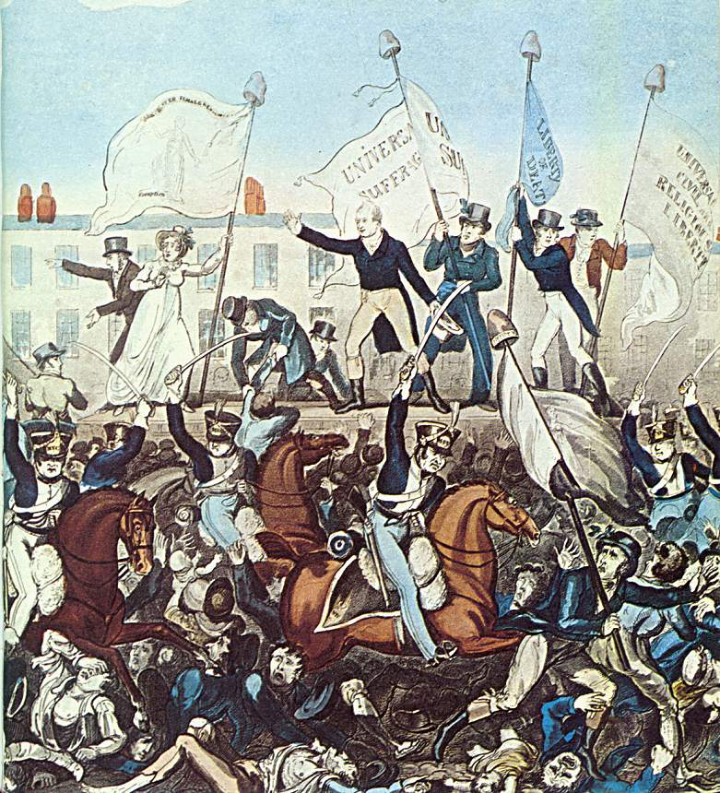
Peterloo Massacre, 1819
British Soldiers Fire on British Workers: Let us die like men, and not be sold like slaves!

Slide 28
The Chartists
Key
 | Chartist settlements
 | Centres of Chartism
 | Area of plug riots, 1842

Slide 29
The “Peoples’ Charter”
Drafted in 1838 by William Lovett.
Radical campaign for Parliamentary reform of the inequalities created by the Reform Bill of 1832.
Votes for all men.
Equal electoral districts.
Abolition of the requirement that Members of Parliament [MPs] be property owners.
Payment for Members of Parliament.
Annual general elections.
The secret ballot.

Slide 30
Anti-Corn Law League, 1845
Give manufactures more outlets for their products.
Expand employment.
Lower the price of bread.
Make British agriculture more efficient and productive.
Expose trade and agriculture to foreign competition.
Promote international peace through trade contact.

Slide 31
New Ways
of
Thinking

Slide 32
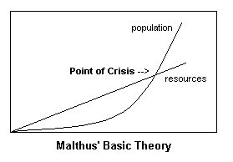
Thomas Malthus
Population growth will outpace the food supply.
War, disease, or famine could control population.
The poor should have less children.
Food supply will then keep up with population.

Slide 33
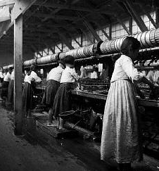
David Ricardo
“Iron Law of Wages.”
When wages are high, workers have more children.
More children create a large labor surplus that depresses wages.

Slide 34
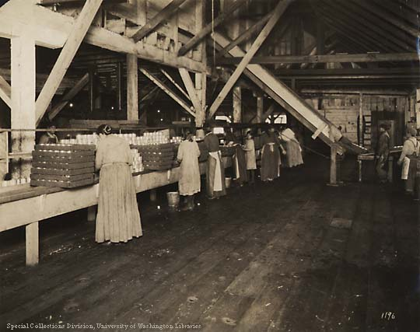
The Utilitarians: Jeremy Bentham & John Stuart Mill
The goal of society is the greatest good for the greatest number.
There is a role to play for government intervention to provide some social safety net.

Slide 35
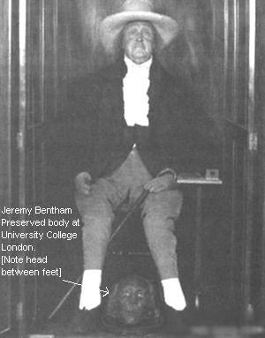
Jeremy Bentham

Slide 36
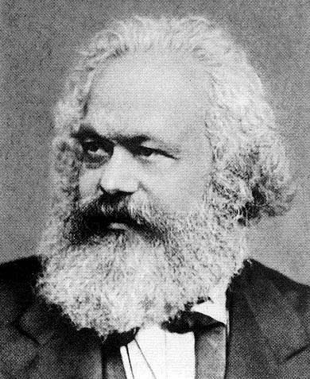
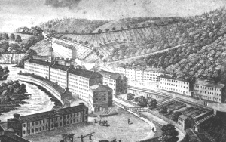
The Socialists: Utopians & Marxists
People as a society would operate and own the means of production, not individuals.
Their goal was a society that benefited everyone, not just a rich, well-connected few.
Tried to build perfect communities [utopias].

Slide 37
Br. Govt. Response
to the Dislocation
Created by
Industrialization

Slide 38
Government Response
Abolition of slavery in the colonies in 1832 [to raise wages in Britain].
Sadler Commission to look into working conditions
Factory Act [1833] – child labor.
New Poor Law [1834] – indoor relief.
Poor houses.
Reform Bill [1832] – broadens the vote for the cities.

Slide 39
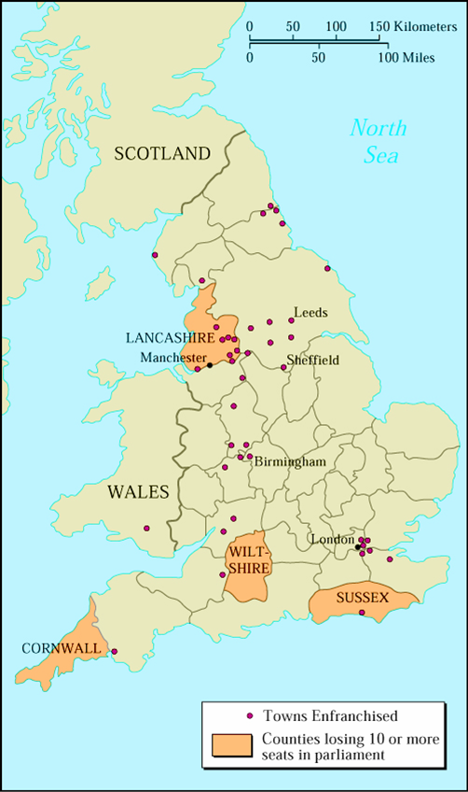
British Reform Bill of 1832

Slide 40
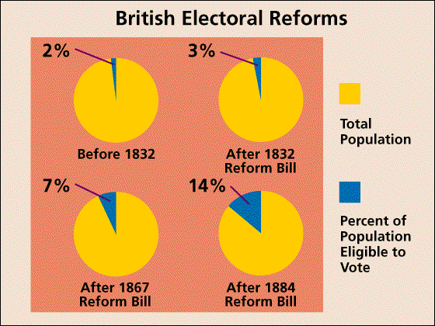
British Reform Bills

