Slide 1
Crime and Punishment in the Victorian Era

Slide 2
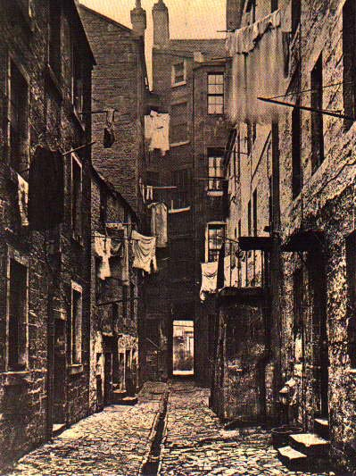
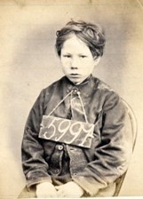
Crime in Victorian England
Crime rates in Victorian England rose from 5,000 cases a year - 1800 to approx. 20,000 in 1840.
The reason crime skyrocketed was due to the Industrial Revolution. The Industrial Revolution not only created more wealth, but took it away from many. Poverty increased. Urbanization caused many families to move into densely populated cities. The high poverty rates in these cities indirectly caused the crime rates to soar.
Notes:
http://ourwardfamily.com/1800%27s_britain.htm#Crime

Slide 3
Minor Crimes in Victorian England
Drunkenness
Vagrancy
Wandering about without employment, when the person is capable, however chooses to instead live off charity.
Prostitution
Larceny
Minor theft of others possessions, such as pick pocketing
Common among young children in large cities
Major Crimes in Victorian England
Burglary Usually any major
Murder crime resulted in
Rape death.

Slide 4
Criminals in Society
The Victorian Era drastically changed how a criminal was treated in society.
In the beginning many saw criminals as the lowest working class - people who refused to make an honest living.
Near the middle of the era, people began to view criminals as a social class. This “class” was obviously at the very bottom of society.
By the end of the Victorian Era the view of criminals had changed towards a mental illness - their actions could be blamed on their parents and/or upbringing.
All of these views contributed as to how criminals were treated in court.
Notes:
http://www.nationalarchives.gov.uk/education/victorians.htm

Slide 5
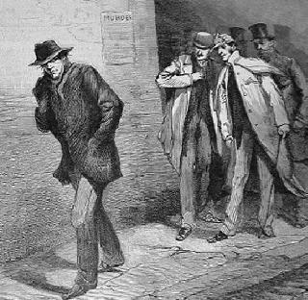
Jack “The Ripper”
Jack the Ripper - famous for his murders in East London, 1888. He was never found, or tried for the crimes he committed.
-He murdered approximately 5 prostitutes.
- After murdering his victim he would cut out their organs and leave them beside the body
-His “reign of terror” only lasted for
12 weeks.
Notes:
http://jack-the-ripper.org/

Slide 6
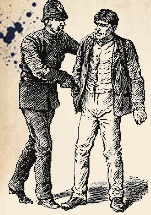
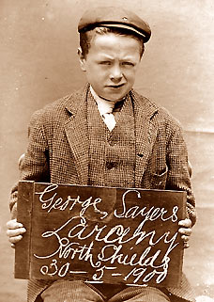
The police force did not really manifest in England until the 1840’s.
A 13 year old boy charged for larceny in late Victorian Era.

Slide 7
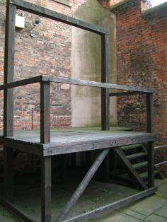
Death by Hanging
During the 18th century, the amount of crimes punishable by hanging accelerated to around 200!!
Some crimes punishable by hanging were reasonable, like treason or murder.
However, crimes such as pick pocketing and stealing food were also punished with hanging.
hanging platform- short drop

Slide 8
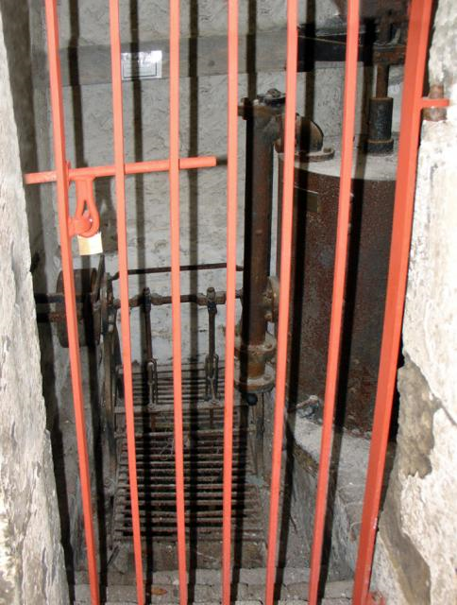
Prisons
Prisons were first used only as for debtors and a place for those accused of a crime to stay before their trial.
By the Victorian Era, prisons were being used more often, and seen as a fit way to reduce crime.
Prison became a main form of punishment for almost all offences.

Slide 9
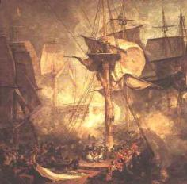
War In Victorian Era
In time of war it was often difficult to recruit people for armed forces; especially the navy.
Some prisoners were reprimanded into the army as punishment
Some criminals could be pardoned by enlisting in the navy.

Slide 10
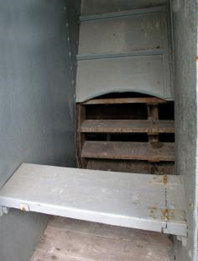
Labor During Victorian Era
Prisoners were often used as the main work force in quarrying, building of roads and/or laboring on the docks.
All strict sentences often included a form of hard labor.
In the early 19th Century children and adults worked side by side doing hard labor.
Crimes dictating hard labor were wide and varied and generally depended on the result of the trial.
Prison Treadmill

Slide 11
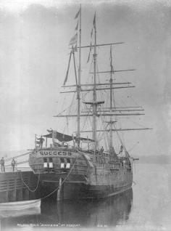
Transportation
The alternative to hanging was transportation; convicted criminals were sent to the colonies to serve their sentence.
At first only a criminal with a sentence of 7 years or more could be transported.
In Victorian period, transportation changed to Penal Servitude.
Depending on the crime committed, rank, and wealth determined the length of servitude
A ship used to transport prisoners

Slide 12
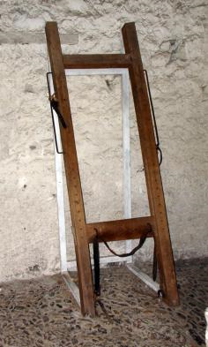
Physical Punishment
In the 18th and 19th century public whippings declined in number.
Private whippings, however, increased due to the restrictions on other forms of punishment
In 1817, the public whipping of women was abolished.
In 1830, the public whipping of men was abolished.
Private whippings continued until 1948
A whipping device

