Slide 1
Brainstorm before you begin:
The Protestant Reformation is sweeping across Central Europe, England, and even Scandinavia! You have been hired by the Pope to develop ideas that the Church can implement in order to stop believers from converting to these heretical faiths. What are your top 3 ideas? Hurry, you must act quickly, or Protestantism may overrun Europe!

Slide 2
The Counter Reformation 1530s-1648
The Catholic Church’s Response to the Protestant Reformation

Slide 3
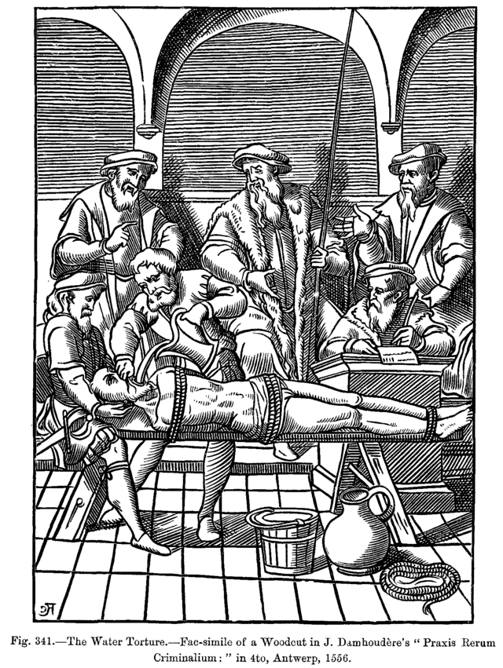
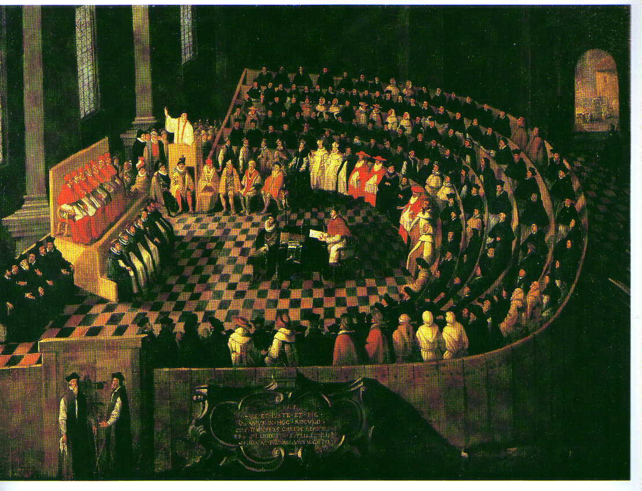
The Counter Reformation
The Church had two tactics:
Reform the Church from Within
Council of Trent
Stop the Spread of Protestantism
Water Torture during the Inquisition

Slide 4
What does this sentence mean?
I recognize the Holy Catholic and Apostolic Roman Church as the Mother and Mistress of all churches; and I vow and swear true obedience to the Roman Pontiff. (Pope)
This is an excerpt from a statement that was written during the Council of Trent. The Council of Trent was a large meeting held by the Catholic Church to discuss the issue of Protestantism. Based on this excerpt, predict whether they made significant changes to their beliefs.

Slide 5
Reform Within the Church
The Council of Trent (1545-1563)
Purpose: The Church held three meetings to discuss reform AND define dogma (official teachings)
Some areas were actually reformed
Called for the education of priests
Improved discipline and administration among the clergy
Indulgences got banned after the Council finished its meetings
But many teachings were not changed, and were instead reinforced; the ideas of the Protestants were rejected
You need faith AND good works to achieve salvation
7 sacraments, not just 2
Bible is written in Latin, not the vernacular language
Pope is supreme leader
Man has free will (your fate is NOT predestined)

Slide 6
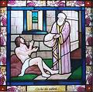
Reform Within the Church
The Council helped revitalize the Catholic Church, as did the creation of new Catholic groups
These new religious orders were created to focus on performing charity and good works
This reaffirmed the Catholic tradition that one needed more than just faith to be saved
Lived among the poor and sick
Strengthened rural parishes
Encouraged pious and simple living

Slide 7
Stopping the Spread of Protestantism
The Church also tried to prove that it was still a powerful institution, just like it had been in the Middle Ages
It continued to stress its orthodox teachings during the Counter-Reformation, and was usually very intolerant of different ways of thinking.
The Church also took measures to reassert its authority in the following ways:
The Jesuits
The Inquisition
The Index of Prohibited Books

Slide 8
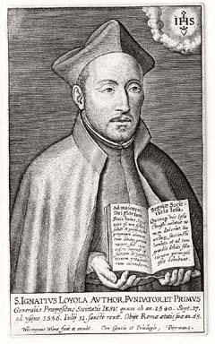
Stopping the Spread of Protestantism
The Society of Jesus: The Jesuits
A religious group founded by Ignatius Loyola in 1540
Promoted education
Famous for missionary work
Strived to gain political influence
Countered the populist Protestant
Reformation by working top-down and
counseling kings and princes
Also a bit fanatical in their devotion…

Slide 9
What does this quote by Loyola mean?
“We should always be disposed to believe that that which appears white is really black, if the hierarchy of the Church so decides.”

Slide 10
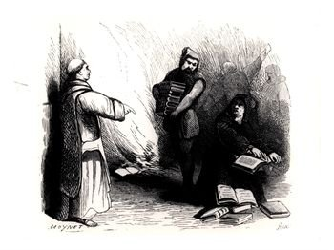
Stopping the Spread of Protestantism
Index (List) of Banned Books
Created in 1559 by the Pope
Purpose was to prevent heresy (make sure you know what this word means) and ensure books were morally correct
Banned both Protestant literature and texts by some intellectuals, like Erasmus
Click on this link to see the list: http://www.fordham.edu/halsall/mod/indexlibrorum.asp

Slide 11
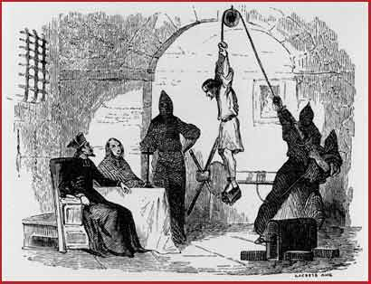
Stopping the Spread of Protestantism
The Inquisition
Why?
General purpose was to discover heretics (mostly Jews and Muslims, but also Protestants), reinforce Catholic doctrine, and prove the power of the Church
When?
1400s-1800s
Where?
Mostly Spain and Italy
Different variations took place
across Europe, but it was most notorious
in Spain
Ironic! (These places were strongholds of Catholicism)
How?
The accused were put
on trial and were guilty
until proven innocent…
Torture was used to elicit
confessions

Slide 12
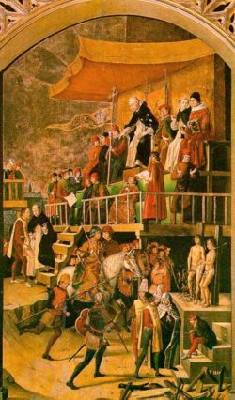
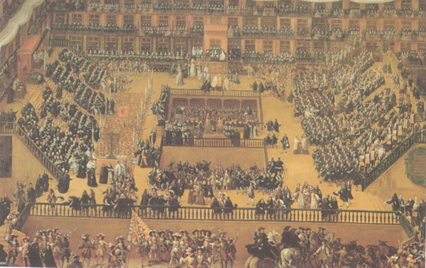
Stopping the Spread of Protestantism
The Inquisition often used the Auto-da-fe: “Act of Faith”, a public trial that was usually followed by torture or execution

Slide 13
Was the Counter-Reformation a success?
The Church did not win back many of the “lost souls” that had converted to Protestantism…
But, it shed its reputation for corruption and it spread widely through missionary work

Slide 14
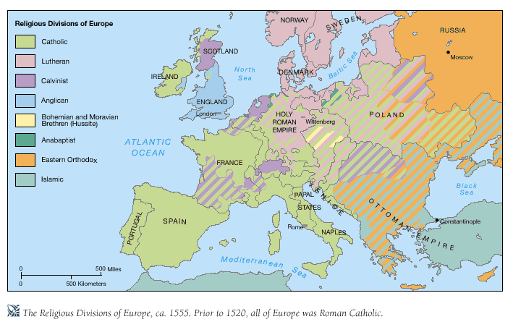
Europe in 1555

Slide 15
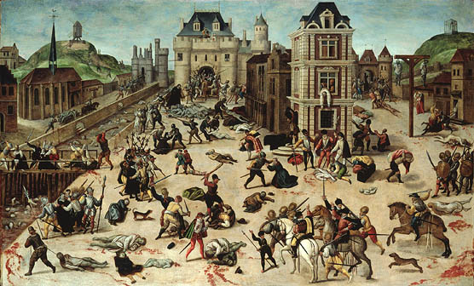
Based on the divisions on the preceding map, can you predict what will happen in Europe next?
Massive bloodshed and warfare as members of the different religions battle with each other.

