Slide 1
The Congress
of
Vienna
Peace, Man, Peace

Slide 2
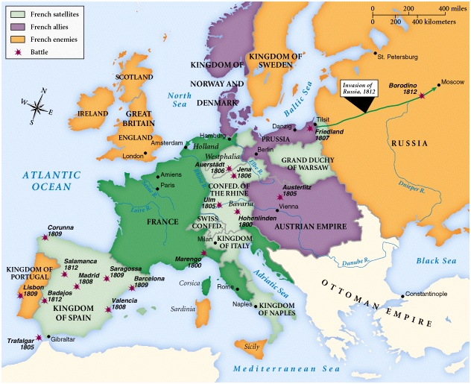
Europe in 1812

Slide 3
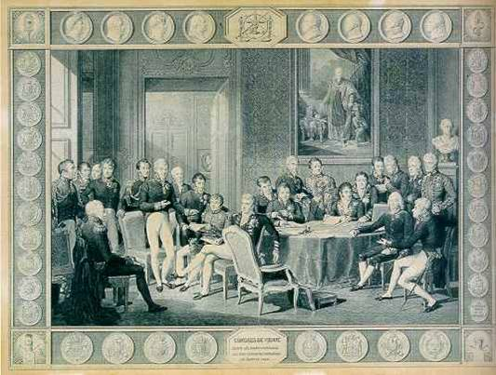
The Congress of Vienna (September 1, 1814 – June 9, 1815)

Slide 4
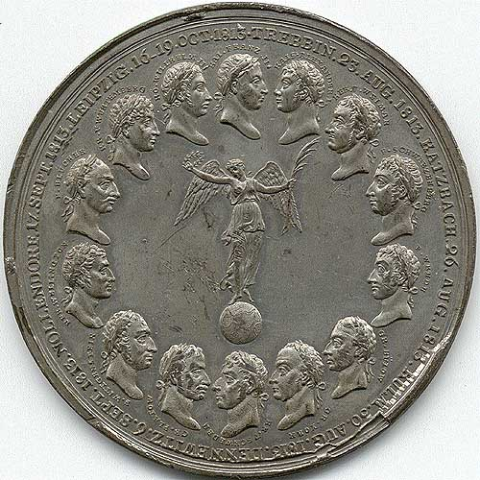
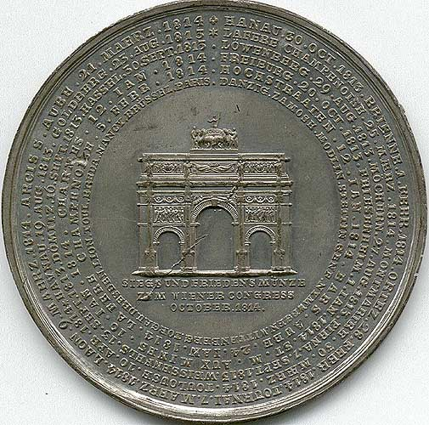
Coin Commemorating the Opening of the Congress of Vienna

Slide 5
Main Objectives
It’s job was to undo everything that Napoléon had done:
Reduce France to its old boundaries → her frontiers were pushed back to 1790 level.
Restore as many of the old monarchies as possible that had lost their thrones during the Napoléonic era.
Supported the resolution: There is always an alternative to conflict.

Slide 6
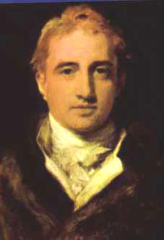
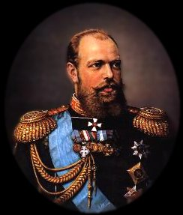
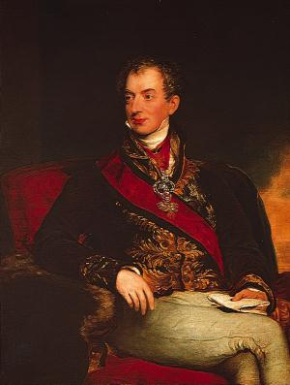
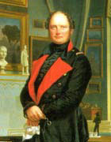
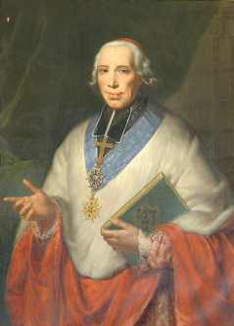
Key Players at Vienna
Tsar Alexander I (Rus.)
Foreign Minister, Viscount Castlereagh (Br.)
The “Host” Prince Klemens von Metternich (Aus.)
King Frederick William III (Prus.)
Foreign Minister, Charles Maurice de Tallyrand (Fr.)

Slide 7
Key Principles Established at Vienna
Balance of Power
Legitimacy
Compensation
Coalition forces would occupy France for 3-5 years.
France would have to pay an indemnity of 700,000,000 francs.

Slide 8
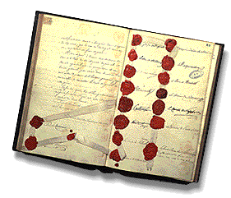
Changes Made at Vienna (1)
France was deprived of all territory conquered by Napoléon.
Russia was given most of Duchy of Warsaw (Poland).
Prussia was given half of Saxony, parts of Poland, and other German territories.
A Germanic Confederation of 30+ states (including Prussia) was created from the previous 300, under Austrian rule.
Austria was given back territory it had lost recently, plus more in Germany and Italy.
The House of Orange was given the Dutch Republic and the Austrian Netherlands to rule.

Slide 9
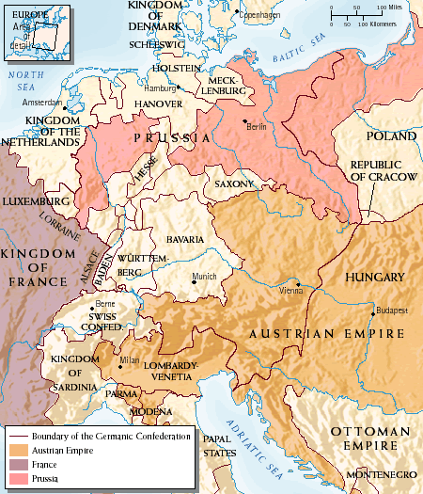
The Germanic Confederation, 1815

Slide 10
Changes Made at Vienna (2)
Norway and Sweden were joined.
The neutrality of Switzerland was guaranteed.
Hanover was enlarged, and made a kingdom.
Britain was given Cape Colony, South Africa, and various other colonies in Africa and Asia.
Sardinia was given Piedmont, Nice, Savoy, and Genoa.
The Bourbon Ferdinand I was restored in the Two Sicilies.
The Duchy of Parma was given to Marie Louise.
The slave trade was condemned (at British urging).
Freedom of navigation was guaranteed for many rivers.

Slide 11
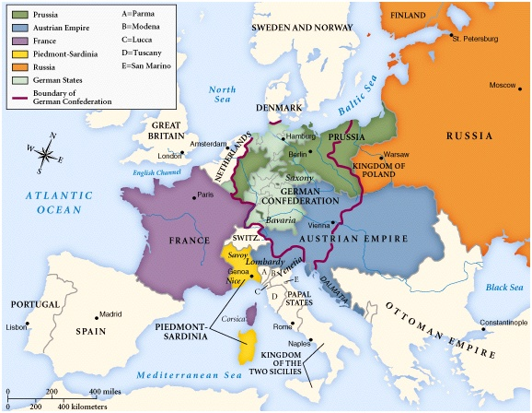
Europe After the Congress of Vienna

Slide 12
What was the legacy of the Congress of Vienna?

