Slide 1
Conflicts in the Middle East

Slide 2
Background
Israel: promised land of the Jews dating back 3000 years
Palestine: land consisting of Israel, West Bank and Gaza Strip
Palestinians (both Muslim and Christian) claim Palestine since Jews were driven out of the region in 135 A.D.
Arabs claim Palestine is theirs since their conquest of the region in the 7th century

Slide 3
Background
When Jews were forced out of Israel in 135 A.D. they dispersed throughout the world—Diaspora
Zionists—Jews who want to return to their homeland in Israel/Palestine (began organizing 19th and 20th centuries)

Slide 4
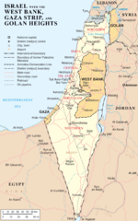

Slide 5
Background
Palestine was controlled by the Ottoman Empire until it collapsed after WWI
League of Nations asked Britain to oversee Palestine until it is ready for independence

Slide 6
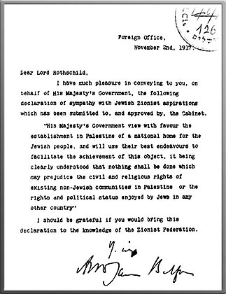
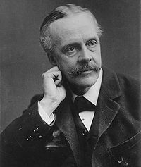
The Balfour Declaration
1917—Zionist leaders write a letter to British Foreign Secretary Sir Arthur Balfour asking for a Jewish homeland in Palestine

Slide 7
1. Britain issues the Balfour Declaration
CAUSES:
Increase of Jews immigrating to Palestine
Request for a Jewish homeland
Need to retain support of Palestinians and Jews during WWI
EFFECTS:
Issue not solved
British refer issue to UN
Hostility grows b/t Jews and Palestinians

Slide 8
2. Independent Israel is created
Causes:
1947--UN recommends partitioning Palestine
International support for Jews after the Holocaust
Effects:
Outbreak of full-scale Arab-Israeli war

Slide 9
Independent Israel
Jerusalem is a city owned by neither side
Jews get 55% of land (they are only 34% of population)—sympathy from UN
Palestinians and Arabs reject it—say UN should not partition a country against the wishes of the majority of residents

Slide 10
The conflict begins
The day after Israel is created it’s invaded by its Islamic neighbors
The state of Israel never came into being due to constant invasions—Jews are able to claim about half the promised land
600,000 Palestinians flee because of fighting—settle in UN refugee camps
Arabs also start seizing Palestinian lands
Egypt takes control of Gaza Strip
Jordan annexes the West Bank

Slide 11
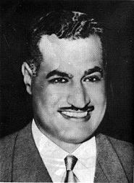
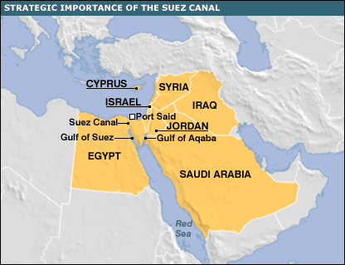
3. The 1956 Arab-Israeli war breaks out
CAUSES:
Egypt (led by Nasser) seized Suez Canal
EFFECTS:
Egyptians defeated
Israel and British/French allies withdraw from Egypt, who regains control of the canal

Slide 12
4. The 1967 Six-Day War begins
CAUSES:
Tension b/t Israel and Arab states
EFFECTS:
Heavy Arab losses
Israeli annexation of Jerusalem, West Bank, Sinai Peninsula and Golan Heights (as a buffer zone)

Slide 13
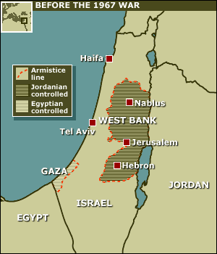
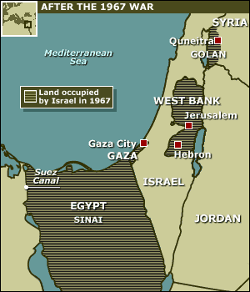
Before and After 1967 War

Slide 14
After 1967 War:
Palestinians living in Jerusalem given a choice of citizenship—Israeli or Jordanian (most chose Jordan)
Palestinians living in other areas not given choice—under Jewish control

Slide 15
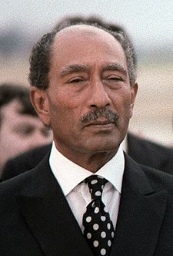
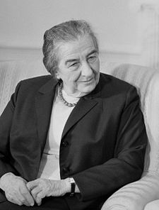
5. The 1973 Yom Kippur War begins
CAUSES:
Joint Arab attack on holiest Jewish holiday
Led by new Egyptian President Anwar Sadat
EFFECTS:
Israeli counterattack followed by an uneasy truce
Led by Israel prime minister Golda Meier

Slide 16
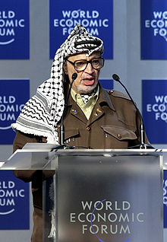
Creation of the PLO
Israel and its Arab neighbors continue to battle for control of region
Palestinians struggle for recognition
UN grants Palestinians West Bank and Gaza Strip, but Israelis take control of it
1964— Palestine Liberation Organization formed to push for a Palestinian state
dominated by guerilla troops
1969— Yasir Arafat becomes leader of PLO

Slide 17
6. Sadat and Begin sign the Camp David Accords (1979)
CAUSES:
Sadat offers peace to Israel in exchange for recognition of Palestinian state
US President Carter invited Sadat and Begin to Camp David to work out differences
EFFECTS:
Egypt recognized Israel as a nation
Sinai peninsula transferred back to Egypt
1981-Sadat is assassinated by Arab Muslim extremists

Slide 18
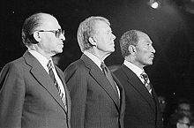
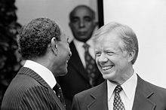
The Camp David Accords

Slide 19
Israeli-Palestinian tensions 1970s-1980s
PLO & Israel fight forcefully for control of West Bank and Gaza Strip
Palestinians call for intifada (uprising), or civil disobedience against Israel
Peace talks needed—1993 meet secretly in Oslo, Norway

Slide 20
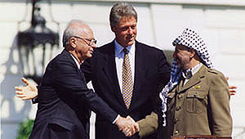
7. Rabin & Arafat issue a Declaration of Principles (a.k.a. Oslo Accords)
CAUSES:
Ongoing conflict over Israeli-occupied territories led to series of peace talks
EFFECTS:
Self-rule for Palestinians in Gaza Strip and West Bank
Rabin is assassinated (1995) by Jewish extremist

Slide 21
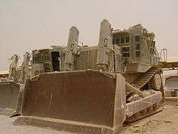
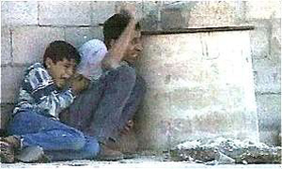
Israel-Palestine conflict continues
July 2000—US President Clinton attempts more peace talks, but PLO and Israel can’t reach agreement
Second Intifada begins—this time with suicide bombers
Israel starts invading refugee camps and bulldozing Palestinian towns

Slide 22
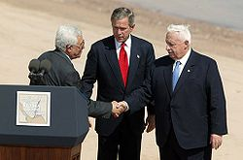
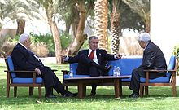
Israel-Palestine tensions continue
2003: US President Bush brings together Abbas (PLO) and Sharon (Israel)
Work on “road map” for peace
Key issue is still independent Israel and Palestine states

Slide 23
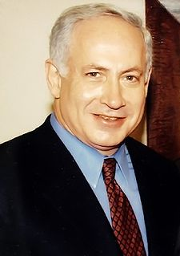
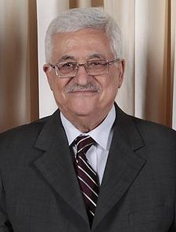
The Struggle Continues Today. Current leaders:
Israel: Benjamin Netanyahu
Palestinians: Mahmoud Abbas

