Slide 1
© Morgan AP Teaching
Period 1: 1450 CE -1648 CE
The Price Revolution and Commercialization

Slide 2
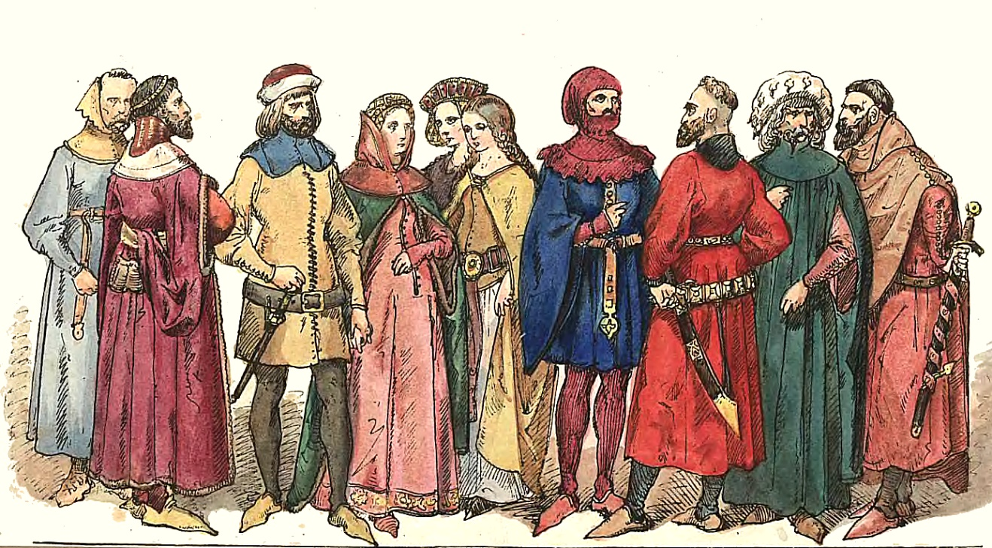
© Morgan AP Teaching
Price Revolution
The influx of New World goods and silver had a
dramatic impact on Europe: the Price Revolution–-
a drastic increase in goods, money, and prices
Essentially, the massive flow of Spanish silver and
American goods into Europe provided Europeans
with plenty of cash from silver and trade
This in return drove the prices of goods up very quickly including the demand and prices for food, which was in short supply due to inefficient farming methods
To accommodate this, lords and governments increasingly closed off their land to the peasants to harvest more efficiently
As a result, land owners now became substantially more rich —especially the ones who fenced off and organized their land

Slide 3
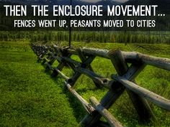
© Morgan AP Teaching
The Enclosure Movement
During the Middle Ages, European economies were
dominated by large landowners who used peasant labor
to grow and harvest crops
Known as peasant agriculture, these peasants were bound
to the land of their lord, paying him taxes in grain, while
being protected by the lord from hardship
The land they lived on was largely unorganized, and called
common land that any could use for farming, foraging, or hunting
However, beginning in England the 16th century, due to the Price Rev, Lords began to close off their land from the peasants to farm for large profits
Fences were built, and the peasants who remained were used in a more organized manner to plant and harvest crops

Slide 4
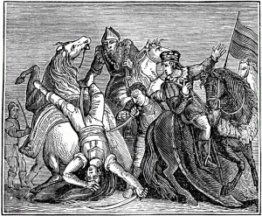
© Morgan AP Teaching
Commercialization
The Enclosure Movement was the beginning of commercialization
in Europe—the harvesting and selling of crops by land owners
for profit
By the 16th century, some of the new economic ideas such as
printed money banks, loans, and credit had made their way
into Europe through Italy
No longer did simply having land mean you had power, to increase
your power, you needed to sell goods, and that meant commercializing agriculture
The peasants did not go quietly however, many openly rebelled when they were stripped of their peasant rights
Kett’s Rebellion was on such example in England in 1549

Slide 5
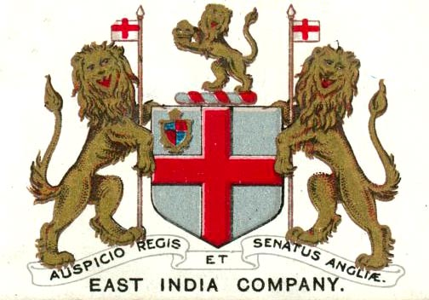
© Morgan AP Teaching
Mercantilism
This drastic rise in money supply, as well as new systems of
banking and loans allowed for more investment opportunities
This expanded joint-stock investment, as more people were
able to invest in exploration, as well as start new companies
Additionally, increased money and income resulted in more taxes for govs to fund exploration, thus enabling more colonization and charter companies to form
Two excellent examples of successful charter companies are the British East India Company and the Dutch East India Company
These companies then established new settlements in the New World, and brought back the goods and the profits to enrich the mother country

Slide 6
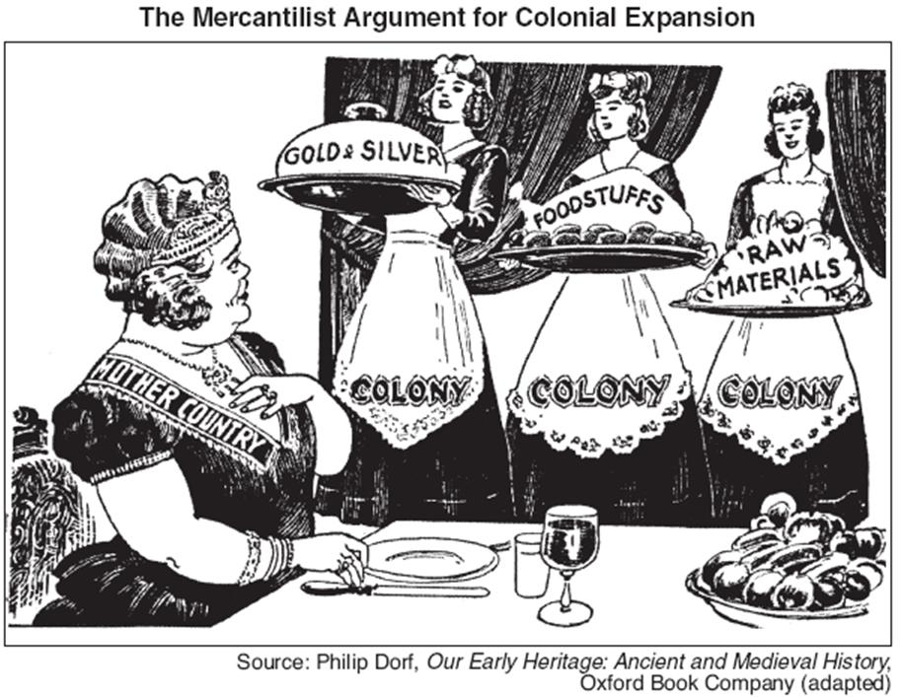

Slide 7
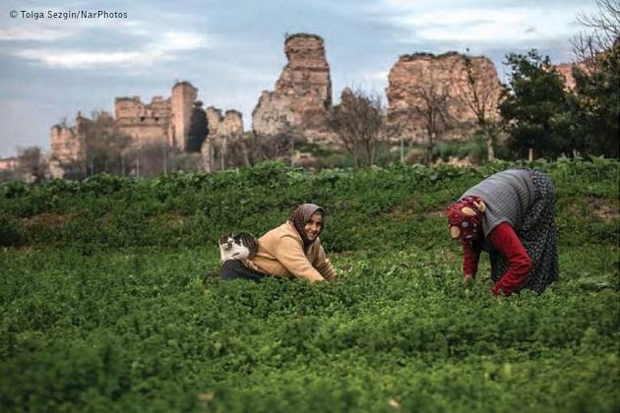
© Morgan AP Teaching
Agriculture
While much of Western Europe was commercializing, exploring, and
profiting during the 16th century, the people of Europe were still
mostly peasants
While many were making their way to the cities, peasant agriculture was,
during the 16th and 17th centuries, still the dominant economic form
In Eastern Europe, almost no commercialization occurred
Poland, Hungary, and Russia all remained largely agricultural and tied to serfdom
As a result, in Eastern Europe land-based nobles would hold the majority of the power and prevent Eastern Europe from growing economically

