Slide 1
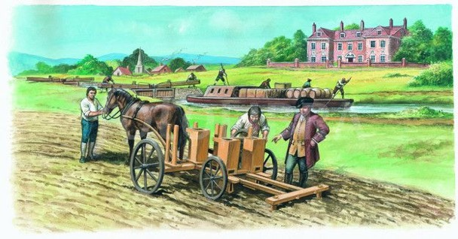
Period 2: 1648 CE – 1815 CE
Commercial Agriculture &
the Agricultural Revolution

Slide 2
Capitalism Grows
Banking and capitalist policies caused an unexpectedly rapid period
of economic growth in Europe during the 18th and 19th centuries
More developed banking and investment led to the creation of
new money through loans, deposits, and spending (multiplier effect)
This allowed people to make and spend more money,
and governments to become more and more wealthy from taxes
As a result, European economies skyrocketed, and wages,
money, and standards of living rose for all Western Europeans
This also caused militaries to grow stronger and infrastructure began to improve

Slide 3
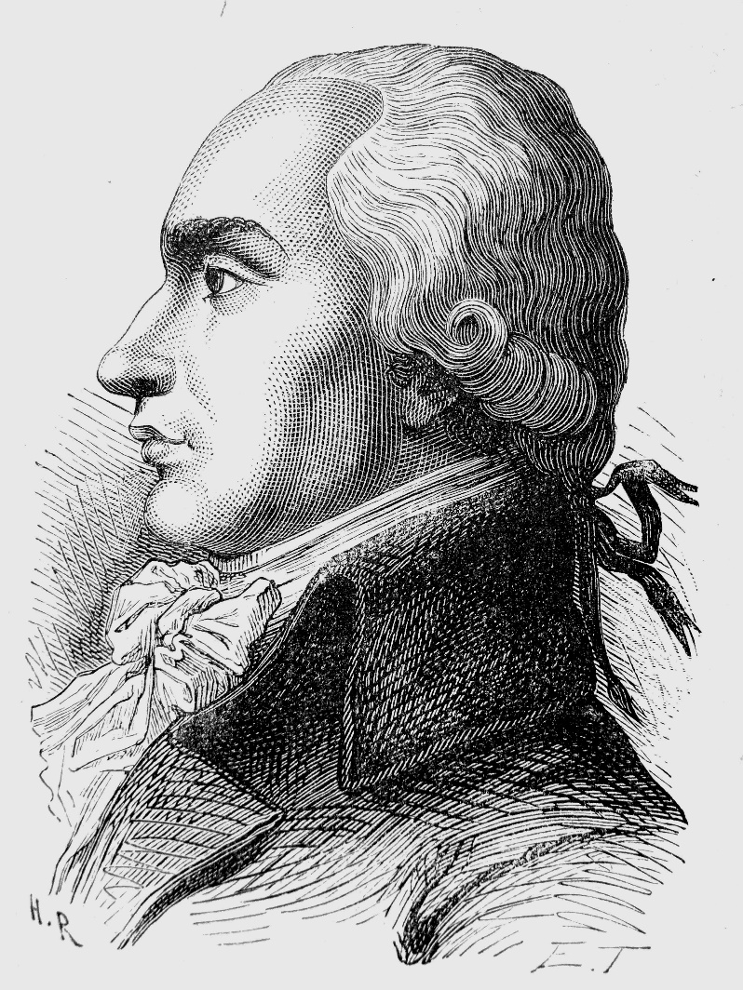
Pro-Capitalist Policies
Witnessing the success of free market economics, governments began to start making changes to facilitate free trade and capitalism
In France, Le Chapelier Laws in 1791 officially banned all guilds in France
Laissez-faire trade rose, and governments, especially Britain, began to reduce or eliminate tariffs
Governments began to remove price controls, and parliaments (made mostly of gentry) increased protections on private property
Example: property was now owned by tenants, not leased by the king; therefore, it can only take property with a fair trial

Slide 4
Physiocrats
Groups like the Physiocrats in France advocated the organization
and enhancement of agriculture for profit rather than trade balance
and wealthy rulers (mercantilism)
They believed that economies should focus on developing cheap
and effective labor to sell agr. goods for more than it cost to make them
Rather than focusing on wealthy rulers or balanced trade, they argued
free-market labor and production were the best way to make a nation wealthy
Since manufacturing was still small-scale in 17th and 18th century Europe, agriculture was the largest economic category
This encouraged more landowners outside of great Britain to close off their land

Slide 5
Consumer Culture
This massive amount of economic growth and money supply
created, for the first time, a consumer culture in Europe
With more money supply and higher wages, Europeans in the 18th century,
began buying far more tobacco, sugar, coffee, silk, rum and other goods
Middle class people began to have more spare time, which they would
spend reading novels in new types of houses
These new houses included boudoirs, private dressing rooms, and
these larger houses were decorated with porcelain dishes, curtains, and linens
This in turn created more jobs, businesses, and expansion as more money meant more spending, and more luxury goods

Slide 6
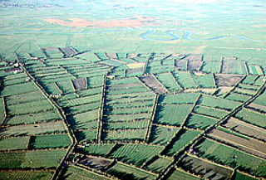
Agricultural Revolution
New food from the New World, and commercialized
agriculture (Enclosure Movement) also provided far more
food for Europeans, causing large-scale population growth
Enclosure and commercial agr. allowed owners to use more
productive agricultural techniques without interference
or trampling
Convertible Husbandry replaced three-crop rotation, allowing the entire field to be used, increasing agr. output
Fallow soil now planted clovers, turnips, and livestock manure to increase production
The rapid rise in food supply and population has led historians to label this spike in agricultural production the British Agricultural Revolution as the spike occurred first in Britain and spread from there

