Slide 1
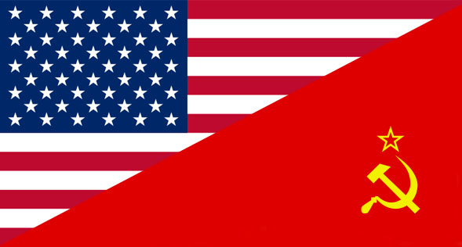
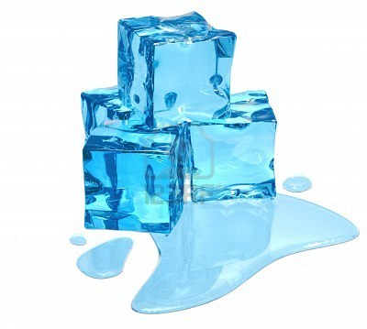
The Cold War Thaws

Slide 2
Refresh
What was the Cold War?
How did Stalin go against the decision made at the Yalta conference?
What was containment?
What was the purpose of NATO?
Why was the Berlin Wall built?
Why did the US get involved in Vietnam/Korea?

Slide 3
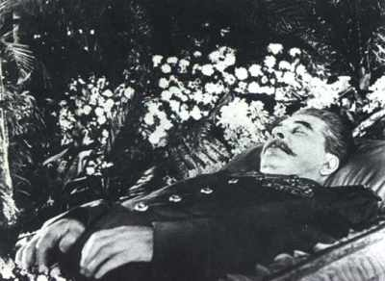
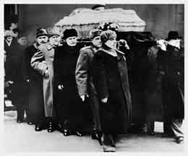
1. Stalin Dies
March 1953
Names no successor…
What will happen to Soviet Communism?

Slide 4
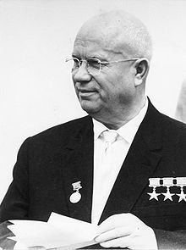
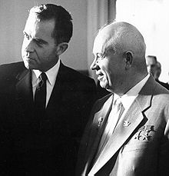
2. Khrushchev and Destalinization
Khrushchev takes over in 1956
Begins “destalinization” policy
Purging the country of Stalin’s memory
Wants peaceful competition with capitalist states

Slide 5
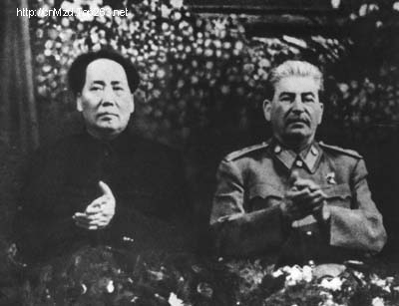
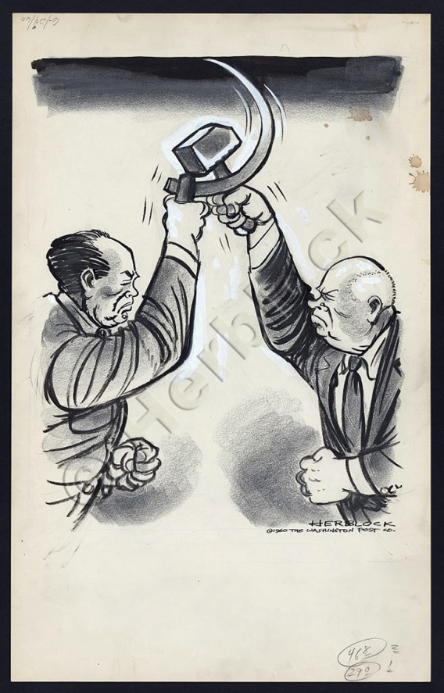
3. Soviet- Chinese Split
China and USSR signed 30 year treaty of friendship in 1950…which ended
BUT the Soviet Union thought the Chinese would follow their leadership…
the Chinese hated that!
Led to fighting along their border

Slide 6
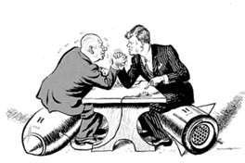
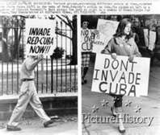
4. Cuban Missile Crisis
Khrushchev decides to build missile sites in Cuba and JFK finds out
JFK demands that they be removed
Creates a blockade of Cuba
Cold War becomes very hot
Almost a full on nuclear war!
Luckily, Khrushchev backs down at the last possible second
…Whew!

Slide 7
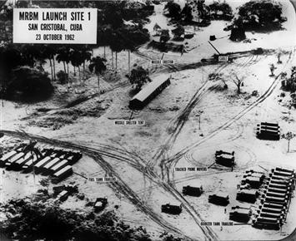
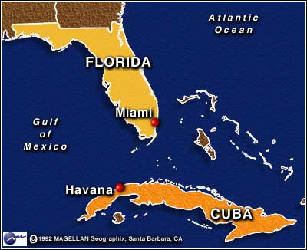

Slide 8
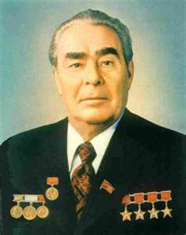
5. Brezhnev’s Harsh Policies
Brezhnev takes over after Khrushchev loses popularity
Limits freedom of speech and worship
Censorship and secret police
Brezhnev Doctrine- made sure that the satellite countries don’t rid of communism

Slide 9
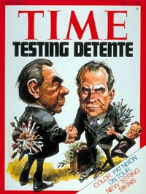
6. Brinkmanship to Détente
Brinkmanship – pushing to the brink (edge) of war
Détente - a cooling of tensions
This does NOT mean they stop fighting communism
The two sides just agree to reduce the tension

Slide 10
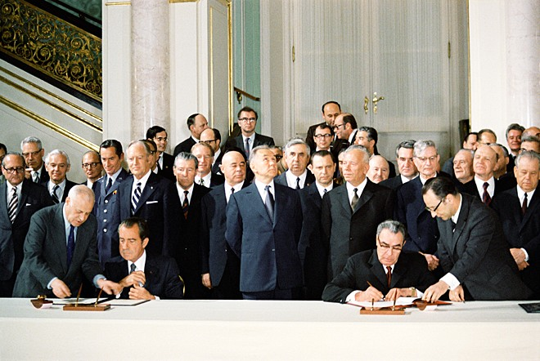
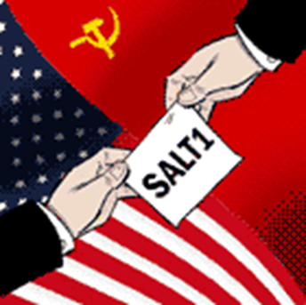
7. SALT
Nixon visits USSR in 1972
Strategic Arms Limitation Talks
US/USSR sign 5 year agreement to reduce the # of nuclear missiles

Slide 11
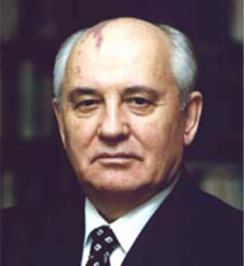
8. Gorbachev’s reforms
Gorbachev – took office in 1981
Glasnost- “openness”
Needed a free flow of ideas
Churches opened, dissidents released from prisoners, reporters could criticize
Perestroika- “economic restructuring”
Revive economy
Small businesses allowed to open
managers given more control over farms and factories

Slide 12
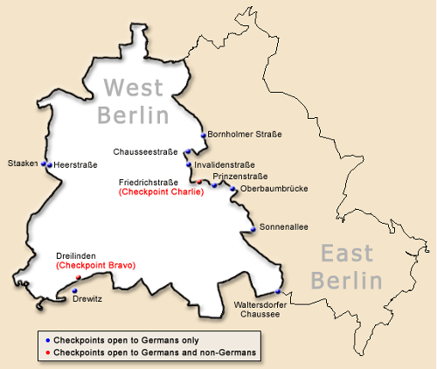

Slide 13
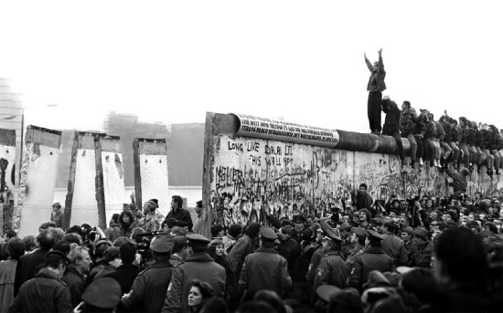
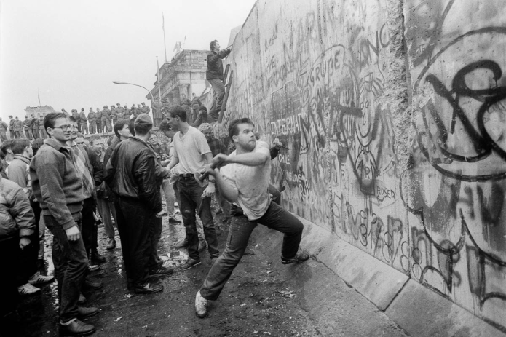
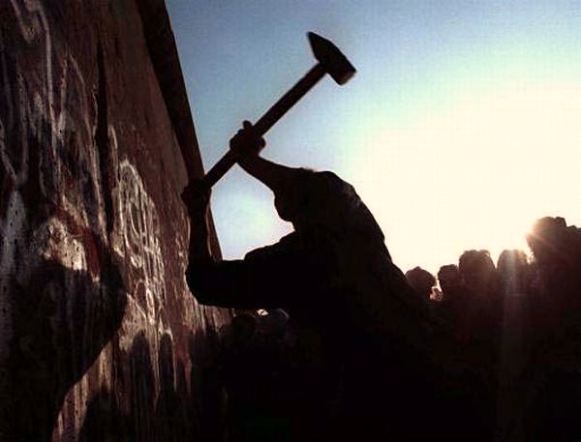
9. Fall of the Berlin Wall
Cause: East Germans were furious that their government had completely closed the borders…no one could get out!
So how would you react if you were an East German?
PROTEST!!!
Finally, on November 9, 1989, the new East German leader opened the Berlin Wall

Slide 14
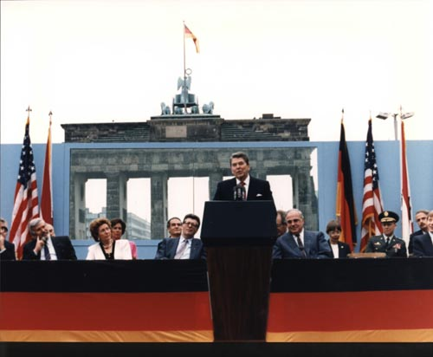
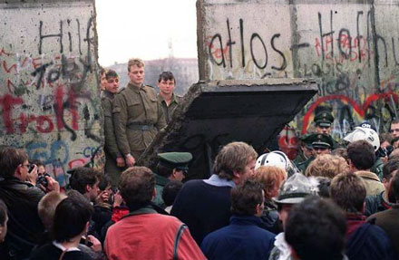
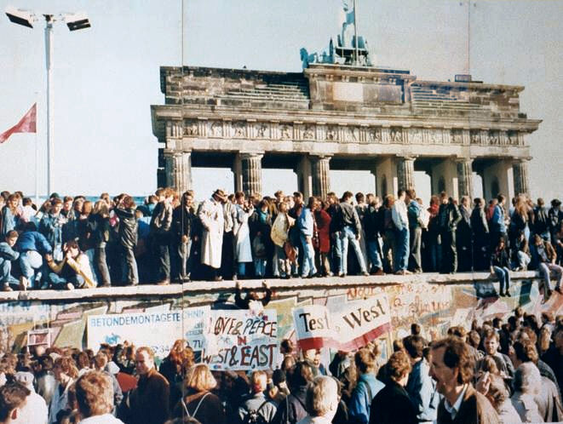
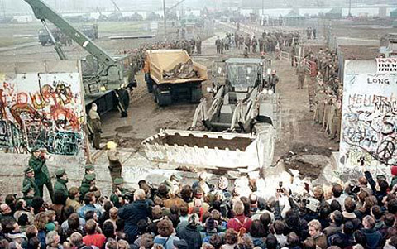
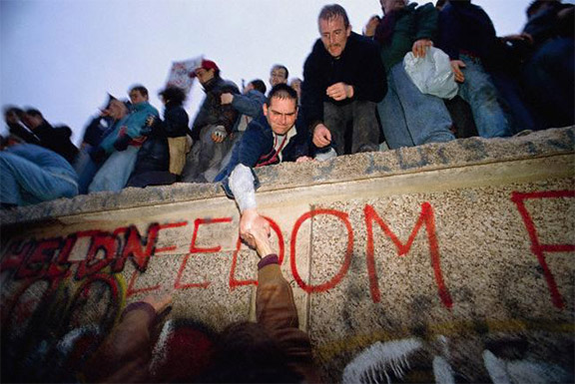

Slide 15
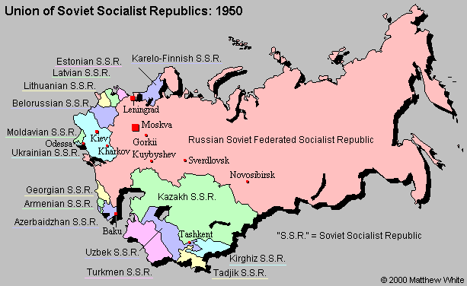
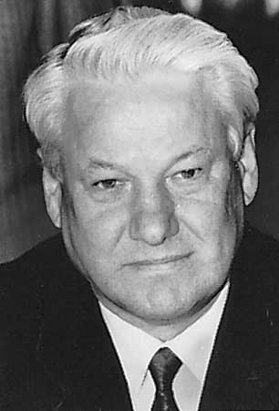
10. Collapse of the Soviet Union
Gorbachev resigns
December 1991, all satellite nations had declared independence
Boris Yeltsin became Head of State
Russian Soviet Federated Socialist Republic
CIS - Commonwealth of Independent States
Marks the death of the Soviet Union

Slide 16
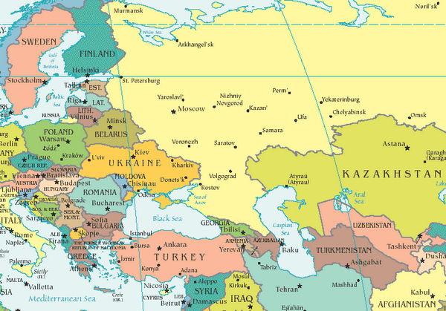

Slide 17
One more woman Margaret Thatcher of the United Kingdom
Prime Minister 1979-1990 (1st female)
Only woman to have held this post or leader of a major political party
Nicknamed “iron lady”
Fought for capitalism, economic privatization, ending of Soviet communism
“She combined a flamboyant willpower with evident femininity”
Times Magazine, 100 most influential people

Slide 18
