Slide 1
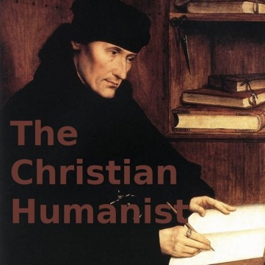
© Morgan AP Teaching
Period 1: 1450 CE -1648 CE
Christian & Civic
Humanisn

Slide 2
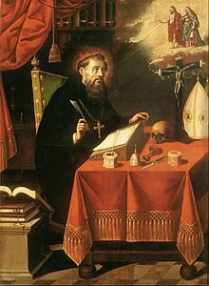
© Morgan AP Teaching
Christian Humanism
In addition to a focus on secular political life, Renaissance emphasis
on the individual and classic knowledge impacted religious life
Mostly in northern Europe, thinkers like began reading
classical Christian texts, such as the Bible and St. Augustine
During the Middle Ages, Christianity had become highly
dependent on the pope, and religious rituals, traditions, & relics
Upon re-reading classical, early Christian writers, Christian humanists
found none of these things in the Bible or St. Augustine’s writings
Instead of focusing on pleasing the Church, the pope, and its traditions, these thinkers focused on an individual spiritual life and relationship with God
These became characteristics of the Northern Renaissance: an emphasis on regular human life and religious themes (mostly personal relationships with God)

Slide 3
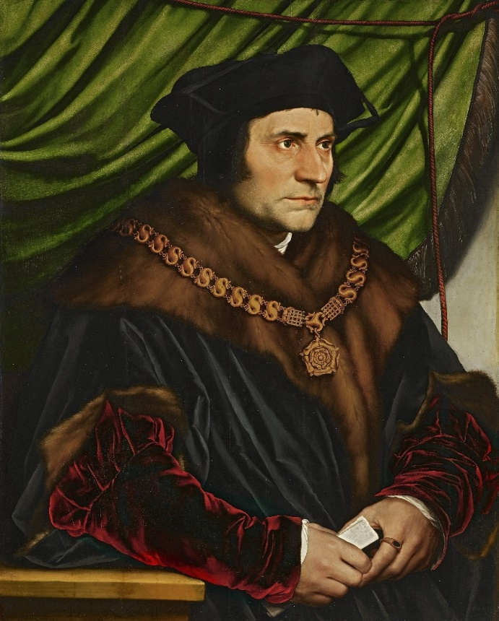
© Morgan AP Teaching
Church Reform Calls
Two Christian humanists and their works embodied the movement:
Erasmus in the Praise of Folly and Thomas Moore in Utopia
Both of these men agreed Christianity should serve as a guiding
moral philosophy- not a stern set of rules and traditions
Both men also wrote heavily on the topic of corruption in the
Catholic Church, and highly criticized the ‘sale’ of salvation,
Church positions, and nepotism (hiring family) in Church office
These thinkers and ideas began question the Church itself and its power, claiming
the Church had drifted from the true intentions and beliefs of Christianity

Slide 4
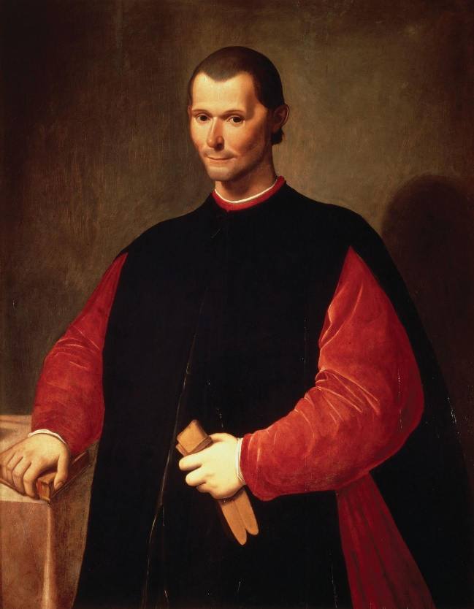
© Morgan AP Teaching
Machiavelli
With a focus on the individual, and a break from the importance of theology, thinkers also began to question how governments were operated
One of the first Renaissance thinkers to question the role of the government
was Niccolo Machiavelli, who came from the war-torn Italian city-states
In the Middle Ages, politics were ruled by the idea that a king,
prince, noble, etc, ought to rule as a just and moral Christian
Machiavelli argued that this was an ineffective approach—that an effective
ruler would use whatever means necessary to obtain and run a kingdom
In his book, The Prince, Machiavelli outlined that in politics, anything goes—
it can be just, unjust, brutal, violent, loving--whatever, as long as it works

Slide 5
© Morgan AP Teaching
Secularism
With an already corrupt Church, by the 16th century, this message
from Machiavelli really stuck with European intellectuals
At this point in European history, people truly began to question
the legitimacy of the Church and its power over governments
One intellectual in particular that agreed with the message
of Erasmus and Machiavelli was a man named Jean Bodin
Jean Bodin was an influential intellectual who believed the corrupt Church,
the pope in particular, should not be involved in European politics
Laws, taxes, lands, annointings, etc.
Instead, Bodin strongly advocated strong, centralized governments that
controlled their own taxes and politics with no Church involvement

Slide 6
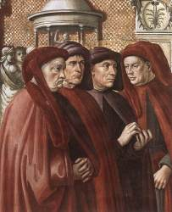
© Morgan AP Teaching
Civic Humanism
The questioning of the corrupt Church and emphasis on secular political life
without Church interference spawned a new movement: civic humanism
Drawing still from the classics, intellectuals advocated that not only should people seek a well-rounded education, but they should be involved in the community
Rather than be an educated hermit, writing about what you think is wrong
with the world, intellectuals like Leonardo Bruni advocated being proactive
This meant voting, participating in politics, and discussing issues and reforms
Because of humanism, Bruni and others emphasized focusing on secular life
and politics, as well as being involved as a citizen in shaping their own world

