Slide 1
Challenges to the “Concert” System: The 1820s-1830 Revolutions
AP European History
Chapter 11

Slide 2
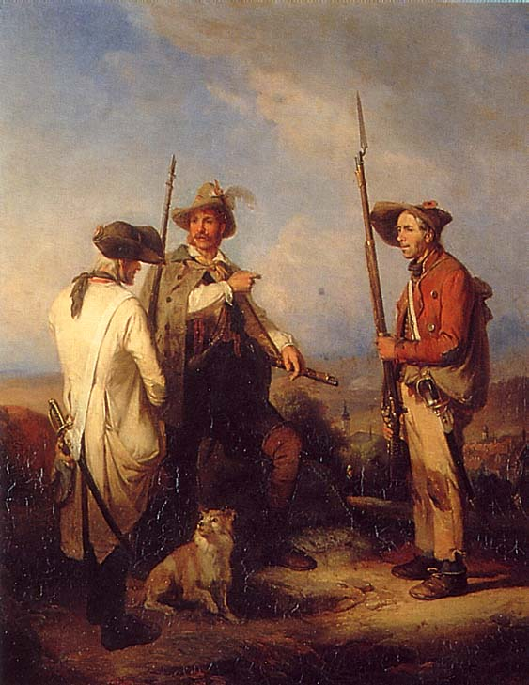
An Evaluation of the Congress of Vienna
The Congress of Vienna was criticized for ignoring the liberal & nationalist aspirations of so many peoples.
The leading statesmen at Vienna underestimated the new nationalism and liberalism generated by the French Revolution.
Not until the unification of Germany in 1870-71 was the balance of power upset.
Not until World War I did Europe have another general war.

Slide 3
The “Concert” of Europe System Established
The principle of collective security was established.
The Congress of Aix-la-Chapelle [1816]
The Congress of Troppau [1820]
The Congress of Laibach [1821]
The Congress of Verona [1822]
Their goal was to define and monitor the status quo.

Slide 4
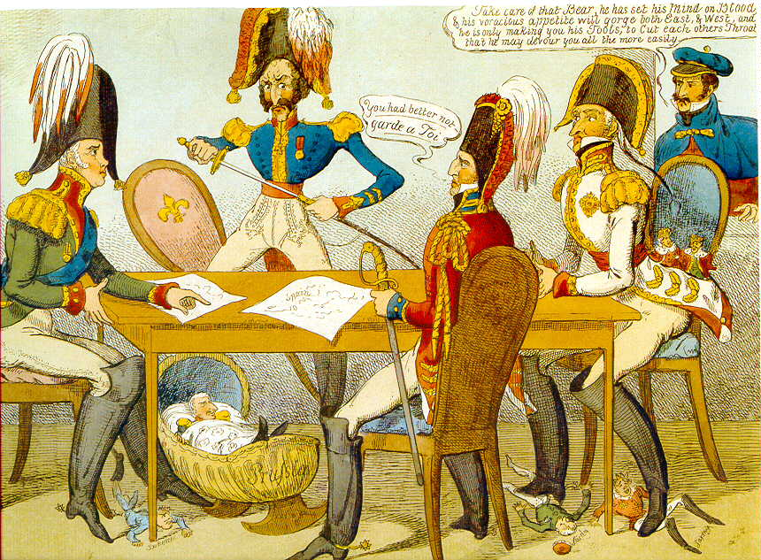
Congress of Verona

Slide 5
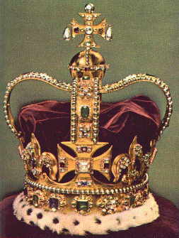
19^{c} Conservatism
Conservatism arose in reaction to liberalism & became a popular alternative for those who were frightened by the violence unleashed by the French Revolution.
Early conservatism was allied to the restored monarchical governments of Austria, Prussia, France, and England.
Support for conservatism:
Came from the traditional ruling class.
Also supported by the peasants.
Supported by Romantic writers, conservatives believed in order, society and the state, faith, and tradition.

Slide 6
Characteristics of Conservatism
Conservatives viewed history as a continuum.
The basis of society is organic, not contractual.
Stability & longevity, not progress and change, mark a good society.
The only legitimate sources of political authority were God and history.
They rejected the “social contract” theory.
Conservatives believed that self-interests do not lead to social harmony, but to social conflict.
Denounced individualism and natural rights.
To conservatives, society was hierarchical.

Slide 7
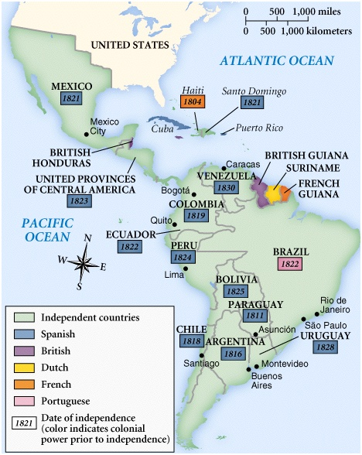
19^{c} Latin American Independence Movements

Slide 8
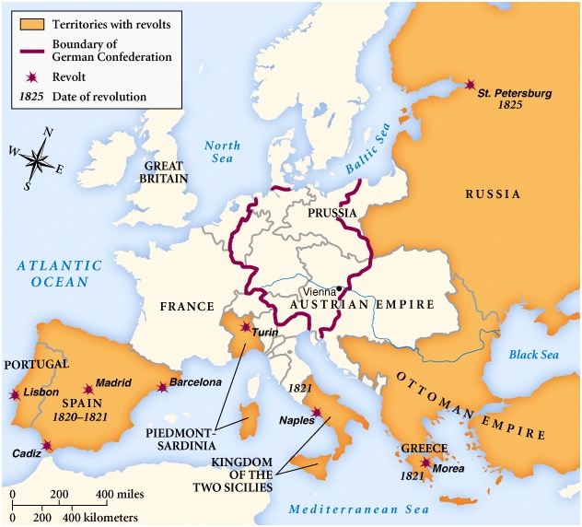
Revolutionary Movements in the Early 19^{c}

Slide 9
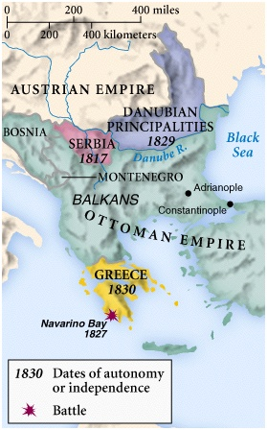
Wallachia & Moldavia
Independence Movements in the Balkans

Slide 10
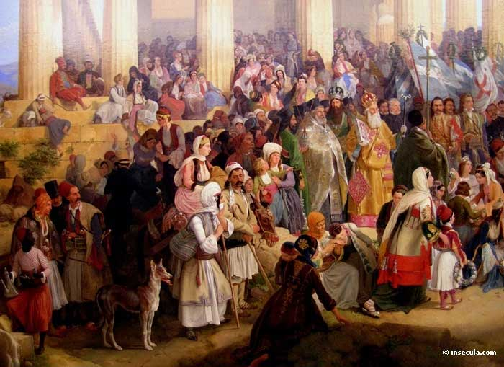
Greek Revolution - 1821

Slide 11
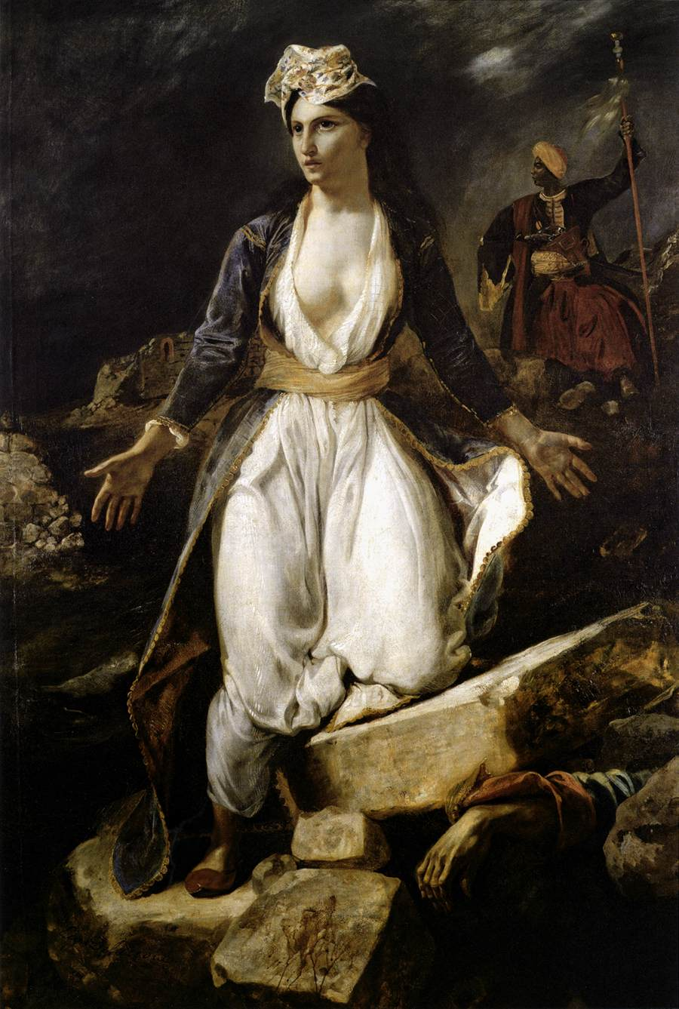
Greek Independence
The “Eastern Question”
Hetairia Philike → a secret society that inspired an uprising against the Turks in 1821.
Pan-Hellenism
1827 → Battle of Navarino
Br, Fr, Rus destroyed the Ottoman-Egyptian fleet.
1828 → Rus declared war on the Otts.
1829 → Treaty of Adrianople
1830 → Greece declared an independent nation [Treaty of London].
Greece on the Ruins of Missilonghi by Delacroix, 1827

Slide 12
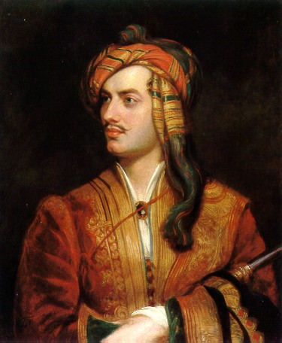
Lord Byron – Martyr in Greece

Slide 13
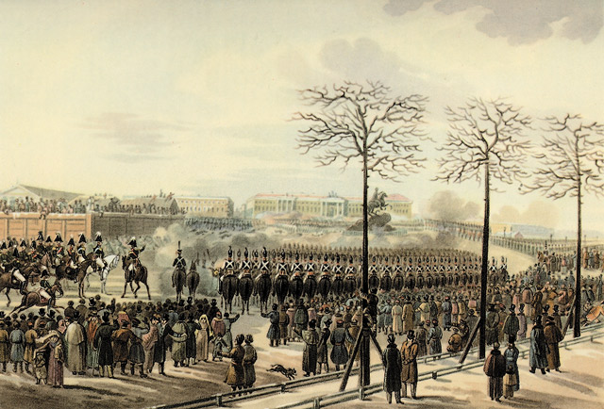
The Decembrist Uprising - 1825

Slide 14
The Decembrist Revolt, 1825
Russian upper class had come into contact with western liberal ideas during the Napoleonic Wars.
Late November, 1825 → Czar Alexander I died suddenly.
He had no direct heir → dynastic crisis
Constantine → married a woman, not of royal blood.
Nicholas → named by Alexander I as his heir before his death.
Russian troops were to take an oath of allegiance to Nicholas, who was less popular than Constantine [Nicholas was seen as more reactionary].
December 26, 1825 → a Moscow regiment marched into the Senate Square in St. Petersburg and refused to take the oath.

Slide 15
The Decembrist Revolt, 1825
They wanted Constantine.
Nicholas ordered the cavalry and artillery to attack the insurgents.
Over 60 were killed.
5 plotters were executed.
Over 100 insurgents were exiled to Siberia.
Results:
The first rebellion in modern Russian history where the rebels had specific political goals.
In their martyrdom, the Decembrists came to symbolize the dreams/ideals of all Russian liberals.
Nicholas was determined that his power would never again come into question → he was terrified of change!

Slide 16
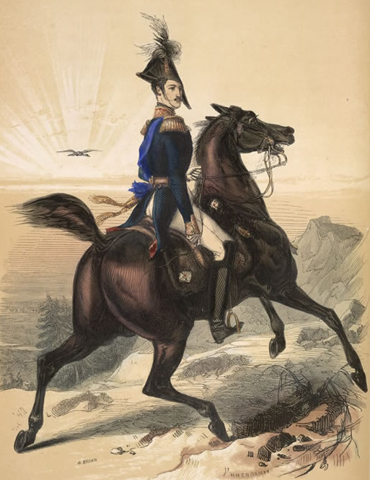
The Decembrist Uprising - 1825
Orthodoxy!
Autocracy!
Nationalism!
Nicholas I

Slide 17
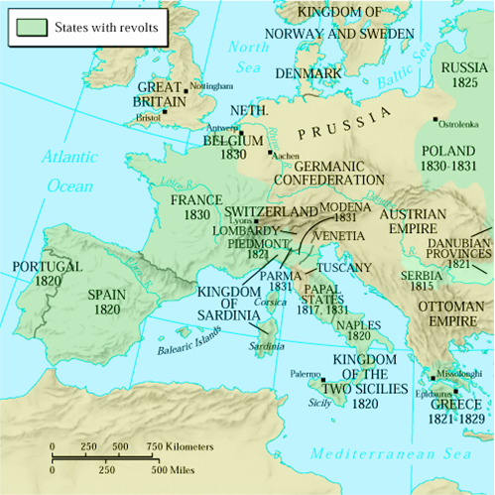
The 1830 Revolutions

Slide 18
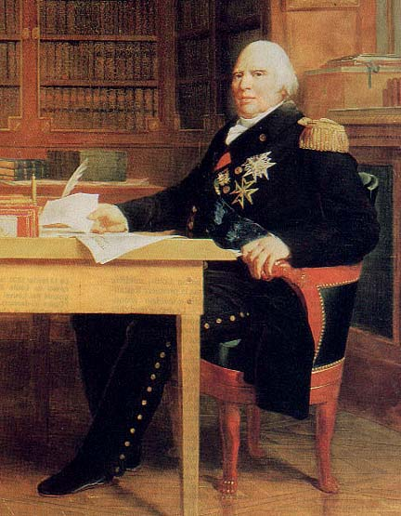
France: The “Restoration” Era (1815-1830)
France emerged from the chaos of its revolutionary period as the most liberal large state in Europe.
Louis XVIII governed France as a Constitutional monarch.
He agreed to observe the 1814 “Charter” or Constitution of the Restoration period.
Limited royal power.
Granted legislative power.
Protected civil rights.
Upheld the Napoleon Code.
Louis XVIII (r. 1814-1824)

Slide 19
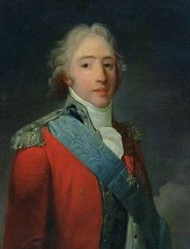
The “Ultras”
France was divided by those who had accepted the ideals of the Fr. Revolution and those who didn’t.
The Count of Artois was the leader of the “Ultra-Royalists”
1815→ “White Terror”
Royalist mobs killed 1000s of former revolutionaries.
1816 elections
The Ultras were rejected in the Chamber of Deputies election in favor of a moderate royalist majority dependent on middle class support.
The Count of Artois, the future King Charles X (r. 1824-1830)

Slide 20
France: Conservative Backlash
1820→the Duke of Berri, son of Artois, was murdered.
Royalists blamed the left.
Louis XVIII moved the govt. more to the right
Changes in electoral laws narrowed the eligible voters.
Censorship was imposed.
Liberals were driven out of legal political life and into illegal activities.
1823→ triumph of reactionary forces!
Fr troops were authorized by the Concert of Europe to crush the Spanish Revolution and restore another Bourbon ruler, Ferdinand VII, to the throne there.

Slide 21
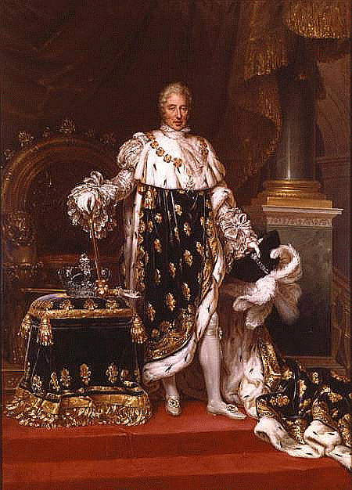
King Charles X of France (r. 1824-1830)
His Goals:
Lessen the influence of the middle class.
Limit the right to vote.
Put the clergy back in charge of education.
Public money used to pay nobles for the loss of their lands during the Fr Revolution.
His Program:
Attack the 1814 Charter.
Control the press.
Dismiss the Chamber of Deputies when it turned against him.
Appointed an ultra-reactionary as his first minister.
Limited royal power.
Granted

Slide 22
King Charles X of France (r. 1824-1830)
1830 Election brought in another liberal majority.
July Ordinances
He dissolved the entire parliament.
Strict censorship imposed.
Changed the voting laws so that the government in the future could be assured of a conservative victory.

Slide 23
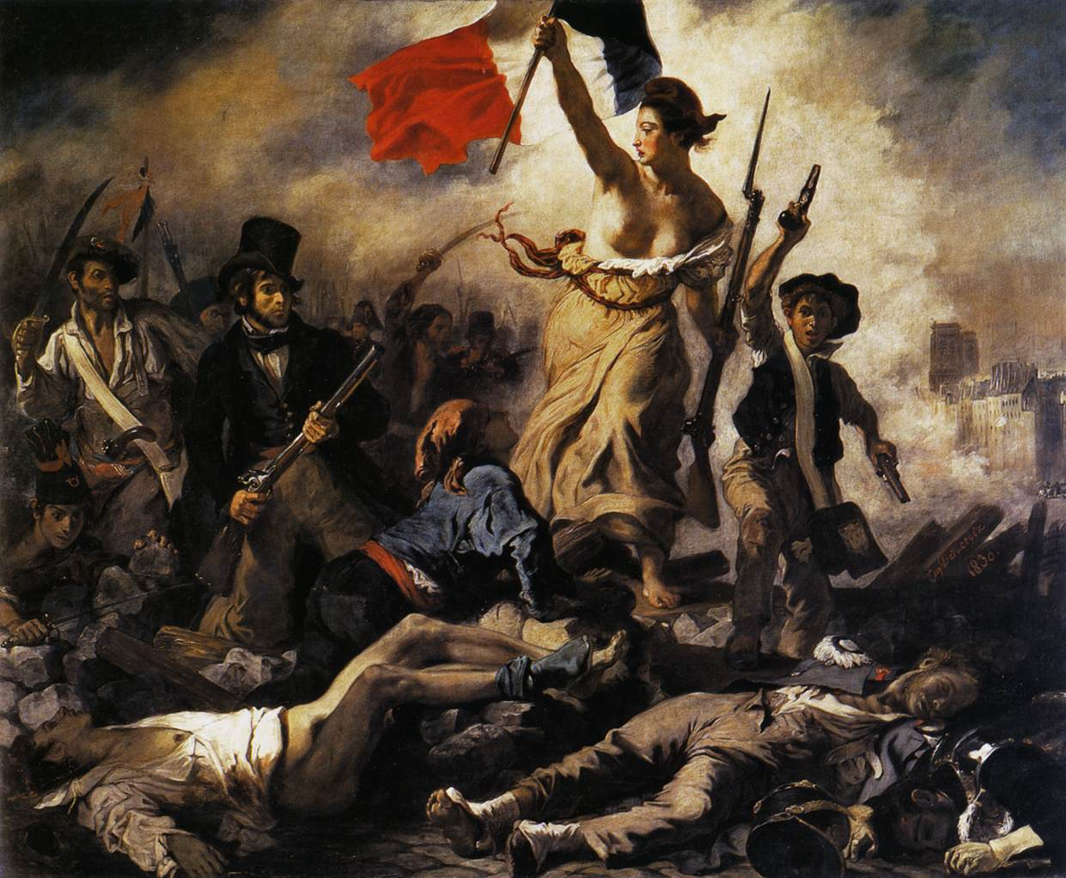
To the Barracades → Revolution, Again!!
Workers, students and some of the middle class call for a Republic!

Slide 24
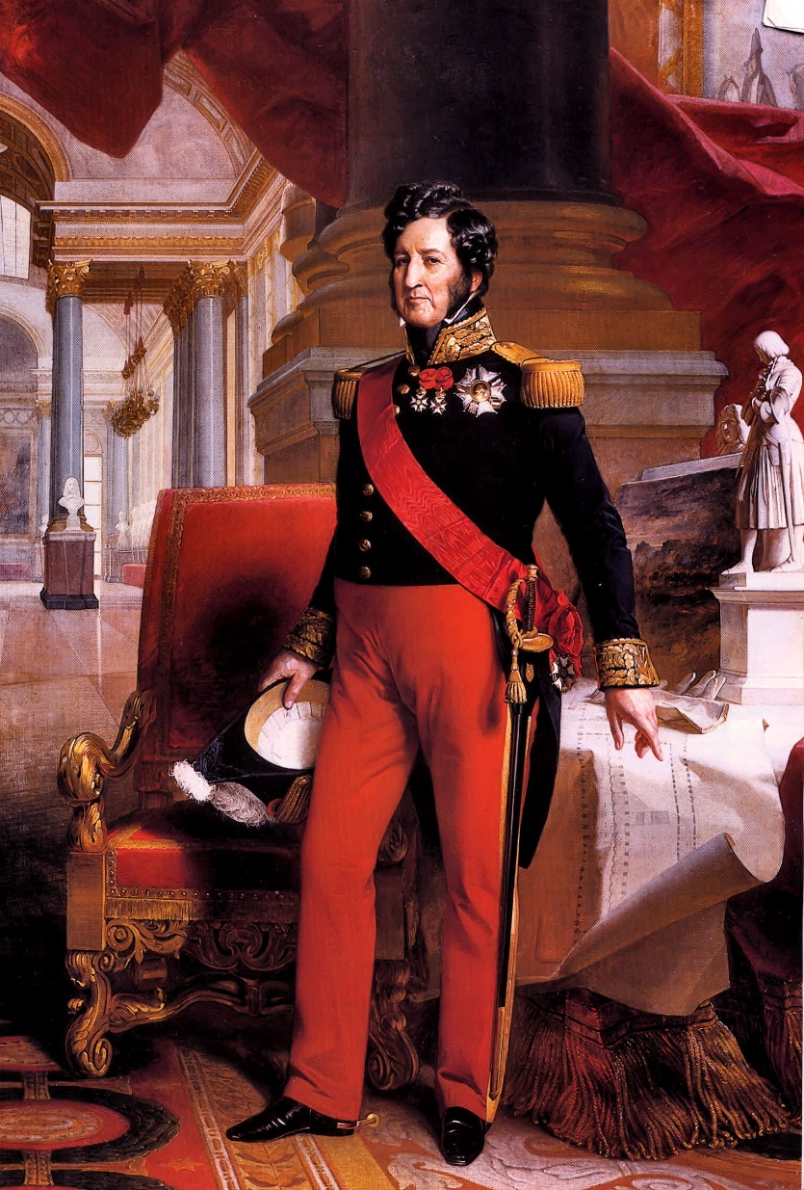
Louis Philippe → The “Citizen King”
The Duke of Orleans.
Relative of the Bourbons, but had stayed clear of the Ultras.
Lead a thoroughly bourgeois life.
His Program:
Property qualifications reduced enough to double eligible voters.
Press censorship abolished.
The King ruled by the will of the people, not by the will of God.
The Fr Revolution’s tricolor replaced the Bourbon flag.
The government was now under the control of the wealthy middle class.
(r. 1830-1848)

Slide 25
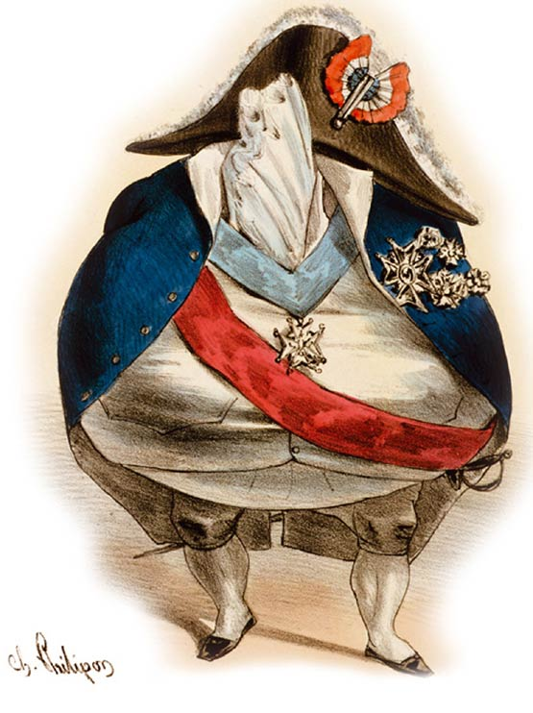
Louis Philippe → The “Citizen King”
His government ignored the needs and demands of the workers in the cities.
They were seen as another nuisance and source of possible disorder.
July, 1832 → an uprising in Paris was put down by force and 800 were killed or wounded.
1834 → Silk workers strike in Lyon was crushed.
Seething underclass.
Was seen as a violation of the status quo set down at the Congress of Vienna.
A caricature of Louis Philippe

Slide 26
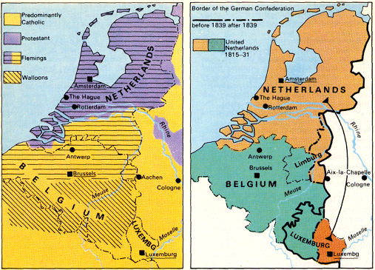
Belgian Independence, 1830
The first to follow the lead of France.
Its union with Holland after the Congress of Vienna had not proved successful.
There had been very little popular agitation for Belgian nationalism before 1830 → seldom had nationalism arisen so suddenly.
Wide cultural differences:
North → Dutch → Protestant → seafarers and traders.
South → French → Catholic → farmers and individual workers.

Slide 27
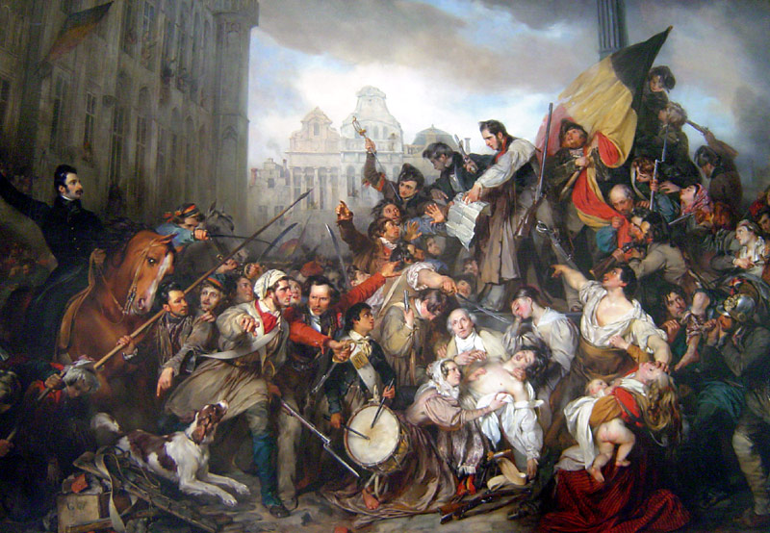
Belgian Revolution - 1830

Slide 28
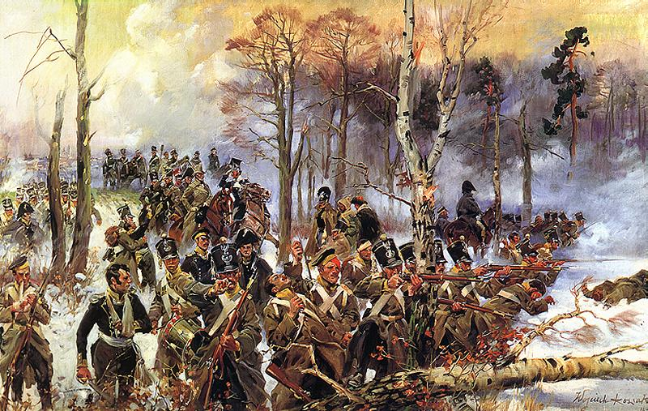
A Stirring of Polish Nationalism - 1830

Slide 29
A Stirring of Polish Nationalism - 1830
The bloodiest struggle of the 1830 revolutions.
The Poles in and around Warsaw gain a special status by the Congress of Vienna within the Russian Empire.
Their own constitution.
Local autonomy granted in 1818.
After Tsar Alexander I dies, the Poles became restless under the tyrannical rule of Tsar Nicholas I.
Polish intellectuals were deeply influenced by Romanticism.
Rumors reached Poland that Nicholas I was planning to use Polish troops to put down the revolutions in France and Belgium.
Several Polish secret societies rebelled.

Slide 30
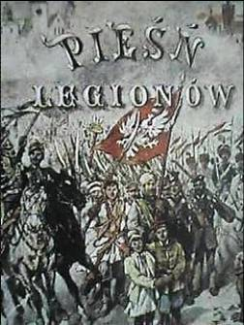
A Stirring of Polish Nationalism - 1830
Had the Poles been united, this revolt might have been successful.
But, the revolutionaries were split into moderates and radicals.
The Poles had hoped that Fr & Eng would come to their aid, but they didn’t.
Even so, it took the Russian army a year to suppress this rebellion.
The irony → by drawing the Russian army to Warsaw for almost a year, the Poles may well have kept Nicholas I from answering Holland’s call for help in suppressing the Belgian Revolt.

Slide 31
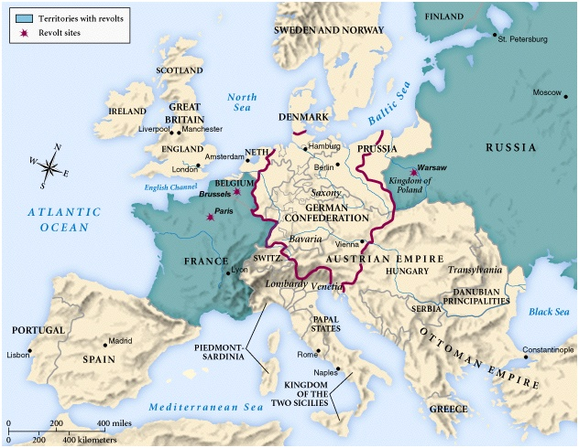
Europe in 1830

Slide 32
The Results of the 1820s-1830 Revolutions?
The Concert of Europe provided for a recovery of Europe after the long years of Revolution and Napoleonic Wars.
The conservatives did NOT reverse ALL of the reforms put in place by the French Revolution.
Liberalism would challenge the conservative plan for European peace and law and order.
These revolutions were successful only in W. Europe:
Their success was in their popular support.
Middle class lead, aided by the urban lower classes.
The successful revolutions had benefited the middle class → the workers, who had done so much of the rioting and fighting, were left with empty hands!
Therefore, these revolutions left much unfinished & a seething, unsatisfied working class.

