Slide 1
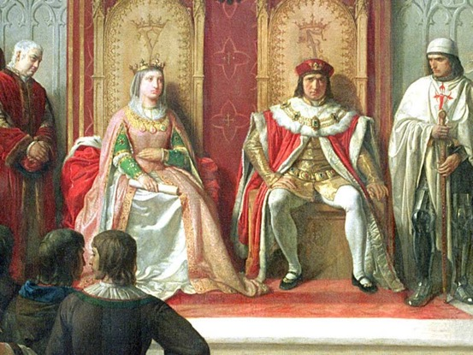
© Morgan AP Teaching
Period 1: 1450 CE -1648 CE
Centralization of Power

Slide 2
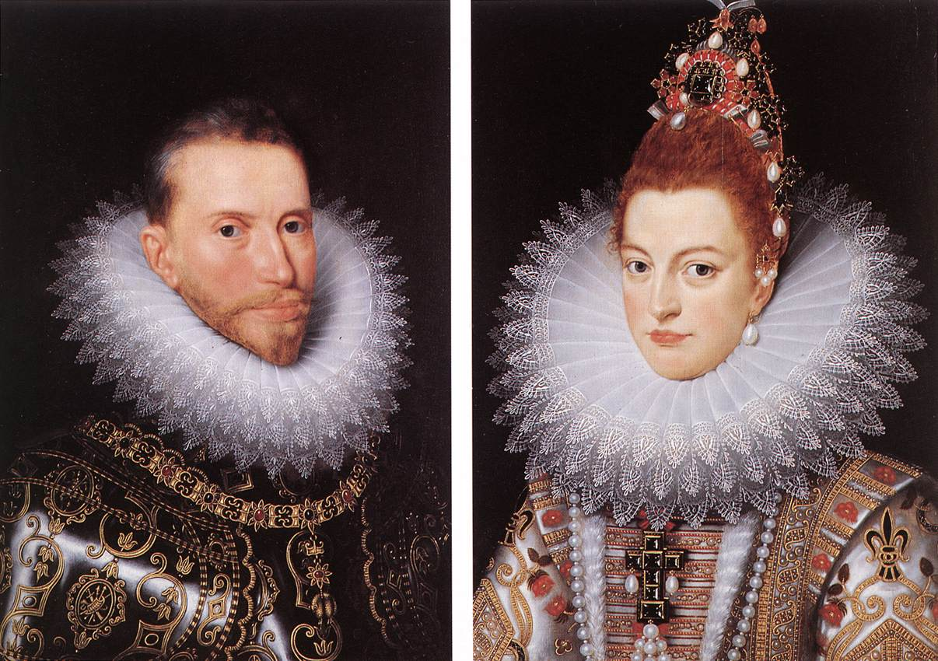
© Morgan AP Teaching
Spain and France
The first major powers in Europe to break the feudal cycle
in were Spain and France, as they began to centralize their
states and dominate the Italy and the rest of Europe
From being dominated by Muslims in Spain and local rulers
in France in the 1400s, by the end of the 1500s, Spain and
France would be the strongest European powers
Both started the process of centralization with the military
and then expanded that to control of taxes and religion
In Spain, Ferdinand and Isabella united all Christians in Spain against the Muslims and forced them out by 1492
In France, Charles VII created the first standing army for France, organizing and defeating their English and Burgundian opponents

Slide 3
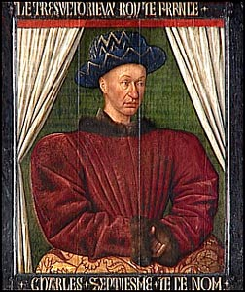
© Morgan AP Teaching
Centralization of Power – Late 1400s
When Ferdinand and Isabella conquered Spain, they setup a new system that centralized power in primarily two ways:
They gave more law-making and tax collection power to themselves
They reduced the role and power of the nobles
In France, Charles VII setup the first ever united army run directly by him, as well as enhanced his taxing privileges
By uniting the taxes and militaries of these large states, Spain and France soon found that this new money and power made them almost unstoppable in Europe
Both were able to invade and profit heavily from the Italian city-states who were too localized and small to stand a chance on their own

Slide 4
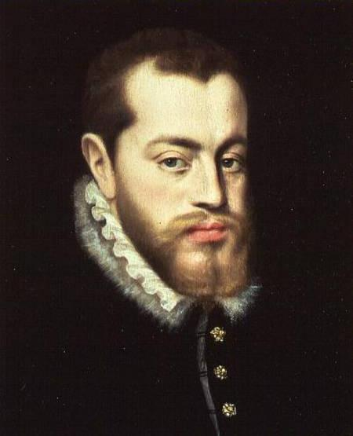
© Morgan AP Teaching
Philip II of Spain
In Spain, centralization would root itself to firmest and quickest
Within 100 years of Ferdinand and Isabella, Philip II had become the king of Spain, and had almost complete control of lawmaking and power by the 1590s
In Spain, he determined the official religion (Catholicism), banning all others & sent The Inquisition and soldiers to chase out all non-Catholics
He also had developed a complex system of bureaucrats to collecttaxes and run his vast kingdom which now expanded to the New World
While most Catholic leaders had laws against non-Catholics and collected taxes, none did on the scale or with as much authority as did Philip II of Spain

Slide 5
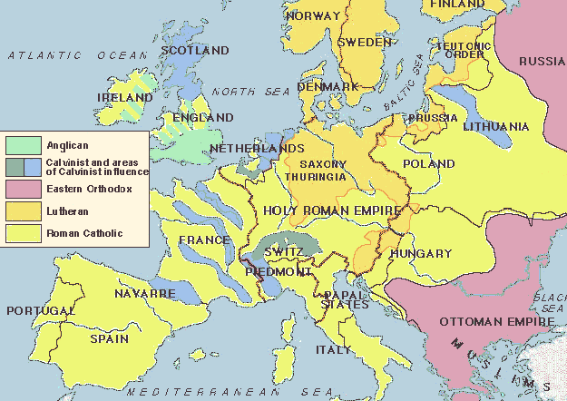
Map of Europe 1550

Slide 6
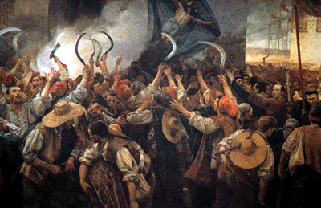
© Morgan AP Teaching
Resistance to Centralization
Centralizing under the monarchy in Spain and France came at the
expense of power of the nobles, who traditionally had their own
taxes, laws, and militaries
Both kingdoms experienced large-scale revolts in the early 1600s as
nobles attempted to regain power: the Catalan Revolt (Spain) and
the Fronde (France)
In Spain, the area of Catalonia grew tired of fighting the endless wars of the Spanish king in Europe, as well as paying for the massive Spanish debt
With help from France, the nobles of Catalonia revolted and won; Catalonia then left Spain, the king lost complete control over the military and taxes
A decade later, the same happened in France, however, the monarchy won during the Fronde revolts, and control over taxes and the army were actually increased

Slide 7
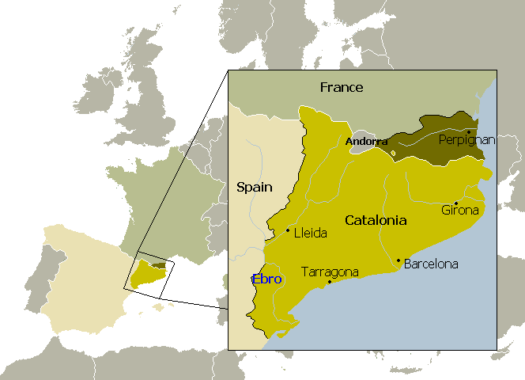

Slide 8
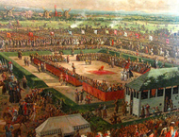
© Morgan AP Teaching
Poland
With the success of Spain and France apparent, other European states began to attempt to centralize according to their model
When the Sigismund I & II attempted to centralize power in 1572, the nobles refused to comply, and instead chose to elect kings and keep their privileges
The significance of this development is that this would result in nobles exercising a large amount of local, un-centralized control
Poland, like must of Eastern Europe, would forever remain un-centralized, and controlled by agricultural-based nobles
This would lead to Poland’s weakness in the coming conflicts with Russia, Prussia (Ger), and Austria a century later

