Slide 1
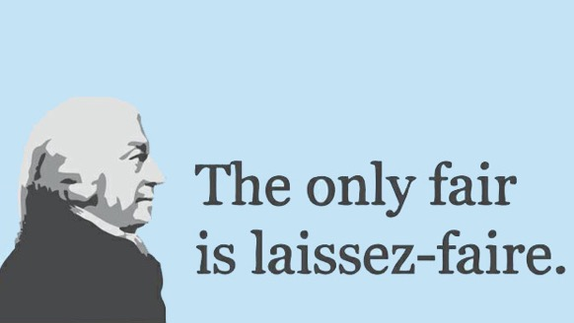
Period 2: 1648 CE – 1815 CE
Capitalism

Slide 2
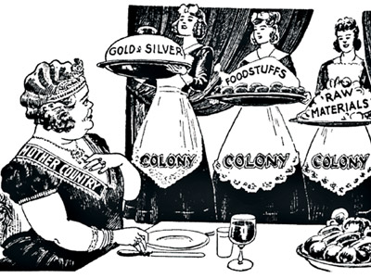
18th-Century Mercantilism
The 18th century was still dominated by European trade and commerce through the mercantile system
Guilds still controlled wages, prices, and professions, and governments still used tariffs to reduce imports
Europeans continued to exploit and control single-export based colonies, such as Jamaica, Haiti, Brazil, Mexico, and others
These colonies would provide cheap raw materials and goods to benefit and enrich the mother country
Additionally, Europeans still used privateers, such as Sir Francis Drake, to disrupt and steal the trade of other European nations

Slide 3
Africa and Asia
The African Slave Trade and plantation systems peaked
in the 1700s, as tobacco and cotton demanded
skyrocketed
Triangular Trade also grew as Europeans would begin to
start manufacturing textiles from raw materials for sale
outside of Europe
Additionally, after the Seven Years War, the British and
the Dutch had eliminated the Spanish, Portuguese, and French competition in Asia
This allowed their charter companies to settle and spread, dominating the governments and economies of India and Indonesia
However, near the end of the 18th century, new economic ideas and wealth would begin to lay the ground for the Industrial Revolution

Slide 4
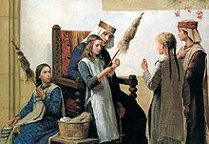
Protoindustrialization
The biggest change in European economics before the emergence
of factory industrialization was the putting-out system in the
mid 18th century
With a large flow of cotton coming from slave plantations,
workshops had to distribute textile (cloth) production
Peasants who had recently been displaced by the Enc. Mov.
or who needed extra money were paid to weave in their homes
The putting-out system was the first time Europeans began using raw materials from the Americas for manufacturing on a large scale
Additionally, paying families to manufacture these goods at home provided regular people with more money, and increased the living standards for Western Europeans

Slide 5
Laissez-faire Capitalism
Seeing the massive growth of wealth and money supply in Europe,
Adam Smith codified a new economic theory in his book the
Wealth of Nations in 1776 to help economies grow
Smith advocated ‘free market’ economics, with no guild or
government interference, thus allowing more trade at lower costs,
which brings down market prices
If people were able to make what they want, they would make
what other people wanted, and would compete for their business
This competition, and the balance of supply and demand, would ensure
low prices, and high quality, and eliminate the need for gov/guild interference
In other words, monetary incentives would regulate the economy on its own, and allow freedom and creativity

