Slide 1
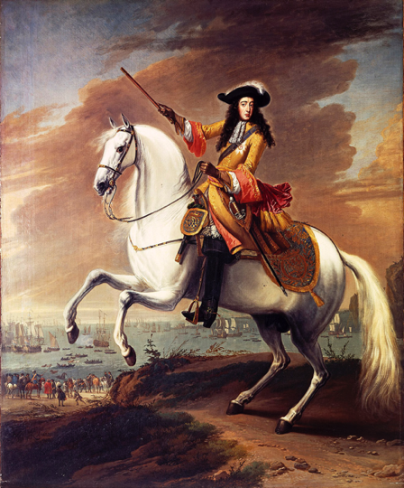
© Morgan AP Teaching
Period 2: 1648 CE – 1815 CE
Alternatives to Absolutism

Slide 2
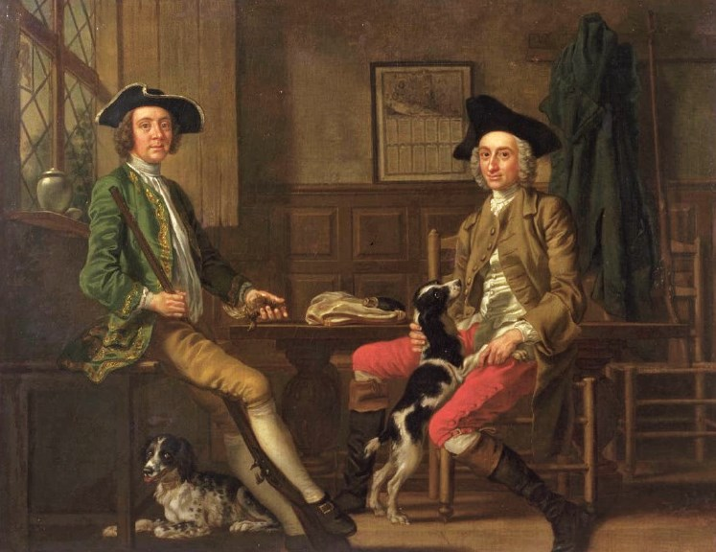
© Morgan AP Teaching
England’s Struggle Against Absolutism
As opposed to the rest of Europe, England and the Dutch Republic furthered the power of representative assemblies (Parliament) instead of kings
The gentry in England (self-made rich) had been a very powerful force in the government through parliament since the English Civil War
James II wanted, like those before him, to rule as or near to an absolute monarchy
He also happened to be Catholic, and was very clear in his actions that he intended to give Catholics more power and privilege

Slide 3
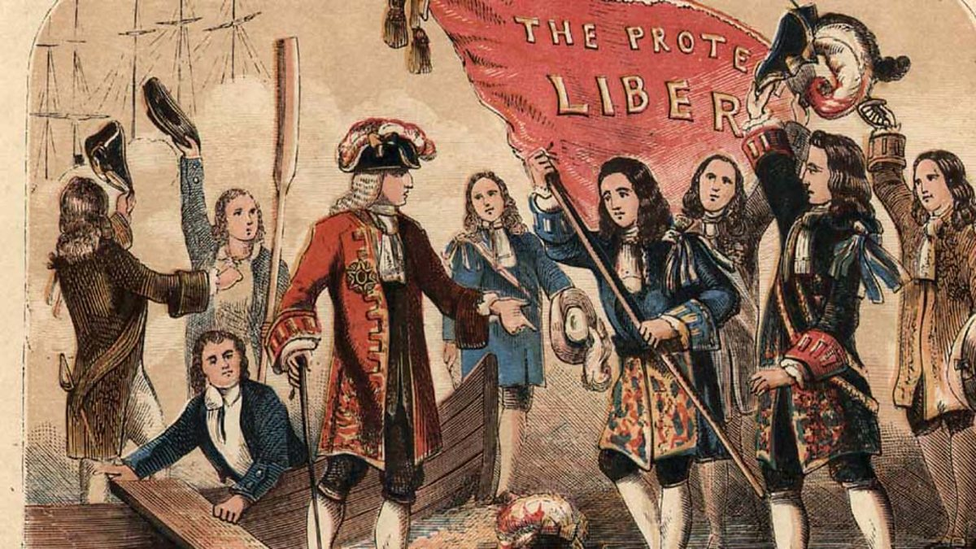
© Morgan AP Teaching
The Glorious Revolution
When James II began dismissing judges and military officials
and replacing them with Catholics; the largely Anglican and
Puritan Parliament became concerned
Given James II’s ambitions, Parliament feared a Catholic
takeover was lining up
To remedy the situation, and remove James II, Parliament
invited the Dutch stadtholder William of Orange to invade England and take the throne
They promised to send their forces and supplies to aid of William ONLY if William agreed to their terms to limit his power and increase theirs
William agreed to these terms, and when he arrived with his army, a large portion of James’ army defected to William
Fearing for his head, James fled to France where his big cousin Louis XIV protected him and gave him a castle

Slide 4
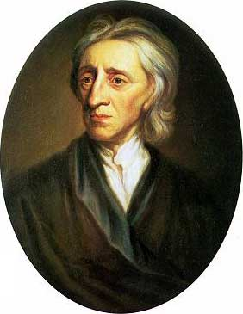
© Morgan AP Teaching
Parliament’s Protections
The two things that concerned the gentry the most were liberty and property
That the rights of the individual (liberty) and their money, businesses, and land (property) should be protected against the government arbitrarily taking it away
Furthermore, these rights should not be alienated without the ‘consent’ (permission) of the governed
Example: no new laws without approval by Parliament; no taking Property without a fair trial, etc.
With these in mind, Parliament made reforms designed to make sure the king/gov could not violate these rights without due process

Slide 5
© Morgan AP Teaching
English Reforms - 1698
Two major anti-absolutist reforms were made in England after the Glorious Revolution: Parliamentary sovereignty and the English Bill of Rights
Parliamentary sovereignty: that Parliament was an equal part of the government and could make or reject their own laws
English Bill of Rights (1689):
1) Guaranteed freedom of speech for Parliament members
2) Eliminated cruel and unusual punishment requiring trial by jury
3) Limited the monarchs’ power and established free elections for
Parliament
England had therefore made the first official constitutional government by creating a limited, constitutional monarchy and a protection of people’s rights

