Slide 1
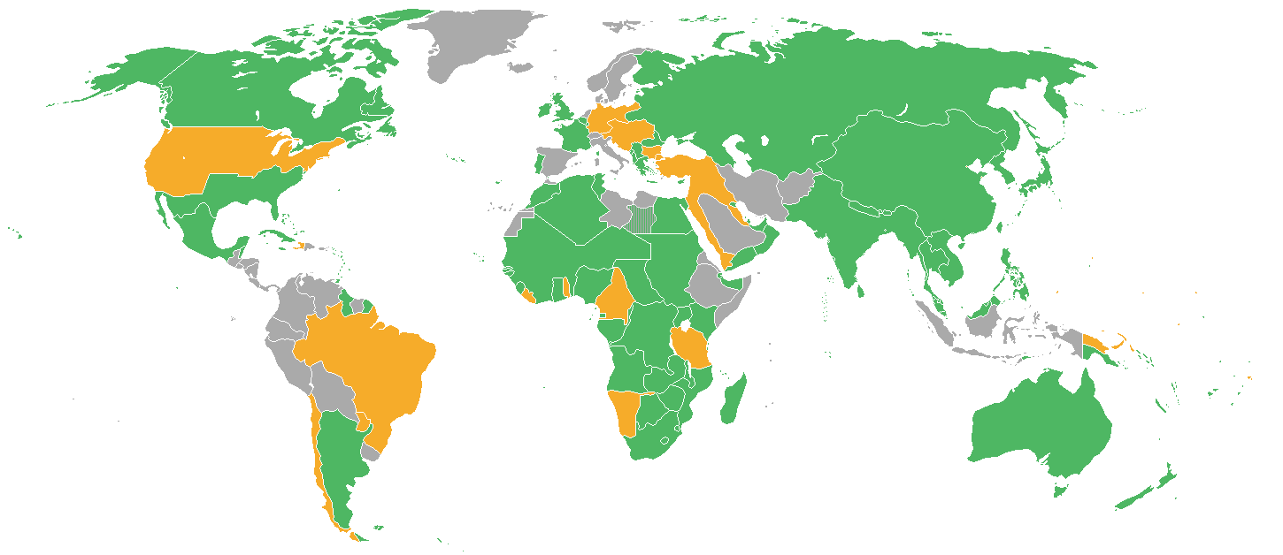
Welcome World History Honors
Mrs. Braun

Slide 2
MRS. BRAUN
Personal Information
B.A. in Education from Oakland University in Michigan, M.Ed. +45 in Curriculum and Instruction, ESOL Endorsed, Gifted Endorsed
Have been at Pine View since 2005 – this is my 16th year.
My daughter has graduated from Pine View and is in the FSU Honors Program. My husband, Duane, is a retired Michigan Friend of the Court Employee.
I LOVE teaching and would show up to work even if I won the Powerball.
Contact Information- Christine.Braun@sarasotacountyschools.net
Best to contact me by email, but I do regularly check up front for any messages

Slide 3
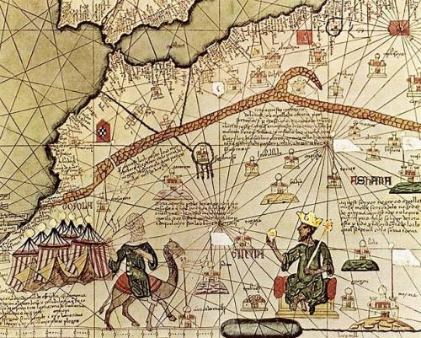
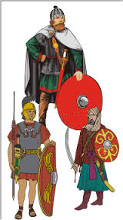
We will be studying: (not necessarily in this order)
West African civilizations
China and Japan
Europe
The Middle Ages,
Renaissance,
Reformation,
Scientific Revolution,
Age of Exploration, and
Enlightenment (or the rise of democratic ideas).
World War I and II
Cold War

Slide 4
Course Information
This course is a continued in-depth study of the history of civilizations and societies from the middle school course, and includes the history of civilizations and societies of North and South America. Students will be exposed to historical periods leading to the beginning of the 21st Century. So that students can clearly see the relationship between cause and effect in historical events, students should have the opportunity to review those fundamental ideas and events from ancient and classical civilizations.
Honors/Advanced courses offer scaffolded learning opportunities for students to develop the critical skills of analysis, synthesis, and evaluation in a more rigorous and reflective academic setting. Students are empowered to perform at higher levels as they engage in the following: analyzing historical documents and supplementary readings, working in the context of thematically categorized information, becoming proficient in note-taking, participating in Socratic seminars/discussions, emphasizing free-response and document-based writing, contrasting opposing viewpoints, solving problems, etc.

Slide 5
Class Policies and Procedures
Please check Blackboard frequently to confirm information about assignments, due dates, and documents for class
Please use the parent portal on CrossPointe/Family Access to stay informed about your student’s grades on specific assignments and to monitor their overall progress in the class. If you see that an assignment is listed as an M or ZERO - check with your student to ensure that they get the assignment turned in ASAP.
I am available to help students after school by appointment (except Fridays). I also have my 3rd period free for planning.

Slide 6
Homework and grades
Exams/Projects/Quizzes 60%
Homework/Classwork 20%
Employability 20%

Slide 7
If you have questions, please feel free to contact me by email.
I look forward to getting to know your students
and working with you to help them have a successful year.

