Slide 1
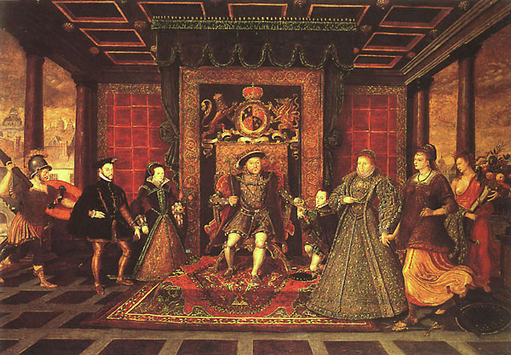
Henry VIII and the Reformation in England
Politics and Dynastic Concerns

Slide 2
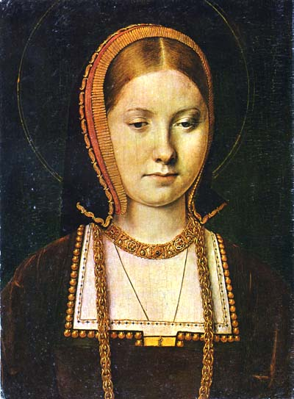
Marriage to Catherine of Aragon
In 1509, Henry VIII had married Catherine of Aragon, daughter of Ferdinand and Isabella of Spain, and the aunt of Emperor Charles V. By 1527, the union had produced no male heir to the throne and only one surviving child, a daughter, Mary. Henry was justifiably concerned about the political consequences of leaving only a female heir. In this period, people believed it unnatural for women to rule over men. At best a woman ruler meant a contested reign, at worst turmoil and revolution.

Slide 3
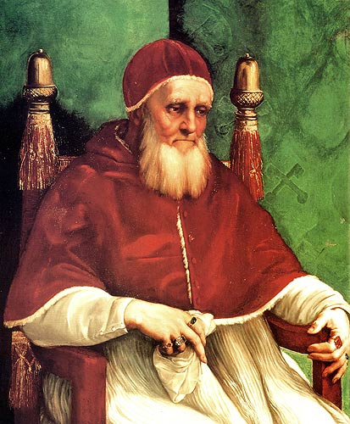
Dispensation from Pope Julius II
Henry even came to believe that his union with Catherine, who had many miscarriages and stillbirths, had been cursed by god, because Catherine had first been the wife of his brother, Arthur. Henry’s father, Henry VII, had betrothed Catherine to Henry after Arthur’s untimely death in order to keep the English alliance with Spain intact. They were officially married in 1509. a few days before Henry VIII received his crown. Because marriage to the wife of one’s brother was prohibited by both canon and biblical law (see Leviticus 18:16, 20:21), the marriage had required a special dispensation from Pope Julius II.

Slide 4
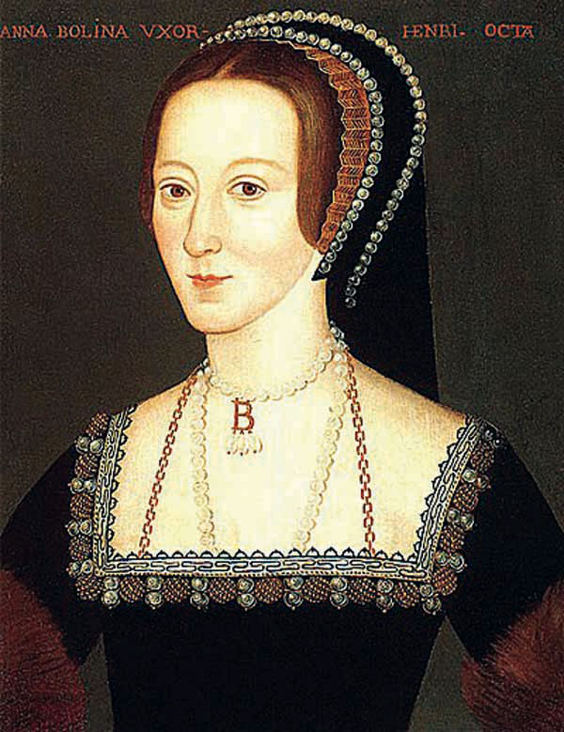
The King’s Affair
By 1527, Henry was thoroughly enamored of Anne Bolyn, one of Catherine’s ladies in waiting. He determined to put Catherine aside and take Anne as his wife. This he could not do in Catholic England, however, without papal annulment of the marriage to Catherine. The year 1527 was also the year when soldiers of the Holy Roman Empire mutinied and sacked Rome. The reigning Pope Clement VII was at the time a prisoner of Charles V, who happened also to be Catherine’s nephew.

Slide 5
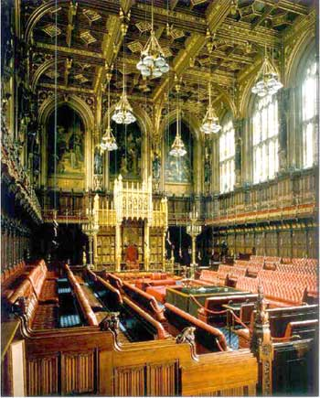
The Reformation Parliament
When the king’s advisors could not obtain a papal annulment, they conceived of a plan to declare the king supreme in English spiritual affairs as he was in English temporal affairs. In 1529, Parliament convened for what would be a seven-year session that earned it the title the “Reformation Parliament.”

Slide 6
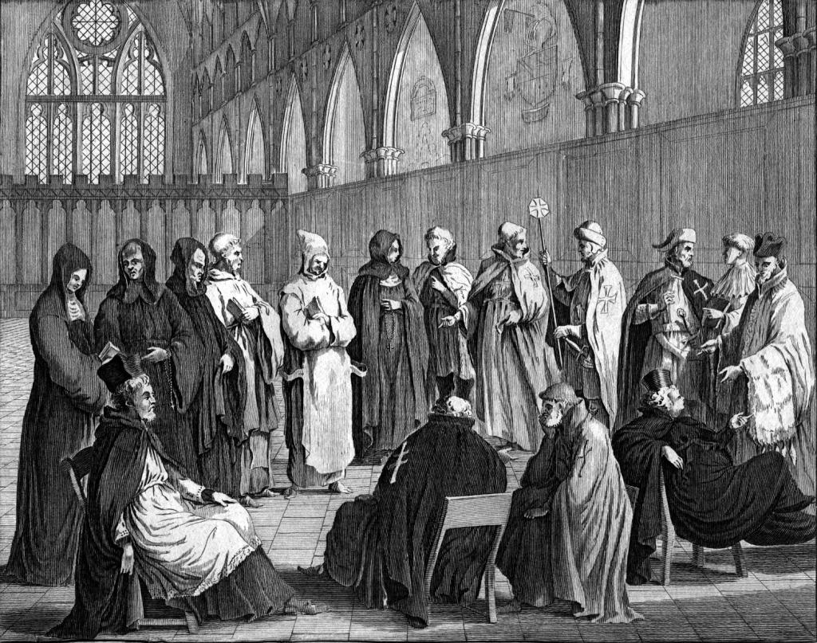
Royal Reins on the Clergy
During this period, it passed a flood of legislation that harassed, and finally placed royal reins on, the clergy. In so doing, it established a precedent that would remain a feature of English government: Whenever fundamental changes are made in religion, the monarch must consult with and work through parliament.

Slide 7
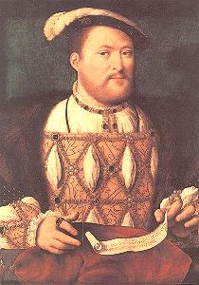
Head of the Church of England
In January 1531, the Convocation (a legislative assembly representing the English clergy) publicly recognized Henry as Head of the Church in England “as far as the law of Christ allows.”

Slide 8
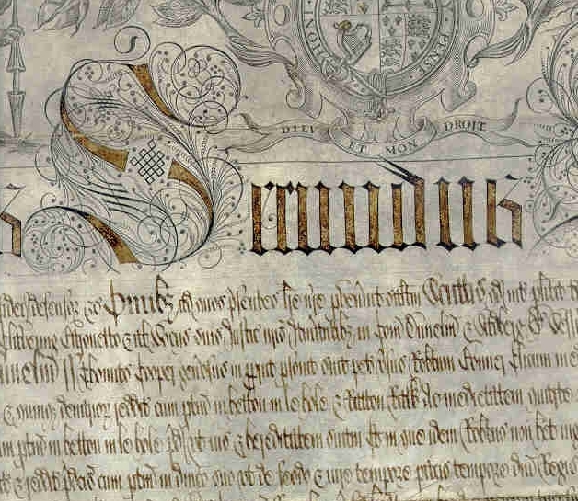
Grievances Against the Church
In 1532. Parliament published official grievances against the church, ranging from alleged indifference to the needs of the laity to an excessive number of religious holidays.

Slide 9
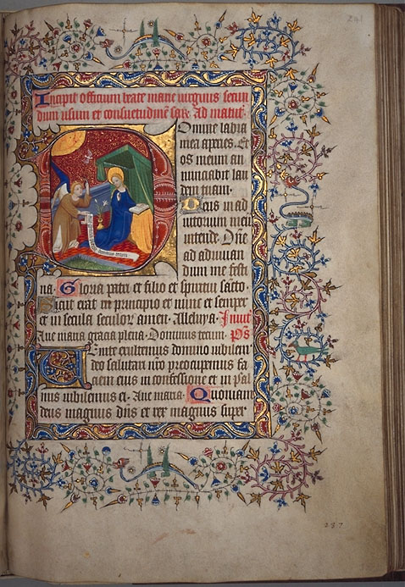
Submission of the Clergy
In the same year, Parliament passed the Submission of the Clergy, which effectively placed canon law under royal control and thereby the clergy under royal jurisdiction.

Slide 10
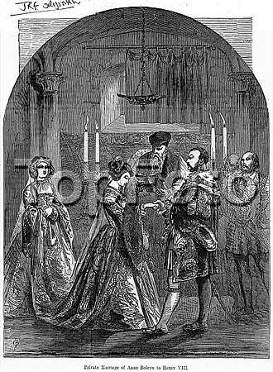
Marriage to Anne Boleyn
In January 1533, Henry wed the pregnant Anne Boleyn, with Thomas Cranmer officiating.

Slide 11
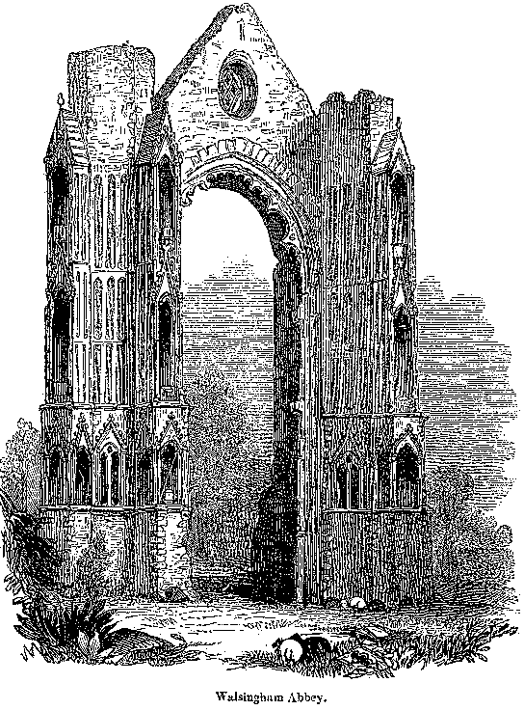
King the Highest Court of Appeal
In February 1533. Parliament made the King the Highest Court of Appeal for all English subjects.

Slide 12
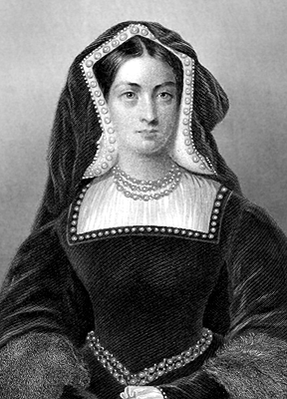
Invalidation of First Marriage
In March 1533. Cranmer became archbishop of Canterbury and led the Convocation in invalidating the King’s marriage to Catherine.

Slide 13
Ended Payments to Rome/Church Appointments
In 1534. Parliament ended all payments by the English clergy and laity to Rome and gave Henry sole jurisdiction over high ecclesiastical appointments.

Slide 14
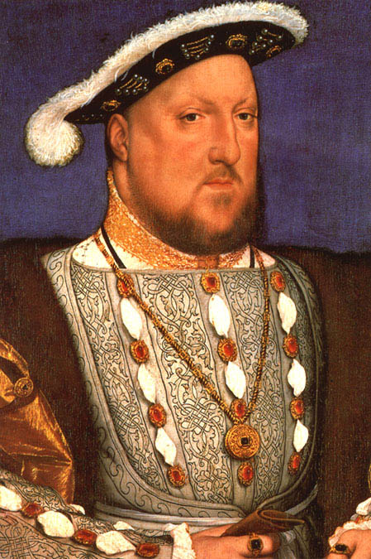
Acts of Succession & Supremacy
The Act of Succession in the same year made Anne Boleyn’s children legitimate heirs to the throne and the Act of Supremacy declared Henry “the only supreme head on earth of the Church of England. When Thomas More and John Fisher, Bishop of Rochester, refused to recognize the Act of Succession and the Act of Supremacy, Henry had them executed, making clear his determination to have his way regardless of the cost.

Slide 15
Dissolution of the Monasteries
In 1538. Parliament dissolved England’s monasteries and convents.

Slide 16
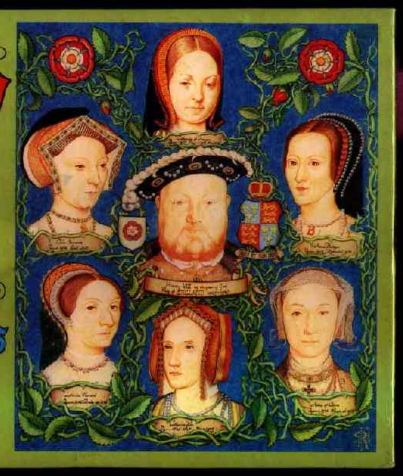
The Six Wives of Henry VIII
To satisfy his desires and to secure a male heir, Henry married six times:
His marriage to CATHERINE OF ARAGON was annulled 1533.
In 1536, ANNE BOLEYN was executed for alleged treason and adultery and her daughter Elizabeth was declared illegitimate.
JANE SEYMOUR died in 1537 shortly after giving birth to the future Edward VI.
Henry wed ANNE OF CLEVES sight unseen on the advice of Cromwell, the purpose being to create by the marriage an alliance with the Protestant princes. The marriage was annulled by Parliament and Cromwell was dismissed and eventually executed.
CATHERINE HOWARD was beheaded for adultery in 1542.
Henry’s last wife, CATHERINE PARR, a patron of humanists and reformers, survived him.

Slide 17
Religious Conservatism
Despite the break with Rome, Henry remained decidedly conservative in his religious beliefs. With the TEN ARTICLES of 1536, he made only mild concessions to Protestant tenets, otherwise maintaining Catholic doctrine in a country filled with Protestant sentiments. Despite his many wives and amorous adventures, Henry absolutely FORBADE THE ENGLISH CLERGY TO MARRY and threatened any clergy who were caught twice in concubinage with execution.

Slide 18
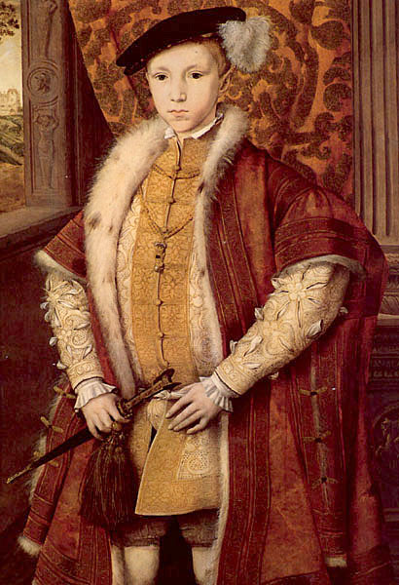
Edward VI (1547-1553)
When Henry died, his son and successor, Edward VI, was only ten years old. Under the regencies of the duke of Somerset and the duke of Northumberland, England fully enacted the Protestant Reformation.
During Somerset’s regency, Henry’s Six Articles and laws against heresy were repealed and clerical marriage and communion with cup were sanctioned.
In 1547, the chantries, places where endowed masses had traditionally been said for the dead, were dissolved.
In 1549, the Act Of Uniformity imposed Thomas Cranmer’s Book of Common Prayer on all English churches.
Images and altars were removed from the churches in 1550.
The Second Act Of Uniformity, passed in 1552, imposed a revised edition of the Book of Common Prayer on all English churches.
A Forty-Two-Article Confession of Faith, also written by Thomas Cranmer, was adopted, setting forth a moderate Protestant doctrine.:
It taught justification by faith and the Supremacy of Holy Scripture.
It denied transubstantiation (although not real presence).
It recognized only two sacraments

Slide 19
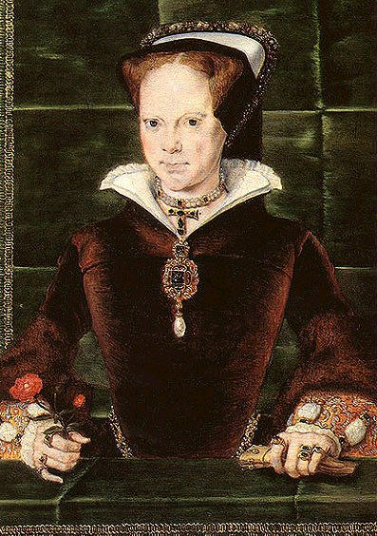
Mary I (1553-1558)
In 1533, Catherine of Aragon’s daughter succeeded Edward (who had died in his teens) to the English throne as Mary I and proceeded to restore Catholic doctrine and practice.

Slide 20
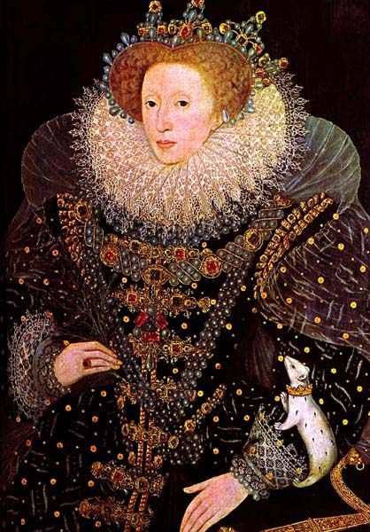
Elizabeth I (1558-1603)
It was not until the reign of Anne Boleyn’s daughter, Elizabeth I, that a lasting religious settlement was worked out in England. Elizabeth merged a centralized Episcopal system, which she firmly controlled, with broadly defined Protestant doctrine and traditional Catholic ritual.

Slide 21
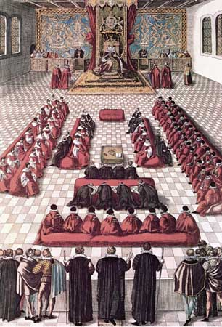
Supreme Governor
In 1559, an Act of Supremacy passed parliament, repealing all the anti-Protestant legislation of Mary Tudor and asserting Elizabeth’s right as “supreme governor” over both spiritual and temporal affairs.

Slide 22
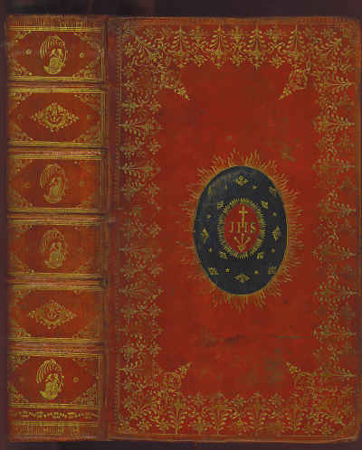
Act of Uniformity
In the same year, the Act of Uniformity mandated a revised version of the second Book of Common Prayer for every English parish.

Slide 23
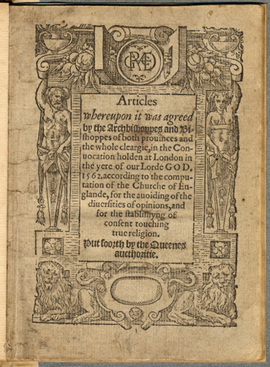
Thirty-Nine Articles
In 1563, the issuance of the Thirty-Nine Articles of Religion, made a moderate Protestantism the official religion within the Church of England.

