Slide 1
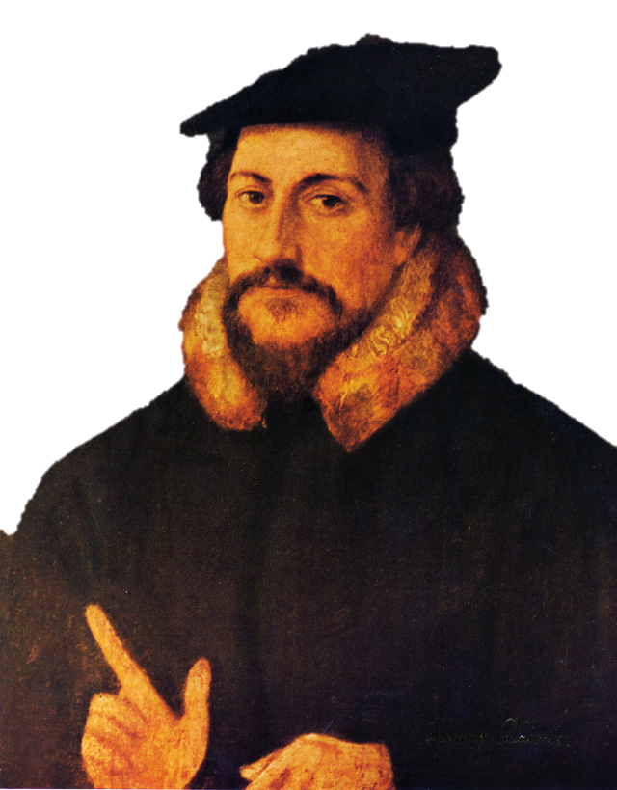
Calvinism
A Brief
Introduction

Slide 2
John Calvin
1509-1564
Geneva, Switzerland
Reformed Christianity

Slide 3
RADICAL REFORMER
John Calvin’s doctrines didn’t modify Catholicism – they took an entirely different direction.

Slide 4
Institutes of the Christian Religion
John Calvin’s work of
SYSTEMATIC
THEOLOGY

Slide 5
A Lawyer
Feel free to disagree with Calvin’s premise, but his logic is hard to refute.

Slide 6
SOVEREIGNTY OF GOD
The FOUNDATION of Calvin’s Theology

Slide 7
PREDESTINATION
God controls all. Including you.

Slide 8
THE ELECT
Salvation is God’s choice – not yours.

Slide 9
FREE WILL
Incompatible with God’s Sovereignty

Slide 11
The “Five Points”
of Calvinist Theology
TOTAL DEPRAVITY of human beings
UNCONDITIONAL ELECTION God’s mercy alone
LIMITED ATONEMENT Only for the Elect
IRRESISTABLE GRACE Resistance is futile
PERSEVERANCE OF THE SAINTS You can’t do anything to lose election

Slide 12
NOTHING
There is
you can do.

Slide 13
ICONOCLASM
Removal of Statues & Paintings from Churches

Slide 14
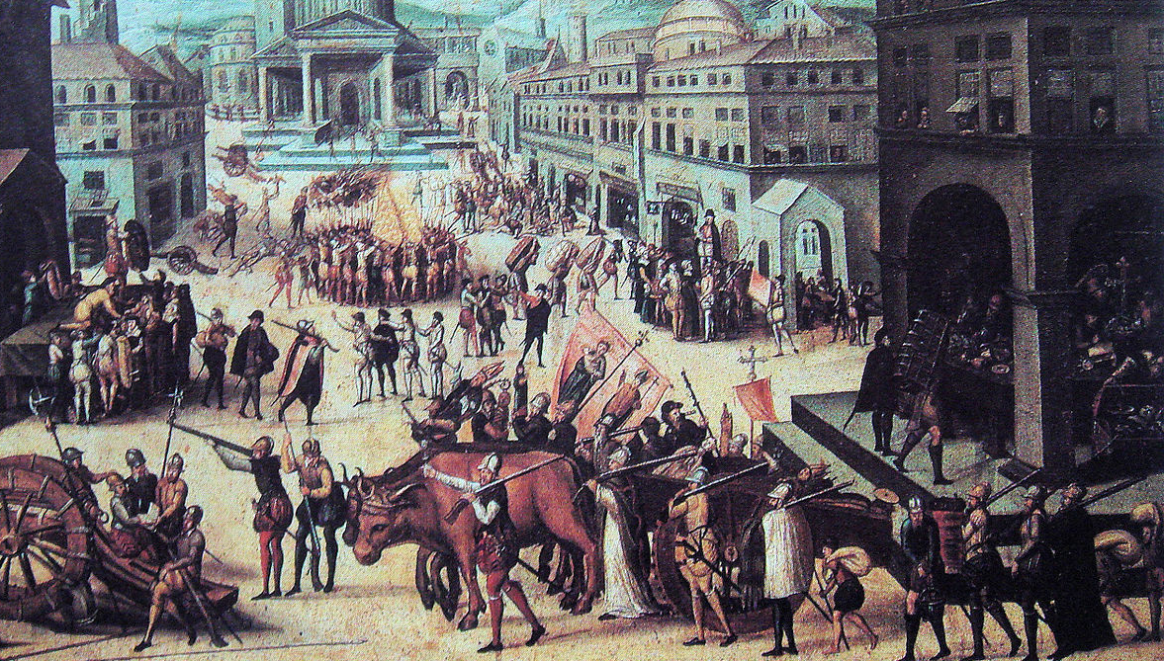
LOOTING OF CHURCHES IN LYON (1562)

Slide 15
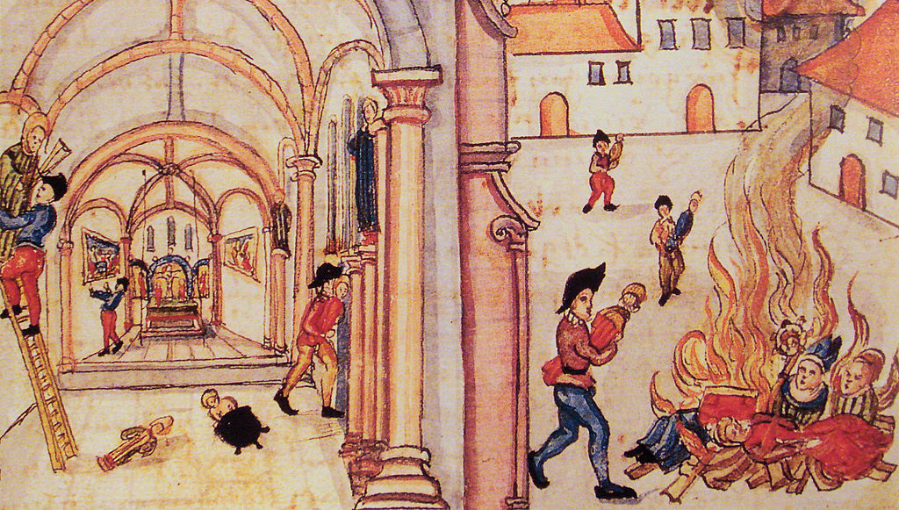
Destruction of Religious Icons in Zurich

Slide 16
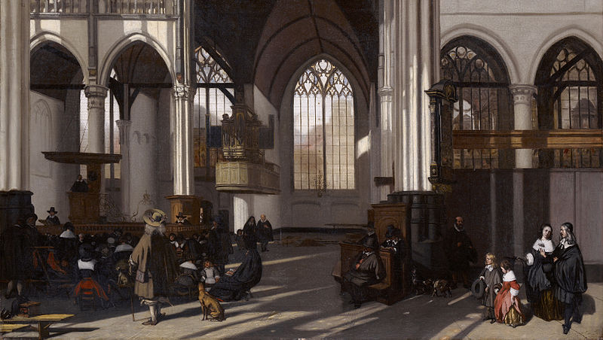
Interior of the Oude kerk in Amsterdam (south nave), by Emanuel de Witte

Slide 17
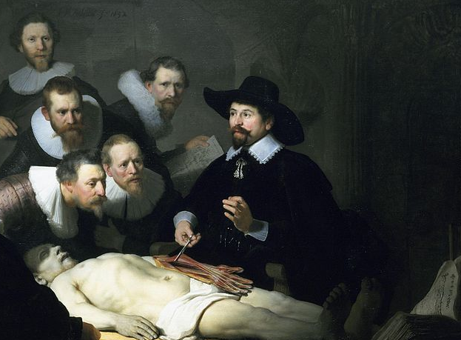
PLAIN CLOTHES
Fashion is a sign of vanity.

Slide 18
Calvinism Outside Switzerland
Presbyterians
(John Knox)
Puritans
Separatists
Calvinists became visible minorities in France, England, and Scotland.
Huguenots

