Slide 1
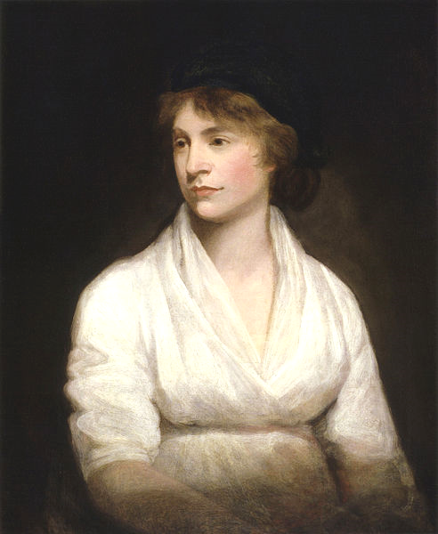
Women
and the French
Revolution

Slide 2
SEPARATE SPHERES

Slide 3
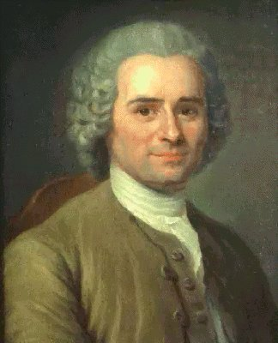
Rousseau
(French Philosophe)
Emile (On Education)
“Mother, do not make a decent man out of your daughter. Make a decent woman out of her.”

Slide 4
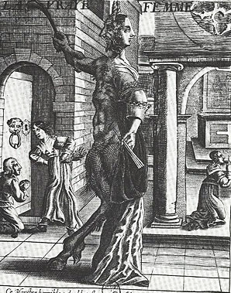
An Early Modern View of Women
The True Woman, anonymous engraving, seventeenth century. Paris, Bibliothèque Nationale

Slide 5
HYSTERICAL
Illustration from Anatomy & Physiology, Connexions Web site. http://cnx.org/content/col11496/1.6/

Slide 6
Okay… I’ll try it.

Slide 7
The Greek Version

Slide 8
CORRUPTING INFLUENCE

Slide 9
Marie Antoinette
Tragic Queen of France

Slide 10
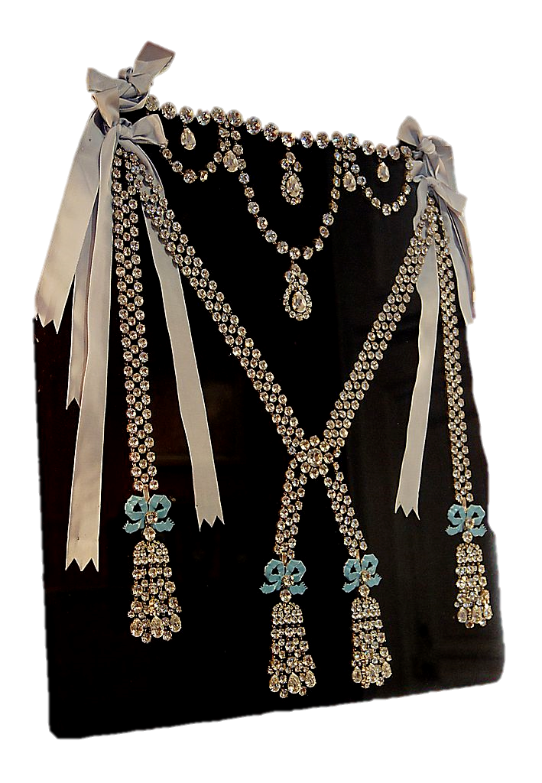
Diamond Necklace Affair
The queen’s name was tarnished when she became associated with an attempted fraud that had taken place without her knowledge.

Slide 11
Marie Antoinette became a symbol for the French monarchy’s extravagance in hard times.
Some rights reserved by St0rmz

Slide 12
Madame Deficit

Slide 13
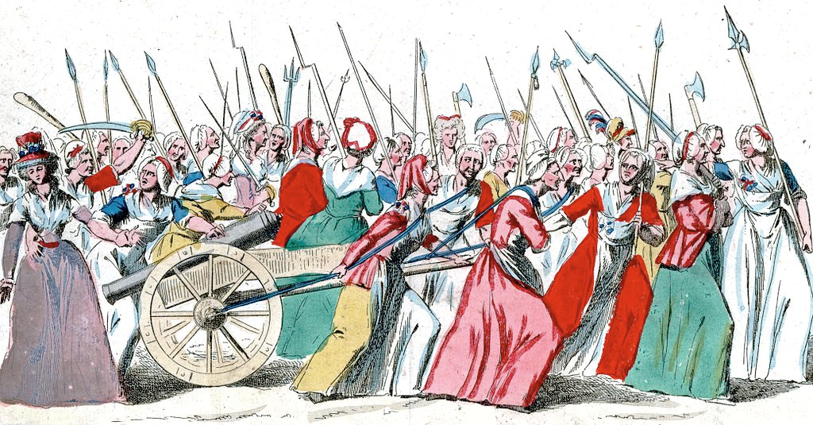
Women’s March on Versailles
October 5, 1789
An angry mob of armed women demanded that the king and queen vacate Versailles and come with them to Paris.

Slide 14
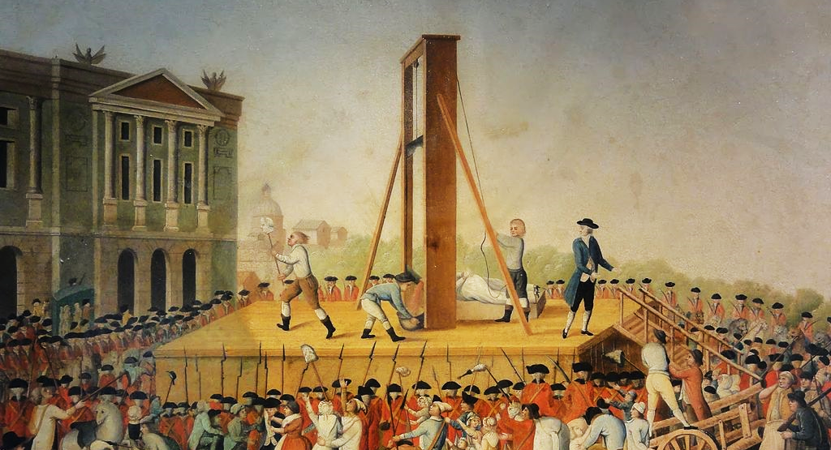
1793

Slide 15
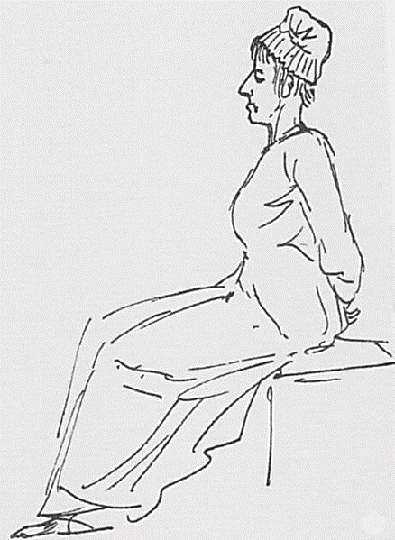
Jacques-Louis David, Marie Antoinette on the Way to the Guillotine, 1793

Slide 16
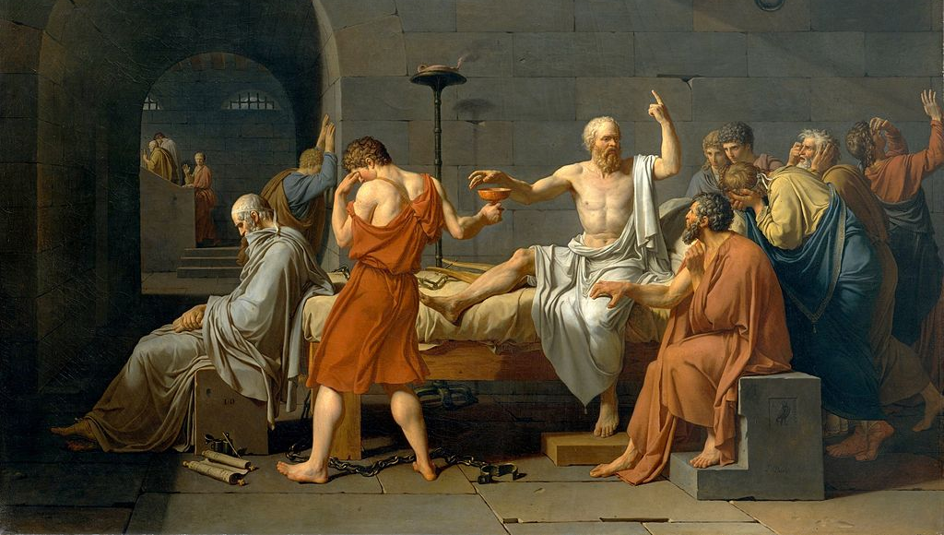

Slide 18
Not Worth a Painting

Slide 19
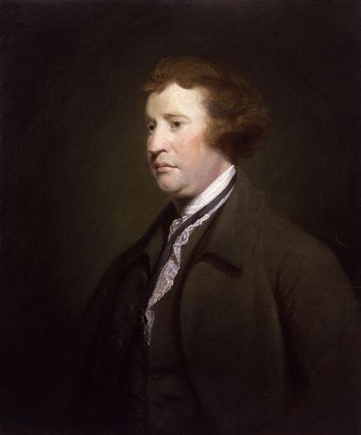
Edmund Burke
British MP

Slide 20
Little did I dream that I should have lived to see such disasters fallen upon her, in a nation of gallant men, in a nation of men of honor, and of cavaliers! I thought ten thousand swords must have leaped from their scabbards, to avenge even a look that threatened her with insult.

Slide 21
But the age of chivalry is gone; that of sophisters, economists, and calculators has succeeded, and the glory of Europe is extinguished forever.

Slide 22
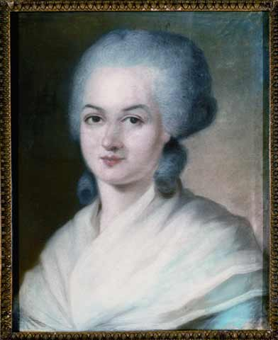
THE RIGHTS OF WOMAN
Olympe de Gouges and Her Declaration

Slide 23
Olympe de Gouges
Declaration of the Rights of Woman and the Female Citizen
“Woman has the right to mount the scaffold; she must equally have the right to mount the rostrum.”

Slide 24
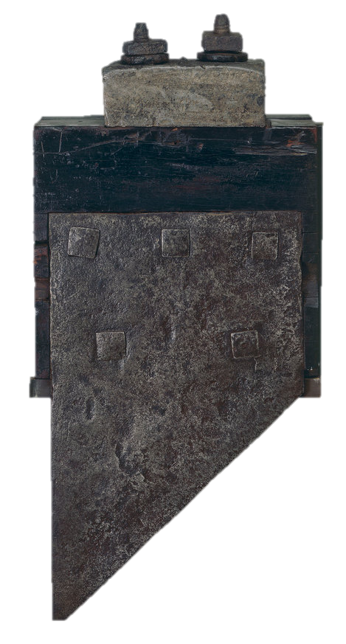
Olympe de Gouges
BEHEADED
(1793)

Slide 25
Place Olympe de Gouges
Photo by Groume

Slide 26
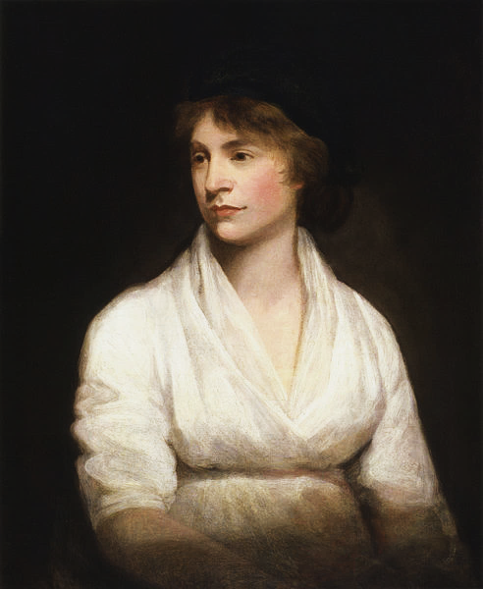
Burke vs. Wollstonecraft

Slide 27
The British
Debate

Slide 28
Edmund Burke
Reflections on the Revolution in France
(1790)

Slide 29
Edmund Burke
Reflections on the Revolution in France
(1790)
ANTI

Slide 30
Edmund Burke
Conservatism
Inherited Rights

Slide 31
Mary Wollstonecraft
A Vindication of the Rights of Man
(1790)

Slide 32
Mary Wollstonecraft
PRO
A Vindication of the Rights of Man
(1790)

Slide 33
Mary Wollstonecraft
Liberalism
Natural Rights

Slide 34
Mary Wollstonecraft
A Vindication of the Rights of Woman
(1792)

Slide 35
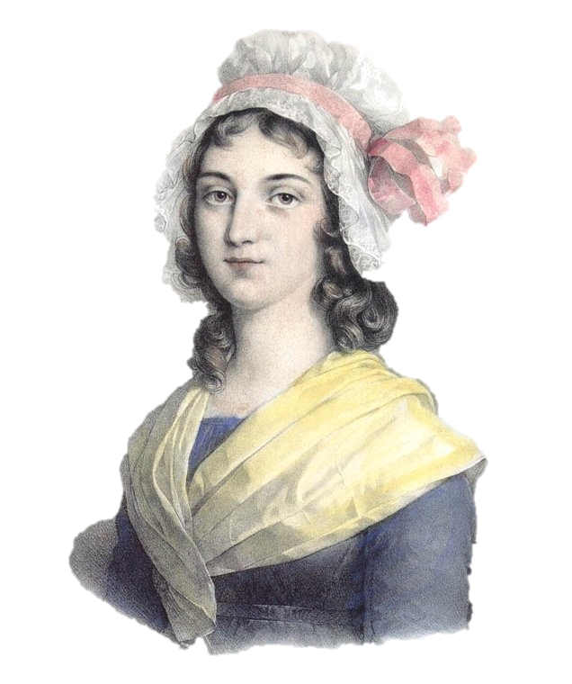
Charlotte Corday
Women and the French Revolution

Slide 36
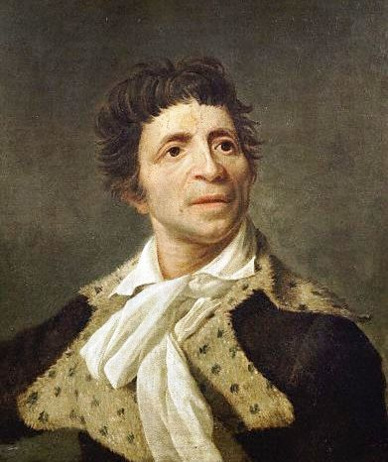
Jean-Paul Marat
Professional Revolutionary

Slide 37
MASS MURDERER

Slide 38
Who?
Will do something about it?

Slide 39
Charlotte Corday
ASSASSINATED
Jean-Paul Marat
(a Jacobin fanatic)
in 1793

Slide 40
The Death of Marat
Jacques-Louis David
(1793)

Slide 41
I have killed
one man
to save
a hundred thousand.

Slide 42
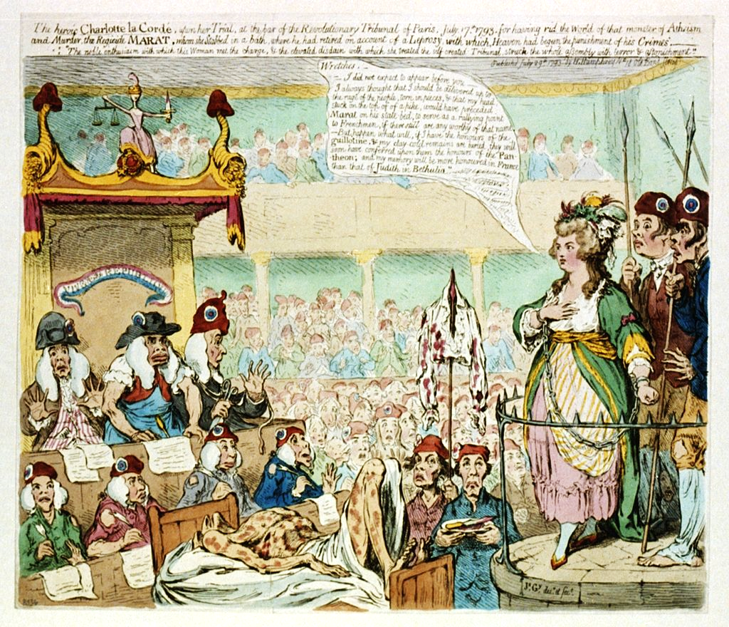
An English Perspective
Caricature of Corday's trial by James Gillray
(1793)

Slide 43
The heroic Charlotte la Cordé, upon her trial, at the bar of the revolutionary tribunal of Paris, July 17, 1793
For having rid the world of that monster of Atheism and Murder, the Regicide Marat, whom she stabbed in a bath, where he had retired on account of a Leprosy, with which Heaven had begun the punishment of his Crimes. The noble enthusiasm with which this woman met the charge, & the elevated disdain with which she treated the self-created Tribunal, struck the whole assembly with terror & astonishment.

Slide 44
Revolutionary leaders of the day did not see Corday as a hero.
Photo by E. C.

Slide 45
French authorities were disappointed to find no evidence that Corday had ever shared a bed with a man.
Photo by Prayitno

Slide 46
And afraid of the idea of women being able to do such things on their own.
Photo by Capture Queen

Slide 47
REVISIONISM
The French Reconsider

Slide 48
Corday as National Heroine
Charlotte Corday by Paul Jacques Aimé Baudry (1860)

Slide 49
Corday as National Heroine
Champion of reason
FANATIC
Charlotte Corday by Paul Jacques Aimé Baudry (1860)

Slide 50
Women
and the French
Revolution

Slide 51
Marie Antoinette
Tragic Queen of France

Slide 52
THE RIGHTS OF WOMAN
Olympe de Gouges and Her Declaration

Slide 53
Mary Wollstonecraft
A Vindication of the Rights of Man
(1790)

Slide 54
Charlotte Corday
Women and the French Revolution

Slide 55
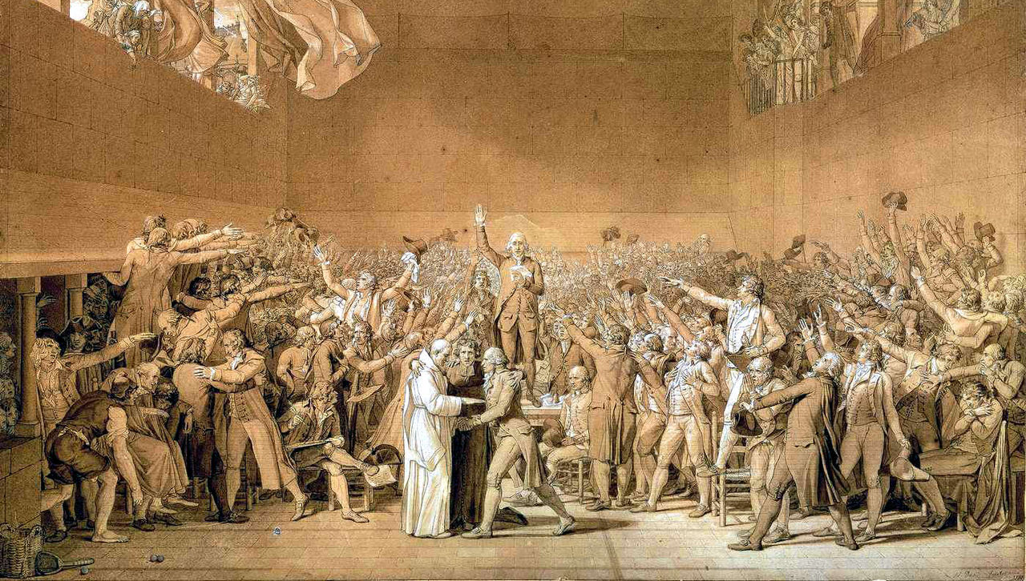
The French Revolution was not a feminist revolution

Slide 56
DEFINITELY NOT

Slide 57
But it was a start

Slide 58
Women began the Revolution as Villains

Slide 59
And walked out of it as HEROES

Slide 60
The stage was set for the feminist movement.
Photo by Max Wolfe

