Slide 1
A History of Western Society Twelfth Edition
McKay • Crowston • Wiesner-Hanks • Perry
CHAPTER 30
Life in an Age of Globalization
1990 to the present
Copyright © 2017 by Bedford/St. Martin’s
Distributed by Bedford/St. Martin's/Macmillan Higher Education strictly for use with its products; Not for redistribution.

Slide 2
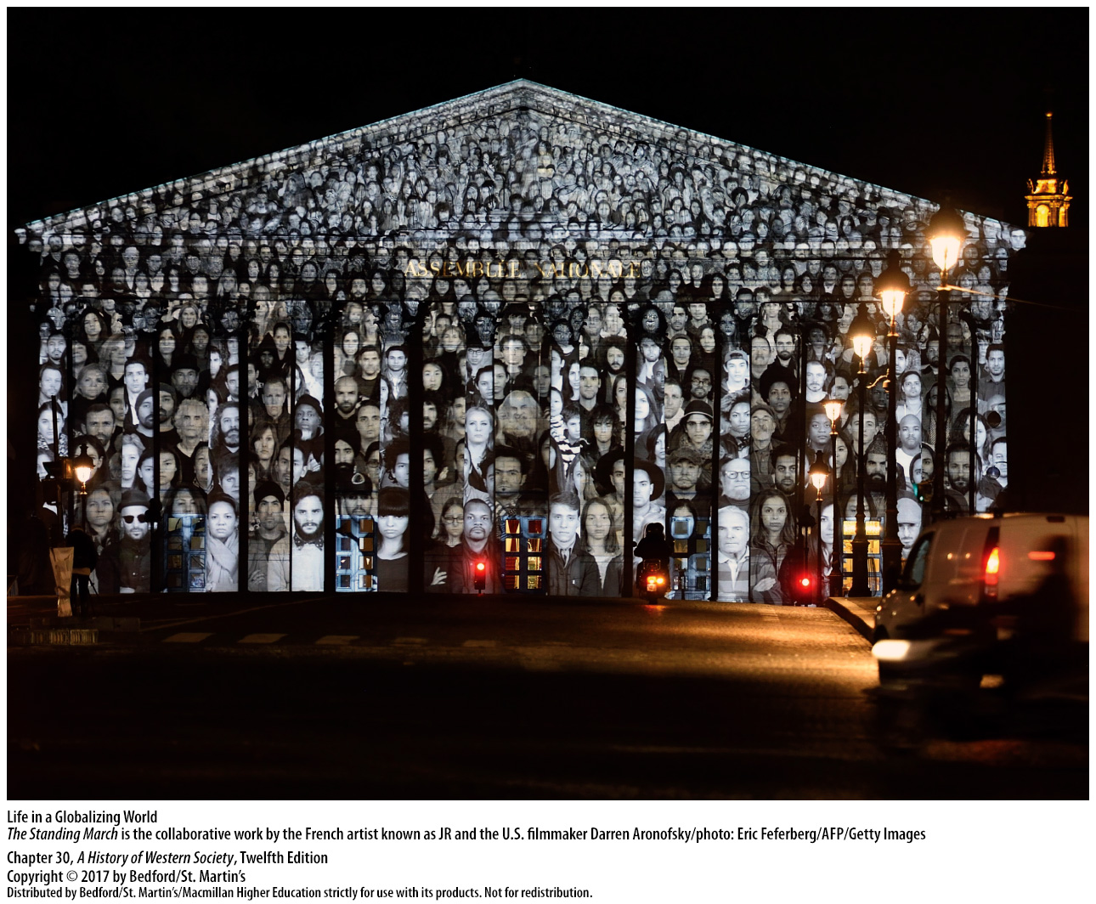

Slide 3
I. Reshaping the Soviet Union and the Former East Bloc
Economic Shock Therapy in Russia
1. Neoliberal Western advisers
2. Rapid privatization
3. Yeltsin and his economic reformers
4. Asia’s financial crisis
5. Highly monopolized
6. “Oligarchs”
7. Poverty
Notes:
I. Reshaping the Soviet Union and the Former East Bloc
A. Economic Shock Therapy in Russia
1. Neoliberal Western advisers argued that a quick turn to free markets would speed economic growth, and thus Russian reformers opted in January 1992 for liberalization at breakneck speed.
2. The Russian government launched rapid privatization, abolishing price controls on 90 percent of all Russian goods and selling thousands of formerly state-owned factories and mines to new private companies.
3. Yeltsin and his economic reformers believed that shock therapy would revive production and bring widespread prosperity, but prices increased by 250 percent on the very first day and increased by a factor of twenty-six in the course of 1992, while production fell a staggering 20 percent.
4. The Russian economy crashed again in 1998 in the wake of Asia’s financial crisis.
5. Rapid economic liberalization worked poorly in Russia partly because Soviet industry had been highly monopolized and strongly tilted toward military goods; these powerful state monopolies became powerful private monopolies that cut production and raised prices to maximize profits. Moreover, powerful corporate managers and bureaucrats forced Yeltsin’s government to hand out enormous subsidies to reinforce faltering firms, and the new corporate leaders included criminals who intimidated would-be rivals and competing businesses.
6. The capitalist new elite—the so-called “Oligarchs”—acquired great wealth and power and maintained control with corrupt business practices and rampant cronyism.
7. Large numbers of people fell into poverty, and the majority struggled to make ends meet, as savings became practically worthless and pensions lost much of their value.

Slide 4
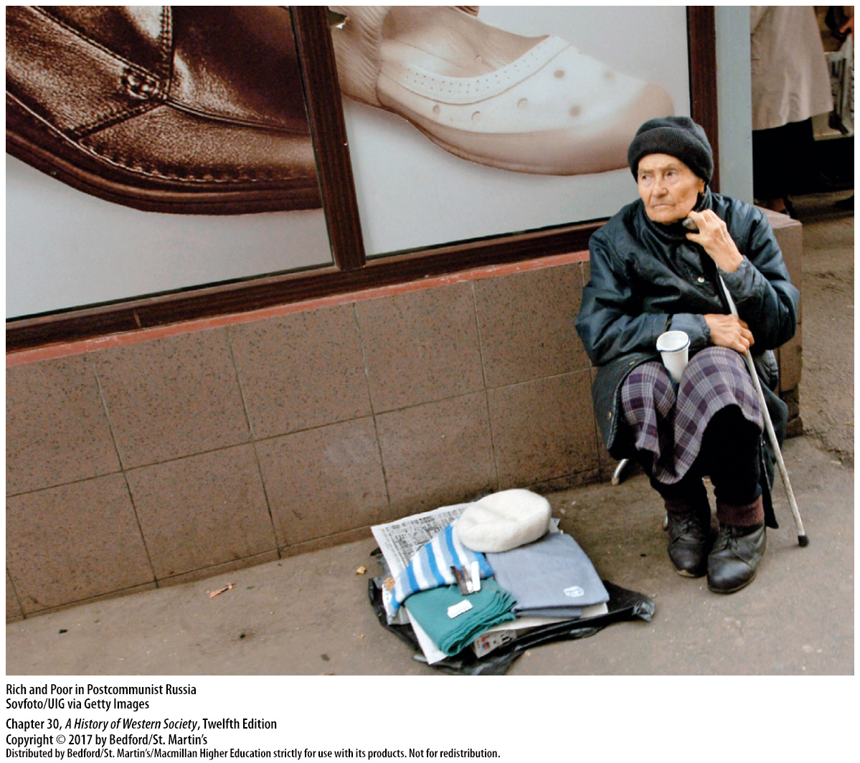

Slide 5
I. Reshaping the Soviet Union and the Former East Bloc
Russian Revival Under Vladimir Putin
1. Vladimir Putin
2. Economic expansion and a new middle class
3. Putin’s reforms
4. Anti-Western Russian nationalism
5. Dimitri Medvedev
6. Putin again
Notes:
I. Reshaping the Soviet Union and the Former East Bloc
B. Russian Revival Under Vladimir Putin
1. This widespread disillusionment set the stage for the rise of Vladimir Putin (b. 1952), first elected president in 2000. Putin maintained relatively liberal economic policies but reestablished semi-authoritarian political rule, as conservative Russian intellectuals argued that free markets required strong political rule to control corruption and prevent chaos.
2. The combination of Putin’s autocratic politics and economic reform, aided greatly by high world prices for oil and natural gas, led to nine years of economic expansion and the growth of a new middle class.
3. Putin’s housing, education, and healthcare reforms significantly improved living standards and proved immensely popular with a majority of Russians.
4. Putin championed an assertive anti-Western Russian nationalism, taking a forceful stand against NATO expansion and expressing pride in the accomplishments of the former Soviet Union; he also centralized power in the Kremlin, increased military spending, and expanded the secret police.
5. Putin stepped down in 2008 when his term limits expired, and his handpicked successor, Dimitri Medvedev (b. 1965), easily won election that year and then appointed Putin prime minister.
6. Putin won the presidential election of March 2012; shortly after, some 15,000 people marched in Moscow to protest election fraud and Putin’s authoritarian-style of government.

Slide 6
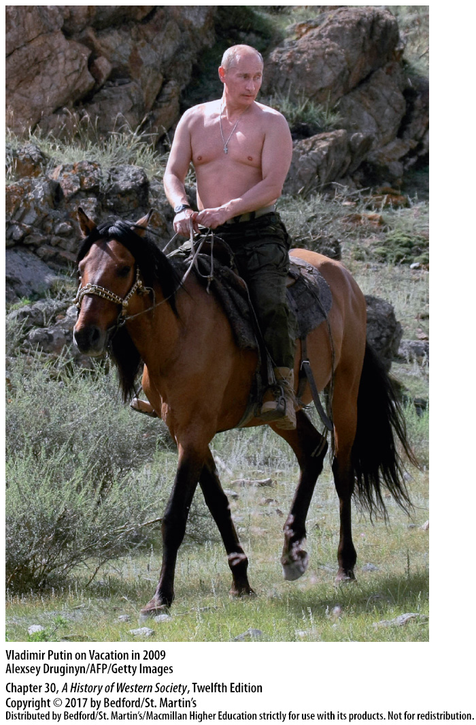

Slide 7
I. Reshaping the Soviet Union and the Former East Bloc
Coping with Change in the Former East Bloc
1. Former satellite states
2. Poland’s “shock therapy”
3. Czechoslovakia’s gradual approach
4. Poland, the Czech Republic, and Hungary
5. New civic institutions, legal systems, and independent media outlets
Notes:
I. Reshaping the Soviet Union and the Former East Bloc
C. Coping with Change in the Former East Bloc
1. The former satellite states of eastern Europe also worked to replace state planning and socialism with market mechanisms and private property, and Western-style electoral politics took hold.
2. Poland’s leaders used “shock therapy,” liberalizing prices and trade policies, raising taxes, cutting spending to reduce budget deficits, and selling state-owned industries to private investors. These radical moves at first brought high inflation and a rapid decline in living standards, which generated protests and strikes; however, the West provided financial support that eased the pain, and by the end of the decade, Poland had one of the strongest economies in the former East bloc.
3. Czechoslovakia took a more gradual approach, issuing its citizens vouchers that they could use to buy shares in privatized companies, while Slovenia transferred up to 60 percent of company ownership to employees, and Estonia experimented with employee ownership, vouchers, and worker cooperatives.
4. Most observers agreed that Poland, the Czech Republic, and Hungary were the most successful in meeting the critical challenge of economic reconstruction, partly because of their considerable experience with limited market reforms before 1989, flexibility and lack of dogmatism in government policy, and an enthusiastic embrace of capitalism by a new entrepreneurial class.
5. Poland, the Czech Republic, and Hungary did far better than Russia in creating new civic institutions, legal systems, and independent media outlets that reinforced political freedom and national revival.

Slide 8
I. Reshaping the Soviet Union and the Former East Bloc
Coping with Change in the Former East Bloc
6. “Velvet divorce”
7. NATO and the European Union (EU)
8. Romania and Bulgaria lagged
9. Inequalities increased
10. Question of former Communist leaders
Notes:
I. Reshaping the Soviet Union and the Former East Bloc
C. Coping with Change in the Former East Bloc
6. After Czechoslovakia’s Velvet Revolution in 1989, Havel and the Czech parliament accepted a “velvet divorce” in 1993 when Slovakian nationalists wanted to break off and form their own state, creating the separate Czech and Slovak Republics.
7. In 1999 Poland, Hungary, and the Czech Republic were accepted into NATO, and in 2004 they and Slovakia gained admission to the European Union (EU).
8. Romania and Bulgaria lagged behind in the postcommunist transition because they were much poorer than their more successful neighbors and Western traditions were much weaker there; but the two countries made progress after 2000, and they joined NATO in 2004 and the EU in 2007.
9. Inequalities between richer and poorer regions increased; capital cities such as Warsaw, Prague, and Budapest concentrated wealth, power, and opportunity as never before, while provincial centers stagnated and industrial areas declined; crime, corruption, and gangsterism increased both in the streets and in the executive suites.
10. The question of whether or how to punish former Communist leaders who had committed political crimes or abused human rights emerged as a pressing issue in the former East Bloc.

Slide 9
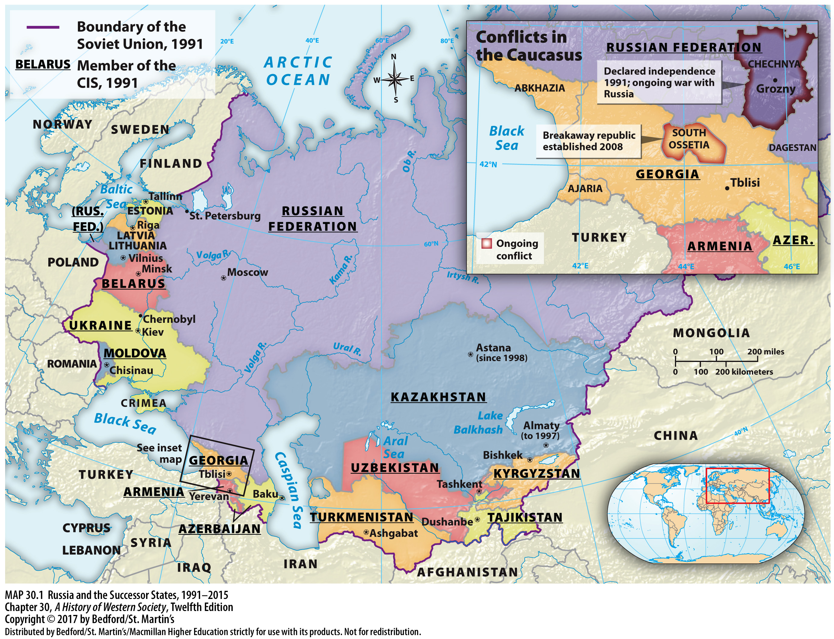

Slide 10
I. Reshaping the Soviet Union and the Former East Bloc
Tragedy in Yugoslavia
1. Josip Tito
2. Slobodan Milošević
3. “Greater Serbia”
4. Civil war spreads
5. Genocide
Notes:
I. Reshaping the Soviet Union and the Former East Bloc
D. Tragedy in Yugoslavia
1. The great postcommunist tragedy was Yugoslavia, which under Josip Tito had been a federation of republics under centralized Communist rule.
2. In 1989 Serbian president Slobodan Milošević (1941–2006), a former Communist bureaucrat, tried to strengthen the federation’s centralized government under Serbian control by severely limiting self-rule in the Serbian province of Kosovo, where Albanian-speaking, primarily Muslim, peoples constituted the overwhelming majority.
3. Milošević supported calls to grab land from other republics and unite all Serbs, regardless of where they lived, in a “greater Serbia,” strengthening the cause of national separatism in the federation and causing relatively wealthy Slovenia and Croatia to declare their independence in June 1991.
4. Milošević ordered the federal army to invade and reassert Serbian control; though the Serbs were quickly repulsed in Slovenia, they managed to take about 30 percent of Croatia. In 1992 the civil war spread to Bosnia-Herzegovina, which also had declared its independence.
5. The new goal of both armed factions in the Bosnian civil war was ethnic cleansing, or genocide: the attempt to establish ethnically homogeneous territories by intimidation, forced deportation, and killing.

Slide 11
I. Reshaping the Soviet Union and the Former East Bloc
Tragedy in Yugoslavia
6. NATO
7. Bill Clinton
8. Kosovo Liberation Army (KLA)
9. UN-NATO peacekeeping force
Notes:
I. Reshaping the Soviet Union and the Former East Bloc
D. Tragedy in Yugoslavia
6. The turning point came in July 1995 when Bosnian Serbs overran Srebrenica—a Muslim city previously declared a United Nations safe area—and killed 8,000 Bosnian Muslim civilians; the public outrage that followed prompted NATO to bomb Bosnian Serb military targets.
7. In November 1995 U.S. President Bill Clinton helped the warring sides hammer out a complicated accord that gave the Bosnian Serbs about 49 percent of Bosnia and the Muslims and Roman Catholic Croats the rest, as troops from NATO countries patrolled Bosnia to try to keep the peace.
8. The Albanian Muslims of Kosovo, who hoped to establish self-rule, gained nothing from the Bosnian agreement, so frustrated Kosovar militants formed the Kosovo Liberation Army (KLA) and began to fight for independence.
9. NATO redoubled its highly destructive bombing campaign, which eventually forced Milošević to withdraw and allowed the Kosovars to regain their homeland; a UN-NATO peacekeeping force occupied Kosovo, ending ten years of Yugoslavian civil wars.

Slide 12
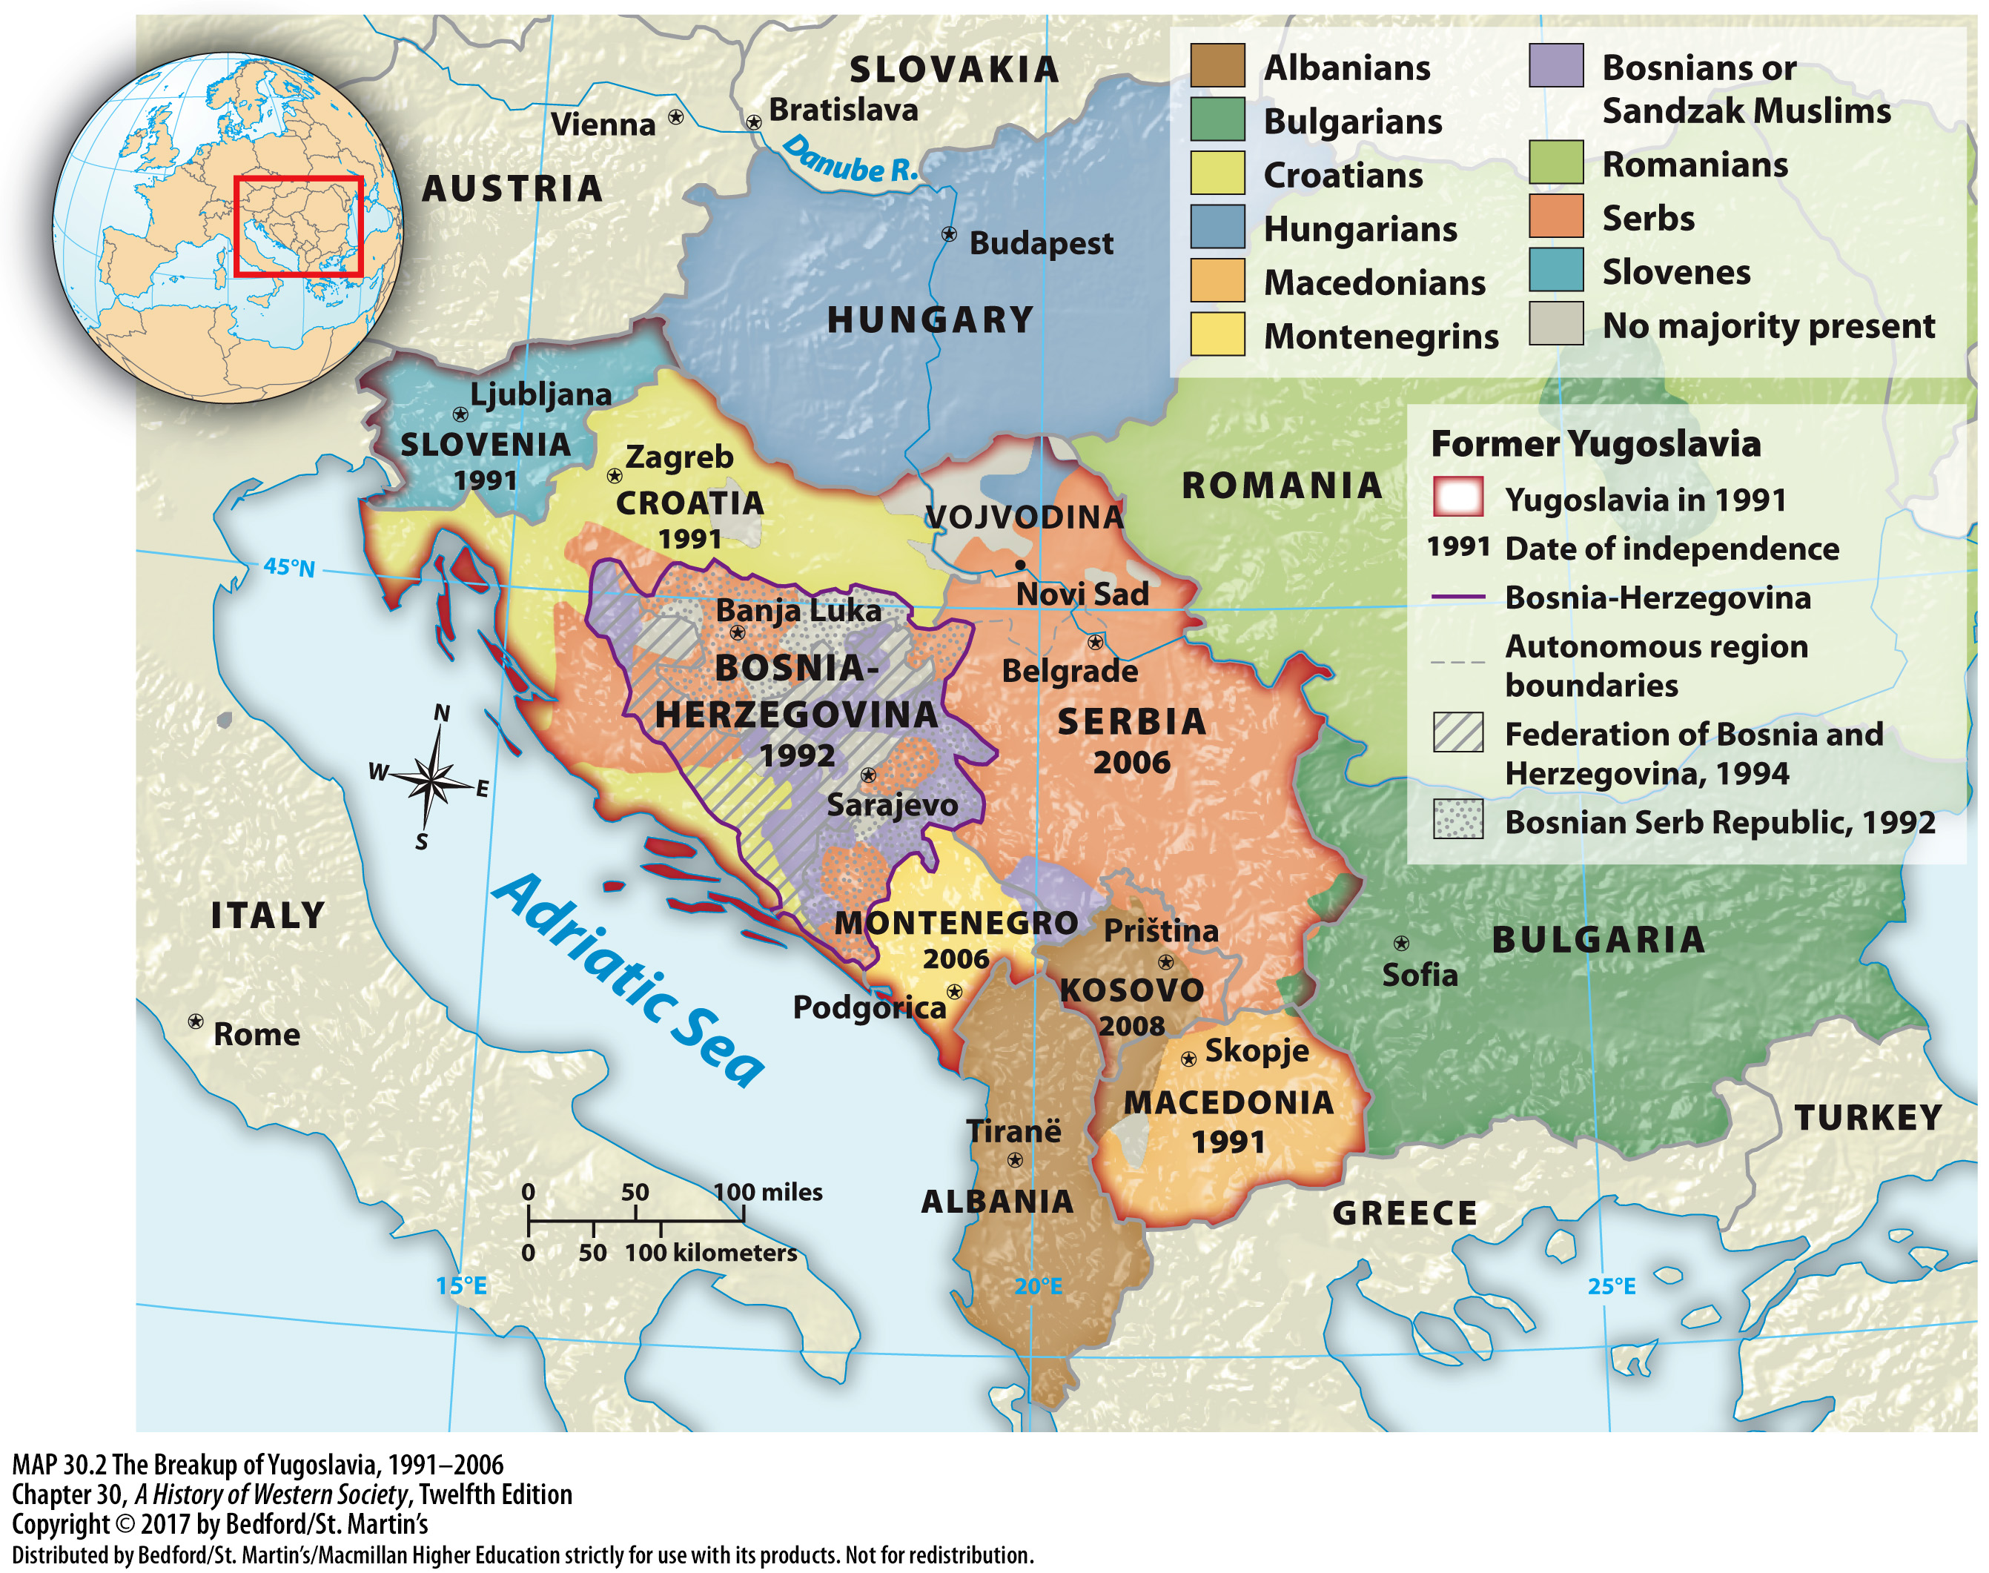

Slide 13
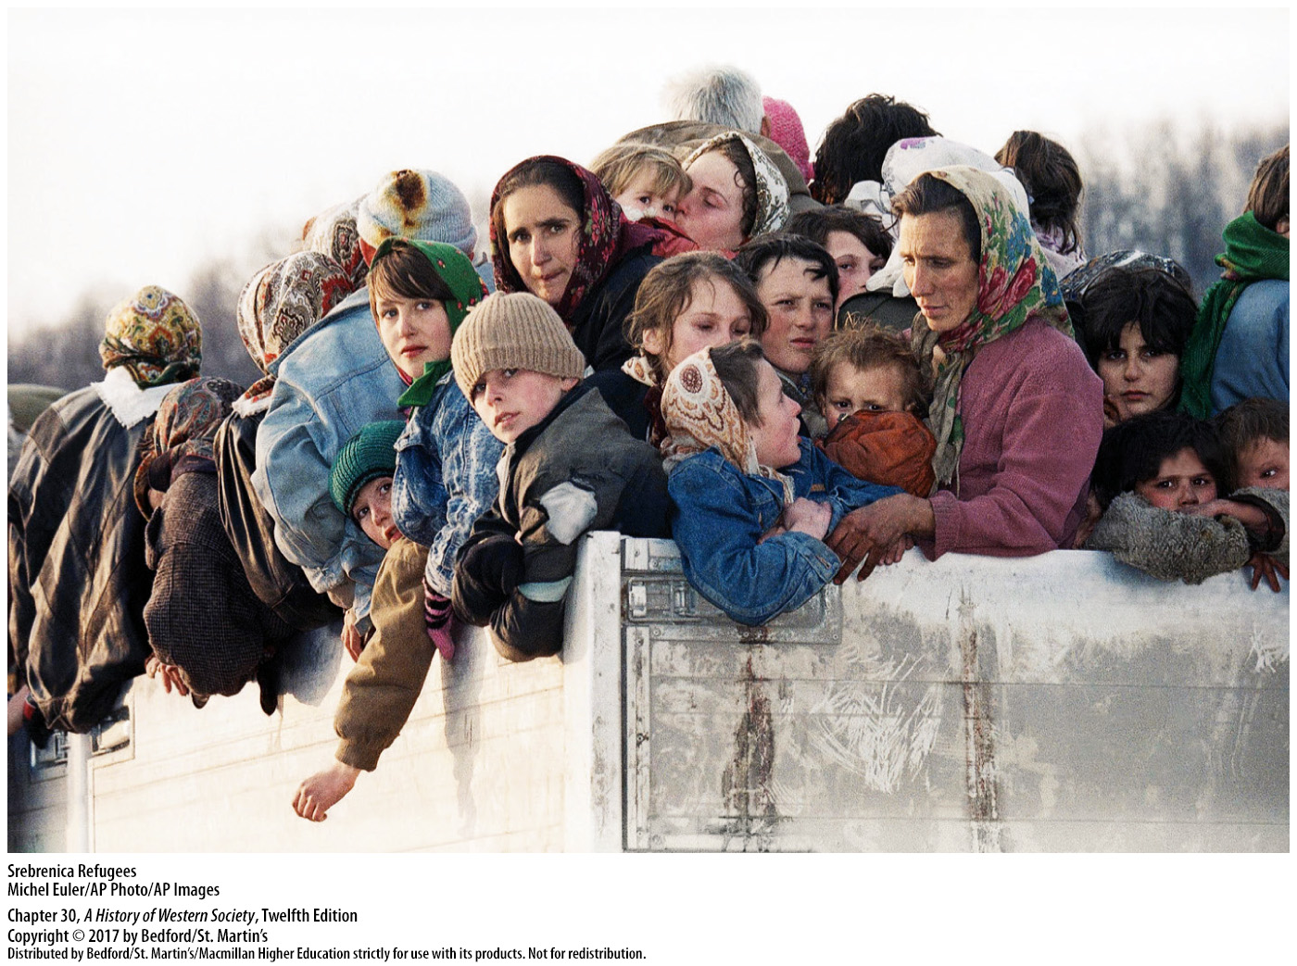

Slide 14
I. Reshaping the Soviet Union and the Former East Bloc
Instability in the Former Soviet Republics
1. Political reforms varied
2. Commonwealth of Independent States
3. Putin’s interventionist stance
4. Revolution in Ukraine
Notes:
I. Reshaping the Soviet Union and the Former East Bloc
E. Instability in the Former Soviet Republics
1. Though most of the fourteen new republics, which comprised almost one-half of the former Soviet Union’s total population, adopted some sort of liberal market capitalism, political reforms varied broadly. Ukrainians struggled to construct a working democratic system. Elsewhere, in Belarus, Kazakhstan and the other central Asian republics, and the new republics in the Caucasus, systems of “imitation democracy” and outright authoritarian rule took hold.
2. Though Putin encouraged the former Soviet republics to join the Commonwealth of Independent States, stability and agreement proved elusive. Popular protests and revolts challenged local politicians and Russian interests.
3. Putin took an aggressive and at times interventionist stance toward anti-Russian revolt in the Commonwealth of Independent States and the Russian borderlands.
4. Revolution broke out again in Ukraine in February 2014, and when popular protests brought down the pro-Russian government, Putin’s response was rapid and radically interventionist. In response, the United States and the European Union placed economic sanctions on Russia.

Slide 15
II. The New Global System
The Global Economy
1. Multinational corporations
2. Internet
3. Information across international borders
4. London, Moscow, New York, and Hong Kong
5. Economic panics and downturns
6. Global recession
Notes:
II. The New Global System
A. The Global Economy
1. Multinational corporations built global systems of production and distribution that generated unprecedented wealth and generally escaped the control of national regulators and politicians.
2. The development of sophisticated personal computer technologies and the Internet at the end of the twentieth century, coupled with the deregulation of national and international financial systems, further encouraged the growth of international trade.
3. The ability to rapidly exchange information and capital meant that economic activity was no longer centered on national banks or stock exchanges, but rather flowed quickly across international borders.
4. The influence of multinational enterprises headquartered in global cities such as London, Moscow, New York, and Hong Kong extended far beyond the borders of the traditional nation-state.
5. The close connections between national economies also made the entire world vulnerable to economic panics and downturns.
6. A global recession triggered by a crisis in the U.S. housing market and financial system created the worst worldwide economic crisis since the Great Depression of the 1930s.

Slide 16
II. The New Global System
The New European Union
1. European Common Market
2. Maastricht Treaty
3. “Eurocrats”
4. EU operating budget
5. The euro
Notes:
II. The New Global System
B. The New European Union
1. Global economic pressures encouraged the expansion and consolidation of the European Common Market, which in 1993 proudly rechristened itself the European Union (EU).
2. The 1991 Maastricht Treaty defined the strict financial criteria that member states were required to meet in order to share the single currency of the EU; it also set legal standards and anticipated the development of common policies on defense and foreign affairs.
3. Increased unity meant yielding still more power to distant “Eurocrats” and political insiders, thereby limiting national sovereignty and democratic control.
4. Many citizens feared that the European Union was being created at their expense because joining the union required governments to impose budget cuts and contribute to the EU operating budget, which resulted in reductions in health care and social benefits.
5. In 2002 the new euro replaced the national currencies of all Eurozone residents.

Slide 17
II. The New Global System
The New European Union
6. East Bloc neighbors
7. Failed EU constitution
8. Treaty of Lisbon
Notes:
II. The New Global System
B. The New European Union
6. On May 1, 2004, the European Union began admitting its former East Bloc neighbors, and by 2007 the EU was home to 493 million citizens in twenty-seven different countries.
7. In June 2004 a special commission presented a new EU constitution that moved toward a more centralized federal system while allowing each state to retain veto power over taxation, social policy, foreign affairs, and other sensitive areas. The constitution ultimately failed to win the unanimous support that it needed to take effect because nationalist fears about losing sovereignty and cultural identity outweighed the perceived benefits of a more unified Europe.
8. In 2007 the rejected constitution was replaced with the Treaty of Lisbon, which kept many sections of the constitution but further streamlined the EU bureaucracy; the treaty was ratified by all the EU states and went into effect on December 1, 2009.

Slide 18
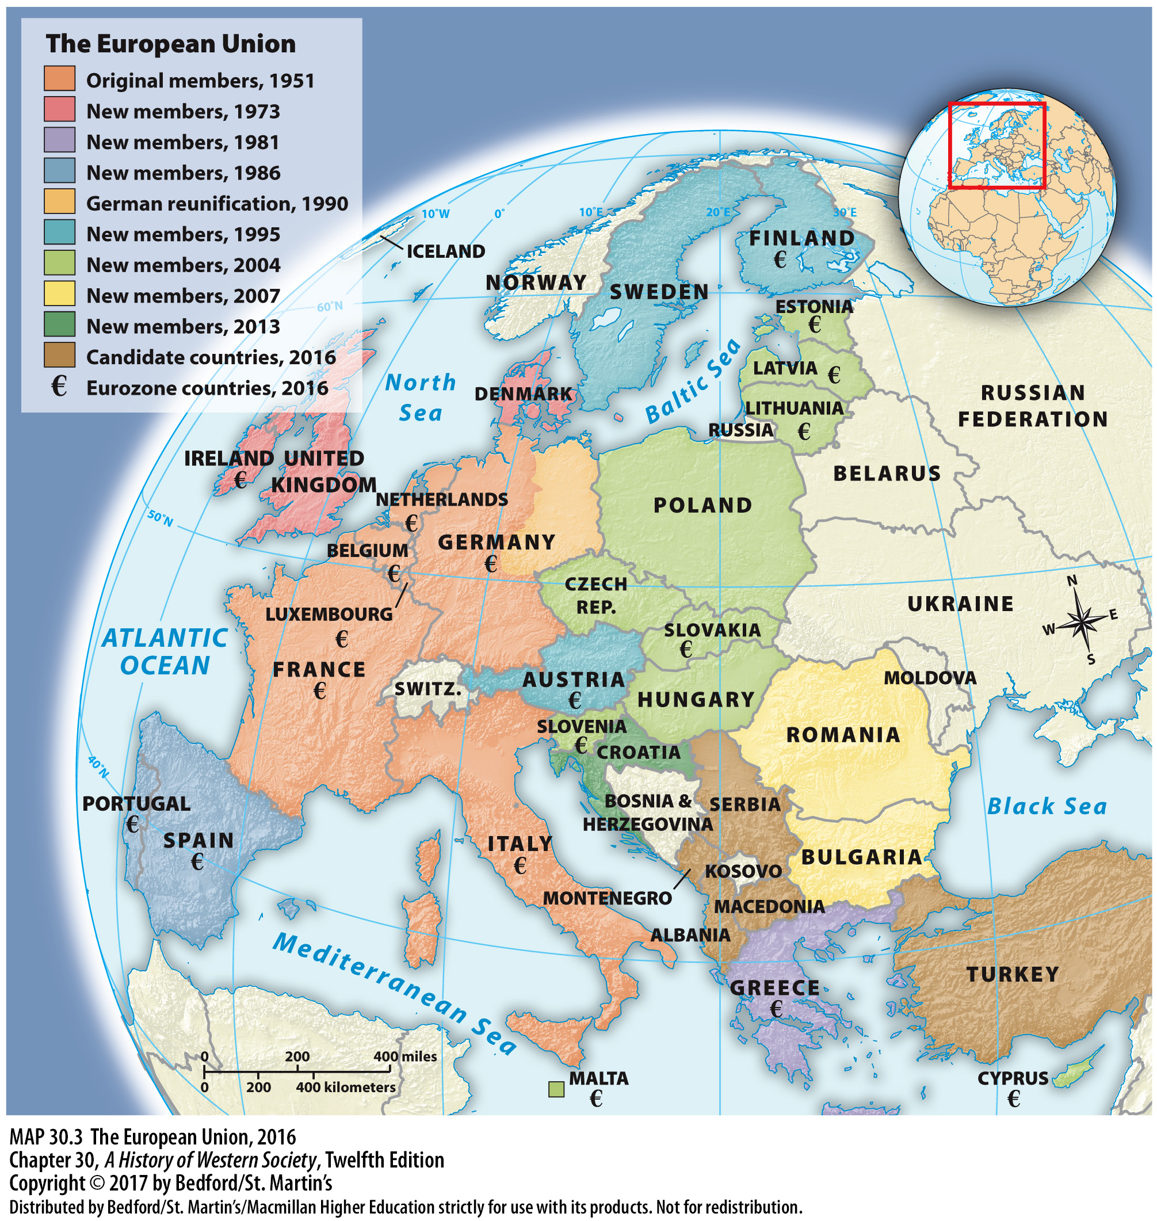

Slide 19
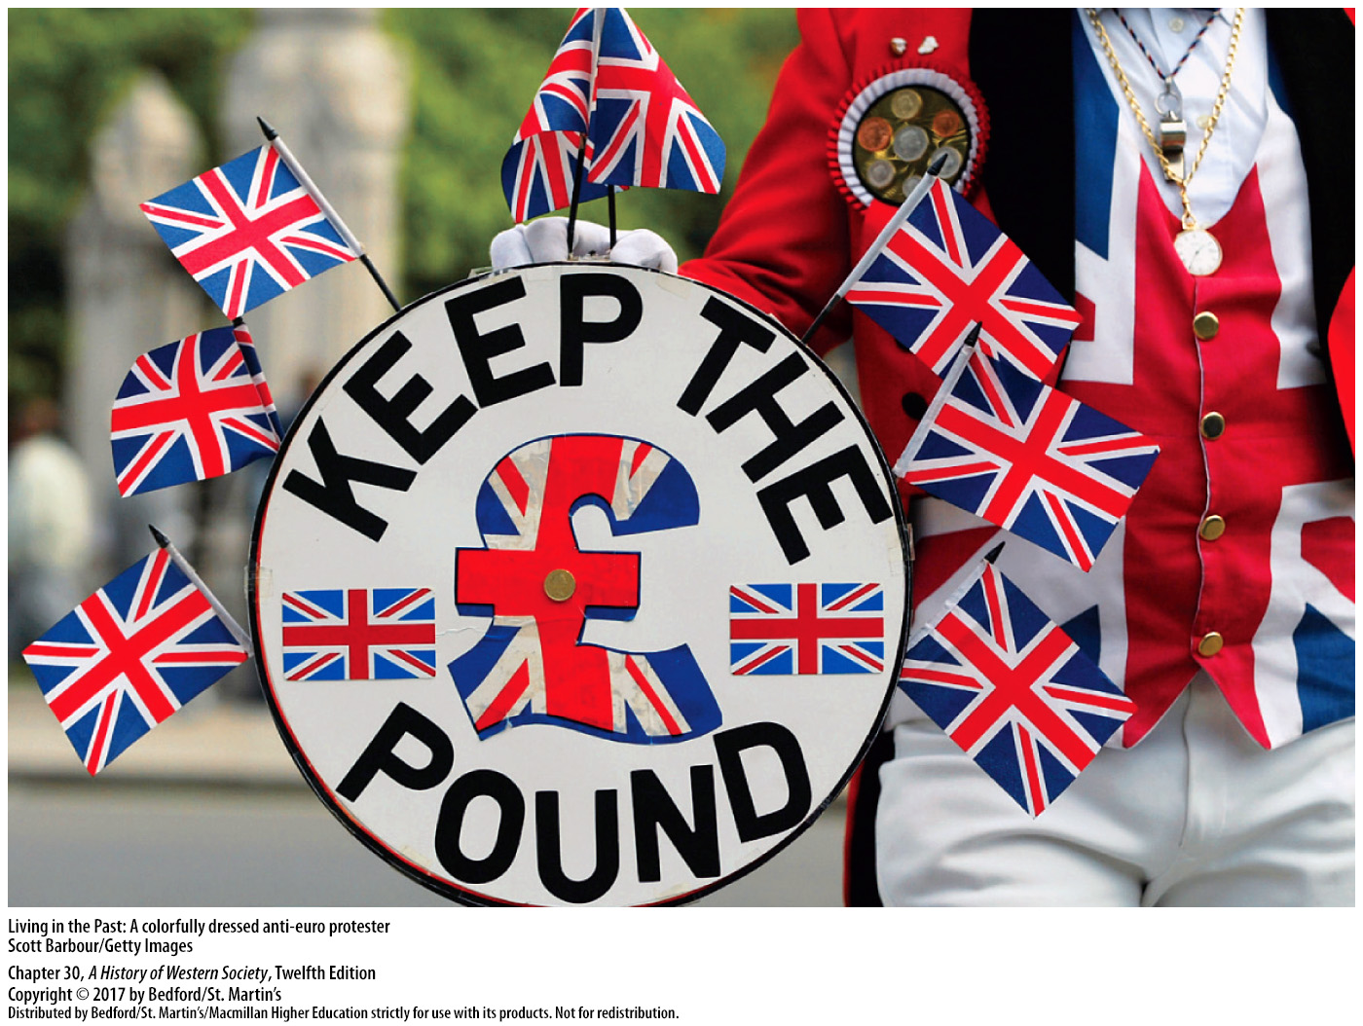

Slide 20
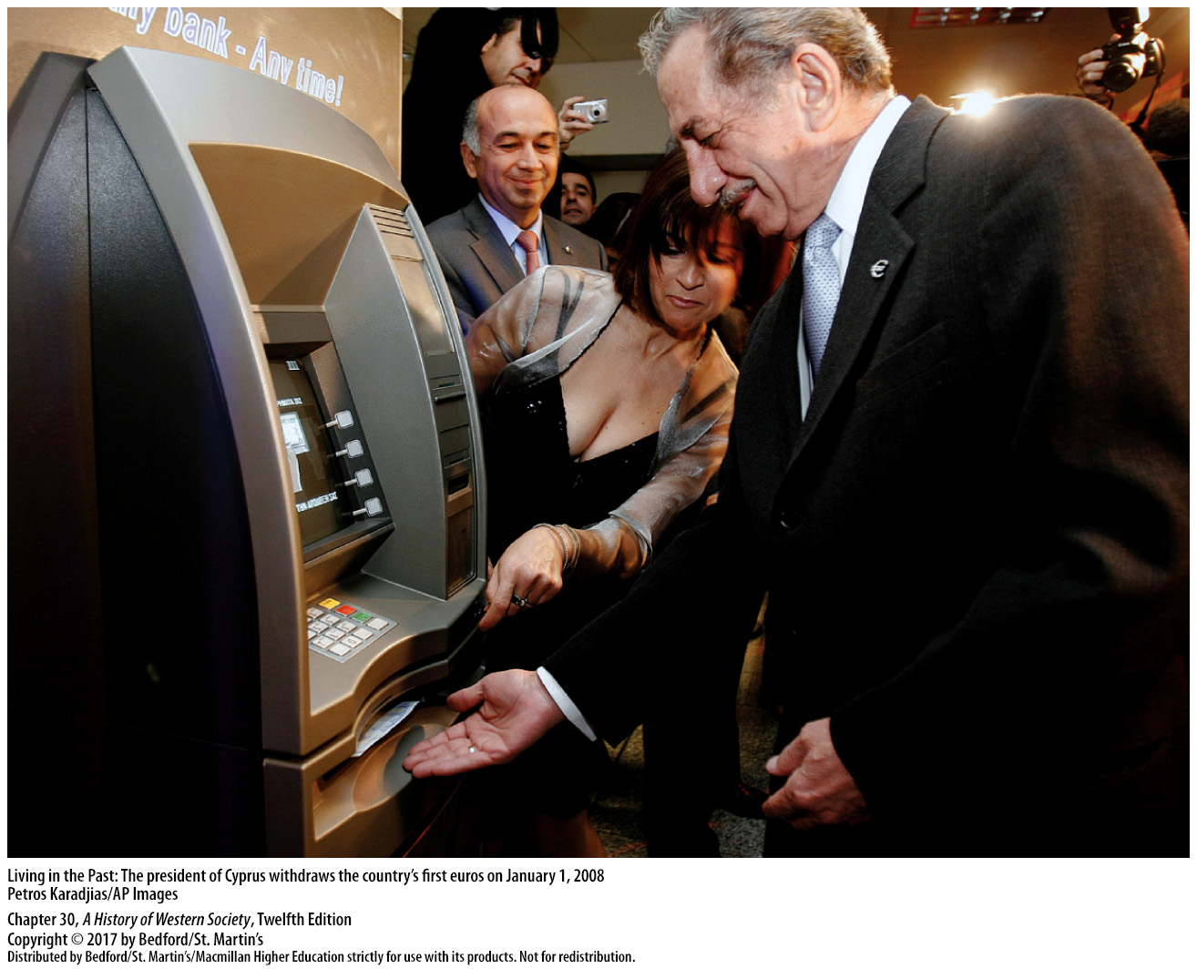

Slide 22
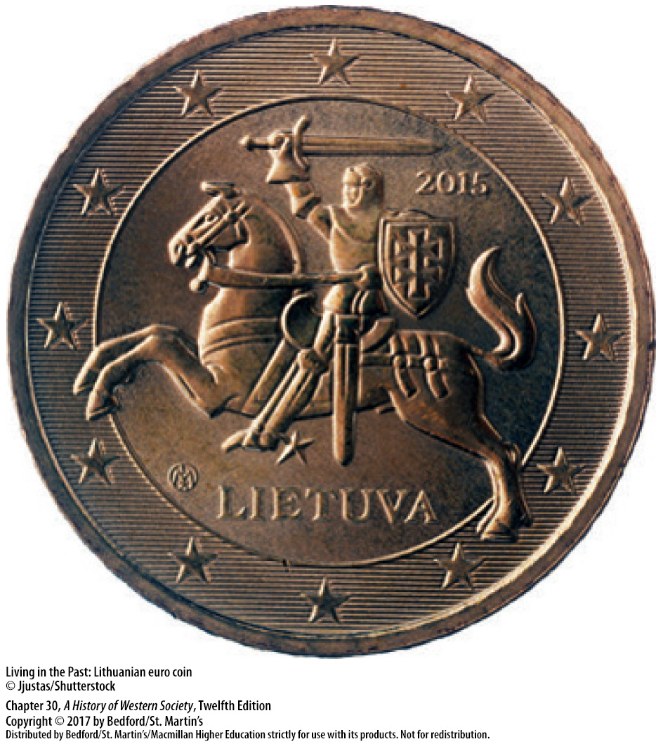

Slide 23
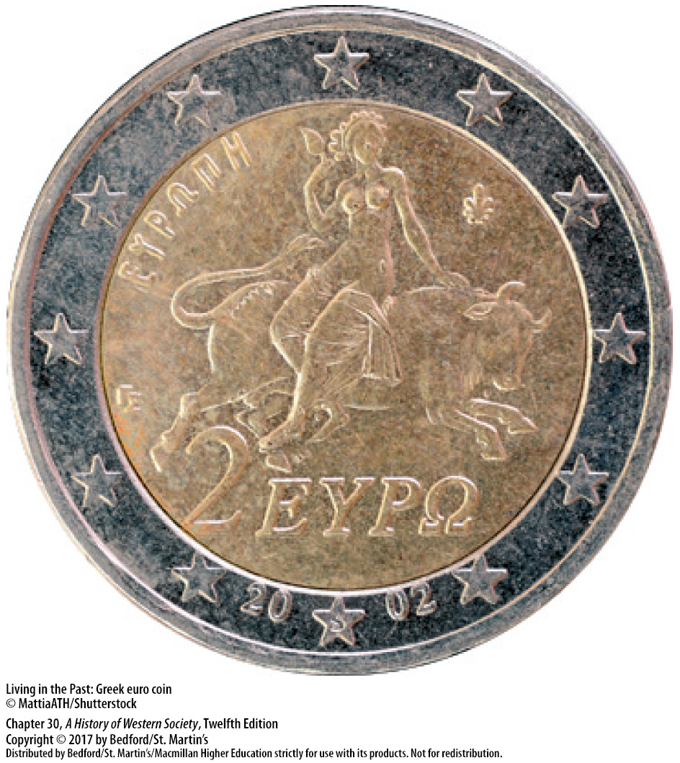

Slide 24
II. The New Global System
Supranational Organizations
1. International Court of Justice
2. UN Security Council
3. Western neocolonial interests
4. International Monetary Fund (IMF) and World Bank
5. World Trade Organization (WTO)
6. Nongovernmental organizations (NGOs)
Notes:
II. The New Global System
C. Supranational Organizations
1. The UN sends troops in attempts to preserve peace between warring parties, and UN agencies deal with issues such as world hunger and poverty; the International Court of Justice in The Hague, Netherlands, hears cases that violate international law.
2. The UN Security Council, made up of five permanent members—the United States, Russia, France, Great Britain, and China—has the ability to impose sanctions to punish uncooperative states and to endorse military action.
3. The predominance of the United States and western European powers on the Security Council has led some critics to accuse the UN of implementing Western neocolonial interests; others argue that UN policies should never take precedent over national needs.
4. Initially founded to help rebuild war-torn Europe, the International Monetary Fund (IMF) and the World Bank now provide loans to the developing world, with funding coming primarily from the United States and western Europe on the condition that recipient countries adopt neoliberal economic reforms, including budget reduction, deregulation, and private trade.
5. One of the most powerful supranational financial institutions, the World Trade Organization (WTO), sets trade and tariff agreements for more than 150 member countries and helps manage many of the world’s import-export policies.
6. The rise of the WTO, the IMF, and the World Bank was paralleled by the emergence of a variety of nongovernmental organizations, or NGOs, some of which act as lobbyists for specific issues and others which conduct international programs and activities.

Slide 25
II. The New Global System
The Human Side of Globalization
1. Outsourced labor-intensive manufacturing jobs
2. China as an economic powerhouse
3. Outsourcing changes nature of work
4. Top tier
5. Middle tier
Notes:
II. The New Global System
D. The Human Side of Globalization
1. Neoliberal free-trade policies and low labor costs in developing countries encouraged corporations to outsource labor-intensive manufacturing jobs and then import their products for sale in the West.
2. In the 1990s China, with its inexpensive wages and rapidly growing industrial infrastructure, emerged as an economic powerhouse that supplied goods across the world—even as the West’s industrial heartlands continued to decline.
3. Outsourcing dramatically changed the nature of work in western Europe and North America: by 2005 only about one in three workers was still employed in the once-booming manufacturing sector.
4. The deindustrialization of Europe established a multitiered society: at the top was a small, affluent group of highly paid experts, executives, and professionals—about one-quarter of the total population—who managed the new global enterprises.
5. In the second, larger tier, a struggling middle class faced stagnating incomes and a declining standard of living; many workers who had been well-paid industrial workers were forced to take low-paying jobs in the retail service sector.

Slide 26
II. The New Global System
The Human Side of Globalization
6. Bottom tier
7. Global north-south divide
8. Human costs of globalization
9. Antiglobalization protest in 1999 and Occupy movement in 2011
Notes:
II. The New Global System
D. The Human Side of Globalization
6. In the bottom tier—as much as a quarter of the population in some areas—a poorly paid underclass, often linked to race, ethnicity, or a lack of educational opportunity, performed the unskilled jobs of a postindustrial economy or were chronically unemployed.
7. A global north-south divide increasingly separated the relatively affluent countries of Europe and North America from the industrializing nations of Africa and Latin America.
8. The human costs of globalization resulted in new forms of global protest, often aimed at global corporations and financial groups, which critics charge have done little to address problems caused by their activities, such as social inequality, pollution, and unfair labor practices.
9. A major antiglobalization protest occurred at the 1999 meeting of the WTO in Seattle, Washington, when thousands of grassroots protesters from around the world—including environmentalists, consumer and antipoverty activists, and labor-rights groups—marched in the streets and disrupted the meeting. Similar feelings inspired the Occupy movement, begun in the United States in 2011, which organized under the slogan “We are the 99 percent” to protest the rapidly growing social inequality that divided a tiny elite (the “1 percent”) from the vast majority of ordinary people.

Slide 27
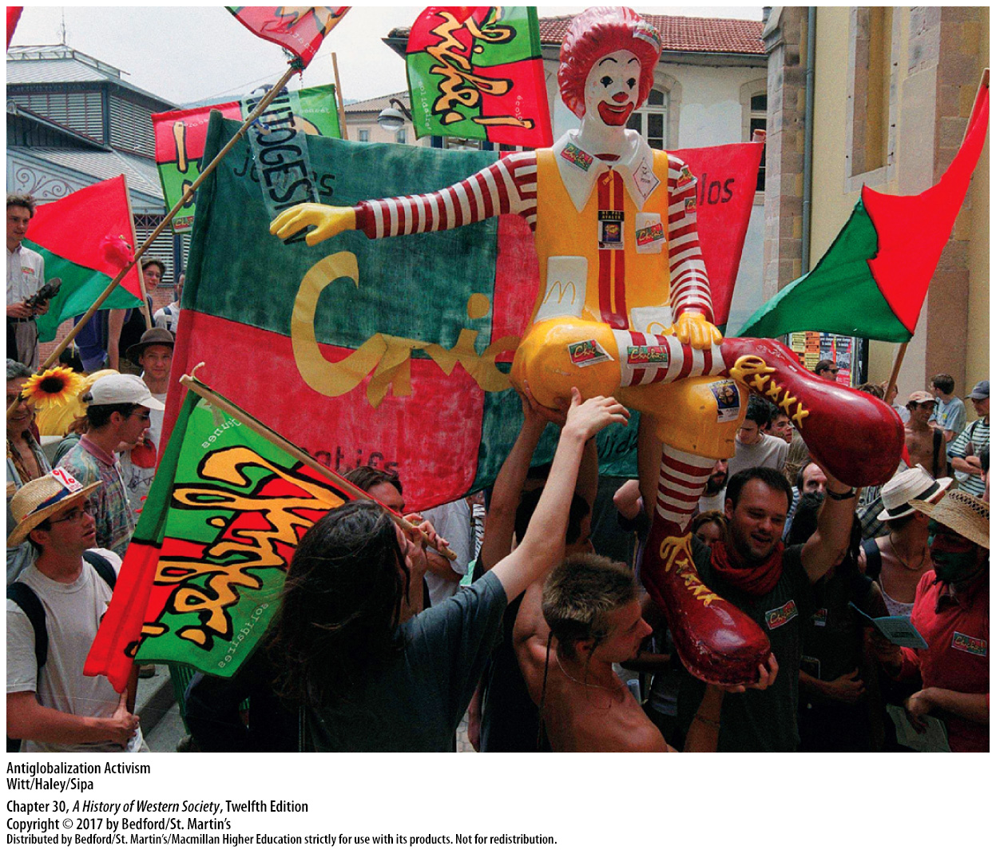

Slide 28
II. The New Global System
Life in the Digital Age
1. Digital microchips
2. Internet-based communication
3. e-Commerce
4. Personal privacy
5. Yet, organize protest campaigns
Notes:
II. The New Global System
E. Life in the Digital Age
1. As tiny digital microchips replaced bulky transistors and the Internet grew in scope and popularity, more and more people organized their lives around the use of ever-smaller and more powerful high-tech devices.
2. The growing popularity of Internet-based e-mail, text messaging, Facebook, Twitter, and other social media changed the way friends, families, and businesses communicated. As Skype, introduced in 2003, offered video communications around the world, the old-fashioned “landline” began to seem obsolete.
3. With faster speeds and better online security, people increasingly relied on the Internet to purchase goods, transforming traditional distribution and retail systems; online file sharing of books and popular music transformed the publishing and music industries.
4. The rapid growth of the Internet and social media, however, raised complex questions related to personal privacy, as governments and businesses could amass an extraordinary amount of information on individuals.
5. Yet, citizens could also use smart phones and social media sites to organize protest campaigns.

Slide 29
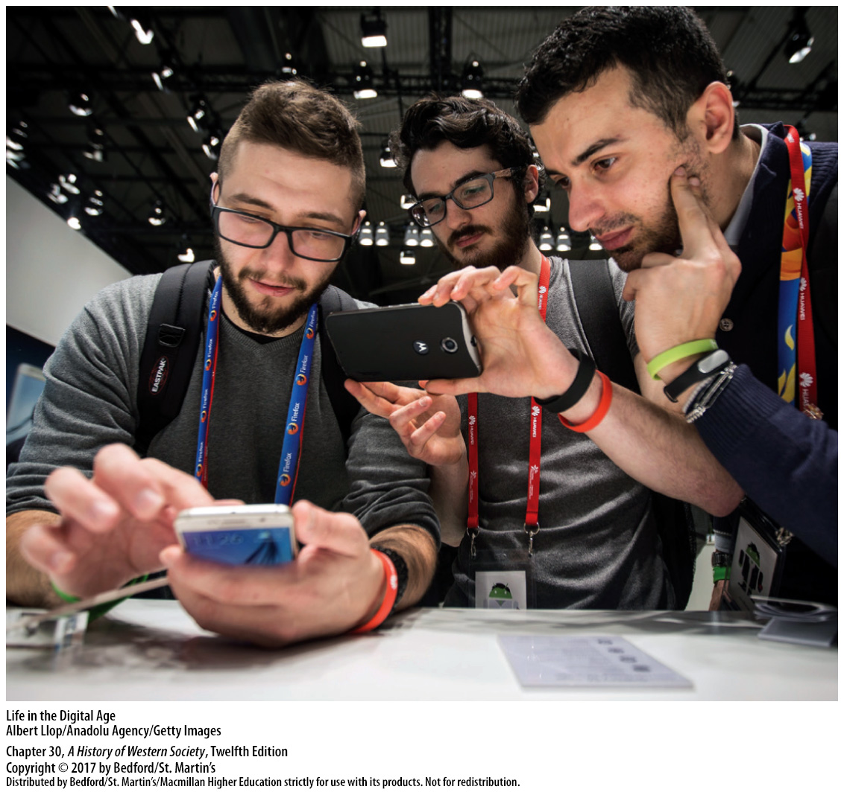

Slide 30
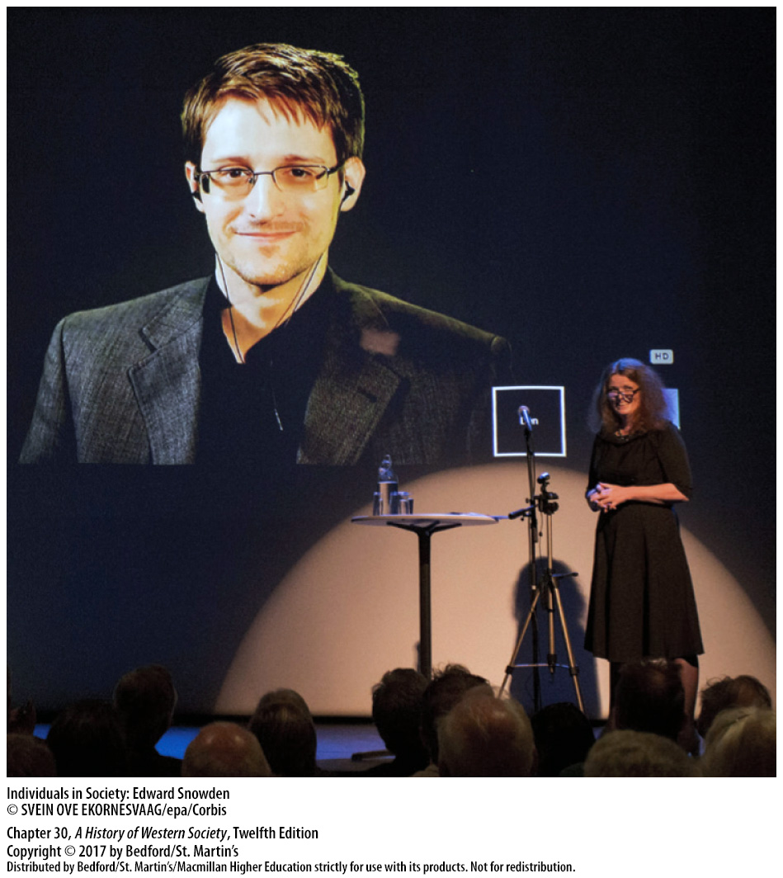

Slide 31
III. Ethnic Diversity in Contemporary Europe
The Prospect of Population Decline
1. Birthrates fall in European countries
2. Long-term consequences
3. Women and work
4. European economic conditions
5. Appeared to have stabilized in 2005
Notes:
III. Ethnic Diversity in Contemporary Europe
A. The Prospect of Population Decline
1. In European countries, where birthrates had been falling since the 1950s, national fertility rates in 2000 ranged from 1.2 to 1.8 children per woman of childbearing age and averaged 1.4 by 2006.
2. If the current baby bust continues, the long-term consequences could be dramatic, particularly if the number of people of working age drops and a shrinking labor force would have to pay higher social security taxes to fund pensions and health care for seniors.
3. Many women postponed the birth of their first child until their thirties in order to finish their education and establish careers, and then, after finding that balancing a child and a career was more difficult than anticipated, they postponed or even decided to forgo having a second child.
4. European economic conditions since the mid-1970s also played a role in falling birthrates, as high unemployment fell heavily on young people, convincing them to delay settling down and having children.
5. By 2005 European birthrates appeared to have stabilized, but the frightening implications of dramatic population decline had emerged as a major public issue and opinion makers, politicians, and the media started to press for more babies and more support for families with children.

Slide 32
III. Ethnic Diversity in Contemporary Europe
Changing Immigration Flows
1. Collapse of communism and savage civil wars
2. Conflicts in Afghanistan, Iraq, Somalia, and Rwanda
3. Rejected and classified as illegal job seekers
4. Criminal gangs
5. Dislocation in North Africa and the Middle East
Notes:
III. Ethnic Diversity in Contemporary Europe
B. Changing Immigration Flows
1. In the 1990s the collapse of communism in the East Bloc and savage civil wars in Yugoslavia drove hundreds of thousands of refugees westward.
2. Equally brutal conflicts in Afghanistan, Iraq, Somalia, and Rwanda brought thousands more from Central Asia and Africa.
3. Though many migrants in the early twenty-first century applied for political asylum and refugee status, most were eventually rejected and classified as illegal job seekers.
4. Undocumented immigration was aided by powerful criminal gangs that smuggled people for profit and contributed to the large number of young women either smuggled or kidnapped and forced into prostitution.
5. More recently, immigration flows shifted to reflect the dislocation that emerged in North Africa and the Middle East in the wake of the failed “Arab Spring” and the war against the Islamic State.

Slide 33
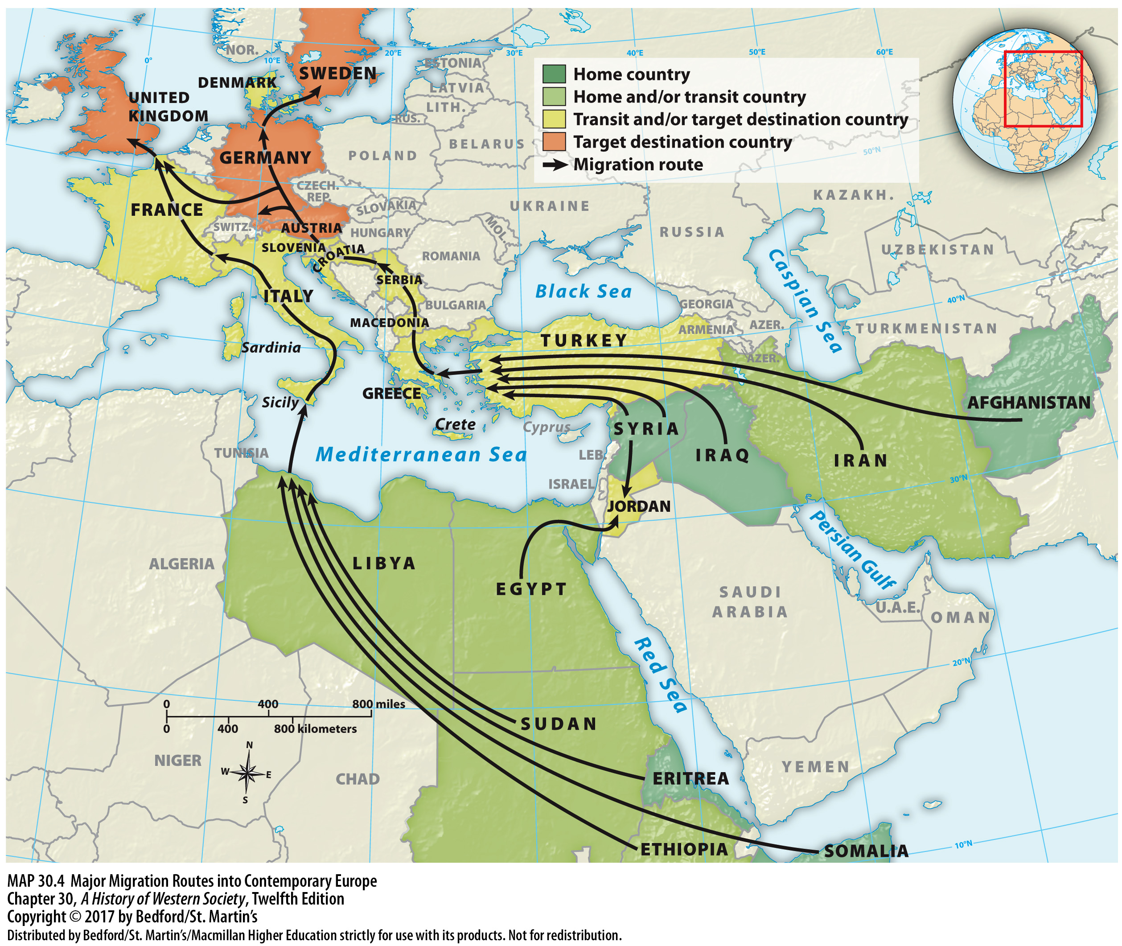

Slide 34
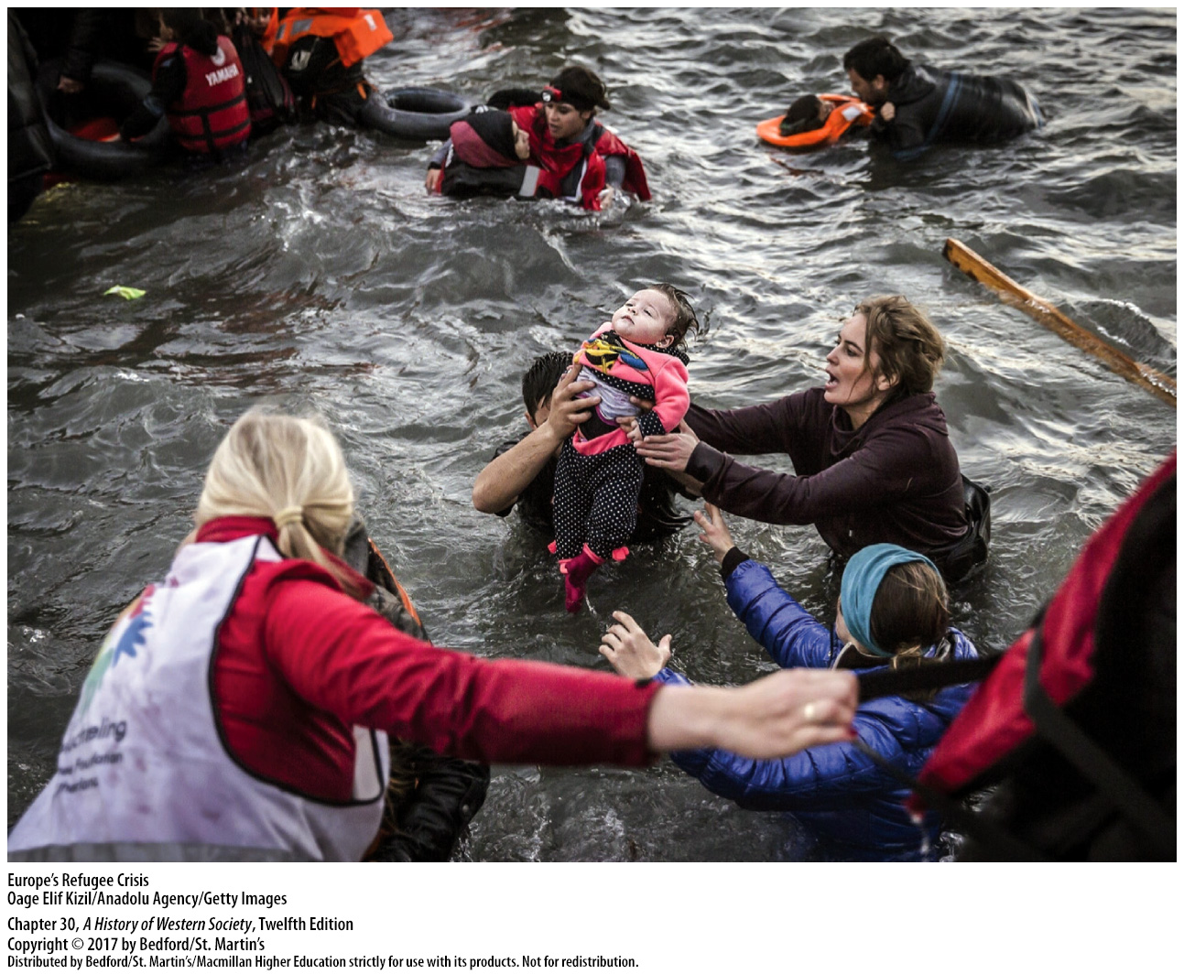

Slide 35
III. Ethnic Diversity in Contemporary Europe
Toward a Multicultural Continent
1. Ethnic enclaves
2. Job training
3. New cultural forms
4. Multiculturalism and ethnic diversity
5. Legal qualifications for citizenship
Notes:
III. Ethnic Diversity in Contemporary Europe
C. Toward a Multicultural Continent
1. For centuries the number of foreign residents living in Europe had been relatively small, but high levels of immigration resulted in enclaves of ethnic groups, or diasporas, that brought ethnic diversity to the continent.
2. A small percentage of the new immigrants were highly trained specialists who could find work in the upper ranks of education, business, and the high-tech industries. The mass of immigrants, however, did not have access to high-quality education or language training, which limited their employment opportunities and made integration more difficult.
3. A variety of new cultural forms, ranging from sports and cuisine to music, the fine arts, and film, brought together native and foreign traditions and transformed European lifestyles.
4. The multiculturalism and ethnic diversity associated with globalization have inspired numerous works in literature, film, popular music, and the fine arts. Rai, which originated in the Bedouin culture of North Africa and blends Arab and North African folk music, U.S. rap, and French and Spanish pop styles, exemplifies the new forms that have emerged from cultural mixing.
5. Immigration and ethnic diversity have also generated controversy over the legal qualifications for citizenship, raising questions about who, exactly, could or should be European and about the way these new citizens might change European society.

Slide 36
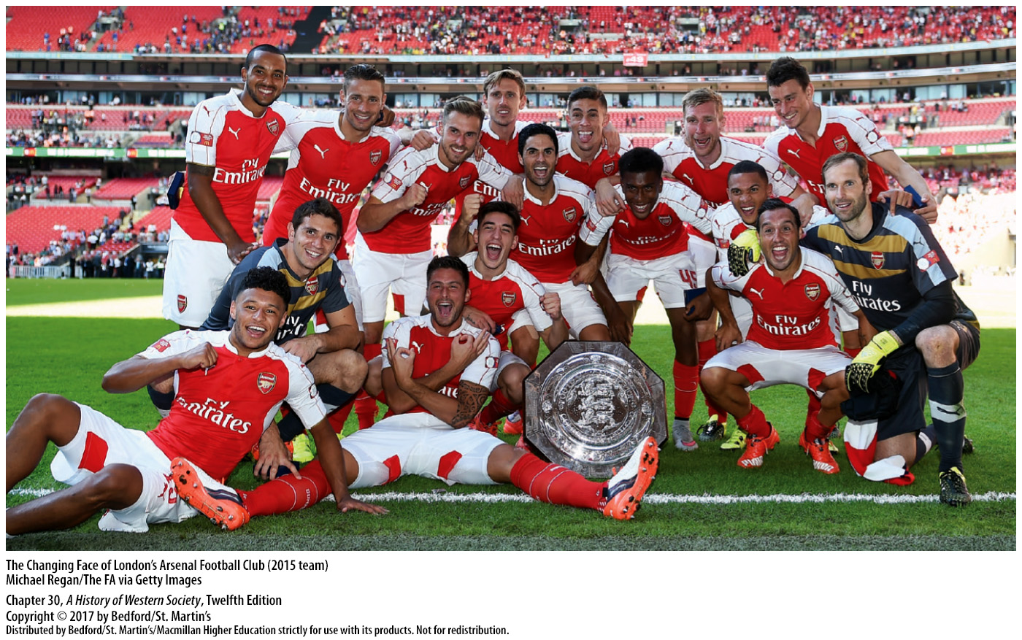

Slide 37
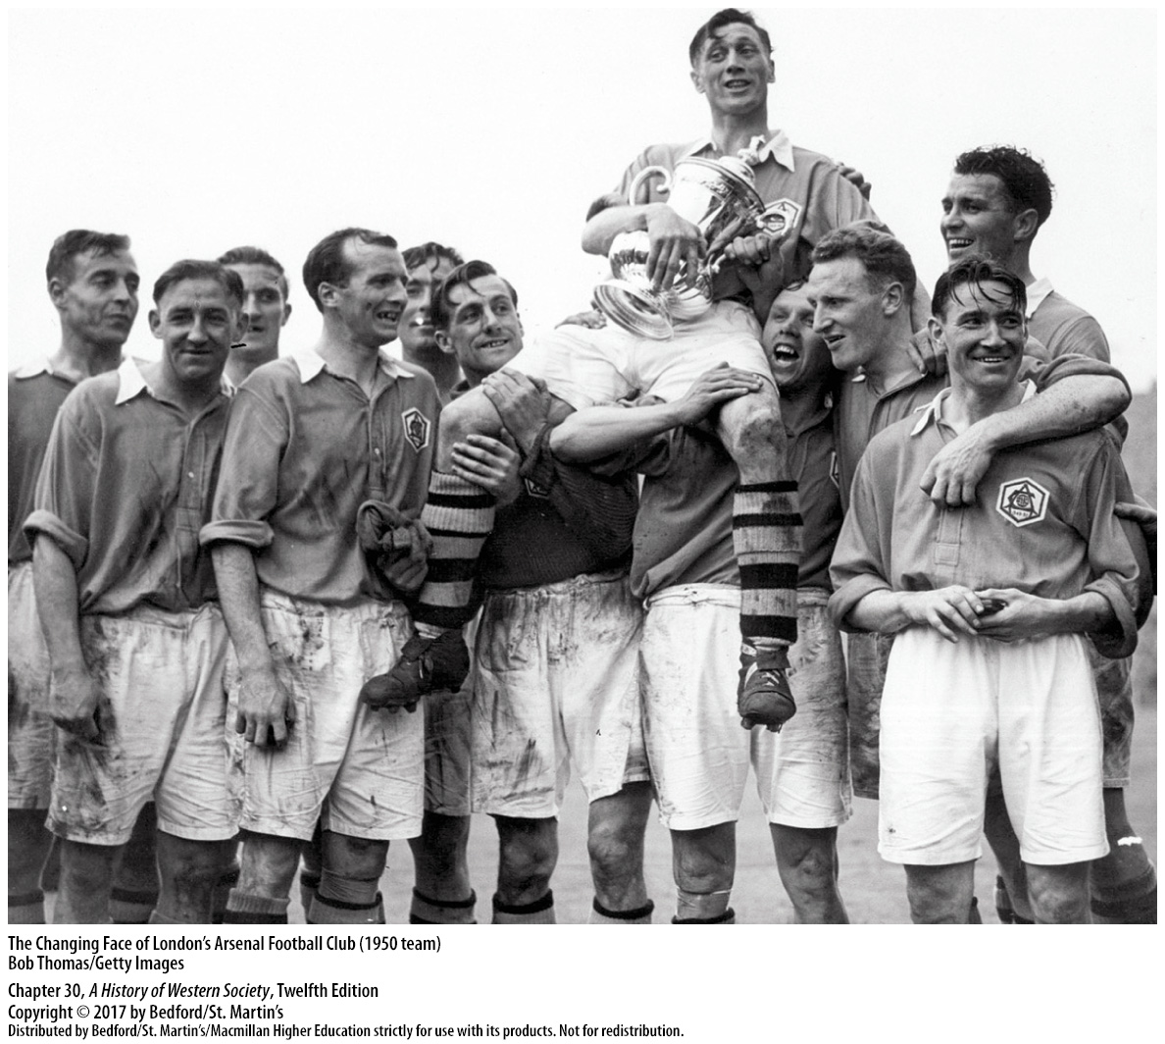

Slide 38
III. Ethnic Diversity in Contemporary Europe
Europe and Its Muslim Population
1. Largest minority religion in Europe
2. September 11, 2001
3. Vast majority of Europe’s Muslims reject radical extremism
4. Integration
Notes:
III. Ethnic Diversity in Contemporary Europe
D. Europe and Its Muslim Population
1. Islam is now the largest minority religion in Europe, with Muslims outnumbering Catholics in Europe’s mainly Protestant north and outnumbering Protestants in Europe’s Catholic south.
2. Fears of Muslim migrants and residents increased after the September 11, 2001, al-Qaeda attack on New York’s World Trade Center and the subsequent war in Iraq, the March 2004 bombing of trains bound for Madrid by radical Moroccan Muslims, and an attack on the London transit system organized by British citizens of Pakistani descent the following year.
3. The vast majority of Europe’s Muslims clearly support democracy and reject radical extremism, but these spectacular attacks and lesser actions by Islamic militants nonetheless sharpened the European debate on immigration.
4. Some observers focused on the problem of integration, suggesting that economics, inadequate job training, and discrimination had more influence on immigrant attitudes about their host communities than did religion and extremist teachings. Riots in France in 2005 and again in 2009 by Muslim youths strengthened this argument; the rioters complained of high unemployment, systematic discrimination, and exclusion; studies of the rioting showed that religious ideology was almost nonexistent in their thinking.

Slide 39
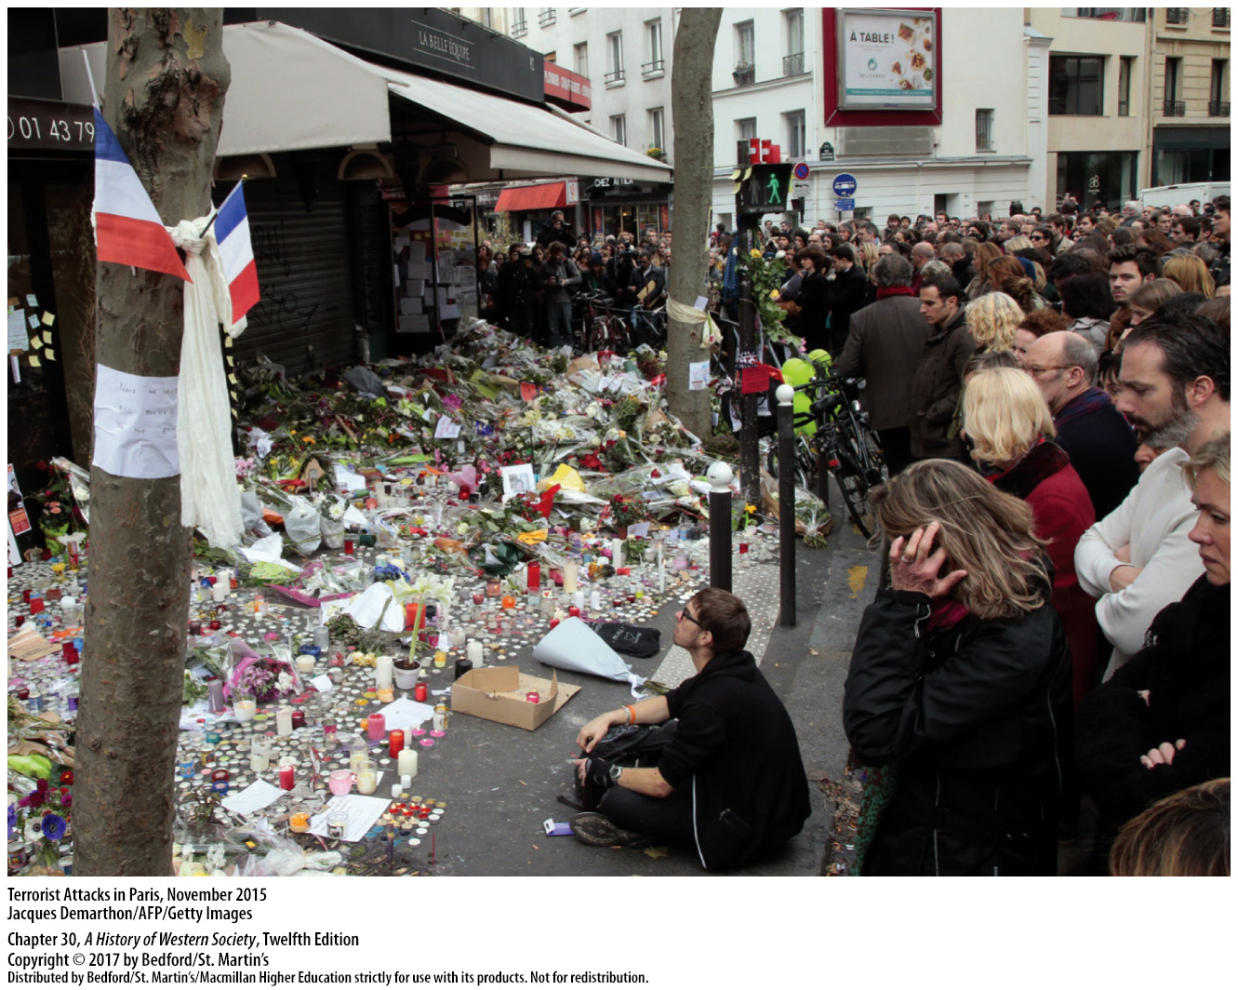

Slide 40
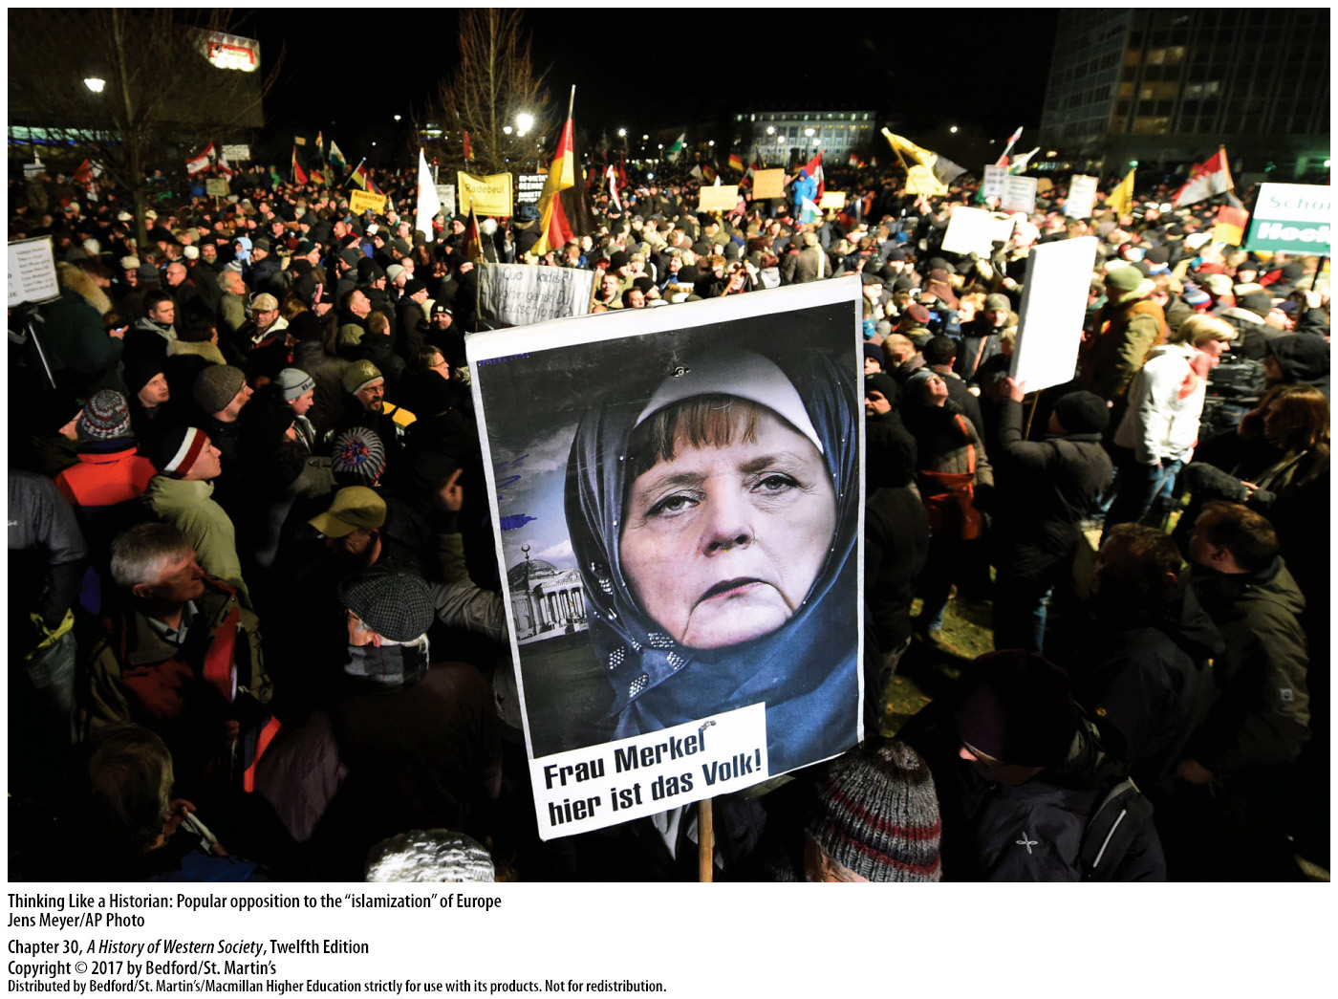

Slide 41
IV. Confronting Long- Term Challenges
Growing Strains in U.S.-European Relations
1. Growing power of the European Union and U.S. foreign policy
2. Challenged predominance of the United States
3. European businesses invested in the United States
4. Global warming, crimes against humanity
5. Secular Europeans
Notes:
IV. Confronting Long-Term Challenges
A. Growing Strains in U.S.-European Relations
1. Over time, the growing power of the European Union and the new unilateral thrust of Washington’s foreign policy created strains in traditional transatlantic relations.
2. The European Union was now the world’s largest trading block, challenging the predominance of the United States.
3. Prosperous European businesses invested heavily in the United States, reversing a decades-long economic relationship in which investment dollars had flowed the other way.
4. Under Presidents George W. Bush (in office 2001–2009) and Barack Obama (in office 2009–present), the United States often ignored international opinion in pursuit of its own interests, taking positions on global warming, crimes against humanity, and other issues that troubled EU leaders.
5. Ever more secular Europeans had a hard time understanding the religiosity of many Americans and viewed relatively lax gun control laws and capital punishment with dismay.

Slide 42
IV. Confronting Long- Term Challenges
Growing Strains in U.S.-European Relations
6. NATO expands
7. “War on terror”
8. European leaders worried about tactics, international law
9. Barack Obama brought some improvement to U.S.-European relations
Notes:
IV. Confronting Long-Term Challenges
A. Growing Strains in U.S.-European Relations
6. The dissolution of the Communist Warsaw Pact left NATO without its Cold War adversaries, yet NATO continued to expand, primarily in the territories of the former East Bloc, angering Russia’s leaders.
7. Over time, however, tensions between Europe and the United States reemerged and deepened markedly, particularly after President Bush declared a unilateral U.S. “war on terror”—a determined effort to fight terrorism in all its forms around the world—and the United States led wars in Afghanistan (begun in 2001) and Iraq (2003–2011). Some European leaders questioned the rationale for and effectiveness of a “war” on terror, arguing that because terrorist groups easily crossed national borders, terrorism was better fought through police and intelligence measures than through military action.
8. Although Europeans shared U.S. worries about stability in the Middle East, European leaders worried that the tactics used in the war on terror, exemplified by Washington’s readiness to use its military without international agreements or UN backing, violated international law.
9. The election of Barack Obama, America’s first African American president, in 2008, and his reelection in 2012, brought some improvement to U.S.-European relations.

Slide 43
IV. Confronting Long- Term Challenges
Turmoil in the Muslim World
1. Radical political Islam
2. Muslim Brotherhood
3. Moderate group and militant radical minority
4. Containment policy
5. “Blowback”
6. Mujahideen
Notes:
IV. Confronting Long-Term Challenges
B. Turmoil in the Muslim World
1. Radical political Islam, a mixture of religious beliefs and innovative social and political reform ideas, was at first a reaction against the foreign control and secularization represented by the mandate system established in the Middle East after World War I.
2. Groups like the Muslim Brotherhood, founded in Egypt in 1928 and expanded across the Middle East and North Africa, called for national liberation from European control and a return to shari’a law and demanded land reform, extensive social welfare programs, and economic independence.
3. Adherents of radical Islam tended to fall into two main groups: a moderate or centrist group that worked peacefully to reform society within existing institutions and a much smaller, more militant radical minority willing to use violence to achieve their goals.
4. In the era of decolonization and the Cold War, the western European powers loosened their ties to the Middle East; the U.S. stepped in, applying containment policy and eager to preserve steady supplies of oil, to support secular, authoritarian regimes friendly to U.S. interests.
5. U.S. policies in the Middle East at times produced “blowback,” or unforeseen and unintended consequences; for example, in the Iranian revolution of 1979, Islamist radicals, antagonized by Western intervention, state corruption, and secularization, overthrew the U.S.-supported shah and established an Islamic republic.
6. U.S. military aid and arms, funneled to the mujahideen, Muslim guerilla fighters in Afghanistan who fought off the Soviet army from 1979 to 1989, also had unintended consequences.

Slide 44
IV. Confronting Long- Term Challenges
Turmoil in the Muslim World
7. United States and western Europe
9. Collapse of Saddam Hussein’s dictatorship
10. Ethnic and religious tensions
11. U.S. combat troops withdraw from the country in 2014
12. Arab Spring
13. Young activists
Notes:
IV. Confronting Long-Term Challenges
B. Turmoil in the Muslim World
7. As a result of these policies, the United States and western Europe became the main targets for Islamist militants, and in the 1990s, bin Laden and al-Qaeda mounted several terrorist attacks on U.S. installations.
9. Though the UN failed to approve an invasion, in March 2003 the United States and Britain, with token support from a handful of other European states, invaded Iraq, quickly overwhelming the Iraqi army and causing the collapse of Saddam Hussein’s dictatorship.
10. Ethnic and religious tensions among non-Arab Kurds, Arab Sunni Muslims, and Arab Shi’ite Muslims also contributed to instability, and by 2006 a deadly sectarian conflict among these groups and against the U.S. and its Iraqi supporters had taken hold.
11. Although U.S. commandos finally killed Osama bin Laden in Pakistan in May 2011, the war became increasingly unpopular in the U.S. and among NATO allies, and though the conflict continued, President Obama withdrew U.S. combat troops from the country in 2014.
12. In early 2011 an unexpected chain of events that came to be called the Arab Spring further destabilized the Middle East and North Africa.
13. Young activists seeking greater political and social freedoms from West-backed authoritarian regimes initiated the Arab Spring, and the changes they unleashed opened power to many different groups, including military leaders, old elites, liberal secularists, local chieftains, and moderate and radical Islamists.

Slide 45
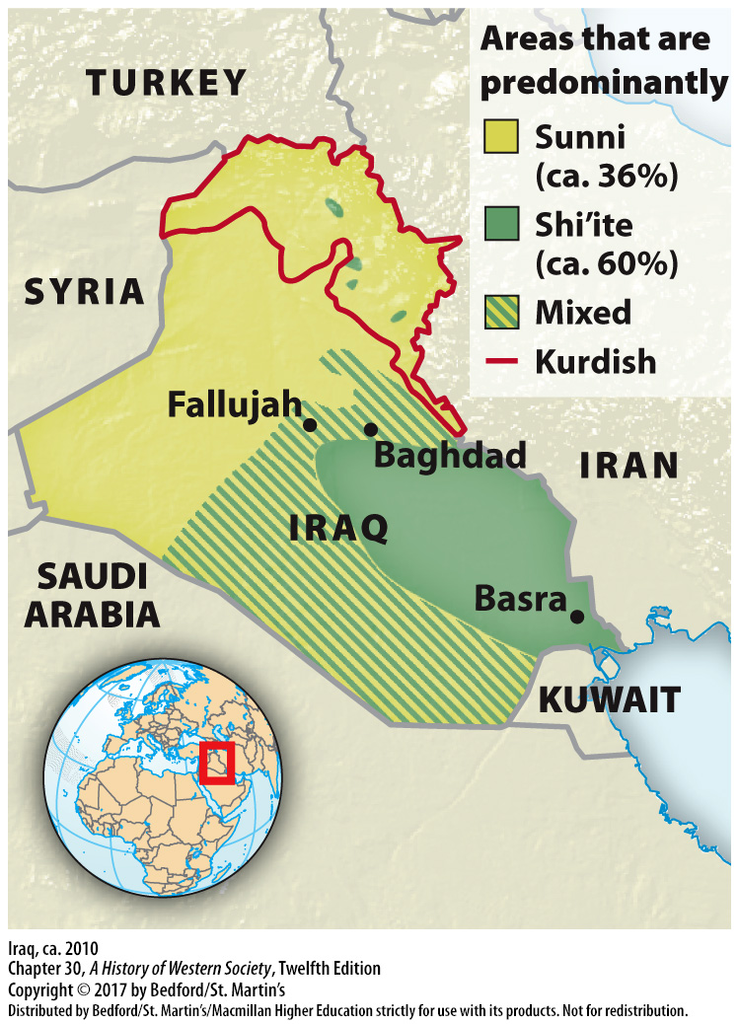

Slide 46
IV. Confronting Long- Term Challenges
The Global Recession and the Viability of the Eurozone
1. 2008 United States recession
2. Recession in Europe
3. Greek neoliberal austerity plan
4. Euro crisis shook faith in European unity
5. Anti-EU sentiment and anti-immigrant extremism
6. Great Britain voted to leave the EU
Notes:
IV. Confronting Long-Term Challenges
C. The Global Recession and the Viability of the Eurozone
1. In 2008 the United States entered a deep recession, caused by the burst of the housing boom, bank failures, and an overheated financial securities market. The U.S. government spent massive sums in attempts to recharge the economy, granting banks, insurance and auto companies, and financial service conglomerates billions of dollars in aid; by 2013 the economy showed modest improvement.
2. The recession quickly swept across Europe, hitting particularly hard in Iceland, where in October 2008 the currency and banking system collapsed. Other countries followed, with Ireland and Latvia making deep and painful cuts in government spending to balance national budgets; Britain deeply in debt by 2010; and Spain, Portugal, and Greece close to bankruptcy.
3. Greek leaders implemented a neoliberal austerity plan as a condition for receiving financial aid from the IMF and the European Union, but in the summer of 2012, Greece was still flailing.
4. The euro crisis shook faith in European unity, and in January 2013, British Conservative Party leader and prime minister David Cameron (in office 2010–present) pledged to hold an “in/out” popular vote on Britain’s membership in the EU.
5. The crisis generated even stronger anti-EU sentiment and anti-immigrant extremism on the far right and helped far-right parties gain in electoral contests.
6. In June 2016 Great Britain voted to leave the EU altogether. Prime Minister David Cameron (r. 2010– 2016) resigned immediately. Though Britain had two years to negotiate the terms of the exit, global financial markets fell, far-right populist parties on the continent rejoiced, and EU supporters expressed deep concern about the future of the union.

Slide 47
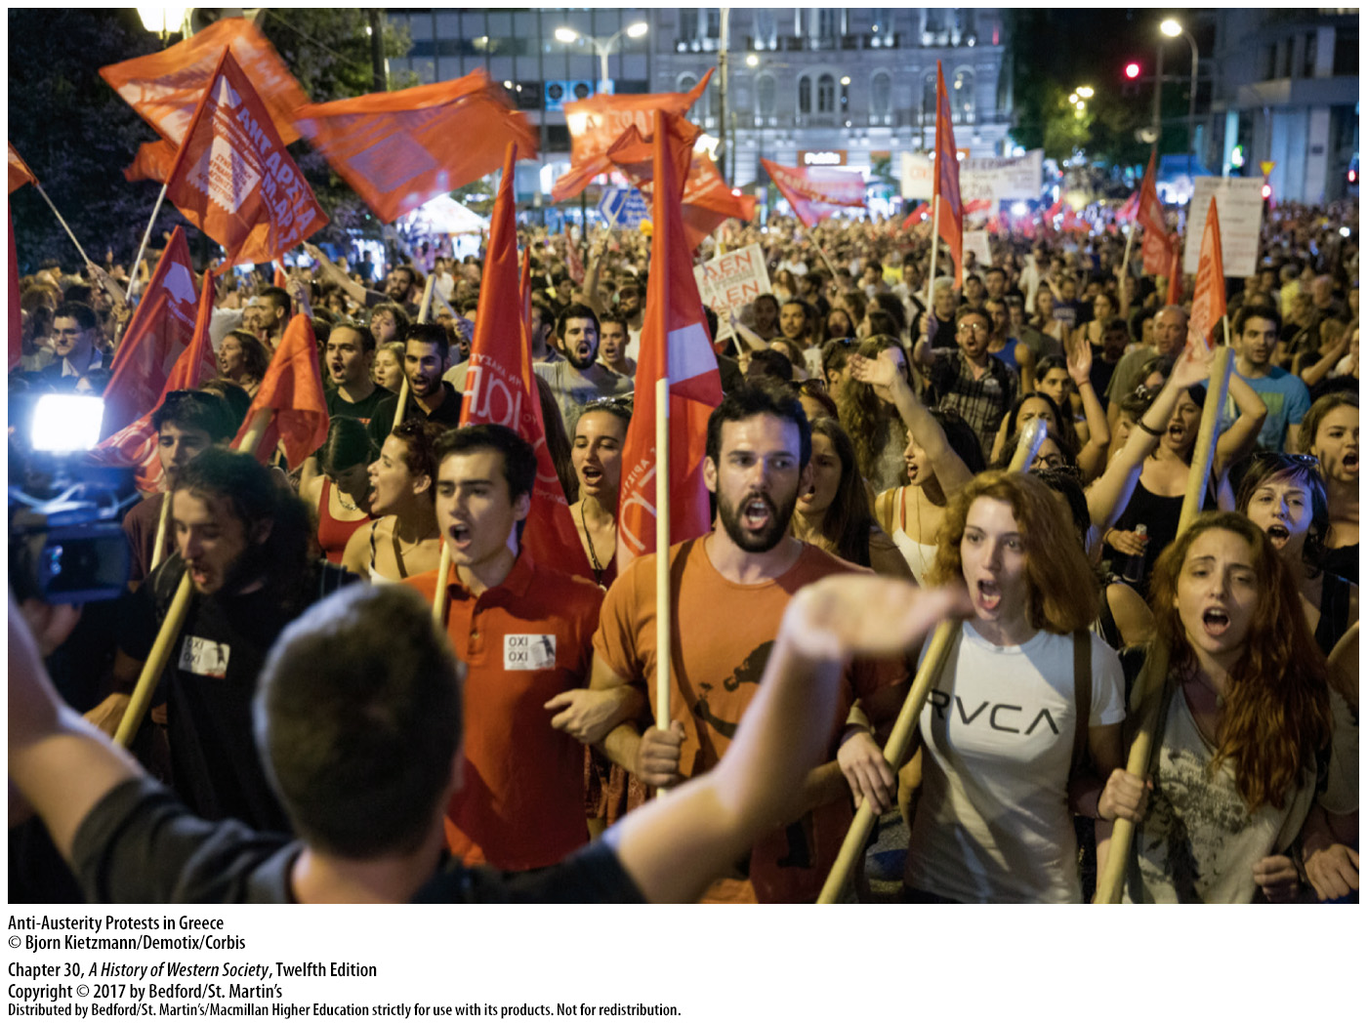

Slide 48
IV. Confronting Long- Term Challenges
Dependence on Fossil Fuels
1. Adequate energy resources
2. Geopolitical conflicts
3. Military power concentrated in oil-producing areas
4. Russia
Notes:
IV. Confronting Long-Term Challenges
D. Dependence on Fossil Fuels
1. One of the most significant long-term challenges facing Europe and the world in the twenty-first century is the need for adequate energy resources necessary to maintain standards of living in industrialized countries and modernize the developing world.
2. Struggles to control and profit from these shrinking resources often resulted in tense geopolitical conflicts.
3. Military power is increasingly concentrated in oil-producing areas such as the Middle East, which holds about 65 percent of the world’s oil reserves.
4. The global struggle for ample energy has placed Russia, which in 2011 became the world’s number-one oil producer and number-two natural gas producer, in a powerful but strained position, as evidenced by its invasions of Chechnya and Georgia, both attempts to preserve control of the region’s rich energy resources.

Slide 49
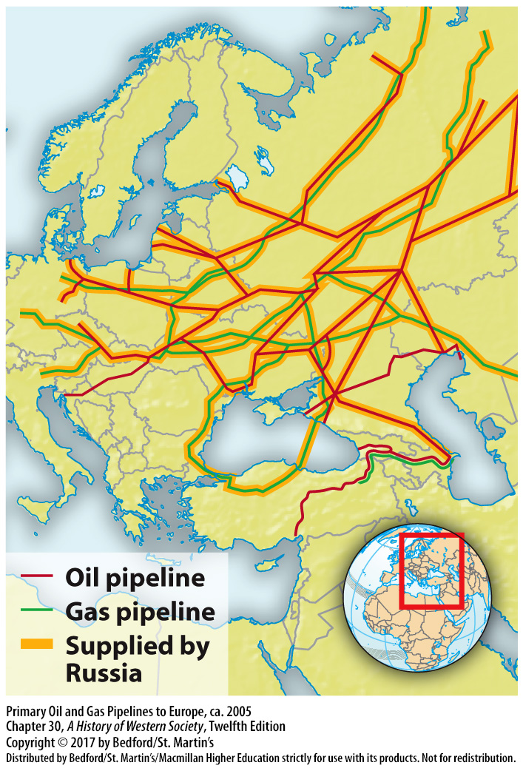

Slide 50
IV. Confronting Long- Term Challenges
Climate Change and Environmental Degradation
1. Global warming
2. EU efforts to control energy consumption
3. Overfishing and toxic waste
4. Deforestation, land degradation, soil erosion, overfertilization, extinction
5. India and China
6. United Nations Climate Change Conference
Notes:
IV. Confronting Long-Term Challenges
E. Climate Change and Environmental Degradation
1. Burning oil and coal releases massive amounts of carbon dioxide (CO2), the leading cause of climate change or global warming, into the atmosphere. Although the future effects of climate change are difficult to predict, climatologists generally agree global warming is proceeding dramatically faster than previously predicted and that some climatic disruption is now unavoidable.
2. Since the 1990s the EU has spearheaded efforts to control energy consumption and contain climate change by imposing tight restrictions on emissions and by leading efforts to harness alternate energy sources such as solar and wind power.
3. The world’s oceans and freshwater lakes, which once seemed to be inexhaustible sources of food and drinking water, have been threatened by overfishing and toxic waste.
4. Deforestation, land degradation, soil erosion, overfertilization, species extinction, the accumulation of toxins, and the disposal of poisonous nuclear waste will continue to pose serious problems.
5. Though North American and European governments have taken steps to limit environmental degradation and regulate energy use, industrializing countries such as India and China have had a difficult time balancing environmental concerns and economic growth.
6. In December 2012 the representatives of 192 nations met at the annual United Nations Climate Change Conference in Doha, Qatar, and set goals to reduce CO2 emissions by 2020 and to help developing countries manage the effects of climate change.

Slide 51
IV. Confronting Long- Term Challenges
Promoting Human Rights
1. Global agreements and new international institutions
2. Military intervention
3. Broader definitions of individual rights
4. Poorer countries
5. Social Democrats
6. 1948 UN Universal Declaration of Human Rights
Notes:
IV. Confronting Long-Term Challenges
F. Promoting Human Rights
1. European leaders and humanitarians believed that more global agreements and new international institutions were needed to set moral standards and to regulate countries, leaders, armies, corporations, and individuals.
2. In practical terms, Europe’s evolving human rights mission would require, first of all, military intervention to stop civil wars and to prevent tyrannical governments from slaughtering their own people.
3. Europeans also pushed for broader definitions of individual rights that included condemning the continued use of the death penalty in China, the United States, Saudi Arabia, and elsewhere and expanding personal rights for their citizens.
4. Europeans also pushed to extend their broad-based concept of social and economic rights to the world’s poorer countries.
5. Europe’s Social Democrats joined human rights campaigners in 2001 to combat Africa’s AIDS crisis and advocate for greater social equality and state-funded health care, embracing morality as a basis for action and the global expansion of human rights as a primary goal.
6. Despite criticism that the EU (and the United States) selectively promotes human rights, the general trend suggested that Europe’s leaders and peoples took seriously the 1948 UN Universal Declaration of Human Rights.

Slide 52
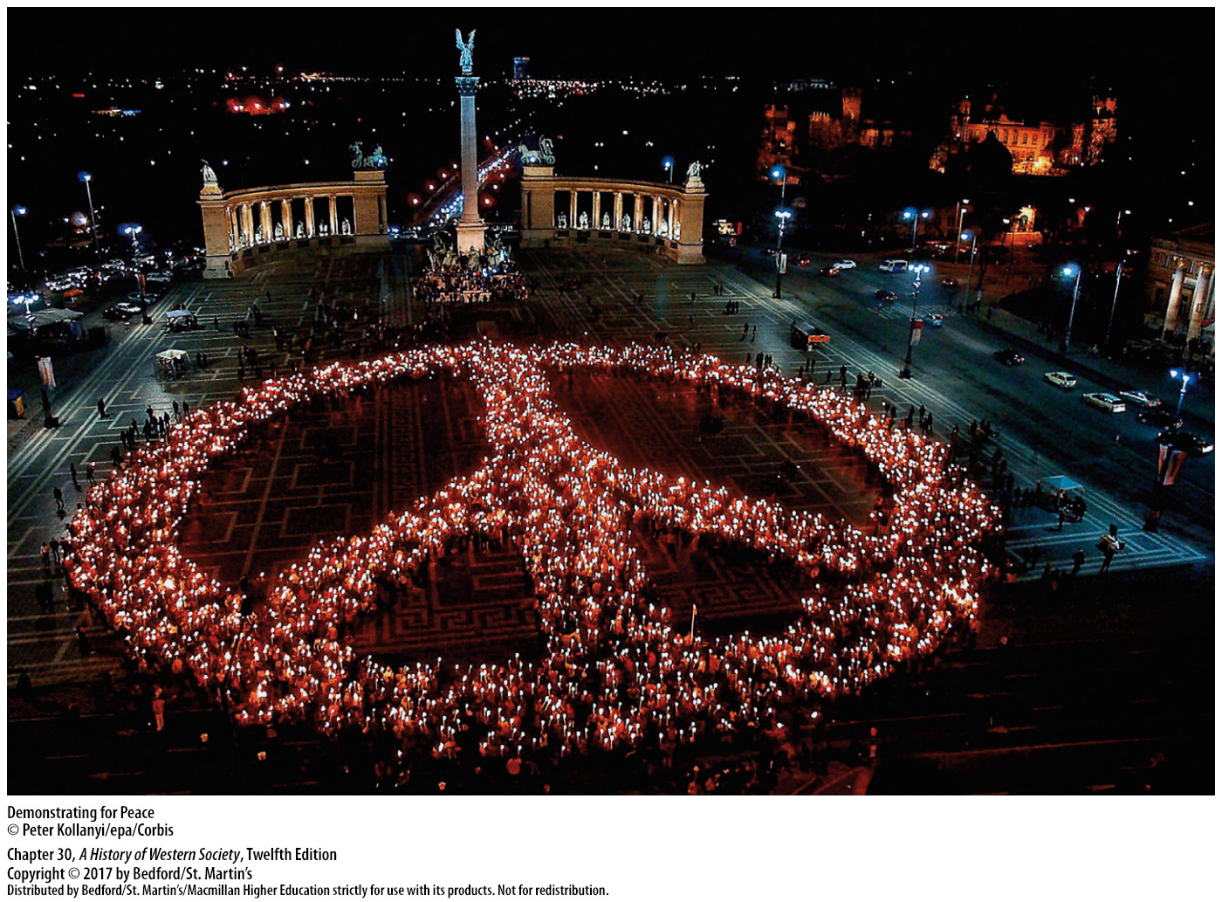

Slide 53
