Slide 1
A History of Western Society Twelfth Edition
McKay • Crowston • Wiesner-Hanks • Perry
CHAPTER 29
Challenging the Postwar Order
1960–1991
Copyright © 2017 by Bedford/St. Martin’s
Distributed by Bedford/St. Martin's/Macmillan Higher Education strictly for use with its products; Not for redistribution.

Slide 2
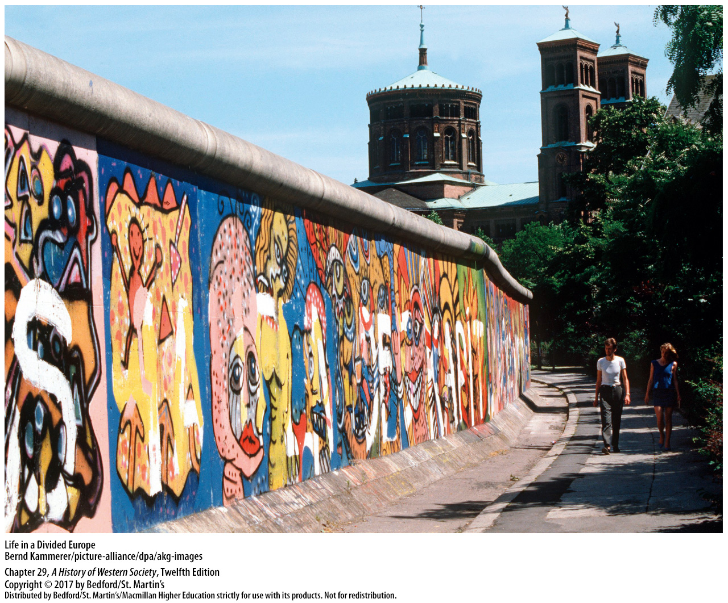

Slide 3
I. Reform and Protest in the 1960s
Cold War Tensions Thaw
1. Western Europe moves to the left
2. Western Europe and the East Bloc
3. Ostpolitik
4. Mutual renunciation of force
5. Final Act of the Conference on Security and Cooperation in Europe
Notes:
I. Reform and Protest in the 1960s
A. Cold War Tensions Thaw
1. In the mid to late 1960s, buoyed by the rapidly expanding economy, much of western Europe moved politically to the left.
2. While the Cold War continued to rage outside Europe and generally defined relations between the Soviet Union and the United States, western European leaders took major steps to normalize relations with the East Bloc.
3. In December 1970 Willy Brandt flew to Poland for the signing of a historic treaty of reconciliation. Brandt also laid a wreath at the tomb of the Polish unknown soldier and another at the monument commemorating the armed uprising of Warsaw’s Jewish ghetto against occupying Nazi armies. These gestures and the treaty were part of his conciliatory foreign policy with eastern Europe, termed Ostpolitik.
4. Brandt, believing that the Berlin Wall revealed the limitations of West Germany’s hard line, negotiated new treaties with the Soviet Union, Poland, and Czechoslovakia that formally accepted existing state boundaries in return for a mutual renunciation of force or the threat of force.
5. Brandt’s Ostpolitik was part of a general relaxation of East-West tensions and less strained diplomatic relations, termed détente, which began in the early 1970s. Détente reached a high point when the United States, Canada, the Soviet Union, and thirty-two European nations signed the Final Act of the Conference on Security and Cooperation in Europe in 1975, agreeing that Europe’s existing political frontiers could not be changed by force.

Slide 4
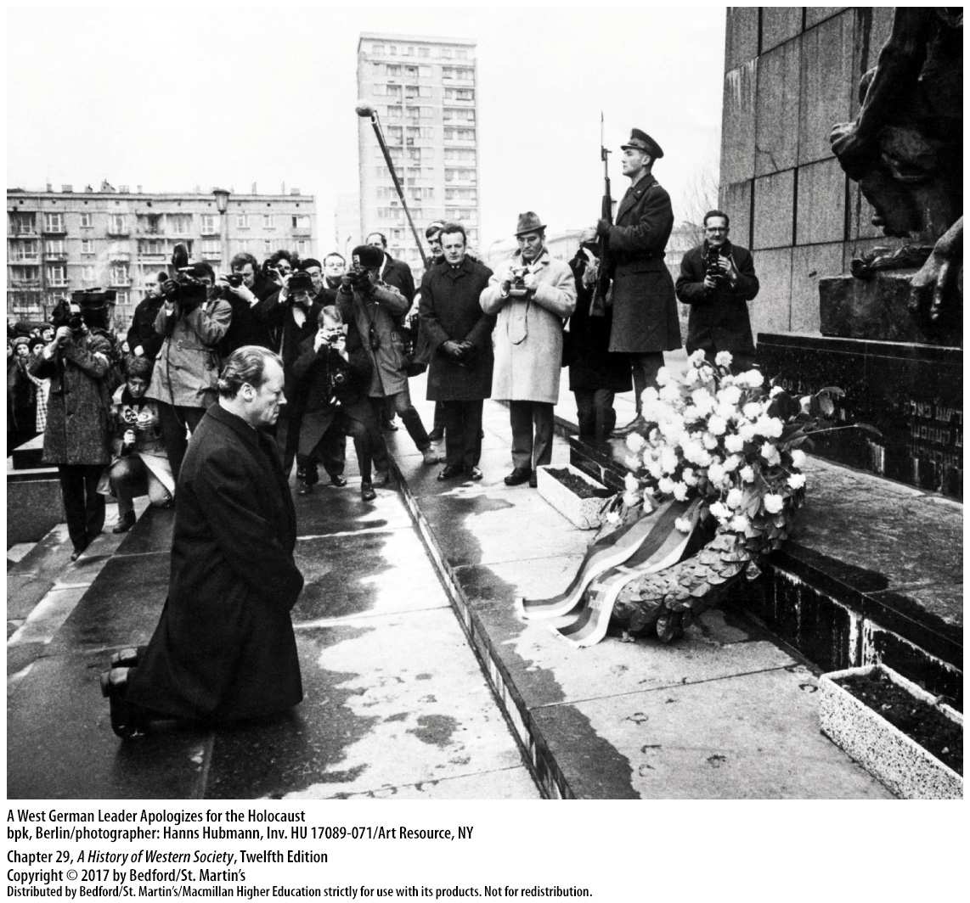

Slide 5
I. Reform and Protest in the 1960s
The Affluent Society
1. “Age of affluence”
2. Leisure time and recreational pursuits
3. U.S.-style self-service supermarkets
4. Intellectuals and cultural critics
5. Moral authority of religious doctrine
6. Family ties
Notes:
I. Reform and Protest in the 1960s
B. The Affluent Society
1. The “age of affluence” did not include everyone: the living standards of workers and immigrants did not rise as fast as those of the educated middle classes, and the expanding economy did not reach underdeveloped regions.
2. Many Europeans had more money to spend on leisure time and recreational pursuits; one of the most noticeable leisure-time developments was the blossoming of mass travel and tourism, facilitated by month-long paid vacations and widespread automobile ownership.
3. The establishment of U.S.-style self-service supermarkets across western Europe changed the way food was produced, purchased, and prepared and threatened to put independent bakers, butchers, and neighborhood grocers out of business.
4. Intellectuals and cultural critics worried that rampant consumerism created a bland conformity that wiped out regional and national traditions and sapped creativity and individualism. Others complained bitterly that these changes threatened to Americanize European culture; although such worries were overstated, social change was unavoidable.
5. The moral authority of religious doctrine lost ground before the growing materialism of consumer society; in predominantly Protestant lands, church membership and regular attendance declined.
6. Family ties also weakened in the age of affluence: men and women married later, the nuclear family became smaller and more mobile, divorce rates rose rapidly, and the number of adults living alone grew remarkably.

Slide 7
I. Reform and Protest in the 1960s
The Counterculture Movement
1. “Sixties generation”
2. Inequality and social injustice
3. Civil Rights Act of 1964 and Voting Rights Act of 1965
Notes:
I. Reform and Protest in the 1960s
C. The Counterculture Movement
1. The “sixties generation,” children born during the postwar baby boom, grew up in an era of political liberalism and material abundance; they knew about the horrors of totalitarian governments that caused World War II, watched colonial peoples forge new paths to freedom, and worried about the growing conformity that seemed inherent to consumer society and unequal distribution of wealth that arose from market economics.
2. Baby boomers had the education to see problems like inequality and social injustice, as well as the freedom from want to act on their concerns.
3. The landmark Civil Rights Act of 1964, which prohibited discrimination in public services and on the job, and the Voting Rights Act of 1965, which guaranteed all African Americans the right to vote, were the crowning achievements of the long struggle against racism.

Slide 8
I. Reform and Protest in the 1960s
The Counterculture Movement
4. University of California–Berkeley
5. New Left
6. “Free love”
Notes:
I. Reform and Protest in the 1960s
C. The Counterculture Movement
4. At the University of California–Berkeley in 1964 and 1965, students consciously adapted the tactics of the civil rights movement to challenge limits on free speech and academic freedom at the university.
5. Many student activists in western Europe and the United States embraced new forms of Marxism, creating a movement that came to be known as the New Left. Adherents of the New Left argued for a more humanitarian style of socialism that could avoid the worst excesses of both capitalism and Soviet-style communism, and they attacked what they saw as the conformity of consumer society and the control of the “culture industry.”
6. The merging of political and daily life was obvious in the so-called sexual revolution, characterized by frank discussion about sexuality, a new willingness to engage in premarital sex, and a growing acceptance of homosexuality. The development of the birth control pill, which went on the market in most western European countries in the 1960s, eliminated the risk of unwanted pregnancy and facilitated sexual experimentation. For the young, the idea of sexual emancipation was closely linked to radical politics: sexual openness and “free love,” the sixties generation claimed, moved people beyond traditional norms and had the potential to shape a more humane society.

Slide 9
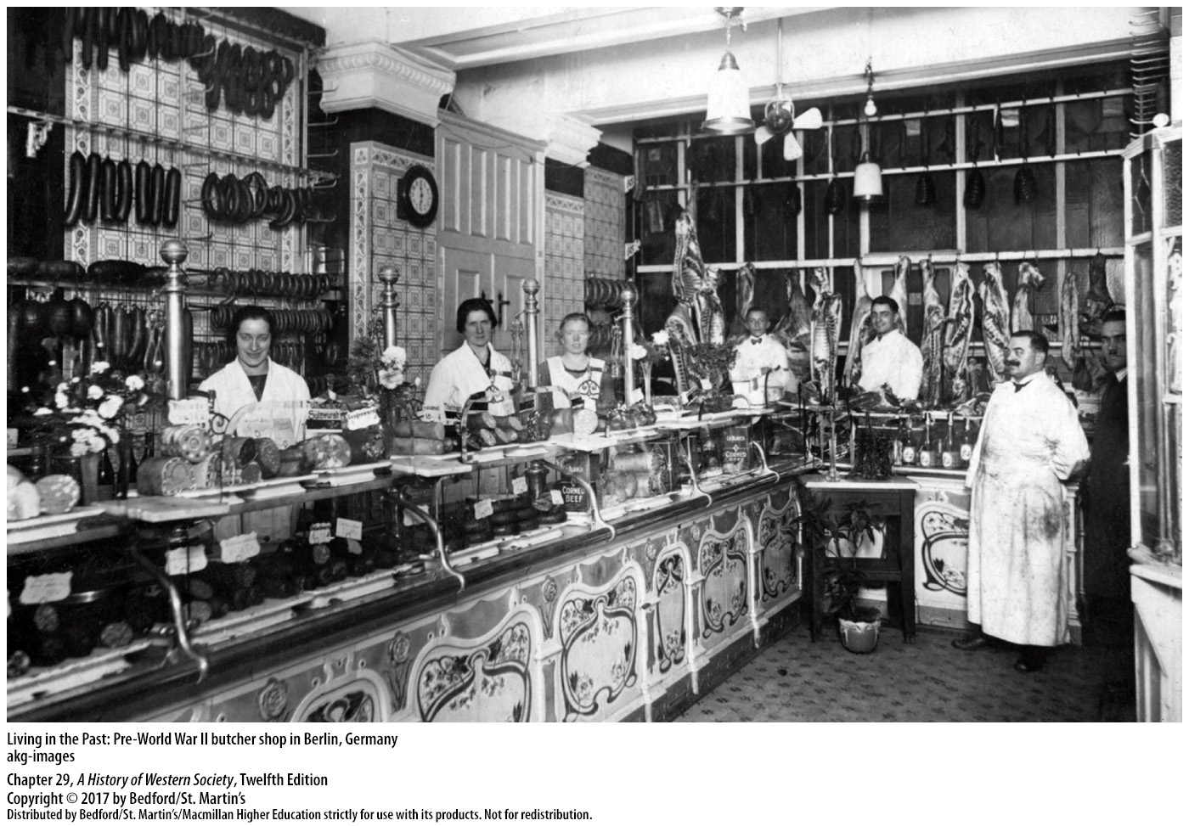

Slide 10
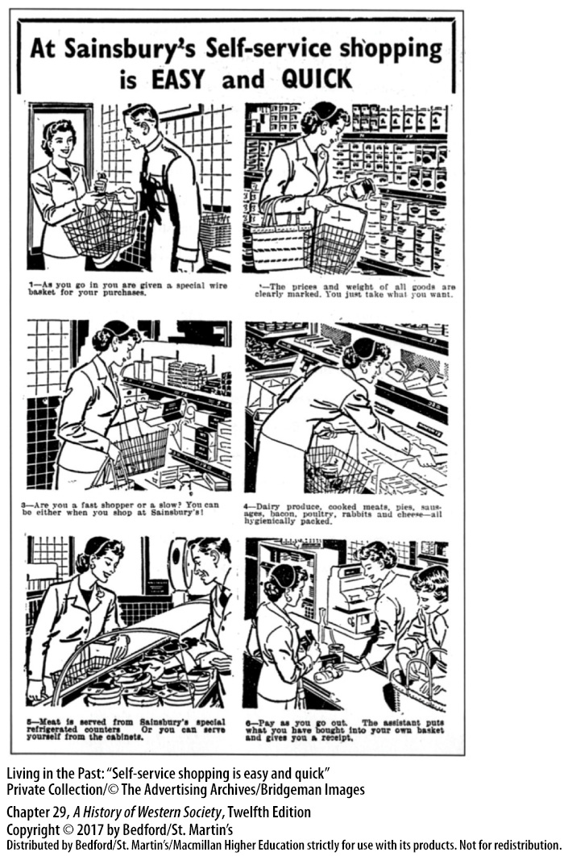

Slide 11
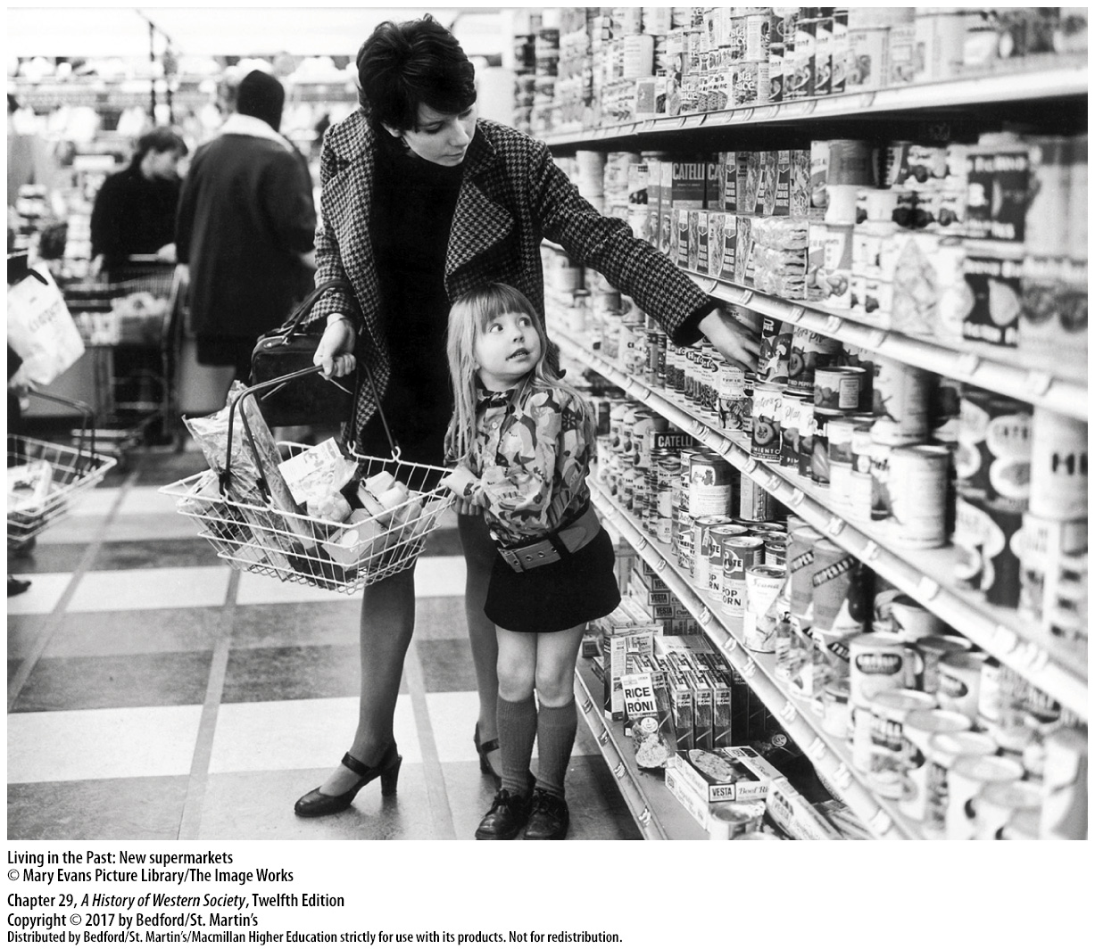

Slide 12
I. Reform and Protest in the 1960s
The United States and Vietnam
1. Dwight D. Eisenhower
2. John F. Kennedy
3. Limited warfare backfired
4. Vietcong Tet Offensive
Notes:
I. Reform and Protest in the 1960s
D. The United States and Vietnam
1. After the South Vietnamese government in 1955 declined to hold free elections that would unify the north and south zones, U.S. president Dwight D. Eisenhower (in office 1953–1961) provided South Vietnam with military aid.
2. President John F. Kennedy (in office 1961–1963) later increased the number of American “military advisers” in South Vietnam, and in 1964 President Lyndon B. Johnson (in office 1963–1969) expanded America’s role with massive military aid and a half million American troops.
3. In the end, the American strategy of limited warfare—it did not invade North Vietnam or set up a naval blockade—backfired: politicians, the media, and the population initially saw the war as part of a legitimate defense against communism, but an antiwar movement led to the growing criticism that the U.S. presence was a criminal intrusion into a distant and complex civil war.
4. Criticism reached a crescendo after the Vietcong Tet Offensive in January 1968, which signaled that the war was not close to ending, as Washington had claimed.

Slide 13
I. Reform and Protest in the 1960s
The United States and Vietnam
5. Negotiations with North Vietnam
6. Richard M. Nixon
7. Peace agreement
8. South Vietnamese forced to accept Communist dictatorship
Notes:
I. Reform and Protest in the 1960s
D. The United States and Vietnam
5. Within months, President Johnson announced that he would not stand for re-election and called for negotiations with North Vietnam.
6. President Richard M. Nixon (in office 1969–1974) sought to gradually disengage America from Vietnam, intensifying the bombing campaign as he opened peace talks, suspending the draft, and cutting American forces in Vietnam from 550,000 to 24,000 in four years.
7. Nixon finally reached a peace agreement with North Vietnam and the Vietcong in 1973 that allowed remaining American forces to complete their withdrawal.
8. When North Vietnam launched a general invasion against South Vietnamese armies in 1974, the U.S. Congress refused to permit any American military response, and the South Vietnamese were forced to accept a unified country under a Communist dictatorship.

Slide 14
I. Reform and Protest in the 1960s
Student Revolts and 1968
1. New Left activists
2. Assassination of Martin Luther King, Jr.
3. Student protests
4. University of Paris
5. President de Gaulle
Notes:
I. Reform and Protest in the 1960s
E. Student Revolts and 1968
1. New Left activists believed that the United States was fighting an immoral and imperialistic war in Vietnam against a small and heroic people, and the counterculture became increasingly radical.
2. Political activism erupted in 1968, as African Americans rioted across the United States after the assassination of civil rights leader Martin Luther King, Jr., and antiwar demonstrators battled police at the Democratic National Convention in Chicago.
3. In Mexico City, police shot and killed several hundred young protesters calling for political reform, and students in Tokyo demonstrated against the war in Vietnam. Students in Warsaw marched to protest government censorship, and youths in Prague were in the forefront of the attempt to radically reform communism from within.
4. In France in May 1968, a group of students inspired by New Left ideals occupied buildings at the University of Paris, which led to violent clashes with police and triggered a national revolt in which some 10 million workers went out on strike, bringing the Fifth French Republic to the verge of collapse. In the end, however, the idealistic goals of the radical students did not correspond to the bread-and-butter demands of the striking workers, who returned to work after receiving government promises of workplace reforms and immediate pay raises.
5. In new elections called by President de Gaulle, his conservative party won almost 75 percent of the seats in the French parliament, showing that the majority of the French people did not support general strikes or student-led revolutions.

Slide 15
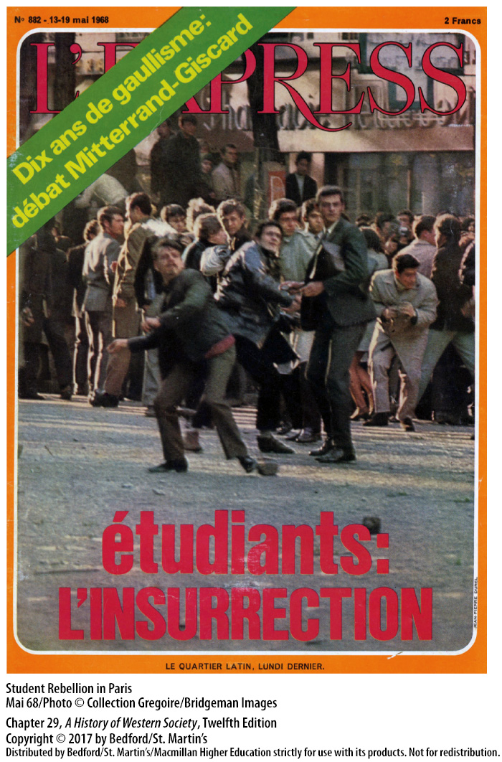

Slide 16
I. Reform and Protest in the 1960s
The 1960s in the East Bloc
1. Cautious forms of decentralization
2. East German Bitterfeld Movement
3. Outspoken dissidents forced to emigrate west
4. Underground samizdat (“self-published”) literature
Notes:
I. Reform and Protest in the 1960s
F. The 1960s in the East Bloc
1. It was clear to Communist leaders that East Bloc economies lagged behind those of the West, and so they implemented cautious forms of decentralization and limited market policies, with mixed results.
2. In East Germany, the regime encouraged intellectuals to take a more critical view of life in the East Bloc, so long as they did not directly oppose communism itself. Christa Wolf’s novel Divided Heaven (1963) is a classic example of the genre produced by this East German Bitterfeld Movement.
3. Despite some cultural openness, the most outspoken dissidents were harassed and often forced to emigrate to the West.
4. Some critics in Russia, Poland, and elsewhere contributed to an underground samizdat (“self-published”) literature that directly criticized communism and kept critical thought live.

Slide 17
I. Reform and Protest in the 1960s
The 1960s in the East Bloc
5. “Prague Spring”
6. Brezhnev Doctrine
7. Status quo
Notes:
I. Reform and Protest in the 1960s
F. The 1960s in the East Bloc
5. Modest prosperity and limited cultural tolerance only went so far, and the limits on reform were sharply revealed in Czechoslovakia during the 1968 “Prague Spring.” In January 1968 reform elements in the Czechoslovak Communist Party gained a majority and voted out the long-time Stalinist leader in favor of Alexander Dubček (1921–1992), whose new government launched dramatic reforms.
6. Shortly after the Soviet and East Bloc invasion of Czechoslovakia, Soviet premier Leonid Brezhnev (1906–1982) declared the so-called Brezhnev Doctrine, asserting the right of the Soviet Union and its allies to intervene militarily in any East Bloc country whenever they thought it necessary to preserve Communist rule.
7. This event demonstrated the Communist elite’s determination to maintain the status quo and also encouraged dissidents to begin building a civil society that might bring freedoms independent of the regimes.

Slide 19
II. Crisis and Change in Western Europe
Economic Crisis and Hardship
1. Value of American currency
2. Fixed rates of exchange were abandoned
3. OPEC raised oil prices
4. Worst economic decline since the 1930s
5. Stagflation
Notes:
II. Crisis and Change in Western Europe
A. Economic Crisis and Hardship
1. The value of American currency had been weakened by the United States’ postwar spending on foreign aid and foreign wars; when President Nixon tried to reverse this trend by abruptly stopping the exchange of U.S. currency for gold, the value of the dollar fell sharply, and inflation accelerated worldwide.
2. Fixed rates of exchange were abandoned, and great uncertainty replaced postwar predictability in international trade and finance.
3. Even more damaging to the global economy was the dramatic reversal in the price and availability of energy that occurred when OPEC raised oil prices and declared an embargo on oil shipments to the United States in retaliation for the United States providing military aid to Israel in the fourth Arab-Israeli war, which began in October 1973.
4. Coming on the heels of upheaval in the international monetary system, the explosion in energy prices plunged the world into its worst economic decline since the 1930s: unemployment rose, productivity and living standards declined, and inflation soared.
5. Economists coined a new term—stagflation—to describe the combination of low growth and high inflation that drove the worldwide recession.

Slide 20
II. Crisis and Change in Western Europe
Economic Crisis and Hardship
6. Collapse of oil production in Iran
7. Developing world
8. East Asia
9. “The information age” or postindustrial society
10. “Rust belts”
Notes:
II. Crisis and Change in Western Europe
A. Economic Crisis and Hardship
6. By 1976 a modest recovery was in progress, but the 1979 fundamentalist Islamic revolution in Iran led to the collapse of oil production in that country and the price of crude oil doubled again, sending the world economy into a second oil shock.
7. The developing world was hit hard by slowed growth, widening the gap between rich and poor countries and leading governments in South America, sub-Saharan Africa, and South Asia to borrow heavily from the United States and western Europe in attempts to restructure their economies.
8. At the same time, the East Asian “tiger economies” of Japan, Singapore, South Korea, and Taiwan—where labor costs were comparatively low—started exporting high-tech consumer goods to the West, which shifted manufacturing jobs away from the highly industrialized countries of northern Europe and North America.
9. By the end of the 1970s, the foundations of economic growth in the industrialized West had begun shifting to high-tech information industries, such as computing and biotechnology, and to services, including medicine, banking, and finance—a change described as the arrival of “the information age” or postindustrial society.
10. As heavy industry lost ground, factories closed, leading to the emergence of “rust belts”—formerly prosperous industrialized areas that were now ghost lands, such as the Ruhr district in northwest West Germany and the factory regions around Birmingham (Great Britain) and Detroit, Michigan.

Slide 21
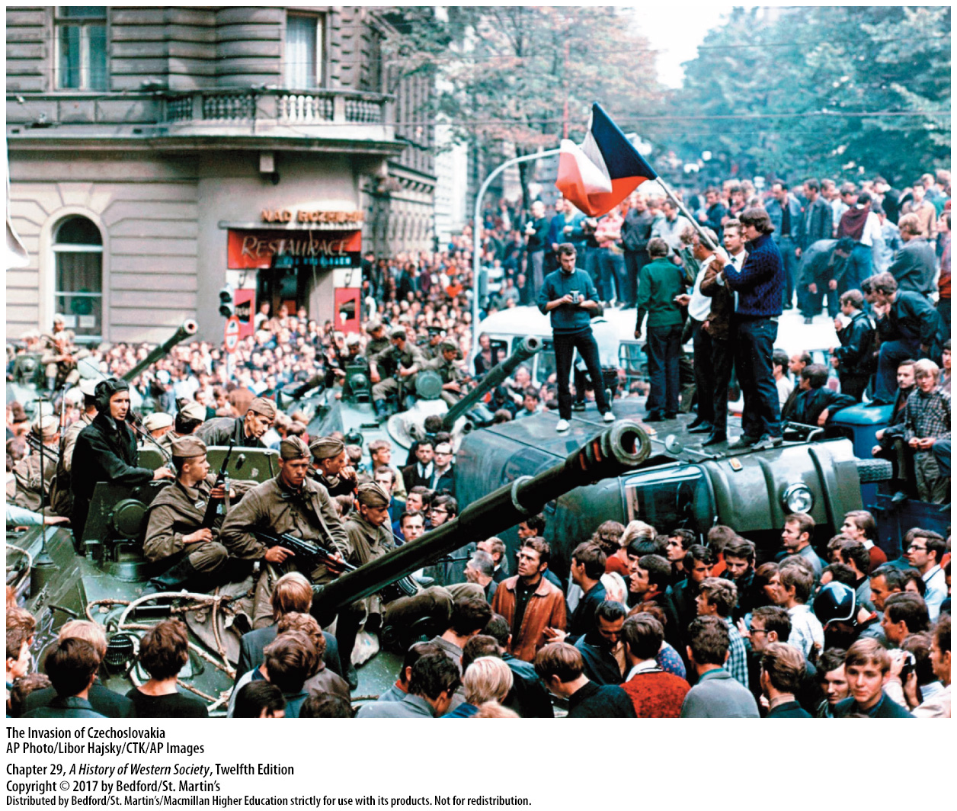

Slide 22
II. Crisis and Change in Western Europe
The New Conservatism
1. Post–World War II consensus unraveled
2. Neoliberalism
3. Privatization
4. Margaret Thatcher (1925–2013)
5. Controversial free-market policies
Notes:
II. Crisis and Change in Western Europe
B. The New Conservatism
1. The post–World War II consensus that economic growth and social stability were best achieved through full employment, high wages, some government regulation, and generous welfare provisions began to unravel in the 1970s, as economies weakened and global competition increased.
2. The new conservatives of the 1980s followed a philosophy that came to be known as neoliberalism, the main goal of which was to increase private profits, which neoliberals believed to be the real engine of economic growth. Neoliberal theorists like U.S. economist Milton Friedman argued that government should cut spending on social services such as housing, education, and health insurance; limit business subsidies; and retreat from regulation of all kinds.
3. They also called for privatization—the sale of state-managed industries to private owners—arguing that it would both tighten government spending and lead to greater workplace efficiency.
4. The broad shift toward greater conservatism, coupled with growing voter dissatisfaction with high taxes and runaway state budgets, helped elect Margaret Thatcher (1925–2013) as prime minister of Great Britain in 1979.
5. A member of the Conservative Party and a convinced neoliberal, Thatcher pushed through a series of controversial free-market policies that cut spending on health care, education, and public housing; reduced taxes; and privatized or sold off government-run enterprises, thus scaling back the role of government and transforming Britain.

Slide 23
II. Crisis and Change in Western Europe
The New Conservatism
6. Significant human costs
7. Ronald Reagan
8. Soaring U.S. budget deficit and debt
9. Helmut Kohl
10. François Mitterrand
Notes:
II. Crisis and Change in Western Europe
B. The New Conservatism
6. The significant human costs involved in this transition included unemployment rates that doubled to over 12 percent, a widening gap between rich and poor, and increasing poverty that led to discontent, strikes, riots, and crime.
7. In the United States, two-term president Ronald Reagan (in office 1981–1989) followed a similar path, though his success in cutting government was more limited.
8. A massive military buildup and rapid growth in spending on social programs contributed to the soaring U.S. budget deficit and the tripling of U.S. government debt.
9. West Germany also turned to the right as Christian Democrat Helmut Kohl (b. 1930) became the new chancellor in 1982. Like Thatcher, Kohl cut taxes and government spending, which led to unemployment in heavy industry but solid economic growth, so that by the mid-1980s West Germany was one of the most prosperous countries in the world.
10. After his election as president in 1981, François Mitterrand (1916–1996) and his Socialist Party led France on a lurch to the left, marking a significant change in French politics.

Slide 24
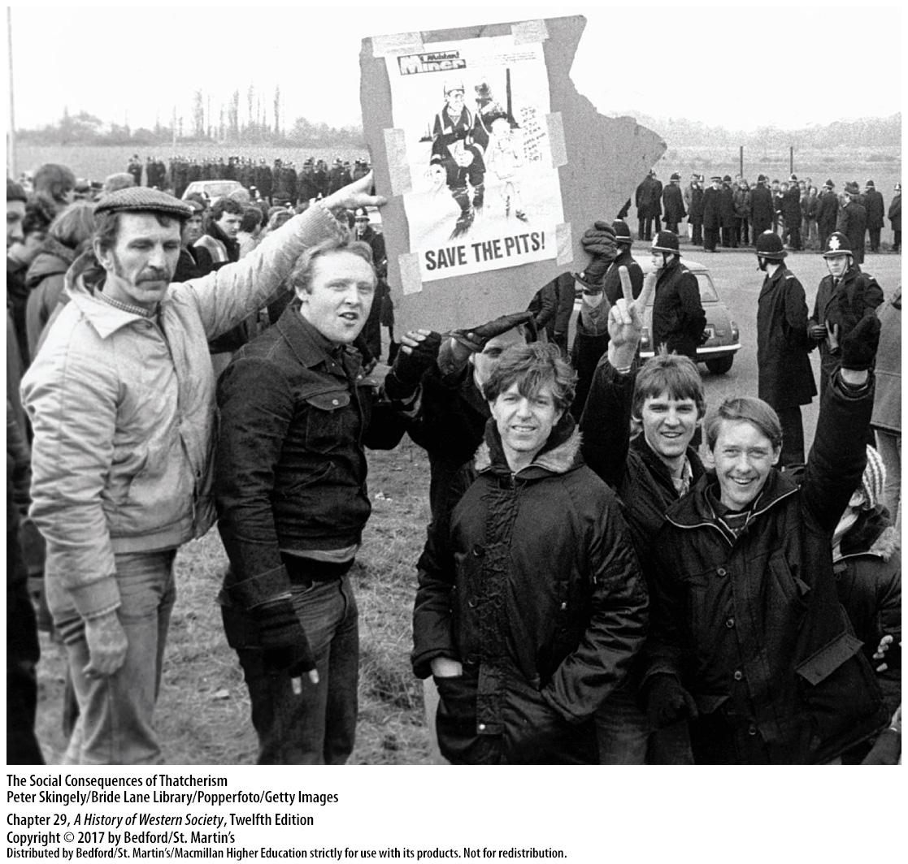

Slide 25
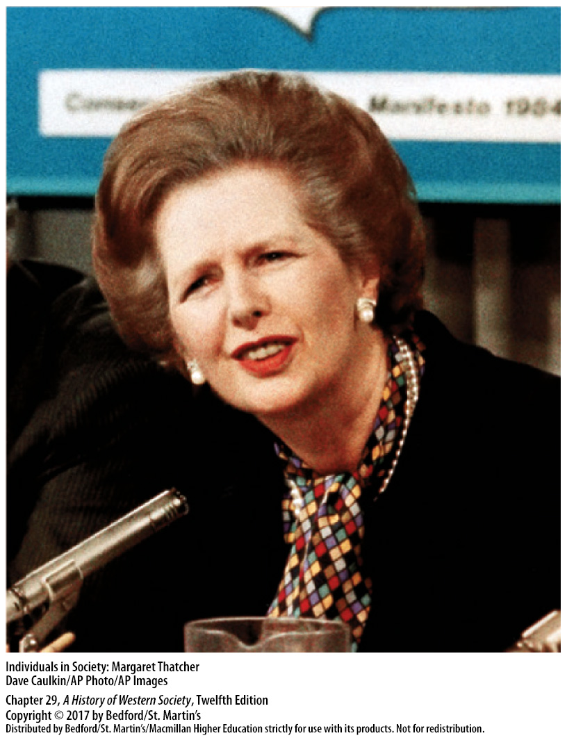

Slide 26
II. Crisis and Change in Western Europe
Challenges and Victories for Women
1. The Second Sex (1949)
2. “Second-wave feminism”
3. The Feminine Mystique (1963)
4. Patriarchy and sexism
5. Advocates pushed for statutes
6. Resurgence of antifeminist opposition
Notes:
II. Crisis and Change in Western Europe
C. Challenges and Victories for Women
1. Feminists were inspired by works such as the foundational book The Second Sex (1949) by French writer and philosopher Simone de Beauvoir (1908–1986), which argued that a woman had to take courageous, self-assertive action to become a completely free person and escape the role of the inferior “other” that men had constructed.
2. The Second Sex inspired a generation of women intellectuals, and by the late 1960s and 1970s, “second-wave feminism” had spread through North America and Europe.
3. In the United States, writer and organizer Betty Friedan’s (1921–2006) pathbreaking study The Feminine Mystique (1963) called attention to the stifling aspects of women’s domestic life and exclusion from professional jobs. In 1966 Friedan helped found the National Organization for Women (NOW) to press for women’s rights.
4. Feminists attacked patriarchy, the domination of society by men, and sexism, the inequalities faced by women simply because they were female.
5. Advocates of women’s rights pushed for new statutes in the workplace: laws against discrimination, equal pay for equal work, and measures such as maternal leave and affordable day care designed to help women combine careers and family responsibilities. The movement also addressed gender and family questions, including the right to divorce (in some Catholic countries), legalized abortion, the needs of single mothers, and protection from rape and physical violence.
6. The women’s movement of the 1970s won new rights for women, but it subsequently became more diffuse, a victim of both its successes and the resurgence of an antifeminist opposition.

Slide 27
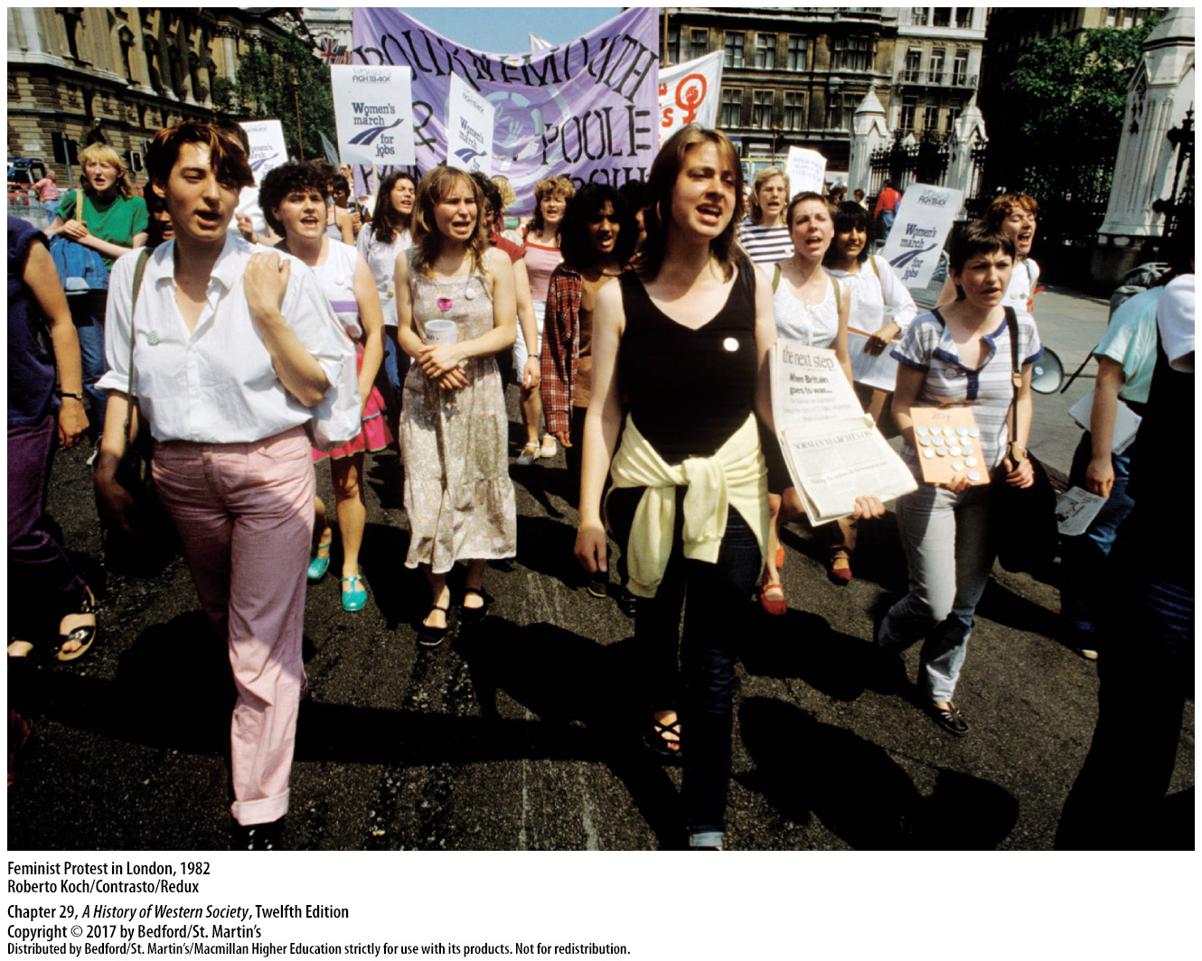

Slide 28
II. Crisis and Change in Western Europe
The Rise of the Environmental Movement
1. Destructive environmental costs were apparent
2. Unbridled industrial development
3. Tactics
4. Greenpeace
5. Green Party
6. East Bloc
Notes:
II. Crisis and Change in Western Europe
D. The Rise of the Environmental Movement
1. By the 1970s the destructive environmental costs of industrial development in western and eastern Europe were apparent everywhere, inspiring a growing environmental movement to challenge government and industry to clean up their acts.
2. Environmentalists worked to lessen the ill effects of unbridled industrial development on the natural environment, and they linked local environmental problems to poverty, inequality, and violence around the globe.
3. Some environmental groups used the mass media to reach potential supporters; some worked closely with politicians and public officials to change state policies; and still others took a more activist stance.
4. In 1971 Canadian activists established Greenpeace, a nongovernmental organization dedicated to environmental conservation and protection that quickly grew into an international organization, with strong support in Europe and the United States.
5. In West Germany in 1979, environmentalists founded the Green Party, a political party intended to fight for environmental causes that was successful in electing members to parliament in the 1983 elections.
6. In the East Bloc, government planners tried to ameliorate environmental problems, although groups like the Greens did not emerge until after the end of Communist rule.

Slide 29
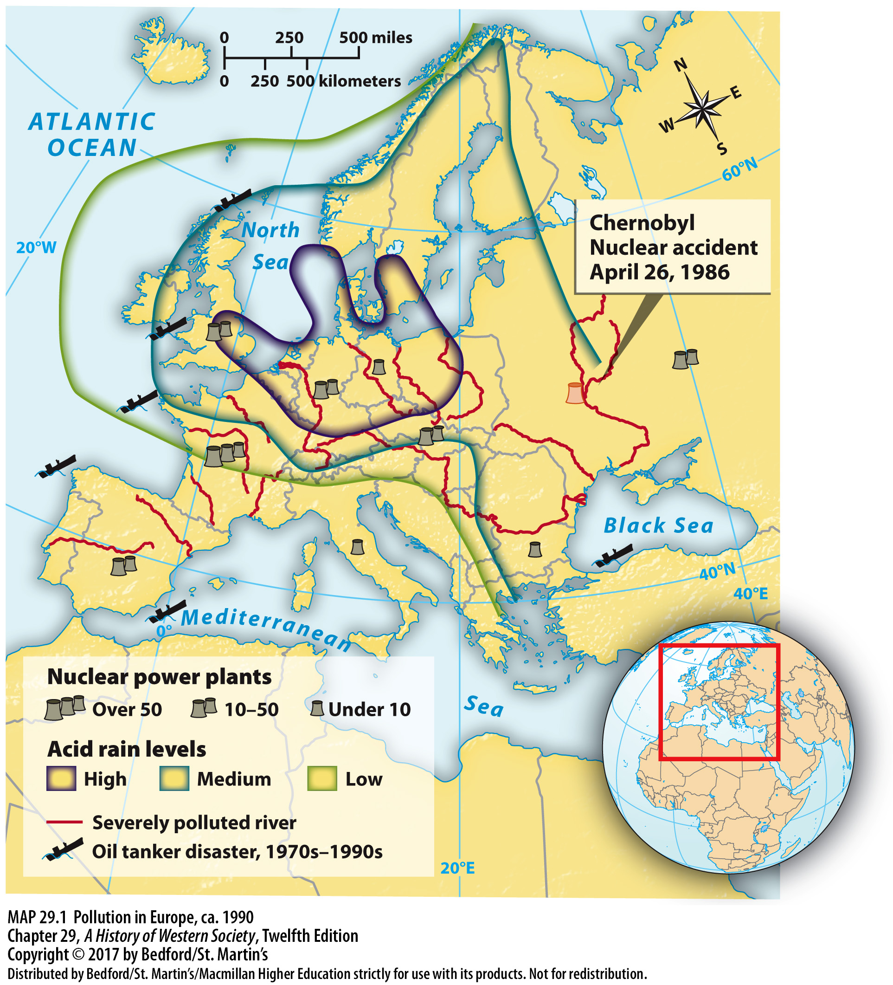

Slide 30
II. Crisis and Change in Western Europe
Separatism and Right-Wing Extremism
1. Spain and Northern Ireland
2. ETA (Basque Homeland and Freedom)
3. Provisional Irish Republican Army (IRA)
4. Bloody Sunday
5. French National Front
6. Right-wing as champions of white workers
Notes:
II. Crisis and Change in Western Europe
E. Separatism and Right-Wing Extremism
1. Separatism was most violent in Spain and Northern Ireland, where well-established insurgent groups used terrorist attacks to win government concessions.
2. In the ethnic Basque region of northern Spain, the ETA (short for Basque Homeland and Freedom) used bombings and assassinations to try to force the government to grant independence.
3. The Provisional Irish Republican Army (IRA), a paramilitary organization in Northern Ireland, used similar tactics against the British security forces, which it saw as an occupying army.
4. On Bloody Sunday in January 1972, British soldiers killed thirteen demonstrators and the violence escalated over the next thirty years as the IRA attacked soldiers and civilians in Northern Ireland and Britain, ending only in 1998 when a settlement was reached.
5. Mainstream European politicians also faced challenges from newly assertive rightwing political parties such as the French National Front, which opposed European integration and promised a return to traditional national customs.
6. New right-wing politicians promoted themselves as the champions of ordinary (white) workers, complaining that immigrants swelled welfare rolls and stole jobs from native-born Europeans.

Slide 31
III. The Decline of “Developed Socialism”
State and Society in the East Bloc
1. “Developed socialism”
2. Collectivized and nationalized
3. Government-supported welfare benefits
4. Outward conformity and private disengagement
5. Centralized economic planning
6. Secret police
Notes:
III. The Decline of “Developed Socialism” A. State and Society in the East Bloc
1. By the 1970s Communist leaders in central and eastern Europe and the Soviet Union adopted the term “developed socialism” (or “real existing socialism”) to describe the accomplishments of their societies in achieving many of the professed goals of communism.
2. Agriculture had been thoroughly collectivized, industry and business had been nationalized, and class leveling had reduced the gap between rich and poor.
3. An extensive system of government-supported welfare benefits included free medical care, guaranteed employment, inexpensive public transportation, and large subsidies for rent and food costs.
4. Everyday life under developed socialism was defined by an uneasy mixture of outward conformity and private disengagement—or apathy.
5. Centralized economic planning continued to lead to shortages, and people complained about poor quality and lack of choice of the most basic goods.
6. Though the secret police persecuted those who openly challenged the system and kept files on ordinary people, they generally left alone those who demonstrated conformity.

Slide 32
III. The Decline of “Developed Socialism”
State and Society in the East Bloc
7. Women
8. Energy crisis and stagflation
9. Loans from Western banks
10. One-party state
11. Promise of egalitarian socialism was appealing
Notes:
III. The Decline of “Developed Socialism” A. State and Society in the East Bloc
7. Women in particular experienced the contradictions of the socialist system: the state guaranteed equal rights for women, encouraged them to join the workforce, and offered an extensive child care system, while at the same time rarely allowing them into the upper ranks of business or politics. East Bloc women faced the same double burden as those in the West—on top of their full-time jobs, they were expected to do the shopping, the cooking, and the cleaning at home.
8. East Bloc countries were hit hard by the energy crisis and stagflation of the 1970s, but their leaders refused to make the economic reforms that might have made developed socialism more effective.
9. The state continued to subsidize heavy industries, and as industrial goods produced in the East Bloc became increasingly uncompetitive in the new global system, governments borrowed massive amounts from Western banks and governments, setting up a cycle of indebtedness.
10. The one-party state repeatedly squashed popular reform movements, retreated from economic liberalization, and jailed or exiled dissidents.
11. Many East Bloc citizens still found the promise of egalitarian socialism appealing, but came to doubt the legitimacy of Soviet-style communism: the dream of distributing goods “from each according to his means, to each according to his needs” (as Marx had once put it) hardly made up for the structural weaknesses of real existing socialism.

Slide 33
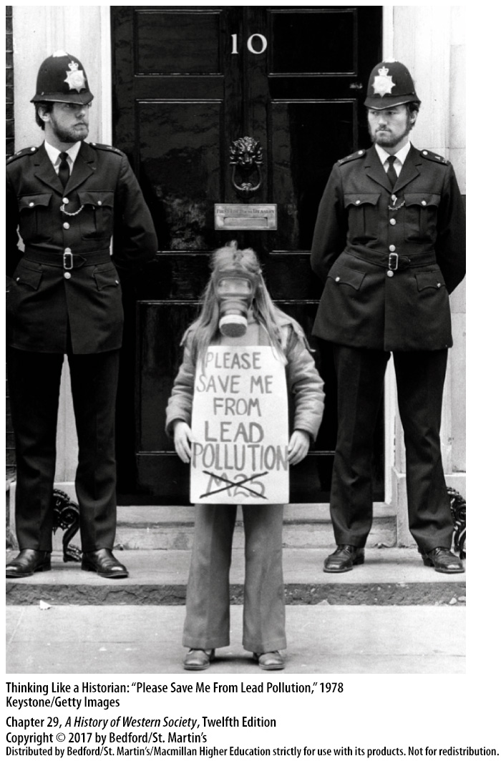

Slide 34
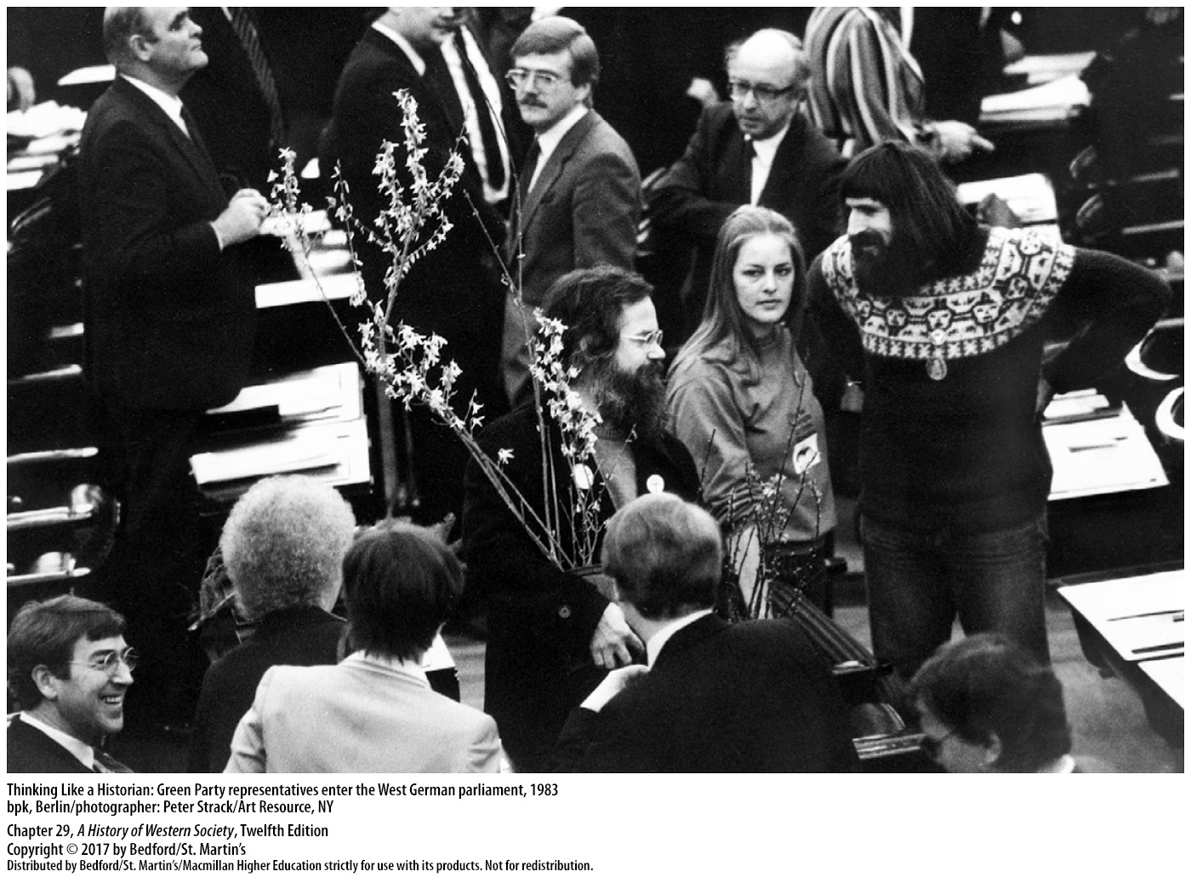

Slide 35
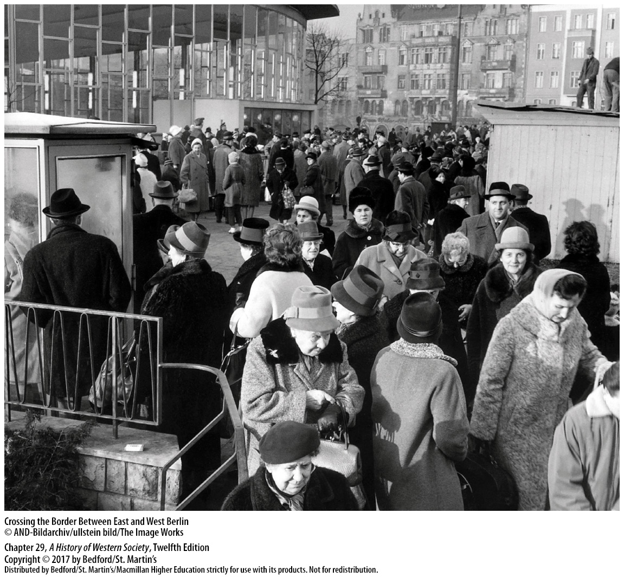

Slide 36
III. The Decline of “Developed Socialism”
Dissent in Czechoslovakia and Poland
1. Dissenters
2. Charter 77
3. Protest in Poland
4. Pope John Paul II
5. Lenin Shipyards
Notes:
III. The Decline of “Developed Socialism” B. Dissent in Czechoslovakia and Poland
1. Dissenters worked to build a civil society from below—to create a realm of freedom beyond formal politics, where civil liberties and human rights could be exercised independent of the Communist system.
2. In Czechoslovakia in 1977 a group of citizens that included future Czechoslovak president Václav Havel (1936–2011) signed a manifesto—known as Charter 77—in which they criticized the government for ignoring the human rights provision of the Helsinki Accords and called on Communist leaders to respect civil and political liberties.
3. In Poland, the Communists had failed to dominate society and to manage the economy effectively, and the stagnation of the 1960s motivated Poland’s working class to rise up in angry protest in 1970.
4. In 1978 Cardinal Karol Wojtyla, archbishop of Kraków, was elected pope as John Paul II; in June 1979 he visited Poland and preached before enormous crowds about love of Christ and country and the “inalienable rights of man.”
5. In August 1980 the sixteen thousand workers at the gigantic Lenin Shipyards in Gdansk laid down their tools and occupied the plant. As other workers joined “in solidarity,” the strikers advanced the ideals of civil society, including the right to form free-trade unions, freedom of speech, release of political prisoners, and economic reforms.

Slide 37
III. The Decline of “Developed Socialism”
Dissent in Czechoslovakia and Poland
6. Gdansk Agreement
7. Lech Wałęsa and Solidarity
8. General Wojciech Jaruzelski
9. Popular support for Solidarity
Notes:
III. The Decline of “Developed Socialism” B. Dissent in Czechoslovakia and Poland
6. After eighteen days of shipyard occupation, the government gave in and accepted the workers’ demands in the Gdansk Agreement: an unprecedented, even revolutionary, victory.
7. Led by feisty Lenin Shipyards electrician and devout Catholic Lech Wałęsa (b. 1943), the workers proceeded to organize a free and democratic trade union called Solidarity and to work cautiously to shape an active civil society. Joined by intellectuals and supported by the Catholic Church, Solidarity became a national union of 9.5 million members that enjoyed tremendous public support.
8. The Polish Communist leadership shrewdly denounced Solidarity for promoting economic collapse, and in December 1981 General Wojciech Jaruzelski, who headed Poland’s Communist government, suddenly proclaimed martial law and arrested Solidarity’s leaders.
9. Millions of Poles decided to continue acting as if they were free, and popular support for outlawed Solidarity remained strong under martial law in the 1980s, preparing the way for the union’s political rebirth toward the end of the decade.

Slide 38
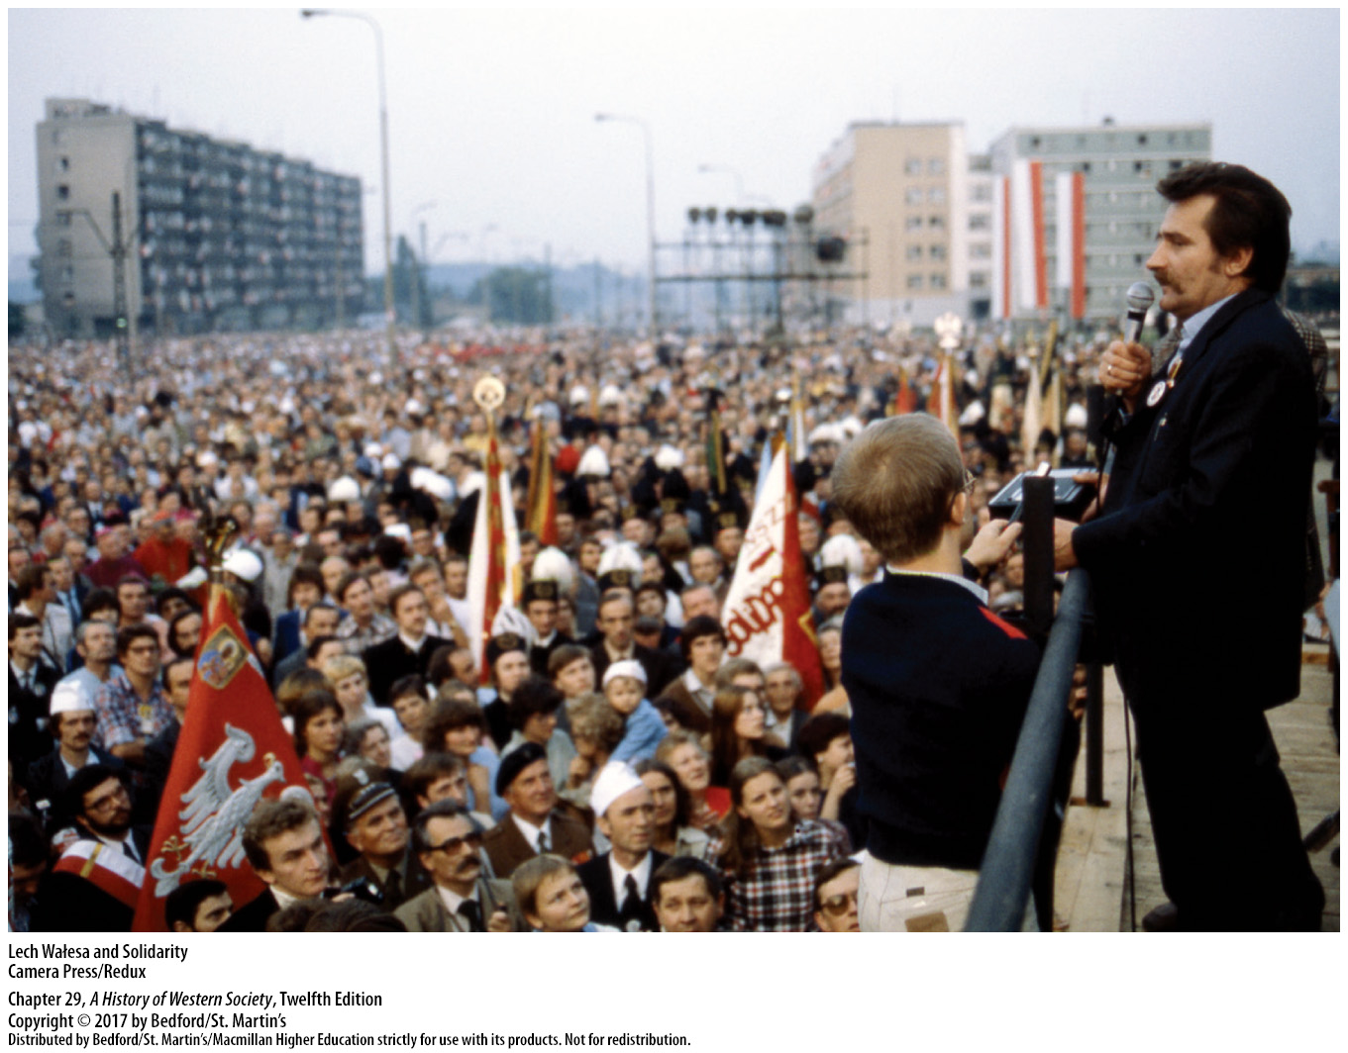

Slide 39
III. The Decline of “Developed Socialism”
From Détente Back to Cold War
1. Afghanistan
2. Jimmy Carter
3. President Reagan and the “evil empire”
4. Margaret Thatcher and Reagan
Notes:
III. The Decline of “Developed Socialism” C. From Détente Back to Cold War
1. The Soviet invasion of Afghanistan in December 1979 caused many Americans to fear that the oil-rich states of the Persian Gulf would be next, and they once again looked to the NATO alliance and military might to thwart Communist expansion.
2. U.S. President Jimmy Carter (in office 1977–1981) tried to lead NATO beyond verbal condemnation and urged economic sanctions against the Soviet Union, but only Great Britain among the European allies supported the American initiative.
3. The U.S. military buildup launched by Carter in his last years in office was greatly accelerated by President Reagan, who was swept into office in 1980 by a wave of patriotism and economic discontent. The new American leadership acted as if the military balance had tipped in favor of the Soviet Union, which Reagan anathematized as the “evil empire,” and it increased defense spending enormously.
4. Margaret Thatcher worked well with Reagan and was a forceful advocate for a revitalized Atlantic alliance, and under Helmut Kohl, West Germany worked with the U.S. to coordinate military and political policy toward the Soviet bloc.

Slide 40
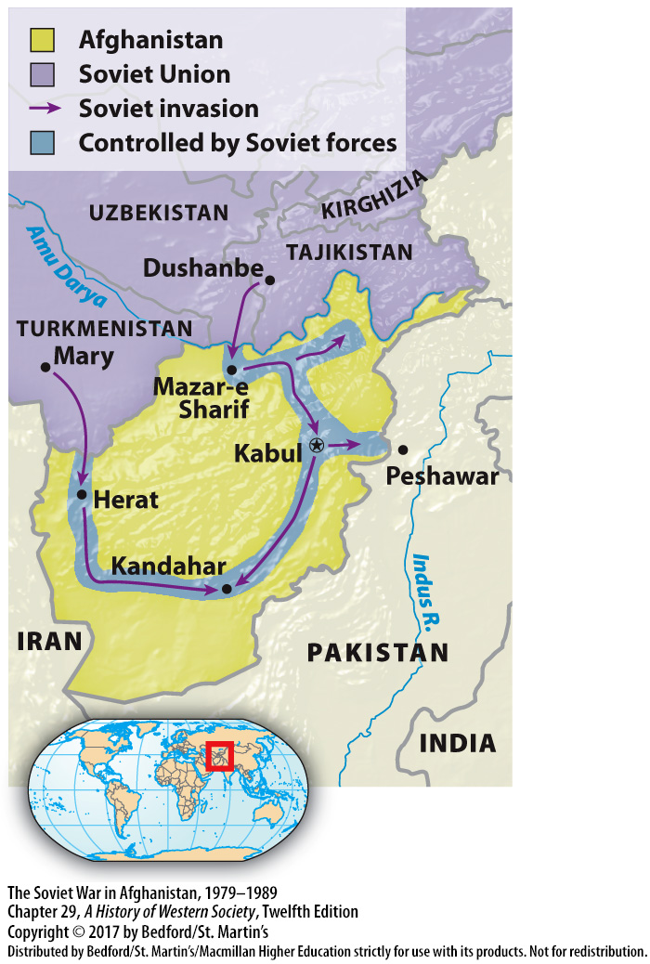

Slide 41
III. The Decline of “Developed Socialism”
Gorbachev’s Reforms in the Soviet Union
1. Mikhail Gorbachev
2. Gorbachev’s position
3. Reform policies
4. Economy stalled
5. Glasnost
Notes:
III. The Decline of “Developed Socialism” D. Gorbachev’s Reforms in the Soviet Union
1. A sharply worsening economic situation set the stage for the emergence in 1985 of Mikhail Gorbachev (b. 1931), the most vigorous Soviet leader in a generation and an idealist who wanted to improve conditions for ordinary citizens.
2. Gorbachev believed in communism but realized the Soviet Union was failing to keep up with the West and understood that the enormous expense of the Cold War arms race had had a disastrous impact on living conditions in the Soviet Union.
3. In order to meet the real needs of the Soviet population, some of Gorbachev’s first reform policies set out an ambitious program of economic restructuring, or perestroika, which allowed an easing of government price controls on some goods, more independence for state enterprises, and the creation of profit-seeking private cooperatives.
4. After a few initial improvements, however, the economy stalled, and by late 1988 widespread consumer dissatisfaction posed a serious threat to Gorbachev’s leadership and reform program.
5. Gorbachev’s bold and far-reaching campaign of openness, or glasnost, was much more successful and very popular in a country where censorship, dull uniformity, and outright lies had long characterized public discourse. Glasnost proceeded quickly and went much further than even Gorbachev intended, leading to a veritable cultural revolution.

Slide 42
III. The Decline of “Developed Socialism”
Gorbachev’s Reforms in the Soviet Union
6. Democratization
7. Non-Russian minorities
8. East-West relations
9. President Reagan and Gorbachev
10. Encouraged reform movements
Notes:
III. The Decline of “Developed Socialism” D. Gorbachev’s Reforms in the Soviet Union
6. Democratization, the third element of reform, began as an attack on corruption in the Communist Party and led to the first free elections in the Soviet Union since 1917.
7. Democratization ignited demands from non-Russian minorities for greater autonomy, leading to the emergence of national independence movements in the fifteen Soviet republics.
8. Gorbachev also brought reforms to the field of foreign affairs, withdrawing Soviet troops from Afghanistan in February 1989 and seeking to reduce East-West tensions.
9. In a Washington summit in December 1987, President Reagan and Gorbachev agreed to eliminate all land-based intermediate-range missiles in Europe, setting the stage for more arms reductions.
10. Gorbachev also encouraged reform movements in Poland, Czechoslovakia, and Hungary and pledged to respect the political choices of the peoples of East Bloc countries, repudiating the Brezhnev Doctrine.

Slide 43
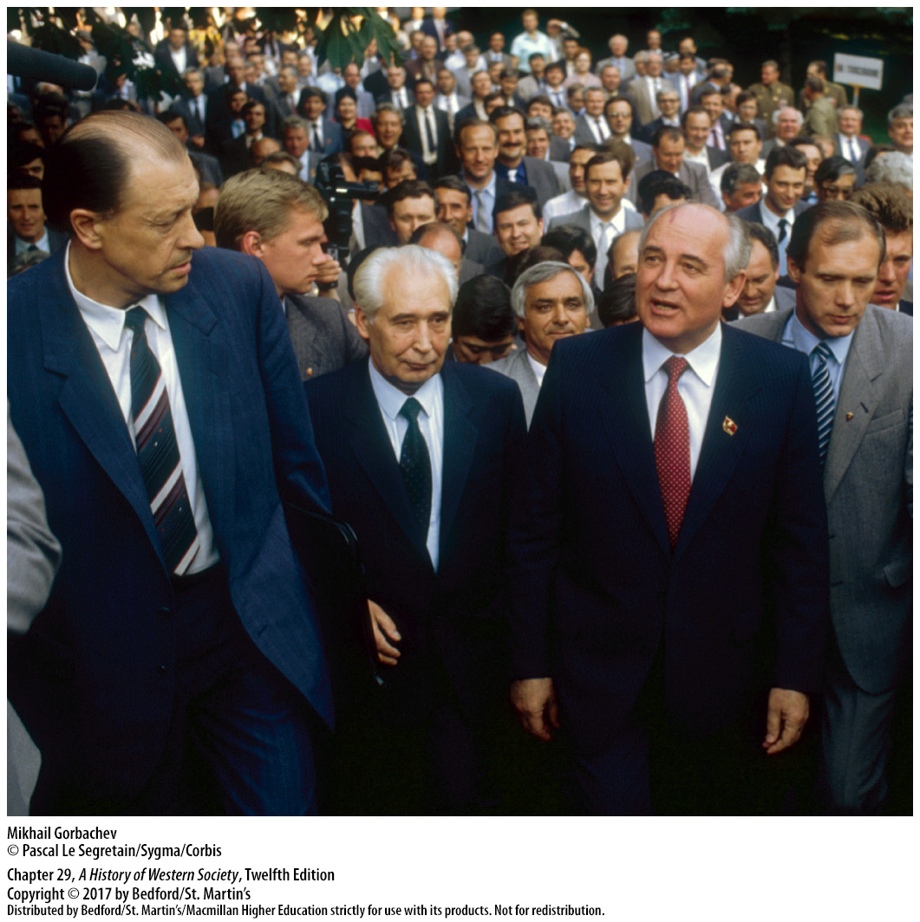

Slide 44
IV. The Revolutions of 1989
The Collapse of Communism in the East Bloc
1. Free elections
2. Solidarity’s overwhelming victory
3. Tadeusz Mazowiecki
4. Revolutionary political changes
5. Economic shock therapy
Notes:
IV. The Revolutions of 1989
A. The Collapse of Communism in the East Bloc
1. In April 1989 Solidarity and Communist leaders worked out an agreement that legalized Solidarity and declared that a large minority of representatives to the Polish parliament would be chosen by free elections that June.
2. Lacking access to the state-run media, Solidarity succeeded nonetheless in mobilizing the country and winning all but one of the contested seats in an overwhelming victory.
3. In August 1989 the editor of a Solidarity weekly newspaper, Tadeusz Mazowiecki (b. 1927), was sworn in as Poland’s new noncommunist leader.
4. In its first year and a half, the Solidarity-led government cautiously introduced revolutionary political changes, eliminating the secret police, Communist government ministers, and Communist party leader Jaruzelski in a step-by-step fashion that avoided confrontation with the army or the Soviet Union.
5. However, in economic affairs, the Solidarity government applied economic shock therapy, an intense dose of neoliberal policy designed to make a clean break with state planning and move quickly to market mechanisms and private property; thus the government abolished many price controls on January 1, 1990, and reformed the monetary system.

Slide 45
IV. The Revolutions of 1989
The Collapse of Communism in the East Bloc
6. Hungarian Communist Party
7. East German government opened the Berlin Wall
8. New, reformist government
9. Velvet Revolution
Notes:
IV. The Revolutions of 1989
A. The Collapse of Communism in the East Bloc
6. In the summer of 1989, the Hungarian Communist Party agreed to hold free elections in the spring; Hungary’s Communists, who welcomed Western investment and moved rapidly toward multiparty democracy, enjoyed considerable popular support and believed they could defeat the opposition.
7. In a desperate attempt to stabilize the situation, the East German government opened the Berlin Wall in November 1989, and people danced for joy atop that grim symbol of the prison state.
8. A new, reformist government took power and scheduled free elections.
9. In Czechoslovakia, communism dissolved peacefully in November–December 1989 in the so-called Velvet Revolution that grew out of popular demonstrations led by students, intellectuals, and a dissident playwright-turned-moral-revolutionary named Václav Havel.

Slide 46
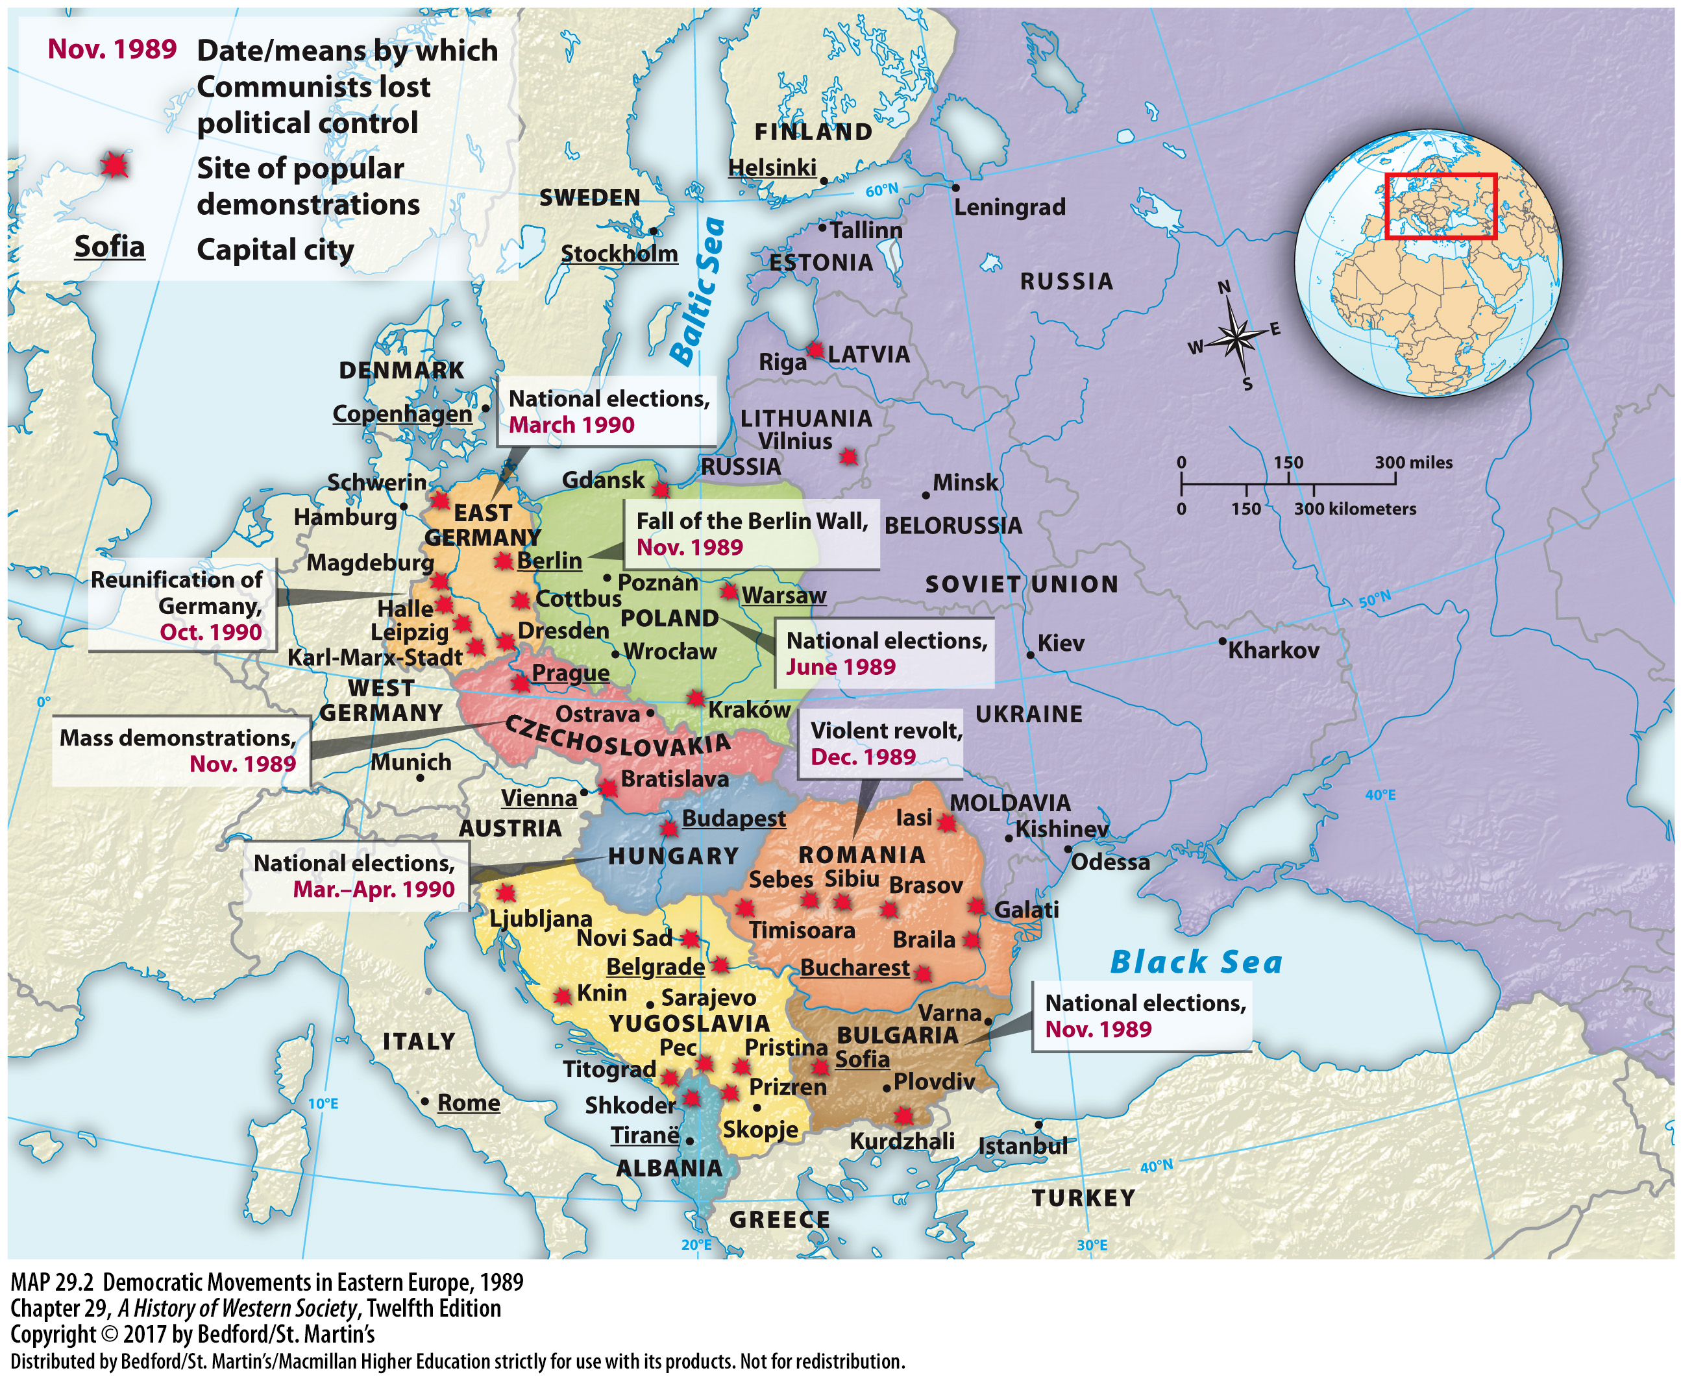

Slide 47
IV. The Revolutions of 1989
German Unification and the End of the Cold War
1. East Germans and the Berlin Wall
2. Helmut Kohl
3. Exchange of East German marks
4. Alliance for Germany
Notes:
IV. The Revolutions of 1989
B. German Unification and the End of the Cold War
1. In the first week after the Berlin Wall was opened, almost 9 million East Germans—roughly half of the population—poured across the border into West Germany, where they were welcomed by long-lost friends and relatives and exhilarated by crossing a long-closed border; nearly all returned to their homes in the East, but the experience aroused long-dormant hopes of unity among ordinary citizens.
2. West German chancellor Helmut Kohl skillfully exploited the historic opportunity and presented a ten-point plan for a step-by-step unification in cooperation with both East Germany and the international community.
3. Kohl promised East Germans a generous, though limited, exchange of East German marks for West German marks, helping to overwhelm those who argued for the preservation of an independent socialist society in East Germany.
4. In March 1990 the Alliance for Germany (closely associated with Kohl’s West German Christian Democrats) outdistanced the ex-Communist Party of Democratic Socialism and the revived Social Democratic Party and won almost 50 percent of the votes in an East German parliamentary election; it quickly negotiated an economic and political union with West Germany.

Slide 48
IV. The Revolutions of 1989
German Unification and the End of the Cold War
5. Kohl affirmed peaceful intentions
6. Single German nation
7. International scaling down of armed forces
8. Paris Accord
Notes:
IV. The Revolutions of 1989
B. German Unification and the End of the Cold War
5. In July 1990 the crucial international aspect of unification—the security of the Soviet Union—was successfully resolved when Gorbachev and Kohl signed a historic agreement in which Kohl affirmed Germany’s peaceful intentions, pledging never to develop nuclear, biological, or chemical weapons and promising loans to the hard-pressed Soviet Union.
6. In October 1990 East Germany merged into West Germany, forming henceforth a single nation under the West German laws and constitution.
7. The peaceful reunification of Germany accelerated the pace of agreements to liquidate the Cold War, and in November 1990 delegates from twenty-two European countries, the United States, and the Soviet Union met in Paris and agreed to a scaling down of all their armed forces.
8. The delegates also affirmed that all existing borders in Europe were legal and valid, making the Paris Accord, for all practical purposes, a general peace treaty that brought an end to World War II and the Cold War that followed.

Slide 49
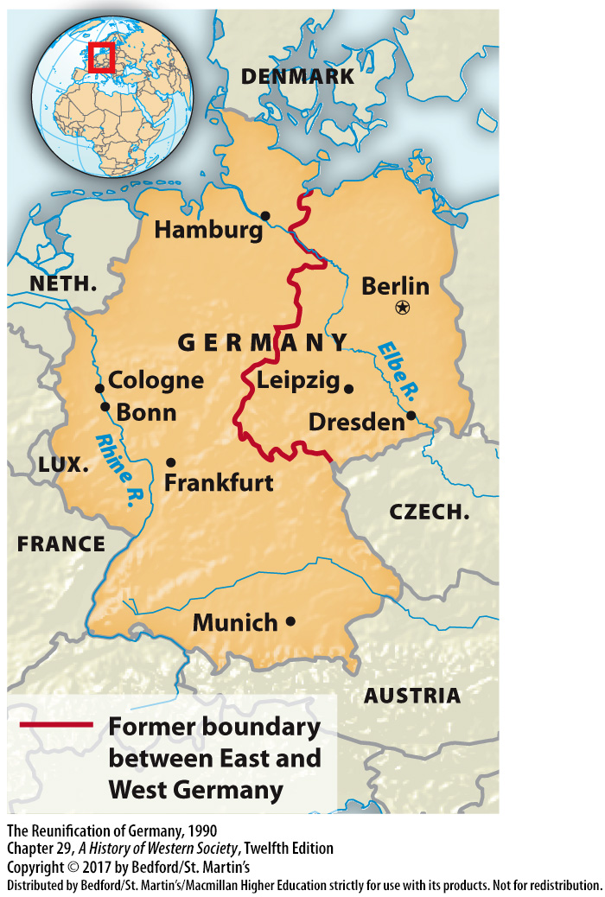

Slide 50
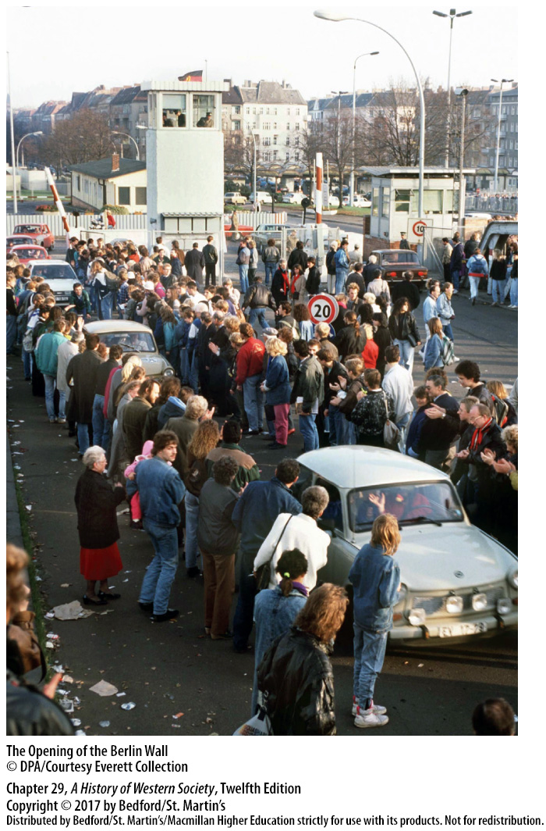

Slide 51
IV. The Revolutions of 1989
The Disintegration of the Soviet Union
1. Defeat in local elections
2. Abolished the Communist Party’s monopoly
3. Boris Yeltsin
4. Independence from the Soviet Union
5. Gorbachev tried to save the Soviet Union
6. Gorbachev resigned
7. Commonwealth of Independent States
Notes:
IV. The Revolutions of 1989
C. The Disintegration of the Soviet Union
1. In February 1990, as competing Russian politicians noisily presented their programs and nationalists in the non-Russian republics demanded autonomy or independence from the Soviet Union, the Communist Party suffered a stunning defeat in local elections throughout the country.
2. Gorbachev asked Soviet citizens to ratify a new constitution that formally abolished the Communist Party’s monopoly of political power and expanded the power of the Congress of People’s Deputies, and he convinced a majority of delegates to elect him president of the Soviet Union.
3. Gorbachev’s eroding power and his unwillingness to risk a universal suffrage election for the Soviet presidency strengthened his great rival, Boris Yeltsin (1931–2007).
4. Yeltsin embraced the democratic movement, and after he was elected parliamentary leader of the Russian Soviet Republic in May 1990, he boldly announced that Russia would put its interests first and declare its independence from the Soviet Union.
5. Gorbachev tried to save the Soviet Union with a new treaty linking the member republics in a looser, freely accepted confederation, but six of the fifteen Soviet republics rejected his plan.
6. Gorbachev resigned on December 25, 1991, and the next day the Supreme Soviet dissolved itself, marking the end of the Soviet Union.
7. The independent republics of the old Soviet Union then established a loose confederation, the Commonwealth of Independent States, which played a minor role in the 1990s.

Slide 52
