Slide 1
A History of Western Society Twelfth Edition
McKay • Crowston • Wiesner-Hanks • Perry
CHAPTER 28
Cold War Conflict and Consensus
1945–1965
Copyright © 2017 by Bedford/St. Martin’s
Distributed by Bedford/St. Martin's/Macmillan Higher Education strictly for use with its products; Not for redistribution.

Slide 2
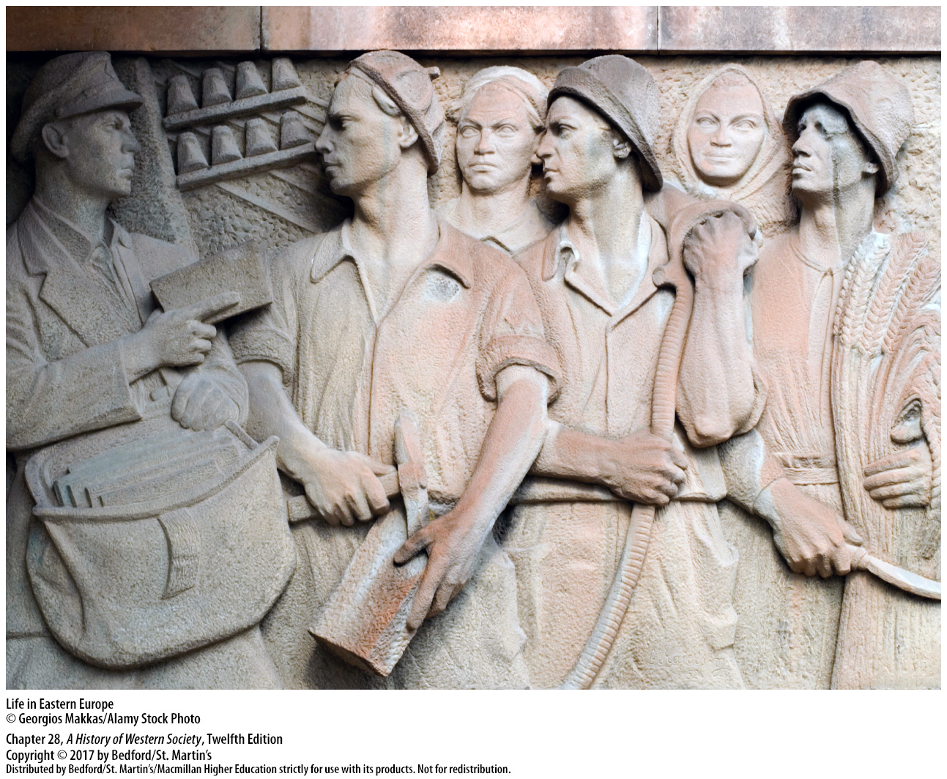

Slide 3
I. Postwar Europe and the Origins of the Cold War
The Legacies of the Second World War
1. Post-war Europe
2. United Nations Relief and Rehabilitation Administration (UNRRA)
3. Israel
4. Four occupation zones
5. War reparations
6. “Denazification”
7. Nuremberg trials (1945–1946)
Notes:
I. Postwar Europe and the Origins of the Cold War
A. The Legacies of the Second World War
1. In the summer of 1945, Europe lay in ruins: fighting had destroyed cities and landscapes and obliterated buildings, factories, farms, rail tracks, roads, and bridges. About 50 million human beings perished in the Second World War. Tens of millions were left homeless.
2. Because going home was not always the best option for DPs, the newly established United Nations Relief and Rehabilitation Administration (UNRRA) opened over 760 DP camps and spent $10 billion to house, feed, clothe, and repatriate the refugees between 1945 and 1947.
3. After the creation of Israel in 1948, over 330,000 European Jews left for the new Jewish state, while others immigrated to the United States, western Europe, South America, and Britain.
4. Germany and Austria were divided into four occupation zones, each governed by one of the Allies—the Soviet Union, the United States, Britain, and France.
5. East Germany, Hungary, and Romania—countries that had fought against Russia in World War II—were forced to pay substantial war reparations to the Soviet Union.
6. In Germany and Austria, occupation authorities set up “denazification” procedures meant to eradicate National Socialist ideology from institutions and identify and punish former Nazi Party members responsible for the worst crimes.
7. At the Nuremberg trials (1945–1946), an international military tribunal organized by the four Allied powers tried and sentenced twenty-two high-ranking Nazi military and civilian leaders.

Slide 4
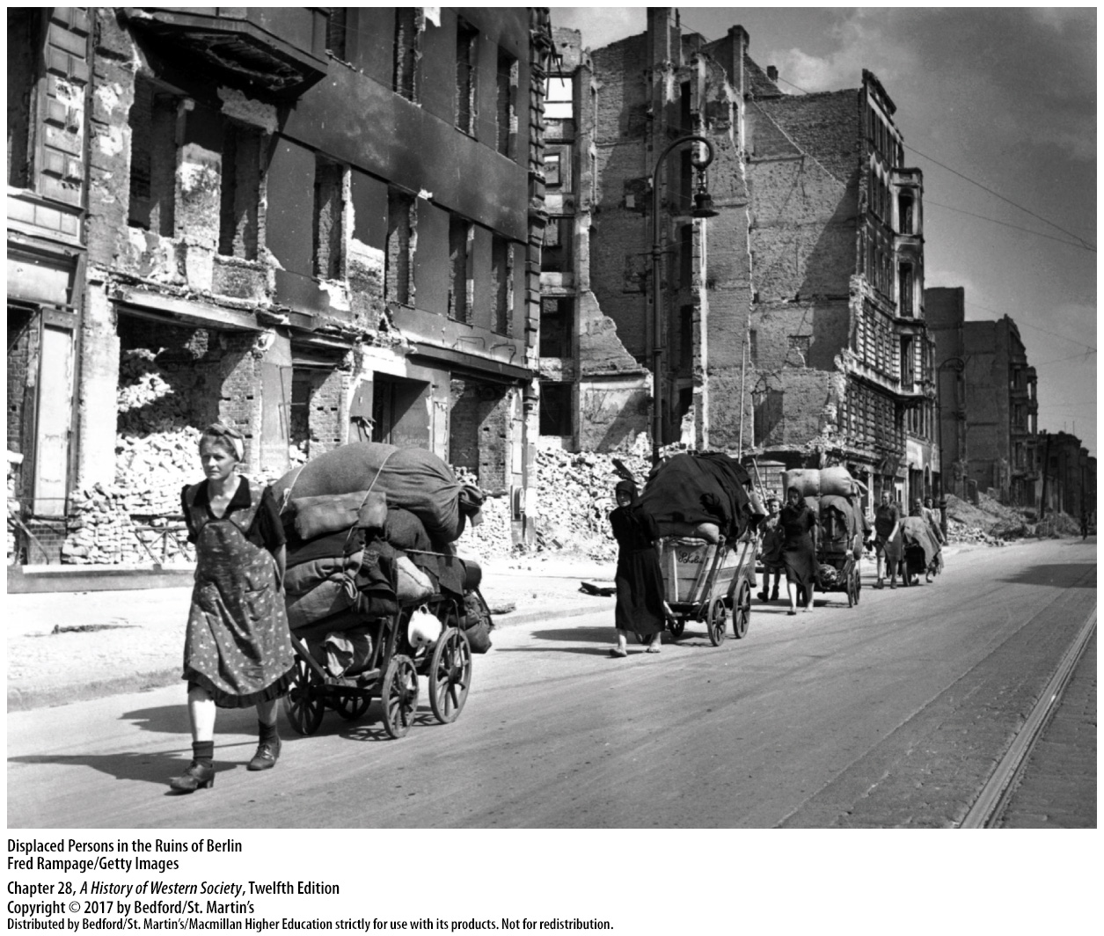

Slide 5
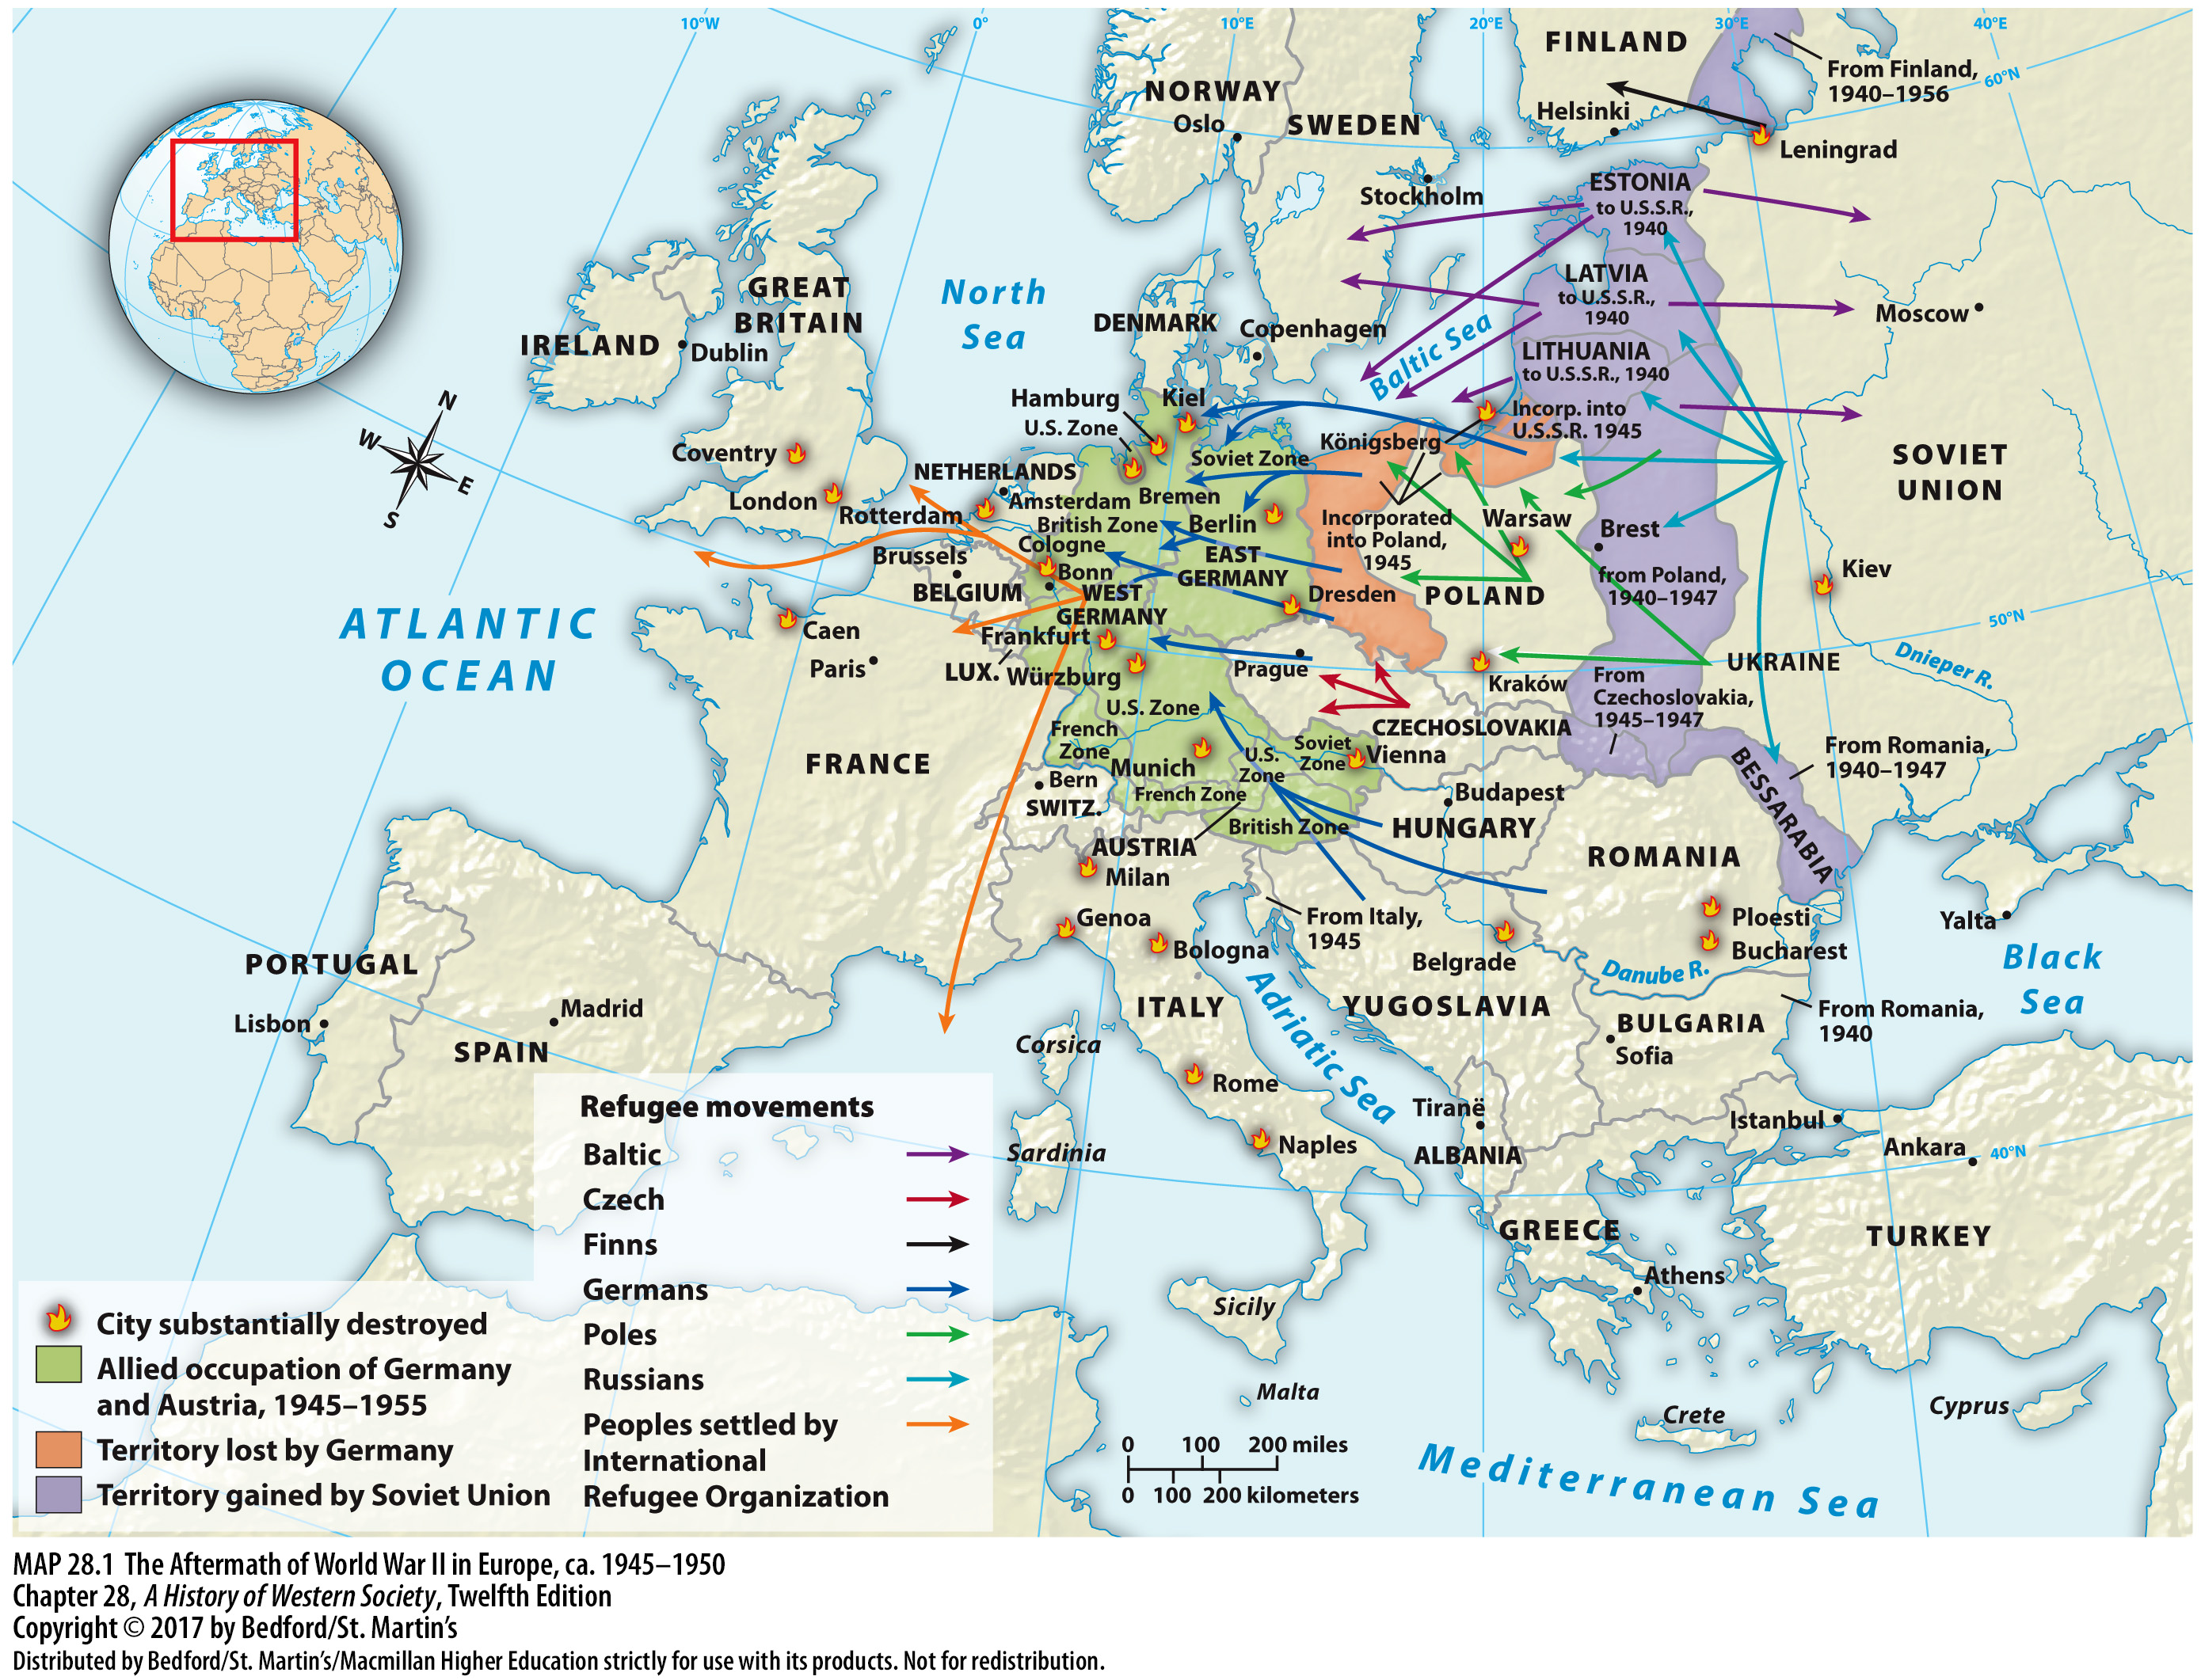

Slide 6
I. Postwar Europe and the Origins of the Cold War
The Peace Settlement and Cold War Origins
1. Shaping a reasonable and lasting peace
2. Hostility between East and West
3. Yalta compromise
4. Potsdam Conference
5. Mutual distrust
6. Stalin’s buffer zone
7. United States sphere of influence
Notes:
I. Postwar Europe and the Origins of the Cold War
B. The Peace Settlement and Cold War Origins
1. As ordinary people struggled to recover, the most powerful allies in the wartime coalition—the U.S.S.R., United States, and Britain—tried to shape a reasonable and lasting peace.
2. Hostility between the Eastern and Western superpowers, which began as the threat of Nazi Germany disappeared, was the sad but logical outgrowth of military developments, wartime agreements, and long-standing political and ideological differences.
3. The Yalta compromise over elections in eastern Europe broke down almost immediately, as the Soviets formed coalition governments that included Social Democrats and other leftist parties but reserved key government posts for Moscow-trained Communists.
4. At the postwar Potsdam Conference of July 1945, the differences over elections in Soviet-occupied Europe surged to the fore when Roosevelt’s successor, President Harry Truman (in office 1945–1953), demanded immediate free elections throughout central and eastern Europe and Stalin refused point-blank.
5. Mutual distrust, security concerns, and antagonistic desires for economic, political, and territorial control began to destroy the former partnership.
6. Stalin, who had lived through two enormously destructive German invasions, was determined to establish a buffer zone of sympathetic states around the U.S.S.R. and at the same time expand the reach of communism and the Soviet state.
7. The United States, for its part, pushed to maintain democratic capitalism and open access to free markets in western Europe, showing that it, too, was willing to use its vast political, economic, and military power to maintain predominance in its own sphere of influence.

Slide 7
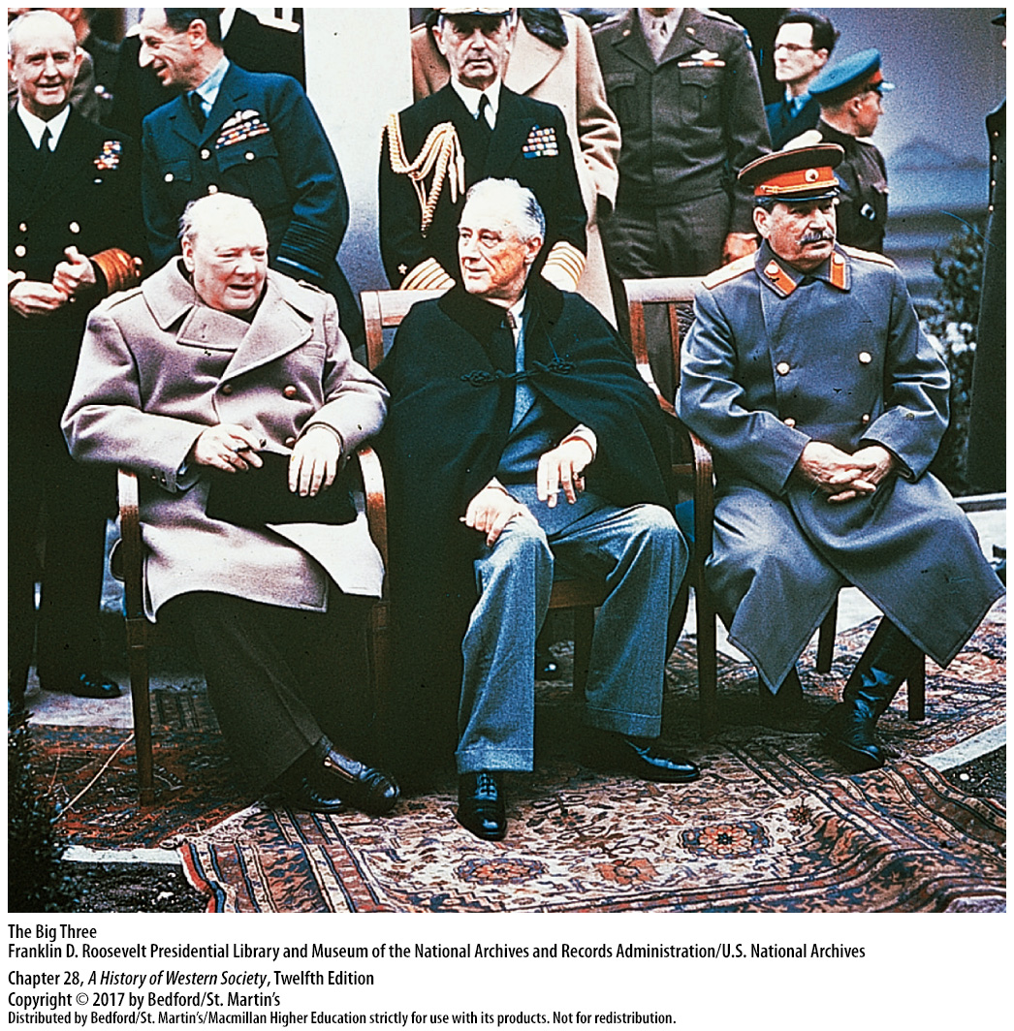

Slide 8
I. Postwar Europe and the Origins of the Cold War
West Versus East
1. Truman cuts off all aid
2. “Iron curtain”
3. One-party Communist dictatorships
4. Truman Doctrine
5. Resist the expansion of communism
6. Soviets’ atomic bomb
7. U.S. restructures military
Notes:
I. Postwar Europe and the Origins of the Cold War
C. West Versus East
1. After Japan’s surrender in September 1945, Truman cut off all aid to the ailing Soviet Union, and in October he declared that the United States would never recognize any government established by force against the free will of its people.
2. In March 1946 former British Prime Minister Churchill ominously informed an American audience that an “iron curtain” had fallen across the continent, dividing Europe into two antagonistic camps.
3. Communists quickly realized they could not take power in free elections, and in several countries they purged noncommunists from the coalition governments set up after the war and established Soviet-style, one-party Communist dictatorships.
4. In early 1947, when it appeared to many Americans that the U.S.S.R. was determined to export communism by subversion around the world, the United States responded with the Truman Doctrine, aimed at “containing” communism to areas already under Communist governments.
5. The United States, President Truman promised, would use diplomatic, economic, and even military means to resist the expansion of communism anywhere on the globe.
6. The American determination to enforce containment hardened when the Soviets exploded their own atomic bomb in 1949.
7. By the early 1950s, the U.S. government was restructuring its military to meet the Soviet threat, pouring money into defense spending and testing nuclear weapons.

Slide 9
I. Postwar Europe and the Origins of the Cold War
West Versus East
8. Marshall Plan
9. Council for Mutual Economic Assistance (COMECON)
10. Two separate German states
11. North Atlantic Treaty Organization (NATO)
12. Warsaw Pact
13. North Korea
Notes:
I. Postwar Europe and the Origins of the Cold War
C. West Versus East
8. In 1947, recognizing that an economically and politically stable western Europe could be an effective block against the popular appeal of communism, U.S. Secretary of State George C. Marshall offered Europe economic aid—the Marshall Plan—to help it rebuild.
9. In 1949 the Soviets established the Council for Mutual Economic Assistance (COMECON) to rebuild the East Bloc independently of the West.
10. Breaking the Berlin blockade paved the way for the creation of two separate German states in 1949: the Federal Republic of Germany (West Germany), aligned with the United States; and the German Democratic Republic (East Germany), aligned with the Soviet Union.
11. In 1949 the United States formed NATO (the North Atlantic Treaty Organization), an anti-Soviet military alliance of Western governments.
12. The Soviets countered by organizing the Warsaw Pact, a military alliance among the U.S.S.R. and its Communist satellites, dividing Europe politically and militarily into two hostile blocs.
13. The Cold War spread when Soviet-backed Communist North Korea invaded South Korea in 1950 and President Truman swiftly sent troops; a fragile truce negotiated in 1953 stopped the fighting, but it left Korea divided between a Communist north and a capitalist south.

Slide 10
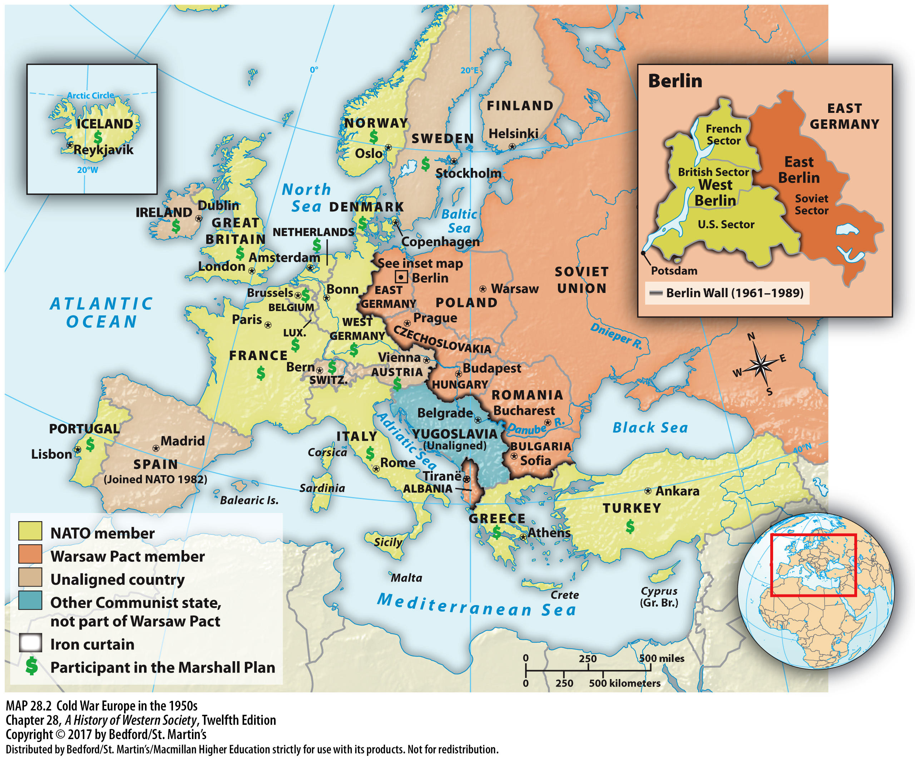

Slide 11
I. Postwar Europe and the Origins of the Cold War
Big Science in the Nuclear Age
1. Weapons for military and products for consumers
2. Expensive
3. Growing arms race
4. Science and engineering in the West
5. Sputnik
Notes:
I. Postwar Europe and the Origins of the Cold War
D. Big Science in the Nuclear Age
1. By combining theoretical work with sophisticated engineering in a large organization, Big Science could tackle extremely difficult problems, from new and improved weapons for the military to better products for consumers.
2. Big Science was extremely expensive, requiring large-scale financing from governments and large corporations.
3. A large portion of all postwar scientific research supported the growing arms race.
4. After 1945 roughly one-quarter of all men and women trained in science and engineering in the West—and perhaps more in the Soviet Union—were employed full-time in the production of weapons to kill other humans.
5. In 1957 the Soviets used long-range rockets developed in their nuclear weapons program to launch Sputnik, the first man-made satellite to orbit the earth, and in 1961 they sent the world’s first cosmonaut circling the globe.

Slide 12
I. Postwar Europe and the Origins of the Cold War
Big Science in the Nuclear Age
6. National Aeronautics and Space Administration (NASA)
7. ENIAC (Electronic Numerical Integrator and Computer)
8. Transistor
9. Agricultural research
Notes:
I. Postwar Europe and the Origins of the Cold War
D. Big Science in the Nuclear Age
6. Embarrassed by Soviet triumphs, the United States made an all-out commitment to catch up with the U.S.S.R., founding the National Aeronautics and Space Administration (NASA) in 1958 and landing a manned spacecraft on the moon in 1969, with four more moon landings by 1972.
7. The massive mainframe ENIAC (Electronic Numerical Integrator and Computer), built for the U.S. Army, went into operation in 1945.
8. The invention of the transistor in 1947 further advanced computer design, and by the 1960s sophisticated computers were indispensable tools for a variety of military, commercial, and scientific uses.
9. During the postwar green revolution, directed agricultural research greatly increased the world’s food supplies, as farming was industrialized and became more productive per acre.

Slide 13
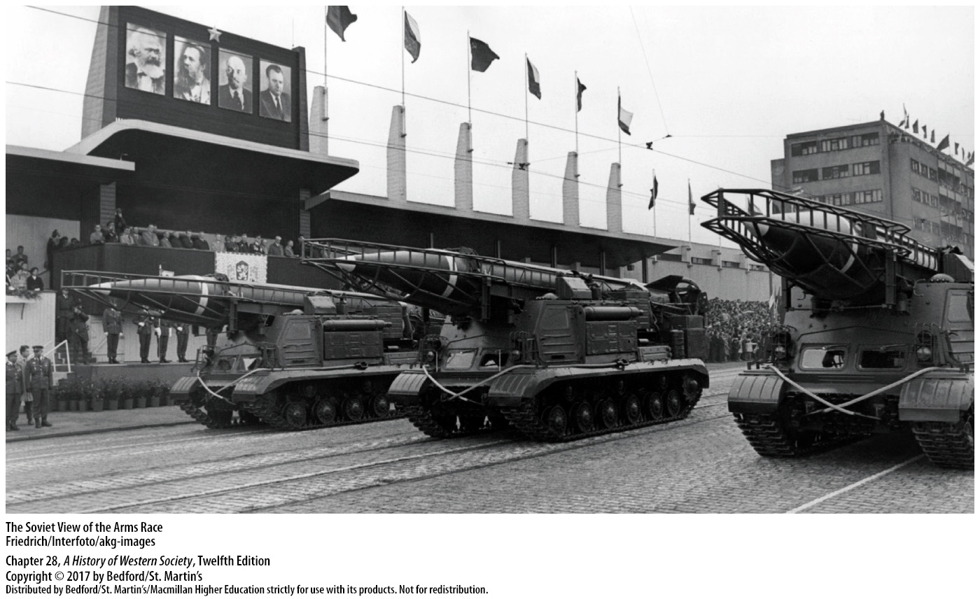

Slide 14
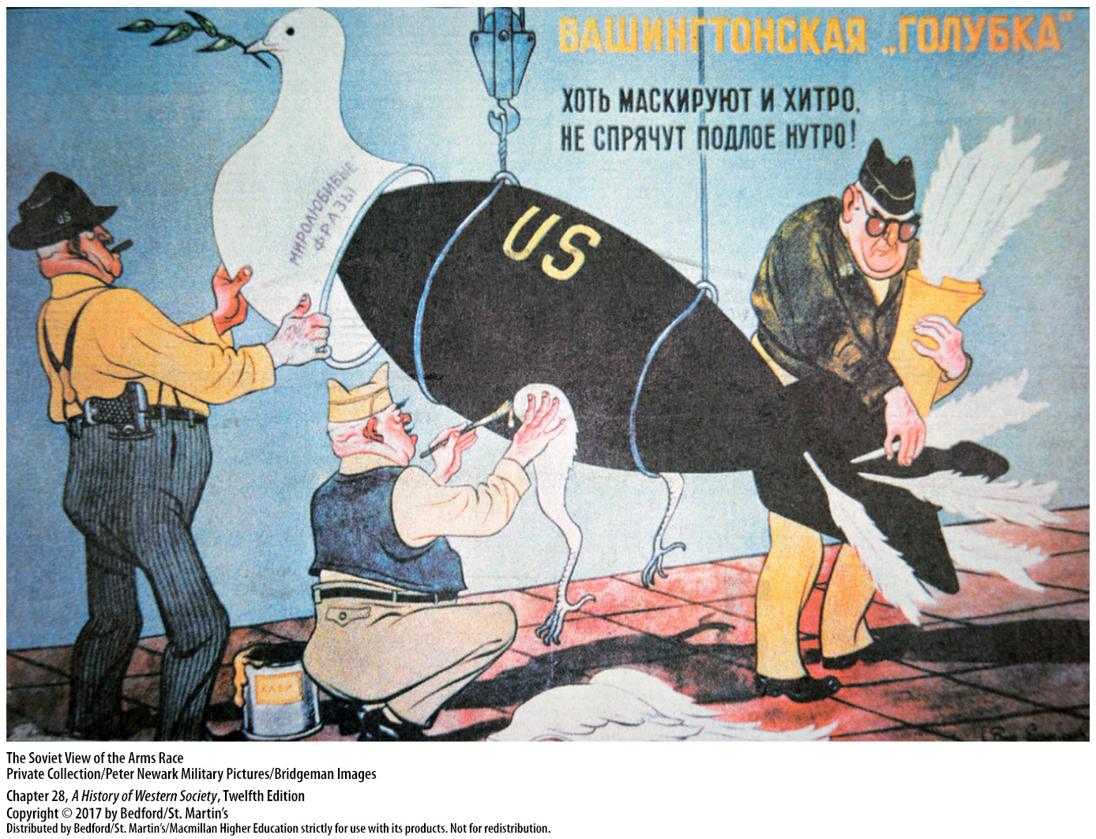

Slide 15
II. The Western Renaissance/ Recovery in Western Europe
The Search for Political and Social Consensus
1. New political and economic policies
2. Keynesian economics
3. Christian Democratic parties
4. Free-market economics
5. “Social-market economy”
6. Labour Party
7. Western European living standards
Notes:
II. The Western Renaissance/ Recovery in Western Europe
A. The Search for Political and Social Consensus
1. Determined to avoid a return to the dangerous and demoralizing stagnation of the 1930s, postwar governments in western Europe embraced new political and economic policies that led to a remarkably lasting social consensus.
2. They turned to liberal democracy and generally adopted Keynesian economics, applying an imaginative mixture of government planning and free-market capitalism to promote economic growth.
3. New European politicians emerged across the West, as newly formed Christian Democratic parties offered voters tired of radical politics a center-right vision of reconciliation and recovery.
4. Christian Democrats advocated free-market economics and promised voters prosperity and consumer goods; at the same time, they established education subsidies, family and housing allowances, public transportation, and public health insurance.
5. In France, state-controlled banks funded industrial development, while in West Germany, Christian Democrats promoted a “social-market economy” based on a combination of free-market liberalism, some state intervention, and an extensive social benefits network.
6. In Britain, the social-democratic Labour Party took power after the war and ambitiously established a “cradle-to-grave” welfare state, giving citizens free medical and hospital care and retirement pensions, and nationalized many industries.
7. Economic growth and state-sponsored welfare measures meant that by the early 1960s, western European living standards were higher than ever before.

Slide 16
II. The Western Renaissance/ Recovery in Western Europe
Toward European Unity
1. “European nation”
2. European integration
3. Bretton Woods
4. Organization for European Economic Cooperation (OEEC)
5. European Economic Community/Common Market
6. President Charles de Gaulle
Notes:
II. The Western Renaissance/ Recovery in Western Europe
B. Toward European Unity
1. Many European intellectuals believed that only a new “European nation” could effectively rebuild the continent and reassert its influence in world affairs.
2. A number of new financial arrangements and institutions encouraged slow but steady moves toward European integration, as did cooperation with the United States.
3. The Bretton Woods agreement of 1944 had already linked Western currencies to the U.S. dollar and established the International Monetary Fund and the World Bank to facilitate free markets and world trade.
4. The close cooperation among European states as required by the Americans to receive Marshall Plan aid led to the creation of the Organization for European Economic Cooperation (OEEC) and the Council of Europe in 1948, both of which promoted international commerce and cooperation.
5. In 1957 the six nations of the Coal and Steel Community signed the Treaty of Rome, which created the European Economic Community, or Common Market.
6. France took the lead when President Charles de Gaulle withdrew all French military forces from what he called an “American-controlled” NATO, developed France’s own nuclear weapons, and vetoed the scheduled advent of majority rule within the Common Market.

Slide 17
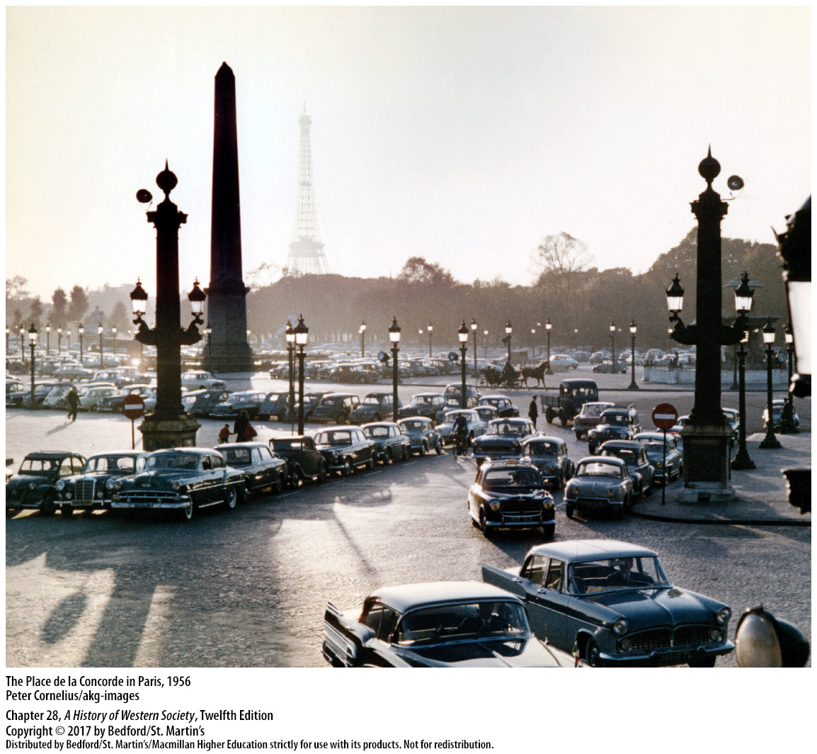

Slide 18
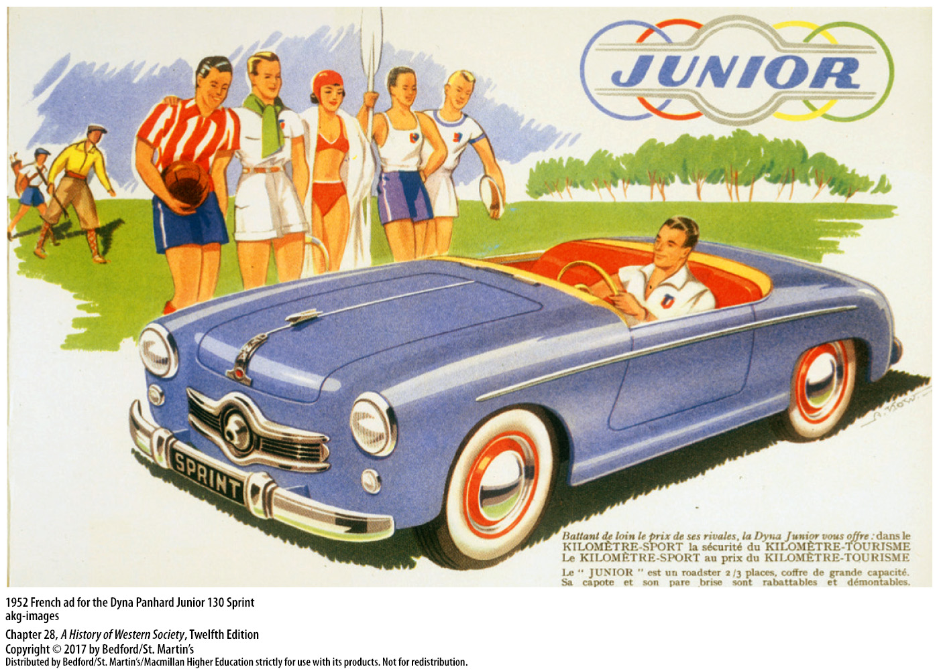

Slide 19
II. The Western Renaissance/ Recovery in Western Europe
The Consumer Revolution
1. Installment purchasing
2. Consumer market
3. Western capitalism surpassed Eastern planned economies
4. Standard of living race
Notes:
II. The Western Renaissance/ Recovery in Western Europe
C. The Consumer Revolution
1. The purchase of consumer goods was greatly facilitated by the increased use of installment purchasing, which allowed people to buy on credit; with the expansion of social security safeguards, ordinary people were increasingly willing to take on debt, and banks offered loans for consumer purchases on easy terms.
2. The consumer market became an increasingly important component of economic growth; for example, the European automobile industry expanded phenomenally as car ownership became possible for better-paid workers.
3. Western capitalism clearly surpassed Eastern planned economies in the production and distribution of inexpensive products, and Western leaders boasted about the arrival of prosperity and new forms of social equality based on equal access to consumer goods rather than forced class leveling.
4. The race to provide ordinary people with higher living standards would be a central aspect of the Cold War.

Slide 20
III. Developments in the Soviet Union and the East Bloc
Postwar Life in the East Bloc
1.“Great Patriotic War of the Fatherland”
2. Cominform
3. Te Soviet satellite states
4. One-party dictatorships subservient to Moscow
5. Five-year plans
Notes:
II. The Western Renaissance/ Recovery in Western Europe
A. Postwar Life in the East Bloc
1. The “Great Patriotic War of the Fatherland” had fostered Russian nationalism and a relaxation of dictatorial terror and produced a rare but real unity between Soviet rulers and most citizens.
2. Even before the war ended, however, Stalin was moving the U.S.S.R. back toward rigid dictatorship and establishing the Cominform to maintain control over Communist parties in Europe, using capitalism and the new foe, the United States, as excuses.
3. The Soviet satellite states, including East Germany, Poland, Hungary, Czechoslovakia, Romania, Albania, and Bulgaria, were remade on the Soviet model.
4. In those states, popular Communist leaders were ousted and national Communist parties established one-party dictatorships subservient to Moscow; state security services arrested, imprisoned, and sometimes executed dissenters, while show trials of supposedly disloyal Communists took place.
5. Within the East Bloc, Communist governments restructured economies along Soviet lines by introducing five-year plans and nationalizing most industries and businesses; their efforts transformed patterns of everyday life and laid the groundwork for industrial development.

Slide 21
III. Developments in the Soviet Union and the East Bloc
Postwar Life in the East Bloc
6. Priority on heavy industry
7. Collectivized agriculture
8. Production problems and shortages
9. Communist censors
Notes:
II. The Western Renaissance/ Recovery in Western Europe
A. Postwar Life in the East Bloc
6. Communist planners placed top priority on heavy industry and the military and neglected consumer goods and housing; they believed an overabundance of consumer goods created waste, encouraged rampant individualism, and led to social inequality.
7. Communist regimes also moved aggressively to collectivize agriculture, and by the early 1960s independent farmers had virtually disappeared in most of the East Bloc, with only Poland as the exception.
8. Throughout the 1950s, socialist planned economies often led to production problems and persistent shortages of basic household items.
9. Communist censors purged culture and art in aggressive campaigns that reimposed rigid anti-Western ideological conformity and required artists and writers to conform to the dictates of socialist realism, which idealized the working classes and the Soviet Union.

Slide 22
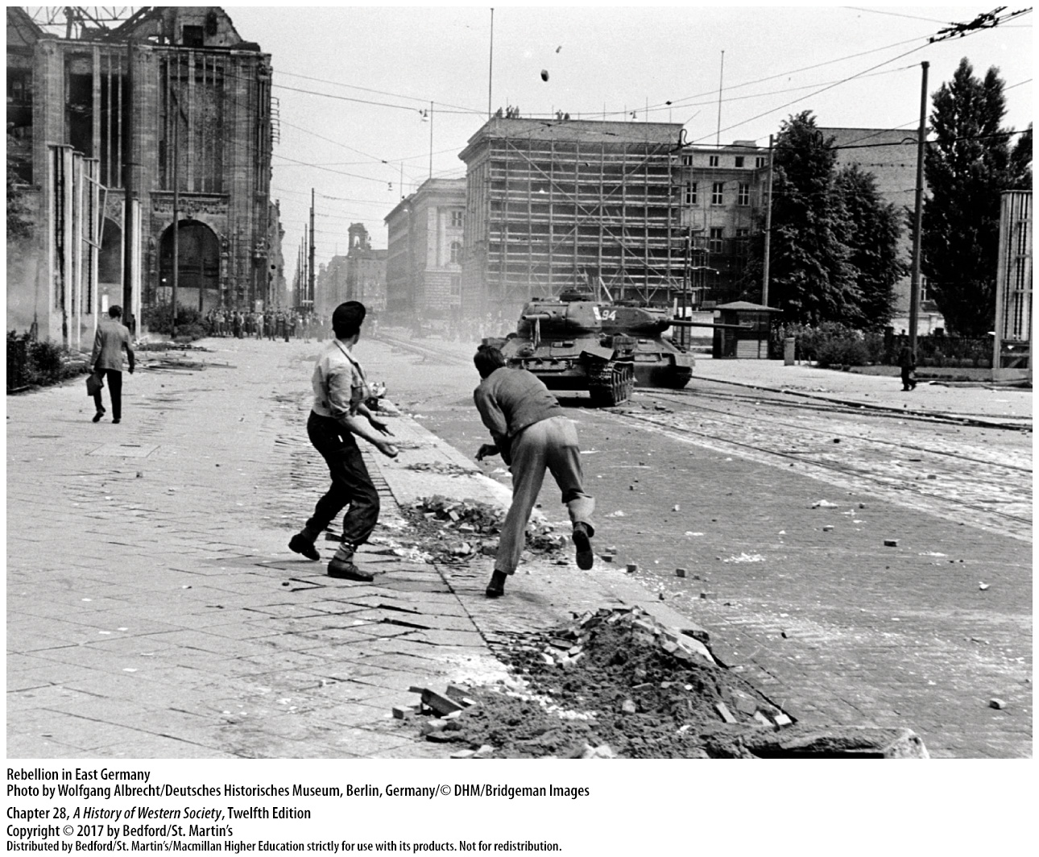

Slide 23
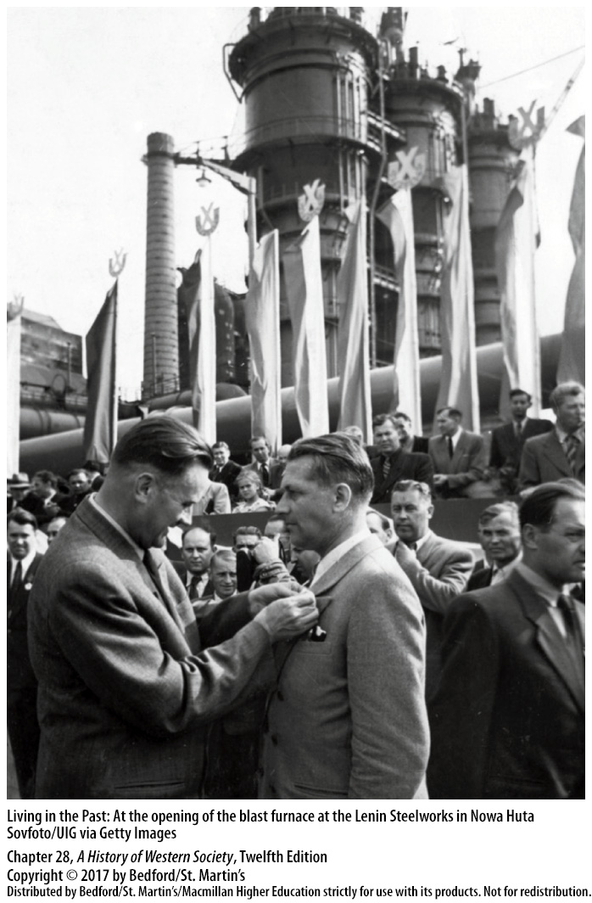

Slide 24
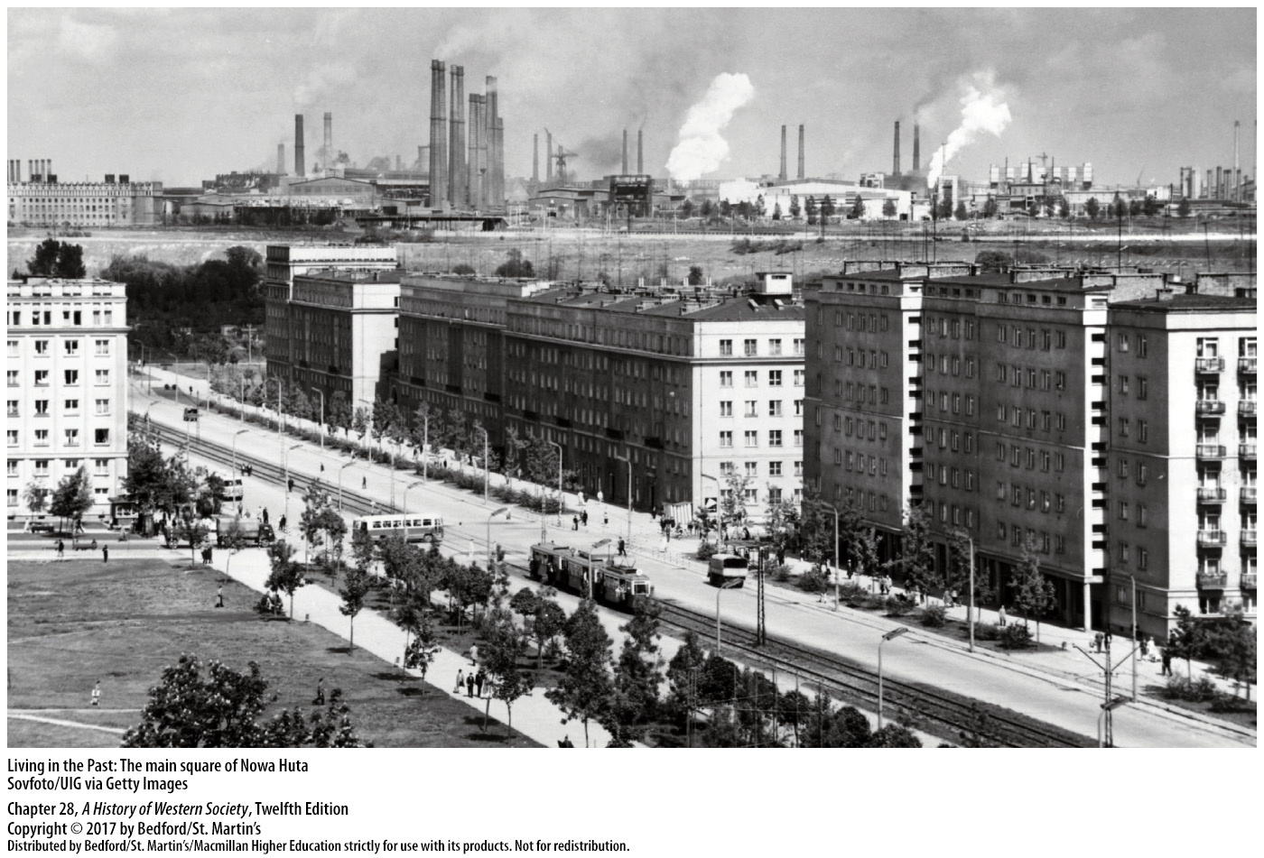

Slide 25
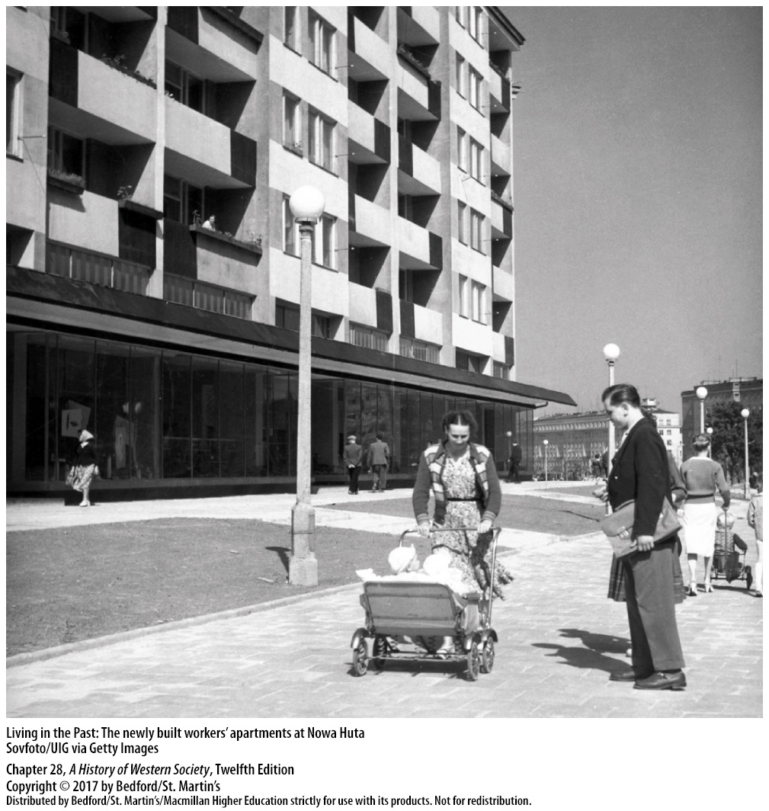

Slide 26
III. Developments in the Soviet Union and the East Bloc
Reform and De-Stalinization
1. Stalin’s successors
2. Khrushchev’s “secret speech”
3. De-Stalinization
4. “Peaceful coexistence”
5. Shifting resources
6. Boris Pasternak (1890–1960)
Notes:
III. Developments in the Soviet Union and the East Bloc
B. Reform and De-Stalinization
1. After Stalin died in 1953, his successors realized that reforms were necessary because of the widespread fear and hatred created by Stalin’s political terrorism. Changes included curbing the power of the secret police, closing forced-labor camps, spurring economic growth, and reconsidering Stalin’s belligerent foreign policy, which had led to a strong Western alliance that was isolating the Soviet Union.
2. To strengthen his position and that of his fellow reformers within the party, Khrushchev launched a surprising attack on Stalin and his crimes in a famous “secret speech” at a closed session of the Twentieth Party Congress in 1956. Khrushchev criticized Stalin’s “cult of personality,” his bungling of the country defense in World War II, and unjust imprisonment and torturing of thousands of loyal Communists.
3. The liberalization, or de-Stalinization, of the Soviet Union strengthened the reform movement; the party jealously maintained its monopoly on political power, but Khrushchev brought in new members.
4. Calling for a relaxation of tensions with the West, Khrushchev announced a policy of “peaceful coexistence.”
5. As state planners in the Soviet Union and East Bloc shifted resources from heavy industry and the military toward consumer goods and agriculture, the standard of living began to improve and a limited consumer revolution ensued.
6. In 1957 Boris Pasternak (1890–1960) finished his great novel Doctor Zhivago, a literary masterpiece and a powerful challenge to communism that was published in the West but not in the U.S.S.R. until 1988.

Slide 27
III. Developments in the Soviet Union and the East Bloc
Foreign Policy and Domestic Rebellion
1. Asia and Africa
2. Demonstrations in Poland
3. Hungarian prime minister Imre Nagy
4. Weakened support
5. Western leaders
Notes:
III. Developments in the Soviet Union and the East Bloc
C. Foreign Policy and Domestic Rebellion
1. At the same time, Khrushchev began wooing the new nations of Asia and Africa—even those that were not Communist—with promises of support and economic aid.
2. In 1956 extensive popular demonstrations in Poland brought a new government that argued there were “many roads to socialism” and managed to win greater autonomy from Soviet control.
3. When Hungarian prime minister Imre Nagy announced that Hungary would leave the Warsaw Pact, Soviet leaders ordered an invasion and crushed the revolution.
4. The outcome of the Hungarian uprising weakened support for Soviet-style communism in western Europe—for those who still believed in socialist equality, the brutal repression was deeply discouraging.
5. At the same time, Western leaders saw that the U.S.S.R. would use military force to defend its control of the East Bloc and realized that only open war—a price they felt was too high—had the potential to overturn Communist rule.

Slide 28
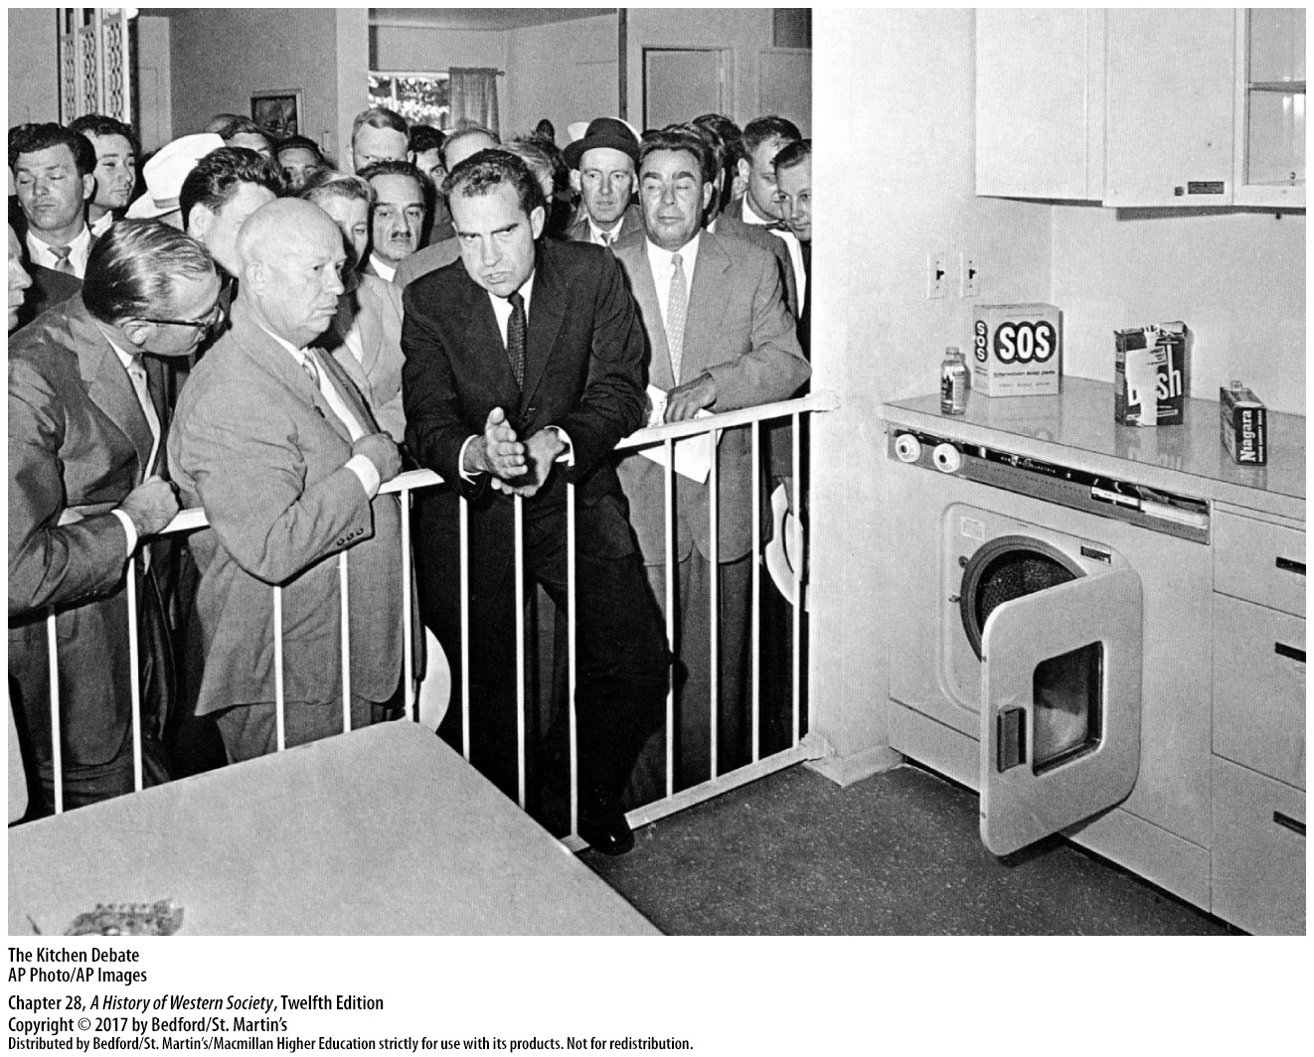

Slide 29
III. Developments in the Soviet Union and the East Bloc
The Limits of Reform
1. Opposition to Khrushchev
2. Berlin Wall
3. John F. Kennedy
4. Cuba
5. Leonid Brezhnev (1906–1982)
6. Massive arms buildup
Notes:
III. Developments in the Soviet Union and the East Bloc
D. The Limits of Reform
1. By late 1962 opposition to Khrushchev’s reformist policies had gained momentum, as his Communist colleagues began to see de-Stalinization as a dangerous threat to the authority of the party.
2. After failed attempts to staunch the flow of disgruntled East Germans to the West, in 1961 East German authorities built a wall between East and West Berlin, thereby sealing off West Berlin in clear violation of existing access agreements between the Great Powers.
3. The recently elected U.S. president John F. Kennedy (in office 1961–1963) insisted publicly that the United States would never abandon Berlin; hoping that the Berlin Wall would lessen Cold War tensions, Kennedy did little to prevent its construction.
4. Seeing a chance to change the balance of military power decisively, Premier Khrushchev ordered missiles with nuclear warheads installed in Fidel Castro’s Communist Cuba in 1962. President Kennedy countered with a naval blockade of Cuba, creating a tense diplomatic crisis until Khrushchev agreed to remove the Soviet missiles in return for American pledges not to disturb Castro’s regime.
5. Khrushchev’s influence in the party, already slipping, declined rapidly after the Cuban missile crisis, and he was replaced by Leonid Brezhnev (1906–1982) in a bloodless coup in 1964.
6. Soviet leaders, determined never to suffer Khrushchev’s humiliation in the face of American nuclear superiority, launched a massive arms buildup, yet proceeded cautiously in the mid-1960s and avoided direct confrontation with the United States.

Slide 30
IV. The End of Empires
Decolonization and the Global Cold War
1. Decolonization
2. Varied experiences
3. Rising demands
4. Effect of Japan
5. Rebuilding at home
6. Mao Zedong, Mohandas Ghandi, Frantz Fanon
7. Policy of nonalignment
Notes:
IV. The End of Empires
A. Decolonization and the Global Cold War
1. In the postwar era, Europe’s long-standing overseas expansion was dramatically reversed in a process that Europeans called decolonization; the retreat from imperial control remade the world map, as some one hundred new nations in Africa, Asia, and the Middle East joined the global community.
2. In some cases, decolonization proceeded relatively smoothly, with an orderly transition and little violence, while in others, colonized peoples won independence only after long and bloody struggles.
3. The most basic cause of imperial collapse was the rising demand of non-Western peoples for national self-determination, racial equality, and personal dignity.
4. Also, the Japanese had driven imperial rulers from large parts of East Asia during the war, shattering the myth of European superiority and invincibility; after Japan’s defeat, strong anticolonial nationalist movements re-emerged with new enthusiasm.
5. After the horrors of the First and Second World Wars, the economically weakened imperial powers preferred to avoid bloody colonial wars and concentrate on rebuilding at home.
6. Popular anticolonial politicians and intellectuals, including China’s Mao Zedong, India’s Mohandas Ghandi, and Frantz Fanon, provided determined leadership and trenchant critiques of imperial power, inspiring colonized peoples to resist and overturn imperial rule.
7. The leaders of many of the new nations adopted a policy of nonalignment, attempting to remain neutral in the Cold War and playing both sides for what they could get.

Slide 31
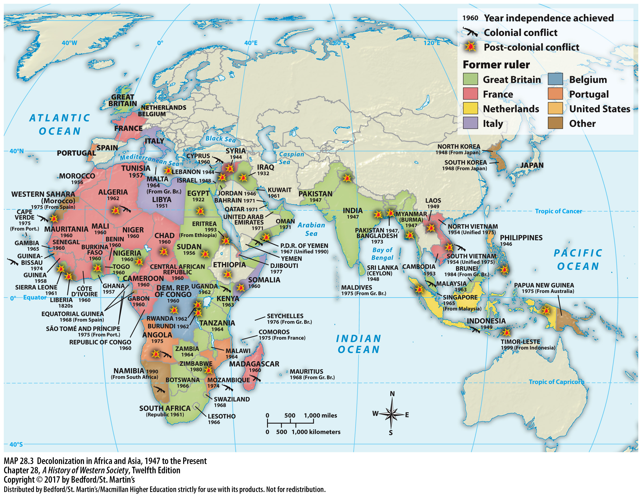

Slide 32
IV. The End of Empires
The Struggle for Power in Asia
1. Dutch East Indies
2. New Indonesian president
3. Combination of communism and anticolonialism
4. Ho Chi Minh (1890–1969)
5. Mohandas (“Mahatma”) Gandhi (1869–1948)
Notes:
IV. The End of Empires
B. The Struggle for Power in Asia
1. During the Second World War, the Japanese had overrun the archipelago of the Dutch East Indies (today’s Indonesia) and encouraged hopes for independence from Western control. When the Dutch returned after Japan’s defeat in 1945, they faced a determined group of rebels inspired by a powerful combination of nationalism, Marxism, and Islam. Four years of deadly guerrilla war followed, ending in 1949 when the Netherlands reluctantly accepted Indonesian independence.
2. The New Indonesian president became an effective advocate of nonalignment, maintaining close ties to the Indonesian Communist Party, but receiving aid from both the U.S. and the U.S.S.R.
3. A similar combination of communism and anticolonialism inspired the independence movement in French Indochina (now Vietnam, Cambodia, and Laos), though noncommunist nationalists were also involved.
4. France desperately wished to maintain control over these prized colonies, but the French army was defeated in 1954 by forces under the guerrilla leader Ho Chi Minh (1890–1969), who was supported by the U.S.S.R. and China; a shaky truce divided Vietnam into a Communist North and a pro-Western South Vietnam.
5. Nationalist opposition to British rule in India coalesced after the First World War under the leadership of British-educated lawyer Mohandas (“Mahatma”) Gandhi (1869–1948). In the 1920s and 1930s, Gandhi built a mass movement by preaching nonviolent “noncooperation” with the British, and in 1935 he wrested from the frustrated and unnerved British a new, liberal constitution that was practically a blueprint for independence.

Slide 33
IV. The End of Empires
The Struggle for Power in Asia
6. Lasting dilemma for South Asia
7. Prime Minister Jawaharlal Nehru
8. Chinese nationalism
9. China’s civil war
10. Mao and the Communists
Notes:
IV. The End of Empires
B. The Struggle for Power in Asia
6. Britain withdrew peacefully, but conflict between India’s Hindu majority and Muslim minority posed a lasting dilemma for South Asia.
7. Under the leadership of Prime Minister Jawaharlal Nehru, India became a liberal, if socialist-friendly, democratic state and successfully maintained a policy of nonalignment, dealing with both the United States and the Soviet Union.
8. Chinese nationalism developed and triumphed in the framework of Marxist-Leninist ideology.
9. After the withdrawal of the occupying Japanese army in 1945, China erupted again in open civil war between the authoritarian Guomindang (Kuomintang, or National People’s Party), led by Chiang Kai-shek (1887–1975), and the Chinese Communists, headed by Mao Zedong.
10. Mao and the Communists united China’s 550 million inhabitants in a strong centralized state, expelled foreigners, and began building a new society that adapted Marxism to Chinese conditions and brought Stalinist-style repression to the Chinese people.

Slide 34
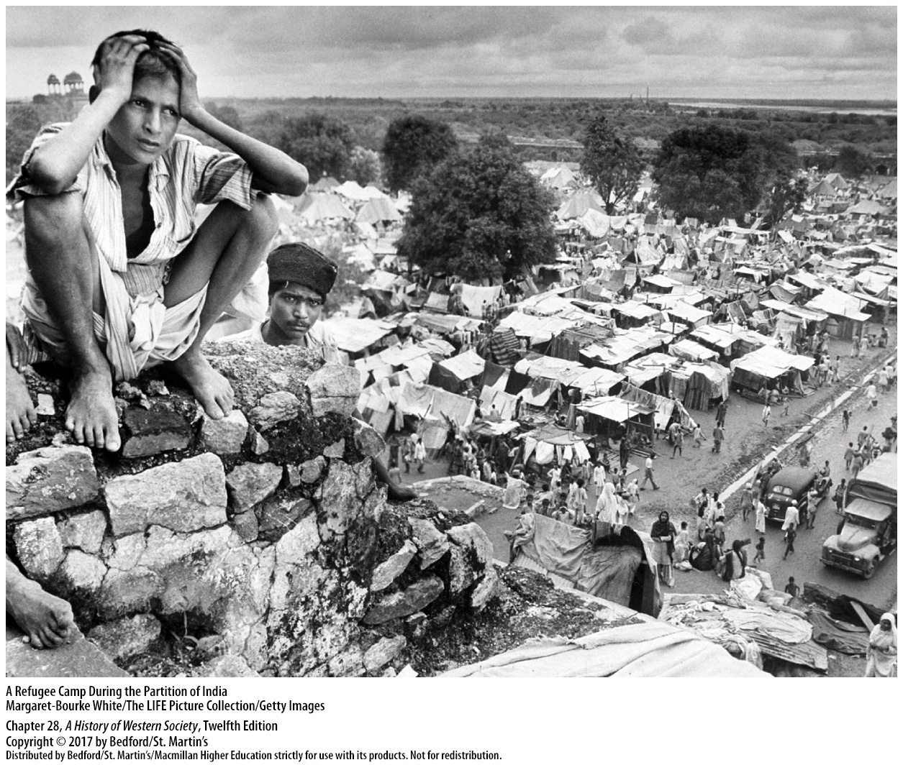

Slide 35
IV. The End of Empires
Independence and Conflict in the Middle East
1. Saudi Arabia and Transjordan
2. British rule and Palestine
3. State of Israel
4. Palestinians and the surrounding Arab nations
Notes:
IV. The End of Empires
C. Independence and Conflict in the Middle East
1. Saudi Arabia and Transjordan had already achieved independence from Britain.
2. The tenuous compromise that had established a Jewish homeland alongside the Arab population in the British mandate of Palestine unraveled after World War II, with neither Jews nor Arabs happy with British rule. In 1947 the frustrated British decided to leave Palestine, and the United Nations voted in a nonbinding resolution to divide the territory into two states—one Arab and one Jewish.
3. The Jews accepted the plan and founded the state of Israel in 1948.
4. The Palestinians and the surrounding Arab nations viewed Jewish independence as a betrayal of their own interests, and they attacked the Jewish state as soon as it was proclaimed.

Slide 36
IV. The End of Empires
Independence and Conflict in the Middle East
5. Persistent refugee problem
6. Gamal Abdel Nasser (1918–1970)
7. Suez Canal Company
8. Israeli army invades the Sinai Peninsula
Notes:
IV. The End of Empires
C. Independence and Conflict in the Middle East
5. The Israelis drove off the invaders and conquered more territory, and roughly 900,000 Arab Palestinians fled or were expelled from their homes, creating a persistent refugee problem.
6. The Arab defeat in 1948 triggered a powerful nationalist revolution in Egypt in 1952, led by the young army officer Gamal Abdel Nasser (1918–1970), who became president of an independent Egyptian republic after revolutionaries drove out the pro-Western king.
7. In July 1956 Nasser abruptly nationalized the foreign-owned Suez Canal Company; the resulting Suez crisis showed that the European powers could no longer maintain their global empires.
8. The Israeli army invaded the Sinai Peninsula bordering the canal, and British and French bombers attacked Egyptian airfields, but the United States—fearing that such a blatant show of imperialism would propel the Arab states into the Soviet bloc—joined with the Soviets to force the British, French, and Israelis to back down.

Slide 37
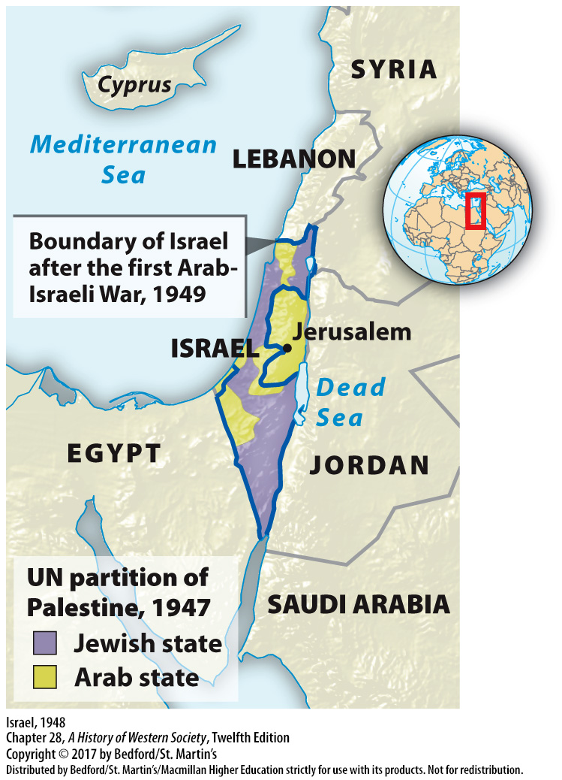

Slide 38
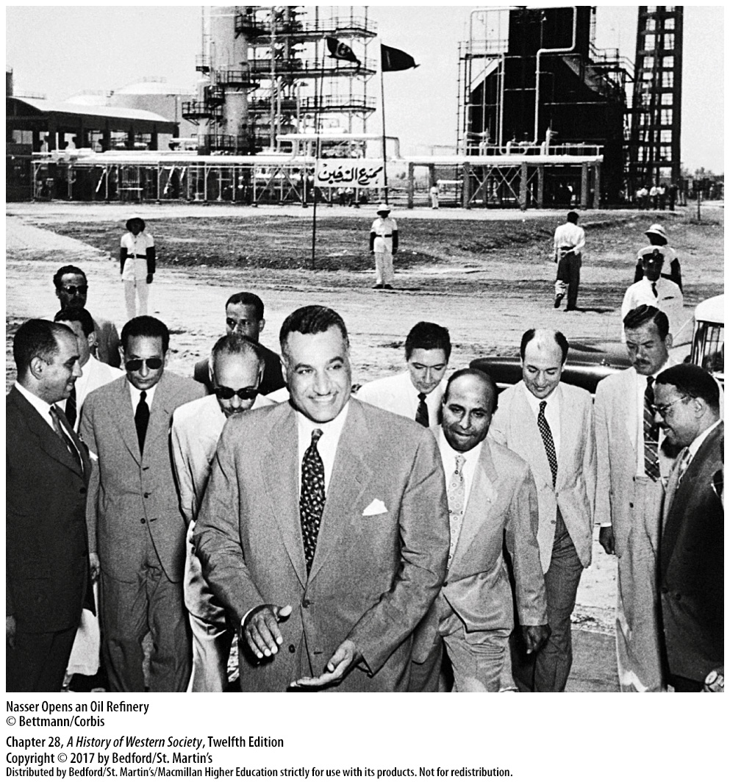

Slide 39
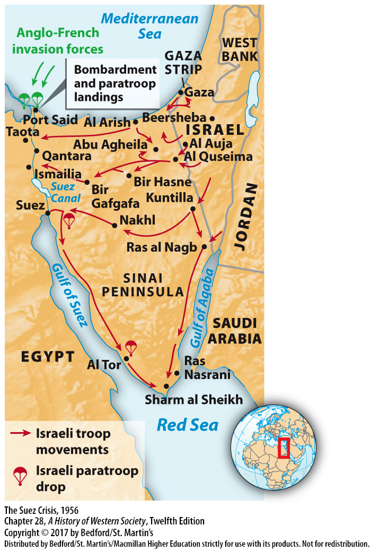

Slide 40
IV. The End of Empires
Decolonization in Africa
1. Independence with little or no bloodshed
2. Kenya and the Mau Mau rebellion
3. Apartheid
4. Belgian Congo and Patrice Lumumba
5. U.S.-backed dictatorship under Joseph Mobutu
Notes:
IV. The End of Empires
D. Decolonization in Africa
1. Starting in 1957 most of Britain’s African colonies—including Ghana, Nigeria, and Tanzania—achieved independence with little or no bloodshed and then entered a very loose association with Britain as members of the British Commonwealth.
2. In Kenya in the early 1950s, however, British forces brutally crushed the Mau Mau rebellion, but nonetheless recognized Kenyan independence in 1963.
3. In the former British colony of South Africa, the white-dominated government left the Commonwealth in 1961 and declared an independent republic in order to preserve apartheid—an exploitative system of racial segregation enforced by law.
4. An anticolonial movement in the Belgian Congo grew increasingly aggressive in the late 1950s under the leadership of Patrice Lumumba.
5. Worried that the new nation might fall into Soviet hands, U.S. leaders cast Lumumba as a Soviet proxy; the CIA helped implement a military coup against Lumumba, who was captured and assassinated, and set up a U.S.-backed dictatorship under the corrupt general Joseph Mobutu, who ruled until 1997.

Slide 41
IV. The End of Empires
Decolonization in Africa
6. French commonwealth
7. National Liberation Front (FLN)
8. Algerian war
9. General Charles de Gaulle
10. Neocolonialism
Notes:
IV. The End of Empires
D. Decolonization in Africa
6. Like the British, the French offered most of their African colonies the choice of a total break with France or independence within a kind of French commonwealth; all but one of the new states chose the latter option.
7. Things were more difficult in the French colony of Algeria, a large Muslim state on the Mediterranean Sea where some 800,000 French settlers had taken up permanent residency by the 1950s. These Pied-Noirs (“black feet”) pressured the French government to help ensure their long-established and privileged positions when Algerian rebels, inspired by Islamic fundamentalism and Communist ideals, formed the National Liberation Front (FLN) and revolted against French colonialism in the early 1950s.
8. In response, France sent some 400,000 troops to crush the FLN and put down the revolt, resulting in a long and bloody war marked by atrocities that lasted from 1954 to 1962. News reports of systematic torture and attacks on civilians by the French army turned French public opinion, and indeed the government, against the Algerian war.
9. The immensely popular General Charles de Gaulle was reinstated as French prime minister, and pragmatically accepted Algerian self-determination. He ended the conflict by granting Algeria independence.
10. Even after decolonization, western European countries managed to increase their economic and cultural ties with their former African colonies in what some called a system of neocolonialism that perpetuated Western economic domination and undermined independence.

Slide 42
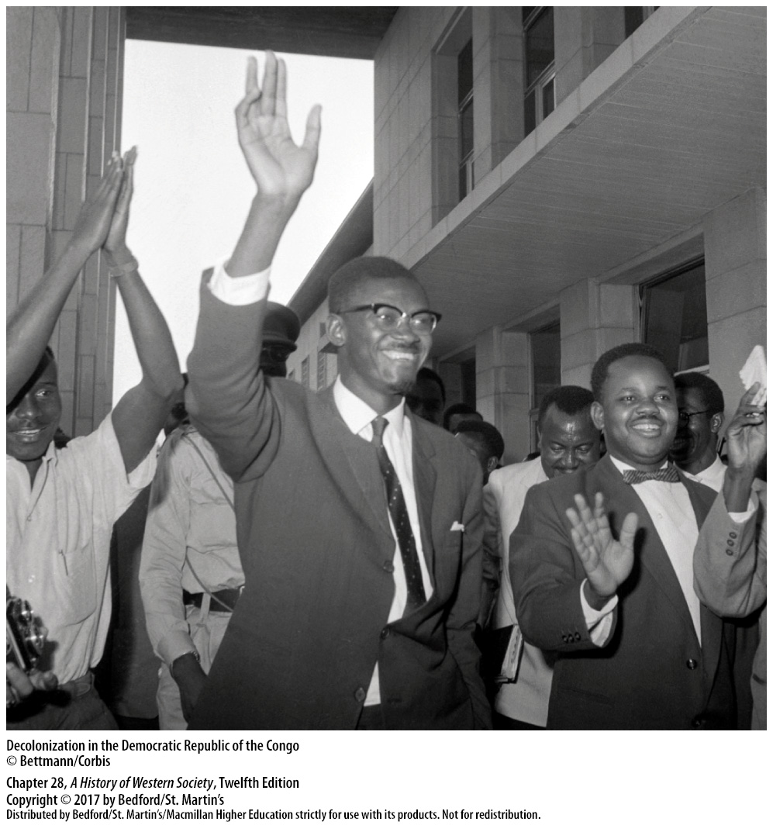

Slide 43
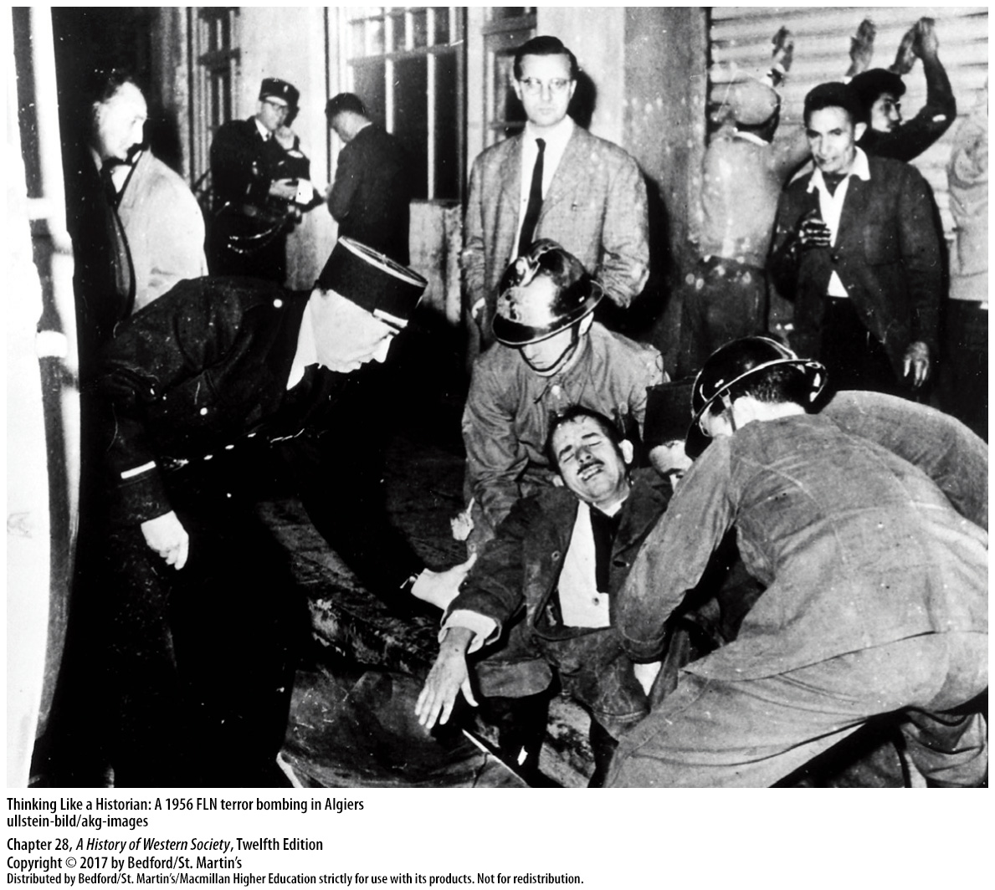

Slide 44
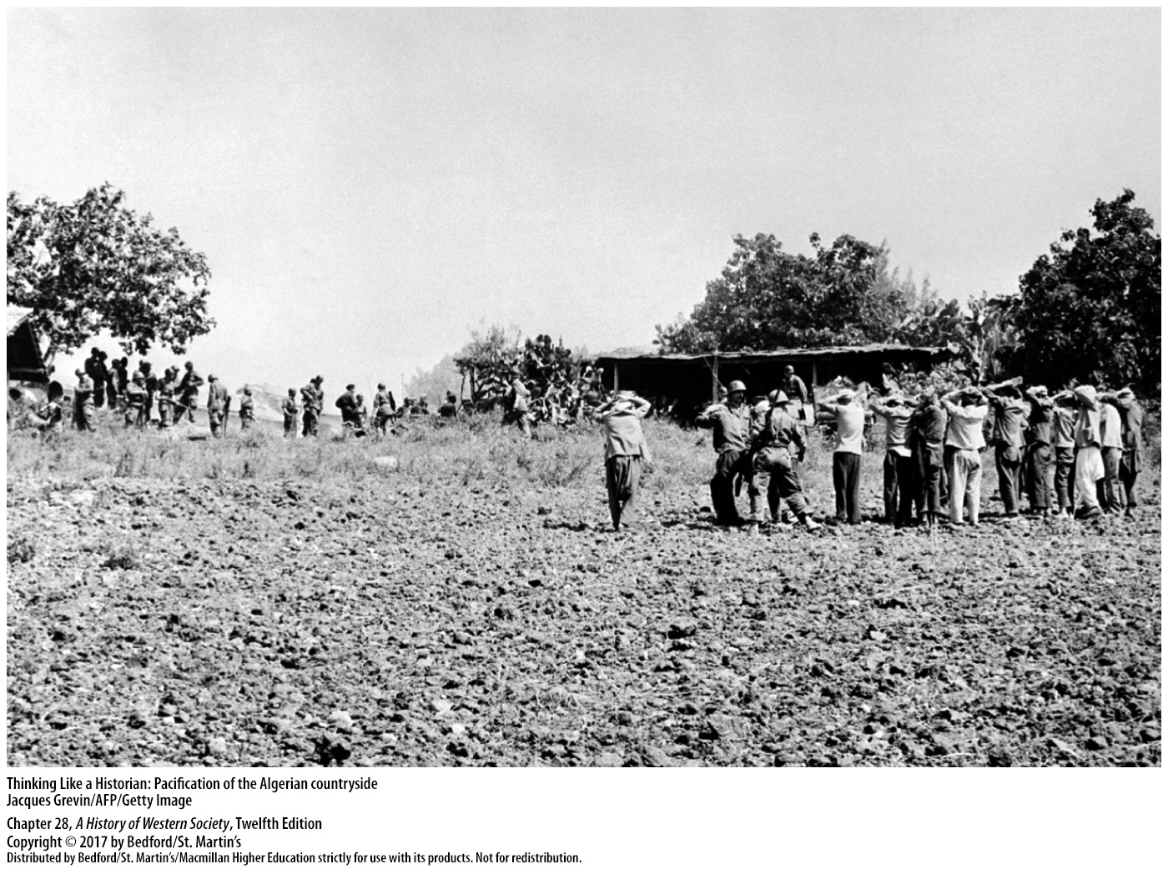

Slide 45
V. Postwar Social Transformations
Changing Class Structures
1. White-collar workers
2. Rapid industrial expansion
3. Nationalization of industry
4. Communist Party members
5. Middle class
Notes:
V. Postwar Social Transformations
A. Changing Class Structures
1. A new breed of managers and experts—so-called white-collar workers—replaced property owners as the leaders of the middle class because the ability to serve the needs of a big organization largely replaced inherited property and family connections in determining social position.
2. Rapid industrial and technological expansion and the consolidation of businesses created a powerful demand for technologists and managers in large corporations and government agencies.
3. In the Communist states of the East Bloc, the nationalization of industry, expropriation of property, and aggressive attempts to open employment opportunities to workers and equalize wage structures effectively reduced class differences.
4. Communist Party members typically received better jobs and more pay than nonmembers, but by the 1960s the income gap between the top and bottom strata of East Bloc societies was far smaller than in the West.
5. In general, better-educated and more-specialized European workers bore a greater resemblance to the growing middle class of salaried specialists than to traditional industrial workers.

Slide 46
V. Postwar Social Transformations
Patterns of Postwar Migration
1. Prospects in the city
2. Forced collectivization
3. Across national borders
4. “Guest workers”
5. Postcolonial migration
6. Anti-immigrant views
Notes:
V. Postwar Social Transformations
B. Patterns of Postwar Migration
1. Some migration occurred within countries, as declining job prospects in Europe’s rural areas encouraged many peasants and small farmers to seek better prospects in the city.
2. In the East Bloc, forced collectivization of agriculture and state subsidies for heavy industry opened opportunities in urban areas.
3. Many other Europeans moved across national borders seeking work; the general pattern was south to north, as workers from less developed countries like Italy, Spain, and socialist Yugoslavia moved to the industrialized north, particularly to West Germany.
4. Most “guest workers” were young, unskilled single men who worked for low wages in entry-level jobs and sent much of their pay to their families at home. Governments had planned for these guest workers to return to their home countries after a specified period, but many chose to live permanently in their adoptive countries.
5. Europe also was changed by postcolonial migration—people from the former colonies, who could often claim citizenship rights from their former European colonizers, moved spontaneously to Europe.
6. Though immigrant labor fueled economic recovery, and growing ethnic diversity changed the face of Europe and enriched the cultural life of the continent, the new residents were not always welcome.

Slide 47
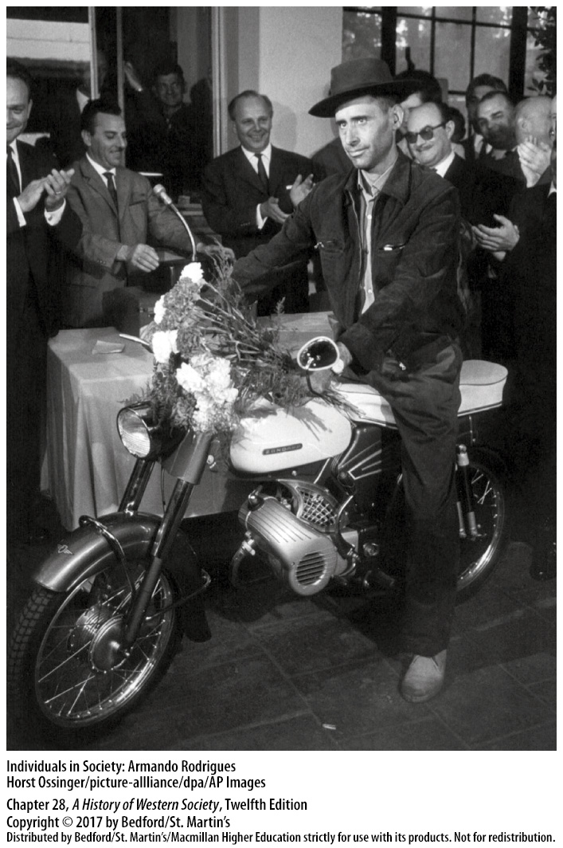

Slide 48
V. Postwar Social Transformations
New Roles for Women
1. Pregnancy and child care
2. Postwar education revolution
3. East Bloc opened up numerous jobs to women
4. Married women workers faced discrimination
5. Part-time work
6. Married working women still carried most responsibilities
7. Movements for women’s equality
Notes:
V. Postwar Social Transformations
C. New Roles for Women
1. Pregnancy and child care occupied a much smaller portion of a woman’s life than in earlier times; by the early 1970s, about half of Western women were having their last baby by the age of twenty-six or twenty-seven.
2. Young women shared fully in the postwar education revolution and could take advantage of the growing need for office workers and well-trained professionals.
3. In the East Bloc, Communist leaders opened up numerous jobs to women, as many women made their way into previously male professions, such as factory work, medicine, and engineering.
4. Married women workers faced widespread and long-established discrimination in pay, advancement, and occupational choice in comparison to men.
5. Many women could find only part-time work, which as the divorce rate rose in the 1960s, often meant poverty for many women with children.
6. Married working women in both the East and West still carried most of the child-rearing and housekeeping responsibilities; women bearing this exhausting “double burden” struggled to live up to society’s seemingly contradictory ideals.
7. The injustices that wage-earning women encountered contributed greatly to the movements for women’s equality and emancipation that arose in the United States and western Europe in the 1960s.

Slide 49
V. Postwar Social Transformations
Youth Culture and the Generation Gap
1. Baby boomers and the “generation gap”
2. American jazz and rock ’n’ roll
3. “Teenagers”
4. Higher education enrollments skyrocketed
5. Rapid expansion of higher education
6. Counterculture
Notes:
V. Postwar Social Transformations
D. Youth Culture and the Generation Gap
1. The postwar baby boomers of western Europe and the United States created an international youth subculture rooted in fashion and musical tastes that set them apart from their elders and fueled anxious comments about a growing “generation gap.”
2. American jazz and rock ’n’ roll spread rapidly in western Europe, aided by the invention of the long-playing record album (or LP) and the 45 rpm “single” in the late 1940s and by the growth of the corporate music industry.
3. Postwar prosperity gave “teenagers” money to spend, and marketing experts and manufacturers quickly and consciously targeted the youth market with an array of advertisements and products.
4. As government subsidies made higher education more affordable to ordinary people, enrollments skyrocketed, particularly in western Europe.
5. The rapid expansion of higher education opened new opportunities for the middle and lower classes, but it also made for overcrowded classrooms and left many students with the feeling that they were not getting the kind of education they needed for jobs in the modern world. At the same time, some reflective students feared that universities were doing nothing but turning out docile technocrats both to stock and to serve “the establishment.”
6. Thus it was no coincidence that students became leaders in a counterculture that attacked the ideals of the affluent postwar society and shocked the West in the late 1960s.

Slide 50
