Slide 1
A History of Western Society Twelfth Edition
McKay • Crowston • Wiesner-Hanks • Perry
CHAPTER 27
Dictatorships and the Second World War
1919–1945
Copyright © 2017 by Bedford/St. Martin’s
Distributed by Bedford/St. Martin's/Macmillan Higher Education strictly for use with its products; Not for redistribution.

Slide 2
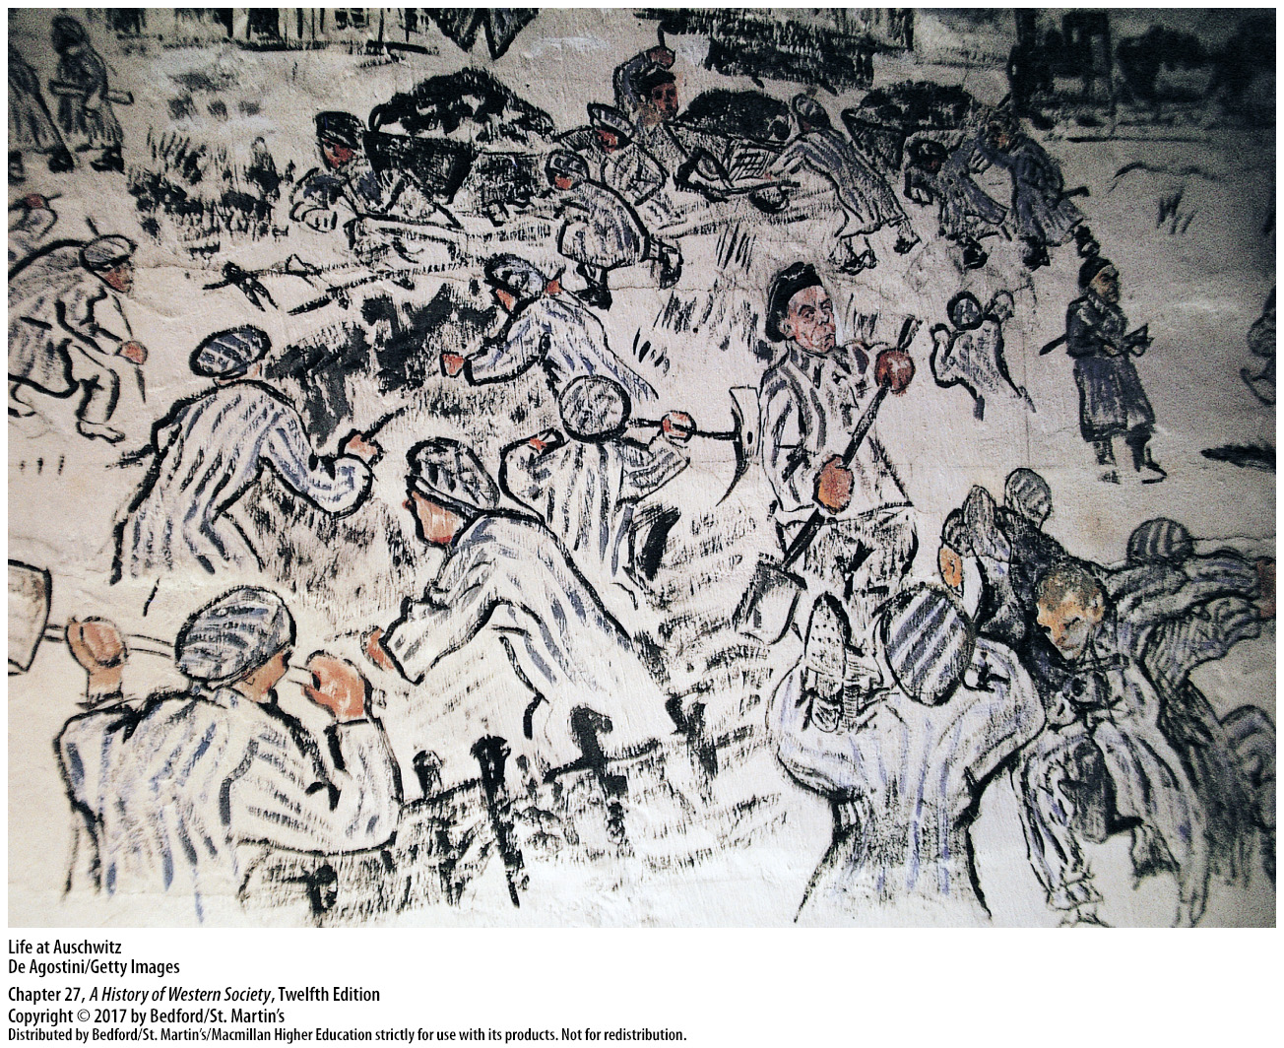

Slide 3
I. Authoritarian States
Conservative Authoritarianism and Radical Totalitarian Dictatorships
1. Conservative authoritarianism
2. Communist and Fascist parties well established in all major European nations
3. Totalitarianism
4. One-party political systems
5. Charismatic leader
6. Censorship and propaganda campaigns
Notes:
I. Authoritarian States
A. Conservative Authoritarianism and Radical Totalitarian Dictatorships
1. The traditional form of antidemocratic government in European history was conservative authoritarianism; the leaders of such governments relied on obedient bureaucracies in their efforts to control society. After the First World War, new kinds of radical dictatorship that went much further than conservative authoritarianism emerged in the Soviet Union, Germany, and Italy.
2. Communist and Fascist parties also became well established in all major European nations.
3. Some scholars use the term totalitarianism to describe these radical dictatorships, which made unprecedented “total claims” on the beliefs and behavior of their citizens and used violent political repression and intense propaganda to gain complete power. In addition, the state tried to dominate the economic, social, intellectual, and cultural aspects of people’s lives.
4. Communist and Fascist dictatorships built one-party political systems and rejected parliamentary government and liberal values, believing that liberal individualism undermined equality and unity.
5. A charismatic leader typically dominated the totalitarian state—Stalin in the Soviet Union, Mussolini in Italy, Hitler in Germany—and used force and terror to intimidate and destroy political opponents, while pursuing policies of expansion to exploit other lands.
6. They censored the mass media, instituted propaganda campaigns to advance their goals, and engaged in massive projects of state-controlled social engineering dedicated to replacing individualism with a unified “people” capable of exercising the collective will.

Slide 4
I. Authoritarian States
Communism and Fascism
1. Soviet Communists strove for radical social equality
2. Fascist leaders thought of the nation as the highest embodiment of the people
3. Differed over the question of race
4. Nazis and eugenics
5. The “gray zone” of moral compromise
Notes:
I. Authoritarian States
B. Communism and Fascism
1. Following Marx, Soviet Communists strove to create an international brotherhood of workers in which economic exploitation would disappear and society would be based on radical social equality. In pursuit of this social leveling, the Stalinist state used brute force to destroy the upper and middle classes, nationalize private property, push rapid industrialization, and collectivized agriculture.
2. For leaders such as Mussolini and Hitler who embraced fascism, the nation was the highest embodiment of the people, and the powerful leader was supposedly the materialization of the people’s collective will. Fascist governments intervened in the economy, but unlike Communist regimes, they did not try to level out class differences or nationalize private property.
3. Communists and Fascists also differed over the question of race: Communists sought to build a new world around the destruction of class differences, while Fascists typically endeavored to build a new national community grounded in racial homogeneity.
4. Adopting the doctrine of eugenics, a pseudoscience based on the idea that the selective breeding of human beings could improve the general characteristics of a national population, the Nazis believed that the German nation had to be “purified” of people they deemed “unfit.”
5. Questions about the ways in which their dictatorial regimes generated popular consensus lead toward what Primo Levi called the “gray zone” of moral compromise which defined everyday life in Nazi Germany and the Soviet Union.

Slide 5
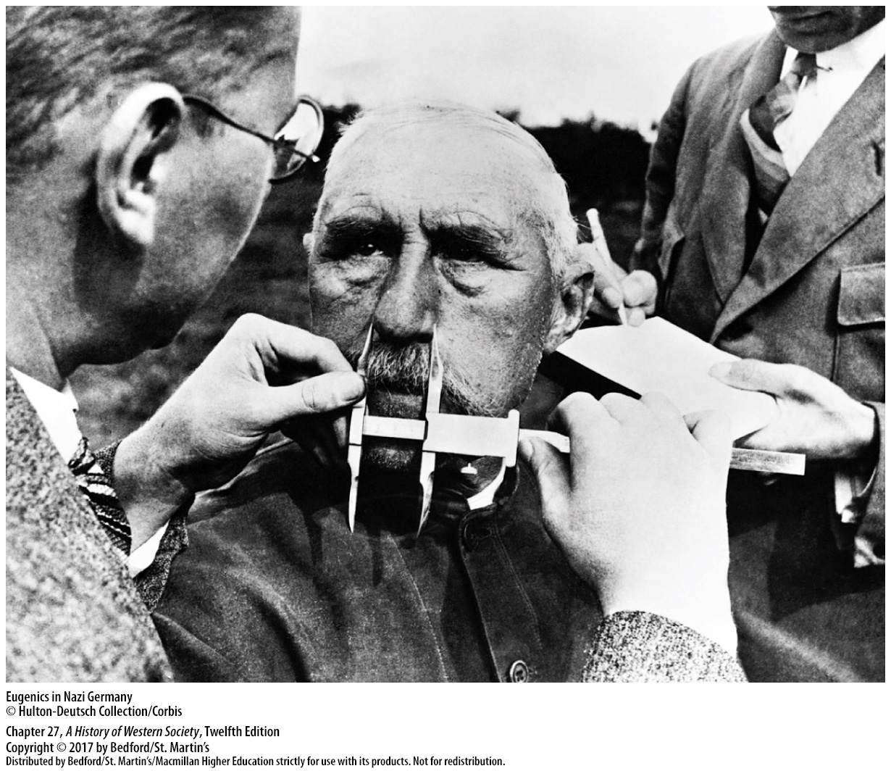

Slide 6
II. Stalin’s Soviet Union
From Lenin to Stalin
1. New Economic Policy (NEP)
2. Rapid economic recovery
3. Joseph Stalin vs Leon Trotsky
4. “Socialism in one country” vs “permanent revolution”
Notes:
II. Stalin’s Soviet Union
A. From Lenin to Stalin
1. In the face of economic disintegration, riots by peasants and workers, and open rebellion, Lenin changed course and replaced War Communism with the New Economic Policy (NEP), which re-established limited economic freedom in an attempt to rebuild agriculture and industry. The NEP was a political and economic success, a necessary but temporary compromise with the Soviet Union’s overwhelming peasant majority that allowed peasant producers to sell their surpluses in free markets.
2. The NEP brought rapid economic recovery, and by 1926 industrial output surpassed, and agricultural output almost equaled, prewar levels.
3. The principal contenders to replace Lenin were Joseph Stalin, a good organizer but a poor speaker and writer, and Leon Trotsky, a great and inspiring leader who had planned the 1917 Bolshevik takeover and then created the Red Army. Even though Trotsky appeared to have all the advantages, Stalin triumphed because he was more effective at using his position as general secretary of the party’s Central Committee to win friends and allies with jobs and promises.
4. Stalin also won because he was better able to relate Marxist teaching to Soviet realities in the 1920s, developing a theory of “socialism in one country” that was more appealing to the majority of party members than Trotsky’s doctrine of “permanent revolution.” Stalin’s willingness to break with the NEP and “build socialism” at home appealed to young party militants, who detested the capitalist-appearing NEP.

Slide 7
II. Stalin’s Soviet Union
From Lenin to Stalin
5. Vast multiethnic territories
6. Union of Soviet Socialist Republics (U.S.S.R.)
7. Centralized Russian control
8. Party congress condemned all “deviation from the general party line”
Notes:
II. Stalin’s Soviet Union
A. From Lenin to Stalin
5. The Communists had inherited the vast multiethnic territories of the former Russian empire, and Lenin had initially argued that these ethnic groups should have the right to self-determination.
6. Reflecting this concept, the Union of Soviet Socialist Republics (U.S.S.R.) was organized in 1922 as a federation of four Soviet republics.
7. In contrast to Lenin, Stalin argued for more centralized Russian control of these ethnic regions and granted the non-Russian republics some cultural independence but no real political autonomy, thus establishing a far-flung Communist empire.
8. His final triumph came in December 1927, when the party congress condemned all “deviation from the general party line”; Stalin and his followers were then ready to launch the revolution from above, radically changing the lives of millions of ordinary Russians.

Slide 8
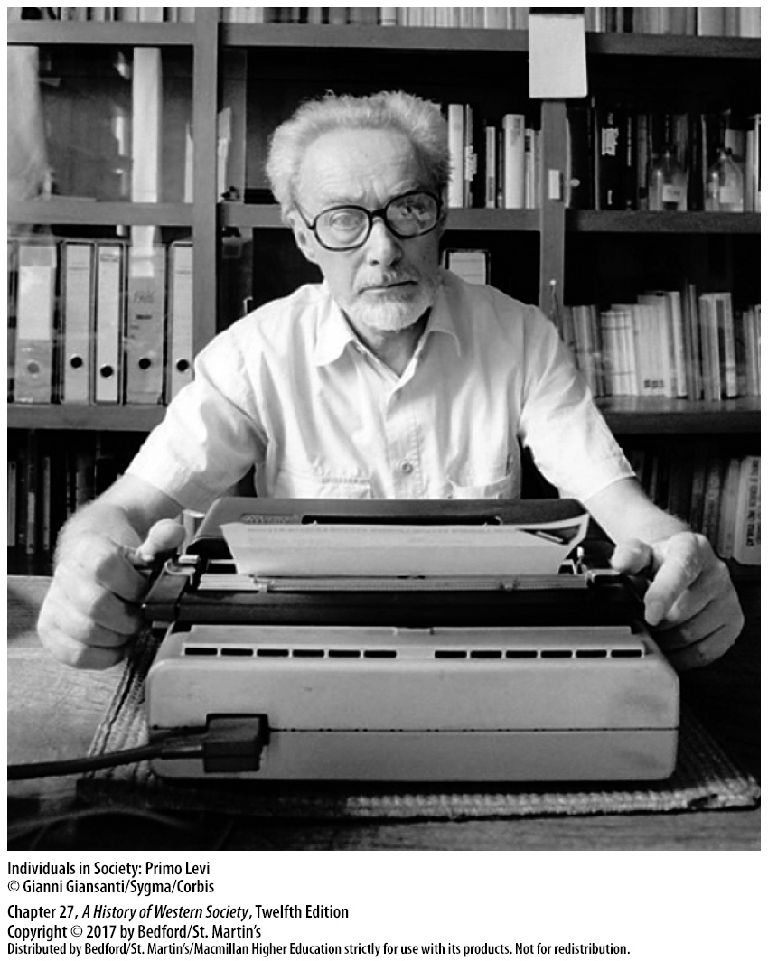

Slide 9
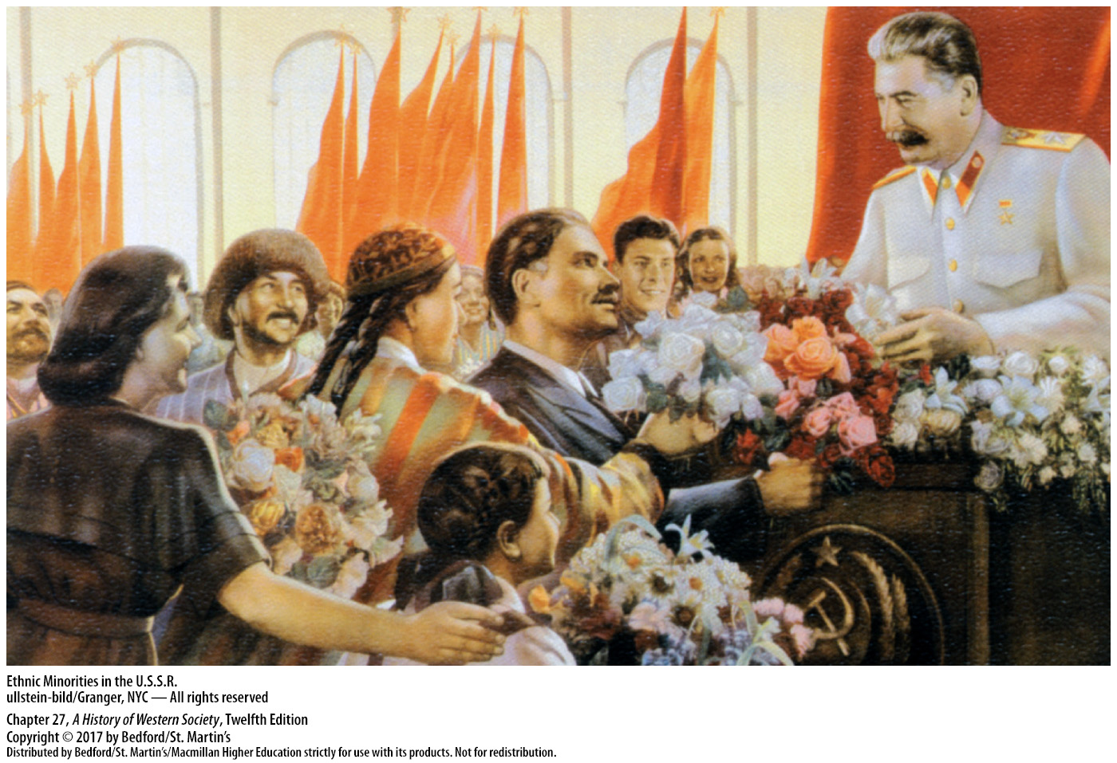

Slide 10
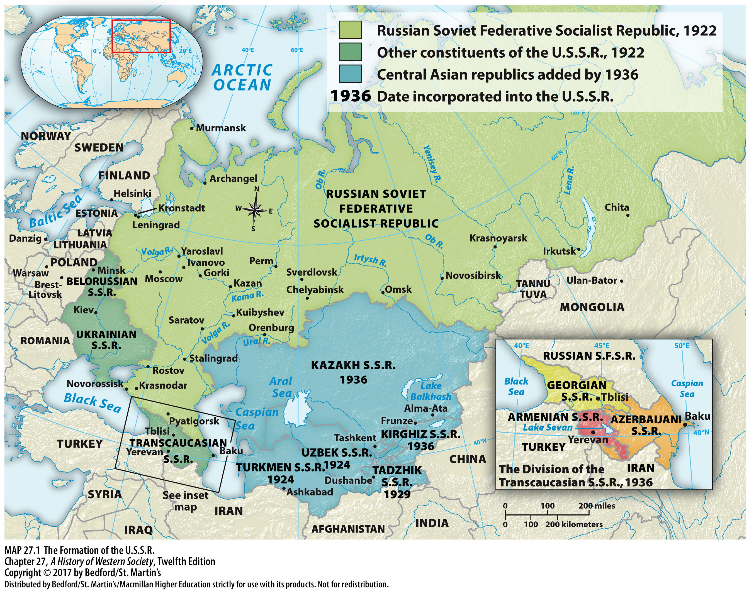

Slide 11
II. Stalin’s Soviet Union
The Five-Year Plans
1. Objectives of the first five-year plan
2. Pressed for rapid economic development
3. Stalin ordered the collectivization of agriculture
4. Forced collectivization led to disaster
5. Collectivization in the Ukraine
Notes:
II. Stalin’s Soviet Union
B. The Five-Year Plans
1. The first five-year plan had staggering economic objectives: in just five years, total industrial output was to increase by 250 percent, agricultural production was slated to increase by 150 percent, and one-fifth of the peasants were to give up their private plots and join collective farms.
2. Stalin also pressed for rapid economic development in the belief that it would allow the U.S.S.R. to catch up with the West and, thus, overcome traditional Russian “backwardness.”
3. In 1929 Stalin ordered the collectivization of agriculture—the forced consolidation of individual peasant farms into large, state-controlled enterprises, partly to keep peasants from embracing conservative capitalism and posing a threat to the regime and partly to generate the enormous sums needed for all-out industrialization.
4. Forced collectivization led to disaster, as large numbers of peasants slaughtered their animals and burned their crops rather than turn them over to state commissars.
5. Collectivization in the Ukraine was more rapid and violent and snowballed into an assault on Ukrainians in general, who had sought independence after the First World War, resulting in a man-made famine in 1932 and 1933 that claimed between 3 and 3.5 million lives.

Slide 12
II. Stalin’s Soviet Union
The Five-Year Plans
6. Cruel but real victory
7. Rapid industrialization was successful
8. Industrial labor force
9. Urban development
Notes:
II. Stalin’s Soviet Union
B. The Five-Year Plans
6. Collectivization was a cruel but real victory for Stalinist ideologues; though millions died, by the end of 1938, 93 percent of peasant households had been herded onto collective farms, effectively neutralizing them as a political threat.
7. Rapid industrialization mandated by the five-year plans was much more successful—despite bottlenecks and shortages of basic goods, Soviet industry produced about four times as much in 1937 as it had in 1928.
8. Because the Soviet state needed heavy machinery to build the future, an industrial labor force was created almost overnight, as peasant men and women began working in the huge steel mills built across the country.
9. Rapid industrial growth produced urban development: more than 25 million people, mostly peasants, migrated to cities during the 1930s.

Slide 13
II. Stalin’s Soviet Union
Life and Culture in Soviet Society
1. Lack of housing
2. Collectivized peasants experienced hardships
3. Social benefits
4. Personal advancement
5. Revoked many laws supporting women’s emancipation
6. Medicine became a woman’s profession
7. Culture was politicized
Notes:
II. Stalin’s Soviet Union
C. Life and Culture in Soviet Society
1. Daily life was difficult in Stalin’s Soviet Union, with the lack of housing a particularly serious problem.
2. Because consumption was reduced to pay for investment, there was little improvement in the average standard of living; collectivized peasants experienced greater hardships.
3. On a more practical level, Soviet workers received important social benefits, such as old-age pensions, free medical services, free education, and day-care centers for children.
4. Rapid industrialization also offered possibilities for personal advancement; to acquire the necessary skilled workers, engineers, and managers, the Stalinist state broke with the egalitarian policies of the 1920s and provided high salaries and special privileges to its growing technical and managerial elite.
5. Following the Russian Revolution of 1917, women gained complete equality of rights; divorce and abortion were made easily available in the 1920s, and women were urged to work outside the home. After Stalin came to power, the government revoked many laws supporting women’s emancipation in order to strengthen the traditional family and build up the state’s population.
6. The Soviet government also opened higher education to women, with the result that medicine practically became a woman’s profession.
7. Culture was thoroughly politicized for propaganda and indoctrination purposes, as Stalin ordered intellectuals to become “engineers of human minds” and instructed them to exalt the lives of ordinary workers and glorify Russian nationalism.

Slide 14
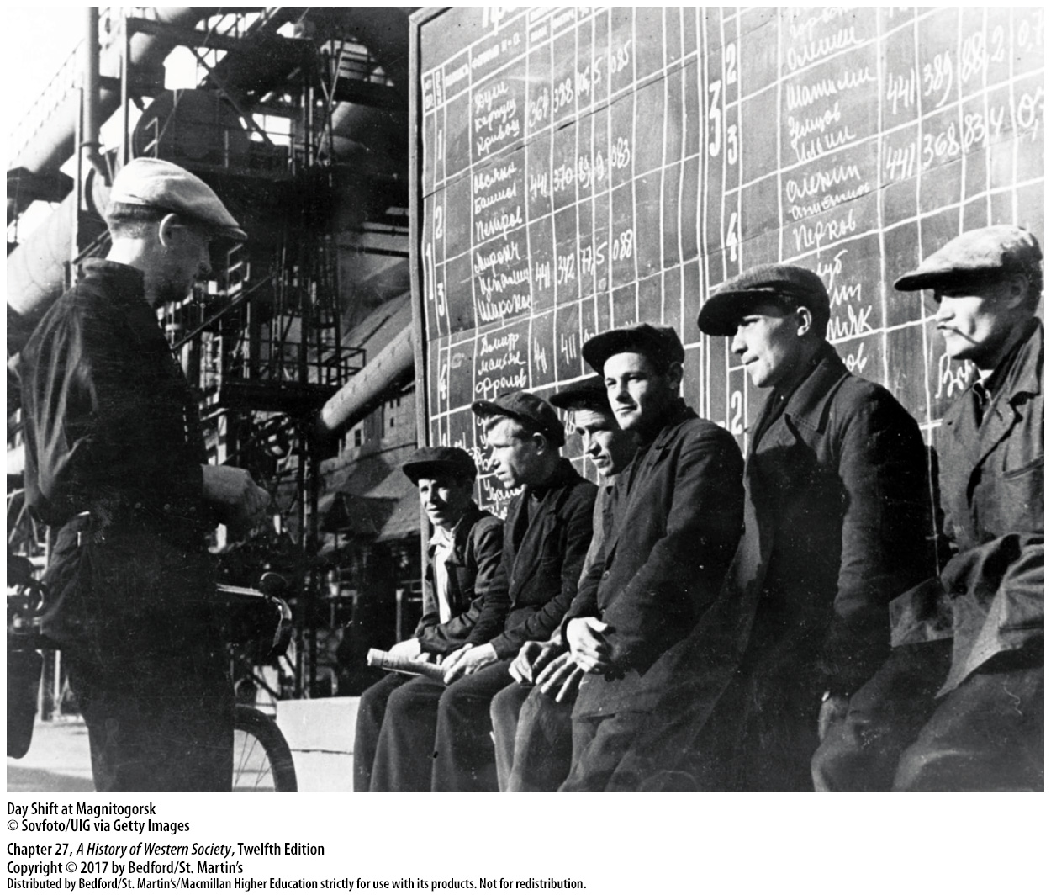

Slide 15
II. Stalin’s Soviet Union
Stalinist Terror and the Great Purges
1. Sergei Kirov’s death
2. The “great purge” of 1936–1938
3. Weakened the Soviet Union in economic, intellectual, and military terms
4. Despite terrible human costs, the great purges brought substantial practical rewards
Notes:
II. Stalin’s Soviet Union
D. Stalinist Terror and the Great Purges
1. When Stalin’s number-two man, Sergei Kirov, was mysteriously killed in 1934, Stalin blamed it on “Fascist agents” within the Communist Party and used the incident to purge the party of supposed traitors and solidify his own control.
2. The resulting state-sponsored repression culminated in the “great purge” of 1936–1938, a series of public show trials in which false evidence, often gathered using torture, was used to incriminate party administrators and Red Army leaders. During this period, at least 6 million people, including faithful party members, union officials, managers, intellectuals, army officers, and countless ordinary citizens, were accused of counter-revolutionary activities and arrested; probably 1 to 2 million of them were executed or never returned from prisons and forced-labor camps.
3. The purges seriously weakened the Soviet Union in economic, intellectual, and military terms, although Stalin and the party leadership enlisted 1.5 million new Party members to replace the purge victims.
4. Despite its terrible human costs, the great purges brought substantial practical rewards to this new generation of committed Communists.

Slide 16
III. Mussolini and Fascism in Italy
The Seizure of Power
1. Constitutional monarchy
2. Extreme class differences
3. Soaring postwar unemployment and inflation
4. Radical workers and peasants occupy factories
5. Pope lifted ban on Catholic participation politics
Notes:
III. Mussolini and Fascism in Italy
A. The Seizure of Power
1. In the early twentieth century, Italy was a constitutional monarchy with civil rights and a parliament elected by universal male suffrage and appeared to be moving toward democracy. However, the papacy, many devout Catholics, conservatives, and landowners remained strongly opposed to liberal institutions, and relations between church and state were often tense.
2. Much of the Italian population was poor, and class differences were extreme, leading to the development of a powerful revolutionary socialist movement. The war worsened the political situation; workers and peasants who had been promised social and land reform to win their support for the war felt cheated when the government did not deliver after the war ended.
3. Soaring postwar unemployment and inflation created mass hardship and energized Italy’s revolutionary socialist movement.
4. Radical workers and peasants began occupying factories and seizing land in 1920, actions that mobilized the property-owning classes.
5. The pope had lifted his ban on Catholic participation in Italian politics, and a strong Catholic party quickly emerged.

Slide 17
III. Mussolini and Fascism in Italy
The Seizure of Power
6. Benito Mussolini
7. Sworn enemy of socialism
8. Black Shirts
9. Fascism became a mass movement
10. Armed Fascists threaten the king, Victor Emmanuel III (r. 1900–1946)
Notes:
III. Mussolini and Fascism in Italy
A. The Seizure of Power
6. Into these crosscurrents of unrest and fear stepped Benito Mussolini, who began his political career before World War I as a Socialist Party leader, but after being wounded, he returned home and began organizing bitter war veterans like himself into a band of Fascists (from the Italian word for “a union of forces”). Mussolini and his supporters were the first to call themselves “Fascists”—revolutionaries determined to create a new totalitarian state based on extreme nationalism and militarism.
7. At first Mussolini’s program was a radical combination of nationalist and socialist demands, but when Mussolini saw that his verbal assaults on rival Socialists won him support from conservatives and the middle classes, he shifted gears in 1920 and became a sworn enemy of socialism.
8. Mussolini and his private militia of Black Shirts grew increasingly violent, destroying Socialist Party newspapers, local headquarters, and union halls, while pushing Socialists out of city governments in northern Italy.
9. Fascism soon became a mass movement, and in the midst of chaos largely created by the Black Shirts in 1922, Mussolini stepped forward as the savior of order and property to demand the resignation of the existing government.
10. In October 1922 a band of armed Fascists marched on Rome to threaten the king, Victor Emmanuel III (r. 1900–1946), and force him to appoint Mussolini prime minister of Italy.

Slide 18
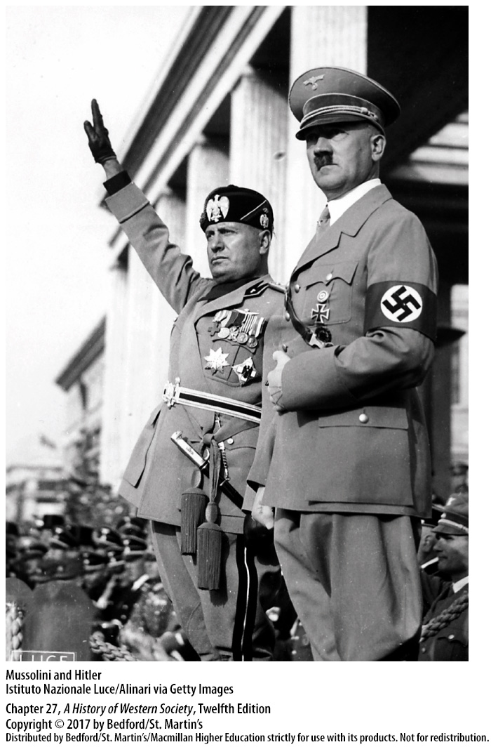

Slide 19
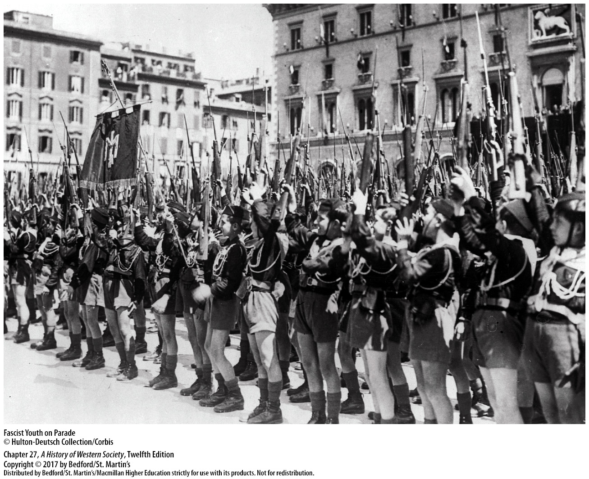

Slide 20
III. Mussolini and Fascism in Italy
The Regime in Action
1. Fascist Party won an overwhelming majority
2. Repressive measures
3. “Everything in the state, nothing outside the state, nothing against the state”
4. Lateran Agreement of 1929
Notes:
III. Mussolini and Fascism in Italy
B. The Regime in Action
1. A change in electoral law allowed the Fascist Party and its allies to win an overwhelming majority in April 1924, and Mussolini charged forward, declaring his desire to “make the nation Fascist” and imposing a series of repressive measures.
2. Freedom of the press was abolished, elections were fixed, and the government ruled by decree as Mussolini arrested his political opponents, disbanded all independent labor unions, and put dedicated Fascists in control of Italy’s schools.
3. Mussolini trumpeted his famous slogan—“Everything in the state, nothing outside the state, nothing against the state”—and by the end of 1926, Italy was a one-party dictatorship headed by Mussolini.
4. In the Lateran Agreement of 1929, Mussolini recognized the Vatican as an independent state in return for the pope’s support of Mussolini’s government.

Slide 21
III. Mussolini and Fascism in Italy
The Regime in Action
5. Engineered popular consent
6. Opposed liberal feminism
7. Invaded Ethiopia in 1935
8. Influenced by Hitler’s example
Notes:
III. Mussolini and Fascism in Italy
B. The Regime in Action
5. The Fascist state engineered popular consent by staging massive rallies and sporting events, creating Fascist youth and women’s movements, and providing new welfare benefits.
6. Mussolini’s government vehemently opposed liberal feminism and promoted traditional gender roles.
7. Mussolini matched his aggressive rhetoric with military action: Italian armies invaded the African nation of Ethiopia in 1935, defeating the poorly armed Ethiopian army in a brutal colonial war that shocked international opinion and resulted in close ties between Italy and Nazi Germany.
8. Deeply influenced by Hitler’s example, Mussolini’s government passed a series of anti-Jewish racial laws in 1938, but extreme anti-Semitic persecution did not occur in Italy until late in World War II, when Italy was under Nazi control.

Slide 22
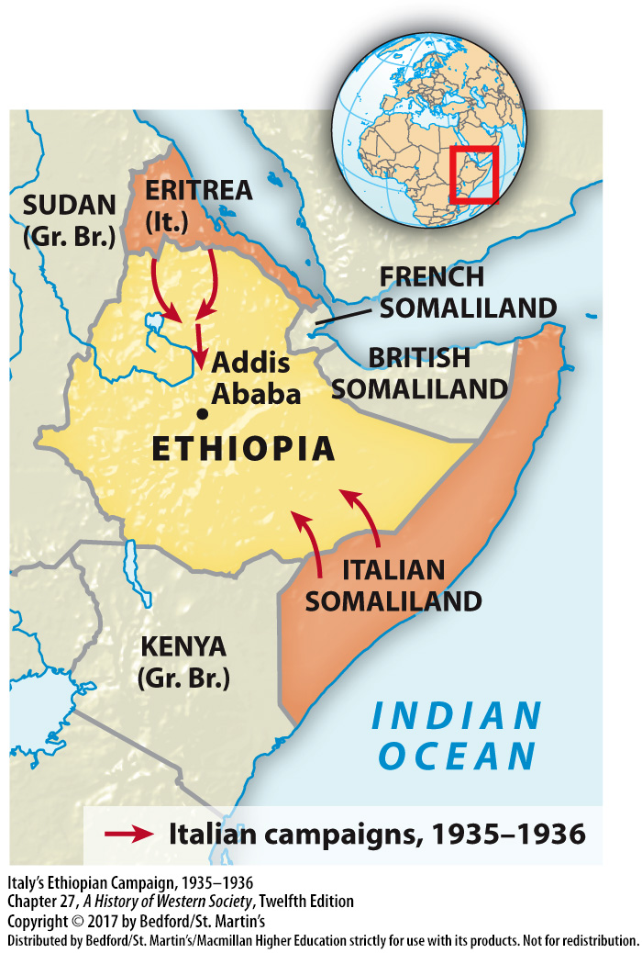

Slide 23
IV. Hitler and Nazism in Germany
The Roots of National Socialism
1. Influenced by extreme nationalism and racism
2. Distortions of Social Darwinism
3. Rooted Christian anti-Semitism
4. German Workers’ Party
5. Beer Hall Putsch
Notes:
IV. Hitler and Nazism in Germany
A. The Roots of National Socialism
1. National Socialism grew out of many complex developments, of which the most influential were extreme nationalism and racism—two ideas that captured the mind of Adolf Hitler (1889–1945), who dominated Nazism until the end of World War II.
2. In Vienna Hitler developed an unshakable belief in the crudest distortions of Social Darwinism, the superiority of Germanic races, and inevitability of racial conflict, while his exposure to poor east European Jews contributed to his anti-Semitism prejudice.
3. Rooted in centuries of Christian anti-Semitism, racist anti-Semitism became wildly popular on the far right wing of European politics and was given pseudoscientific legitimacy by nineteenth-century developments in biology and eugenics.
4. In late 1919 Hitler joined the German Workers’ Party, a tiny extremist group that denounced Jews, Marxists, and democrats and promised a uniquely German National Socialism that would abolish the injustices of capitalism and create a mighty “people’s community.”
5. In late 1923, when the Weimar Republic seemed on the verge of collapse, Hitler organized an armed uprising in Munich—the so-called Beer Hall Putsch, a poorly planned coup that ended with Hitler’s arrest.

Slide 24
IV. Hitler and Nazism in Germany
Hitler’s Road to Power
1. Mein Kampf
2. Hitler’s Führer
3. De-emphasized anticapitalist sentiments and vowed to fight communism
4. The Great Depression of 1929
Notes:
IV. Hitler and Nazism in Germany
B. Hitler’s Road to Power
1. Using his brief prison term to dictate his book Mein Kampf (My Struggle), Hitler laid out his basic ideas on “racial purification” and the German race’s need for Lebensraum (“living space”).
2. Hitler also championed the idea of the leader-dictator, or Führer, and portrayed a sweeping vision of war and conquest in which the German master race would colonize and ultimately replace the “subhuman” Slavs and Jews living in east and central Europe.
3. In the years of relative prosperity and stability between 1924 and 1929, Hitler built up the Nazi Party by de-emphasizing anticapitalist sentiments and vowing to fight communism.
4. The Great Depression of 1929 brought the ascent of National Socialism, as Hitler’s promises of economic and political salvation and calls for “national rebirth” attracted a broad spectrum of voters, including middle- and lower-class groups.

Slide 25
IV. Hitler and Nazism in Germany
Hitler’s Road to Power
5. Voters desert the conservative and moderate parties for the Nazis
6. Communists and the Social Democrats failed to resolve their differences
7. Hitler gains support of conservative politicians
8. Hitler appointed chancellor
Notes:
IV. Hitler and Nazism in Germany
B. Hitler’s Road to Power
5. Seized by panic as bankruptcies increased, unemployment soared, and the Communists made dramatic election gains, voters deserted the conservative and moderate parties for the Nazis, which became the largest party in the Reichstag after the election of 1932.
6. The two left-wing parties, the Communists and the Social Democrats, who together outnumbered the Nazis in the Reichstag, failed to resolve their differences and mount an effective opposition to the Nazi takeover.
7. Finally, Hitler excelled in the dirty backroom politics of the decaying Weimar Republic and cleverly gained the support of conservative politicians who thought that they could use Hitler to resolve the political crisis and clamp down on leftists.
8. They accepted Hitler’s demand to be appointed chancellor in a coalition government, thinking that he could be used and controlled, and so Hitler was appointed chancellor by President Hindenburg on January 30, 1933.

Slide 26
IV. Hitler and Nazism in Germany
State and Society in Nazi Germany
1. Hitler outlawed the Communist Party
2. Germany became a one-party Nazi state
3. Dual government was disorganized
4. Constructing a National Socialist society
5. Nazis’ eliminate political enemies
6. The SS
Notes:
IV. Hitler and Nazism in Germany
C. State and Society in Nazi Germany
1. When the Nazis won only 44 percent of the vote in the elections, Hitler outlawed the Communist Party, arrested its parliamentary representatives, and pushed through the so-called Enabling Act on March 23, 1933, which gave him dictatorial power for four years.
2. Germany became a one-party Nazi state, as the new regime took over the government bureaucracy, installing Nazis in top positions, while at the same time creating a series of overlapping Nazi Party organizations responsible solely to Hitler.
3. The resulting system of dual government was often disorganized and lacked the all-encompassing unity that its propagandists claimed, but Hitler used this fractured system to maintain dictatorial control.
4. Once the Nazis were firmly in command, Hitler and the party began constructing a National Socialist society defined by national unity and racial exclusion.
5. The Nazis’ first step was to eliminate political enemies; they arrested Communists, Social Democrats, and union leaders and placed them in concentration camps, while also outlawing strikes and abolishing independent labor unions. Hitler then purged the Nazi Party of its more extremist elements, including the leadership of the storm troopers (the SA), some of whom talked of a “second revolution.”
6. On June 30, 1934, Hitler’s elite personal guard—the SS—arrested and executed about 100 SA leaders and political enemies; under the ruthless Heinrich Himmler (1900–1945), the SS took over the political police and the concentration camp system.

Slide 27
IV. Hitler and Nazism in Germany
State and Society in Nazi Germany
7. Racial purity
8. Race hatred becomes institutionalized
9. Sterilization laws
10. Nuremberg Laws
11. Kristallnacht (the Night of Broken Glass)
Notes:
IV. Hitler and Nazism in Germany
C. State and Society in Nazi Germany
7. Acting on their vision of racial purity, the Nazis began persecuting those they deemed incapable of contributing to the “master race,” targeting a number of supposedly undesirable groups that included Jews, Slavic peoples, Sinti and Roma (Gypsies,) homosexuals, Jehovah’s Witnesses, and people considered handicapped.
8. In the Nazi “racial state,” barbarism and race hatred were institutionalized with the force of science and law, as new university academies wrote studies that presented prejudice in the guise of enlightened science as a means of creating a strong national race.
9. A series of sterilization laws led to the forced sterilization of some four hundred thousand “undesirable” citizens.
10. By the end of 1934, most Jewish professionals had been banned from their occupations, and in 1935 the infamous Nuremberg Laws classified as Jewish anyone having three or more Jewish grandparents, outlawed marriage and sexual relations between Jews and those defined as Germans, and deprived Jews of all rights of citizenship.
11. In late 1938 the assault on the Jews accelerated with a well-organized wave of violence, known as Kristallnacht (the Night of Broken Glass), in which Nazi gangs smashed windows, looted Jewish-owned shops, destroyed homes and synagogues, and killed dozens of Jews.

Slide 28
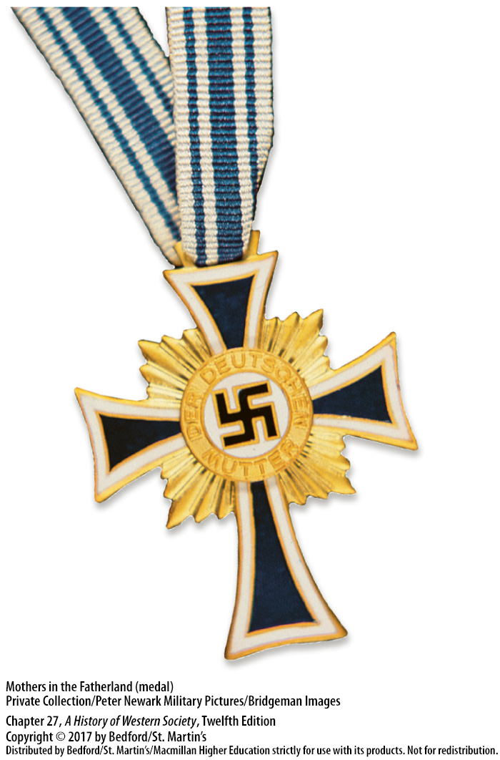

Slide 29
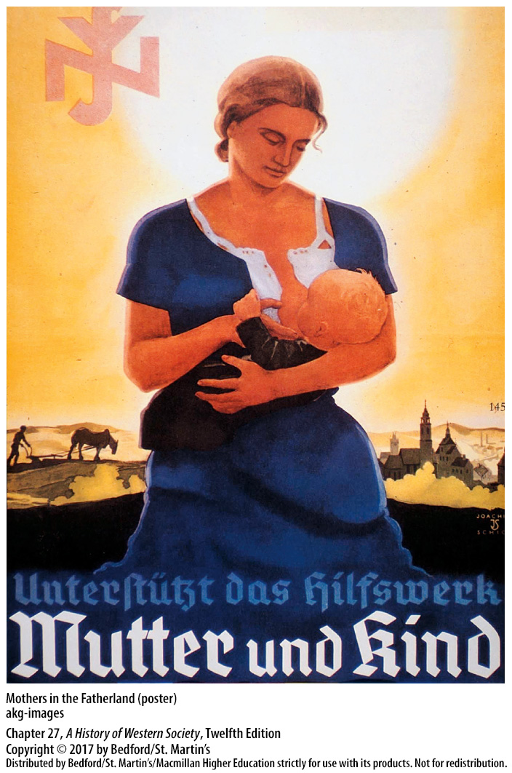

Slide 30
IV. Hitler and Nazism in Germany
Popular Support for National Socialism
1. Large public works program
2. Standard of living for the average worker had increased moderately
3. Aryanization
4. Hitler Youth
5. “Liberate women from women’s liberation”
6. Small resistance
Notes:
IV. Hitler and Nazism in Germany
D. Popular Support for National Socialism
1. Hitler had promised the masses economic recovery, and he delivered by launching a large public works program to help pull Germany out of the depression.
2. By 1938 unemployment had fallen to 2 percent, the standard of living for the average worker had increased moderately, and business profits had risen sharply.
3. Ordinary Germans benefited from the persecution of Jews: as Jews were forced out of their jobs, homes, and businesses, Germans stepped in to take their places in a process known as Aryanization.
4. A wave of social and cultural innovation intended to construct the Volksgemeinschaft—a people’s community for racially pure Germans—featured mass organizations such as the Hitler Youth that spread Nazi ideology and enlisted volunteers for the Nazi cause.
5. Promising to “liberate women from women’s liberation,” Nazi ideologues championed a return to traditional family values by outlawing abortion, discouraging women from holding jobs or obtaining higher education, and glorifying domesticity and motherhood.
6. Not all Germans supported Hitler, however, and a number of German groups actively resisted him after 1933. Opponents’ lack of success was due to a failure to unify their efforts and to the regime’s relentless repression, arrest, and execution of political enemies.

Slide 31
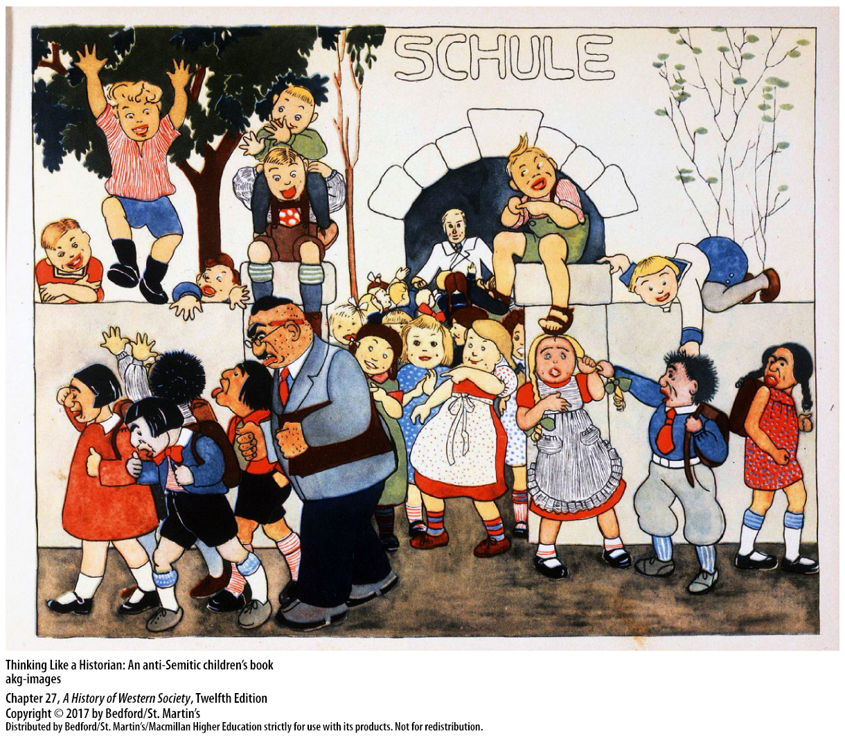

Slide 32
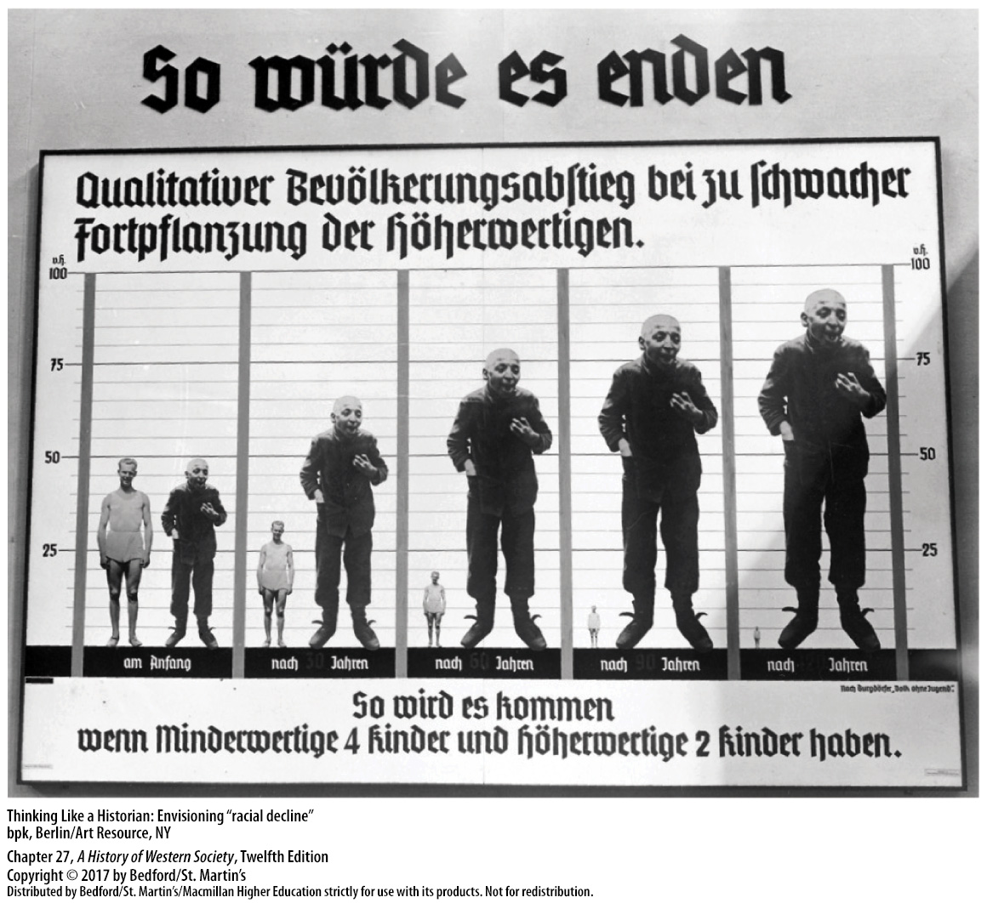

Slide 33
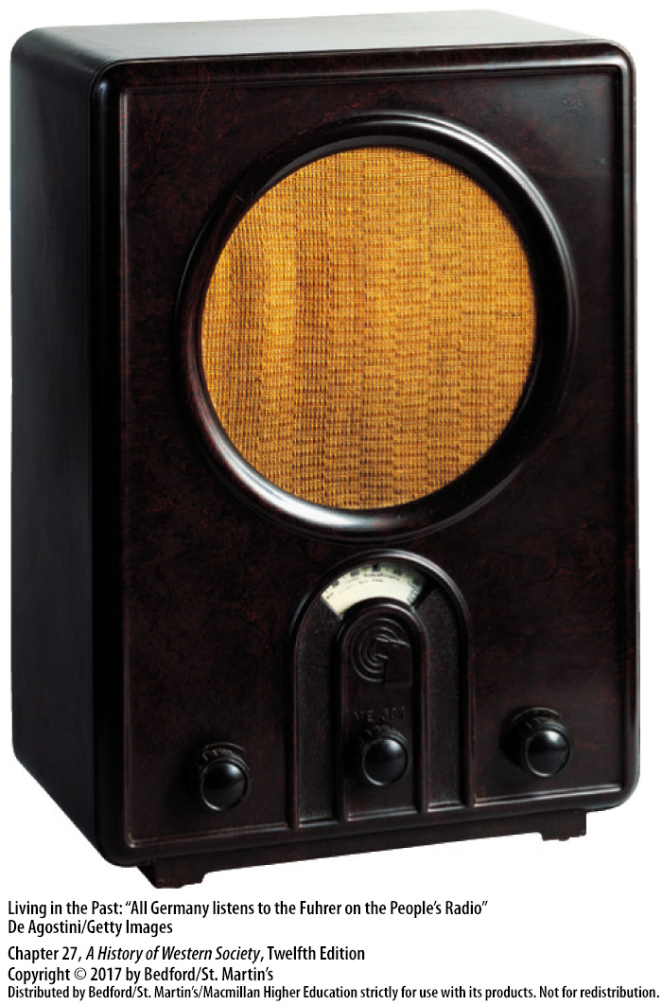

Slide 34
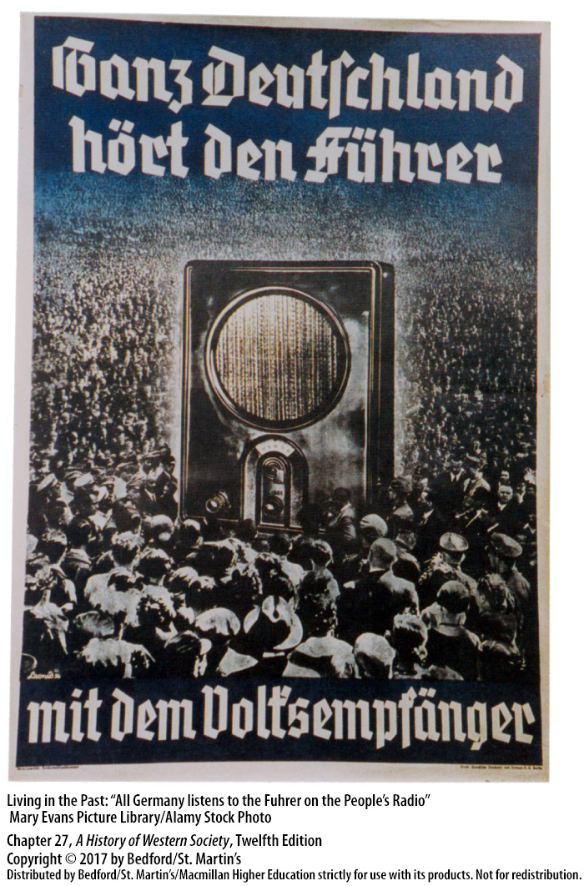

Slide 35
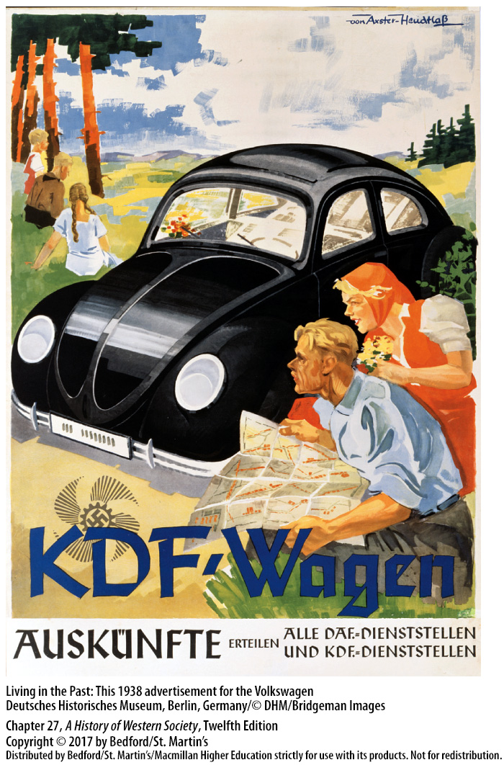

Slide 36
IV. Hitler and Nazism in Germany
Aggression and Appeasement
1. German withdrawal from the League of Nations 2. Britain adopted a policy of appeasement
3. Rome-Berlin Axis
4. Spanish Civil War (1936–1939)
5. Seize Austria and Czechoslovakia
Notes:
IV. Hitler and Nazism in Germany
E. Aggression and Appeasement
1. Germany’s withdrawal from the League of Nations in October 1933, however, indicated that Gustav Stresemann’s policy of peaceful cooperation was dead.Then in March 1935, Hitler proclaimed that Germany would no longer abide by the disarmament clauses of the Treaty of Versailles, and he began to build up the German army.
2. Britain adopted a policy of appeasement, granting Hitler everything he could reasonably want (and more) in order to avoid war, a tack that was motivated in large part by the pacifism of a British population still horrified by the memory of the First World War. Many powerful conservatives in Britain also underestimated Hitler, believing that Soviet communism was the real danger and that Hitler could be used to stop it.
3. Emboldened, Hitler enlisted powerful allies, establishing the so-called Rome-Berlin Axis with Italy in 1936 and then including Japan in the alliance later that year.
4. Germany and Italy intervened in the Spanish Civil War (1936–1939), where their military aid helped General Francisco Franco’s revolutionary Fascist movement defeat the democratically elected republican government.
5. Moving forward with his plans to seize Austria and Czechoslovakia in his drive for living space in the east, Hitler initiated the Austrian Anschluss (annexation) in March 1938, as German armies moved in unopposed and Nazis took control of the government.

Slide 37
IV. Hitler and Nazism in Germany
Aggression and Appeasement
6. Britain and France vowed to fight if Hitler attacked Poland
7. Hitler did not take these warnings seriously
8. German armies and attack Poland; Britain and France declare war on Germany
Notes:
IV. Hitler and Nazism in Germany
E. Aggression and Appeasement
6. In March 1939 Hitler’s armies invaded and occupied the rest of Czechoslovakia—home to ethnic Czechs and Slovaks—electrifying Western public opinion and rousing a suddenly militant Chamberlain, who declared that Britain and France would fight if Hitler attacked Poland.
7. Hitler did not take these warnings seriously and in August 1939 signed a nonaggression pact with Stalin that not only pledged neutrality if the other became involved in war but also divided Poland, the Baltic nations, Finland, and a part of Romania into German and Soviet spheres of influence.
8. On September 1, 1939, German armies and warplanes smashed into Poland from three sides; two days later, Britain and France declared war on Germany.

Slide 38
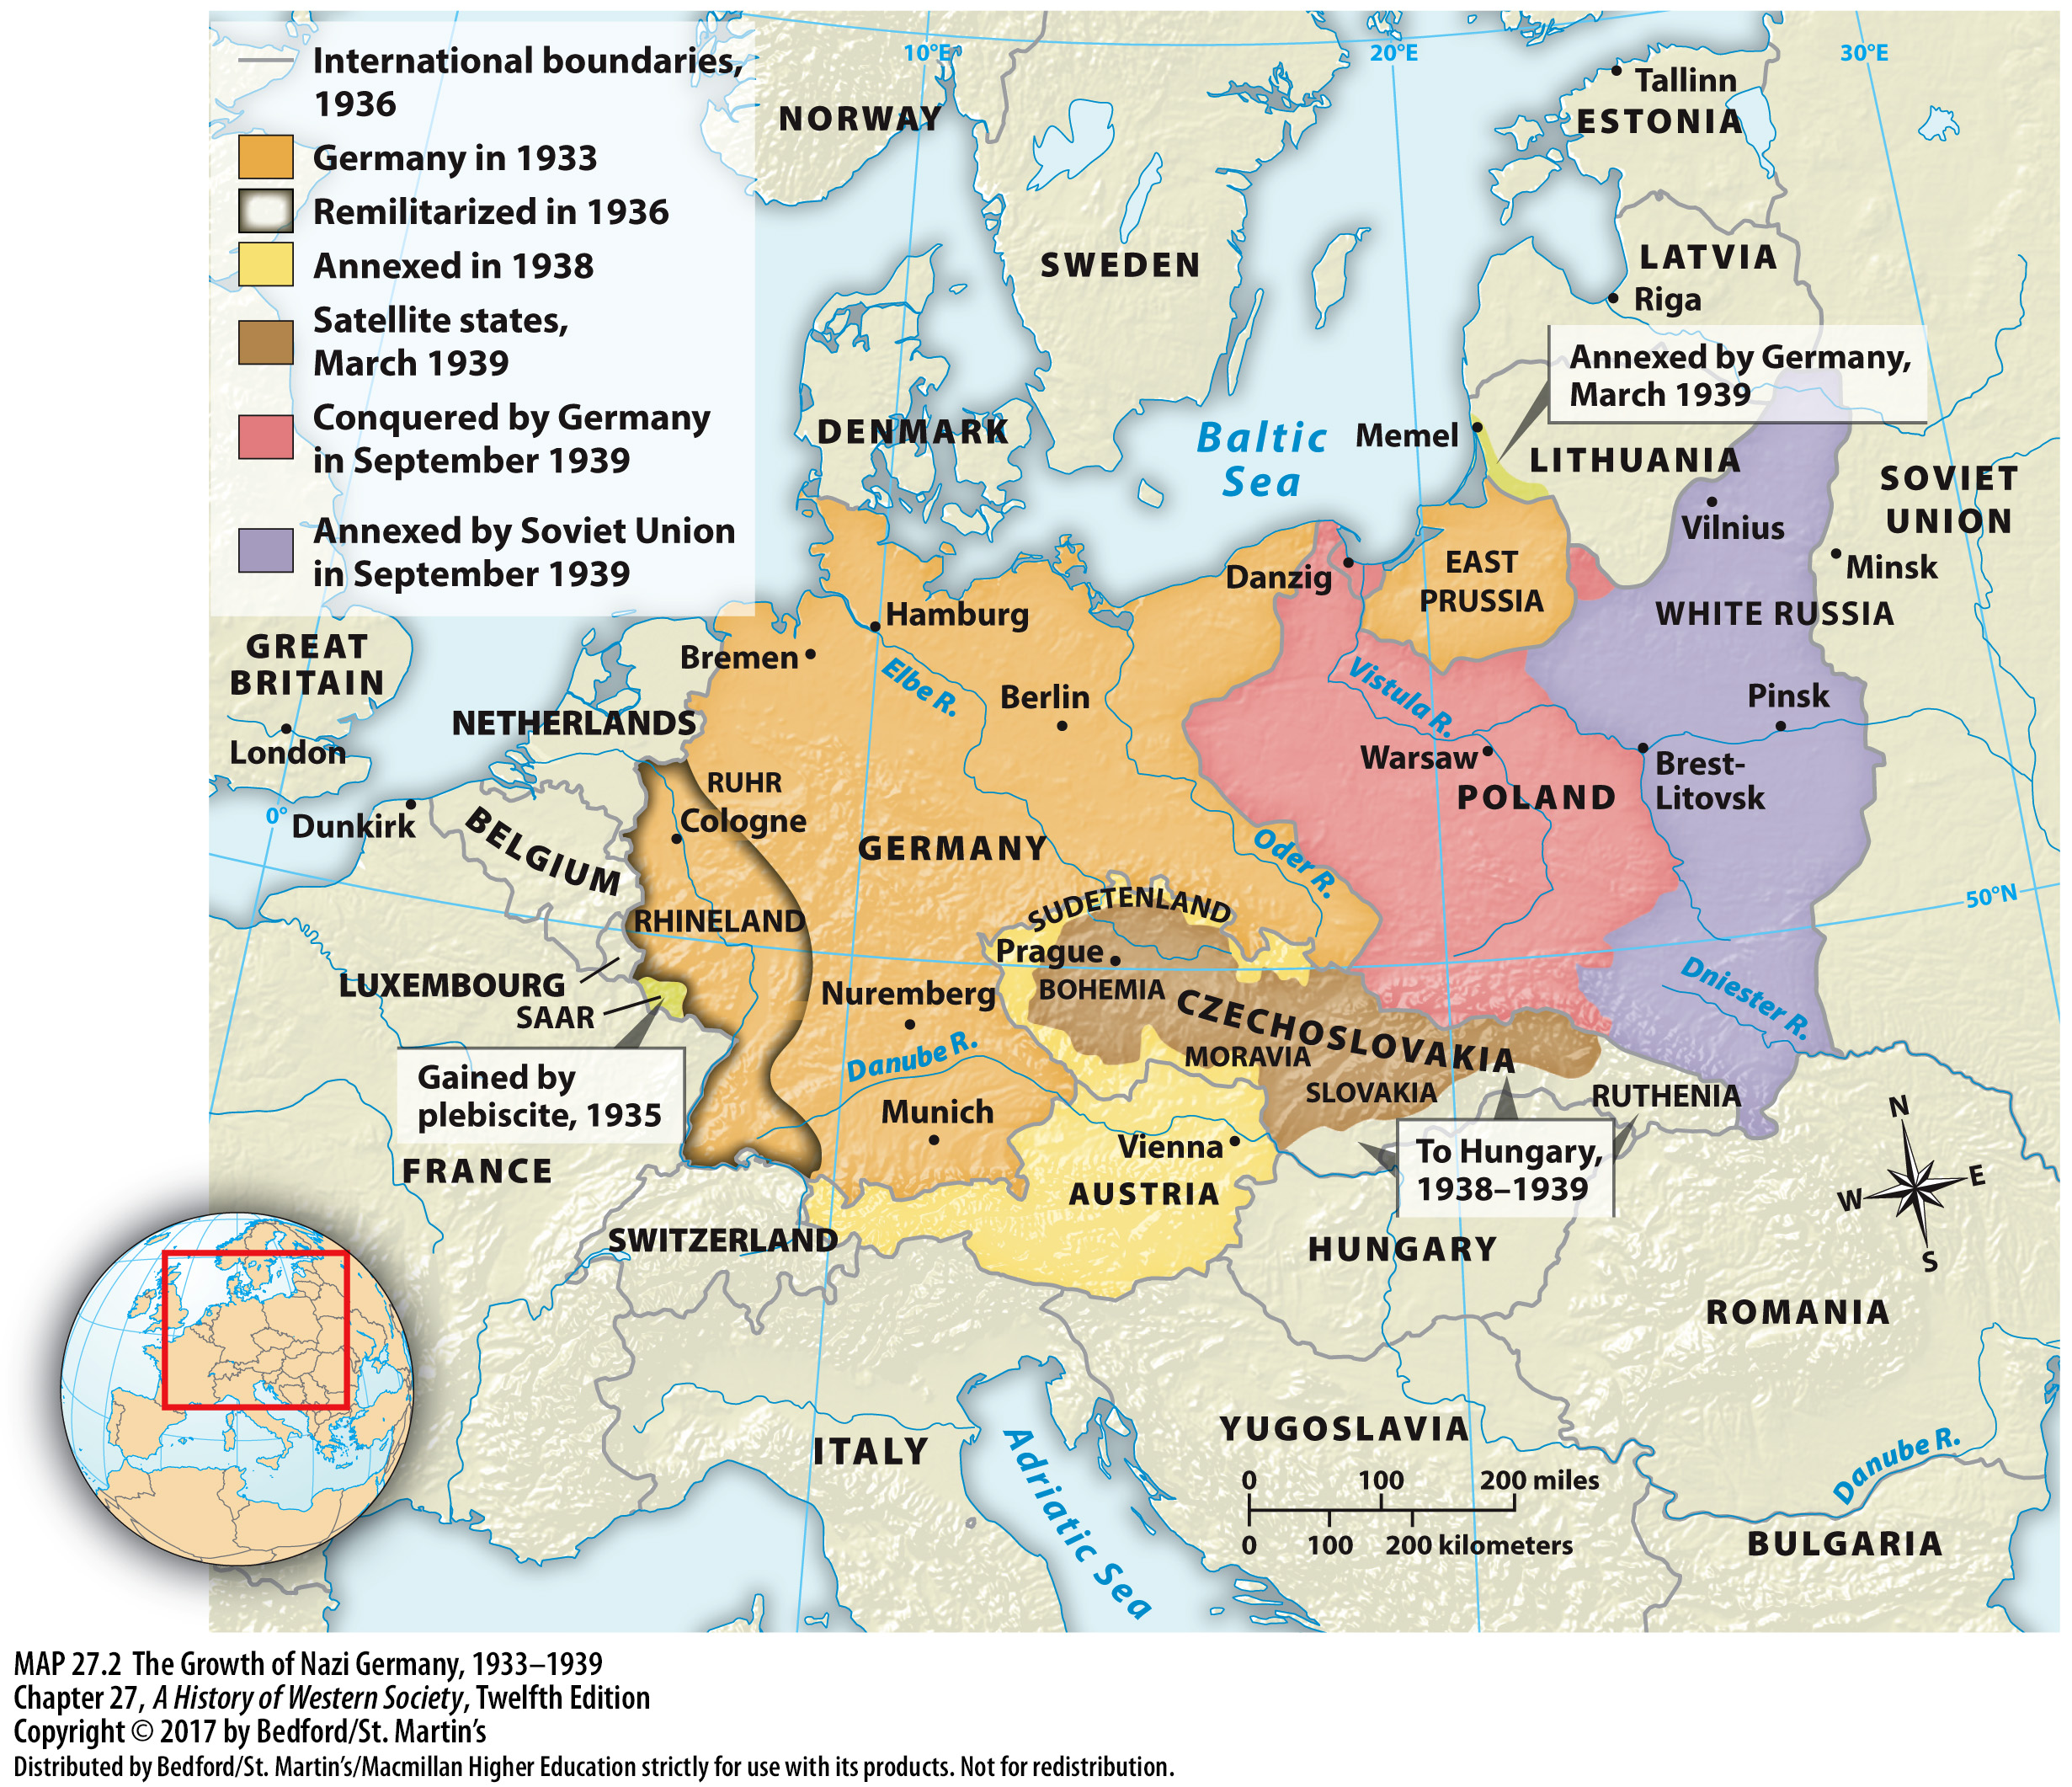

Slide 39
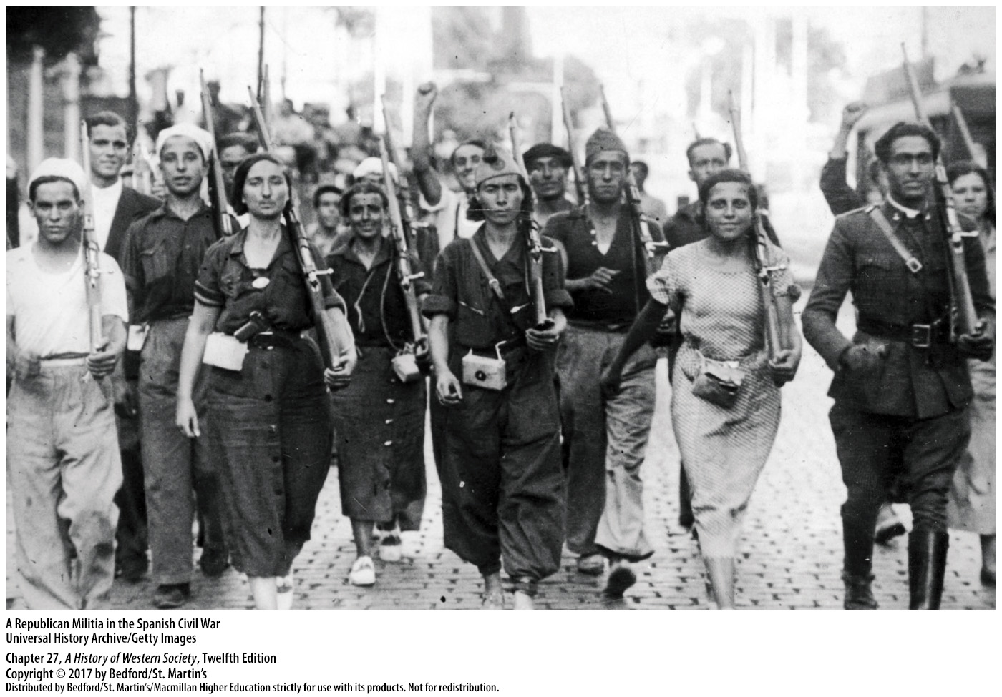

Slide 40
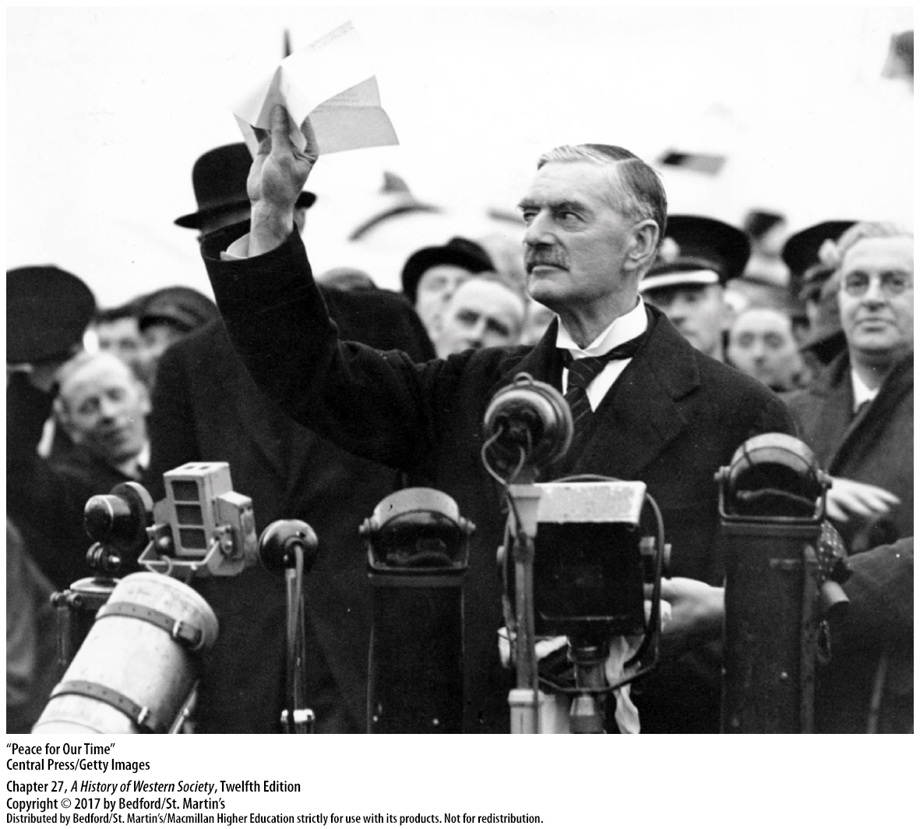

Slide 41
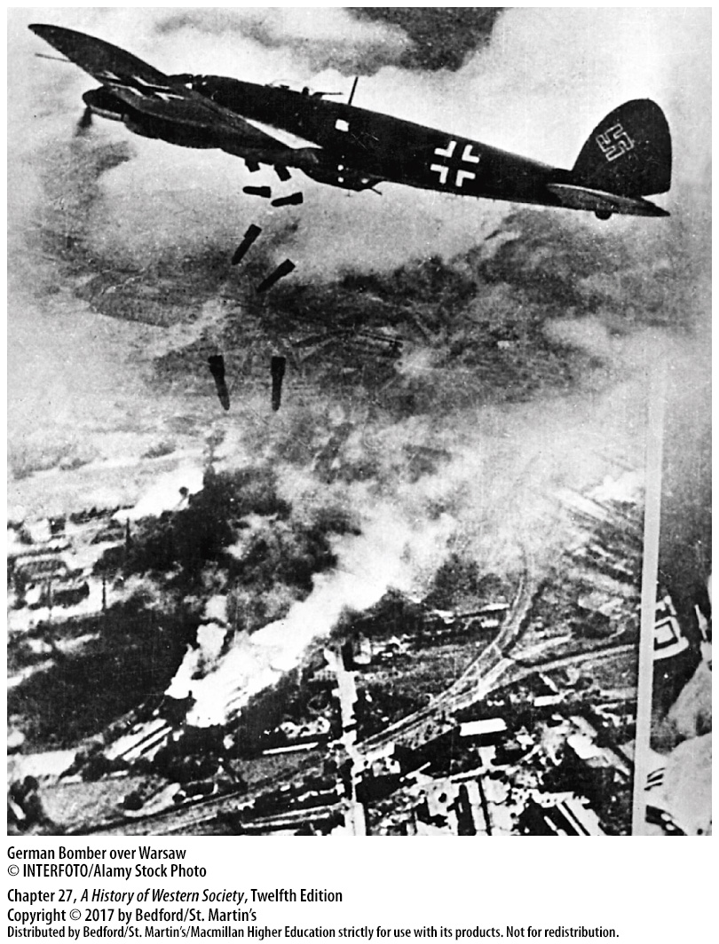

Slide 42
V. The Second World War
German Victories in Europe
1. Blitzkrieg in Poland
2. Blitzkrieg in Denmark, Norway, Holland, France
3. France was taken by Nazis
4. Hitler ruled practically all of continental Europe
5. Battle of Britain
6. Invaders of Soviet Union were stopped by severe winter
Notes:
V. The Second World War
A. German Victories in Europe
1. Using planes, tanks, and trucks in the first example of a blitzkrieg, or “lightning war,” Hitler’s armies crushed Poland in four weeks.
2. In spring 1940 the Nazi lightning war struck again, as German motorized columns occupied Denmark, Norway, and Holland before breaking into France through southern Belgium and splitting the Franco-British forces there.
3. The British withdrew their troops, and soon after, France was taken by the Nazis.
4. By July 1940 Hitler ruled practically all of continental Europe: Italy was an ally; Romania, Hungary, and Bulgaria joined the Axis powers; and the Soviet Union, Spain, and Sweden were friendly neutrals.
5. Germany’s assault on Britain, whose leader was Winston Churchill (1874–1965), began with attempts to gain control of the air; in the Battle of Britain, which began in July 1940, up to a thousand German planes a day attacked British airfields and key factories.
6. By October most of Ukraine had been conquered, Leningrad was practically surrounded, and Moscow was besieged, but the Soviet Union did not collapse, and the invaders were stopped by a severe winter.

Slide 43
V. The Second World War
Europe Under Nazi Occupation
1. Hitler’s New Order
2. Germany divides France
3. Occupied nations were forced to pay for the costs of the war
4. Nazi victory placed Jewish populations under German control
5. Underground resistance groups commit sabotage and pass to the Allies
Notes:
V. The Second World War
B. Europe Under Nazi Occupation
1. Hitler’s New Order was based firmly on the Nazis’ guiding principle of racial imperialism, and occupied peoples were subject to harsh policies dedicated to ethnic cleansing and the plunder of resources for the Nazi war effort. Within the New Order, the so-called Nordic peoples—who the Germans believed were related to the “Aryan master race”—received preferential treatment, but they were subject to Nazi-established puppet governments.
2. Germany divided France into two parts: the German army occupied the north, and the southeast remained nominally independent under the aging Marshal Henri-Philippe Pétain, who formed the Vichy regime, which adopted many aspects of National Socialist ideology.
3. To enrich Germany and support the war effort, occupied nations were forced to pay for the costs of the war and for the occupation itself.
4. Nazi victory also placed national Jewish populations across Europe under German control, thus easing the mass murder of Europe’s Jews.
5. In response to such atrocities, small but determined underground resistance groups fought back, presenting a real challenge to the Nazi New Order by committing sabotage and passing intelligence about German operations to the Allies.

Slide 44
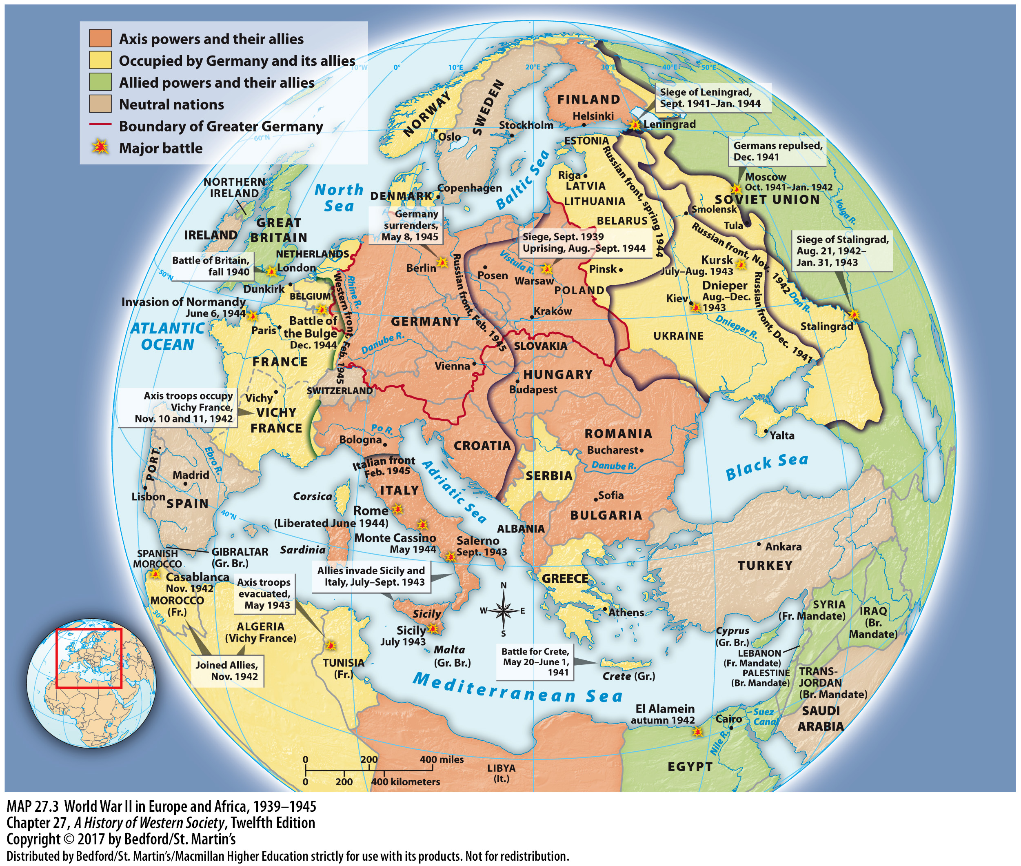

Slide 45
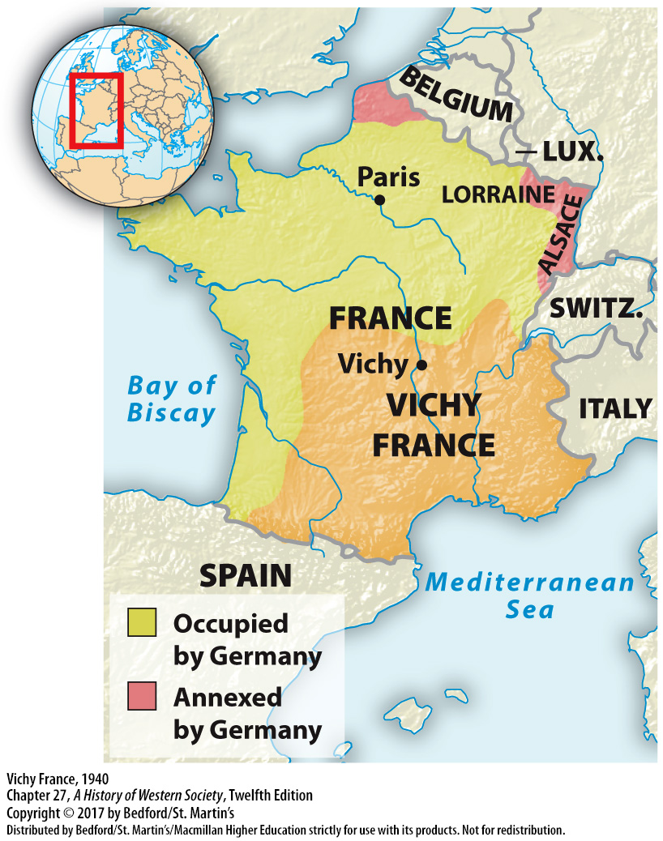

Slide 46
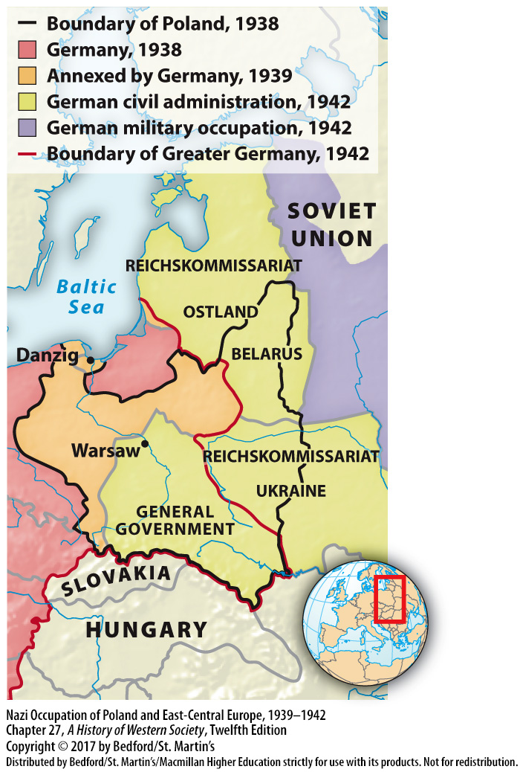

Slide 47
V. The Second World War
The Holocaust
1. Special Task Forces
2. Hitler orders “final solution of the Jewish question”
3. Extensive network of concentration camps
4. “Willing executioners” or “reluctant killers”?
5. Conditioning of racist propaganda
Notes:
V. The Second World War
C. The Holocaust
1. In 1941 military death squads known as Special Task Forces (Einsatzgruppen) followed the advancing German armies into eastern Europe, systematically moving from town to town shooting Jews and other target populations.
2. In late 1941 Hitler and the Nazi leadership ordered the SS to implement the “final solution of the Jewish question,” which meant the mass murder of all Jews in Europe.
3. The Germans established an extensive network of concentration camps, industrial complexes, and railroad transport lines to imprison and murder Jews and other so-called undesirables and to exploit their labor before they died.
4. Some historians believe that widely shared anti-Semitism led “ordinary Germans” to become Hitler’s “willing executioners,” while others argue that heightened peer pressure, the desire to advance in the ranks, and brutalizing wartime violence turned average Germans into reluctant killers.
5. The conditioning of Nazi racist propaganda clearly played a role, preparing numerous Germans to join the SS ideologues and perpetrate ever-greater crimes, from mistreatment to arrest to mass murder.

Slide 48
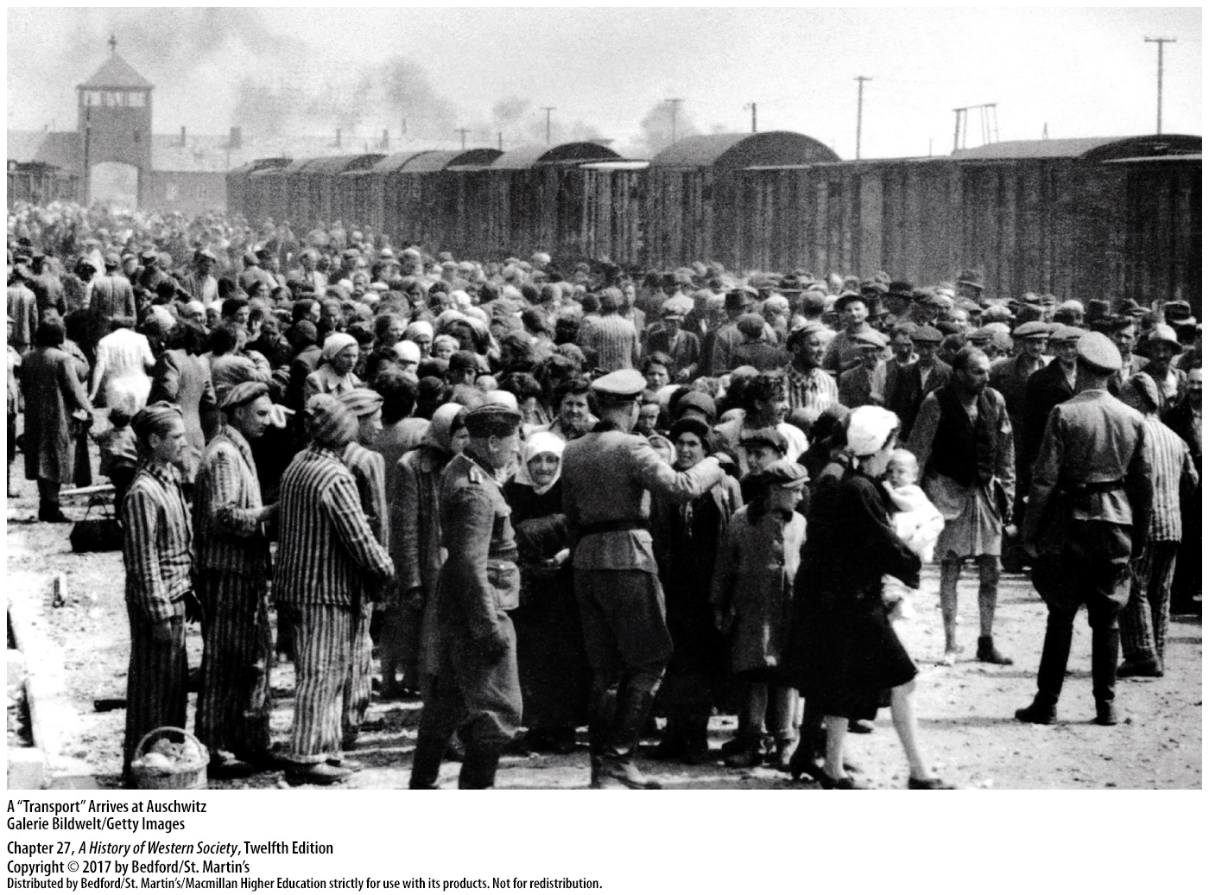

Slide 49
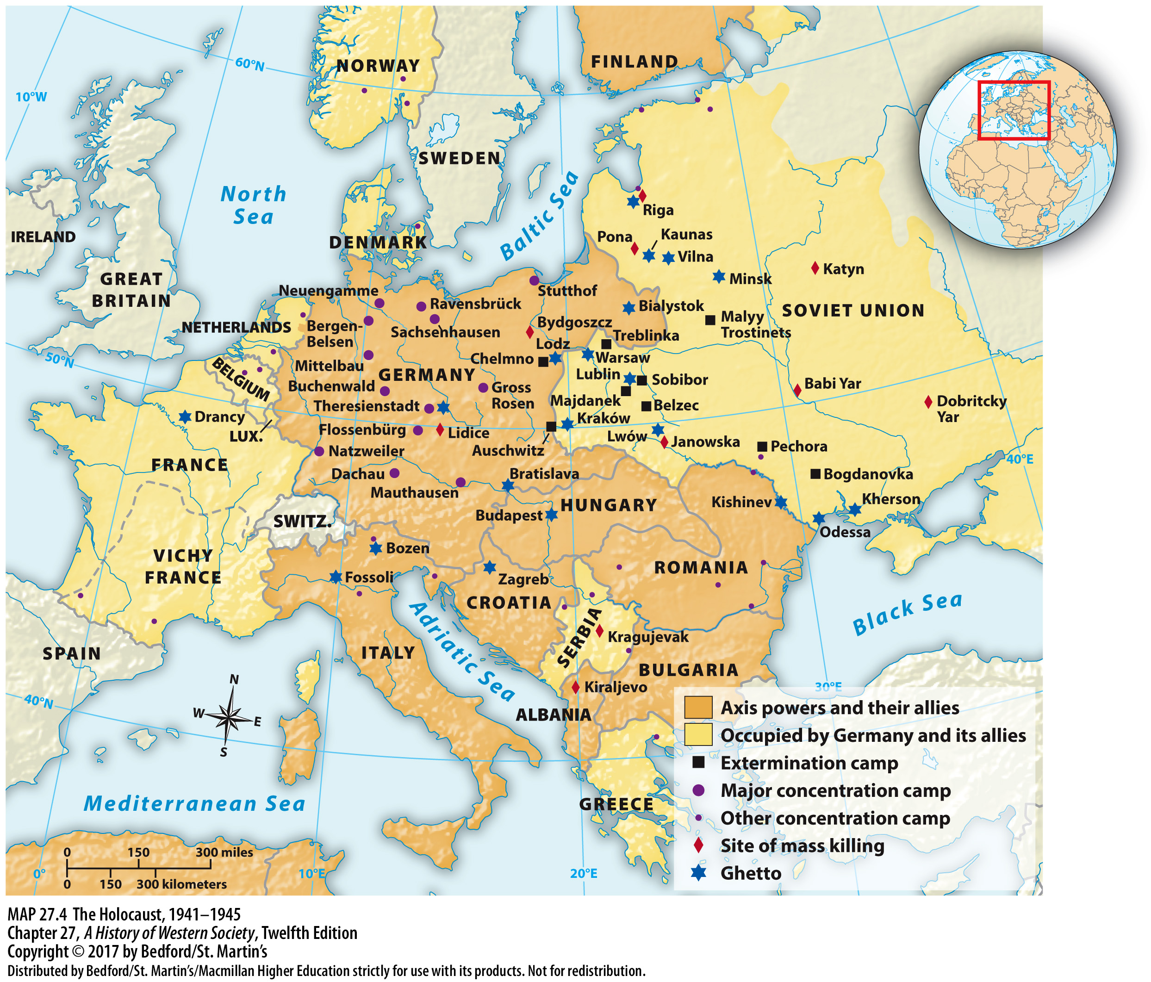

Slide 50
V. The Second World War
Japanese Empire and the War in the Pacific
1. Fascist government takes control of Japan
2. Manchuria
3. Formal alliance with Italy and Germany
4. Greater East Asia Co-Prosperity Sphere
5. Japanese expansion in the Pacific
6. Pearl Harbor
Notes:
V. The Second World War
D. Japanese Empire and the War in the Pacific
1. In response to political divisions and economic crisis, a Fascist government—one that was highly nationalistic and militaristic and deeply committed to imperial expansion—had taken control of Japan in the 1930s. In speeches, schools, and newspapers, Japanese ultranationalists eagerly voiced the extremist anti-Western views that had risen in the 1920s and 1930s, glorifying the warrior virtues of honor and sacrifice and proclaiming that Japan would liberate East Asia from Western colonialists.
2. In 1931 Japanese armies invaded and occupied Manchuria, a vast territory bordering northeastern China, and in 1937 Japan brutally invaded China itself.
3. In 1940 the Japanese entered into a formal alliance with Italy and Germany, and in the summer of 1941 the Japanese occupied southern portions of the French colony of Indochina.
4. The goal of a Greater East Asia Co-Prosperity Sphere was a sham, however, as Japanese military occupiers exploited local peoples for Japan’s wartime needs and exhibited great cruelty toward civilian populations.
5. Japanese expansion in the Pacific evoked a sharp response from U.S. President Franklin Roosevelt, and Japan’s leaders came to believe that war with the United States was inevitable.
6. In a surprise attack on the U.S. fleet at Pearl Harbor in the Hawaiian Islands on December 7, 1941, the Japanese sank or crippled every American battleship.

Slide 51
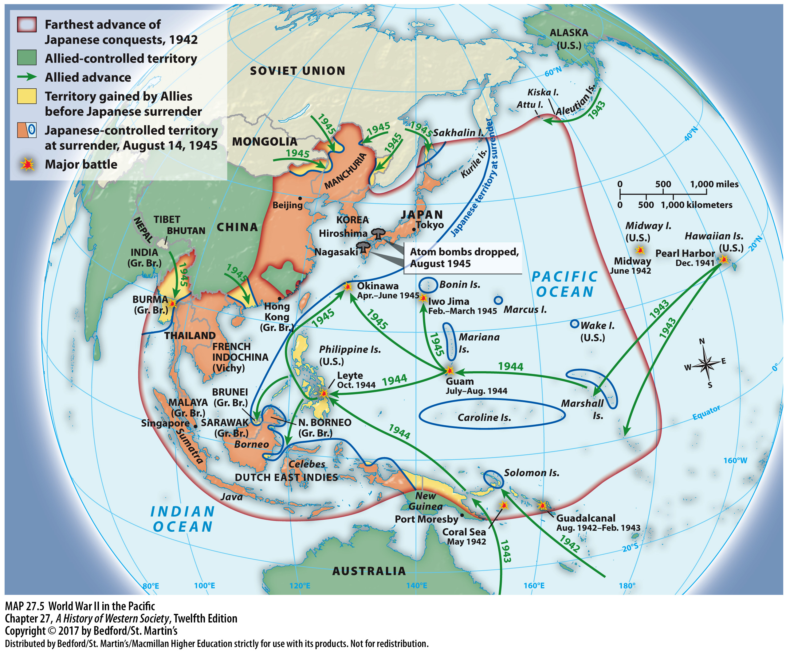

Slide 52
V. The Second World War
The “Hinge of Fate”
1. The Grand Alliance
2. “Europe first”
3. Military resources of the Grand Alliance
4. Battle of El Alamein, the “hinge of fate” that cemented Allied victory
Notes:
V. The Second World War
E. The “Hinge of Fate”
1. Great Britain, the United States, and the Soviet Union joined together in a military pact that Churchill termed the Grand Alliance, though their pact was a matter of chance more than choice.
2. The Grand Alliance did agree on a policy of “Europe first”: only after Hitler was defeated would the Allies mount an all-out attack on Japan.
3. The military resources of the Grand Alliance were awesome: the United States harnessed its vast industrial base, Great Britain became an impregnable floating fortress, and Stalin drew heavily on the Soviet Union’s great military strength and the heroic resolve of the Soviet people. The combined might of the Allies forced back Nazi armies on all fronts.
4. In May 1942 British forces halted the Axis penetration of North Africa by decisively defeating combined German and Italian armies at the Battle of El Alamein, which Winston Churchill called the “hinge of fate” that cemented Allied victory.

Slide 53
V. The Second World War
The “Hinge of Fate”
5. Mussolini overthrown by a coup d’état
6. Antisubmarine technologies
7. Battle of Stalingrad
8. German public opinion turned decisively against the war
Notes:
V. The Second World War
E. The “Hinge of Fate”
5. After driving the Axis power out of North Africa, U.S. and British forces invaded Sicily in the summer of 1943 and then mainland Italy; Mussolini was overthrown by a coup d’état, and the new Italian government publicly accepted unconditional surrender.
6. The spring of 1943 brought crucial Allied victories at sea and in the air, as new antisubmarine technologies allowed hundreds of ships to bring much-needed troops and supplies from the United States to Britain.
7. The German campaign of 1942 against the Soviet Union turned disastrous when, at the Battle of Stalingrad in November 1942, the Soviets surrounded and systematically destroyed the entire German Sixth Army.
8. Hitler, who had refused to allow a retreat, suffered a catastrophic defeat, and for the first time, German public opinion turned decisively against the war.

Slide 54
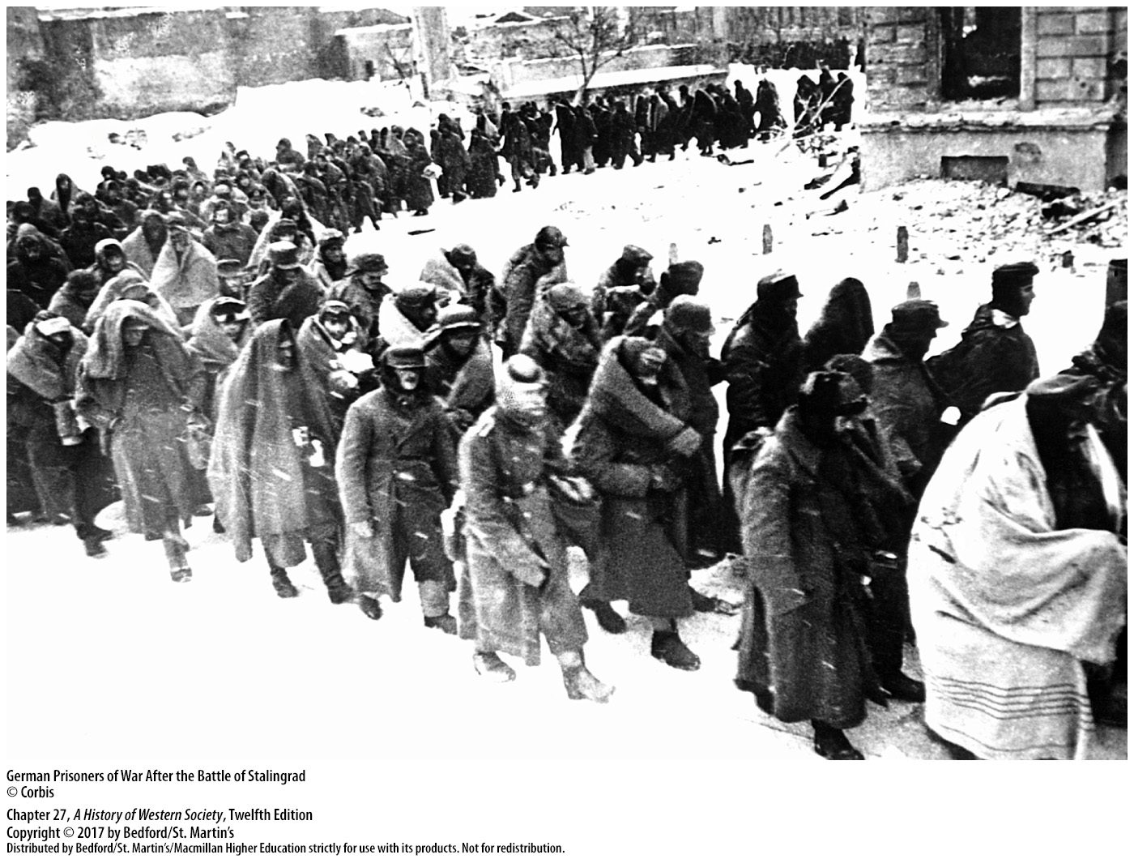

Slide 55
V. The Second World War
Allied Victory
1. Unsuccessful attempt by army leaders to assassinate Hitler
2. American and British forces land in Normandy
3. When Soviet forces enter Berlin, Hitler committed suicide
4. Japanese troops continued to fight
5. U.S. leaders drop atomic bombs on Hiroshima and Nagasaki, and Japan announces surrender
Notes:
V. The Second World War
F. Allied Victory
1. German resistance against Hitler failed to halt the fighting, and an unsuccessful attempt by army leaders to assassinate Hitler in July 1944 only brought increased repression by the fanatic Nazis who had taken over the government.
2. On June 6, 1944, American and British forces under General Dwight Eisenhower landed on the beaches of Normandy, France, in history’s greatest naval invasion.
3. As Soviet forces fought their way into Berlin, Hitler committed suicide, and on May 8 the remaining German commanders capitulated.
4. In the Pacific, Japanese troops continued to fight with enormous courage and determination in spite of repeated U.S. victories through the summer of 1945.
5. Because American commanders believed the conquest of Japan might cost a million American casualties and claim 10 to 20 million Japanese lives, U.S. leaders made the decision to drop atomic bombs on Hiroshima and Nagasaki on August 6 and 9, 1945. The mass bombing of cities and civilians, one of the terrible new practices of World War II, ended in a final nightmare, and on August 14, 1945, the Japanese announced their surrender.

Slide 56
