Slide 1
A History of Western Society Twelfth Edition
McKay • Crowston • Wiesner-Hanks • Perry
CHAPTER 26
The Age of Anxiety
1880–1940
Copyright © 2017 by Bedford/St. Martin’s
Distributed by Bedford/St. Martin's/Macmillan Higher Education strictly for use with its products; Not for redistribution.

Slide 2
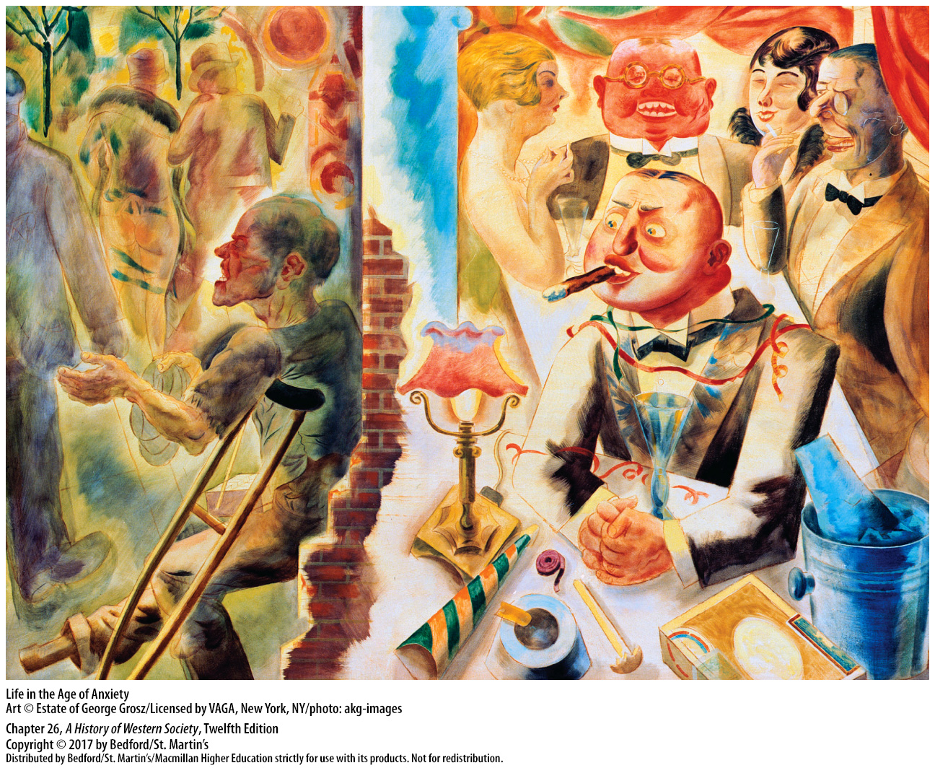

Slide 3
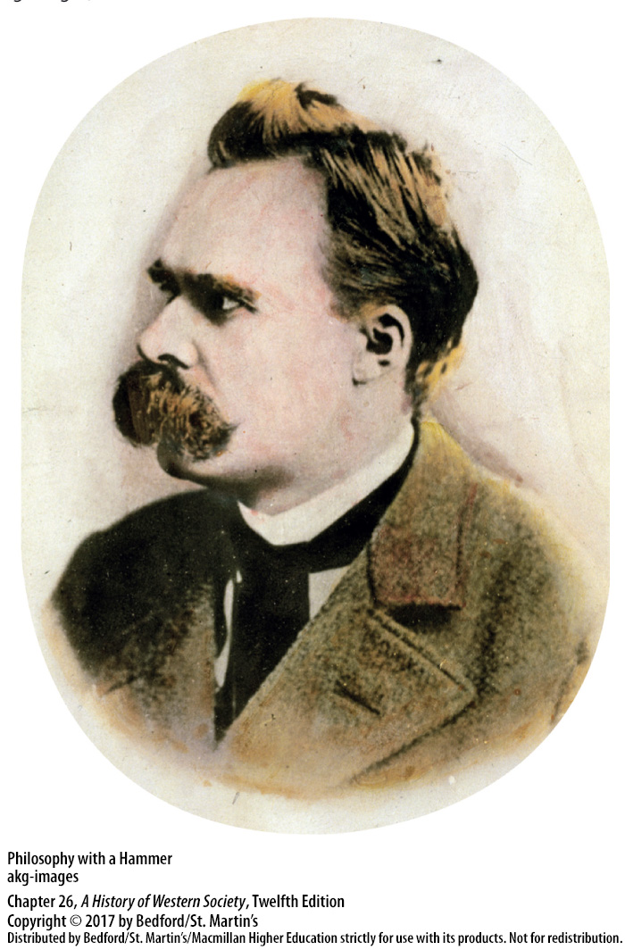

Slide 4
I. Uncertainty in Modern Thought
Modern Philosophy
1. Friedrich Nietzsche (1844–1900)
2. Nihilism
3. Henri Bergson (1859–1941)
4. Ludwig Wittgenstein
Notes:
I. Uncertainty in Modern Thought
A. Modern Philosophy
1. As the nineteenth century ended, a small group of serious thinkers, most notably the German philosopher Friedrich Nietzsche (1844–1900), rejected the general faith in progress and the rational human mind.
2. He warned that Western society was entering a period of nihilism—the philosophical idea that human life is entirely without meaning, truth, or purpose—and that the West was in decline because false values had triumphed.
3. French philosophy professor Henri Bergson (1859–1941) argued that immediate experience and intuition were as important as rational and scientific thinking for understanding reality.
4. Austrian philosopher Ludwig Wittgenstein (1889–1951) argued in his Tractatus Logico-Philosophicus (1922) that the great philosophical issues of the ages—God, freedom, morality, and so on—are a waste of time, for neither scientific experiments nor mathematical logic could demonstrate their validity.

Slide 5
I. Uncertainty in Modern Thought
Modern Philosophy
5. Martin Heidegger (1889–1976) and Karl Jaspers (1883–1969)
6. Atheism
7. Jean-Paul Sartre (1905–1980)
8. Simone de Beauvoir (1908–1986)
Notes:
I. Uncertainty in Modern Thought
A. Modern Philosophy
5. Modern existentialism had many nineteenth-century forerunners, including Nietzsche, and gained recognition in the 1920s Germany where Martin Heidegger (1889–1976) and Karl Jaspers (1883–1969) found a sympathetic audience among disillusioned university students.
6. Most existential thinkers in the twentieth century were atheists and did not believe a supreme being had established humanity’s fundamental nature and given life its meaning.
7. French existentialist Jean-Paul Sartre (1905–1980) asserted that “existence precedes essence,” by which he meant that there are no God-given, timeless truths outside or independent of individual existence.
8. Existentialists like Sartre and Simone de Beauvoir (1908–1986) recognized that human beings must act in the world and believed that individuals are forced to create their own meaning and define themselves through their actions.

Slide 6
I. Uncertainty in Modern Thought
The Revival of Christianity
1. Revival of Christian thought
2. Theologians on the defensive
3. Great moral teacher
4. Søren Kierkegaard (1813–1855)
5. Sickness unto Death (1849)
Notes:
I. Uncertainty in Modern Thought
B. The Revival of Christianity
1. The decades after the First World War witnessed a tenacious revival of Christian thought.
2. On the defensive in intellectual circles since the Enlightenment, some theologians, especially Protestant ones, in the years before 1914 had felt the need to interpret Christian doctrine and the Bible so that they did not seem to contradict science, evolution, and common sense.
3. These thinkers saw Christ primarily as a great moral teacher and downplayed the mysterious, spiritual aspects of his divinity.
4. The revival of Christian belief after World War I was fed by the rediscovery of the work of the nineteenth-century Danish theologian Søren Kierkegaard (1813–1855), who rejected the notion that Christianity was an empty practice.
5. In his classic work Sickness unto Death (1849), Kierkegaard suggested that people must take a “leap of faith” and accept the existence of an objectively unknowable but nonetheless awesome and majestic God.

Slide 7
I. Uncertainty in Modern Thought
The Revival of Christianity
6. Karl Barth (1886–1968)
7. Gabriel Marcel (1889–1973)
8. Jacques Maritain (1882–1973)
9. T. S. Eliot, W. H. Auden, Evelyn Waugh, Aldous Huxley, Arnold Toynbee, C. S. Lewis, Karl Stern, Max Planck
Notes:
I. Uncertainty in Modern Thought
B. The Revival of Christianity
6. In the 1920s the Swiss Protestant theologian Karl Barth (1886–1968) argued that human beings are imperfect, sinful creatures whose reason and will are hopelessly flawed; religious truth is therefore made known to human beings only through God’s grace, not through reason.
7. French existentialist Gabriel Marcel (1889–1973) believed that Catholicism and religious belief provided the hope, humanity, honesty, and piety for which he and the rest of the postwar “broken world” hungered.
8. Along with his countryman Jacques Maritain (1882–1973), Marcel denounced anti-Semitism and supported closer ties with non-Catholics.
9. Illustrious intellectuals such as poets T. S. Eliot and W. H. Auden, novelists Evelyn Waugh and Aldous Huxley, historian Arnold Toynbee, writer C. S. Lewis, psychoanalyst Karl Stern, and physicist Max Planck were all either converted to a faith or attracted to religion for the first time.

Slide 8
I. Uncertainty in Modern Thought
The New Physics
1. Discovery of electrons and protons
2. Marie Curie (1867–1934)
3. Max Planck (1858–1947)
4. Albert Einstein (1879–1955)
5. Ernest Rutherford (1871–1937)
6. Werner Heisenberg (1901–1976)
Notes:
I. Uncertainty in Modern Thought
The New Physics
1. An important first step toward the new physics was the discovery that atoms were actually composed of many far-smaller, fast-moving particles, such as electrons and protons.
2. Polish-born physicist Marie Curie (1867–1934) and her French husband, Pierre, discovered that radium constantly emits subatomic particles and thus does not have a constant atomic weight.
3. German physicist Max Planck (1858–1947) showed in 1900 that subatomic energy is emitted in uneven little spurts, which he called “quanta,” and not in a steady stream, calling into question the old distinction between matter and energy.
4. In 1905 the German-Jewish genius Albert Einstein (1879–1955) further undermined Newtonian physics with his theory of special relativity, which postulated that time and space are relative to the viewpoint of the observer and that only the speed of light is constant for all frames of reference.
5. Breakthrough followed breakthrough: in 1919 Ernest Rutherford (1871–1937) showed that the atom could be split, and by 1944 seven subatomic particles had been identified, the most important of which was the neutron.
6. In 1927 German physicist Werner Heisenberg (1901–1976) formulated the “uncertainty principle,” which postulates that nature itself is ultimately unknowable and unpredictable; according to Heisenberg, everything was “relative.”

Slide 9
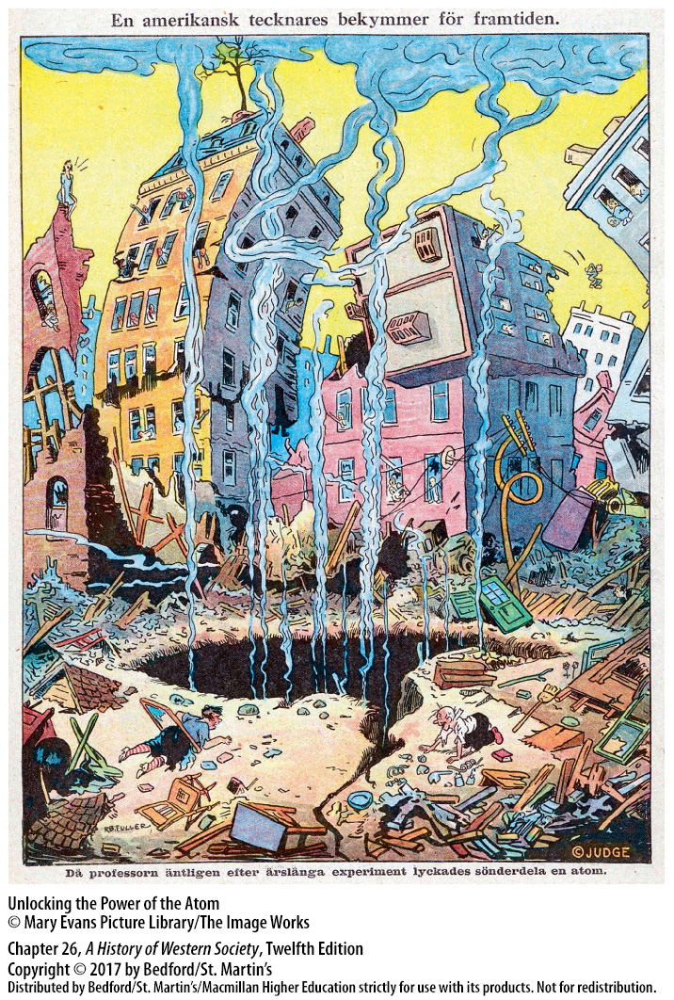

Slide 10
I. Uncertainty in Modern Thought
Freudian Psychology
1. Sigmund Freud
2. Id, ego, and superego
3. Civilization and Its Discontents (1930)
Notes:
I. Uncertainty in Modern Thought
D. Freudian Psychology
1. Before Sigmund Freud, most scientists assumed that the conscious mind processed sense experiences in a rational and logical way; human behavior in turn was the result of rational calculation—of “thinking.” Freud developed a different view of the human psyche; basing his insights on the analysis of dreams and of hysteria, Freud concluded that human behavior was basically irrational and governed by the unconscious, which contained vital instinctual drives and powerful memories.
2. Freud’s three structures of the self included the primitive, irrational id, which was entirely unconscious; the superego, the conscience or internalized voice of control, which Freud also identified as irrational; and the ego, the mostly conscious rational self that negotiated between the id and the superego.
3. In Civilization and Its Discontents (1930), Freud argued that civilization was possible only when individuals renounced their irrational instincts in order to live peaceably in groups; unfortunately, such renunciation left basic instincts unfulfilled and so led to widespread unhappiness.

Slide 11
II. Modernism in Architecture, Art, Literature, and Music
Architecture and Design
1. Chicago School of architects
2. Frank Lloyd Wright (1867–1959)
3. Le Corbusier (1887–1965)
4. Walter Gropius (1883–1969)
5. Bauhaus
Notes:
II. Modernism in Architecture, Art, Literature, and Music
A. Architecture and Design
1. In the 1890s the Chicago School of architects, led by Louis H. Sullivan (1856–1924), used inexpensive steel, reinforced concrete, and electric elevators to build skyscrapers and office buildings lacking almost any exterior ornamentation.
2. Sullivan’s student Frank Lloyd Wright (1867–1959) built a series of radically modern houses featuring low lines, open interiors, and mass-produced building materials.
3. In Towards a New Architecture (1923), the Franco-Swiss architect Le Corbusier (1887–1965) laid out a series of guidelines meant to revolutionize building design, arguing that architects should adopt the latest technologies.
4. In Germany in 1919 Walter Gropius (1883–1969) merged the schools of fine and applied arts at Weimar into a single interdisciplinary school, the Bauhaus.
5. Throughout the 1920s the Bauhaus, with its stress on functionalism and quality design for everyday goods, attracted enthusiastic students from all over the world.

Slide 13
II. Modernism in Architecture, Art, Literature, and Music
New Artistic Movements
1. Commercial art galleries and exhibition halls
2. Impressionism
3. Postimpressionists and expressionists
4. Cubism
5. Futurism
6. Dadaism
7. Surrealism
Notes:
II. Modernism in Architecture, Art, Literature, and Music
B. New Artistic Movements
1. Commercial art galleries and exhibition halls in the world’s major cities exhibited the new work, and young artists flocked to these cultural centers to participate in the new movements.
2. Impressionism blossomed in Paris in the 1870s; French artists such as Claude Monet (1840–1926) and Edgar Degas (1834–1917) and the American Mary Cassatt (1844–1926) tried to portray their sensory “impressions” of the world around them in their work.
3. Postimpressionists and expressionists, such as Vincent van Gogh (1853–1890), built on impressionist motifs of color and light but added a deep psychological element to their pictures.
4. In Paris in 1907, Pablo Picasso (1881–1973), along with other artists, established cubism—a highly analytical approach to art concentrated on a complex geometry of zigzagging lines and sharply angled overlapping planes.
5. In 1909 Italian Filippo Tommaso Marinetti (1876-1944) announced the founding of futurism, a radical art and literary movement that embraced modern technology and the future.
6. In 1916 a group of artists and intellectuals in exile in Zurich, Switzerland, championed a new movement they called Dadaism. Dadaists tried to shock their audiences with “anti-art”—works and public performances that were insulting and nonsensical—arguing that since the war had revealed that life is meaningless, art should also be meaningless.
7. Some Dadaists were attracted to surrealism; surrealists such as Salvador Dali (1904–1989) were deeply influenced by Freudian psychology and portrayed images of wild dreams and the unconscious in their art.

Slide 14
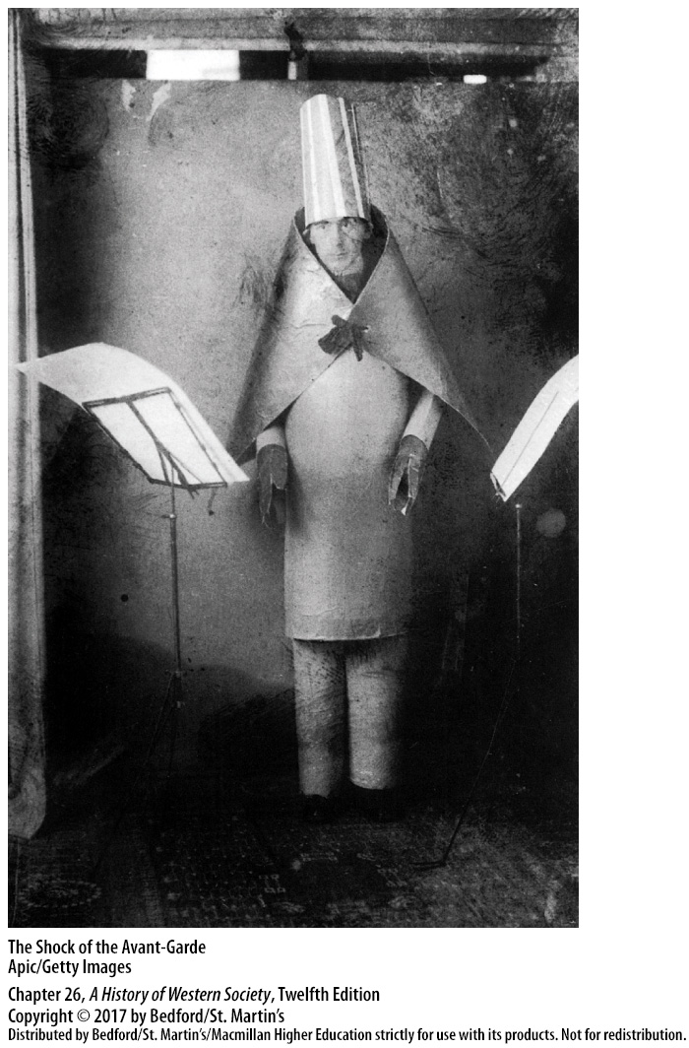

Slide 15
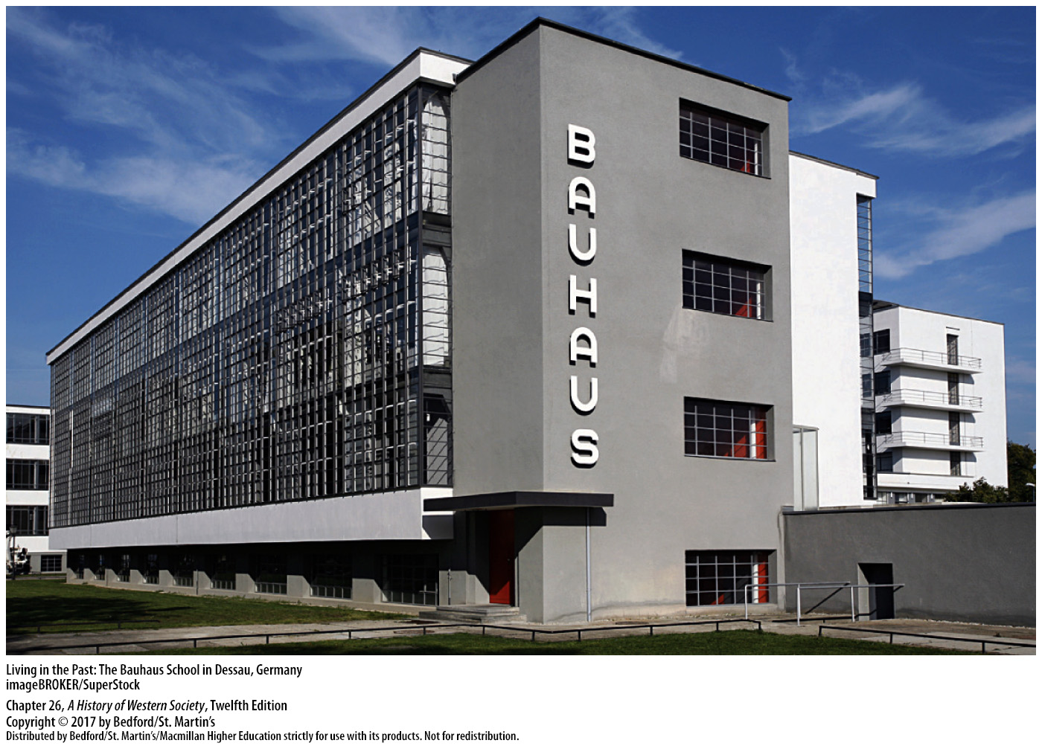

Slide 16
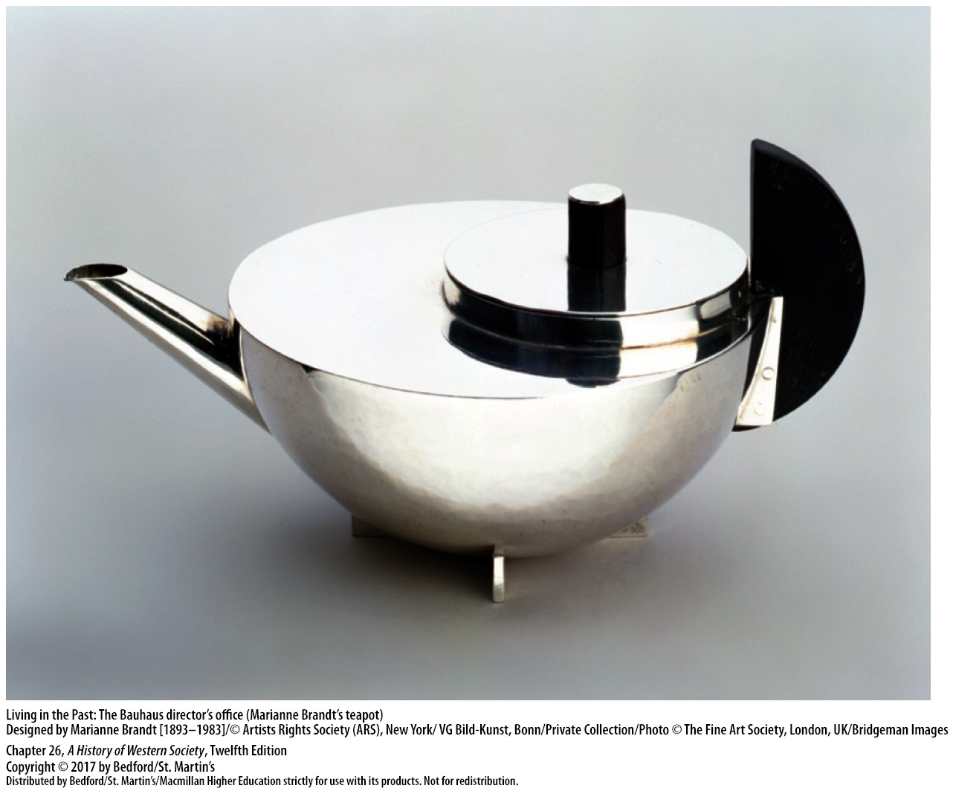

Slide 18
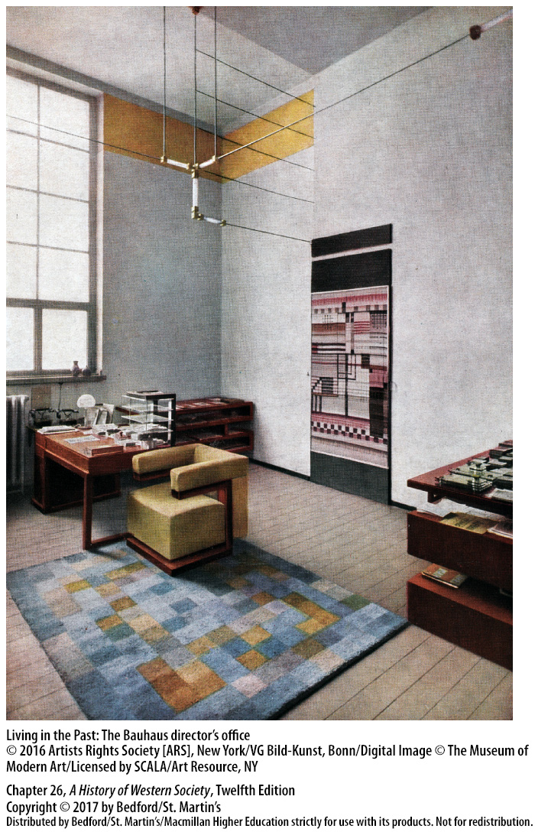

Slide 19
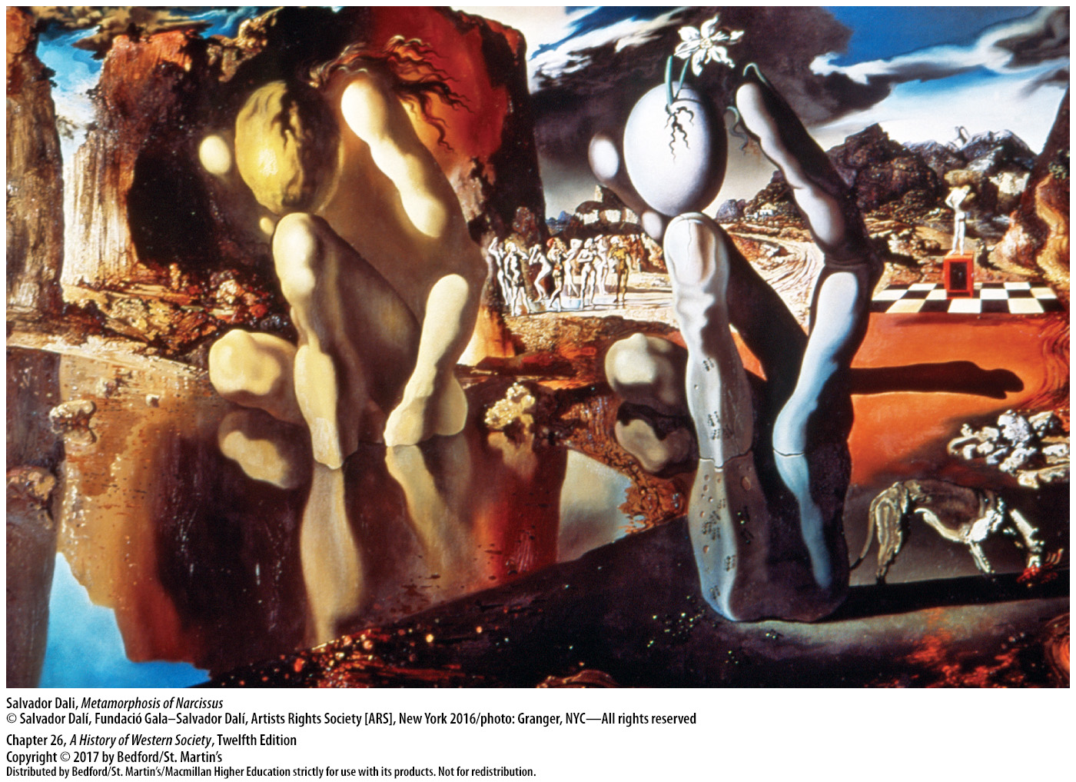

Slide 20
II. Modernism in Architecture, Art, Literature, and Music
Twentieth-Century Literature
1. Pessimism and alienation
2. Marcel Proust (1871–1922)
3. Stream-of-consciousness technique
4. The Waste Land by T. S. Eliot (1888–1965)
5. Franz Kafka (1883–1924)
Notes:
II. Modernism in Architecture, Art, Literature, and Music
C. Twentieth-Century Literature
1. Western literature was deeply influenced by the general intellectual climate of pessimism and alienation, as writers began to develop new techniques to express new realities. In the twentieth century, many novelists, paralleling Freud, focused their attention on the complexity and irrationality of the human mind, where feelings, memories, and desires are forever scrambled.
2. In Remembrance of Things Past (1913–1927), French novelist Marcel Proust (1871–1922) recalled bittersweet memories of childhood and youthful love and tried to discover their innermost meaning.
3. Some novelists used the stream-of-consciousness technique; for example, the 1922 novel Jacob’s Room by Virginia Woolf (1882–1941) is made up of a series of internal monologues in which Woolf tried to capture the inner voice in prose. William Faulkner (1897–1962), one of America’s greatest novelists, used the same technique in The Sound and the Fury (1929), with much of its intense drama confusedly seen through the eyes of a mentally disabled man. The most famous stream-of-consciousness novel is Ulysses (1922) by Irish novelist James Joyce (1882–1941), who weaves an extended ironic parallel between his hero’s wanderings through the streets of Dublin and the adventures of Homer’s hero Ulysses.
4. The Waste Land (1922) by T. S. Eliot (1888–1965) depicts a world of growing desolation and expresses the widespread despair that followed the First World War.
5. In The Metamorphosis (1915), The Trial (1925), and The Castle (1926), Czech writer Franz Kafka (1883–1924) portrayed an incomprehensible, alienating world in which helpless individuals are crushed by inexplicably hostile forces.

Slide 21
II. Modernism in Architecture, Art, Literature, and Music
Modern Music
1. Developments paralleled those in painting and fiction
2. The Rite of Spring by Russian composer Igor Stravinsky (1882–1971)
3. Wozzeck by Alban Berg (1885–1935)
4. Arnold Schönberg (1874–1951)
Notes:
II. Modernism in Architecture, Art, Literature, and Music
D. Modern Music
1. Developments in modern music paralleled those in painting and fiction, as composers and performers expressed emotional intensity and shock in radically experimental forms.
2. The ballet The Rite of Spring by Russian composer Igor Stravinsky (1882–1971) practically caused a riot when it was first performed in Paris in 1913.
3. The opera Wozzeck by Alban Berg (1885–1935)—a gruesome tale of a soldier driven by inner terrors and suspicion to murder his mistress—was first performed in Berlin in 1925 and blended a half-sung, half-spoken kind of dialogue with harsh, atonal music.
4. The modern atonal music composed by Arnold Schönberg (1874–1951) and others who abandoned traditional harmony and tonality in favor of independent and unrelated musical notes was generally resisted by audiences accustomed to the harmonies of classical and romantic music.

Slide 22
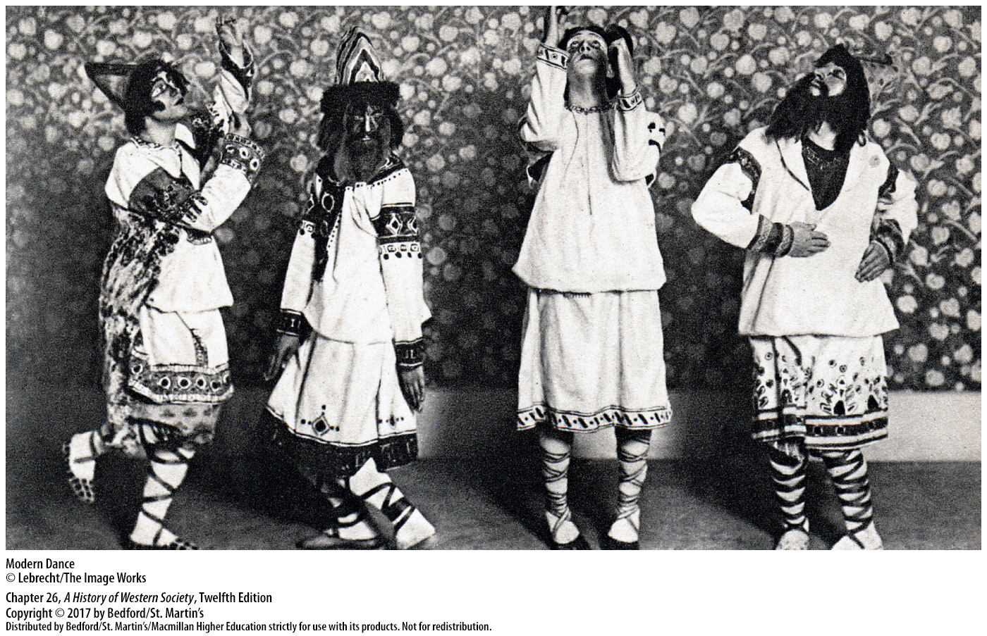

Slide 23
III. An Emerging Consumer Society
Mass Culture
1. Technological developments
2. Housework and private life
3. Mass production and marketing of automobiles 4. Commercialized mass entertainment
Notes:
III. An Emerging Consumer Society
Mass Culture
1. In the 1920s a number of technological developments led to a revolution in the way consumer goods were made, marketed, and used by ordinary people. Consumer goods themselves seemed to modernize society by changing ingrained habits; some people embraced the new ways, while others worried that the modern consumer culture threatened familiar values and precious traditions.
2. Housework and private life were increasingly organized around an array of modern appliances, and the aggressive marketing of fashionable clothing and personal care products encouraged a cult of youthful “sex appeal” determined by the use of brand-name products.
3. The mass production and marketing of automobiles and the rise of tourist agencies opened roads to increased mobility and travel.
4. Commercialized mass entertainment, including movies, radio, professional sporting events, and print media, likewise prospered and began to dominate the way people spent their leisure time.

Slide 24
III. An Emerging Consumer Society
Mass Culture
5. Department stores
6. The “modern girl”
7. Complaints from cultural critics
Notes:
III. An Emerging Consumer Society
Mass Culture
5. Department stores epitomized the emergence of consumer society, making optimum use of aggressive advertising campaigns, youthful and attractive salespeople, and easy credit and return policies to attract customers in droves.
6. Contemporaries spoke repeatedly about the arrival of the “modern girl,” a surprisingly independent female who could vote and held a job, spent her salary on the latest fashions, applied makeup, smoked cigarettes, and used her sex appeal to charm young men. The “modern girl” was in some ways a stereotype, a product of marketing campaigns and an image that few young women could afford to live up to, and yet the emergence of consumer society did loosen traditional limits on women’s behavior.
7. The emerging consumer culture generated a chorus of complaints from cultural critics of all stripes: socialist writers feared that workers would turn into passive consumers; conservatives bemoaned the money spent on mass-produced goods; and religious leaders worried that materialism was replacing spirituality.

Slide 25
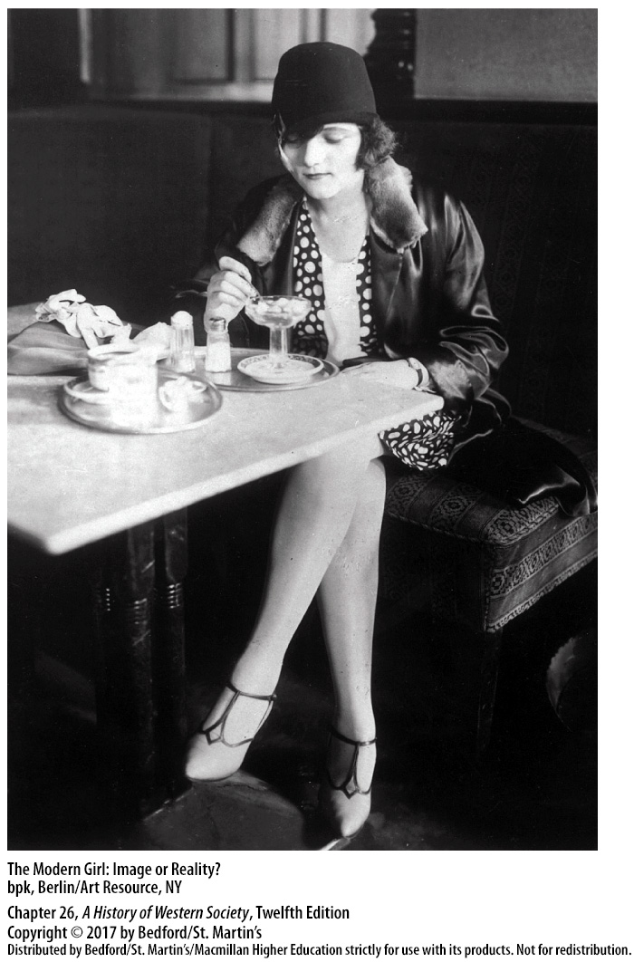

Slide 27
III. An Emerging Consumer Society
The Appeal of Cinema
1. “Movie factories”
2. World War I and the film industry
3. Mass medium on an international scale
4. Motion pictures for the masses
5. Lenin and Soviet film
6. Sergei Eisenstein (1898–1948)
7. Leni Riefenstahl (1902–2003)
Notes:
III. An Emerging Consumer Society
B. The Appeal of Cinema
1. By 1910 American directors and business people had set up “movie factories,” at first in the New York area and then in Los Angeles, and by 1914 production companies had formed in Great Britain, France, Germany, and Italy.
2. World War I quickened the development of the film industry, as national leaders realized that movies offered distraction to troops and citizens and served as an effective means of spreading propaganda.
3. Cinema became a true mass medium in the 1920s, and film making became big business on an international scale as studios competed to place their movies on foreign screens.
4. Motion pictures became the main entertainment of the masses, as growing numbers of people flocked to gigantic, splendid movie palaces built to seat thousands.
5. Because motion pictures could be powerful tools of indoctrination, Lenin encouraged the development of Soviet film making, believing that the new medium was essential to the social and ideological transformation of the country.
6. In the mid-1920s, a series of epic films, the most famous of which were directed by Sergei Eisenstein (1898–1948) dramatized the Communist view of Russian history.
7. In Nazi Germany, Leni Riefenstahl (1902–2003) directed a masterpiece of documentary propaganda, Triumph of the Will, which combined stunning aerial photography with mass processions of young Nazis and images of joyful crowds welcoming Adolf Hitler.

Slide 28
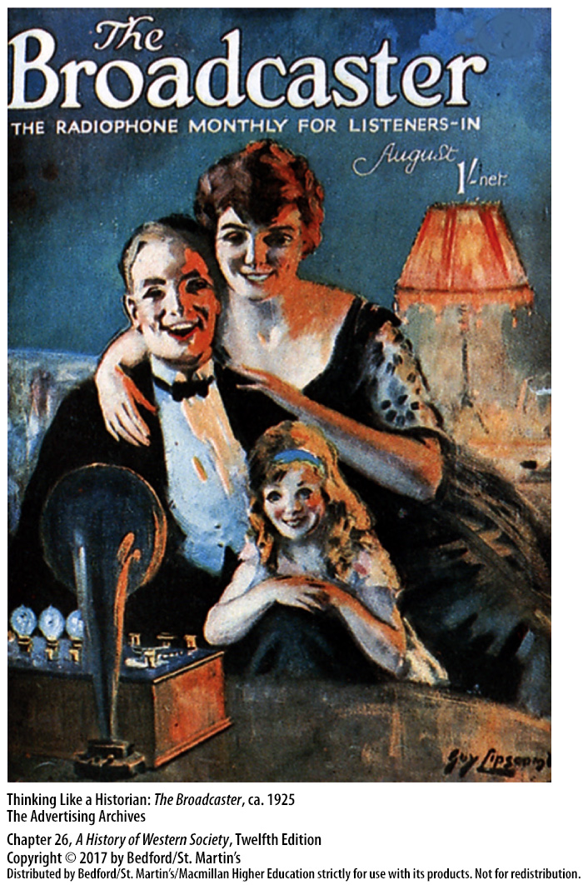

Slide 29
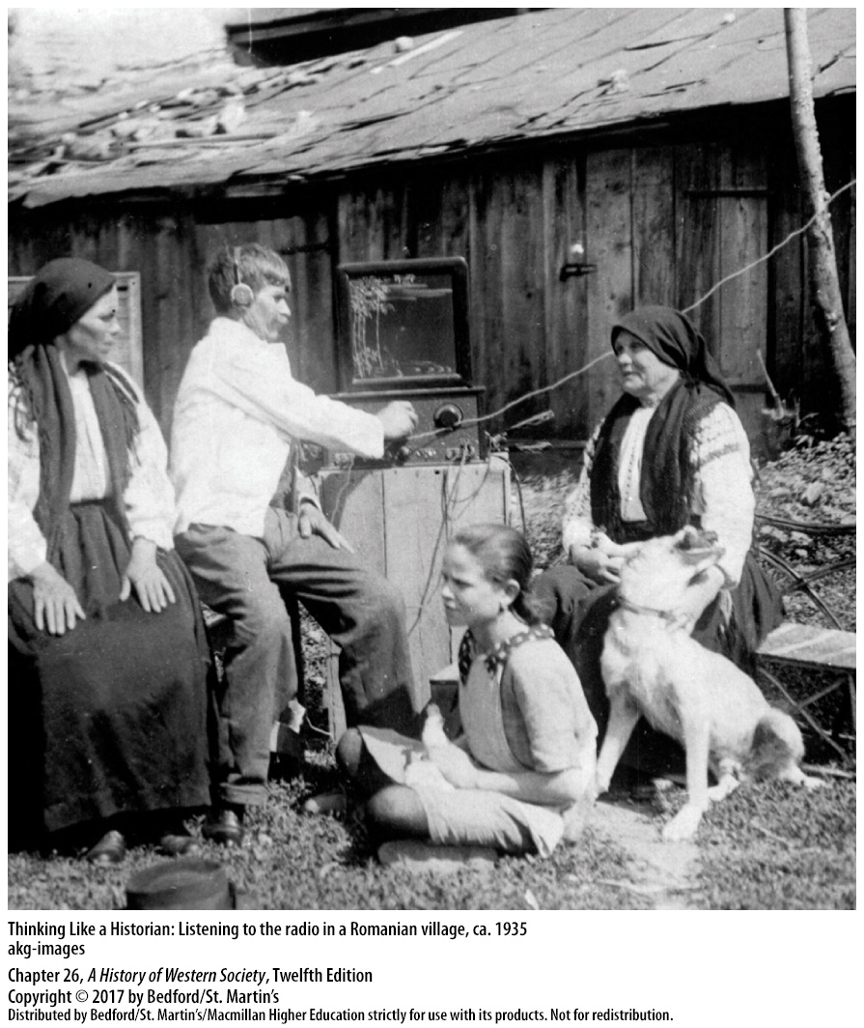

Slide 30
III. An Emerging Consumer Society
The Arrival of Radio
1. Guglielmo Marconi (1874–1937)
2. National broadcasting networks
3. British Broadcasting Corporation (BBC)
4. Political propaganda
5. “Fireside chats”
Notes:
III. An Emerging Consumer Society
C. The Arrival of Radio
1. The work of the Italian inventor Guglielmo Marconi (1874–1937) and development of the vacuum tube in 1904 made possible primitive transmissions of speech and music, but the first major public broadcasts occurred in 1920 in Great Britain and the United States.
2. Every major country quickly established national broadcasting networks; in the United States such networks were privately owned and were financed by advertising, but in Europe the typical pattern was direct control by the government.
3. In Great Britain, Parliament set up an independent public corporation, the British Broadcasting Corporation (BBC), supported by licensing fees.
4. Radio was well suited for political propaganda; dictators such as Hitler and Italy’s Benito Mussolini controlled the airwaves and could reach enormous national audiences with their dramatic speeches.
5. In democratic countries, American president Franklin Roosevelt and British prime minister Stanley Baldwin used the radio for informal “fireside chats” to bolster their popularity.

Slide 31
IV. The Search for Peace and Political Stability
Germany and the Western Powers
1. International view of the Treaty of Versailles
2. John Maynard Keynes (1883–1946)
3. Germany to pay 132 billion gold marks
4. France and Belgium occupy the Ruhr district
Notes:
IV. The Search for Peace and Political Stability
A. Germany and the Western Powers
1. To Germans, the Treaty of Versailles represented a harsh, dictated peace, to be revised or repudiated as soon as possible. French politicians, on the other hand, believed that massive reparations from Germany were vital for economic recovery because they covered the expected costs of reconstruction in France, as well as repayment of war debts, and ensured France’s security by holding Germany down indefinitely. The British soon felt differently, recognizing that a healthy, prosperous Germany was essential to the British economy.
2. This analysis was articulated by English economist John Maynard Keynes (1883–1946), who eloquently denounced the Treaty of Versailles in his book The Economic Consequences of the Peace (1919), warning that astronomical reparations and harsh economic measures would impoverish Germany, encourage Bolshevism, and increase economic hardship in all countries.
3. As French and British leaders drifted in different directions, the Allied reparations commission announced in April 1921 that Germany had to pay the enormous sum of 132 billion gold marks ($33 billion) in annual installments of 2.5 billion gold marks.
4. Despite strong British protests, in early January 1923 armies of France and its ally Belgium began to occupy the Ruhr district, the heartland of industrial Germany, with the intention of using occupation to paralyze Germany and force it to accept the Treaty of Versailles. Strengthened by a wave of patriotism, the German government ordered the people of the Ruhr to stop working and passively resist the occupation; in response, the French sealed off the Ruhr and Rhineland from the rest of Germany and sent colonial troops from North and West Africa to control the territory.

Slide 32
IV. The Search for Peace and Political Stability
Germany and the Western Powers
5. Germany prints money, causing inflation
6. Nazi Party capitalized on discontent
7. Gustav Stresemann (1878–1929)
Notes:
IV. The Search for Peace and Political Stability
A. Germany and the Western Powers
5. To support the striking workers and their employers, the German government began to print money to pay its bills, causing runaway inflation and soaring prices as German money rapidly lost all value.
6. Many Germans felt betrayed and blamed the Western governments, their own government, big business, Jews, workers, and Communists; right-wing nationalists, including Adolf Hitler and the newly established Nazi Party, eagerly capitalized on the widespread discontent.
7. In August 1923 Gustav Stresemann (1878–1929) assumed leadership of the German government and tried to compromise, calling off passive resistance in the Ruhr and agreeing in principle to pay reparations if the Allies would re-examine Germany’s ability to pay; Raymond Poincaré (1860–1934), the French prime minister, accepted.

Slide 33
IV. The Search for Peace and Political Stability
Hope in Foreign Affairs
1. Dawes Plan
2. Private loans from the United States
3. Political settlement
4. Settled boundary disputes
5. League of Nations and the Kellogg-Briand Pact
Notes:
IV. The Search for Peace and Political Stability
B. Hope in Foreign Affairs
1. In 1924 an international committee of financial experts met to re-examine reparations, and the resulting Dawes Plan (1924) reduced Germany’s yearly reparations and linked them to the level of German economic output.
2. In addition, Germany would receive private loans from the United States in order to pay reparations to France and Britain, thus enabling those countries to repay the large war debts they owed the United States.
3. The economic accords were accompanied by a political settlement in 1925, as Germany and France solemnly pledged to accept their common border and Britain and Italy agreed to fight either France or Germany if one invaded the other.
4. Stresemann reluctantly agreed to settle boundary disputes with Poland and Czechoslovakia, although he did not agree to permanent borders to Germany’s east, which angered the Poles.
5. Other developments strengthened hopes for international peace: Germany joined the League of Nations in 1926, and in 1928 fifteen countries signed the Kellogg-Briand Pact, renouncing war as an instrument of international policy and fostering a cautious optimism.

Slide 34
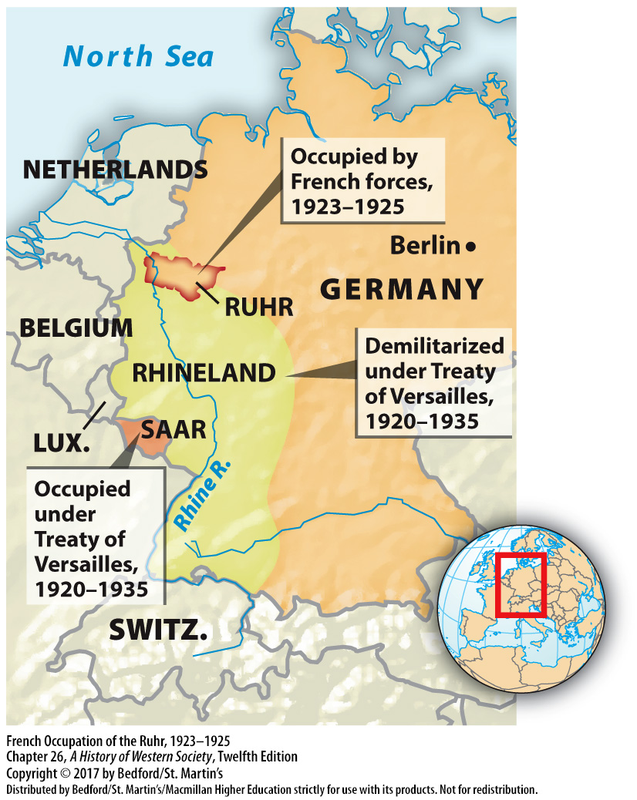

Slide 35
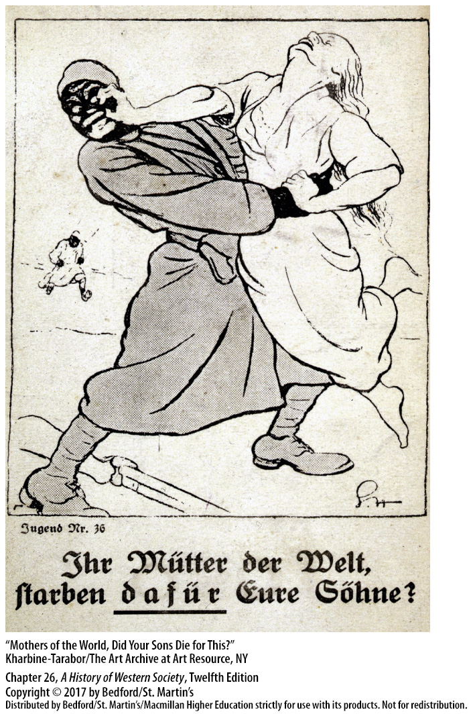

Slide 36
IV. The Search for Peace and Political Stability
Hope in Democratic Government
1. Hitler’s “national socialist revolution” led to prison sentence
2. Liberal democracy in Weimar Germany
3. Nazi Party still had support
4. Post-war France
Notes:
IV. The Search for Peace and Political Stability
C. Hope in Democratic Government
1. In November 1923 an obscure politician named Adolf Hitler proclaimed a “national socialist revolution,” but Hitler’s plot to seize control was easily crushed and he was sentenced to prison.
2. In the late 1920s, liberal democracy seemed to take root in Weimar Germany, as a new currency was established and the economy stabilized; elections were held regularly, and support for the republican democracy appeared to be growing among a majority of Germans. Moderate businessmen were convinced that economic prosperity demanded good relations with the Western Powers, and they supported parliamentary government at home.
3. However, the country was sharply divided politically, with the Nazi Party attracting support from fanatical anti-Semites, ultranationalists, and disgruntled ex-servicemen; nationalists and monarchists on the right and in the army; noisy and active Communist Party members on the left; and the nonrevolutionary Social Democrats supported by a majority of the working classes.
4. France’s rapid rebuilding of its war-torn northern region was an expensive undertaking that led to a large deficit and substantial inflation, causing a severe crisis as the franc fell to 10 percent of its prewar value. The newly recalled Poincaré government slashed spending and raised taxes, restoring confidence in the economy and stabilizing the franc.

Slide 37
IV. The Search for Peace and Political Stability
Hope in Democratic Government
5. Post-war Britain
6. Ireland gets autonomy
Notes:
IV. The Search for Peace and Political Stability
C. Hope in Democratic Government
5. Britain met the problem of high unemployment by providing unemployment benefits and supplementing those payments with subsidized housing, medical aid, and increased old-age pensions, which kept living standards from seriously declining and helped moderate social tensions. The Labour Party, committed to moderate revisionist socialism, replaced the Liberal Party as the main opposition to the Conservatives, a shift that reflected the decline of old liberal ideals of competitive capitalism, limited government control, and individual responsibility.
6. In 1922, after a bitter guerrilla war, Britain granted southern, Catholic Ireland full autonomy, thereby removing a key source of prewar friction.

Slide 38
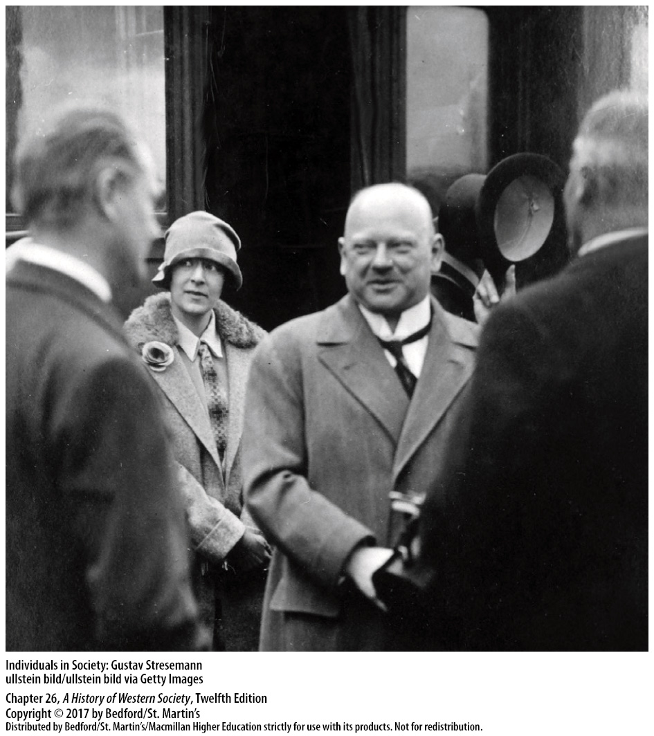

Slide 39
V. The Great Depression, 1929–1939
The Economic Crisis
1. U.S. stock market crash initiated a worldwide crisis
2. Prices fell, production slowed down, unemployment rose
3. U.S. bankers recall foreign business loans
4. Worldwide general crisis of production
5. Each country tried to manage the crisis alone
Notes:
V. The Great Depression, 1929–1939
A. The Economic Crisis
1. Though economic activity was already declining moderately in many countries by early 1929, the crash of the stock market in the United States in October of that year initiated a worldwide crisis.
2. Stripped of wealth and confidence, battered investors and their fellow citizens started buying fewer goods; prices fell, production slowed down, and unemployment rose, and soon the entire American economy was caught in a downward spiral.
3. Once the panic broke, U.S. bankers began recalling the loans they had made to foreign businesses, making it difficult for business people to borrow money and causing panicky Europeans to withdraw their savings from banks. American bankers’ recall of loans also accelerated a collapse in world prices when businesses dumped industrial goods and agricultural commodities in a frantic attempt to get cash to pay their loans.
4. The financial crisis led to a general crisis of production: between 1929 and 1933, world output of goods fell by an estimated 38 percent.
5. Each country tried to manage the crisis alone; for example, Britain and the United States both went off the gold standard to make their goods cheaper and more salable in the world market, but to little effect. Country after country followed the example of the United States and raised protective tariffs to their highest levels ever, further limiting international trade.

Slide 40
V. The Great Depression, 1929–1939
Mass Unemployment
1. Lack of large-scale government spending
2. Dramatic increase in poverty
3. Homes and ways of life were disrupted
Notes:
V. The Great Depression, 1929–1939
B. Mass Unemployment
1. The lack of large-scale government spending contributed to the rise of mass unemployment: in Britain, unemployment averaged more than 18 percent between 1930 and 1935; in Germany, one in every three workers was jobless in 1932; and in the United States, unemployment soared to about 30 percent in 1933.
2. Mass unemployment caused a dramatic increase in poverty, although in most countries, unemployed workers generally received some kind of meager unemployment benefits or public aid that prevented starvation.
3. Homes and ways of life were disrupted in millions of personal tragedies; young people postponed marriages, birthrates fell sharply, and the incidence of suicide and mental illness increased.

Slide 41
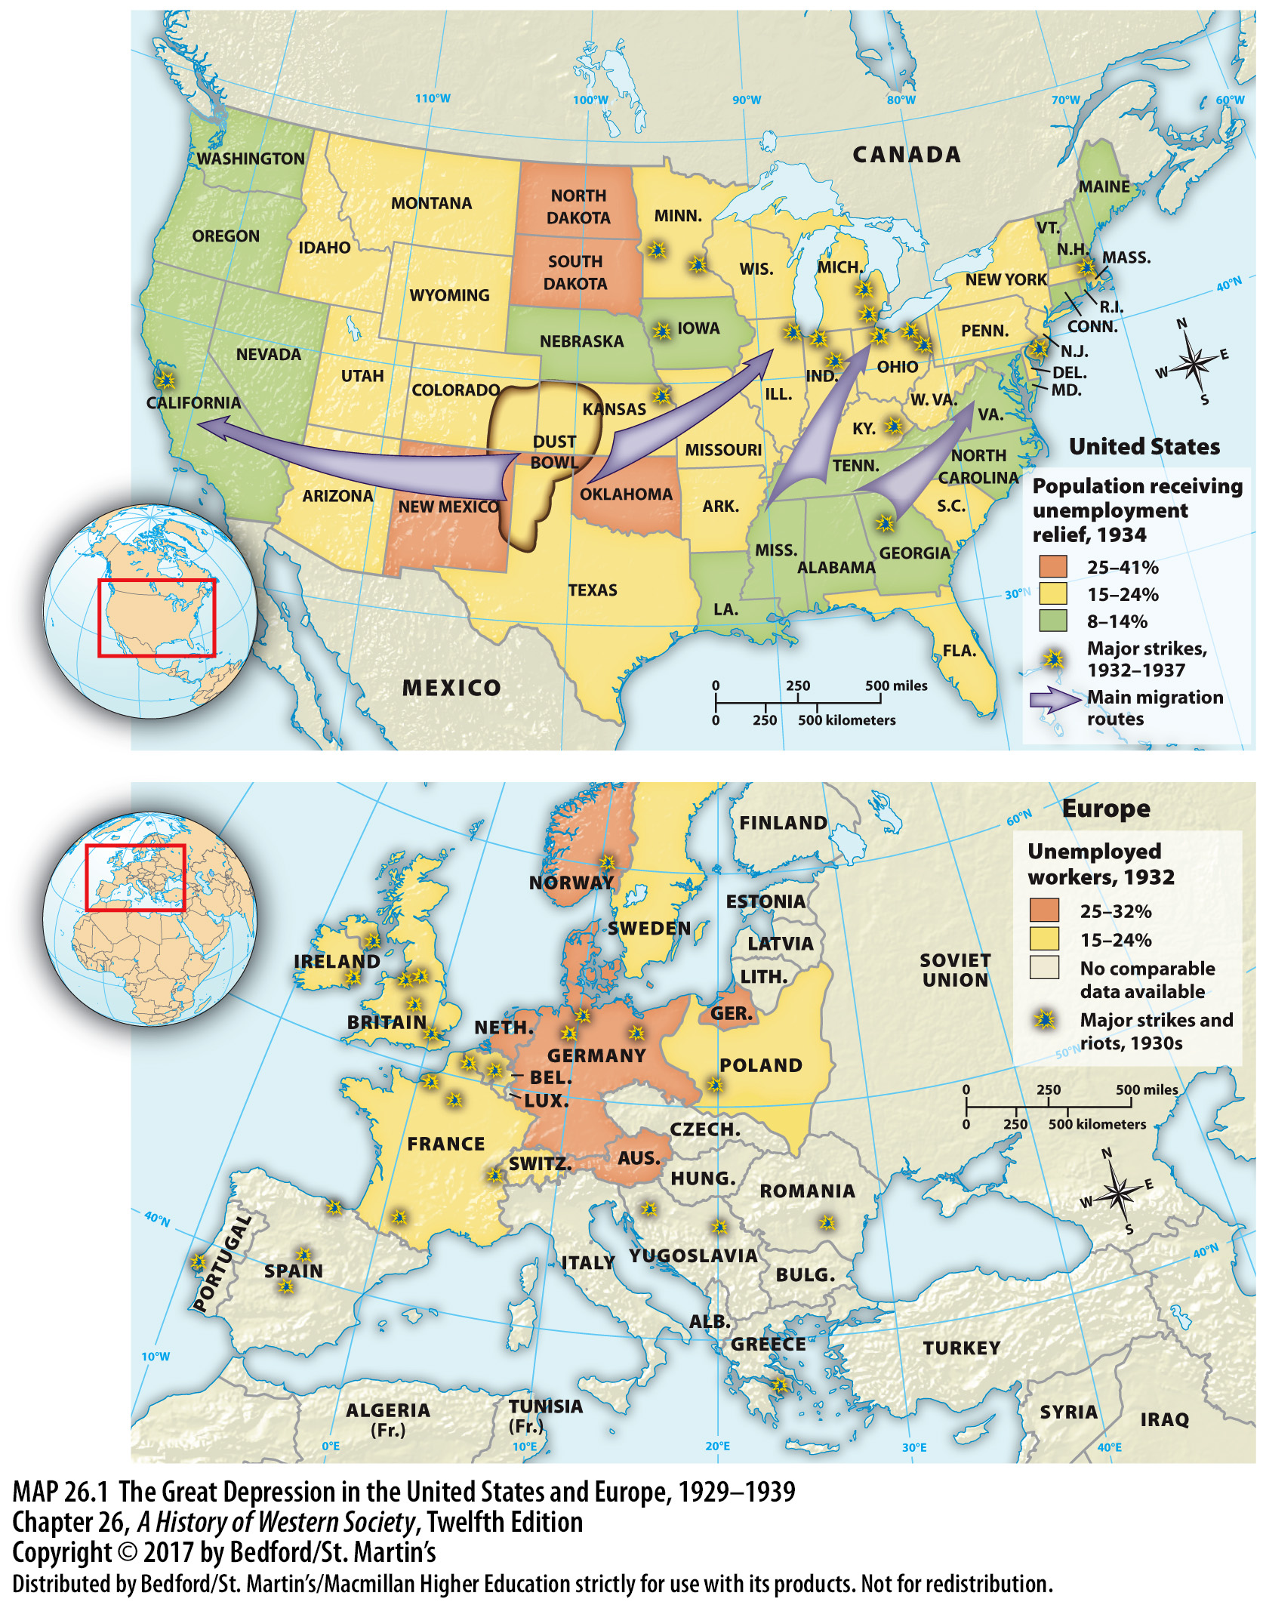

Slide 42
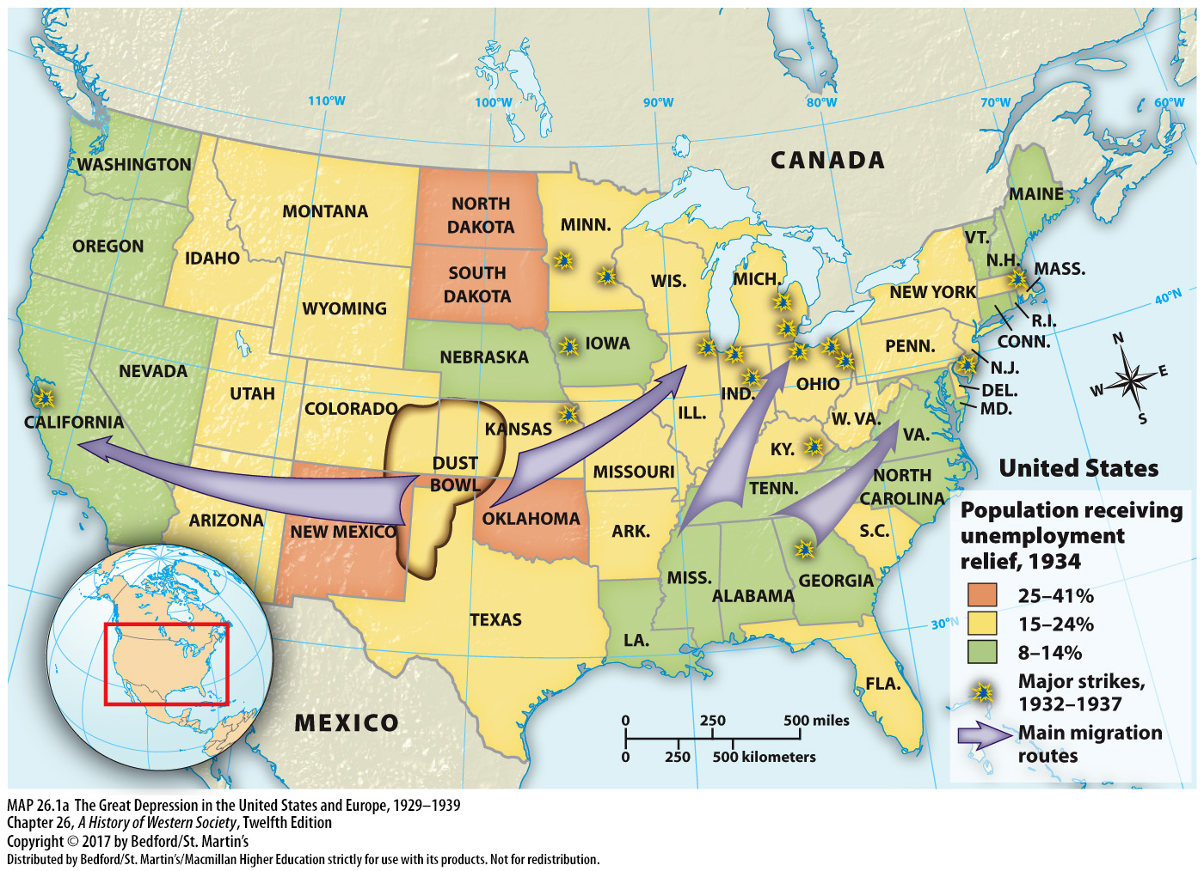

Slide 43
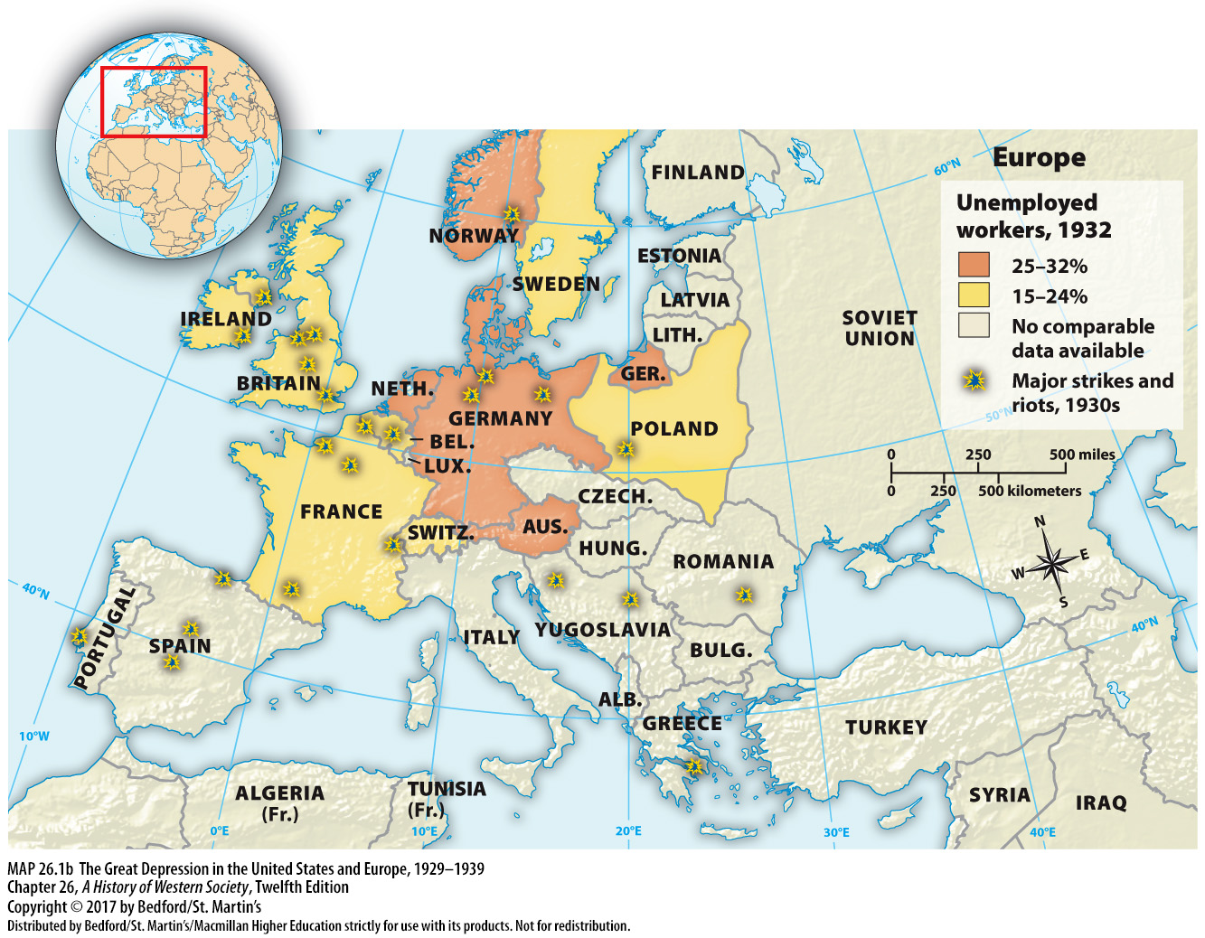

Slide 44
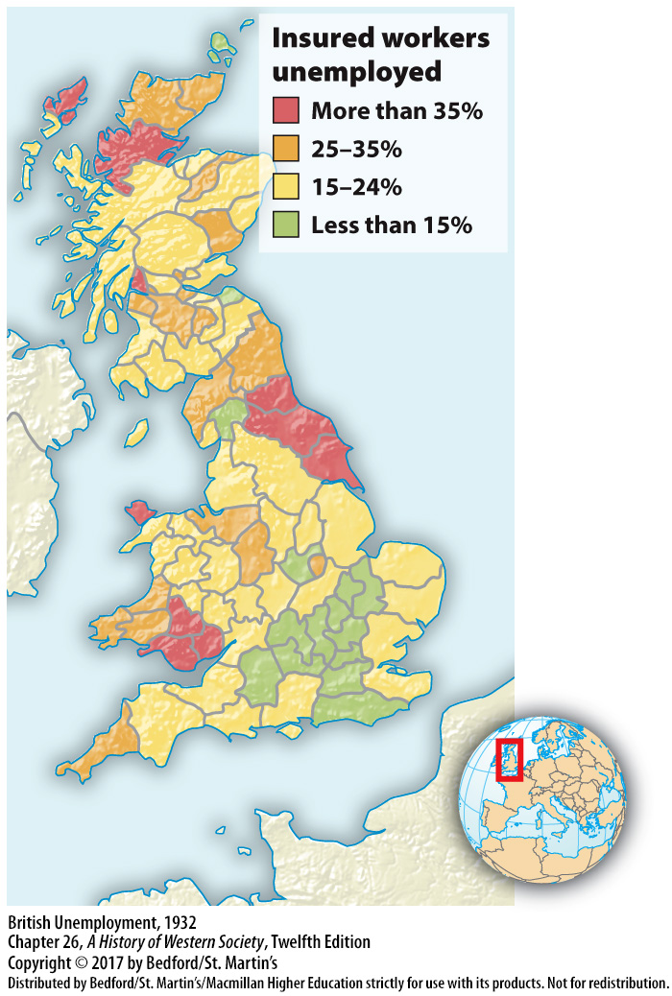

Slide 45
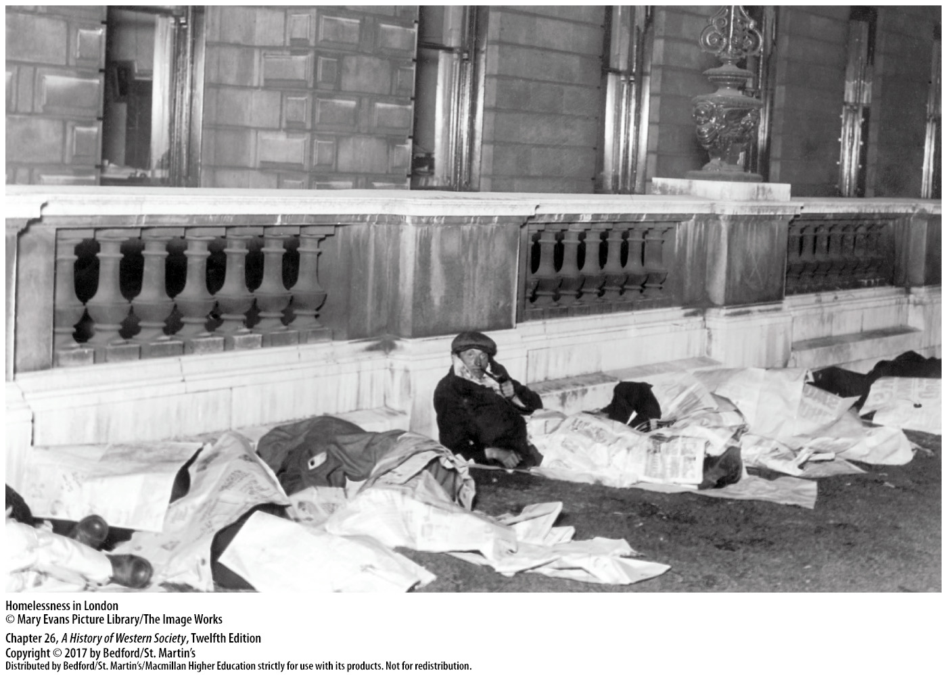

Slide 46
V. The Great Depression, 1929–1939
The New Deal in the United States
1. Franklin Delano Roosevelt (r. 1933–1945)
2. Federal programs for agricultural recovery
3. National Recovery Administration (NRA)
4. Works Progress Administration (WPA)
5. National social security system
6. The National Labor Relations Act of 1935
Notes:
V. The Great Depression, 1929–1939
C. The New Deal in the United States
1. Franklin Delano Roosevelt (r. 1933–1945) won a landslide presidential victory in 1932 with grand but vague promises of a “New Deal for the forgotten man” and with the goal of reforming capitalism in order to preserve it. Although Roosevelt rejected socialism and government ownership of industry, he advocated forceful government intervention in the economy and instituted a broad range of government-supported social programs designed to stimulate the economy and provide jobs.
2. In the United States, innovative federal programs promoted agricultural recovery, a top priority.
3. The most ambitious attempt to control and plan the economy was the National Recovery Administration (NRA), which broke with the American tradition of free competition and thus was declared unconstitutional by the Supreme Court in 1935.
4. The federal government accepted the responsibility of employing as many people as financially possible, creating new agencies—such as the Works Progress Administration (WPA)—to undertake a vast range of projects that included constructing public buildings, bridges, and highways.
5. In 1935 the U.S. government also established a national social security system with old-age pensions and unemployment benefits.
6. The National Labor Relations Act of 1935 declared collective bargaining to be the policy of the United States, and union membership more than doubled from 4 to 9 million between 1935 and 1940.

Slide 47
V. The Great Depression, 1929–1939
The Scandinavian Response to the Depression
1. Social Democratic leadership was successful
2. Social reform legislation for peasants, workers
3. Use of large-scale deficits to finance public works
4. Social welfare benefits
5. Large bureaucracy and high taxes
6. Both private and cooperative enterprise thrived
Notes:
V. The Great Depression, 1929–1939
D. The Scandinavian Response to the Depression
1. The Scandinavian countries under Social Democratic leadership responded most successfully to the challenge of the Great Depression.
2. In the 1920s the Social Democrats in Sweden and Norway passed important social reform legislation that benefited both peasants and workers and developed a flexible and nonrevolutionary kind of socialism.
3. Scandinavian socialism grew out of a strong tradition of cooperative community action and pioneered the use of large-scale deficits to finance public works and thereby maintain production and employment.
4. Scandinavian socialism also increased social welfare benefits such as old-age pensions, unemployment insurance, subsidized allowances, and maternity allowances.
5. All this spending required a large bureaucracy and high taxes, first on the rich and then on practically everyone.
6. Yet both private and cooperative enterprise thrived, as did democracy.

Slide 48
V. The Great Depression, 1929–1939
Recovery and Reform in Britain and France
1. Britain: orthodox economic theory and concentration on national market
2. French Fascist organizations vs French Communist Party
3. The Popular Front
Notes:
V. The Great Depression, 1929–1939
E. Recovery and Reform in Britain and France
1. In Britain, MacDonald’s Labour government and then, after 1931, the Conservative-dominated coalition government followed orthodox economic theory in balancing the budget, tightly controlling spending, and doling out the bare minimum of welfare to unemployed workers. Britain concentrated increasingly on the national, rather than the international, market, and new industries, such as automobiles and electrical appliances, grew in response to British home demand, while low interest rates encouraged a housing boom.
2. French Fascist organizations agitated against parliamentary democracy and turned to Mussolini’s Italy and Hitler’s Germany for inspiration, while the French Communist Party and many workers opposed to the existing system looked to Stalin’s Russia for guidance.
3. Frightened by the growing strength of the Fascists at home and abroad, the Communists, the Socialists, and the Radicals formed an alliance—the Popular Front—for the national elections of May 1936 and won a clear victory that reflected the trend toward polarization.

Slide 49
V. The Great Depression, 1929–1939
Recovery and Reform in Britain and France
4. Union movement and social reform
5. Spanish Civil War (1936–1939)
6. Popular Front collapsed
Notes:
V. The Great Depression, 1929–1939
E. Recovery and Reform in Britain and France
4. To deal with the social and economic problems of the 1930s, the Popular Front government led by Léon Blum, a Socialist, encouraged the union movement and launched a far-reaching program of social reform, complete with paid vacations and a forty-hour workweek. These measures were quickly sabotaged by rapid inflation and accusations of revolution from Fascists and frightened conservatives, and when France entered a severe financial crisis, Blum was forced to announce a “breathing spell” in social reform.
5. Political dissension in France was encouraged by the Spanish Civil War (1936–1939), during which authoritarian Fascist rebels overthrew the democratically elected republican government.
6. Extremism grew, and France itself was within sight of civil war; Blum was forced to resign in June 1937, and the Popular Front quickly collapsed.

Slide 50
