Slide 1
A History of Western Society Twelfth Edition
McKay • Crowston • Wiesner-Hanks • Perry
CHAPTER 25
War and Revolution
1914–1919
Copyright © 2017 by Bedford/St. Martin’s
Distributed by Bedford/St. Martin's/Macmillan Higher Education strictly for use with its products; Not for redistribution.

Slide 2
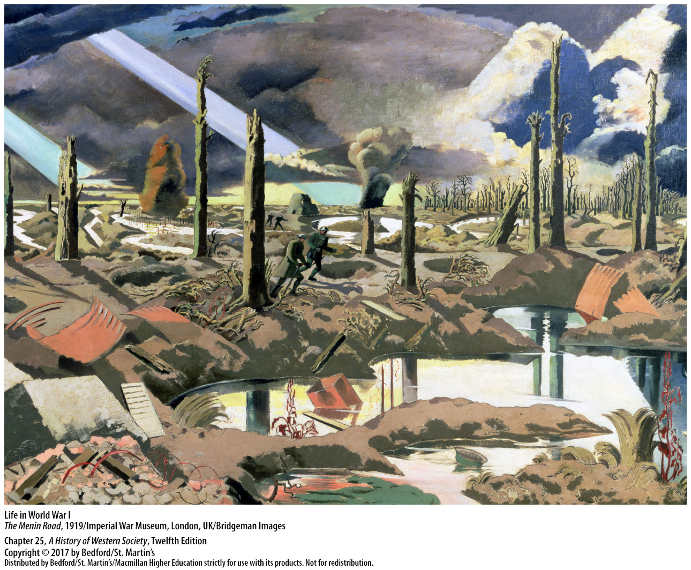

Slide 3
I. The Road to War
Growing International Conflict
1. Germany’s rise to Great Power status
2. Bismarck declared that Germany was a “satisfied” power
3. Bismarck’s concern of the threat to posed by the multinational empires of Austria-Hungary and Russia
4. Foreign policy
5. Germany refused to renew a nonaggression pact with Russia
Notes:
The Road to War
Growing International Conflict
1. The First World War began, in part, because European statesmen did not resolve diplomatic problems created by Germany’s rise to Great Power status.
2. Bismarck declared after 1871 that Germany was a “satisfied” power that had no territorial ambitions and wanted only peace; his first concern was to keep an embittered France diplomatically isolated and without allies.
3. Another concern of Bismarck’s was the threat to peace posed by the multinational empires of Austria-Hungary and Russia, particularly in southeastern Europe, where the waning strength of the Ottoman Empire was creating a power vacuum in the Balkans.
4. Bismarck’s accomplishments in foreign policy were great, but his carefully planned alliance system began to unravel after the new German emperor William II dismissed him in 1890.
5. Germany refused to renew a nonaggression pact with Russia, the centerpiece of Bismarck’s system, in spite of Russia’s willingness to do so, which prompted France to court Russia with offers of loans, arms, and support.

Slide 4
I. The Road to War
Growing International Conflict
6. Two rival blocs
7. Britain was the only uncommitted Great Power
8. Prussia and Great Britain
9. Response to German expansion
10. William II declared Morocco an independent, sovereign state
Notes:
The Road to War
Growing International Conflict
6. Two rival blocs emerged—the Triple Alliance of Austria, Germany, and Italy faced an increasingly hostile Dual Alliance of Russia and France—as the Germans began secret preparations for a war on two fronts.
7. After 1891 Britain was the only uncommitted Great Power.
8. The good relations that had prevailed between Prussia and Great Britain since the mid-eighteenth century gave way to a bitter Anglo-German rivalry stemming from commercial rivalry in world markets, Germany’s new status as a great industrial power, Germany’s ambitious pursuit of colonies, and Germany’s decision in 1900 to expand its battle fleet.
9. In response to German expansion, Britain improved its often-strained relations with the United States, concluded an alliance with Japan in 1902, and allied with France in the Anglo-French Entente of 1904.
10. In 1905 William II declared Morocco an independent, sovereign state in an aggressive, saber-rattling move, termed the First Moroccan Crisis, which challenged long-standing French colonial interests.

Slide 5
I. The Road to War
Growing International Conflict
11. Britain, France, Russia, United States began to see Germany as a potential threat
12. Anglo-Russian Agreement
13. Germany’s expanding navy
14. Britain saw the German buildup as a military challenge
15. Failure to incorporate Bismarck’s empire permanently and peacefully into the international system
Notes:
The Road to War
Growing International Conflict
11. Britain, France, Russia, and even the United States began to see Germany as a potential threat, and German leaders began to see plots to encircle Germany and block its development as a world power.
12. Russia agreed to settle its quarrels with Great Britain over Persia and Central Asia and signed the Anglo-Russian Agreement, which laid the foundation for the Triple Entente, an alliance between Britain, Russia, and France prior to the First World War.
13. Germany’s decision to add a large, enormously expensive fleet of big-gun battleships to its already expanding navy, which German patriots saw as the legitimate right of a great world power, also heightened tensions.
14. Britain saw the German buildup as a military challenge that forced it to spend the “People’s Budget” on battleships rather than social welfare.
15. The division of Europe’s leading nations into two hostile camps—the Triple Entente and the German-led Triple Alliance—confirmed the failure of all European leaders to incorporate Bismarck’s mighty empire permanently and peacefully into the international system.

Slide 6
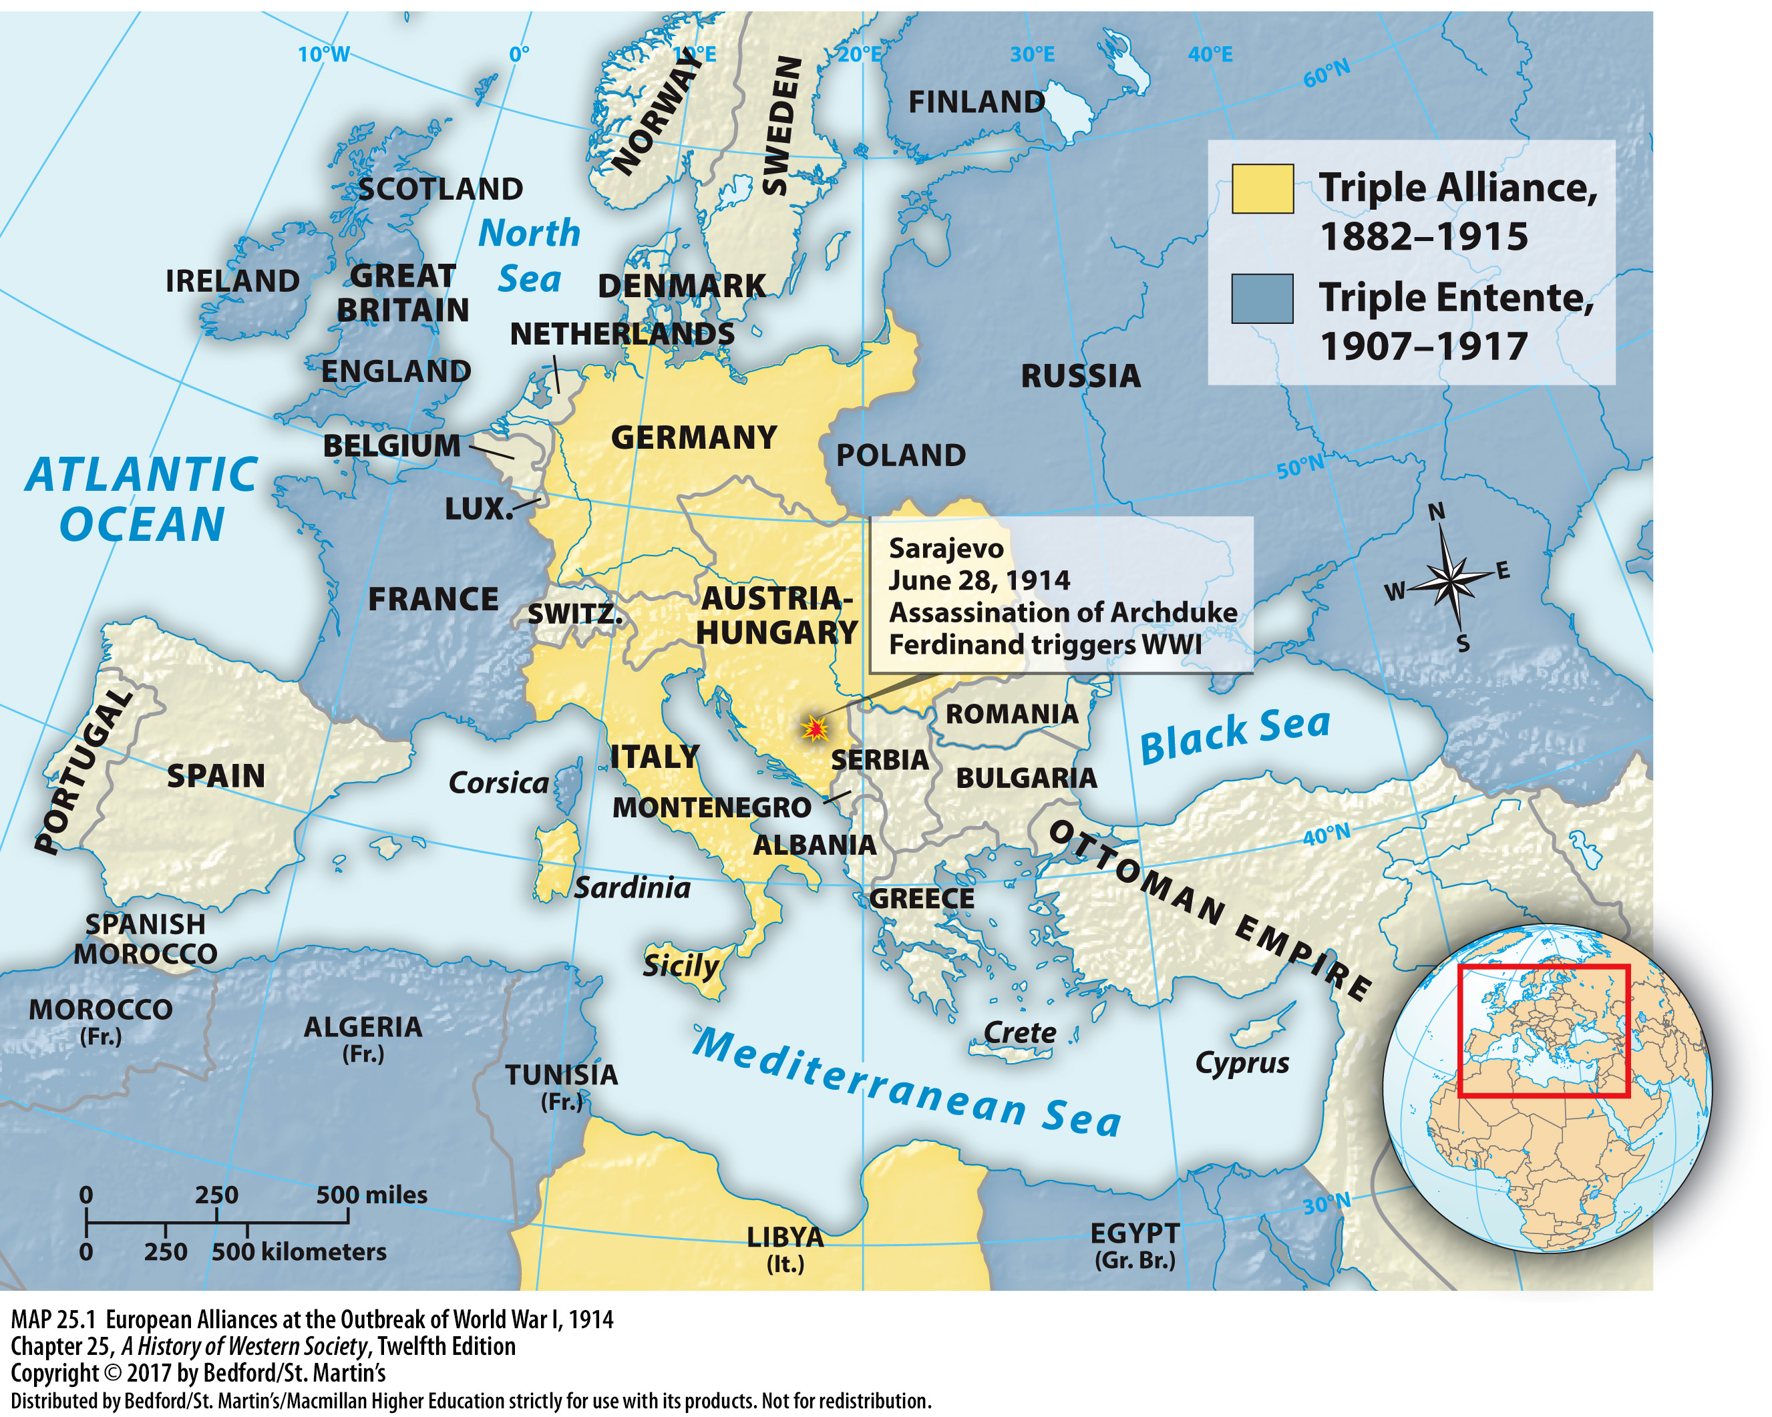

Slide 7
I. The Road to War
The Mood of 1914
1. Germany was famous for its powerful and aggressive army
2. All the great powers built up their armed forces and designed mobilization plans
3. Europeans underestimated the destructive potential of modern weapons
4. Many believed that war was heroic and that any conflict would be over quickly
Notes:
The Road to War
B. The Mood of 1914
1. Germany was famous for its powerful and aggressive army, but military institutions played a prominent role in affairs of state and in the lives of ordinary people across Europe.
2. All the great powers built up their armed forces and designed mobilization plans to rush men and weapons to the field of battle, and all except Britain had instituted universal conscription, which exposed hundreds of thousands of young men each year to military culture and discipline.
3. The continent had not experienced a major conflict since the Franco-Prussian War (1870–1871), so Europeans vastly underestimated the destructive potential of modern weapons.
4. Many believed that war was glorious, manly, and heroic and that any conflict would be over quickly; politicians and intellectuals portrayed war as a test of strength that would lead to national unity and renewal.

Slide 8
I. The Road to War
The Mood of 1914
5. Popular nationalism
6. Promoting militarism and nationalism
7. Ruling classes postpone dealing with social and political conflicts
8. Patriotic nationalism did bring unity in the short run
Notes:
The Road to War
B. The Mood of 1914
5. Support for military values was linked closely to a growing sense of popular nationalism, and broad popular commitment to national interests above all else weakened groups that thought in terms of international communities and consequences.
6. On the practical side of promoting militarism and nationalism, political leaders had long used foreign adventurism and diplomatic posturing to distract the people from domestic conflicts.
7. Determined to hold onto power and frightened by the women’s suffrage movement, socialist parties, and revolution, ruling classes across Europe were willing to gamble on diplomatic brinkmanship and even war in order to postpone dealing with social and political conflicts.
8. Patriotic nationalism did bring unity in the short run, but the wealthy governing classes underestimated the risk of war to themselves, forgetting that great wars and great social revolutions often go hand in hand.

Slide 9
I. The Road to War
The Outbreak of War
1. Assassination of Archduke Francis Ferdinand
2. Western powers forced the Ottoman rulers to give up their European territories
3. Independent Serbia
4. First Balkan War (1912)
5. Second Balkan War (1913)
Notes:
The Road to War
C. The Outbreak of War
1. On June 28, 1914, Archduke Francis Ferdinand, heir to the Austro-Hungarian throne, was assassinated in Sarajevo by Gavrilo Princip, a Serbian nationalist and fanatical member of the radical group the Black Hand.
2. Between 1900 and 1914, the Western powers had forced the Ottoman rulers to give up their European territories, and the ethnic nationalism inspired by the changing state boundaries was destroying the Ottoman Empire and threatening Austria-Hungary.
3. Independent Serbia in particular was eager to build a state that would include all ethnic Serbs and, thus, was openly hostile to Austria-Hungary and the Ottoman Empire because both states contained substantial Serbian minorities.
4. The tensions in the Balkans soon erupted into the First Balkan War (1912), in which Serbia joined Greece and Bulgaria to attack the Ottoman Empire.
5. In the Second Balkan War (1913), Bulgaria attacked its former allies until Austria intervened and forced Serbia to give up Albania.

Slide 10
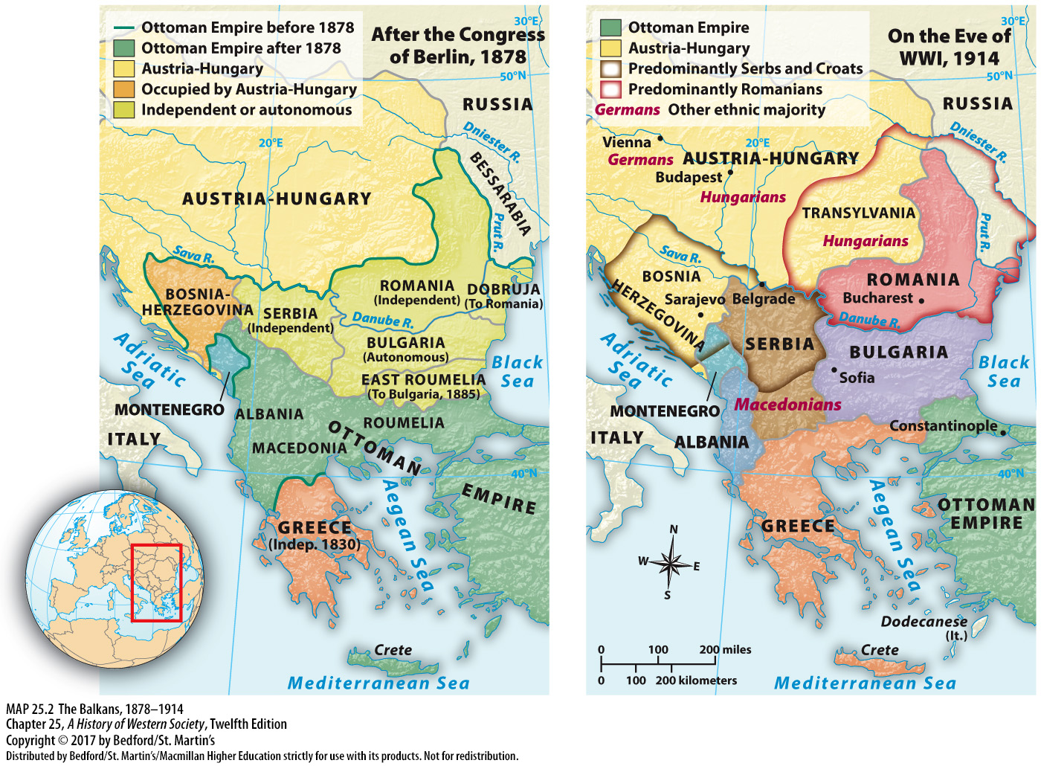

Slide 11
I. The Road to War
The Outbreak of War
6. Balkan nationalists demand freedom
7. Serbia was implicated in Archduke Ferdinand’s assassination
8. Austria declared war on Serbia
9. Germany pushed Austria-Hungary to confront Serbia
10. German chancellor encouraged the pro-war faction
Notes:
The Road to War
C. The Outbreak of War
6. Encouraged by their success against the Ottomans, Balkan nationalists increased their demands for freedom from Austria-Hungary.
7. Within this complex context, the leaders of Austria-Hungary concluded that Serbia was implicated in Archduke Ferdinand’s assassination and deserved severe punishment.
8. On July 23 Austria-Hungary presented Serbia with an unconditional ultimatum; Serbia replied evasively, leading Austria to mobilize its armies and declare war on Serbia on July 28.
9. Germany—knowing that war was likely between Austria and Russia because Russia would stand by its Serbian ally—pushed Austria-Hungary to confront Serbia and thus bore much responsibility for turning a little war into a world war.
10. The German chancellor promised Austria-Hungary Germany’s unconditional support in case of war, thereby encouraging the pro-war faction in Vienna to take a hard line against the Serbs at a time when moderation might still have limited the crisis.

Slide 12
I. The Road to War
The Outbreak of War
11. Tsar Nicholas II ordered full mobilization
12. Schlieffen Plan
13. Great Britain declared war on Germany
14. Austrian-Serbian war turns into a European-wide conflict in a little over a month
Notes:
The Road to War
C. The Outbreak of War
11. The diplomatic situation quickly spiraled out of control, as military plans and timetables began to dictate policy, and on July 29 Tsar Nicholas II of Russia ordered full mobilization, in effect declaring war on two fronts against Germany and Austria.
12. The German general staff, also thinking in terms of a two-front war, rolled out their misguided Schlieffen Plan, which called for a quick victory over France after a lightning attack through neutral Belgium, before turning on Russia.
13. German armies invaded Belgium on August 3, and Great Britain declared war on Germany the following day.
14. Excited crowds shouting pro-war slogans pushed politicians and military leaders toward the increasingly inevitable confrontation, turning a limited Austrian-Serbian war into a European-wide conflict in a little over a month.

Slide 13
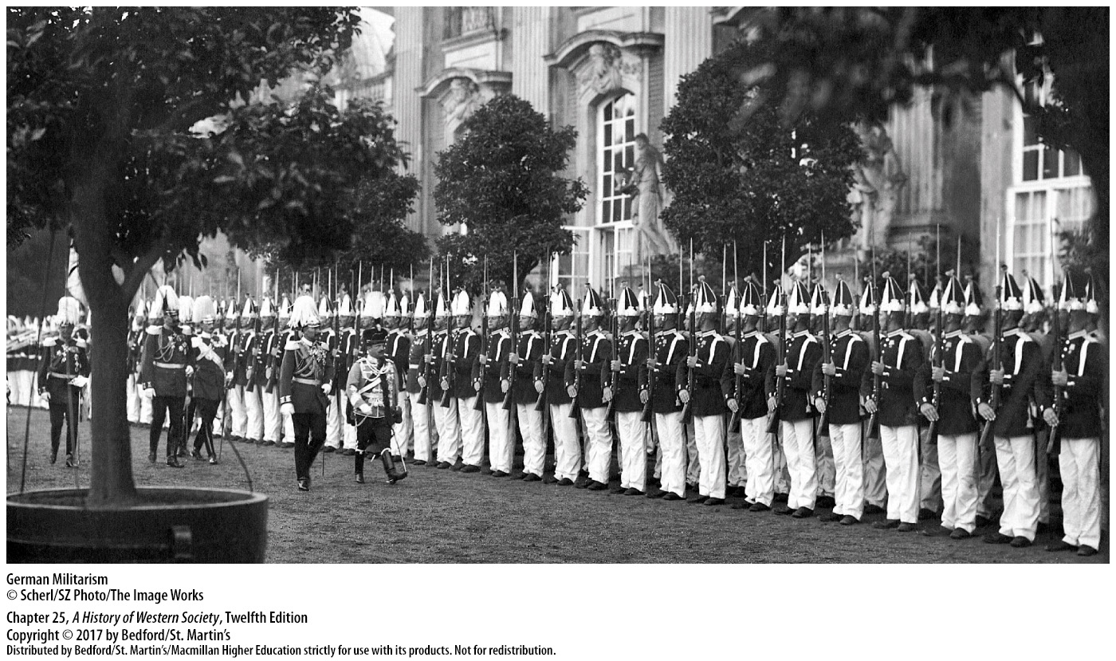

Slide 14
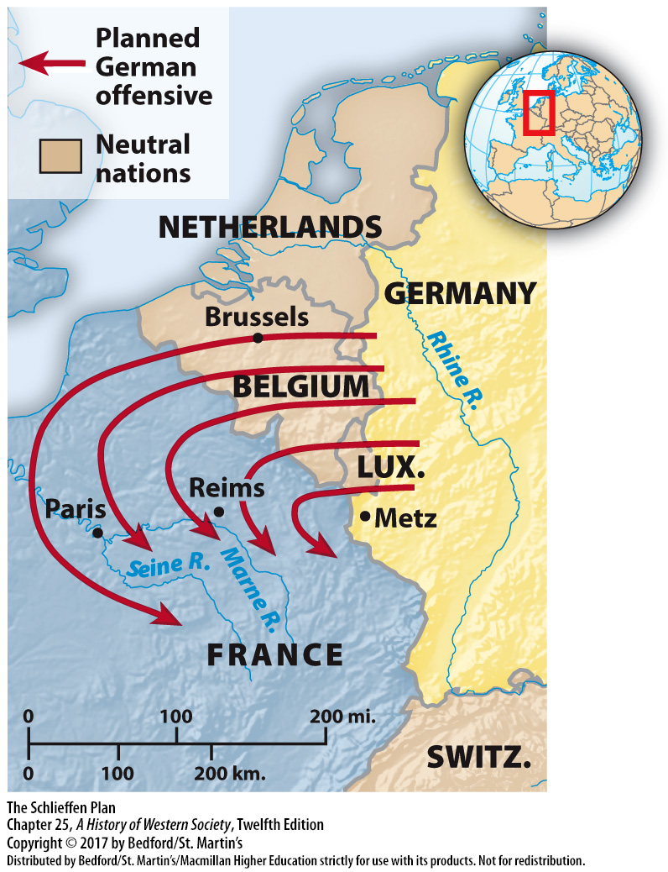

Slide 15
II. Waging Total War
Stalemate and Slaughter on the Western Front
1. Many believed that the conflict would be short
2. Total war
3. Russian armies attacked eastern Germany
4. Battle of the Marne
Notes:
II. Waging Total War
Stalemate and Slaughter on the Western Front
1. At the start of the war, many believed that the conflict would be short, but the belligerent armies bogged down on the western front in France and the eastern front in Russia in a new and extremely costly kind of war, termed total war.
2. At the front, total war meant lengthy, deadly battles fought with all the weapons a highly industrialized society could produce; at home, national economies were geared toward the war effort.
3. As the Belgian army defended its homeland against the German invasion and then joined British troops on the Franco-Belgian border, Russian armies attacked eastern Germany, forcing the Germans to transfer much-needed troops to the east and derailing their plans to quickly capture Paris.
4. On September 6 the French attacked a gap in the German line at the Battle of the Marne and, after three days of fighting, repelled the German advance, saving France.

Slide 16
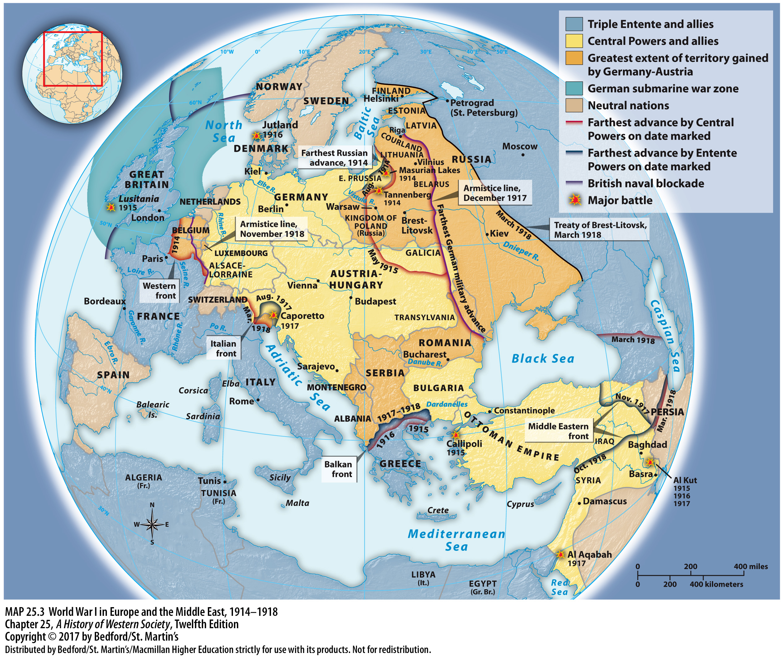

Slide 17
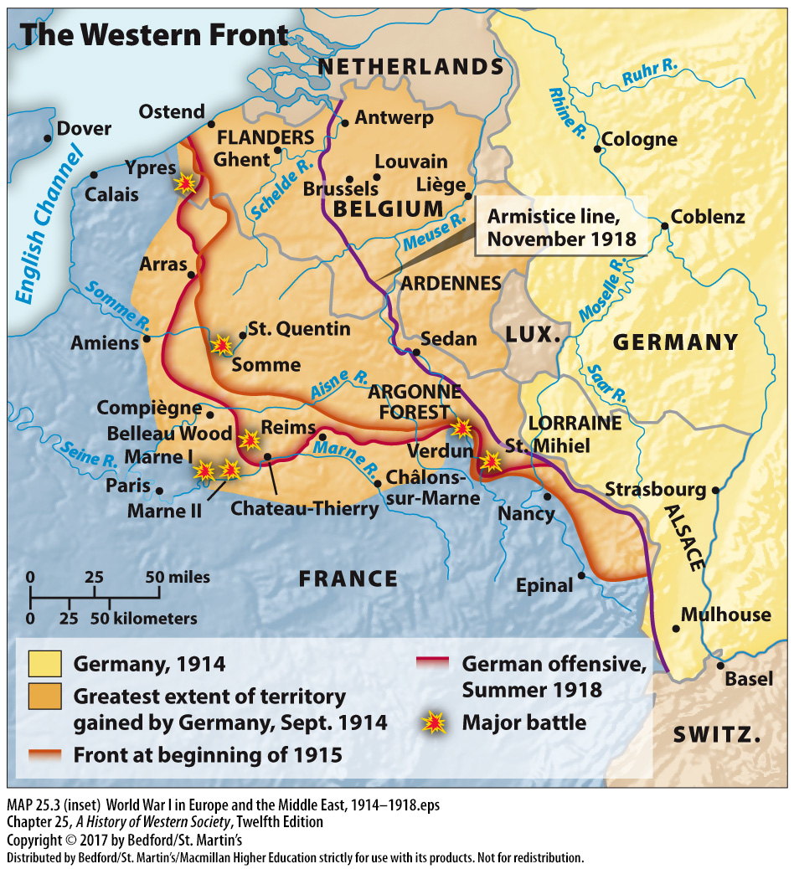

Slide 18
II. Waging Total War
Stalemate and Slaughter on the Western Front
5. Armies stalled
6. Cost of trench warfare
7. Recently invented weapons
8. Industrial age revolutionized the practice of war
Notes:
II. Waging Total War
Stalemate and Slaughter on the Western Front
5. With the armies stalled, both sides dug in behind rows of trenches, mines, and barbed wire defenses to protect themselves from machine-gun fire; by November 1914 a line of four hundred miles of defensive trenches extended from Belgium through northern France to the Swiss border.
6. The cost in lives of trench warfare was staggering, while the gains in territory were minuscule.
7. Recently invented weapons such as machine guns, hand grenades, poison gas, long-range artillery, and the airplane made battle impersonal, traumatic, and extremely deadly.
8. These products of an industrial age favored the defense, increased casualty rates, and revolutionized the practice of war.

Slide 19
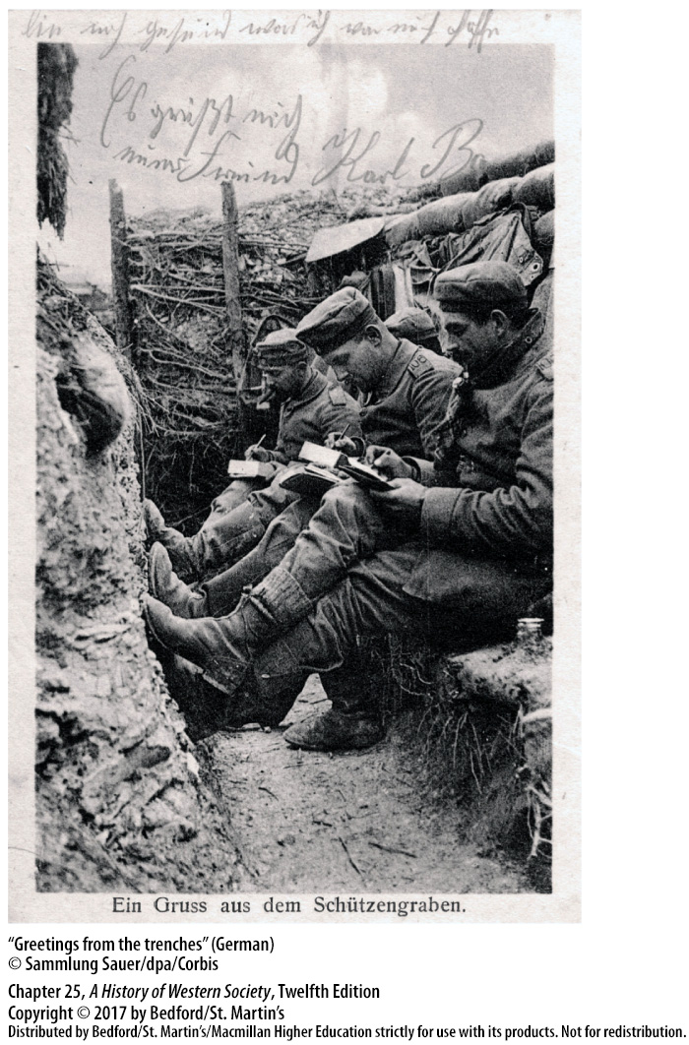

Slide 20
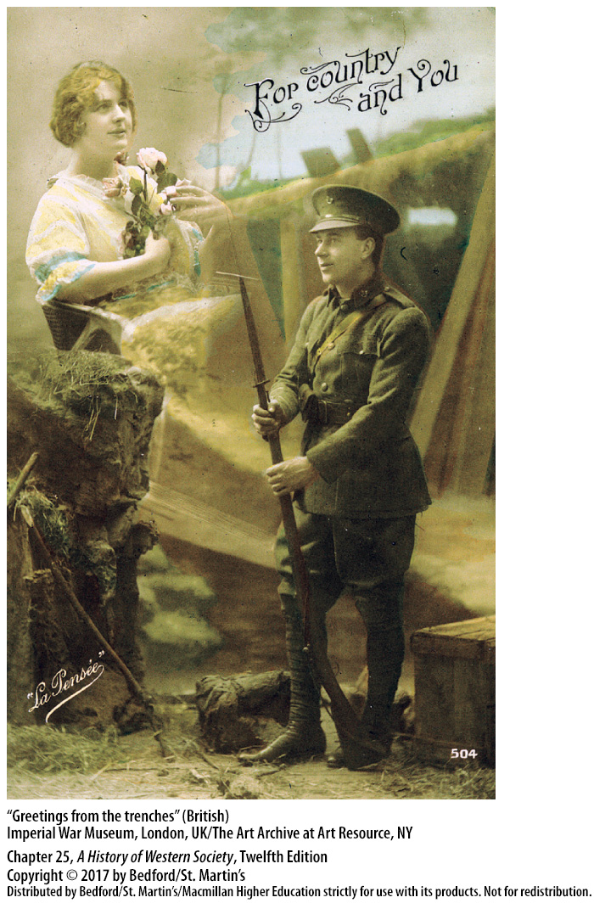

Slide 21
II. Waging Total War
Stalemate and Slaughter on the Western Front
9. Four years of mistakes
10. German campaign against Verdun cost some 700,000 lives on both sides
11. Battle of the Somme
12. Exhausted soldiers
13. Art and literature
Notes:
II. Waging Total War
Stalemate and Slaughter on the Western Front
9. For four years the generals repeated the same mistakes, mounting massive offensives against highly fortified trenches that might overrun the enemy’s frontline but rarely captured any substantial territory.
10. In 1916 the unsuccessful German campaign against Verdun cost some 700,000 lives on both sides and ended with the combatants in their original positions.
11. The Battle of the Somme, a British offensive begun in June 1916, dragged on until November, by which time the British had pushed the Germans back all of seven miles and some 420,000 British, 200,000 French, and 600,000 Germans had been killed or wounded defending an insignificant piece of land.
12. Exhausted soldiers found it difficult to comprehend or describe the bloody reality of their experiences at the front.
13. The anonymous, almost unreal qualities of high-teach warfare appeared in art and literature, as artists and writers sought to portray the nightmarish quality of total war.

Slide 22
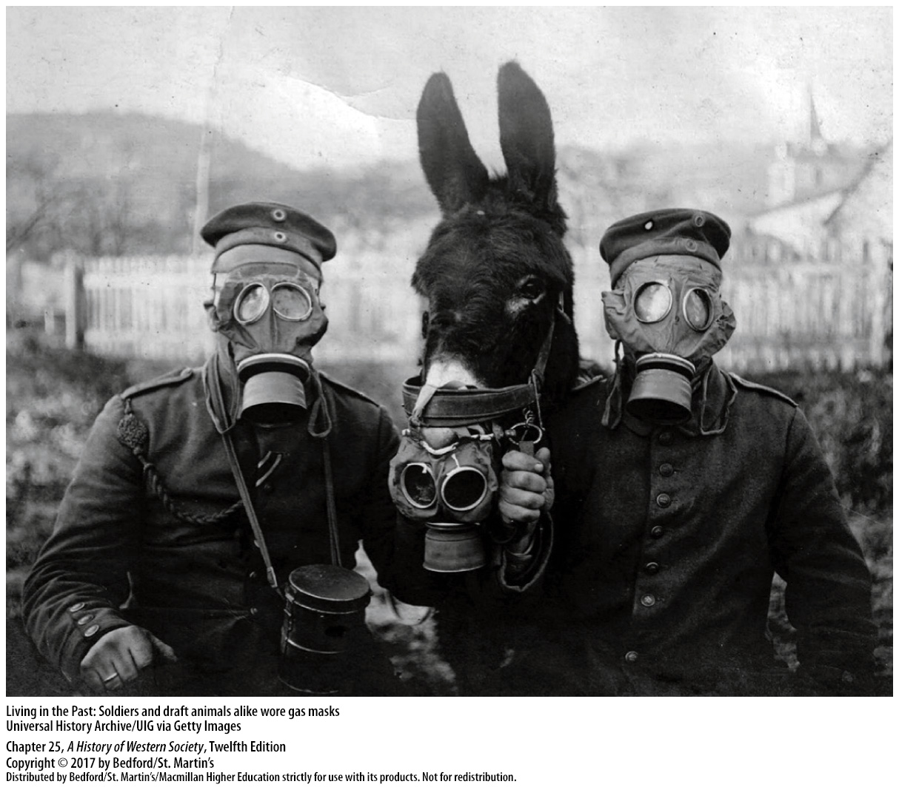

Slide 23
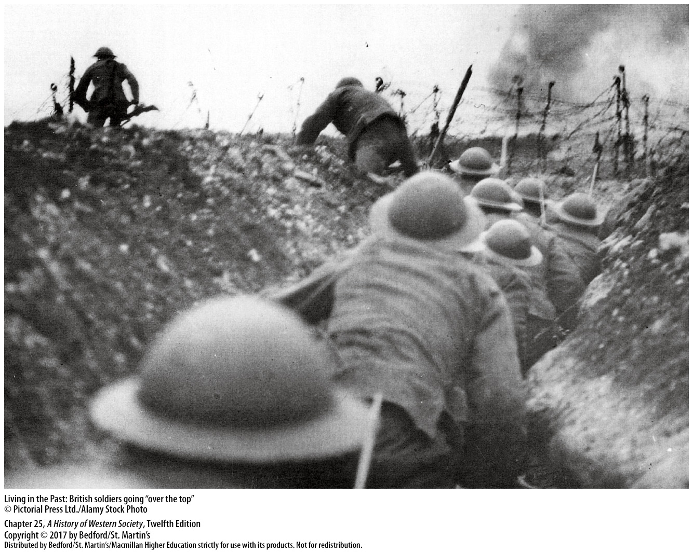

Slide 24
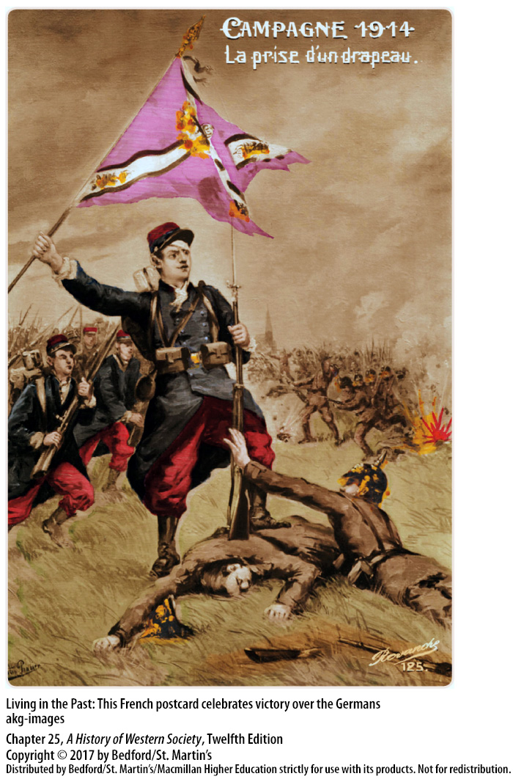

Slide 25
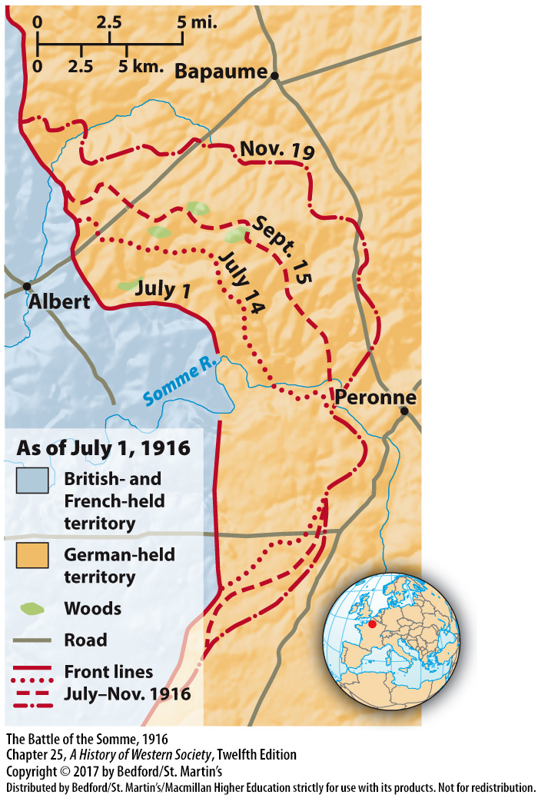

Slide 26
II. Waging Total War
The Widening War
1. Battles of Tannenberg and the Masurian Lakes 2. 2.5 million Russian soldiers had been killed, wounded, or captured
3. German military bureaucracy
4. One-third of the civilian population was killed or became refugees
Notes:
II. Waging Total War
B. The Widening War
1. On the eastern front, the Germans repulsed the initial Russian attacks and won major victories at the Battles of Tannenberg and the Masurian Lakes in August and September 1914.
2. By 1915 a staggering 2.5 million Russian soldiers had been killed, wounded, or captured, and German armies occupied huge swaths of the Russian empire; yet, Russia continued to fight, marking another failure of the Schlieffen Plan.
3. The Germans installed a vast military bureaucracy of some 15,000 army administrators and professional specialists to govern the occupied territories in central Europe.
4. About one-third of the civilian population was killed or became refugees under this brutal occupation, which was characterized by an anti-Slavic prejudice.

Slide 27
II. Waging Total War
The Widening War
5. Italy joined the Triple Entente
6. Entry of the Ottoman Turks
7. Armenians welcomed Russian armies as liberators
8. Battle of Gallipoli
Notes:
II. Waging Total War
B. The Widening War
5. Italy, a member of the Triple Alliance since 1882, had declared its neutrality in 1914, but in May 1915 it joined the Triple Entente in return for promises of Austrian territory.
6. The entry of the Ottoman Turks on the side of the Central Powers (Austria and Germany) in October 1914 carried the war into the Middle East.
7. In 1915, when some Armenians welcomed Russian armies as liberators, the Ottoman government ordered a mass deportation of its Armenian citizens; in this example of modern ethnic cleansing, about one million Armenians died from murder, starvation, and disease.
8. In 1915, at the Battle of Gallipoli, British forces failed to take the Dardanelles and Constantinople from the Ottoman Turks.

Slide 28
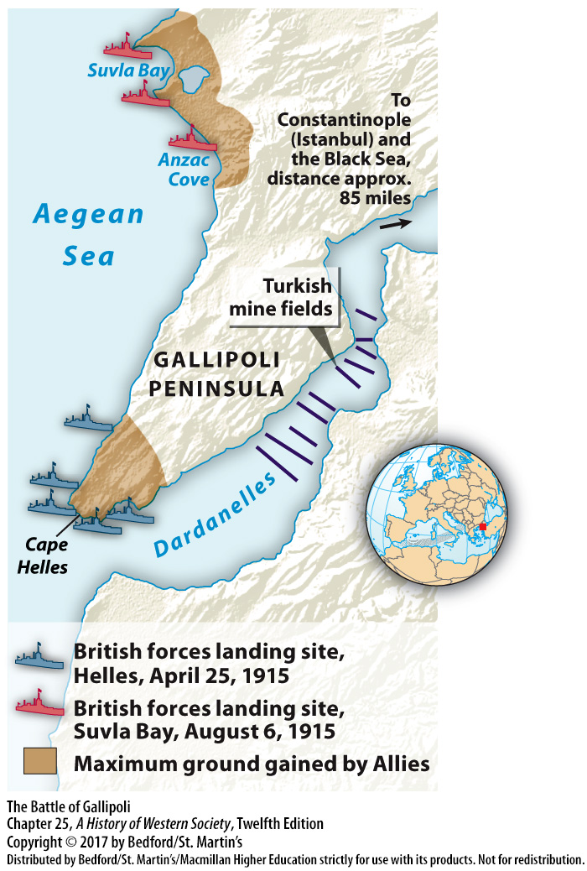

Slide 29
II. Waging Total War
The Widening War
9. Hussein ibn-Ali (1856–1931)
10. British troops occupied southern Iraqi city
11. War spread to East Asia
12. Colonial subjects in Africa generally supported the Allied powers
Notes:
II. Waging Total War
B. The Widening War
9. The British made vague commitments for an independent Arab kingdom to the Arab leader Hussein ibn-Ali (1856–1931) in return for his joining forces with the British and leading Arab soldiers in a successful guerrilla war against the Turks on the Arabian peninsula.
10. With Arab help, British troops occupied the southern Iraqi city of Basra in 1914, captured Baghdad in 1917, and rolled into Syria in September 1918.
11. The war spread to East Asia, where Japan, after declaring war on Germany in 1914, seized Germany’s colonies and expanded its influence in China.
12. In Africa, Britain’s and France’s colonial subjects generally supported the Allied powers and helped local British and French commanders take over German colonies.

Slide 30
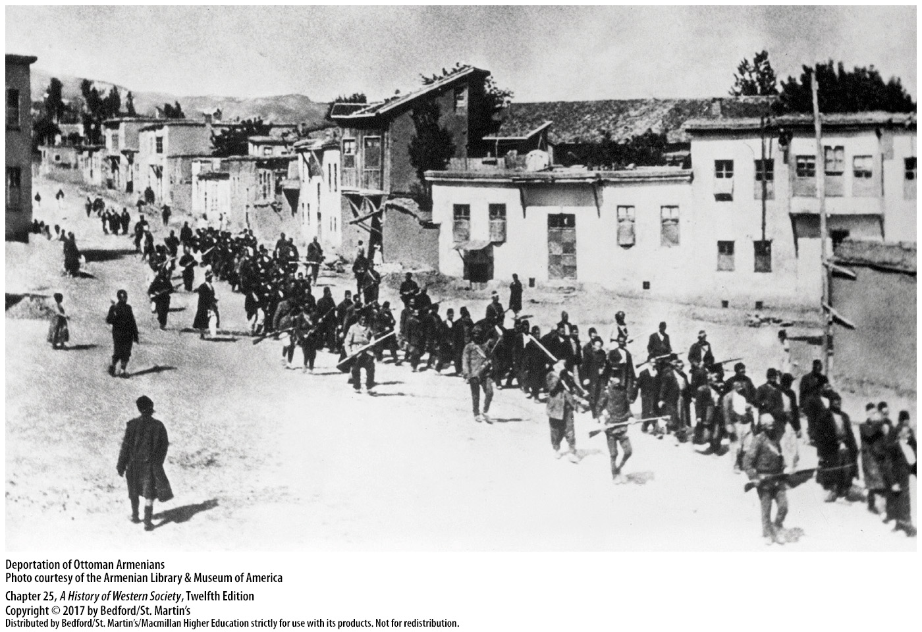

Slide 31
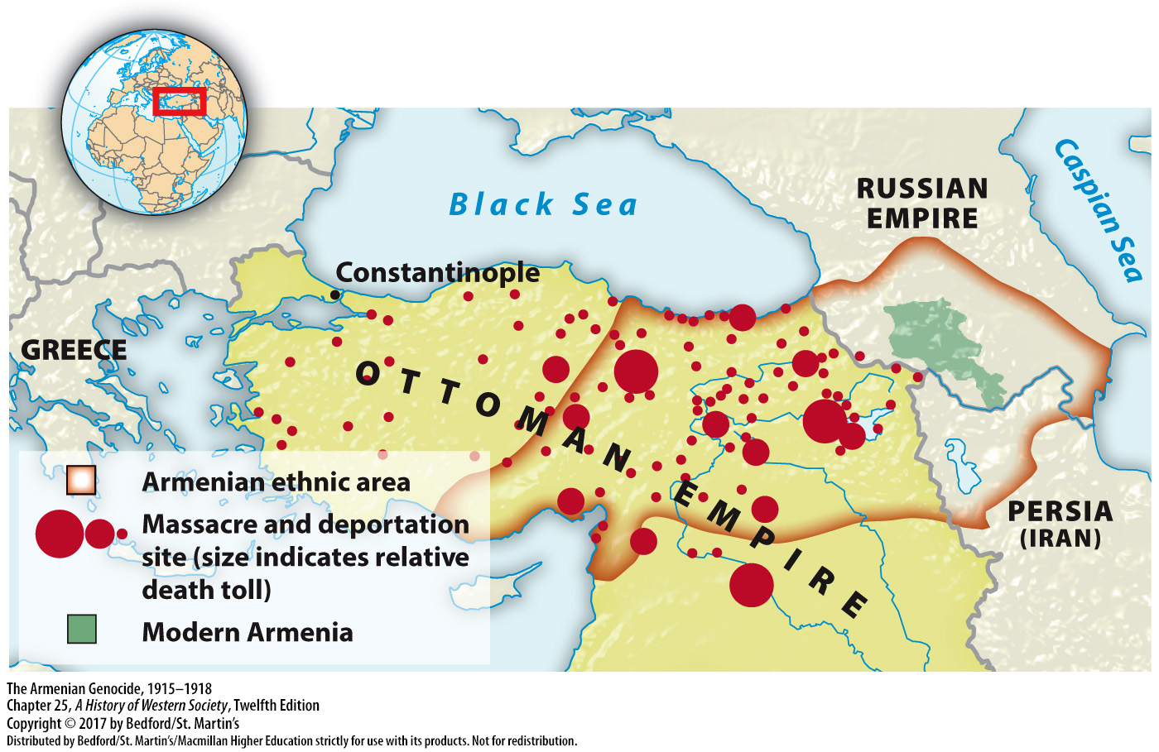

Slide 32
II. Waging Total War
The Widening War
13. Africans and Asians served in the armies
14. Commonwealth countries fought with the British
15. Lusitania
16. Germany halted its submarine warfare
17. The United States declared war on Germany
Notes:
II. Waging Total War
B. The Widening War
13. More than a million Africans and Asians served in the various armies of the warring powers, and more than double that number served as porters to carry equipment.
14. Large numbers of troops from the Commonwealth countries of Canada, Australia, and New Zealand fought with the British.
15. After a German submarine sank the British passenger liner Lusitania in May 1915, with 139 U.S. citizens among the more than 1,000 who died, President Woodrow Wilson protested vigorously.
16. Germany halted its submarine warfare for almost two years to avoid war with the United States, but early in 1917 the German military command resumed it again, believing that it could starve Britain into submission before the United States could come to its rescue.
17. The United States declared war on Germany in April 1917 and eventually tipped the balance in favor of the British, French, and their allies.

Slide 33
III. The Home Front
Mobilizing for Total War
1. Positive popular opinion
2. National leaders aggressively intervened in society and the economy
3. Government ministries further intervene in daily life
4. Censorship offices
5. Government planning boards
Notes:
III. The Home Front
Mobilizing for Total War
1. In August 1914 many people greeted the outbreak of hostilities enthusiastically, with ordinary people in every country believing that their nation was right to defend itself from foreign aggression.
2. Faced with a desperate need for men and weapons, and to keep the war machine moving, national leaders aggressively intervened in society and the economy.
3. The state intruded even further into people’s lives, as each combatant state established new government ministries to mobilize soldiers and armaments, establish rationing programs, and provide care for war widows and wounded veterans.
4. Censorship offices controlled news about the course of the war.
5. Government planning boards temporarily abandoned free-market capitalism and set mandatory production goals and limits on wages and prices, managing highly productive industrial economies that yielded an effective war effort.

Slide 34
III. The Home Front
Mobilizing for Total War
6. War Raw Materials Board
7. Walter Rathenau
8. Germany failed to tax the war profits of private firms heavily enough
9. Battles of Verdun and the Somme
10. Women workers
Notes:
III. The Home Front
Mobilizing for Total War
6. Germany went furthest in developing a planned economy to wage total war, beginning with its establishment of the War Raw Materials Board to ration and distribute raw materials.
7. Under the direction of Jewish industrialist Walter Rathenau, the board also launched successful attempts to produce substitutes, such as synthetic rubber and nitrates for scarce war supplies.
8. Germany, however, failed to tax the war profits of private firms heavily enough, which contributed to massive deficit financing, inflation, the growth of a black market, and the eventual re-emergence of class conflict.
9. Following the terrible Battles of Verdun and the Somme in 1916, German military leaders forced the Reichstag to accept the Auxiliary Service Law, which required all males between seventeen and sixty to work only at jobs considered critical to the war effort.
10. Women also worked in war factories, mines, and steel mills, where they labored, like men, at heavy and dangerous jobs.

Slide 35
III. The Home Front
Mobilizing for Total War
11. War rations
12. Fatherland Party
13. Germany directly ruled by a military government
14. British Ministry of Munitions, War Labor Board, and the War Industries Board
Notes:
III. The Home Front
Mobilizing for Total War
11. While war production increased, people lived on little more than one thousand calories a day.
12. After 1917, with the support of the newly formed ultraconservative Fatherland Party, Generals Paul von Hindenburg and Erich Ludendorff established a military dictatorship and called for the ultimate mobilization for total war; thus in Germany, total war led to the establishment of the first “totalitarian” society.
13. Only Germany was directly ruled by a military government; however, leaders in all the belligerent nations took power from parliaments, suspended civil liberties, and ignored democratic procedures.
14. For example, the British Ministry of Munitions organized private industry to produce for the war, allocated labor, set wage and price rates, and settled labor disputes; in the United States, the War Labor Board and the War Industries Board regulated industry, labor regulations, and agricultural production, while the Espionage and Sedition Acts weakened civil liberties.

Slide 36
III. The Home Front
The Social Impact
1. National conscription
2. Labor unions
3. Role of women
4. Women’s activities
5. Sexual morality
Notes:
III. The Home Front
B. The Social Impact
1. National conscription sent millions of men to the front, exposing many to foreign lands for the first time in their lives.
2. The tremendous need for workers to produce arms and ammunition meant greater power and prestige for labor unions whose leaders cooperated with governments on workplace rules, wages, and production schedules in return for participation in important decision and policy making.
3. The role of women changed dramatically, as large numbers of women moved into skilled industrial jobs long considered men’s work and found work as bank tellers, mail carriers, police officers, firefighters, and farm laborers, as well as auxiliaries and nurses at the front.
4. The war expanded the range of women’s activities and helped change attitudes about proper gender roles, although women’s employment gains were mostly temporary; millions of demobilized soldiers demanded their jobs back after the war, and governments forced women out of the workplace.
5. The war loosened sexual morality, and some women bobbed their hair, shortened their skirts, and smoked in public.

Slide 37
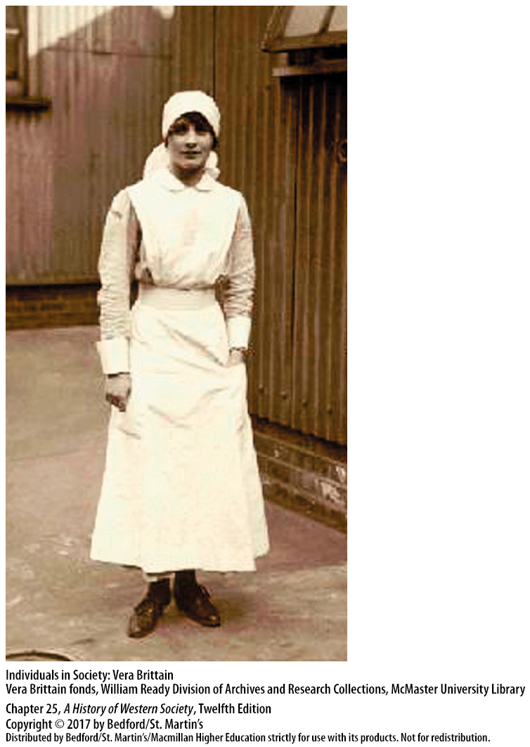

Slide 38
III. The Home Front
The Social Impact
6. Women’s the right to vote
7. Social equality
8.European society became more uniform and egalitarian,
9. Death decimated young aristocratic officers
Notes:
III. The Home Front
B. The Social Impact
6. As a result of women’s contributions to the war effort, the United States, Germany, Poland, and other countries granted women the right to vote immediately after the war.
7. To some extent, war promoted greater social equality, blurring class distinctions and lessening the gap between rich and poor.
8.In general, European society became more uniform and egalitarian, as reflected in full employment, rationing according to physical needs, and a sharing of hardships.
9. Death savagely decimated young aristocratic officers who led battle charges, falling heavily on the mass of drafted peasants and unskilled workers while often sparing highly skilled workers and foremen needed to train newly recruited women and older unskilled men laboring in war plants at home.

Slide 39
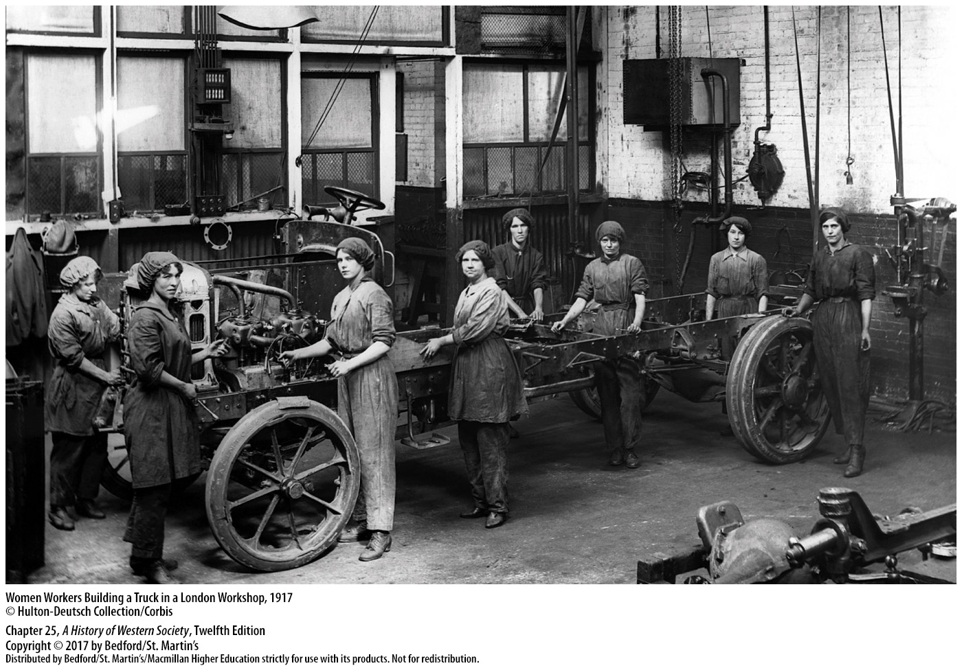

Slide 40
III. The Home Front
Growing Political Tensions
1. Patriotic nationalism
2. Censorship and propaganda
3. Strikes and protest marches
4. Karl Liebknecht (1871–1919)
Notes:
III. The Home Front
C. Growing Political Tensions
1. During the first two years of war, belief in a just cause and patriotic nationalism united peoples behind their national leaders.
2. Each government used rigorous censorship and crude propaganda—patriotic posters and slogans, slanted news, and biased editorials that inflamed national hatreds—to control public opinion, bolster popular support, and encourage soldiers to keep fighting.
3. By the spring of 1916, however, people were beginning to crack under the strain of total war, and strikes and protest marches over war-related burdens and shortages erupted in every country.
4. On May 1, 1916, several thousand demonstrators in Berlin heard the radical socialist leader Karl Liebknecht (1871–1919) attack the costs of the war effort.

Slide 41
III. The Home Front
Growing Political Tensions
5. Liebknecht was arrested
6. Georges Clemenceau (1841–1929)
7. Irish republican nationalists in Dublin
8. Soldiers’ morale began to decline
Notes:
III. The Home Front
C. Growing Political Tensions
5. Although Liebknecht was arrested and imprisoned, his daring action electrified Europe’s far left.
6. In France, Georges Clemenceau (1841–1929) established a virtual dictatorship, arresting strikers and jailing journalists and politicians who dared to suggest a compromise peace with Germany.
7. In April 1916 Irish republican nationalists in Dublin revolted against British rule in the great Easter Rising, but after a week of bitter fighting, British troops crushed the rebels and executed their leaders.
8. On all sides, soldiers’ morale began to decline: numerous French units refused to fight after the disastrous French offensive of May 1917, Russian soldiers deserted in droves, the Italian army collapsed in despair after the Battle of Caporetto in 1917, and the British armies had been “bled dry” in massive battles in 1916 and 1917.

Slide 42
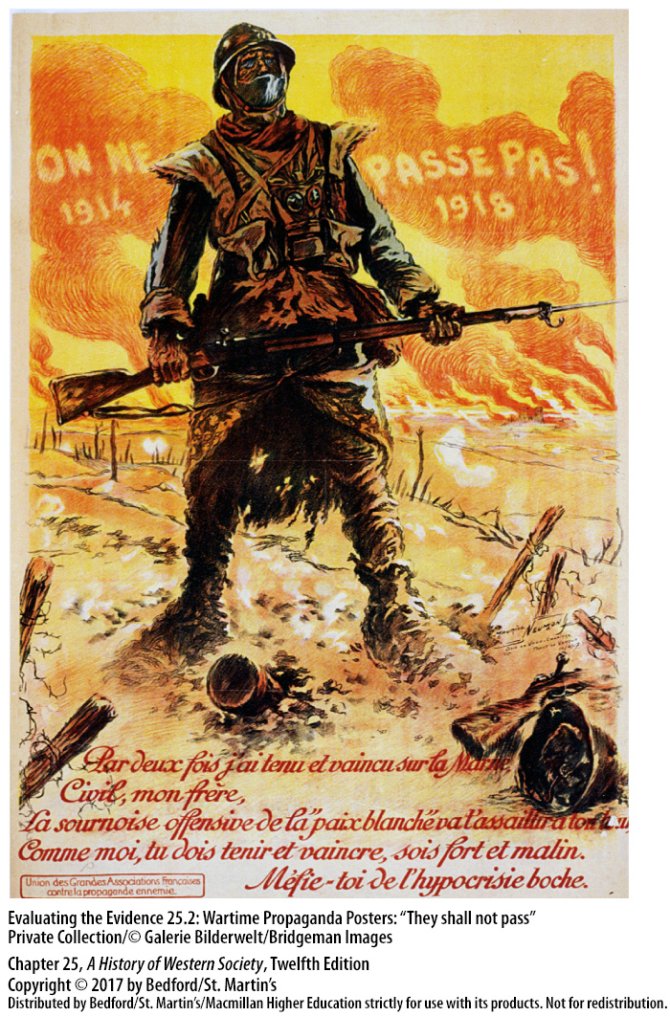

Slide 43
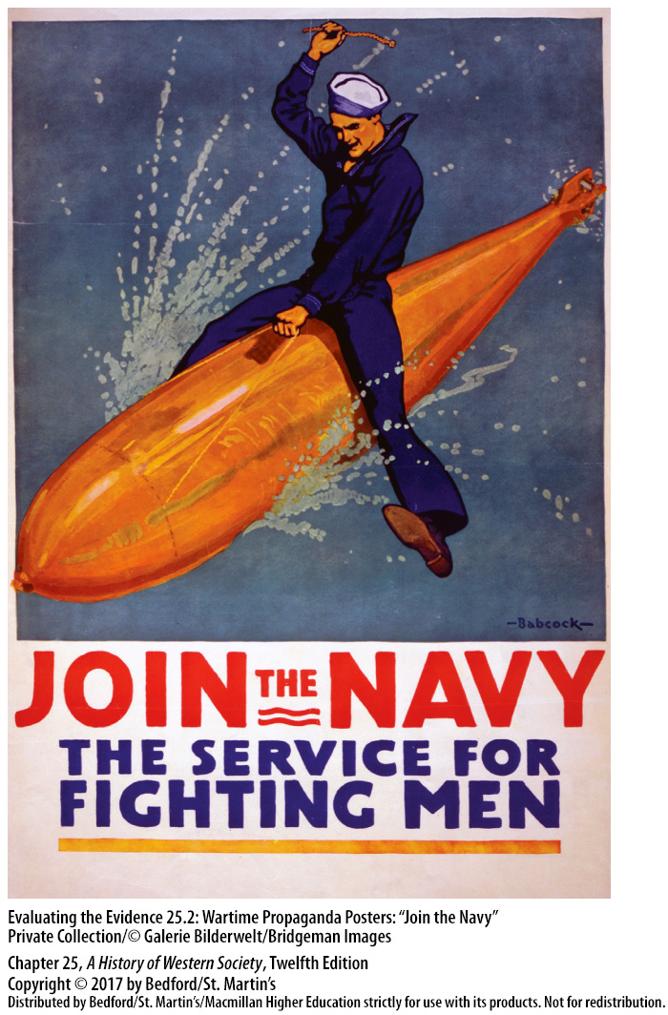

Slide 44
III. The Home Front
Growing Political Tensions
9. Henri-Philippe Pétain
10. United States troops stiffen resolve of the allies
11. Strains for the Central Powers
12. Austrian emperor Francis Joseph died
Notes:
III. The Home Front
C. Growing Political Tensions
9. France’s new general-in-chief, Henri-Philippe Pétain, was able to restore order within the French forces only through tough military justice and a tacit agreement that there would be no more grand offensives.
10. The promised arrival of fresh troops from the United States stiffened the resolve of the allies.
11. The strains were even worse for the Central Powers, where political dissatisfaction and conflicts among nationalities grew in spite of absolute censorship.
12. In November 1916 the aging Austrian emperor Francis Joseph died, and with him a symbol of unity disappeared, as Czech and Yugoslav leaders demanded independent states for their peoples.

Slide 45
III. The Home Front
Growing Political Tensions
13. British naval blockade
14. Growing minority of moderate socialists
15. Strike in Berlin
16. Germany begins to crack
Notes:
III. The Home Front
C. Growing Political Tensions
13. Germans on the home front likewise suffered immensely, as the British naval blockade greatly limited food imports, producing a scarcity of basic necessities that resulted in some 750,000 German civilians starving to death.
14. The national political unity of the first year of the war collapsed as a growing minority of moderate socialists in the Reichstag called for a compromise “peace without annexations or reparations.”
15. When the bread ration was further reduced in April 1917, more than 200,000 workers and women struck and demonstrated for a week in Berlin, returning to work only under the threat of prison and military discipline.
16. Thus Germany, like its ally Austria-Hungary (and its enemy France), was beginning to crack in 1917.

Slide 46
IV. The Russian Revolution
The Fall of Imperial Russia
1. Enthusiasm wanes in Russia
2. Russia mobilized less effectively than the other combatants
3. Nicholas II resisted popular involvement in government
4. Progressive bloc
5. Nicholas traveled to front in order to lead armies
6. Alexandra and Rasputin
Notes:
IV. The Russian Revolution
The Fall of Imperial Russia
1. Although Russia had embraced war with patriotic enthusiasm in 1914 and had stood united behind Tsar Nicholas II (r. 1894–1917) and the Duma that voted to support the war, enthusiasm waned as better-equipped German armies inflicted terrible losses.
2. Russia’s battered peasant army nevertheless continued to fight, as Russia moved toward full mobilization and the government set up special committees to coordinate defense, industry, transportation, and agriculture; however, overall, Russia mobilized less effectively than the other combatants.
3. At a time when the country needed strong leadership, Nicholas II, who distrusted the publicly elected Duma and resisted popular involvement in government, relied on the old bureaucracy, excluding the Duma, educated middle classes, and the masses.
4. In September 1915 parties ranging from conservative to moderate socialist formed the Progressive bloc, which called for a completely new government responsible to the Duma instead of the tsar.
5. In answer, Nicholas temporarily adjourned the Duma and subsequently traveled to the front in order to lead and rally Russia’s armies, leaving the government in the hands of his wife, Tsarina Alexandra.
6. Alexandra arbitrarily dismissed loyal political advisers and turned to her court favorite, the disreputable and unpopular Rasputin, an uneducated Siberian preacher whose influence with the tsarina rested on his purported power to heal her son, Alexis, the heir to the throne.

Slide 47
IV. The Russian Revolution
The Fall of Imperial Russia
7. Murder of Rasputin
8. Desertion
9. Food and fuel shortages
10. Violent street demonstrations
11. Provisional government
Notes:
IV. The Russian Revolution
The Fall of Imperial Russia
7. Three members of the high aristocracy murdered Rasputin in December 1916, and the ensuing scandal further undermined support for the tsarist government.
8. Heavy casualties, a lack of equipment, and concern for those at home led to opposition in the ranks and the desertion of tens of thousands of soldiers from the front.
9. By early 1917 the cities were wracked by shortages of food and heating fuel, and the economy was breaking down.
10. In March violent street demonstrations broke out in Petrograd and engulfed the city, but when the tsar ordered the army to open fire on the protesters, the soldiers refused and joined the revolutionary crowd.
11. The Duma declared a provisional government on March 12, 1917, and Nicholas abdicated three days later.

Slide 48
IV. The Russian Revolution
The Provisional Government
1. February Revolution
2. Provisional government new laws
3. Alexander Kerensky
4. Kerensky refused to confiscate large landholdings and give them to peasants
Notes:
IV. The Russian Revolution
B. The Provisional Government
1. The February Revolution that led to the establishment of the provisional government was the result of an unplanned uprising of hungry, angry people in the capital, but it was eagerly accepted throughout the country.
2. After generations of autocracy, the provisional government established equality before the law; freedom of religion, speech, and assembly; and the right of unions to organize and strike.
3. Yet both liberal and moderate socialist leaders rejected these broad political reforms, and a new government formed in May 1917 that included the fiery socialist Alexander Kerensky, who became prime minister in July.
4. Kerensky refused to confiscate large landholdings and give them to peasants, fearing it would complete the disintegration of Russia’s peasant army and make it impossible for Russia to continue the war, which the patriotic Kerensky saw as a national duty.

Slide 49
IV. The Russian Revolution
The Provisional Government
5. The Petrograd Soviet of Workers’ and Soldiers’ Deputies
6. Army Order No. 1
7. Failed offensive campaign against the Germans 8. Russia’s descent into anarchy
Notes:
IV. The Russian Revolution
B. The Provisional Government
5. The Petrograd Soviet (or council) of Workers’ and Soldiers’ Deputies, modeled on the revolutionary soviets of 1905, acted as a parallel government and issued its own radical orders, weakening the authority of the provisional government.
6. The most famous edict of the Petrograd Soviet—Army Order No. 1, issued in May 1917, which stripped officers of their authority and placed power in the hands of elected committees of common soldiers—led to a collapse of army discipline.
7. In July 1917 an offensive campaign against the Germans failed miserably; peasant soldiers began deserting in droves and returning to their villages to help their families get a share of the land, which peasants were seizing in a grassroots agrarian upheaval.
8. Russia’s descent into anarchy in the summer of 1917 provided an unparalleled opportunity for the most radical and talented of Russia’s many revolutionary leaders, Vladimir Ilyich Lenin (1870–1924).

Slide 50
IV. The Russian Revolution
Lenin and the Bolshevik Revolution
1. Lenin eagerly studied Marxist socialism
2. Argued that Communist revolution was possible 3. Possibility of revolution was determined by human leadership
4. Lenin’s Marxism had impact on events in Russia
5. Lenin’s Bolsheviks vs Mensheviks
6. War as a product of imperialist rivalries and an opportunity for socialist revolution
Notes:
IV. The Russian Revolution
C. Lenin and the Bolshevik Revolution
1. As a law student, Lenin eagerly studied Marxist socialism and began updating Marx’s revolutionary philosophy to address existing conditions in Russia.
2. Lenin denounced all theories of a peaceful evolution to socialism as a betrayal of Marx’s message of violent class conflict, and he argued that under certain conditions a Communist revolution was possible even in a predominantly agrarian country like Russia.
3. Lenin believed that the possibility of revolution was determined by human leadership; he called for a highly disciplined workers’ party strictly controlled by a small, dedicated elite of intellectuals and professional revolutionaries who would not stop until they had brought about a revolution.
4. Lenin’s version of Marxism had a major impact on events in Russia and ultimately changed the way future revolutionaries engaged in radical revolt around the world.
5. Russian Marxists were not uniform in their beliefs, however, and in 1903 they broke into two rival factions: Lenin’s Bolsheviks, or “majority group,” and the opposing Mensheviks, or “minority group,” who wanted a more democratic, reformist party with mass membership.
6. Observing events from Switzerland, where he lived in exile, Lenin viewed the war as a product of imperialist rivalries and an opportunity for socialist revolution.

Slide 51
IV. The Russian Revolution
Lenin and the Bolshevik Revolution
7. February Revolution of 1917
8. Lenin rejected cooperation with provisional government
9. Lenin’s radical slogans
10. Bolsheviks’ attempt to seize power collapsed
11. General Lavr Kornilov
12. Bolsheviks were re-armed
Notes:
IV. The Russian Revolution
C. Lenin and the Bolshevik Revolution
7. After the February Revolution of 1917, the German government provided Lenin with safe passage across Germany and back into Russia in the hope that Lenin would undermine the sagging war effort of the provisional government.
8. Upon his arrival in April, Lenin rejected all cooperation with what he called the “bourgeois” provisional government.
9. Lenin’s radical slogans—“All power to the soviets,” “All land to the peasants,” “Stop the war now”—and his promises of “Peace, Land, and Bread” spoke to the expectations of suffering workers, peasants, and soldiers alike and earned the Bolsheviks substantial popular support.
10. The Bolsheviks’ premature attempt to seize power in July collapsed, and Lenin once again went into hiding.
11. In September the army’s commander in chief, General Lavr Kornilov, led a feeble coup against Kerensky’s provisional government.
12. In the face of this counter-revolutionary threat, the Bolsheviks were re-armed, leading not only to the disintegration of Kornilov’s forces but also to Kerensky’s loss of credibility with the army, the only force that might have saved democratic government in Russia.

Slide 52
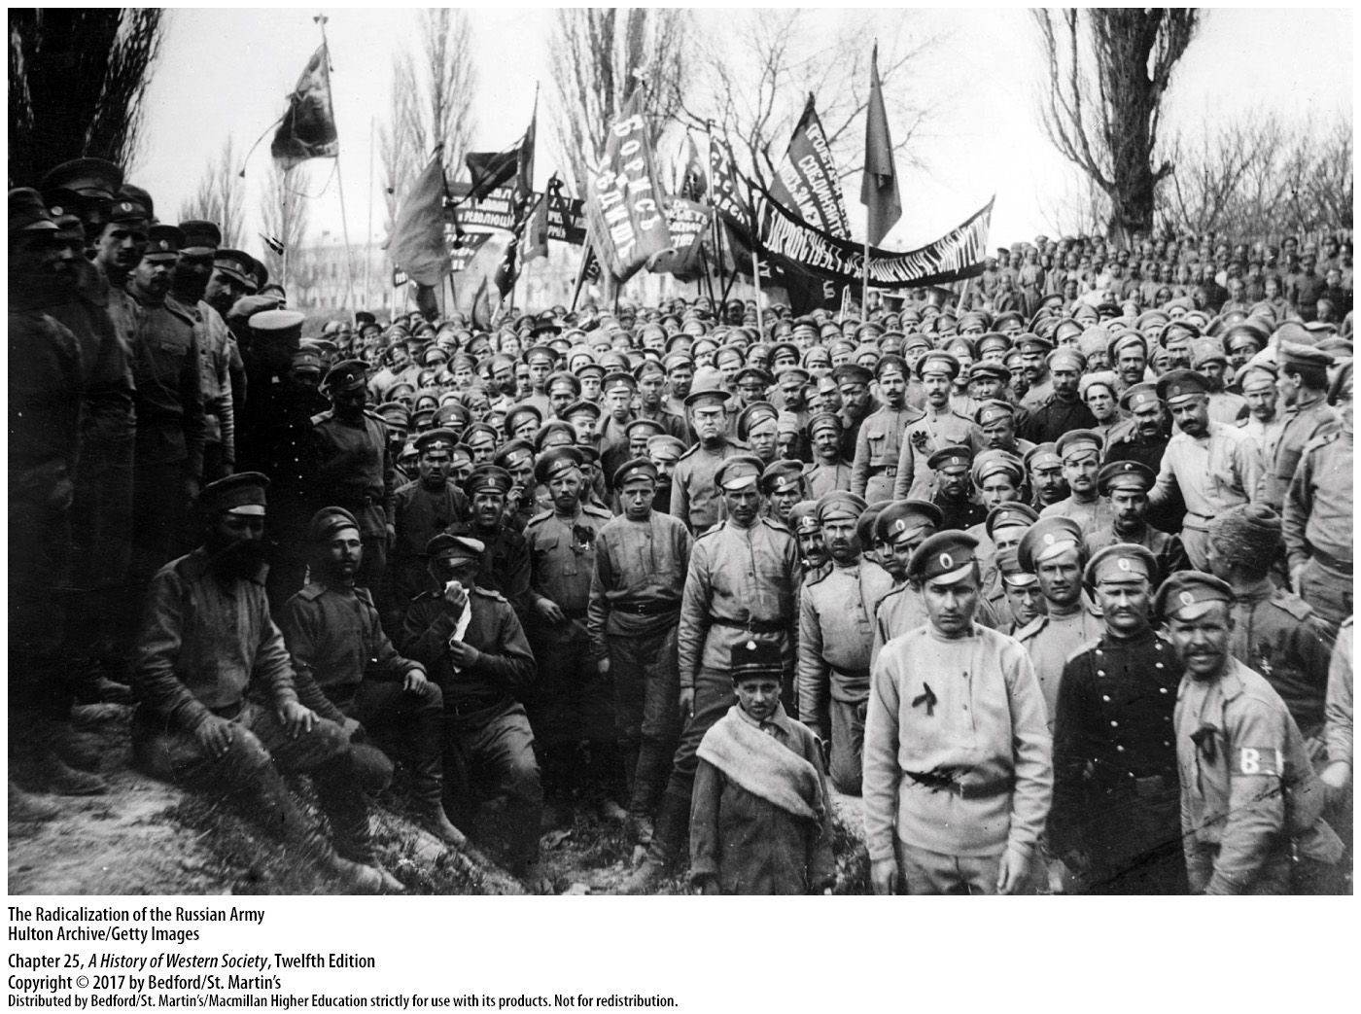

Slide 53
IV. The Russian Revolution
Trotsky and the Seizure of Power
1. Bolsheviks gain majority in the Petrograd Soviet
2. Leon Trotsky (1879–1940)
3. Special military-revolutionary committee
4. Lenin becomes head of the new government
5. Reasons for Lenin and Trotsky’s success
Notes:
IV. The Russian Revolution
D. Trotsky and the Seizure of Power
1. Popular support for the Bolsheviks continued to increase throughout the summer, and in October they gained a fragile majority in the Petrograd Soviet.
2. At that moment, Lenin’s fellow party member Leon Trotsky (1879–1940), a spellbinding revolutionary orator and radical Marxist, brilliantly executed the Bolshevik seizure of power.
3. Claiming danger from German and counter-revolutionary plots, Trotsky convinced the Petrograd Soviet to form a special military-revolutionary committee in October and make him its leader, which placed military power in the capital in Bolshevik hands.
4. On November 6 militants from Trotsky’s committee joined with Bolshevik soldiers to seize government buildings and arrest members of the provisional government; the Bolsheviks declared that all power had passed to the soviets and named Lenin head of the new government.
5. Lenin and Trotsky succeeded in bringing the Bolsheviks to power because they recognized that power was there for the taking and used their determined superior leadership to appeal to ordinary Russians, who were exhausted by war, weary of tsarist autocracy, and eager for radical changes.

Slide 54
IV. The Russian Revolution
Dictatorship and Civil War
1. Bolsheviks’ monumental accomplishment
2. Reasons for Lenin’s success
3. Peasant revolution
4. Decree ratifying urban workers’ establishment of their own local soviets
Notes:
IV. The Russian Revolution
E. Dictatorship and Civil War
1. The Bolsheviks’ truly monumental accomplishment was in conquering the chaos they had helped create and then beginning to build a Communist society.
2. Lenin’s genius lay in profiting from developments over which the Bolsheviks had little control.
3. Since summer, a peasant revolution had swept across Russia, as impoverished peasants seized for themselves the estates of the landlords and the church; thus when Lenin mandated land reform, he merely approved what peasants were already doing.
4. Likewise, in November 1917 Lenin issued a decree ratifying urban workers’ establishment of their own local soviets and their demands for direct control of factories.

Slide 55
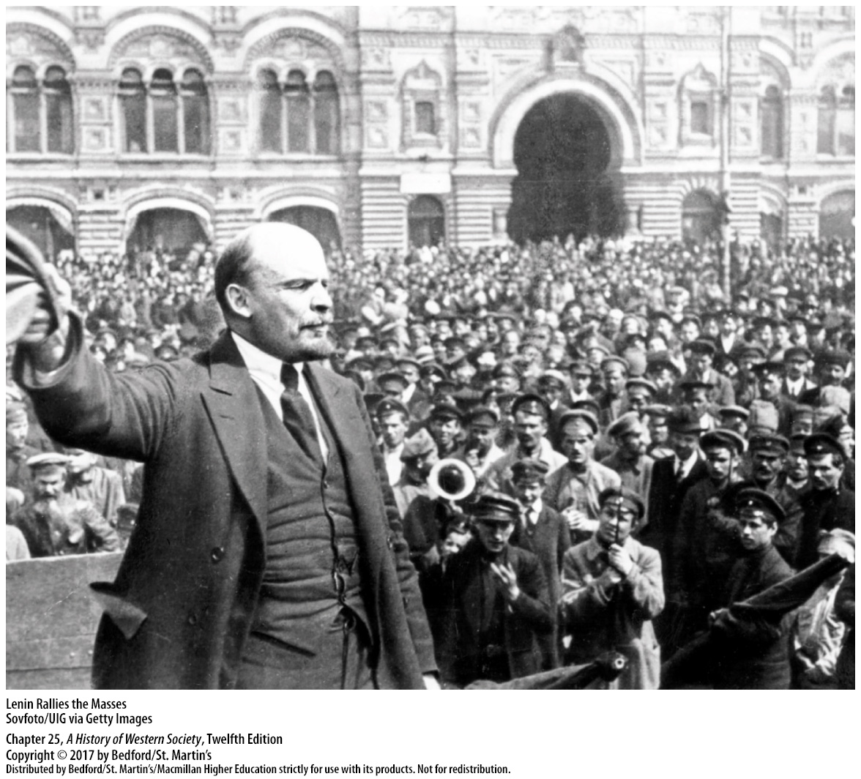

Slide 56
IV. The Russian Revolution
Dictatorship and Civil War
5. “Provisional workers’ and peasants’ government” 6. The Constituent Assembly
7. Lenin acknowledged that Russia had effectively lost the war with Germany
8. Treaty of Brest-Litovsk
Notes:
IV. The Russian Revolution
E. Dictatorship and Civil War
5. The Bolsheviks proclaimed their regime a “provisional workers’ and peasants’ government” and promised that a freely elected Constituent Assembly would draw up a new constitution, but the elections produced a stunning setback: the Bolsheviks won only 23 percent of the delegates.
6. The Constituent Assembly, with a plurality of delegates from the Socialist Revolutionary Party, met for one day in January 1918 before Lenin disbanded it using Bolshevik soldiers and began to build a one-party state.
7. Unlike many of his fellow Bolsheviks, Lenin acknowledged that Russia had effectively lost the war with Germany and that the only realistic goal was peace at any price.
8. That price was very high: in the Treaty of Brest-Litovsk, signed with Germany in March 1918, the Soviet government gave up all its western territories, areas that were inhabited primarily by Poles, Finns, Lithuanians, and other non-Russians.

Slide 57
IV. The Russian Revolution
Dictatorship and Civil War
9. Lenin escaped the continued war
10. Armed opposition to the Bolshevik regime
11. White opposition
12. Civil war
Notes:
IV. The Russian Revolution
E. Dictatorship and Civil War
9. With peace, Lenin escaped the disaster of continued war and could pursue his goal of absolute political power for the Bolsheviks—now also called Communists—within Russia.
10. The peace treaty and the abolition of the Constituent Assembly inspired armed opposition to the Bolshevik regime.
11. The officers of the old army organized the so-called White opposition to the Bolsheviks in southern Russia, Ukraine, Siberia, and west of Petrograd.
12. By the summer of 1918, Russia was in a full-fledged civil war; by the end of the year, White armies were on the attack, but the Red Army beat back the counter-revolutionary White armies, in part because the Bolsheviks had quickly developed a better army.

Slide 58
IV. The Russian Revolution
Dictatorship and Civil War
13. Red Army
14. Allies support the White armies
15. Bolsheviks controlled central Russia
16. The Whites had a poorly defined political program
Notes:
IV. The Russian Revolution
E. Dictatorship and Civil War
13. After becoming war commissar of the newly formed Red Army in March 1918, Trotsky re-established strict discipline and the draft, and he recruited former tsarist army officers, who were given unprecedented powers over their troops.
14. The intervention of the Allies in support of the White armies—primarily to stop the spread of Communism—did not aid the Whites effectively and allowed the Bolsheviks to appeal to the patriotic nationalism of ethnic Russians, who objected to foreign involvement in Russian affairs.
15. Strategically, the Bolsheviks controlled central Russia and the crucial cities of Moscow and Petrograd, while the Whites attacked from the fringes and lacked coordination.
16. The Whites had a poorly defined political program and were never able to unite the Bolsheviks’ enemies, and while the Bolsheviks promised ethnic minorities substantial autonomy, the nationalist Whites sought to preserve the tsarist empire.

Slide 59
IV. The Russian Revolution
Dictatorship and Civil War
17. War Communism
18. Rationing
19. The Cheka
20. The tsar and his family were executed
21. Attempts to spread communism were halted by Polish troops
22. End of civil war
Notes:
IV. The Russian Revolution
E. Dictatorship and Civil War
17. The Bolsheviks mobilized the home front by establishing a system of centralized controls called War Communism, which nationalized all banks and industries and outlawed private enterprise.
18. Bolshevik commissars introduced rationing, seized grain from peasants to feed the cities, and maintained strict workplace discipline, measures that kept the Red Army supplied with men and material.
19. A fearsome secret police known as the Cheka was dedicated to suppressing counter-revolutionaries of all types, including clergymen, aristocrats and wealthy Russian bourgeoisie, deserters from the Red Army, and political opponents of all kinds.
20. The tsar and his family were callously executed in July 1918.
21. By the spring of 1920, the White armies were almost completely defeated, and the Bolsheviks had retaken much of the territory ceded to Germany under the Treaty of Brest-Litovsk; they were stopped outside of Warsaw by Polish troops and their attempts to spread communism were halted.
22. The Russian civil war ended in 1921, and the Bolsheviks had won an impressive victory.

Slide 60
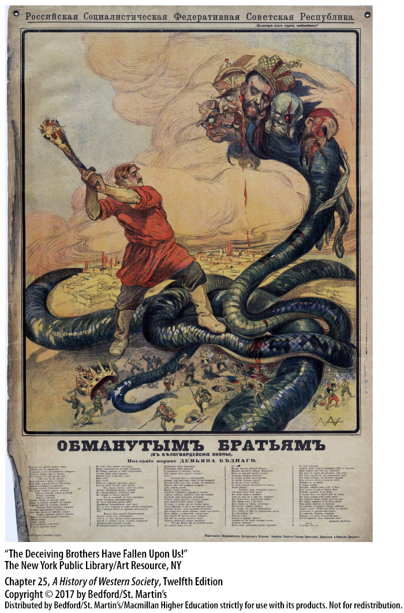

Slide 61
V. The Peace Settlement
The End of the War
1. German attack on France
2. Spring Offensive
3. American intervention tipped the scales in favor of Allied victory
4. Germany lost the war
Notes:
V. The Peace Settlement
The End of the War
1. In early 1918 the German leadership decided to make a last-ditch, all-out attack on France after the defeat of Russia released men and materials for the western front.
2. Though the German armies came within thirty-five miles of Paris during the great Spring Offensive of 1918, General Ludendorff’s exhausted, overextended forces never broke through.
3. The late but massive American intervention tipped the scales in favor of Allied victory following the second Battle of the Marne in July 1918.
4. By September Hindenburg and Ludendorff realized that Germany had lost the war; not wanting to shoulder the blame, they insisted that moderate politicians should take responsibility for the defeat.

Slide 62
V. The Peace Settlement
The End of the War
5. New liberal civilian government sues for peace
6. German people rose up in revolt
7. Emperor William II abdicated and fled
8. The armistice
Notes:
V. The Peace Settlement
The End of the War
5. On October 4 the German emperor formed a new, more liberal civilian government to sue for peace.
6. As negotiations over an armistice dragged on, the frustrated German people rose up in revolt, and masses of workers demonstrated for peace in Berlin.
7. With army discipline collapsing, Emperor William II abdicated and fled to Holland; socialist leaders in Berlin proclaimed a German republic on November 9 and agreed to tough Allied terms of surrender.
8. The armistice went into effect on November 11, 1918—the war was over.

Slide 63
V. The Peace Settlement
Revolution in Austria-Hungary and Germany
1. Revolution in Austria-Hungary and Germany
2. Austro-Hungarian Empire dismantled
3. German popular uprising
4. Social Democratic Party established the Weimar Republic
5. Marxist politicians in the Social Democratic Party were moderates
Notes:
V. The Peace Settlement
B. Revolution in Austria-Hungary and Germany
1. Military defeat brought turmoil and revolution to Austria-Hungary and Germany, as it had to Russia.
2. Having started the war to preserve an imperial state, the Austro-Hungarian Empire perished in the attempt—its territory was carved into the independent states of Austria, Hungary, and Czechoslovakia and a larger Romania.
3. In late 1918 Germany experienced a genuine popular uprising that welled up from below, toppled the authoritarian monarchy, and created a liberal provisional republic.
4. Moderates from the Social Democratic Party and their liberal allies held on to power and established the Weimar Republic—a democratic government that would lead Germany for the next fifteen years.
5. The great majority of the Marxist politicians in the Social Democratic Party were moderates who wanted political democracy, civil liberties, and the gradual elimination of capitalism.

Slide 64
V. The Peace Settlement
Revolution in Austria-Hungary and Germany
6. Appalled by the prospect of civil war
7. Radical Communists led by Karl Liebknecht and Rosa Luxemburg
8. Uprisings repressed by the central government
9. New Nazi Party emerges
Notes:
V. The Peace Settlement
B. Revolution in Austria-Hungary and Germany
6. They were also German nationalists, appalled by the prospect of civil war and revolutionary terror; so they quickly came to terms with the army and big business, which helped prevent total collapse.
7. Radical Communists led by Karl Liebknecht and Rosa Luxemburg tried to seize control of the government in the Spartacist Uprising in Berlin in January 1919, but the uprising was crushed by nationalist Free Corps militias, and Liebknecht and Luxemburg were brutally murdered.
8. Nationwide strikes by leftist workers, a Soviet-style republic in Bavaria, and a short-lived, right-wing military takeover—the Kapp Putsch—were also repressed by the central government.
9. By the summer of 1920, the situation had calmed down, but the new republican government faced deep discontent among Communist and radical socialists and among right-wing nationalists, including the new Nazi Party, who despised the new government from the start and spread the myth that the German army had not lost the war but that the nation had been “stabbed in the back.”

Slide 65
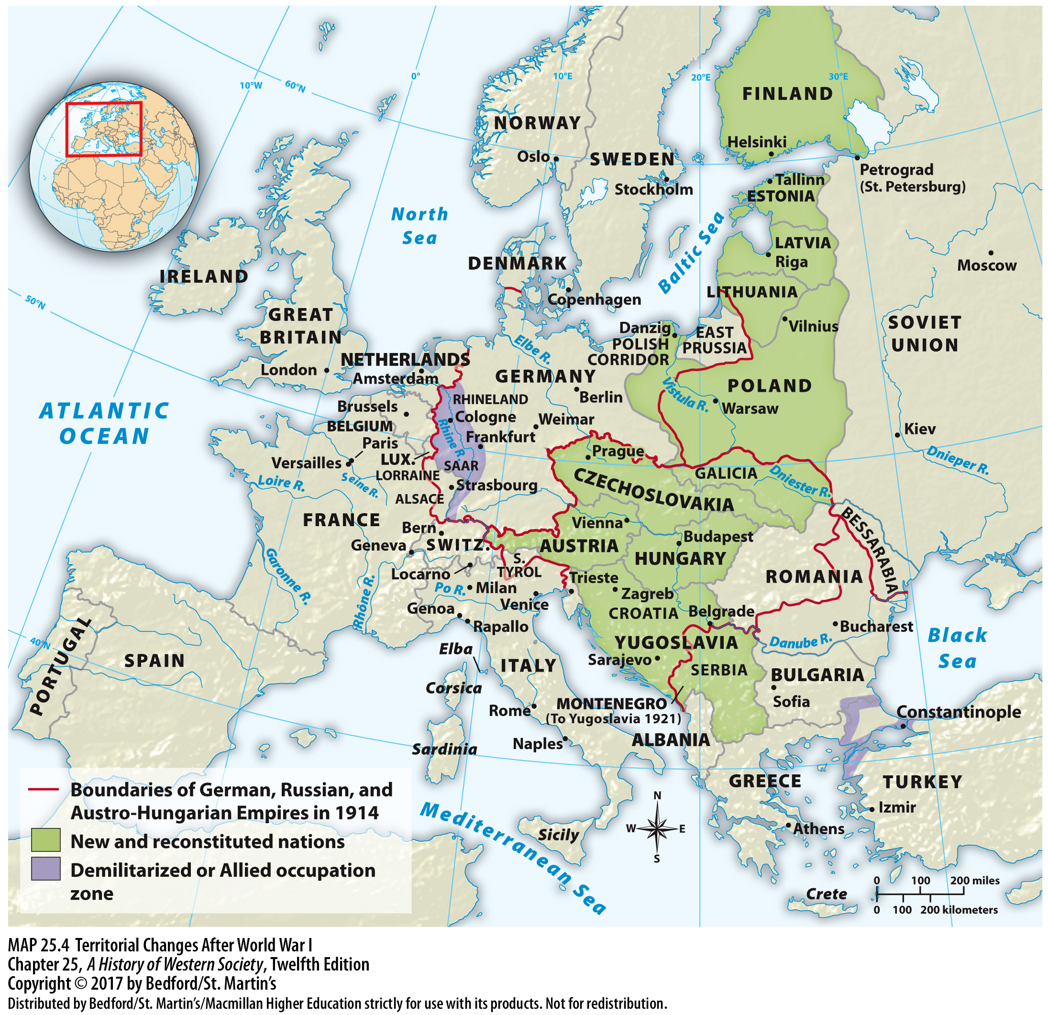

Slide 66
V. The Peace Settlement
The Treaty of Versailles
1. Treaty of Versailles
2. Fourteen Points
3. Wilson demand for national self-determination
4. Quarrels among “Big Three”
5. Disagreements among leaders
Notes:
V. The Peace Settlement
C. The Treaty of Versailles
1. In January 1919 more than seventy delegates from twenty-seven nations met in Paris to hammer out a peace accord; the Treaty of Versailles laid out the terms of the postwar settlement.
2. Expectations for the process were heightened greatly by U.S. president Woodrow Wilson’s January 1918 peace proposal, the Fourteen Points, which called for open diplomacy, a reduction in armaments, freedom of commerce and trade, and the establishment of a League of Nations.
3. Wilson demanded that peace be based on national self-determination, meaning that peoples should be able to choose their own national governments through democratic majority-rule elections and live free from outside interference.
4. Despite the general optimism inspired by these ideas, the “Big Three”—the United States, Great Britain, and France—began to quarrel almost immediately.
5. President Wilson prevailed in his insistence that the issue of the League of Nations be addressed first, though Prime Ministers Lloyd George of Great Britain and Georges Clemenceau of France were unenthusiastic and were primarily concerned with punishing Germany.

Slide 67
V. The Peace Settlement
The Treaty of Versailles
6. Clemenceau sought the creation of a buffer state 7. Clemenceau received the support of Lloyd George but not that of Wilson
8. French military occupation of the Rhineland
9. Map of Europe redrawn
10. The Ottoman Empire was split apart
Notes:
V. The Peace Settlement
C. The Treaty of Versailles
6. Because the war in the west had been fought on French soil, Clemenceau sought the creation of a buffer state between France and Germany, the permanent demilitarization of Germany, and vast German reparations.
7. Clemenceau received the support of Lloyd George but not that of Wilson, who saw France’s demands as vindictive and a violation of the principle of national self-determination.
8. In the end, Clemenceau, convinced that France could not afford to face Germany alone in the future, agreed to a compromise, dropping his demand for a buffer state in return for French military occupation of the Rhineland for fifteen years and a formal defensive alliance with the United States and Great Britain.
9. The various agreements signed at Versailles redrew the map of Europe, creating the independent nations of Poland, Czechoslovakia, Finland, the Baltic states, and Yugoslavia out of the Austro-Hungarian and Russian Empires.
10. The Ottoman Empire also was split apart, with its territories placed under the control of the victors.

Slide 68
V. The Peace Settlement
The Treaty of Versailles
11. Germany’s African and Asian colonies
12. Alsace-Lorraine returned to France
13. Germany (with Austria) responsible for the war
14. Reparations were a crippling financial burden
Notes:
V. The Peace Settlement
C. The Treaty of Versailles
11. Germany’s African and Asian colonies were given to France, Britain, and Japan as League of Nations mandates or administered territories.
12. The Treaty of Versailles returned Alsace-Lorraine to France, limited Germany’s army to 100,000 men, prohibited Germany from building military fortifications in the Rhineland, and required Germany to accept temporary French occupation of that region.
13. In the treaty’s war guilt clause, the Allies declared that Germany (with Austria) was entirely responsible for the war and therefore had to pay reparations equal to all civilian damages caused by the fighting.
14. For the Germans, reparations were a crippling financial burden, and the war guilt clause was a cutting insult to German national pride.

Slide 69
V. The Peace Settlement
The Treaty of Versailles
15. German government protested the treaty
16. The Versailles treaties
17. U.S. and the League of Nations
18. Principle of national self-determination
Notes:
V. The Peace Settlement
C. The Treaty of Versailles
15. The new German government vigorously protested the treaty but to no avail, and on June 28, 1919, representatives of the German Social Democrats signed the treaty.
16. The Versailles treaties were far from perfect, but within the context of war-shattered Europe, they were a beginning, offering the hope of peace and tranquility for war-weary peoples, especially in the wake of the Bolshevik Revolution and Lenin’s calls for worldwide upheaval.
17. Yet the great hopes of early 1919 had been dashed by the end of the year: the U.S. Senate refused to ratify the treaty that would have allowed the entry of the U.S. into the League of Nations as well as the treaties forming a defensive alliance with France and Great Britain; the U.S. effectively turned its back on Europe and embraced an isolationist attitude.
18. The principle of national self-determination was good in theory but flawed in practice: the borders of the new European states cut through a jumble of ethnic and religious groups that often despised each other, while in the colonies, desires for self-determination were simply ignored.

Slide 70
V. The Peace Settlement
The Peace Settlement in the Middle East
1. Political settlement on the former Ottoman Empire
2. Secret wartime agreements to divide and rule the Ottoman lands
3. Sykes-Picot Agreement of 1916
4. Allies intentions
Notes:
V. The Peace Settlement
D. The Peace Settlement in the Middle East
1. Though Allied leaders at Versailles focused mainly on European questions, they also imposed a political settlement on the former Ottoman Empire that brought radical and controversial changes to the Middle East.
2. The British government had encouraged the wartime Arab revolt against the Ottoman Turks and had vaguely endorsed an independent Arab kingdom, but after the war, Britain and France chose to honor secret wartime agreements to divide and rule the Ottoman lands.
3. In secret accords such as the Sykes-Picot Agreement of 1916, Britain and France agreed that France would receive a mandate to govern modern-day Lebanon, Syria, and much of Turkey, and Britain would control Palestine, Transjordan, and Iraq.
4. Though the official goal of the mandate system was to eventually grant these regions national independence, it quickly became clear that the Allies never intended to do so.

Slide 71
V. The Peace Settlement
The Peace Settlement in the Middle East
5. Balfour Declaration
6. “National Home for the Jewish People”
7. Implications of the declaration
8. General Syrian Congress
Notes:
V. The Peace Settlement
D. The Peace Settlement in the Middle East
5. British plans for the Ottoman lands of Palestine—set forth in the Balfour Declaration of November 1917—also angered Arab nationalists.
6. The Balfour Declaration stated that Britain favored a “National Home for the Jewish People” in Palestine, but without discriminating against the civil and religious rights of the non-Jewish communities already living in the region.
7. The declaration implied the establishment of a state founded on religious and ethnic exclusivity, which was out of keeping with both Islamic and Ottoman tradition, and one that would violate majority rule.
8. Arab efforts at the Versailles Peace Conference to secure autonomy in the Middle East proved fruitless, so Arab nationalists came together in Damascus as the General Syrian Congress in 1919 and proclaimed Syria an independent kingdom; a similar congress declared Iraqi independence.

Slide 72
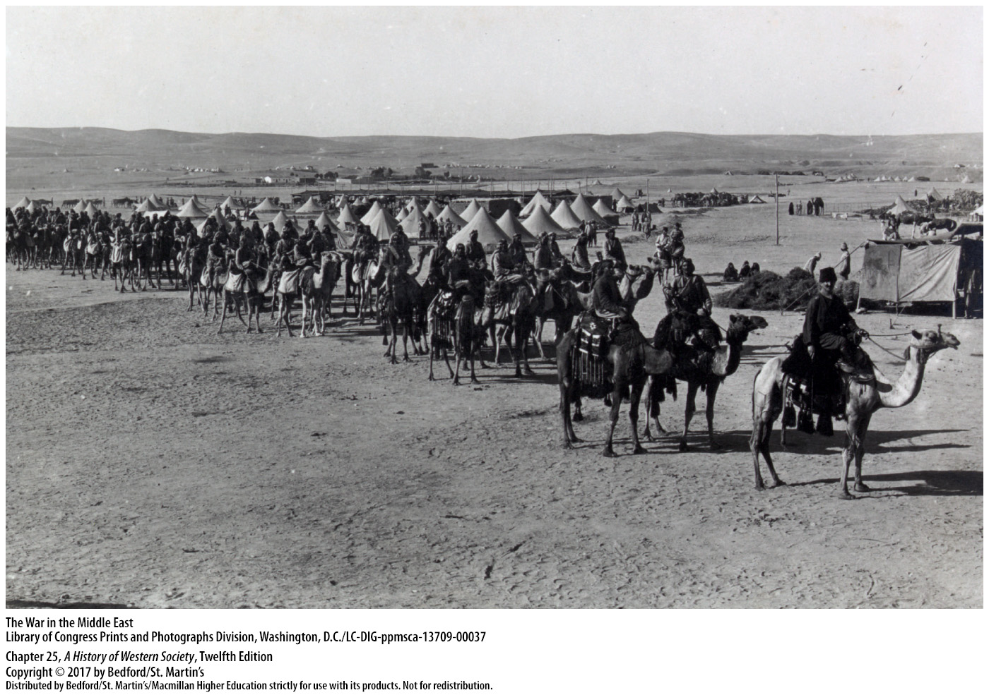

Slide 73
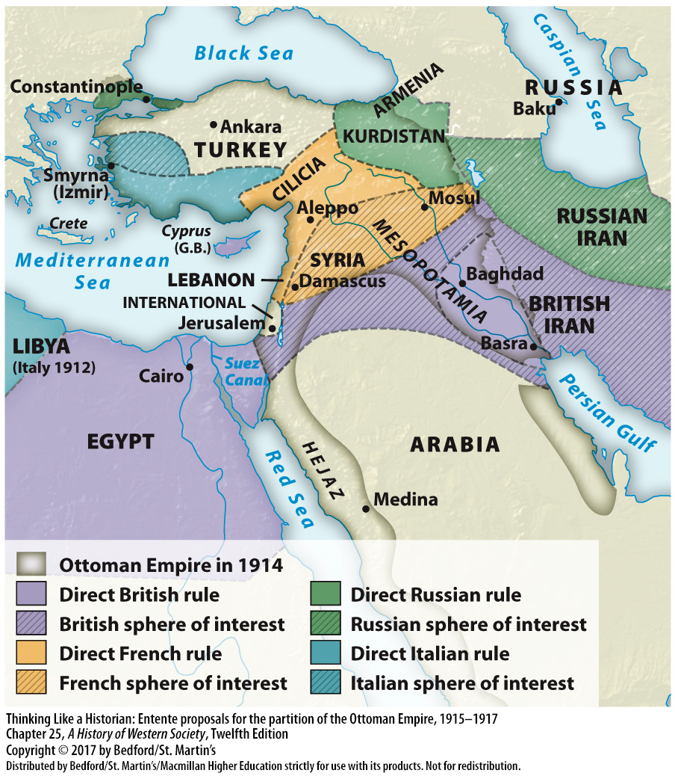

Slide 74
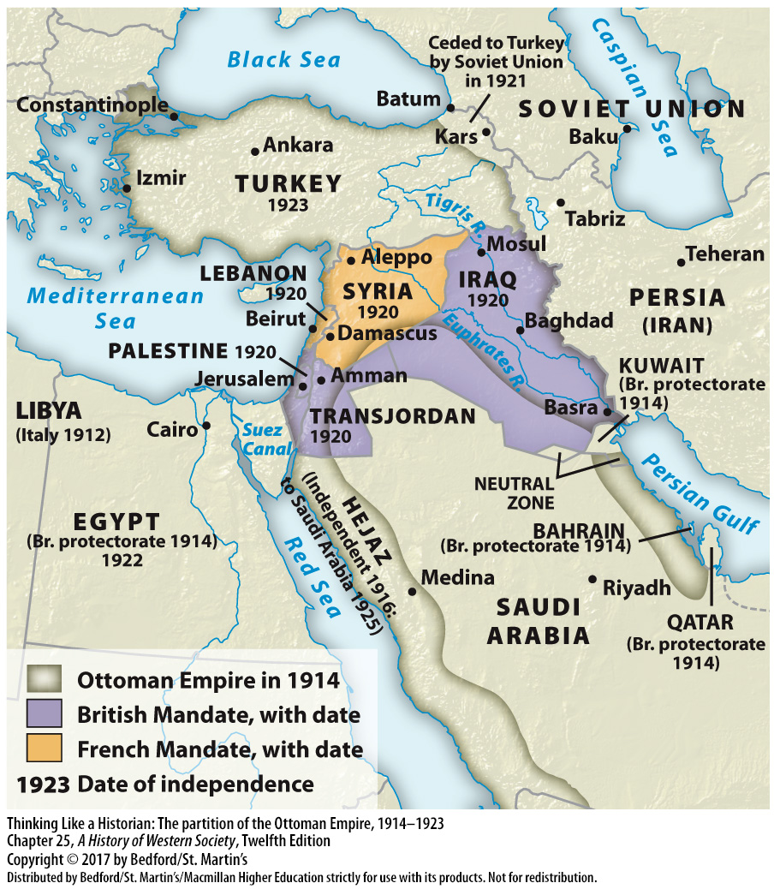

Slide 75
V. The Peace Settlement
The Peace Settlement in the Middle East
9. French army attacked Syria
10. British put down an uprising in Iraq
11. Western imperialism
12. Occupation of Turkey
Notes:
V. The Peace Settlement
D. The Peace Settlement in the Middle East
9. The Western reaction was swift: a French army stationed in Lebanon attacked Syria, taking Damascus in July 1920 and assuming control after the Arab government fled.
10. Meanwhile, the British bloodily put down an uprising in Iraq and established control there.
11. Western imperialism, in the form of the League of Nations’s mandate system, appeared to have replaced Ottoman rule in the Arab Middle East.
12. After a treaty dismembered the Turkish heartland, Great Britain and France occupied parts of modern-day Turkey, and Italy and Greece also claimed shares.

Slide 76
V. The Peace Settlement
The Peace Settlement in the Middle East
13. Greek nationalists
14. Mustafa Kemal (1881–1938)
15. Treaty of Lausanne
16. Kemal was elected president and created a one-party system
17. Kemal’s western influences
Notes:
V. The Peace Settlement
D. The Peace Settlement in the Middle East
13. Greek nationalists aiming to build a modern Greek empire landed on the Turkish coast in British ships and advanced into Turkey’s interior, while French troops moved in from the south.
14. Led by Mustafa Kemal (1881–1938), the Turks refused to acknowledge the Allied dismemberment of their country and gradually mounted a forceful resistance.
15. The Greeks and their British allies sued for peace, and the resulting Treaty of Lausanne (1923) recognized the territorial integrity of Turkey.
16. Kemal, a nationalist who believed that Turkey should modernize and secularize along Western lines, established a republic, was elected president, and created a one-party system to transform his country.
17. Profoundly influenced by the example of western Europe, Kemal decreed a separation of church and state, promulgated law codes inspired by European models, established a secular public school system, and granted rights to women.

Slide 77
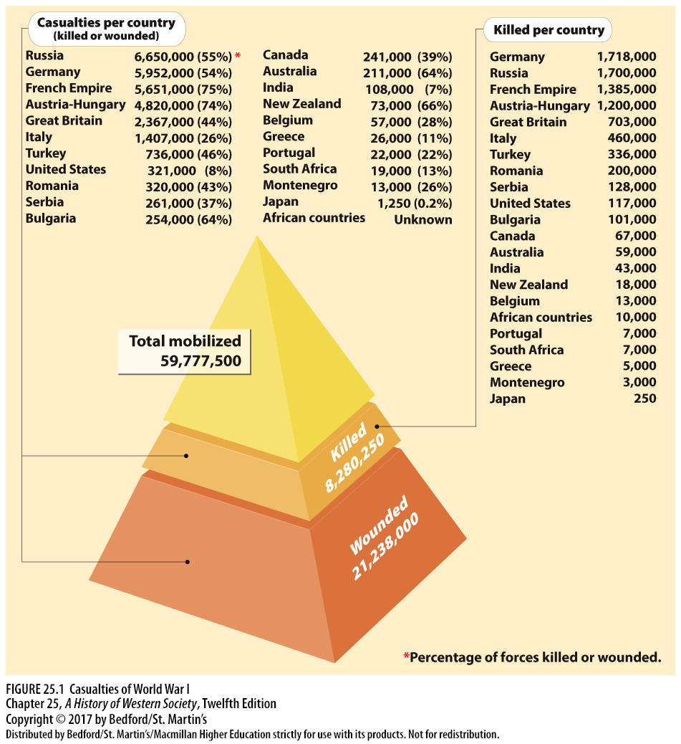

Slide 78
V. The Peace Settlement
The Human Costs of the War
1. Cost of World War I
2. 8 million soldiers
3. Between 7 and 10 million civilians died
4. Proper burials were difficult
5. Millions of ordinary people grieved
Notes:
V. The Peace Settlement
E. The Human Costs of the War
1. World War I broke empires, inspired revolutions, and changed national borders on a world scale, but it also had immense human costs.
2. Although estimates vary, total deaths on the battlefield numbered about 8 million soldiers: Russia had the highest number of military casualties, followed by Germany, although France had the highest proportionate number of losses.
3. Between 7 and 10 million civilians died because of the war and war-related hardships, and another 20 million people died in the worldwide influenza epidemic that followed the war in 1918.
4. The vast number of violent deaths and the nature of trench warfare made proper burials difficult, if not impossible, and the chaos and danger of the battlefield limited accurate identification.
5. Millions of ordinary people grieved, turning to family, friends, neighbors, and the church for comfort.

Slide 79
V. The Peace Settlement
The Human Costs of the War
6. Tomb of the Unknown Soldier
7. The victims of the First World War
8. Veterans’ groups
9. Great Depression in 1929
10. Newly formed radical right-wing parties like the German Nazis and the Italian Fascists
Notes:
V. The Peace Settlement
E. The Human Costs of the War
6. Towns and villages across Europe raised public memorials to honor the dead and held ceremonies on important anniversaries, and for the first time, each nation built a Tomb of the Unknown Soldier as a national mourning site.
7. The victims of the First World War included millions of widows and orphans and huge numbers of disabled and emotionally scarred veterans, who were victimized even further when governments denied them benefits or failed to adequately fund pensions and job training programs.
8. Veterans’ groups in Germany organized to lobby for state support, and fully one-third of the federal budget in the Weimar Republic was tied up in war-related pensions and benefits.
9. With the onset of the Great Depression in 1929, benefits were cut, leaving bitter veterans vulnerable to Nazi propagandists who paid homage to the sacrifices of the war while calling for the overthrow of the government.
10. Another steep price of the war was that newly formed radical right-wing parties such as the German Nazis and the Italian Fascists successfully manipulated popular feelings of loss and resentment to undermine fragile parliamentary governments.

Slide 80
