Slide 1
A History of Western Society Twelfth Edition
McKay • Crowston • Wiesner-Hanks • Perry
CHAPTER 24
The West and the World
1815–1914
Copyright © 2017 by Bedford/St. Martin’s
Distributed by Bedford/St. Martin's/Macmillan Higher Education strictly for use with its products; Not for redistribution.

Slide 2
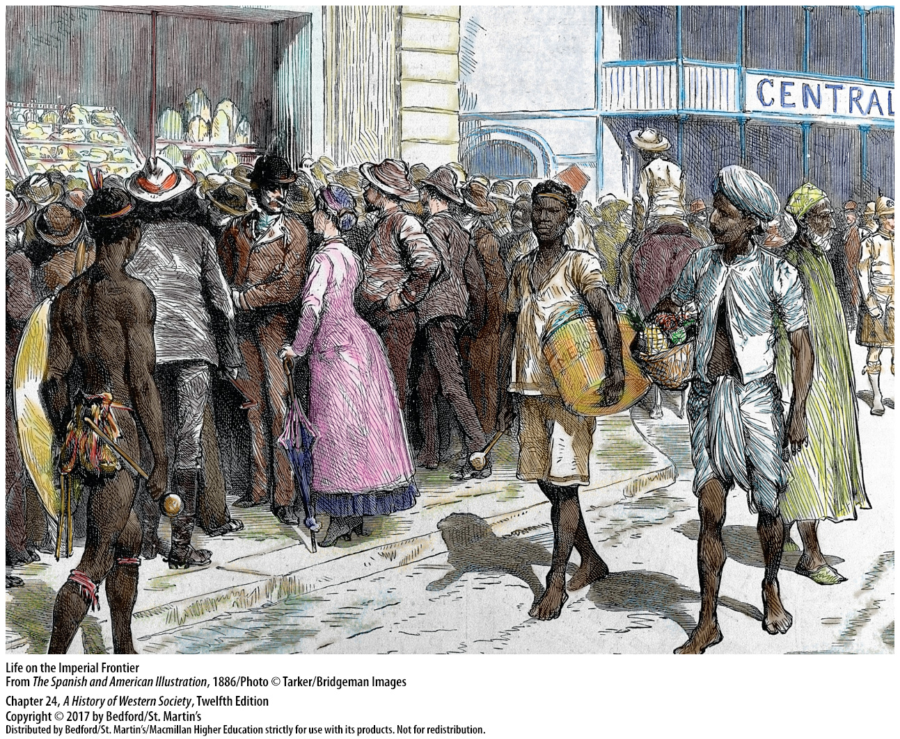

Slide 3
I. Industrialization and the World Economy
The Rise of Global Inequality
1. Gap between the industrializing regions and the soon-to-be colonized regions
2. “Lopsided world”
3. Two schools of interpretation
Notes:
Industrialization and the World Economy
The Rise of Global Inequality
1. Areas that industrialized in the nineteenth century (mainly Europe and North America) increased their wealth and power enormously, opening a gap between the industrializing regions and the soon-to-be colonized or semi-colonized regions (mainly in Africa, Asia, the Middle East, and Latin America).
2. This pattern of uneven global development became institutionalized, or built into the structure of the world economy, and a “lopsided world” evolved with a rich north and a poor south.
3. One school of interpretation stresses that the West used science, technology, capitalist organization, and even its rational worldview to create its massive wealth, and then used that wealth and power to its advantage. Another school argues that the West used its political and economic power to steal much of the world’s riches, continuing the aggressive colonialism born during the era of expansion.

Slide 4
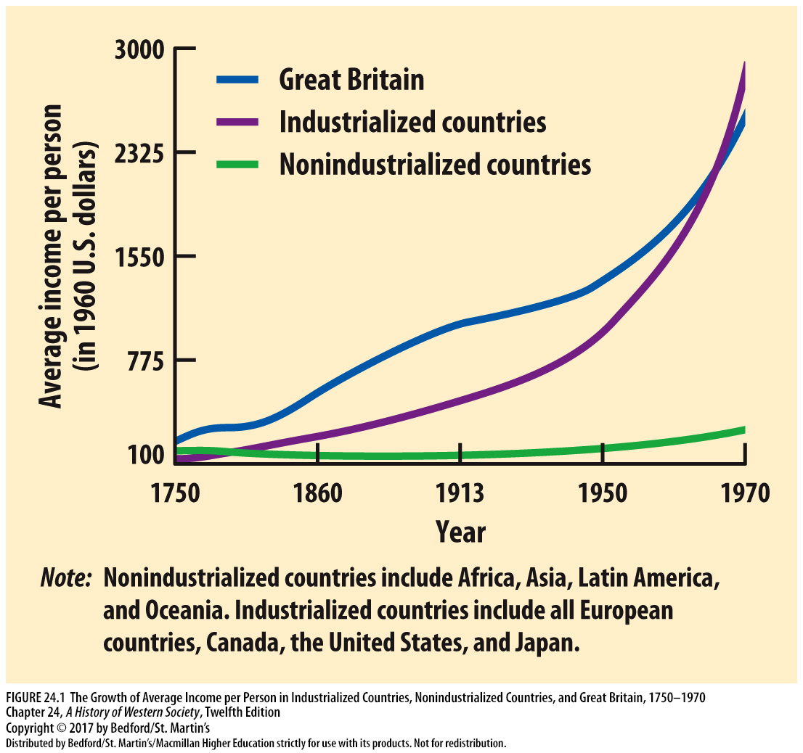

Slide 5
I. Industrialization and the World Economy
The World Market
1. Great Britain led export markets
2. Protective tariffs
3. As a British colony, India could not raise tariffs
4. Development of mines and plantations in non-Western areas
5. Transportation systems improved
6. European investors funded railroad construction in Latin America, Asia, and Africa
Notes:
Industrialization and the World Economy
B. The World Market
1. In the nineteenth century, Great Britain took the lead in cultivating export markets for its booming industrial output.
2. As European nations and the United States erected protective tariffs to promote domestic industry, British cotton textile manufacturers aggressively sought markets in non-Western areas for their products.
3. As a British colony, India could not raise tariffs to protect its ancient, indigenous cotton textile industry, which collapsed, leaving thousands of Indian weavers unemployed.
4. Under free-trade policies, open access to Britain’s market stimulated the development of mines and plantations in many non-Western areas.
5. International trade also grew as transportation systems improved; railroads drastically reduced transportation costs, opened new economic opportunities, and called forth new skills and attitudes.
6. European investors funded much of the railroad construction in Latin America, Asia, and Africa, connecting seaports with resource-rich inland cities and regions and facilitating the inflow and sale of Western manufactured goods and the export and development of local raw materials.

Slide 6
I. Industrialization and the World Economy
The World Market
7. Steam power
8. Suez and Panama Canals
9. Improved transportation enabled Asia, Africa, and Latin America to ship to the West
10. New communications systems
11. Europeans make massive foreign investments
12. Native Americans and Australian aborigines decimated by expanding Western society
Notes:
Industrialization and the World Economy
B. The World Market
7. The power of steam revolutionized transportation by sea and land, and passenger and freight rates tumbled, making the intercontinental shipment of low-priced raw materials feasible.
8. The opening of the Suez and Panama Canals shortened global transport time considerably.
9. Improved transportation enabled Asia, Africa, and Latin America to ship to Western manufacturers spices, tea, sugar, and coffee, as well as new raw materials for industry such as jute, rubber, cotton, and coconut oil.
10. New communications systems directed the flow of goods across global networks, and transoceanic telegraph cables enabled rapid communications.
11. As their economies grew, Europeans began to make massive foreign investments, with three-quarters of investment going to other European countries or “neo-Europes”—regions with large proportions of ethnic Europeans, including the United States, Canada, Australia, New Zealand, Latin America, and Siberia.
12. Native Americans and Australian aborigines were decimated by the diseases, liquor, and weapons of an aggressively expanding Western society.

Slide 7
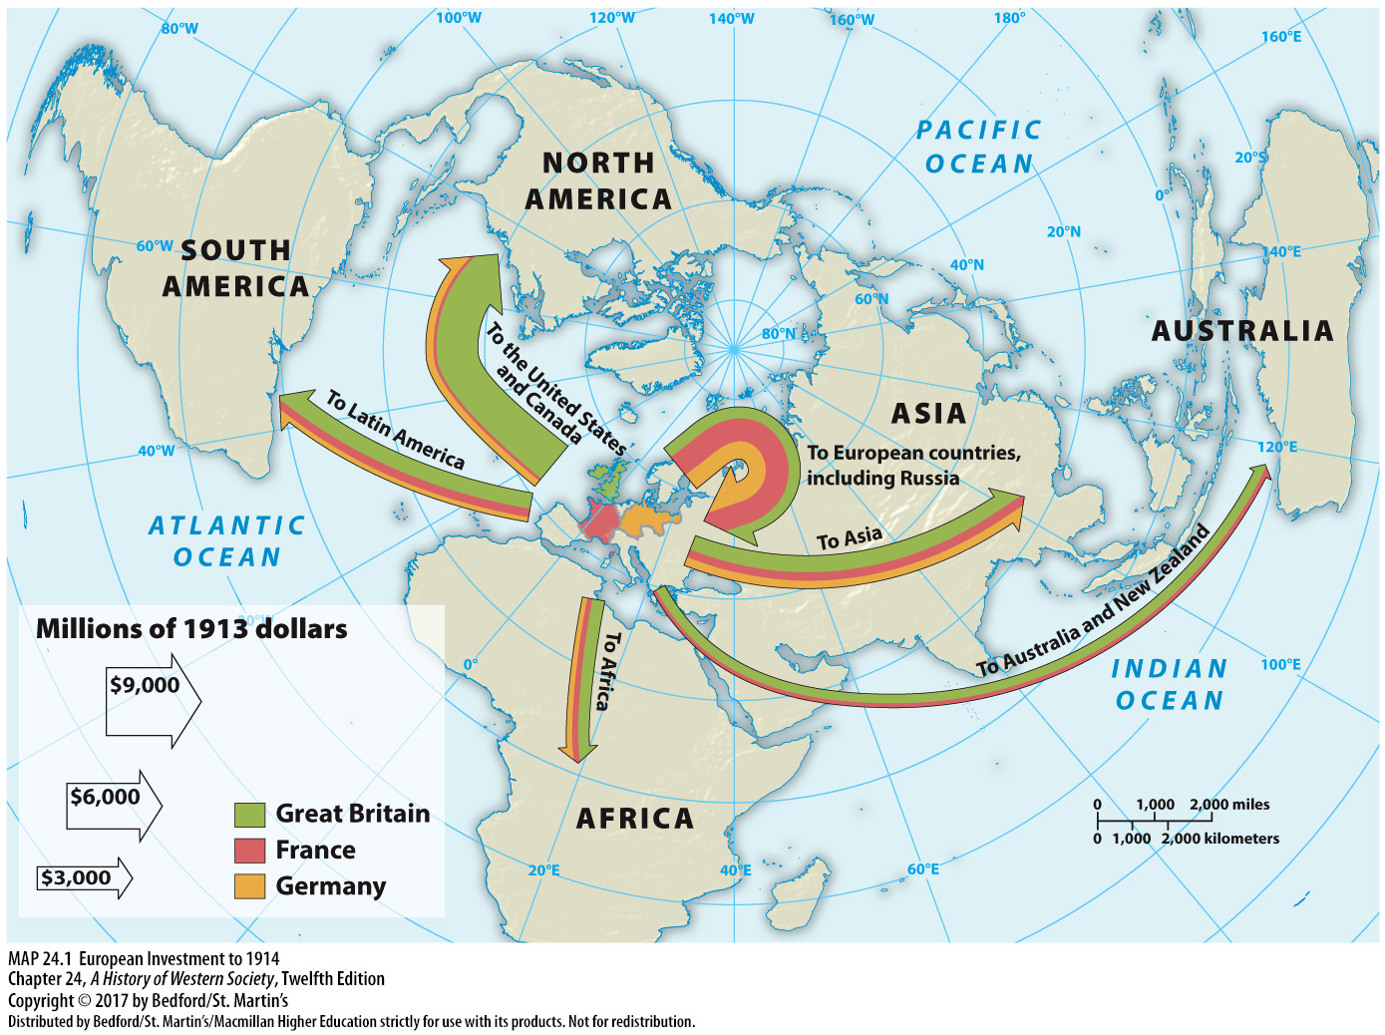

Slide 8
I. Industrialization and the World Economy
The Opening of China
1. Qing Dynasty regulated trade
2. British discover huge profits in Chinese addiction to opium
3. Merchants pressured British government to take decisive action to open China
4. Qing government pushes back against opium trade
Notes:
Industrialization and the World Economy
C. The Opening of China
1. China’s trade with Europe was carefully regulated in the 1800s by the Chinese imperial government—the Qing, or Manchu, Dynasty—which required all foreign merchants to live in the southern port of Guangzhou (Canton) and to buy and sell only to licensed Chinese merchants.
2. Then in the 1820s, the British discovered that they could make huge profits by exploiting the growing Chinese addiction to opium, which could be grown legally in British-occupied India and then smuggled into China, where its use and sale were illegal.
3. Spurred on by economic motives, the merchants pressured the British government to take decisive action and enlisted the support of other British manufacturers with visions of vast Chinese markets to be opened to their goods also.
4. At the same time, the Qing government decided that the opium trade was ruining the people and stripping the empire of its silver, which was going to British merchants to pay for the opium.

Slide 9
I. Industrialization and the World Economy
The Opening of China
5. First Opium War
6. Treaty of Nanking
7. Second Opium War
Notes:
Industrialization and the World Economy
C. The Opening of China
5. Using troops from India and taking advantage of its control of the seas, Britain, in the first of two Opium Wars, forced China to give into its demands.
6. In the Treaty of Nanking (1842), China ceded the island of Hong Kong to Britain, paid an indemnity of $100 million, and opened up four large cities to unlimited foreign trade with low tariffs.
7. Disputes over trade between China and the Western powers continued in the second Opium War (1856–1860), culminating in the occupation of Beijing by British and French troops and another round of one-sided treaties that forced the Chinese to accept trade and investment on unfavorable terms in several more cities.

Slide 10
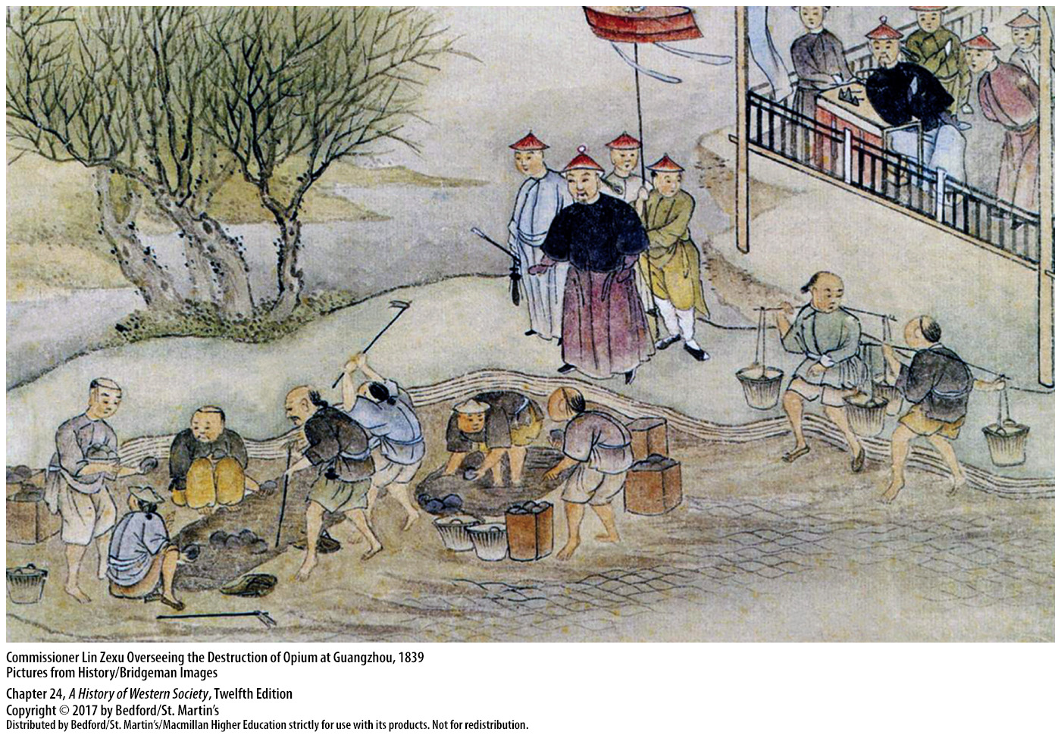

Slide 11
I. Industrialization and the World Economy
Japan and the United States
1. Japan had sealed off from all European influences
2. U.S. believed it their duty to force the Japanese to behave as a “civilized” nation
3. Commodore Matthew Perry
4. Reluctantly signed a trade treaty with the United States
Notes:
Industrialization and the World Economy
D. Japan and the United States
1. Japan had its own highly distinctive civilization and even less use for Westerners; by 1640 the government had expelled all foreigners and sealed off the country from all European influences.
2. Japan’s unbending isolation seemed hostile and barbaric to the West, particularly to the United States; Americans shared the self-confidence of expanding Western society and felt destined to play a role in the Pacific, believing it their duty to force the Japanese to share their ports and behave as a “civilized” nation.
3. After several unsuccessful American attempts to establish commercial relations with Japan, Commodore Matthew Perry steamed into Edo (now Tokyo) Bay in 1853.
4. Senior Japanese officials realized how defenseless their cities were against naval bombardment and reluctantly signed a treaty with the United States that opened two ports and permitted trade.

Slide 12
I. Industrialization and the World Economy
Western Penetration of Egypt
1. Succession of foreigners rule Egypt
2. Muhammad Ali (1769–1849)
3. Modernization program attracted Europeans
4. “Modernized” agriculture
6. Ismail (r. 1863–1879)
Notes:
Industrialization and the World Economy
E. Western Penetration of Egypt
1. Since 525 b.c.e., Egypt had been ruled by a succession of foreigners, most recently by the Ottoman sultans.
2. First appointed governor of Egypt in 1805 by the Ottoman sultan, Muhammad Ali (1769–1849) set out to build his own state on the strength of a large, powerful army organized along European lines.
3. His modernization program attracted large numbers of Europeans to the banks of the Nile to work as army officers, engineers, doctors, government officials, and merchants.
4. To pay for his ambitious plans, Muhammad Ali encouraged the development of commercial agriculture.
5. Faced with the possibility of export agriculture, high-ranking officials and members of Ali’s family began carving large private landholdings out of state-owned lands; they made the peasants their tenants and forced them to grow cash crops such as cotton and rice for European markets. Thus Egyptian landowners “modernized” agriculture, but to the detriment of peasant well-being, a trend that continued under Muhammad Ali’s grandson Ismail.
6. Educated at France’s leading military academy, Ismail (r. 1863–1879) was a westernizing autocrat who promoted large irrigation networks, which boosted cotton production and exports to Europe, and supported the completion of the Suez Canal in 1869.

Slide 13
I. Industrialization and the World Economy
Western Penetration of Egypt
7. Enormous national debt
8. French and British commissioners to oversee Egyptian finances
9. Egyptian Nationalist Party
10. Anti-European riots
12. “Temporary” British occupation remained
13. New model for European expansion
Notes:
Industrialization and the World Economy
E. Western Penetration of Egypt
7. Young Egyptians educated in Europe spread new skills, and Cairo acquired modern boulevards and Western hotels, but an impatient and reckless Ismail had amassed an enormous national debt by 1876.
8. France and Great Britain then intervened on behalf of foreign bondholders and forced Ismail to appoint French and British commissioners to oversee Egyptian finances and ensure repayment.
9. Foreign financial control evoked a violent nationalistic reaction among Egyptian religious leaders, young intellectuals, and army officers, who in 1879 formed the Egyptian Nationalist Party under the leadership of Colonel Ahmed Arabi.
10. Bloody anti-European riots in 1882 provoked a British bombardment of Alexandria, which resulted in more riots and a revolt led by Colonel Arabi, but the rebellion was quashed by British forces that subsequently occupied all of Egypt.
12. Although the British claimed their occupation was temporary, British armies remained in Egypt until 1956.
13. British rule in Egypt provided a new model for European expansion based on military force, political domination, and a self-justifying ideology of beneficial reform.

Slide 14
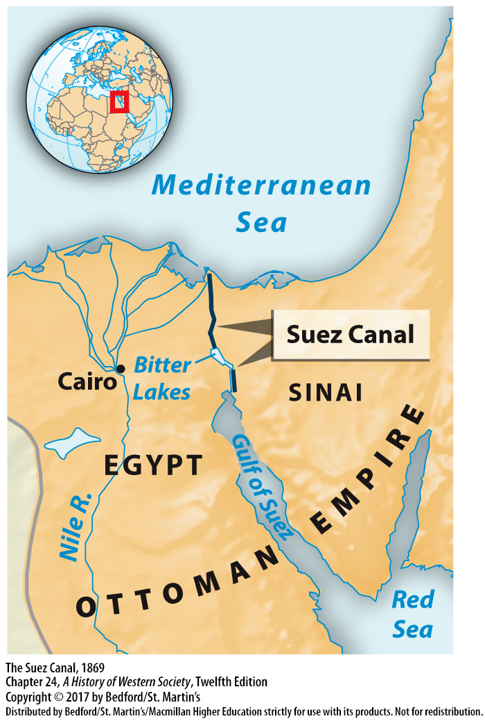

Slide 15
II. Global Migration Around 1900
The Pressure of Population
1. European birthrates and death rates
2. Emigration to neo-Europes
3. Large-scale emigration was a defining characteristic of European society
4. United States, Asiatic Russia, Canada, Argentina, Brazil, Australia, and New Zealand
Notes:
II. Global Migration Around 1900
The Pressure of Population
1. European birthrates eventually declined in the nineteenth century, but so did death rates, mainly because of the rising standard of living and the revolution in medicine; thus the population of Europe grew from approximately 188 million in 1800 to roughly 432 million in 1900.
2. Between 1815 and 1932 more than 60 million people left Europe, emigrating primarily to the rapidly growing neo-Europes—North and South America, Australia, New Zealand, and Siberia—where they contributed to a rapid growth of people of predominately European origin.
3. Large-scale emigration was a defining characteristic of European society at the turn of the century, although different countries had very different patterns of migration.
4. Though the United States absorbed the largest overall number of European emigrants, fewer than half of all emigrants went to the United States; Asiatic Russia, Canada, Argentina, Brazil, Australia, and New Zealand also attracted large numbers.

Slide 16
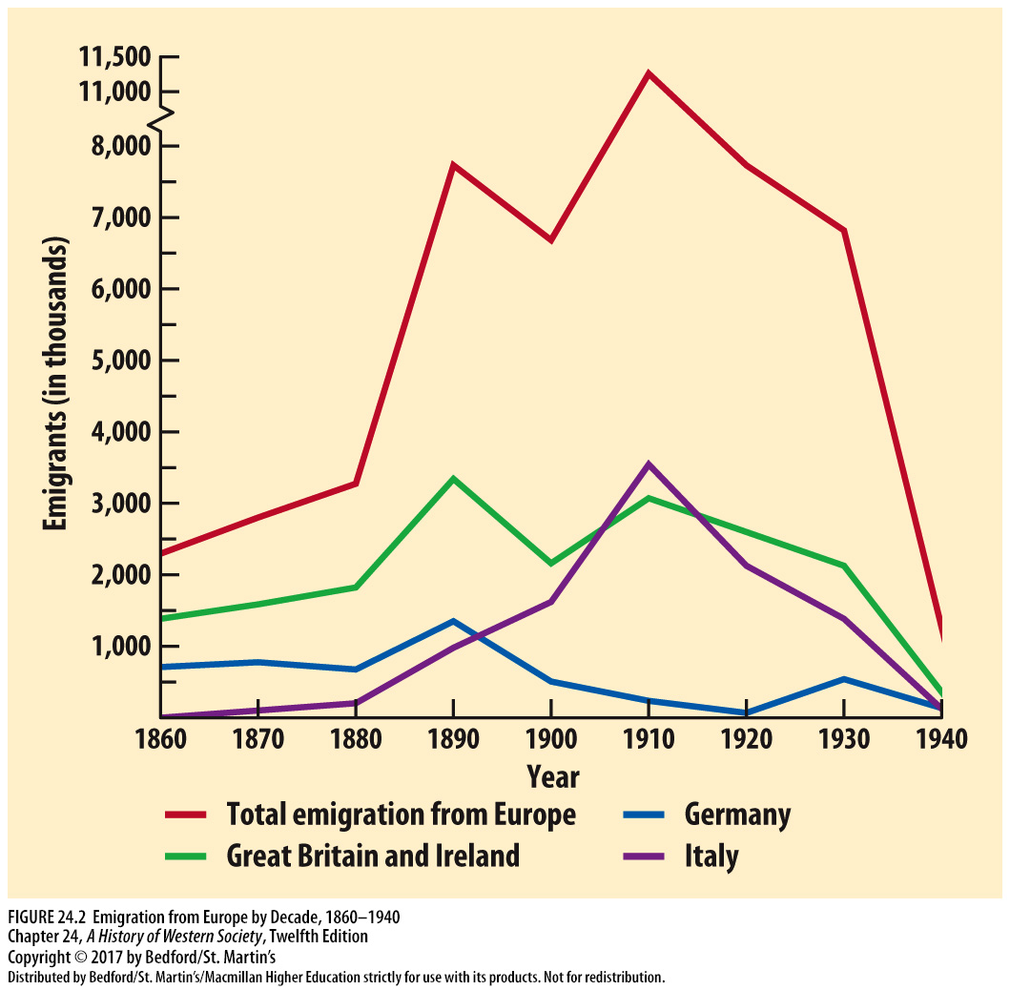

Slide 17
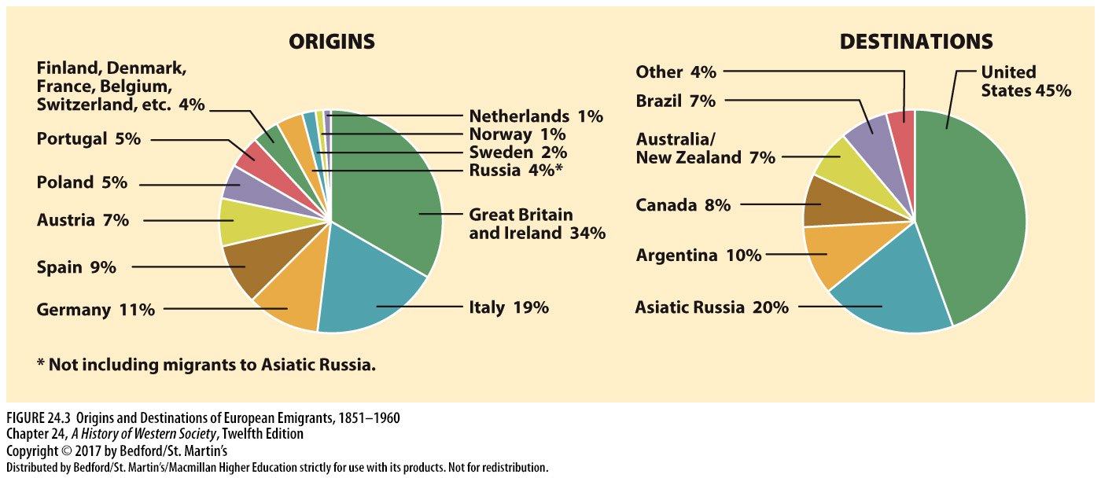

Slide 18
II. Global Migration Around 1900
European Emigration
1. European migrant demographics
2. Migrants were a great asset
3. Migrants vs immigrants
4. Emigration rates slowed where people won basic political and social reforms
Notes:
II. Global Migration Around 1900
B. European Emigration
1. European migrants were generally energetic small farmers or skilled artisans trying hard to stay ahead of poverty; they typically left Europe because the lack of available land and growing availability of cheap factory-made goods threatened their livelihoods.
2. Migrants were a great asset to the countries that received them because the vast majority of them were young, unmarried, and ready to work hard in the new land, at least for a time.
3. Many Europeans were migrants as opposed to immigrants—that is, they returned home after some time abroad; for example, one in two migrants to Argentina and probably one in three to the United States eventually returned to their native land.
4. Emigration rates slowed in countries where the people won basic political and social reforms, such as the right to vote, equality before the law, and social security.

Slide 19
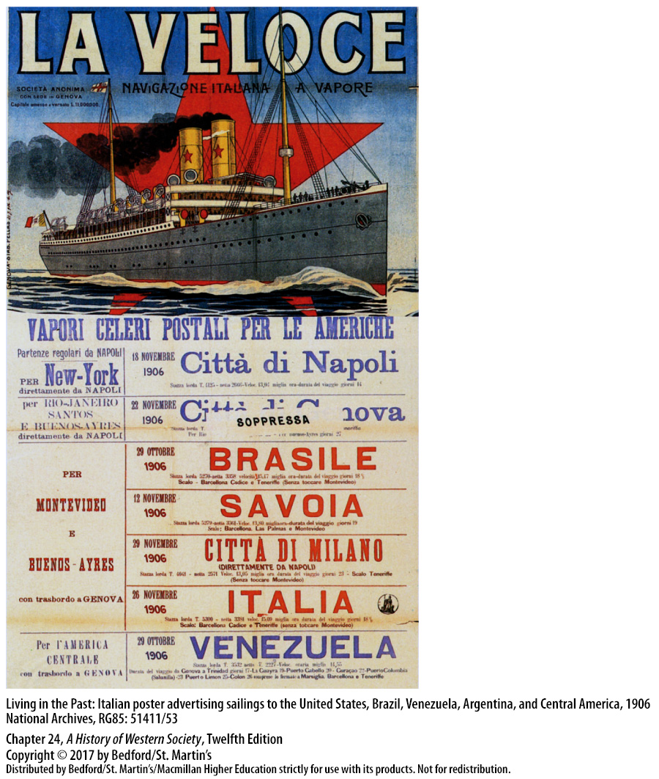

Slide 20
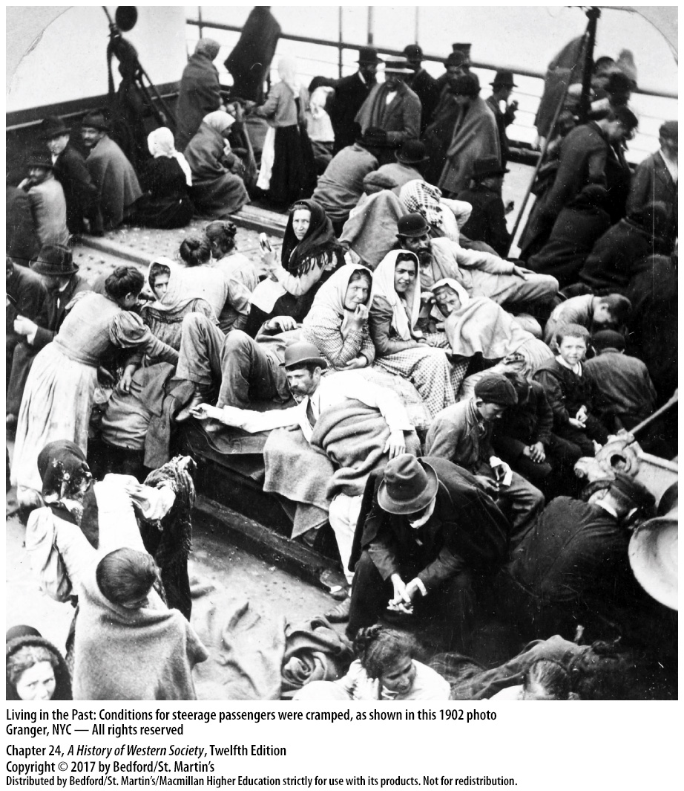

Slide 23
II. Global Migration Around 1900
Asian Emigration
1. Chinese, Japanese, Indians, and Filipinos
2. Indentured laborers
3. American and Australian governments enacted discriminatory laws
4. Nativism
5. Europeans reaped the main benefits from the great migration
Notes:
II. Global Migration Around 1900
C. Asian Emigration
1. A substantial number of Chinese, Japanese, Indians, and Filipinos responded to rural hardship with temporary or permanent emigration.
2. Most went as indentured laborers to work under incredibly difficult conditions on the plantations or gold mines of Latin America, the Caribbean, southern Asia, Africa, California, Hawaii, and Australia.
3. By the 1880s, the American and Australian governments had enacted discriminatory laws to keep Asians from entering the country.
4. Inspired by nativism, governments established strict rules for granting citizenship and asylum to foreigners and monitored movement across increasingly tight national boundaries.
5. Largely successful in monopolizing the best overseas opportunities, Europeans and people of European ancestry reaped the main benefits from the great migration.

Slide 24
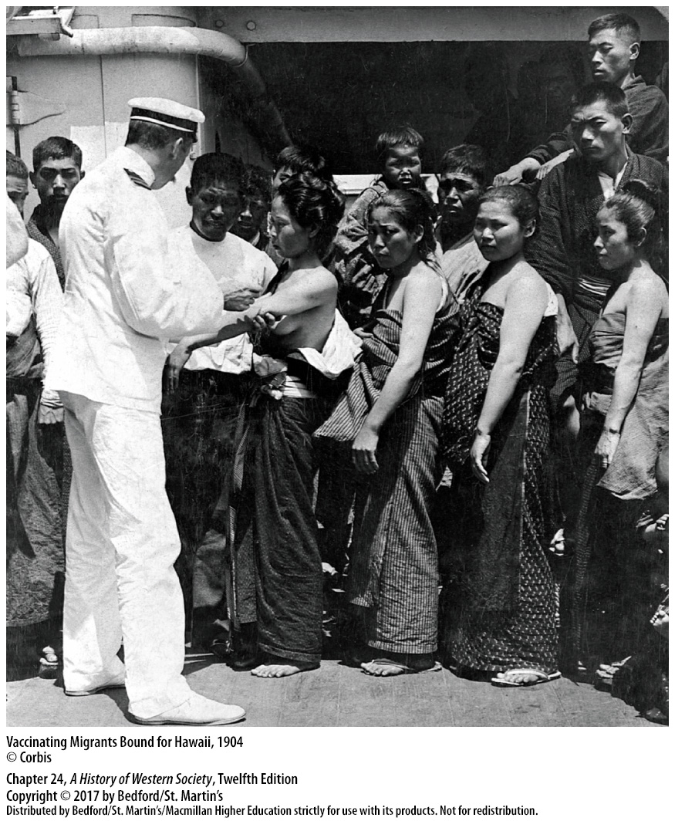

Slide 25
III. Western Imperialism, 1880 – 1914
The European Presence in Africa Before 1880
1. European nations controlled only 10 percent
2. Cape Town
3. Afrikaner settlers
4. European trading posts and forts
Notes:
III. Western Imperialism, 1880 – 1914
The European Presence in Africa Before 1880
1. Prior to 1880, European nations controlled only 10 percent of the African continent.
2. At the southern tip of the continent, Britain had taken possession of the Dutch settlements at Cape Town, which led disgruntled Dutch cattle ranchers and farmers in 1835 to move into the interior, where they fought the Zulu and Xhosa peoples for land.
3. By 1880 Afrikaner settlers—the descendants of the Dutch in the Cape Colony—and British settlers, who detested each other, had wrested control of much of South Africa from the Zulu, Xhosa, and other African peoples.
4. In addition to the French presence in Algeria in the north and the British and Afrikaners in the south, European trading posts and forts dotted the coast of West Africa and the Portuguese maintained a loose hold on possessions in Angola and Mozambique, but Europeans did not rule elsewhere on the enormous continent.

Slide 26
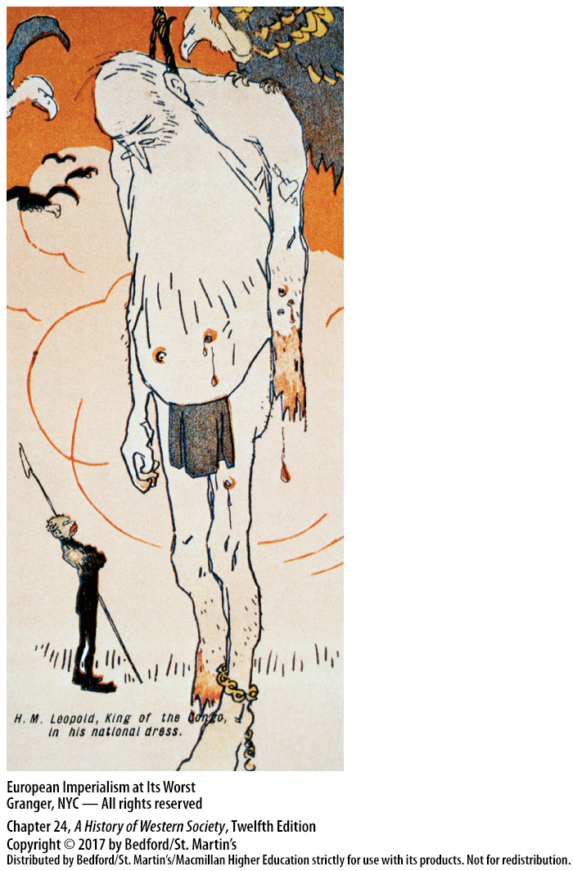

Slide 27
III. Western Imperialism, 1880 – 1914
The Scramble for Africa After 1880
1. Nearly the entire continent under European rule
2. British occupation of Egypt in 1882
3. Leopold II of Belgium (r. 1865–1909)
4. Leopold’s intrusion led to a race for territory
Notes:
III. Western Imperialism, 1880 – 1914
B. The Scramble for Africa After 1880
1. Between 1880 and 1900, Britain, France, Belgium, Germany, and Italy scrambled for African possessions until nearly the entire continent had been carved up and placed under European rule.
2. In the complex story of the European seizure of Africa, certain events and individuals stand out, such as the British occupation of Egypt in 1882, which established the new model of formal political control.
3. Another example is Leopold II of Belgium (r. 1865–1909), an energetic, strong-willed monarch of a tiny country with a lust for distant territory who by 1876 had focused his sights on central Africa.
4. Leopold’s intrusion into the Congo called attention to the possibilities of African colonization, and by 1882 the gold rush mentality that had set in among Europeans led to a race for territory.

Slide 28
III. Western Imperialism, 1880 – 1914
The Scramble for Africa After 1880
5. The Berlin Conference (1884–1885)
6. Germany established protectorates
7. Boer War (1899–1902)
8. Natives who resisted European rule were blown away by vastly superior military force
Notes:
III. Western Imperialism, 1880 – 1914
B. The Scramble for Africa After 1880
5. The Berlin Conference (1884–1885) established the principle that European claims to African territory had to rest on “effective occupation” in order to be recognized by other states.
6. In the mid-1880s, Germany established protectorates over a number of small African kingdoms and tribes in Togo, the Cameroons region, southwest Africa, and, later, East Africa.
7. The British, led by Cecil Rhodes (1853–1902) in the Cape Colony, leapfrogged over the two Afrikaner states—the Orange Free State and the Transvaal—and eventually conquered their white rivals in the bloody South African War, or Boer War (1899–1902).
8. The British conquest of Sudan exemplifies the general process of empire building in Africa: all native peoples who resisted European rule were blown away by vastly superior military force, but Europeans stopped short of fighting each other.

Slide 29
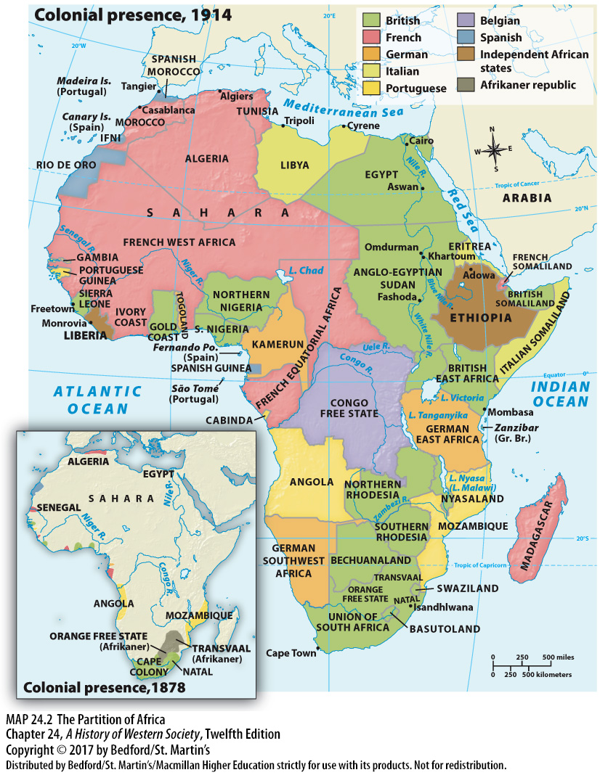

Slide 30
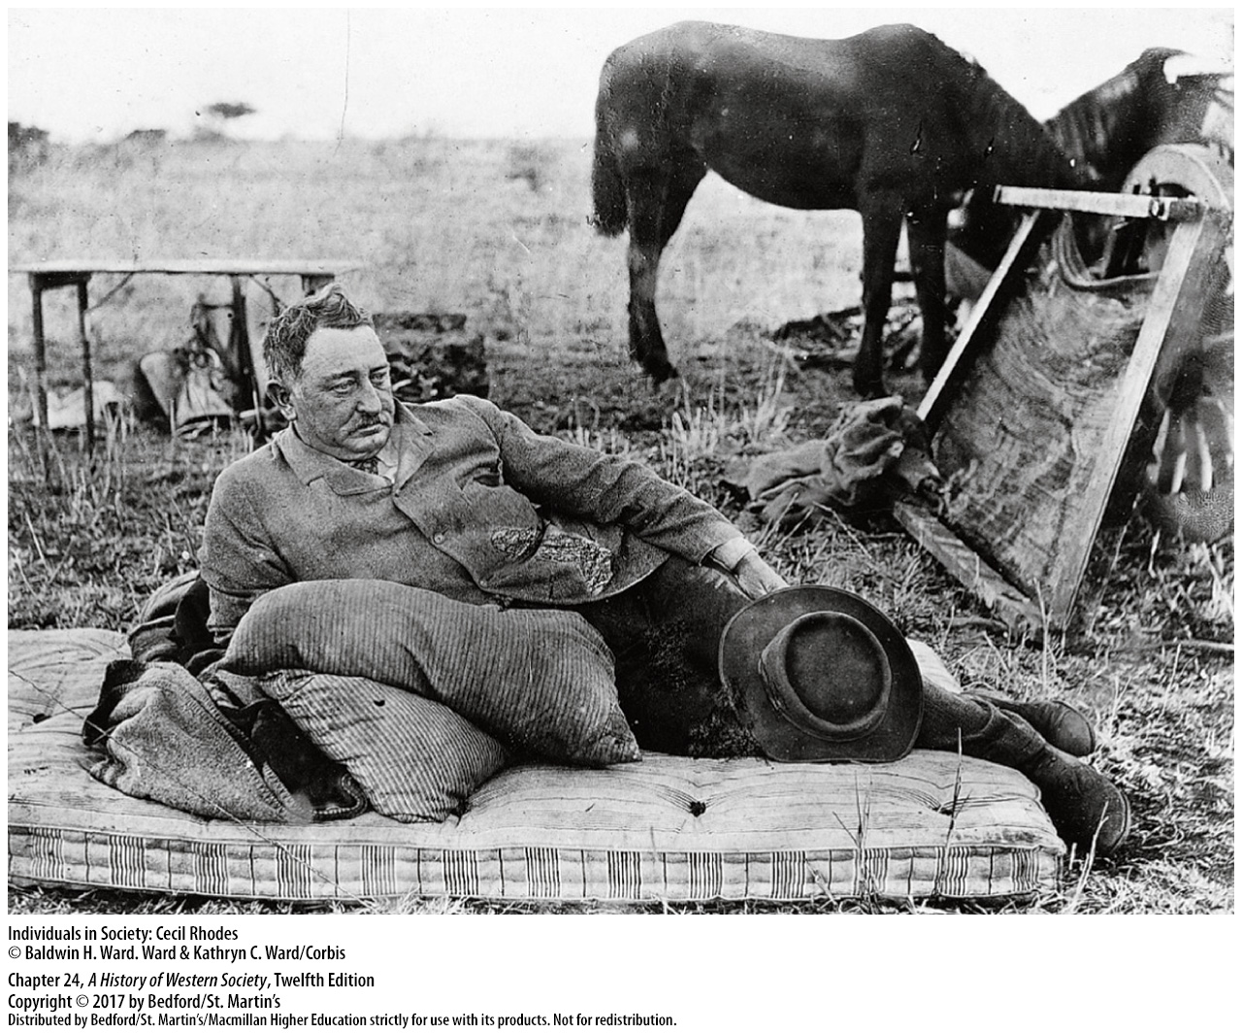

Slide 31
III. Western Imperialism, 1880 – 1914
Imperialism in Asia
1. The Dutch and the Malay Archipelago
2. French took Indochina
3. Russia conquered Muslim areas
4. United States takes the Philippines
Notes:
III. Western Imperialism, 1880 – 1914
C. Imperialism in Asia
1. The Dutch, who in 1815 ruled little more than the island of Java in the East Indies, gradually brought almost all of the three-thousand-mile Malay Archipelago under their political authority.
2. In the 1880s the French took Indochina, and India, Japan, and China also experienced a profound imperialist impact.
3. Russia conquered Muslim areas to the south in the Caucasus and in Central Asia and in the 1890s proceeded to nibble greedily on China’s outlying provinces.
4. The United States’s great conquest was the Philippines, taken from Spain in 1898 through the Spanish-American War.

Slide 32
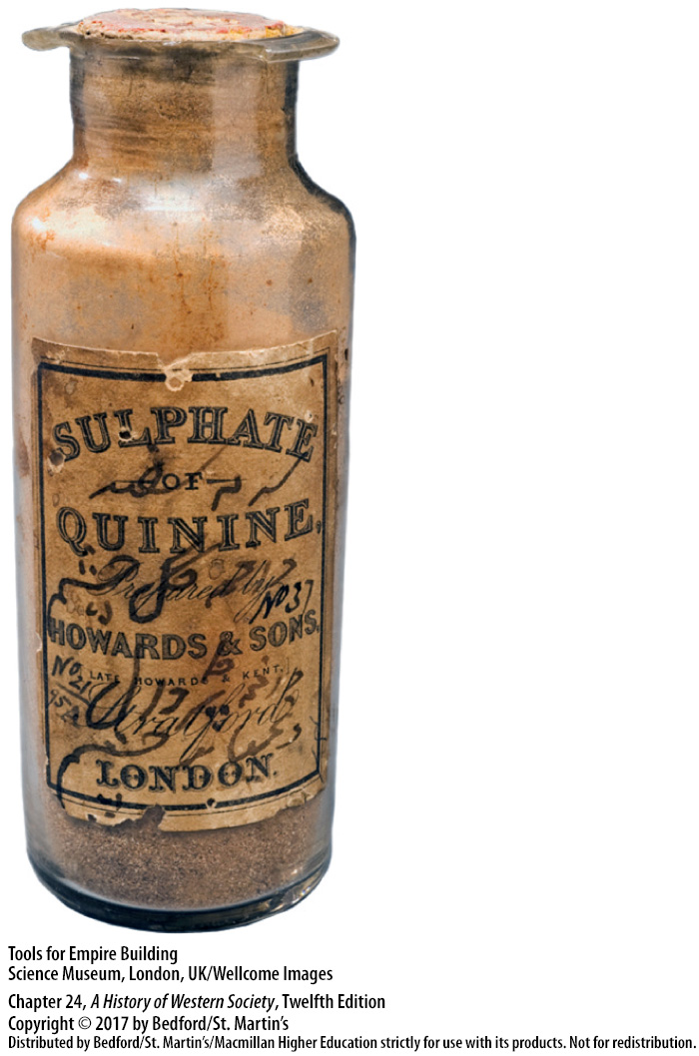

Slide 33
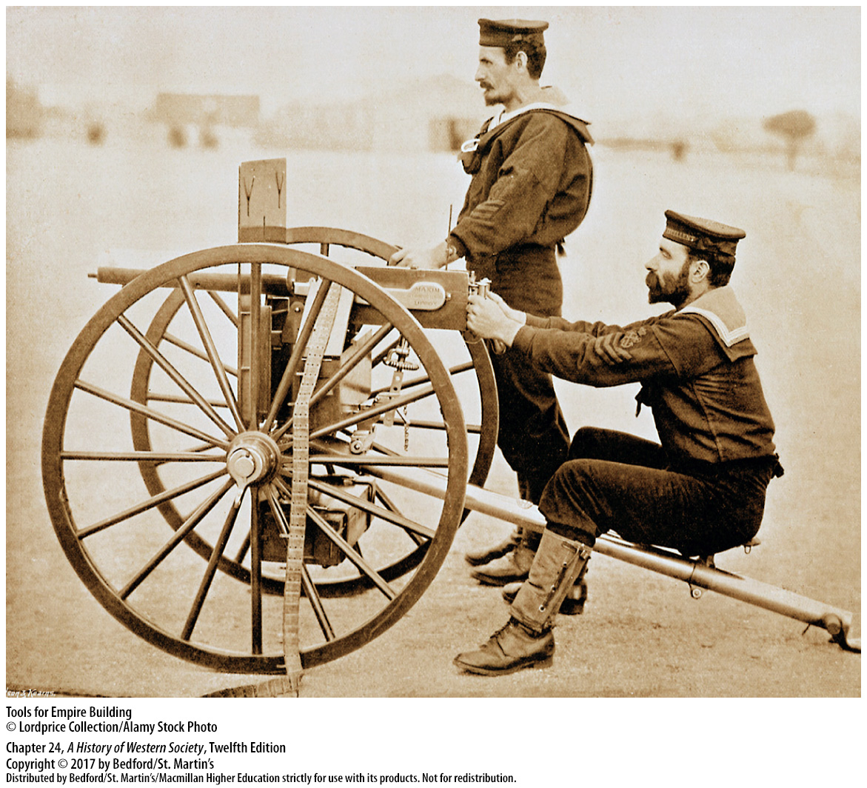

Slide 34
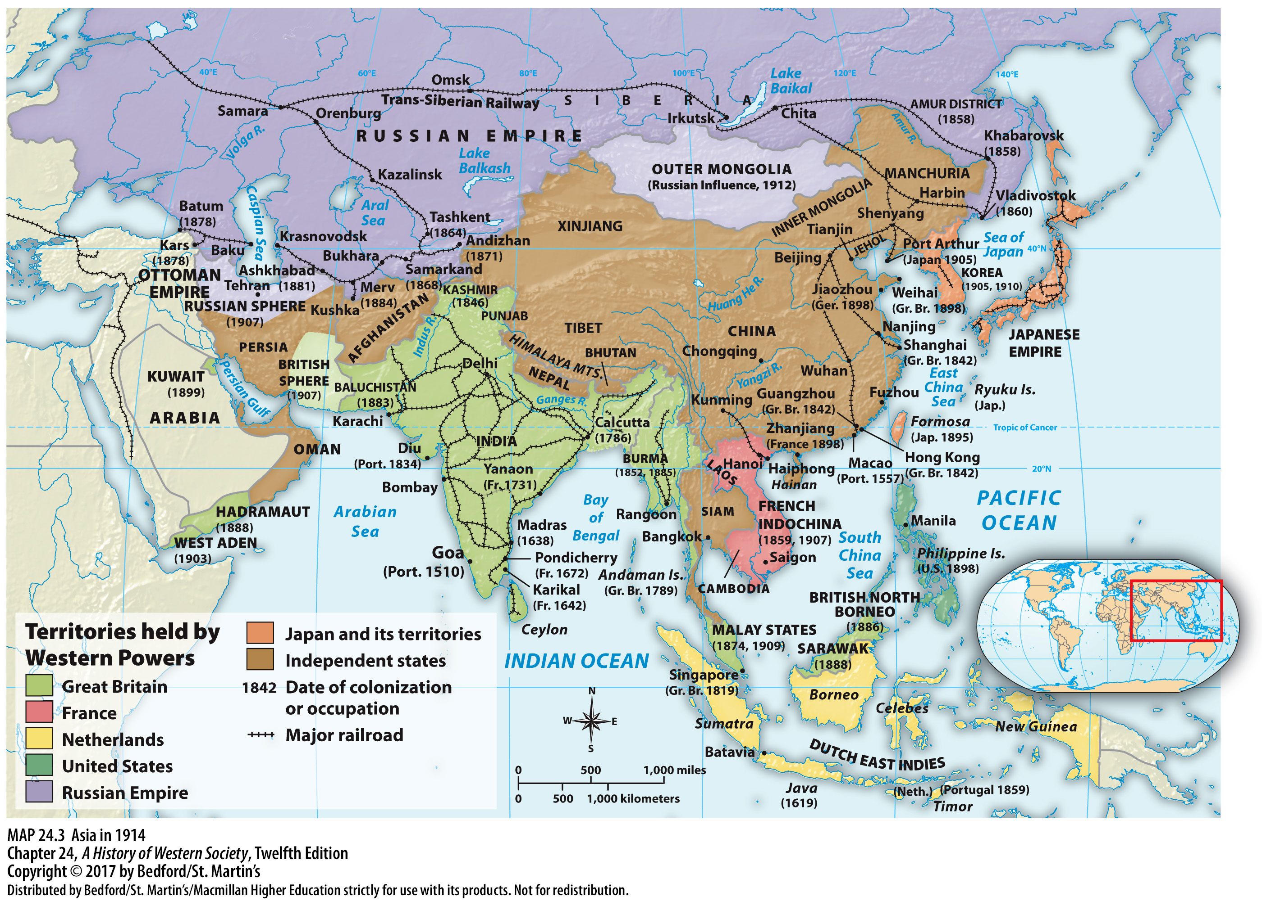

Slide 35
III. Western Imperialism, 1880 – 1914
Causes of the New Imperialism
1. Economic motives
2. National security and military power
3. Colonies as essential to great nations
4. Unprecedented technological and military superiority
5. Colonial issues divert popular attention
6. Special-interest groups
Notes:
III. Western Imperialism, 1880 – 1914
D. Causes of the New Imperialism
1. Economic motives played an important role in the extension of political empires, especially in the British Empire, which was losing its early economic lead and facing increasing competition in foreign markets.
2. Each leading European power saw colonies as crucial to national security and military power; for example, safeguarding the Suez Canal played an important role in the British occupation of Egypt.
3. Many people were convinced that colonies were essential to great nations, an attitude that reflects both the increasing aggressiveness of European nationalism and Social Darwinian theories of brutal competition among races.
4. Another enormous factor was the industrial world’s unprecedented technological and military superiority, as evidenced by the rapidly firing Maxim machine gun, the use of quinine in controlling malaria, and the steamship and the international telegraph.
5. Conservative political leaders manipulated colonial issues in order to divert popular attention from the class struggle at home and to create a false sense of unity.
6. Special-interest groups in each country were powerful agents of expansion: white settlers demanded more land and greater state protection, missionaries and humanitarians wanted to spread religion and stop the slave trade, shipping companies wanted lucrative subsidies, and military men and colonial officials sought positions and rapid advancement.

Slide 36
III. Western Imperialism, 1880 – 1914
A “Civilizing Mission”
1. New imperialists arguments
2. “The White Man’s Burden”
3. Protect natives from tribal warfare
4. Spread of Christianity
5. Christianity in Africa vs Asia
Notes:
III. Western Imperialism, 1880 – 1914
E. A “Civilizing Mission”
1. Imperialists developed additional arguments in order to satisfy their consciences and answer their critics. A favorite idea was that Europeans could and should civilize more primitive nonwhite peoples.
2. In 1899 Rudyard Kipling (1865–1936), perhaps the most influential British writer of the 1890s, summarized these ideas in his poem “The White Man’s Burden.”
3. Another argument was that imperial government protected natives from tribal warfare as well as from cruder forms of exploitation by white settlers and business people.
4. Peace and stability under European control also facilitated the spread of Christianity, as Catholic and Protestant missionaries competed with Islam in sub-Saharan Africa for converts and built schools to spread the Gospel.
5. The occasional successes in converting Africans to Christianity contrasted with the general failure of missionary efforts in India, China, and the Islamic world, where Christians often preached in vain to peoples with ancient, complex religious beliefs.

Slide 37
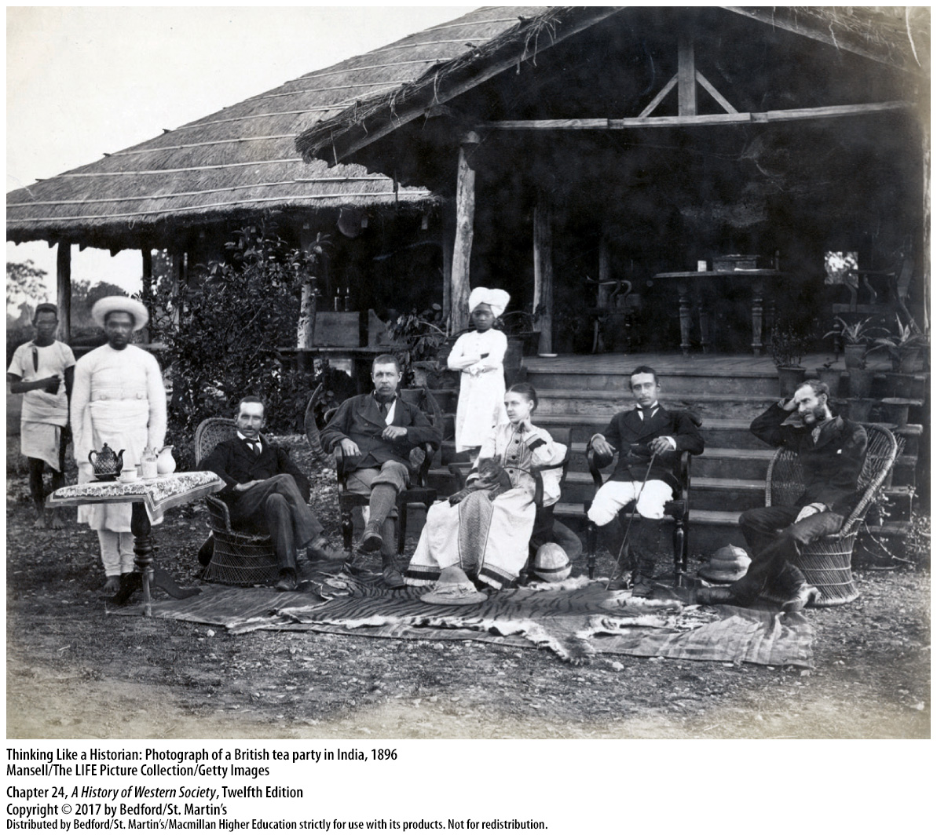

Slide 38
III. Western Imperialism, 1880 – 1914
Orientalism
1. Edward Said (1935–2003)
2. “us vs. them” and “other”
3. The Orient as a place of mystery and romance
4. Studying supposedly “primitive” cultures
5. Writers and artists contributed to Orientalist worldview
Notes:
III. Western Imperialism, 1880 – 1914
F. Orientalism
1. In the late 1970s, literary scholar Edward Said (1935–2003) coined the term “Orientalism” to describe the stereotypical and often racist Western views of non-Westerners that dominated nineteenth-century Western thought.
2. Politicians, scholarly experts, writers and artists, and ordinary people adopted “us vs. them” views and regarded the non-Western world as the “other”: the West, they believed, was modern, white, rational, and Christian, while the non-West was primitive, colored, emotional, and pagan or Islamic.
3. As part of this view, Westerners imagined the Orient as a place of mystery and romance, where Westerners might have remarkable experiences.
4. Scholars and adventurers went into the field to study supposedly “primitive” cultures, reporting their findings in publications and filling museums with the intriguing objects they traded for, bought, or stole.
5. Writers and artists contributed to the Orientalist worldview and helped spread attitudes of Western superiority through novels and paintings that depicted romance and high adventure in the colonies.

Slide 39
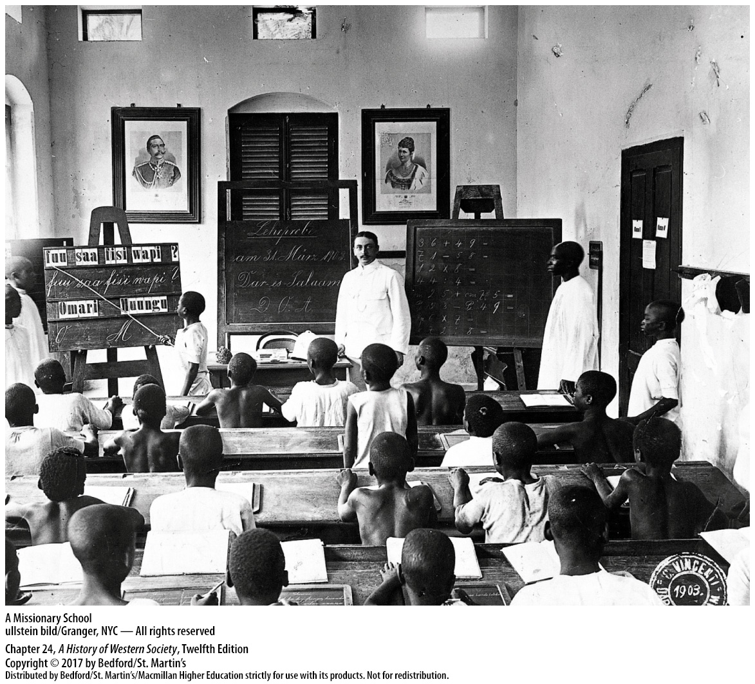

Slide 40
III. Western Imperialism, 1880 – 1914
Critics of Imperialism
1. J. A. Hobson (1858–1940)
2. Rosa Luxembourg
3. Vladimir Lenin
4. Moral condemnation
5. In The Heart of Darkness (1902)
6. Liberties at home vs in colonies
Notes:
III. Western Imperialism, 1880 – 1914
G. Critics of Imperialism
1. Following the unpopular South African War, radical English economist J. A. Hobson (1858–1940) wrote Imperialism (1902), a forceful attack on the expansion of empire.
2. Rosa Luxembourg, a radical member of the German Social Democratic Party, argued that capitalism needed to expand into noncapitalist Asia and Africa to maintain high profits.
3. Future Russian revolutionary leader, Vladimir Lenin concluded that imperialism represented the “highest stage” of advanced monopoly capitalism and predicted that its onset signaled the coming decay and collapse of capitalist society.
4. Hobson and many other critics struck home with their moral condemnation of whites imperiously ruling nonwhites and their arguments against crude Social Darwinian thought.
5. In The Heart of Darkness (1902), Polish-born novelist Joseph Conrad (1857–1924) castigated the “pure selfishness” of Europeans in supposedly civilizing Africa.
6. At home, Europeans had won or were winning representative government, individual liberties, and a certain equality of opportunity, but in their empires, Europeans imposed military dictatorships on Africans and Asians, forced them to work involuntarily, and discriminated against them shamelessly.

Slide 41
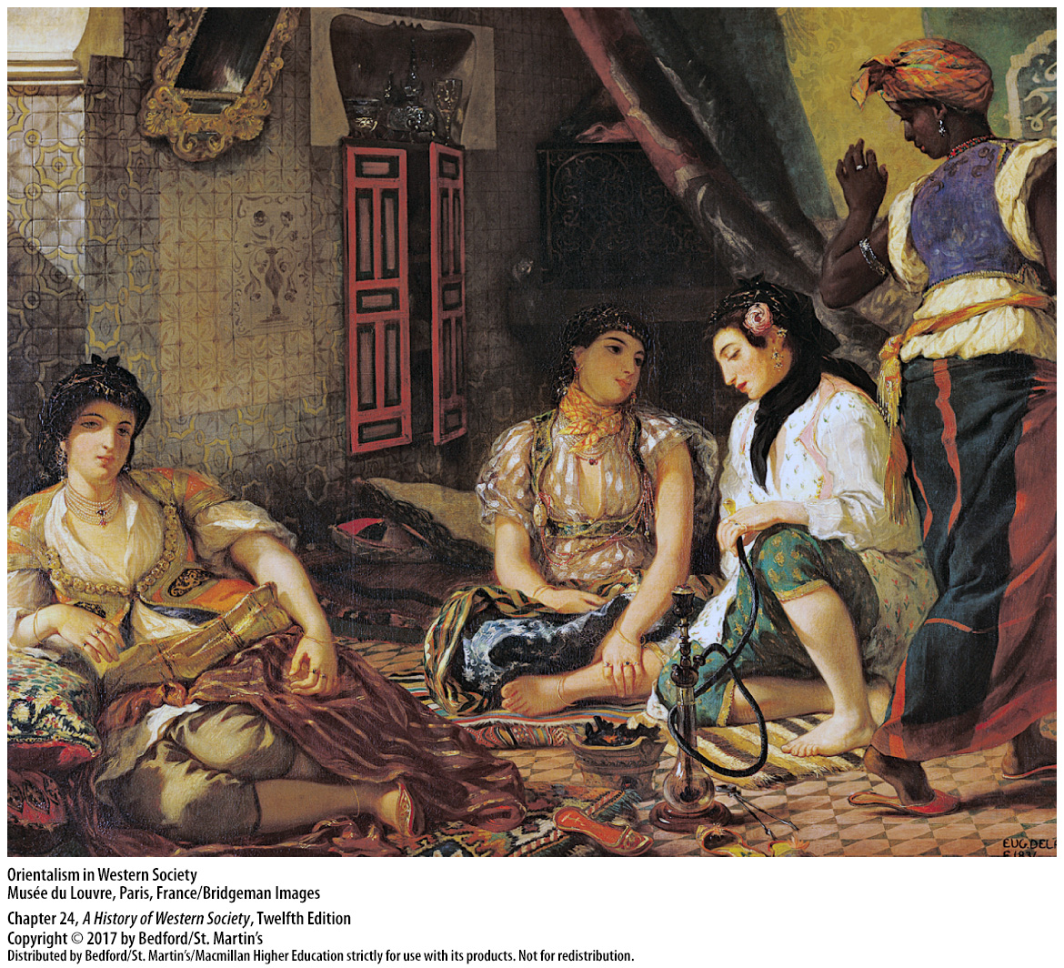

Slide 42
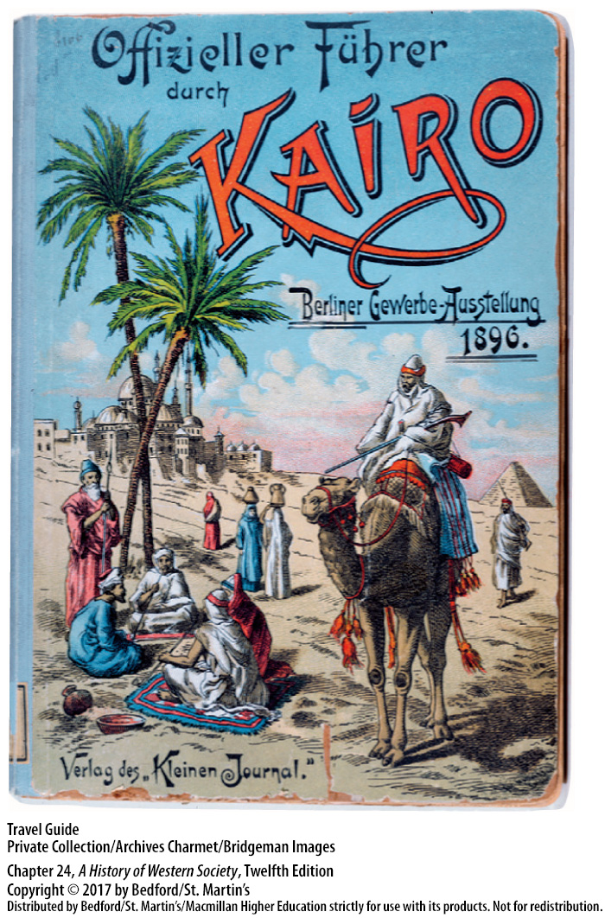

Slide 43
IV. Responding to Western Imperialism
The Pattern of Response
1. Spectrum of responses
2. Weak support for European rule among subjugated peoples
3. “Weapons of the weak”
4. Native people followed those who openly opposed Europeans
5. Nonconformists
6. Marxist socialism.
Notes:
IV. Responding to Western Imperialism
The Pattern of Response
1. Responses to the Western impact can be thought of as a spectrum, with “traditionalists” (those who worked to preserve their culture at all costs) at one end, “westernizers” or “modernizers” at the other, and many shades of opinion in between.
2. Support for European rule among subjugated peoples was shallow and weak.
3. Small farmers and others who bore the burden of colonization tenaciously fought for some autonomy using the “weapons of the weak,” such as playing dumb and foot dragging, to undermine colonial rule.
4. Native people followed with greater or lesser enthusiasm the few determined people who came to openly oppose the Europeans.
5. The nonconformists—the eventual anti-imperialist leaders—somewhat ironically, found in the Western world the ideologies—liberalism, with its credo of civil liberties and political self-determination, and nationalism—that justified their protest.
6. After 1917 anti-imperialist revolt would find another European-made weapon in Lenin’s version of Marxist socialism.

Slide 44
IV. Responding to Western Imperialism
Empire in India
1. Jewel of the British Empire
2. Direct British rule
3. Administered by a tiny, all-white civil service in India
4. Suez Canal brings British wives and children
5. System of secondary education
Notes:
IV. Responding to Western Imperialism
B. Empire in India
1. India, the jewel of the British Empire, had been ruled more or less absolutely by Britain since the British East India Company had conquered the last independent native state in 1848.
2. After crushing an insurrection by Muslim and Hindu mercenaries in the British army in northern and central India in 1857–1858 (the years of the Great Rebellion), Britain ruled India directly.
3. After 1858 India was ruled by the British Parliament in London and administered by a tiny, all-white civil service in India.
4. After the opening of the Suez Canal in 1869 made travel to India much easier, British civil servants and businessmen increasingly brought their wives and children with them.
5. Buoyed by a sense of mission and strong feelings of racial and cultural superiority, the British acted energetically and introduced many desirable changes to India, establishing, for example, a modern system of secondary education.

Slide 45
IV. Responding to Western Imperialism
Empire in India
6. High-caste Indians emerged intermediaries
7. Native elite had crucial role in development of irrigation projects for agriculture
8. Rise of nationalism
9. Hindu Indian National Congress
10. Movement for national independence
Notes:
IV. Responding to Western Imperialism
B. Empire in India
6. High-caste Indians emerged as skilled intermediaries between the British and the Indian people and formed a new elite that was profoundly influenced by Western thought and culture.
7. The new native elite played a crucial role in the development of irrigation projects for agriculture, the world’s third-largest railroad network, and large tea and jute plantations.
8. The decisive reaction to European rule was the rise of nationalism among the Indian elite.
9. By 1885, when educated Indians came together to found the predominately Hindu Indian National Congress, demands for equality and self-government were increasing.
10. Although Hindus and Muslims disagreed about the shape the Indian future should take, British rule and Western ideals, combined with the reform and revitalization of the Hindu religion, had created a movement for national independence.

Slide 46
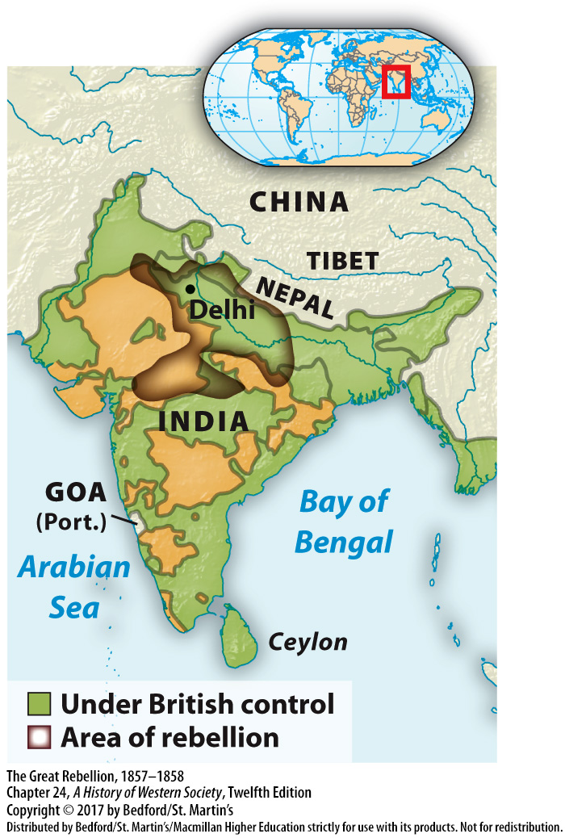

Slide 47
IV. Responding to Western Imperialism
The Example of Japan
1. Commodore Matthew Perry
2. Samurai humiliated by the sudden American intrusion
3. Antiforeign terrorism
4. Fleet of American, British, Dutch, and French warships demolished key forts
5. Meiji Restoration
Notes:
IV. Responding to Western Imperialism
C. The Example of Japan
1. When Commodore Matthew Perry arrived in Tokyo in 1853 with his crude but effective gunboat diplomacy, Japan was a complex feudal society.
2. The intensely proud samurai, a warrior nobility that helped the shogun govern, were humiliated by the sudden American intrusion and the unequal treaties with Western countries.
3. When foreigners began to settle in Yokohama, radical samurai reacted with a wave of antiforeign terrorism and antigovernment assassinations that lasted from 1858 to 1863.
4. An allied fleet of American, British, Dutch, and French warships responded by demolishing key forts, further weakening the power and prestige of the shogun’s government.
5. Then in 1867, a coalition led by patriotic samurai seized control of the government and restored the political power of the emperor in the Meiji Restoration. To deal with the immediate foreign threat, the leaders of Meiji Japan dropped their antiforeign attacks and initiated a series of measures to reform Japan along modern lines and thereby protect their country and catch up with the West.

Slide 48
IV. Responding to Western Imperialism
The Example of Japan
6. Strong unified state
7. Declared social equality
8. Creation of a modern navy and reorgainzed army
9. Western science and technology
10. Japan competed aggressively with European powers for influence and territory
11. Inspiring example of national recovery and liberation
Notes:
IV. Responding to Western Imperialism
C. The Example of Japan
6. In 1871 the new leaders abolished the old feudal structure of aristocratic, decentralized government and formed a strong unified state.
7. The Meiji leaders dismantled the four-class legal system and declared social equality; they also decreed freedom of movement and created a free, competitive, government-stimulated economy.
8. The overriding concern to maintain a powerful state and strong military led to the creation of a modern navy and an army reorganized along European lines.
9. Japan adapted skillfully the West’s science and technology, particularly in industry, medicine, and education.
10. Japan “opened” Korea with its own gunboat diplomacy in 1876 and decisively defeated China in a war over Korea in 1894 and 1895; in the next years, Japan competed aggressively with the European powers for influence and territory in China.
11. Japan demonstrated that a modern Asian nation could defeat and humble a great European power and provided patriots in Asia and Africa with an inspiring example of national recovery and liberation.

Slide 49
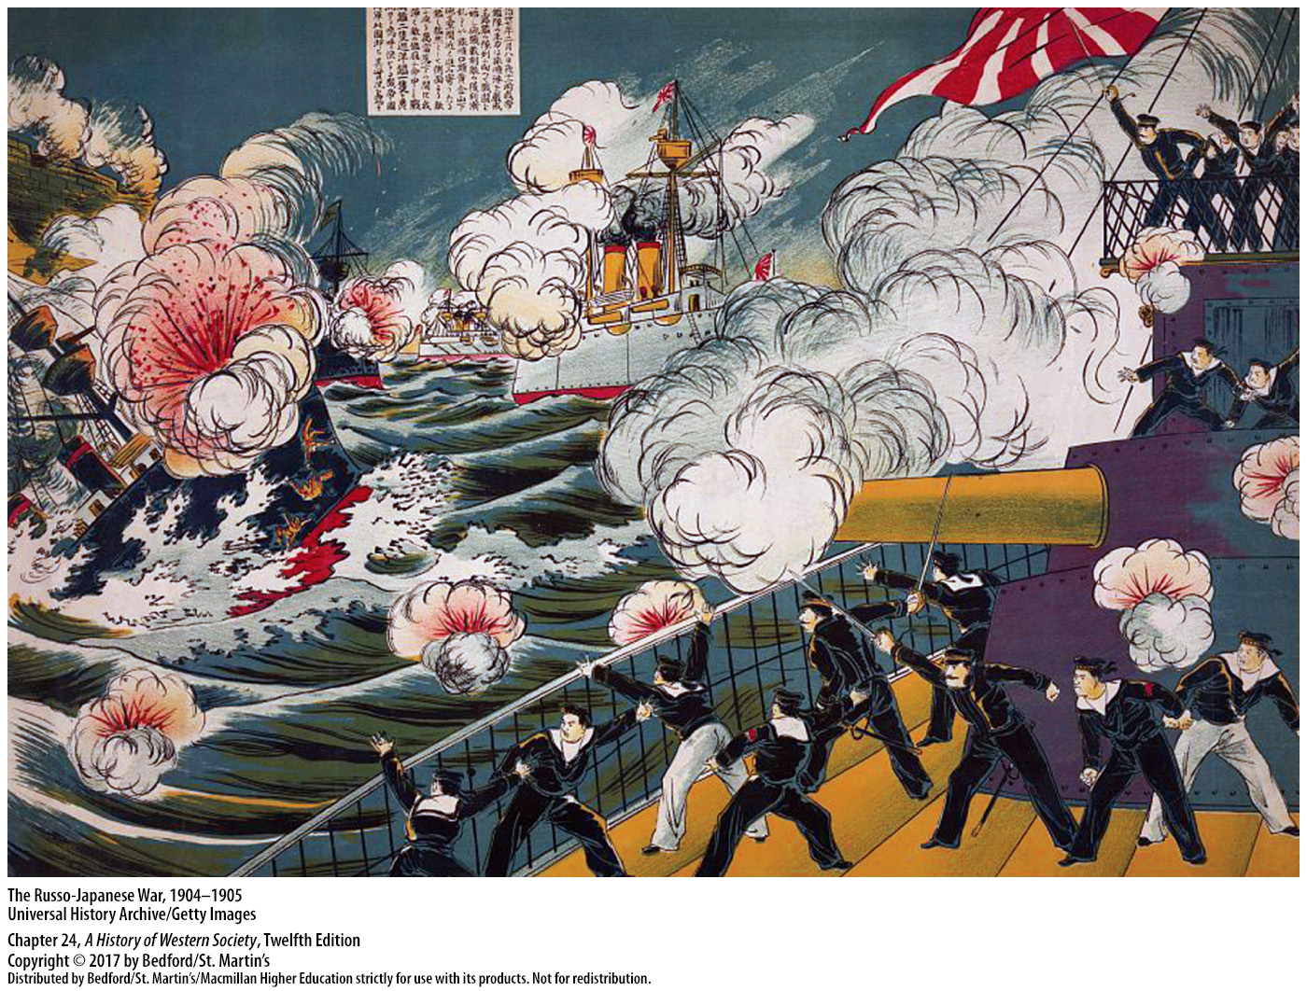

Slide 50
IV. Responding to Western Imperialism
Toward Revolution in China
1. Qing Dynasty in China appeared on the verge of collapse
2. Empress dowager Tzu Hsi
3. Some Europeans even contributed to the dynasty’s recovery
4. Sino-Japanese War of 1894 to 1895
5. Sun Yatsen (1866–1925)
Notes:
IV. Responding to Western Imperialism
D. Toward Revolution in China
1. In 1860 the two-hundred-year-old Qing Dynasty in China appeared on the verge of collapse; efforts to repel foreigners had failed, and rebellion and chaos wracked the country.
2. The remarkable empress dowager Tzu Hsi combined shrewd insight with vigorous action to revitalize the bureaucracy.
3. Destructive foreign aggression also lessened, with some Europeans even contributing to the dynasty’s recovery.
4. The parallel movement toward domestic reform and limited cooperation with the West collapsed under the harsh peace treaty that followed China’s defeat in the Sino-Japanese War of 1894 to 1895.
5. Radical reformers, such as the revolutionary Sun Yatsen (1866–1925), sought to overthrow the dynasty and establish a republic.

Slide 51
IV. Responding to Western Imperialism
Toward Revolution in China
6. Antiforeign reaction swept the country
7. The empress dowager declares war
8. Western armies defeated the Boxers
9. Qing Dynasty is toppled
10. Revolutionaries proclaimed a Western-style republic
Notes:
IV. Responding to Western Imperialism
D. Toward Revolution in China
6. A violent antiforeign reaction swept the country, encouraged by the Qing court and led by a secret society that foreigners called the Boxers; the Boxers blamed China’s ills on foreigners, especially foreign missionaries.
7. The empress dowager answered by declaring war, hoping that the Boxers might relieve foreign pressure on the government.
8. Western armies defeated the Boxers and occupied and plundered Beijing, and in 1901 China was forced to accept a long list of penalties that included a heavy financial indemnity.
9. Anarchy and foreign influence spread, and antiforeign and antigovernment revolutionary groups agitated and plotted, until a spontaneous uprising in 1912 toppled the Qing Dynasty.
10. After thousands of years of emperors and empires, a loose coalition of revolutionaries proclaimed a Western-style republic and called for an elected parliament.

Slide 52
