Slide 1
A History of Western Society Twelfth Edition
McKay • Crowston • Wiesner-Hanks • Perry
CHAPTER 23
The Age of Nationalism
1850–1914
Copyright © 2017 by Bedford/St. Martin’s
Distributed by Bedford/St. Martin's/Macmillan Higher Education strictly for use with its products; Not for redistribution.

Slide 2
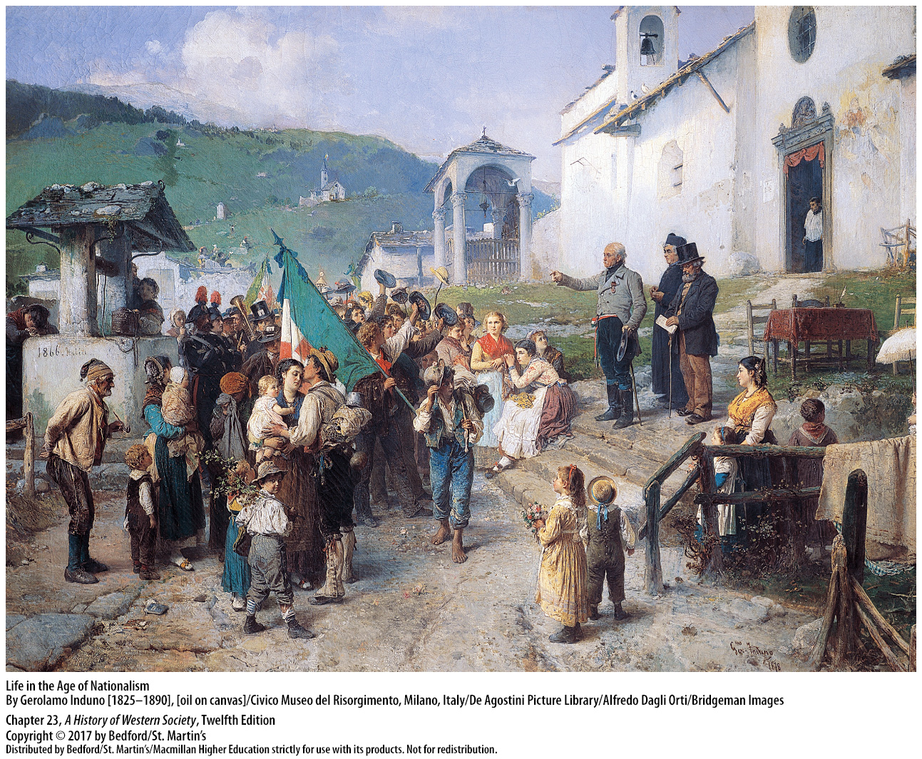

Slide 3
I. Napoleon III in France
France’s Second Republic
1. Government should represent the people
2. Strong, authoritarian, national leader
3. Strong leader and a champion of popular interests
4. Increased the role of the Catholic Church in education
5. Coup d’état
6. Emperor
Notes:
Napoleon III in France
France’s Second Republic
1. Louis Napoleon believed that the government should represent the people and help them economically.
2. To Louis Napoleon, France needed a strong, even authoritarian, national leader who would be linked to each citizen by direct democracy, his sovereignty uncorrupted by politicians and legislative bodies.
3. To the many common people who voted for him, Louis Napoleon appeared to be a strong leader and a forward-looking champion of popular interests.
4. President Louis Napoleon, required by the constitution to share power with an overwhelmingly conservative National Assembly, signed bills that increased the role of the Catholic Church in education and deprived many poor people of the right to vote.
5. After the Assembly failed to vote funds to pay his debts and to make it constitutional for him to run for a second term, Louis Napoleon illegally dismissed the Assembly and seized power in a coup d’état on December 2, 1851.
6. Restoring universal male suffrage and claiming to stand above divisive political bickering, Louis Napoleon called on the French people to legalize his actions; they did, and a year later they made him emperor.

Slide 4
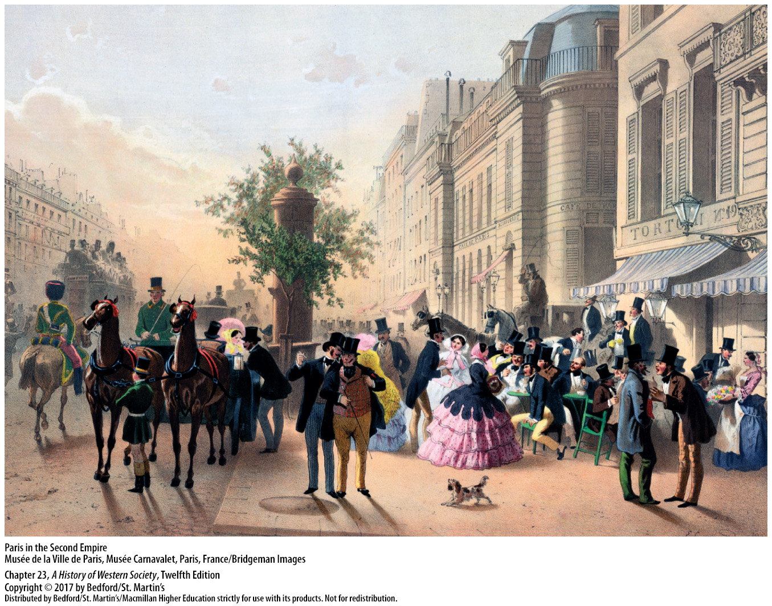

Slide 5
I. Napoleon III in France
Napoleon III’s Second Empire
1. Stimulated economic growth
2. Unions and strikes
3. Napoleon III solidified his political power
4. Middle-class liberals denounced his rule
5. Progressively liberalized the empire
6. New constitution
Notes:
Napoleon III in France
B. Napoleon III’s Second Empire
1. Louis Napoleon—now Emperor Napoleon III—stimulated economic growth as his government encouraged new investment banks and massive railroad construction in the 1850s.
2. In the 1860s he granted workers the right to form unions and the right to strike.
3. Napoleon III solidified his political power by choosing his own ministers and allowing them great freedom of action, while at the same time restricting but not abolishing the reformed Assembly.
4. In 1857 and again in 1863, Louis Napoleon’s electoral system worked brilliantly, but in the 1860s it gradually disintegrated, as the middle-class liberals who had always wanted a less authoritarian regime denounced his rule, with increasing effectiveness.
5. Sensitive to the public mood, Napoleon responded to critics by progressively liberalizing his empire, giving the Assembly greater powers and opposition candidates greater freedoms.
6. The next year, a sick and weary Louis Napoleon again granted France a new constitution, which combined a basically parliamentary regime with a hereditary emperor as chief of state.

Slide 6
II. Nation Building in Italy, Germany, and the United States
Italy to 1850
1. Three approaches to a unified Italy
2. Sardinia
3. Pius IX
Notes:
II. Nation Building in Italy, Germany, and the United States
Italy to 1850
1. Three approaches to a unified Italy: First, radical and idealistic patriot Giuseppe Mazzini called for a centralized democratic republic based on universal male suffrage and the will of the people. Second, Vincenzo Gioberti, a Catholic priest, called for a federation of existing states under the presidency of a progressive pope, an idea that received initial cautious support from Pius IX (pontificate 1846–1878). Third, many Italians looked to the constitutional monarchy of Sardinia-Piedmont and its new monarch, Victor Emmanuel, for leadership, especially after the failures of 1848, when Austria smashed Mazzini’s republicanism.
2. To some of the Italian middle classes, Sardinia appeared to be a liberal, progressive state ideally suited to drive Austria out of northern Italy and lead a united Italy.
3. Pius IX’s support for unification gave way to hostility after he was temporarily driven from Rome during the upheavals of 1848; thereafter, he opposed national unification and in the Syllabus of Errors (1864) denounced rationalism, socialism, separation of church and state, and religious liberty.

Slide 7
II. Nation Building in Italy, Germany, and the United States
Cavour and Garibaldi in Italy
1. Count Camillo Benso di Cavour
2. Consolidated Sardinia
3. Secret alliance with Napoleon III
4. Napoleon abandons Cavour
5. Cavour resigned
6. Pro-Sardinian nationalists toppled their ruling princes
Notes:
II. Nation Building in Italy, Germany, and the United States
B. Cavour and Garibaldi in Italy
1. Sardinia’s brilliant statesman Count Camillo Benso di Cavour had limited and realistic national goals, seeking unity only for the states of northern and perhaps central Italy in an expanded kingdom of Sardinia.
2. In the 1850s Cavour worked to consolidate Sardinia as a liberal constitutional state capable of leading northern Italy; he successfully built support for Sardinia through a program of highways and railroads, civil liberties, and opposition to clerical privilege.
3. Cavour realized that Sardinia could not drive Austria out of northern Italy without a powerful ally, and so in 1858 he established a secret alliance with Napoleon III against Austria.
4. Napoleon then did an about-face, abandoning Cavour and making a compromise peace with the Austrians in July 1859 that required Austria to give up only Lombardy to Sardinia.
5. Cavour resigned in a rage, but his plans for Italian unification were salvaged by the skillful maneuvers of his allies in the moderate nationalist movement.
6. By encouraging popular revolts, pro-Sardinian nationalists in central Italy easily toppled their ruling princes and called for fusion with Sardinia.

Slide 8
II. Nation Building in Italy, Germany, and the United States
Cavour and Garibaldi in Italy
7. Cavour and Victor Emmanuel
8. Giuseppe Garibaldi (1807–1882)
9. Cavour secretly supported Garibaldi’s plan
10. Red Shirts
11. Symbolically sealed the union of north and south
12. Parliamentary monarchy under Victor Emmanuel II
Notes:
II. Nation Building in Italy, Germany, and the United States
B. Cavour and Garibaldi in Italy
7. Cavour returned to power in early 1860, gained Napoleon III’s support, and achieved his original goal of a northern Italian state when the people of central Italy voted to join a greatly enlarged kingdom of Sardinia under Victor Emmanuel.
8. For superpatriots such as Giuseppe Garibaldi (1807–1882), the job of unification was still only half done. Garibaldi, the son of a poor sailor, personified the romantic, revolutionary nationalism and republicanism; he led a corps of volunteers against Austria in 1859 and emerged in 1860 as an independent force in Italian politics.
9. Partly to use him and partly to get rid of him, Cavour secretly supported Garibaldi’s bold plan to “liberate” the kingdom of the Two Sicilies.
10. In 1860 Garibaldi’s guerrilla band of a thousand Red Shirts landed in Sicily, capturing the imagination of the peasantry, which revolted against their landlords, and outwitting the royal army to win battles, gain volunteers, and take Palermo.
11. When Garibaldi and Victor Emmanuel rode together through Naples to cheering crowds, they symbolically sealed the union of north and south, of monarch and nation-state.
12. The parliamentary monarchy under Victor Emmanuel II was neither radical nor democratic, and although it was politically unified, a growing social and cultural gap separated the progressive, industrializing north from the stagnant, agrarian south.

Slide 9
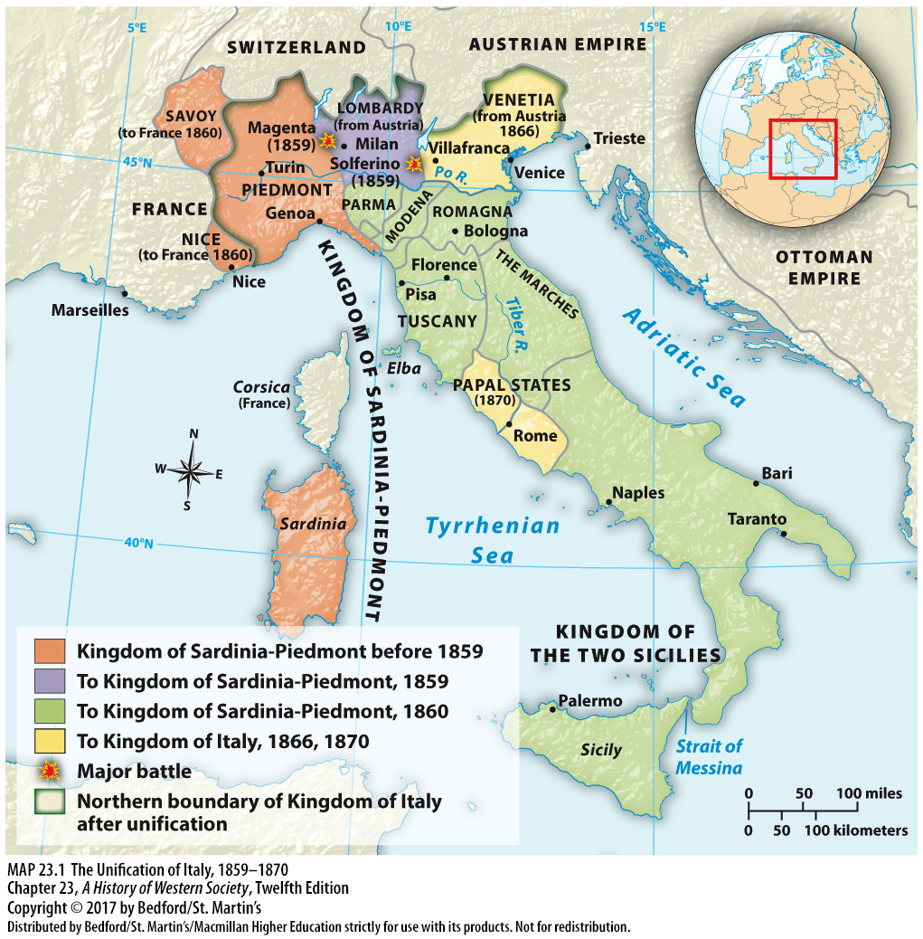

Slide 10
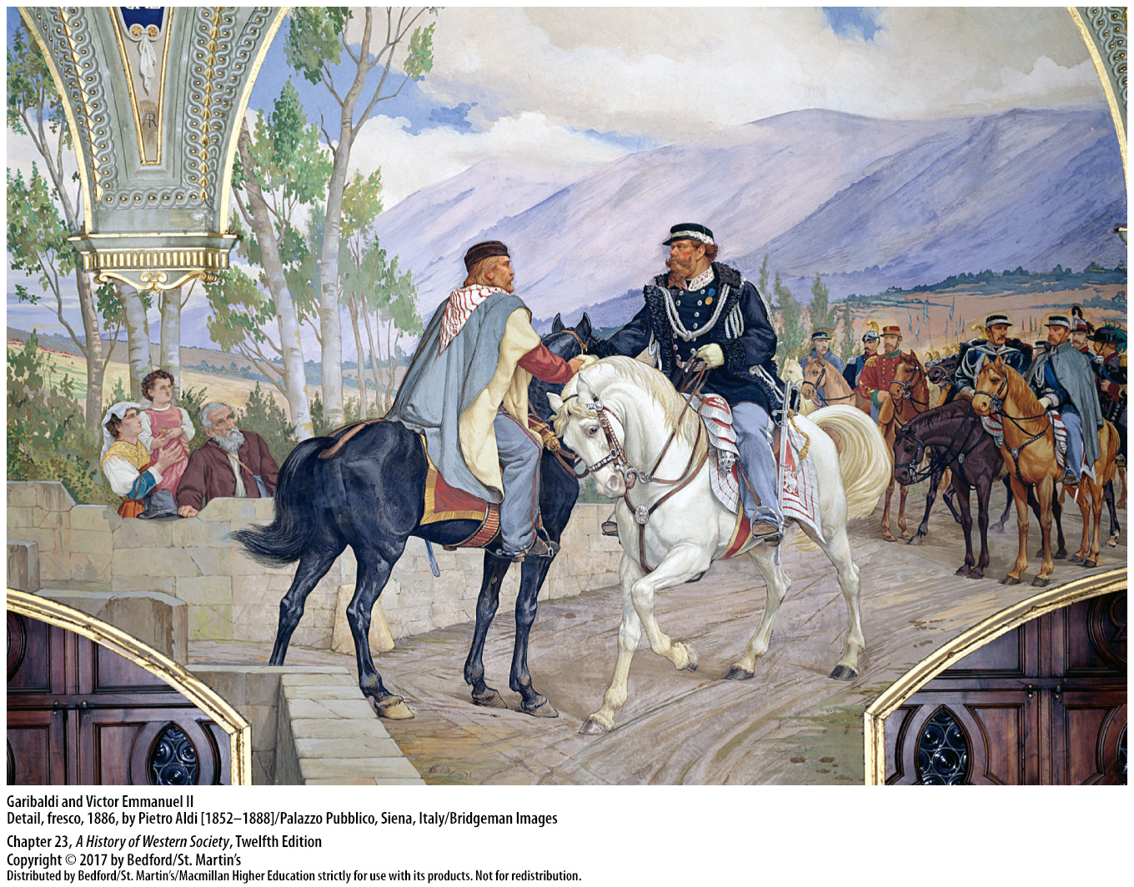

Slide 11
II. Nation Building in Italy, Germany, and the United States
Growing Austro-Prussian Rivalry
1. Tension between Austria and Prussia
2. German Customs Union (Zollverein)
3. Prussia had a weak parliament
4. William I (r. 1861–1888)
5. Count Otto von Bismarck
Notes:
II. Nation Building in Italy, Germany, and the United States
C. Growing Austro-Prussian Rivalry
1. In the aftermath of 1848, tension grew between Austria and Prussia as each sought to dominate the German Confederation.
2. By the end of 1853, Austria was the only German Confederation state outside the German Customs Union (Zollverein), which gave Prussia, with its leading role within the customs union, an advantage in its struggle against Austria.
3. Prussia had emerged from the upheavals of 1848 with a weak parliament, whose wealthy, liberal, middle-class representatives wanted to establish once and for all that the parliament, not the king, held ultimate political power, including control of the army.
4. Prussia’s tough-minded William I (r. 1861–1888), convinced that great political change and war were quite possible, pushed to raise taxes and increase the defense budget to double the size of the army.
5. When the Prussian parliament rejected the military budget in 1862 and the liberals triumphed completely in new elections, King William appointed Count Otto von Bismarck as Prussian prime minister and encouraged him to defy the parliament.

Slide 12
II. Nation Building in Italy, Germany, and the United States
Bismarck and the Austro-Prussian War
1. Master of politics
2. “Might makes right”
3. Schleswig-Holstein
4. Austro-Prussian War of 1866
5. North German Confederation
Notes:
II. Nation Building in Italy, Germany, and the United States
D. Bismarck and the Austro-Prussian War
1. Prussian aristocrat Otto von Bismarck (1815–1898), a great hero to some and a great villain to others, was above all a master of politics who combined a strong personality and desire for power with extraordinary flexibility and pragmatism.
2. Denounced by liberals for his view that “might makes right,” Bismarck had the Prussian bureaucracy continue collecting taxes, even though the parliament refused to approve the budget, and he reorganized the army.
3. In the extremely complicated question of Schleswig-Holstein—two provinces that belonged to Denmark but were members of the German Confederation—Prussia enlisted Austria in a short and successful war against Denmark.
4. In the Austro-Prussian War of 1866, which lasted only seven weeks, the modernized Prussian army defeated Austria decisively at the Battle of Sadowa.
5. Anticipating Prussia’s future needs, Bismarck offered Austria generous peace terms that dissolved the existing German Confederation and negotiated for Austria to withdraw from German affairs. Prussia also conquered and annexed several small states and completely dominated the remaining principalities in the newly formed North German Confederation, as Bismarck began to realize his goal of Prussian expansion.

Slide 13
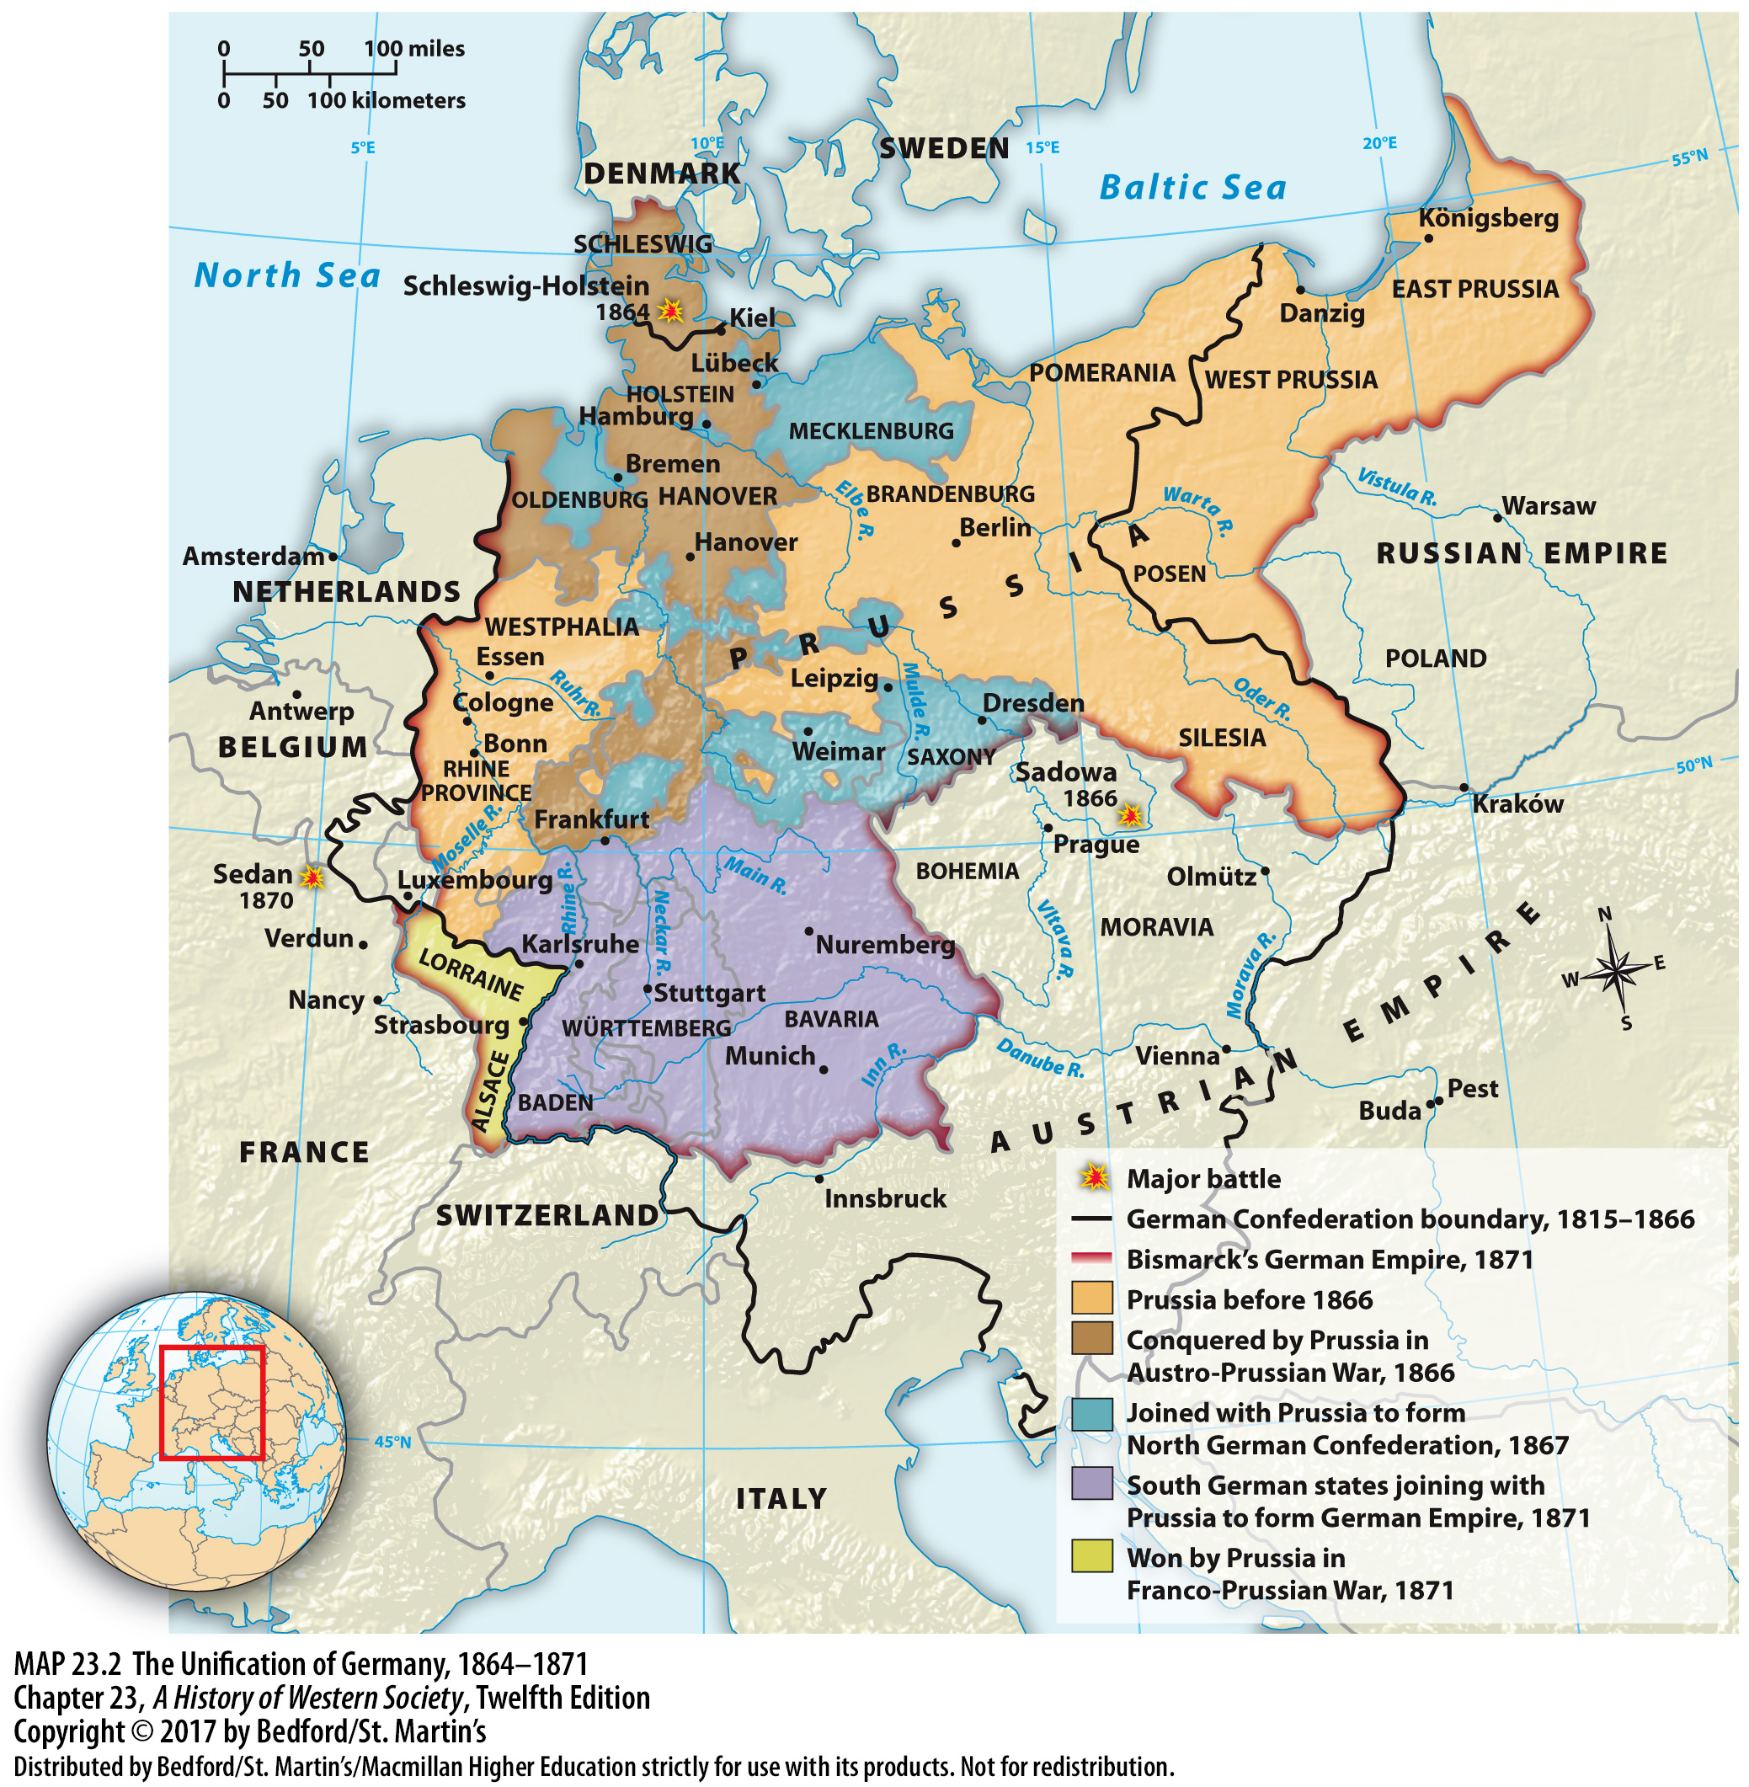

Slide 14
II. Nation Building in Italy, Germany, and the United States
Taming the German Parliament
1. “National development of Germany”
2. William I and Bismarck
3. Popular participation
4. Bill to approve government’s spending between 1862 and 1866
5. Constitutional struggle in Prussia ended
Notes:
II. Nation Building in Italy, Germany, and the United States
E. Taming the German Parliament
1. Bismarck realized that the liberal middle class and nationalists were not necessarily hostile to conservative, authoritarian government; thus, during the war with Austria, he increasingly identified Prussia’s fate with the “national development of Germany.”
2. The chancellor—Bismarck—was responsible only to the president, and the federal government—William I and Bismarck—controlled the army and foreign affairs.
3. The radical innovation of a legislature with members of the lower house elected by universal male suffrage allowed Bismarck to open the door to popular participation and the possibility of going over the head of the middle class directly to the people.
4. Offering an olive branch to the parliamentary opposition, Bismarck asked parliament to pass a bill to approve after the fact the government’s spending between 1862 and 1866; with German unity in sight, most liberals eagerly cooperated.
5. The constitutional struggle in Prussia ended, and the German middle class came to accept the monarchical authority that Bismarck represented.

Slide 15
II. Nation Building in Italy, Germany, and the United States
The Franco-Prussian War
1. Patriotic war with France
2. Support of the south German states
3. William I
Notes:
II. Nation Building in Italy, Germany, and the United States
F. The Franco-Prussian War
1. Bismarck calculated that a patriotic war with France would drive the south German states into his arms. In 1870 the French leaders of the Second Empire, goaded by Bismarck and alarmed by their powerful new neighbor, declared war to teach Prussia a lesson.
2. As soon as war began, Bismarck had the wholehearted support of the south German states, which by the end of the war agreed to join a new German Empire.
3. William I was proclaimed emperor of Germany, heading a state that, according to the 1866 constitution, gave him and his ministers ultimate power and provided for a lower legislative house elected by universal male suffrage.

Slide 16
II. Nation Building in Italy, Germany, and the United States
The Franco-Prussian War
4. France accepted Bismarck’s harsh peace terms
5. Poisoned relations between France and Germany
6. Surge of patriotic feeling in the German Empire
7. Prussia’s rise
Notes:
II. Nation Building in Italy, Germany, and the United States
F. The Franco-Prussian War
4. Paris surrendered in January 1871, and France accepted Bismarck’s harsh peace terms: France was forced to pay a colossal indemnity of 5 billion francs and to cede the rich eastern province of Alsace and part of Lorraine to Germany.
5. The French people viewed these territorial losses as a terrible crime, poisoning relations between France and Germany.
6. The Franco-Prussian War, viewed by many Europeans as a test of nations in a pitiless Darwinian struggle for existence, released an enormous surge of patriotic feeling in the German Empire.
7. Prussia, the weakest of the Great Powers in 1862, had become the most powerful state in Europe in less than a decade, and most Germans were enormously proud.

Slide 17
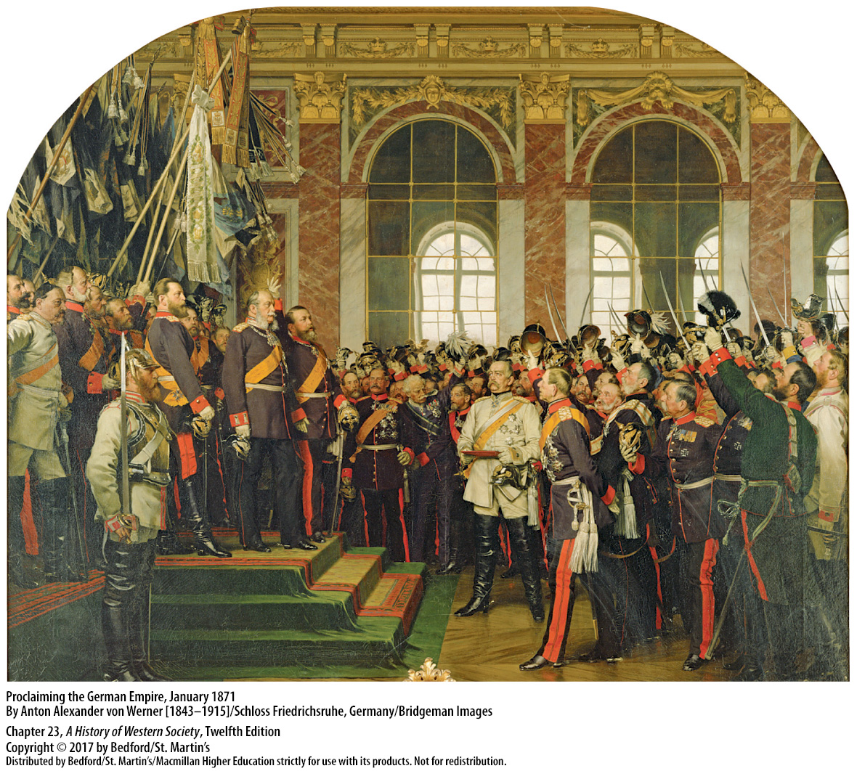

Slide 18
II. Nation Building in Italy, Germany, and the United States
Slavery and Nation Building in the United States
1. Northern U.S. states
2. Influential Southerners defend slavery
3. North-South antagonisms
4. Debate over extension of slavery in new territory
Notes:
II. Nation Building in Italy, Germany, and the United States
G. Slavery and Nation Building in the United States
1. By 1850 the industrializing, urbanizing Northern U.S. states were building canals and railroads and attracting the majority of European immigrants to the United States.
2. The large profits flowing from cotton led influential Southerners to defend slavery and to develop a cultural identity based on a closely knit “we” distinct from the Northern “they.”
3. Because Northern whites viewed their free-labor system as more just and economically and morally superior to slavery, North-South antagonisms intensified.
4. Tensions intensified after 1848 when war with Mexico gave the United States a vast area stretching from west Texas to the Pacific Ocean; debate over the extension of slavery in this new territory hardened attitudes on both sides.

Slide 19
II. Nation Building in Italy, Germany, and the United States
Slavery and Nation Building in the United States
5. Abraham Lincoln
6. The Civil War (1861–1865)
7. Homestead Act of 1862
8. “Manifest destiny”
Notes:
II. Nation Building in Italy, Germany, and the United States
G. Slavery and Nation Building in the United States
5. Abraham Lincoln’s election as president in 1860 gave Southern secessionists the opportunity they had been waiting for; determined to win independence, eleven states left the Union and formed the Confederate States of America.
6. The Civil War (1861–1865), the bloodiest conflict in American history, ended with the South’s defeat and preservation of the Union.
7. The emergence of powerful business corporations, passage of the Homestead Act of 1862, which gave western land to settlers, and the Thirteenth Amendment of 1865 ending slavery all reinforced the concept of free labor taking its chances in a market economy and gave shape to American life and national culture.
8. The outcome of the civil war sparked a new American nationalism and confirmed for many in the United States that the country’s “manifest destiny” was to straddle a continent as a great world power.

Slide 20
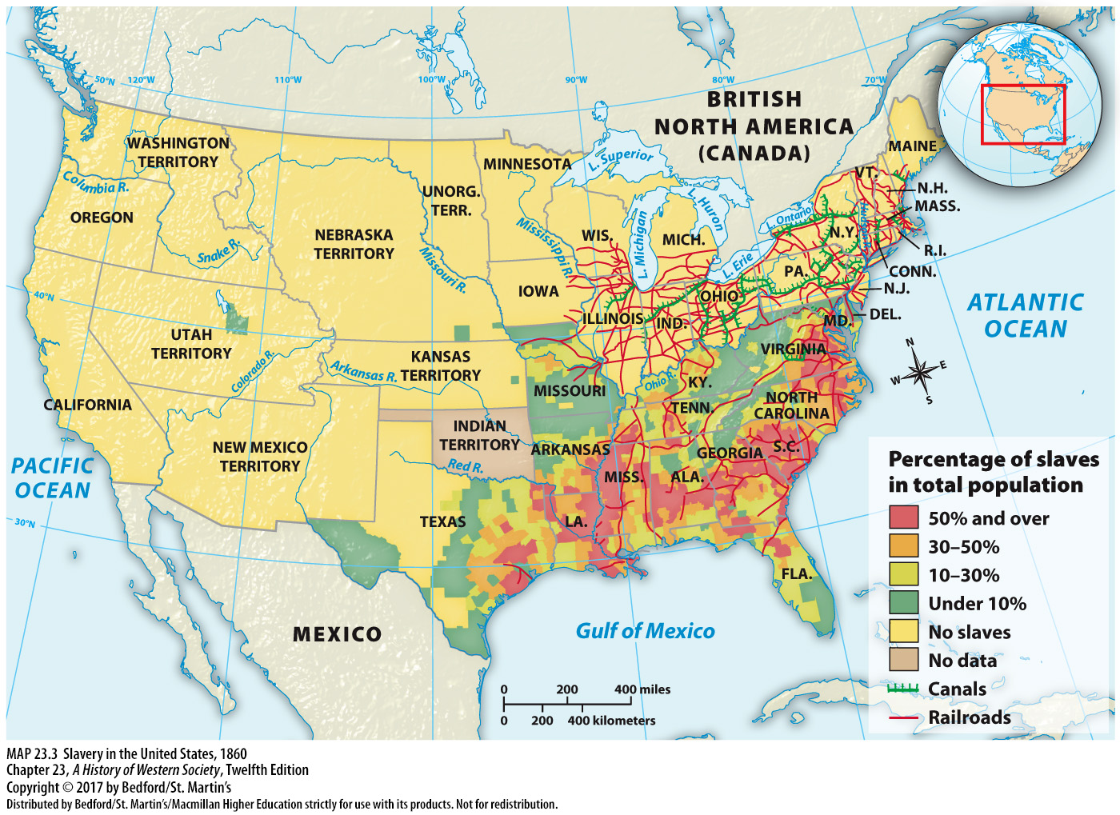

Slide 21
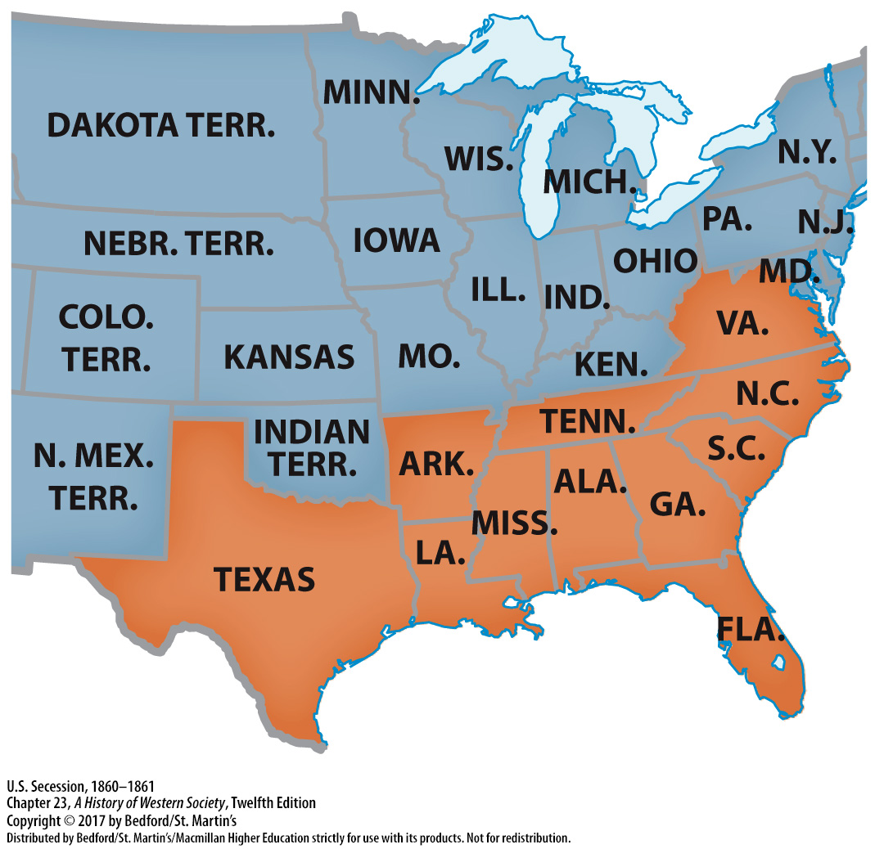

Slide 22
III. The Modernization of Russia and the Ottoman Empire
The “Great Reforms” in Russia
1. Serfdom
2. Crimean War (1853–1856)
3. Tsar Alexander II (r. 1855–1881)
4. Changes to the legal system
Notes:
III. The Modernization of Russia and the Ottoman Empire
The “Great Reforms” in Russia
1. In the 1850s Russia was a poor agrarian society with a rapidly growing population and slowly developing industrial sector. Serfdom, in which the peasant serf was bound to the lord from birth and little more than a slave, had become the central moral and political issue for the government by the 1840s.
2. France and Great Britain inflicted a humiliating defeat on Russia in the Crimean War (1853–1856), demonstrating how far Russia had fallen behind the industrializing nations of western Europe and underscoring the need for modernizing reforms.
3. Tsar Alexander II (r. 1855–1881) abolished serfdom in 1861, but because collective ownership of the land made it difficult for individual peasants to improve agricultural methods or leave their villages, the old patterns of behavior predominated and the effects of reform were limited.
4. Changes to the legal system established independent courts and equality before the law.

Slide 23
III. The Modernization of Russia and the Ottoman Empire
The “Great Reforms” in Russia
5. Efforts to promote economic modernization
6. Industrial suburbs
7. Eastern Siberia, central Asia, and the Islamic lands of the Caucasus
8. The assassination of Alexander II
9. Sergei Witte
Notes:
III. The Modernization of Russia and the Ottoman Empire
The “Great Reforms” in Russia
5. Efforts to promote economic modernization proved more successful, when after 1860, the government encouraged and subsidized private railway companies, which enabled Russia to export grain and earn money to finance further development.
6. Industrial suburbs grew up around Moscow and St. Petersburg, giving rise to a class of factory workers and spread of Marxist thought.
7. Strengthened by industrial development, Russia began seizing territory in far eastern Siberia, central Asia, and the Islamic lands of the Caucasus, and it suppressed nationalist movements among Poles, Ukrainians, and Baltic peoples.
8. The assassination of Alexander II in 1881 by a small anarchist group ended the era of reform and brought to power a new tsar, Alexander III (r. 1881–1894), who was a determined reactionary.
9. Led by Sergei Witte, the finance minister from 1892 to 1903, Russia’s economic modernization and industrialization surged from 1890 to 1900.

Slide 24
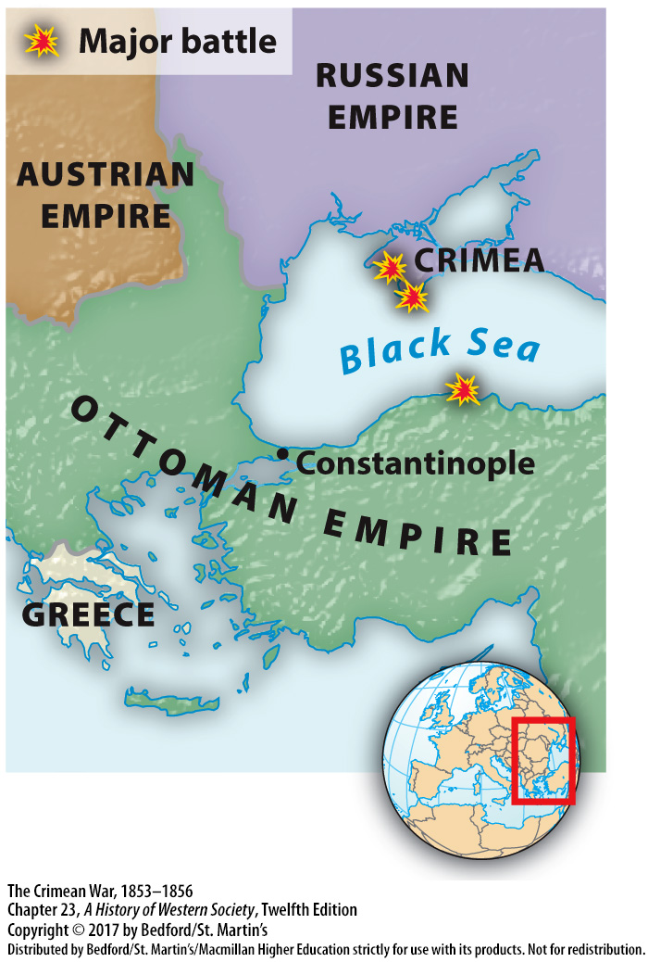

Slide 25
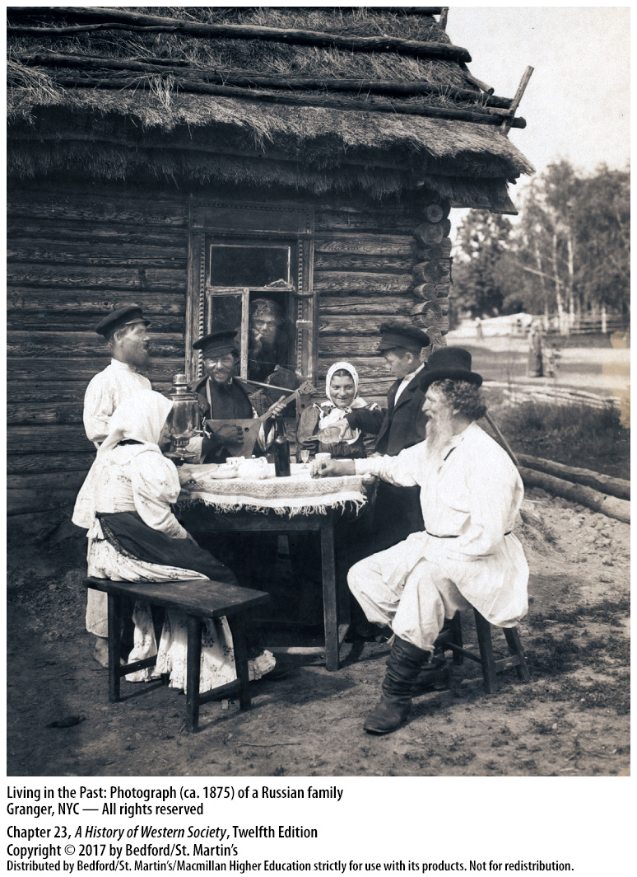

Slide 27
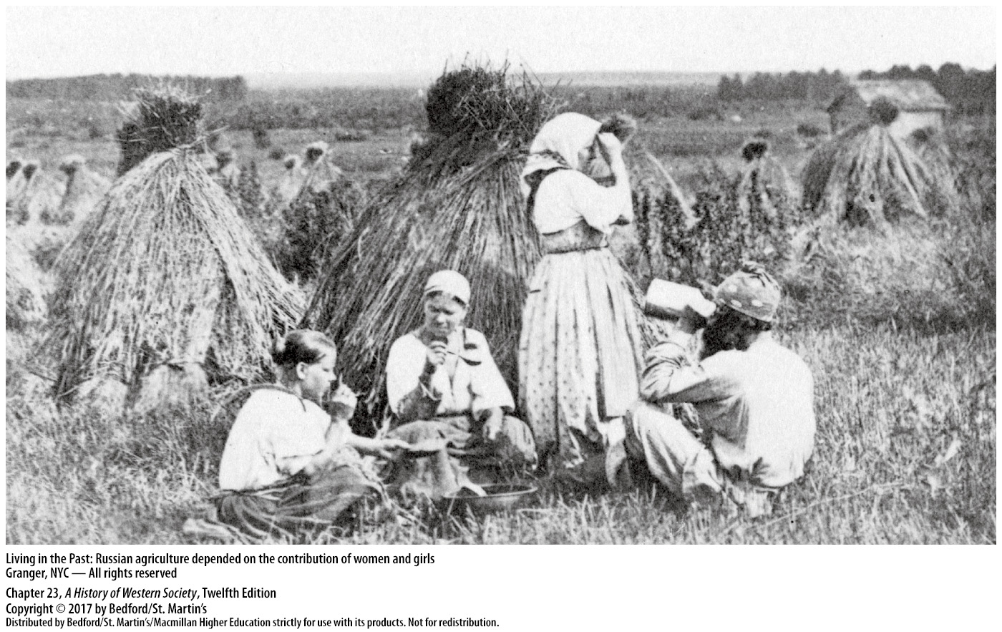

Slide 28
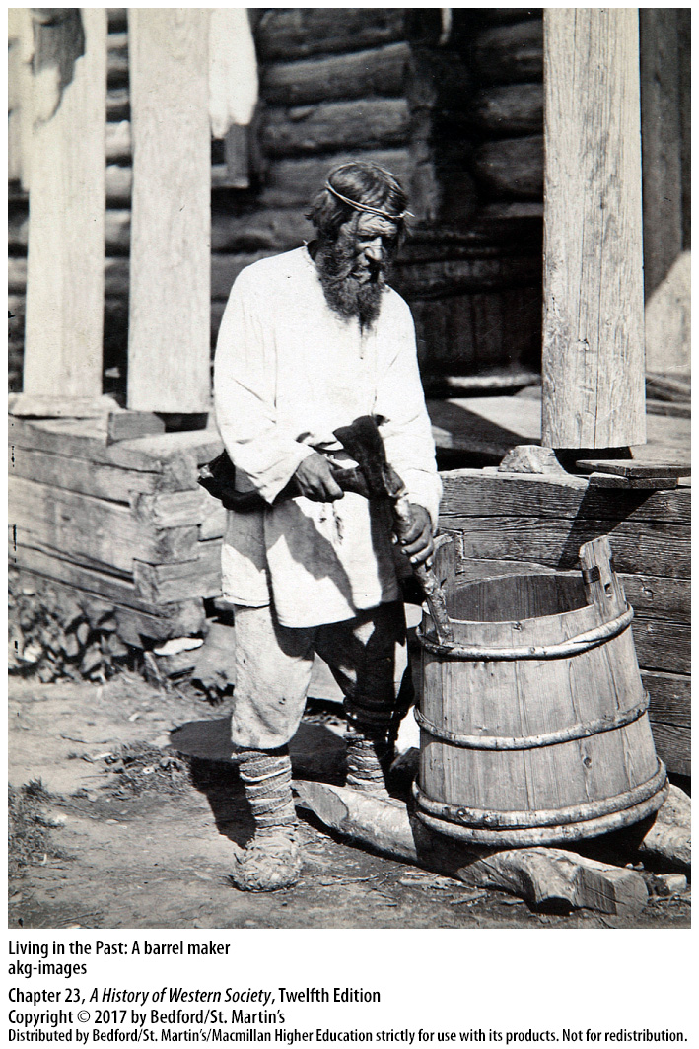

Slide 29
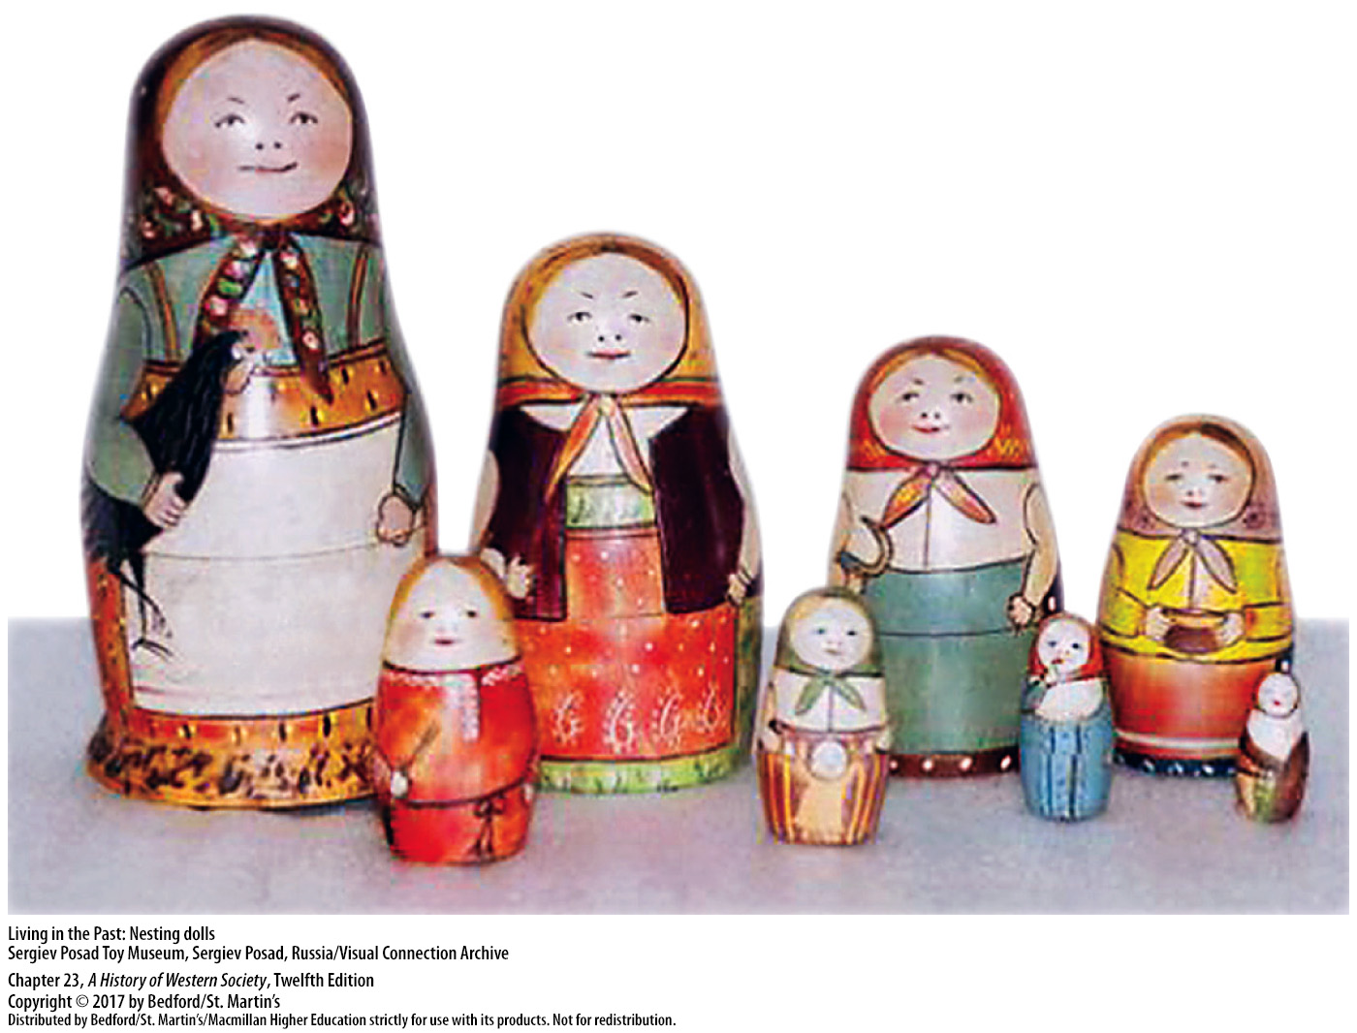

Slide 30
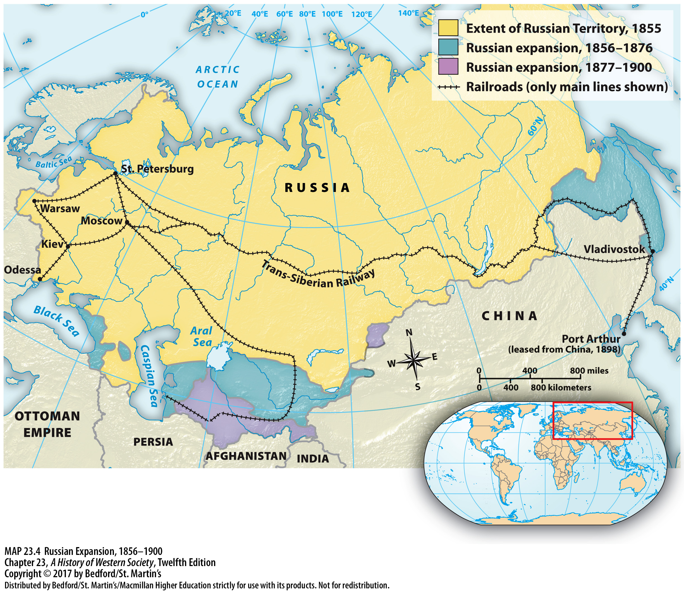

Slide 31
III. The Modernization of Russia and the Ottoman Empire
The Russian Revolution of 1905
1. Political upheaval at home
2. Revolution of 1905
3. Bloody Sunday massacre
4. General strike
5. October Manifesto
6. Fundamental Laws
Notes:
III. The Modernization of Russia and the Ottoman Empire
B. The Russian Revolution of 1905
1. Military disaster abroad brought political upheaval at home: the business and professional elite had long wanted a liberal, representative government; urban factory workers were organized in a radical and still-illegal labor movement; despite reforms, peasants still suffered from poverty; and the empire’s minorities and subject nationalities continued to call for self-rule.
2. Defeats in the war and all of these currents of discontent converged in the revolution of 1905.
3. The Bloody Sunday massacre produced a wave of general indignation that turned many Russians against the tsar.
4. Strikes, political rallies, peasant uprisings, revolts among minority nationalities, and troop mutinies throughout the summer culminated in October 1905 in a paralyzing general strike that forced the government to capitulate.
5. The tsar issued the October Manifesto, which granted full civil rights and promised a popularly elected Duma (parliament) with real legislative power, to be elected indirectly by universal male suffrage.
6. On the eve of the opening of the first Duma in May 1906, the government issued the new constitution, the Fundamental Laws, in which the tsar retained great powers, including an absolute veto over any laws passed by the Duma.

Slide 32
III. The Modernization of Russia and the Ottoman Empire
Reform and Readjustment in the Ottoman Empire
1. Modernizing reforms in agriculture, industry, and the military
2. Syria and Palestine
3. Mahmud II’s dynasty
4. Tanzimat (“Reorganization”)
5. Imperial Rescript of 1856
Notes:
III. The Modernization of Russia and the Ottoman Empire
C. Reform and Readjustment in the Ottoman Empire
1. Ruling Egypt in the name of the Ottoman sultan from 1805 to 1848, Ali introduced modernizing reforms in agriculture, industry, and the military that helped turn Egypt into the most powerful state in the eastern Mediterranean.
2. Ali’s growing strength challenged Ottoman power, when from 1831 to 1840 Egyptian troops occupied and governed the Ottoman province of Syria and Palestine and threatened to depose the Ottoman Sultan Mahmud II (r. 1808–1839).
3. Mahmud II’s dynasty survived because Britain and other European powers preferred a weak and dependent Ottoman Empire to a strong, economically independent state under Muhammad Ali and thus allied with the Ottomans to discipline Ali.
4. In 1839 liberal Ottoman statesmen launched a series of radical reforms, known as the Tanzimat (“Reorganization”), that were designed to modernize the empire on a western European model.
5. The high point of reform came with Sultan Abdul Mejid’s Imperial Rescript of 1856, which called for equality before the law regardless of religious faith, a modernized administration and army, and private ownership of land.

Slide 33
III. The Modernization of Russia and the Ottoman Empire
Reform and Readjustment in the Ottoman Empire
6. Loans from British and French bankers
7. Increased religious disputes
8. Sultan Abdülhamid II (r. 1876–1909)
9. Committee of Union and Progress (CUP)
10. Young Turks
Notes:
III. The Modernization of Russia and the Ottoman Empire
C. Reform and Readjustment in the Ottoman Empire
6. Sultan Mejid was forced to take a series of loans from British and French bankers to cover state deficits, which led to indebtedness and, two decades later, to the bankruptcy of the Ottoman state.
7. Equality before the law for all citizens regardless of religious affiliation actually increased religious disputes, which were encouraged and manipulated by European powers, and embittered relations between religious conservatives and social liberals in both Muslim and Greek Orthodox communities.
8. Conservatives detested the religious reforms’ departure from Islamic tradition and threw their support to Sultan Abdülhamid II (r. 1876–1909), who abandoned the model of European liberalism in his long and repressive reign.
9. By the 1890s the government’s failures had encouraged a powerful resurgence of the modernizing impulse under the Committee of Union and Progress (CUP), an organization that united multiethnic reformist groups across the empire.
10. These fervent patriots, unofficially called Young Turks, seized power in a 1908 coup and forced the sultan to implement reforms.

Slide 34
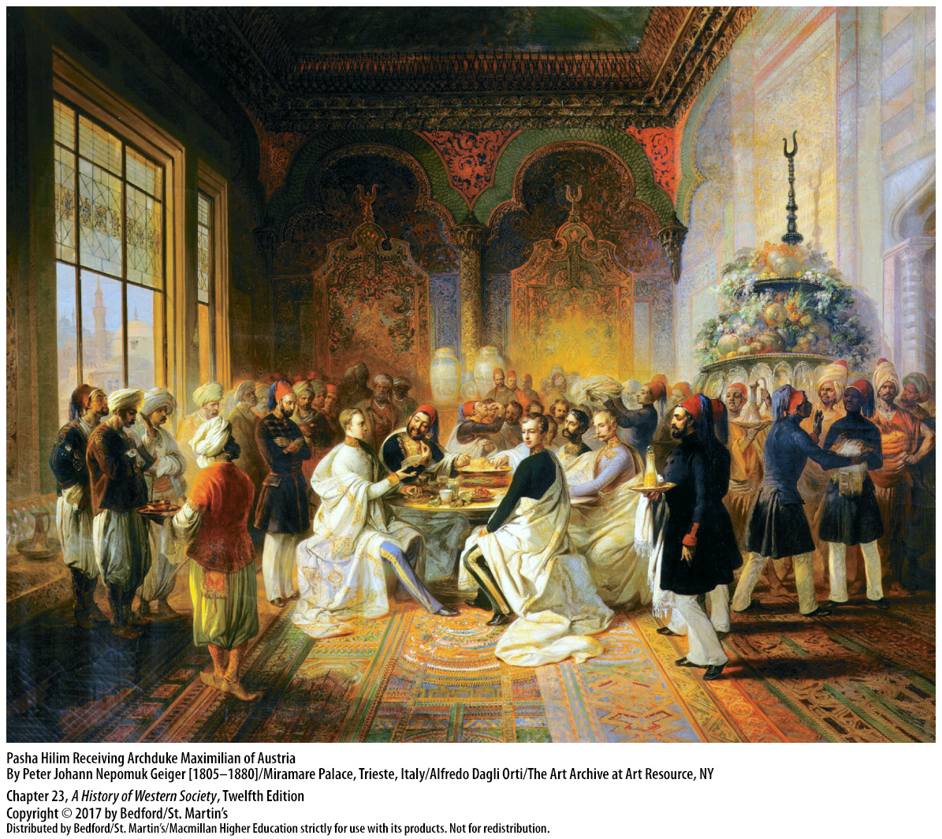

Slide 35
IV. The Responsive National State, 1871 – 1914
1. Common framework
2. Constitutions and universal male suffrage
3. New pragmatic politicians and political parties
4. Education, welfare, and public health benefits
5. Antiliberal and militaristic policies
Notes:
IV. The Responsive National State, 1871 – 1914
1. Despite some major differences between countries, European domestic politics after 1870 had a common framework, the nation-state, and saw the emergence of mass politics and growing popular loyalty toward the nation.
2.The major states of western Europe adopted constitutions, and universal male suffrage was granted in Britain, France, Germany, and elsewhere.
3. A group of new, pragmatic politicians took leading roles, while new political parties representing a broad spectrum of interests and groups campaigned to provide benefits to their constituencies.
4. The new responsive national state, managed by a powerful bureaucracy, offered its citizens free education and some welfare and public health benefits, making many ordinary people increasingly loyal to their governments and nations.
5. After 1871 governments found that they could mask or resolve domestic conflicts by using antiliberal and militaristic policies to manipulate national feeling and create a sense of unity, though they did so at the expense of increasing international tensions.

Slide 36
IV. The Responsive National State, 1871 – 1914
The German Empire
1. The Reichstag
2. National Liberals
3. Kulturkampf in Prussia
4. Catholic Center Party
5. Protectionism in Europe
Notes:
IV. The Responsive National State, 1871 – 1914
The German Empire
1. The new German Empire—a federal union of Prussia and twenty-four smaller states—was led by a strong national government with a chancellor and a popularly elected lower house, called the Reichstag.
2. The National Liberals supported Bismarck’s attack on the Catholic Church, the so-called Kulturkampf (“culture struggle”), which in response to Pius IX’s declaration of papal infallibility in 1870, aimed to make the Catholic Church subject to government control.
3. Only in Protestant Prussia did the Kulturkampf have any success, because Catholics elsewhere generally voted for the Catholic Center Party, which blocked passage of laws hostile to the church.
4. In 1878 Bismarck abandoned his attack on the church and instead courted the Catholic Center Party by enacting high tariffs on grain imports, which won over both the Catholic Center and the Protestant Junkers, nobles with large landholdings.
5. Other governments followed Bismarck’s lead, and the 1880s and 1890s saw a widespread return to protectionism in Europe, the downside of which was international name-calling and nasty trade wars.

Slide 37
IV. The Responsive National State, 1871 – 1914
The German Empire
6. German Social Democratic Party (SPD)
7. Anti-Socialist Laws
8. William II (r. 1888–1918)
9. Social Democrats become largest party
Notes:
IV. The Responsive National State, 1871 – 1914
The German Empire
6. Bismarck’s government tried to stop the growth of the German Social Democratic Party (SPD) out of fear of its revolutionary language and allegiance to a Marxist movement transcending the nation-state.
7. In 1878 Bismarck pushed through the Reichstag the Anti-Socialist Laws, which banned Social Democratic associations, meetings, and publications, and drove the party underground.
8. In 1890 the new emperor, William II (r. 1888–1918), forced Bismarck to resign, but he was no more successful than Bismarck in getting workers to renounce socialism.
9. Social Democrats became Germany’s largest single party in 1912, which shocked aristocrats and their wealthy conservative middle-class allies; however, the revolutionary socialists were actually becoming less radical by adopting a more patriotic tone and concentrating on gradual social and political reform instead of working for revolution.

Slide 38
IV. The Responsive National State, 1871 – 1914
Republican France
1. Alsace and Lorraine and the Paris Commune
2. The National Assembly
3. Léon Gambetta
4. The Dreyfus Affair
Notes:
IV. The Responsive National State, 1871 – 1914
B. Republican France
1. Conservatives and monarchists in the National Assembly decided they had no choice but to surrender Alsace and Lorraine to Germany, causing Parisians to proclaim the Paris Commune in March 1871 in order to govern Paris without interference from the conservative countryside.
2. The National Assembly, led by aging politician Adolphe Thiers, ordered the French army into Paris and brutally crushed the Commune.
3. Another stabilizing factor was the skill and determination of Léon Gambetta and other moderate republican leaders, who gave the Third Republic firm foundations by legalizing trade unions, pursuing a colonial empire, and establishing a system of public schools and compulsory education.
4. In 1894 Alfred Dreyfus, a Jewish captain in the French army, was falsely accused and convicted of treason, an action that was supported by anti-Semites and most of the Catholic establishment and opposed by civil libertarians and most of the more radical republicans.

Slide 39
IV. The Responsive National State, 1871 – 1914
Great Britain and Ireland
1. Second Reform Bill of Benjamin Disraeli and the Conservative Party
2. The Third Reform Bill
3. House of Commons and House of Lords
4. The Liberal Party
5. Irish famine
6. Home-rule bill
Notes:
IV. The Responsive National State, 1871 – 1914
C. Great Britain and Ireland
1. In 1867 the Second Reform Bill of Benjamin Disraeli and the Conservative Party extended the vote to all middle-class males and the best-paid workers in order to broaden its base of support beyond the land-owning class.
2. The Third Reform Bill of 1884 gave the vote to almost every adult male.
3. While the House of Commons was drifting toward democracy, the House of Lords tried to reassert itself by ruling against labor unions and vetoing several measures passed by the Commons, including the so-called People’s Budget, which was designed to increase spending on social welfare services.
4. The Liberal Party, inspired by David Lloyd George (1863–1945), enacted the People’s Budget and substantially raised taxes on the rich; this income helped the government pay for national health insurance, unemployment benefits, old-age pensions, and a host of other social measures.
5. The terrible Irish famine of the 1840s and early 1850s fueled an Irish revolutionary movement, and liberal prime minister William Gladstone (1809–1898) introduced bills to give Ireland self-government in 1886 and in 1893, both of which failed to pass.
6. In 1913 a home-rule bill put Ireland on the brink of achieving self-government, but Protestants in the northern counties of Ulster refused to submerge themselves in a majority Catholic Ireland.

Slide 40
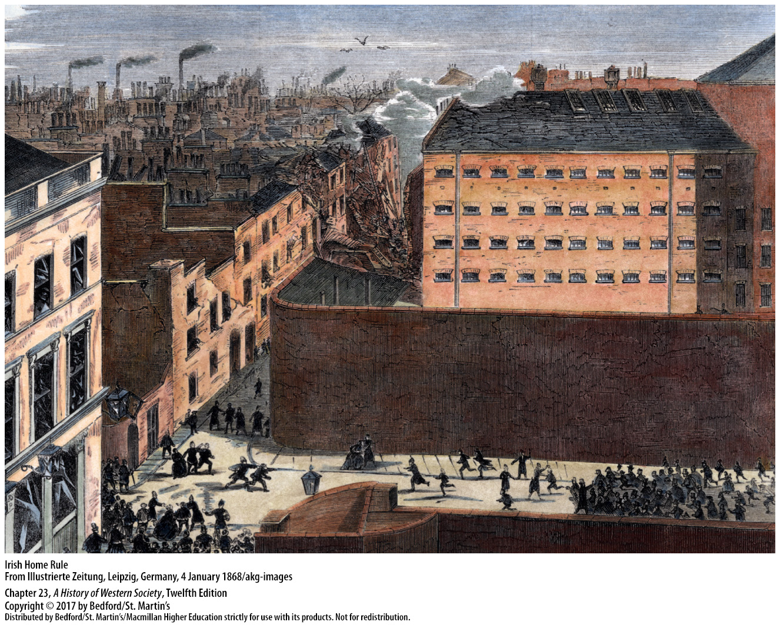

Slide 41
IV. The Responsive National State, 1871 – 1914
The Austro-Hungarian Empire
1. Emperor Francis Joseph
2. Dual monarchy
3. Magyar nobility
4. Magyar extremists
5. Austro-Hungarian Empire weakened by nationalism
Notes:
IV. The Responsive National State, 1871 – 1914
D. The Austro-Hungarian Empire
1. Throughout the 1850s, Hungary was ruled as a conquered territory, and Emperor Francis Joseph tried hard to centralize the state and Germanize the language and culture of the different nationalities.
2. When Austria agreed to establish the so-called dual monarchy after its defeat by Prussia in 1866, the empire was divided into two, and the Magyars gained virtual independence for Hungary.
3. In Hungary, the Magyar nobility restored the constitution of 1848 and used it to dominate both the Magyar peasantry and the minority populations, alienating those minorities, especially the Croatians and Romanians, by enacting laws promoting the use of the Magyar language in schools and government.
4. While Magyar extremists campaigned loudly for total separation from Austria, the radical leaders of the subject nationalities dreamed of independence from Hungary.
5. Unlike most major countries, which harnessed nationalism to strengthen the state after 1871, the Austro-Hungarian Empire was weakened by it.

Slide 42
V. The Nation and the People
Making National Citizens
1. Question of national loyalty
2. Challenges of nation building
3. Eroding regional differences
4. Transportation and communication networks
5. National superiority
Notes:
V. The Nation and the People
Making National Citizens
1. As the nation-state extended voting rights and welfare benefits to more people, the question of national loyalty became more pressing, and politicians and nationalist ideologues made forceful attempts to ensure the people’s conformity to their laws.
2. In most European countries differences in customs, language, religions, and political traditions undermined unity and challenged the project of nation building.
3. In Italy and Germany, the introduction of a common currency, standard weights and measures, and a national post office eroded regional differences.
4. Better transportation and communication networks ended rural isolation, boosted the growth of national markets, and helped turn “peasants into Frenchmen,” while growing literacy rates enabled more people to read about national history and current events.
5. Scholars championed national superiority and uncovered the roots of national identity in ancient folk traditions, shared language, customs, race, and religion, which were popularized in the classroom and in the press.

Slide 43
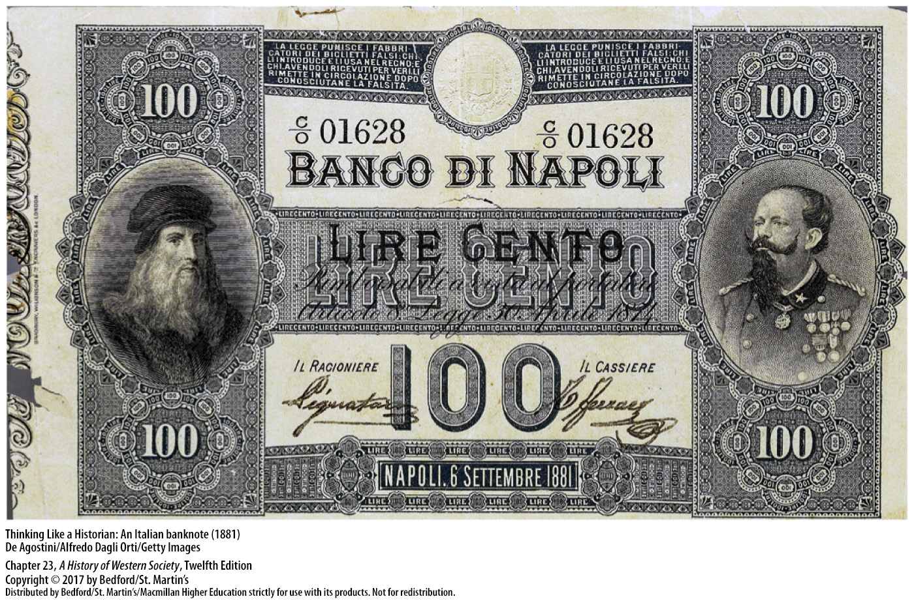

Slide 45
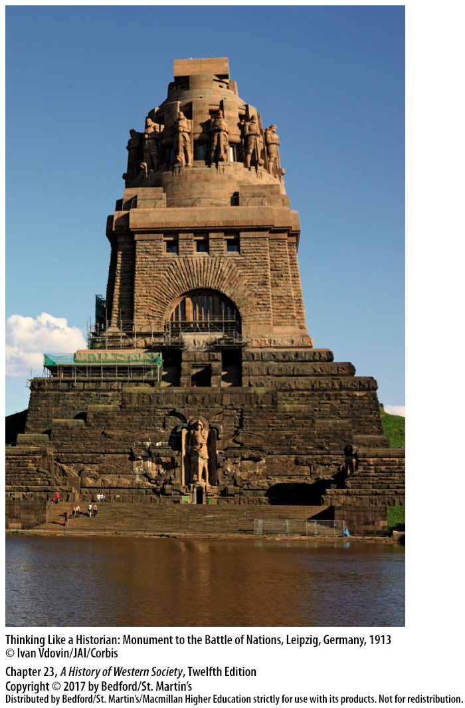

Slide 46
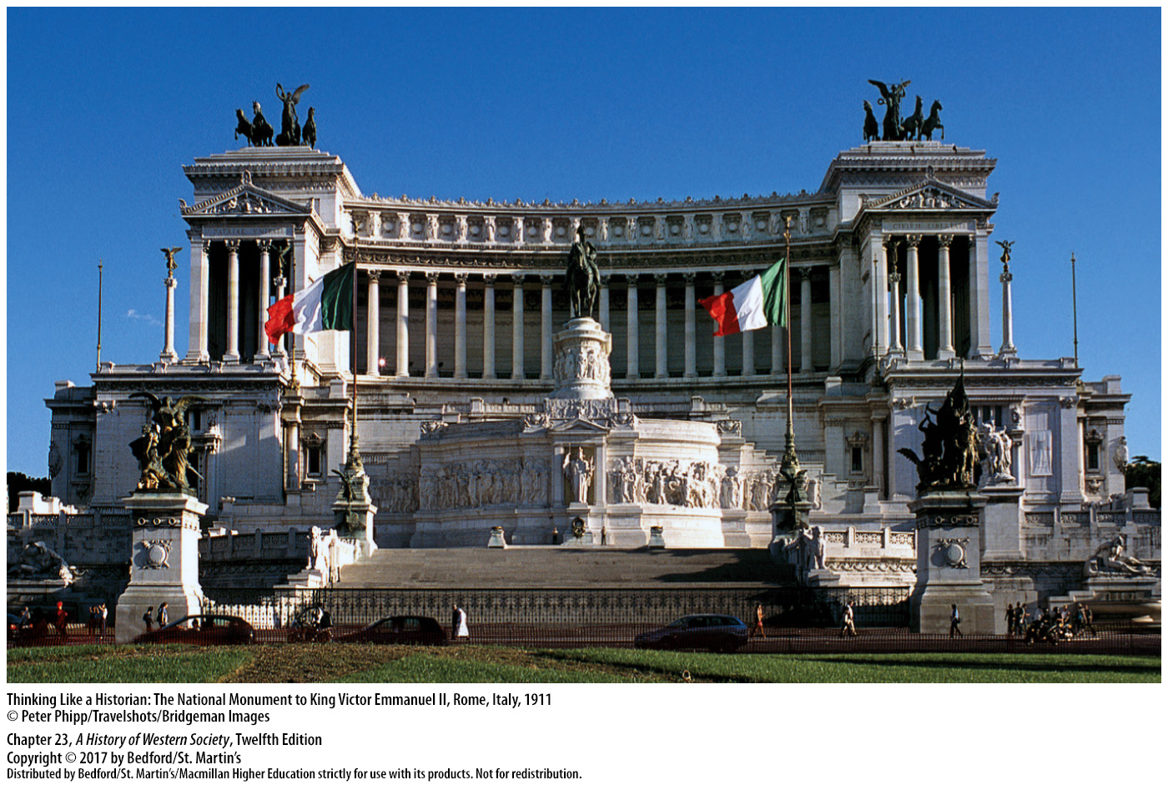

Slide 47
V. The Nation and the People
Nationalism and Racism
1. National racial characteristics
2. On the Inequality of the Human Races (1854)
3. Social Darwinist ideas
4. Nationalism and scientific racism
5. Race theorists
6. Jews were the ultimate outsiders
Notes:
V. The Nation and the People
B. Nationalism and Racism
1. Most people in the late-nineteenth century believed that race was a product of heredity and felt pride in their own national racial characteristics that were supposedly passed down from generation to generation, although such pride easily led to the denigration of another group.
2. In his book On the Inequality of the Human Races (1854), Count Arthur de Gobineau divided humanity into the white, black, and yellow races and championed the “Aryan race” for its supposedly superior qualities.
3. Social Darwinist ideas about the “survival of the fittest,” when applied to the “contest” between nations and races, drew on such ideas to further popularize stereotypes about inferior and superior races.
4. The close links between nationalism and scientific racism helped justify imperial expansion and fostered domestic persecution and exclusion.
5. According to race theorists, the nation was supposed to be racially pure; ethnic minorities, such as Poles and Czechs in the Russian empire and Poles in East Prussia, were viewed as a “national threat” that required cultural transformation and assimilation.
6. For many nationalists, Jews were the ultimate outsiders, the stereotypical “inferior race” that posed the greatest challenge to national purity.

Slide 48
V. The Nation and the People
Jewish Emancipation and Modern Anti-Semitism
1. Jewish emancipation
2. Improved economic situation
3. Patriotic citizens
4. Stock market crash of 1873
Notes:
V. The Nation and the People
C. Jewish Emancipation and Modern Anti-Semitism
1. In 1871 the constitution of the new German Empire consolidated the process of Jewish emancipation and abolished all restrictions on Jewish marriage, choice of occupation, place of residence, and property ownership, although exclusion from government employment and social discrimination continued.
2. Many Jews responded energetically to the opening up of career paths, excelling in wholesale and retail trade, banking and finance, consumer industries, journalism, medicine, and law; by 1871 a majority of Jews in western and central Europe had improved their economic situation and entered the middle classes.
3. Most Jewish people also identified strongly with their respective nation-states and saw themselves as patriotic citizens.
4. Vicious anti-Semitism reappeared after the stock market crash of 1873, whipped up by resentment against Jewish achievement and Jewish “financial control” and claims that the Jewish race or “blood” posed a biological threat to Christian peoples.

Slide 49
V. The Nation and the People
Jewish Emancipation and Modern Anti-Semitism
5. “The Protocols of the Elders of Zion”
6. Karl Lueger and his Christian Socialist Party
7. Theodor Herzl
Notes:
V. The Nation and the People
C. Jewish Emancipation and Modern Anti-Semitism
5. Such ideas were popularized by publications of the notorious forgery “The Protocols of the Elders of Zion,” a tract written by the Russian secret police suggesting that Jewish elders planned to dominate the world.
6. In the early 1890s, Karl Lueger, the mayor of Vienna from 1897 to 1910, and his Christian Socialist Party won electoral victories by appealing to the German-speaking lower middle class with a combination of fierce anti-Semitic rhetoric and municipal ownership of basic services.
7. Leading Zionists such as Theodor Herzl advocated the creation of a Jewish state in Palestine, where Europe’s Jews could live free of social prejudice.

Slide 50
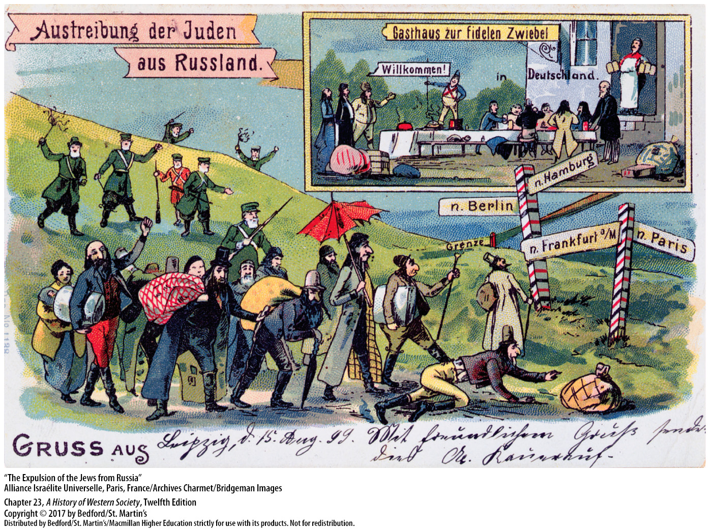

Slide 51
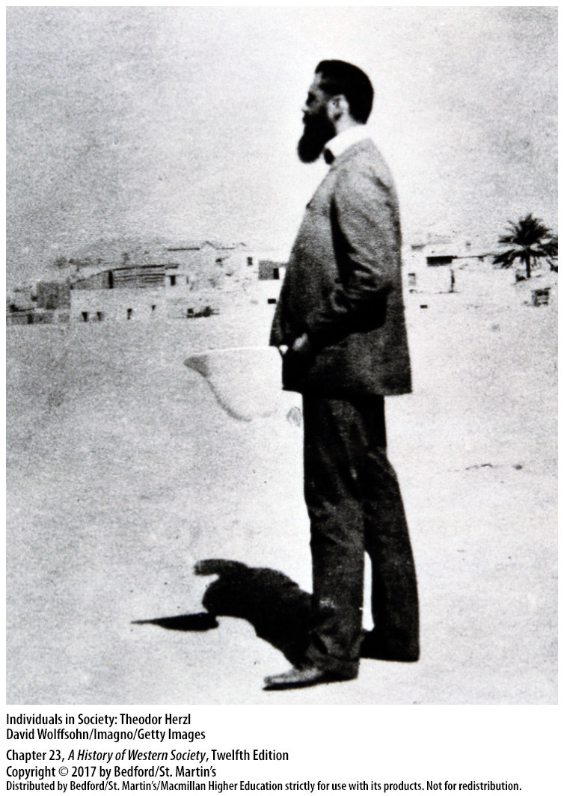

Slide 52
VI. Marxism and the Socialist Movement
The Socialist International
1. Growth of the German Social Democratic Party (SPD)
2. Socialist parties grew elsewhere
3. International Working Men’s Association
4. Marx endorsed the Paris Commune
5. Second International
Notes:
VI. Marxism and the Socialist Movement
The Socialist International
1. Neither Bismarck’s anti-socialist laws nor his extensive social security system checked the phenomenal growth of the German Social Democratic Party (SPD), which espoused radical Marxism even while seeking reform through legal parliamentary politics.
2. Socialist parties also grew elsewhere, including among Russian exiles in Switzerland, France, Belgium, and Austria-Hungary.
3. Marx himself played an important role in founding the First International of socialists—the International Working Men’s Association—which was an organization he battled successfully to control and used as a means of spreading his doctrines of socialist revolution.
4. Marx endorsed the radical patriotism of the Paris Commune and its terrible struggle against the French state as a giant step toward socialist revolution, frightening many of his early supporters and causing the First International to collapse.
5. In 1889, as the individual parties in different countries grew stronger, socialist leaders formed the Second International, a federation of national socialist parties whose delegates met every three years to interpret Marxist doctrines and plan coordinated action.

Slide 53
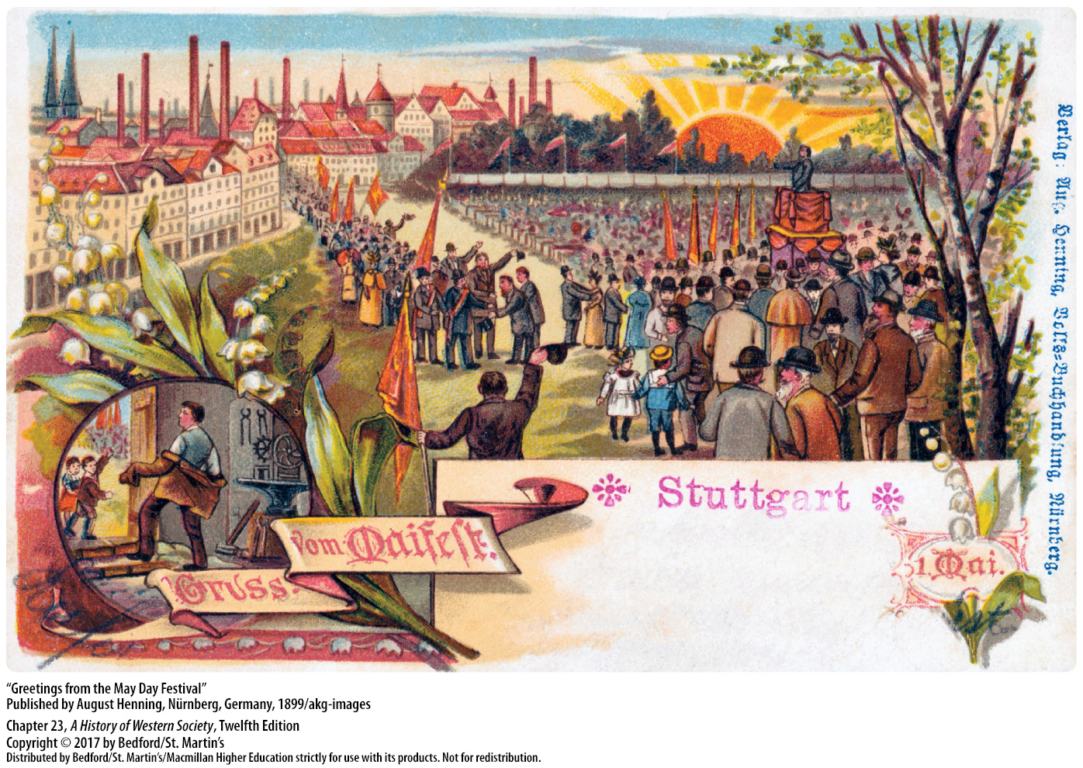

Slide 54
VI. Marxism and the Socialist Movement
Labor Unions and Marxist Revisionism
1. Elections vs revolutions
2. Workers’ standard of living rose
3. Unions
4. Collective bargaining and compromise
Notes:
VI. Marxism and the Socialist Movement
B. Labor Unions and Marxist Revisionism
1. As workers gained the right to vote and to participate politically in the nation-state, they focused their attention more on elections than on revolutions.
2. Most importantly, as workers’ standard of living rose gradually but substantially after 1850 and the quality of life in urban areas improved dramatically, workers became more moderate.
3. In the early stages of industrialization, unions were generally prohibited by law: a law of the French Revolution had declared all guilds and unions illegal; British workers’ attempts to unite were made criminal conspiracies in 1799, and other countries saw unions as subversive and enacted laws that hampered their development.
4. New and more practical kinds of unions, limited primarily to highly skilled workers such as machinists and carpenters, concentrated on winning better wages and hours through collective bargaining and compromise.

Slide 55
VI. Marxism and the Socialist Movement
Labor Unions and Marxist Revisionism
5. German Trade Union Congress
6. Eduard Bernstein (1850–1932)
7. Jean Jaurès (1859–1914)
Notes:
VI. Marxism and the Socialist Movement
B. Labor Unions and Marxist Revisionism
5. Genuine collective bargaining, long opposed by socialist intellectuals as a sellout, was officially recognized as desirable by the German Trade Union Congress in 1899.
6. The socialist Eduard Bernstein (1850–1932) argued in his Evolutionary Socialism (1899) that many of Marx’s predictions had been proved false.
7. In France the socialist leader Jean Jaurès (1859–1914) formally repudiated revisionism, but he remained at heart a gradualist and optimistic secular humanist.

