Slide 1
A History of Western Society Twelfth Edition
McKay • Crowston • Wiesner-Hanks • Perry
CHAPTER 22
Life in the Emerging Urban Society
1840–1914
Copyright © 2017 by Bedford/St. Martin’s
Distributed by Bedford/St. Martin's/Macmillan Higher Education strictly for use with its products; Not for redistribution.

Slide 2
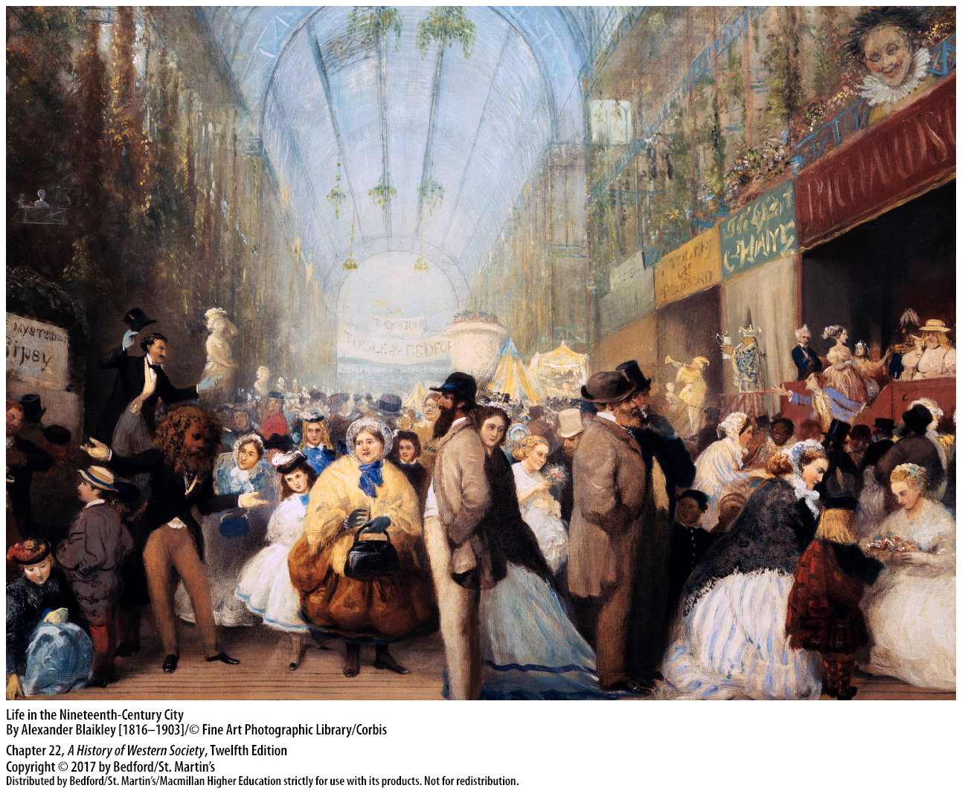

Slide 3
I. Taming the City
Industry and the Growth of Cities
1. Urban spread of infectious disease
2. Advantages of cities
3. Unsanitary and unhealthy conditions
Notes:
Taming the City
Industry and the Growth of Cities
1. Because masses of people needed to live in close proximity to shops, markets, and workplaces, city dwellers were packed tightly together and suffered and died from the spread of infectious disease in far greater numbers than their rural counterparts.
2. Cities had many advantages over the countryside, including better shipping facilities and supplies, a larger pool of labor, and nearby factories to supply a business’s needs and buy its products; therefore, as industry grew, cities expanded rapidly.
3. These highly concentrated urban populations lived in extremely unsanitary and unhealthy conditions, with open drains and sewers flowing alongside or down the middle of unpaved streets.

Slide 4
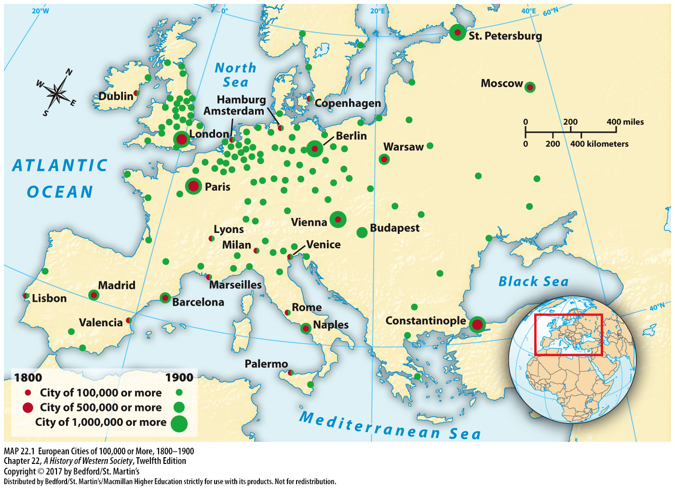

Slide 5
I. Taming the City
The Advent of the Public Health Movement
1. Edwin Chadwick
2. Jeremy Bentham (1748–1832)
3. Great Britain’s first public health law
4. United States, France, and Germany
Notes:
Taming the City
B. The Advent of the Public Health Movement
1. Edwin Chadwick, one of the commissioners charged with the administration of relief to paupers under Britain’s revised Poor Law of 1834, emerged as a powerful voice for reform.
2. Chadwick was inspired by the ideas of radical philosopher Jeremy Bentham (1748–1832), who developed utilitarianism, an approach to social issues that advocated dealing with public problems on a rational, scientific basis to advance the “greatest good for the greatest number.”
3. In 1848, after a cholera epidemic, Chadwick’s report became the basis of Great Britain’s first public health law, which created a national health board and gave cities broad authority to build modern sanitation systems.
4. From the late 1840s on, the public health movement won supporters in the United States, France, and Germany, and governments began to accept at least limited responsibility for the health of all citizens.

Slide 6
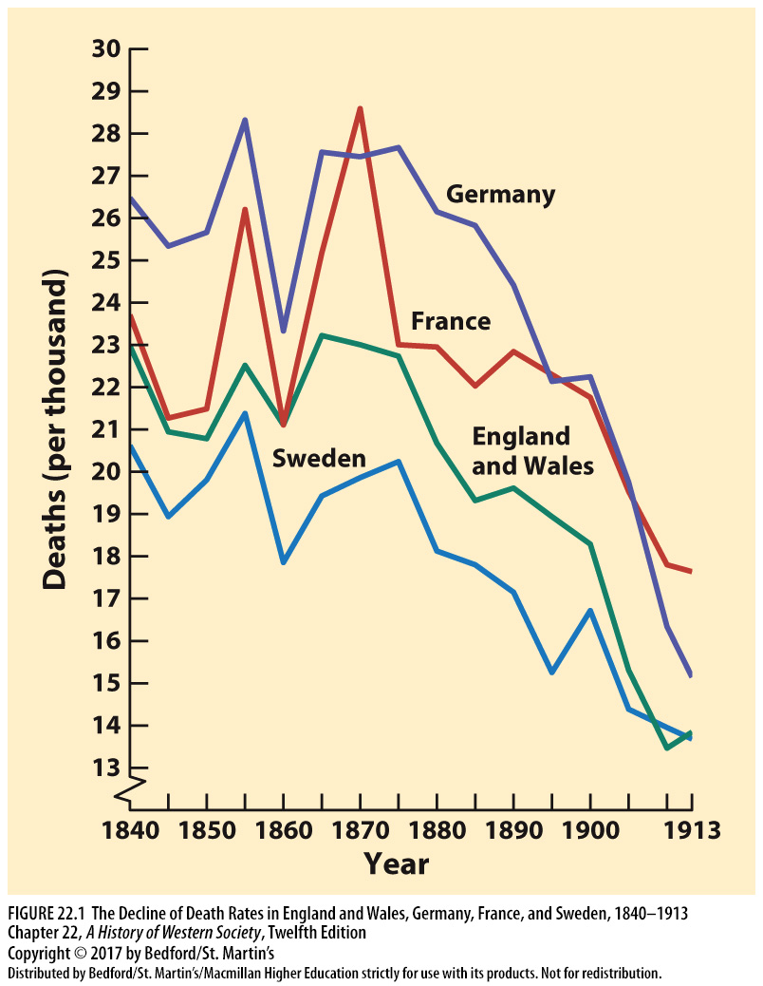

Slide 7
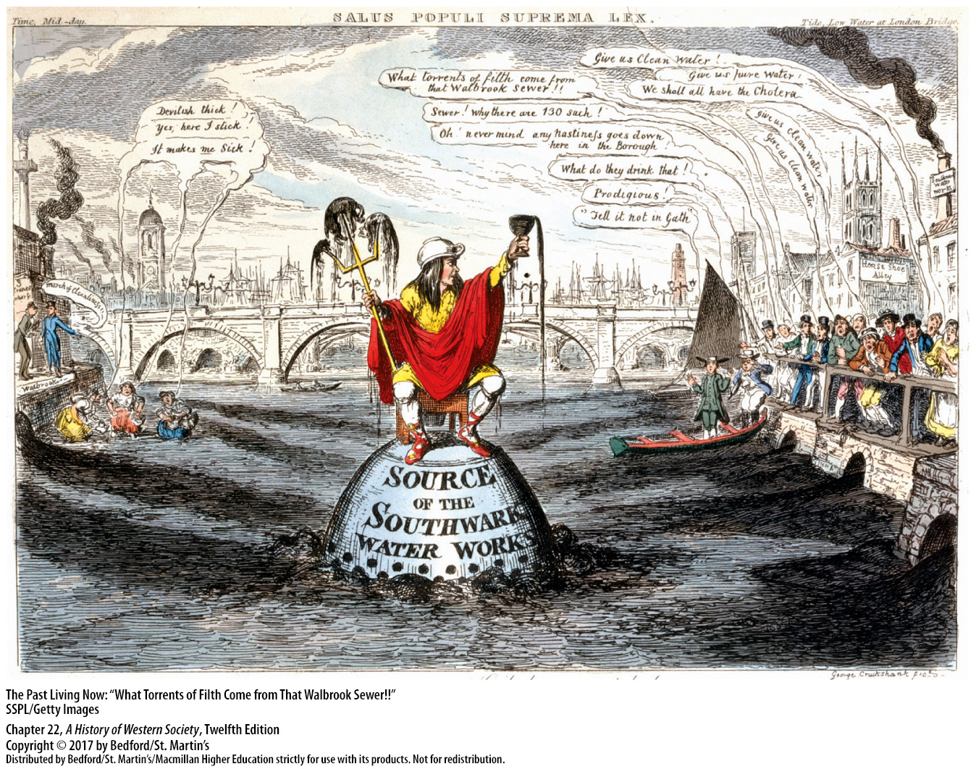

Slide 8
I. Taming the City
The Bacterial Revolution
1. Drinking water and transmission of disease
2. Louis Pasteur (1822–1895)
3. Robert Koch
4. Joseph Lister (1827–1912)
5. Sterilization in the operating room
Notes:
Taming the City
C. The Bacterial Revolution
1. In the 1840s and 1850s, keen observation by doctors and public health officials pinpointed the role of bad drinking water in the transmission of disease and suggested that contagion was spread through physical contact with filth, not by its odors.
2. Louis Pasteur (1822–1895), a French chemist studying fermentation for brewers using a microscope, developed the germ theory of disease, which holds that disease is caused by the spread of living organisms that can be controlled.
3. After German country doctor Robert Koch and his coworkers developed pure cultures of harmful bacteria and described their life cycles, other researchers identified the organisms responsible for various diseases and developed effective vaccines.
4. Germ theory dramatically improved hospital and surgery environments, especially when English surgeon Joseph Lister (1827–1912) reasoned that applying a chemical disinfectant to a wound dressing would kill aerial bacteria.
5. In the 1880s German surgeons began sterilizing not only the wound but also everything else—hands, instruments, clothing—that entered the operating room.

Slide 9
I. Taming the City
Improvements in Urban Planning
1. Napoleon III (r. 1848–1870)
2. Baron Georges Haussmann (1809–1884)
3. Boulevards
4. Parks
5. Sewers and aqueducts
6. Rebuilding Paris
7. Zoning expropriation laws
Notes:
Taming the City
D. Improvements in Urban Planning
1. Napoleon III (r. 1848–1870) believed that rebuilding much of Paris would provide employment, improve living conditions, limit the outbreak of cholera epidemics, and testify to the power and glory of his empire.
2. Baron Georges Haussmann (1809–1884), appointed by Napoleon III, proved to be an authoritarian planner capable of bulldozing both buildings and opposition and transforming Paris in a matter of twenty years.
3. The creation of the boulevards demolished some of the worst slums and stimulated the construction of better housing, especially for the middle classes.
4. Two very large parks, small neighborhood parks, and open spaces were created throughout the city.
5. The city also improved its sewers, and a system of aqueducts more than doubled the city’s supply of clean, fresh water.
6. Rebuilding Paris provided a new model for urban planning and stimulated urban reform throughout Europe, particularly after 1870.
7. Zoning expropriation laws, which allowed a majority of the owners of land in a given quarter of the city to impose major street or sanitation improvements on a reluctant minority, were an important mechanism of the new urban reform movement.

Slide 10
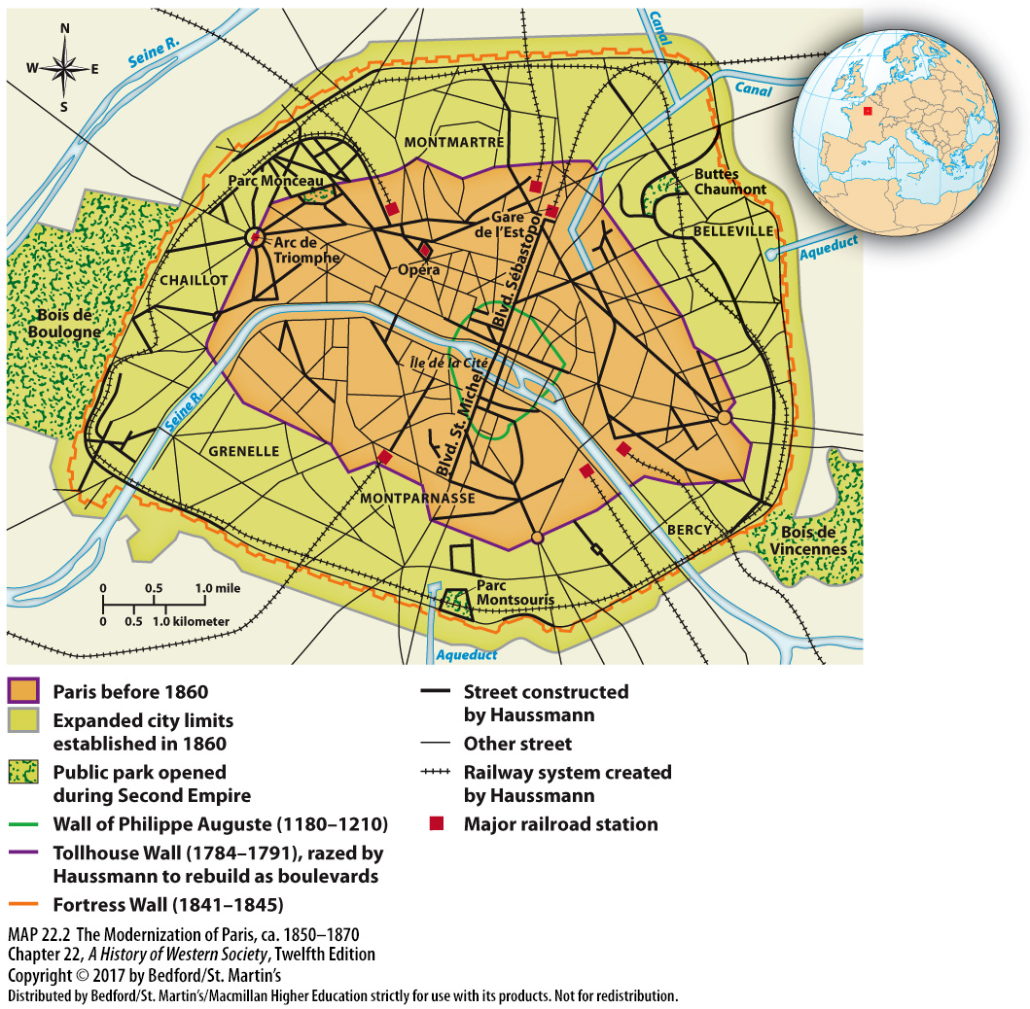

Slide 11
I. Taming the City
Public Transportation
1. Streetcars
2. Spacious housing
3. Suburban commuting
Notes:
Taming the City
E. Public Transportation
1. In the 1870s many cities authorized private companies to operate horse-drawn streetcars; then in the 1890s cities adopted the electric streetcar, which was cheaper, faster, more dependable, cleaner, and more comfortable than horse-drawn streetcars.
2. Boulevards and horse-drawn streetcars facilitated a middle-class move to better and more spacious housing in the 1860s and 1870s; after 1890 electric streetcars gave people of modest means access to new, improved housing and helped the city, though still crowded, to expand and become less congested.
3. On the continent, many city governments built electric streetcar systems that provided transportation to new housing developments for the working classes beyond the city limits; thus suburban commuting was born.

Slide 12
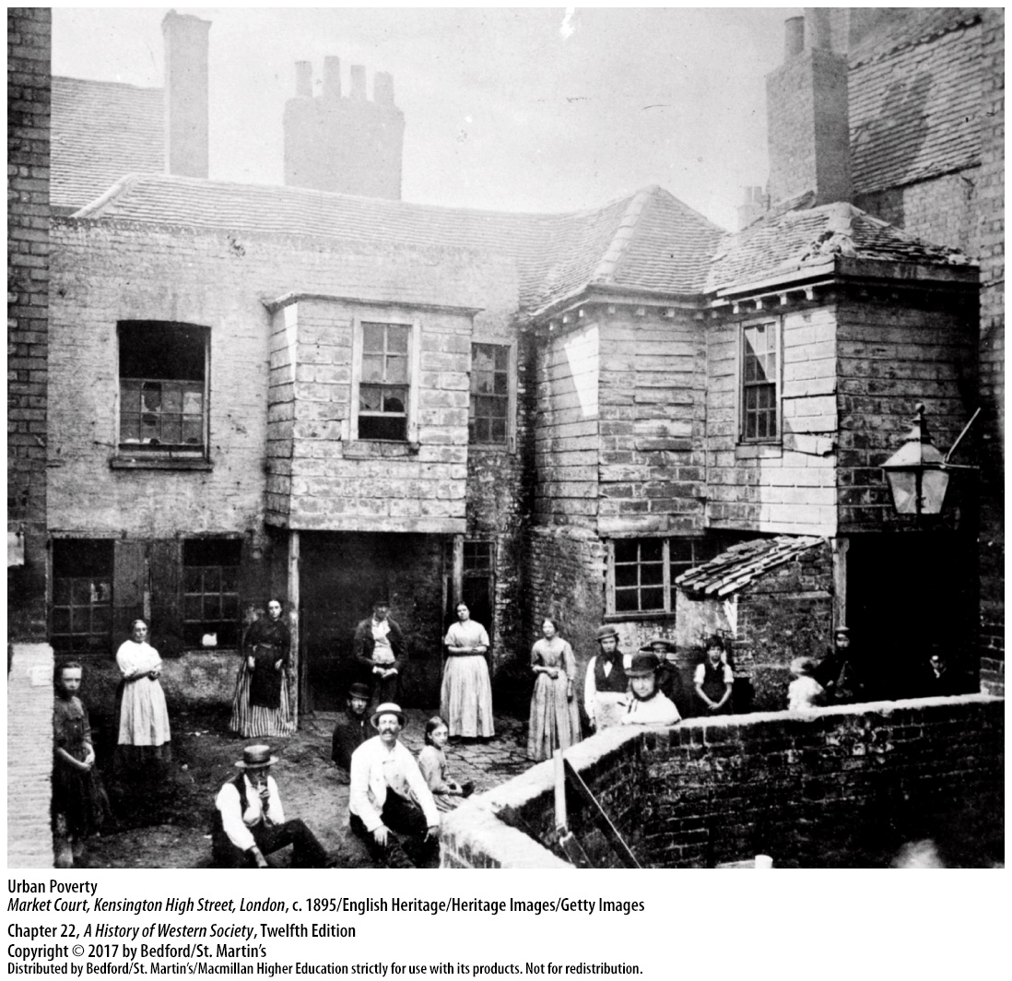

Slide 13
II. Rich and Poor and Those in Between
The Distribution of Income
1. The social ladder
2. Richest 5 percent vs bottom 30 percent
3. The middle classes
4. Economic specialization
Notes:
II. Rich and Poor and Those in Between
The Distribution of Income
1. The aristocracy retained its position at the top of the social ladder, followed closely by the new elite, composed mainly of the most successful families from banking, industry, and commerce.
2. In almost every advanced country around 1900, the richest 5 percent of all households in the population received about a third of all national income, and the bottom 30 percent of all households received 10 percent or less of all income.
3. The middle classes, accounting for less than 20 percent of the population, were much smaller than they are today, and income taxes on the wealthy were light or nonexistent; thus the gap between rich and poor remained enormous at the start of the twentieth century.
4. Economic specialization had created a variety of new social groups, as an almost unlimited range of jobs, skills, and earnings developed and one group or subclass blended into another in a complex, confusing hierarchy.

Slide 14
II. Rich and Poor and Those in Between
The People and Occupations of the Middle Classes
Increasingly diversified middle classes
2. Specialized knowledge and advanced education
3. Independent, property-owning shopkeepers
4. White-collar workers
5. Nurses and dentists
Notes:
II. Rich and Poor and Those in Between
B. The People and Occupations of the Middle Classes
1. The much larger, much less wealthy, and increasingly diversified middle classes included the moderately successful industrialists and merchants as well as professionals in law, business, and medicine.
2. As industry and technology expanded, a demand developed for experts with specialized knowledge, and advanced education soared in importance among the middle classes.
3. The number of independent, property-owning shopkeepers and small businesspeople grew, as did the number of white-collar employees.
4. White-collar workers, though they owned little property and often earned no more than some skilled or semiskilled workers, were fiercely committed to the middle-class ideal of upward social mobility.
5. Nurses also rose from the lower ranks of unskilled labor, and dentistry was taken out of the hands of working-class barbers and placed in the hands of highly trained professionals.

Slide 15
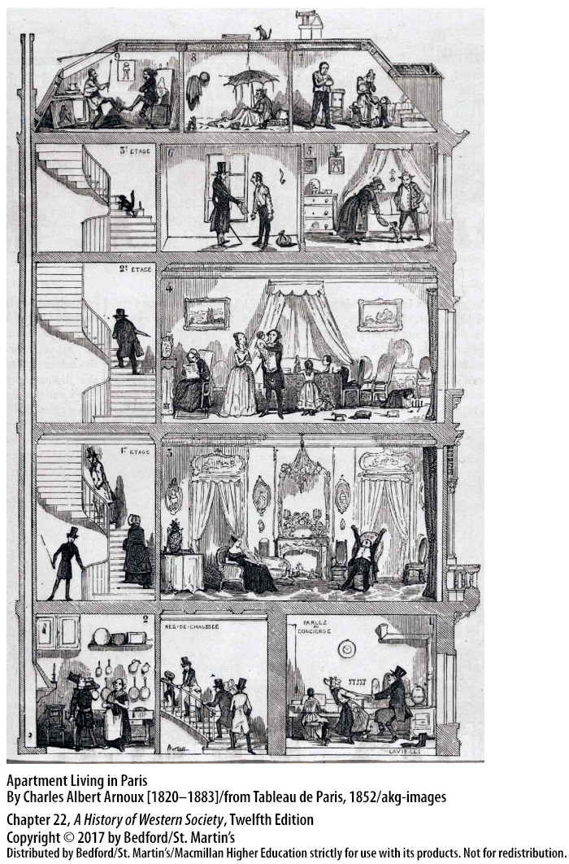

Slide 16
II. Rich and Poor and Those in Between
Middle-Class Culture and Values
1. Food and entertainment
2. Full-time maids
3. Rented homes
4. Clothing
5. Books, music, and travel
6. Strict code of behavior and morality
Notes:
II. Rich and Poor and Those in Between
C. Middle-Class Culture and Values
1. Unlike the working classes, the middle classes had the money to eat well and spent a substantial portion of their household budget on food and entertainment.
2. Employing a full-time maid to cook and clean was the clearest sign that a family had crossed the cultural divide separating it from the working classes.
3. Many prosperous families rented, rather than owned, their homes and perhaps purchased country places or built beach houses for weekend and summer use.
4. The factory, the sewing machine, and the department store all helped reduce the cost and expand the variety of clothing, particularly for middle-class women and men.
5. Rich Europeans devoted less time to business and more time to books, music, and travel than less wealthy families did.
6. In addition to their material tastes, the middle classes generally agreed upon a strict code of behavior and morality that stressed hard work, self-discipline, and personal achievement.

Slide 17
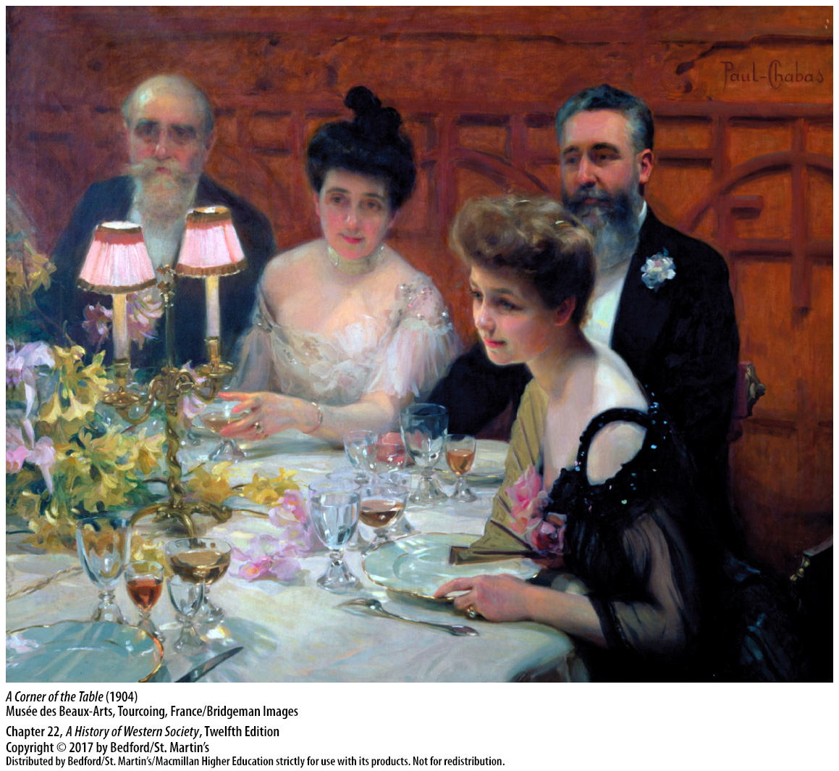

Slide 18
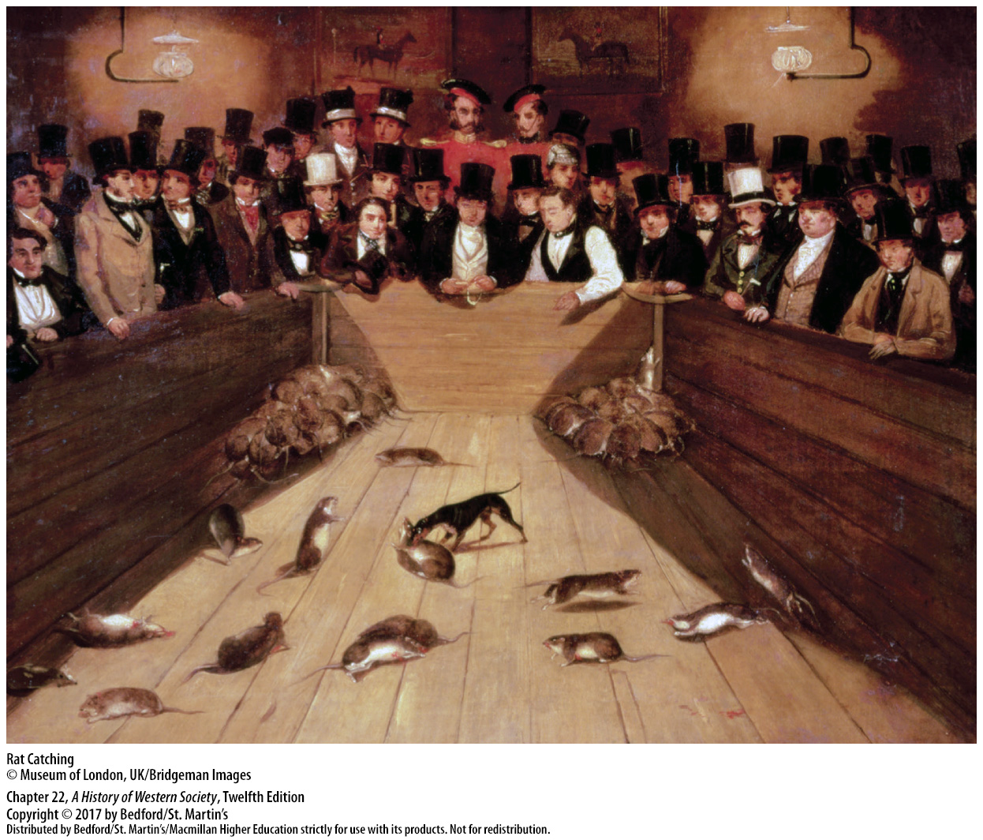

Slide 19
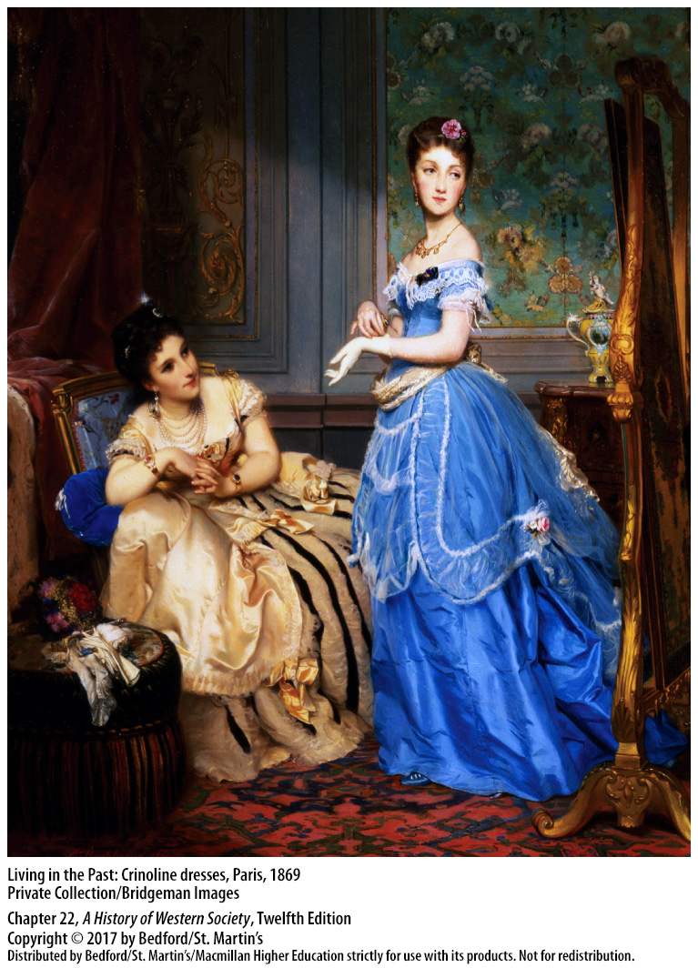

Slide 20
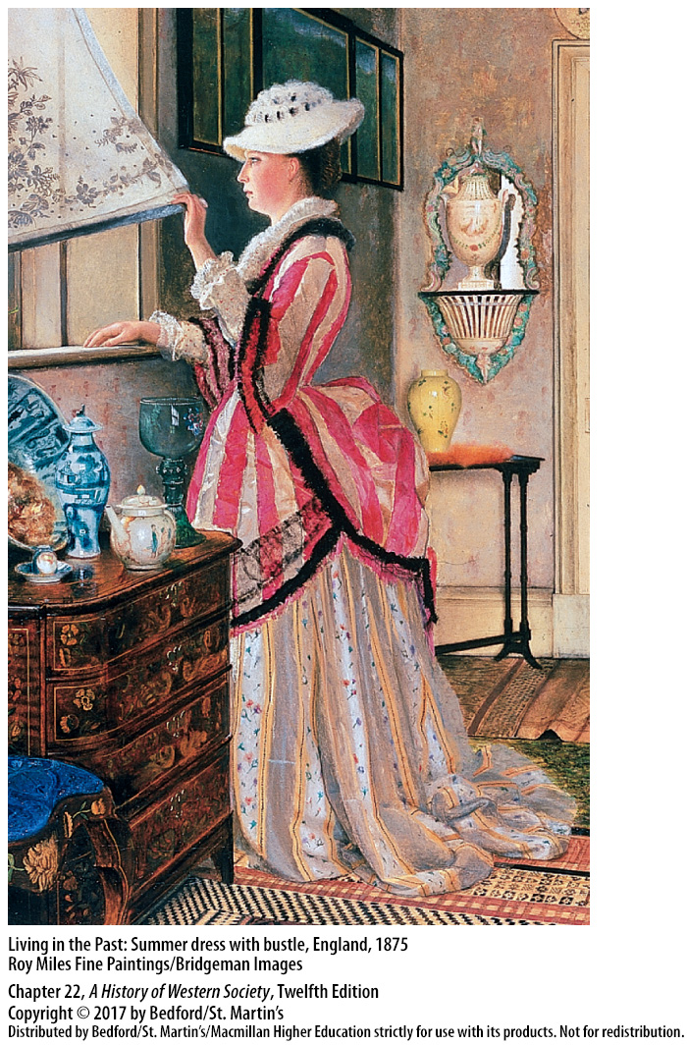

Slide 21
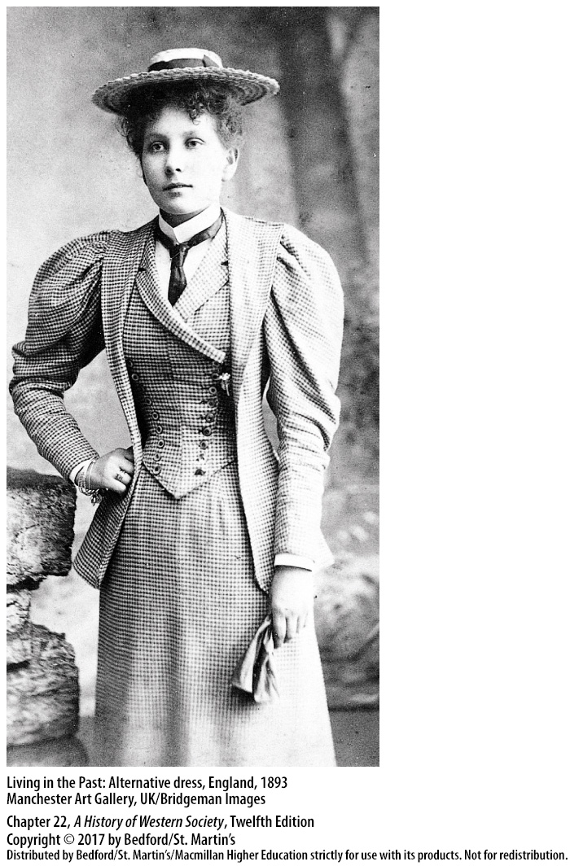

Slide 23
II. Rich and Poor and Those in Between
The People and Occupations of the Working Classes
1. Less unified and homogeneous
2. Skilled, semiskilled, and unskilled workers
3. The labor aristocracy
4. Distinctive values
Notes:
II. Rich and Poor and Those in Between
D. The People and Occupations of the Working Classes
1. The urban working classes were even less unified and homogeneous than the middle classes, as economic development and increased specialization expanded the traditional range of working-class skills, earnings, and experiences.
2. Skilled, semiskilled, and unskilled workers developed widely divergent lifestyles and cultural values; these differences contributed to a keen sense of social status and hierarchy.
3. The labor aristocracy—highly skilled workers such as construction bosses, factory foremen, cabinetmakers, jewelers, and printers that comprised about 15 percent of the working classes—existed in a state of flux as individuals and whole crafts moved in and out of it.
4. To maintain its precarious standing, members of the upper working class, who considered themselves the natural leaders of all the working classes, adopted distinctive values, including a strong commitment to the family, middle-class morality, and the goal of economic improvement.

Slide 24
II. Rich and Poor and Those in Between
The People and Occupations of the Working Classes
5. Workers in the established crafts
6. Unskilled workers
7. Domestic servants
8. Working-class wives
Notes:
II. Rich and Poor and Those in Between
D. The People and Occupations of the Working Classes
5. Workers in the established crafts—carpenters, bricklayers, pipe fitters—stood near the top of the semiskilled hierarchy; a large number of the semiskilled were factory workers, including substantial numbers of unmarried women, who earned highly variable but relatively good wages.
6. Below the semiskilled workers was a larger group of unskilled workers that included day laborers who were unorganized and divided, united only by the common fate of meager earnings and poor living conditions.
7. One of the largest components of the unskilled group was domestic servants, the great majority of whom were women; indeed, one out of every three girls in Britain between the ages of fifteen and twenty worked as a domestic servant.
8. Many working-class wives had to join the broad ranks of working women in the “sweated industries,” which involved poorly paid handicraft production by women working in their homes and getting paid by the piece.

Slide 25
II. Rich and Poor and Those in Between
Working-Class Leisure and Religion
1. Heavy problem drinking declined
2. Drinking became more publicly acceptable
3. Commercialized spectator sports
4. Music halls and vaudeville theaters
Notes:
II. Rich and Poor and Those in Between
E. Working-Class Leisure and Religion
1. Heavy problem drinking declined in the late nineteenth century, as it became less socially acceptable, which reflected the moral leadership of the labor aristocracy.
2. At the same time, drinking became more publicly acceptable, and cafés and pubs became the loci for both moderate and radical working-class political activities.
3. As “cruel sports” such as bullbaiting and cockfighting declined, modern, commercialized spectator sports such as horse racing and soccer became popular.
4. Music halls and vaudeville theaters, the working-class counterparts of middle-class opera and classical theater, were enormously popular.

Slide 26
II. Rich and Poor and Those in Between
Working-Class Leisure and Religion
5. Religion
6. Decline in both church attendance and church donations
7. Socialists attacked religion
8. “Feminization”
Notes:
II. Rich and Poor and Those in Between
E. Working-Class Leisure and Religion
5. Religion continued to provide working people with solace and meaning, as eighteenth-century Catholic vitality and the Protestant rejuvenation exemplified by German Pietism and English Methodism carried over into the nineteenth century.
6. Yet, by the late nineteenth century, a considerable decline in both church attendance and church donations was occurring in most European countries, especially among the urban working classes.
7. Socialists attacked religion as a pillar of bourgeois society, and as the working classes became more politically conscious, they tended to see established churches as allied with their political opponents.
8. Religion also underwent “feminization” because women of both the working- and middle-classes exhibited more piety and attended service more regularly than men.

Slide 27
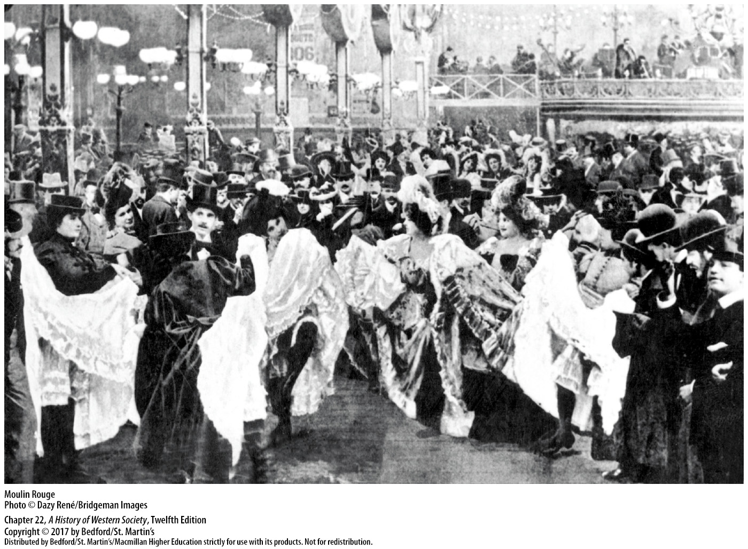

Slide 28
III. Changing Family Lifestyles
Middle-Class Marriage and Courtship Rituals
1. Culture of romantic love
2. Rules for engagements
3. Middle-class marriage requirements
4. Gender roles in courtship
5. Inequality of marriage
Notes:
III. Changing Family Lifestyles
Middle-Class Marriage and Courtship Rituals
1. Economic considerations by no means disappeared, but a culture of romantic love—popularized in advice manuals, fiction, and art and practiced in courtship rituals, weddings, and married life—made the companionate marriage the ideal.
2. Engagements followed a complicated set of rules: following a public announcement, a couple could appear in public together and walk arm in arm, but custom placed strict limits on physical intimacy.
3. A middle-class man could marry only if he could support a wife, children, and a servant, which meant he should be fairly prosperous and in the middle of his career; thus, he was typically much older than his young wife.
4. Women, trained to fall passionately in love, equated marriage with emotional intensity, while men, encouraged to “find a wife” and to see themselves as the protector of a young and fragile creature, took a more active but dispassionate role in courtship.
5. The inequality of marriage was codified in European legal systems that, with rare exceptions, placed property ownership in the hands of the husband.

Slide 29
III. Changing Family Lifestyles
Middle- and Working-Class Sexuality
1. Double standard in sexual relations
2. Science legitimized double standard
3. Sexual standards among the classes
4. Establishment of two-parent household
5. Spread of middle-class ideals
Notes:
III. Changing Family Lifestyles
B. Middle- and Working-Class Sexuality
1. A double standard in sexual relations—men were aggressive sexual creatures and women were pure—paralleled the gender inequalities of middle-class standards of love and marriage.
2. Contemporary science legitimized this double standard; according to physicians, men could easily be aroused and fall prey to their raging biological drives, while respectable women were, by nature, supposedly uninterested in sex.
3. In the early nineteenth century, sexual standards among the working classes differed greatly from middle-class norms; premarital sex for working-class men and women was common and more acceptable, and about one-third of births in many urban areas occurred out of wedlock.
4. Sexuality activity did not decrease among young, unmarried workers, but in the later nineteenth century, pregnancy led increasingly to marriage and the establishment of a two-parent household.
5. This development reflected the spread of middle-class ideals of family respectability among the working classes, as well as their gradual economic improvement.

Slide 30
III. Changing Family Lifestyles
Prostitution
1. Source of second income
2. Considered a stage of life, not permanent employment
3. Increasingly viewed as immoral
4. British Contagious Diseases
5. Josephine Butler and the Ladies National Association
Notes:
III. Changing Family Lifestyles
C. Prostitution
1. Young working-class women used prostitution as a source of second income or as a way to weather a period of unemployment; they serviced lower-class men, soldiers, and sailors, as well as middle- and upper-class men.
2. Among the working-classes, prostitution, like domestic service, was considered a stage of life, not permanent employment, and after having done it for a while, many women went on to marry and have homes and families.
3. As middle-class values became more prominent after the 1860s, the prostitute increasingly was viewed as immoral, lascivious, and unhealthy and blamed for the spread of crime and diseases such as syphilis.
4. State and city authorities subjected prostitutes to increased surveillance; in Great Britain the British Contagious Diseases Acts required women identified as “common prostitutes” to undergo biweekly medical exams and confined those who showed signs of venereal disease in a “lock hospital.”
5. A middle-class campaign against this controversial policy, led by Josephine Butler and the Ladies National Association, proclaimed the Acts physically abused poor women, violated their constitutional rights, and legitimized male vice.

Slide 31
III. Changing Family Lifestyles
Separate Spheres and the Importance of Homemaking
1. Division of labor and lifestyles by gender
2. Single-family home
3. Middle-class homes expanded
4. Wife’s responsibilities
5. Working-class families and the separate spheres
6. Running an urban household
Notes:
III. Changing Family Lifestyles
D. Separate Spheres and the Importance of Homemaking
1. The ideal of “separate spheres,” a strict division of labor and lifestyles by gender, cast men as breadwinners and women as homemakers.
2. The single-family home, a symbol of middle-class status and a sanctuary from the world, was central to the notion of separate spheres.
3. Middle-class homes expanded to include separate bedrooms for parents and each family member and a drawing room used for entertaining guests, as well as ostentatious interior displays of furniture, bric-a-brac, heavy curtains, and colorful silks.
4. Housekeeping manuals prescribed the wife’s responsibilities to include ensuring her husband a “restful and refreshing atmosphere” and making “his stay at home as pleasant as possible.”
5. By 1900 working-class families had adopted many middle-class values, although they did not have the means to fully realize the ideal of separate spheres.
6. Running an urban household was a complicated, demanding, and valuable task; it was a full-time occupation that included twice-a-day food shopping, careful economizing, and the growing crusade against dirt, not to mention child rearing.

Slide 32
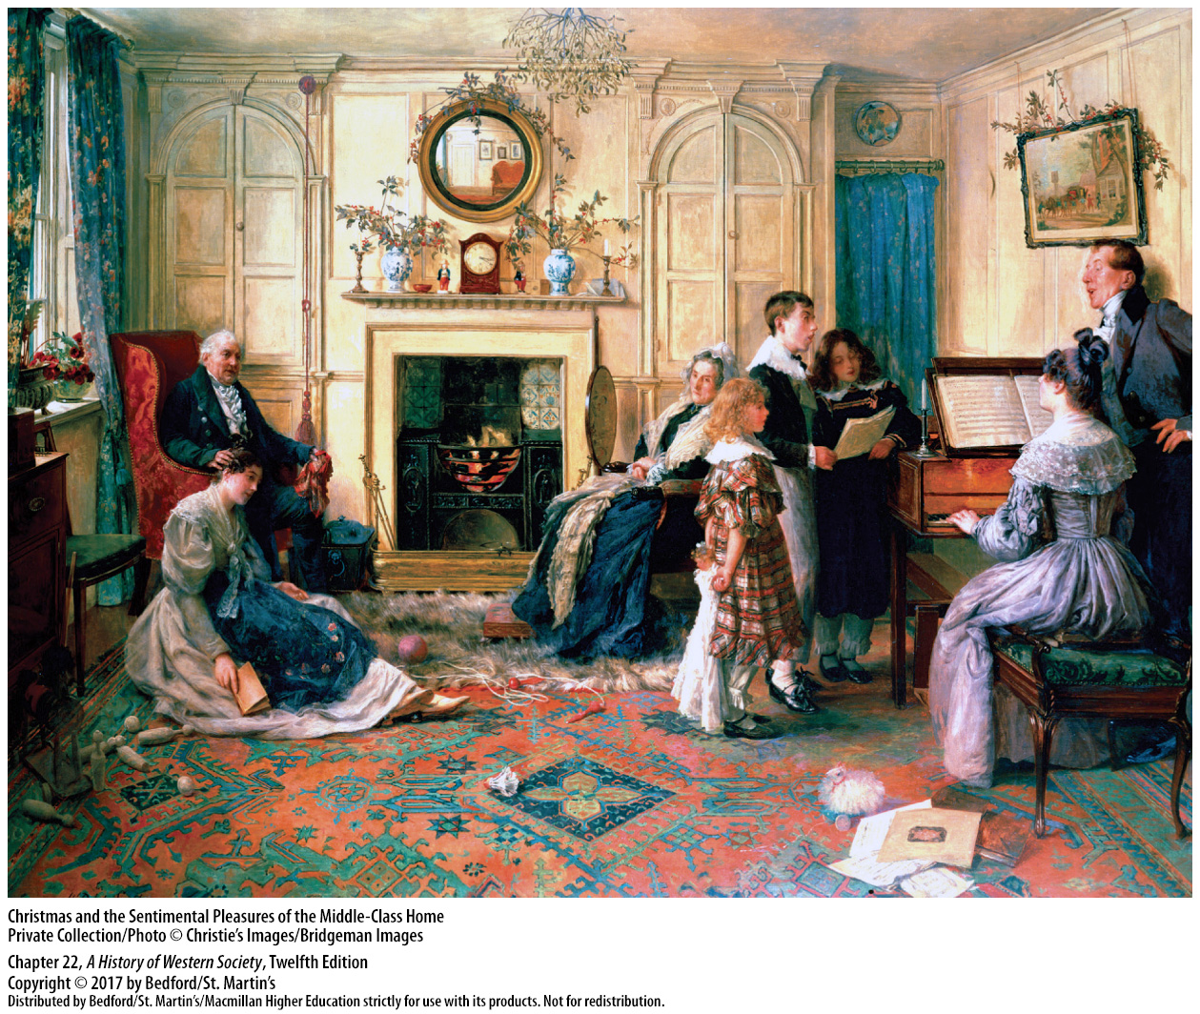

Slide 33
III. Changing Family Lifestyles
Child Rearing
1. Gustav Droz’s Papa, Mama, and Baby
2. Mothers increasingly breast-fed their infants
3. Concern for older children and adolescents
4. Valuable advantages
Notes:
III. Changing Family Lifestyles
E. Child Rearing
1. This surge of maternal feeling was shaped by and reflected in specialized books on child rearing and infant hygiene, some of which, including Gustav Droz’s popular Papa, Mama, and Baby, encouraged fathers to become more affectionate toward their children.
2. Mothers increasingly breast-fed their infants rather than paying wet nurses to do so, even though breast-feeding involved a temporary loss of freedom.
3. The loving care lavished on infants was matched by greater concern for older children and adolescents, who were also wrapped in the strong emotional ties of a more intimate and protective family.
4. By having fewer youngsters, parents could give those they had valuable advantages, from music lessons and summer vacations to long, expensive university educations and suitable dowries.

Slide 34
III. Changing Family Lifestyles
Child Rearing
5. Declining birthrate
6. Children’s self-control, self-fulfillment, and sense of Christian morality
7. Distance in wealthy families
8. Working-class children had more independence
Notes:
III. Changing Family Lifestyles
E. Child Rearing
5. By the end of the nineteenth century, the birthrate was declining across Europe, and it continued to decline until after World War II.
6. Professional family experts encouraged parents to focus on developing their children’s self-control, self-fulfillment, and sense of Christian morality and discouraged corporal punishment.
7. Distance between parents and children was most apparent in the wealthiest families in which domestic servants, nannies, and tutors did much of the work of child rearing.
8. Working-class children probably had more independence because, unlike their middle-class peers who remained economically dependent until a long education was finished or a proper marriage secured, working-class boys and girls went to work when they reached adolescence.

Slide 35
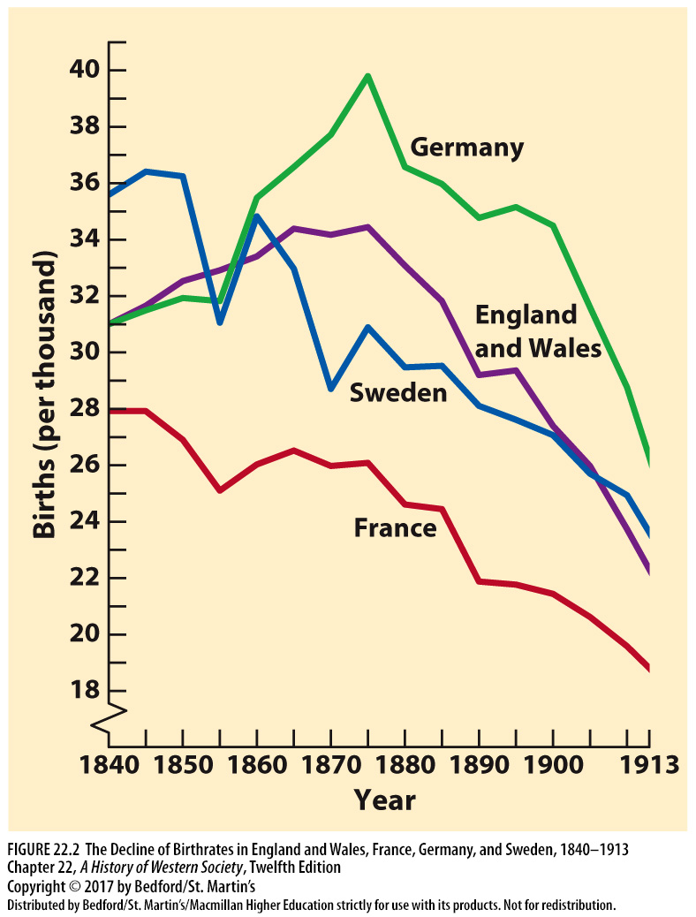

Slide 36
III. Changing Family Lifestyles
The Feminist Movement
1. Middle-class feminists
2. 1882 law gave English married women full property rights
3. Professional and white-collar employment
4. “Suffragettes”
Notes:
III. Changing Family Lifestyles
F. The Feminist Movement
1. Organizations founded by middle-class feminists campaigned for equal legal rights for women and access to higher education and professional employment, arguing that unmarried women and middle-class widows with inadequate incomes needed more opportunities to support themselves.
2. These organizations scored some significant victories, such as the 1882 law giving English married women full property rights.
3. More women gradually found professional and white-collar employment, especially after about 1880, in fields such as teaching, nursing, and social work.
4. In Britain in the decade before World War I, the women’s suffrage movement mounted a militant campaign for the right to vote. “Suffragettes” marched in protest demonstrations, heckled members of Parliament, and destroyed property, and when jailed, they went on highly publicized hunger strikes; British women received the vote in 1919.

Slide 37
III. Changing Family Lifestyles
The Feminist Movement
5. Federation of German Women’s Association
6. Socialist women leaders
Notes:
III. Changing Family Lifestyles
F. The Feminist Movement
5. Before 1900, women in Germany fought to break barriers to advanced education and the professions; by 1913, protests organized by the Federation of German Women’s Association brought changes in the German Civil Code of 1906, granting women some family and property rights.
6. Socialist women leaders, who argued that the liberation of working-class women would come only with the liberation of the entire working class through revolution, championed working women and won some practical improvements, especially in Germany.

Slide 38
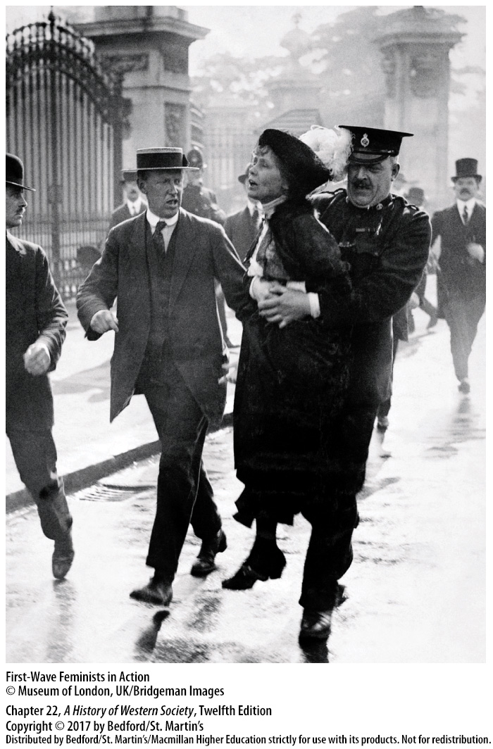

Slide 39
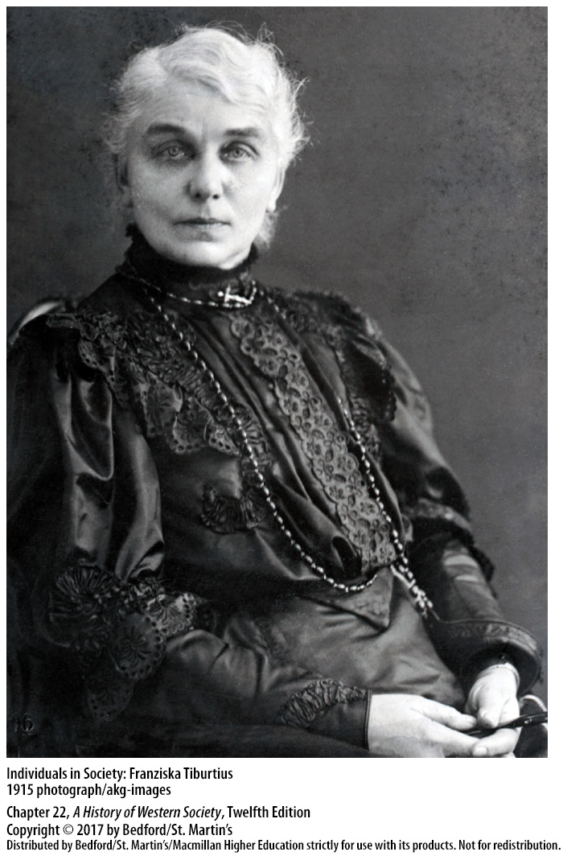

Slide 40
IV. Science and Thought
The Triumph of Science in Industry
1. Growth of fundamental scientific discoveries
2. Laws of thermodynamics
3. Dmitri Mendeleev (1834–1907)
4. Transforming coal tar into synthetic dyes
Notes:
IV. Science and Thought
The Triumph of Science in Industry
1. An explosive growth of fundamental scientific discoveries from the 1830s onward increasingly translated into material improvements for the general population.
2. Building on Isaac Newton’s laws, physicists formulated the fundamental laws of thermodynamics, which were then applied to mechanical engineering, chemical processes, and many other fields.
3. Chemists devised ways of measuring the atomic weight of different elements, and in 1869 the Russian chemist Dmitri Mendeleev (1834–1907) codified the rules of chemistry in the periodic law and the periodic table.
4. Applying theoretical insights gleaned from organic chemistry, researchers in German chemical companies discovered ways of transforming coal tar into synthetic dyes for the world of fashion.

Slide 41
IV. Science and Thought
The Triumph of Science in Industry
5. Electricity transformed into a commercial form of energy
6. Internal combustion engine
7. Second Industrial Revolution
8. Inferior “unscientific” intuitions
Notes:
IV. Science and Thought
The Triumph of Science in Industry
5. Electricity was transformed by a century of technological advancement into a commercial form of energy, first used in communications, then in electrochemistry, and finally in central power generation.
6. By 1890 the internal combustion engine fueled by petroleum was an emerging competitor.
7. This burst of industrial creativity and technological innovation, often called the Second Industrial Revolution, promoted strong economic growth and was a leading force driving urban reforms and the rising standard of living.
8. The methods of science acquired unrivaled prestige after 1850, and the conclusion of many that the union of careful experiment and abstract theory was the only reliable route to truth and objective reality made the “unscientific” intuitions of poets and religious revelations seem hopelessly inferior.

Slide 42
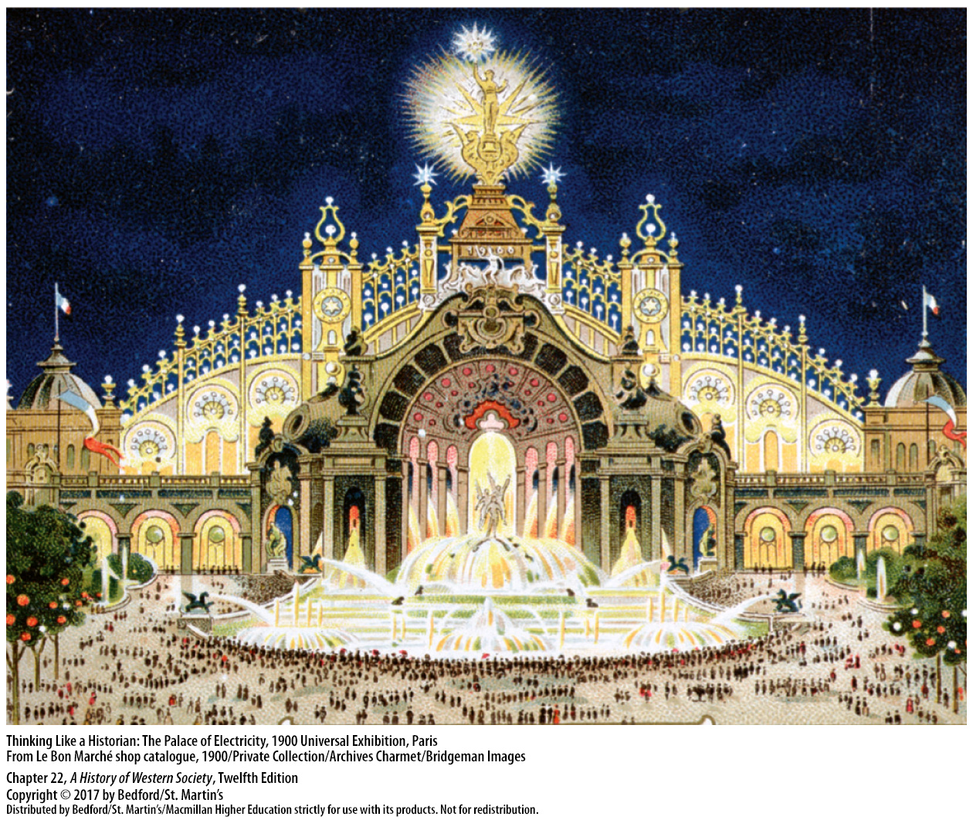

Slide 44
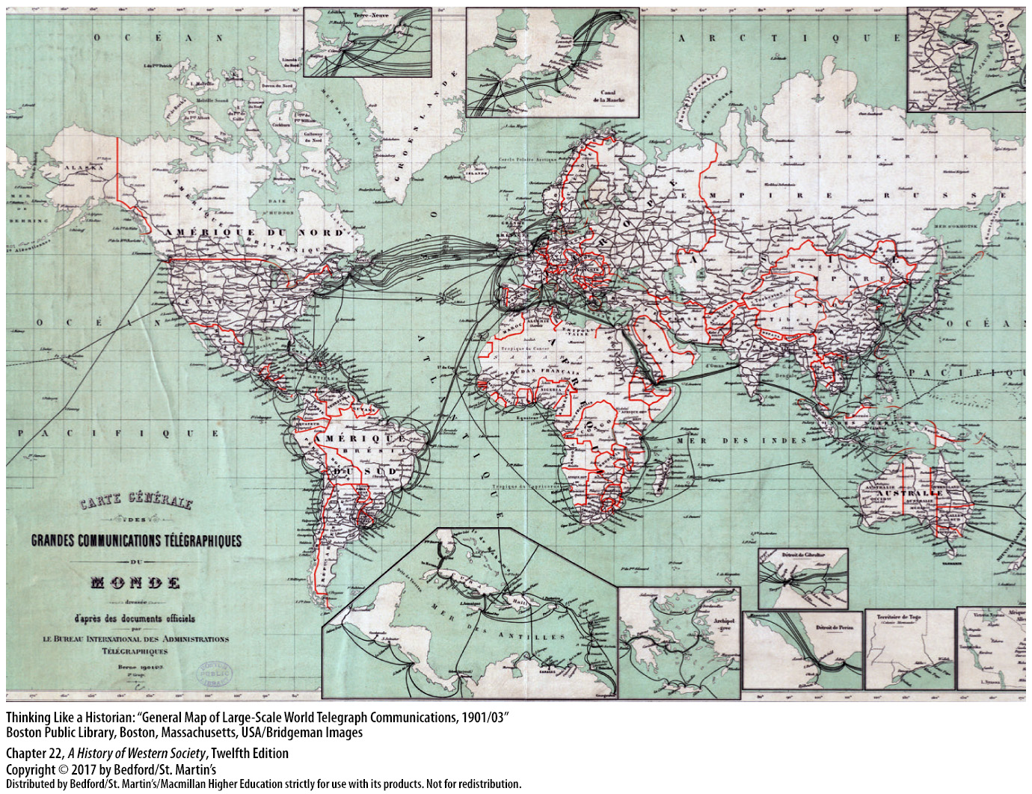

Slide 45
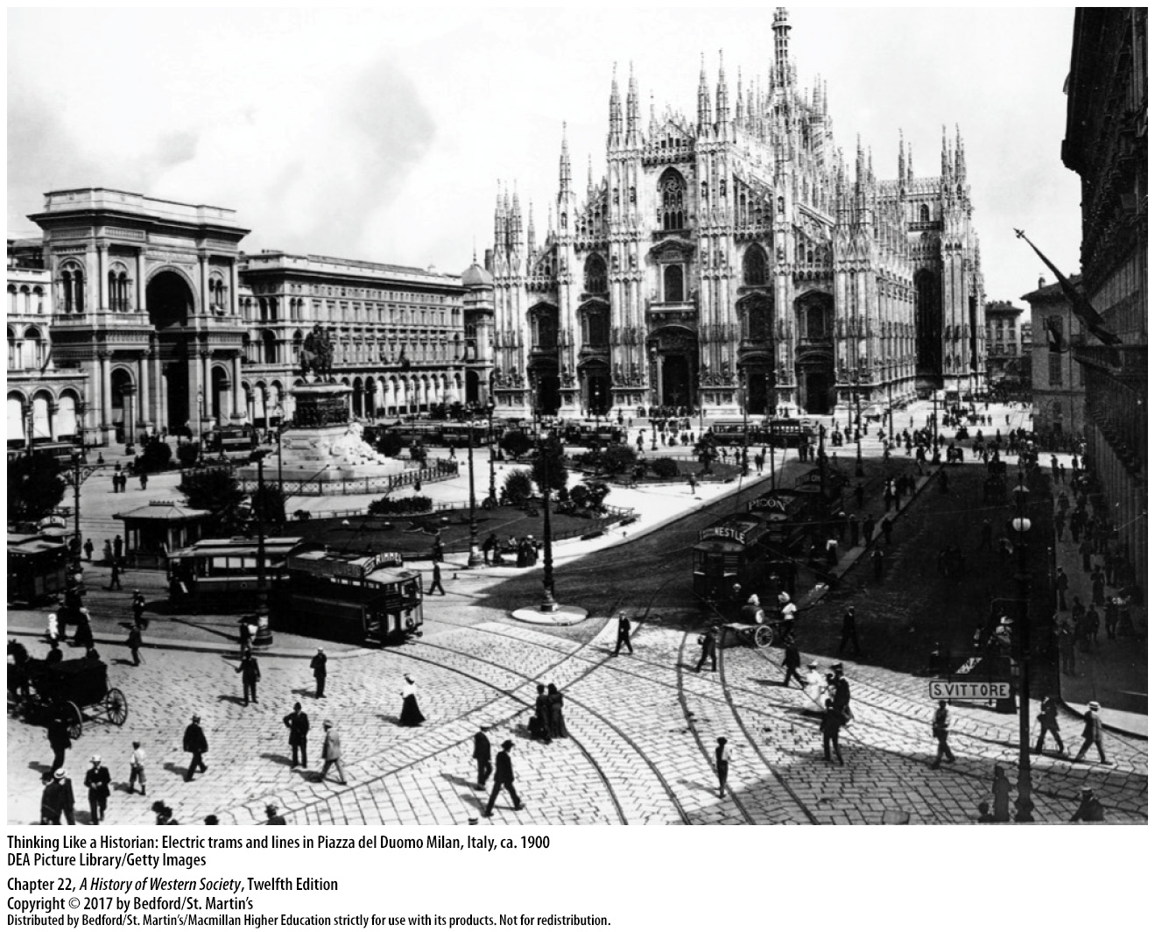

Slide 46
IV. Science and Thought
Darwin and Natural Selection
1. Charles Lyell (1797–1875)
2. Jean Baptiste Lamarck (1744–1829)
3. On the Origin of Species by the Means of Natural Selection (1859)
4. Herbert Spencer (1820–1903)
Notes:
IV. Science and Thought
B. Darwin and Natural Selection
1. In geology, Charles Lyell (1797–1875) effectively discredited the view that the earth’s surface had been formed by short-lived cataclysms, such as earthquakes and biblical floods, postulating instead that geological processes slowly formed the earth’s surface over an immensely long time. Lyell’s findings undermined religious teachings about the age of the earth.
2. Similarly, the evolutionary view of biological development, first proposed by Anaximander in the sixth century b.c.e., reemerged in the work of French naturalist Jean Baptiste Lamarck (1744–1829), who asserted that all forms of life had arisen through a long process of continuous adjustment to the environment.
3. In his work On the Origin of Species by the Means of Natural Selection (1859), Darwin argued that chance variations among members of a given species that prove useful in the struggle for survival are selected naturally and gradually spread to the entire species through reproduction.
4. English philosopher Herbert Spencer (1820–1903) applied Darwin’s theory to human affairs, claiming that the human race was driven forward to ever-greater specialization and progress by a brutal economic struggle that determined the “survival of the fittest.”

Slide 47
IV. Science and Thought
The Modern University and the Social Sciences
1. Major universities
2. Max Weber (1864–1920)
3. Émile Durkheim (1858–1917)
4. Ferdinand Tönnies (1855–1936)
5. Gustav Le Bon (1841–1931)
Notes:
IV. Science and Thought
C. The Modern University and the Social Sciences
1. By the 1880s Europe’s major universities had been modernized and professionalized; education emphasized controlled research projects, and faculty devoted to the newly instituted human or social sciences took their place alongside the hard sciences.
2. German sociologist Max Weber (1864–1920) argued in The Protestant Ethic and the “Spirit” of Capitalism (1890) that the rise of capitalism in northern Europe was directly linked to Protestant values of hard work, saving, and investing—the foundations for capitalist development.
3. French sociologist Émile Durkheim (1858–1917) earned an international reputation for The Elementary Forms of Religious Life (1912), a study of the psychic and social basis of religion, and Suicide (1897), a pioneering work of quantitative sociology that concluded that growing suicide rates were caused by widespread feelings of rootlessness.
4. The German Ferdinand Tönnies (1855–1936) argued that industrialization had transformed European civilization from a “community” to a “society,” replacing traditional values with rationalized self-interest and leading to intensified alienation.
5. In The Crowd (1895), French sociologist Gustav Le Bon (1841–1931) wrote that the alienated masses were prone to gathering in mass crowds, in which individuals lost control of their emotions and actions and could be easily manipulated by a charismatic leader.

Slide 48
IV. Science and Thought
Realism in Art and Literature
1. Art and literature
2. Unexplored and taboo subjects
3. Gustave Courbet, Jean-François Millet, and Honoré Daumier
4. Honoré de Balzac, Gustave Flaubert, and Émile Zola
Notes:
IV. Science and Thought
D. Realism in Art and Literature
1. In art and literature, the key themes of realism—a strict, supposedly scientific objective approach to depicting life exactly as it is—emerged in the 1840s.
2. Beginning with a dissection of the middle classes, the realists eventually focused on the working classes, putting a microscope to many unexplored and taboo subjects—sex, labor strikes, violence, alcoholism—to reveal the savage behaviors of humans living in urban industrial society.
3. Artists such as Gustave Courbet, Jean-François Millet, and Honoré Daumier painted scenes of laboring workers and peasants in somber colors and simple compositions.
4. Literary realism also began in France, where Honoré de Balzac, Gustave Flaubert, and Émile Zola became internationally famous novelists.

Slide 49
IV. Science and Thought
Realism in Art and Literature
5. Zola sympathized with socialism
6. George Eliot
7. Count Leo Tolstoy (1828–1910)
Notes:
IV. Science and Thought
D. Realism in Art and Literature
5. Like many later realists, Zola sympathized with socialism, a view evident in his overpowering novel Germinal (1885).
6. In the novel Middlemarch: A Study of Provincial Life (1871–1872), George Eliot—the pen name of the English author Mary Ann Evans (1819–1880)—achieved a more deeply felt, less sensational kind of realism.
7. In his monumental novel War and Peace (1864–1869), Russian realist, Count Leo Tolstoy (1828–1910) developed his fatalistic theory of history, which regards free will as an illusion, but offered the message that human love, trust, and everyday family ties are life’s enduring values.

Slide 50
