Slide 1
A History of Western Society Twelfth Edition
McKay • Crowston • Wiesner-Hanks • Perry
CHAPTER 21
Ideologies and Upheavals
1815–1850
Copyright © 2017 by Bedford/St. Martin’s
Distributed by Bedford/St. Martin's/Macmillan Higher Education strictly for use with its products; Not for redistribution.

Slide 2
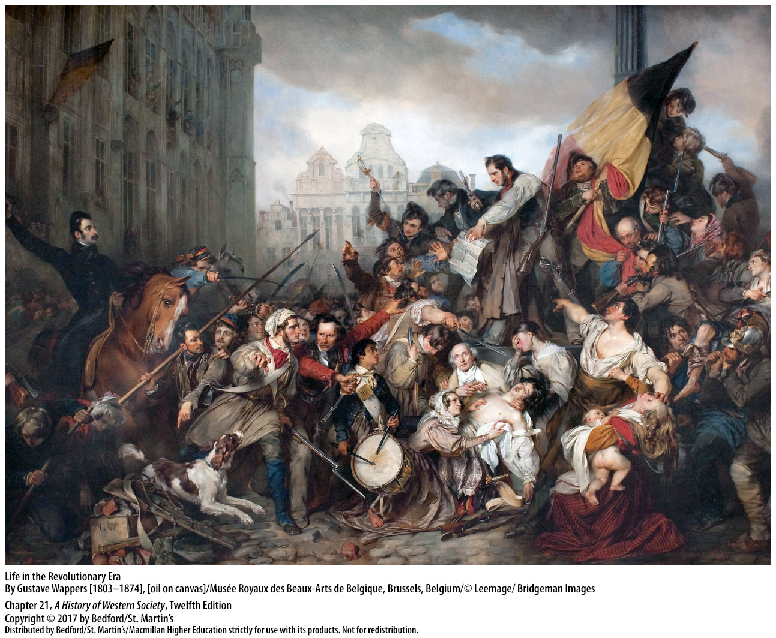

Slide 3
I. The Aftermath of the Napoleonic Wars
The European Balance of Power
1. Quadruple Alliance
2. First Treaty of Paris
3. Klemens von Metternich and Robert Castlereagh
4. The Great Powers
Notes:
The Aftermath of the Napoleonic Wars
The European Balance of Power
1. In 1814 the Quadruple Alliance of Russia, Prussia, Austria, and Great Britain finally defeated France and agreed to meet at the Congress of Vienna to fashion a general peace settlement.
2. The first Treaty of Paris gave France the boundaries it possessed in 1792, which were larger than those of 1789, restored the Bourbon dynasty, and did not require France to pay war reparations.
3. Klemens von Metternich and Robert Castlereagh, the foreign ministers of Austria and Great Britain, respectively, as well as their French counterpart, Charles Talleyrand, were motivated by self-interest and a balance-of-power ideology in discouraging aggression by any combination of states or the domination of Europe by a single state.
4. The Great Powers agreed that each of them should receive territory for their victory against France: Great Britain gained colonies and strategic outposts; Austria took Venetia, Lombardy, and some Polish possessions; Russia’s and Prussia’s claims were disputed, and in the end, Russia accepted a small Polish kingdom and Prussia took part of Saxony.

Slide 4
I. The Aftermath of the Napoleonic Wars
The European Balance of Power
5. Napoleon escaped from Elba
6. Second Treaty of Paris
7. European “Congress System”
Notes:
The Aftermath of the Napoleonic Wars
The European Balance of Power
5. Napoleon escaped from Elba and reignited his wars of expansion, but he was defeated at Waterloo in 1815.
6. The second Treaty of Paris, concluded after Napoleon’s final defeat, was still relatively moderate toward France, although this time France was required to pay an indemnity and to support an army of occupation for five years.
7. The Quadruple Alliance then agreed to meet periodically to discuss common interests and to consider measures for maintaining peace in Europe. This European “Congress System” lasted long into the nineteenth century and settled many international crises through international conferences and balance-of-power diplomacy.

Slide 5
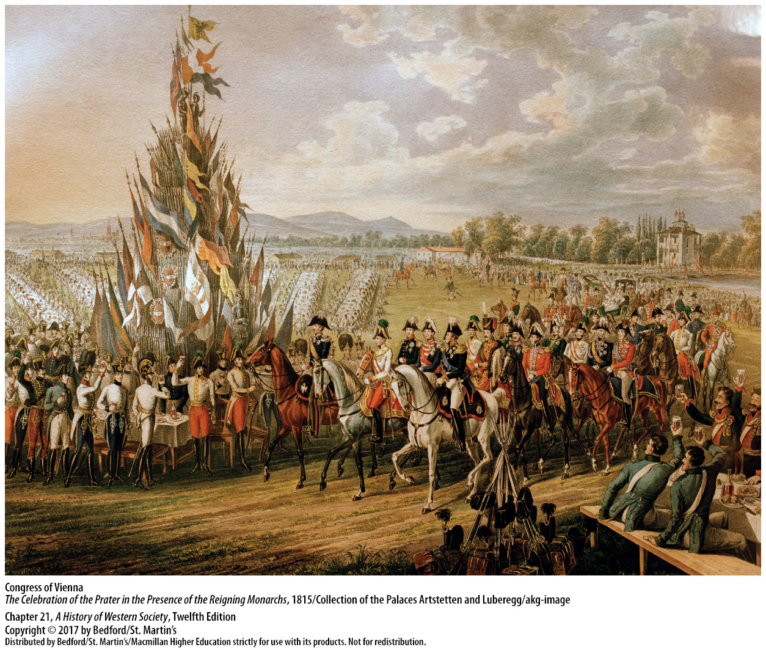

Slide 6
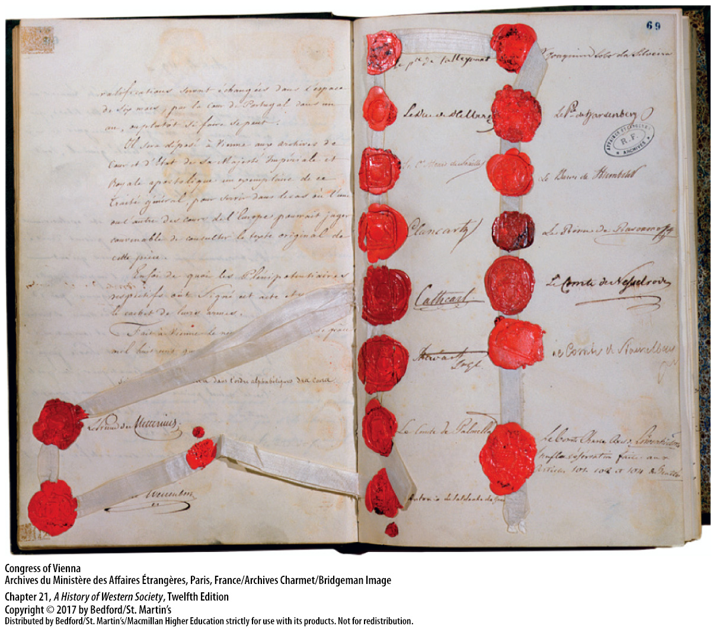

Slide 7
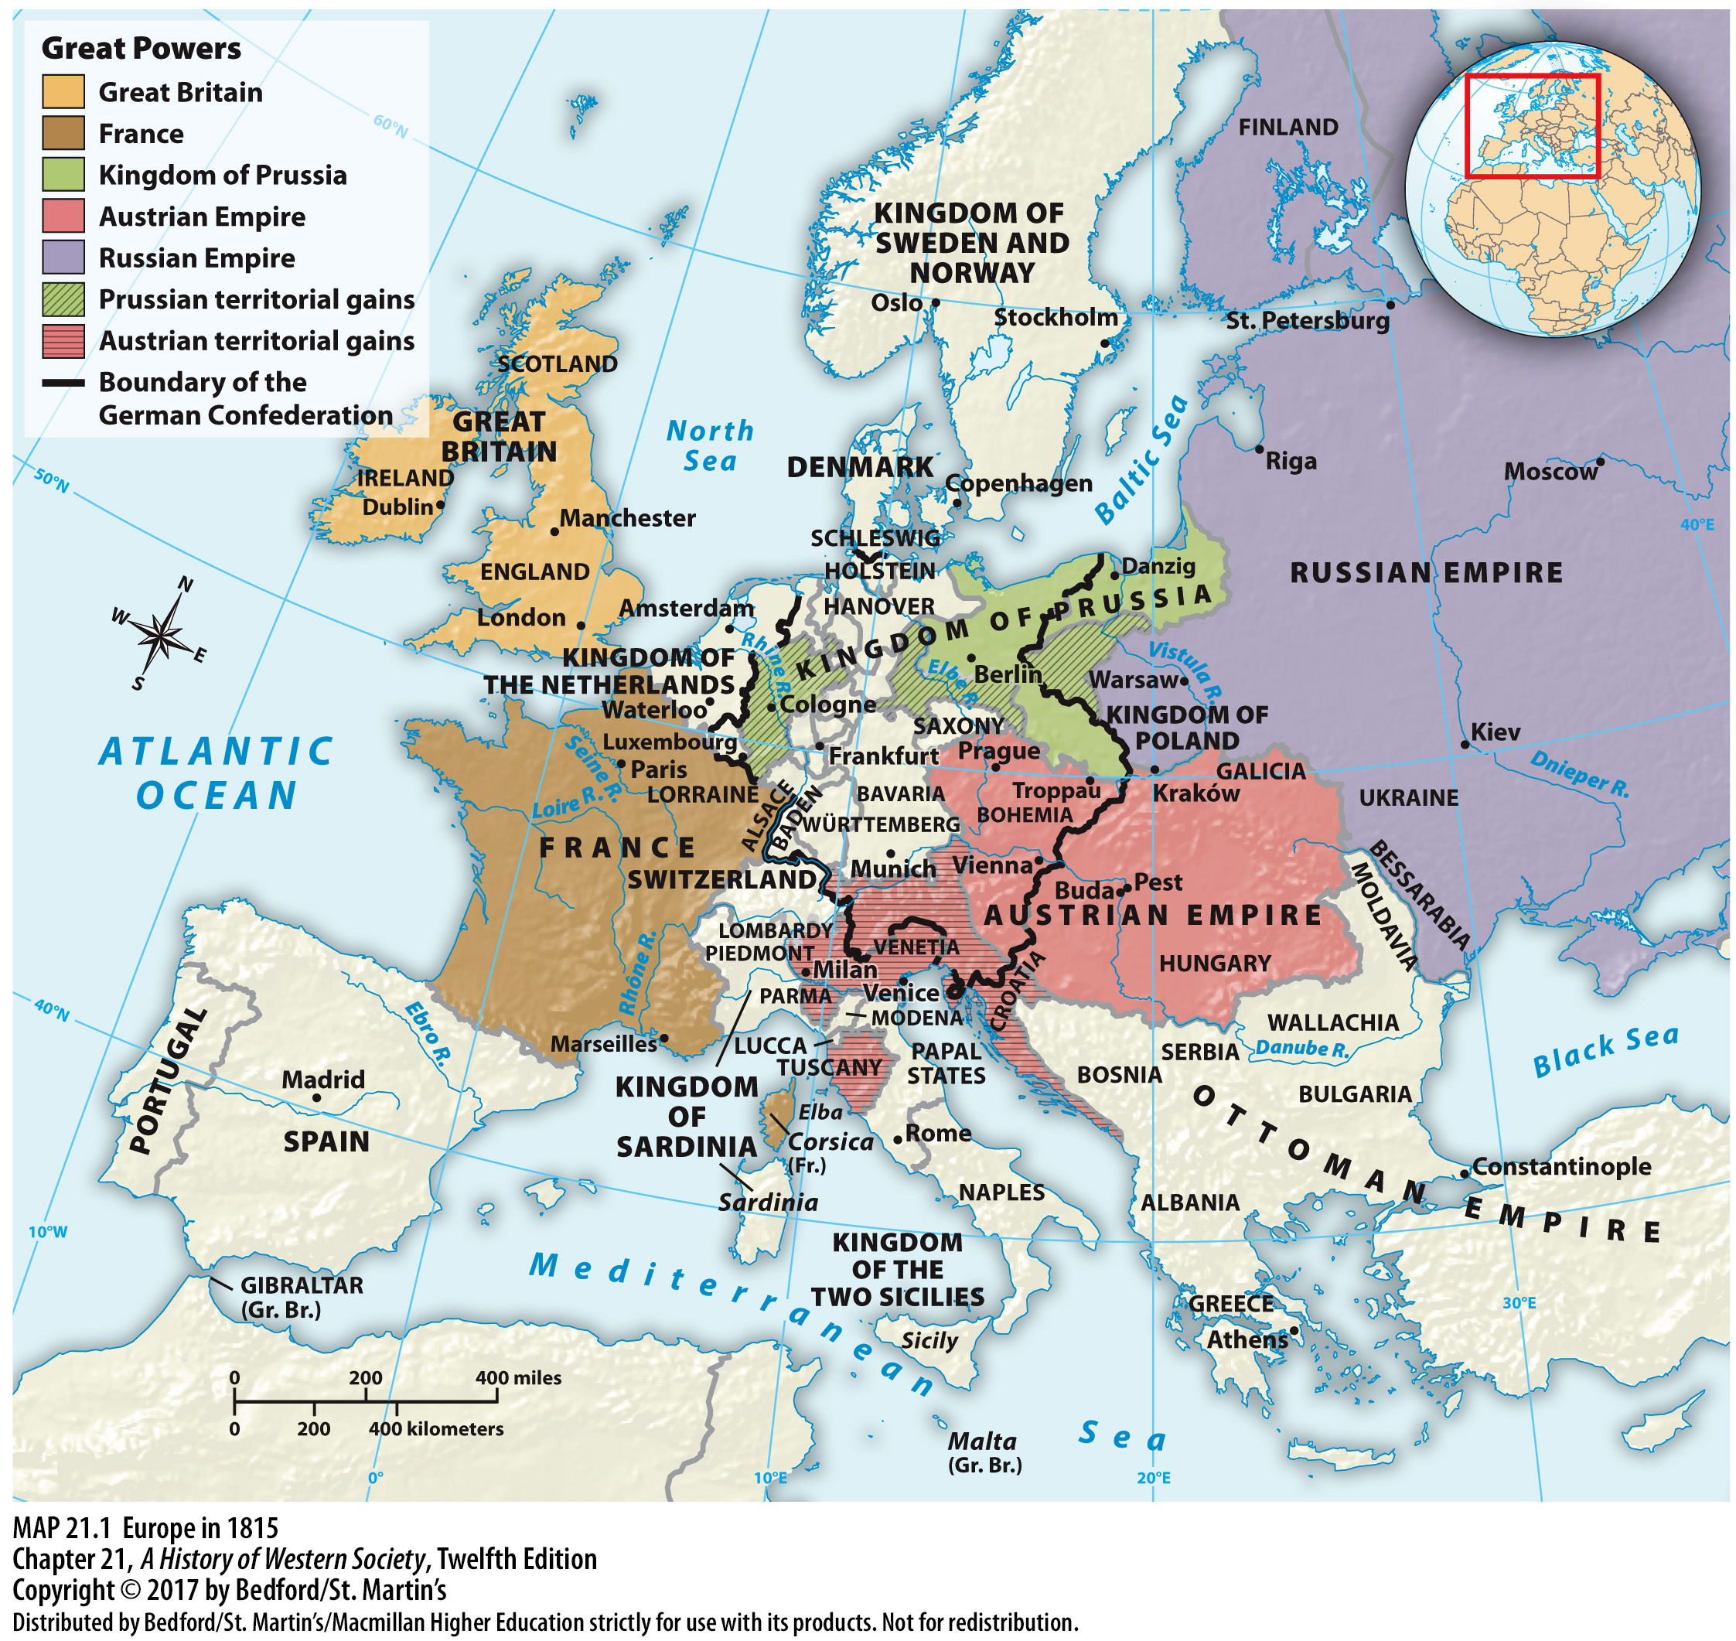

Slide 8
I. The Aftermath of the Napoleonic Wars
Metternich and Conservatism
1. Congress of Vienna
2. Prince Klemens von Metternich (1773–1859)
3. Pessimistic view of human nature
4. Authoritarian governments
Notes:
The Aftermath of the Napoleonic Wars
B. Metternich and Conservatism
1. The political ideals of conservatism dominated discussions at the Congress of Vienna.
2. Determined defender of the monarchical status quo, Prince Klemens von Metternich (1773–1859) was an internationally oriented aristocrat who made a brilliant diplomatic career as Austria’s foreign minister from 1809 to 1848.
3. Metternich’s pessimistic view of human nature as prone to error, excess, and self-serving behavior was confirmed by the disruptive events of the American and French revolutions and the Napoleonic wars, which he believed responsible for twenty-five years of bloodshed and suffering.
4. He concluded that authoritarian governments were necessary to protect society from the baser elements of human behavior, which were released in a democratic system.

Slide 9
I. The Aftermath of the Napoleonic Wars
Metternich and Conservatism
5. Church and nobility
6. Austrian Empire included many peoples
7. Russia and the Ottoman Empire
Notes:
The Aftermath of the Napoleonic Wars
B. Metternich and Conservatism
5. Metternich defended his class and its rights and privileges with a clear conscience, believing the church and nobility were among Europe’s most valuable institutions and bulwarks against radical change.
6. The vast Austrian Empire of the Habsburgs included many peoples who spoke at least eleven different languages, observed vastly different customs, and lived with a surprising variety of regional civil and political institutions.
7. In his efforts to hold back liberalism and nationalism, Metternich was supported by Russia and, to a lesser extent, the Ottoman Empire.

Slide 10
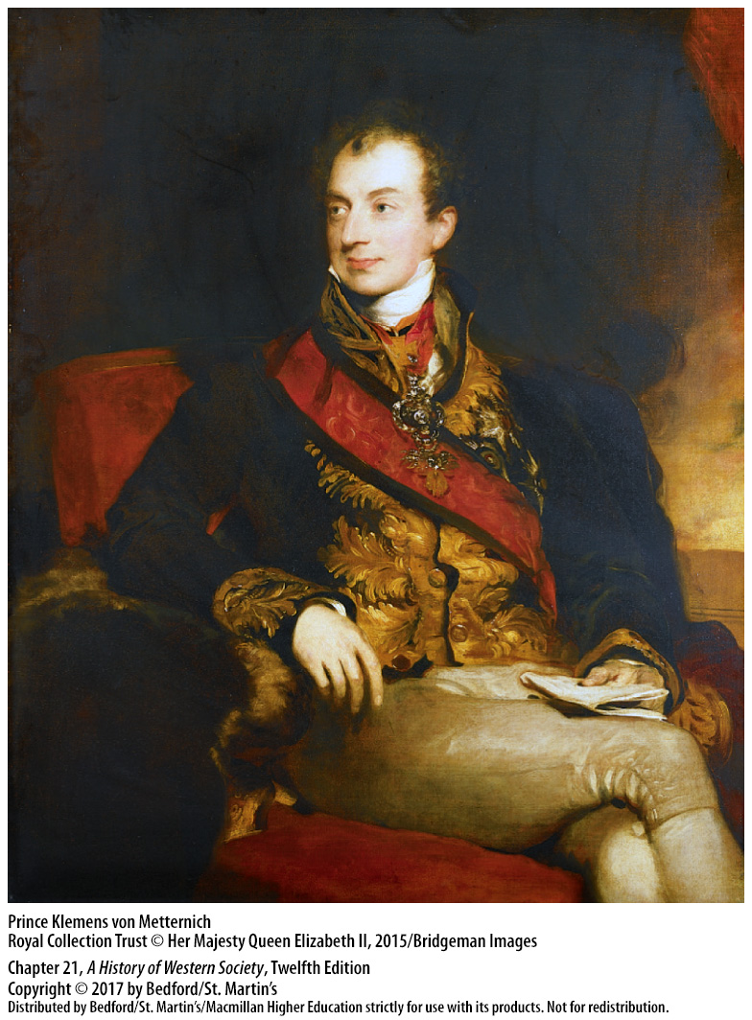

Slide 11
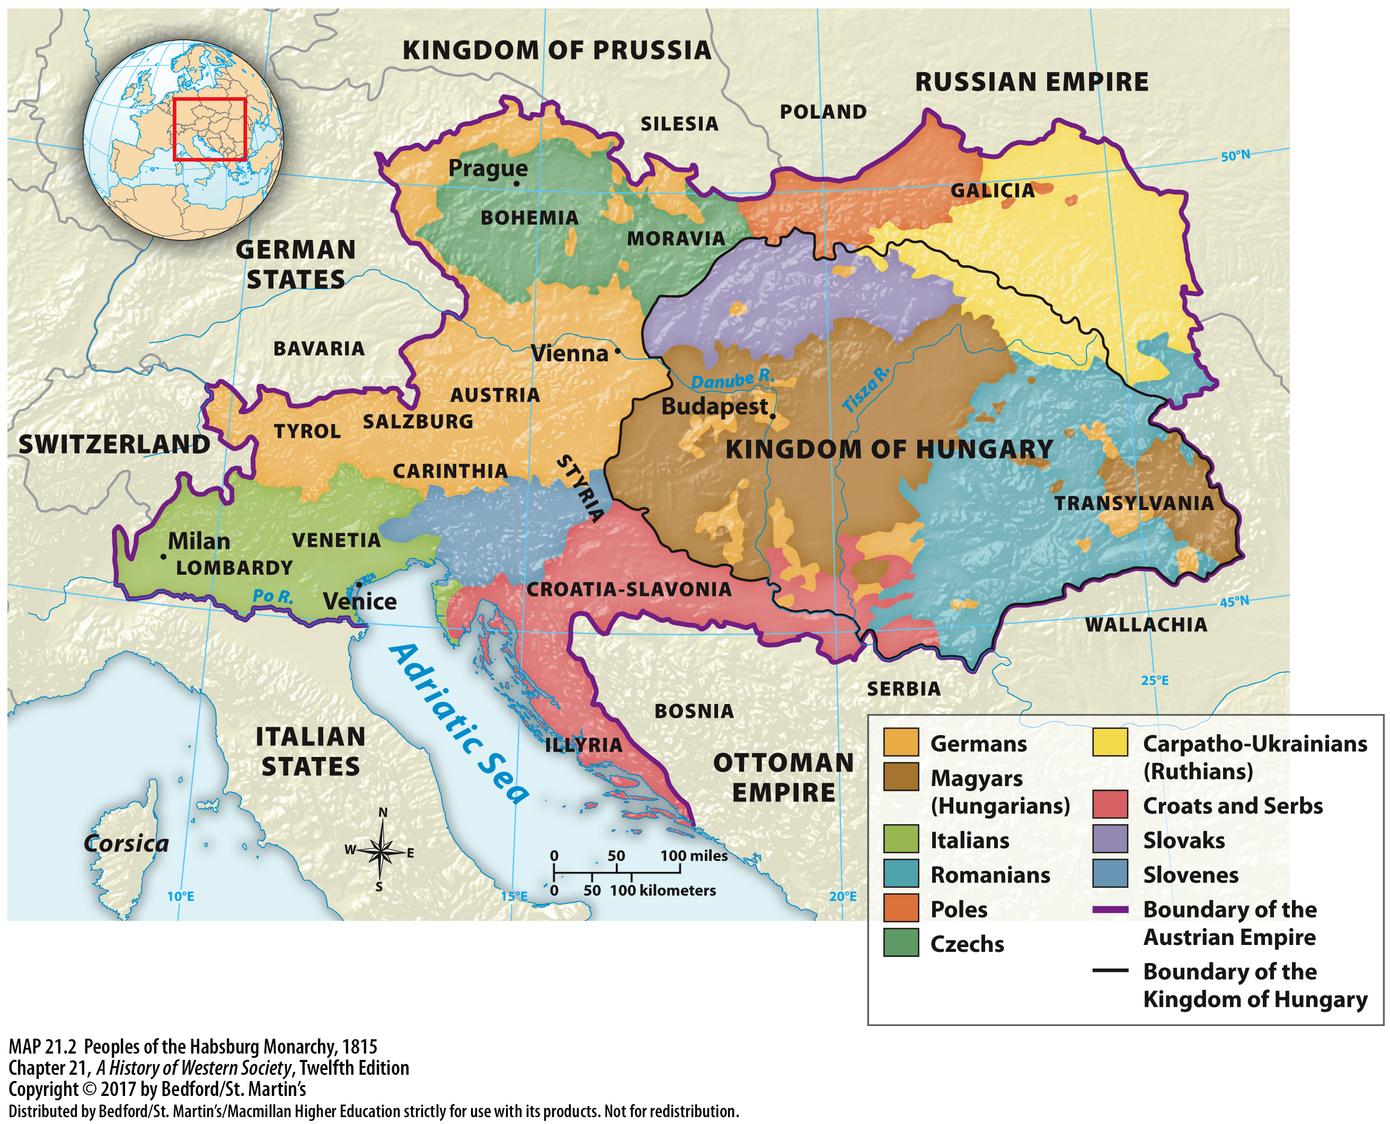

Slide 12
I. The Aftermath of the Napoleonic Wars
Repressing the Revolutionary Spirit
1. Holy Alliance
2. Metternich and Alexander I
3. Two Sicilies
4. Karlsbad Decrees
5. Protest against Nicholas I
Notes:
The Aftermath of the Napoleonic Wars
C. Repressing the Revolutionary Spirit
1. In 1815 under Metternich’s leadership, the conservative rulers of Austria, Prussia, and Russia formed the Holy Alliance, which worked to repress reformist and revolutionary movements and stifle desires for national independence across Europe.
2. Metternich and Alexander I proclaimed the principle of active intervention to maintain all autocratic regimes whenever they were threatened.
3. Austrian forces then restored the autocratic Ferdinand I in the Two Sicilies in 1821, while French armies restored power to the king in 1823.
4. In 1819, following calls for the national unification of the German states, Austrian and Prussian leaders used the Confederation Diet to issue and enforce the infamous Karlsbad Decrees, which required the German states to outlaw liberal political organizations, police their universities, and establish a permanent committee to clamp down on liberal or radical reformers.
5. In Russia in 1825, a group of army officers inspired by liberal ideals staged a protest against the new tsar, Nicholas I, which ended in the death, public hanging, or exile of the movement’s leaders.

Slide 13
I. The Aftermath of the Napoleonic Wars
Limits to Conservative Power and Revolution in South America
1. Failed to stop dynastic change in France and Belgium
2. South America
3. Simón Bolívar
4. José de San Martín
5. “Caudillos”
Notes:
The Aftermath of the Napoleonic Wars
D. Limits to Conservative Power and Revolution in South America
1. Metternich’s system proved quite effective in central Europe, at least until 1848, but failed to stop dynastic change in France in1830 or prevent Belgium from gaining independence from the Netherlands in 1831.
2. The most dramatic challenge to conservative power occurred in the 1820s in South America, where wealthy “Creole” elites broke away from the Spanish crown and established new republics based initially on liberal, Enlightenment ideals.
3. In the north, the general Simón Bolívar, the “people’s liberator,” defeated Spanish forces and established a “Gran Colombia,” which lasted from 1819 to 1830.
4. In the south, José de San Martín, a liberal-minded military commander, successfully threw off Spanish control by 1825.
5. These liberal experiments soon gave way to a system controlled by “caudillos,” or strong men, who ruled territories on the basis of military strength, family patronage, and populist politics.

Slide 14
II. The Spread of Radical Ideas
Liberalism and the Middle Class
1. Liberalism
2. Laissez faire
3. Business elites embraced laissez faire policies
4. Labor unions were outlawed
5. Radical republicans
Notes:
II. The Spread of Radical Ideas
Liberalism and the Middle Class
1. Liberalism—based on the principal ideas of liberty and equality—demanded representative government as opposed to autocratic monarchy, equality before the law as opposed to legally separate classes, and individual freedoms.
2. Liberal economic principles, the doctrine of laissez faire, called for free trade, unrestricted private enterprise, and no government interference in the economy.
3. In early nineteenth-century Britain, business elites enthusiastically embraced laissez faire policies because they proved immensely profitable, and they used liberal ideas to defend their right to conduct business as they wished.
4. Labor unions were outlawed because, these elites argued, they restricted free competition and the individual’s “right to work.”
5. As liberalism increasingly became identified with upper-class business interests, some opponents of conservatism felt that liberalism did not go nearly far enough.These radical republicans called for universal voting rights, at least for males, and for democracy, and they showed more willingness than most liberals to endorse violent upheaval to achieve their goals.

Slide 15
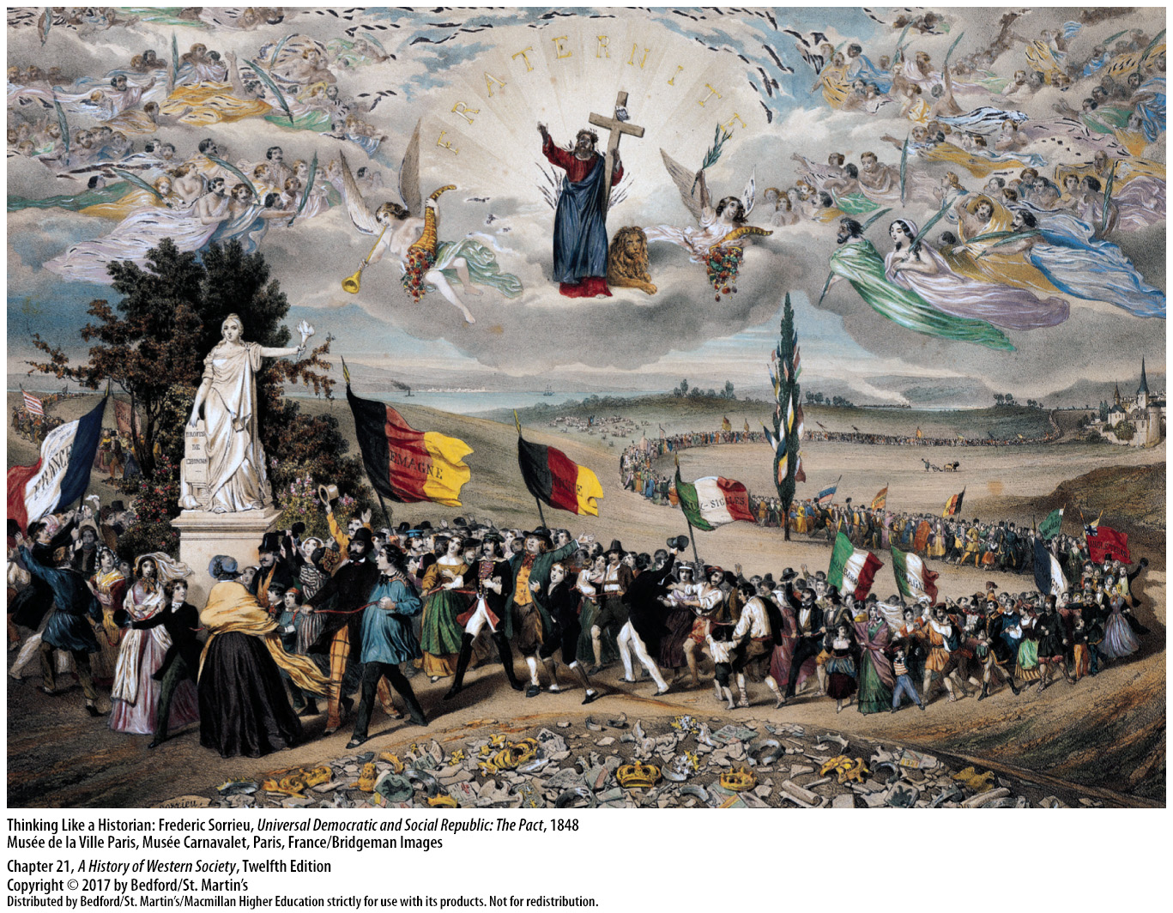

Slide 16
II. The Spread of Radical Ideas
The Growing Appeal of Nationalism
1. “Fatherland”
2. Nationalism as a political philosophy
3. Disintegration
4. Austrian, Russian, and Ottoman Empires
5. Nationalism, liberalism and radical republicanism
6. National superiority
Notes:
II. The Spread of Radical Ideas
B. The Growing Appeal of Nationalism
1. In German-speaking central Europe, defeat by Napoleon’s armies had made the vision of a national people united in defense of their “fatherland” particularly attractive.
2. Nationalism gathered force as a political philosophy, facilitated by higher literacy rates, a mass press, large state bureaucracies, compulsory education and conscription armies, which created a common culture and encouraged people to take pride in their national heritage.
3. In multiethnic states, nationalism also promoted disintegration, as European nationalists sought to turn the cultural unity they desired into political reality.
4. The refusal of the Austrian, Russian, and Ottoman Empires to allow national minorities independence fomented discontent among nationalists; contrarily, in Italy and the German Confederation, nationalists yearned for unification across what they saw as divisive and obsolete borders.
5. Between 1815 and 1850, most people who believed in nationalism also believed in either liberalism or radical republicanism.
6. Early nationalism developed a strong sense of “us” versus “them,” to which nationalists added two highly volatile ingredients: a sense of national mission and a sense of national superiority.

Slide 17
II. The Spread of Radical Ideas
The Foundations of Modern Socialism
1. Socialists preached economic equality
2. Count Henri de Saint-Simon (1760–1825)
3. Charles Fourier (1772–1837)
4. Robert Owen
Notes:
II. The Spread of Radical Ideas
C. The Foundations of Modern Socialism
1. With an intense desire to help the poor, socialists preached economic equality and advocated economic planning and the regulation of private property by the government, or its abolition and replacement with state or community ownership.
2. Count Henri de Saint-Simon (1760–1825) optimistically proclaimed that the key to progress was proper social organization in which leading scientists, engineers, and industrialists would carefully plan the economy and guide it forward by undertaking vast public works projects.
3. Charles Fourier (1772–1837) envisaged a socialist utopia of mathematically precise, self-sufficient communities and advocated the total emancipation of women.
4. Robert Owen, an early proponent of labor unions, also called for society to be organized into model industrial-agricultural communities.

Slide 18
II. The Spread of Radical Ideas
The Foundations of Modern Socialism
5. “Utopian socialists”
6. Pierre-Joseph Proudhon (1809–1865)
7. Louis Blanc (1811–1882)
8. French urban workers
Notes:
II. The Spread of Radical Ideas
C. The Foundations of Modern Socialism
5. Saint-Simon, Fourier, and Owen, who became known as “utopian socialists,” all had followers who tried to implement their ideas; their attempts collapsed by the 1850s, although they inspired future reformers and revolutionaries.
6. In What Is Property? (1840), Pierre-Joseph Proudhon (1809–1865) argued that property was profit that was stolen from the worker, who was the source of all wealth.
7. Louis Blanc (1811–1882) focused on practical reforms, and in his Organization of Work (1839), he urged workers to agitate for universal voting rights and to take control of the state peacefully.
8. As industrialization spread, the socialist message was embraced by French urban workers, who had become violently opposed to laissez-faire laws that denied workers the right to organize in guilds and unions.

Slide 19
II. The Spread of Radical Ideas
The Birth of Marxist Socialism
1. Karl Marx (1818–1883)
2. Synthesized ideas
3. Class struggle produced change in human history
4. Capitalism as exploitative
5. The Communist Manifesto
Notes:
II. The Spread of Radical Ideas
D. The Birth of Marxist Socialism
1. The German intellectual Karl Marx (1818–1883) wove the diffuse strands of socialist thought into a distinctly modern ideology, Marxist socialism—or Marxism.
2. Marx synthesized sociology, economics, philosophy, and history, and he drew on the ideas of utopian socialists, though he criticized them for their fanciful utopian schemes and claimed that his version of “scientific” socialism was rooted in historic law.
3. Marx argued that class struggle over economic wealth produced change in human history; one class had always exploited the other, and with the advent of modern industry, society was split between the upper class—the bourgeoisie—and the working class—the proletariat.
4. To Marx, capitalism was immensely productive but highly exploitative, as the bourgeoisie, in a never-ending search for profit, squeezed workers dry and expanded across the globe.
5. When Marx and Engels published The Communist Manifesto in 1848, the Communist movement was in its infancy, but by the time of Marx’s death in 1883, Marxism had profoundly reshaped left-wing radicalism.

Slide 20
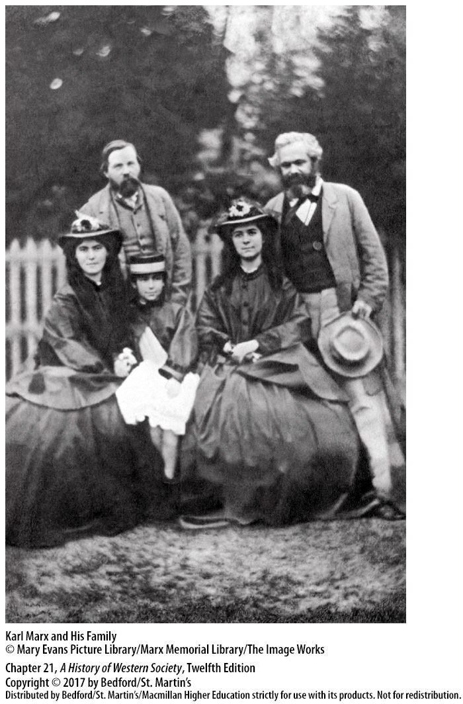

Slide 21
III. The Romantic Movement
The Tenets of Romanticism
1. New romantic movement
2. Intuition and nostalgia
3. Jules Michelet
4. Lifestyle
5. Individualists
Notes:
III. The Romantic Movement
The Tenets of Romanticism
1. Followers of the new romantic movement, which reached its height from about 1790 to the 1840s, revolted against the emphasis on rationality, order, and restraint that characterized the Enlightenment and the controlled style of classicism.
2. Romantics valued intuition and nostalgia for the past over the scientific method and progress, sought the inspiration of religious ecstasy instead of secularization, and turned inward and delved into the supernatural instead of engaging in public life and civic affairs.
3. Historians influenced by romanticism, such as Jules Michelet who wrote books on the history of France, promoted the growth of national aspirations and encouraged the French people to search the past for their special national destiny.
4. Romanticism was also a lifestyle, and many early-nineteenth century romantics lived lives of emotional intensity that included obsessive love affairs, duels, madness, illnesses, and suicide.
5. Great individualists, the romantics believed that the full development of one’s unique potential was the supreme purpose in life.

Slide 22
III. The Romantic Movement
Romantic Literature
1. William Wordsworth (1770–1850).
2. Germaine de Staël (1766–1817)
3. Victor Hugo (1802–1885)
4. Romanticism and early nationalism
5. Jacob and Wilhelm Grimm
6. Influence in Slavic lands
7. Nationalism in Austrian, Russian, and Ottoman Empires
Notes:
III. The Romantic Movement
B. Romantic Literature
1. Romanticism found its distinctive voice in a group of English poets led by William Wordsworth (1770–1850).
2. Classicism remained strong in France until Germaine de Staël (1766–1817), in her study On Germany (1810), extolled the spontaneity and enthusiasm of German writers and thinkers.
3. Victor Hugo’s (1802–1885) powerful novels, including The Hunchback of Notre Dame (1831), exemplified the romantic fascination with fantastic characters, exotic historical settings, and human emotions.
4. In central and eastern Europe, literary romanticism and early nationalism often reinforced each other, as romantics championed their own people’s histories, culture, and unique greatness.
5. The brothers Jacob and Wilhelm Grimm were particularly successful at rescuing German fairy tales from oblivion.
6. In the Slavic lands, romantics played a decisive role in converting spoken peasant languages into modern written languages.
7. In the vast Austrian, Russian, and Ottoman Empires, the combination of romanticism and nationalism was particularly potent.

Slide 23
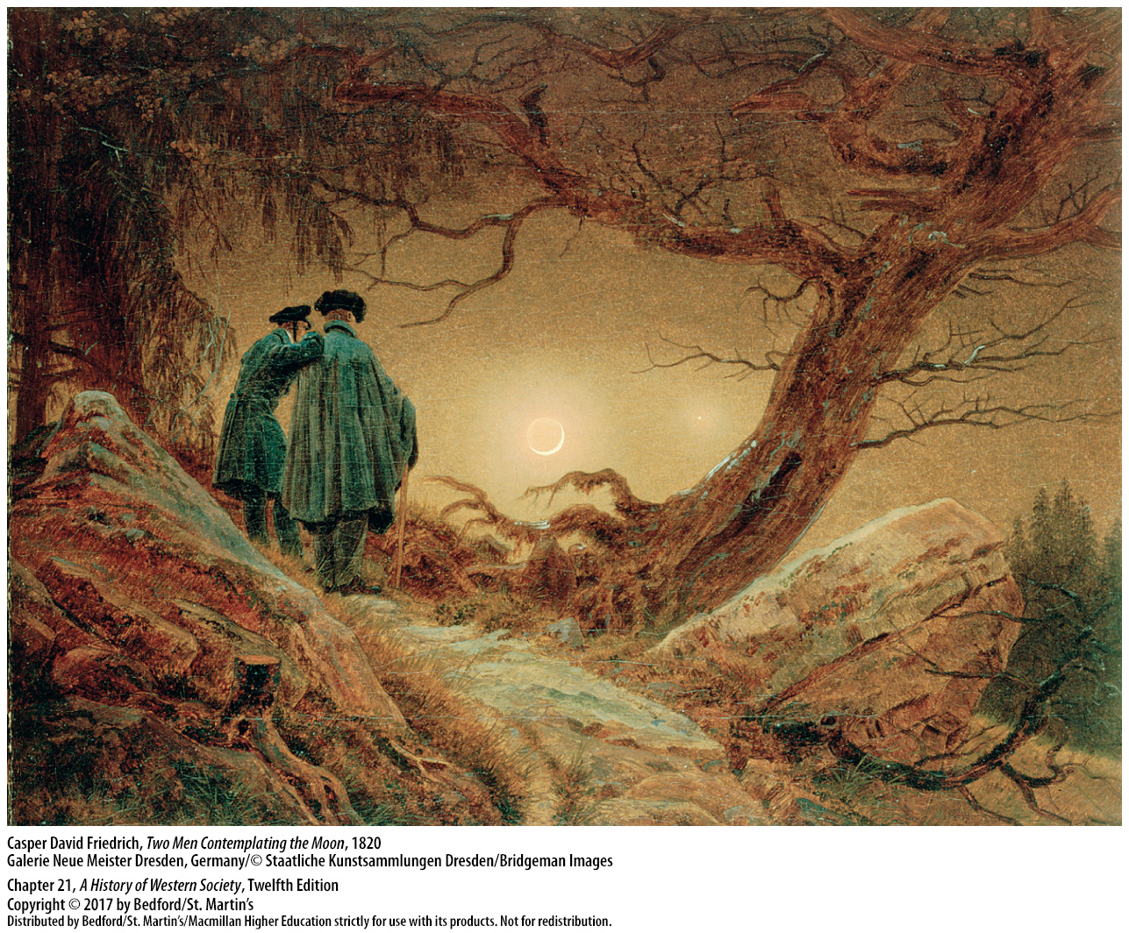

Slide 24
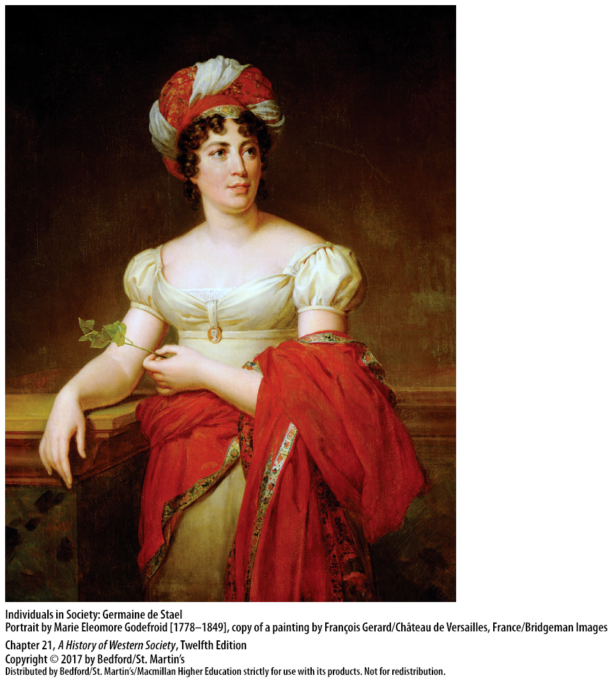

Slide 25
III. The Romantic Movement
Romanticism in Art and Music
1. Eugène Delacroix (1798–1863)
2. Casper David Friedrich (1774–1840)
3. Joseph M. W. Turner (1775–1851) and John Constable (1776–1837)
4. Musical landscapes
5. Franz Liszt (1811–1886)
6. Ludwig van Beethoven (1770–1827)
Notes:
III. The Romantic Movement
C. Romanticism in Art and Music
1. The great French painter Eugène Delacroix (1798–1863) was a master of dramatic, colorful scenes that stirred the emotions.
2. German-speaking Casper David Friedrich (1774–1840) painted somber landscapes of ruined churches or remote arctic shipwrecks, capturing the divine presence in natural forces.
3. Notable romantic English painters included Joseph M. W. Turner (1775–1851), who often depicted nature’s power and terror, and John Constable (1776–1837), who painted humans living peacefully amid rural landscapes.
4. Abandoning well-defined structures, the great romantic composers used a wide range of forms to create a thousand musical landscapes and evoke a host of powerful emotions.
5. Music became a sublime end in itself, expressing the endless yearning of the soul, and made cultural heroes of romantic composers such as Franz Liszt (1811–1886), whose performances evoked great emotional responses.
6. Ludwig van Beethoven (1770–1827), the most famous romantic composer, used contrasting themes and tones to produce dramatic conflict and inspiring resolutions.

Slide 26
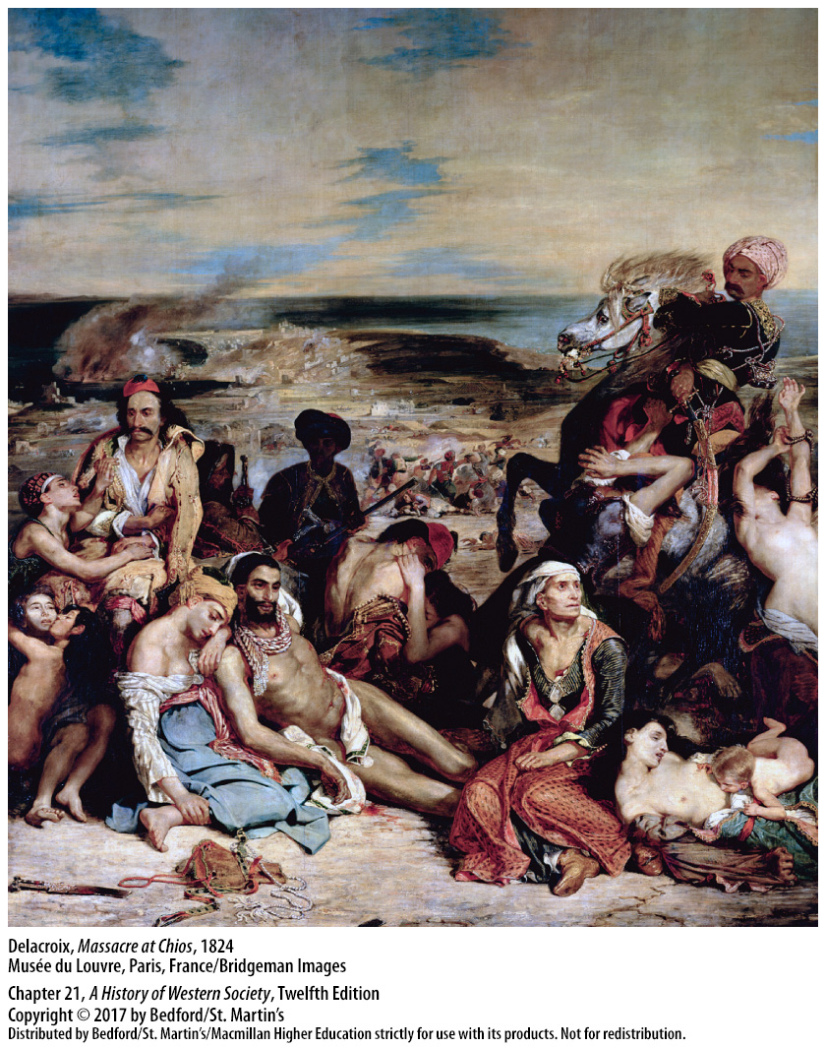

Slide 27
IV. Reforms and Revolutions Before 1848
National Liberation in Greece
1. Language and the Greek Orthodox religion
2. Secret societies and revolt
3. Great Powers opposed the revolution
4. Great Britain, France, and Russia yield to popular demands
5. Greek independence and a German prince
Notes:
IV. Reforms and Revolutions Before 1848
National Liberation in Greece
1. Despite living under the domination of the Ottoman Turks since the fifteenth century, the Greeks had survived as a people, united by their language and the Greek Orthodox religion.
2. The rising nationalism of the early nineteenth century led to the formation of secret societies and then to revolt in 1821, led by Alexander Ypsilanti, a Greek patriot and a general in the Russian army.
3. At first, the Great Powers opposed the revolution and refused to back Ypsilanti.
4. In 1827 Great Britain, France, and Russia yielded to popular demands at home and directed Turkey to accept an armistice.
5. Great Britain, France, and Russia finally declared Greece independent in 1830 and installed a German prince as king of the new country in 1832.

Slide 28
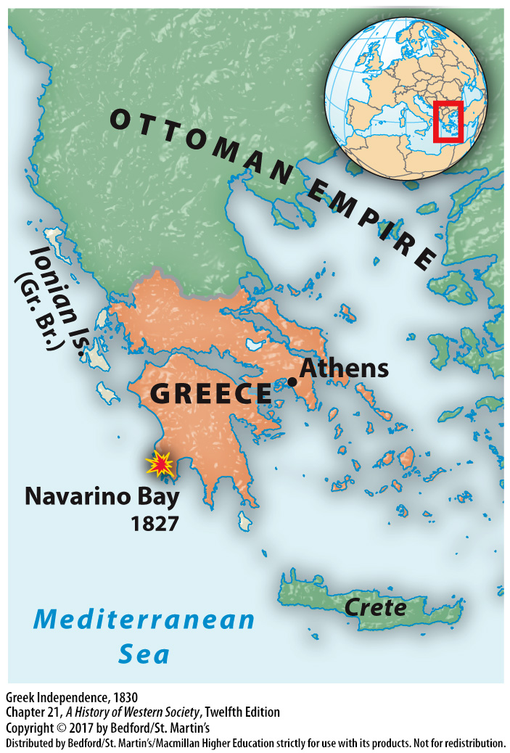

Slide 29
IV. Reforms and Revolutions Before 1848
Liberal Reform in Great Britain
1. Government policies supported the aristocracy and new industrial capitalists
2. Aristocracy was hostile to attempts to change the status quo
3. Corn Laws
4. Six Acts
5. Saint Peter’s Fields
Notes:
IV. Reforms and Revolutions Before 1848
B. Liberal Reform in Great Britain
1. Successful business and professional people could join the landed aristocracy, and the common people enjoyed limited civil rights; yet only about 8 percent of the population had the right to vote, and government policies supported the aristocracy and the new industrial capitalists.
2. By the 1780s there was growing interest in political reform, and by the time of the Napoleonic wars, unions began to form; however, the British aristocracy was extremely hostile to attempts to change the status quo.
3. Conflicts between the ruling class and laborers were sparked in 1815 when the aristocracy selfishly forced changes in the Corn Laws, prohibiting the importation of foreign grain unless the price at home rose to improbable levels. This triggered protests and demonstrations by urban laborers, with the support of radical intellectuals
4. Parliament passed the infamous Six Acts, which placed controls on a heavily taxed press and practically eliminated all mass meetings.
5. These acts were followed by an enormous but orderly protest at Saint Peter’s Fields in Manchester, which was savagely repressed by armed cavalry.

Slide 30
IV. Reforms and Revolutions Before 1848
Liberal Reform in Great Britain
6. Tory government
7. Whig sponsored Reform Bill of 1832
8. “People’s Charter” and the Chartist movement
9. Anti–Corn Law League
10. Ten Hours Act of 1847
11. Peaceful evolution
Notes:
IV. Reforms and Revolutions Before 1848
B. Liberal Reform in Great Britain
6. In response to calls for reform from the new manufacturing and commercial elite, in the 1820s the Tory government moved in the direction of better urban administration, greater economic liberalism, civil equality for Catholics, and limited importation of foreign grain.
7. The Whig Party had by tradition been more responsive to middle-class commercial and manufacturing interests and sponsored the Reform Bill of 1832.
8. The “People’s Charter” of 1838 and the Chartist movement, that demanded universal male (but not female) suffrage, pressed British elites for more radical reform.
9. In addition to calling for universal male suffrage, many working-class people joined with middle-class manufacturers in the Anti–Corn Law League, founded in Manchester in 1839. When Ireland’s potato crop failed in 1845 and famine prices for food seemed likely in England, a few Tories joined with the Whigs to repeal the Corn Laws in 1846 and allow free imports of grain.
10. The Tories passed the Ten Hours Act of 1847, which limited the workday for women and young people in factories to ten hours, and they continued to support legislation regulating factory conditions.
11. This competition between a still-powerful aristocracy and a strong middle class to gain the support of the working class was a crucial factor in Great Britain’s peaceful evolution.

Slide 31
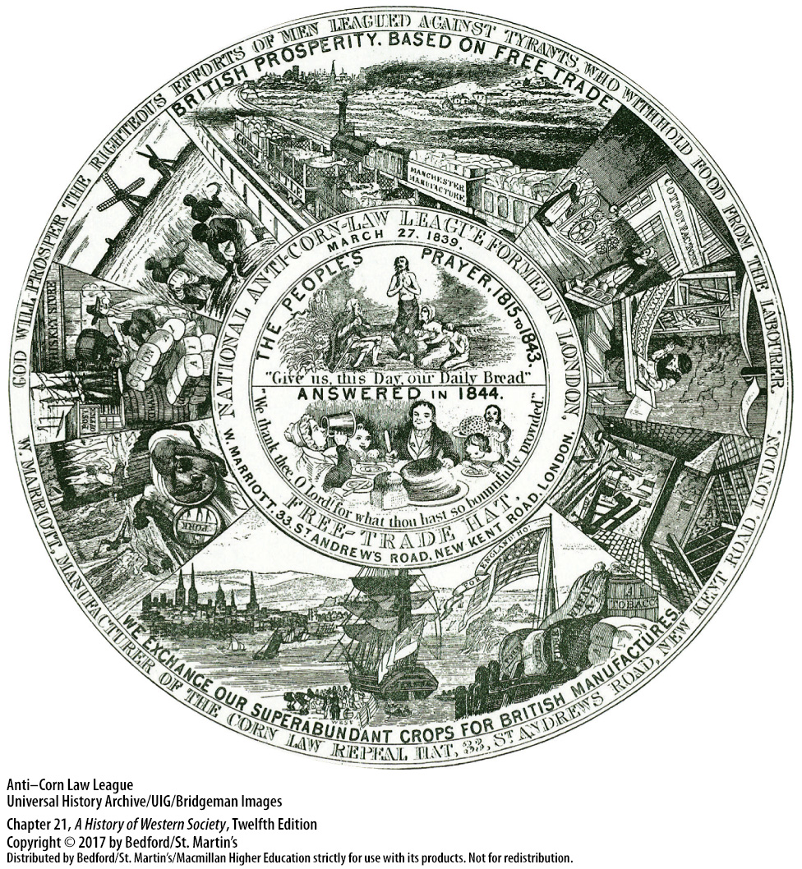

Slide 32
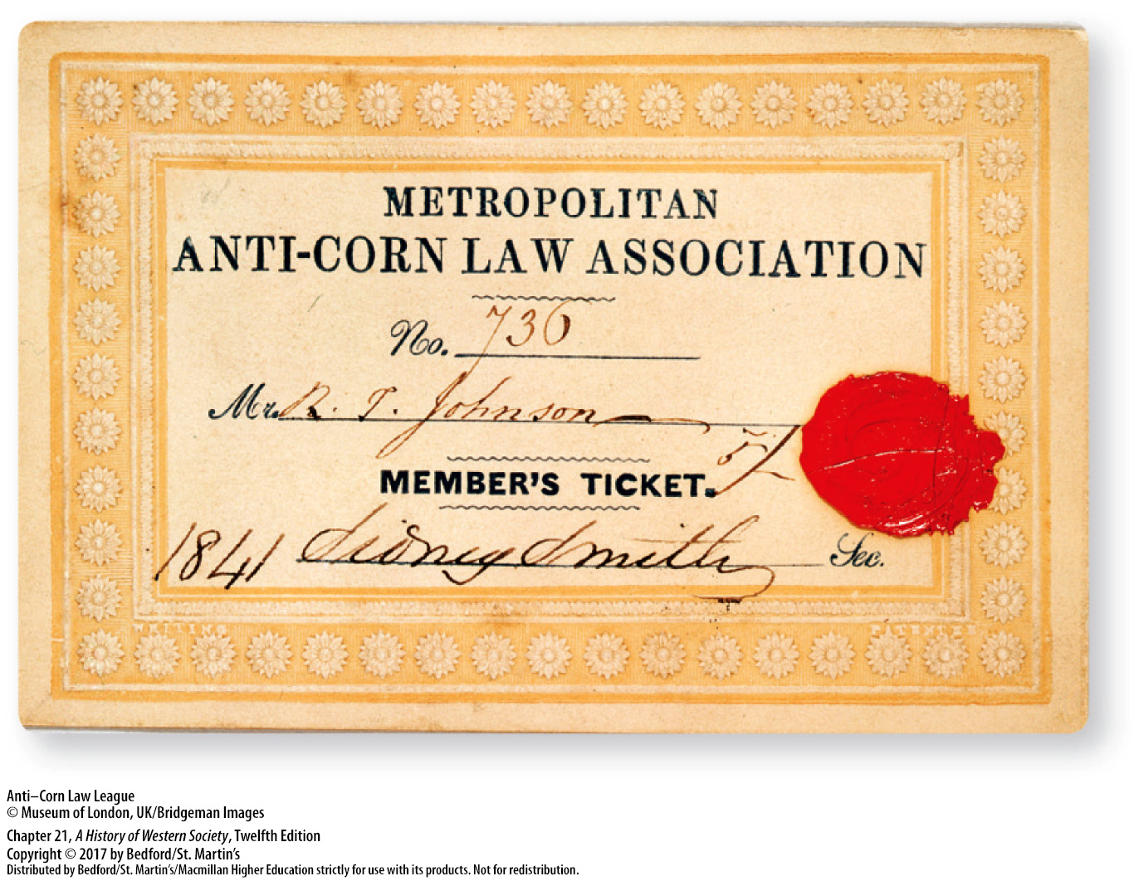

Slide 33
IV. Reforms and Revolutions Before 1848
Ireland and the Great Famine
1. Exploitative tenant system
2. Population doubled
3. Great Famine
4. British government was slow to act
5. Continued to collect taxes
6. Irish independence
Notes:
IV. Reforms and Revolutions Before 1848
C. Ireland and the Great Famine
1. The people of Ireland did not benefit from the political competition in Britain; the great majority of the rural population, Irish Catholic peasants, were trapped in an exploitative tenant system under a tiny minority of Church of England Protestant landlords.
2. Despite the terrible conditions, the population of Ireland doubled, from 4 million in 1780 to 8 million by 1840, a population explosion that was caused primarily by the extensive cultivation of the potato.
3. As population and potato dependency grew, conditions became more precarious, and potato crop failures in 1845, 1846, 1848, and 1851 resulted in the Great Famine, a period of widespread sickness and starvation.
4. The British government, committed to free-trade ideology, was slow to act, and when it did, its relief efforts were tragically inadequate.
5. Moreover, the government continued to collect taxes, landlords demanded their rents, and tenants who could not pay were evicted and their homes destroyed.
6. The Great Famine also intensified anti-British feeling and promoted Irish nationalism, leading to campaigns for land reform, home rule, and, eventually, Irish independence.

Slide 34
IV. Reforms and Revolutions Before 1848
The Revolution of 1830 in France
1. Constitutional Charter of 1814
2. Charles X (r. 1824–1830)
3. War and revolt in Algeria
4. Charles repudiated the Constitutional Charter
Notes:
IV. Reforms and Revolutions Before 1848
D. The Revolution of 1830 in France
1. Louis XVIII’s Constitutional Charter of 1814 was basically a liberal constitution that protected the economic and social gains of the middle class and the peasantry in the French Revolution, permitted great intellectual and artistic freedom, and created a parliament with upper and lower houses.
2. Louis’s conservative successor, Charles X (r. 1824–1830), wanted to re-establish the old order in France but was blocked by the opposition of the deputies, so in 1830 he turned to military adventure in an effort to rally French nationalism and gain popular support.
3. In June 1830, in response to a long-standing dispute with Muslim Algeria, a French force of 37,000 crossed the Mediterranean and took the Algerian capital city of Algiers in three weeks. In 1831 Algerians in the interior revolted and waged a fearsome war until 1847, when French armies finally subdued the country and expropriated large tracts of Muslim land.
4. Emboldened by the good news from Algeria, Charles repudiated the Constitutional Charter in July 1830, stripped much of the wealthy middle class of its voting rights, and censored the press.

Slide 35
IV. Reforms and Revolutions Before 1848
The Revolution of 1830 in France
5. Insurrection in the capital
6. Louis Philippe (r. 1830–1848)
7. Political situation in France was fundamentally unchanged
Notes:
IV. Reforms and Revolutions Before 1848
D. The Revolution of 1830 in France
5. The immediate reaction was insurrection in the capital, and three days of vicious fighting brought down the government and forced Charles to flee. The upper middle class, which had fomented the revolt, seated Charles’s cousin, Louis Philippe, duke of Orléans, on the vacant throne.
6. Louis Philippe (r. 1830–1848) accepted the Constitutional Charter of 1814 and adopted the red, white, and blue flag of the French Revolution.
7. The political situation in France remained fundamentally unchanged, however—the upper middle classes had brought about a change in dynasty that maintained the status quo—and popular demands for reform went unanswered.

Slide 36
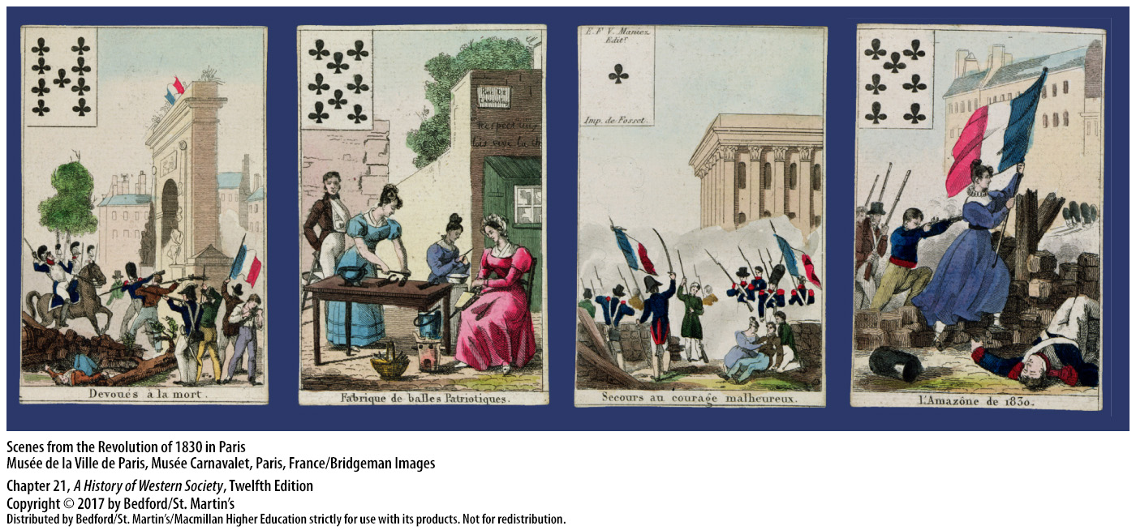

Slide 37
V. The Revolutions of 1848
A Democratic Republic in France
1. “Bourgeois monarchy”
2. Popular revolt in Paris
3. Provisional republic
4. France’s Second Republic
5. 900-person Constituent Assembly
Notes:
V. The Revolutions of 1848
A Democratic Republic in France
1. For eighteen years Louis Philippe’s “bourgeois monarchy,” characterized by stubborn inaction and complacency, had served the selfish interests of wealthy elites and failed to enact social legislation or electoral reform.
2. The government’s failures, combined with a severe depression and crop failures in 1846–1847, united a diverse group of opponents and eventually touched off a popular revolt in Paris on February 22, 1848; workers and students, armed with guns and dug in behind makeshift fortresses, demanded a new government.
3. When Louis Philippe refused to call in the army and then abdicated, the revolutionaries proclaimed a provisional republic, headed by a ten-man executive committee, and immediately began drafting a democratic, republican constitution for France’s Second Republic.
4. They gave the right to vote to every adult male, freed all slaves in French colonies, abolished the death penalty, and guaranteed workplace reforms.
5. Voters elected to the new 900-person Constituent Assembly 500 monarchists and conservatives, about 270 moderate republicans, and 80 radicals or socialists.

Slide 38
V. The Revolutions of 1848
A Democratic Republic in France
6. Alexis de Tocqueville (1805–1859)
7. Clash of ideologies
8. “June Days”
9. Louis Napoleon
Notes:
V. The Revolutions of 1848
A Democratic Republic in France
6. Alexis de Tocqueville (1805–1859), one of the moderate republicans, observed that the socialist movement in Paris aroused the fierce hostility of France’s peasants, who owned land, and of the middle and upper classes.
7. The clash of ideologies—of liberal moderation and radical socialism—became a clash of classes and arms after the elections.
8. After three terrible “June Days” of street fighting and the death or injury of more than ten thousand people, the republican army under General Louis Cavaignac stood triumphant in a sea of working-class blood and hatred.
9. Louis Napoleon, nephew of Napoleon Bonaparte, won the election of December 1848, fulfilling the desire of the propertied classes for order at any cost and producing a semi-authoritarian regime.

Slide 39
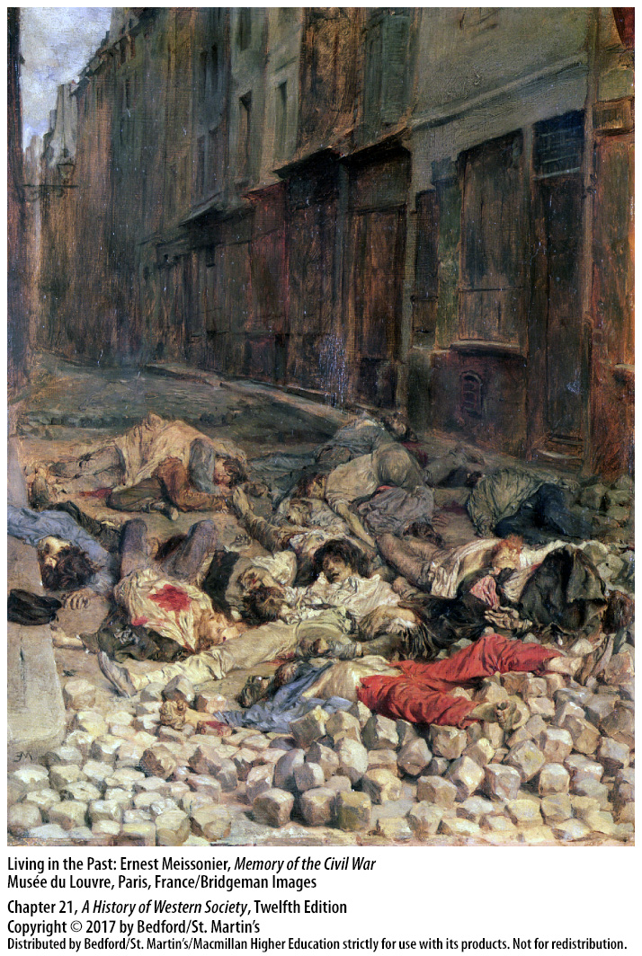

Slide 40
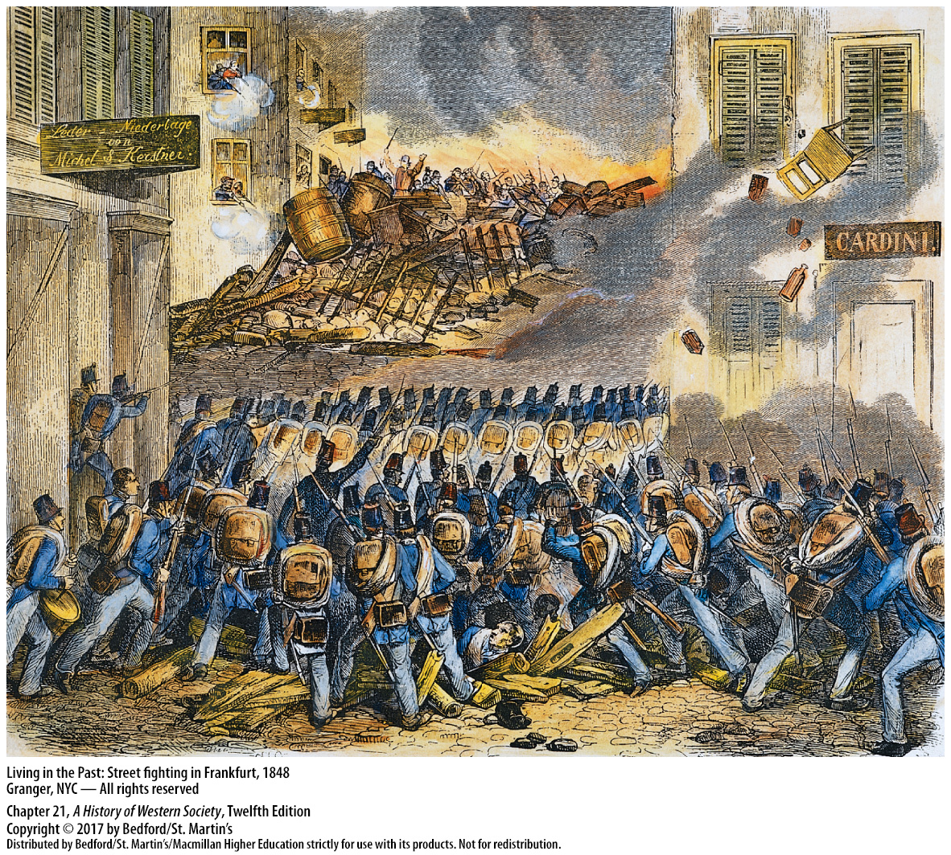

Slide 42
V. The Revolutions of 1848
Revolution and Reaction in the Austrian Empire
1. News of the upheaval in France
2. Revolution in the Austrian Empire
3. Ferdinand I (r. 1835–1848)
4. Unstable coalition of revolutionaries
Notes:
V. The Revolutions of 1848
B. Revolution and Reaction in the Austrian Empire
1. News of the upheaval in France evoked excitement, as liberals demanded constitutions, representative governments, and greater civil liberties from authoritarian regimes and then revolted when governments hesitated.
2. The revolution in the Austrian Empire began in Hungary in 1848, where nationalistic Hungarians demanded national autonomy, full civil liberties, and universal suffrage.
3. The Habsburg emperor Ferdinand I (r. 1835–1848) capitulated and promised reforms and a liberal constitution, while Metternich fled to London.
4. The coalition of revolutionaries was not stable, however, and once the monarchy abolished serfdom, the newly free peasants lost interest in the political and social questions agitating the cities.

Slide 43
V. The Revolutions of 1848
Revolution and Reaction in the Austrian Empire
5. Desires for national autonomy
6. Sophia and her son, Francis Joseph
7. Austrian army retook the city
8. Francis Joseph (r. 1848–1916) and Nicholas I of Russia (r. 1825–1855)
Notes:
V. The Revolutions of 1848
B. Revolution and Reaction in the Austrian Empire
5. To the minority groups that formed half of the population—the Croats, Serbs, and Romanians—unification was unacceptable, as each group felt entitled to political autonomy and cultural independence. Thus, desires for national autonomy enabled the monarchy to play one ethnic group against the other.
6. Finally, the conservative aristocratic forces rallied under the leadership of the archduchess Sophia, Ferdinand’s sister-in-law, who insisted that Ferdinand abdicate in favor of her son, Francis Joseph.
7. At the end of October, the regular Austrian army attacked the student and working-class radicals barricaded in Vienna and retook the city at the cost of more than four thousand casualties.
8. After Francis Joseph (r. 1848–1916) was crowned emperor of Austria, Nicholas I of Russia (r. 1825–1855) sent 130,000 Russian troops into Hungary on June 6, 1849, to subdue the country after bitter fighting.

Slide 44
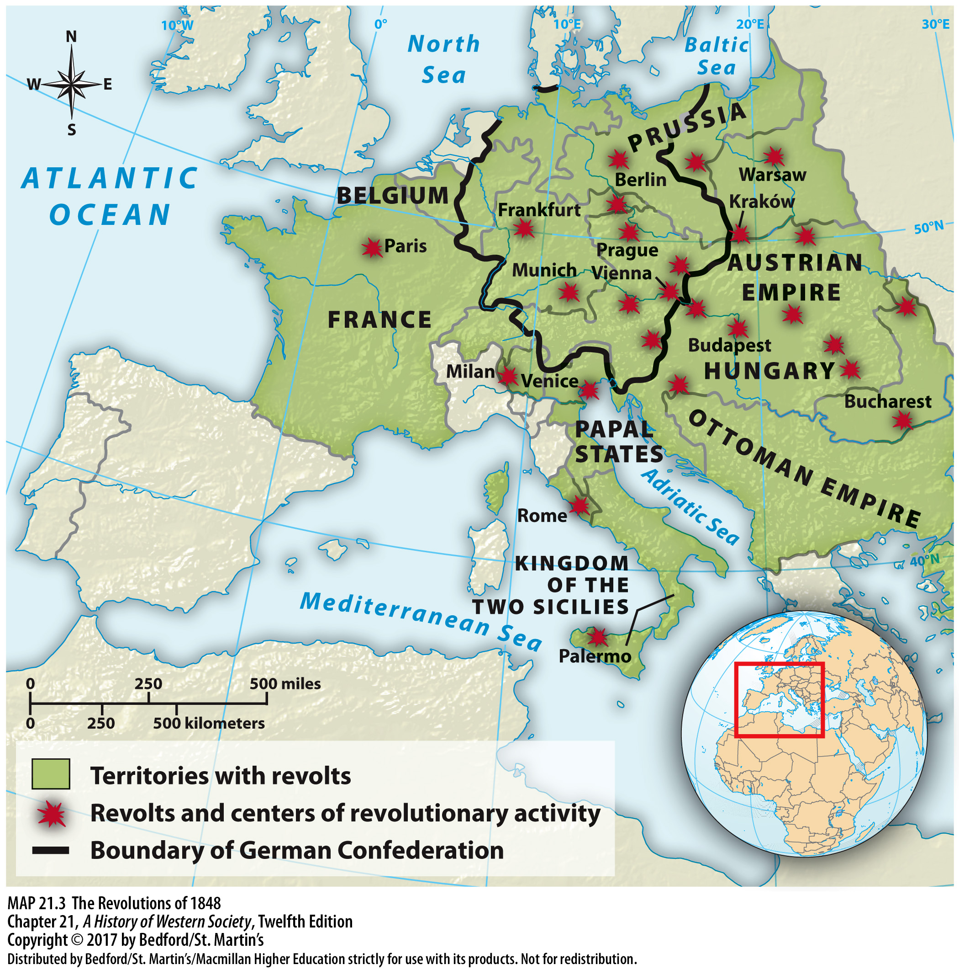

Slide 45
V. The Revolutions of 1848
Prussia, the German Confederation, and the Frankfurt National Parliament
1. Liberal German reformers
2. Frederick William IV (r. 1840–1861)
3. Democratic and vaguely socialist demands
4. German federal constitution
Notes:
V. The Revolutions of 1848
C. Prussia, the German Confederation, and the Frankfurt National Parliament
1. Since the Napoleonic wars, liberal German reformers had sought to transform absolutist Prussia into a constitutional monarchy, hoping it would eventually lead to a unified nation-state.
2. In 1848, when the artisans and factory workers rioted in Berlin and temporarily joined with middle-class liberals in the struggle against the Prussian monarchy, the autocratic yet compassionate Frederick William IV (r. 1840–1861) vacillated and finally caved in. On March 21 he promised to grant Prussia a liberal constitution and to merge Prussia into a new national German state.
3. When the workers issued a series of democratic and vaguely socialist demands that troubled their middle-class allies, a conservative clique gathered around the king to urge counter-revolution.
4. In May, a national parliament convened in Frankfurt to write a German federal constitution; the middle-class elites who were elected as deputies called for constitutional monarchy, free speech, religious tolerance, and abolition of aristocratic privileges, but they ignored calls for more radical action.

Slide 46
V. The Revolutions of 1848
Prussia, the German Confederation, and the Frankfurt National Parliament
5. Proposed unification around a “Greater Germany”
6. Elected King Frederick William of Prussia emperor of a “lesser” German national state
7. German Confederation was re-established
8. Failed attempts to unite the Germans
Notes:
V. The Revolutions of 1848
C. Prussia, the German Confederation, and the Frankfurt National Parliament
5. In October deputies proposed unification around a “Greater Germany” that would include the German-speaking lands of the Austrian Empire, but the proposal foundered on Austrian determination to maintain its empire.
6. In March 1849 the national parliament finally completed its draft liberal constitution and elected King Frederick William of Prussia emperor of a “lesser” German national state (minus Austria). Frederick William reasserted his royal authority, disbanded the Prussian Constituent Assembly, and refused to accept the “crown from the gutter” offered by the parliament in Frankfurt.
7. Supported by Russia, Austria forced Prussia to renounce all schemes of unification in late 1850, and the German Confederation was re-established.
8. Attempts to unite the Germans—first in a liberal national state and then in a conservative Prussian empire—had failed completely.

