Slide 1
A History of Western Society Twelfth Edition
McKay • Crowston • Wiesner-Hanks • Perry
CHAPTER 20
The Revolution in Energy and Industry
ca. 1780–1850
Copyright © 2017 by Bedford/St. Martin’s
Distributed by Bedford/St. Martin's/Macmillan Higher Education strictly for use with its products; Not for redistribution.

Slide 2
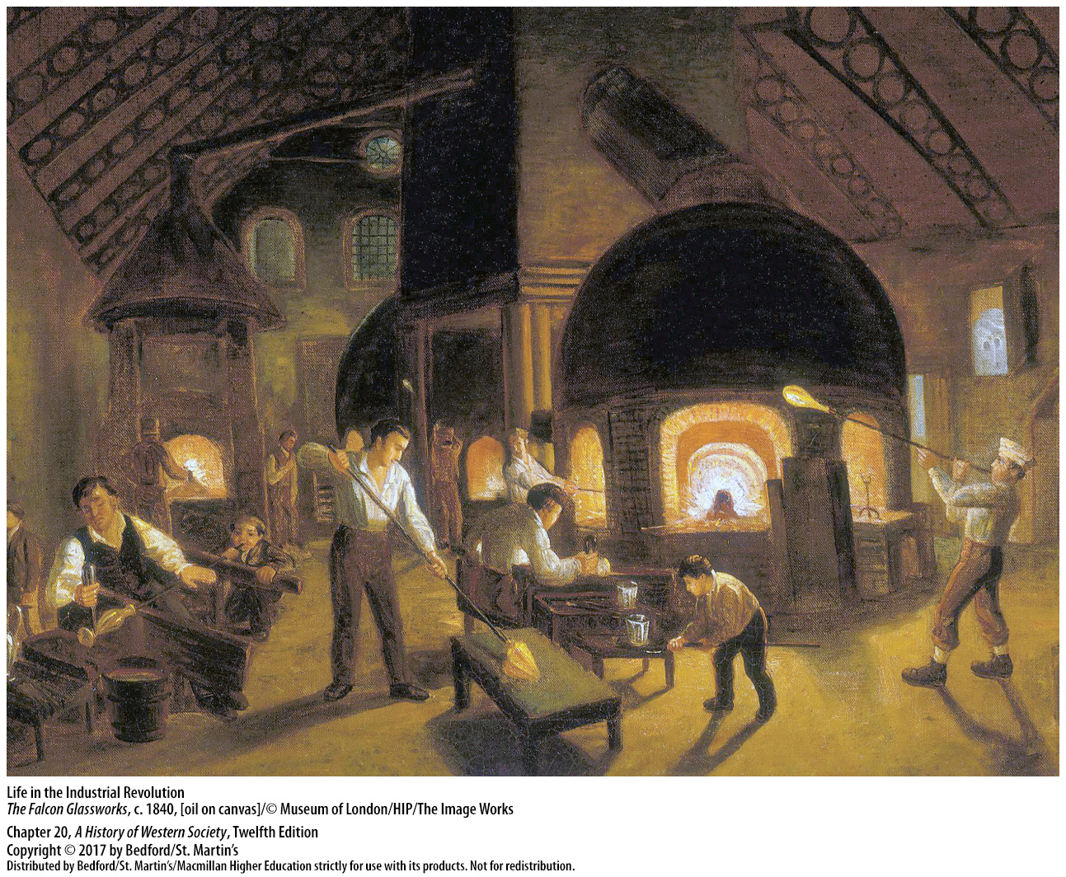

Slide 3
I. The Industrial Revolution in Britain
Why Britain?
Vibrant scientific and Enlightenment culture
Mercantilist colonial empire
Workers moved from agriculture to factories
English families spent more on goods
Notes:
The Industrial Revolution in Britain
Why Britain?
1. Britain’s vibrant scientific and Enlightenment culture, which included the British Royal Society of Arts and its sponsorship of prizes for innovations in machinery, allowed British industrialists to exploit the latest findings of scientists and technicians from other countries.
2. The mercantilist colonial empire Britain aggressively built, buttressed by a strong position in Latin America and in the African slave trade, provided raw materials such as cotton and a growing market for British manufactured goods.
3. Greater efficiency meant that a smaller workforce could produce more food, and by the mid-eighteenth century, less than half of Britain’s population worked in agriculture. The enclosure movement had produced a large pool of potential laborers for the new factories.
4. Not having to spend almost everything it earned to buy bread meant that the ordinary English family could spend more on manufactured goods and could pay to send its children to school. Members of the average British family began redirecting their labor away from unpaid work for household consumption toward work for wages that they could spend on goods.

Slide 4
I. The Industrial Revolution in Britain
Why Britain?
Abundance of coal
Aggressive taxes; money spent on the navy
The Industrial Revolution (coined in 1799)
Technical revolution and industrial growth
Notes:
The Industrial Revolution in Britain
Why Britain?
5. A canal-building boom greatly enhanced the easy movement of critical raw materials, such as England’s and Wales’s enormous deposits of iron and coal. The abundance of coal combined with high wages in manufacturing motivated British manufacturers to develop technologies to draw on the power of coal to increase workmen’s productivity.
6. The British Parliament taxed the population aggressively and spent the money on a navy to protect imperial commerce and on an army that could be used to quell labor uprisings. The British state also adopted aggressive tariffs, or duties, on imported goods to protect its industries.
7. All these factors combined to initiate the Industrial Revolution, a term first coined in 1799 to describe the burst of major inventions and technical changes that were taking place in certain industries.
8. This technical revolution went hand in hand with a quickening in the annual rate of industrial growth in Britain, which grew from 0.7 percent between 1700 and 1760 to 3 percent between 1801 and 1831.

Slide 5
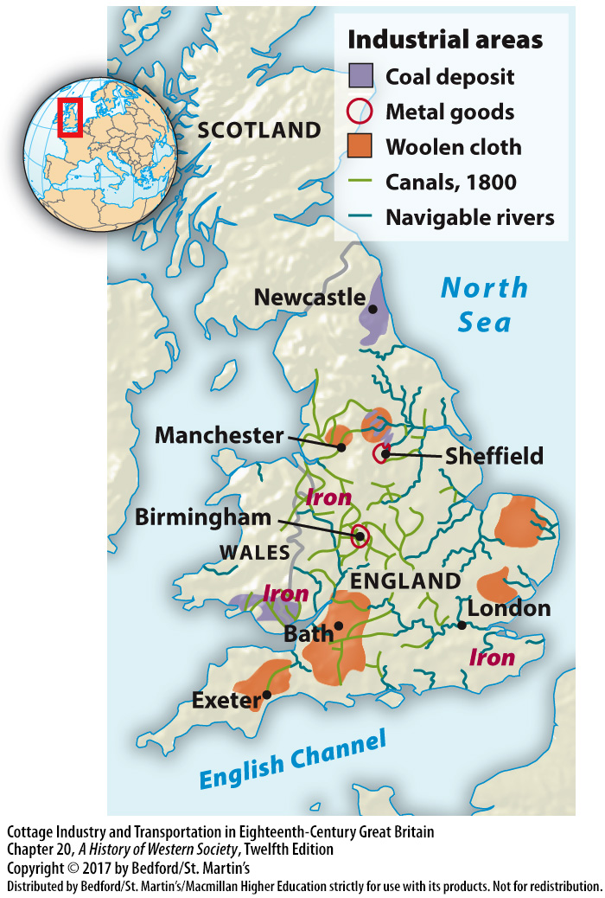

Slide 6
I. The Industrial Revolution in Britain
Technological Innovations and Early Factories
Machine power in the factory
Cotton textiles and the market for cloth
The cotton-spinning jenny and the water frame
Limitations of water frame
Notes:
The Industrial Revolution in Britain
B. Technological Innovations and Early Factories
1. Although older forms of a “factory” had existed previously in Europe, the crucial innovation in Britain was the introduction of machine power into the factory and the organization of labor around the functioning of highly productive machines.
2. Cotton textiles had first been imported into Britain from India by the East India Company; in the eighteenth century, a lively market for cotton cloth emerged in West Africa, where the English and other Europeans traded it for slaves.
3. James Hargreaves invented his simple hand-powered cotton-spinning jenny about 1765, at almost the same moment that Richard Arkwright developed another kind of spinning machine, the water frame; by 1790 the new machines were producing ten times as much cotton yarn as had been made in 1770.
4. The capacity of Arkwright’s water frame for several hundred spindles meant that much more power—waterpower—was needed, requiring large specialized mills near water sources that employed as many as one thousand workers from the very beginning. The water frame did not completely replace cottage industry, however; the cotton threads it produced were still put out to be respun into finer threads on hand-operated jennies.

Slide 7
I. The Industrial Revolution in Britain
Technological Innovations and Early Factories
Samuel Crompton’s hybrid machine (1790)
Allowed for international competition
Handloom weavers and the power loom
Owners exploited orphans for labor
Notes:
The Industrial Revolution in Britain
B. Technological Innovations and Early Factories
5. After Samuel Crompton invented a hybrid machine around 1790, all cotton spinning gradually became concentrated in large-scale water-powered factories.
6. These revolutionary developments allowed British textile manufacturers to compete successfully in international markets. The machines were too expensive to build and did not provide enough savings in labor to be adopted in most places, until further innovations in machine manufacturing increased their productivity and made them less expensive to build.
7. As families using cotton in cottage industry no longer had to search constantly for adequate amounts of yarn for weaving, the income of weavers rose markedly, and large numbers of agricultural laborers became handloom weavers. In 1785, Edmund Cartwright invented a power loom that began to replace handlooms in the 1820s.
8. Because adults were reluctant to work in factories, owners often turned to young orphans and abandoned children who were in the care of local parishes. Apprenticed as young as five or six years of age, boy and girl workers were forced by law to labor for their “masters” for as many as fourteen years. Working as much as fourteen hours a day, six days a week for little or no pay and under brutal discipline, these orphans experienced exploitation on an unprecedented scale.

Slide 8
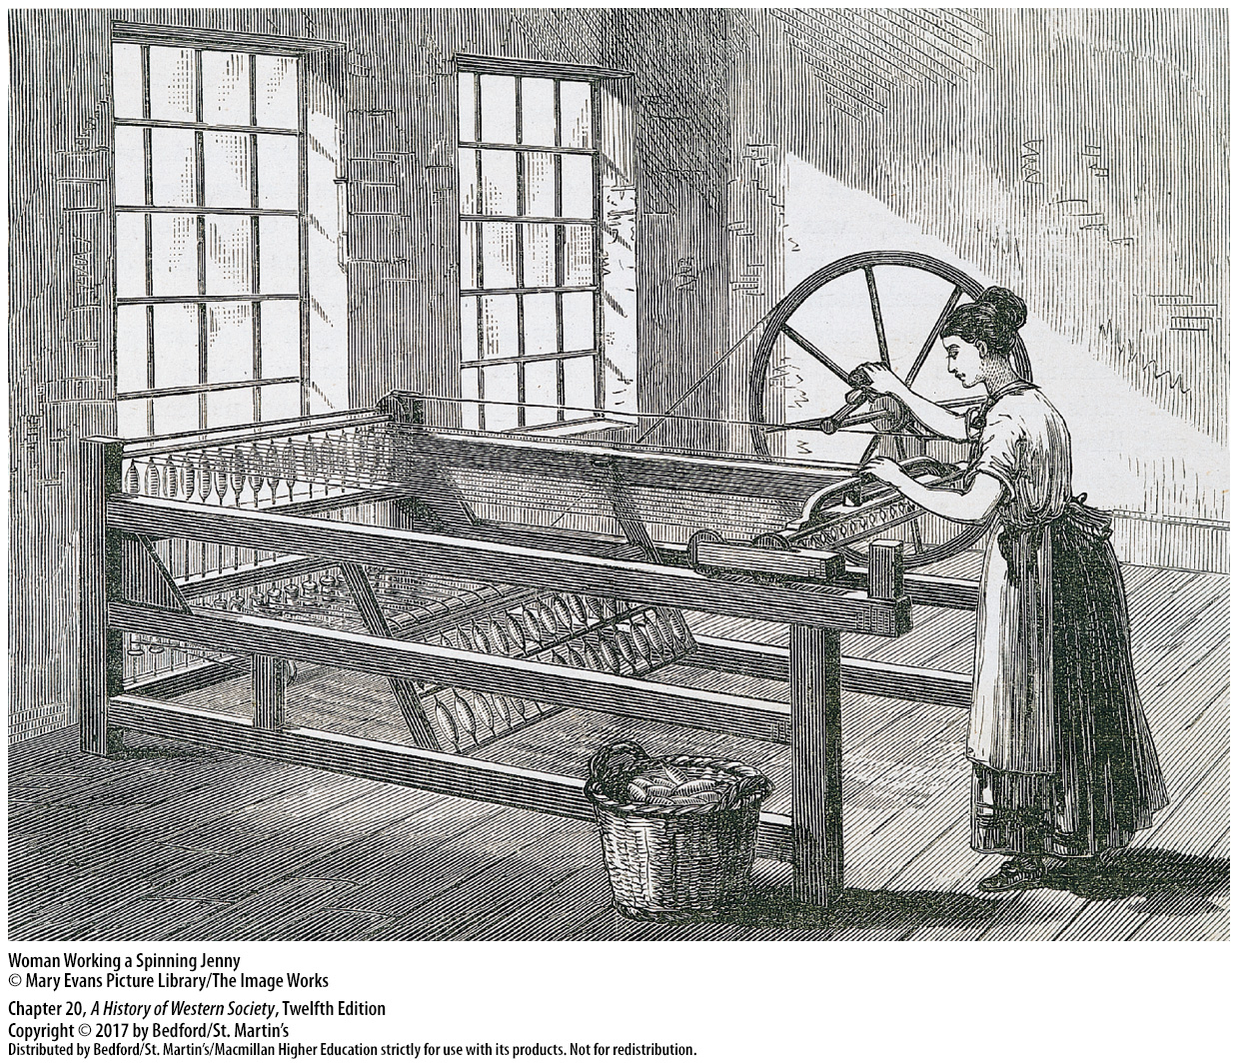

Slide 9
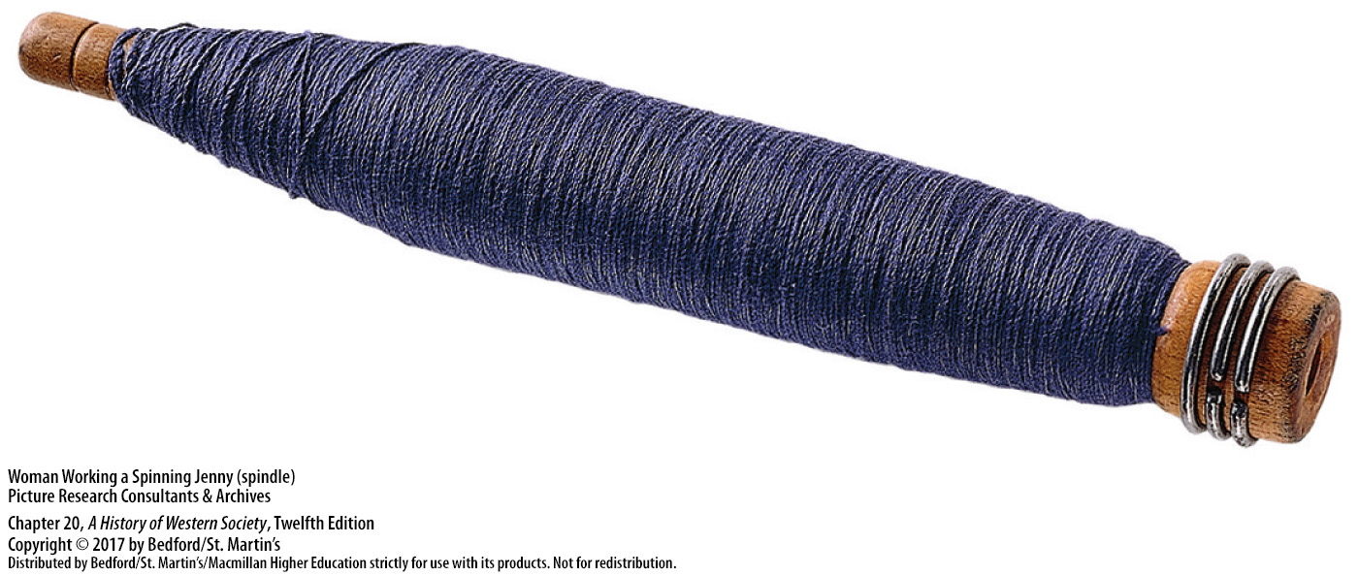

Slide 10
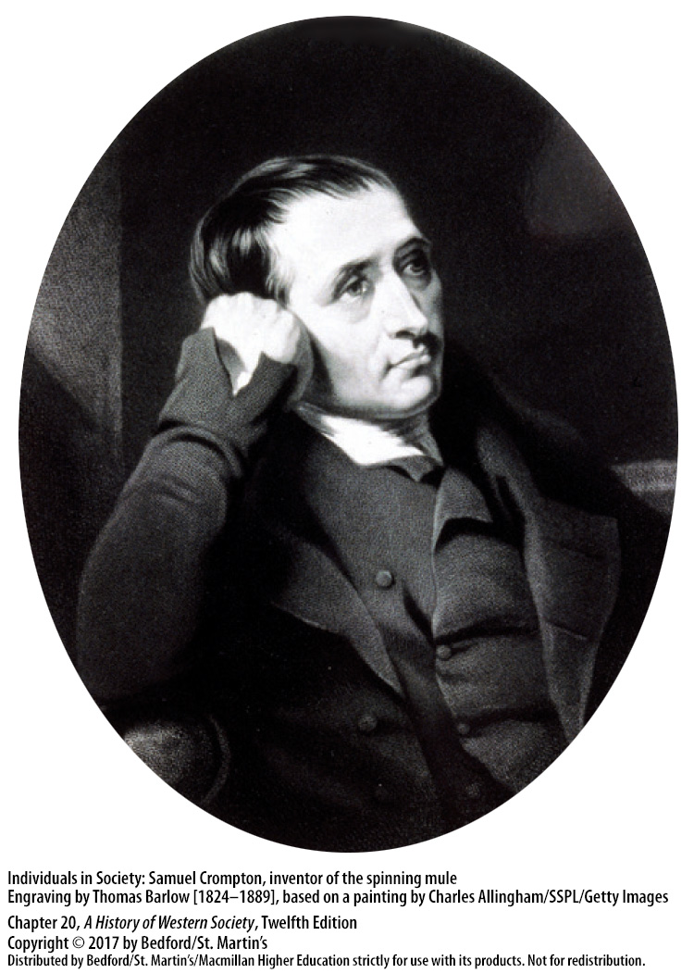

Slide 11
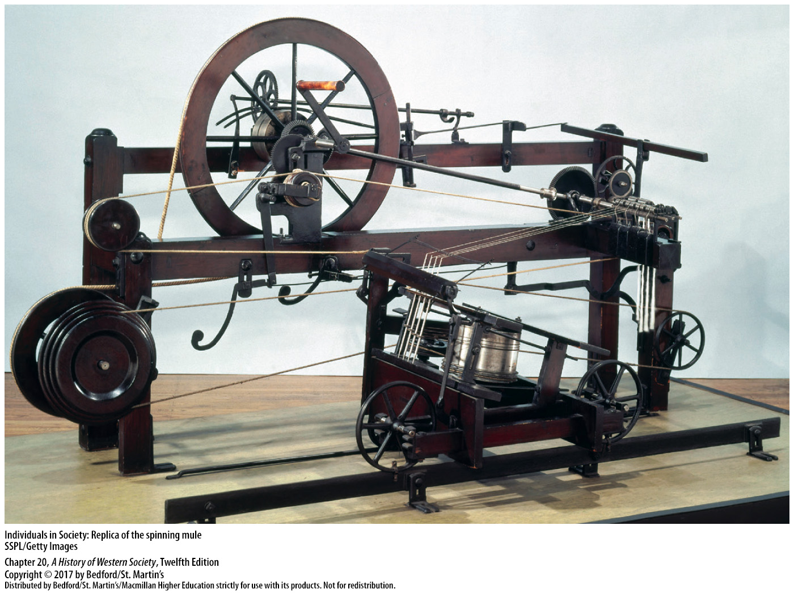

Slide 12
I. The Industrial Revolution in Britain
The Steam Engine Breakthrough
World poor in energy and power sources
British iron industry stagnating by 1740
Coal production
The coal-burning steam engine
The puddling furnace; steam-powered rolling mills
Iron production increased; iron became the building block of the economy
Notes:
The Industrial Revolution in Britain
C. The Steam Engine Breakthrough
1. More efficient use of water and wind in the sixteenth and seventeenth centuries enabled humans to accomplish more. European society, like others, however, continued to rely mainly on wood for energy, and human beings and animals continued to perform most work, so the world remained poor in energy and power sources.
2. By the eighteenth century, wood was in ever-shorter supply, and because the iron industry depended on processed wood (charcoal), by 1740 the British iron industry was stagnating.
3. Britain looked toward coal as an alternative to increasingly scarce supplies of wood; a breakthrough occurred when industrialists began to use coal to produce mechanical energy and to power machinery.
4. The coal-burning steam engine, the Industrial Revolution’s most fundamental advance in technology, put almost unlimited power at humans’ disposal and enabled inventors and engineers to devise all kinds of power equipment to aid people in their work. Steam engines drained mines, increasing coal production, and replaced waterpower in spinning factories; flour, malt, and flint mills; and in mills in the West Indies that crushed sugarcane.
5. Henry Cort’s development of the puddling furnace and of steam-powered rolling mills proved to be a great boon to the British iron industry.
6. With the production of iron increasing from 17,000 tons in 1740 to 3 million tons in 1844, iron—once expensive—became the cheap and indispensable building block of the economy.

Slide 13
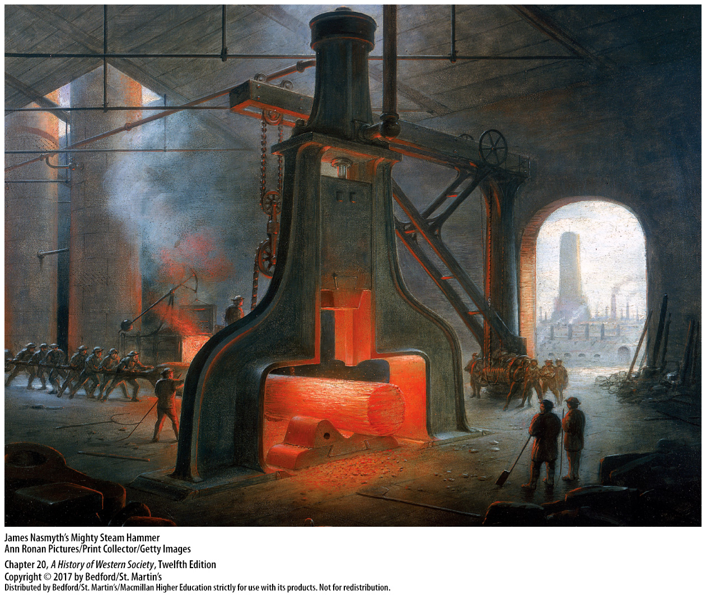

Slide 14
I. The Industrial Revolution in Britain
Steam-Powered Transportation
Experiments with steam engines on rails
1829 George Stephenson’s Rocket
Private companies organized to build more rail lines
Other countries followed
Notes:
The Industrial Revolution in Britain
D. Steam-Powered Transportation
1. After a rail capable of supporting a heavy locomotive was developed in 1816, all sorts of experiments with steam engines on rails followed.
2. Richard Trevithick built the first steam locomotive, and in 1829 George Stephenson’s Rocket sped down the track of the just-completed Liverpool and Manchester Railway.
3. With the financial and technical success of the Liverpool–Manchester line, many private companies were organized quickly to build more rail lines, and within twenty years they had completed the main lines of the United Kingdom.
4. Other countries quickly followed, with the first steam-powered trains operating in the United States in the 1830s and in Brazil, Chile, Argentina, and the British colonies of Canada, Australia, and India in the 1850s.

Slide 15
I. The Industrial Revolution in Britain
Steam-Powered Transportation
Markets became larger and nationwide
Larger factories, demand for unskilled labor
Water travel transformed in France with the first steam ships (1770s)
Notes:
The Industrial Revolution in Britain
D. Steam-Powered Transportation
5. The railroad dramatically reduced the cost and uncertainty of shipping freight over land, and markets became larger and even nationwide.
6. Larger markets encouraged larger factories with more sophisticated machinery in a growing number of industries, creating a strong demand for unskilled labor and contributing to the growth of a class of urban workers.
7. Water travel also was transformed after French engineers completed the first steam ships in the 1770s; the first commercial steam ships came into use in North America several decades later.

Slide 16
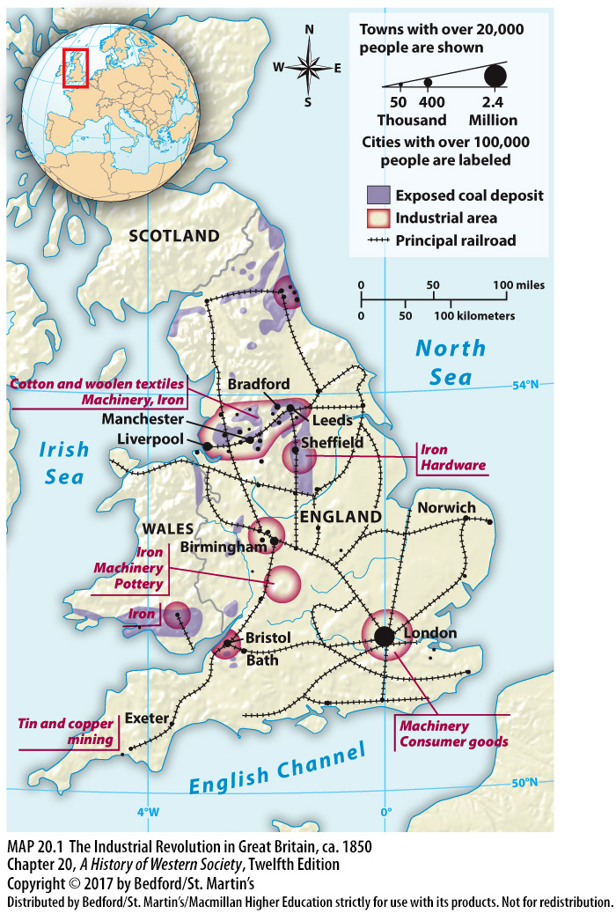

Slide 17
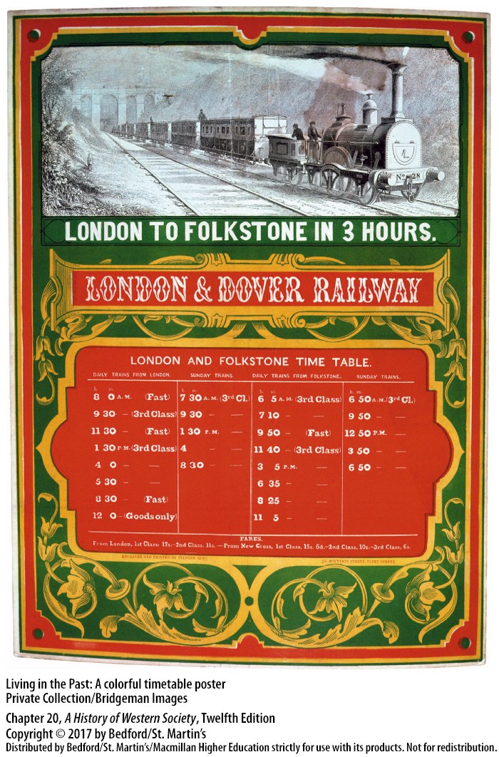

Slide 18
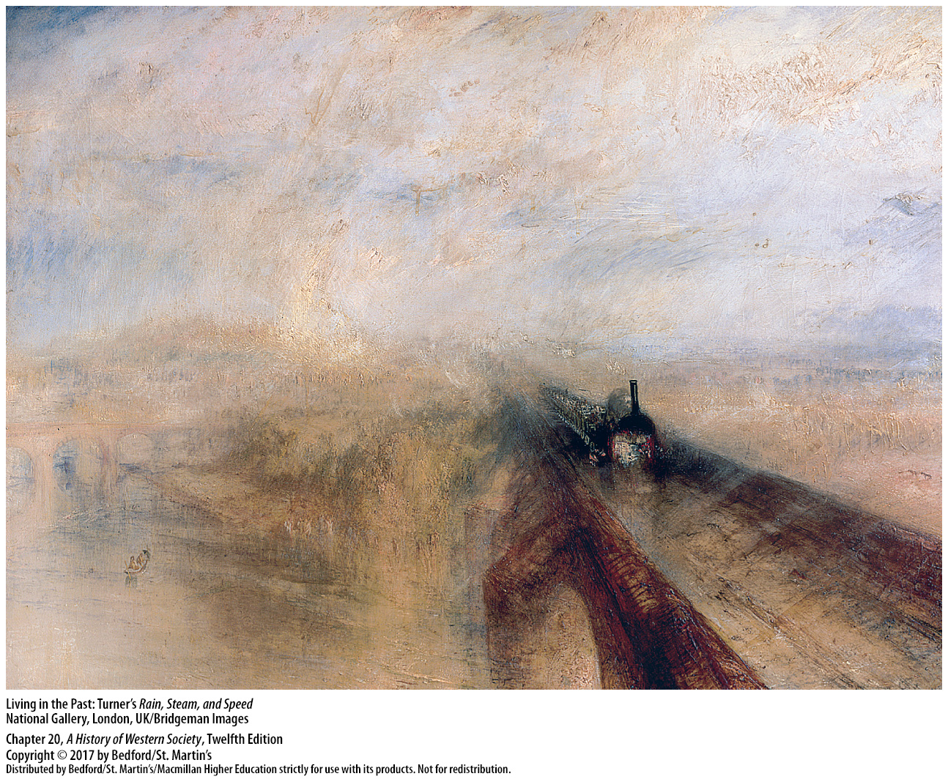

Slide 19
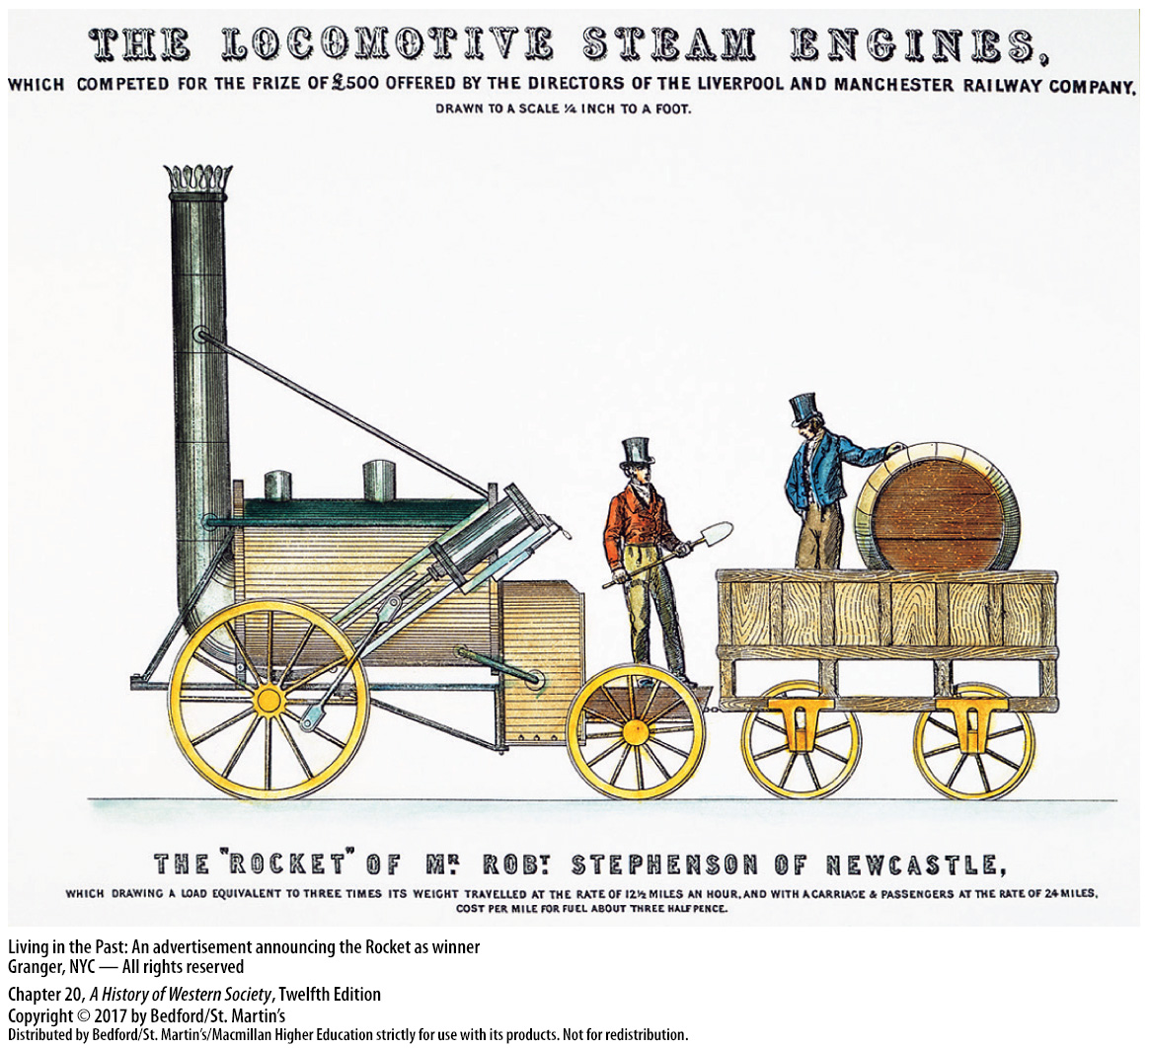

Slide 20
I. The Industrial Revolution in Britain
Industry and Population
The Great Exhibition in the Crystal Palace
“Workshop of the world”
Gross National Product rose
Rapid population growth was key to industrial development for labor
Thomas Malthus, Essay on the Principles of Population (1798)
David Ricardo, the iron law of wages
Notes:
The Industrial Revolution in Britain
E. Industry and Population
1. In 1851 London hosted an industrial fair called the Great Exhibition in the newly built Crystal Palace, a gigantic new exhibition hall made entirely of glass and iron that helped draw millions of visitors from all over Europe.
2. In 1860 Britain, the self-proclaimed “workshop of the world,” produced a remarkable 20 percent of the entire world’s output of industrial goods, whereas it had produced only about 2 percent of the world total in 1750.
3. Although the gross national product (GNP) of Britain rose roughly fourfold at constant prices between 1780 and 1851, the population grew from about 9 million to almost 21 million during the same period, consuming much of the increase in total production.
4. Rapid population growth was key to industrial development: more people meant a more mobile labor force, with many young mobile workers in need of employment.
5. Thomas Malthus (1766–1834) believed that population would always tend to grow faster than the food supply, and in his Essay on the Principle of Population (1798), he concluded that “prudential restraint” was the only hope of warding off such “positive checks” to population growth as war, famine, and disease.
6. English economist David Ricardo (1772–1823) developed the iron law of wages, which stated that the pressure of population growth would always cause wages to sink to subsistence level, meaning wages would be just high enough to keep workers from starving.

Slide 21
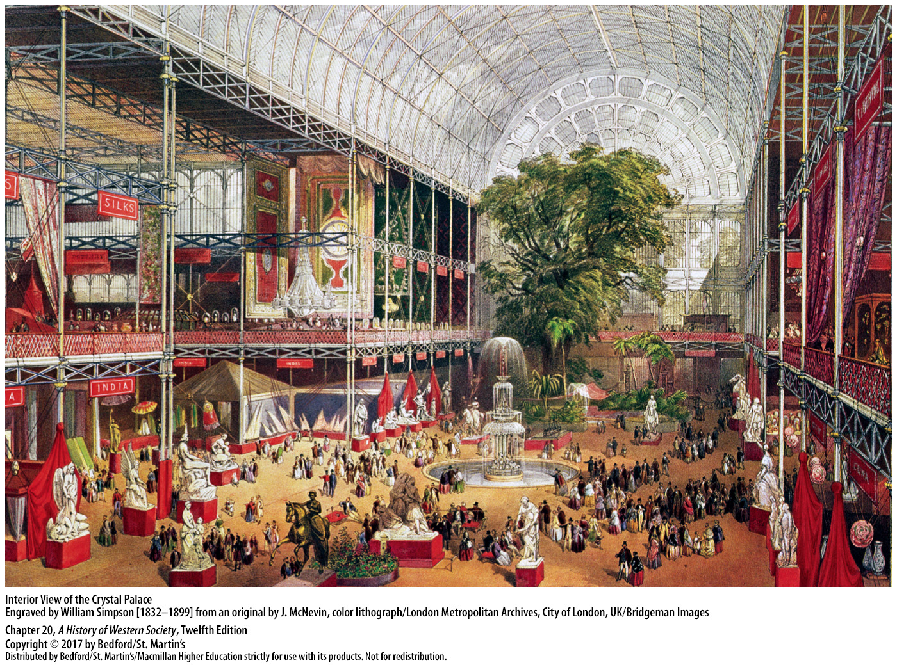

Slide 22
II. Industrialization in Europe and the World
National and International Variations
British lead in industrialization
Belgium rich in iron and coal, surged between 1830 – 1860
France’s slow but steady growth
Growth in Austria-Hungary, Italy, and Russia
Non-Western countries saw their levels of industrial production decline
Japan an exception to this pattern
Notes:
II. Industrialization in Europe and the World
National and International Variations
1. In 1750 European countries, the United States, India, and China were all fairly close in their level of industrialization. Britain opened up a noticeable lead over all countries by 1800, and that gap progressively widened as the Industrial Revolution accelerated to 1830 and reached full maturity by 1860.
2. Belgium, achieving independence from the Netherlands in 1831 and rich in iron and coal, experienced a truly revolutionary surge between 1830 and 1860.
3. France’s slow but steady growth and continued dominance of the market in luxury goods using traditional artisanal techniques was overshadowed by the spectacular rise of the German lands and the United States after 1860 in the “second industrial revolution.”
4. Eastern and southern Europe began the process of modern industrialization later but made real progress in the late nineteenth century, as demonstrated by growth in Austria-Hungary, Italy, and Russia.
5. While European countries and the United States industrialized to a greater or lesser extent, most non-Western countries, including China and India, saw their levels of industrial production decline.
6. Japan stands out as an exception to this pattern; after the forced opening of the country to the West in the 1850s, Japanese entrepreneurs began to adopt Western technology and manufacturing methods, resulting in a production boom by the late nineteenth century.

Slide 23
II. Industrialization in Europe and the World
Industrialization in Continental Europe
Western European economic development temporarily halted by war
British economic advantages and technology
Steam power involved large investments
Western European advantages
Strong, independent governments
Slow adoption of factory technology
Notes:
II. Industrialization in Europe and the World
B. Industrialization in Continental Europe
1. During the years of revolution and the Napoleonic wars, from 1793 to 1815, western Europe experienced tremendous political and social upheaval that temporarily halted economic development; with the return of peace in 1815, western European countries began to catch up.
2. By that time, Britain enjoyed significant advantages, including the dominance of its goods in world markets due to newly mechanized industries that produced goods very economically.
3. The technology of steam power involved large investments in the iron and coal industries, and after 1830, required railroads. Continental business people had difficulty finding the large sums of money the new methods demanded and enough laborers willing to move to work in factories.
4. Western European countries, nevertheless, possessed several advantages, including a rich tradition of putting-out enterprise, merchant capitalists, and skilled urban artisans, which gave them the ability to adapt and survive in the face of new market conditions.
5. European countries also had strong, independent governments that did not fall under foreign political control and that would use the power of the state to promote industry and catch up with Britain.
6. Most continental businesses adopted factory technology slowly, and handicraft methods lived on.

Slide 24
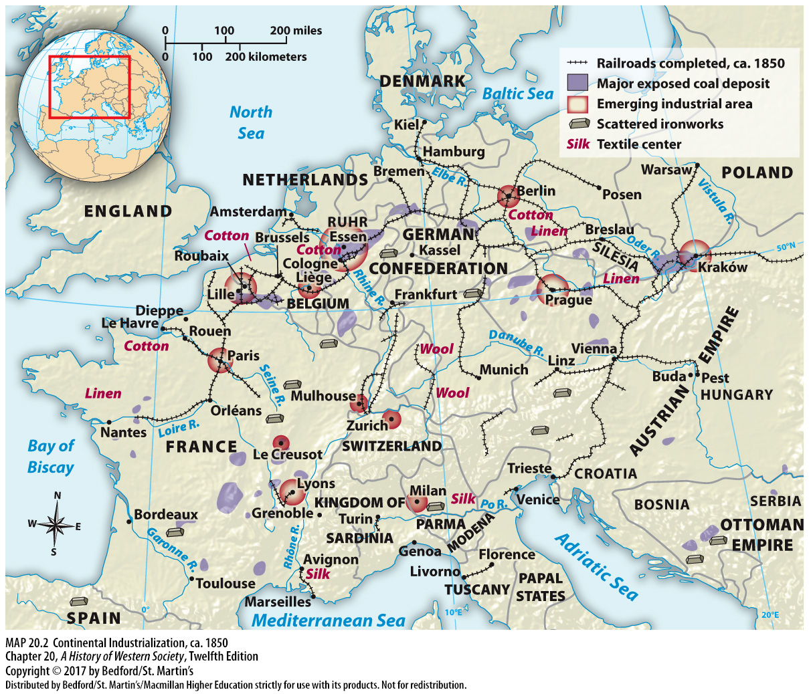

Slide 25
II. Industrialization in Europe and the World
Agents of Industrialization
British protection of technical discoveries
William Cockerill in Belgium
Fritz Harkort (1793 – 1880)
Tariff protection and other government measures
Continental governments paid for improved transportation
Notes:
II. Industrialization in Europe and the World
C. Agents of Industrialization
1. The British realized the great value of their technical discoveries; until 1825 it was illegal for artisans and skilled mechanics to leave Britain, and until 1843 Britain prohibited the export of textile machinery and other equipment. Many talented, ambitious workers, however, slipped out of the country illegally and introduced the new methods abroad.
2. William Cockerill and his sons, for example, moved to Belgium and created a large industrial enterprise in the Liège area; Cockerill’s plants continually gathered new information from the skilled British workers who came to work for him and transmitted it across Europe.
3. In addition to British technicians and skilled workers being a powerful force in the spread of early industrialization, talented entrepreneurs in other countries, such as Fritz Harkort (1793–1880) who was a pioneer in the Germany machinery industry, pushed to match England’s achievements.
4. In other parts of Europe, governments helped business people overcome difficulties in their industrialization efforts through tariff protection and other measures. After 1815, for example, France was flooded with cheaper British goods; the French government responded by imposing high tariffs on some imports to protect the French economy.
5. Continental governments bore the cost of building roads, canals, and railroads to improve transportation. Built rapidly as a unified network, Belgium’s state-owned railroads stimulated the development of heavy industry and made the country an early industrial leader.

Slide 26
II. Industrialization in Europe and the World
Agents of Industrialization
Larger role for banks on the continent
Industrial banks
Corporate banks
Unprecedented continental economic growth
Britain led by a smaller margin in early 1870s
Notes:
II. Industrialization in Europe and the World
C. Agents of Industrialization
6. Banks, like governments, also played a larger role on the continent than in Britain. In the 1830s two Belgian banks received permission from the growth-oriented government to establish themselves as corporations with limited liability.
7. Publicizing the risk-reducing advantage of limited liability for investors, these Belgian banks attracted many shareholders; they mobilized impressive resources for investment in big companies, became industrial banks, and successfully promoted industrial development.
8. Similar corporate banks, usually working in collaboration with governments, became important in France and the German lands in the 1850s and 1860s in establishing and developing railroads and companies in heavy industry.
9. The combined efforts of governments, skilled workers, entrepreneurs, and industrial banks meshed to usher in a period of unprecedented economic growth on the continent.
10. In the early 1870s, Britain was still Europe’s most industrial nation, but a handful of countries had closed the gap.

Slide 27
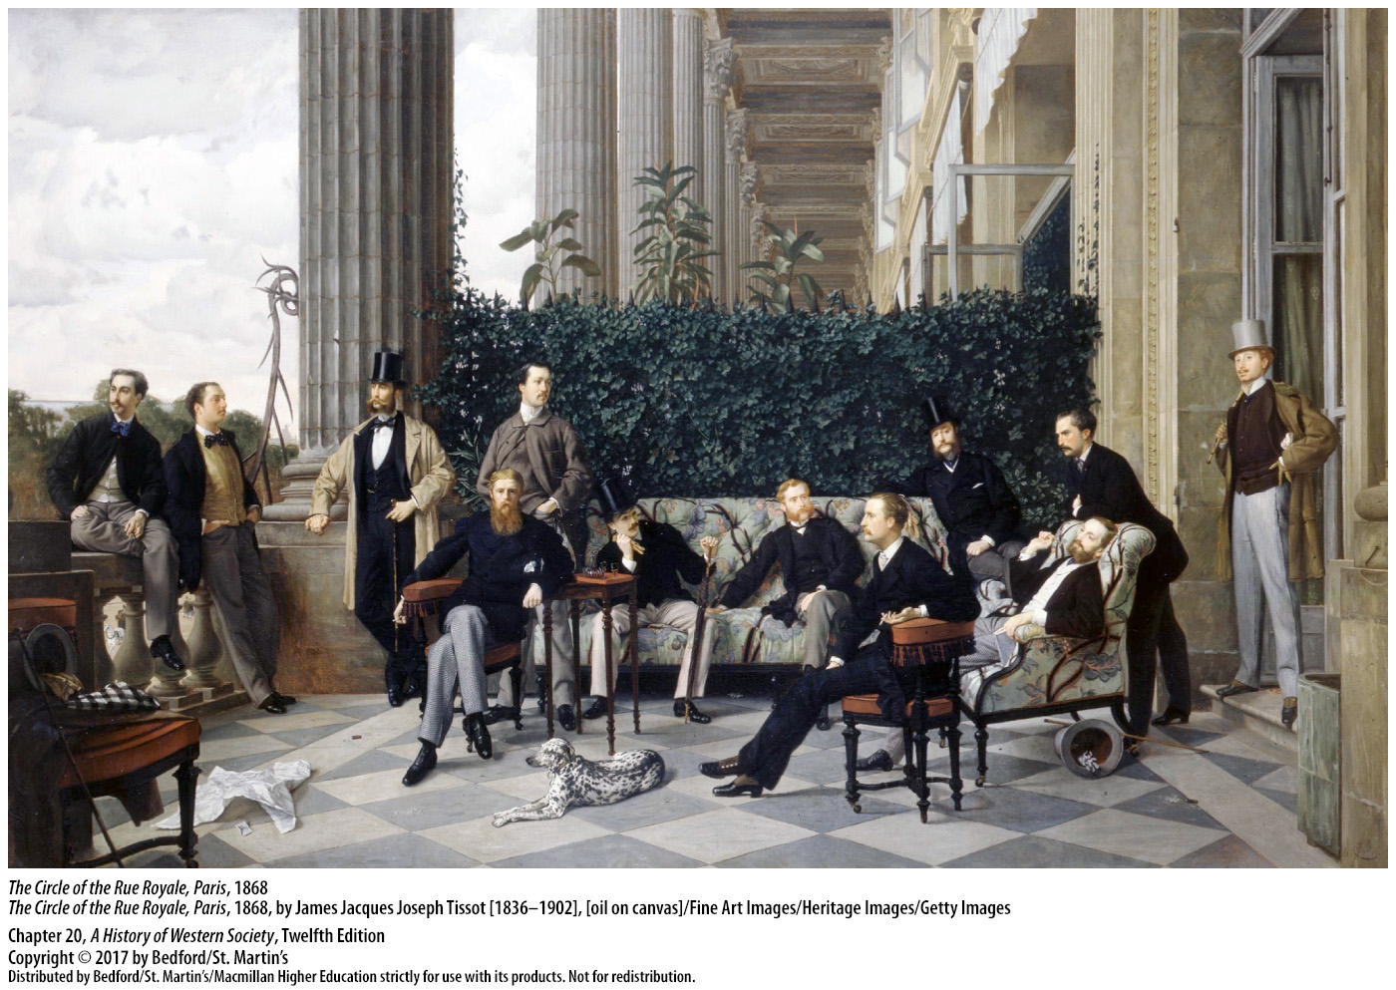

Slide 28
II. Industrialization in Europe and the World
The Global Picture
1. British technologies and methods of production
2. Russia
3. Egypt
4. Monopolized colonial markets
Notes:
II. Industrialization in Europe and the World
D. The Global Picture
1. In many countries, governments and entrepreneurs made efforts to adopt British technologies and methods of production, but they fell short of transitioning to an industrial economy.
2. In Russia, for example, steamships, a railroad, and steam-powered cotton factories had been introduced by the mid-nineteenth century, but these advances did not lead to full industrialization; instead, Russia continued to provide raw materials such as timber and grain to the West.
3. In the early nineteenth century, Egypt began to import British technology and experts in textile manufacture and other industries, but it could not compete with lower-priced European imports and fell back on agricultural exports to European markets.
4. In places where European governments maintained direct or indirect political control, they monopolized colonial markets and prevented the establishment of tariffs on their goods instead of encouraging the spread of industrialization.

Slide 29
II. Industrialization in Europe and the World
The Global Picture
5. India
6. Countries in Latin America
7. De-industrialization
8. China
Notes:
II. Industrialization in Europe and the World
D. The Global Picture
5. Millions of poor textile workers in India lost their livelihoods because they could not compete with industrially produced British goods.
6. By the mid-nineteenth century, countries in Latin America had adopted steam power for sugar and coffee processing, but as elsewhere, these developments did not lead to a rise in industrial production, but to increased reliance on agricultural crops for export.
7. Instead of industrializing, many territories underwent a process of de-industrialization due to imperialism and economic competition.
8. China did not adopt mechanized production until the end of the nineteenth century but continued as a market-based, commercial society with a large rural sector and industrial production based on traditional methods.

Slide 30
III. New Patterns of Working and Living
Work in Early Factories
Cottage workers reluctant to work in factories
Brick factories and stone poorhouses too similar
Work of abandoned and pauper children
Semi-forced child labor, brutal toil on children
Notes:
III. New Patterns of Working and Living
Work in Early Factories
1. Cottage workers, accustomed to the putting-out system but not the pace of work and discipline demanded by factories, were reluctant to work in the new factories even when they received relatively good wages.
2. The similarity between brick factories and stone poorhouses also increased cottage workers’ fear of factories and their hatred of factory discipline.
3. Cottage workers’ reluctance to work in factories prompted the early cotton mill owners to turn to abandoned and pauper children for their labor.
4. Semi-forced child labor seemed necessary and was socially accepted in the eighteenth century, but at the end of the century, attitudes began to change as middle-class reformers publicized the brutal toil imposed on these children.

Slide 31
III. New Patterns of Working and Living
Working Families and Children
Use of pauper apprentices banned in 1802
The “working class”
Working in family units
Many Irish urban workers in Great Britain
Notes:
III. New Patterns of Working and Living
B. Working Families and Children
1. By the 1790s the use of pauper apprentices was in decline, and in 1802 Parliament forbade it.
2. Many more textile factories were being built, mainly in urban areas, where they could use steam power rather than waterpower and attract workers more easily. People came to work in the cities, both as factory workers and as porters, builders, and servants; these wage laborers came to be called the “working class,” a term first used in the late 1830s.
3. Some workers were able to adjust to the system by carrying over familiar traditions such as working in family units in the same way they had worked on farms and in the putting-out system. The mill or mine owner bargained with the head of the family and paid him or her for the work of the whole family.
4. Ties of kinship were particularly important for newcomers, who had traveled great distances to find work. Many urban workers in Great Britain were from Ireland; forced out by population growth and deteriorating economic conditions, they worked together, formed their own neighborhoods, and thrived.

Slide 32
III. New Patterns of Working and Living
Working Families and Children
Control given to impersonal managers
Robert Owen (1771 – 1858)
The Factory Acts of 1802 – 1833
Employment of children declined rapidly
Notes:
III. New Patterns of Working and Living
B. Working Families and Children
5. Only when technical changes threatened to place control in the hands of impersonal managers instead of family groups did adult workers protest against inhuman conditions in the name of their children.
6. Some enlightened employers and social reformers in Parliament argued that more humane standards were necessary and used parliamentary reports to influence public opinion. Robert Owen (1771–1858), a successful manufacturer in Scotland, testified in 1816 that employing children under ten years of age as factory workers was “injurious to the children, and not beneficial to the proprietors.”
7. The Factory Acts of 1802–1833 prohibited the employment of children under age nine and limited the workday for children between ages nine and thirteen to a maximum of eight hours and teenagers ages fourteen to eighteen to twelve hours; they also set minimum hygiene and safety requirements and installed full-time professional inspectors to enforce the acts.
8. After 1833 the employment of children declined rapidly, breaking the pattern of whole families working together.

Slide 33
III. New Patterns of Working and Living
The New Sexual Division of Labor
New sexual division of labor; “separate spheres”
Working-class married women
Young unmarried women
Discipline of the clock and the machine
Notes:
III. New Patterns of Working and Living
C. The New Sexual Division of Labor
1. By 1850 a new sexual division of labor and pattern of “separate spheres” were emerging in which the man was becoming the family’s primary wage earner, while the married woman was expected to concentrate on duties at home.
2. Working-class married women were much less likely to work full time for wages outside the house after the first child arrived, although they often earned small amounts doing putting-out handicrafts at home and taking in boarders. When married women did work for wages outside the house, they usually came from the poorest families, where the husbands were poorly paid, sick, unemployed, or missing.
3. Legions of young unmarried women worked full time but only in certain jobs, such as textile factory work, laundering, and domestic service. All women generally were confined to low-paying, dead-end jobs.
4. Among the factors that created this new sexual division of labor was the new and unfamiliar discipline of the clock and the machine, which was especially hard on working-class married women.

Slide 34
III. New Patterns of Working and Living
The New Sexual Division of Labor
Factory discipline conflicted with child care
Urban poverty and running a household
The Mines Act of 1842
Middle-class women urged poor women to devote more time to their homes and families
Notes:
III. New Patterns of Working and Living
C. The New Sexual Division of Labor
5. Relentless factory discipline also conflicted with child care in a way that labor on the farm or in the cottage had not; therefore, a working-class woman had strong incentives to concentrate on child care within her home if her family could afford it.
6. Running a household in conditions of primitive urban poverty was an extremely demanding job, with shopping, washing clothes, and feeding the family a never-ending challenge; taking on a “second shift” held limited appeal for many working-class women. Thus, many women might well have accepted the emerging division of labor as the best available strategy for family survival in the industrializing society.
7. Because factories and mines offered unprecedented opportunities for girls and boys to mix on the job, the segregation of jobs by gender also can be explained partly as an effort by older people to control the sexuality of working-class youths. Investigations into the British coal industry generated concerns that the mines were inappropriate and dangerous places for girls and married women to work. The Mines Act of 1842 prohibited underground work for all women and girls as well as for boys under ten.
8. Middle-class women and reformers, who had largely embraced the “separate spheres” ideology, also urged poor women to devote more care and attention to their homes and families.

Slide 35
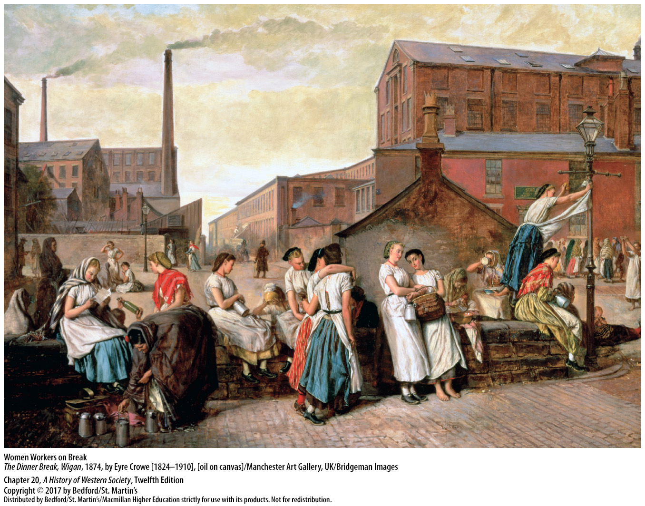

Slide 36
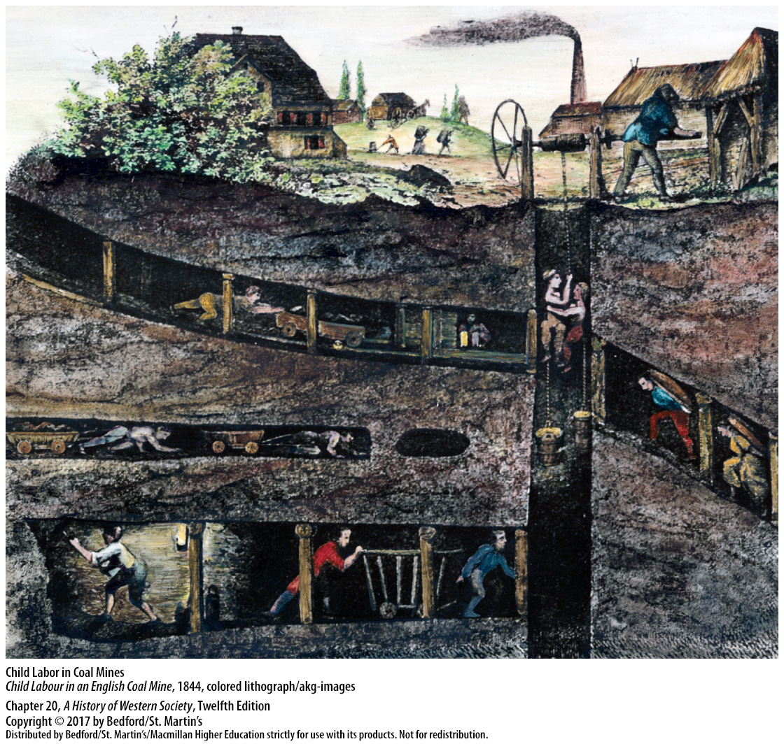

Slide 37
III. New Patterns of Working and Living
Living Standards for the Working Class
Decline in wages and standard of living
Rise in wages offset by a decline in labor of child and married women
Increase in productivity, not purchasing power
Migrants in over-crowded, unsafe apartments
Notes:
III. New Patterns of Working and Living
D. Living Standards for the Working Class
1. The stresses of war with France from 1792 to 1815 led to a decline in the average British worker’s real wages and standard of living.
2. Factory wages began to rise slightly after 1815, but these gains were offset by a decline in the labor of children and married women, meaning that many households had less total income than before. Meanwhile, many people worked outside the factories as cottage workers or rural laborers, and those wages declined.
3. The increase in the productivity of industry did not lead to an increase in the purchasing power of the British working classes.
4. Migrants to the booming cities found expensive, hastily constructed, over-crowded apartments and inadequate sanitary systems.

Slide 38
III. New Patterns of Working and Living
Living Standards for the Working Class
Life expectancy around twenty-five to twenty-seven, fifteen years less than average
Matters improved in 1840s
Quality of life improvements
Notes:
III. New Patterns of Working and Living
D. Living Standards for the Working Class
5. Infant mortality, disease, malnutrition, and accidents took such a high toll in human life that life expectancy was only around twenty-five to twenty-seven years, some fifteen years less than the national average.
6. From the 1840s onward, matters improved considerably as wages made substantial gains and the prices of many goods dropped.
7. Quality of life improvements included access to new foods (including canned foods), advances in medicine, improvements in transportation, and the ability to communicate instantly via telegraph.

Slide 39
IV. Relations Between Capital and Labor
The New Class of Factory Owners
Problems between capital and labor
Early industrialist competition
Opportunities for artisans and skilled workers
New chances for ethnic and religious groups
Opportunities declined as factories grew larger
Notes:
IV. Relations Between Capital and Labor
The New Class of Factory Owners
1. Industrial development led to the creation of new social groups and intensified long-standing problems between capital and labor.
2. Early industrialists, who came from a variety of backgrounds, operated in a highly competitive economic system, waging a constant battle to cut their production costs and stay afloat while pouring most of the profit back into the business for better machinery.
3. Artisans and skilled workers of exceptional ability had unparalleled opportunities.
4. Members of ethnic and religious groups who had been discriminated against jumped at new chances and often helped each other.
5. As factories and firms grew larger, opportunities declined, as it became considerably harder for a gifted but poor young mechanic to start a small enterprise and end up a wealthy manufacturer.

Slide 40
IV. Relations Between Capital and Labor
The New Class of Factory Owners
Formal education became more important
Gap between industrialists and their workers
Gentility of businessmen’s wives and daughters
Middle-class wives and daughters
Notes:
IV. Relations Between Capital and Labor
The New Class of Factory Owners
6. Formal education became more important for young men as a means of success and advancement, but studies at the advanced level were expensive.
7. By the mid-nineteenth century, leading industrialists were financially more secure, with a greater sense of class-consciousness and a full awareness of the gap that industrial development had created between themselves and their workers.
8. The wives and daughters of successful businessmen also found fewer opportunities for active participation in Europe’s increasingly complex business world, and they were increasingly valued for their ladylike gentility.
9. Middle-class wives and daughters were encouraged to avoid work in offices and factories and concentrate instead on their proper roles as wife and mother.

Slide 41
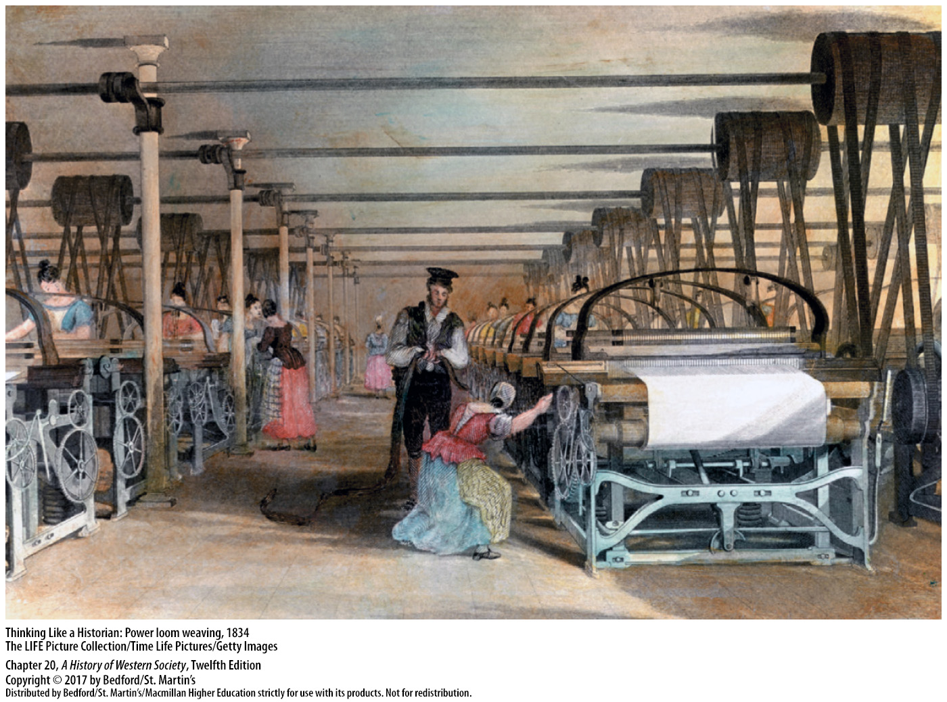

Slide 42
IV. Relations Between Capital and Labor
Responses to Industrialization
1. William Blake (1757–1827)
2. William Wordsworth (1770–1850)
3. Luddites
4. Friedrich Engels (1820–1895)
5. Andre Ure (1835)
Notes:
IV. Relations Between Capital and Labor
B. Responses to Industrialization
1. The poet William Blake (1757–1827), one of the first critics of industrialization, called the early factories “satanic mills” and protested against the hard life of the London poor.
2. William Wordsworth (1770–1850) lamented the destruction of the rural way of life and pollution of the land and water.
3. In northern England, some handicraft workers—the Luddites—smashed the new machines, which they believed were putting them out of work.
4. After studying conditions in northern England, Friedrich Engels (1820–1895) published in 1844 The Condition of the Working Class in England, a blistering indictment of the capitalist classes. According to Engels, the culprit was industrial capitalism, with its relentless competition and constant technical change.
5. By contrast, Andre Ure concluded in his 1835 study of the cotton industry that conditions in most factories were not harsh and were even quite good; Edwin Chadwick, a government official familiar with the problems of the working classes, concluded that workers could increasingly afford “to buy more of the necessities and minor luxuries of life.”

Slide 43
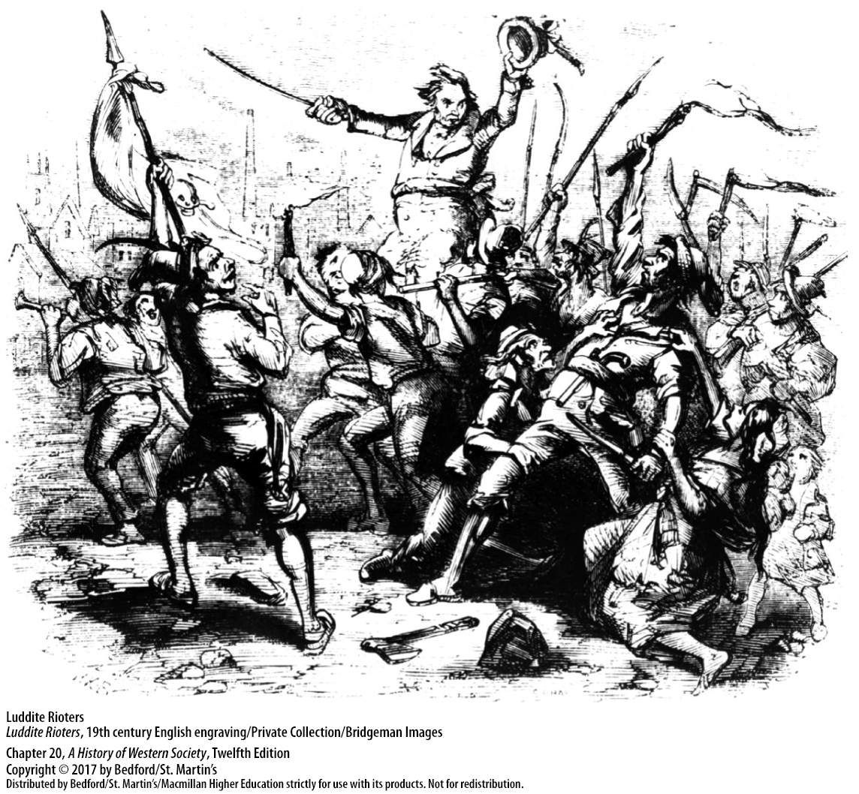

Slide 44
IV. Relations Between Capital and Labor
The Early British Labor Movement
1. Farms and domestic service
2. Working-class solidarity
3. Anti-capitalist sentiment
4. Combination Acts
Notes:
IV. Relations Between Capital and Labor
C. The Early British Labor Movement
1. In 1850 more British people still worked on farms than in any other occupation; domestic service was the second-largest occupation, with more than one million household servants, 90 percent of whom were women.
2. Working-class solidarity and class-consciousness developed in small workshops as well as in large factories.
3. An anti-capitalist sentiment was growing in Britain’s northern factory districts in the early nineteenth century, as the classical liberal concept of economic freedom and laissez faire gathered strength in opposition to working-class anger.
4. In 1799 Parliament passed the Combination Acts, which outlawed unions and strikes; in 1813 and 1814 it repealed the old and often disregarded law of 1563 that regulated the wages of artisans and the conditions of apprenticeship. Parliament repealed the Combination Acts in 1824, and unions were tolerated, though not completely legal until 1867.

Slide 45
IV. Relations Between Capital and Labor
The Early British Labor Movement
5. Grand National Consolidated Trades Union
6. Amalgamated Society of Engineers
7. Chartist movement
Notes:
IV. Relations Between Capital and Labor
C. The Early British Labor Movement
5. Social reformers such as Robert Owen experimented with cooperative and socialist communities, eventually organizing one of the largest and most visionary of the early national unions, the Grand National Consolidated Trades Union.
6. After Owen’s and other such schemes collapsed, the British labor movement moved in the direction of craft unions, the most famous of which, the Amalgamated Society of Engineers, represented skilled machinists.
7. British workers also engaged in direct political activity in defense of their own interests, including involvement in the Chartist movement, which sought to obtain the vote for all men, and in campaigns to limit the factory workday to ten hours.

Slide 46
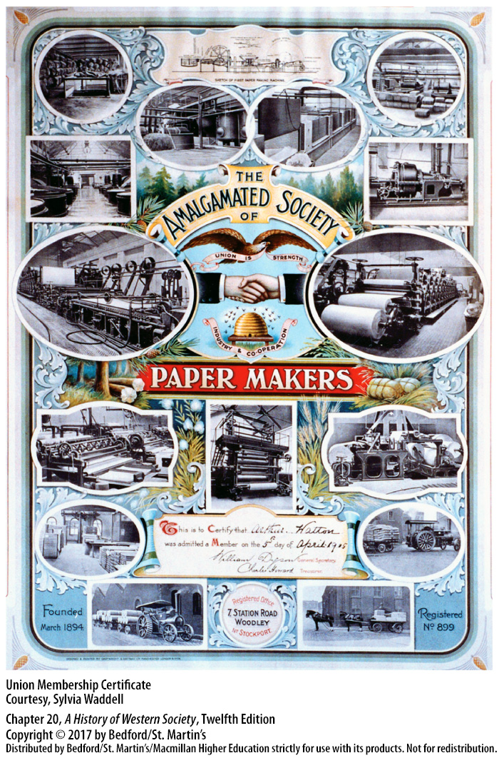

Slide 47
IV. Relations Between Capital and Labor
The Impact of Slavery
1. Mass labor force
2. Small portion of British national income
3. Development of finance and credit institutions
4. Investments
5. Parliament abolished the slave trade in 1807
Notes:
IV. Relations Between Capital and Labor
D. The Impact of Slavery
1. Another mass labor force of the Industrial Revolution consisted of the millions of enslaved men, women, and children who toiled in European colonies in the Caribbean and in North and South America.
2. Most historians agree that profits from colonial plantations and slave trading were a small portion of British national income in the eighteenth century and were probably mostly invested in land rather than in industry. Nevertheless, the need for items to exchange for colonial cotton, sugar, tobacco, and slaves stimulated demand for British manufactured goods in the Caribbean, North America, and West Africa.
3. Britain’s dominance in the slave trade also led to the development of finance and credit institutions that helped early industrialists obtain capital.
4. Investments in canals, roads, and railroads made possible by profits from colonial trade provided the infrastructure needed to move raw materials and factory-made products.
5. Parliament abolished the slave trade in 1807 and freed all slaves in British territories in 1833, but by 1850 most of the cotton processed by British mills was supplied by the labor of enslaved people in the southern United States.

