Slide 1
19c
European
Liberalism
Hippies

Slide 2
Origins of 19^{c} Liberalism
The word was first used when the term was adopted by the Spanish political party, the Liberales, in 1812.
The roots of liberalism came from two very different traditions of English & French political thought.
England
John Locke
Adam Smith
France
Jean Jacques Rousseau
Francois Guizot

Slide 3
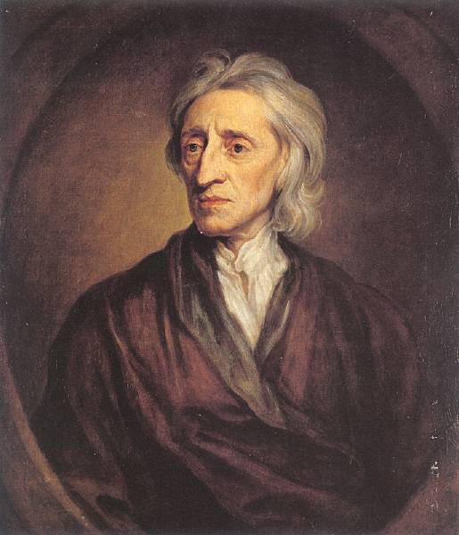
John Locke
Contract theory of government.
Regarded the state as a human construction, established by an original contract.
Limited, constitutional government.
Civil society of free men, equal under the rule of law, bound together by no common purpose but sharing respect for each other’s rights.
Doctrine of natural rights.
Links private property with individual liberty.

Slide 4
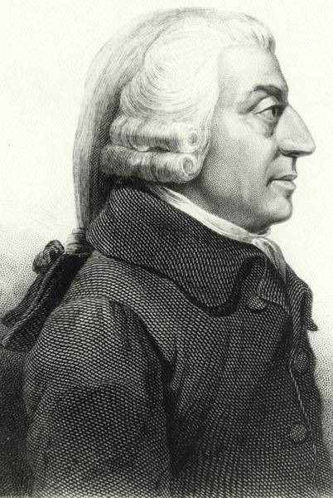
Adam Smith
His Wealth of Nations adds an economic dimension.
He merged Locke’s ideas of civil society with economic theory.
Free trade economics.
Saw the “invisible hand” where a benevolent God administered a universe in which human happiness was maximized.

Slide 5
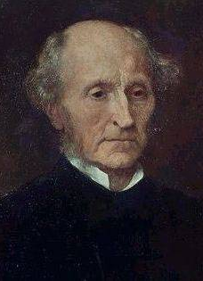
John Stuart Mill (1806-1873)
Wrote works on logic and metaphysics, history and literature, economics and political theory.
Learned Greek at 3; Latin a bit later.
By 12 he was a competent logician.
By 16 he was a trained economist.
A utilitarian:
The greatest happiness for the greatest number.
Wrote On Liberty in 1859.

Slide 6
On Liberty (1859)
Government might be antagonistic to the causes of individual freedom.
The sole purpose of government is “self-protection.”
Government may only coerce others in self-defense.
We should maximize human development for a more equal society:
Mill favored a more open administration.
Organized interest groups.
Workers cooperatives
Workers would own the factories and elect the managers.
Tax wealth.
Redistribution system of wealth:
Confiscation of excess profits
Abolish the wage system.
Emancipation of women.

Slide 7
Classical Liberalism in England
Important legislation:
Catholic Emancipation Act of 1829.
Reform Act of 1832.
Factory Act of 1833.
Repeal of the Corn Laws in 1846.

Slide 8
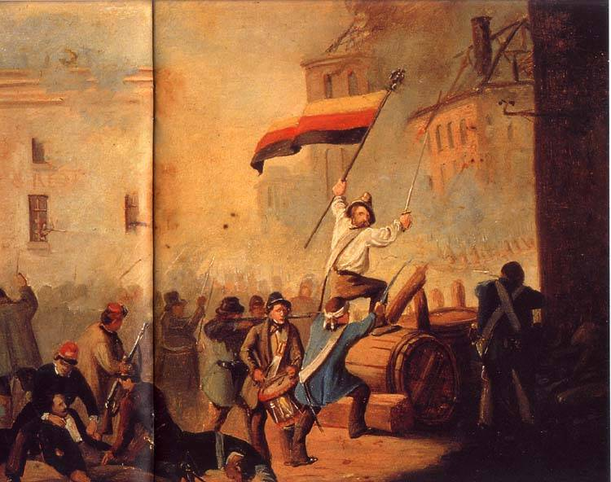
Classical Liberalism in France
Dilemmas faced by French liberals:
How to ‘end’ the French Revolution?
How to reconcile order and liberty in a nation torn apart by civil war?
These problems called for a rethinking of Liberalism.

Slide 9
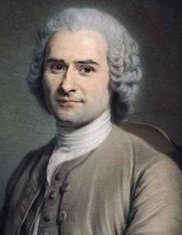
Jean Jacques Rousseau
His Social Contract and theory of the “general will” demonstrates an alternative origin of Liberalism.
Men must resolve problems through our capacity to choose how we ought to live.
Man was born free, and he is everywhere in chains.
Humans are essentially free, but the ‘progress’ of civilization has substituted subservience to others for that freedom.

Slide 10
Rousseau & Totalitarianism
The “General Will” → a strong and direct form of democracy.
Only possible in a relatively small state?
Is Rousseau promoting collective tyranny?
Rousseau rejected representative democracy.

Slide 11
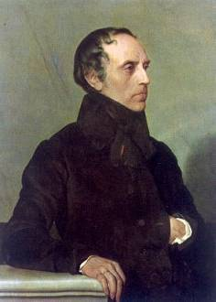
Francois Guizot
He ‘deconstructed’ the French Revolution, and distinguished between “Moderate Liberalism” and extremist Jacobinism.

Slide 12
“Moderate” Liberalism
Favored the idea of the sovereignty of the people, but…
Government should rest on the organized consent of at least the most important sections of the community.
An extension of the franchise to include all men of property.
Exclude the working class!
A good constitutional monarchy was the best form of government.
Valued liberty more than equality.
Confidence in man’s powers of self-government and self-control.
Freedom of the press.
Free right of assembly.
Written constitutions.

Slide 13
“Moderate” Liberalism
Economic policies:
Laissez-faire economy.
Free trade.
Lower tariffs.
Against the right of the working class to organize into unions.
The general progress of humanity would emerge from the growth of wealth and from science and inventions.
Established churches & the landed aristocracy were obstacles to the advancement of civilization.
Orderly change by legislative process.
A dislike of wars, conquests, a standing army, and military expenditures.
Hated the idea of revolution!

Slide 14
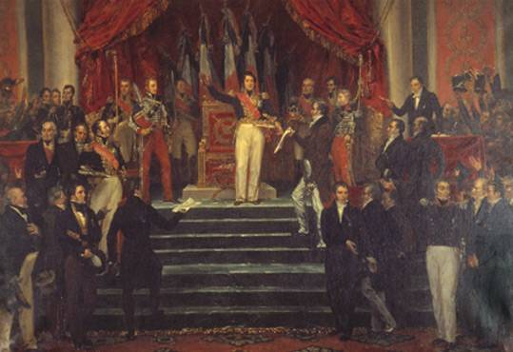
Guizot Accepts the Charter from Louis Philippe

Slide 15
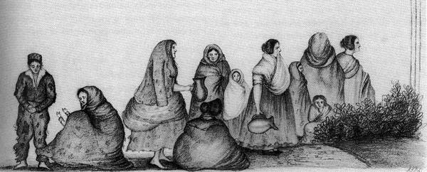
Challenges to Liberalism
From above → the conservative upper class.
From below → socialism/Marxism.
From organized religions.
From militarism and imperialism.
From economic upheavals:
Irish Potato Famine [1845-1852].
Great Depressions [1873-1896].

