Slide 1
A History of Western Society Twelfth Edition
McKay • Crowston • Wiesner-Hanks • Perry
CHAPTER 19
Revolution in Politics
1775–1815
Copyright © 2017 by Bedford/St. Martin’s
Distributed by Bedford/St. Martin's/Macmillan Higher Education strictly for use with its products; Not for redistribution.

Slide 2
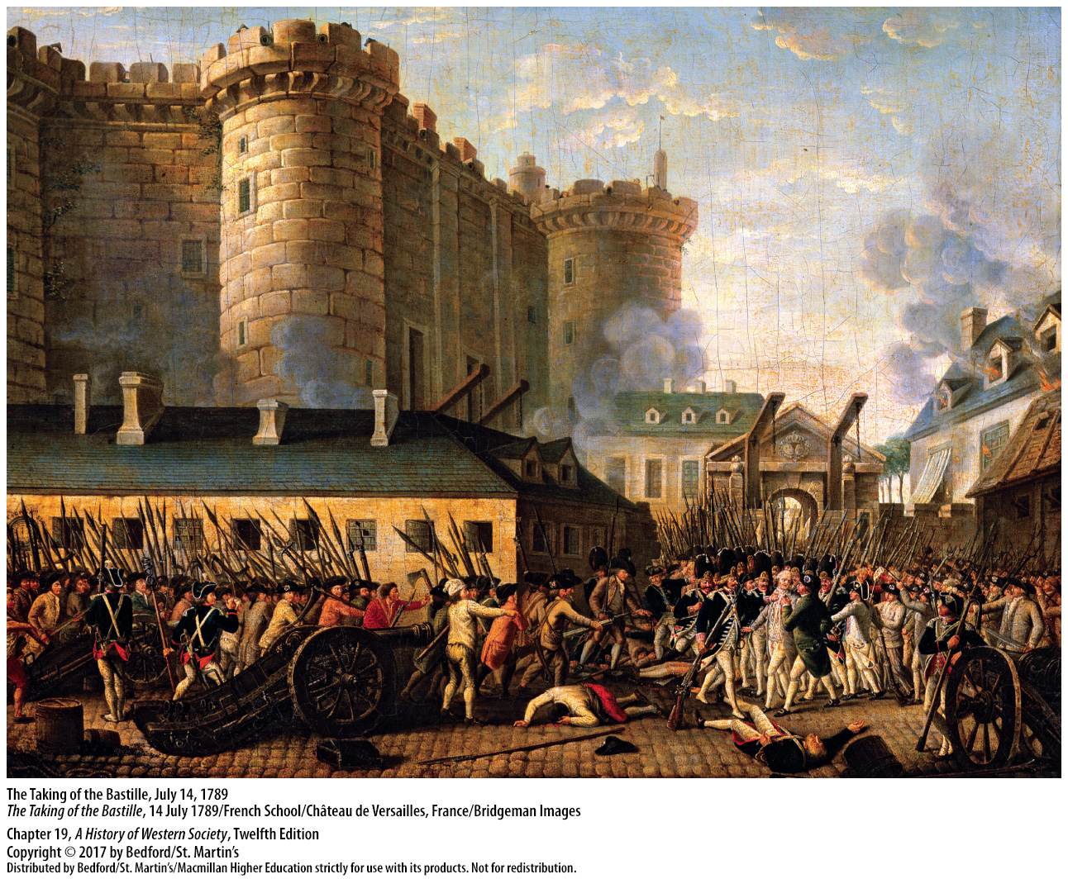

Slide 3
I. Background to Revolution
Social Change
Rights of nobles
Middle-class privileges
Taxed peasants and urban laborers
Urban population and inflation rose
Poor struggled while investors grew rich
Notes:
Background to Revolution
Social Change
1. In France, nobles constituted less than 2 percent of the population while possessing one-quarter of the agricultural land and enjoying exemption from direct taxation as well as exclusive rights to hunt game, bear swords, and wear gold ribbons in their clothing.
2. In most countries, various middle-class groups—professionals, merchants, and guild masters—enjoyed privileges that allowed them to monopolize all sorts of economic activity.
3. Poor peasants and urban laborers, who constituted the vast majority of the population, bore the brunt of taxation and were excluded from the world of privilege.
4. As Europe’s urban population rose rapidly after 1750 and inflation rose, the poor kept up by working harder and for longer hours and by sending more women and children to enter the paid labor force.
5. While the poor struggled with rising prices, investors grew rich from the spread of manufacture in the countryside and overseas trade.

Slide 4
I. Background to Revolution
Social Change
Mixed-caste elite and the bourgeoisie
Ancient privileges seemed intolerable
Racial regimes
Enforced racial privilege
Notes:
Background to Revolution
Social Change
7. A mixed-caste elite emerged as enterprising nobles invested in commerce and wealthy educated commoners (the bourgeoisie) purchased landed estates and noble titles and married into noble families.
8. In the context of these changes, ancient privileges seemed intolerable to many observers.
9. By the late eighteenth century, laws governing Europe’s colonies had created racial regimes under which only Africans and people of African descent were subject to slavery and the rights of free people of color to own property, marry, and wear certain clothing were restricted.
10. Racial privilege conferred a new dimension of entitlement on European settlers in the colonies, and they used brutal methods to enforce it. The contradiction between slavery and the Enlightenment ideals of liberty and equality was evident to the enslaved and free people of color.

Slide 5
I. Background to Revolution
Growing Demands for Liberty and Equality
“Liberals”
The Declaration of the Rights of Man and of the Citizen
Government run by the will of the people
Ambiguous idea of equality
Did not believe in economic equality
Revolutionary demands
Notes:
Background to Revolution
B. Growing Demands for Liberty and Equality
1. Opposing monarchs’ long-standing practice of regulating what people wrote and believed, supporters of the cause of individual liberty (known as “liberals”) demanded freedom to worship, an end to censorship, and freedom from arbitrary laws and judges who obeyed the orders of governments.
2. The Declaration of the Rights of Man and of the Citizen, issued at the beginning of the French Revolution, posed a radical challenge to monarchical and absolutist forms of government.
3. The call for liberty also was a call for a new kind of government in which the people had sovereignty and chose legislators who would represent them and be accountable to them. If monarchs retained their thrones, their rule should be constrained by the will of the people.
4. Equality was a more ambiguous idea: eighteenth-century liberals argued that, in theory, all citizens should have identical rights and liberties, but they accepted a number of distinctions, including slavery and inequality between men and women, and thus limited formal political rights.
5. Liberals did not believe in economic equality either, arguing instead that every free white male should have a legally equal chance at economic gain.
6. Despite these limitations, the demands for liberty and equality were revolutionary.

Slide 6
I. Background to Revolution
Growing Demands for Liberty and Equality
7. Referenced John Locke
8. Also the baron de Montesquieu
9. Restrictions on representative government
10. Appealed to nobility and educated middle classes
11. Poor had little time to plan for reform
12. Some demands for a fuller realization of liberal notions
Notes:
Background to Revolution
B. Growing Demands for Liberty and Equality
7. One of the liberals’ most important Enlightenment references was John Locke, who maintained that England’s political traditions rested on “the rights of Englishmen” and argued that if a government oversteps its proper function of protecting the natural rights of life, liberty, and private property, it becomes a tyranny.
8. The second important Enlightenment reference was the baron de Montesquieu, who believed that powerful “intermediary groups” offered the best defense of liberty against despotism.
9. Representative government did not mean democracy, which liberal thinkers tended to equate with mob rule; liberals envisioned voting for representatives as being restricted to men who owned property—those with a “stake in society.”
10. These ideas appealed to the educated middle classes, as well as to members of the hereditary nobility in western Europe, creating an alliance between landed aristocrats and wealthy commoners.
11. The poor usually had little time to plan for reform, given the time required to work to earn their daily bread.
12. Some revolutionaries demanded a fuller realization of liberal notions of equality and liberty, including political rights for women and free people of color, the emancipation of slaves, and government regulations to reduce economic inequality.

Slide 7
I. Background to Revolution
The Seven Years’ War
Prussia survived attempt to re-establish Habsburg rule
War broke out in North America between the French and British colonies
The 1763 Treaty of Paris
Britain, the leading European power
France retained Caribbean colonies
Both governments raised taxes to repay loans
Notes:
Background to Revolution
C. The Seven Years’ War
1. In Europe, Maria Theresa nearly succeeded in re-establishing the Habsburgs’ traditional leadership in German affairs, but in the end Prussia survived with its boundaries intact.
2. In North America, war broke out over unresolved tensions regarding the border between the French and British colonies, drawing in Native American tribes on both sides, and ended in 1759 with Britain’s decisive defeat of the French.
3. British victory was ratified in the 1763 Treaty of Paris, which stipulated that Canada and all French territory east of the Mississippi River pass to Britain and that France cede Louisiana to Spain and give up most of its holdings in India.
4. Britain became the leading European power in both trade and empire, although shouldering a tremendous war debt.
5. France emerged humiliated and broke, but with its profitable Caribbean colonies intact.
6. After the war, both British and French governments had to raise taxes to repay loans, raising a storm of protests and demands for fundamental reforms and sowing the seeds of revolutionary conflict.

Slide 8
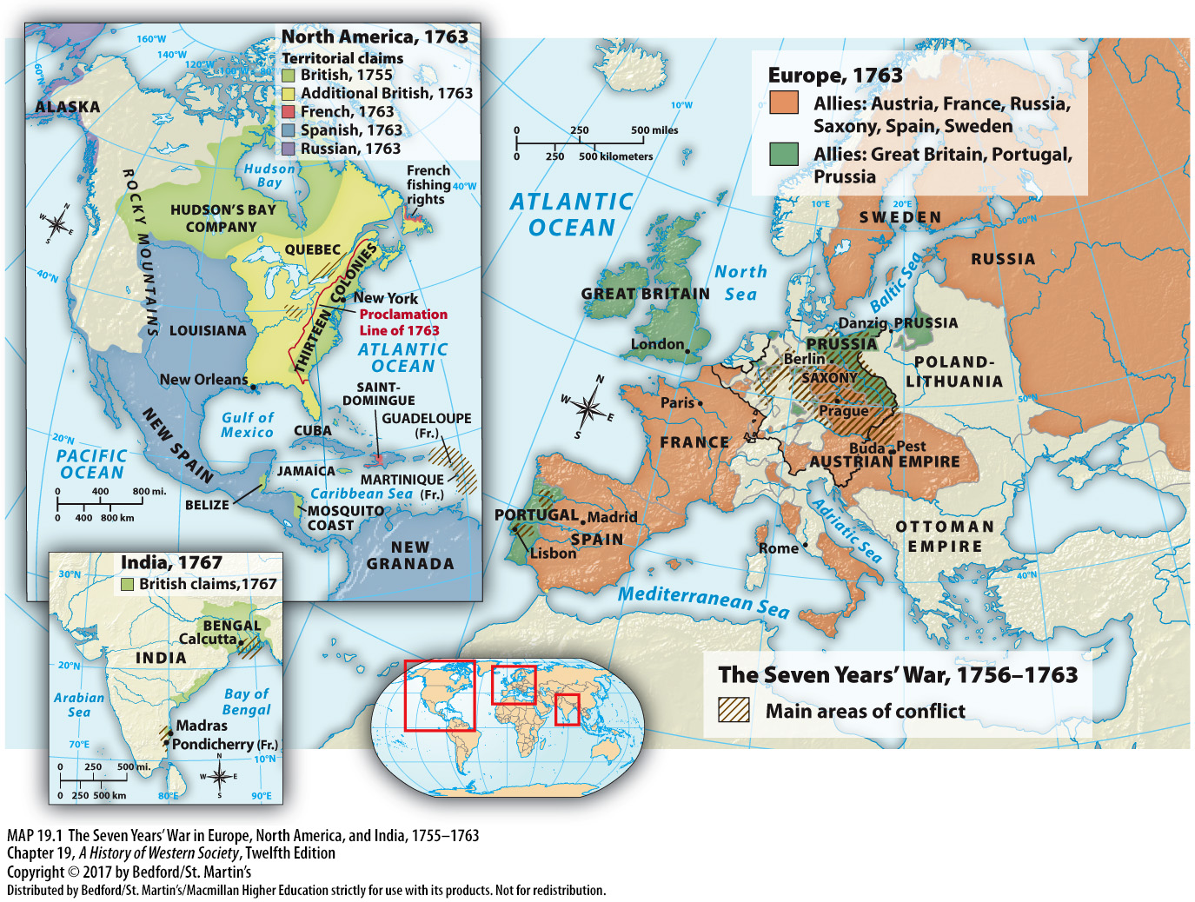

Slide 9
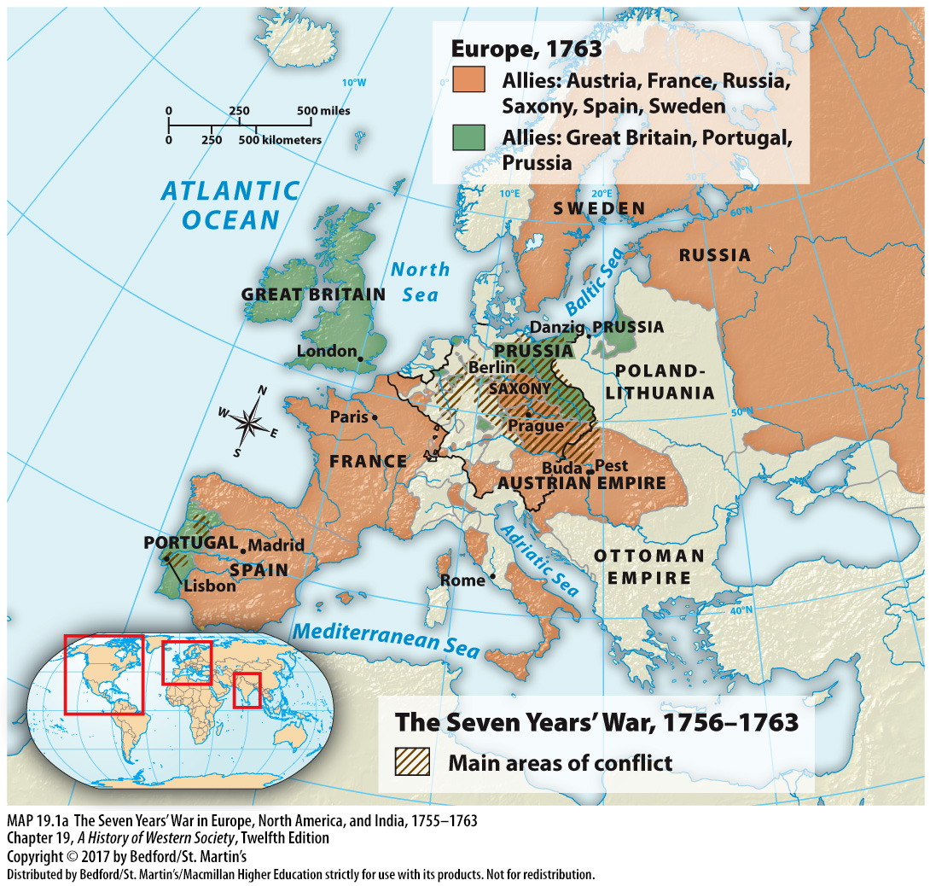

Slide 10
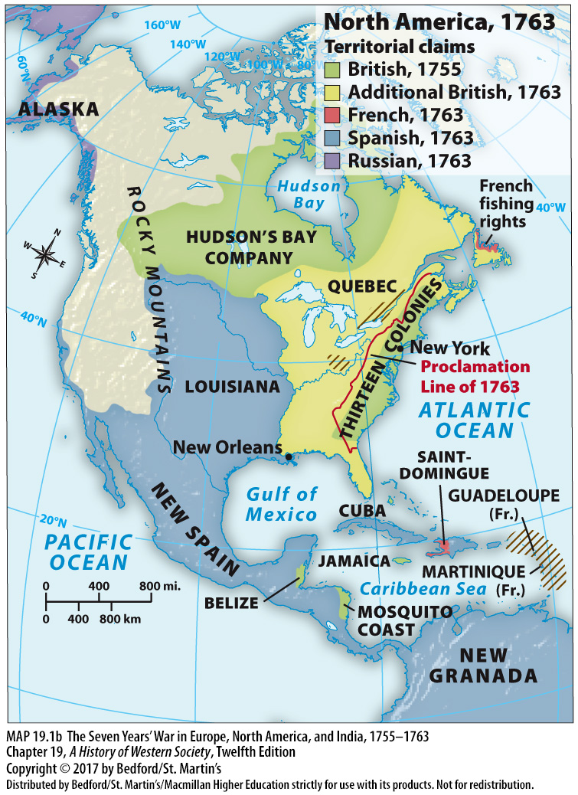

Slide 11
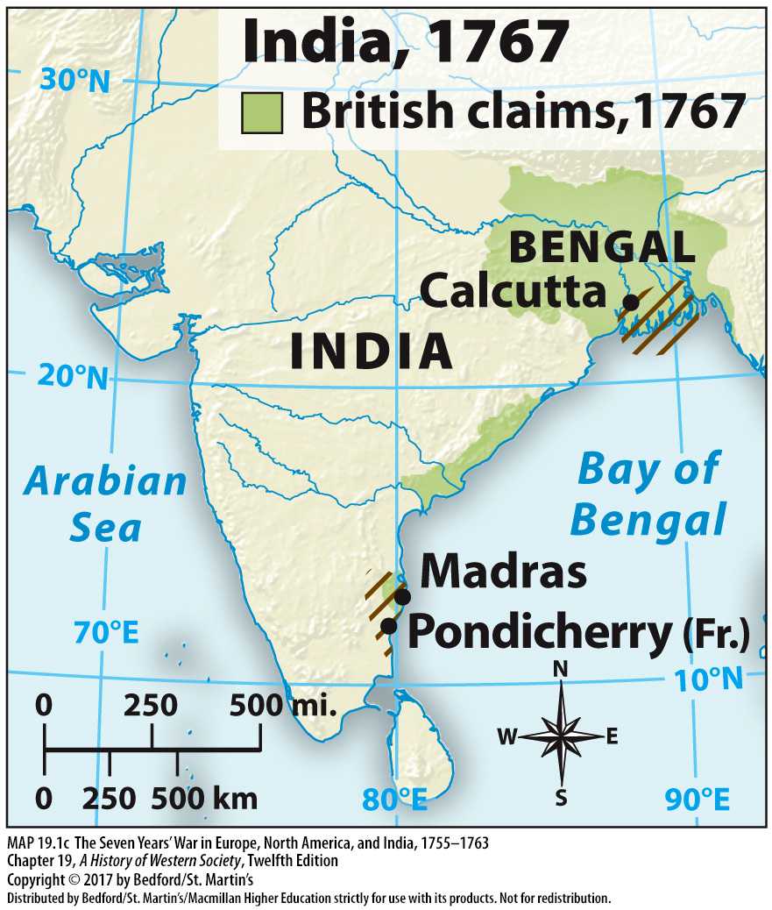

Slide 12
II. The American Revolutionary Era, 1775 – 1789
The Origins of the Revolution
Seven Years’ War doubled the British national debt
Parliament passed the 1765 Stamp Act
Colonists protested the Stamp Act
Proclamation prohibiting colonists from settling west of the Appalachian Mountains
Questions over British authority over America
British administration seen as threat to American liberties
Notes:
II. The American Revolutionary Era, 1775 – 1789
The Origins of the Revolution
1. The high cost of the Seven Years’ War doubled the British national debt and led the government in London to break with its tradition of loose colonial oversight and impose bold new measures.
2. The British announced that they would maintain a large army in North America and tax the colonies directly, and in 1765 Parliament passed the Stamp Act, which levied taxes on many kinds of commercial and legal documents.
3. The colonists vigorously protested the Stamp Act by rioting and boycotting British goods until Parliament repealed it.
4. At the end of the Seven Years’ War settlers moved west across the Appalachian Mountains into the Ohio Valley, sparking conflict with the Ottawa and other tribes already present in the region as well as remaining French settlers. To prevent costly wars in distant territory, the British government issued a royal proclamation prohibiting colonists to settle west of the Appalachian Mountains.
5. These disputes raised two important issues: (1) Could the British government reassert its power and still limit the authority of elected colonial bodies? (2) Who had the right to make laws for Americans?
6. The British government believed that Americans were represented indirectly in Parliament (like most British people) and that Parliament ruled throughout the empire, but American proponents of colonial independence saw British colonial administration and parliamentary supremacy as unacceptable threats to existing American liberties.

Slide 13
II. The American Revolutionary Era, 1775 – 1789
The Origins of the Revolution
7. Freedoms of Americans
8. Indpendent farmers; no hereditary nobility
9. The “Tea Party” in Boston (1773)
10. The Coercive Acts
11. Colonial assemblies
12. The First Continental Congress
13. Fighting began at Lexington and Concord (1775)
Notes:
II. The American Revolutionary Era, 1775 – 1789
The Origins of the Revolution
7. Resistance to these threats were fed by the independence that Americans enjoyed: no powerful established church existed and religious freedom was taken for granted, colonial assemblies made the important laws, and the right to vote was more widespread than in England.
8. No hereditary nobility exercised privileges over peasants and other social groups, and independent farmers dominated colonial society.
9. In 1773 the British government awarded to the East India Company a monopoly on Chinese tea that left out colonial merchants and caused a rowdy protest in Boston called the “Tea Party.”
10. Britain responded with the so-called Coercive Acts, which closed the port of Boston, curtailed local elections, and expanded the royal governor’s power.
11. Colonial assemblies joined Massachusetts in urging that these measures be rejected.
12. The First Continental Congress—consisting of colonial delegates who sought at first to peacefully resolve the conflicts—met in Philadelphia in September 1774.
13. The Congress and Parliament both ultimately rejected compromise, and in April 1775 fighting between colonial and British troops began at Lexington and Concord.

Slide 14
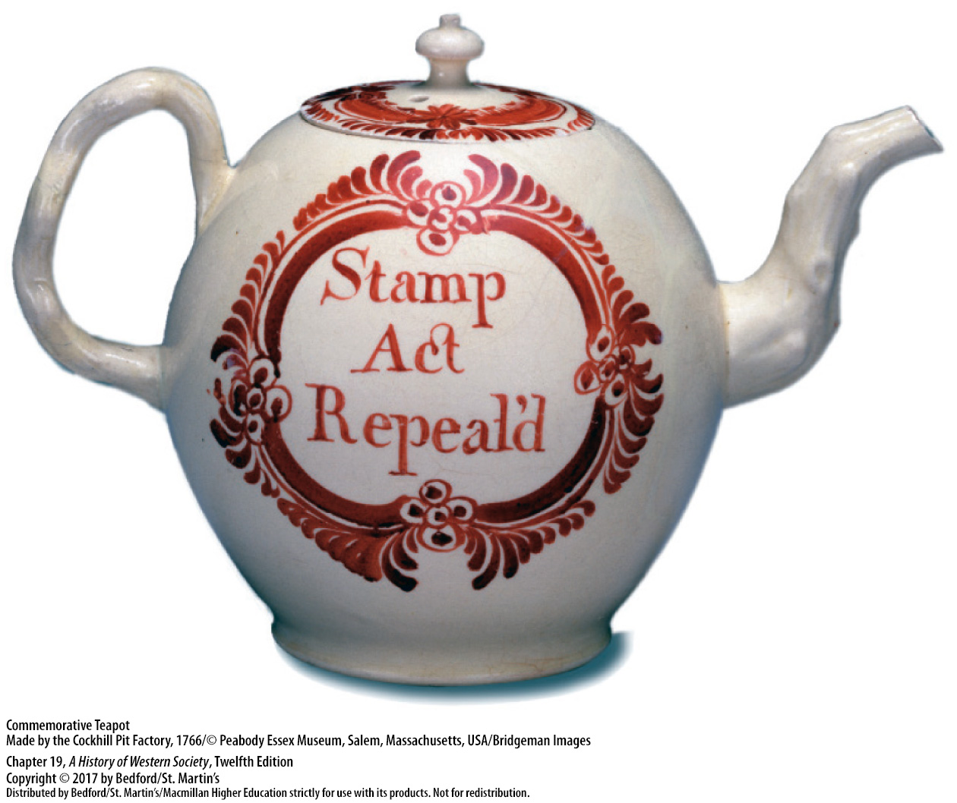

Slide 15
II. The American Revolutionary Era, 1775 – 1789
Independence from Britain
Thomas Paine, Common Sense (1775)
The Declaration of Independence
Civil War of Patriots against Loyalists
Many Loyalists fled to Canada
Notes:
II. The American Revolutionary Era, 1775 – 1789
B. Independence from Britain
1. Common Sense (1775), an attack on British rule by English radical Thomas Paine (1737–1809), also helped mobilize public opinion in favor of independence.
2. On July 4, 1776, the Second Continental Congress adopted the Declaration of Independence, written by Thomas Jefferson, which proclaimed the natural rights of mankind and sovereignty of the American states. The Declaration in effect universalized the traditional rights of English people, making them the rights of all mankind.
3. In the colonies, the conflict took the form of a civil war that pitted patriots against Loyalists, who maintained an allegiance to the Crown and made up about 20 percent of the white population.
4. Many wealthy patriots allied with farmers and artisans in a coalition that harassed Loyalists and confiscated their property to help pay for the war, causing tens of thousands of them to flee, mostly to Canada.

Slide 16
II. The American Revolutionary Era, 1775 – 1789
Independence from Britain
More democratic revolution
French supplied guns and gunpowder
The marquis de Lafayette (1757 – 1834)
Spanish and Dutch declared war on Britain
Notes:
II. The American Revolutionary Era, 1775 – 1789
B. Independence from Britain
5. The broad social base of the coalition made the revolution more democratic, with state governments extending the right to vote to many more men, including some free African American men, but not to women.
6. The French, who wanted revenge against the British for the humiliating defeats of the Seven Years’ War, sympathized with the rebels and supplied guns and gunpowder.
7. French volunteers arrived in Virginia, and one of them, the marquis de Lafayette (1757–1834), became one of George Washington’s most trusted generals.
8. In 1778 the French government offered a formal alliance to the American ambassador in Paris, Benjamin Franklin, and in 1779 and 1780 the Spanish and Dutch declared war on Britain, their rival in transatlantic trade.

Slide 17
II. The American Revolutionary Era, 1775 – 1789
Framing the Constitution
The Constitutional Convention (1787)
Frameworks of checks and balances
Power of federal government checked by individual states
Antifederalists
Bill of Rights
Notes:
II. The American Revolutionary Era, 1775 – 1789
C. Framing the Constitution
1. Delegates to the Constitutional Convention, held in Philadelphia in the summer of 1787, granted the federal government the power to regulate domestic and foreign trade, the right to tax, and the means to enforce its laws.
2. The federal government would operate within a framework of checks and balances in which authority was distributed across three branches—the executive, legislative, and judicial—that would balance one another and prevent one from gaining too much power.
3. Senators and congressmen would be the lawmaking delegates of the voters, and the president of the republic would be an elected official; the power of the federal government, in turn, would be checked by that of the individual states.
4. Opponents of the proposed Constitution—the Antifederalists—charged that the framers had taken too much power from the individual states and made the federal government too strong, and they feared for the individual freedoms for which they had fought.
5. To address these fears, ten amendments were added to the Constitution after its adoption in March 1789 that spelled out basic freedoms. These amendments, ratified in 1791, formed an effective Bill of Rights to safeguard the individual. Most of them—trial by jury, due process of law, the right to assemble, freedom from unreasonable search—had their origins in English law and the English Bill of Rights of 1689; other rights—freedoms of speech, the press, and religion—reflected natural-law theory and the value colonists had placed on independence.

Slide 18
II. The American Revolutionary Era, 1775 – 1789
Limitations of Liberty and Equality
Equality before the law, not equal rights
Emancipation laws in the North
Three-Fifths Compromise
Better representation for the South in Congress
Native American lands
Women contributed to the American Revolution but did not receive voting rights
Notes:
II. The American Revolutionary Era, 1775 – 1789
D. Limitations of Liberty and Equality
1. Liberty meant individual freedoms, political safeguards, and representative government, but it did not mean democracy. Equality meant equality before the law, not equality of political participation or wealth or equal rights for slaves, indigenous peoples, or women.
2. In the 1780s, emancipation laws had been passed in all northern states, but slavery remained prevalent in the South.
3. Discord between pro- and anti-slavery delegates at the Constitutional Convention led to a compromise which stipulated that an enslaved person would count as three-fifths of a person for the purposes of taxation and proportional representation.
4. This solution levied higher taxes on the South, but it also guaranteed slaveholding states greater representation in Congress, which they used to oppose emancipation.
5. The 1787 Constitution promised protection to Native Americans and guaranteed that their land would not be taken without consent; the federal government nonetheless forced tribes to concede their land for meager returns, and state governments and the population often simply seized Native American land for new settlements.
6. Women lacked voting rights, but they participated in boycotts of British goods, raised funds for the Continental Army, and took care of homesteads, workshops, and businesses when their men went off to fight. Despite their contributions to the American Revolution, women did not receive the right to vote in the new Constitution.

Slide 19
III. Revolution in France, 1789 – 1791
Breakdown of the Old Order
King Louis XV (r. 1715 – 1774) and national debt
No central bank or paper currency
Increasing taxes meant reforming the system
Louis XVI (r. 1774 – 1792)
Notes:
III. Revolution in France, 1789 – 1791
Breakdown of the Old Order
1. The French Revolution, like the American Revolution, had its immediate origins in the government’s financial difficulties. The high courts—the parlements—thwarted the efforts of the ministers of King Louis XV (r. 1715–1774) to raise taxes to meet the expenses of the War of the Austrian Succession and the Seven Years’ War and involvement in the American Revolution, and the national debt soared.
2. By 1786 fully 50 percent of France’s annual budget went to interest payments on the growing debt, while less than 20 percent was available for productive functions of the state. Unlike England and the Dutch Republic, France had no central bank or paper currency and had difficulty obtaining new loans.
3. Faced with imminent financial disaster, the government had no alternative but to try to increase taxes, which meant reforming a system that was unfair and out of date; such reforms were guaranteed to create social and political unrest.
4. In the midst of the monarchy being stripped of the sacred aura of God’s anointed on earth (a process called desacralization), Louis XVI (r. 1774–1792) came to the throne. Louis XVI waffled on political reform and the economy and proved unable to quell the rising storm of opposition.

Slide 20
III. Revolution in France, 1789 – 1791
The Formation of the National Assembly
Session of the Estates General
Local assemblies elected representatives
Consensus in calls for a constitutional monarchy
Debates over how the estates should vote
Notes:
III. Revolution in France, 1789 – 1791
B. The Formation of the National Assembly
1. In an attempt to reassert his authority, the king established new taxes by decree. The judges of the Parlement of Paris promptly declared the royal initiative null and void, setting off a wave of protest across the country that forced Louis XVI to call for a session of the Estates General in July 1788. The Estates General was a legislative body with elected representatives from the three orders, or estates, of society—the clergy, nobility, and commoners.
2. Local assemblies elected representatives: the clergy elected mostly parish priests; the nobility elected mostly conservatives from the provinces, one-third of whom were liberals committed to change; commoners of the third estate elected mostly lawyers and government officials.
3. Petitions from the three estates showed a surprising degree of consensus in their calls for a constitutional monarchy, the consent of the Estates General to any taxes and laws, a guarantee of individual liberties through written law, and a loosening of economic regulations.
4. Despite high hopes for serious reform at the opening session at Versailles on May 5, 1789, the estates quickly deadlocked over arguments about whether each estate should meet and vote separately or whether the three estates should vote as a single assembly dominated by the third estate.

Slide 21
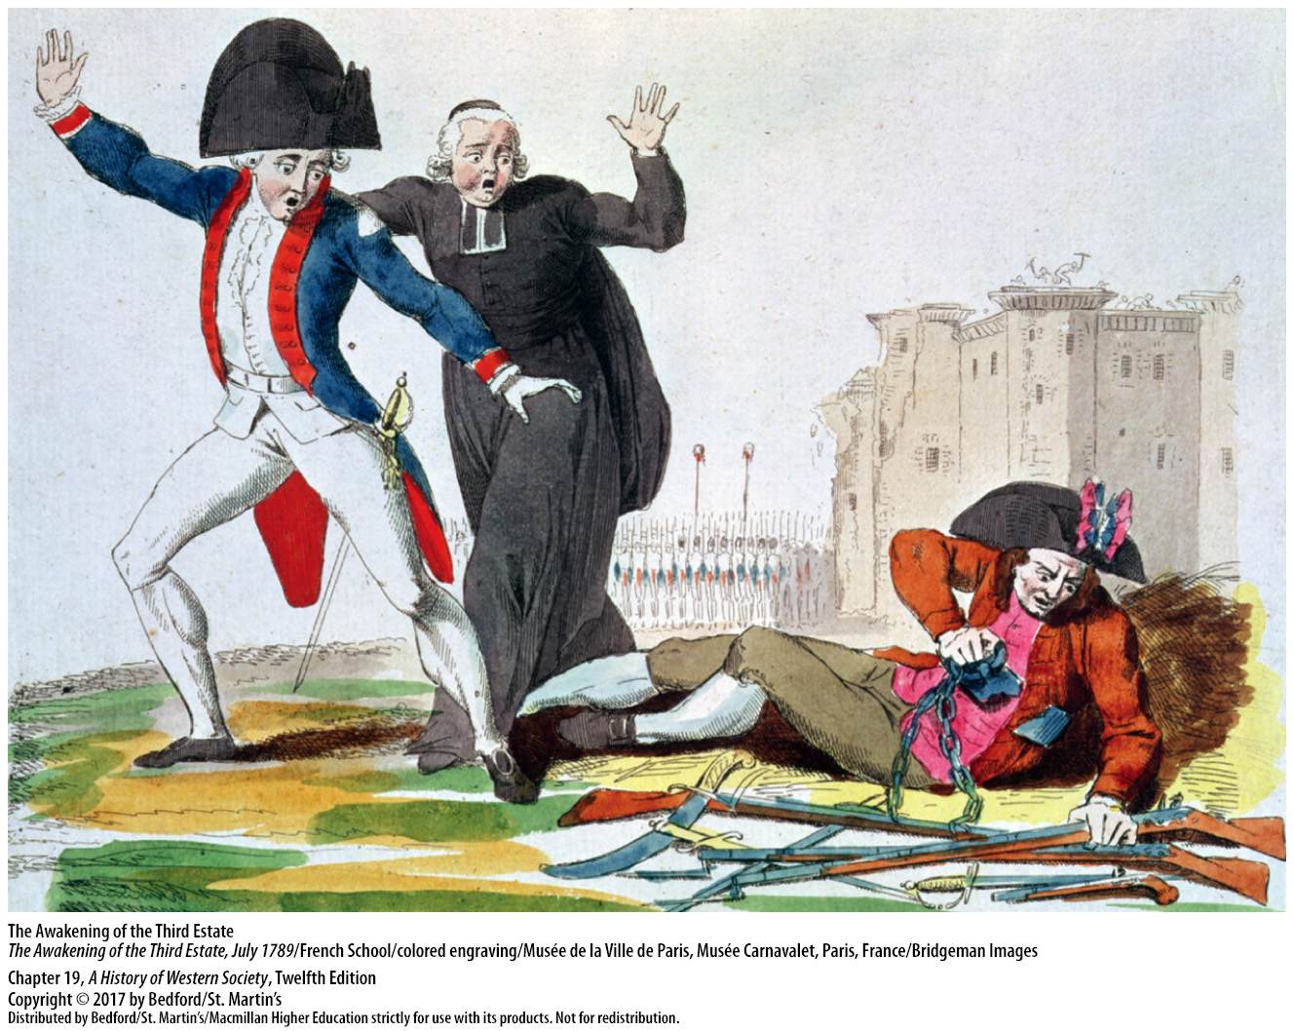

Slide 22
III. Revolution in France, 1789 – 1791
The Formation of the National Assembly
5. abbé Emmanuel Joseph Sieyès, What is the Third Estate?
One vote granted to each estate
The National Assembly and the Tennis Court Oath (1789)
Louis XVI’s response
Notes:
III. Revolution in France, 1789 – 1791
B. The Formation of the National Assembly
5. In his pamphlet What Is the Third Estate? the abbé Emmanuel Joseph Sieyès argued that the nobility was a tiny overprivileged minority and that the third estate constituted the true strength of the French nation.
6. The government agreed to allow the third estate as many delegates as the clergy and nobility combined, but it upheld the system granting one vote to each estate instead of one vote per person.
7. On June 17, 1789, the third estate, joined by a few parish priests, voted to call itself the National Assembly. On June 20 the delegates pledged, in the famous Tennis Court Oath, not to disband until they had been recognized as a national assembly and had written a new constitution.
8. Louis XVI responded to this crucial challenge to his authority in disastrously ambivalent fashion; on June 23 he made a conciliatory speech in which he urged reforms, and on June 27 he ordered the three estates to meet together. The king also called eighteen thousand troops toward the capital, and on July 11 dismissed his finance minister and other more liberal ministers.

Slide 23
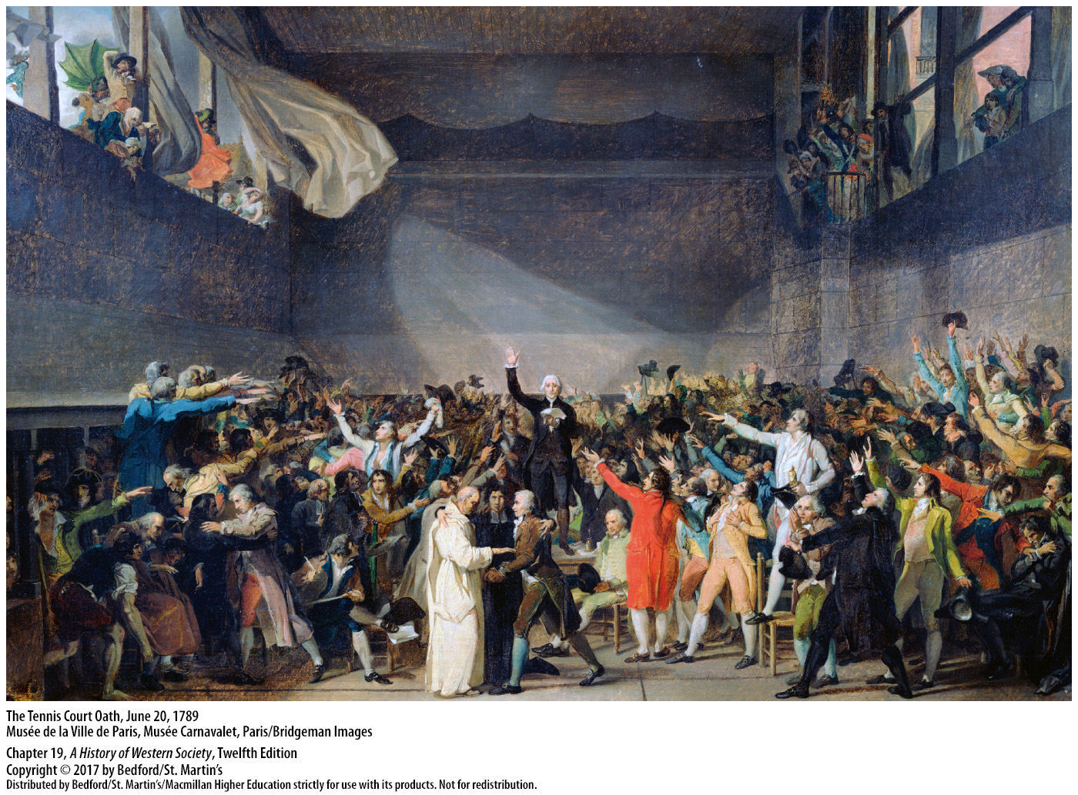

Slide 24
III. Revolution in France, 1789 – 1791
Popular Uprising and the Rights of Man
Soaring bread prices and inflation
Storming of the Bastille (July 14, 1789)
Peasants rose up against their lords
The Declaration of the Rights of Man and of the Citizen (1789)
Women marched to Versailles demanding bread
Notes:
III. Revolution in France, 1789 – 1791
C. Popular Uprising and the Rights of Man
1. While delegates at Versailles were pressing for political rights, the common people were dealing with soaring bread prices, inflation, the collapse of demand for manufactured goods, and rising unemployment.
2. At the beginning of July, knowledge spread of the massing of troops near Paris. On July 14, 1789, several hundred people stormed the Bastille, a royal prison in Paris, to obtain weapons for the city’s defense. Faced with popular violence, Louis announced the reinstatement of his finance minister and the withdrawal of troops from Paris.
3. By the summer of 1789, the struggling French peasants also had reached their boiling point and began to rise in insurrection against their lords, ransacking manor houses and burning feudal documents that recorded their obligations. In some areas peasants reoccupied common lands enclosed by landowners and seized forests.
4. Having granted new rights to the peasantry, the National Assembly issued the Declaration of the Rights of Man and of the Citizen on August 27, 1789, guaranteeing equality before the law, representative government for a sovereign people, and individual freedom.
5. On October 5 some seven thousand women marched the twelve miles from Paris to Versailles, invaded the National Assembly, and demanded bread. The women invaded the royal apartments, killed some of the royal bodyguards, and searched for the queen, Marie Antoinette, who was saved only through the intervention of Lafayette and the National Guard.

Slide 25
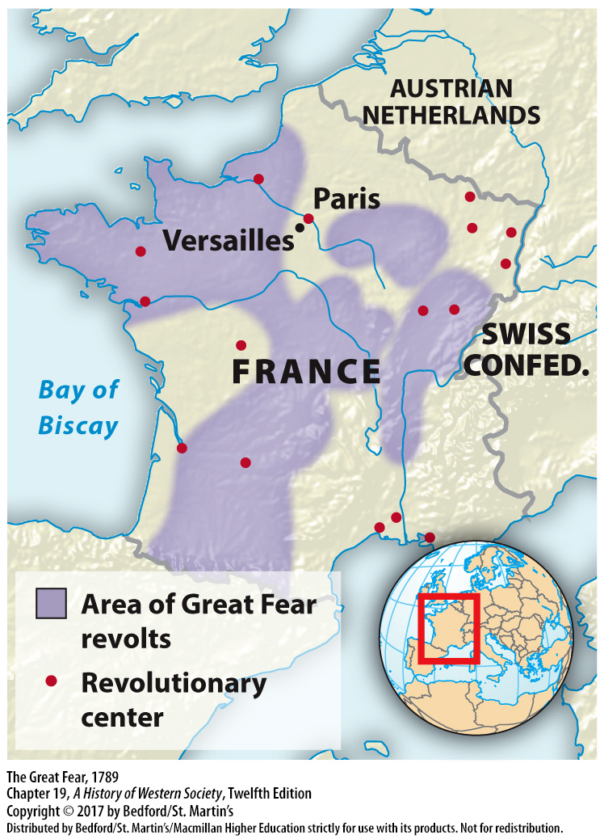

Slide 26
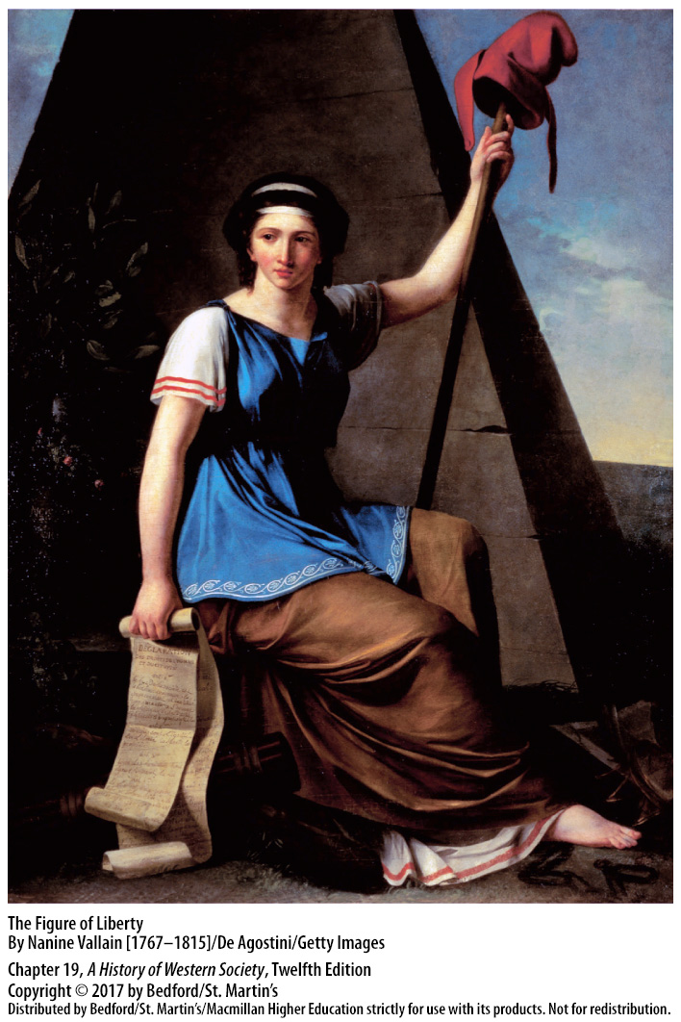

Slide 27
III. Revolution in France, 1789 – 1791
A Constitutional Monarchy and Its Challenges
Abolishment of the French nobility in 1790
Lawmaking power with the National Assembly
Women and the constitution
Olympe de Gouges, Declaration of the Rights of Woman (1791)
Notes:
III. Revolution in France, 1789 – 1791
D. A Constitutional Monarchy and Its Challenges
1. The day after the women’s march on Versailles, the National Assembly followed the king to Paris, as the crowd had demanded. In June 1790 the National Assembly abolished the French nobility, and in July Louis XVI swore to uphold the as-yet-unwritten constitution, effectively enshrining a constitutional monarchy.
2. The king remained the head of state, but all lawmaking power resided in the National Assembly, elected by the wealthiest half of French males.
3. The constitution, passed in September 1791, broadened women’s rights to seek divorce, inherit property, and obtain financial support for illegitimate children from fathers, but it excluded women from political office and voting.
4. In September 1791 Olympe de Gouges (1748–1793) published her Declaration of the Rights of Woman, which echoed the Declaration of the Rights of Man and of the Citizen and challenged revolutionaries to extend the ideal of equality to women. De Gouges’s position found little sympathy among the Revolution’s leaders, as the majority of legislators and ordinary Frenchmen believed that women should focus on their domestic duties.

Slide 28
III. Revolution in France, 1789 – 1791
A Constitutional Monarchy and Its Challenges
5. Abolishment of guilds and workers’ associations
6. Reorganization of country’s religious life
7. Sold church property
8. Established a national church
9. The pope condemned the Assembly’s actions
10. Educated classes vs. common people
Notes:
III. Revolution in France, 1789 – 1791
D. A Constitutional Monarchy and Its Challenges
5. The National Assembly established eighty-three departments to replace the historic provinces and, in the name of economic liberty, abolished guilds, workers’ associations, and internal customs fees.
6. In a radical reorganization of the country’s religious life, the Assembly granted religious freedom to the small minority of French Jews and Protestants, nationalized the Catholic Church’s property, and abolished monasteries.
7. The government used all former church property as collateral to guarantee a new paper currency, the assignats, and then sold the property in an attempt to put the state’s finances on a solid footing.
8. Imbued with the rationalism and skepticism of the eighteenth-century philosophes, the National Assembly established a national church and required the Catholic clergy to take an oath of loyalty to the new government.
9. The pope formally condemned the Assembly’s actions, and only half of all French priests swore the oath.
10. The attempt to remake the Catholic Church, like the abolition of guilds and workers’ associations, sharpened the conflict between the educated classes and the common people.

Slide 29
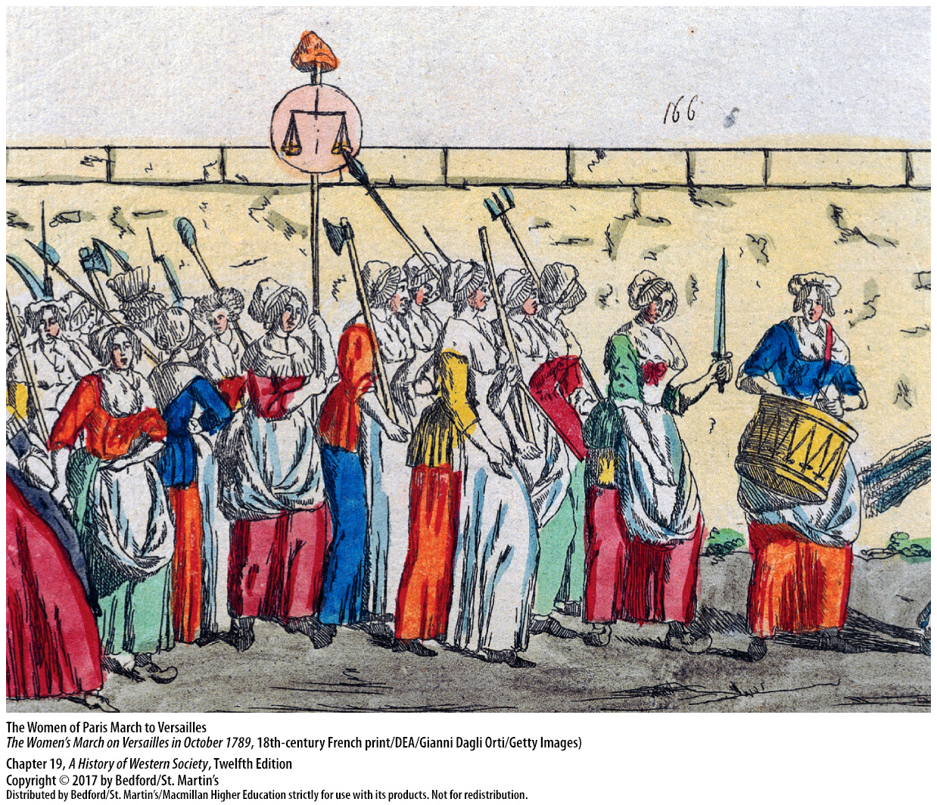

Slide 30
IV. World War and Republican France, 1791 – 1799
The International Response
Edmund Burke, Reflections on the Revolution in France (1790)
Mary Wollstonecraft, A Vindication of the Rights of Man (1790)
A Vindication of the Rights of Woman (1792)
The Declaration of Pillnitz
Notes:
IV. World War and Republican France, 1791 – 1799
The International Response
1. In 1790 British statesman Edmund Burke (1729–1797) published Reflections on the Revolution in France in which he defended inherited privileges and predicted that reform like that occurring in France would lead only to chaos and tyranny.
2. Burke’s work sparked much debate, including a passionate rebuttal from a young writer in London, Mary Wollstonecraft (1759–1797), in a blistering attack, A Vindication of the Rights of Man (1790).
3. Two years later, Wollstonecraft published her masterpiece, A Vindication of the Rights of Woman (1792), in which she demanded equal rights for women and advocated coeducation that would make women better wives and mothers, good citizens, and economically independent.
4. In June 1791 Louis XVI and Marie Antoinette were arrested after they attempted to leave France, prompting the monarchs of Austria and Prussia to issue the Declaration of Pillnitz professing their willingness to intervene to restore Louis XVI’s rule. The Declaration was expected to have a sobering effect on revolutionary France without causing war, but the rulers misjudged the situation.

Slide 31
IV. World War and Republican France, 1791 – 1799
The International Response
The Jacobins
Prussia and Austria vs. the French
King Louis imprisoned
Notes:
IV. World War and Republican France, 1791 – 1799
The International Response
5. Many members of the Legislative Assembly that convened in October 1791 belonged to the Jacobin club, which drew in men and women who debated the burning political questions of the day. Jacobins and other deputies reacted with patriotic fury to the Declaration of Pillnitz and declared war on Francis II, the Habsburg monarch, in April 1792.
6. Prussia joined Austria against the French, who broke and fled at their first military encounter with this First Coalition of foreign powers.
7. When a revolutionary crowd attacked the royal palace on August 10, 1792, the king and his family fled to the Legislative Assembly. Instead of offering refuge, the Assembly suspended the king from all of his functions, imprisoned him, and called for a constitutional assembly to be elected by universal male suffrage.

Slide 32
IV. World War and Republican France, 1791 – 1799
The Second Revolution and the New Republic
Radicalization of the revolution
The September Massacres
France declared a republic
The National Convention and Jacobins
Louis and Marie Antoinette executed (1793)
French occupation of the Austrian Netherlands
Notes:
IV. World War and Republican France, 1791 – 1799
B. The Second Revolution and the New Republic
1. The fall of the monarchy marked a radicalization of the revolution, a phase that historians often call the second revolution.
2. Fearing a Prussian invasion and riled up by rumors that counter-revolutionaries would aid the Prussians, angry crowds stormed the prisons and killed jailed priests and aristocrats, an incident known as the September Massacres.
3. In late September 1792, the new, popularly elected National Convention proclaimed France a republic—a nation in which the people, rather than a monarch, held sovereign power.
4. Many members of the National Convention belonged to the Jacobin Club of Paris, but Jacobins were increasingly divided into two bitterly competitive groups—the Girondists and the Mountain led by Maximilien Robespierre and Georges Jacques Danton.
5. The National Convention overwhelmingly convicted Louis XVI of treason, but the Girondists did not wish to put the king to death. The Mountain prevailed, however, and Louis was executed on January 21, 1793, by the recently perfected guillotine; Marie Antoinette was executed later that year.
6. Both Girondists and the Mountain, determined to continue the “war against tyranny,” celebrated victory over the Prussians at the Battle of Valmy on September 20, 1792; French armies subsequently invaded Savoy and captured Nice, moved into the German Rhineland, and by November 1792 occupied the entire Austrian Netherlands.

Slide 33
IV. World War and Republican France, 1791 – 1799
The Second Revolution and the New Republic
7. French armies like foreign invaders
8. France at war with almost all of Europe
9. Peasants revolted
10. The san-culottes, the Mountain, and the Girondists
11. The Committee of Public Safety (1793)
Notes:
IV. World War and Republican France, 1791 – 1799
B. The Second Revolution and the New Republic
7. Everywhere they went, French armies of occupation chased princes, abolished feudalism, and found support among some peasants and middle-class people. In requisitioning food and supplies and plundering local treasures, however, the French liberators began to look like foreign invaders.
8. International tensions increased in February 1793 when the National Convention declared war on Britain, the Dutch Republic, and Spain; thus France was at war with almost all of Europe.
9. Groups within France added to the turmoil, as peasants in western France revolted against being drafted into the army and received encouragement from devout Catholics, royalists, and foreign agents.
10. In March 1793, when the National Convention was locked in a political struggle between members of the Mountain and the more moderate Girondists, the laboring poor of Paris—called the sans-culottes—demanded radical political action to defend the Revolution and once again emerged as the decisive political factor. The Mountain, sensing a chance to outmaneuver the Girondists, sided with sans-culottes activists to engineer a popular uprising. When armed sans-culottes invaded the Convention and forced the arrest of twenty-nine Girondist deputies for treason on June 2, 1793, all power passed to the Mountain.
11. The Convention also formed the Committee of Public Safety in April 1793 to deal with threats from within and outside France.

Slide 34
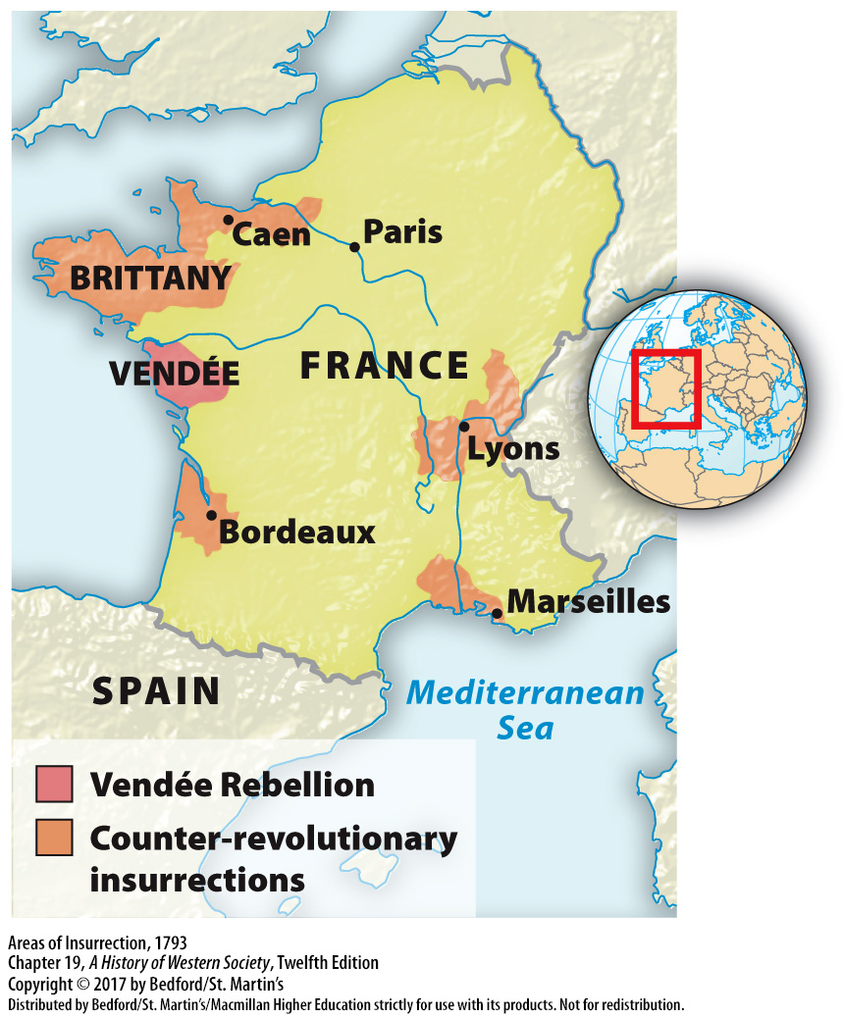

Slide 35
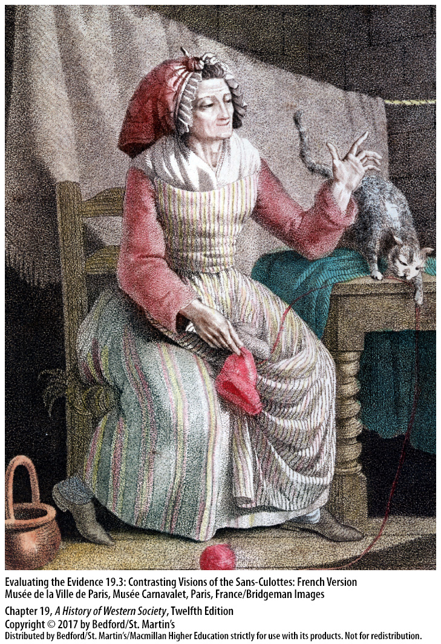

Slide 36
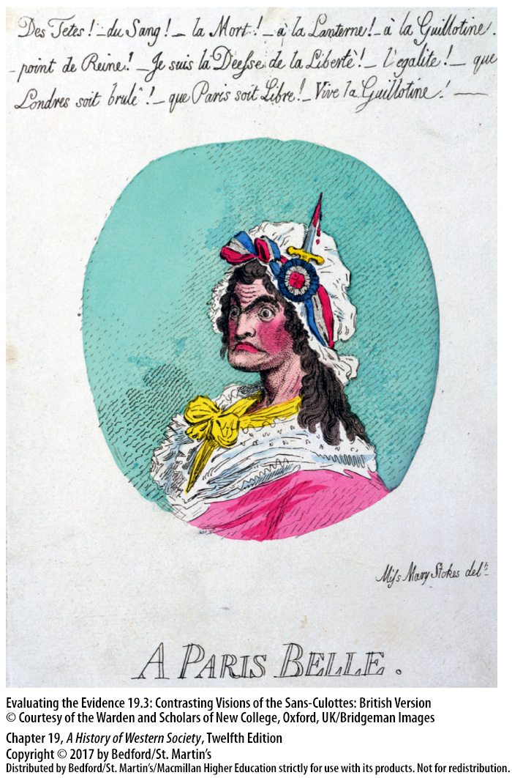

Slide 37
IV. World War and Republican France, 1791 – 1799
Total War and the Terror
Emergency form of socialism
The Reign of Terror (1793 – 1794)
Jacobins suppressed women’s role in politics; Olympe de Gouges executed for sedition
Fervor of nationalism
French armies victorious by spring 1794
Notes:
IV. World War and Republican France, 1791 – 1799
C. Total War and the Terror
1. In September 1793 Robespierre and his colleagues established a planned economy with egalitarian social overtones, setting maximum prices for key products and putting people to work producing arms and munitions for the war effort. The government told craftsmen what to produce, nationalized many small workshops, and requisitioned raw materials and grain.
2. Radical economic measures supplied the poor with bread and the armies with weapons, and the Reign of Terror (1793–1794) enforced compliance with republican beliefs and practices. Special revolutionary courts responsible only to Robespierre’s Committee of Public Safety tried “enemies of the nation” for political crimes.
3. In their efforts to impose unity, the Jacobins suppressed women’s participation in political debate and banned women’s clubs. The writer Olympe de Gouges was among those convicted of sedition and sent to the guillotine.
4. The all-out mobilization of French resources under the Terror combined with the fervor of nationalism to create an awesome fighting machine. Well trained, well equipped, and constantly indoctrinated, the enormous armies of the republic were led by young, impetuous generals who had often risen through the ranks.
5. By spring 1794 French armies were victorious on all fronts, and the republic was saved.

Slide 38
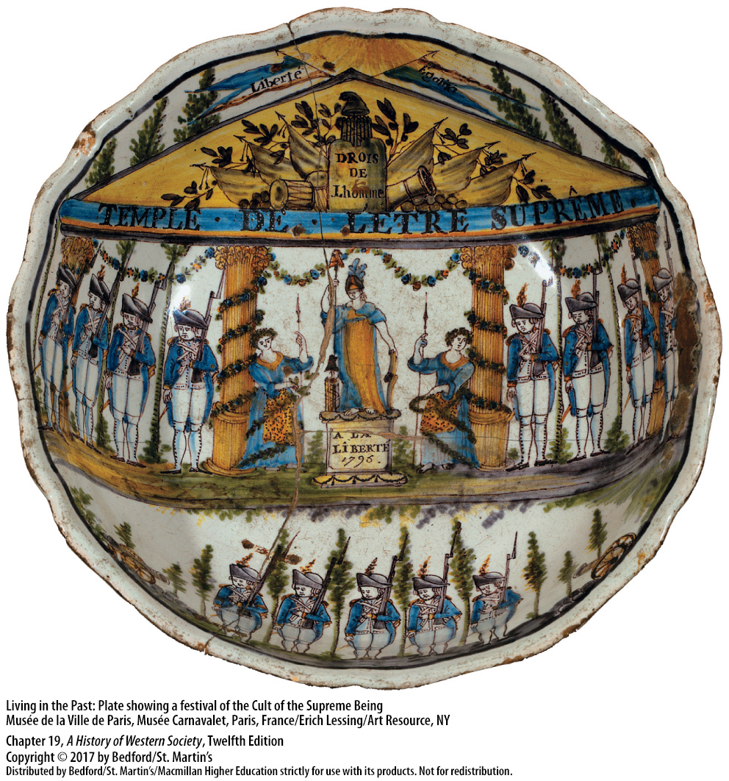

Slide 39
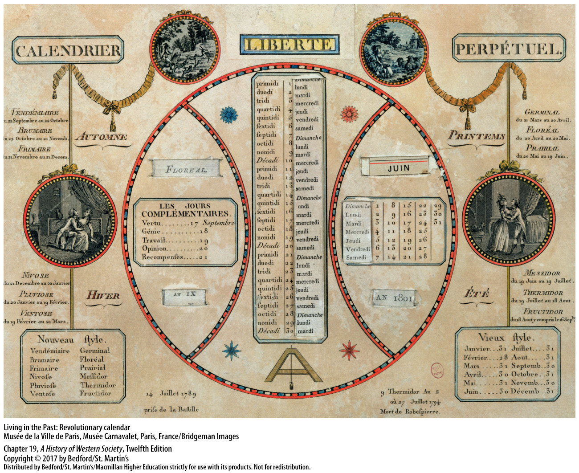

Slide 40
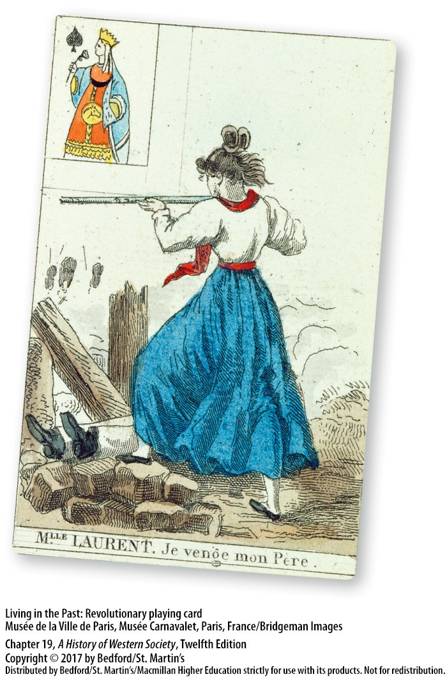

Slide 41
IV. World War and Republican France, 1791 – 1799
The Thermidorian Reaction and the Directory
Extension of the Terror
Robespierre executed in July 1794
The Thermidorian reaction
The Directory
The national elections of 1797
A coup d’état ended the Directory
Notes:
IV. World War and Republican France, 1791 – 1799
D. The Thermidorian Reaction and the Directory
1. The success of the French armies led Robespierre and the Committee of Public Safety to relax emergency economic controls, but they also extended the Terror to wipe out critics and sent long-standing collaborators, including Danton, to the guillotine.
2. A group of radicals and moderates in the Convention, knowing that they might be next, conspired to shout down Robespierre on July 27, 1794—“9 Thermidor” according to France’s new republican calendar—and the next day they sent him to the guillotine.
3. In the Thermidorian reaction, the respectable middle-class lawyers and professionals who had led the liberal revolution of 1789 reasserted their authority, abolishing many economic controls and restricting the local political organizations of the sans-culottes.
4. The middle-class members of the National Convention wrote yet another constitution in 1795, reorganized the Legislative Assembly, and chose a five-man executive body called the Directory. he Directory continued to support French military expansion abroad, using war as a response to economic problems.
5. The French people quickly grew weary of the Directory’s corruptness and ineffectiveness and demonstrated their dissatisfaction in the national elections of 1797, which returned many conservative and even monarchist deputies.
6. Two years later Napoleon Bonaparte ended the Directory in a coup d’état, substituting a strong dictatorship for a weak one.

Slide 43
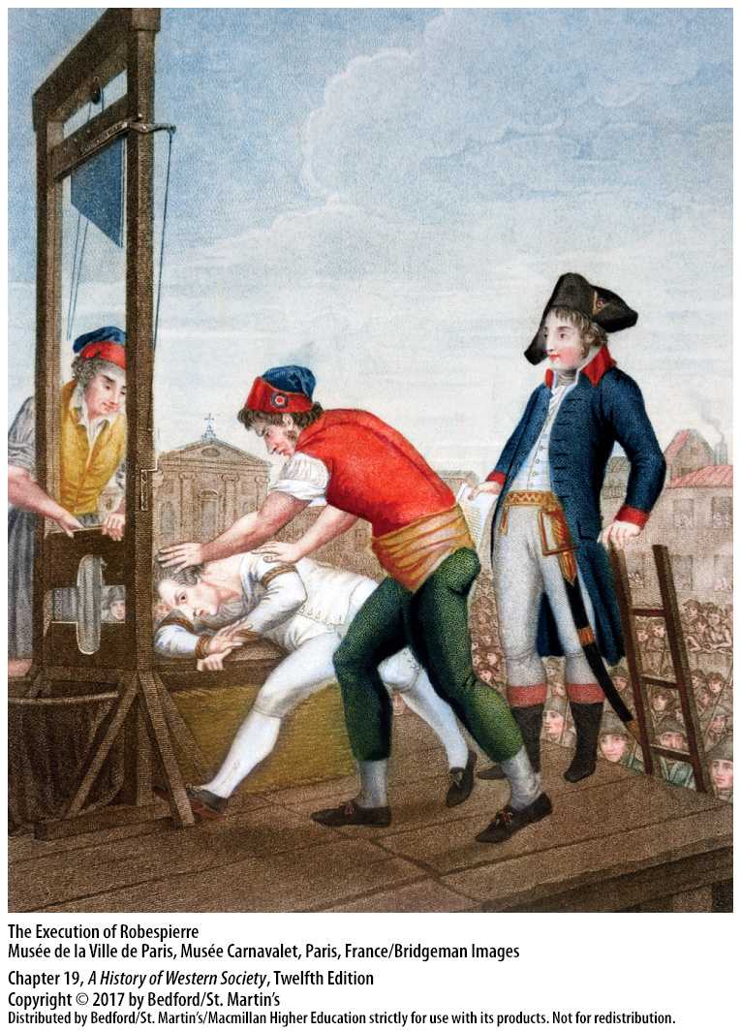

Slide 44
V. The Napoleonic Era, 1799 – 1815
Napoleon’s Rule of France
Napoleon Bonaparte (1769 – 1821)
“Confidence from below, authority from above”
First consul of the republic
The Napoleonic Code (1804)
Bank of France established in 1800
Notes:
V. The Napoleonic Era, 1799 – 1815
Napoleon’s Rule of France
1. One of history’s most fascinating leaders, Napoleon Bonaparte (1769–1821) realized the need to put an end to civil strife in France in order to create unity and consolidate his rule.
2. Napoleon learned of a plot against the Directory that arose out of some prominent legislators’ desire for firm rule rather than a weak dictatorship. The abbé Sieyès personified this evolution in thinking with his motto, “Confidence from below, authority from above.” Napoleon joined the conspirators, and on November 9, 1799, they ousted the Directors and the following day disbanded the legislature through a show of force.
3. Napoleon was named first consul of the republic; a new constitution, approved in December 1799, maintained republican appearances while making Napoleon the real ruler of France.
4. Napoleon used his popularity and charisma to maintain order and end civil strife by working out a bargain with the solid middle class that was codified in the famous Civil Code of March 1804, also known as the Napoleonic Code. The code reasserted two of the fundamental principles of the revolution of 1789: equality of all male citizens before the law, and security of wealth and private property.
5. Napoleon and the leading bankers of Paris established the privately owned Bank of France in 1800.

Slide 45
V. The Napoleonic Era, 1799 – 1815
Napoleon’s Rule of France
Centralized state
The Concordat of 1801
Women lost gains made in the 1790s
Curtailed freedoms
Notes:
V. The Napoleonic Era, 1799 – 1815
Napoleon’s Rule of France
6. Napoleon built on the established bureaucracy to create a centralized state and consolidated his rule by recruiting disillusioned revolutionaries for important posts. As for the old nobility, Napoleon granted amnesty to one hundred thousand émigrés on the condition that they return to France and take a loyalty oath.
7. Using his diplomatic skills to heal the Catholic Church in France, Napoleon and Pope Pius VII (pontificate 1800–1823) signed the Concordat of 1801, which allowed Catholics to practice their religion freely while giving Napoleon the power to nominate bishops in France.
8. Women lost many of the gains they made in the 1790s: the Napoleonic Code deemed them dependents of their fathers or husbands and prohibited them from entering into contracts or holding bank accounts in their own names.
9. Napoleon curtailed free speech and freedom of the press and manipulated voting in the occasional elections. After 1810 political suspects were held in state prisons, as they had been during the Terror.

Slide 46
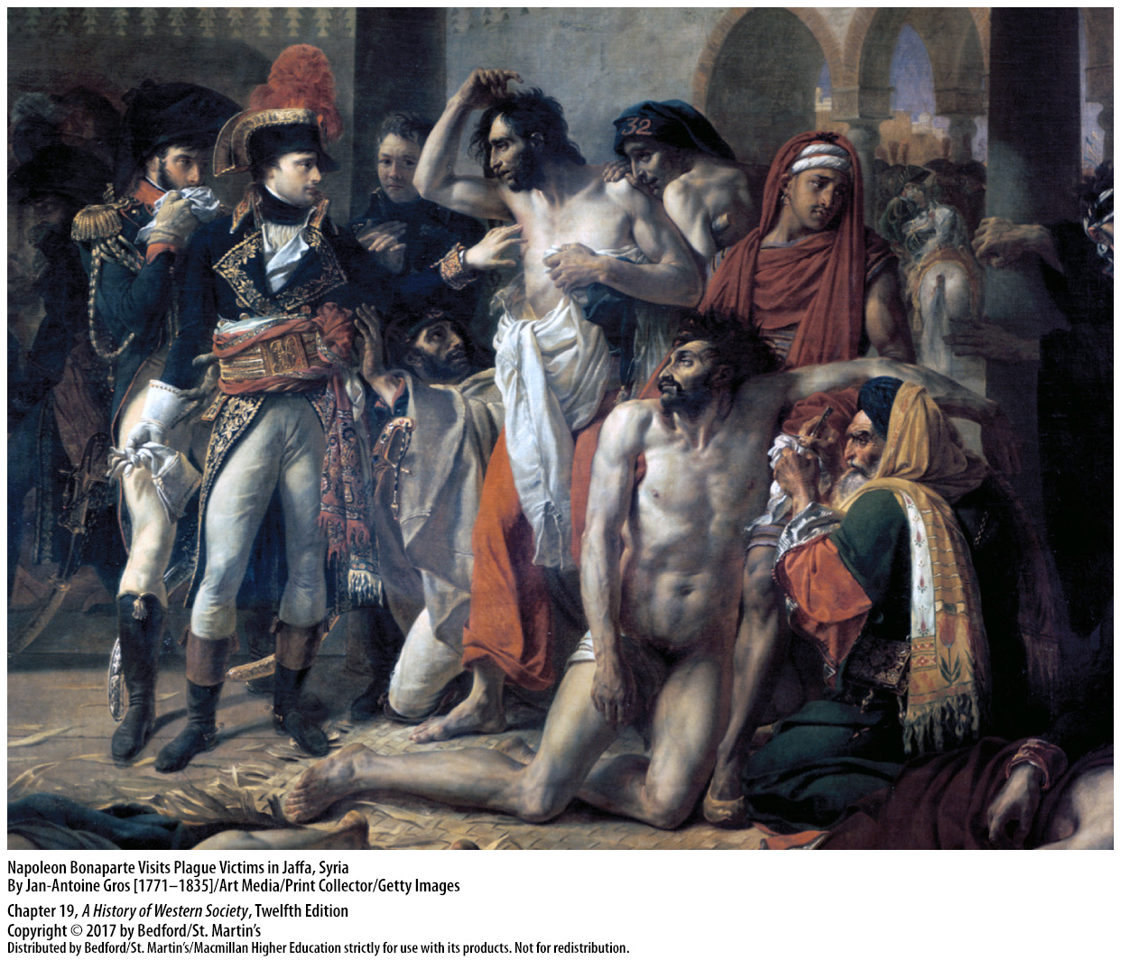

Slide 47
V. The Napoleonic Era, 1799 – 1815
Napoleon’s Expansion in Europe
French armies defeated the Austrians
Treaty of Lunéville (1801)
Treaty of Amiens (1802)
Battle of Trafalgar (1805)
Napoleon proclaimed emperor in late 1804
German Confederation of the Rhine
Treaties of Tilsit in 1807
Notes:
V. The Napoleonic Era, 1799 – 1815
B. Napoleon’s Expansion in Europe
1. When Napoleon’s overtures of peace were rejected by Austria and Great Britain, French armies led by Napoleon decisively defeated the Austrians.
2. In the Treaty of Lunéville (1801), France gained most of Austria’s Italian possessions and German territory on the west bank of the Rhine.
3. The British agreed to the Treaty of Amiens in 1802, a diplomatic triumph for Napoleon.
4. Driven to expand his power, however, Napoleon tried to restrict British trade with all of Europe and then plotted to attack Great Britain. Napoleon’s Mediterranean fleet was destroyed by Lord Nelson at the Battle of Trafalgar on October 21, 1805, making an invasion of England impossible.
5. Napoleon used the wartime atmosphere to have himself proclaimed emperor in late 1804.
6. Napoleon then proceeded to reorganize the German states into the German Confederation of the Rhine, naming himself “protector” of the confederation.
7. Prussians mobilized their armies against France, but Napoleon attacked and won two more brilliant victories in October 1806 at Jena and Auerstädt. Even though Russia joined forces with Prussia, Napoleon won another victory, forcing Alexander I to negotiate peace in the treaties of Tilsit in 1807.

Slide 48
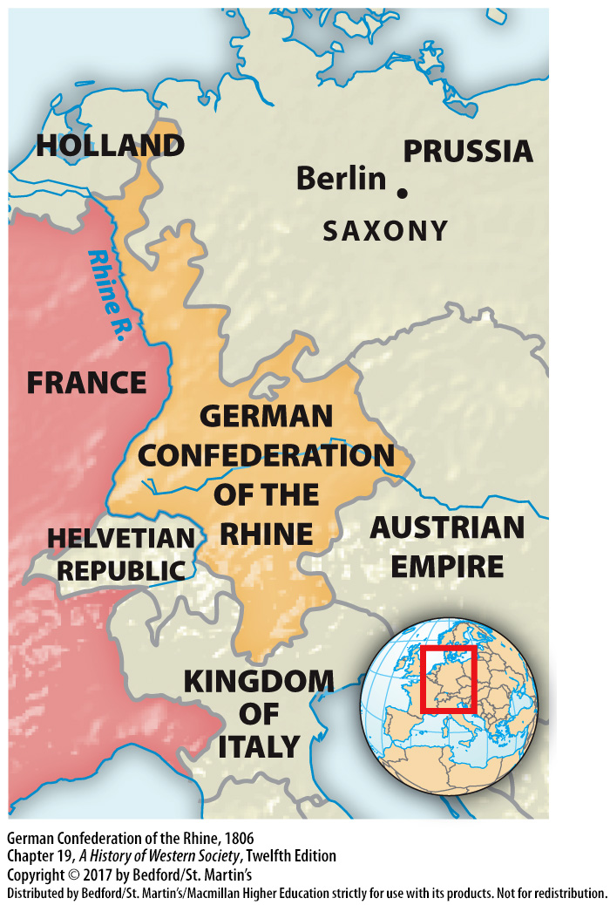

Slide 49
V. The Napoleonic Era, 1799 – 1815
The Grand Empire and Its End
Napoleon’s Grand Empire
Napoleon’s Continental System
Revolt in Spain in 1808
Continental System backfired
Notes:
V. The Napoleonic Era, 1799 – 1815
C. The Grand Empire and Its End
1. Napoleon increasingly saw himself as the emperor of Europe. The core of his so-called Grand Empire was an ever-expanding France; the second part consisted of a number of dependent satellite kingdoms; and the third part comprised the independent but allied states of Austria, Prussia, and Russia.
2. After 1806 both satellites and allies were expected to support Napoleon’s Continental System, a blockade intended to halt all trade between Britain and continental Europe, thereby destroying the British economy and its military force.
3. The first great revolt occurred in Spain in 1808 when a coalition rebelled against Napoleon’s attempts to make Spain a French satellite and waged guerrilla warfare against French armies.
4. In 1810, when the Grand Empire was at its height, Britain still remained at war with France, helping the guerrillas in Spain and Portugal. The Continental System backfired, as a counter-blockade instituted by Britain created hardships for the French population.

Slide 50
V. The Napoleonic Era, 1799 – 1815
The Grand Empire and Its End
Invaded Russia in June 1812
Retreat from Russia; military disaster
European patriots called for a “war of liberation”; Napoleon abdicated in 1814
Notes:
V. The Napoleonic Era, 1799 – 1815
C. The Grand Empire and Its End
5. Napoleon turned on Alexander I, who had openly repudiated Napoleon’s war of prohibitions against British goods, and invaded Russia in June 1812 with what was probably the largest force assembled to date.
6. Though he had originally planned to winter in the Russian city of Smolensk, Napoleon recklessly pressed on toward Moscow. The great Battle of Borodino that followed was a draw, and Alexander ordered the evacuation of Moscow, which the Russians then burned in part, and refused to negotiate. After five weeks in the scorched and abandoned city, Napoleon ordered a retreat that turned into one of the greatest military disasters in history, as the Russian army, the Russian winter, and starvation cut Napoleon’s army to pieces.
7. All across Europe patriots called for a “war of liberation” against Napoleon’s oppression, and on April 4, 1814, a defeated Napoleon abdicated his throne.

Slide 51
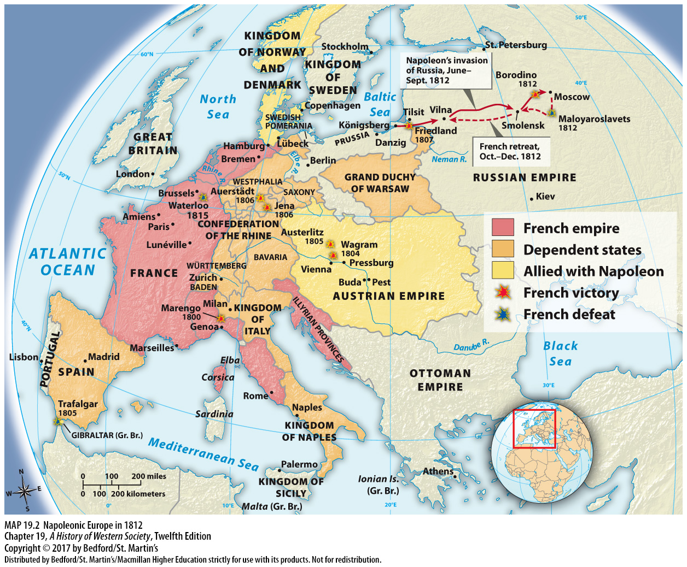

Slide 52
V. The Napoleonic Era, 1799 – 1815
The Grand Empire and Its End
8. Treaty of Chaumont
9. Restoration of the Bourbon dynasty
10. Napoleon escaped from Elba (1815)
11. Napoleon defeated at Waterloo (1815)
12. Napoleon imprisoned on island of St. Helena
Notes:
V. The Napoleonic Era, 1799 – 1815
C. The Grand Empire and Its End
8. The victorious alliance formed in the Treaty of Chaumont—Austria, Prussia, Russia, and Great Britain—granted Napoleon the island of Elba as his own tiny state and allowed him to keep his imperial title.
9. The allies also agreed to the restoration of the Bourbon dynasty under Louis XVIII (r. 1814–1824).
10. Hearing of political unrest in France and diplomatic tensions in Vienna, Napoleon staged a daring escape from Elba in February 1815 and marched on Paris with a small band of followers.
11. French officers and soldiers who had fought so long for their emperor joined him, but the allies were united against Napoleon and crushed his forces at Waterloo on June 18, 1815.
12. The allies imprisoned Napoleon on the island of St. Helena off the western coast of Africa where he wrote his memoirs, nurturing the myth of himself as Europe’s revolutionary liberator.

Slide 53
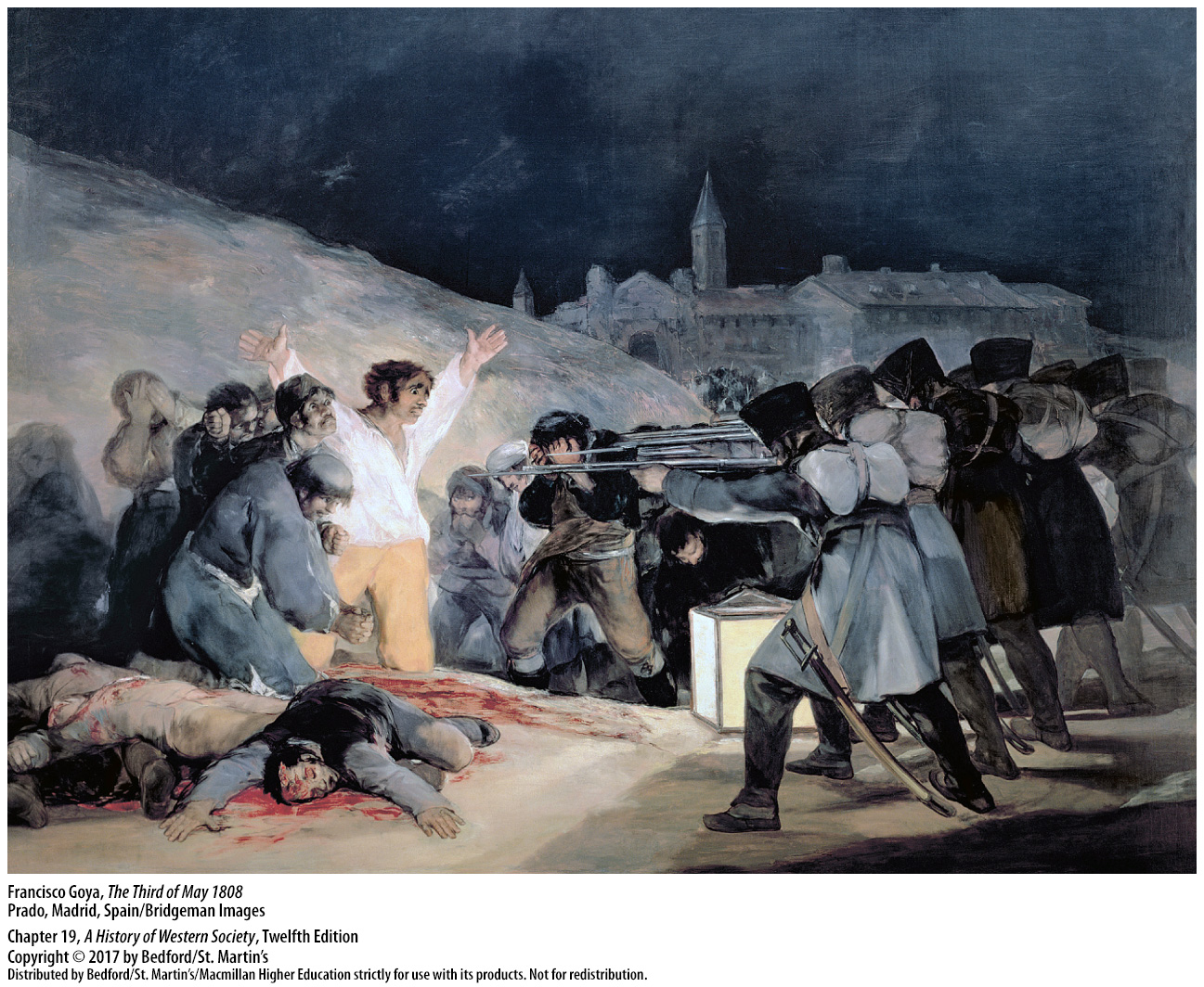

Slide 54
VI. The Haitian Revolution, 1791 – 1804
Revolutionary Aspirations in Saint-Domingue
Social tensions in Saint-Domingue
Creoles developed their own interests
The 1685 Code Noir (Black Code)
Colonial administration began rescinding the rights of free people of color
Notes:
VI. The Haitian Revolution, 1791 – 1804
Revolutionary Aspirations in Saint-Domingue
1. Saint-Domingue—the most profitable of all Caribbean colonies—was even more rife with social tensions than France itself. The white European population of the colony included French colonial officials, wealthy plantation owners, merchants, and poor immigrants, but they were vastly outnumbered by the colony’s five hundred thousand enslaved people and some forty thousand free people of African and mixed African and European descent who referred to themselves as free people of color.
2. Individuals of French or European descent born in the colonies—“Creoles”—had over time developed their own interests, at time distinct from those of metropolitan France.
3. The 1685 Code Noir (Black Code) was intended to provide minimal standards of humane treatment, but its tenets were rarely enforced; masters worked slaves ruthlessly and purchased new ones when they died, rather than provide enough food, rest, and medical care to allow the enslaved population to reproduce naturally.
4. The Code Noir had granted free people of color the same rights and legal status as whites, but the rising prosperity and visibility of this group provoked resentment; from the 1760s on, colonial administrators began rescinding those rights.

Slide 55
VI. The Haitian Revolution, 1791 – 1804
Revolutionary Aspirations in Saint-Domingue
5. Reforms in France inspired hope for enslaved and free people of color
6. Creole elite looked to representative government
7. France reaffirmed monopolies over colonial trade
8. Vincent Ogé and his army
9. Political rights granted to free people of color born to two free parents with property
10. Colonial governor refused to enact it
Notes:
VI. The Haitian Revolution, 1791 – 1804
Revolutionary Aspirations in Saint-Domingue
5. For enslaved people, news of abolitionist movements in France led to hopes of freedom. Free people of color looked to reforms in Paris as a means of gaining political enfranchisement and reasserting equal status with whites.
6. The Creole elite, infuriated by talk of abolition and determined to protect their way of life, looked to revolutionary ideals of representative government for the chance to gain control of their own affairs.
7. The National Assembly refused to extend French constitutional safeguards to the colonies and reaffirmed French monopolies over colonial trade, thereby frustrating the aspirations of slaves and free people of color and angering Creole planters.
8. In July 1790 Vincent Ogé, a free man of color, returned to Saint-Domingue from Paris, raised an army of several hundred, and sent letters to the new Provincial Assembly of Saint-Domingue demanding political rights for all free citizens. After Ogé’s demands were refused, he and his followers turned to armed insurrection, which after initial victories, resulted in his army’s defeat and his torture and execution.
9. In May 1791 the French National Assembly granted political rights to free people of color born to two free parents who possessed sufficient property.
10. This legislation infuriated the white elite, and the colonial governor refused to enact it, causing another eruption of violence between whites and free people of color.

Slide 56
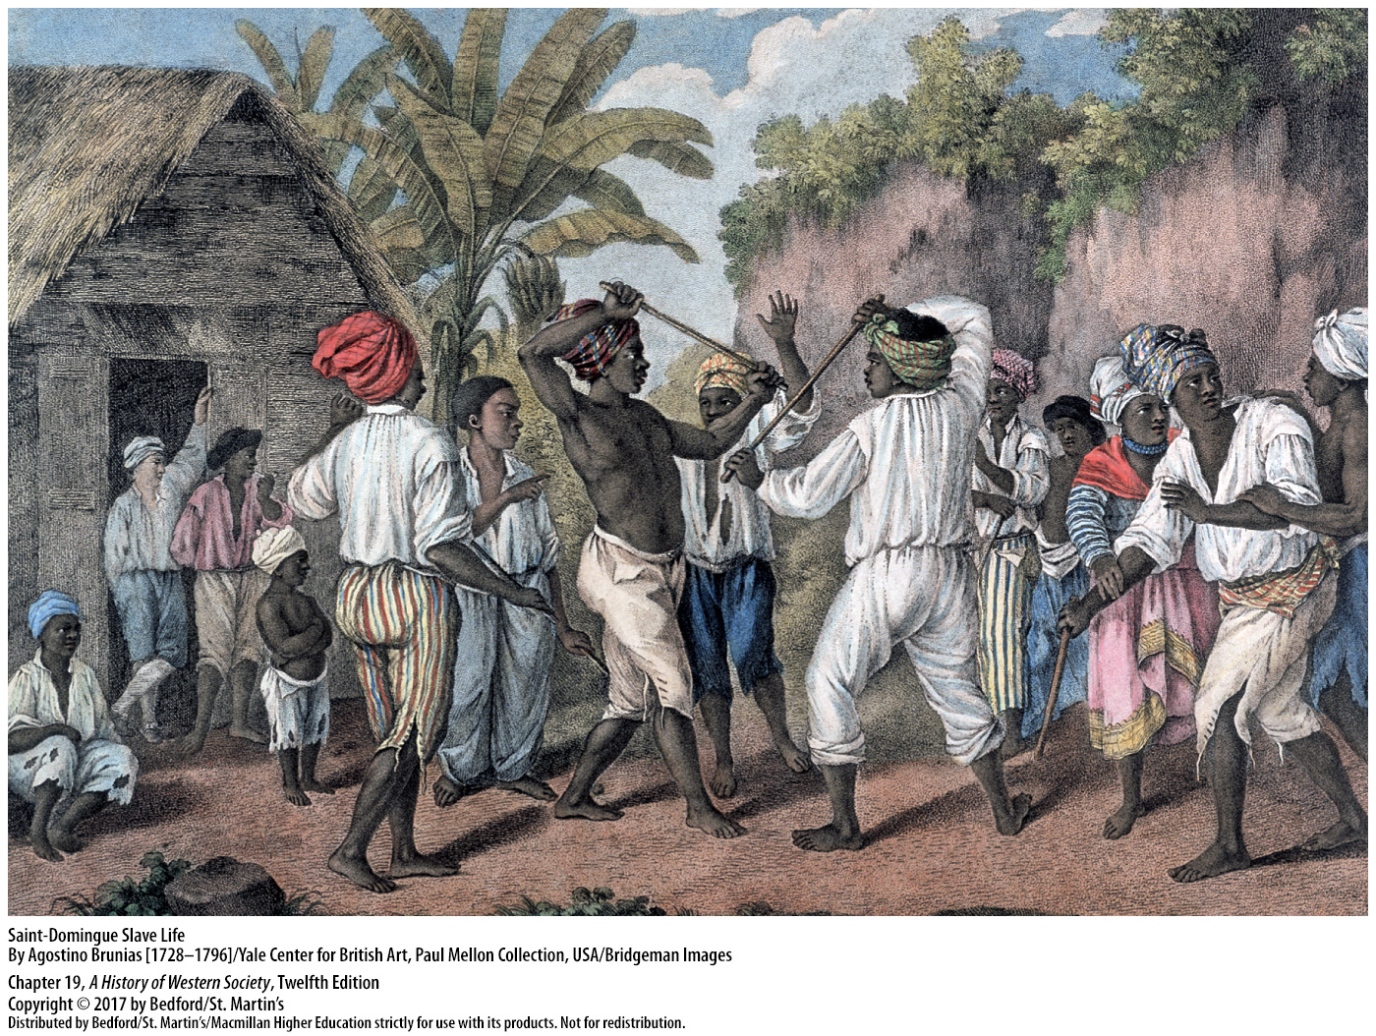

Slide 57
VI. The Haitian Revolution, 1791 – 1804
The Outbreak of Revolt
Slave revolts in August 1791
Full citizenship rights extended to free men of color (1792)
Toussaint L’Ouverture (1743 – 1803)
France abolished slavery (1794)
L’Ouverture named commander of the western province of Saint-Domingue (1796)
Notes:
VI. The Haitian Revolution, 1791 – 1804
B. The Outbreak of Revolt
1. In August 1791 slaves in Saint-Domingue, who had witnessed the confrontation between whites and free people of color, took events into their own hands. Revolts began on August 22 and within a few days had swept much of the northern plain, creating a slave army that was estimated to be 10,000 strong by August 27 ; during the next month, the slave army attacked and destroyed hundreds of plantations.
2. On April 4, 1792, the French National Assembly issued a decree extending full citizenship rights to free men of color.
3. Toussaint L’Ouverture (1743–1803), a freed slave who had joined the revolt, was named a Spanish officer.
4. On February 4, 1794, the Convention ratified the abolition of slavery and extended it to all French territories; in some ways this act merely acknowledged the achievements already won by the slave insurrection.
5. Toussaint L’Ouverture then switched sides, bringing his military and political skills, along with four thousand well-trained soldiers, to support the French war effort against Spanish and British forces. L’Ouverture emerged as a key leader, and in May 1796 he was named commander of the western province of Saint-Domingue.

Slide 58
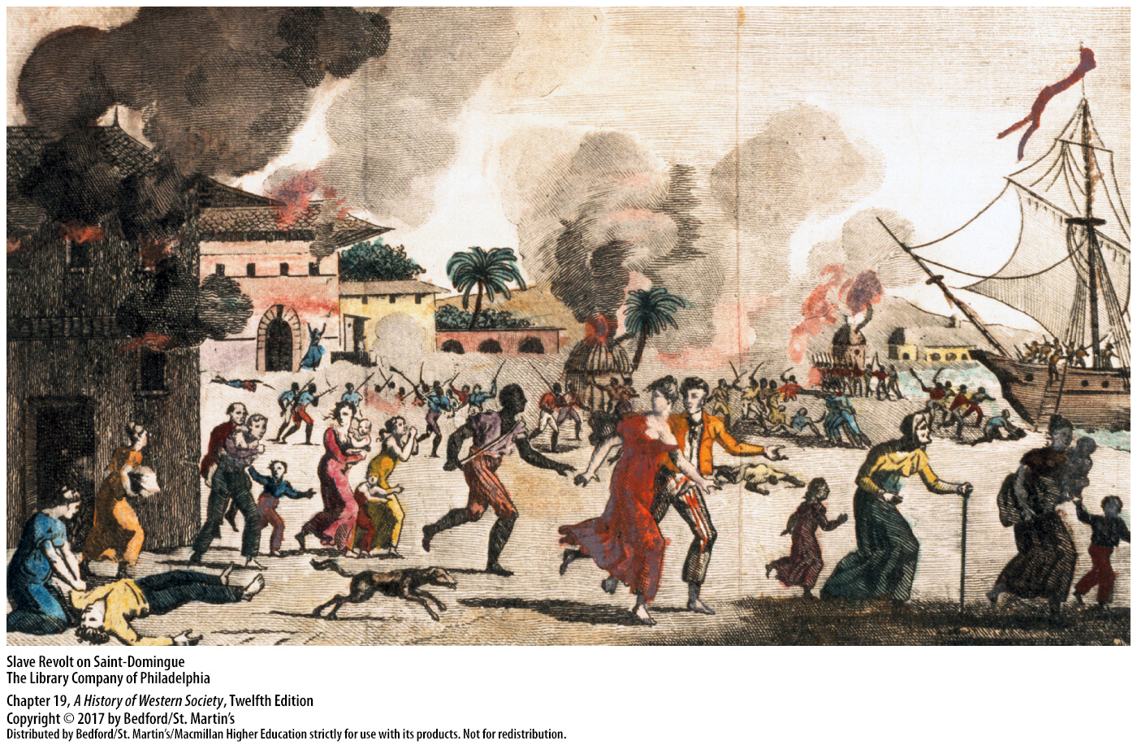

Slide 59
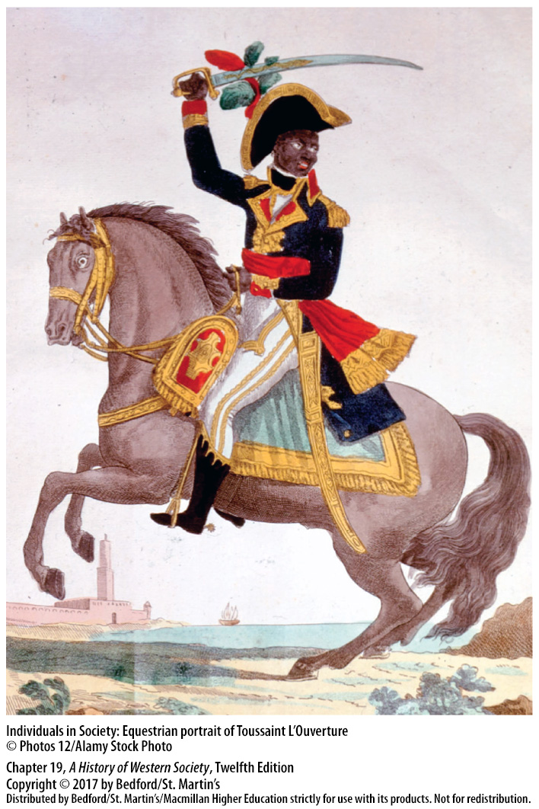

Slide 60
VI. The Haitian Revolution, 1791 – 1804
The War of Haitian Independence
L’Ouverture vs. André Rigaud (1761–1811)
Free colored elite vs. former slaves
L’Ouverture defeated Rigaud (1799)
Napoleon sent army to crush the new regime; L’Ouverture arrested and deported
Notes:
VI. The Haitian Revolution, 1791 – 1804
C. The War of Haitian Independence
1. Toussaint L’Ouverture increasingly acted as an independent ruler of the western province of Saint-Domingue, while another general, André Rigaud (1761–1811), set up his own government in the southern peninsula.
2. Rigaud belonged to the free colored elite; this elite resented the growing power of former slaves like L’Ouverture, who in turn accused them of adopting the racism of white settlers.
3. L’Ouverture’s forces invaded the south in 1799 and defeated Rigaud, giving L’Ouverture control of the entire colony.
4. This victory was soon challenged by Napoleon, who had his own plans for re-establishing slavery and using the profits to expand French power. In 1802 Napoleon’s brother-in-law General Charles-Victor-Emmanuel Leclerc (1772−1802) led an expedition to crush the new regime; when he landed in Saint-Domingue, he arrested L’Ouverture and deported him to France, where he died in 1803.

Slide 61
VI. The Haitian Revolution, 1791 – 1804
The War of Haitian Independence
Jean Jacques Dessalines declared the independence of Saint-Domingue (1804)
Haitian constitution ratified in 1805
President Jefferson refused to recognize Haiti
Notes:
VI. The Haitian Revolution, 1791 – 1804
C. The War of Haitian Independence
5. L’Ouverture’s lieutenant Jean Jacques Dessalines united the resistance under his command and led it to a crushing victory over French forces. On January 1, 1804, Dessalines formally declared the independence of Saint-Domingue and the creation of the new sovereign nation of Haiti.
6. The Haitian constitution was ratified in 1805. Haiti, born from the first successful large-scale slave revolt in history, became the second independent state in the Americas and the first in Latin America.
7. Fearing the spread of slave rebellion to the United States, President Thomas Jefferson refused to recognize Haiti, thus protecting slavery at the expense of revolutionary ideals of universal human rights.

Slide 62
