Slide 1
A History of Western Society Twelfth Edition
McKay • Crowston • Wiesner-Hanks • Perry
CHAPTER 18
Life in the Era of Expansion
1650–1800
Copyright © 2017 by Bedford/St. Martin’s
Distributed by Bedford/St. Martin's/Macmillan Higher Education strictly for use with its products; Not for redistribution.

Slide 2
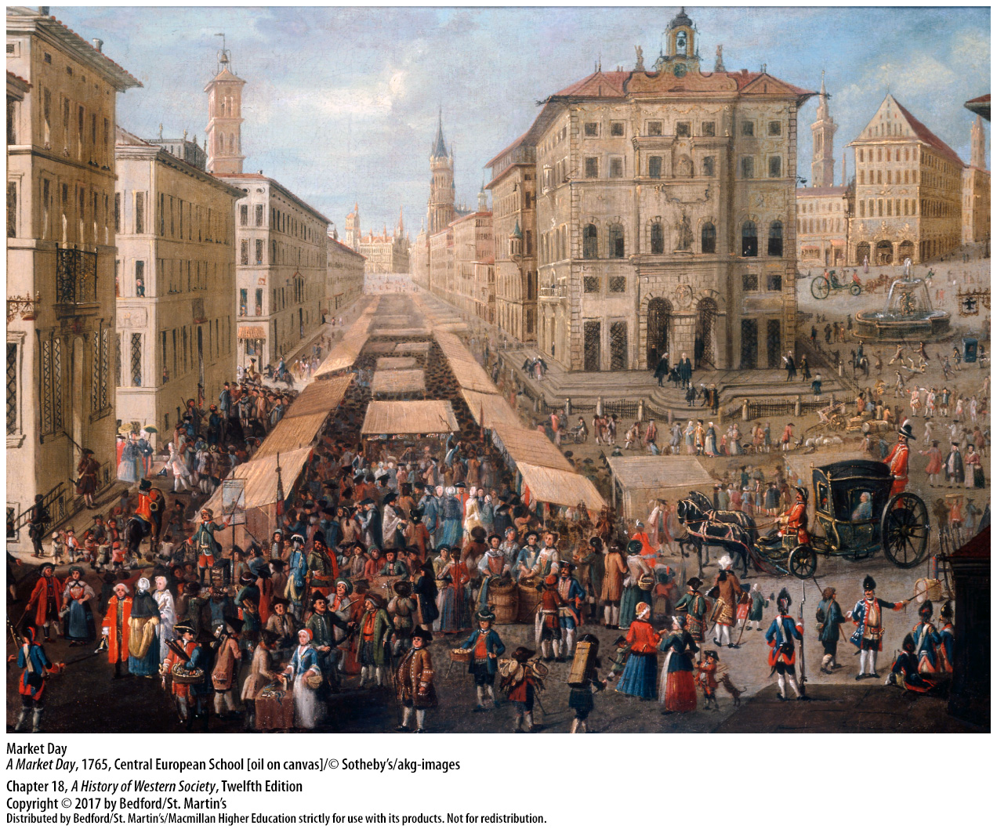

Slide 3
I. Marriage and the Family
Late Marriage and Nuclear Families
Western European couples married late in life
Multi-generation households in eastern Europe
Couples waited until they could start an independent household to marry
The need for permission to marry
Economic advantage in western Europe
Late marriage allowed the accumulation of social and economic capital
Notes:
Marriage and the Family
Late Marriage and Nuclear Families
1. When young eighteenth-century European couples married, they normally established their own households and lived apart from their parents. In the seventeenth and eighteenth centuries, the average person married surprisingly late in life, at an average age of twenty-five to twenty-seven, and 10 to 20 percent of men and women in western Europe never married at all.
2. In eastern Europe, the multigeneration household was the norm, and marriage occurred around age twenty.
3. Couples normally did not marry until they could start an independent household, which sometimes meant waiting until the father’s death to inherit land and marry or accumulating enough savings to start a small business.
4. Laws and tradition in some areas dictated that couples obtain permission from the local lord or landowner in order to marry.
5. The custom of late marriage combined with the nuclear-family household distinguished western European society from other areas of the world, and it partly explains the economic advantage western Europeans acquired relative to other regions in the world.
6. The joining of a mature man and a mature woman in marriage allowed the accumulation of social and economic capital and favored a greater degree of equality between husband and wife.

Slide 4
I. Marriage and the Family
Work Away from Home
Apprenticeships (age fifteen – early twenties)
Many families could not afford apprenticeship
Limited opportunities for adolescent girls
Greater opportunities for skilled women
Domestic service
Notes:
Marriage and the Family
B. Work Away from Home
1. In the trades, a lad would enter apprenticeship around age fifteen and finish in his late teens or early twenties, during which time he was not permitted to marry. If he was lucky or had connections, an apprentice eventually might be admitted to a guild and establish his economic independence.
2. Many poor families could not afford apprenticeship for their sons, and these youths drifted from one tough job to another.
3. Adolescent girls who left their families to work found a more limited range of opportunities.
4. Greater opportunities for women and increased demand for skilled female labor came with the growth in production of finished goods for the emerging consumer economy.
5. Service in another family’s household was by far the most common job for girls, but often the work was endless, for there were few laws to limit exploitation of servants. In theory, domestic service offered a young girl protection and security in a new family, but in practice she was often easy prey for the men of the household or their friends. Servant girls who ended up pregnant were often fired and thrown out in disgrace and turned to prostitution and petty thievery as a matter of survival.

Slide 5
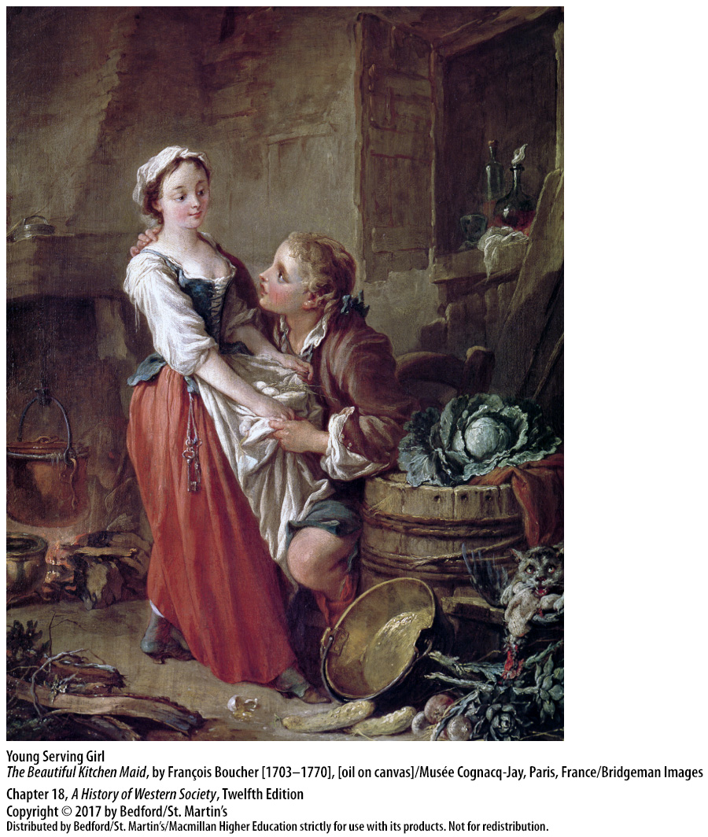

Slide 6
I. Marriage and the Family
Premarital Sex and Community Controls
Birth control primitive and undependable
Condoms made from sheep intestines
Coitus interruptus
Illegitimate babies rare in official church records
Community pressure to marry
Communities policed personal behavior to maintain moral standards
Notes:
Marriage and the Family
C. Premarital Sex and Community Controls
1. Although not unknown, birth control in Europe before the nineteenth century was primitive and quite undependable.
2. Condoms, made from sheep intestines, were expensive and mainly used by aristocratic libertines and prostitutes.
3. The most common method of contraception was coitus interruptus—withdrawal by the male before ejaculation.
4. Despite the lack of reliable contraception, illegitimate babies were apparently a rarity, at least as far as official church records are concerned.
5. The combination of low rates of illegitimate birth with large numbers of pregnant brides reflects the powerful community controls of the traditional village. Community pressures to marry meant that premarital sex was not entered into lightly and that it was generally limited to those contemplating marriage.
6. The community’s effort to police personal behavior and maintain moral standards was a significant part of village life, and violators—spouse beaters or adulterers, for instance—were subject to degrading public rituals such as humiliating donkey rides, rotten vegetables splattered on their doorsteps, and insulting midnight serenades.

Slide 7
I. Marriage and the Family
New Patterns of Marriage and Illegitimacy
Economic autonomy for youths led to increased freedom of action
Migration to the cities increased
Sharp increase in births out of wedlock
Soldiers, day laborers, and male servants hesitant to take on financial burdens of a family
Obstacles to aspirations of young people
Notes:
Marriage and the Family
D. New Patterns of Marriage and Illegitimacy
1. As more youths worked for their own wages, their economic autonomy translated into increased freedom of action.
2. Migration to the cities increased, and urban life provided young people with more social contacts and less social control.
3. Loosened social controls and a rise in sexual activity among young people resulted in a sharp increase in the percentage of out-of-wedlock births, which averaged between 10 to 20 percent of all births by the middle of the nineteenth century.
4. As in previous generations, many of the young couples who engaged in sexual activity intended to marry, but fewer men followed through on their promises once the young women became pregnant. Many soldiers, day laborers, and male servants were no doubt sincere in their proposals, but their insecure economic situation made them hesitant to take on the burden of a wife and child.
5. Old patterns of marriage and family broke down as romantic and practical aspirations of young people were frustrated by low wages, inequality, and changing economic and social conditions.

Slide 8
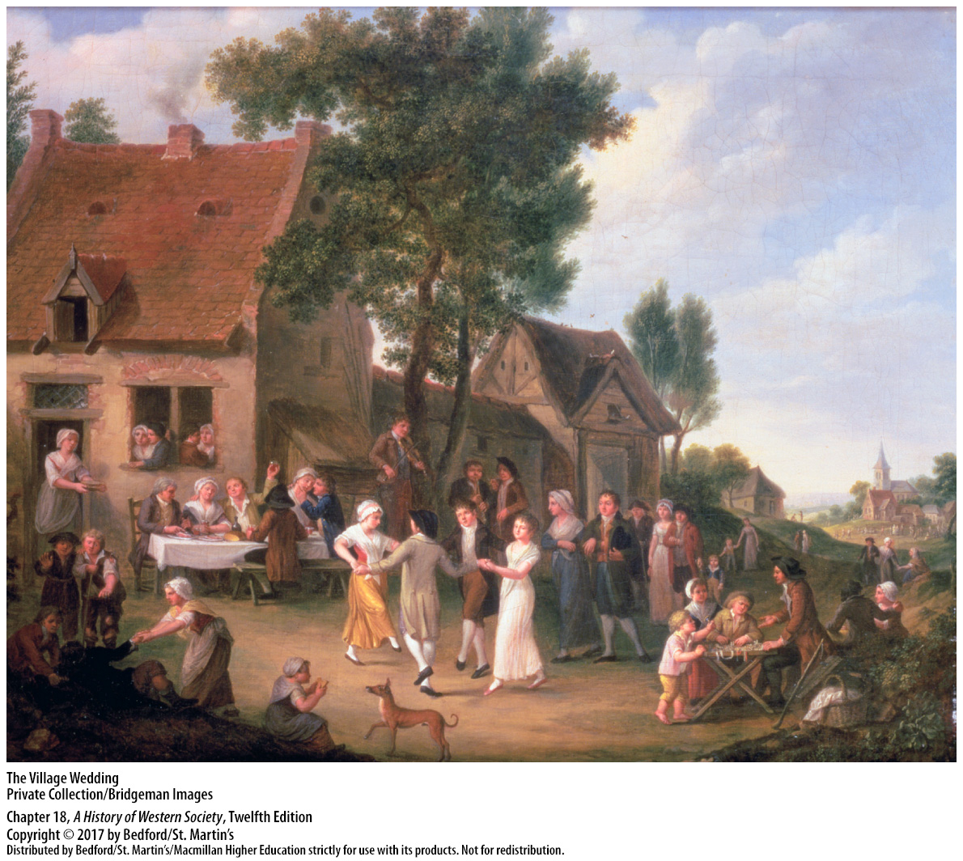

Slide 9
I. Marriage and the Family
Sex on the Margins of Society
Increasingly harsh laws for prostitution
Working women who turned to the sex trade
Threats of imprisonment, banishment, and venereal disease
Courtesans
More condemnation for same-sex relations
Notes:
Marriage and the Family
E. Sex on the Margins of Society
1. Prostitution, which offered both single and married men an outlet for sexual desire, encountered increasingly harsh and repressive laws in the sixteenth and early seventeenth centuries, such as the closing of brothels and outlawing of prostitution.
2. Most prostitutes were working women who turned to the sex trade when confronted with unemployment or seasonal shortages of work.
3. Imprisonment, banishment, and venereal disease were constant threats for prostitutes.
4. Farther up the social scale, courtesans provided sexual services for wealthy protectors, who in turn provided them with apartments, servants, fashionable clothing, and cash allowances.
5. Relations between individuals of the same sex attracted even more condemnation than prostitution and were prohibited by law in most European states, under pain of death.

Slide 10
I. Marriage and the Family
Sex on the Margins of Society
Nobles and royals allowed same-sex passions as long as they married and had heirs
New homosexual subcultures in cities
Same-sex relatioins among women attracted less anxiety and condemnation
Beginnings of a lesbian subculture in London
Fading tolerance for sexual activities outside of heterosexual marriage
Notes:
Marriage and the Family
E. Sex on the Margins of Society
6. Protected by their status, nobles and royals such as King James I sometimes openly indulged their same-sex passions, which were accepted as long as they married and produced legitimate heirs.
7. In the late seventeenth century, new homosexual subcultures began to emerge in Paris, Amsterdam, and London, with their own slang, meeting places, and styles of dress and a belief that their same-sex desire made them fundamentally different from other men.
8. Same-sex relations existed among women as well, but they attracted less anxiety and condemnation than those among men.
9. The beginnings of a distinctive lesbian subculture appeared in London at the end of the eighteenth century.
10. Across the early modern period, traditional tolerance for sexual activities outside of heterosexual marriage faded, as attacks on court immorality and calls for virtue and morality for middle-class men increased.

Slide 11
II. Children and Education
Child Care and Nursing
Newborns vulnerable to infectious diseases
Breast-feeding in the lower classes
Live-in wet nurses hired in upper classes
Rural wet-nursing for working women
Raised infant mortality levels
High infant mortality and fertility rates correlated
Critics of a perceived population decline
Notes:
II. Children and Education
Child Care and Nursing
1. Newborns were vulnerable to infectious diseases and to dehydration brought on by bouts of ordinary diarrhea. Of those who survived infancy, many more died in childhood.
2. Women of the lower classes generally breast-fed their infants for two years or more, which limited the mothers’ fertility but provided infants with precious immunity-producing substances. Areas where babies were not breastfed—for example, Scandinavia, and central and eastern Europe—produced the highest infant mortality rates.
3. Instead of nursing their own children, women of the aristocracy and upper middle class typically hired live-in wet nurses. Working women in the cities also relied on wet nurses because they needed to earn a living; they turned to the cheaper services of women in the countryside.
4. Rural wet-nursing was a widespread business in the eighteenth century, conducted within the framework of the putting-out system, in which children would actually live with the wet nurse until weaned.
5. Reliance on wet nurses raised levels of infant mortality due to the dangers of travel, the lack of supervision of conditions in wet nurses’ homes, and the need to share milk between a wet nurse’s own baby and the one or more babies she was hired to feed.
6. High infant mortality rates correlated with high fertility, and, on balance, the number of children who survived to adulthood tended to be the same across Europe, with higher births balancing the greater loss of life in areas that relied on wet-nursing.
7. In the second half of the eighteenth century, critics blamed a perceived decline in population on women’s failure to nurture their children properly.

Slide 12
II. Children and Education
Foundlings and Infanticide
Few choices for women with unwanted children
Infanticide punishable by death
Foundling homes
About one hundred thousand foundlings per year
50 percent of the babies died within a year in the best foundling homes
No differentiation by sex in the numbers
Notes:
II. Children and Education
B. Foundlings and Infanticide
1. The young woman who could not provide for an unwanted child had few choices: abortions were illegal and dangerous, so some hid their pregnancies, delivered in secret, and then smothered their newborn infants.
2. Infanticide was punishable by death if discovered.
3. Foundling homes (orphanages) first took hold in Italy, Spain, and Portugal in the sixteenth century and spread to France and then the rest of Europe.
4. As new foundling homes were established, the number of foundlings being cared for surged; by the end of the eighteenth century, European foundling hospitals were admitting around one hundred thousand abandoned children each year. By the 1770s one-third of all babies born in Paris were being immediately abandoned to foundling homes by their mothers, and one-third of those came from married couples who were too poor to feed another child.
5. Even in the best foundling homes, 50 percent of the babies normally died within a year, and in the worst homes 90 percent did not survive.
6. There appears to have been no differentiation by sex in the numbers of children sent to foundling hospitals.

Slide 13
II. Children and Education
Attitudes Toward Children
Emotional prudence; emotional distance
Evidence of parental love
Severe discipline
New discourse of the Enlightenment
Notes:
II. Children and Education
C. Attitudes Toward Children
1. Some scholars have claimed that high mortality rates prevented parents from forming emotional attachments to young children and resulted in an attitude of indifference or outright neglect. Parents were well aware of the dangers of infancy and childhood, and emotional prudence could lead to emotional distance.
2. Evidence from diaries, letters, and family portraits, however, indicates that parents of all social classes did love their children, suffered anxiously when they fell ill, and experienced extreme anguish when they died.
3. In a society characterized by much violence and brutality, discipline of children was often severe and reflected a broad consensus that children were born with an innately sinful will that parents had to overcome.
4. The Enlightenment, however, produced an enthusiastic new discourse about childhood and child rearing.

Slide 14
II. Children and Education
Attitudes Toward Children
Called for greater tenderness toward children
Child as innocent product of nature
Jean-Jacques Rousseau’s Emile, or On Education (1762)
Notes:
II. Children and Education
C. Attitudes Toward Children
5. Starting around 1760 critics called for greater tenderness toward children and proposed imaginative new teaching methods. These new voices supported foundling homes, urged women to nurse their babies, and recommended comfortable clothes designed for children that allowed freedom of movement.
6. Enlightenment thinkers celebrated the child as an innocent product of nature and advocated safeguarding and developing children’s innate qualities, rather than thwarting and suppressing them. The best hopes for creating a new society, untrammeled by the prejudices of the past, lay in a radical reform of child-rearing techniques.
7. Jean-Jacques Rousseau’s Emile, or On Education (1762), argued that boys’ education should include plenty of fresh air and exercise as well as training in practical craft skills and rote book learning. Rousseau, believing that women’s “nature” destined them for a life of marriage and child rearing, insisted that girls’ education focus on their future domestic responsibilities.

Slide 15
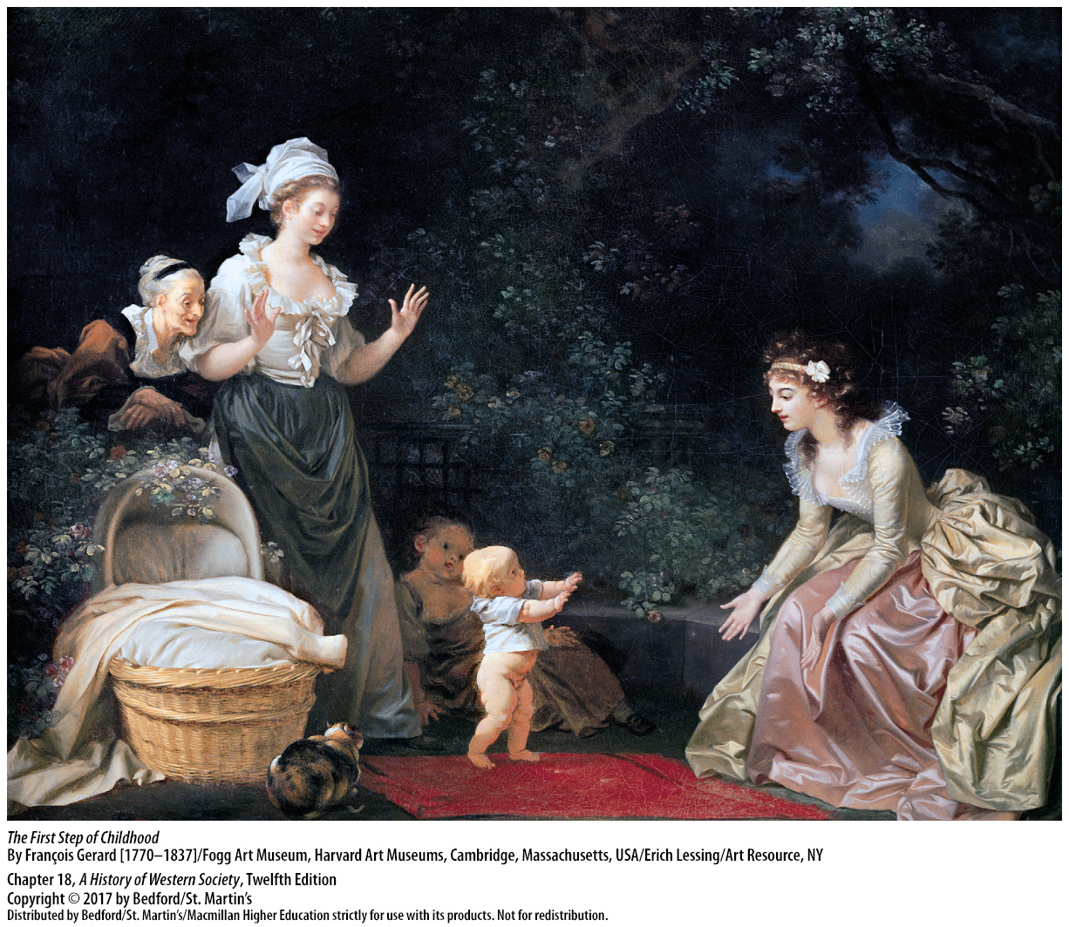

Slide 16
II. Children and Education
The Spread of Elementary Schools
Schools for children of the common people
Scottish Presbyterians and parish schools
“Charity schools”
Prussia made attendance compulsory
Charity schools in Catholic France
Maria Theresa’s compulsory education edict (1774)
Notes:
II. Children and Education
D. The Spread of Elementary Schools
1. Schools charged specifically with educating children of the common people began to appear in the second half of the seventeenth century. Such schools specialized in teaching six- to twelve-year-old children basic literacy, religion, and perhaps some arithmetic for the boys and needlework for the girls.
2. Believing that the path to salvation lay in careful study of the Scriptures, Scottish Presbyterians established an effective network of parish schools for rich and poor alike.
3. The Church of England, as well as Puritans, Presbyterians, and Quakers, established “charity schools” to instruct poor children.
4. Inspired by the Protestant idea that every believer should be able to read the Bible and by the new idea of raising a population capable of effectively serving the state, Prussia made attendance at elementary schools compulsory for boys and girls.
5. In the 1660s Catholic France began setting up charity schools run by parish priests or by new teaching orders to teach poor children their catechism and prayers as well as reading and writing.
6. In 1774 the Habsburg ruler Maria Theresa issued her own compulsory education edict, imposing five hours of school, five days a week, for all children aged six to twelve.

Slide 17
III. Popular Culture and Consumerism
Popular Literature
Childhood education led to growth in literacy
Growth in reading, the Bible and chapbooks
Popular literature
Almanacs
Enlightenment ideas spread to working people
Thomas Paine, Common Sense (1776)
Sold 120,000 copies in first months of publication
Notes:
III. Popular Culture and Consumerism
Popular Literature
1. The surge in childhood education in the eighteenth century led to a remarkable growth in literacy between 1600 and 1800.
2. The growth in literacy promoted growth in reading, both of the Bible and of short pamphlets known as chapbooks that featured Bible stories, prayers, and the lives of saints and exemplary Christians.
3. Entertaining, often humorous stories formed a second element of popular literature that included fairy tales, medieval romances, true crime stories, and fantastic adventures.
4. Much lore was stored in almanacs, where calendars listing secular, religious, and astrological events were mixed with agricultural schedules, arcane facts, and jokes.
5. Although most ordinary people did not read the great works of the Enlightenment, urban working people were exposed to Enlightenment ideas through various means, including cheap pamphlets; rumors and gossip that spread through workshops, markets, and taverns; and the homes of educated employers.
6. Thomas Paine, a working-class Englishman who emigrated to the colonies, authored the 1776 pamphlet Common Sense, an attack on the weight of custom and the evils of government against the natural society of men.
7. Paine’s pamphlet sold 120,000 copies in its first months of publication, a testament to working people’s reception of Enlightenment ideas.

Slide 18
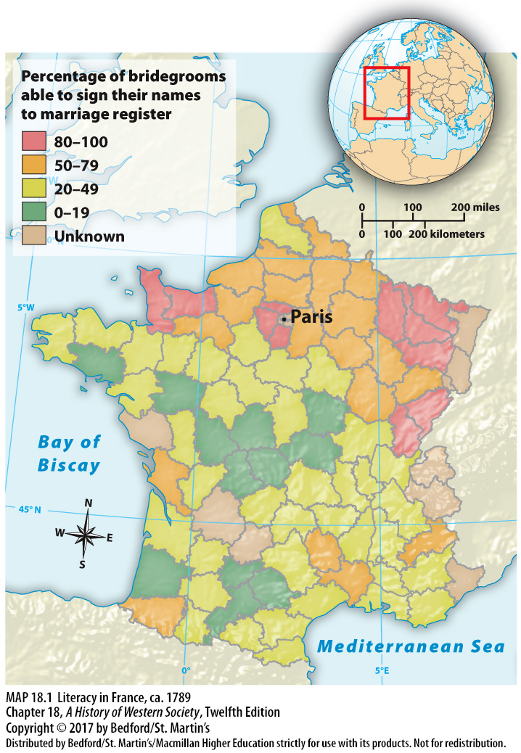

Slide 19
III. Popular Culture and Consumerism
Leisure and Recreation
Village culture remained largely oral
Socializing: story telling, singing, chatting
Amusements in towns and cities
Growing commercialization in leisure activities
Profit-oriented spectator sports
Blood sports
Religious festivals and processions
Educated elites criticized religious recreation
Notes:
III. Popular Culture and Consumerism
B. Leisure and Recreation
1. Despite the spread of literacy, the culture of the village remained largely oral rather than written.
2. Socializing, an important activity in any village, took the form of peasant families telling stories, singing, and doing craftwork around the fireplace; women gathering to sew and chat; and men drinking and talking in the village tavern.
3. Towns and cities offered a wider range of amusements, including pleasure gardens, theaters, lending libraries, and fairs.
4. Leisure activities were another form of consumption marked by growing commercialization.
5. This period saw the emergence of profit-oriented spectator sports such as horse races, boxing matches, and bullfights.
6. Blood sports, such as bullbaiting and cockfighting, also remained popular with the masses.
7. Popular recreation merged with religious celebration in a variety of festivals and processions throughout the year; the most striking of these events was carnival, a time of reveling and excess in Catholic Europe that preceded Lent—the forty days of fasting and penitence before Easter.
8. In the second half of the eighteenth century, educated elites—who had previously shared the popular enthusiasm for religious festivals, carnivals, drinking in taverns, blood sports, and the like—now criticized them as superstitious, sinful, disorderly, and vulgar.

Slide 20
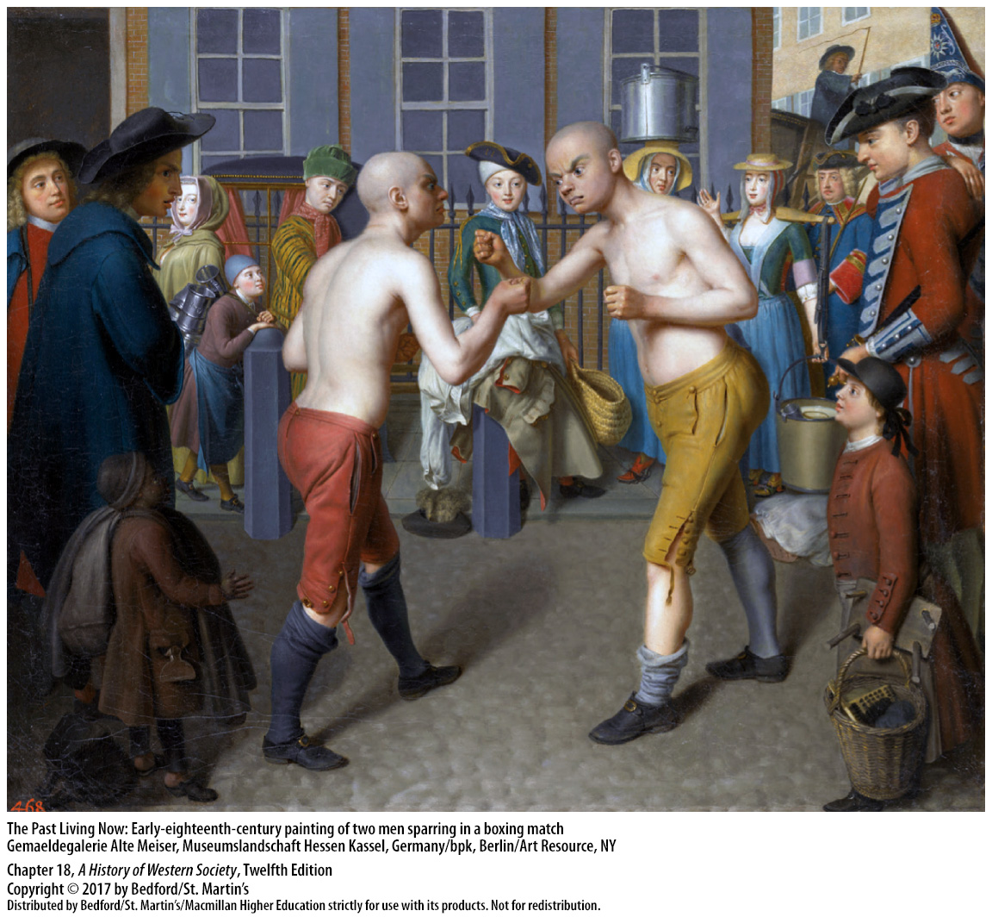

Slide 21
III. Popular Culture and Consumerism
New Foods and Appetites
Bread riots
Vegetables
Cheese and butter for sale
Less meat due to prices
Hunting laws resented by commoners
Upper classes had an abundant variety of foods
Notes:
III. Popular Culture and Consumerism
C. New Foods and Appetites
1. As in previous centuries, bread was the stuff of life. Even peasants normally needed to buy some grain for food, and they, along with landless laborers and urban workers, believed in the moral economy and the just price—that is, a “fair” price that protected both consumers and producers. When prices rose above a level considered fair, consumers often took action in the form of bread riots.
2. The rural poor also ate a fair quantity of vegetables; peas and beans were probably the most common. For the poor in most regions, other vegetables were available in season, with fruit mostly limited to the summer months.
3. Milk was used to make cheese and butter, which peasants sold in the market to earn cash for taxes and land rents.
4. A general decline in the standard of living between 1500 and 1700 and an increase in meat prices meant that common people ate less meat.
5. Moreover, harsh laws in most European countries reserved the right to hunt and eat game for nobles and large landowners; such laws were bitterly resented (and frequently broken) by ordinary people.
6. The upper classes enjoyed a wide variety of foods that included an abundance of meat and fish, complemented with sweets, cheeses, and wine; dinners often became social events lasting several hours.

Slide 22
III. Popular Culture and Consumerism
New Foods and Appetites
7. Imports from the Americas (potato)
8. Sugar, tea, coffee, tobacco
9. Labor of enslaved peoples in the New World
10. Desire to emulate the elite
11. Need for stimulants
12. Dependence on colonial economies, enslaved labor, and global trade networks increased
Notes:
III. Popular Culture and Consumerism
C. New Foods and Appetites
7. Introduced into Europe from the Americas—along with corn, squash, tomatoes, and many other useful plants—the potato provided an excellent new food source and became an important dietary supplement in much of Europe by the end of the century.
8. The most remarkable dietary change in the eighteenth century was the consumption of once-expensive, rare goods such as sugar, tea, coffee, and tobacco— commodities that became dietary staples for people of all social classes.
9. The labor of enslaved peoples in the New World enabled the expansion in production and drop in prices of such goods, allowing them to spread to the masses.
10. Part of the motivation for consuming these products was a desire to emulate the luxurious lifestyles of the elite.
11. The quickened pace of work in the eighteenth century and the need for stimulants also motivated consumption of these products.
12. With the widespread adoption of these products, people in Europe became more dependent on colonial economies, enslaved labor, and global trade networks; their understanding of daily necessities also shifted.

Slide 23
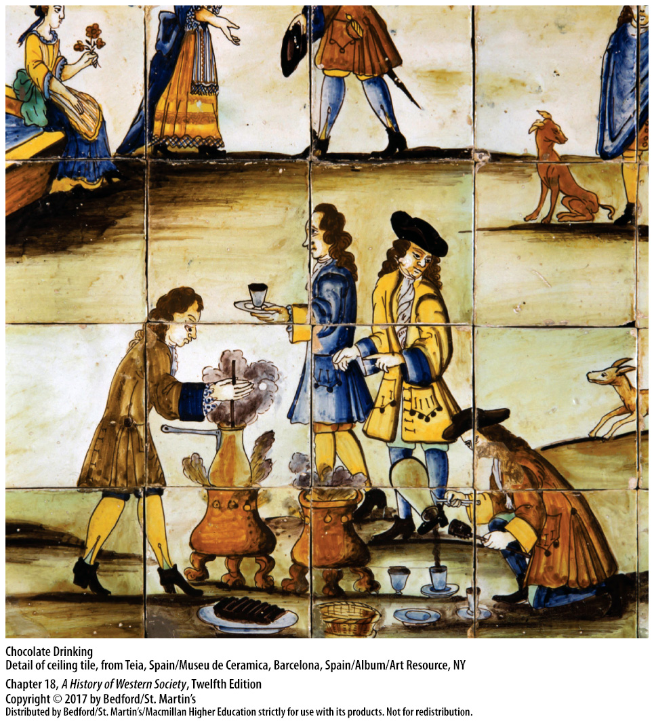

Slide 24
III. Popular Culture and Consumerism
Toward a Consumer Society
Consumer revolution
Merchants inciting demand
Seized the reins of fashion from the courtiers
Fashionable clothing cheaper, more desirable
Notes:
III. Popular Culture and Consumerism
D. Toward a Consumer Society
1. The proliferation of goods, both in number and variety, led to greater consumption and new attitudes toward consumer goods in what some historians refer to as a consumer revolution. The result of this revolution was a new type of society in which people derived their self-identity as much from their consuming practices as from their working lives and place in the production process.
2. Increased demand for consumer goods was stimulated by merchants who cleverly pioneered techniques to incite demand, such as initiating marketing campaigns, opening fancy boutiques, and advertising royal patronage.
3. By diversifying their product lines and accelerating the turnover of styles, merchants seized the reins of fashion from the courtiers who had earlier controlled it.
4. Shrewd entrepreneurs made fashionable clothing seem more desirable, while legions of women entering the textile and needle trades made it ever cheaper.

Slide 25
III. Popular Culture and Consumerism
Toward a Consumer Society
Rise in clothing consumption
Colonial economies supplied cotton and dyes
Fashion blurred social group boundaries
New gender distinctions in dress
Notes:
III. Popular Culture and Consumerism
D. Toward a Consumer Society
5. Western Europe witnessed a dramatic rise in the consumption of clothing, as urban dwellers in particular expanded and diversified their wardrobes by adding new garments, accessories, and colors.
6. Colonial economies again played an important role by supplying new materials, such as cotton and vegetable dyes, at low cost.
7. The spread of fashion challenged Europe’s traditional social order, blurring the boundaries between social groups.
8. Women of all social groups took the lead in spreading fashion; new gender distinctions in dress had emerged by the end of the eighteenth century, with men renouncing brilliant colors and voluptuous fabrics in favor of the plain dark suit.

Slide 26
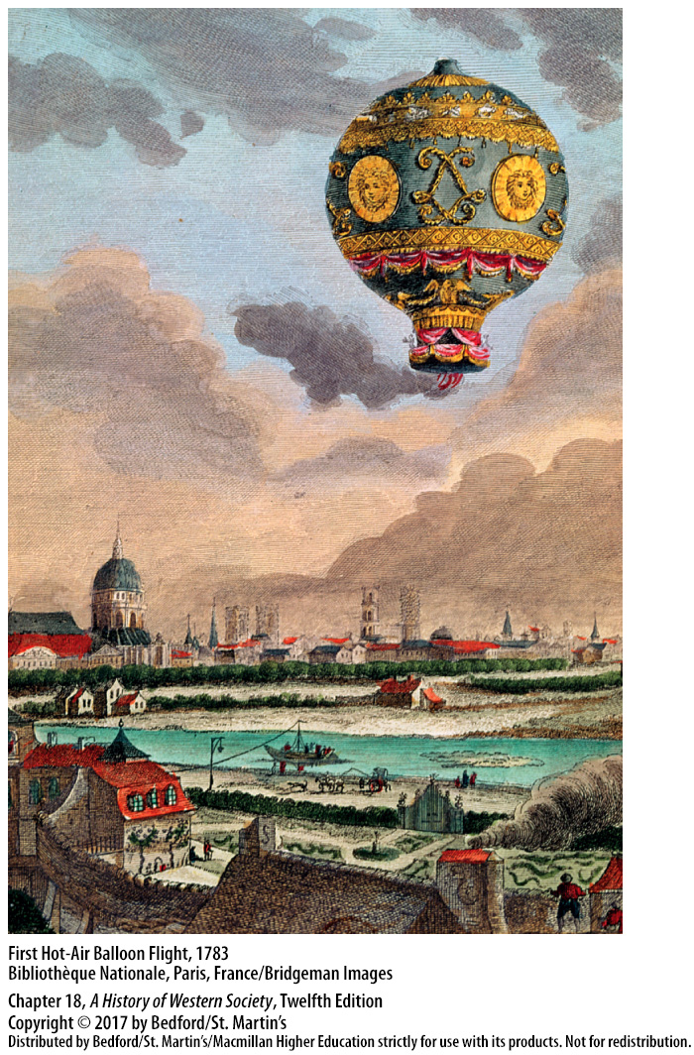

Slide 27
III. Popular Culture and Consumerism
Toward a Consumer Society
9. More privacy in living spaces
10. More individualized ways of life
11. Hygiene standards improved
12. Elite benefitted the most from new consumer economy
Notes:
III. Popular Culture and Consumerism
D. Toward a Consumer Society
9. In the eighteenth century, rents rose sharply, making it impossible for families to gain more living space, but families began assigning specific functions to rooms and erecting inner barriers within the home to provide more privacy.
10. New levels of comfort and convenience accompanied this trend toward more individualized ways of life; households featured a greater variety of cutlery and dishes; more books and prints; window glass that was more transparent; and cleaner, more efficient coal stoves.
11. Standards of bodily and public hygiene improved, as enlightened doctors began to urge more frequent bathing, and officials improved the cleaning of city streets.
12. The development of the new consumer economy was concentrated in large cities in northwestern Europe and North America; even there, the elite benefited the most.

Slide 28
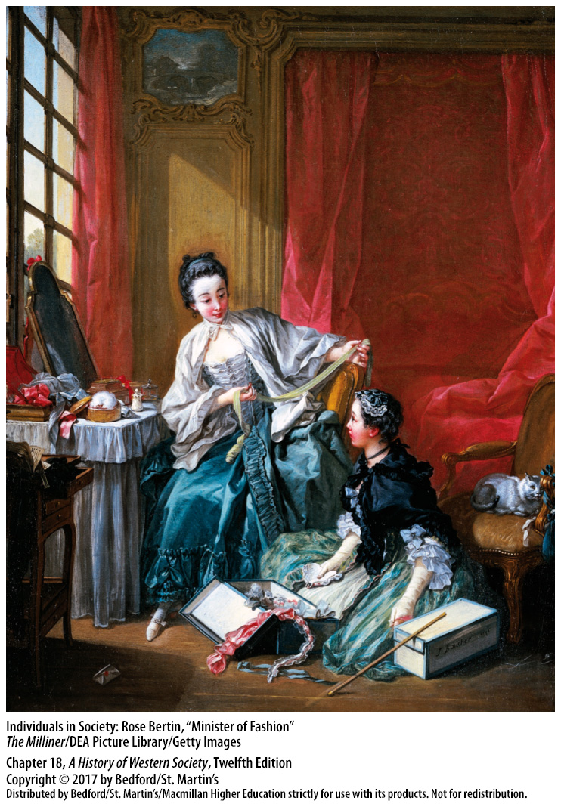

Slide 29
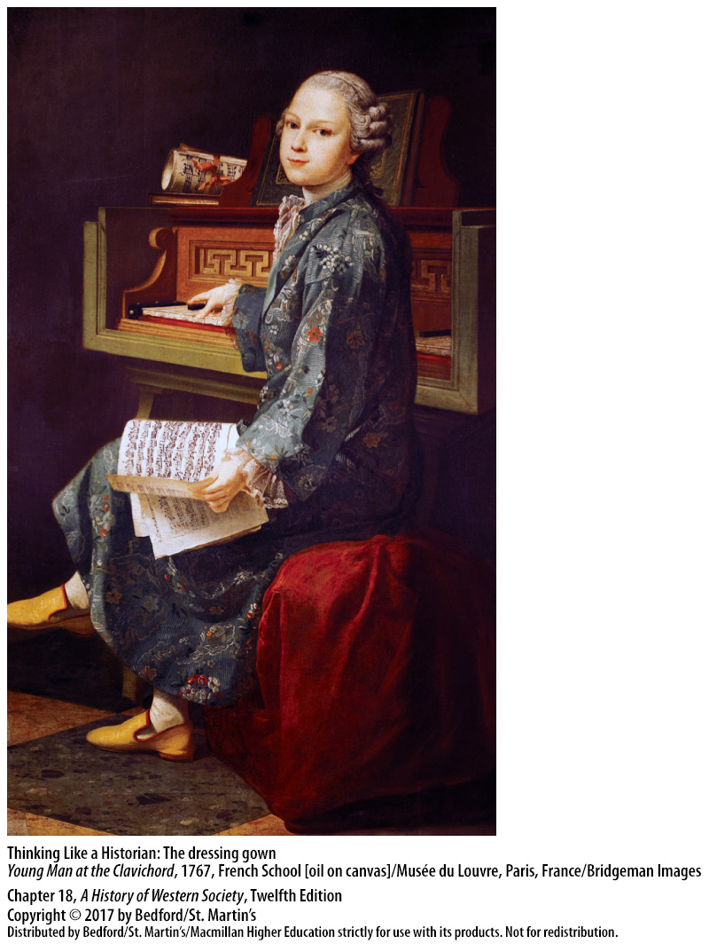

Slide 30
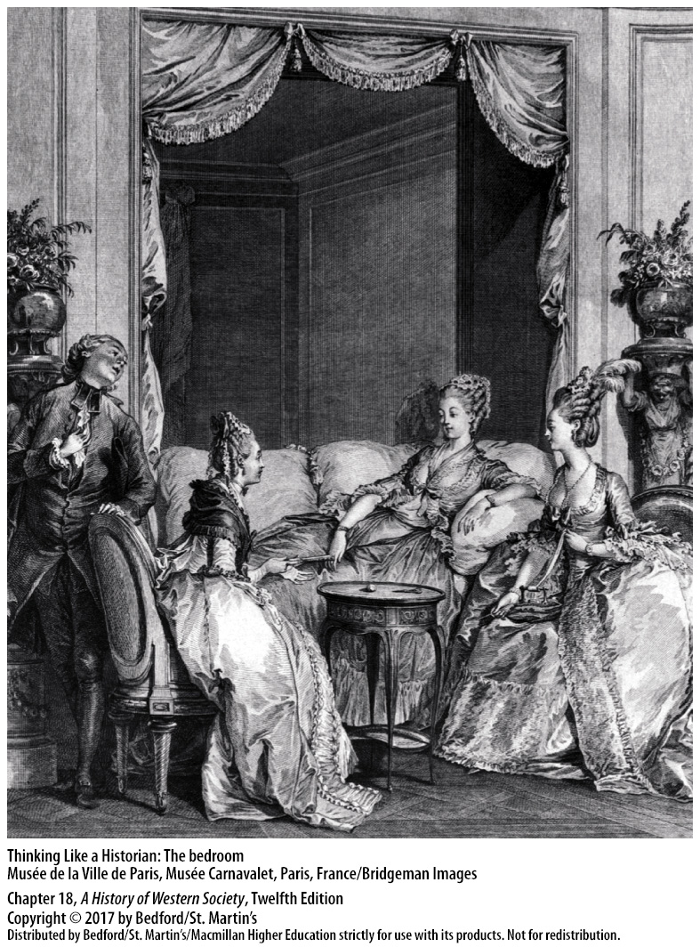

Slide 32
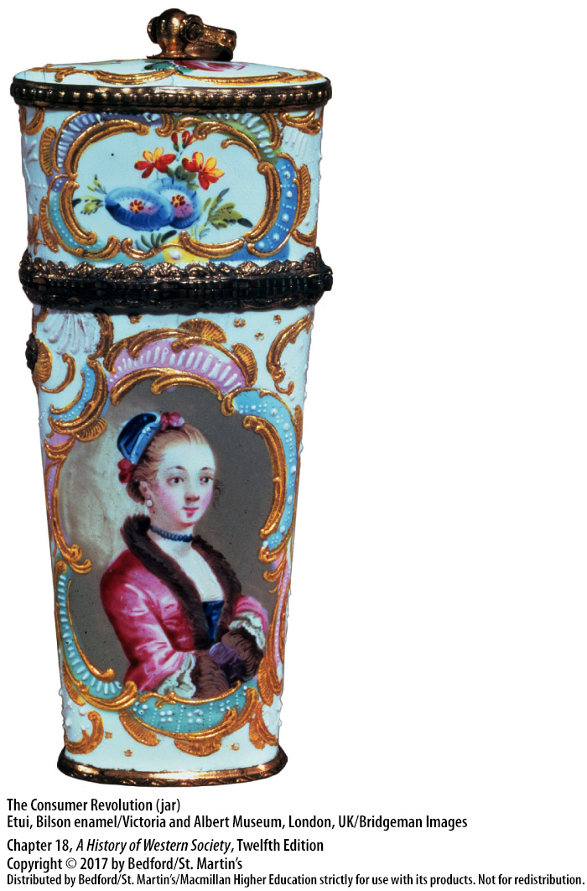

Slide 33
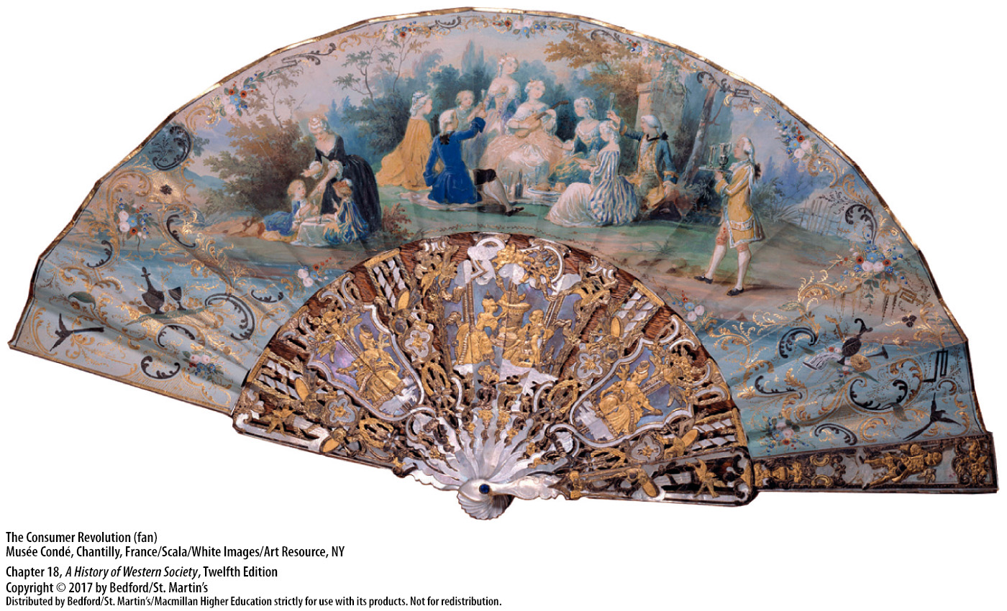

Slide 34
IV. Religious Authority and Beliefs
Church Hierarchy
Parish churches
Catholic monarchs weakened papal authority
Catholicism gained new ground in the Holy Roman Empire
Jesuits had tremendous political influence
Notes:
IV. Religious Authority and Beliefs
Church Hierarchy
1. As in the Middle Ages, the local parish church remained the focal point of religious devotion and community cohesion. Parish churches also were subject to greater control from the state, especially by rulers in Protestant areas who regulated their “territorial churches” strictly, selecting personnel and imposing detailed rules.
2. Catholic monarchs in this period took greater control of religious matters in their kingdoms, weakening papal authority. The Spanish crown took firm control of ecclesiastical appointments and mandated that papal proclamations receive approval from the government. France went even further in establishing a national Catholic church by supplementing Louis XIV’s expulsion of Protestants in 1685 with an insistence on the king’s prerogative to choose and control bishops and issue laws regarding church affairs.
3. Catholicism gained new ground in the Holy Roman Empire with the conversion of a number of Protestant princes and successful missionary work by Catholic orders among the population.
4. The Jesuits played a key role in fostering the Catholic faith by serving as teachers, missionaries, and agents of the papacy and exercised tremendous political influence, holding high government positions and educating the nobility in their colleges.

Slide 35
IV. Religious Authority and Beliefs
Church Hierarchy
France and Spain pressured the pope to dissolve the Jesuits completely
Monarchs wanted practical contributions from clergy
Joseph II issued edicts of religious tolerance
Notes:
IV. Religious Authority and Beliefs
Church Hierarchy
5. Yet by playing politics so effectively, the Jesuits eventually elicited a broad coalition of enemies, and in 1773 the pope reluctantly acquiesced to pressure from France and Spain to dissolve the Jesuits completely.
6. Some Catholic rulers also believed that the clergy in monasteries and convents should make a more practical contribution to social and religious life; in Austria, Maria Theresa and Joseph II permitted only orders that were engaged in teaching, nursing, or other practical work.
7. Joseph II issued edicts of religious tolerance, making Austria one of the first European states to lift centuries-old restrictions on its Jewish population.

Slide 36
IV. Religious Authority and Beliefs
Protestant Revival
Pietism
Bible reading extended to all classes
The practical power of Christian rebirth
John Wesley (1703 – 1791)
Methodists
Notes:
IV. Religious Authority and Beliefs
B. Protestant Revival
1. The Protestant revival, known as Pietism, which began in Germany in the late seventeenth century, called for a warm, emotional religion that everyone could experience. Pietism also reasserted the earlier radical stress on the priesthood of all believers, thereby reducing the gulf between official clergy and Lutheran laity.
2. Bible reading and study were extended enthusiastically to all classes, providing a powerful boost to popular literacy as well as to individual religious development.
3. Pietists believed in the practical power of Christian rebirth in everyday affairs and were expected to lead good, moral lives.
4. As Pietism spread outward from Germany, its impact extended to John Wesley (1703–1791), who served as the catalyst for popular religious revival in England.
5. After becoming a teaching fellow at Oxford, Wesley organized a Holy Club for similarly minded students, who came to be known derisively as Methodists because they were so methodical in their devotion.

Slide 37
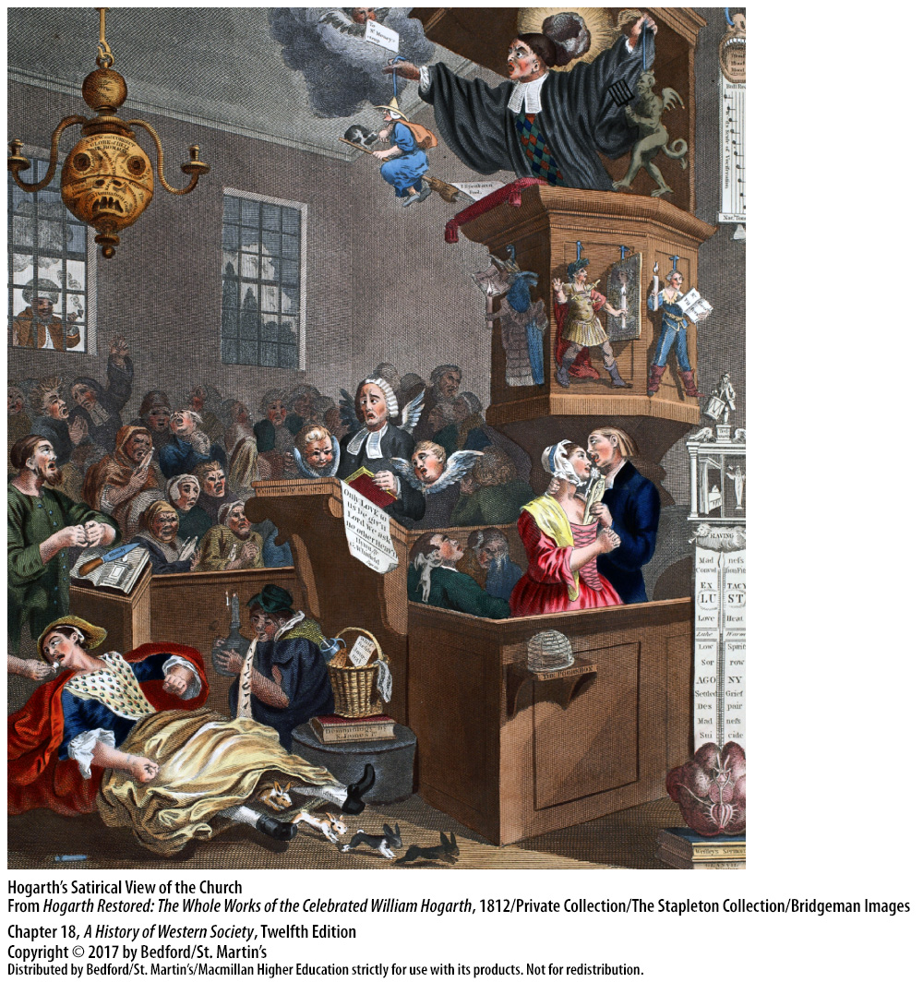

Slide 38
IV. Religious Authority and Beliefs
Catholic Piety
More active formal worship
Role in community life and popular culture
Confraternities
Cornelius Jansen (1585 – 1638)
Jansenism
France’s urban elite
Urban poor took a different strain of Jansenism
Notes:
IV. Religious Authority and Beliefs
C. Catholic Piety
1. Religion also flourished in Catholic Europe around 1700, although important differences distinguished it from Protestant practice. Baroque art still adorned Catholic churches, and Catholic Europeans on the whole participated more actively in formal worship than did Protestants.
2. The tremendous popular strength of religion in Catholic countries can be explained in part by the church’s integral role in community life and popular culture, particularly through religious festivals, saints’ days, processions, and pilgrimages.
3. Millions of Catholic men and women also joined confraternities, participating in prayer and religious services and collecting funds for poor relief and members’ funerals.
4. Catholicism had its own version of the Pietist revival led by Cornelius Jansen (1585–1638), bishop of Ypres in the Spanish Netherlands, who called for a return to the austere early Christianity of Saint Augustine that stressed the heavy weight of original sin and accepted predestination.
5. Although outlawed by papal and royal edicts as Calvinist heresy, Jansenism attracted Catholic followers eager for religious renewal, particularly among the French.
6. Many members of France’s urban elite, especially judicial nobles and some parish priests, became known for their Jansenist piety and spiritual devotion.
7. A different strain of Jansenism took hold among the urban poor, who met in prayer meetings for an ecstatic form of worship during which some members fell into convulsions and spoke in tongues.

Slide 39
IV. Religious Authority and Beliefs
Marginal Beliefs and Practices
Countryside peasants and marginal beliefs
Christian faith combined with superstitions
Authorities sought to “purify” popular spirituality
Pious peasants saw an attack on age-old faith
Intellectual disdain for popular beliefs helped end the persecution of witches
Notes:
IV. Religious Authority and Beliefs
D. Marginal Beliefs and Practices
1. In the countryside, many peasants continued to hold religious beliefs that were marginal to the Christian faith altogether, often of obscure or even pagan origin.
2. The ordinary person combined strong Christian faith with a wealth of time-honored superstitions that involved saints’ relics, healing springs, and rituals and customs intended to ward off disease.
3. Inspired initially by the fervor of the Reformation era, then by the critical rationalism of the Enlightenment, religious and secular authorities increasingly sought to “purify” popular spirituality.
4. Where authorities pursued purification vigorously, pious peasants saw only an incomprehensible attack on age-old faith and drew back in anger, a reaction that dramatized the growing tensions between the educated elite and the common people.
5. It was in this era of growing intellectual disdain for popular beliefs that the persecution of witches slowly came to an end across Europe.

Slide 40
V. Medical Practice
Faith Healing and General Practice
Traditional healers
Apothecaries
Medicine was part of the commercial culture
Physicians
Stress on purging and bloodletting
Notes:
V. Medical Practice
Faith Healing and General Practice
1. Traditional healers drew on folk knowledge about the curative properties of roots, herbs, and other plants; faith healers treated patients by driving out, or exorcising, the evil spirits they believed were lodged in the ill person and causing disease.
2. In the larger towns and cities, apothecaries sold herbs, drugs, and patent medicines for every conceivable “temperament and distemper.”
3. Apothecaries advertised their wares, their high-class customers, and their miraculous cures, making medicine, like food and fashionable clothing, a part of the era’s new and loosely regulated commercial culture.
4. Physicians, who were invariably men, mostly diagnosed and treated patients by correspondence or through oral dialogue, without conducting a physical examination. Because medical training was expensive, physicians came mainly from prosperous families, and they usually concentrated on urban patients from similar social backgrounds, although even poor people sought treatment.
5. Like apothecaries, physicians laid great stress on purging, and the time-honored practice of bloodletting was still considered a medical cure-all.

Slide 41
V. Medical Practice
Improvements in Surgery
Serious study of anatomy
Army surgeons
Amputation
Operations performed without painkillers
Many died from the agony and shock
Unsanitary conditions and lack of knowledge about bacteria and infections
Notes:
V. Medical Practice
B. Improvements in Surgery
1. In the eighteenth century, surgeons began studying anatomy seriously and improved their art.
2. With endless opportunities to practice, army surgeons on battlefields led the way.
3. Surgeons learned they could amputate above a serious wound and cauterize the stump in order to reduce the likelihood of death.
4. Because the anesthesia of the day was hard to control and too dangerous for general use, almost all operations were performed without painkillers.
5. Many patients died from the agony and shock of such operations.
6. Unsanitary conditions and lack of knowledge about bacteria and the nature of infections meant that even the simplest wound could lead to death.

Slide 42
V. Medical Practice
Midwifery
Assisted in labor, delivery, and female problems
Labor and birth part of the female world
Invention of forceps
Madame du Coudray, Manual on the Art of Childbirth (1757)
Midwives lost no more babies than male doctors
Women performed the bulk of informal medical care
Notes:
V. Medical Practice
C. Midwifery
1. Trained initially by another woman practitioner, the midwife primarily assisted in labor and delivering babies; however, she also treated female problems, such as irregular menstrual cycles, breast-feeding difficulties, infertility, and venereal disease, and ministered to small children.
2. The male surgeon (and the husband) rarely entered the female world of labor and birth.
3. However, after the invention of forceps became publicized in 1734, surgeon-physicians attacked midwives as ignorant and dangerous and persuaded growing numbers of wealthy women of the superiority of their services.
4. One enterprising French midwife, Madame du Coudray, wrote a widely used textbook, Manual on the Art of Childbirth (1757), as part of her campaign to teach birthing techniques to village midwives.
5. Midwives generally lost no more babies than did male doctors, who were still summoned to treat non-elite women only when life-threatening situations required surgery.
6. Female religious orders ran many hospitals, and at-home nursing was almost exclusively the province of women; thus, women continued to perform the bulk of informal medical care.

Slide 44
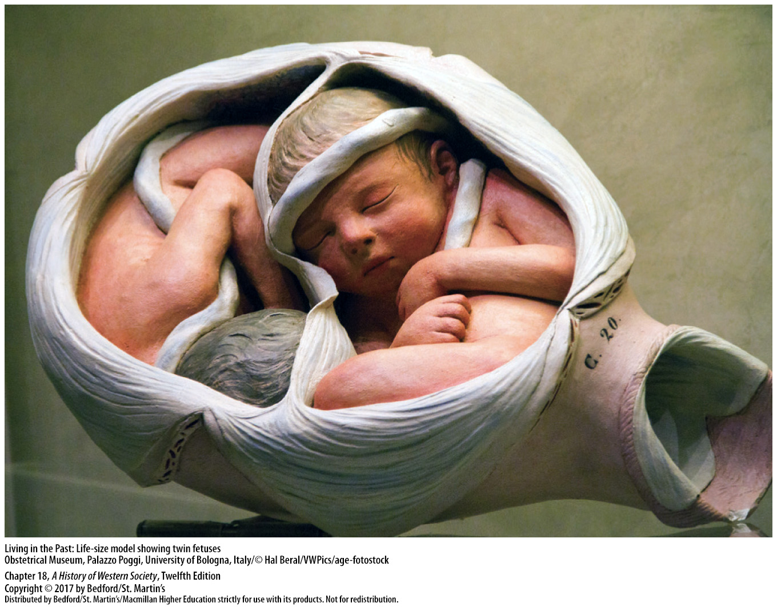

Slide 45
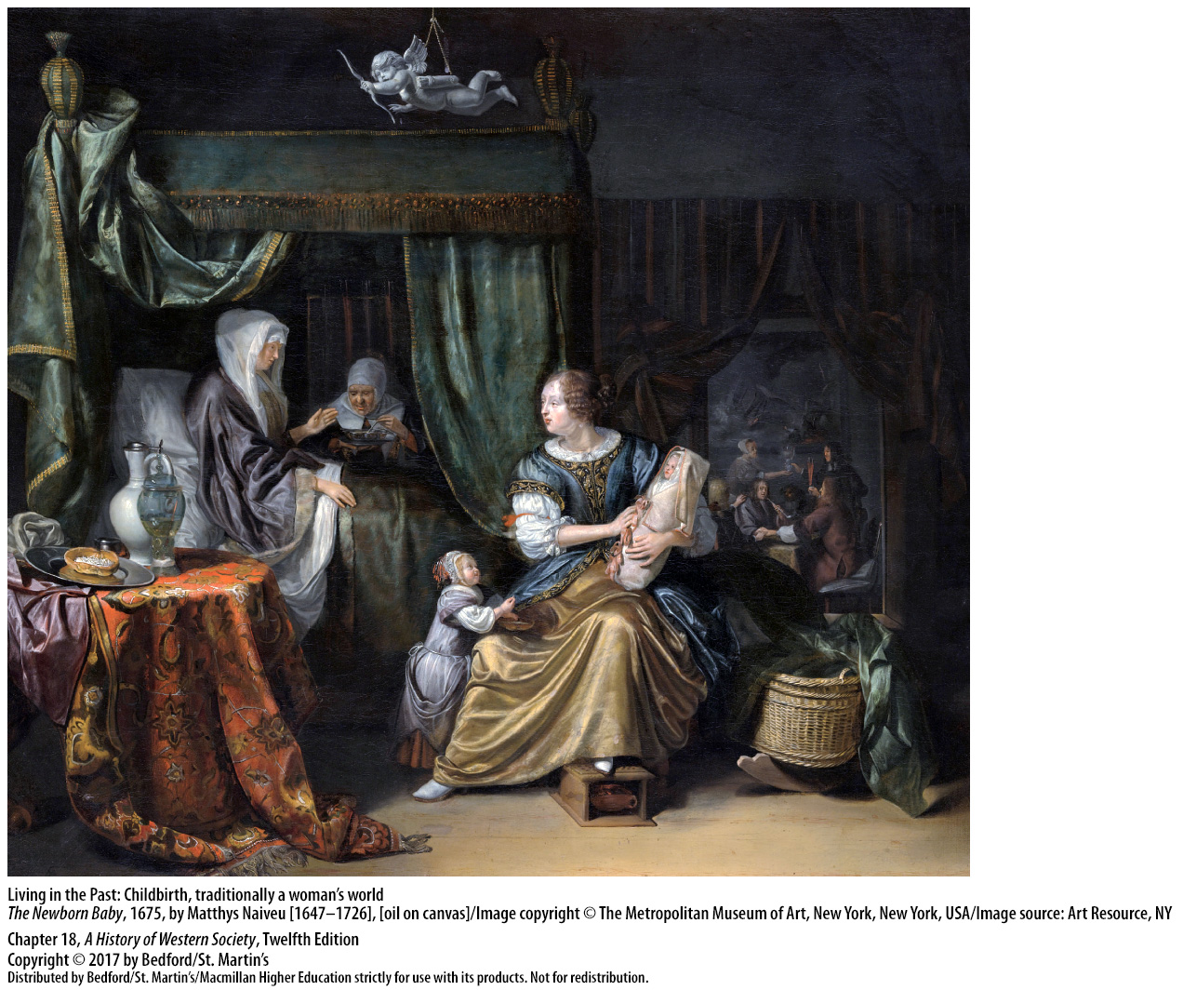

Slide 46
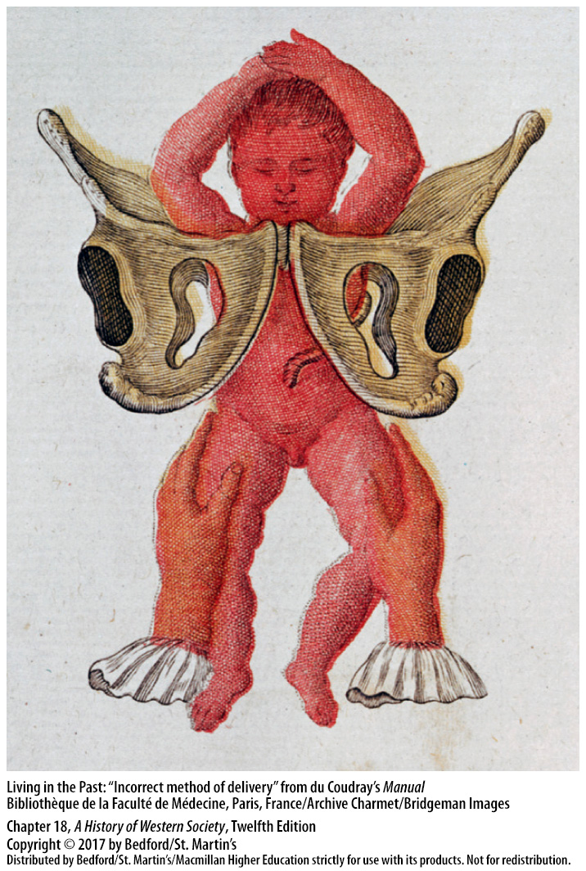

Slide 47
V. Medical Practice
The Conquest of Smallpox
Lady Mary Wortley Montagu
Spread practice of smallpox inoculation from Muslim lands of western Asia to England
Risks of inoculation
Edward Jenner (1749 – 1823)
First successful vaccination in 1796
New method of treatment spread rapidly
Notes:
V. Medical Practice
D. The Conquest of Smallpox
1. Lady Mary Wortley Montagu learned about the practice of smallpox inoculation in the Muslim lands of western Asia while her husband was serving as British ambassador to the Ottoman Empire.
2. She had her own son successfully inoculated with the pus from a smallpox victim and was instrumental in spreading the practice in England after her return in 1722.
3. Inoculation was risky because about one person in fifty died from it, and people who had been inoculated were infectious and often spread the disease.
4. The crucial breakthrough was made by Edward Jenner (1749–1823), who investigated the countryside belief that dairymaids who had contracted cowpox did not get smallpox.
5. After eighteen years of collecting data, Jenner finally performed his first vaccination in 1796 on a young boy using matter taken from a milkmaid with cowpox.
6. After Jenner published his findings in 1798, the new method of treatment spread rapidly, and smallpox disappeared in Europe and then throughout the world.

Slide 48
