Slide 1
A History of Western Society Twelfth Edition
McKay • Crowston • Wiesner-Hanks • Perry
CHAPTER 17
The Expansion of Europe
1650–1800
Copyright © 2017 by Bedford/St. Martin’s
Distributed by Bedford/St. Martin's/Macmillan Higher Education strictly for use with its products; Not for redistribution.

Slide 2
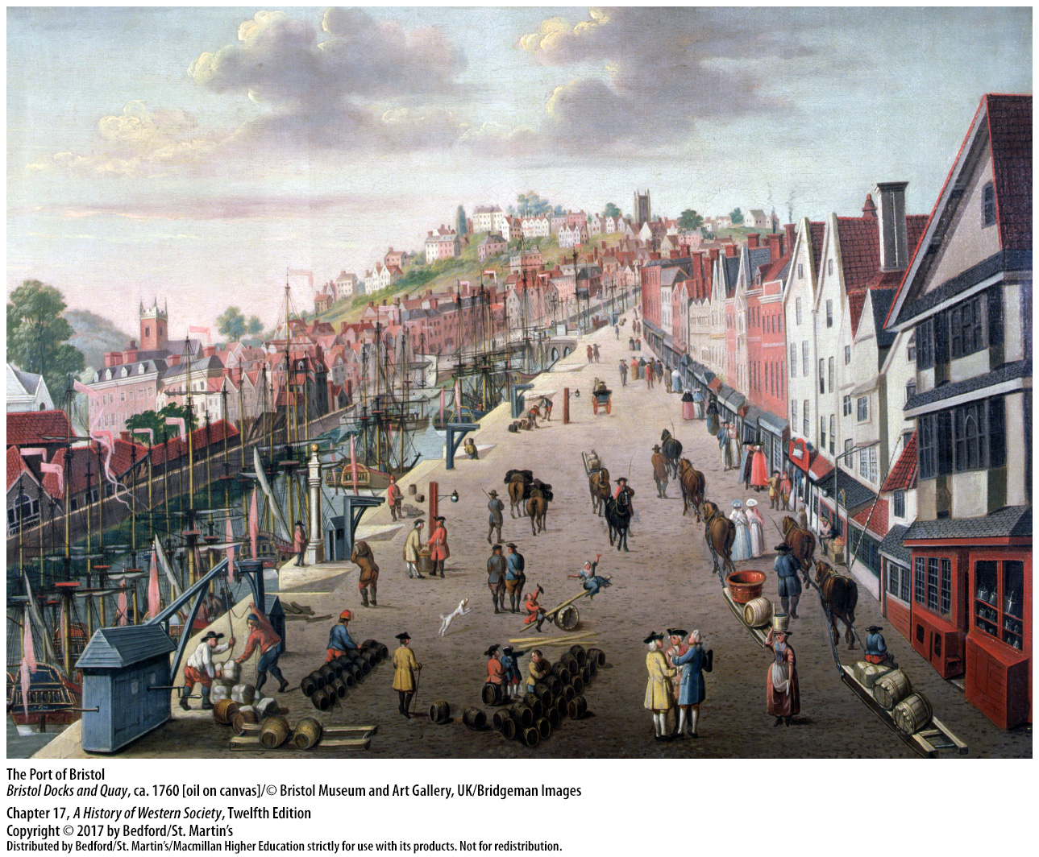

Slide 3
I. Working the Land
The Legacy of the Open-Field System
Open-field system
Rotation of crops staggered
Communal patterns of farming
Heavy taxes and high rents
Serfs in hereditary service
Better social conditions in western Europe
Notes:
Working the Land
The Legacy of the Open-Field System
1. The open-field system of farming, which was developed in the Middle Ages, sustained fairly large numbers of people, but it did not produce material abundance. The land was divided into several large open fields, each cut into long, narrow strips unenclosed by fences or hedges, and farmed according to traditional methods.
2. To deal with the problems of soil exhaustion, peasants staggered the rotation of crops every three years, followed by a year of fallow.
3. Traditional village rights reinforced communal patterns of farming in which villagers rotated field crops, maintained open meadows, allowed the poor to glean the grain, and held surrounding woodlands in common.
4. The state and landlords continued to levy heavy taxes and high rents, stripping peasants of much of their meager earnings.
5. Most peasants in eastern Europe were serfs bound to their lords in hereditary service, and they worked several days a week on the lord’s land.
6. Social conditions were better in western Europe, where peasants were generally free from serfdom, and some owned land that they could pass on to their children.

Slide 4
I. Working the Land
New Methods of Agriculture
New ways of rotating crops
More fodder, hay, and vegetables for animals
New crops like potatoes and types of beans
Enclosure movement
Notes:
Working the Land
B. New Methods of Agriculture
1. New ways of rotating crops, which allowed farmers to forgo the unproductive fallow period and keep land in continuous cultivation, resulted in significant gains in agricultural productivity.
2. Alternating grain with clover and other crops that restored nutrients to the soil yielded more fodder, hay, and vegetables, allowing peasants to build up their herds of cattle and sheep, which in turn meant more meat and dairy products and more manure for fertilizer, as well as power to pull ploughs and carts.
3. The planting of new crops such as potatoes and many types of beans, which came to Europe through the Columbian exchange, also supplemented peasants’ meager diet.
4. Advocates of the new crop rotations argued that innovating agriculturalists needed to enclose and consolidate their scattered holdings and the village’s natural pasturelands into compact, fenced-in fields in order to farm more effectively. This movement, known as enclosure, meant a revolution in village life and organization, but proponents considered it the necessary price of technical progress.

Slide 5
I. Working the Land
The Leadership of the Low Countries and England
Dutch Republic drained marshes for farmland
Jethro Tull (1674 – 1741)
Selective breeding methods
Large-scale enclosure
Notes:
Working the Land
C. The Leadership of the Low Countries and England
1. The Dutch Republic was densely populated, and in order to feed themselves, the Dutch sought maximum yields from their land and strove to increase the cultivated area through the steady draining of marshes and swamps. In the first half of the seventeenth century, Dutch experts contributed to draining the extensive marshes, or fens, of wet and rainy England; their efforts converted swampy wilderness into thousands of acres of productive land.
2. Jethro Tull (1674–1741), an important English innovator who tried to develop better farming methods through empirical research, advocated using horses rather than oxen for plowing and sowing seed with drilling equipment for even distribution at the proper depth.
3. Improvements in livestock developed from selective breeding methods.
4. More than half the farmland in England was enclosed through private initiatives prior to 1700; from the 1760s to 1815, acts of Parliament enclosed most of the remaining common land. Agricultural experimentalists celebrated large-scale enclosure as necessary for progress, a claim that many contemporaries echoed, although recent research has shown that regions that retained open-field farming also adopted crop rotation and other innovations.

Slide 6
I. Working the Land
The Leadership of the Low Countries and England
Critics emphasized the resulting social upheaval
Market-oriented estate agriculture and proletarianization
Widespread unemployment in the countryside
Notes:
Working the Land
C. The Leadership of the Low Countries and England
5. Critics of enclosure emphasized the social upheaval that resulted from the elimination of common rights and the reduction of the access of poor men and women to the land.
6. The enclosure movement gave rise to market-oriented estate agriculture and proletarianization—the transformation of large numbers of small peasant farmers into landless rural wage earners. By the early nineteenth century, a minority of wealthy landowners held most of the land in England and leased their holdings to middle-size farmers, who relied on landless laborers for their workforce.
7. Not only was the small landholder deprived of his land, but improvements in technology also meant fewer laborers were needed, which led to widespread unemployment in the countryside.

Slide 7
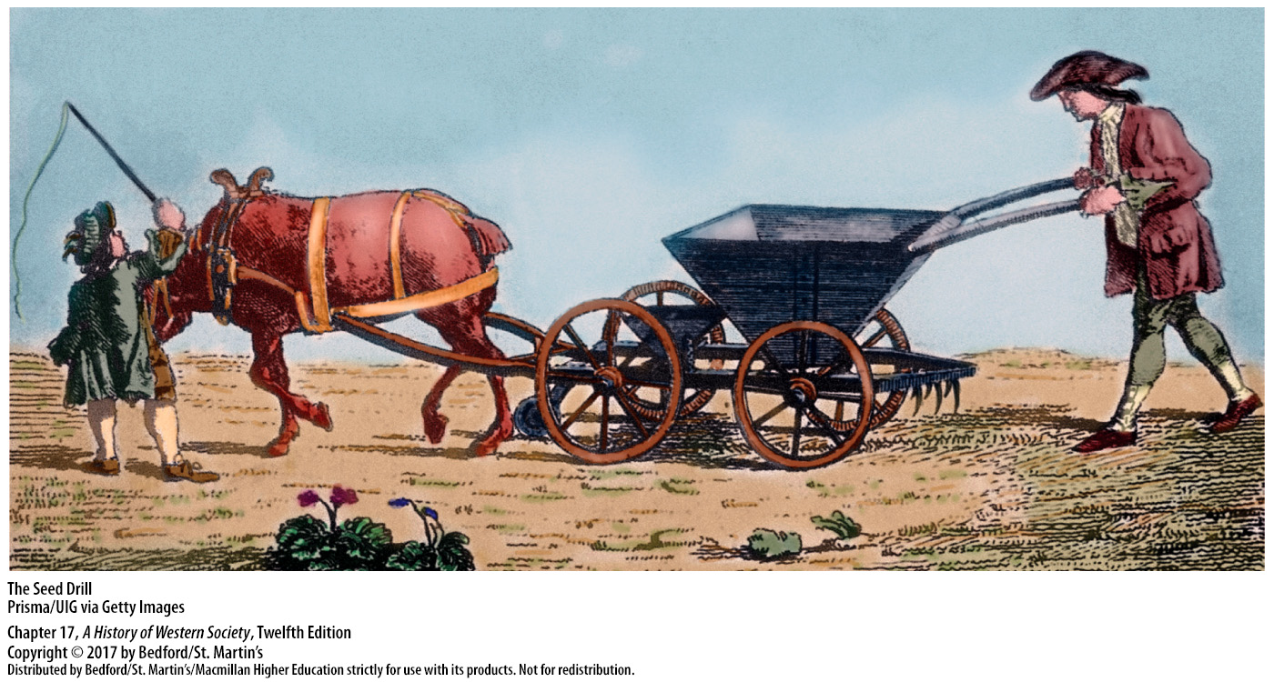

Slide 8
II. The Beginning of the Population Explosion
Long-Standing Obstacles to Population Growth
Irregular cyclical population pattern
Food prices rose more rapidly than wages
Fertility and mortality rates in balance
Famine, disease, and war led to population loss
Years of modest growth followed those losses
Notes:
II. The Beginning of the Population Explosion
Long-Standing Obstacles to Population Growth
1. Until 1700 the total population of Europe grew slowly much of the time, and it followed an irregular cyclical pattern, which both reflected and determined the availability and prices of food.
2. By the mid-sixteenth century, Europe’s population had recovered from the ravages of the Black Death of 1348–1350; however, as population growth outstripped agricultural production, food prices rose more rapidly than wages, and living standards declined substantially.
3. In seventeenth-century Europe, births and deaths, fertility and mortality, were in a crude but effective balance, and in normal years the population grew at a modest rate ranging from 0.5 to 1 percent.
4. In certain abnormal years and tragic periods—due to the ravages of famine, epidemic disease, and war—many more people died than were born, and the total population of Europe fell sharply, even catastrophically.
5. A number of years of modest growth were then necessary to make up for those losses, which effectively kept population growth in check until after 1700.

Slide 9
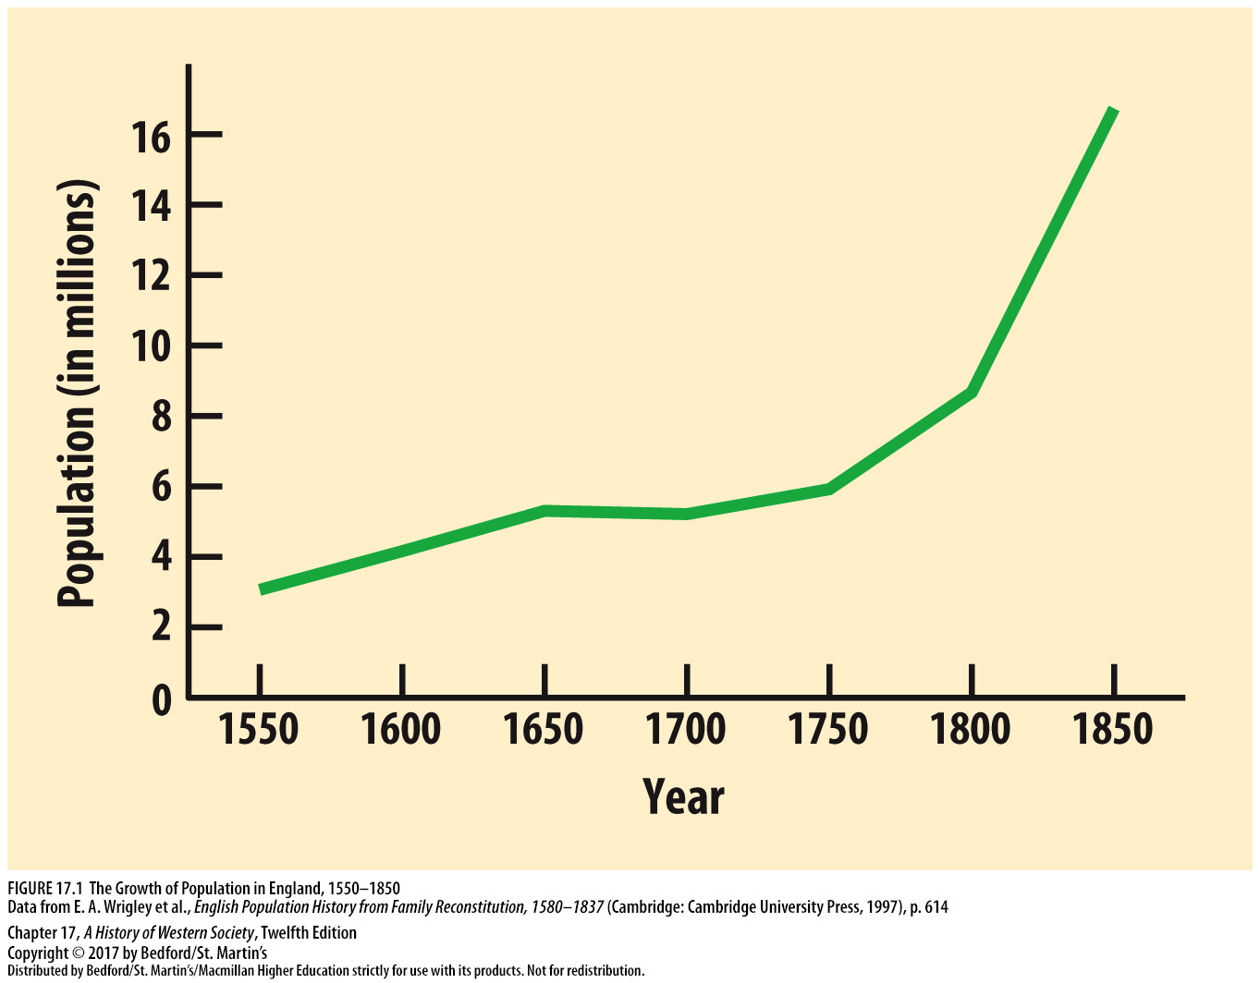

Slide 10
II. The Beginning of the Population Explosion
The New Pattern of the Eighteenth Century
Dramatic increases in population after 1750
Decline in mortality
Disappearance of the bubonic plague
Inoculation against smallpox
Notes:
II. The Beginning of the Population Explosion
B. The New Pattern of the Eighteenth Century
1. The size of the European population grew markedly in the eighteenth century, with especially dramatic increases after about 1750.
2. Although some areas saw an increase in birthrates, the basic cause of European population increase was a decline in mortality.
3. A primary reason behind this decline was the mysterious disappearance of the bubonic plague after a 1720 outbreak in Marseilles.
4. Inoculation against smallpox was developed in England, although, overall, advances in medical knowledge did little to reduce the death rate in this period.

Slide 11
II. The Beginning of the Population Explosion
The New Pattern of the Eighteenth Century
Improvements in water supply and sewage, drainage of swamps; reduced insect population
Better safeguards for food supply
Wars less destructive, food supply increased
Notes:
II. The Beginning of the Population Explosion
B. The New Pattern of the Eighteenth Century
5. Improvements in the water supply and sewage, which were frequently promoted by strong absolutist monarchies, helped reduce diseases such as typhoid and typhus and resulted in somewhat better public health. Improvements in the water supply and the drainage of swamps also reduced Europe’s large insect population, diminishing its role in spreading diseases.
6. Human beings also became more successful in their efforts to safeguard the supply of food due to advances in transportation introduced by strong absolutist states, lessening the impact of local crop failures.
7. Wars became less destructive, and new farming methods increased the food supply and contributed nutritious new foods. Famines, epidemics, and wars continued to occur and to affect population growth, but their severity moderated.

Slide 12
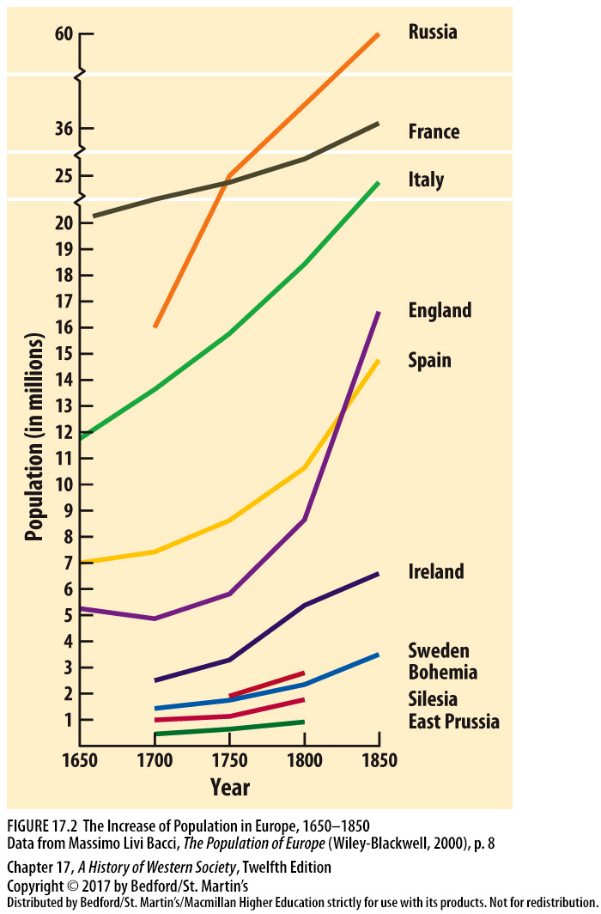

Slide 13
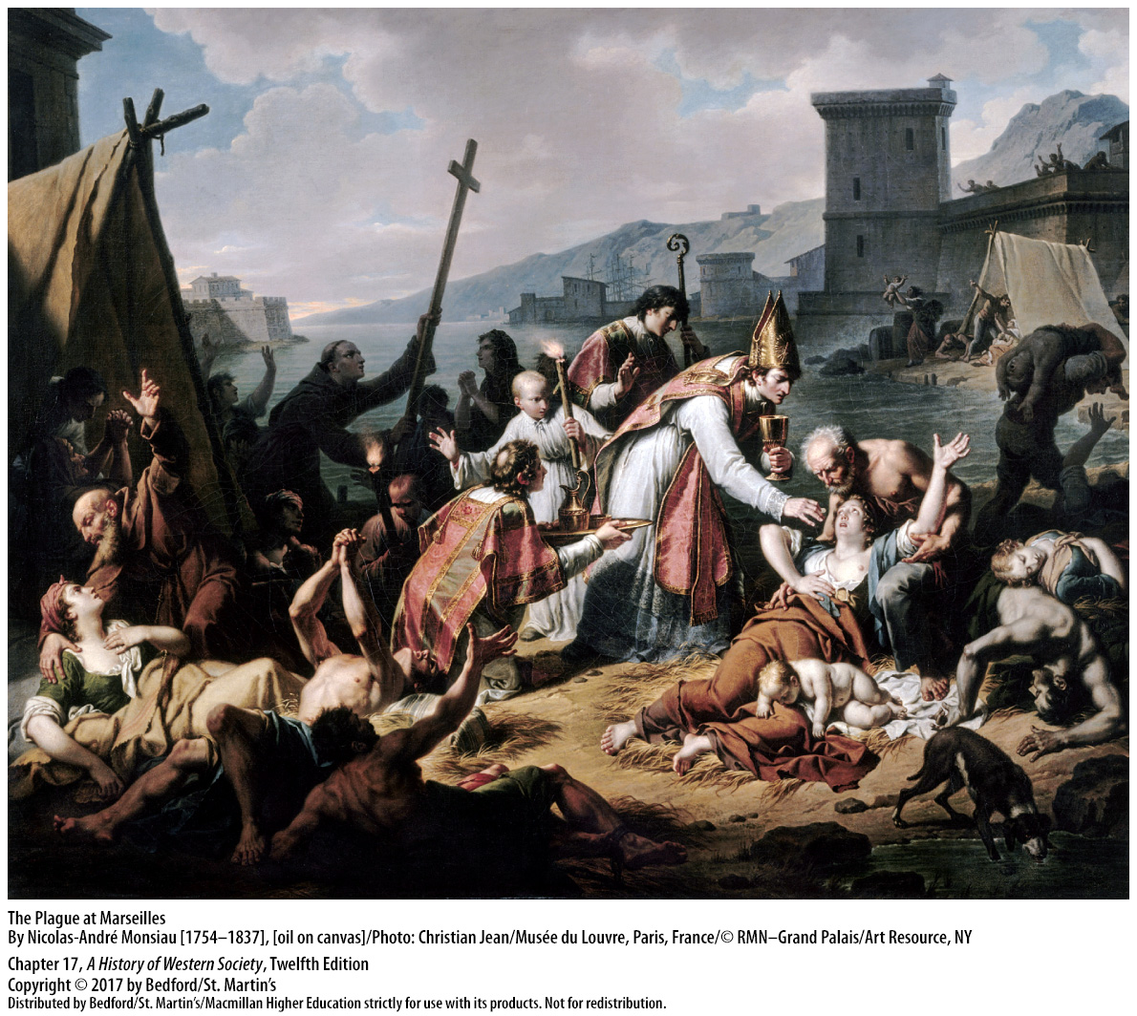

Slide 14
III. The Growth of Rural Industry
The Putting-Out System
Cottage industry, the “putting-out system”
Industries grew in scale and complexity
Underemployed labor abundant
Rural manufacturing most successful in England
Continental countries developed rural industry more slowly
Notes:
III. The Growth of Rural Industry
The Putting-Out System
1. Cottage industry was often organized through the putting-out system, in which a merchant loaned, or “put out,” raw materials to cottage workers who processed the raw materials in their own homes and returned the finished products to the merchant.
2. As industries grew in scale and complexity, production often was broken into stages.
3. The putting-out system grew because underemployed labor was abundant, with poor peasants and landless laborers willing to work for low wages, and because the lack of rigid guild standards meant workers could produce many kinds of goods.
4. Rural manufacturing developed most successfully in England, particularly the spinning and weaving of woolen cloth.
5. Most continental countries developed rural industry more slowly; by the late eighteenth century, rural industry saw a remarkable expansion in some densely populated regions.

Slide 15
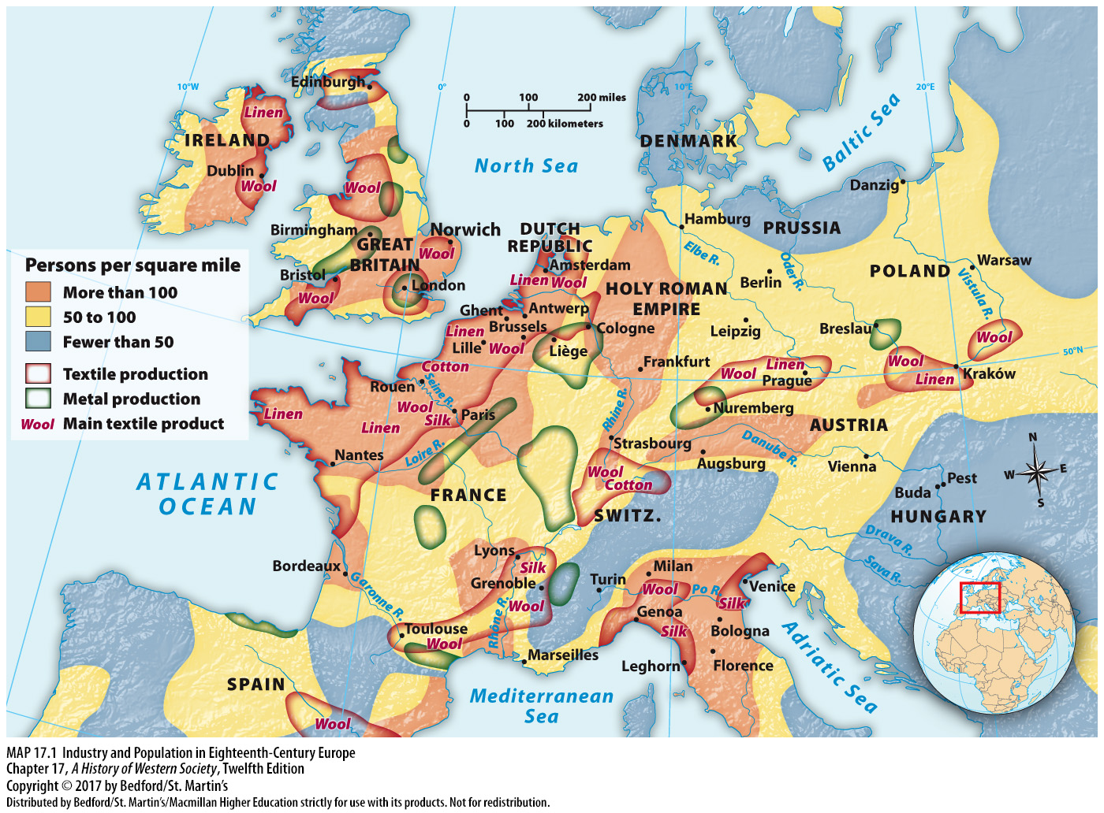

Slide 16
III. The Growth of Rural Industry
The Lives of Rural Textile Workers
Textile industry employed the most people in Europe
Handloom weaving
Merchants hired wives and daughters to spin
Mutual suspicion between workers and employers
Notes:
III. The Growth of Rural Industry
B. The Lives of Rural Textile Workers
1. Until the nineteenth century, the textile industry employed the most people in Europe; the making of linen, woolen, and eventually cotton cloth was the typical activity of cottage workers in the putting-out system.
2. Handloom weaving was a family enterprise, but operating the loom was reserved for the male head of the family. Women and children worked at auxiliary tasks, preparing the warp (vertical) threads, mounting them on the loom, winding threads on bobbins for the weft (horizontal) threads, and sometimes operating the warp frame while the father passed the shuttle.
3. Because the work of four or five spinners was needed to keep one weaver steadily employed, merchants hired the wives and daughters of agricultural workers to spin in their spare time.
4. Relations between workers and employers often were marked by mutual suspicion and disputes over the weights of materials and the quality of finished work.

Slide 17
III. The Growth of Rural Industry
The Lives of Rural Textile Workers
Lower wages for female workers
Low wages to force the “idle” poor to be productive
New police powers over workers
Notes:
III. The Growth of Rural Industry
B. The Lives of Rural Textile Workers
5. Conditions were particularly hard for female workers, whose wages were usually much lower because they were not considered the family’s primary wage earner.
6. Merchants bitterly resented their lack of control over cottage workers, who were scattered across the countryside, because their livelihood depended on their ability to meet orders on time. Merchants thus insisted on maintaining the lowest possible wages to force the “idle” poor into productive labor.
7. They also obtained new police powers over workers, including imprisonment and public whipping for pilfering small bits and pieces of yarn or cloth, which peasants viewed as a right akin to the traditional peasant right of gleaning.

Slide 18
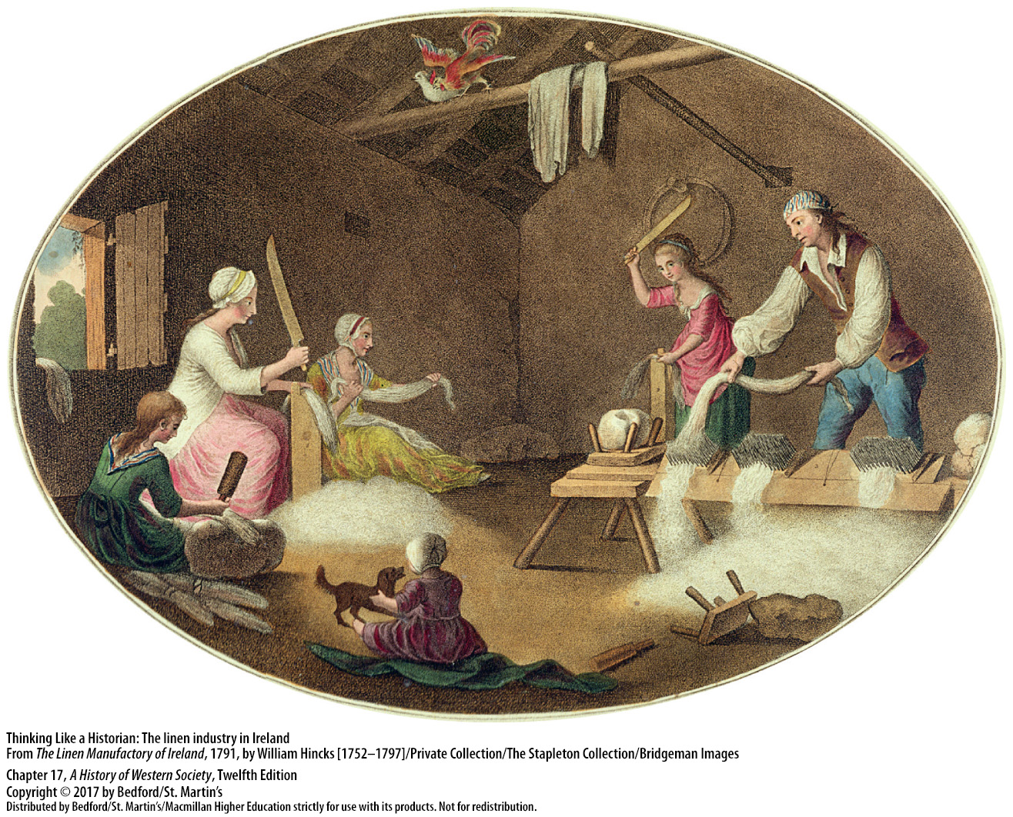

Slide 19
III. The Growth of Rural Industry
The Industrious Revolution
Households stepped up the pace of work
Rural and urban wage workers
Women worked menial, tedious jobs for low wages, but had a greater role in the household
Market-produced versus homemade goods
Notes:
III. The Growth of Rural Industry
C. The Industrious Revolution
1. Households reduced leisure time, stepped up the pace of work, and redirected the labor of women and children toward wage work.
2. The spread of cottage industry can be seen as a rural manifestation of the industrious revolution, while in the cities there was a rise in female employment outside the home. By working harder and increasing the number of wageworkers, rural and urban households could purchase more goods, even in a time of stagnant or falling wages.
3. When women entered the labor market, they almost always worked at menial, tedious jobs for very low wages. Yet it seems that women who earned their own wages also took a greater role in household decision making, and through small purchases, they helped spur the growth of the textile industries in which they labored.
4. The industrious revolution created households in which all members worked for wages rather than in a united family business and in which consumption relied on market-produced rather than homemade goods.

Slide 20
IV. The Debate over Urban Guilds
Urban Guilds
Undermining of the traditional guild system
Jean-Baptiste Colbert revived the urban guilds
Guilds served social and religious functions
Restricted membership to local men
Most men and women worked in non-guild trades
Some women accepted into guilds
Notes:
IV. The Debate over Urban Guilds
Urban Guilds
1. One consequence of the growth of rural industry was an undermining of the traditional guild system that protected urban artisans.
2. Jean-Baptiste Colbert, the French finance minister under Louis XIV, revived the urban guilds and used them to encourage high-quality production and to collect taxes. Each guild had a set of privileges, including exclusive rights to produce and sell certain goods, access to raw materials, and the rights to train apprentices and open shops.
3. Guilds also served social and religious functions, providing a locus of sociability and group identity to the middling classes.
4. Guilds jealously restricted their membership to local men who were good Christians, had several years of work experience, paid high membership fees, and completed a masterpiece; they gave masters’ sons automatic entry to their father’s guilds, while barring outsiders.
5. Most urban men and women worked in non-guild trades as domestic servants, manual laborers, and vendors of food, clothing, and other goods.
6. A few guilds, such as those involving needlework and textile production, accepted women; by the mid-eighteenth century, male masters began to hire more female workers, often in defiance of their own guilds.

Slide 21
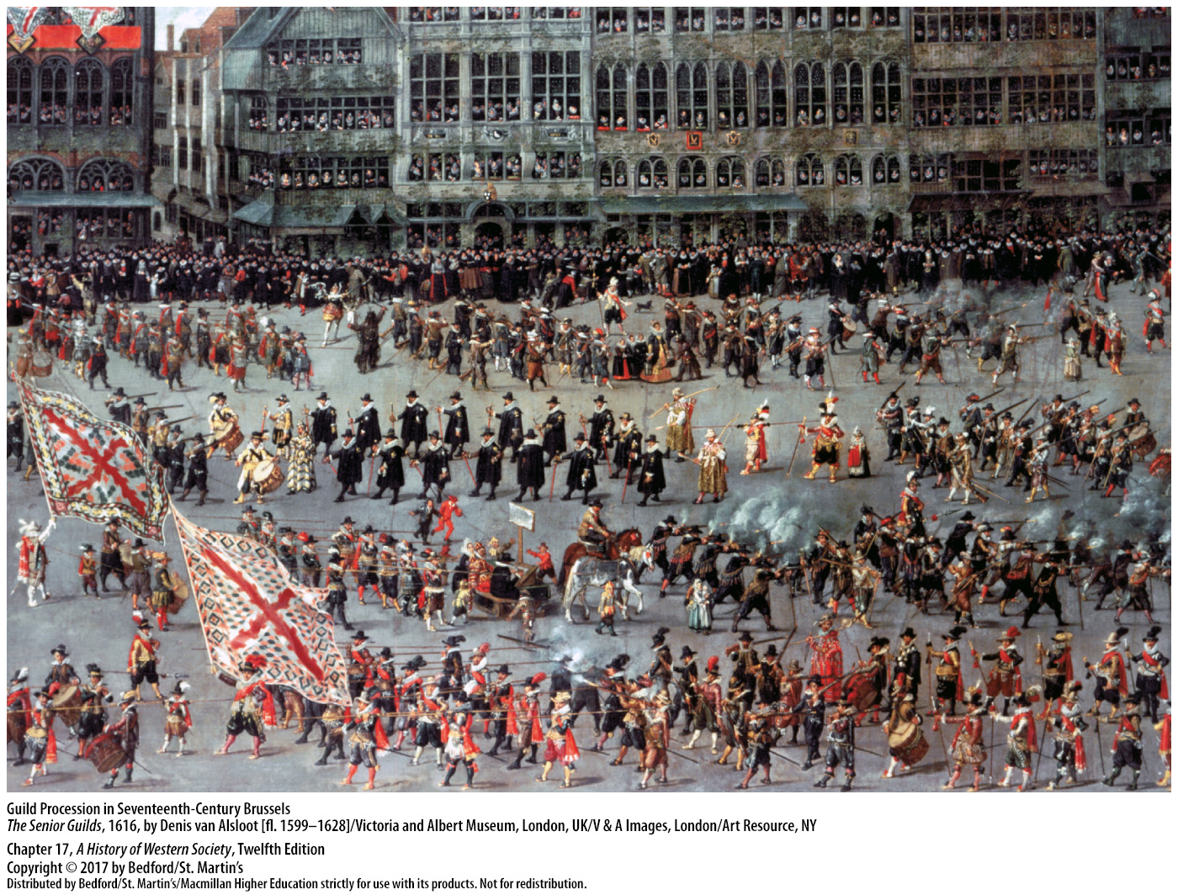

Slide 22
IV. The Debate over Urban Guilds
Adam Smith and Economic Liberalism
Guild critics: outmoded and exclusionary
Adam Smith (1723 – 1790)
Inquiry into the Nature and Causes of the Wealth of Nations (1776)
Criticized guilds for their restrictions
Notes:
IV. The Debate over Urban Guilds
B. Adam Smith and Economic Liberalism
1. Critics of guilds derided them as outmoded and exclusionary institutions that obstructed technical innovation and progress.
2. One of the most well-known critics of government regulation of trade and industry was Adam Smith (1723–1790), a professor of philosophy and a leading figure of the Scottish Enlightenment.
3. Smith developed the general idea of freedom of enterprise and established the basis for modern economics in his groundbreaking work Inquiry into the Nature and Causes of the Wealth of Nations (1776).
4. Smith criticized guilds for their restrictions, a critique he extended to all state monopolies and privileged companies.

Slide 23
IV. The Debate over Urban Guilds
Adam Smith and Economic Liberalism
Free competition and “division of labor”
“Only three duties” for government
Pursuit of self-interest in a competitive market
Notes:
IV. The Debate over Urban Guilds
B. Adam Smith and Economic Liberalism
5. Free competition, Smith argued, would best protect consumers from price gouging and give all citizens a fair and equal right to do what they did best. Smith advocated a more highly developed “division of labor,” which entailed separating craft production into individual tasks to increase workers’ speed and efficiency.
6. Smith argued that government should limit itself to “only three duties”: defense against foreign invasion; maintenance of civil order with courts and police protection; and sponsorship of indispensable public works and institutions that could never profit private investors.
7. He believed the pursuit of self-interest in a competitive market would be sufficient to improve the living conditions of citizens, a view that quickly emerged as the classic argument for economic liberalism.

Slide 24
V. The Atlantic World and Global Trade
Mercantilism and Colonial Competition
System of economic regulations
First of the Navigation Acts (1651)
Form of economic warfare
The War of the Spanish Succession
Notes:
V. The Atlantic World and Global Trade
Mercantilism and Colonial Competition
1. European mercantilism in the seventeenth century was a system of economic regulations aimed particularly at creating a favorable balance of foreign trade to increase a country’s stock of gold and, hence, its ability to wage war.
2. In England in 1651, Oliver Cromwell established the first of the Navigation Acts, which required that most goods imported from Europe be carried on British-owned ships or on ships of the exporting country. These laws gave British merchants and ship owners a virtual monopoly on trade with British colonies.
3. These regulations were enacted in the hopes of eliminating foreign competition and developing a British shipping industry staffed by experienced seamen who could also serve in the Royal Navy. The Navigation Acts were a form of economic warfare that initially targeted the Dutch, who were far ahead of the English in shipping and foreign trade.
4. By the late seventeenth century, after three Anglo-Dutch wars, however, the Dutch Republic was falling behind England in shipping, trade, and colonies. France then stood as England’s most serious rival in the competition for overseas empire, and from 1701 to 1763 the two countries were locked in a series of wars to decide which would become the leading maritime and colonial power. The first round was the War of the Spanish Succession, in which Louis XIV was defeated by a coalition of states and was forced in the Peace of Utrecht (1713) to cede France’s northernmost American holdings to Britain.

Slide 25
V. The Atlantic World and Global Trade
Mercantilism and Colonial Competition
War of the Austrian Succession (1740 – 1748)
The Seven Years’ War (1756 – 1763)
Treaty of Paris (1763)
British trading and colonial empire
Notes:
V. The Atlantic World and Global Trade
Mercantilism and Colonial Competition
5. The War of the Austrian Succession (1740–1748) gradually became a world war that included Anglo-French conflicts in India and North America, but it ended with no change in the territorial situation in North America.
6. The Seven Years’ War (1756–1763), the decisive round in the Franco-British competition for colonial empire, drew in Native American allies on both sides of the conflict.
7. Britain’s victory on all colonial fronts was ratified in the 1763 Treaty of Paris in which France lost its remaining possessions on mainland North America as well as most of its holdings in India.
8. Through naval power and the Navigation Acts, Britain had realized its goal of monopolizing a vast trading and colonial empire.

Slide 26
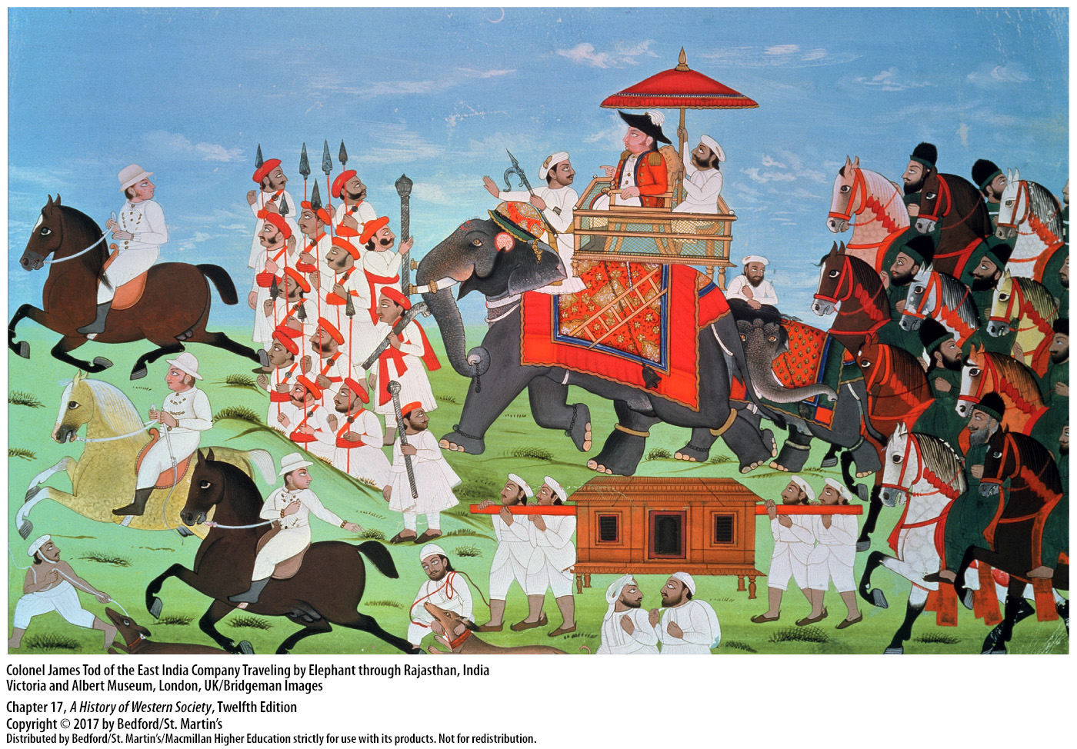

Slide 27
V. The Atlantic World and Global Trade
The Atlantic Economy
Triangular trade
Colonial trade
500,000 slaves in Saint-Domingue by 1789
Spain’s influence expanded westward
System of debt peonage
Intercolonial trade between the Caribbean and North American colonies
Notes:
V. The Atlantic World and Global Trade
B. The Atlantic Economy
1. The growing volume of transatlantic trade drew the four continents bordering the Atlantic Ocean into an increasingly integrated economic system. This triangular trade entailed a three-way transport of European commodities, enslaved Africans, and colonial goods.
2. England benefited from importing colonial products at favorable prices and re-exporting them to other nations at high profits or turning them into processed goods. Colonial trade was profitable for the French as well, thanks to the plantation output of their West Indies colonies and slave trading.
3. By 1789 the population of Saint-Domingue included five hundred thousand slaves whose labor had allowed the colony to become the world’s leading producer of coffee and sugar and the most profitable plantation colony in the New World.
4. Spain’s influence expanded westward all the way to northern California through the efforts of Spanish missionaries and ranchers; at the same time, its mercantilist goals were boosted by a recovery in silver production.
5. To keep up needed food production for the mining camps, Spanish landowners developed a system of debt peonage through which they kept indigenous workers on their estates in perpetual debt bondage by advancing them food, shelter, and a little money.
6. A brisk intercolonial trade existed between the Caribbean and North American colonies.

Slide 28
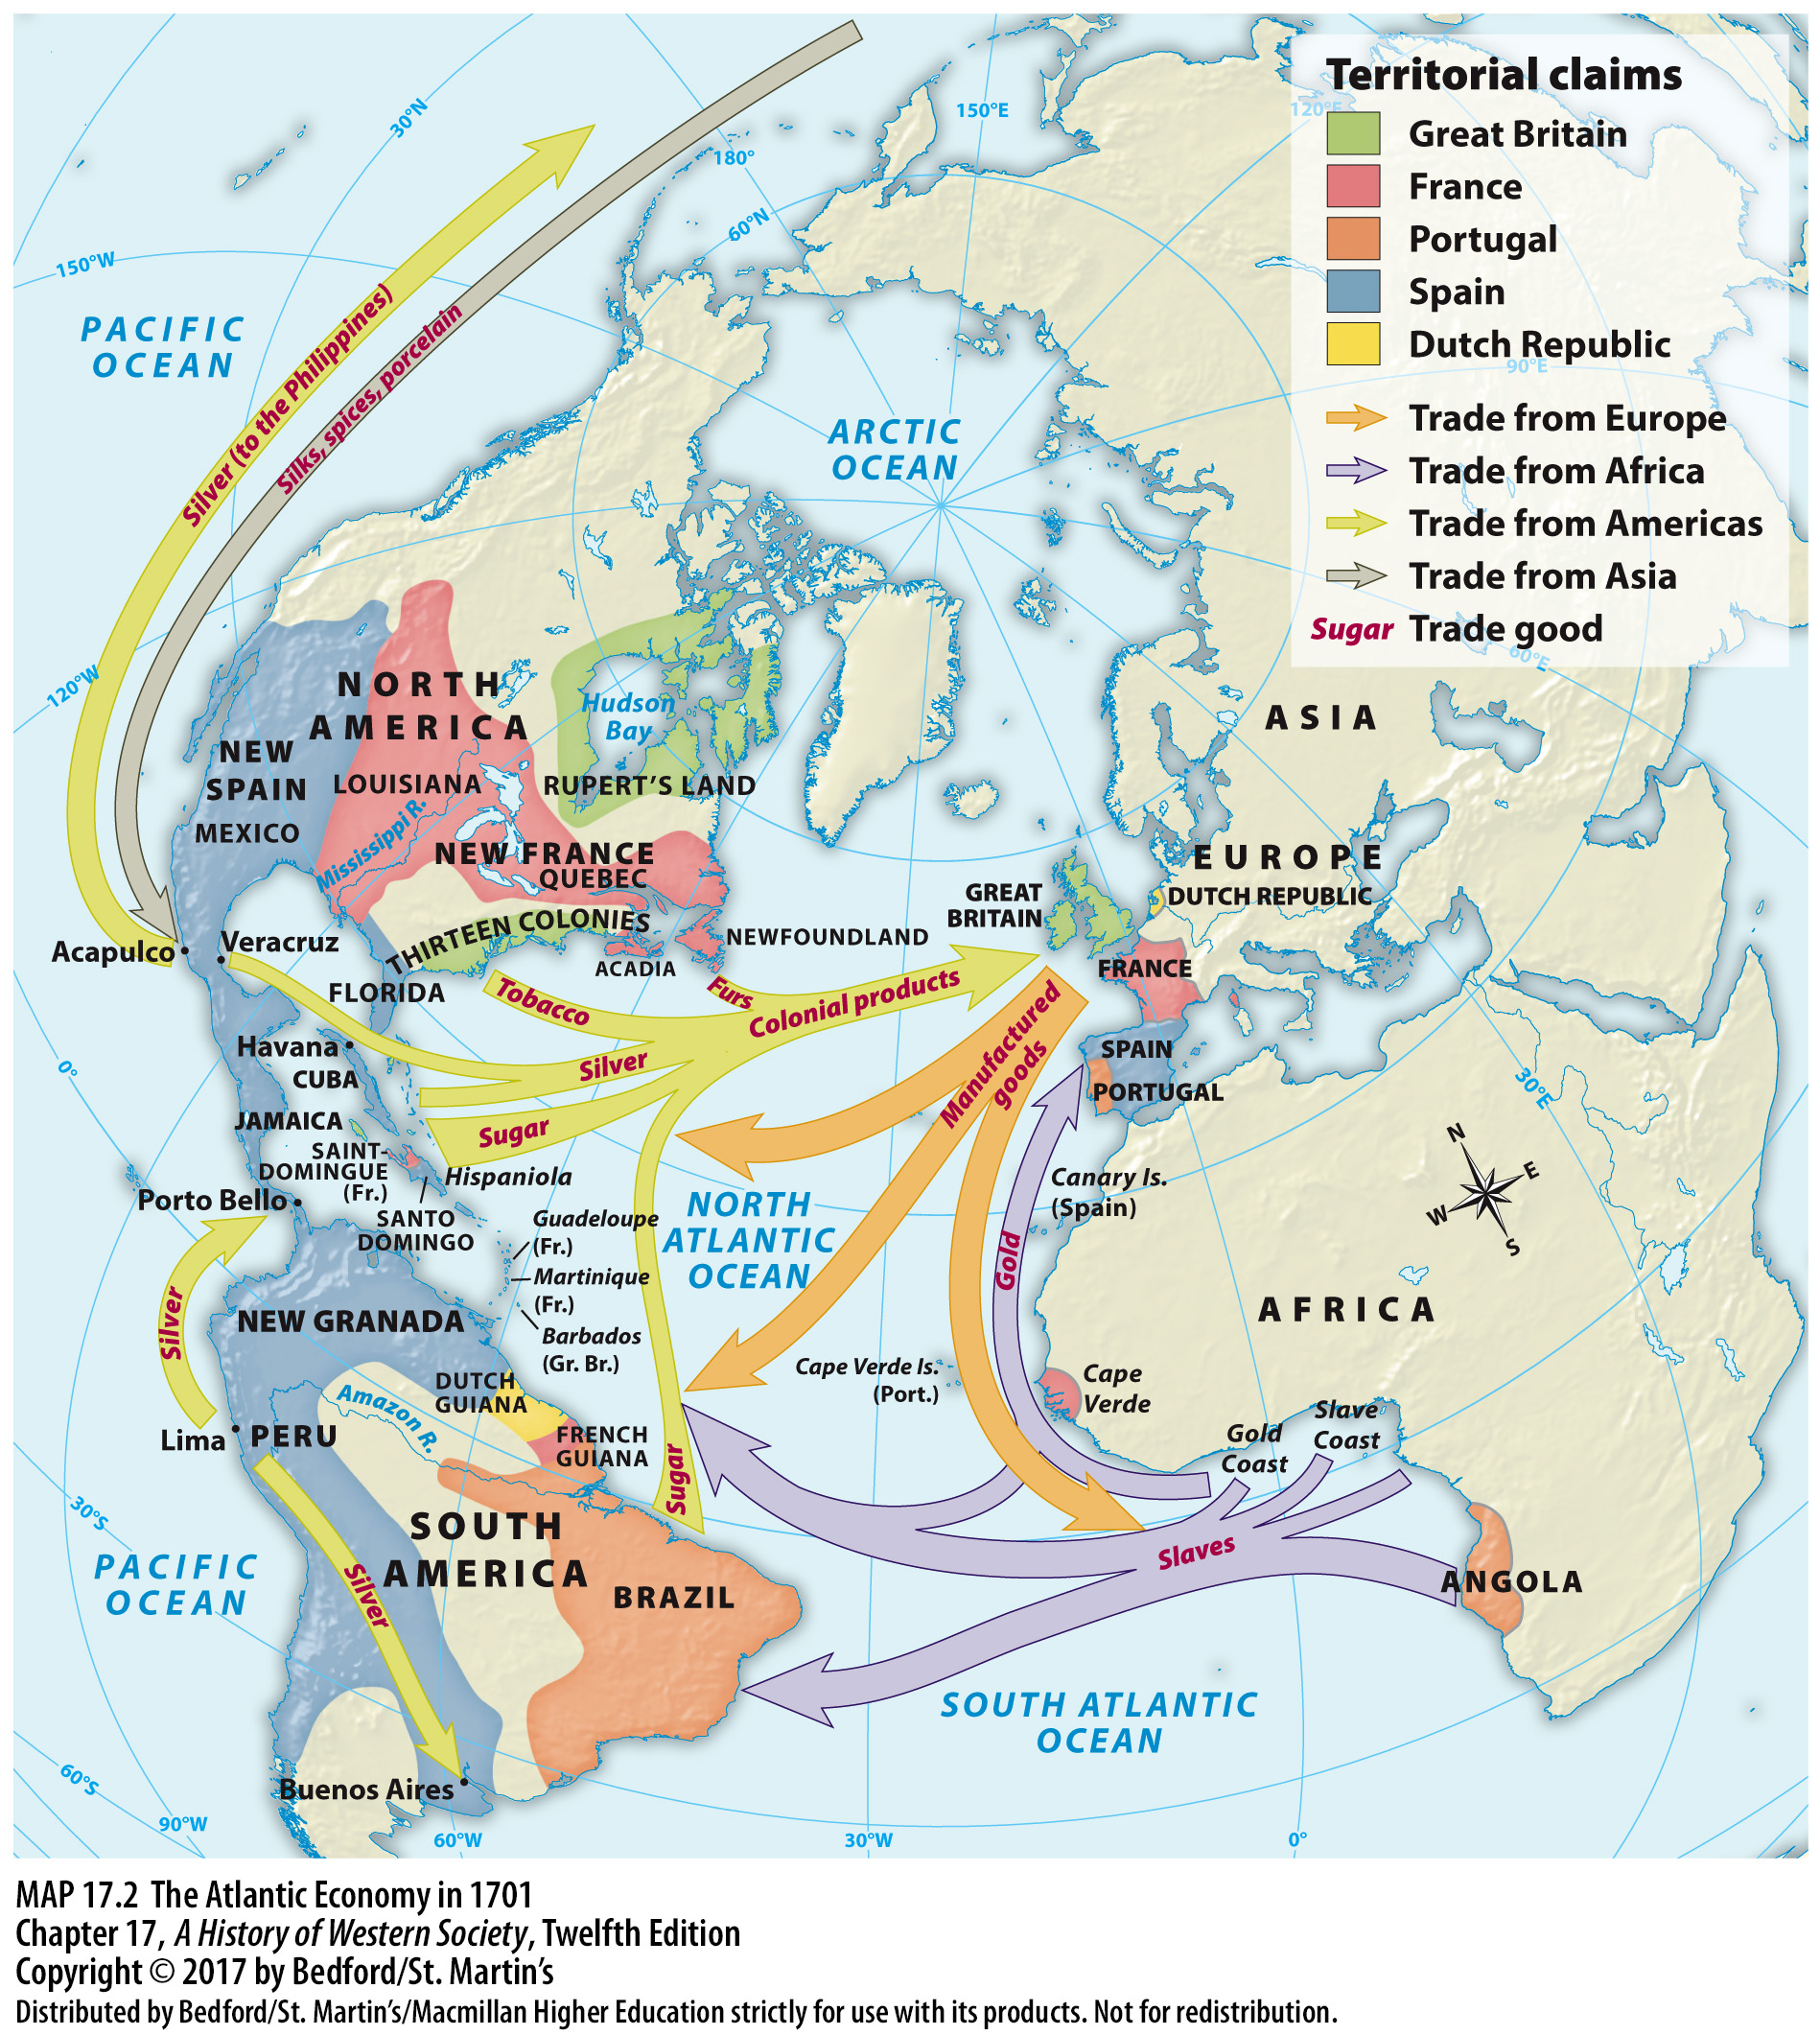

Slide 29
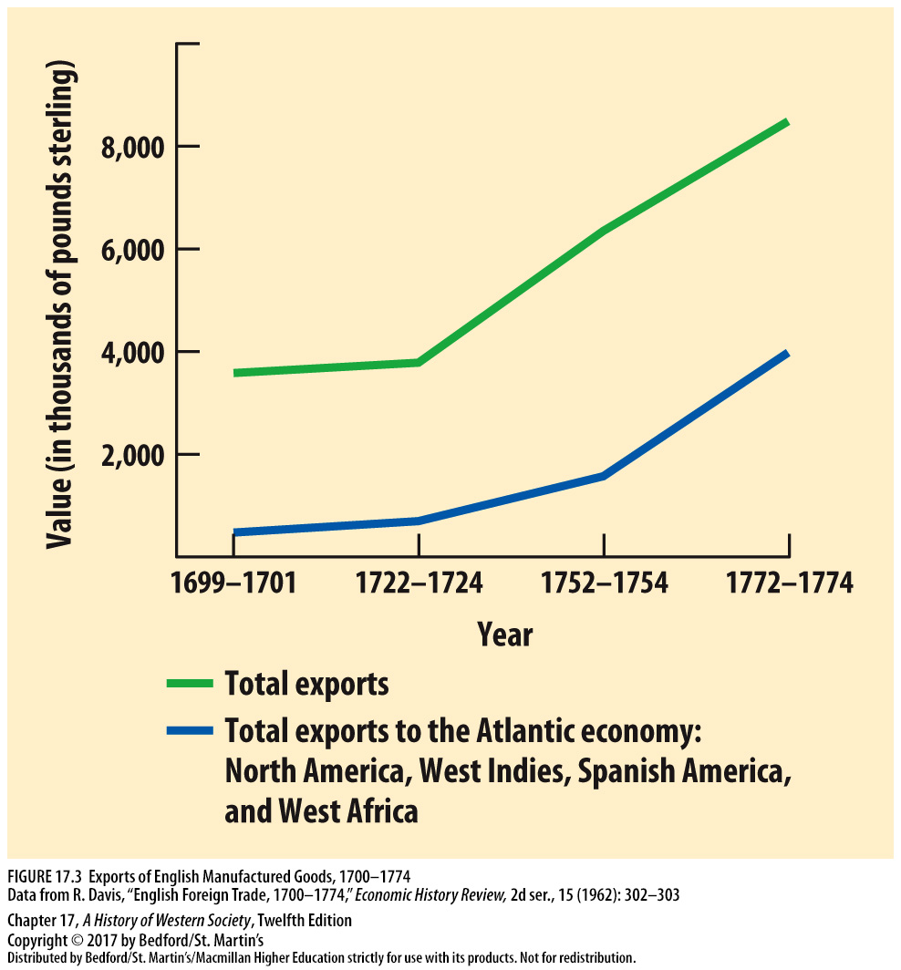

Slide 30
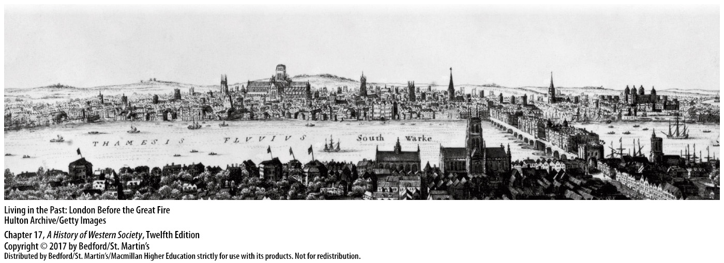

Slide 31
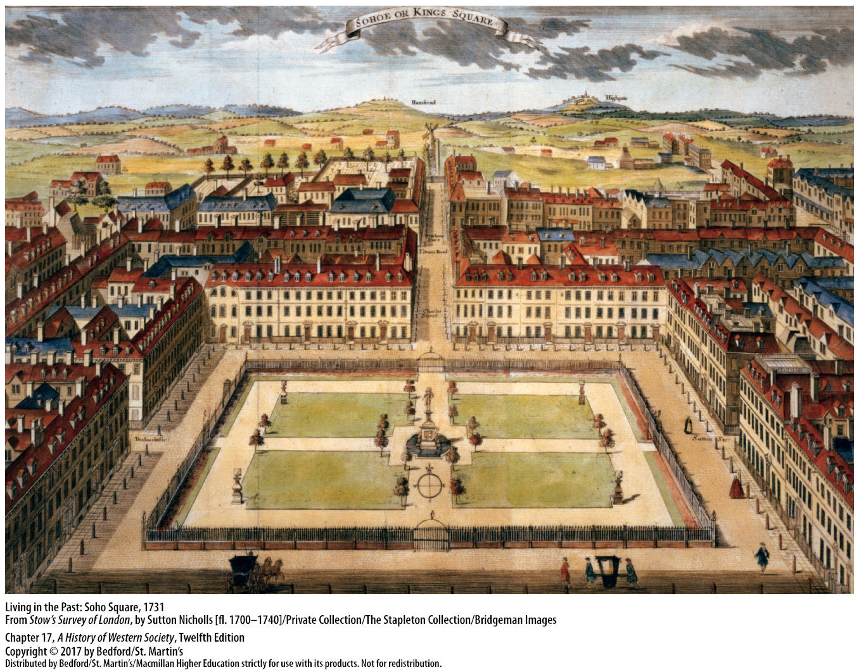

Slide 32
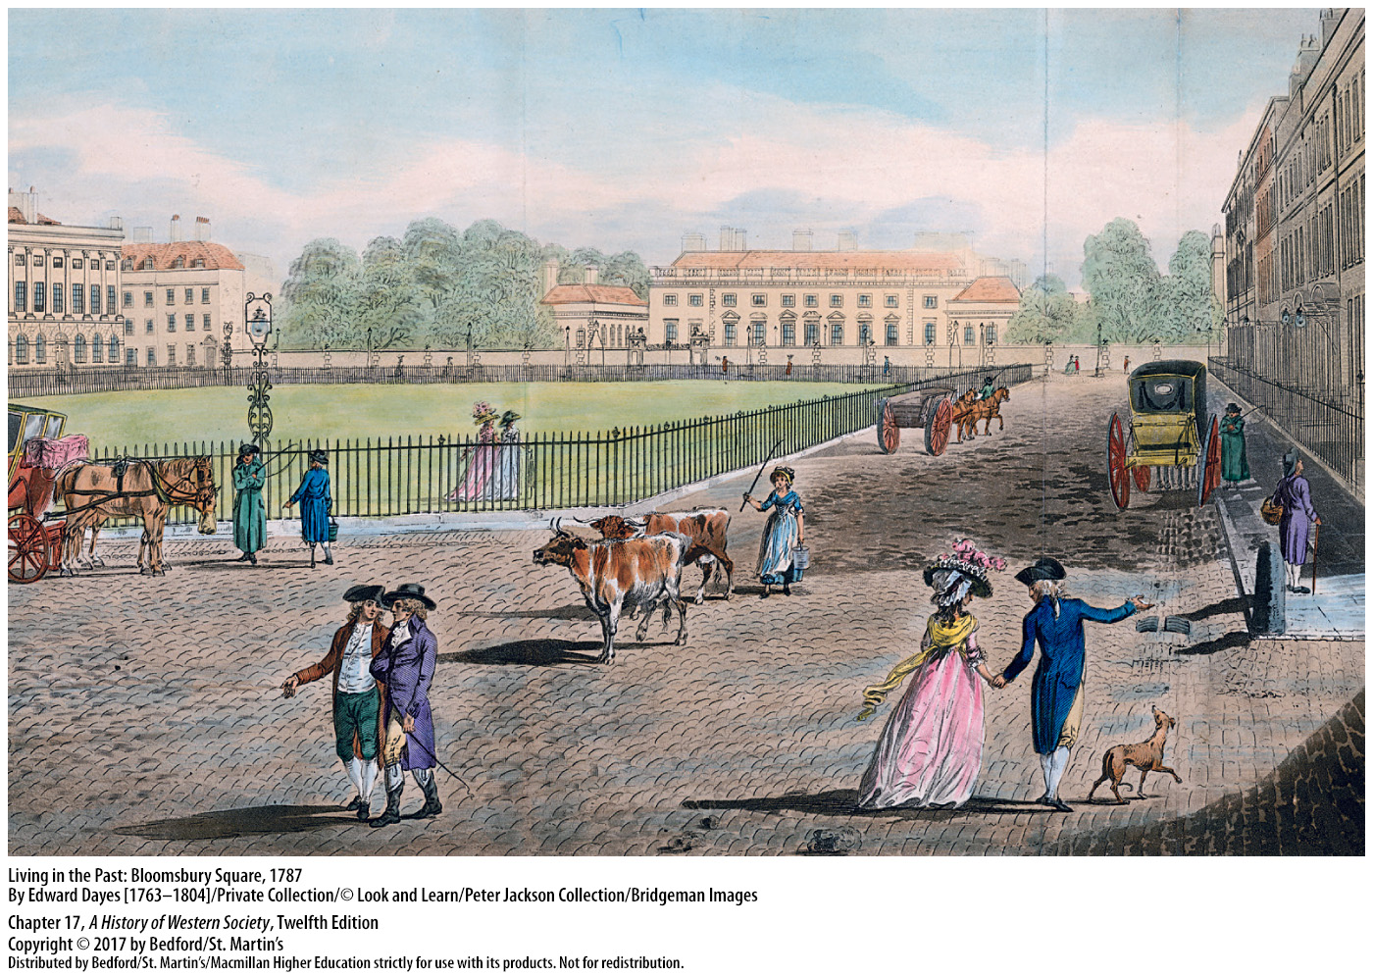

Slide 33
V. The Atlantic World and Global Trade
The Atlantic Slave Trade
Intensified dramatically after 1750
Rise of plantation agriculture
Some African merchants gained access to European and colonial goods, like firearms
Wars among African states
Britain abolished the slave trade in 1807
Notes:
V. The Atlantic World and Global Trade
C. The Atlantic Slave Trade
1. The Atlantic slave trade intensified dramatically after 1750 with the growth of trade and the demand for slave-produced goods such as sugar and cotton. Peaking in the 1780s, when an average of eighty thousand individuals per year were shipped across the Atlantic, the slave trade involved the forcible transport of about 12.5 million Africans between 1450 and 1900.
2. The rise of plantation agriculture was responsible for the tremendous growth of the slave trade, with 45 percent of all enslaved Africans going to Portuguese Brazil and another 45 percent going to the Caribbean colonies.
3. Some African merchants and rulers who controlled exports profited from the greater demand for slaves and gained access to European and colonial goods, including firearms.
4. Wars among African states to obtain salable captives increased, and leaders used slave profits to purchase more arms than textiles and consumer goods, the result being that the population of Africa stagnated or possibly declined.
5. Most Europeans did not personally witness the horrors of the slave trade, but as details of the plight of slaves became known, a campaign to abolish slavery developed in Britain and in the late 1780s grew into a mass movement, until Parliament abolished the British slave trade in 1807.

Slide 34
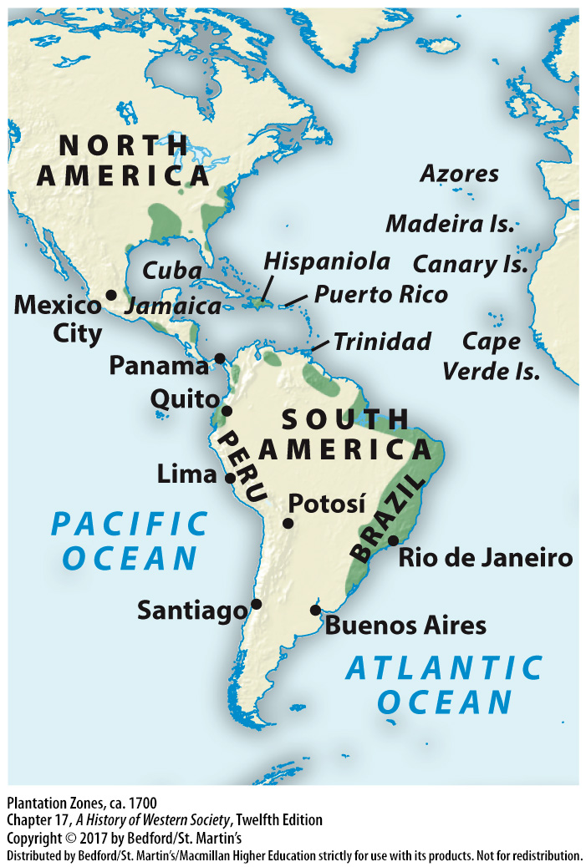

Slide 35
V. The Atlantic World and Global Trade
Identities and Communities of the Atlantic World
Creoles
Unions of European men and indigenous or African women
Mixed-race people could rise to the colonial elite
Many masters acknowledged and freed their mixed-race children
British men forbidden from interracial marriage; left mix-race children in slavery
Notes:
V. The Atlantic World and Global Trade
D. Identities and Communities of the Atlantic World
1. Wealthy Creoles, people of Spanish ancestry born in the Americas, prided themselves on following European ways of life with lavish plantation estates and European luxury goods. Over time, however, Creole traders and planters increasingly resented the regulations and taxes imposed by colonial bureaucrats.
2. Because most European migrants were men, much of the population of the Atlantic world descended from unions of European men and indigenous or African women.
3. Mixed-race populations sometimes rose to the colonial elite, especially in Spanish America, where conquistadors had consolidated their power through marriage to daughters of local rulers and their descendants had become some of the powerful inhabitants.
4. In the Spanish and French Caribbean, as well as in Brazil, many masters acknowledged and freed their mixed-race children, some of whom became wealthy land and slave owners themselves, leading to sizable populations of free people of color.
5. In the British colonies, law forbade marriage between English men and women and Africans or Native Americans, and masters tended to leave their mixed-race progeny in slavery, maintaining a stark division between free whites and enslaved people of color.

Slide 36
V. The Atlantic World and Global Trade
Identities and Communities of the Atlantic World
6. Complex identities and social hierarchies
7. Ambition to convert native peoples to Christianity
8. Large-scale conversion in Central and South America
9. Slavery limited efforts to spread Christianity
10. Jews were eager participants in the new Atlantic economy
Notes:
V. The Atlantic World and Global Trade
D. Identities and Communities of the Atlantic World
6. The identities inspired by racial and ethnic mixing were equally complex: colonial elites became “Americanized,” mixed-race people sometimes sought integration into Creole society, and free people of color established their own social hierarchies.
7. The conversion of indigenous people to Christianity was a key ambition for European powers in the New World, and Jesuits, Franciscans, and Dominicans established missions throughout Spanish, Portuguese, and French colonies.
8. In Central and South America, large-scale conversion forged enduring Catholic cultures in Portuguese and Spanish colonies. Conversion efforts in North America were less effective due to the scattered nature of settlement.
9. The practice of slavery in some ways limited efforts to spread Christianity, because slave owners often refused to baptize their slaves; in some areas, elements of African religious belief and practice endured alongside Christian traditions.
10. Jews were eager participants in the new Atlantic economy and established a network of mercantile communities along its trade routes, but they faced discrimination in European colonies and did not enjoy equal status with Christians.

Slide 37
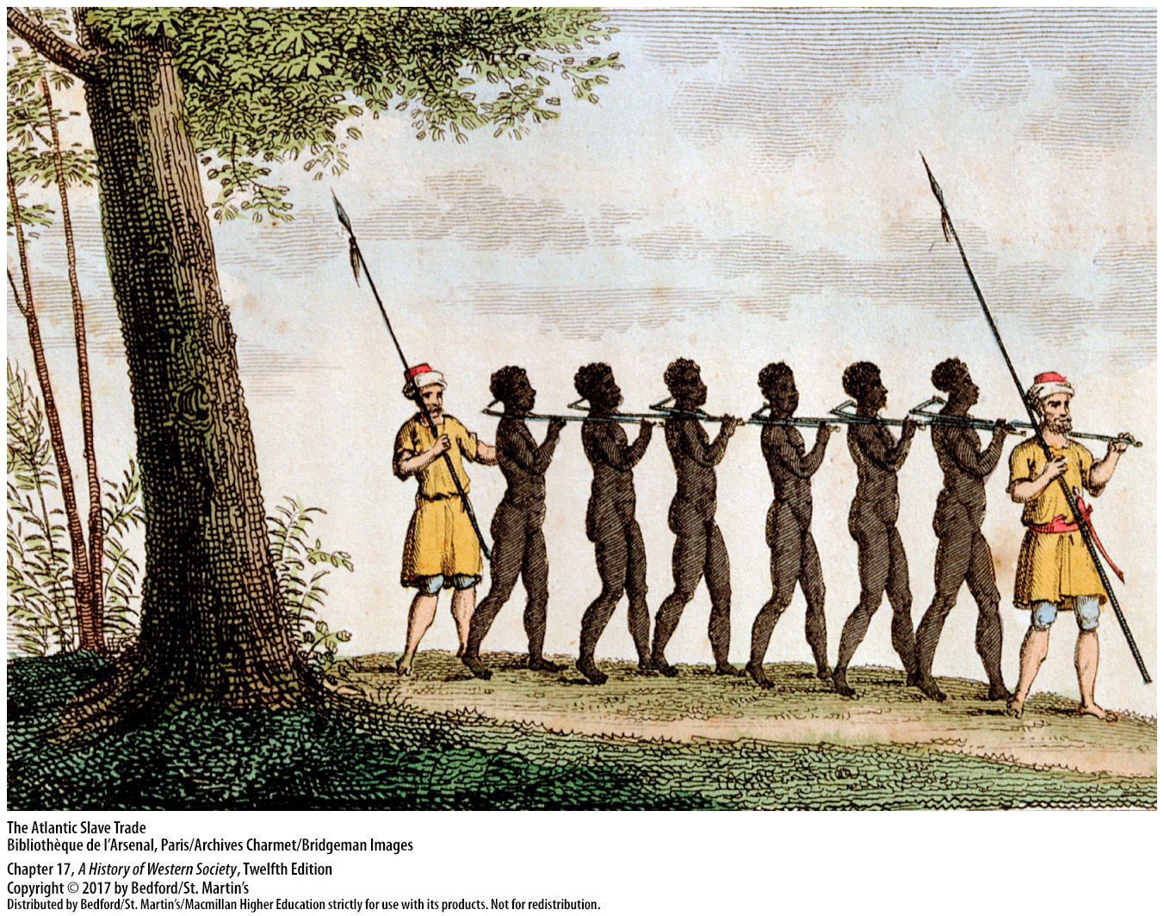

Slide 38
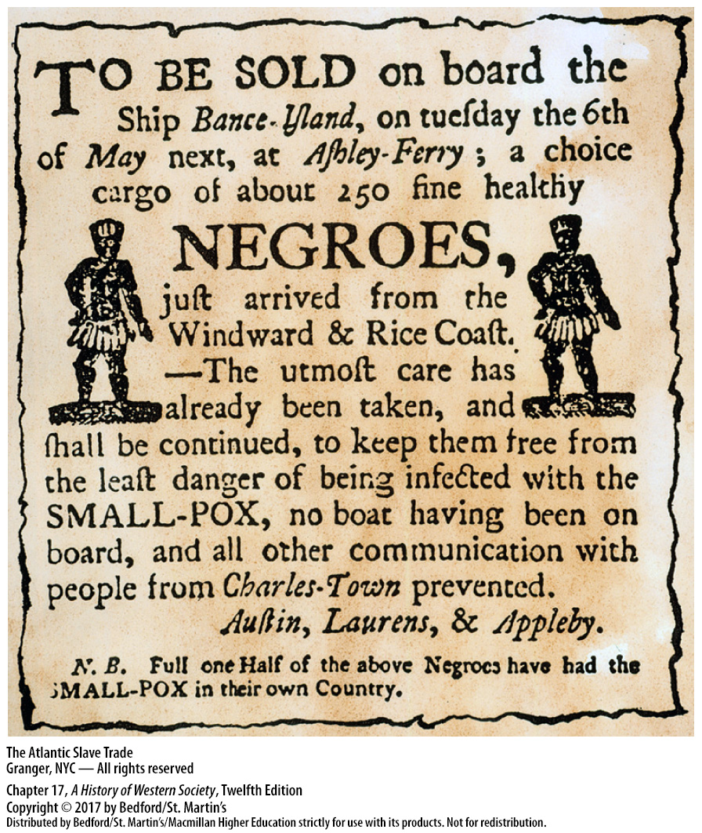

Slide 39
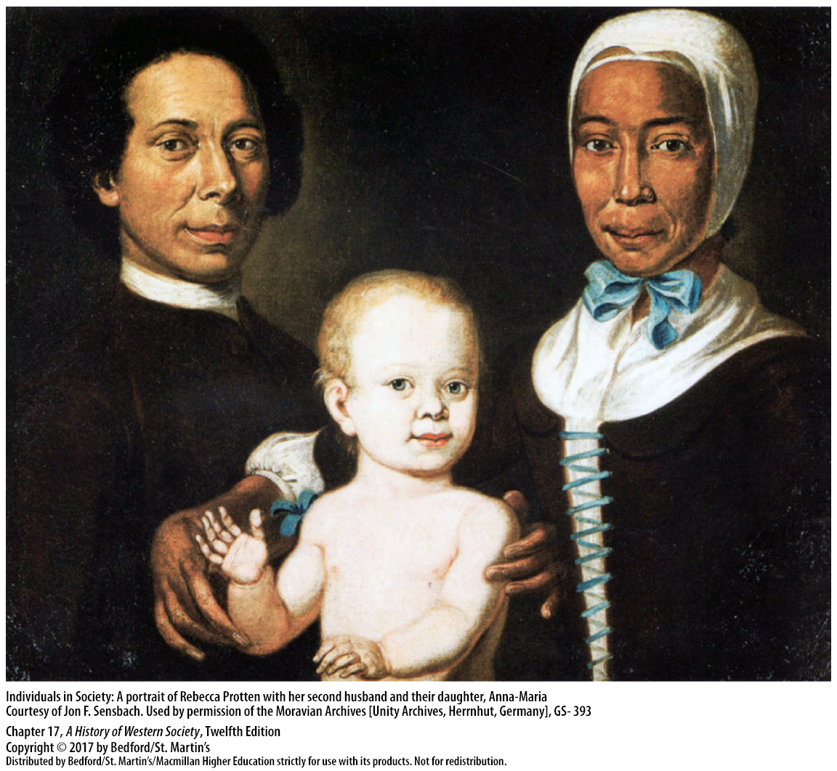

Slide 40
V. The Atlantic World and Global Trade
The Atlantic Enlightenment
British North American colonies adopted the Scottish model of the Enlightenment
Benjamin Franklin’s writings
Reform ideas of educated elites in the Spanish American colonies
Enlightenment encouraged colonist to aspire toward greater autonomy
Notes:
V. The Atlantic World and Global Trade
E. The Atlantic Enlightenment
1. The colonies of British North America adopted the Scottish model of the Enlightenment, emphasizing pragmatism, self-improvement and ethical conduct; Enlightenment ideas were spread through the growing church-based colleges and universities.
2. Benjamin Franklin’s writings and political career epitomize the Scottish Enlightenment, combining the pragmatism and economic interests of the Scottish Enlightenment with deism and the constitutional theories of Locke, Rousseau, and Montesquieu.
3. Educated elites in the Spanish American colonies produced their own reform ideas, spreading them through universities, newspapers, and salons.
4. In all European colonies, one effect of Enlightenment thought was to encourage colonists to criticize the policies of the mother country and aspire toward greater autonomy.

Slide 41
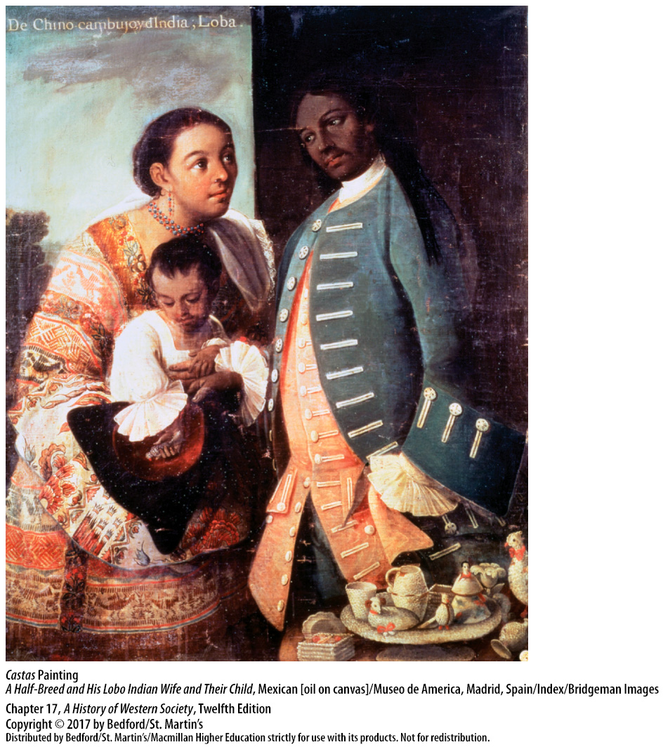

Slide 42
V. The Atlantic World and Global Trade
Trade and Empire in Asia and the Pacific
Dutch controlled East Indian states
Lost their hold on Asia in the eighteenth century
Britain empire-wide trading priveleges
East India Company in Bengal
Direct administration by the British government
British settlement of Australia
Trade in Atlantic inseparable from Asian commerce
Notes:
V. The Atlantic World and Global Trade
F. Trade and Empire in Asia and the Pacific
1. Unlike the Portuguese, the Dutch transformed the Indian Ocean trading world by establishing outright control of East Indian states and peoples and reducing them to dependents.
2. The Dutch hold in Asia faltered in the eighteenth century due to the Dutch East India Company’s failure to diversify to meet changing consumption patterns, even as fierce competition from the English East India Company (est. 1600) severely undercut Dutch trade.
3. Britain struggled for a foothold in Asia until 1716, when the Mughals conceded empire-wide trading privileges. As Mughal power waned, the British East India Company agents increasingly intervened in local affairs and made alliances with, or waged war against, Indian princes.
4. In 1765 the Mughal shah granted the East India Company the right to civil administration and tax collection in Bengal and neighboring provinces. By the early nineteenth century, the company had overcome vigorous Indian resistance to gain economic and political dominance of much of the Indian subcontinent.
5. Direct administration by the British government replaced the rule of the East India Company after a large-scale rebellion in 1857.
6. The beginning of British settlement of the continent of Australia happened in the late eighteenth century, when the first colony was established using the labor of convicted prisoners forcibly transported from Britain.
7. Trade in the Atlantic was inseparable from Asian commerce, and Europeans were increasingly found dominating commerce in both worlds.

Slide 43
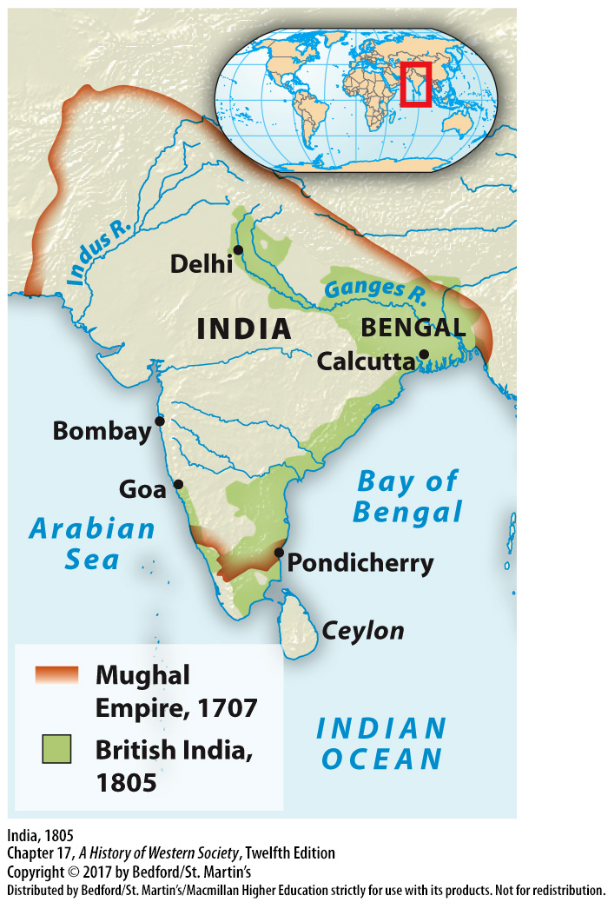

Slide 44
