Slide 1
A History of Western Society Twelfth Edition
McKay • Crowston • Wiesner-Hanks • Perry
CHAPTER 15
Absolutism and Constitutionalism
ca. 1589–1725
Copyright © 2017 by Bedford/St. Martin’s
Distributed by Bedford/St. Martin's/Macmillan Higher Education strictly for use with its products; Not for redistribution.

Slide 2
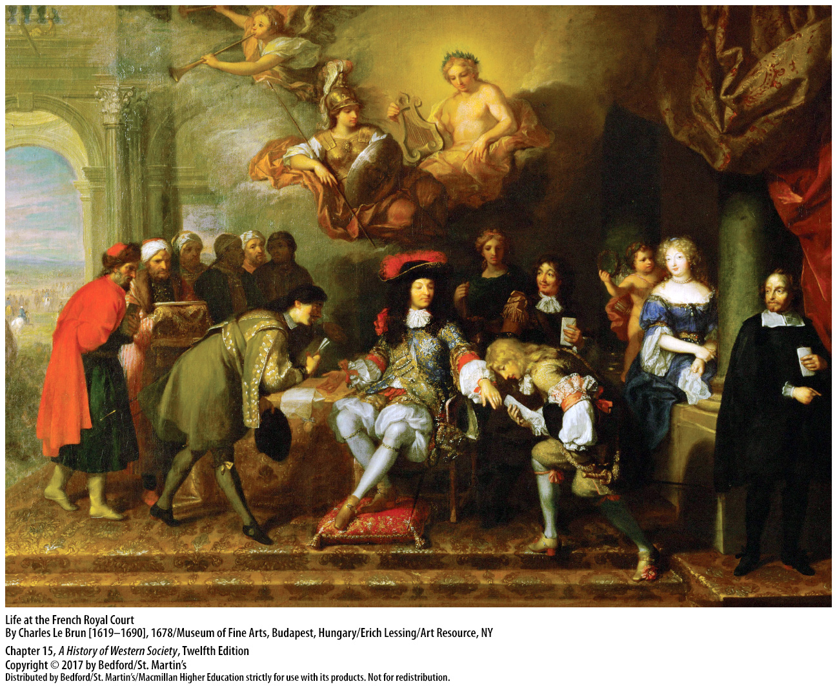

Slide 3
I. Seventeenth-Century Crisis and Rebuilding
The Social Order and Peasant Life
Monarchs
Clergy, nobles
Merchants
Peasants and artisans
Independent farmers, then small landowners and tenant farmers
Villagers (laborers and servants)
Notes:
Seventeenth-Century Crisis and Rebuilding
The Social Order and Peasant Life
1. European society was organized into a social hierarchy, with the monarch, celebrated as a semidivine being chosen by God, at the top.
2. In Catholic countries, the clergy occupied the next level, followed by nobles, whose privileged status derived from their ancient bloodlines and sacrifice on the battlefield.
3. Due to prejudices against commerce, merchants did not occupy the highest positions in the hierarchy but held a middling position, although many prosperous mercantile families had obtained noble status by providing service to the monarchy.
4. Peasants and artisans, who constituted the vast majority of the population, occupied the lower ranks and were expected to defer to their betters.
5. Below these independent farmers were small landowners and tenant farmers who did not have enough land to be self-sufficient and sold their best produce on the market to earn cash for taxes, rent, and food.
6. At the bottom were villagers who worked as dependent laborers and servants.

Slide 4
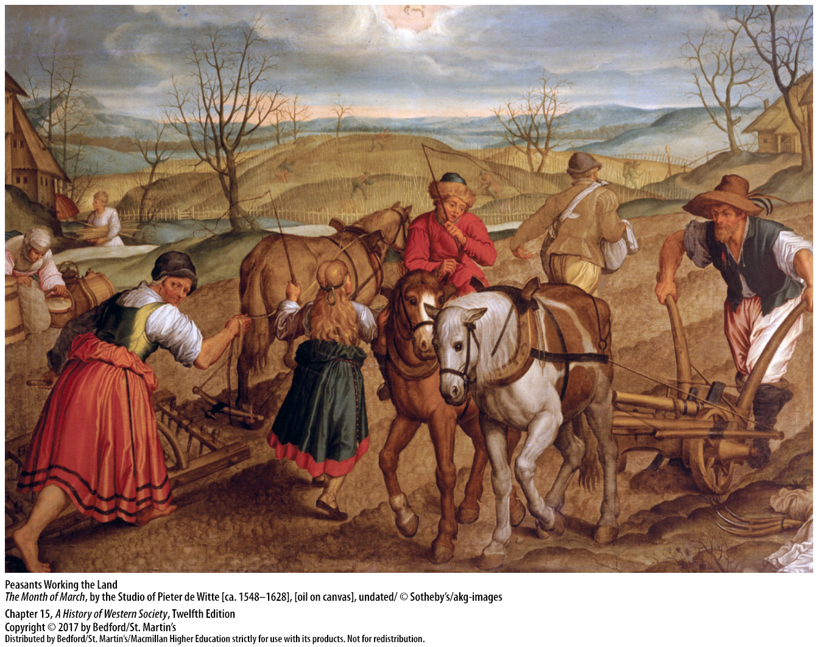

Slide 5
I. Seventeenth-Century Crisis and Rebuilding
Famine and Economic Crisis
The “little ice age”
Recurrent famines
Industry suffered
Price of bread rose; women rioted
“Moral economy”
Notes:
Seventeenth-Century Crisis and Rebuilding
B. Famine and Economic Crisis
1. European rural society lived on the edge of subsistence, with peasants constantly threatened by scarcity and famine, especially in the seventeenth century during a period of colder and wetter climate throughout Europe known as the “little ice age.”
2. Recurrent famines brought on malnutrition and exhaustion that lowered resistance to diseases like smallpox, typhoid, and plague and significantly reduced the population.
3. Given the harsh conditions of life, industry also suffered; food prices were high, wages stagnated, and unemployment soared.
4. When the price of bread rose beyond their capacity to pay, poor women frequently expressed their anger by rioting; in the towns they invaded bakers’ shops and resold bread at a “just price” and in the countryside they attacked convoys that were transporting grain to the cities.
5. Historians have used the term “moral economy” to describe this vision of a world in which community needs predominate over competition and profit

Slide 6
I. Seventeenth-Century Crisis and Rebuilding
The Thirty Years’ War
1618 – 1648
Catholic and Protestant truce deteriorated
The Protestant Union and the Catholic League
The 1648 Peace of Westphalia
Horribly destructive for European economy and society
Trade in southern German cities destroyed
Notes:
Seventeenth-Century Crisis and Rebuilding
C. The Thirty Years’ War
1. The fragile balance of life was violently upturned by the ravages of the Thirty Years’ War (1618–1648).
2. In the Holy Roman Empire, the uneasy truce between Catholics and Protestants created by the Peace of Augsburg in 1555 deteriorated as the faiths of various areas shifted.
3. Lutheran princes formed the Protestant Union (1608), and Catholics retaliated with the Catholic League (1609); each alliance determined that the other should make no religious or territorial advance.
4. The 1648 Peace of Westphalia that ended the Thirty Years’ War marked a turning point in European history, as it suspended conflicts fought over religious faith, confirmed the emperor’s limited authority, and legally sanctioned Calvinism.
5. The Thirty Years’ War was a horribly destructive event for the central European economy and society; perhaps one-third of urban residents and two-fifths of the rural population died, leaving entire areas depopulated.
6. Trade in southern German cities was virtually destroyed, agricultural areas suffered, and many nobles enlarged their estates and consolidated their control as small farmers lost their land.

Slide 7
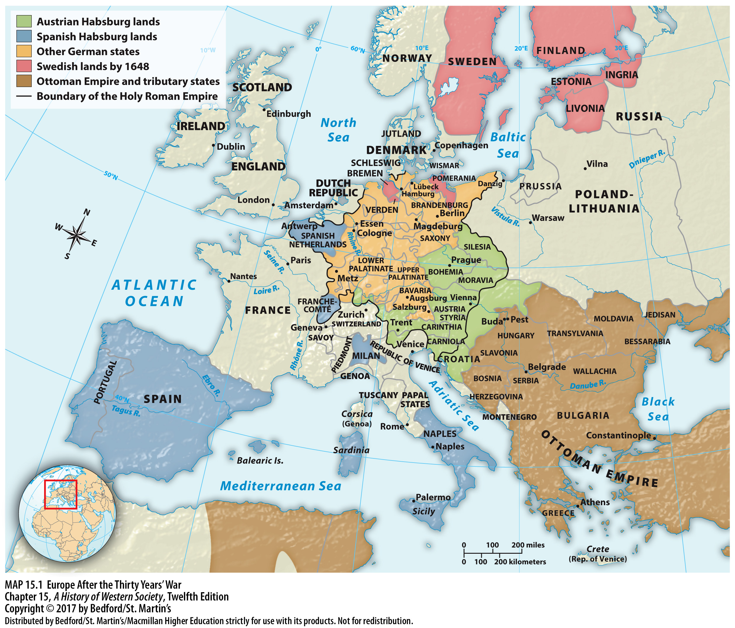

Slide 8
I. Seventeenth-Century Crisis and Rebuilding
Achievements in State-Building
Governments set common goals
Obstacles to these goals
Achieved greater taxation, armed forces, bureaucracies, and obedience from subjects
Centralized power neared sovereignty
Notes:
Seventeenth-Century Crisis and Rebuilding
D. Achievements in State-Building
1. Over the course of the seventeenth century, both absolutist and constitutional governments set common goals: to protect and expand their frontiers, raise new taxes, consolidate central control, and compete for new colonies in the New and Old Worlds.
2. Rulers faced formidable obstacles in achieving these goals, including delays in conveying orders to the provinces, lack of information about their realms, local power structures, and linguistic diversity that limited subjects’ willingness to obey commands.
3. Nevertheless, over time, both absolutist and constitutional governments achieved new levels of control that increased their authority in four areas: greater taxation, growth in armed forces, larger and more efficient bureaucracies, and the increased ability to compel obedience from subjects.
4. Over time, centralized power added up to something close to sovereignty. A state may be termed sovereign when it possesses a monopoly over the instruments of justice and the use of force within clearly defined boundaries.

Slide 9
I. Seventeenth-Century Crisis and Rebuilding
Warfare and the Growth of Army Size
Rise in professional army standards
Explosive growth in army size
Noble officers purchased their positions
Rise of absolutism
Great Britain built the largest navy in the world
Notes:
Seventeenth-Century Crisis and Rebuilding
E. Warfare and the Growth of Army Size
1. New techniques for training and deploying soldiers meant a rise in the professional standards of the army.
2. The explosive growth in army size was encouraged by changes in the style of armies; mustering a royal army took longer than simply hiring a mercenary band, giving enemies time to form coalitions.
3. Noble officers, who personally led their men in battle, purchased their positions in the army and assumed many of the costs of their unit; thus, they experienced high rates of death and debt.
4. The rise of absolutism in central and eastern Europe led to a vast expansion in the size of armies.
5. Great Britain focused on naval forces and eventually built the largest navy in the world.

Slide 10
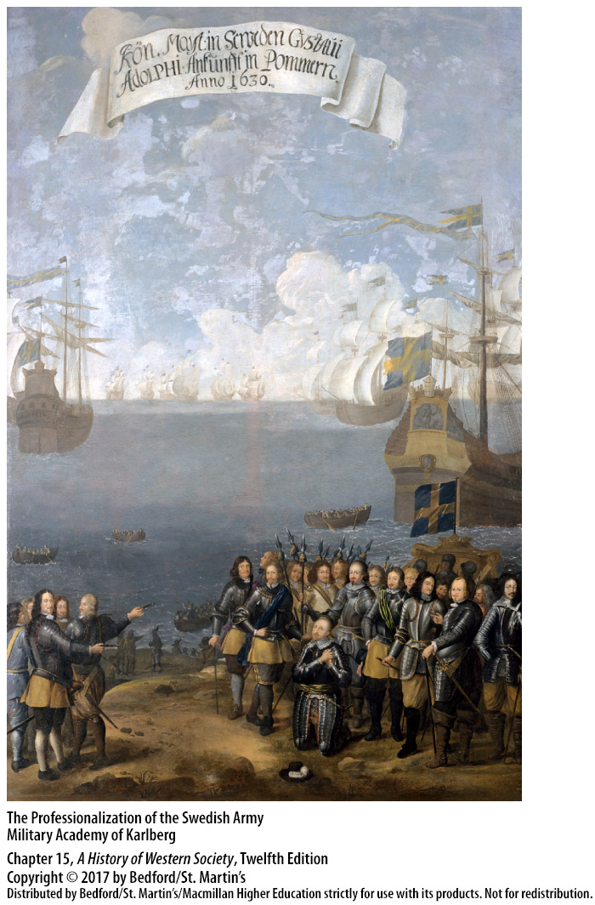

Slide 11
I. Seventeenth-Century Crisis and Rebuilding
Popular Political Action
Revolt leaders in Palermo wanted to abolish noble tax exemptions
In France urban uprisings became frequent
Deep popular anger at tax collectors
Authorities struggled to overcome popular revolt
Limitations of authority gave leverage to rebels
Military support decreased leverage
Swift and sever punishment for those who publicly opposed royal policies
Notes:
Seventeenth-Century Crisis and Rebuilding
F. Popular Political Action
1. In 1647 in Palermo, in Spanish-occupied Sicily, the leaders of a revolt also demanded the suppression of extraordinary taxes and participation in government, and some dreamed of a republic that would abolish noble tax exemptions.
2. In France urban uprisings became a frequent aspect of the social and political landscape.
3. Major insurrections were characterized by deep popular anger and violence directed at outside officials sent to collect taxes.
4. Municipal and royal authorities often struggled to overcome popular revolt, fearing that stern repressive measures would create martyrs and further inflame the situation, while occupation of a city would be expensive and detract from military efforts elsewhere.
5. The limitations of royal authority gave some leverage to rebels; to quell riots, authorities sometimes suspended royal edicts, released prisoners, and initiated discussions.
6. This leverage had largely disappeared by the beginning of the eighteenth century because municipal governments were better integrated into the national structure and local authorities had prompt military support from the central government.
7. People who publicly opposed royal policies and taxes received swift and severe punishment.

Slide 12
II. Absolutism in France and Spain
The Foundation of French Absolutism
Henry IV (r. 1589 – 1610)
Edict of Nantes
Henry murdered in 1610
Cardinal Richelieu (1585 – 1642)
Notes:
II. Absolutism in France and Spain
The Foundation of French Absolutism
1. In 1589 Henry IV (r. 1589–1610), the founder of the Bourbon dynasty in France, acquired a country devastated by civil wars between Protestants and Catholics, poor harvests, and diminished commercial activity.
2. Henry inaugurated a recovery by keeping France at peace during most of his reign, issuing the Edict of Nantes, sharply lowering taxes and instead imposing an annual fee on royal officials, and improving the infrastructure of the country by building new roads and canals and repairing the ravages of years of civil war.
3. Henry was murdered in 1610.
4. In 1628, Cardinal Richelieu (1585–1642) became first minister of the French crown on behalf of Henry’s young son, Louis XIII (r. 1610–1643). Richelieu’s domestic policies were designed to strengthen royal control. Richelieu’s main foreign policy goal was to destroy the Catholic Habsburgs’ grip on territories that surrounded France.

Slide 13
II. Absolutism in France and Spain
The Foundation of French Absolutism
Cardinal Jules Mazarin (1602 – 1661)
Uprisings of 1648 – 1653, or the Fronde
Rebellion died down with King Louis XIV (1651)
Notes:
II. Absolutism in France and Spain
The Foundation of French Absolutism
5. Chief minister for the next child-king, the four-year-old Louis XIV, was Cardinal Jules Mazarin (1602–1661), who along with the regent, Queen Mother Anne of Austria, continued Richelieu’s centralizing policies.
6. Mazarin’s struggle to increase royal revenues to meet the costs of war led to the uprisings of 1648–1653 known as the Fronde.
7. When the queen mother’s regency ended in 1651 with the declaration of Louis XIV as king in his own right, much of the rebellion died away, and its leaders came to terms with the government. Louis XIV assumed personal rule of the largest and most populous country in western Europe in 1661 at the age of twenty-three, at a time when the twin evils of noble rebellion and popular riots left the French wishing for peace and for a strong monarch to reimpose order.

Slide 14
II. Absolutism in France and Spain
Louis XIV and Absolutism
Louis XIV (r. 1643 – 1715)
Divine right of kings
Title of the “Sun King”
Ruled through several councils of state; never called a meeting of the Estates General
Revoked the Edict of Nantes in 1685
Notes:
II. Absolutism in France and Spain
B. Louis XIV and Absolutism
1. In the reign of Louis XIV (r. 1643–1715), the longest in European history, the French monarchy reached the peak of absolutist development.
2. Louis was taught the doctrine of the divine right of kings, which meant that God had established kings as his rulers on earth and that they were answerable to him alone, although rulers had to obey God’s laws and rule for the good of the people.
3. To symbolize his central role in this divine order, Louis acquired the title of the “Sun King.”
4. Louis worked very hard at the business of governing, ruling his realm through several councils of state, whose members were selected from the recently ennobled or upper middle class; he took a personal role in many of the councils’ decisions. Despite increasing financial problems, Louis never called a meeting of the Estates General, depriving the nobility of a means of united expression or action, nor did he have a first minister.
5. Pursuing the policy of Protestant repression launched by Richelieu, Louis revoked the Edict of Nantes in 1685 and ordered the destruction of Huguenot churches, the closing of schools, the Catholic baptism of Huguenots, and the exile of Huguenot pastors who refused to renounce their faith.

Slide 15
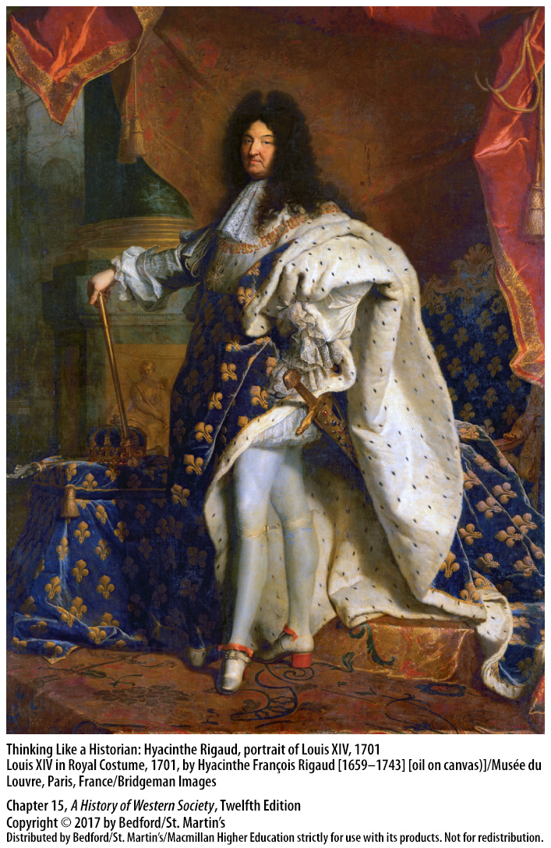

Slide 16
II. Absolutism in France and Spain
Life at Versailles
Louis moved the court to Versailles (1682)
Elaborate etiquette rituals
Women and the patronage system
French classicism
French culture inspired a cosmopolitan Europe
Notes:
II. Absolutism in France and Spain
C. Life at Versailles
1. In 1682 Louis moved his court and government to the newly renovated palace at Versailles, which quickly became the center of political, social, and cultural life.
2. Louis established elaborate etiquette rituals to mark every moment of his day, from waking up and dressing to removing his clothing and retiring at night, and courtiers vied for the honor of participating in these ceremonies. Although seemingly absurd, these rituals symbolized a system of patronage that Louis controlled and used to gain cooperation from powerful nobles.
3. At court, women played a central role in the patronage system by recommending individuals for honors, advocating policy decisions, and brokering alliances between factions, as well as bringing their family connections to marriage to form powerful social networks.
4. French classicism, the art and literature of the late seventeenth century, imitated the subject matter and style of classical antiquity and possessed the classical qualities of discipline, balance, and restraint.
5. French culture inspired a cosmopolitan European culture and grew in international prestige as French became the language of polite society and international diplomacy, gradually replacing Latin as the language of scholarship and learning across Europe.

Slide 17
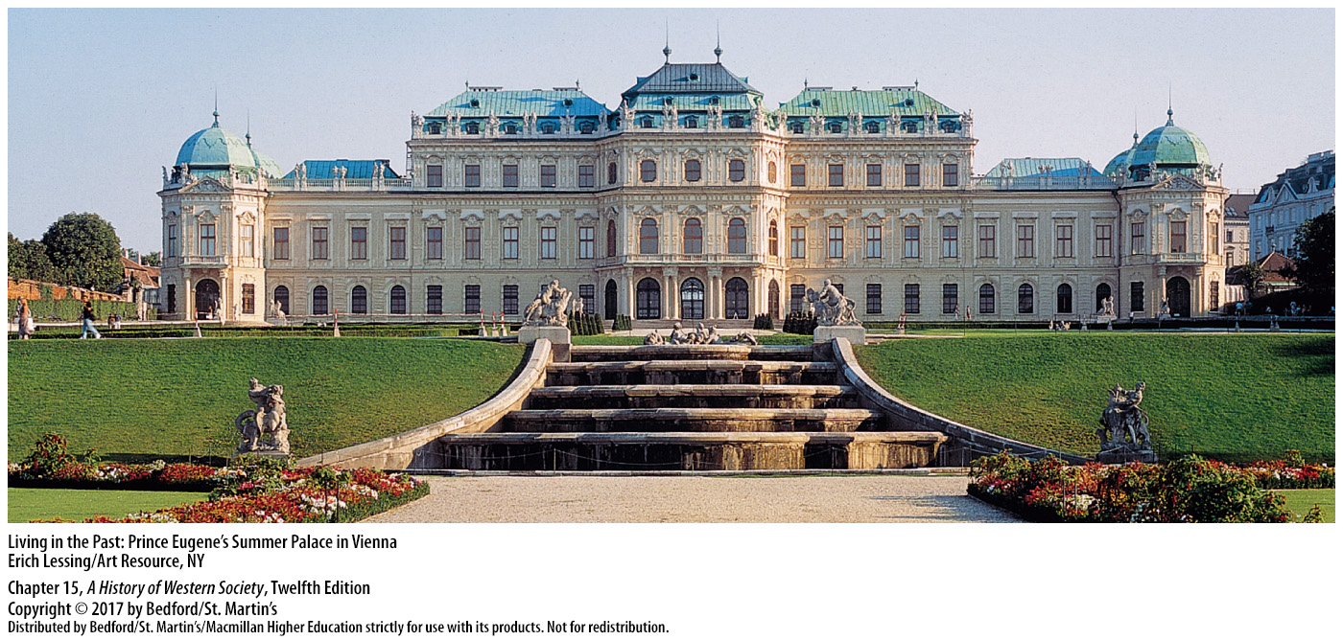

Slide 18
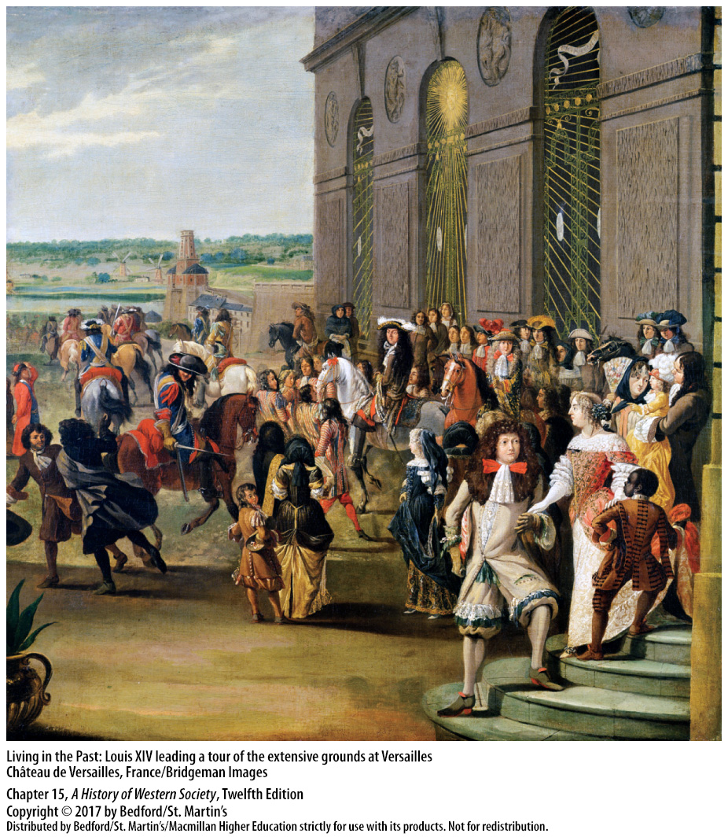

Slide 19
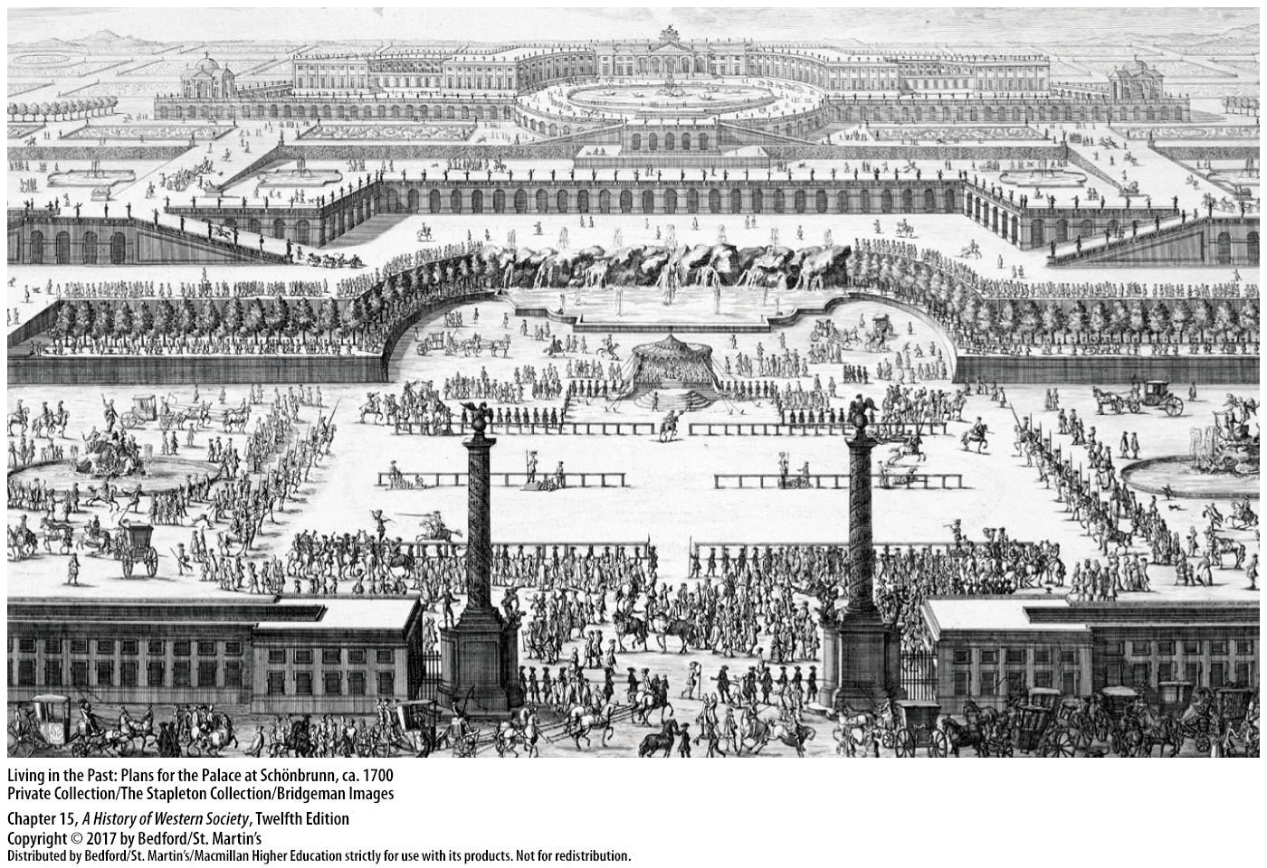

Slide 20
II. Absolutism in France and Spain
The French Economic Policy of Mercantilism
Jean-Baptiste Colbert (1619 – 1683)
Mercantilism
Decreased imports and increased exports
Sent colonists to Quebec
French explorers claimed “Louisiana”
Massive tax increases
Notes:
II. Absolutism in France and Spain
The French Economic Policy of Mercantilism
1. Jean-Baptiste Colbert (1619–1683), Louis’s controller general, proved a financial genius, rigorously applying mercantilist policies in pursuit of his central principle that the wealth and the economy of France should serve the state.
2. Mercantilism is a system of economic regulations aimed at increasing the power of the state by selling more goods abroad than buying them and thereby accumulating wealth in the form of gold and silver.
3. To decrease the purchase of goods outside France, Colbert insisted that French industry should produce everything needed by the French people. To increase exports, Colbert supported old industries and created new ones, enacted new production regulations, created guilds to boost quality standards, and encouraged foreign craftsmen to immigrate to France; he also abolished many domestic tariffs, raised tariffs on foreign products, and founded the Company of the East Indies to compete with the Dutch for Asian trade.
4. Colbert sent four thousand colonists to Quebec in hopes of making Canada part of a vast French empire.
5. Jacques Marquette, Louis Joliet, and other French explorers sailed down the Mississippi River and claimed vast territories for Louis XIV, which came to be called “Louisiana.”
6. During Colbert’s tenure as controller general, Louis was able to pursue his goals without massive tax increases and without creating a stream of new offices.

Slide 21
II. Absolutism in France and Spain
Louis XIV’s Wars
Professional army owned by French state
Goal to expand France
Devaluation of French currency and new taxes
Spanish King Charles II bequeathed the Spanish empire to Philip of Anjou
Notes:
II. Absolutism in France and Spain
E. Louis Xiv’s Wars
1. François le Tellier, marquis de Louvois, Louis’s secretary of state for war, equaled Colbert’s achievements in the economic realm by creating a professional army in which the French state, rather than private nobles, employed the soldiers; his model was adopted across Europe.
2. Louis’s goal was to expand France to what he considered its natural borders, and his armies were able to capture important commercial centers in the Spanish Netherlands and Flanders, the province of Franche-Comté, the city of Strasbourg, and the province of Lorraine.
3. Subsequent wars in the 1680s and 1690s brought no additional territories but placed unbearable strains on French resources that Colbert’s successors desperately tried to alleviate through devaluation of the currency and new taxes.
4. In 1700, when the childless Spanish king Charles II (r. 1665–1700) died, his will bequeathed the Spanish crown and its empire to Philip of Anjou, Louis XIV’s grandson.

Slide 22
II. Absolutism in France and Spain
Louis XIV’s Wars
Violation of prior treaty
War of the Spanish Succession (1701 – 1713)
The Peace of Utrecht (1713)
France on the brink of bankruptcy
Notes:
II. Absolutism in France and Spain
E. Louis Xiv’s Wars
5. The will violated a prior treaty by which the European powers had agreed to divide the Spanish possessions between the king of France and the Holy Roman emperor.
6. Claiming that he was following both Spanish and French interests, Louis broke with the treaty and accepted the will, thereby triggering the War of the Spanish Succession (1701–1713) between France and the Grand Alliance of the English, Dutch, Austrians, and Prussians.
7. The Peace of Utrecht, which ended the war in 1713, allowed Louis’s grandson Philip to remain king of Spain on the understanding that the French and Spanish crowns would never be united and gave French territory in the Americas to England.
8. In 1714 an exhausted France hovered on the brink of bankruptcy.

Slide 23
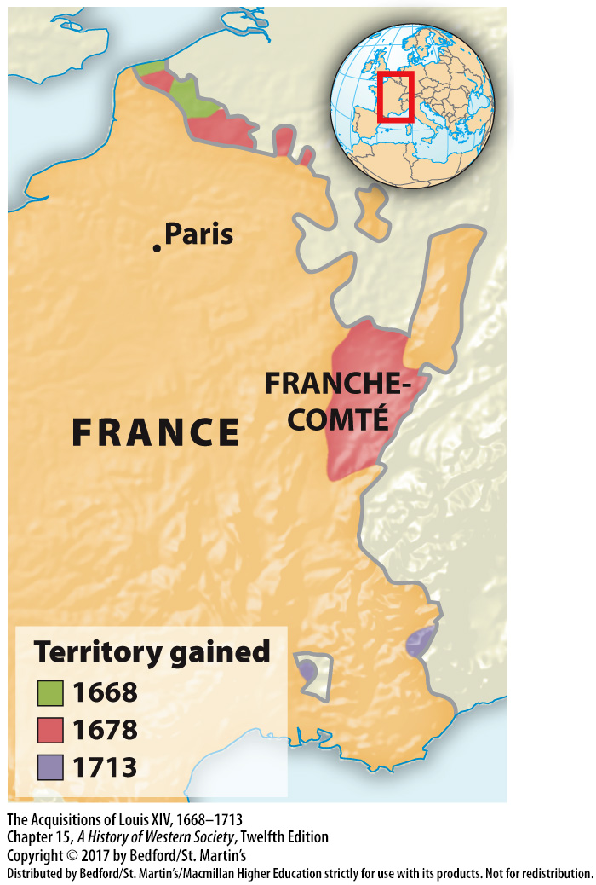

Slide 24
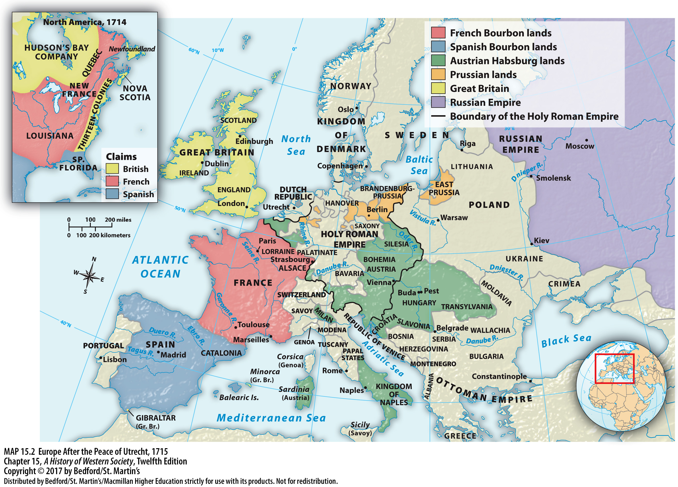

Slide 25
II. Absolutism in France and Spain
The Decline of Absolutist Spain in the Seventeenth Century
Competition and depleted silver resources
Spain bankrupt; national credit collapsed
Manufacturing and commerce shrank
Decline in agricultural productivity
Notes:
II. Absolutism in France and Spain
F. The Decline of Absolutist Spain in the Seventeenth Century
1. By the early seventeenth century, the seeds of Spanish disaster were sprouting, due to competition from local industries in the colonies and from Dutch and English traders and due to the depletion of the South American silver mines.
2. To meet huge state debt created by royal expenditures that exceeded income, the Crown repeatedly devalued the coinage and declared bankruptcy, which resulted in the collapse of national credit.
3. Manufacturing and commerce shrank in part because, in a culture that condemned moneymaking, thousands entered economically unproductive professions and because the Crown expelled thousands of former Muslims who were skilled workers and merchants.
4. Spanish aristocrats, attempting to maintain an extravagant lifestyle they could no longer afford, increased the rents on their estates, which in turn drove the peasants from the land and led to a decline in agricultural productivity.

Slide 26
II. Absolutism in France and Spain
The Decline of Absolutist Spain in the Seventeenth Century
Revolts in Catalonia and Portugal
Treaty of the Pyrenees of 1659
Independence of Portugal in 1688
Notes:
II. Absolutism in France and Spain
F. The Decline of Absolutist Spain in the Seventeenth Century
5. In 1640 Spain faced revolts in Catalonia and Portugal, and in 1643 the French inflicted a crushing defeat on a Spanish army at Rocroi in present-day Belgium.
6. Under the Treaty of the Pyrenees of 1659, which ended the French-Spanish conflict, Spain was compelled to surrender extensive territories to France.
7. In 1688 the Spanish crown reluctantly recognized the independence of Portugal, and the era of Spanish dominance in Europe ended.

Slide 27
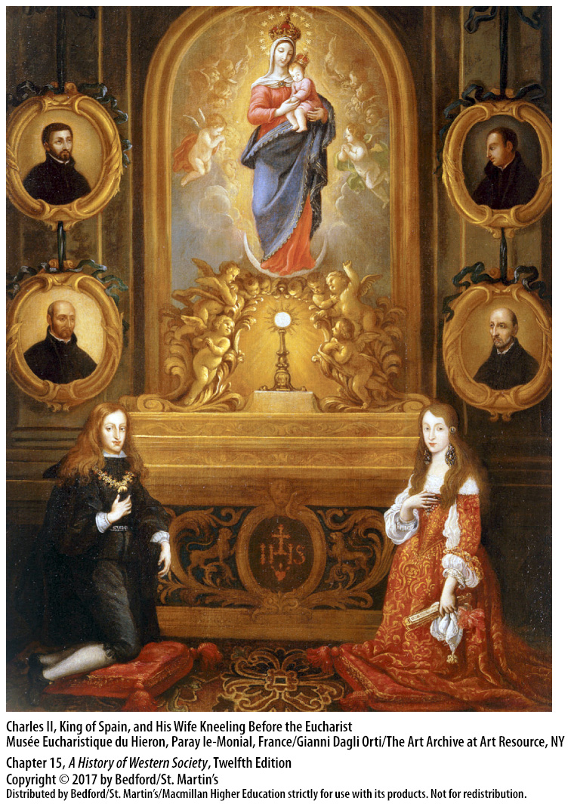

Slide 28
III. Absolutism in Austria and Prussia
The Return of Serfdom in the East
Peasants in Eastern Europe restricted from moving
The power of the lord in serfs’ everyday lives
Growth of commercial agriculture
Eastern landlords sold surplus directly to foreign merchants, bypassing local towns
Eastern towns lost their medieval right of refuge
Population in towns declined greatly
Notes:
III. Absolutism in Austria and Prussia
The Return of Serfdom in the East
1. In the west the demographic losses of the Black Death allowed peasants to escape from serfdom as they acquired enough land to feed themselves. In contrast, in Eastern Europe lords dealt with the labor shortages caused by the Black Death by restricting the right of their peasants to move.
2. In the absence of royal officials, the power of the lord, who was also the local prosecutor, judge, and jailer, reached far down into serfs’ everyday lives and gradually eroded the peasantry’s economic position, as lords took more of their land and imposed increasingly heavy labor obligations. Lords also required serfs to obtain their permission to marry and could sell serfs apart from their families.
3. The consolidation of serfdom in eastern Europe was accompanied by the growth of commercial agriculture, particularly in Poland and eastern Germany.
4. Eastern landlords squeezed sizeable surpluses out of peasants and, bypassing local towns, sold them directly to foreign merchants for export to cities in western Europe, undermining the privileges of the towns and the power of the urban classes.
5. Eastern towns also lost their medieval right of refuge and were compelled to return runaways to their lords.
6. The population of the towns and the urban middle classes declined greatly, both reflecting and promoting the supremacy of noble landlords in eastern Europe.

Slide 29
III. Absolutism in Austria and Prussia
The Austrian Habsburgs
Impoverished from the Thirty Years’ War
Focused inward and eastward
Ferdinand II (r. 1619 – 1637)
Direct rule over Bohemia
Ferdinand III (r. 1637 – 1657)
Pushed out the Ottomans
Hungarian nobles revolted
Notes:
III. Absolutism in Austria and Prussia
B. The Austrian Habsburgs
1. Like all of central Europe, the Habsburgs emerged from the Thirty Years’ War impoverished and exhausted.
2. Defeat in central Europe encouraged the Habsburgs to turn away from a quest for imperial dominance and to focus inward and eastward in an attempt to unify their diverse holdings.
3. Ferdinand II (r. 1619–1637) drastically reduced the power of the Bohemian Estates, the largely Protestant representative assembly, and he confiscated the landholdings of Protestant nobles and gave them to loyal Catholic nobles and the foreign aristocratic mercenaries who led his armies.
4. With the support of this new nobility, the Habsburgs established direct rule over Bohemia, stamped out Protestantism, and required more days of unpaid labor from the enserfed peasantry.
5. Ferdinand III (r. 1637–1657) centralized the government in the empire’s German-speaking provinces and built a permanent standing army to put down any internal opposition.
6. Between 1683 and 1699 the Habsburgs pushed out the Ottomans, and by 1718 they had recovered all of the former kingdom of Hungary.
7. Throughout the seventeenth century, Hungarian nobles, despite their reduced power, revolted against Habsburg attempts to impose absolute rule. In 1703 the Hungarians rose in one last patriotic rebellion under Prince Francis Rákóczy; though the Hungarian rebels were eventually defeated, the Habsburgs agreed to restore many traditional aristocratic privileges, in exchange for their acceptance of hereditary Habsburg rule.

Slide 30
III. Absolutism in Austria and Prussia
Prussia in the Seventeenth Century
Frederick William, the “Great Elector”
The Junkers
Junkers accepted taxation without consent in exchange for authority over serfs
The king eliminated Prussian cities from the estates
Estates’ power declined, state revenue tripled
Frederick I, King of Prussia (1701)
Notes:
III. Absolutism in Austria and Prussia
C. Prussia in the Seventeenth Century
1. When twenty-year-old Frederick William, later known as the “Great Elector,” came to power in 1640, he was determined to unify his three provinces—Brandenburg, Prussia, and scattered holdings along the Rhine—and enlarge them.
2. The estates of Brandenburg and Prussia were dominated by the nobility and the landowning classes, known as the Junkers, who met in parliamentary estates and approved new taxes.
3. In 1660 Frederick William persuaded Junkers in the estates to accept taxation without consent in order to fund an army; they agreed in exchange for reconfirmation of their privileges, including authority over serfs.
4. The king crushed potential opposition from the towns and eliminated Prussian cities from the estates, subjecting them to new taxes on goods and services.
5. Thereafter, the estates’ power declined, state revenue tripled, and the army expanded drastically.
6. In 1701, the elector’s son, Frederick, I, received the title of king of Prussia, instead of elector.

Slide 31
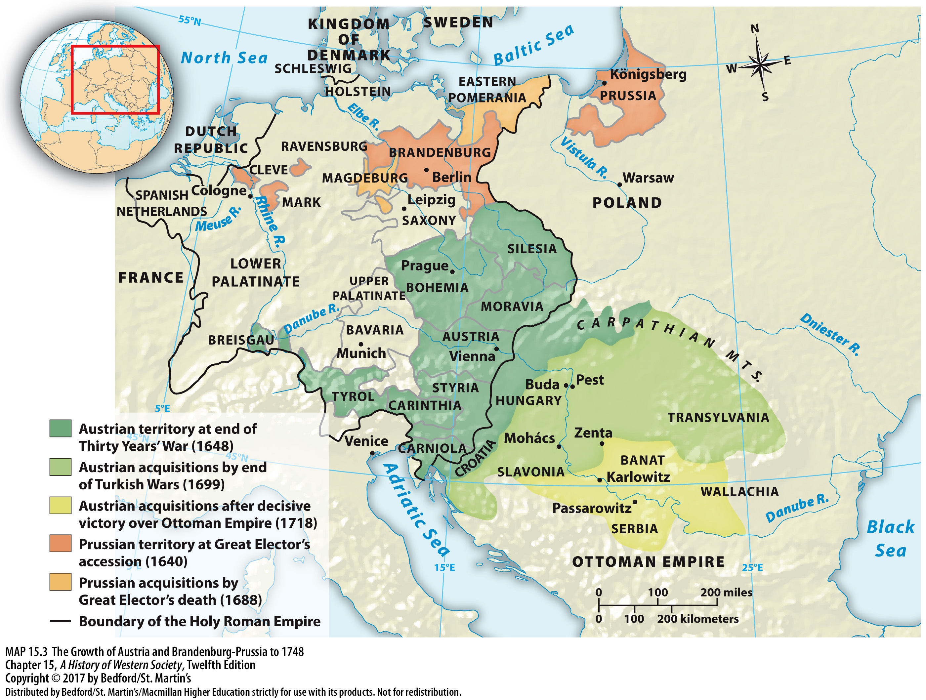

Slide 32
III. Absolutism in Austria and Prussia
The Consolidation of Prussian Absolutism
“The Soldiers’ King” (r. 1713 – 1740)
Bureaucracy; best army in Europe
Expansion of the army through conscription
King enlisted the Junkers to lead the army
Foundations for a rigid and militaristic country
Notes:
III. Absolutism in Austria and Prussia
D. The Consolidation of Prussian Absolutism
1. Frederick William I, “the Soldiers’ King” (r. 1713–1740), completed his grandfather’s work, eliminating the last traces of parliamentary estates and local self-government, and transformed Prussia into a military state.
2. Frederick William and his ministers built an exceptionally honest and conscientious bureaucracy to administer the country and foster economic development, and they built up the army to be the best in Europe in precision, skill, and discipline.
3. The expansion of the army was achieved in part through conscription; in 1713 Frederick William declared conscription to be lifelong, and he amended that in 1733 to order all Prussian men to undergo military training and serve as reservists in the army, thus allowing him to preserve both agricultural production and army size.
4. The king enlisted the Junkers to lead his growing army, so that the nobility commanded the peasantry in the army as well as on the estates.
5. With all men harnessed to the war machine, the policies of Frederick William I, combined with harsh peasant bondage and Junker tyranny, laid the foundations for a rigid and highly militaristic country.

Slide 33
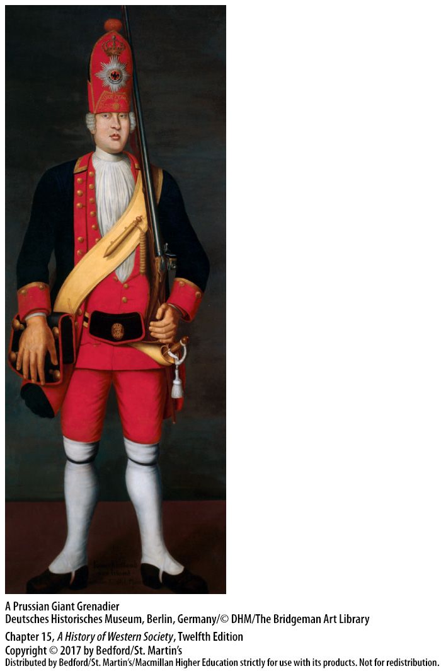

Slide 34
IV. The Development of Russia and the Ottoman Empire
Mongol Rule in Russia and the Rise of Moscow
Mongols conquered Kievan Rus
Ivan the Great (r. 1462 – 1505)
Autonomy of Moscow
Moscow modeled on Mongol institutions
Princes of Moscow took the title of tsar
Received support from Orthodox clergy
Notes:
IV. The Development of Russia and the Ottoman Empire
Mongol Rule in Russia and the Rise of Moscow
1. In the thirteenth century the Mongols had conquered Kievan Rus, the medieval Slavic state centered first at Novgorod and then at Kiev, a city on the Dnieper River, which included most of present-day Ukraine, Belarus, and part of northwest Russia. The Mongols forced the Slavic princes to submit to their rule and to render tribute and slaves.
2. Ivan III (r. 1462–1505), known as Ivan the Great, successfully expanded the principality of Moscow eastward toward the Baltic Sea and westward to the Ural Mountains and the Siberian frontier.
3. By 1480 Ivan III felt strong enough to defy Mongol control and declare the autonomy of Moscow.
4. The Moscow princes modeled themselves on the Mongol khans, forcing weaker Slavic principalities to render tribute previously paid to Mongols, and borrowed Mongol institutions such as the tax system, postal routes, and census.
5. The princes of Moscow saw themselves as the heirs of the caesars (or emperors) and of Orthodox Christianity, and they took the title of tsar (a contraction of caesar).
6. They received support from Orthodox clergy who spoke of “holy Russia” as the “Third Rome.”

Slide 35
IV. The Development of Russia and the Ottoman Empire
Building the Russian Empire
Ivan the Terrible (r. 1533 – 1584)
Defeated the remnants of Mongol power
The Cossacks
Ivan tied peasants more firmly to the land
Checked the growth of Russian middle classes
Notes:
IV. The Development of Russia and the Ottoman Empire
B. Building the Russian Empire
1. Ivan IV (r. 1533–1584), the famous “Ivan the Terrible,” ascended to the throne at age three; at age sixteen he pushed aside his advisers and, in an awe-inspiring ceremony, crowned himself tsar.
2. Ivan successfully defeated the remnants of Mongol power, added vast new territories to the realm, and laid the foundations for the huge, multiethnic Russian empire.
3. As landlords demanded more from the serfs, growing numbers of peasants fled toward the east and south and joined free groups and warrior bands known as Cossacks.
4. In response, Ivan tied peasants even more firmly to the land and to noble landowners, and he bound urban dwellers to their towns and jobs and imposed heavier taxes.
5. These restrictions checked the growth of the Russian middle classes, making even the wealthiest merchants dependent agents of the tsar.

Slide 36
IV. The Development of Russia and the Ottoman Empire
Building the Russian Empire
6. The “Time of Troubles” (1598 – 1613)
7. Nobles crushed peasant rebellion
Gained land in Ukraine, conquest of Siberia
Russian imperialist expansion to the east
Social and religious uprisings continued
The Cossack Stenka Razin (1670)
Notes:
IV. The Development of Russia and the Ottoman Empire
B. Building the Russian Empire
6. After the death of Ivan and his successor, Russia entered a chaotic period known as the “Time of Troubles” (1598–1613), which was characterized by power struggles among Ivan’s relatives and by the suffering and death of many ordinary people from drought, crop failure, and plague.
7. When the Cossacks and peasants rebelled, the nobles banded together, crushed the rebellion, and elected Ivan’s sixteen-year-old grandnephew, Michael Romanov (r. 1613–1645) to the throne.
8. Russia gained land in Ukraine from Poland in 1667 and completed the conquest of Siberia by the end of the century, using foreign experts to reform the army and Cossack warriors to fight campaigns in Siberia.
9. The great profits from Siberia’s natural resources, especially furs, funded Russian imperialist expansion to the east, paralleling the Western powers’ exploration and conquest of the Atlantic world in the same period.
10. The new tsar reconsolidated central authority, but the lot of the common people did not improve under him or his successors, as a 1649 law extended serfdom to all peasants in the realm and gave lords unrestricted rights over them. Social and religious uprisings among the poor and oppressed continued.
11. One of the largest rebellions, led by the Cossack Stenka Razin in 1670, attracted a great army of urban poor and peasants, who killed landlords and government officials and proclaimed freedom from oppression before being defeated in 1671.

Slide 37
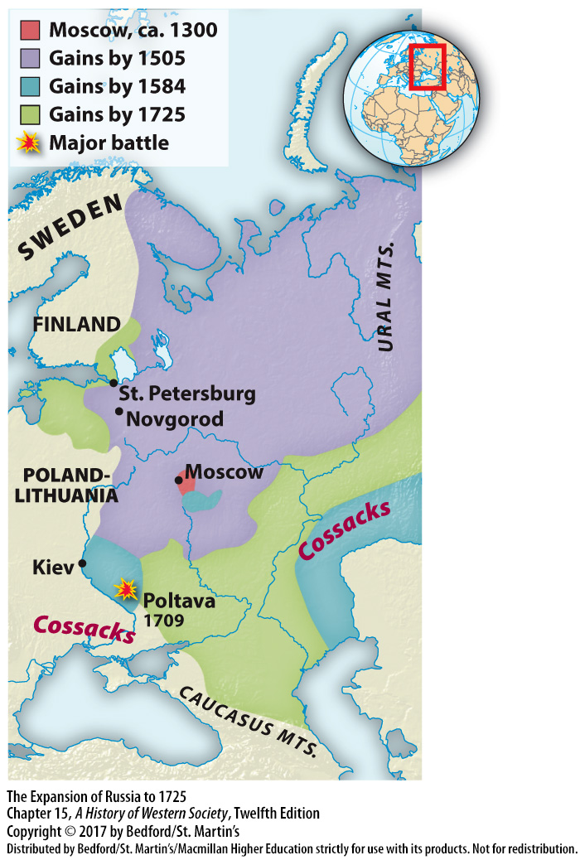

Slide 38
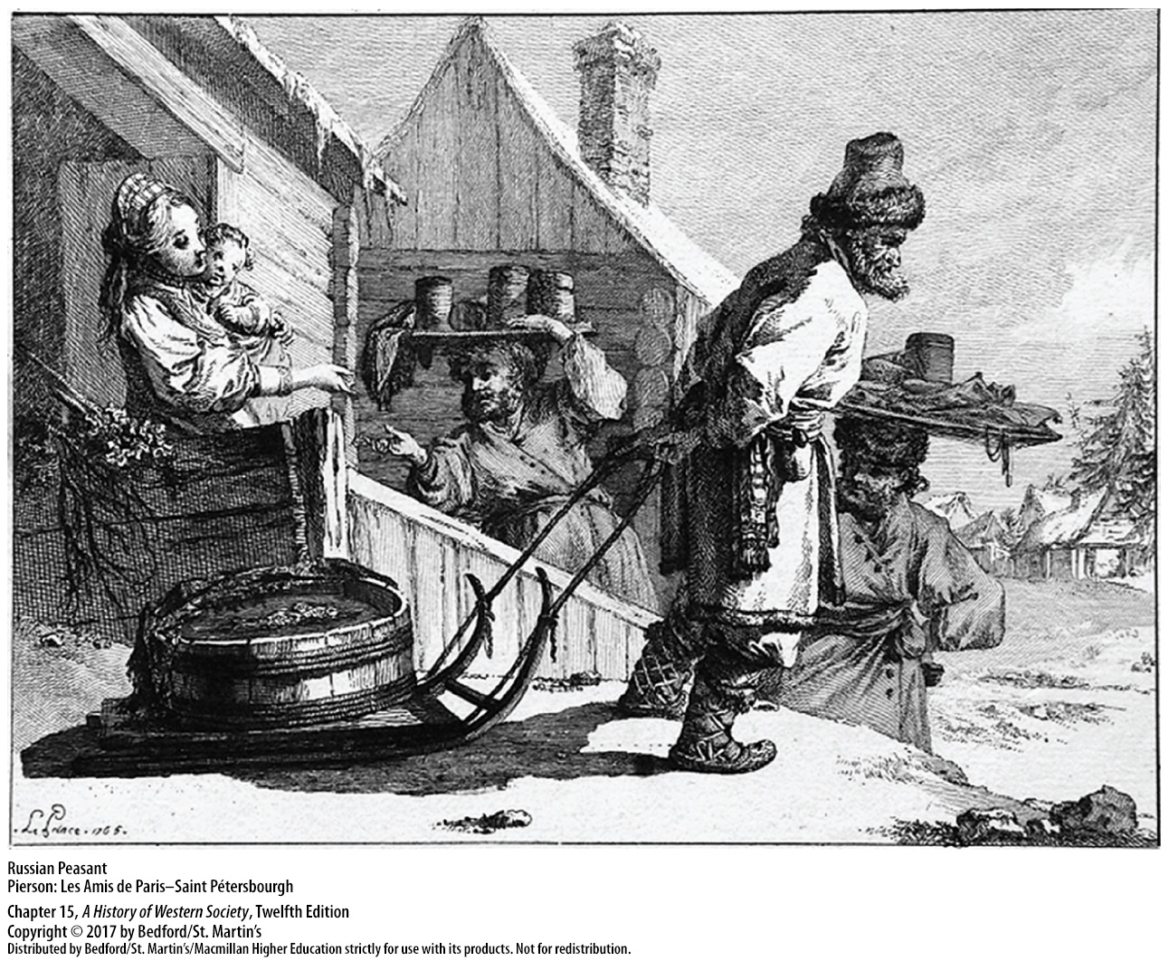

Slide 39
IV. The Development of Russia and the Ottoman Empire
The Reforms of Peter the Great
Peter the Great (r. 1682 – 1725)
Great Northern War (1700 – 1721)
Russian victory in 1721
St. Petersburg
Modernization and westernization
Increased bonds of serfdom
Notes:
IV. The Development of Russia and the Ottoman Empire
C. The Reforms of Peter the Great
1. Heir to Romanov efforts at state-building, Peter the Great (r. 1682–1725) was determined to build and improve the army and to continue Russian territorial expansion.
2. When he returned to Russia, Peter entered into a secret alliance with Denmark and Poland to wage a sudden war of aggression against Sweden in order to secure access to the Baltic Sea.
3. Peter responded to this defeat with measures designed to increase state power, strengthen his armies, and gain victory. Peter’s new war machine crushed the small army of Sweden at Poltava in 1709, and a conclusive victory over Sweden in 1721 brought Estonia and present-day Latvia under Russian rule.
4. Peter then channeled enormous resources into building a new Western-style capital, the magnificent city of St. Petersburg, which was designed to reflect modern urban planning, with wide, straight avenues, buildings set in a uniform line, and large parks.
5. For Peter, modernization meant westernization, so he required nobles to shave their beards, wear Western clothing, and attend parties where young men and women would mix together and freely choose their own spouses, giving rise to a new Western-oriented elite class of Russians.
6. For peasants, the reign of the tsar saw a significant increase in the bonds of serfdom and a widening gulf between the enserfed peasantry and the educated nobility.

Slide 40
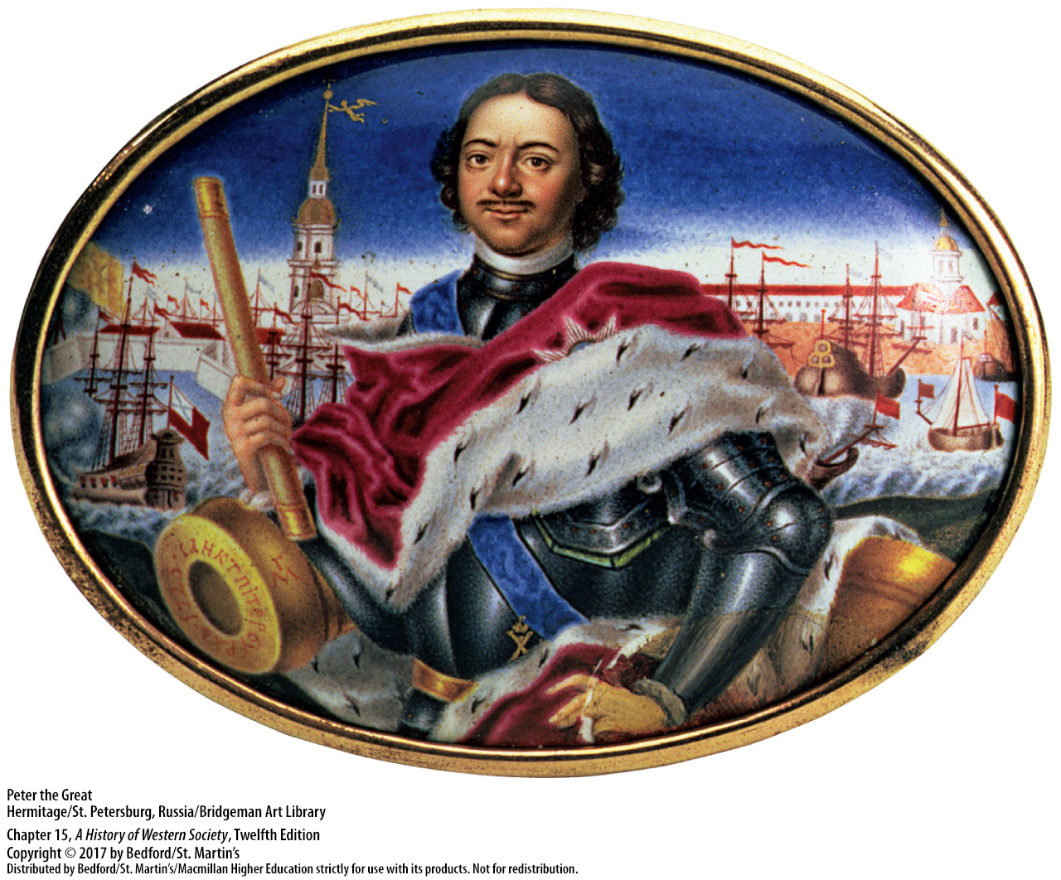

Slide 41
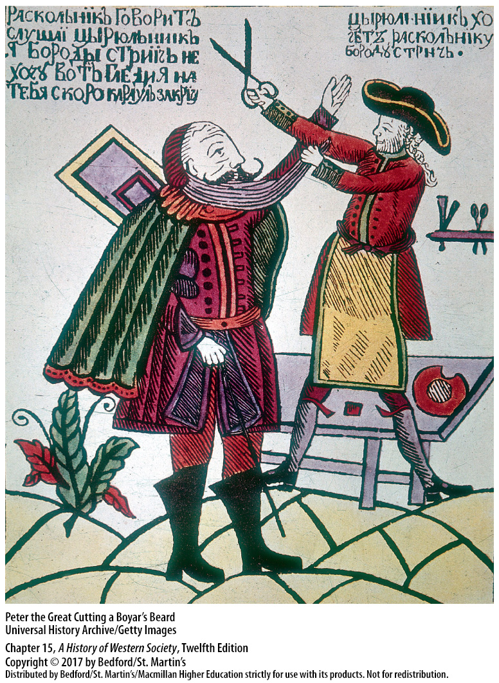

Slide 42
IV. The Development of Russia and the Ottoman Empire
The Ottoman Empire
Conquering warriors of Central Asia, settled in present-day Turkey
No hereditary nobility or private landed property
Levied a “tax” of male children on conquered populations every year
Talented slaves rose to the top of the bureaucracy
Less fortuned joined the sultan’s army
Notes:
IV. The Development of Russia and the Ottoman Empire
D. The Ottoman Empire
1. The Ottomans came out of Central Asia as conquering warriors, settled in Anatolia (present-day Turkey), and, at their peak in the mid-sixteenth century, ruled one of the most powerful empires in the world, with possessions that stretched from western Persia across North Africa and into central Europe.
2. The Ottoman Empire was built on a unique model of state and society: agricultural land was the personal hereditary property of the sultan, and peasants paid taxes to use the land. This model meant that there was an almost complete absence of private landed property and no hereditary nobility.
3. The sultan levied a “tax” of one thousand to three thousand male children on the conquered Christian populations in the Balkans every year; these young slaves were raised in Turkey as Muslims and were trained to fight and to administer.
4. The most talented Ottoman slaves rose to the top of the bureaucracy, where they might acquire wealth and power.
5. The less fortunate formed the core of the sultan’s army, the janissary corps, highly organized and efficient troops that gave the Ottomans a formidable advantage in war with western Europeans.

Slide 43
IV. The Development of Russia and the Ottoman Empire
The Ottoman Empire
Divided into religious communities, “millets”
Bond between ruling class and religious leaders
Wives and concubines of sultans
Sultan Suleiman married his concubine Hürrem; imperial wives took on more power
Inexperienced sultans following Suleiman
The ceding of Hungary and Transylvania to the Austrian Habsburgs in 1699
Notes:
IV. The Development of Russia and the Ottoman Empire
D. The Ottoman Empire
6. The Ottomans divided their subjects into religious communities—Orthodox Christians, Jews, Armenian Christians, and Muslims—and each millet, or “nation,” enjoyed autonomous self-government under its religious leaders.
7. The millet system created a bond between the Ottoman ruling class and religious leaders, who collected taxes for the state, regulated group behavior, and maintained law courts, schools, houses of worship, and hospitals.
8. Sultans married women of the highest social standing, while keeping many concubines of low rank. To prevent the elite families into which they married from acquiring influence over government, sultans procreated only with their concubines and not with official wives.
9. Sultan Suleiman undid these policies when he married his concubine Hürrem and had several children with her; thereafter, imperial wives began to take on more power.
10. The Ottoman empire suffered crisis in the late sixteenth and early seventeenth centuries: the sultans who followed Suleiman were inexperienced and faced numerous political revolts, Ottoman finances suffered from the loss of international trade and from rising prices and a shrinking population, and the Ottomans failed to adopt new military technologies and training methods.
11. Ultimately this led to the ceding of Hungary and Transylvania to the Austrian Habsburgs in 1699.

Slide 44
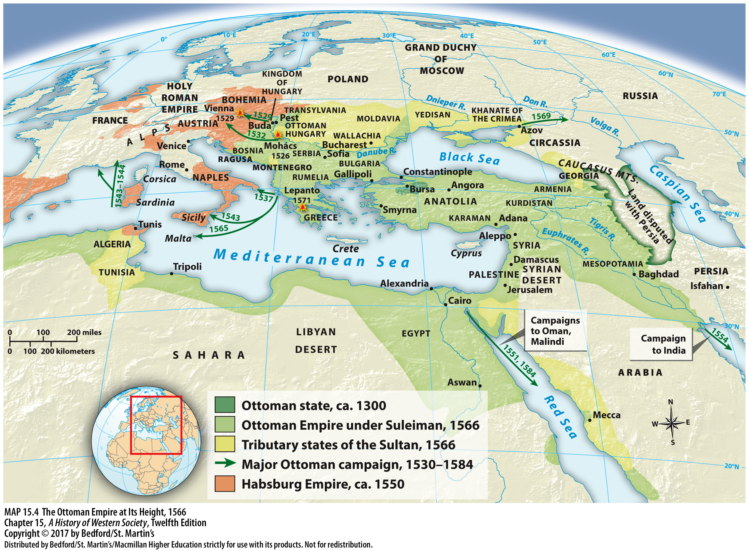

Slide 45
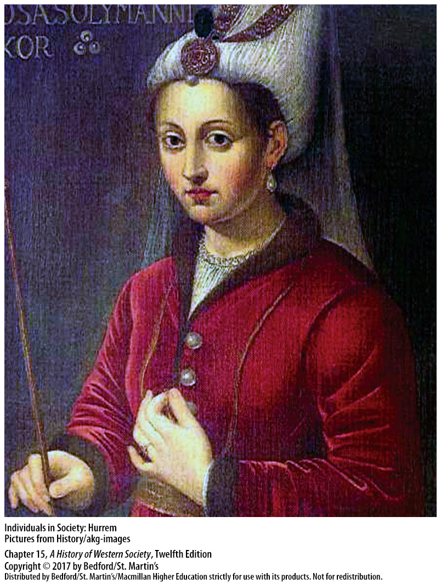

Slide 46
V. Constitutional Rule in England and the Dutch Republic
Constitutionalism
England’s constitutional monarchy established in 1688
Dutch adopted a republican government in 1648
Restraint of arbitrary power and the rule of law
Notes:
V. Constitutional Rule in England and the Dutch Republic
1. While France, Russia, and Austria developed absolutist states, England and Holland evolved toward constitutionalism, a form of government in which power is limited by law and balanced between the authority and power of the government and the rights and liberties of subjects or citizens.
2. In 1688, after decades of civil war, the English established a constitutional monarchy, a form of government in which a monarch is the titular head of government, but sovereignty is vested in an elected parliament.
3. Upon gaining independence from Spain in 1648, the Dutch adopted a republican form of government in which there is no monarch and power rests in the hands of the people through elected representatives.
4. Neither the English nor the Dutch system was a democratic system, but to other Europeans, these forms of government were shining examples of the restraint of arbitrary power and the rule of law.

Slide 47
V. Constitutional Rule in England and the Dutch Republic
Religious Divides and Civil War
James I (r. 1603 – 1625)
The Crown vs. the House of Commons
Charles I attempted to govern without Parliament (1629 – 1640)
Religious issues
Charles I antagonized religious sentiments
The Triennial Act (1641)
Notes:
V. Constitutional Rule in England and the Dutch Republic
Religious Divides and Civil War
1. When Queen Elizabeth I died in 1603 without an immediate heir, her Scottish cousin James Stuart succeeded her as James I (r. 1603–1625). Like Louis XIV, King James believed that a monarch has a divine right to his authority and is responsible only to God.
2. James and his son Charles I (r. 1625–1649) considered such restraints a threat to their divine-right prerogative, and consequently, bitter squabbles erupted between the Crown and the House of Commons.
3. Charles I’s attempt to govern without Parliament (1629–1640) and to finance his government by emergency taxes brought the country to a crisis.
4. Many Puritans believed that the Protestant Reformation had not gone far enough and wanted to “purify” the Anglican Church of elaborate vestments and ceremonials, bishops, and wedding rings.
5. Charles I further antagonized religious sentiments by marrying a Catholic princess and supporting the heavy-handed policies of the Archbishop of Canterbury William Laud (1573–1645), who attempted to impose two new elements on church organization in Scotland: a new prayer book and bishoprics.
6. In 1641 the Commons passed the Triennial Act, which compelled the king to summon Parliament every three years, impeached Archbishop Laud, and threatened to abolish bishops. Fearful of a Scottish invasion, King Charles reluctantly accepted these measures.

Slide 48
V. Constitutional Rule in England and the Dutch Republic
Religious Divides and Civil War
7. Catholic uprising in Ireland (1641)
8. The English Civil War (1642 – 1649)
9. Parliament’s New Model Army defeated the king’s armies in the summer of 1645
10. Charles refused to concede until forces under Oliver Cromwell captured him
11. “Rump Parliament” beheaded Charles in 1649
Notes:
V. Constitutional Rule in England and the Dutch Republic
Religious Divides and Civil War
7. Also in 1641, the Catholic gentry of Ireland led an uprising in response to a feared invasion by anti-Catholic forces of the British Long Parliament. Without an army, Charles I could neither come to terms with the Scots nor respond to the Irish rebellion.
8. After a failed attempt to arrest parliamentary leaders, Charles left London for the north of England and recruited an army drawn from the nobility, the rural gentry, and mercenaries; in response, Parliament formed the New Model Army, and the English civil war ensued (1642–1649).
9. After three years of fighting, Parliament’s New Model Army defeated the king’s armies at the battles of Naseby and Langport in the summer of 1645.
10. Charles refused to concede defeat until forces under the leadership of Oliver Cromwell, a member of the House of Commons and a devout Puritan, captured the king and dismissed members of the Parliament who opposed Cromwell’s actions.
11. In 1649 the remaining representatives, known as the “Rump Parliament,” put Charles on trial and found him guilty of high treason; he was beheaded on January 30, 1649.

Slide 49
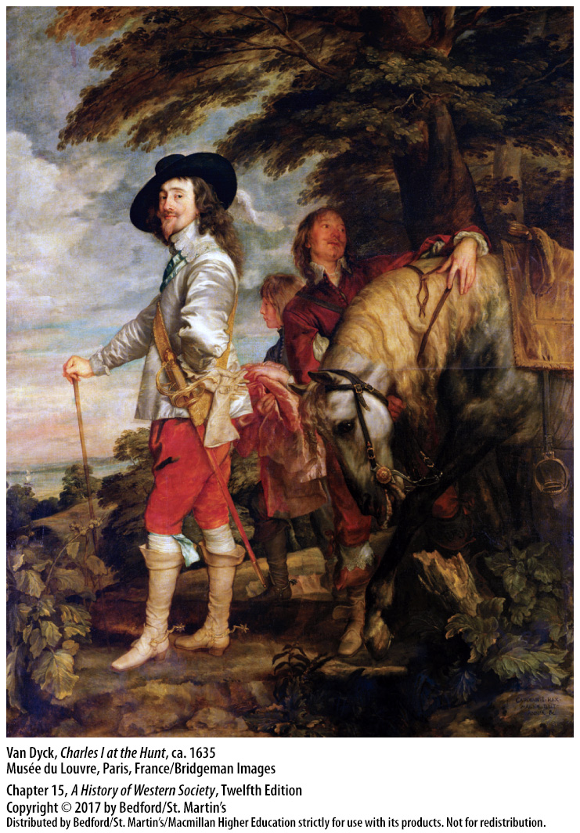

Slide 50
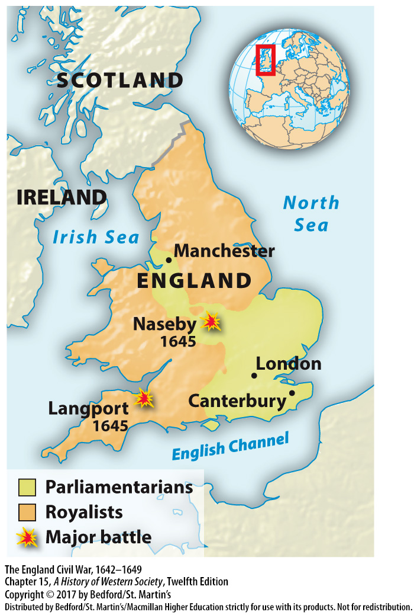

Slide 51
V. Constitutional Rule in England and the Dutch Republic
The Puritan Protectorate
Kingship abolished
Philosopher Thomas Hobbes (1588 – 1679)
Leviathan (1651)
The Protectorate (1653 – 1658)
Military dictatorship ruled by Cromwell
Cromwell dismissed Parliament in 1655
Notes:
V. Constitutional Rule in England and the Dutch Republic
B. The Puritan Protectorate
1. With the execution of Charles, kingship was abolished, but the question remained of how England would be governed.
2. Philosopher Thomas Hobbes (1588–1679) held a pessimistic view of human nature and believed that, left to themselves, humans would compete violently for power and wealth.
3. His solution, outlined in his 1651 treatise Leviathan, was a social contract in which all members of society placed themselves under the absolute rule of the sovereign, who would maintain peace and order. Hobbes’s longing for a benevolent absolute monarch against whom society would not rebel, was not widely shared in England.
4. Instead, Cromwell and his supporters proclaimed a commonwealth, or republican government, known as the Protectorate (1653–1658), in which legislative power theoretically rested in the surviving members of Parliament and executive power in a council of state.
5. In fact, the army that had defeated the king controlled the government, and Oliver Cromwell controlled the army, essentially constituting a military dictatorship.
6. The army prepared a constitution, the Instrument of Government in 1653, but after repeated disputes, Cromwell dismissed Parliament in 1655, continued the standing army, and proclaimed quasi-martial law.

Slide 52
V. Constitutional Rule in England and the Dutch Republic
The Puritan Protectorate
7. Cromwell divided England into military districts
8. Led an army to reconquer Ireland in 1649
9. The English banned Catholicism in Ireland
10. Cromwell enforced a Navigation Act (1651)
11. Welcomed the immigration of Jews
12. Cromwell died in 1658; the English restored the monarchy in 1660
Notes:
V. Constitutional Rule in England and the Dutch Republic
B. The Puritan Protectorate
7. Cromwell divided England into twelve military districts, each governed by a major general, and, reflecting Puritan ideas of morality, he forbade sports, closed the theaters, and censored the press.
8. Cromwell had long associated Catholicism in Ireland with sedition and heresy and led an army there to reconquer the country in August 1649.
9. The English banned Catholicism in Ireland, executed priests, and confiscated land from Catholics for English and Scottish settlers, leaving a legacy of Irish hatred for England.
10. Cromwell adopted mercantilist policies and enforced a Navigation Act (1651) that required English goods to be transported on English ships, which was a great boost to the development of an English merchant marine and led to a short, but successful, war with the Dutch.
11. Cromwell welcomed the immigration of Jews because they possessed business skills, and Jews began to return to England after four centuries of absence.
12. The Protectorate collapsed when Cromwell died in 1658, and the English, ready to return to civilian government and common law and social stability, restored the monarchy in 1660.

Slide 53
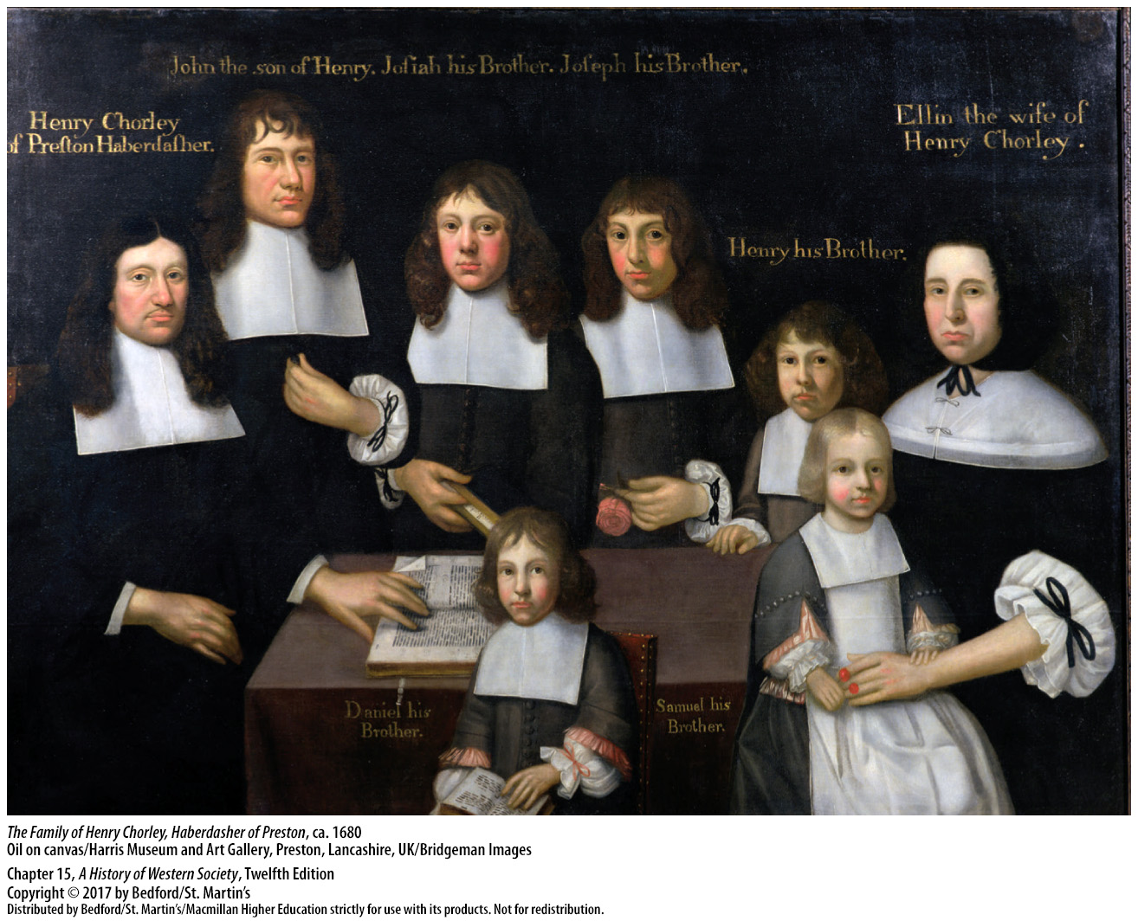

Slide 54
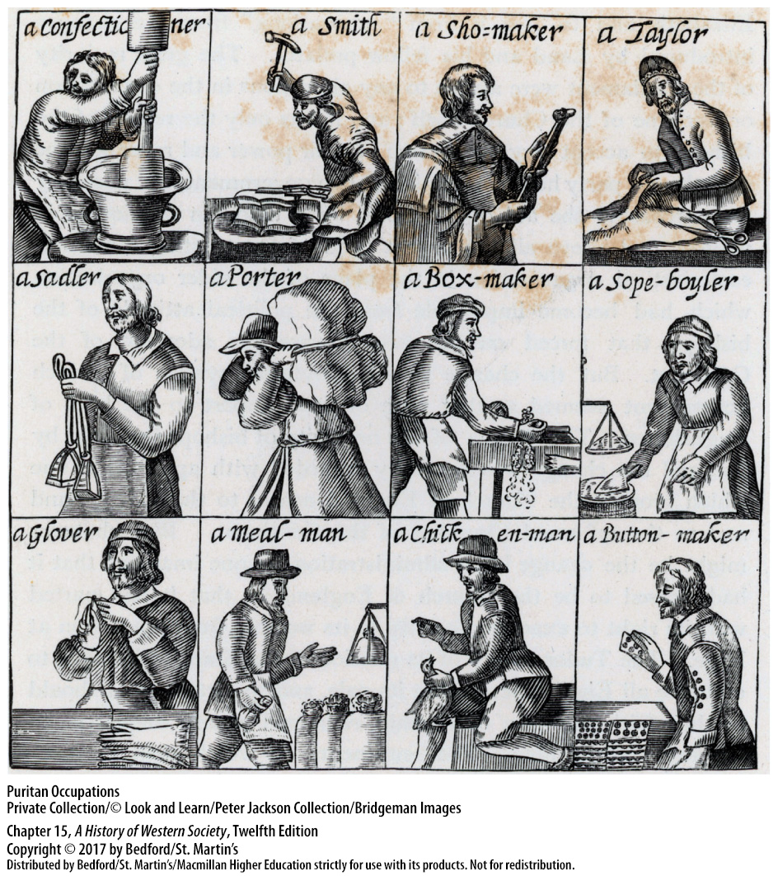

Slide 55
V. Constitutional Rule in England and the Dutch Republic
The Restoration of the English Monarchy
The Restoration of 1660
State vs. Puritans and Catholics; King vs. Parliament
The Test Act of 1673
James II (r. 1685 – 1688) violated the Test Act
Granted religious freedom to all
James forced to flee to France in 1688 to prevent the return of Catholic absolutism
Notes:
V. Constitutional Rule in England and the Dutch Republic
C. The Restoration of the English Monarchy
1. The Restoration of 1660 brought to the throne Charles II (r. 1660–1685), eldest son of Charles I, and restored both houses of Parliament, as well as the established Anglican Church.
2. The Restoration did not, however, resolve two serious problems: the state’s attitude toward Puritans, Catholics, and dissenters and the relationship between the king and Parliament.
3. The Test Act of 1673 denied those outside the Church of England the right to vote, hold public office, preach, teach, attend the universities, or even assemble for meetings, but the restrictions proved unenforceable.
4. When James II (r. 1685–1688) succeeded his brother, he violated the Test Act by appointing Roman Catholics to positions in the army, the universities, and local government.
5. James and his supporters opened new Catholic churches and schools and promoted Catholicism, and in an attempt to broaden his base of support with Protestant dissenters and nonconformists, he granted religious freedom to all.
6. To prevent the return of Catholic absolutism, a powerful coalition of eminent persons in Parliament and the Church of England offered the English throne to James’s Protestant daughter Mary and her Dutch husband, Prince William of Orange, who, after James fled to France in 1688, were crowned queen and king in 1689.

Slide 56
V. Constitutional Rule in England and the Dutch Republic
Constitutional Monarchy
The “Glorious Revolution” of 1688 – 1689
Uprisings in Scotland and a war in Ireland
Sovereignty split between Parliament and the king
The Bill of Rights
Freedom of worship granted to Protestant dissenters, but not Catholics
John Locke’s Second Treatise of Civil Government (1690)
Notes:
V. Constitutional Rule in England and the Dutch Republic
D. Constitutional Monarchy
1. The English call the events of 1688 and 1689 the “Glorious Revolution” because they believe it replaced one king with another with a minimum of bloodshed, but, in truth, William’s arrival sparked riots and violence across the British Isles and in North American cities.
2. Uprisings in Scotland and a war in Ireland broke out, but William’s victory at the Battle of the Boyne (1690) and the subsequent Treaty of Limerick (1691) sealed his accession to power.
3. The revolution destroyed the idea of divine-right monarchy by dividing sovereignty between Parliament and the king, who ruled with the consent of the governed.
4. The men who brought about the revolution framed their intentions in the Bill of Rights, which stated that law was to be made in Parliament and could not be suspended by the crown. The Bill of Rights further guaranteed the independence of the judiciary, specified that no Catholic could ever inherit the throne, and stipulated that there would be no standing army in peacetime.
5. Additional legislation granted freedom of worship to Protestant dissenters, although not to Catholics.
6. In his Second Treatise of Civil Government (1690), political philosopher John Locke (1632–1704) maintained that a government that oversteps its proper function—protecting the natural rights of life, liberty, and property—becomes a tyranny.

Slide 57
V. Constitutional Rule in England and the Dutch Republic
The Dutch Republic in the Seventeenth Century
Dutch established a republic
“Regents”
States General
Dutch came to dominate the shipping business
Political success rested on commercial prosperity
Toleration and assimilation for Jews
Notes:
V. Constitutional Rule in England and the Dutch Republic
E. The Dutch Republic in the Seventeenth Century
1. Rejecting the rule of a monarch, the Dutch established a republic, a state in which power rested in the hands of the people and was exercised through elected representatives.
2. Among the Dutch, an oligarchy of wealthy businessmen called “regents” handled domestic affairs in each province’s Estates (assemblies).
3. A federal assembly, or States General, handled foreign affairs and war; however, all issues had to be approved by the provincial Estates, and each of the seven provinces could veto proposed legislation.
4. The Dutch came to dominate the shipping business, boasting the lowest shipping rates and largest merchant marine in Europe, which allowed them to undersell foreign competitors.
5. The political success of the Dutch rested on their phenomenal commercial prosperity, which was inspired by moral and ethical ideals of thrift, frugality, and religious toleration.
6. Jews enjoyed a level of acceptance and assimilation in Dutch business and culture that was unique in Europe; such toleration attracted a great deal of foreign capital and investment.

Slide 58
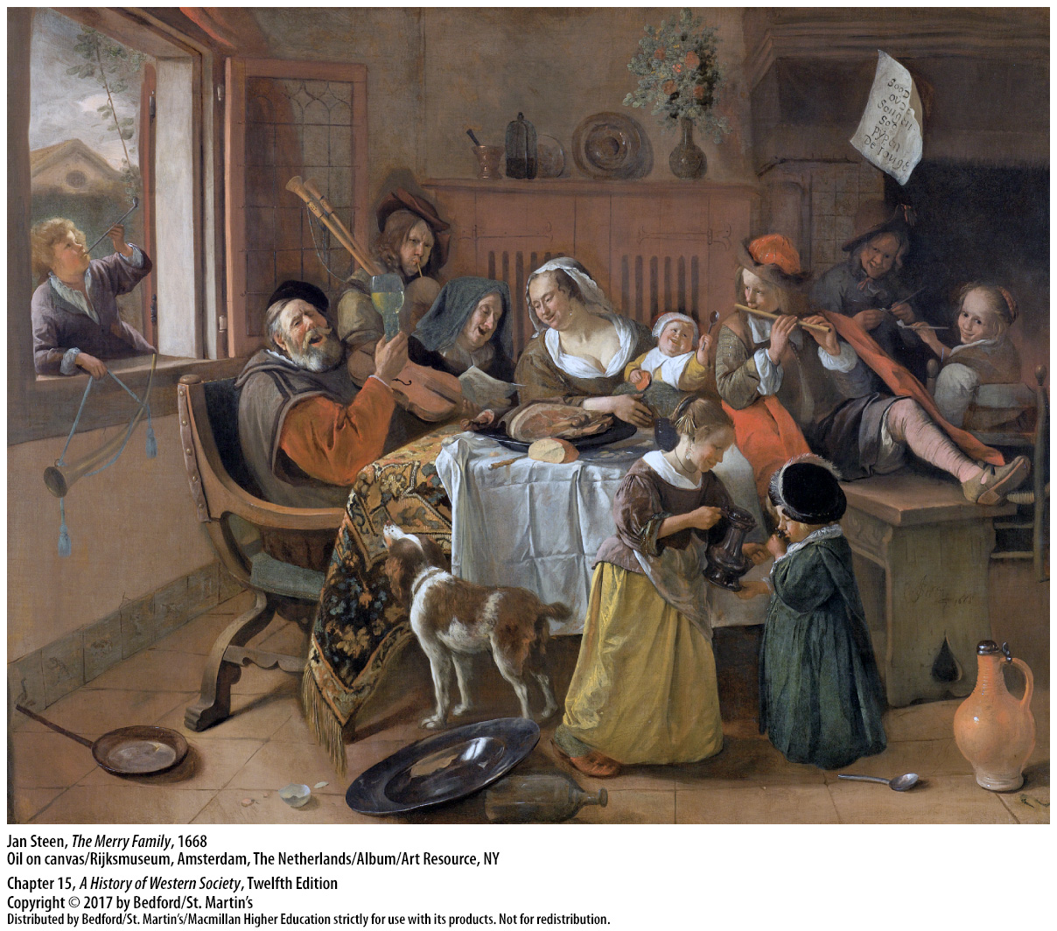

Slide 59
V. Constitutional Rule in England and the Dutch Republic
Baroque Art and Music
Jesuits encouraged artists to appeal to the senses and souls of churchgoers
Drew on themes of the Catholic Reformation
More than just “Catholic art”
Peter Paul Rubens (1577 – 1640)
Johan Sebastian Bach (1685 – 1750)
Notes:
V. Constitutional Rule in England and the Dutch Republic
F. Baroque Art and Music
1. The papacy and the Jesuits of the revitalized Catholic Church encouraged the growth of an intensely emotional, exuberant art and wanted artists to go beyond the Renaissance focus on pleasing a small, wealthy cultural elite to a focus on appealing to the senses and souls of ordinary churchgoers, while proclaiming the power of the Church.
2. In addition to this underlying religious emotionalism, the baroque drew its sense of drama, motion, and ceaseless striving from the Catholic Reformation.
3. Baroque art was more than just “Catholic art,” however, and in fact, Protestants accounted for some of the finest examples of baroque style, especially in music.
4. Baroque painting reached maturity early with Peter Paul Rubens (1577–1640), who developed a rich, sensuous, colorful style that was characterized by animated figures, melodramatic contrasts, and monumental size. Although Rubens was a devout Catholic who often treated Christian subjects and excelled in glorifying monarchs, one of his trademarks was fleshy, sensual nudes portrayed as goddesses, water nymphs, and voluptuous saints and angels.
5. In music, the baroque style reached its culmination almost a century later in the dynamic, soaring lines of the organist and choirmaster Johann Sebastian Bach (1685–1750), who wrote both secular concertos and sublime religious cantatas.

Slide 60
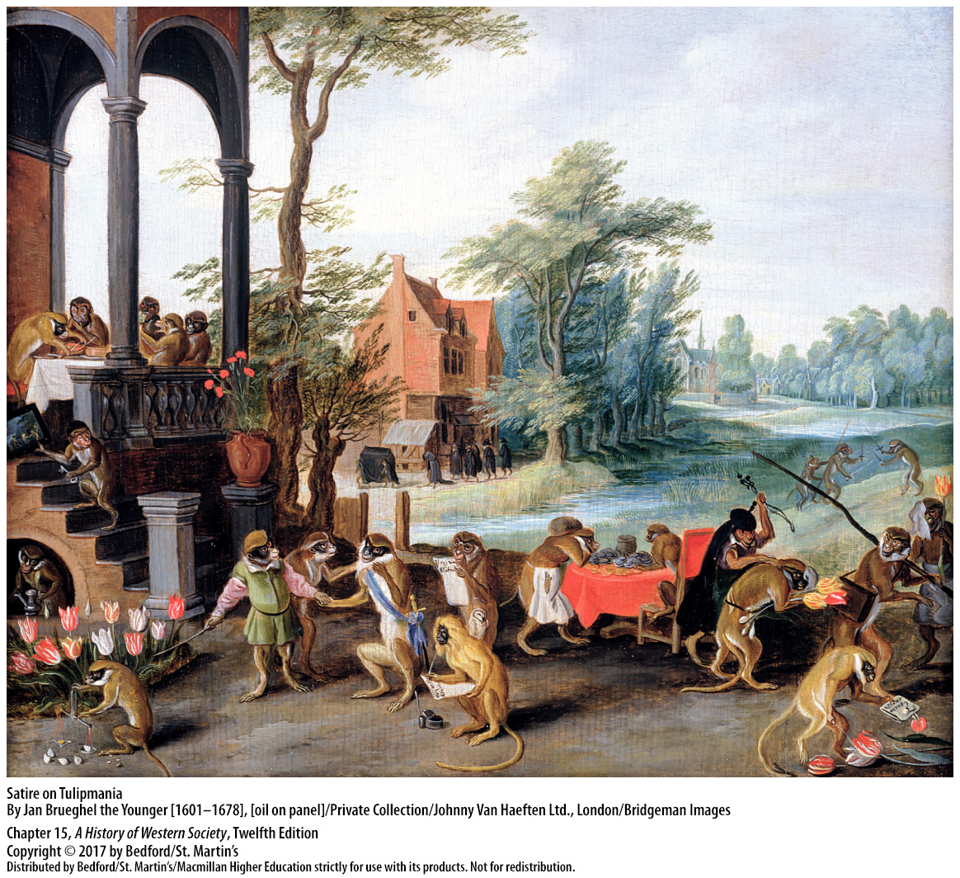

Slide 61
