Slide 1
A History of Western Society Twelfth Edition
McKay • Crowston • Wiesner-Hanks • Perry
CHAPTER 14
European Exploration and Conquest
1450–1650
Copyright © 2017 by Bedford/St. Martin’s
Distributed by Bedford/St. Martin's/Macmillan Higher Education strictly for use with its products; Not for redistribution.

Slide 2
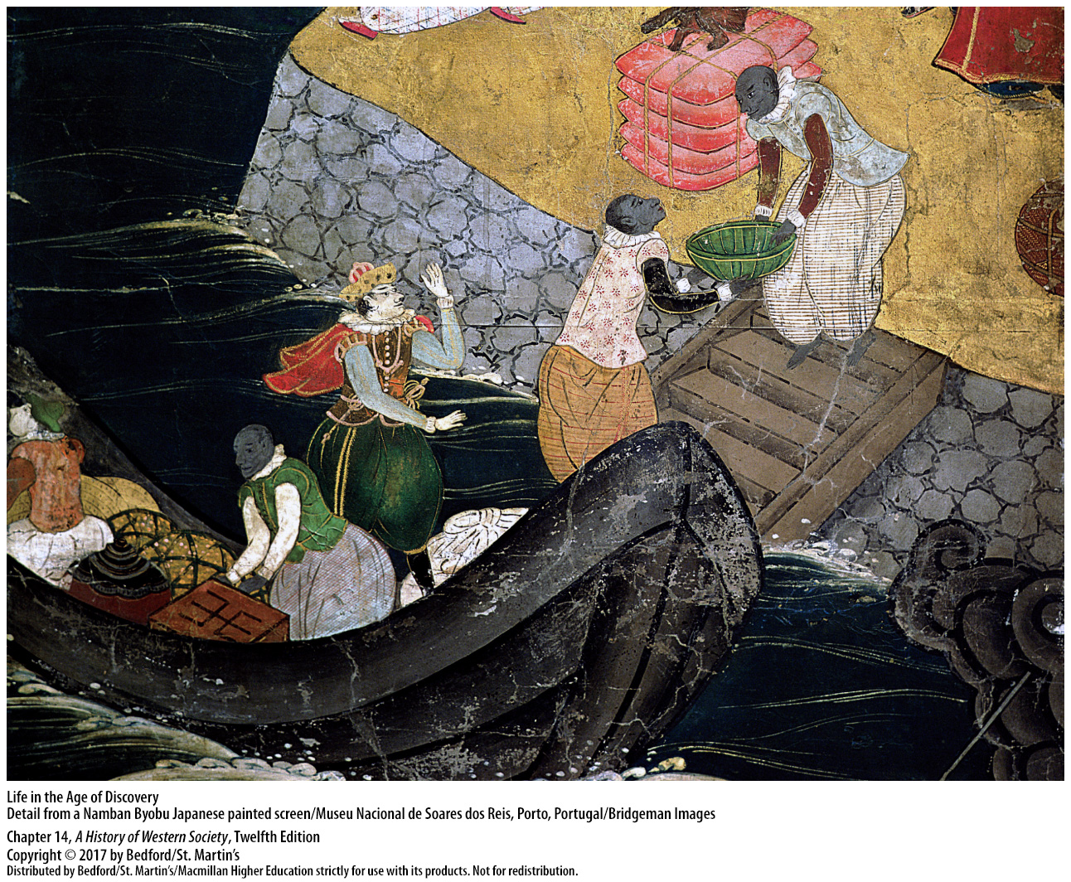

Slide 3
I. World Contacts Before Columbus
The Trade World of the Indian Ocean
Crossroads for commercial and cultural exchange
Mongol emperors opened China’s doors to the West
Marco Polo
Economic expansion in China
Admiral Zheng He
Notes:
World Contacts Before Columbus
The Trade World of the Indian Ocean
1. The location of the Indian Ocean made it a crossroads for commercial and cultural exchange among China, India, the Middle East, Africa, and Europe. Trading volume increased over the centuries as merchants congregated in cosmopolitan port cities strung around the Indian Ocean, most of which had some form of autonomous self-government.
2. The Mongol emperors opened the doors of China to the West, encouraging Europeans like Marco Polo to travel and do business there.
3. Marco Polo’s tales of his travels to the splendid court of the Great Khan and the city of Hangzhou fueled Western fantasies about the exotic Orient.
4. After the Mongols fell to the Ming Dynasty in 1368, China entered a period of economic expansion, population growth, and urbanization. By the end of the dynasty in 1644, China’s population had tripled, making Nanjing the largest city in the world. China had the most advanced economy in the world until at least the end of the eighteenth century.
5. China also took the lead in exploration, sending Admiral Zheng He on seven expeditions (1405–1433) involving hundreds of ships and tens of thousands of men sailing thousands of miles to reach as far west as Egypt.

Slide 4
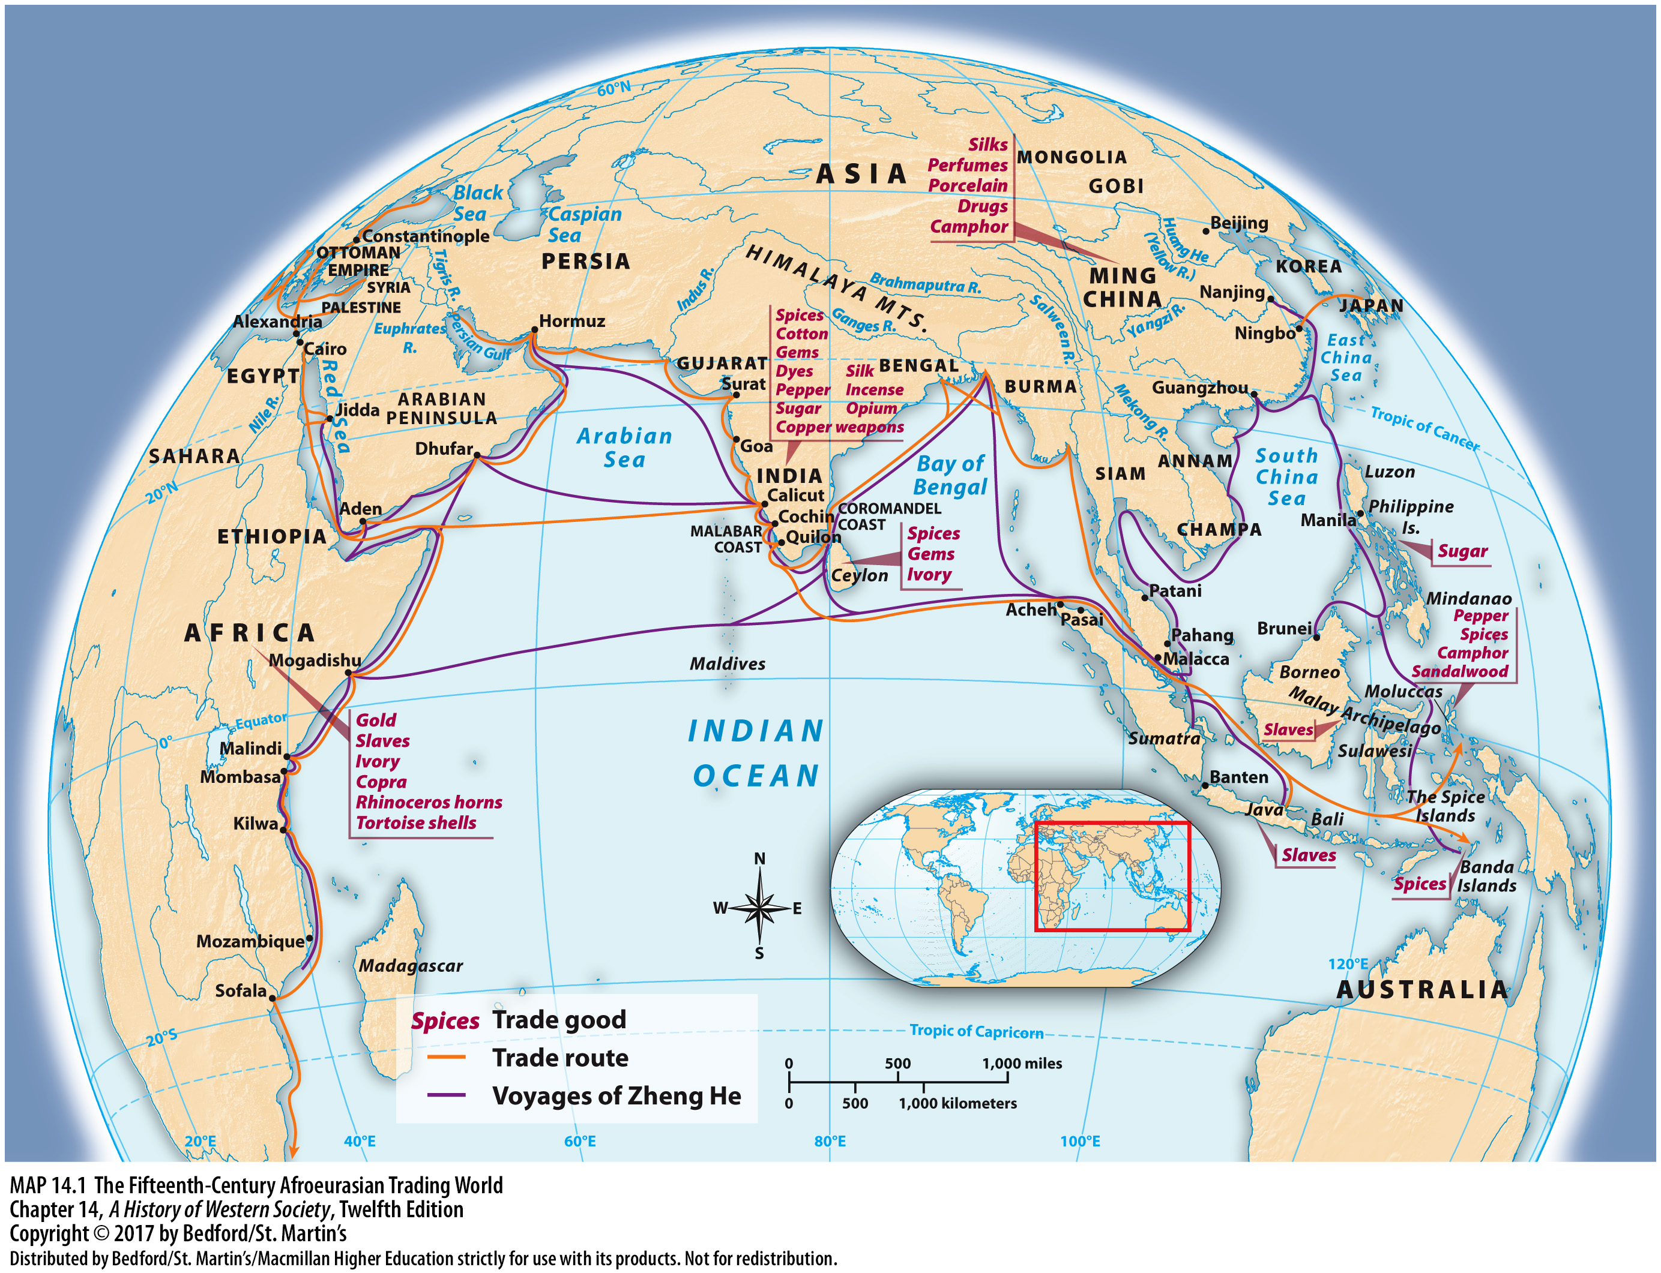

Slide 5
I. World Contacts Before Columbus
The Trading States of Africa
Cairo, capital of the Mamluk Egyptian emprie
Gold commodity
Mansa Musa, ruler of Mali
Slave trade
Mythical king Prester John
Notes:
World Contacts Before Columbus
B. The Trading States of Africa
1. Cairo, the capital of the Mamluk Egyptian empire, was a center of Islamic learning and religious authority as well as a hub for Indian Ocean trade goods. The African highland state of Ethiopia, a Christian kingdom, shared in Cairo’s prosperity.
2. Gold from West Africa and the Akan was another important African commodity and was transported by camel across the Sahara and sold in the ports of North Africa.
3. In the thirteenth century, Mali had emerged as an important player on the overland trade route, gaining prestige from its ruler Mansa Musa’s pilgrimage to Mecca in 1324−1325.
4. Slaves were another important object of trade; Arabic and African merchants took West African slaves to the Mediterranean to be sold in European, Egyptian, and Middle Eastern markets and also brought eastern Europeans to West Africa as slaves. Indian and Arabic merchants also traded slaves in the coastal regions of East Africa.
5. Belief in a legend about a Christian nation in Africa ruled by a mythical king, Prester John, played an important role in Europeans’ imagination of the outside world.

Slide 6
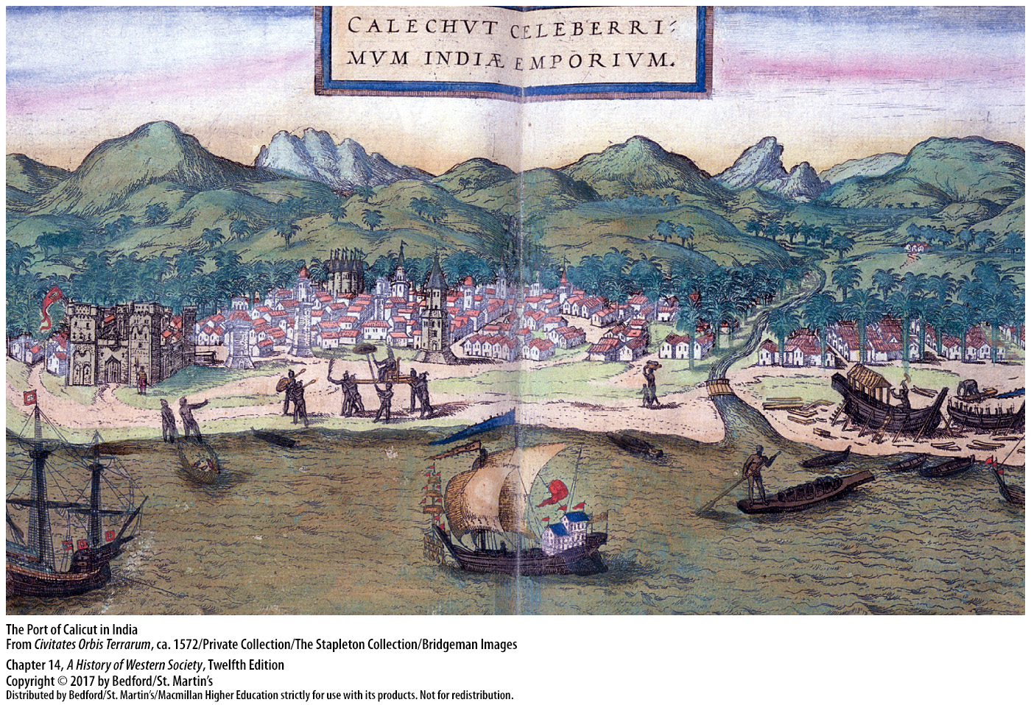

Slide 7
I. World Contacts Before Columbus
The Ottoman and Persian Empires
The Middle East as intermediary and supplier of goods
Persian Safavids v. Turkish Ottomans
Sultan Mohammed II (r. 1451-1481)
Ottoman expansion frightened Europeans
They wanted trade routes free of Ottoman control
Notes:
World Contacts Before Columbus
C. The Ottoman and Persian Empires
1. The Middle East served as an intermediary for trade among Asia, Africa, and Europe and as an important supplier of goods, especially silk and cotton.
2. Two great rival empires, the Persian Safavids and the Turkish Ottomans, dominated the region. Economically, the two competed for control over western trade routes to the East.
3. Under Sultan Mohammed II (r. 1451–1481), the Ottomans captured Constantinople, Europe’s largest city, in May 1453 and renamed it Istanbul; from there they came to control the sea trade in the eastern Mediterranean.
4. Ottoman expansion frightened Europeans; Ottoman armies seemed invincible and the empire’s desire for expansion limitless.
5. With trade routes to the east dominated by the Ottomans, Europeans wished to find new trade routes free of Ottoman control.

Slide 8
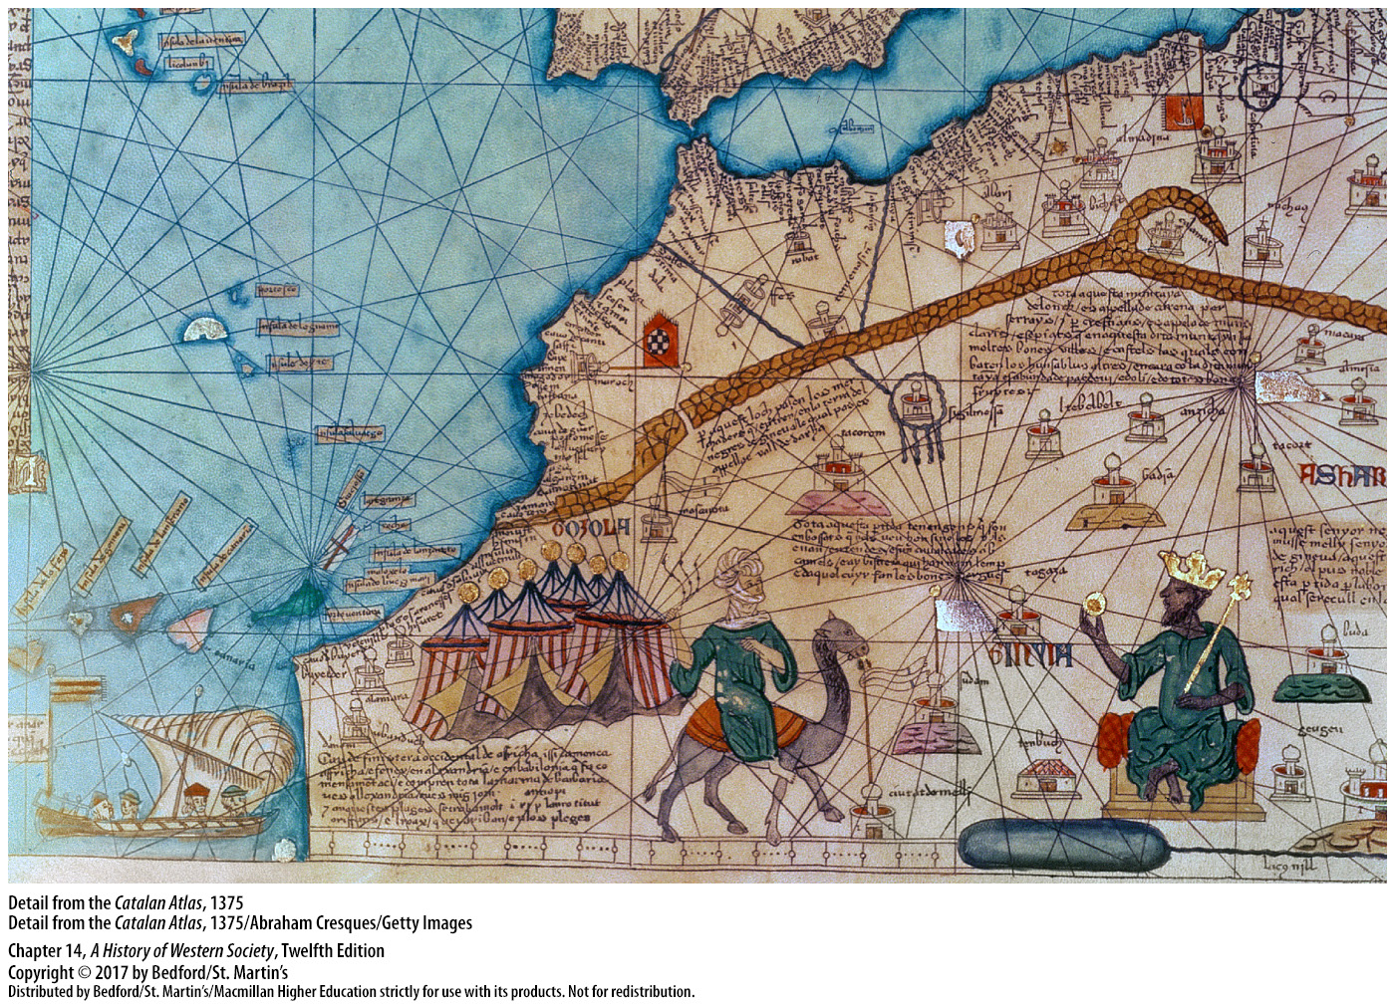

Slide 9
I. World Contacts Before Columbus
Genoese and Venetian Middlemen
Venetian merchants established in Cairo (1304)
Demand for European products low
Genoa sponsored failed expedition to India (1291)
Genoese and Venetian merchants would become important players in the Atlantic slave trade
Notes:
World Contacts Before Columbus
D. Genoese and Venetian Middlemen
1. In 1304 Venice established formal relations with the sultan of Mamluk Egypt, opening operations in Cairo, the gateway to Asian trade; Venetian merchants specialized in luxury goods such as spices, silks, and carpets obtained from middlemen in the eastern Mediterranean and Asia Minor.
2. Because demand for European products such as wool and metal goods in the East was low, the Venetians made up the difference by earning currency in the shipping industry and through trade in firearms, slaves, and precious metals.
3. Genoa had dominated the northern route to Asia through the Black Sea, and in 1291 it sponsored an expedition into the Atlantic in search of India, which never returned.
4. With the growth of Spanish colonies in the New World, Genoese and Venetian merchants would become important players in the Atlantic slave trade.

Slide 10
II. The European Voyages of Discovery
Causes of European Expansion
Demand for luxury goods from the East
Spice
Religious fervor
Curiosity about the physical universe
Spanish monarchs supported foreign ventures
Competition
Notes:
II. The European Voyages of Discovery
Causes of European Discovery
1. By the middle of the fifteenth century, Europe was experiencing a revival of population and economic activity after the lows of the Black Death. This revival created demands for luxury goods from the East, particularly spices.
2. Spices were desirable not only because they added flavor and variety to the monotonous European diet but also because they could be used in religious rituals and as perfumes, medicines, and dyes.
3. Religious fervor was another important catalyst for expansion, especially the passion and energy ignited by the Christian reconquista of the Iberian Peninsula.
4. Combined with an eagerness to earn profits and to spread Christianity was the desire for glory and a curiosity about the physical universe.
5. Eagerness for exploration and a lack of opportunity at home provided the motivation for young men of the Spanish upper classes to make voyages that were now possible because of the growth of government power and the monarchs’ ability to support foreign ventures.
6. Competition among European monarchs and between Protestant and Catholic states was an important factor in encouraging the steady stream of expeditions that began in the late fifteenth century.

Slide 11
II. The European Voyages of Discovery
Causes of European Expansion
Ill pay for sailors
Sailors’ wives struggled to feed their families
Voyages paid for and steered by merchants
Educated public read tales of the travelers
Notes:
II. The European Voyages of Discovery
Causes of European Discovery
7. Ordinary sailors were ill paid, and life at sea meant danger, overcrowding, and hunger. Some chose to join a ship’s crew to escape poverty, continue a family trade, or find better lives; others were orphans or poor boys who were placed on board with little say in the decision.
8. Women also paid a price for the voyages of exploration, as sailors’ wives, left alone for months or years at a time, struggled to feed their families.
9. Merchants provided the capital for many early voyages and had a strong say in their course.
10. An educated public eagerly read tales of fantastic places written by John Mandeville, Marco Polo, and other travelers.

Slide 12
II. The European Voyages of Discovery
Technology and the Rise of Exploration
Developments in shipbuilding
The caravel
Ptolemy’s Geography
The magnetic compass and the astrolabe
Gunpowder and the sternpost rudder
The lateen sail
Advances in cartography drew on the Judeo-Arabic mathematical tradition
Notes:
II. The European Voyages of Discovery
B. Technology and the Rise of Exploration
1. Technological developments in shipbuilding, weaponry, and navigation paved the way for European expansion. The need for sturdier craft to withstand the rough winds of the Atlantic, as well as population losses caused by the Black Death, forced the development of a new style of ship that would not require much manpower to sail.
2. The Portuguese developed the caravel, a small, light, three-mast sailing ship that, although slower than the open boat called a galley, held more cargo. The caravel’s triangular lateen sails and sternpost rudder also made the caravel a more maneuverable vessel, and when fitted with cannon, it could dominate larger vessels.
3. Arab scholars reintroduced Europeans to Ptolemy’s Geography, an ancient text which clearly depicted the world as round and introduced the concepts of latitude and longitude, but also showed the world as much smaller than it was in reality.
4. The magnetic compass enabled sailors to determine their direction and position at sea, and the astrolabe, invented by the ancient Greeks and perfected by Muslim navigators, permitted mariners to plot their latitude.
5. Gunpowder, the compass, and the sternpost rudder were all Chinese inventions.
6. The lateen sail, which allowed European ships to tack against the wind, was a product of the Indian Ocean trade world.
7. Advances in cartography drew on the rich tradition of Judeo-Arabic mathematical and astronomical learning in Iberia.

Slide 13
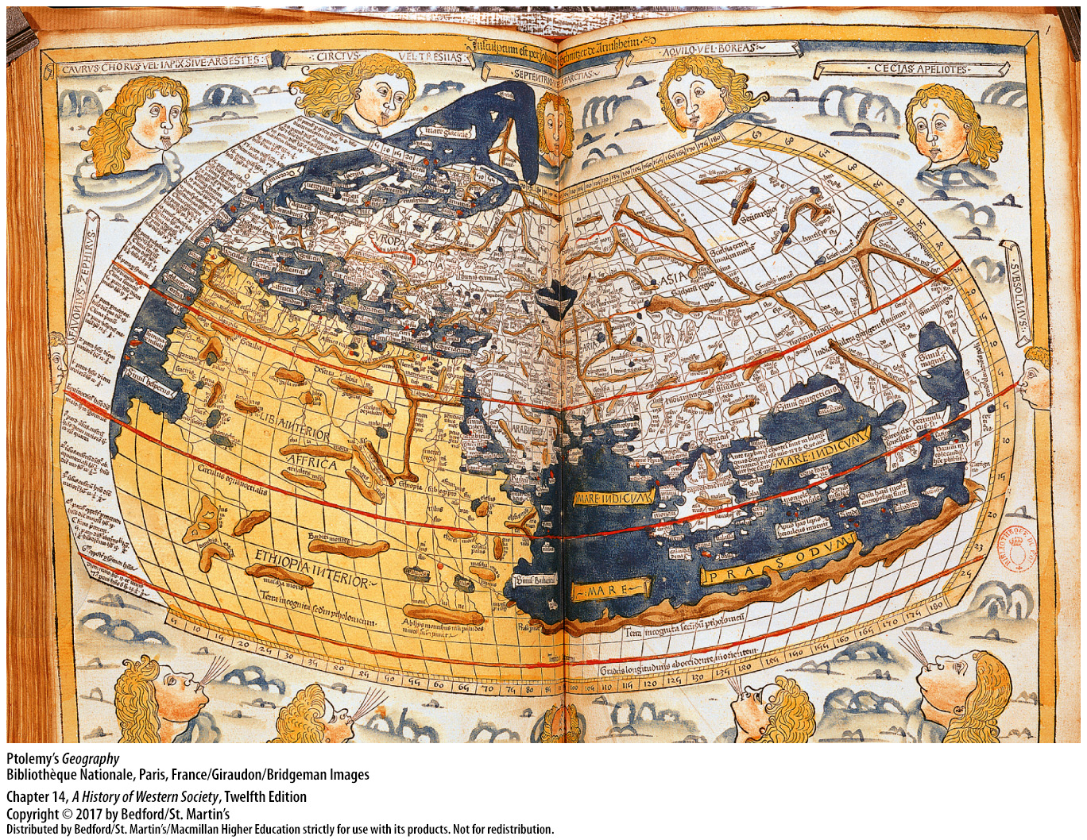

Slide 14
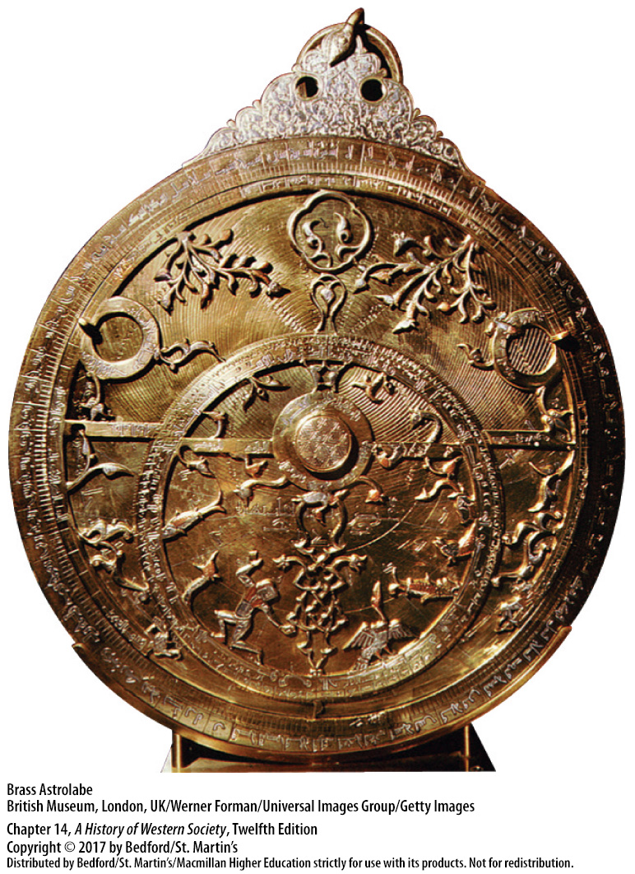

Slide 15
II. The European Voyages of Discovery
The Portuguese Overseas Empire
Prince Henry (1394 - 1460)
Portuguese exploration policy
Conquest of Ceuta (1415)
First Portuguese African commercial settlement at Arguin (1443)
Gold trading posts on the Guinea cost
Notes:
II. The European Voyages of Discovery
C. The Portuguese Overseas Empire
1. Prince Henry (1394–1460), a younger son of the king, sponsored annual expeditions down the western coast of Africa and supported the study of geography and navigation.
2. The objectives of Portuguese exploration policy included the desire to achieve military glory, convert Muslims, and find gold, slaves, and an overseas route to the spice markets of India.
3. Portugal’s conquest of Ceuta in 1415 marked the beginning of European overseas expansion.
4. In the 1420s, under Henry’s direction, the Portuguese began to settle the Atlantic islands of Madeira (ca. 1420) and the Azores (1427) and founded their first African commercial settlement at Arguin (1443).
5. The Portuguese established trading posts and forts on the gold-rich Guinea coast and penetrated Africa to Timbuktu; by 1500, Portugal controlled the flow of African gold to Europe.

Slide 16
II. The European Voyages of Discovery
The Portuguese Overseas Empire
Cape of Good Hope (1487; 1497)
Vasco de Gama, port of Calicut
da Gama proved that trade with the East was possible via the Cape route
Foundation for Portuguese imperialism
Notes:
II. The European Voyages of Discovery
C. The Portuguese Overseas Empire
6. Pushing farther south down the west coast of Africa, Bartholomew Diaz first rounded the Cape of Good Hope in 1487, although he had to turn back; then in 1497 Vasco da Gama succeeded in rounding the Cape of Good Hope with a fleet of four ships.
7. With the help of an Indian guide, da Gama reached the port of Calicut in India and then returned to Lisbon loaded with spices and samples of Indian cloth.
8. Although he had failed to forge any trading alliances with local powers and Portuguese arrogance ensured the future hostility of Muslim merchants who dominated the trading system, da Gama had proved the possibility of lucrative trade with the East via the Cape route.
9. Portuguese cannon blasted open the Muslim-controlled port of Malacca in 1511, followed by Calicut, Hormuz, and Goa, enabling the Portuguese to make Lisbon the entrance port for Asian goods and laying the foundation for Portuguese imperialism in the sixteenth and seventeenth centuries.

Slide 17
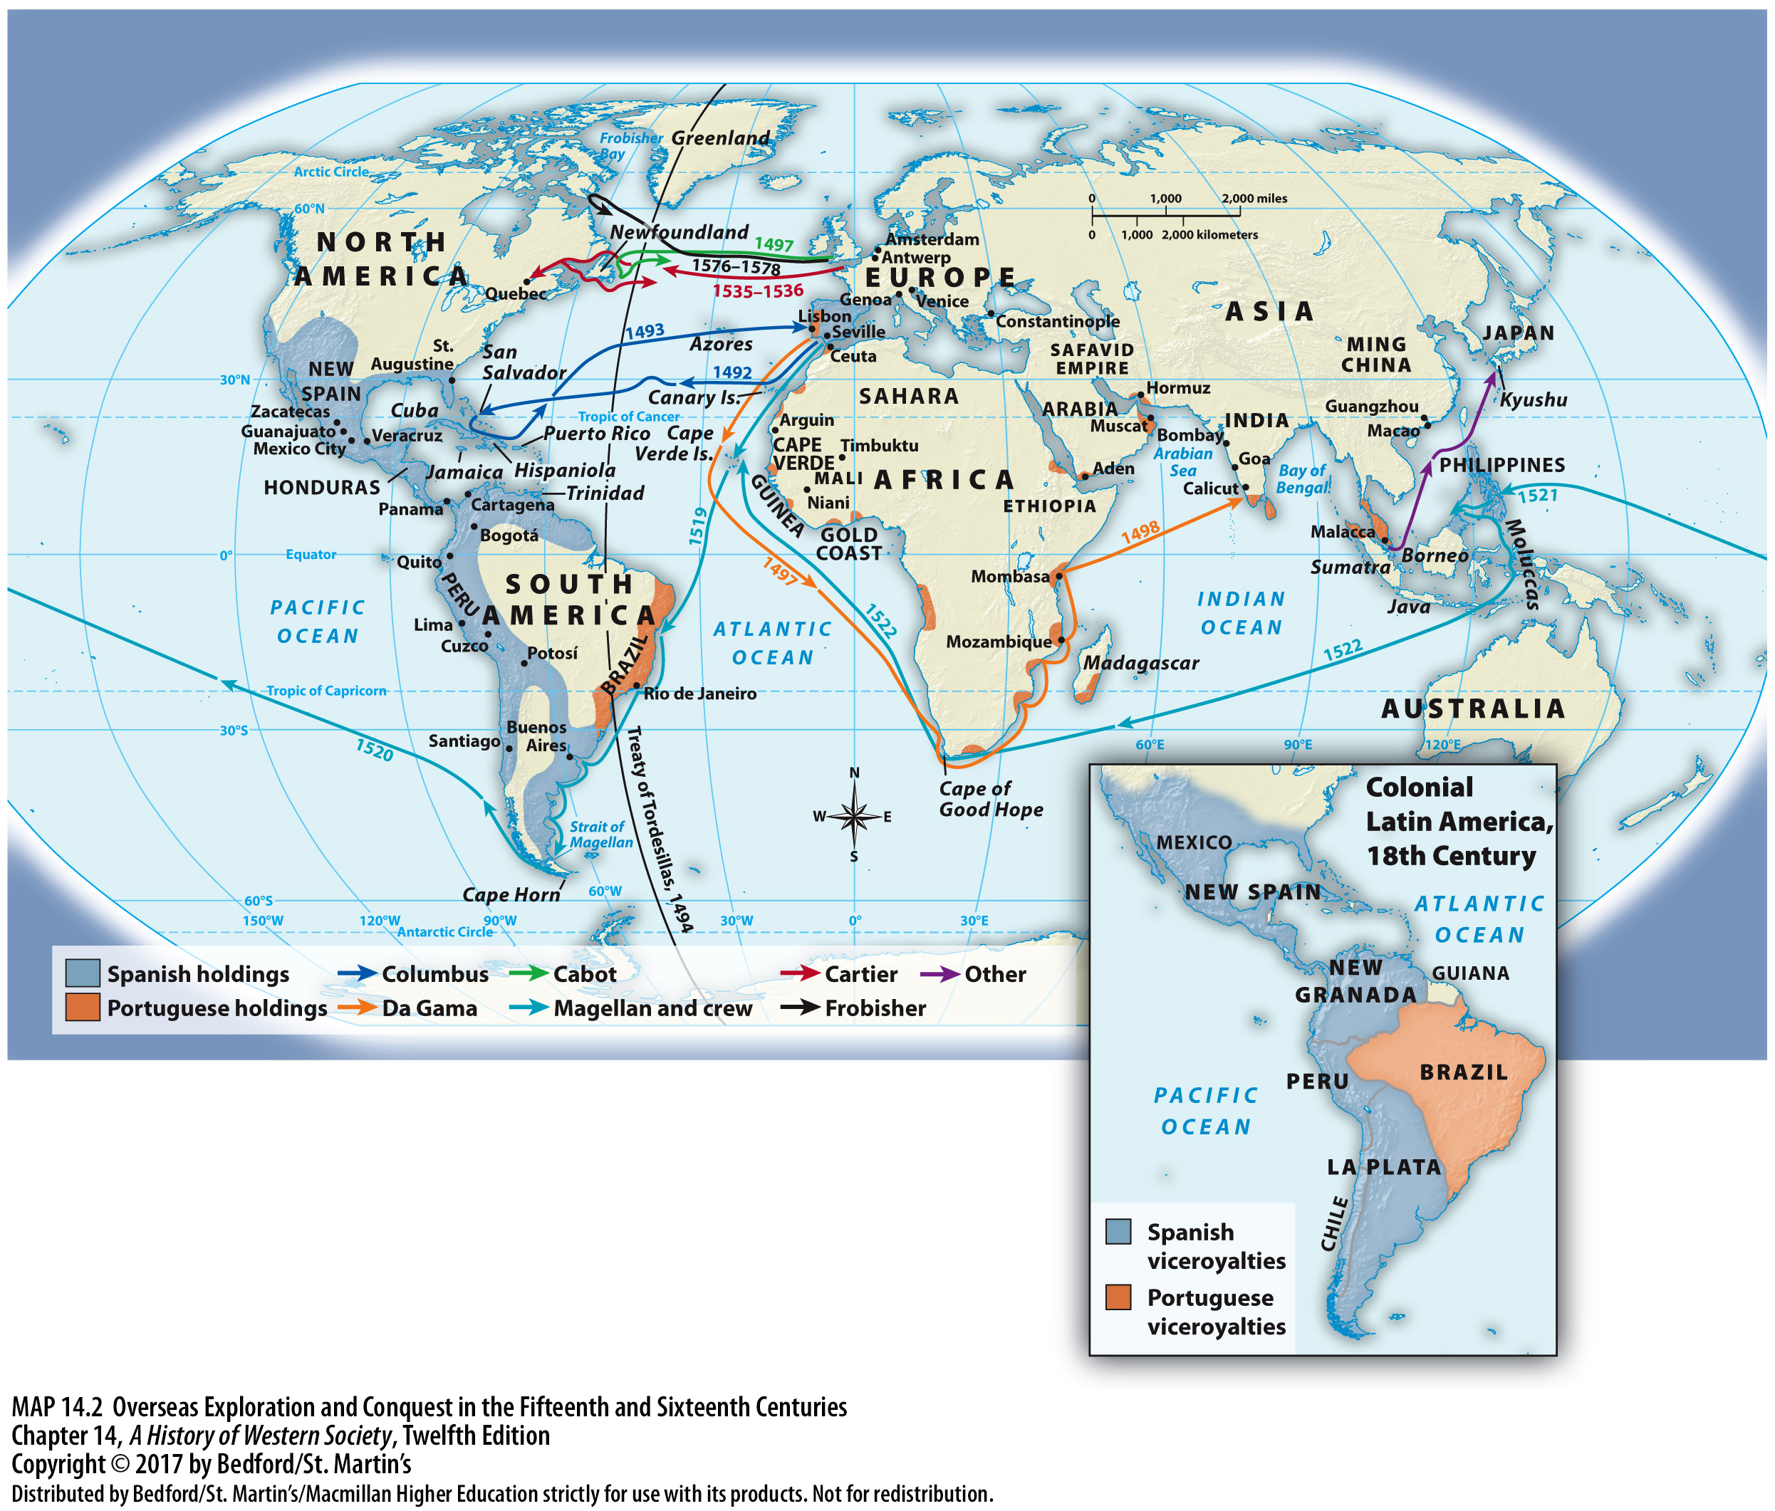

Slide 18
II. The European Voyages of Discovery
Spain’s Voyages to the Americas
Columbus’s expedition (1492)
Landed in the Bahamas, San Salvador
Enslaved the people of Hispaniola and established settlers in new territories
Revolts against Columbus
He believed he had discovered small islands off the coast of Asia
Notes:
II. The European Voyages of Discovery
D. Spain’s Voyages to the Americas
1. Inspired by the stories of Marco Polo and others, Columbus wanted to find a direct ocean trading route to Asia. In 1492, after being rejected by the Portuguese, Columbus’s expedition finally won the backing of Ferdinand and Isabella, who named him viceroy over any territory he might discover and promised him one-tenth of the journey’s material rewards.
2. When he landed in the Bahamas, which he christened San Salvador, on October 12, 1492, Columbus believed he had found some small islands off the east coast of Japan. Believing he was in the Indies, he called the native peoples “Indians,” a name later applied to all inhabitants of the Americas, and he concluded that they would make good slaves and could be converted to Christianity easily.
3. On his second voyage, Columbus subjugated the island of Hispaniola and enslaved its people; he began establishing settlers in the new Spanish territories under his governance.
4. Revolts broke out against Columbus and his brother, and a royal expedition brought them back to Spain for investigation; although Columbus was cleared of wrongdoing, the territories remained under royal control.
5. Columbus was very much a man of his times and believed, to the end of his life, that he had found small islands off the coast of Asia. He never realized the scope of his achievement: to have found a vast continent unknown to Europeans.

Slide 19
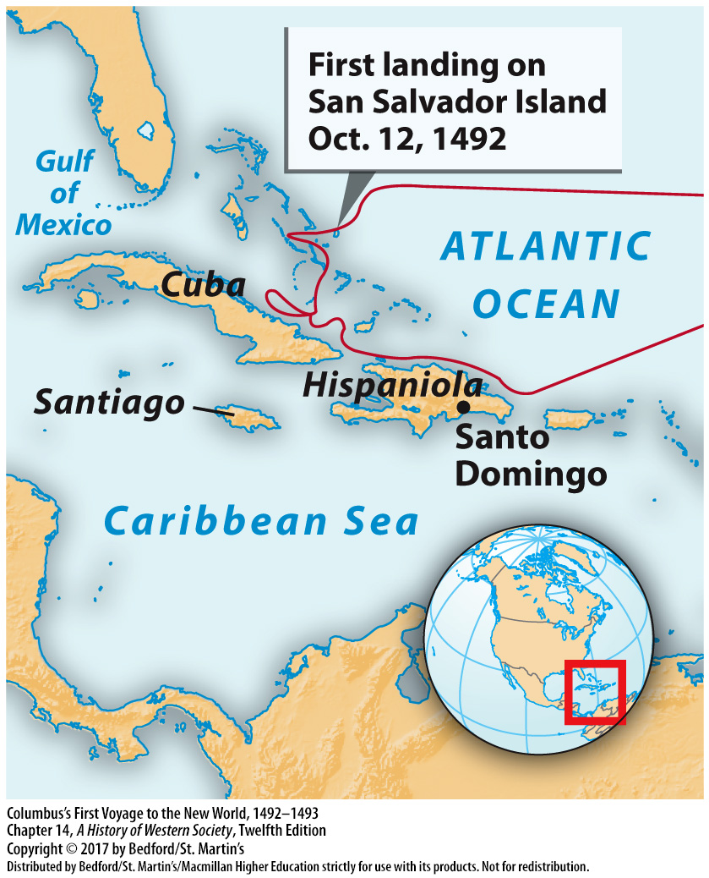

Slide 20
II. The European Voyages of Discovery
Spain “Discovers” the Pacific Early
Amerigo Vespucci (1454 – 1512)
Treaty of Tordesillas (1494)
Pedro Alvares Cabral on the coast of Brazil (1500)
Ferdinand Magellan (1480-1521)
Revolutionized Europeans’ world understanding
Spain abandoned the search for a passage to Asia to focus on its New World territories
Notes:
II. The European Voyages of Discovery
E. Spain “Discovers” the Pacific Early
1. The Florentine navigator Amerigo Vespucci (1454–1512) realized what Columbus had not—that this “New World” was actually a continent separate from Asia—and in recognition of his claim, the continent was named for him.
2. To settle competing claims to the Atlantic discoveries, Spain and Portugal turned to Pope Alexander VI. The resulting Treaty of Tordesillas (1494) gave Spain everything to the west of an imaginary line drawn down the Atlantic and Portugal everything to the east of that line.
3. This arbitrary division worked in Portugal’s favor when in 1500 Pedro Alvares Cabral landed on the coast of Brazil, which Cabral claimed as Portuguese territory.
4. Spain renewed the search for a western passage to Asia in 1519 when Charles V sent the Portuguese mariner Ferdinand Magellan (1480–1521) to find a direct sea route to the spices of the Moluccas off the southeast coast of Asia.
5. This voyage revolutionized Europeans’ understanding of the world by demonstrating the vastness of the Pacific and proving that the earth was clearly much larger than Columbus had believed.
6. It also demonstrated that the westward passage to the Indies was too long and dangerous, and Spain soon abandoned the attempt to oust Portugal from the Eastern spice trade to concentrate on its New World territories.

Slide 21
II. The European Voyages of Discovery
Early Exploration by Northern European Powers
English and French searched for a northwest passage to the Indies
Futile voyages of Newfoundland and Canada
French exploration of the Atlantic
Competition for fishing trade
Notes:
II. The European Voyages of Discovery
F. Early Exploration by Northern European Powers
1. The English and French also set sail across the Atlantic in search of a northwest passage to the Indies.
2. The voyages of John Cabot, a Genoese merchant living in London who explored Newfoundland and the New England coast, and Martin Frobisher, who explored areas of Canada, ultimately proved futile; the English did not establish any permanent colonies in these territories.
3. Early French exploration of the Atlantic was equally frustrating: Jacques Cartier’s exploration of the St. Lawrence River was halted at the great rapids west of the present-day island of Montreal, although the French began a lucrative trade in beaver and other furs there.
4. French fisherman also competed with the Spanish and the English for the teeming schools of cod found around Newfoundland, which the fishing vessels salted on board and brought back to Europe.

Slide 22
III. Conquest and Settlement
Spanish Conquest of the Aztec and Inca Empires
Spanish settlement of Hispaniola, Cuba, Puerto Rico, and other Caribbean islands
Hernando Cortés (1485 – 1547)
Attacked Tenochtitlán in November 1519
Montezuma thought the Spanish were invincible
Spanish victory in 1521 aided by the effects of smallpox and the siege
Notes:
III. Conquest and Settlement
Spanish Conquest of the Aztec and Inca Empires
1. The first two decades after Columbus’ arrival in the New World saw Spanish settlement of Hispaniola, Cuba, Puerto Rico, and other Caribbean islands.
2. The Spanish governor in Cuba sponsored expeditions to the Yucatan coast of the Gulf of Mexico, including one in 1519 under the command of the conquistador Hernando Cortés (1485–1547).
3. After landing on the coast of the Gulf of Mexico in 1519 and receiving an unarmed delegation of Mexica leaders, Cortés realized that he could exploit internal dissension within the empire to his own advantage. Cortés quickly forged an alliance with the Tlaxcalas and other subject kingdoms, which chafed under the tribute demanded by the Mexica, and with a force of a few hundred Spanish and some six thousand indigenous warriors, he marched on Tenochtitlán in November 1519.
4. Montezuma was apparently deeply impressed by Spanish victories and believed they were invincible. Sources written after the Conquest claimed that the emperor believed Cortés was an embodiment of the god Quetzalcoatl, whose return was promised in Aztec myth. Cortés took Montezuma hostage, and the emperor’s influence over his people crumbled.
5. After a second assault on Tenochtitlán in May 1520, which resulted in an uprising and Montezuma’s death, Cortés achieved a hard-won victory in late summer 1521 that was greatly aided by deprivations of the siege and the effects of smallpox.

Slide 23
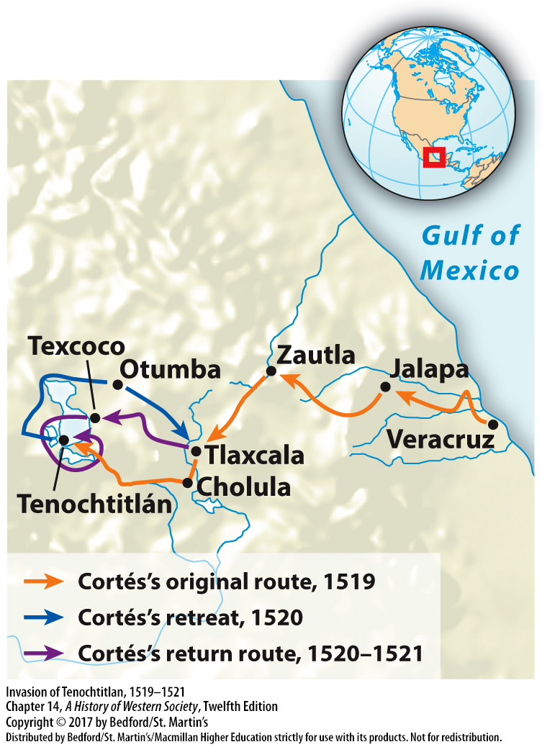

Slide 24
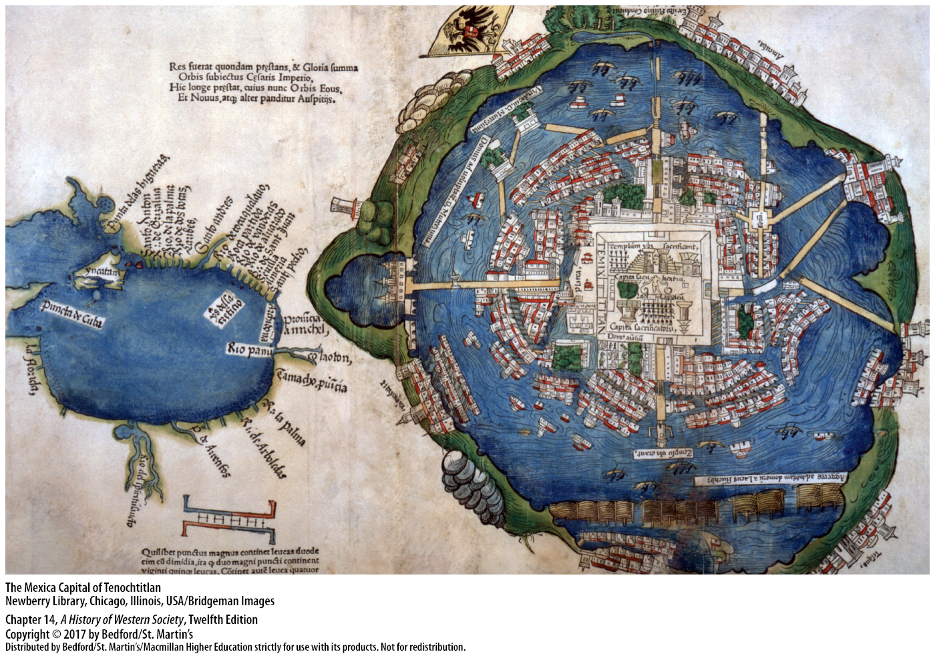

Slide 25
III. Conquest and Settlement
Spanish Conquest of the Aztec and Inca Empires
Systematic conquest of Mexico
The Inca Empire
Weakened by disease and war by the time of the Spanish invasion
Francisco Pizarro (ca. 1474 – 1541) executed Incan ruler Atahualpa
Plundered the capital of Cuzco (1533)
Notes:
III. Conquest and Settlement
Spanish Conquest of the Aztec and Inca Empires
7. Cortés and other conquistadors began the systematic conquest of Mexico, and over time, a series of indigenous kingdoms gradually fell under Spanish domination.
8. In Peru, the Incas had created a vast and well-fortified empire. Their strength lay largely in their bureaucratic efficiency.
9. At the time of the Spanish invasion, the Inca Empire had been weakened by a disease epidemic and by a civil war over succession.
10. In 1532 Francisco Pizarro (ca. 1475–1541), a conquistador of modest Spanish origins, ambushed and captured the new Incan ruler, Atahualpa, collected an enormous ransom in gold, and then executed him on trumped-up charges.
11. In 1533 the Spanish, aided by alliances with local peoples, marched on the capital of Cuzco and plundered immense riches in gold and silver, setting off decades of violence and resistance.

Slide 26
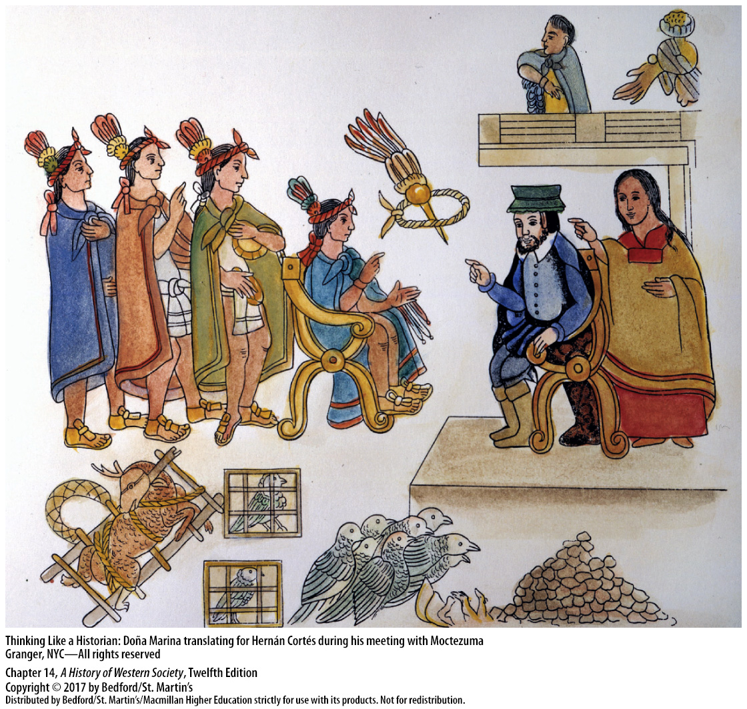

Slide 27
III. Conquest and Settlement
Portuguese Brazil
Brazil territory made up of small tribes, not urban empires
Portuguese settlers introduced sugar cane production, a new form of colonization
Notes:
III. Conquest and Settlement
B. Portuguese Brazil
1. Unlike Mesoamerica or the Andes, the territory of Brazil contained no urban empires, but instead roughly 2.5 million nomadic and settled people divided into small tribes and many different language groups.
2. In the 1520s, Portuguese settlers brought sugar cane production to Brazil, thus creating a new form of colonization in the Americas: large plantations worked by enslaved people. This model would spread throughout the Caribbean along with sugar production in the seventeenth century.

Slide 28
III. Conquest and Settlement
Colonial Empires of England and France
Virginia colony, Jamestown (1607)
Enslaved Africans replaced indentured servants on tobacco and rice plantations
English colonization haphazard and decentralized; greater colonial autonomy
French established trading factories in present-day Canada
Fortified trading posts in West Africa and India
Notes:
III. Conquest and Settlement
C. Colonial Empires of England and France
1. The colony of Virginia, founded at Jamestown in 1607, initially struggled to grow sufficient food and faced hostility from the Powhatan Confederacy. Eventually it thrived by producing tobacco for a growing European market.
2. During the late seventeenth century enslaved Africans replaced indentured servants as laborers on tobacco and rice plantations, and a harsh racial divide was imposed.
3. In place of the unified rule exerted by the Spanish crown, English colonization was haphazard and decentralized in nature, leading to greater colonial autonomy and diversity.
4. Whereas English settlements were largely agricultural, the French established trading factories in present-day Canada, much like those of the Portuguese in Asia and Africa.
5. In the 1600s, France and England – along with Denmark and other northern European powers - established fortified trading posts in West Africa as bases for purchasing slaves and in India and the Indian Ocean for spices and other luxury goods.

Slide 29
III. Conquest and Settlement
Colonial Administration
Spanish territories: New Spain and Peru
Portuguese system of captaincies in Brazil
Catholic Church played role in Iberian rule throughout the Americas
French crown imposed direct rule over North American colonies
Notes:
III. Conquest and Settlement
D. Colonial Administration
1. Early conquest and settlement were conducted largely by private initiatives, but the Spanish and Portuguese governments soon assumed more direct control.
2. Spanish territories themselves were divided initially into two viceroyalties or administrative divisions: New Spain, created in 1535, with its capital at Mexico City, and Peru, created in 1542, with its capital at Lima.
4. To secure the vast expanse of Brazil, the Portuguese implemented the system of captaincies in the 1530s, hereditary grants of land given to nobles and loyal officials who bore the costs of settling and administering their territories.
5. Throughout the Americas, the Catholic Church played an integral role in Iberian rule.
6. By the end of the seventeenth century, the French crown had imposed direct rule over its North American colonies, whereas English colonists established their own autonomous assemblies to regulate local affairs. Wealthy merchants and landowners dominated the assemblies, although even common men had more say in politics than was the case in England.

Slide 30
IV. The Era of Global Contact
Indigenous Population Loss and Economic Exploitation
Encomienda system
Tribute payments from indigenous laborers
The New Laws (1542)
System of forced labor: repartimiento / mita
Disastrous decline of indigenous population
Notes:
IV. The Era of Global Contact
Indigenous Population Loss and Economic Exploitation
1. The conquerors of the New World made use of the encomienda system to profit from the peoples and territories they encountered. This system was a legacy of the methods used to reward military leaders in the time of the Reconquista, when victorious officers received feudal privileges over conquered areas in return for their service.
2. Conquistadors granted their followers the right to employ groups of indigenous people as laborers and to demand tribute payments from them in exchange for providing food, shelter and instruction in the Christian faith.
3. A 1512 Spanish law authorizing the use of encomiendas called for indigenous people to be treated fairly, but in practice the system lead to terrible abuses, including overwork, beatings, and sexual violence. King Charles I responded to these complaints in 1542 with the New Laws, which set limits on the authority of encomienda holders. This provoked a revolt in Peru. Eventually the crown gained control over encomiendas in central areas of the empire and required indigenous people to pay tributes in cash, rather than in labor.
4. Royal officials established a new government-run system of forced labor, called repartimiento in New Spain and mita in Peru. Laborers received modest wages in exchange, which they could use to fulfill tribute obligations.
5. Indigenous peoples saw a disastrous decline in population soon after the arrival of Europeans, caused by violence of conquest, the disruption of agriculture and trade caused by warfare, and infectious disease.

Slide 31
IV. The Era of Global Contact
Life in the Colonies
Reliance on native women
English attitudes of “civilized” vs. “savage”
Traders assimilated in New France
Four-fifths of female immigrants before 1800 were Africans
Mixing of indigenous peoples with Europeans and Africans
“Mestizo,” “mulatto,” “people of color”
Notes:
IV. The Era of Global Contact
B. Life in the Colonies
1. The first explorers formed unions with native women, through coercion or choice, and relied on them to act as translators and guides and to form alliances with indigenous powers.
2. English cultural attitudes drew strict boundaries between “civilized” and “savage,” which prevented English men from forming unions with indigenous women.
3. In contrast, in New France, where royal officials initially encouraged French traders to form ties with native people and to marry local women, assimilation with the native population was seen as a solution to the low levels of immigration from France.
4. Most women who crossed the Atlantic were Africans, comprising four-fifths of the female immigrants before 1800. Wherever slavery existed, masters used their power to engage in sexual relations with enslaved women.
5. In Portuguese, Spanish, and French colonies, substantial populations of free blacks descended from the freed children of such unions, but in English colonies, masters were less likely to free children they had fathered with female slaves. The mixing of indigenous peoples with Europeans and Africans created whole new populations and ethnicities and complex feelings of self-identities.
6. In Spanish America, the word mestizo described people of mixed Native American and European descent; the terms “mulatto” and “people of color” referred to those of mixed African and European origin.

Slide 32
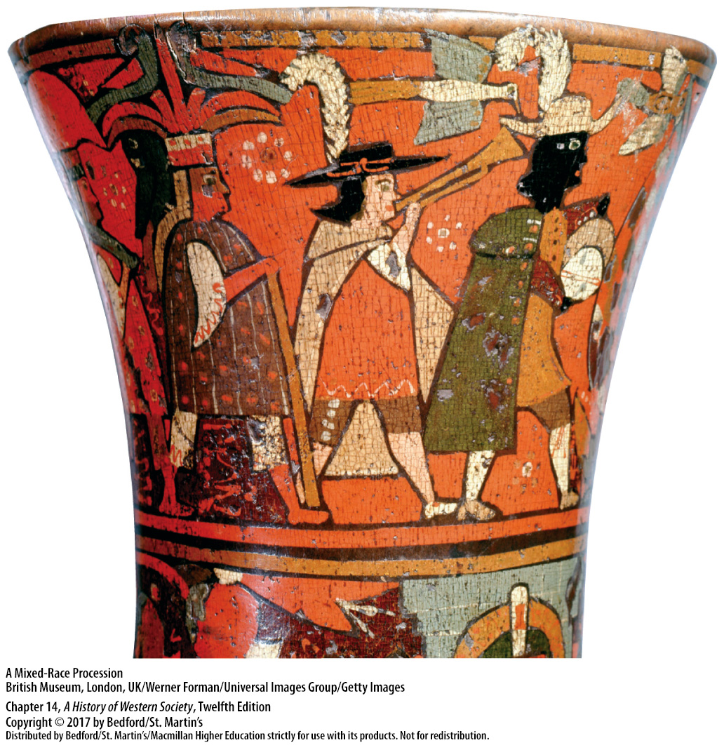

Slide 33
IV. The Era of Global Contact
The Columbian Exchange
Exchange of animals, plants, and disease
Meat and milk of European livestock
Maize
White potato
Epidemic disease swept the Western Hemisphere after 1492
Notes:
IV. The Era of Global Contact
C. The Columbian Exchange
1. The migration of peoples to the New World led to an exchange of animals, plants, and disease, a complex process known as the Columbian exchange.
2. Perhaps the most significant introduction to the diet of Native Americans came via the meat and milk of the livestock that the early conquistadors brought with them, including cattle, sheep, and goats. The horse enabled both the Spanish conquerors and native populations to travel faster and farther and to transport heavy loads.
3. Maize became a staple in Spain, Portugal, southern France, and Italy, and in the eighteenth century it became one of the chief foods of southeastern Europe and southern China.
4. Even more valuable was the nutritious white potato, which slowly spread from west to east contributing everywhere to a rise in population.
5. Disease was perhaps the most important form of exchange; a wave of catastrophic epidemic disease swept the Western Hemisphere after 1492.

Slide 34
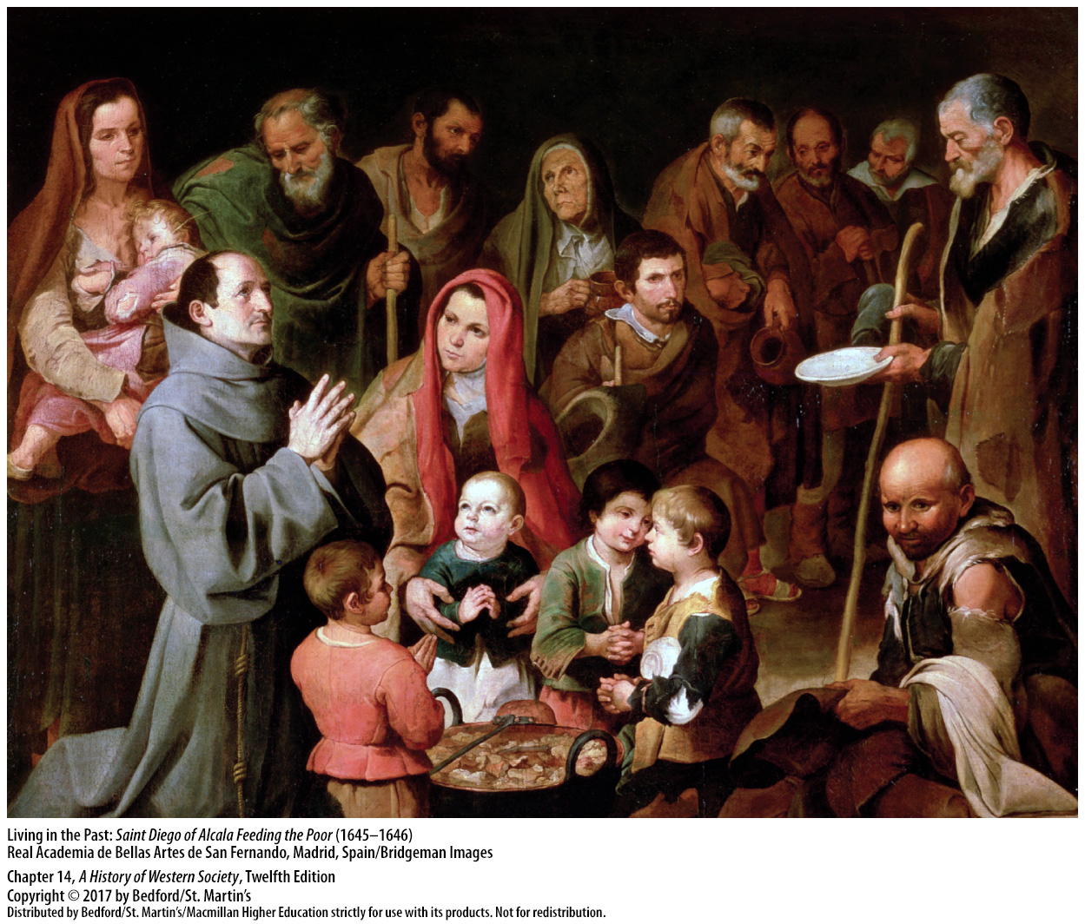

Slide 35
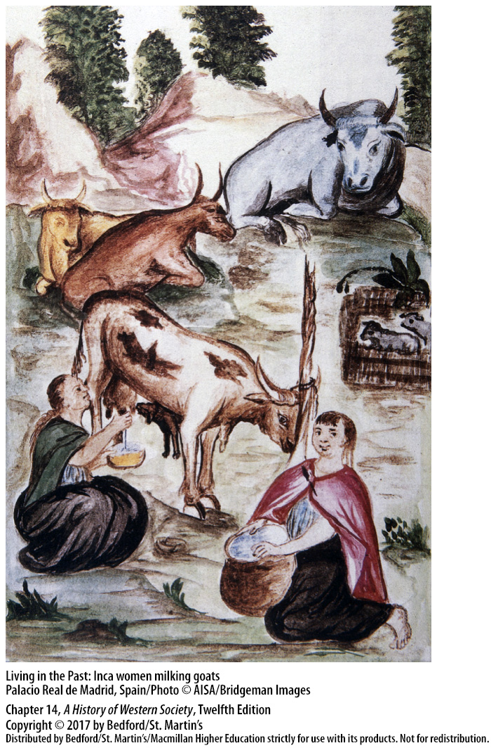

Slide 36
IV. The Era of Global Contact
Sugar and Slavery
Mediterranean Europe turned to sub-Saharn Africa for slaves
Portuguese merchants sought slaves along the western coast of Africa
Brought hundreds of enslaved Africans to Lisbon each year (1490 – 1530)
European demand for sugar grew
Transatlantic slave trade began in 1518
Notes:
IV. The Era of Global Contact
D. Sugar and Slavery
1. Cut off from its traditional sources of slaves—Ottomans halted the flow of white slaves from the eastern Mediterranean, and the reconquista diminished the supply of Muslim captives—Mediterranean Europe turned to sub-Saharan Africa, which had a long history of slave trading.
2. Portuguese explorers sought slaves during their voyages along the western coast of Africa and in 1444 returned to Lisbon with the first cargo of enslaved Africans. While the first slaves were simply seized by small raiding parties, Portuguese merchants found that it was easier to trade with local African leaders, who were accustomed to dealing in slaves captured through warfare with neighboring powers.
3. From 1490 to 1530, Portuguese traders brought hundreds of enslaved Africans to Lisbon each year, where they eventually made up 10 percent of the city’s population.
4. European demand for sugar grew with population increases and monetary expansion in the fifteenth century. To meet the demand for sugar, a difficult and demanding crop to produce for profit, Europeans forced native islanders and then enslaved Africans to provide the backbreaking work.
5. The transatlantic slave trade began in 1518 when emperor Charles V authorized traders to bring enslaved Africans to the Americas.

Slide 37
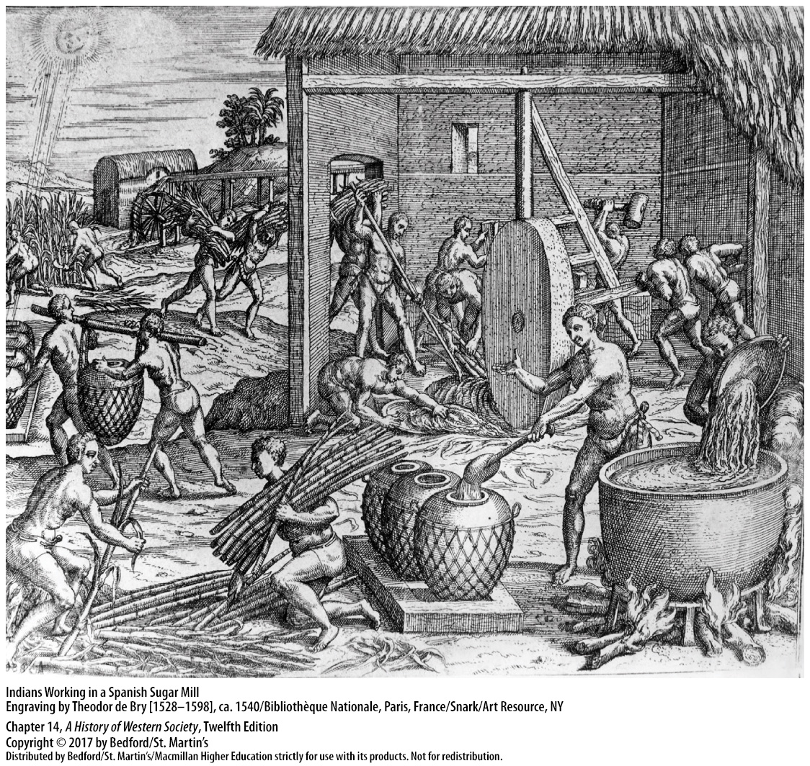

Slide 38
IV. The Era of Global Contact
Sugar and Slavery
6. Dutch West India Company (1621)
7. Royal African Company (1660-1698)
8. The Atlantic passage
9. Estimated 10 million enslaved Africans
10. Miners, soldiers, sailors, servants, artisans, and crop laborers
Notes:
IV. The Era of Global Contact
D. Sugar and Slavery
6. After its founding in 1621, the Dutch West India Company transported thousands of Africans to Brazil and the Caribbean, mostly to work on sugar plantations.
7. In the mid-seventeenth century, the English entered the trade, and from 1660 to 1698, the Royal African Company held a monopoly over the slave trade from the English crown.
8. For African slaves, the Atlantic passage was lethal; some 20 percent of them died on the voyage, most commonly from dysentery caused by poor-quality food and water, crowding, and lack of sanitation.
9. Scholars estimate that European traders embarked more than 10 million enslaved Africans across the Atlantic from 1518 to 1800 (of whom roughly 8.5 million disembarked), compared to only 2 to 2.5 million Europeans who migrated to the New World during the same period.
10. Slaves worked in a variety of occupations as miners, soldiers, sailors, servants, artisans, and in the production of various crops.

Slide 39
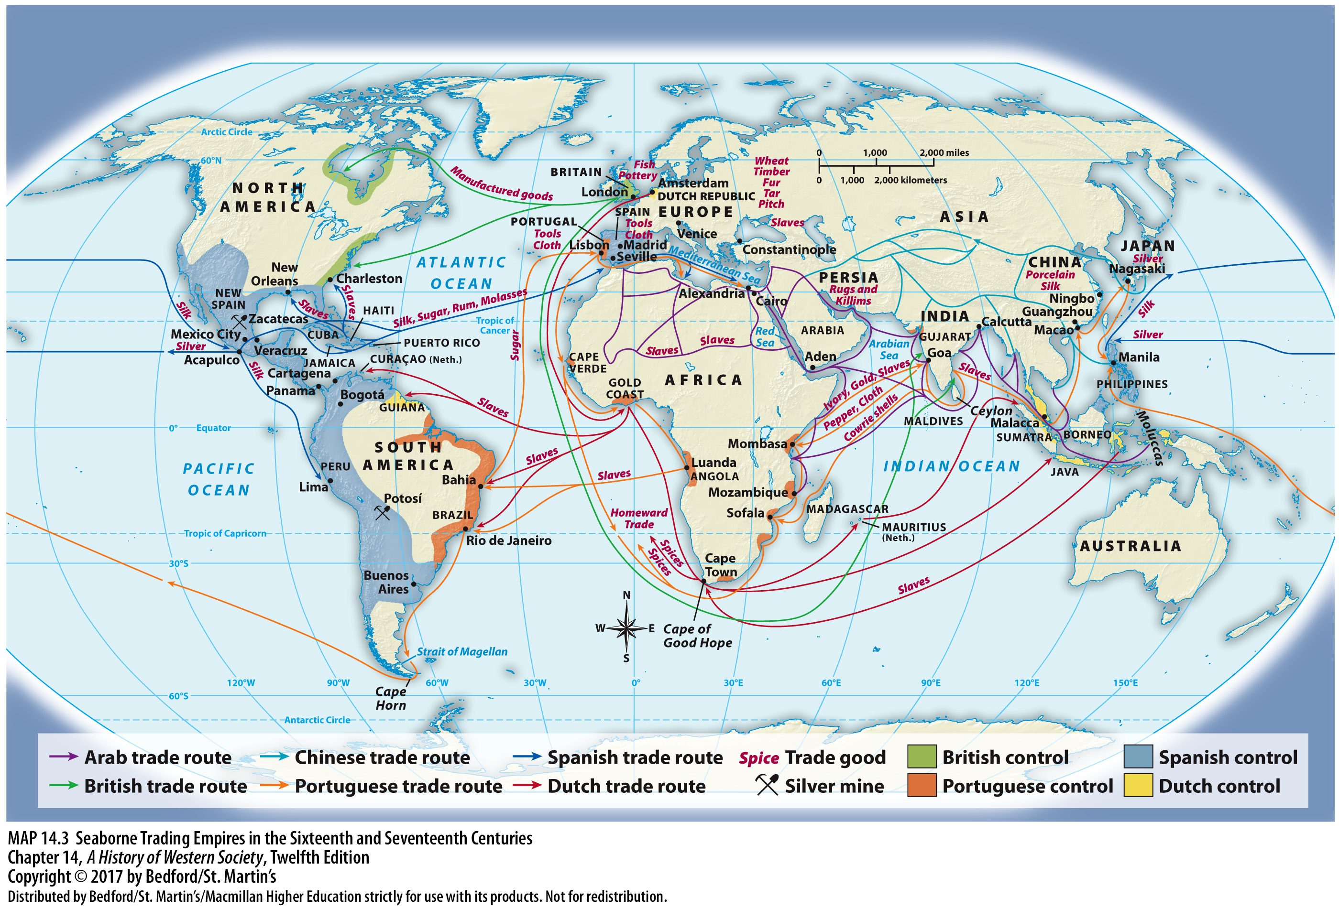

Slide 40
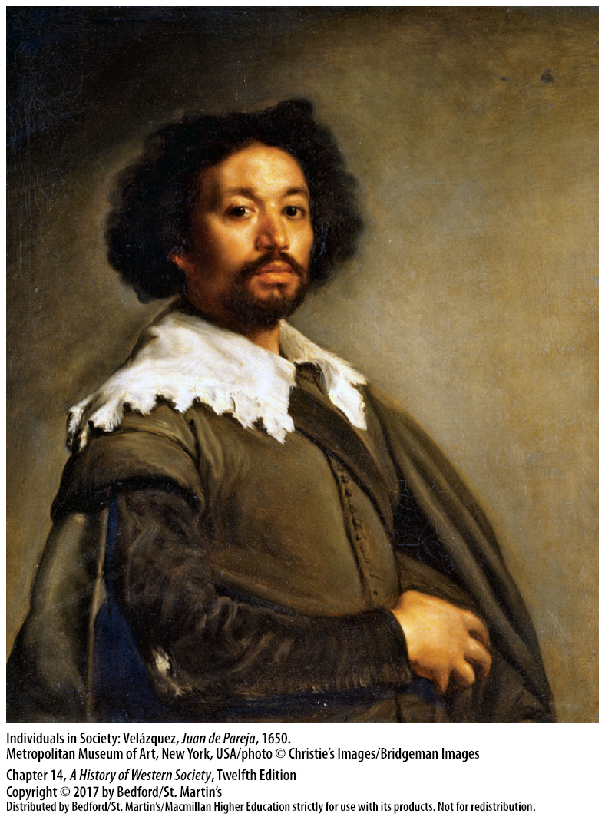

Slide 41
IV. The Era of Global Contact
Spanish Silver and Its Economic Effects
Silver discovered at Potosí (1545)
Precious metals transported to Spain
Widespread inflation in Spain
Spanish inflation spread to England
China absorbed half the world’s production of silver
Notes:
IV. The Era of Global Contact
E. Spanish Silver and Its Economic Effects
1. In 1545 the Spanish discovered an extraordinary source of silver at Potosí (in present-day Bolivia) in territory conquered from the Inca Empire.
2. From Potosí and the mines at Zacatecas and Guanajuato in Mexico, huge quantities of precious metals poured forth—35 million pounds of silver and more than 600,000 pounds of gold between 1503 and 1650—and were transported by armed convoys to Spain each year.
3. In sixteenth-century Spain, a steady population increase and a sharp rise in the demand for food and goods, which Spain could not meet, led to widespread inflation, aggravated by the influx of silver.
4. Because Spain’s King Philip II paid his armies and foreign debts with silver bullion, Spanish inflation was transmitted to the rest of Europe in the form of large price increases, especially for food, hurting the poor worst of all.
5. China, however, absorbed half the world’s production of silver, demanding it in exchange for their products and for the payment of imperial taxes.

Slide 42
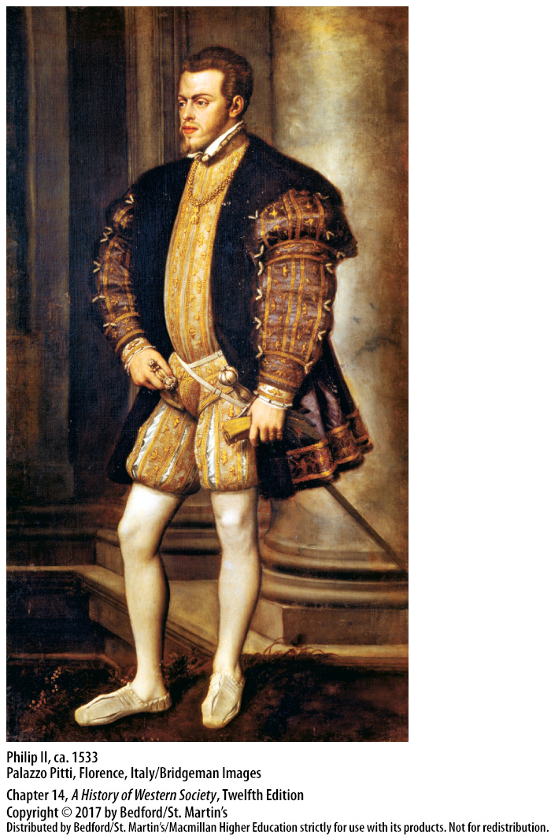

Slide 43
IV. The Era of Global Contact
The Birth of the Global Economy
Three successive commercial empires:
Portuguese (sea route to India; sugar)
Spanish (land empire; silk trade in Manila)
Dutch (spices; Dutch East India Company)
Notes:
IV. The Era of Global Contact
F. The Birth of the Global Economy
1. With the Europeans’ discovery of the Americas and their exploration of the Pacific, the entire world was linked for the first time in history by seaborne trade, bringing three successive commercial empires into being: the Portuguese, Spanish, and Dutch.
2. In the sixteenth century, the Portuguese controlled the sea route to India, exporting horses from Mesopotamia and copper from Arabia to India; hawks and peacocks from India to Chinese and Japanese markets; and Asian spices, purchased with textiles produced in India and with gold and ivory from East Africa, back to Portugal. From their colony in Brazil, the Portuguese shipped back sugar, which had been produced by African slaves whom they had transported across the Atlantic.
3. The Spanish Empire in the New World was a land empire, but across the Pacific the Spaniards built a seaborne empire centered at Manila in the Philippines. In Manila, Spanish traders used silver from American mines to purchase Chinese silk, which was in high demand in European markets.
4. The Dutch Empire, initially built on spices, began to challenge the Spanish and Portuguese commercial empires with the founding of the Dutch East India Company in 1602.

Slide 44
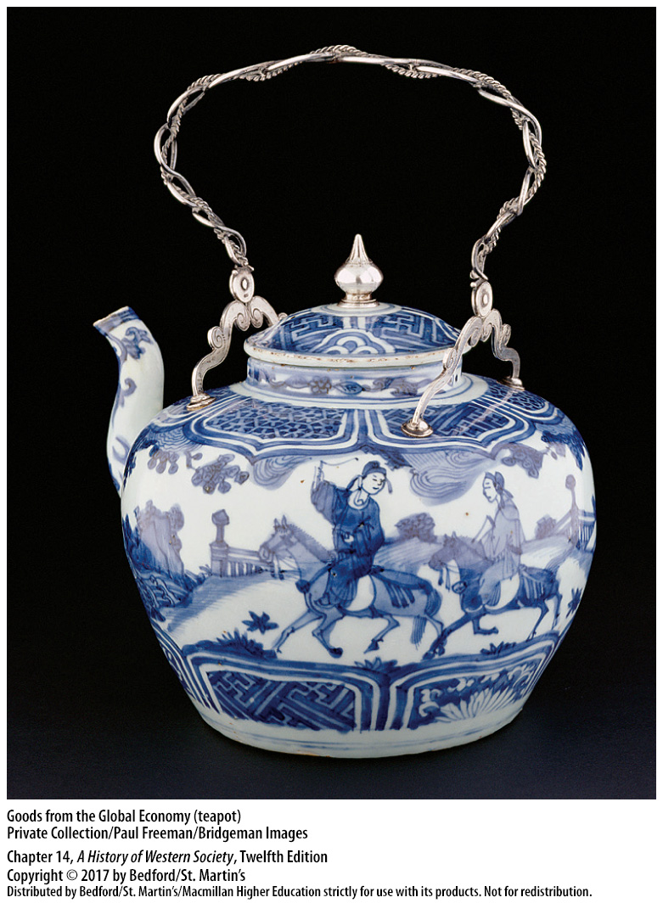

Slide 45
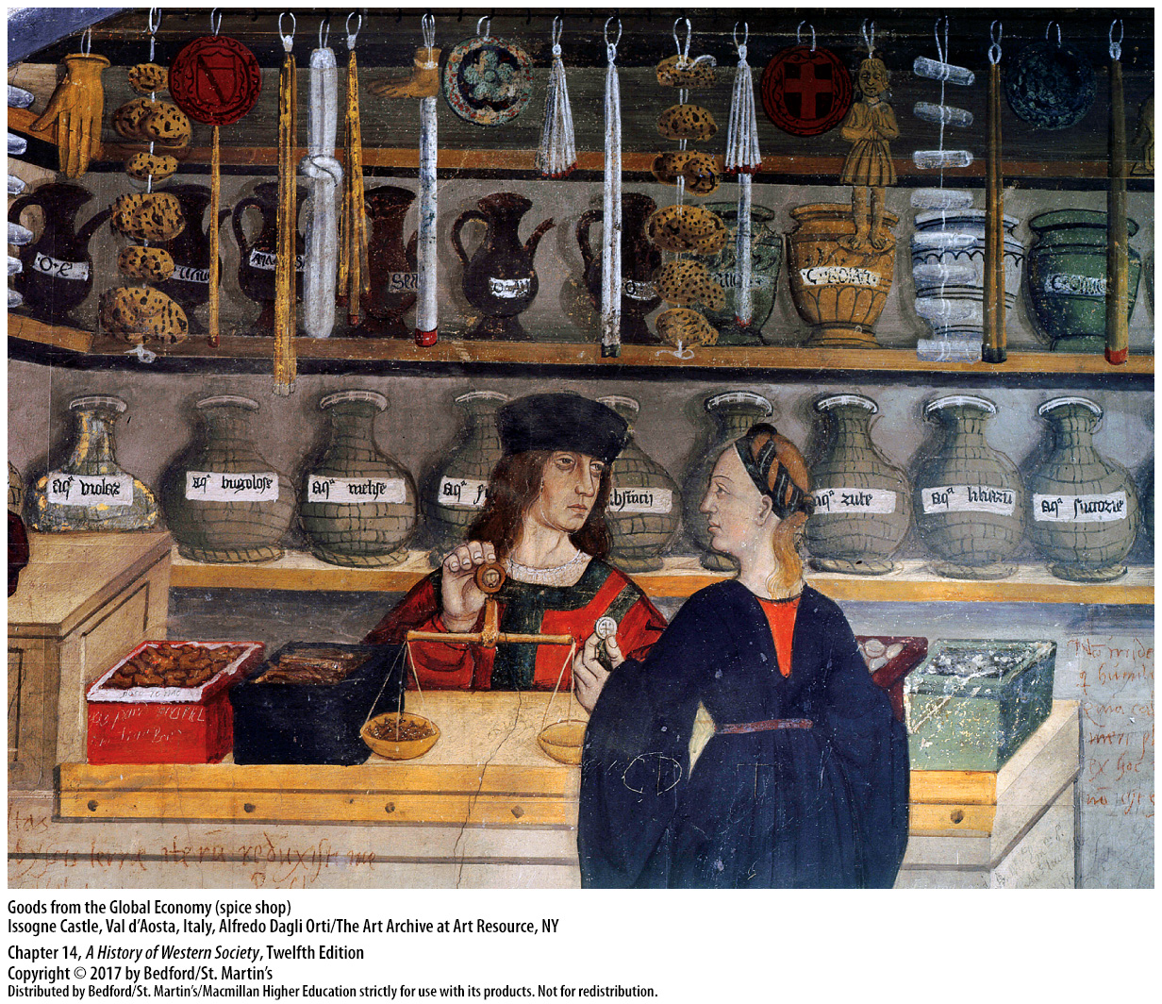

Slide 46
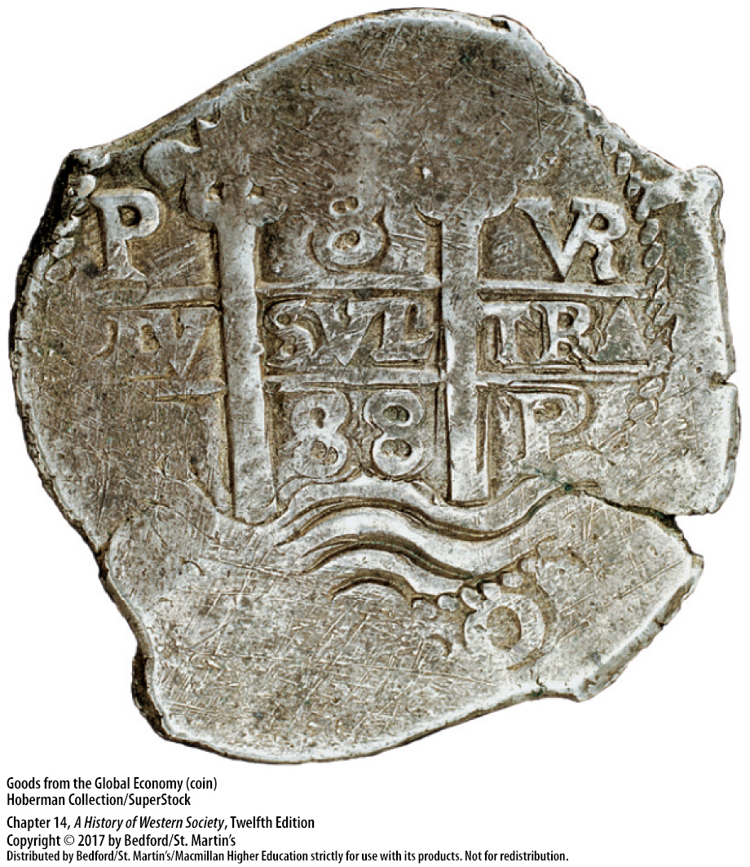

Slide 47
V. Changing Attitudes and Beliefs
Religious Conversion
Justification for European expansion
Columbus’s second voyage brought the first missionaries to the New World
Catholic friars sought understanding of native cultures and languages
Authorities were suspicious of native peoples’ conversion and lingering belief in the old gods
Notes:
V. Changing Attitudes and Beliefs
Religious Conversion
1. Converting indigenous people to Christianity was one of the most important justifications for European expansion.
2. The first missionaries to the New World accompanied Columbus on his second voyage, and more than 2,500 Franciscans, Dominicans, Jesuits, and other friars crossed the Atlantic in the following century.
3. Catholic friars were among the first Europeans to seek an understanding of native cultures and languages as part of their effort to render Christianity comprehensible to indigenous people. They were also the most vociferous opponents of abuses committed by Spanish settlers.
4. Missionaries taught indigenous peoples European methods of agriculture and instilled loyalty to colonial masters.
5. Authorities became suspicious about the thoroughness of native peoples’ conversion and their lingering belief in the old gods.

Slide 48
V. Changing Attitudes and Beliefs
European Debates About Indigenous Peoples
Bartolomé de Las Casas (1474–1566)
Debate on treatment of indigenous peoples in 1550 had little effect
The “Black Legend” of Spanish colonialism
Notes:
V. Changing Attitudes and Beliefs
B. European Debates About Indigenous Peoples
1. Bartolomé de Las Casas (1474–1566), a Dominican friar and former encomienda holder, was one of the earliest and most outspoken critics of the brutal treatment inflicted on indigenous peoples.
2. King Charles I assembled a group of churchmen and lawyers to debate the issue in 1550. Both sides claimed victory in the debate, but it had little effect on the situation in the Americas.
3. Northern Europeans derived the “Black Legend” of Spanish colonialism, the notion that the Spanish were uniquely brutal and cruel in their conquest and settlement of the Americas. This helped northern European powers overlook their own record of colonial violence and exploitation.

Slide 49
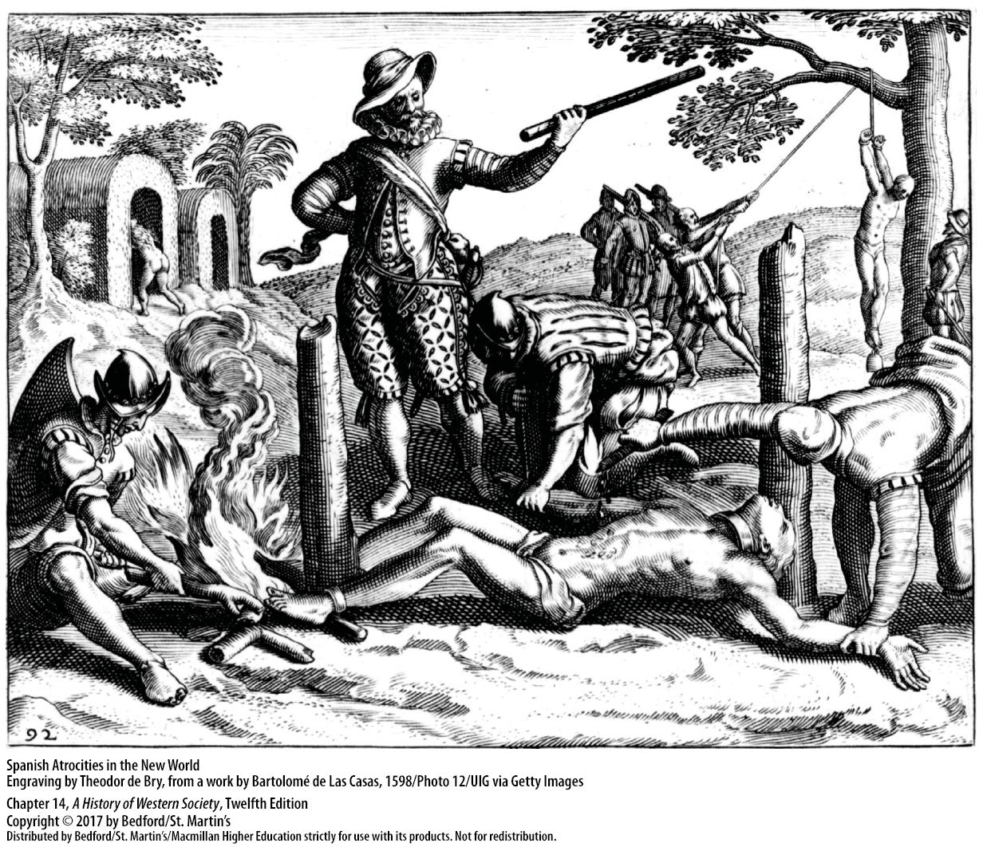

Slide 50
V. Changing Attitudes and Beliefs
New Ideas About Race
Europeans grouped Africans as pagan heathens or Muslim infidels
Argued that enslavement benefitted Africans
Convinced themselves that blacks were destined by God to serve them as slaves
Aristotle’s arguments and biblical associations
Biblical story of Noah’s curse upon Canaan
After 1700 “race” came to mean biologically distinct groups of people
Notes:
V. Changing Attitudes and Beliefs
C. New Ideas About Race
1. Most Europeans grouped Africans into the despised categories of pagan heathens or Muslim infidels; the Irish, Jews, and, more generally, the peasant masses also were viewed as alien peoples and a lower form of humanity.
2. As Europeans turned to Africa for new sources of slaves, they drew on and developed ideas about Africans’ primitiveness and barbarity to defend slavery and even argue that enslavement benefited Africans by bringing the light of Christianity to heathen peoples.
3. Europeans developed increasingly rigid ideas of racial superiority and inferiority to safeguard profits from the slave trade; over time, black skin became equated with slavery itself as Europeans at home and in the colonies convinced themselves that blacks were destined by God to serve them as slaves.
4. Support for this belief went back to the Greek philosopher Aristotle’s argument that some people are naturally destined for slavery and to biblical associations between darkness and sin.
5. Defenders of slavery also cited the Biblical story of Noah’s curse upon Canaan and all of his descendants to be the “servant of servants,” as well as Biblical genealogies that listed Ham’s sons as those who peopled North Africa and Cush.
6. After 1700 the emergence of new methods of observing and describing nature led to the use of science to define “race” to mean biologically distinct groups of people, whose physical differences produced differences in culture, character, and intelligence.

Slide 51
V. Changing Attitudes and Beliefs
Michel de Montaigne and Cultural Curiosity
Skepticism
Cultural relativism
Michel de Montaigne (1533-1592)
Essays (1580)
“Of Cannibals”
Notes:
V. Changing Attitudes and Beliefs
D. Michel de Montaigne and Cultural Curiosity
1. Skepticism as a school of thought holds that total certainty or definitive knowledge is not attainable.
2. Cultural relativism suggests that one culture is not necessarily superior to another, just different.
3. Frenchman Michel de Montaigne (1533–1592) developed a new literary genre, the essay, to express his ideas, which reflected both skepticism and cultural relativism.
4. Essays (1580), which was written in French and drawn from ancient texts, Montaigne’s own experience in government, and his moral judgment, became one of the most widely read texts of the period.
5. Reflecting on the impact of overseas discoveries, Montaigne, in his essay “Of Cannibals,” rejected the notion that one culture is superior to another. Few in Montaigne’s time would have agreed with his challenge to ideas of European superiority, but his popular essays contributed to a basic shift in attitudes, inaugurating an era of doubt.

Slide 52
V. Changing Attitudes and Beliefs
William Shakespeare and His Influence
William Shakespeare
His plays reveal the impact of new discoveries and contacts of his day
Othello, a “Moor of Venice”
The Tempest
References Montaigne’s “Of Cannibals”
Notes:
V. Changing Attitudes and Beliefs
E. William Shakespeare and His Influence
1. The undisputed master of this period was the dramatist William Shakespeare, whose genius lay in his characterizations and plots, his understanding of human psychology, and his unexcelled gift for language.
2. Shakespeare, a Renaissance man with a deep appreciation of classical culture, individualism, and humanism, wrote plays that explore an enormous range of human problems and are open to an almost infinite variety of interpretations.
3. Like Montaigne’s essays, Shakespeare’s work reveals the impact of the new discoveries and contacts of his day.
4. For example, the title character of Othello is described as a “Moor of Venice,” although Othello is also described as “black” in skin color; such discrepancies may reflect uncertainty about racial and religious classifications and Shakespeare’s doubts about the prevailing view of Moors as inferior.
5. Modern scholars often note the echoes between Shakespeare’s last play, The Tempest, which has a plot marked by an interest in race and race relations, and the realities of imperial conquest and settlement in his day.
6. In the play, Shakespeare borrows words from Montaigne’s essay “Of Cannibals,” suggesting that he may have intended to criticize, rather than endorse, racial intolerance.

