Slide 1
A History of Western Society Twelfth Edition
McKay • Crowston • Wiesner-Hanks • Perry
CHAPTER 13
Reformations and Religious Wars
1500–1600
Copyright © 2017 by Bedford/St. Martin’s
Distributed by Bedford/St. Martin's/Macmillan Higher Education strictly for use with its products; Not for redistribution.

Slide 2
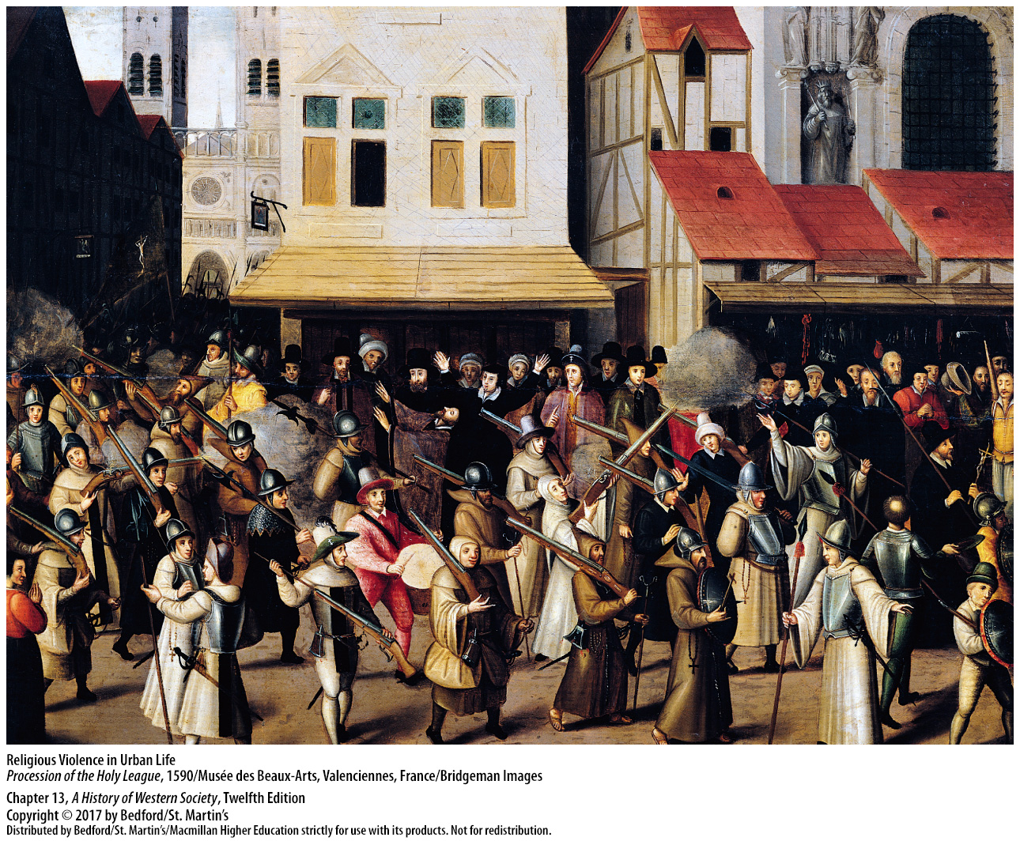

Slide 3
I. The Early Reformation
The Christian Church in the Early Sixteenth Century
Damaged prestige of the church and clergy
Calls for reform
Widespread anticlericalism
Notes:
The Early Reformation
The Christian Church in the Early Sixteenth Century
1. Europeans in the early sixteenth century were deeply pious, and people of all social groups devoted an enormous amount of their time and income to religious causes and foundations. Many people also were highly critical of the Roman Catholic Church and its clergy, whose prestige had been damaged by the papal conflict with the German emperor Frederick II, the Babylonian Captivity, the Great Schism, and the fifteenth-century popes’ concentration on artistic patronage and building up family power.
2. Papal tax collection methods were attacked, and some criticized the papacy itself and the wealth and powerful courts of the entire church hierarchy. Some groups and individuals argued that certain church doctrines, such as the veneration of saints and centrality of the sacraments, were incorrect and suggested measures to reform institutions, improve clerical education and behavior, and alter basic doctrines.
3. Widespread anticlericalism, or opposition to the clergy, concentrated primarily on three problems: clerical immorality, clerical ignorance, and clerical pluralism, with the related problem of absenteeism.

Slide 4
I. The Early Reformation
The Christian Church in the Early Sixteenth Century
Charges of absenteeism
Governments reduced privileges of priests, monks, and nuns
Urban leaders wanted to appoint high church offices, rather than Rome
Notes:
The Early Reformation
The Christian Church in the Early Sixteenth Century
4. Many clerics held several benefices (or offices) simultaneously but seldom visited the benefices, let alone performed the attendant spiritual responsibilities. Instead, they collected revenues from the benefices and hired a poor priest to fulfill the spiritual duties of a particular local church. Many Italian officials held benefices in England, Spain, and Germany, provoking not only charges of absenteeism but also nationalistic resentment against the upper levels of the church hierarchy, which was increasingly viewed as foreign.
5. Priests, monks, and nuns were exempt from defending the city and paying taxes, despite their large landholdings, and city governments became determined to integrate them into civic life by reducing their privileges and giving them public responsibilities.
6. Urban leaders also wanted some say in appointing high church offices, rather than having them appointed by Rome, which brought city leaders into conflict with bishops and the papacy.

Slide 5
I. The Early Reformation
Martin Luther
Martin Luther (1483 – 1546) and the Reformation
Salvation through faith
The sale of indulgences
Ninety-five Theses on the Power of Indulgences
Notes:
The Early Reformation
B. Martin Luther
1. The personal religious struggle of a German university professor and priest, Martin Luther (1483–1546) propelled the wave of movements called the Reformation. 2. Luther’s study of Saint Paul’s letters in the New Testament led him to the belief that salvation and justification come through faith, which is a free gift of God’s grace— not the result of human effort—and that God’s word is revealed only in Scripture— not in the traditions of the church.
3. At the same time that Luther was engaged in scholarly reflections and professorial lecturing, Pope Leo X authorized the sale of a special Saint Peter’s indulgence to finance his building plans in Rome. An indulgence was a piece of parchment signed by the pope or another church official that substituted a virtuous act from the “treasury of merits” (performed by Christ, the apostles, or the saints in their lives) for penance or time in purgatory.
4. In 1517, in a letter to Archbishop Albert stating his “Ninety-five Theses on the Power of Indulgences,” Luther argued that indulgences undermined the seriousness of penance, competed with the preaching of the Gospel, and downplayed the importance of charity in Christian life.

Slide 6
I. The Early Reformation
Martin Luther
Published pamphlets; created broader audience for reform
Papacy condemned Luther’s propositions
Luther’s theological issues interwoven with public controversies about the church
Notes:
The Early Reformation
B. Martin Luther
5. He published a series of pamphlets in which he argued that popes and church councils could err, that secular leaders should reform the church if church leaders did not, and that requiring clergy to be celibate was futile. His appearance created a broader audience for reform; throughout central Europe, other individuals began to preach and publish against the existing doctrines and practices of the church, drawing on the long tradition of calls for change as well as on Luther.
6. The papacy responded with a letter condemning some of Luther’s propositions, ordering that his books be burned and giving him two months to recant or be excommunicated.
7. Luther’s theological issues became interwoven with public controversies about the church’s wealth, power, and structure.

Slide 7
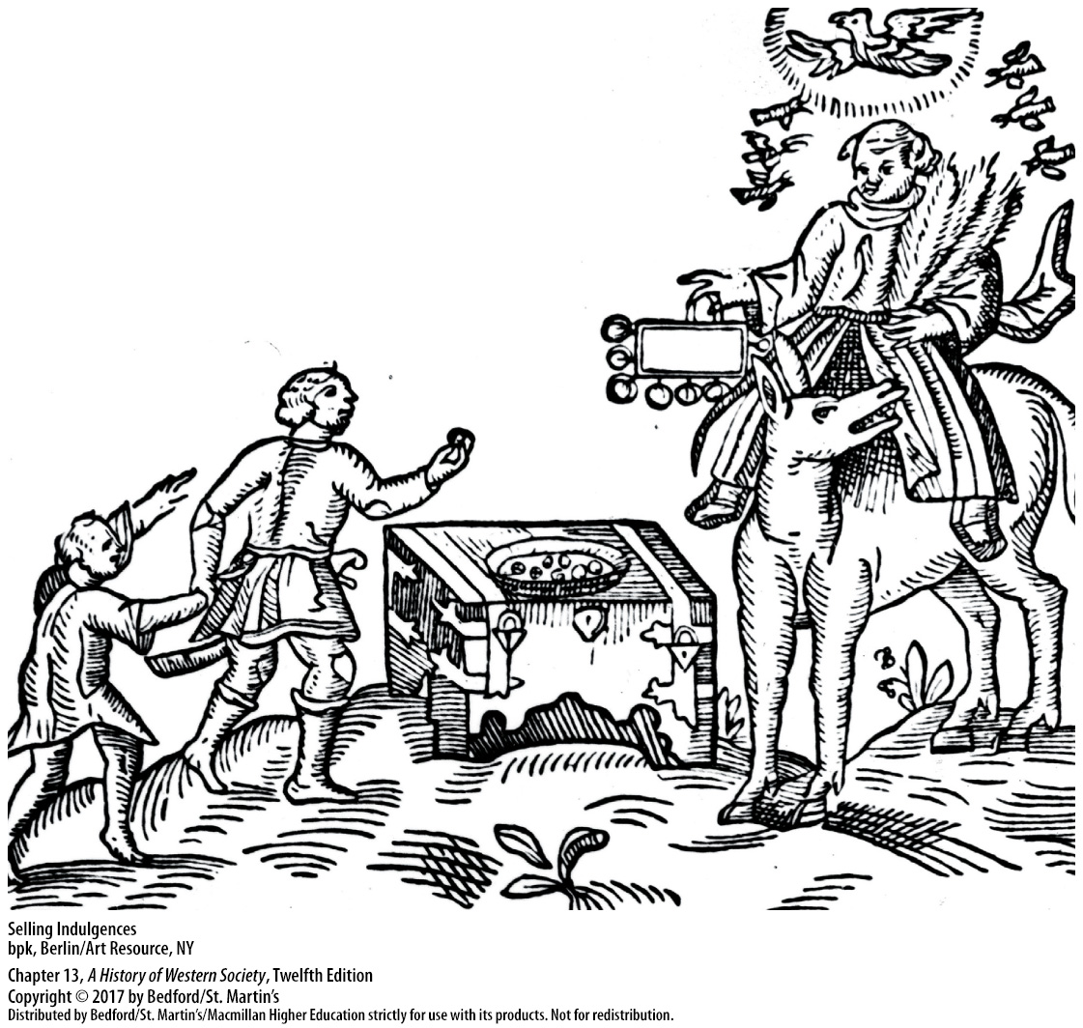

Slide 8
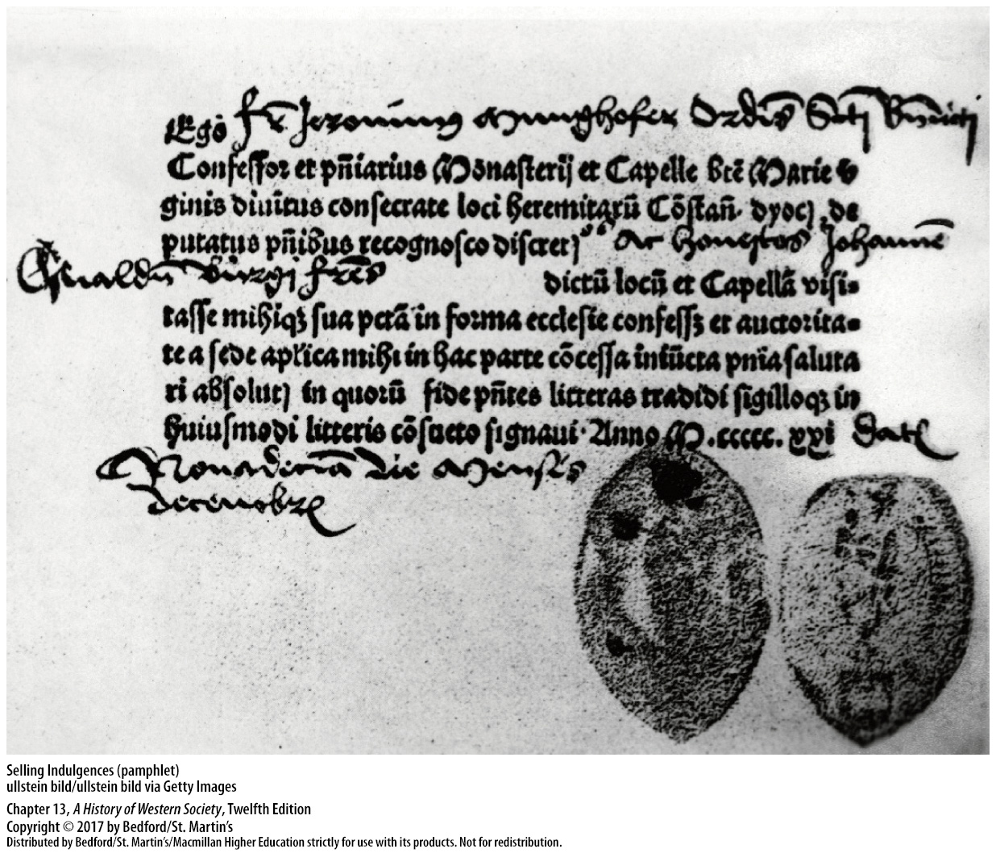

Slide 9
I. The Early Reformation
Protestant Thought
Ulrich Zwingli (1484 – 1531)
Strong support of city authorities
Protestants
Salvation through faith alone
Notes:
The Early Reformation
C. Protestant Thought
1. The Swiss humanist, priest, and admirer of Erasmus, Ulrich Zwingli (1484–1531), was convinced that Christian life rested on the Scriptures, which were the pure words of God and the sole basis of religious truth. Like Luther, he went on to attack indulgences and clerical celibacy, as well as the Mass and monasticism.
2. In his gradual reform of the church in Zurich, Zwingli had the strong support of the city authorities, who resented the privileges of the clergy.
3. The followers of Luther, Zwingli, and others who called for a break with Rome came to be called Protestants, a name derived from a group of reforming German princes who protested the decisions of the Catholic majority at the Diet of Speyer in 1529; The word gradually came to apply to all non-Catholic western European Christians.
4. Protestants held that salvation comes by faith alone, irrespective of good works or the sacraments: God, not people, initiates salvation.

Slide 10
I. The Early Reformation
Protestant Thought
Authority rested in the Bible alone
Church a spiritual priesthood of all believers
The Colloquy of Marburg (1529)
Disagreement over the Eucharist, or communion
Notes:
The Early Reformation
C. Protestant Thought
5. For Protestants, authority rested in the Bible alone, which meant that most Protestants rejected Catholic teachings about the sacraments, holding that only baptism and the Eucharist have scriptural support.
6. Protestants held that the church is a spiritual priesthood of all believers, not a hierarchical clerical institution headed by the pope in Rome, and they argued that every person should serve God in his or her individual calling.
7. The Colloquy of Marburg, summoned in 1529 to unite Protestants, reached agreement on almost every issue except an important one concerning the Eucharist, or communion.
8. Luther believed that Christ is really present in the consecrated bread and wine as a result of God’s mystery, whereas Zwingli understood Christ to be present in spirit among the faithful but not actually in the bread and wine.

Slide 11
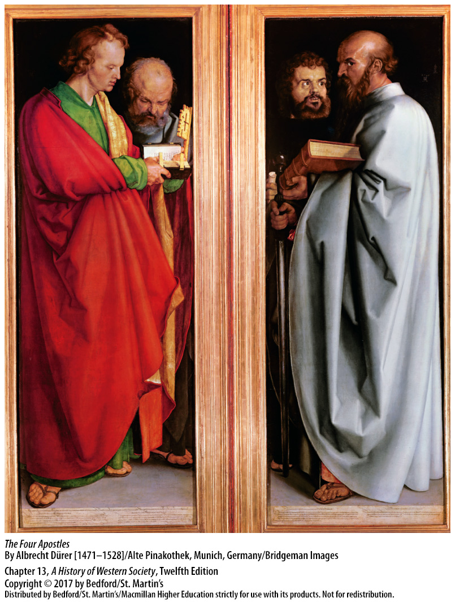

Slide 12
I. The Early Reformation
The Appeal of Protestant Ideas
Simpler personal religion attractive
Idea that clergy should pay taxes and not have legal privileges appealed to townspeople
Ideas spread with the printing press
Political support from city councils
Nobles reeducated the clergy and confiscated church property
Notes:
The Early Reformation
D. The Appeal of Protestant Ideas
1. Educated people and many humanists were much attracted by Luther’s idea of a simpler personal religion based on faith, a return to the spirit of the early church, the centrality of the Scriptures in the liturgy and in Christian life, and the abolition of elaborate ceremonies.
2. Townspeople were attracted by the notion that the clergy should also pay taxes and should not have legal privileges.
3. Scholars in many disciplines have attributed Luther’s fame and success to the invention of the printing press, which rapidly reproduced and made known his ideas. Equally important was Luther’s incredible skill with language, as seen in his two catechisms and in the hymns he wrote.
4. Both Zwingli and Luther knew that it was essential to gain the acceptance of the political authorities in order for reforms to become permanent. Zwingli worked closely with the Zurich city council, and in cities and towns of Switzerland and south Germany, city councils took the lead, appointing Protestant pastors, requiring them to swear an oath of loyalty, and overseeing their preaching and teaching.
5. Individuals may have been convinced of the truth of Protestant teachings by hearing sermons or reading pamphlets, but a territory became Protestant when its ruler, whether a noble or a city council, brought in a reformer or two to reeducate clergy, sponsored public sermons, and confiscated church property.

Slide 13
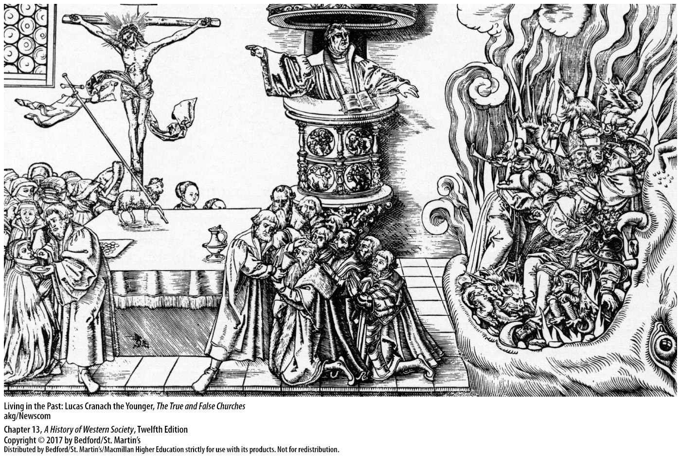

Slide 14
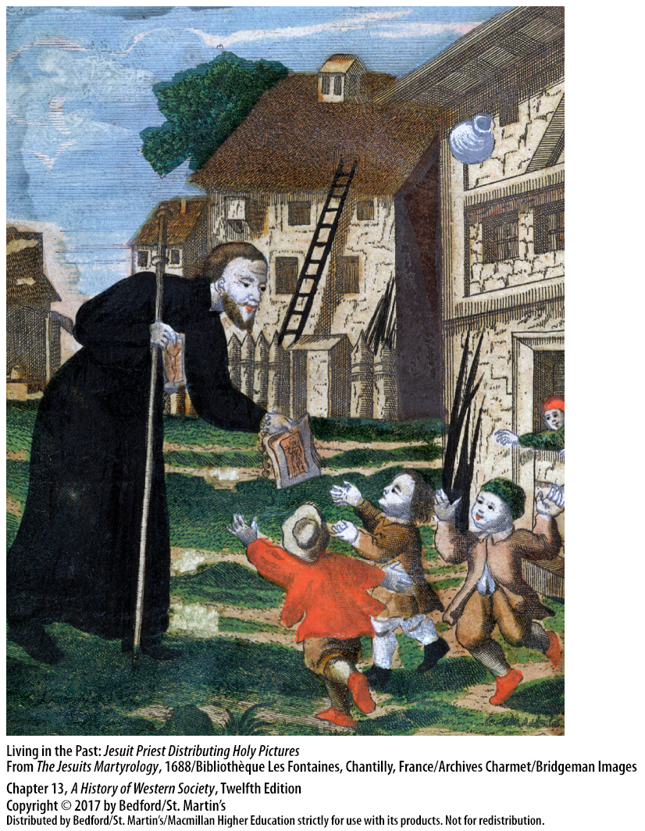

Slide 15
I. The Early Reformation
The Radical Reformation and the German Peasants’ War
Radicals; faith community separate from the state
Anabaptists, “rebaptizers”
City of Münster
Radicals marked as social outcasts
Radical ideas survived
Notes:
The Early Reformation
E. The Radical Reformation and the German Peasants’ War
1. While Luther and Zwingli worked with political authorities, some individuals and groups sought instead to create a voluntary community of believers separate from the state, as they understood it to have existed in New Testament times. The theology and practices of these “radicals” varied, but they all broke more decisively with prevailing ideas.
2. The “Anabaptists,” which means “rebaptizers,” adopted the baptism of adult believers.
3. One group of radicals took over the city of Münster, predicting it would be the site of a New Jerusalem that would survive God’s final judgment; they called for communal ownership of property and expelled those who refused rebaptism. Combined armies of Catholics and Protestants besieged the city and executed its leaders.
4. The radicals’ unwillingness to accept a state church marked them as social outcasts, and Anabaptists and other radicals were banished or cruelly executed.
5. Radical ideas survived, however, influencing the Quakers, Baptists, Congregationalists, and authors of the U.S. Constitution.

Slide 16
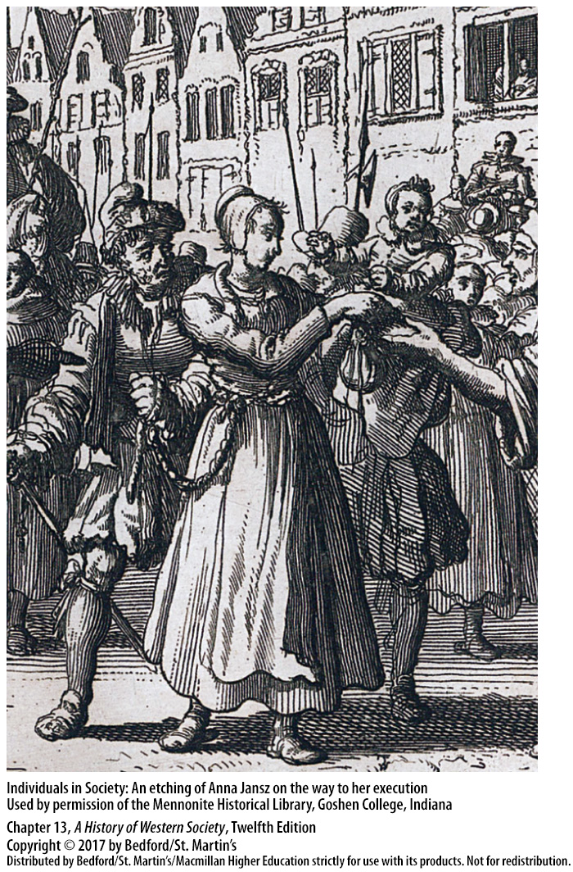

Slide 17
I. The Early Reformation
The Radical Reformation and the German Peasants’ War
Aggrieved peasants made demands based on the ideas of radical thinkers
Luther only sided with them initially
Wrote Against the Murderous, Thieving Hordes of the Peasants
Nobility crushed the revolt
The Reformation lost much of its popular appear after 1525
Notes:
The Early Reformation
E. The Radical Reformation and the German Peasants’ War
6. Crop failures in 1523 and 1524 aggravated the deteriorating economic condition of many German peasants who, aggrieved by nobles’ imposition of new rents and services, made demands they believed conformed to the Scriptures, citing radical thinkers as well as Luther.
7. Although Luther initially sided with the peasants, when rebellion broke out, he found that his idea of freedom from Roman church authority did not support peasants’ opposition to legally established secular powers.
8. Convinced that rebellion would hasten the end of civilized society, Luther wrote the tract Against the Murderous, Thieving Hordes of the Peasants..
9. More than seventy-five thousand peasants were killed as the nobility ferociously crushed the revolt of the German Peasants’ War of 1525, and the authority of lay rulers was strengthened.
10. The Reformation lost much of its popular appeal after 1525, although some peasants and urban rebels found a place in radical groups.

Slide 18
I. The Early Reformation
Marriage, Sexuality, and the Role of Women
The pastor’s wife
Protestant reformers on marriage
Idea that women were to be subject to men
Saw marriage as a contract; accepted divorce
Notes:
The Early Reformation
F. Marriage, Sexuality, and the Role of Women
1. Luther married a former nun, Katharina von Bora (1499–1532), and Zwingli married a Zurich widow, Anna Reinhart (1491–1538); both women and the wives of other Protestant reformers created a new and respectable role for themselves, that of the pastor’s wife, a model of wifely obedience and Christian charity.
2. Protestant reformers denied that marriage was a sacrament, but they stressed that it had been ordained by God, served as a “remedy” for the sin of lust, provided for the pious rearing of the next generation of Christians, and offered husbands and wives companionship and consolation. They believed that a proper marriage reflected both the spiritual equality of men and women as well as the social hierarchy of husbandly authority and wifely obedience.
3. Protestants followed the scholastic theologians’ idea that women were to be subject to men and should be cheerful, not grudging, in their obedience and urged men to treat their wives kindly, but enforce their authority.
4. Because Protestants saw marriage as a contract in which each partner promised the other support, companionship, and the sharing of mutual goods, marriages that did not have these elements or that endangered their souls might be remedied only by divorce, a marked difference from Catholic doctrine. Although divorce represented a dramatic legal change, it was still considered a last resort, and the annual divorce rate in Protestant jurisdictions was very low.

Slide 19
I. The Early Reformation
Marriage, Sexuality, and the Role of Women
Condemned prostitution
Protestant Reformation closed avenues for married women who would not marry
Women could write, but could not be members of the clergy
Notes:
The Early Reformation
F. Marriage, Sexuality, and the Role of Women
5. Protestants, who also believed marriage was the only proper remedy for lust, uniformly condemned prostitution, closing brothels and setting harsh punishments for prostitution, although these actions did not end the exchange of sex for money. Selling sex was considered simply one type of “whoredom,” a term that also included premarital sex, adultery, and other unacceptable sexual activities.
6. The Protestant Reformation clearly had a positive impact on marriage, but its impact on women was more mixed. The Reformation generally brought the closing of monasteries and convents, which eliminated many literary, artistic, medical, or administrative avenues for women who could not or would not marry, making marriage virtually the only occupation for upper-class Protestant women; this made unmarried women (and men) suspect.
7. A few women wrote religious works, and female rulers set religious policies, but sixteenth-century Protestants did not allow women to be members of the clergy.

Slide 20
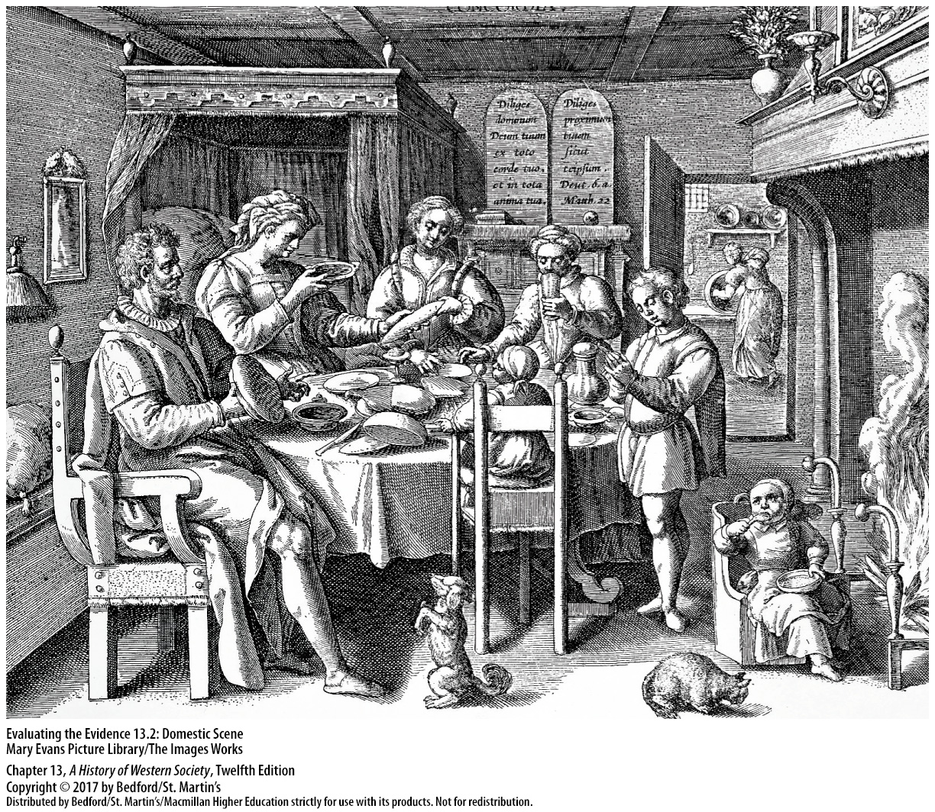

Slide 21
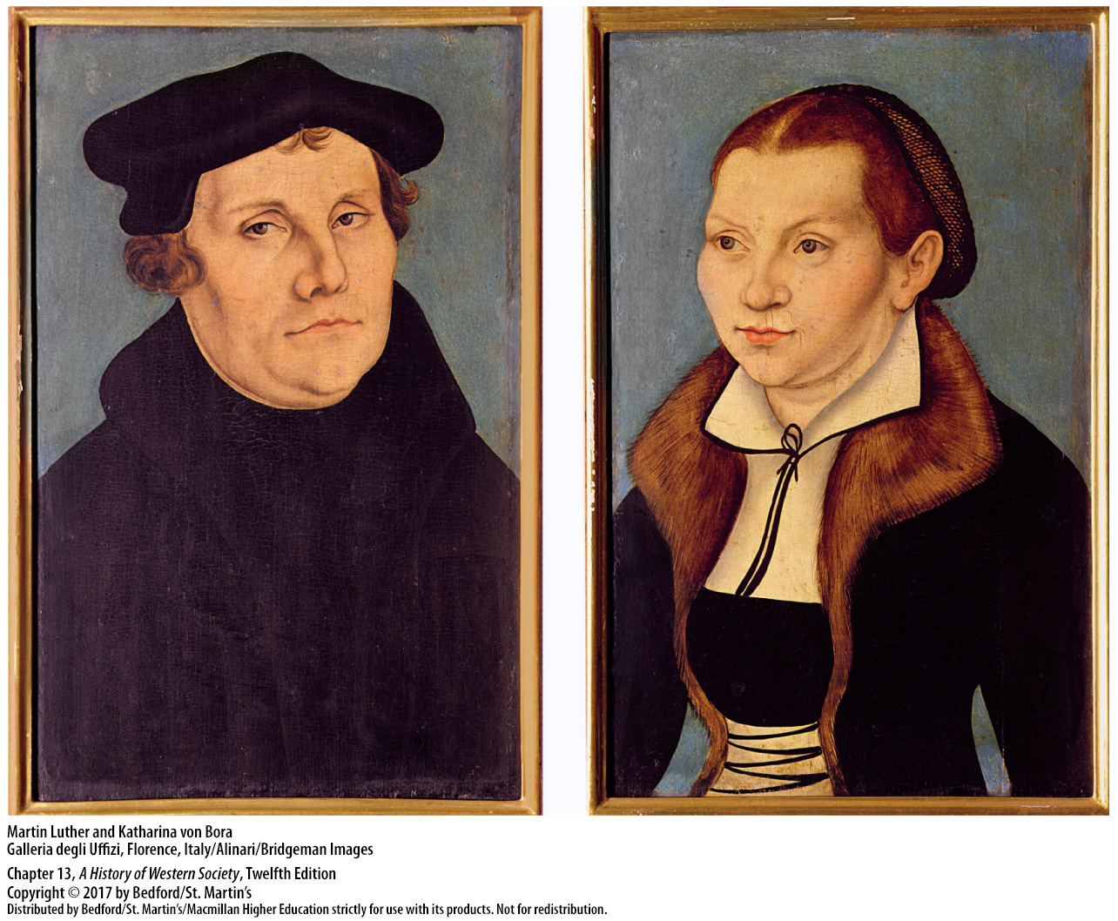

Slide 22
II. The Reformation and German Politics
The Rise of the Habsburg Dynasty
Reformation spread in Holy Roman Empire
Charles V (r. 1519 – 1556)
Frederick III married Princess Eleonore of Portugal in 1452
His son Maximilian married Mary of Burgundy
Charles V’s inheritance
Charles believed it was his duty to maintain the political and religious unity of Western Christendom
Notes:
II. The Reformation and German Politics
The Rise of the Habsburg Dynasty
1. Reform movements were suppressed more easily by the strong central governments in Spain and France, but in the Holy Roman Empire, the Reformation spread as local rulers assumed religious authority.
2. The course of the Reformation was shaped by the election of the Habsburg prince Charles V (r. 1519–1556) as emperor of the Holy Roman Empire and by the political relationships surrounding it.
3. The Holy Roman emperor Frederick III acquired a small amount of territory and a great deal of money with his marriage to Princess Eleonore of Portugal in 1452.
4. In 1477 Frederick’s son Maximilian married Europe’s most prominent heiress, Mary of Burgundy, a union that merged the rich and powerful duchy of Burgundy to the Austrian house of Habsburg, already the strongest ruling family in the empire.
5. Further unions between Maximilian’s children and the children of Ferdinand and Isabella meant that their grandson Charles V inherited a vast and incredibly diverse collection of states and peoples, each governed in a different manner and held together only by the person of the emperor.
6. Charles, a Catholic, was convinced it was his duty to maintain the political and religious unity of Western Christendom.

Slide 23
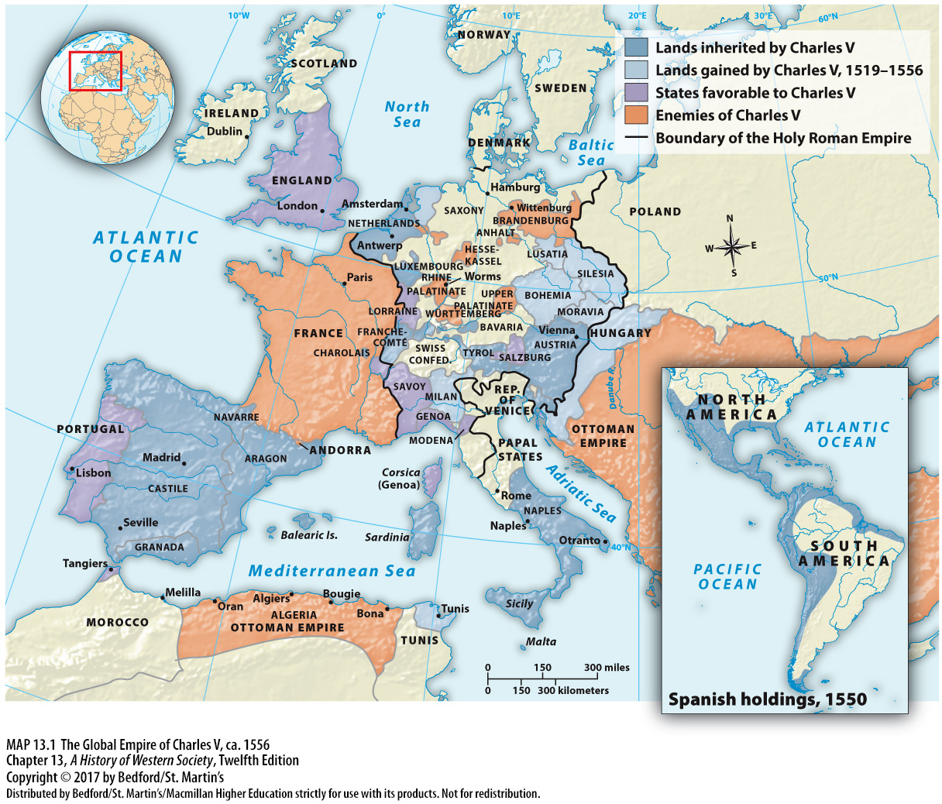

Slide 24
II. The Reformation and German Politics
Religious Wars in Switzerland and Germany
German rulers influenced by Lutheranism
Charles V was a defender of Catholicism
Catholics vs. Protestants within Switzerland
Policy of neutrality
Notes:
II. The Reformation and German Politics
B. Religious Wars in Switzerland and Germany
1. Luther’s appeal to national feeling influenced many German rulers who were otherwise confused by or indifferent to the complexities of religious matters. Some German rulers were sincerely attracted to Lutheran ideas, but more important to many others was that the rejection of Roman Catholicism and adoption of Protestantism would mean the legal confiscation of lush farmlands, rich monasteries, and wealthy shrines, as well as greater independence from the emperor.
2. Charles V was a vigorous defender of Catholicism, so it is not surprising that the Reformation led to religious wars.
3. In Switzerland, some of the thirteen cantons remained Catholic while others became Protestant, and in the late 1520s the two sides went to war.
4. After Zwingli was killed on the battlefield in 1531, both sides agreed to a treaty that allowed each canton to determine its own religion and ordered each side to give up its foreign alliances, a policy of neutrality that has been characteristic of modern Switzerland.

Slide 25
II. The Reformation and German Politics
Religious Wars in Switzerland and Germany
Imperial Diet in 1530, the Augsburg Confession
The Peace of Augsburg (1555)
Territories decided their religion; dissidents had to convert or leave
Charles V abdicated in 1556
Notes:
II. The Reformation and German Politics
B. Religious Wars in Switzerland and Germany
5. To halt the spread of religious division, Charles V called an Imperial Diet in 1530, later called the Augsburg Confession, where the Protestant princes presented the Lutheran statement of faith to the emperor.
6. Finally, in 1555 Charles agreed to the Peace of Augsburg, which officially recognized Lutheranism, but permitted the political authority in each territory to decide whether the territory would be Catholic or Lutheran and ordered that territories be allowed to practice their faiths in peace.
7. There was no freedom of religion within the territories, and dissidents had to convert or leave. Religious refugees became a common feature on the roads of the empire
8. With no further hope of uniting his empire under a single church, Charles V abdicated in 1556 and moved to a monastery, transferring power over his holdings in Spain and the Netherlands to his son Philip and his imperial power to his brother Ferdinand.

Slide 26
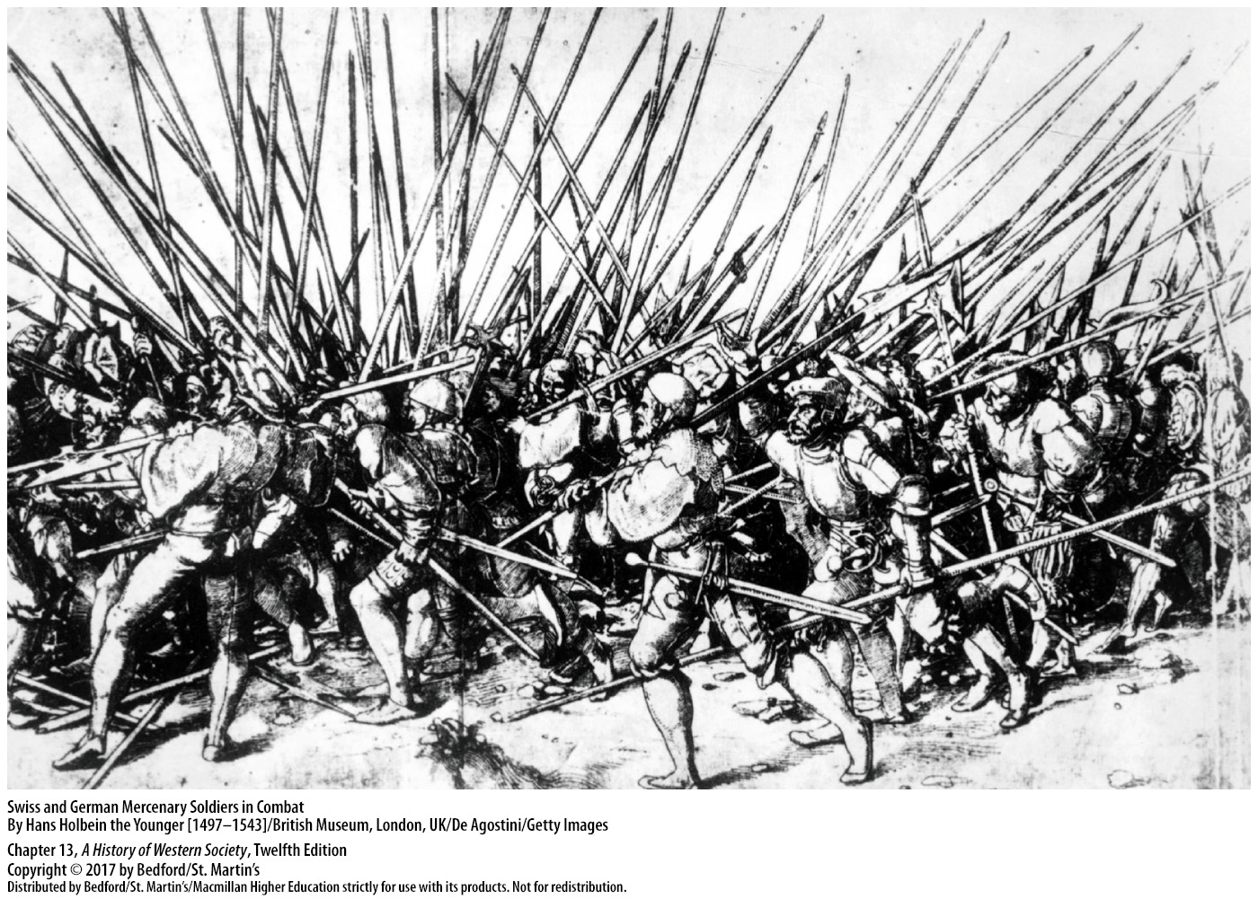

Slide 27
III. The Spread of Protestant Ideas
Scandinavia
Denmark-Norway accepted the Reformation
Lutheran ideas spread to Denmark from Danish scholars
King Christian III broke with the Catholic Church in the 1530s; most clergy folloed
Violent reactions to Lutheranism in northern Norway and Iceland
Gustavus Vasa (r. 1523 – 1560) in Sweden
Notes:
III. The Spread of Protestant Ideas
Scandinavia
1. The first area outside the empire to officially accept the Reformation was the kingdom of Denmark-Norway under King Christian III (r. 1536–1559).
2. Danish scholars studied at the University of Wittenberg, and Lutheran ideas spread into Denmark very quickly.
3. In the 1530s the king officially broke with the Catholic Church, and most clergy followed.
4. In northern Norway and Iceland, which Christian also ruled, reactions were more violent, and Lutheranism was only gradually imposed on a largely unwilling populace.
5. In Sweden, Gustavus Vasa (r. 1523–1560) came to the throne during a civil war with Denmark. Gustavus then took control of church personnel and income, and Protestant ideas spread, though the Swedish church did not officially accept Lutheran theology until later in the century.

Slide 28
III. The Spread of Protestant Ideas
Henry VIII and the Reformation in England
King Henry VIII (r. 1509 – 1547)
Supreme head of the Church of England
Dissolved the English monasteries
Growth of a centralized bureaucratic state
Notes:
III. The Spread of Protestant Ideas
B. Henry VIII and the Reformation in England
1. Henry’s marriage to Catherine of Aragon had produced only one living heir, a daughter, Mary, so in 1527 Henry appealed to the pope to have the marriage annulled so that he could marry Anne Boleyn, who he was in love with and hoped would give him a son.
2. Pope Clement VII—under pressure from Charles V, who was the nephew of Catherine of Aragon and thus was vigorously opposed to an annulment—took no action on Henry’s appeal. Henry used Parliament to remove the English church from papal jurisdiction and to make himself the supreme head of the church in England.
3. Although the English church retained such traditional Catholic practices and doctrines as confession, clerical celibacy, and transubstantiation, Henry dissolved the English monasteries because he wanted their wealth.
4. New bureaucratic machinery was needed to manage the formerly monastic lands, so Henry’s chief minister, Thomas Cromwell, reformed and centralized the king’s household, the council, the secretariats, and the Exchequer and set up new departments. Surplus funds went into a fund to be applied to deficits, resulting in greater efficiency and economy, as well as the growth of a centralized bureaucratic state.

Slide 29
III. The Spread of Protestant Ideas
Henry VIII and the Reformation in England
The Pilgrimage of Grace (1536)
People resistant to convert
Most Irish remained Roman Catholic
English harshly repressed Irish opposition
Notes:
III. The Spread of Protestant Ideas
B. Henry VIII and the Reformation in England
5. Most clergy and officials accepted Henry’s moves, but in 1536 popular opposition in the north led to the Pilgrimage of Grace, a massive rebellion that proved the largest in English history. The “pilgrims” eventually accepted a truce, but their leaders were arrested, tried, and executed.
6. People rarely converted to Protestantism overnight; most reacted to an action of the Crown in their neighborhood with a combination of resistance, acceptance, and collaboration.
7. Most Irish people remained Roman Catholic even after the Irish parliament severed ties with Rome and established the Church of Ireland on the English pattern, thus adding religious antagonism to the ethnic hostility that had been a feature of England’s policy toward Ireland for centuries.
8. The English harshly repressed Irish armed opposition to the Reformation, confiscating and selling Catholic property and shipping the profits to England.

Slide 30
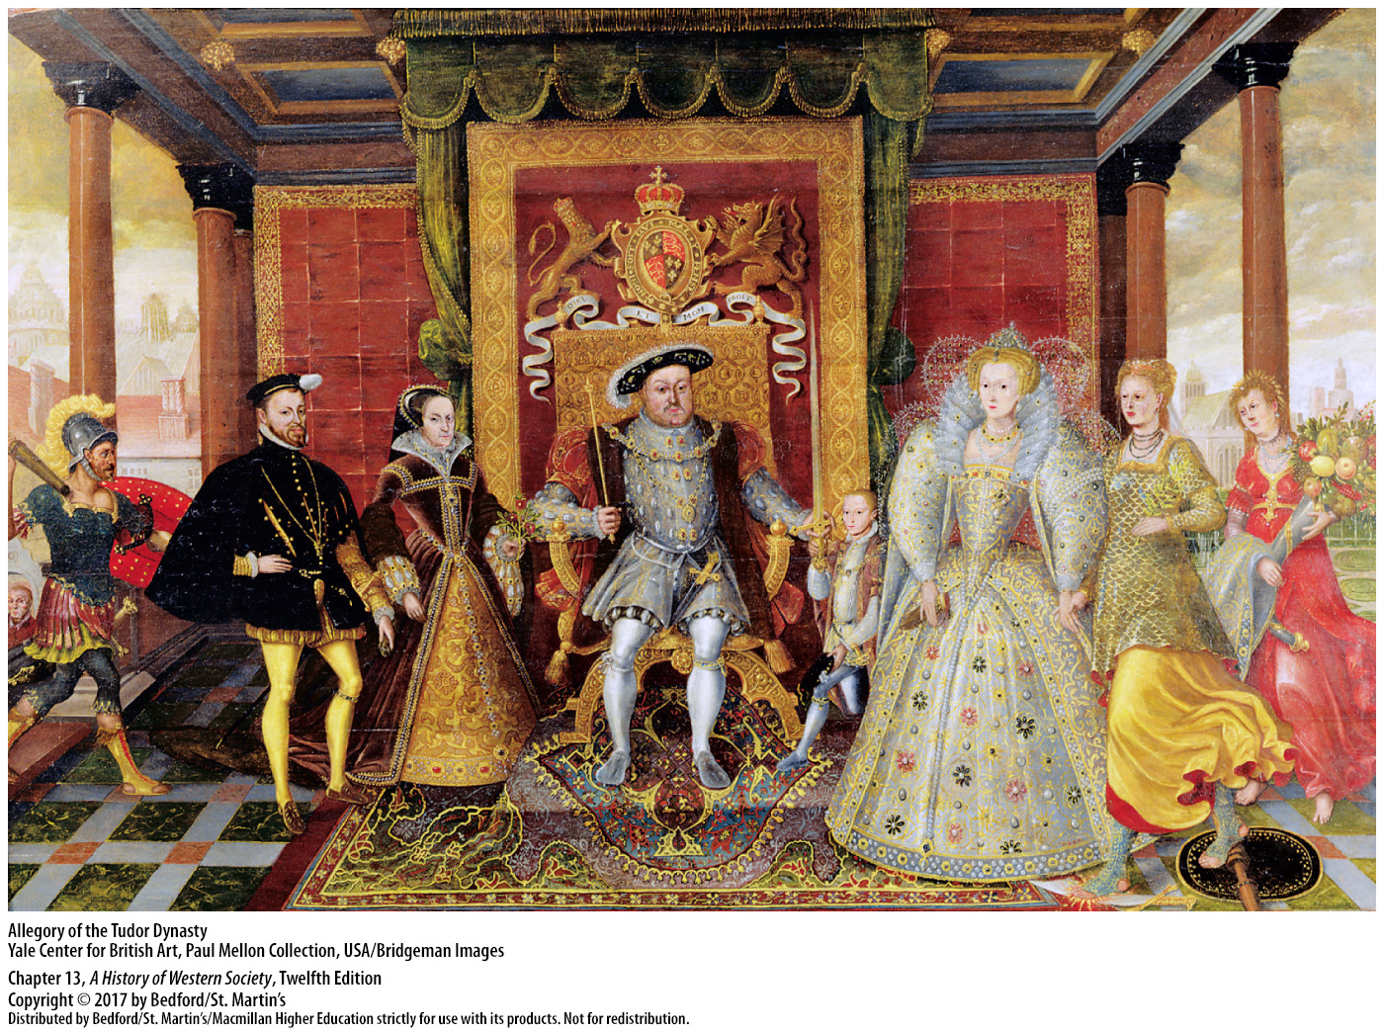

Slide 31
III. The Spread of Protestant Ideas
Upholding Protestantism in England
Edward VI (r. 1547 – 1553)
Mary Tudor (r. 1553 – 1558)
Elizabeth Tudor (r. 1558 – 1603)
Elizabeth declared supreme in religious and political matters
The Anglican Church
Notes:
III. The Spread of Protestant Ideas
C. Upholding Protestantism in England
1. During the reign of Edward VI (r. 1547–1553), Archbishop Thomas Cranmer simplified the liturgy, invited Protestant theologians to England, and prepared the first Book of Common Prayer (1549).
2. Mary Tudor (r. 1553–1558), the devoutly Catholic daughter of Catherine of Aragon, rescinded the Reformation legislation of her father’s reign, restored Roman Catholicism, and executed several hundred Protestants.
3. Following Mary’s death, Elizabeth (r. 1558–1603), Henry’s daughter with Anne Boleyn, who had been raised a Protestant, inaugurated the beginnings of religious stability.
4. Elizabeth shrewdly chose a course between the extremes of the Catholics who wanted a Roman Catholic ruler and the Puritans who wanted all Catholic elements of the Church of England eliminated. Working through Parliament to have officials swear that she was supreme in religious and political matters, she required her subjects to attend services in the Church of England but did not interfere with their privately held beliefs.
5. The Anglican Church, as the Church of England was called, moved in a moderately Protestant direction—conducting services in English and allowing clergy to marry—but the hierarchical structure remained and elaborate services continued.

Slide 32
III. The Spread of Protestant Ideas
Upholding Protestantism in England
6. Mary, Queen of Scots, implicated in a plot to assassinate Elizabeth (1587)
Philip sent fleet to attack England
English victory over Spanish Armada
War between England and Spain
Notes:
III. The Spread of Protestant Ideas
C. Upholding Protestantism in England
6. In 1587 Mary, Queen of Scots, Elizabeth’s Catholic cousin and next in line to the English throne, became implicated in a plot to assassinate Elizabeth, a conspiracy that had the full backing of Spain’s Philip II.
7. When the English executed Mary, the Catholic pope urged Philip to retaliate, which he attempted to do by sending a vast fleet across the English Channel to attack England.
8. On May 9, 1588, the Spanish Armada met an English fleet of ships that were smaller, faster, and more maneuverable and carried greater firing power. A combination of storms and squalls, spoiled food and rank water, inadequate Spanish ammunition, and English fire ships, gave England the victory and enhanced English national sentiment.
9. The defeat of the Spanish Armada prevented Philip II from reimposing Catholicism on England by force, but the war between England and Spain dragged on for years.

Slide 33
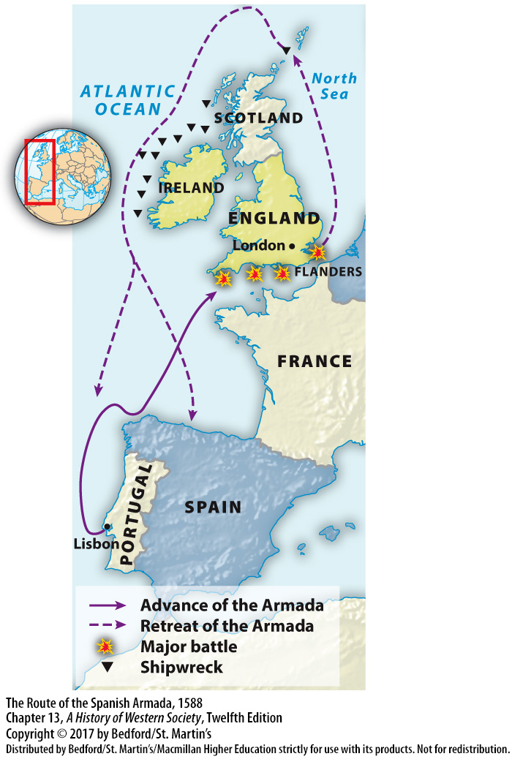

Slide 34
III. The Spread of Protestant Ideas
Calvinism
John Calvin (1509 – 1564)
Wanted a society where church and state acted together
The Institutes of the Christian Religion (1536)
Predestination
The Consistory
Notes:
III. The Spread of Protestant Ideas
D. Calvinism
1. As a young man, John Calvin (1509–1564) studied law, which had a decisive impact on his mind and later his thought. In 1533 he experienced a religious crisis and, as a result, converted to Protestantism.
2. Calvin believed that God had specifically selected him to reform the church, and beginning in 1541, he worked assiduously to establish a Christian society in Geneva in which church and state acted together.
3. The cornerstone of Calvin’s theology, embodied in The Institutes of the Christian Religion (1536), was his belief in the absolute sovereignty and omnipotence of God and the total weakness of humanity.
4. Calvin did not believe humans had free will and ascribed to the theological principle called predestination: men and women cannot actively work to achieve salvation; rather, God in his infinite wisdom decided at the beginning of time who would be saved and who would be damned.
5. The most powerful organization in Calvin’s Geneva was the Consistory, a body of laymen and pastors charged with investigating and disciplining deviations from proper doctrine and conduct. Between 1542 and 1546 alone, seventy-six persons were banished from Geneva by the Consistory, and fifty-eight were executed for heresy, adultery, blasphemy, and witchcraft.

Slide 35
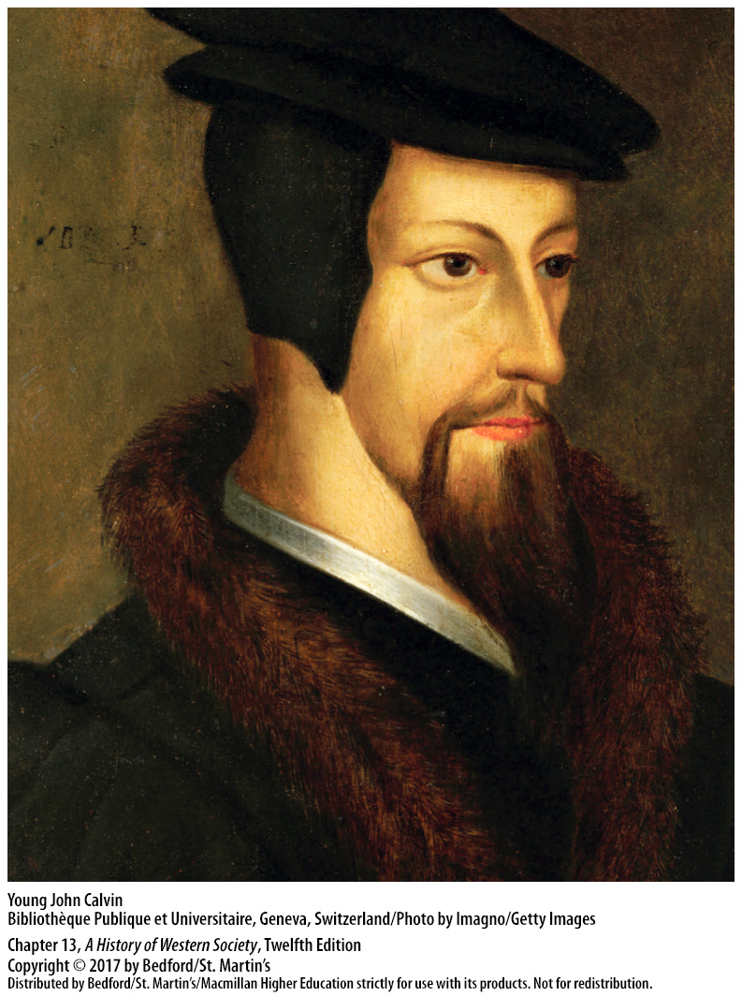

Slide 36
III. The Spread of Protestant Ideas
Calvinism
Geneva: model Christian community
Church of Cavlin: model for Presbyterian, Huguenot, and Puritan Churches
Spread throughout Europe
John Knox (1505? – 1572)
Persuaded the Scottish parliament to establish governance by presbyters
The Presbyterian Church of Scotland
Notes:
III. The Spread of Protestant Ideas
D. Calvinism
6. Geneva became the model of a Christian community, attracting religious refugees from France, England, Spain, Scotland, and Italy.
7. Subsequently, the church of Calvin served as the model for the Presbyterian Church in Scotland, the Huguenot Church in France, and the Puritan Churches in England and New England.
8. Calvinism became the most dynamic force in international Protestantism, spreading throughout the continent of Europe.
9. John Knox (1505?–1572) dominated the reform movement in Scotland and was determined to establish a state church there and structure it after the model of Geneva, where he had studied and worked with Calvin.
10. Knox persuaded the Scottish parliament to end papal authority and rule by bishops and instead establish governance by presbyters, or councils of ministers.
11. The Presbyterian Church of Scotland was strictly Calvinist in doctrine, adopted a simple and dignified service, and emphasized preaching.

Slide 37
III. The Spread of Protestant Ideas
The Reformation in Eastern Europe
Ethnic factors determined the course of the Reformation in eastern Europe
Hussite Czechs in Bohemia
German nobility embraced Lutheranism
Poland became Roman Catholic by 1650
Notes:
III. The Spread of Protestant Ideas
E. The Reformation in Eastern Europe
1. Ethnic factors often determined the course of the Reformation in eastern Europe.
2. Most Czechs in Bohemia in the fifteenth century had adopted the ideas of Jan Hus, and the German emperor had been forced to recognize a separate Hussite church.
3. Lutheranism appealed to Germans in Bohemia in the 1520s and 1530s, and the nobility embraced Lutheranism in opposition to the Catholic Habsburgs.
4. Luther’s ideas took root in Germanized towns in Poland-Lithuania but were opposed by King Sigismund I (r. 1506–1548) as well as by ordinary Poles, who held strong anti-German feeling. The Reformed tradition of John Calvin, which stressed the power of church elders, appealed to the Polish nobility. Doctrinal differences among Calvinists, Lutherans, and other groups prevented united opposition to Catholicism, and by 1650, due to the efforts of the Jesuits, Poland was again staunchly Roman Catholic.

Slide 38
III. The Spread of Protestant Ideas
The Reformation in Eastern Europe
Poland became Roman Catholic by 1650
Hungary and the Reformation
Hungarian nobles accepted Lutheranism
Catholic restoration in Hungary in 1699
Notes:
III. The Spread of Protestant Ideas
E. The Reformation in Eastern Europe
5. Hungary’s experience with the Reformation was even more complex: Lutheranism was spread by Hungarian students who had studied at Wittenberg, and sympathy for it developed at the court of King Louis II; however, its status as “the German heresy” was an issue until the Ottoman sultan Suleiman crushed the Hungarians in 1526 and divided the Hungarian kingdom into three parts.
6. In the face of Turkish indifference to the religious conflicts of Christians, whom they regarded as infidels and required to pay an extra tax to the sultan, many Magyar (Hungarian) nobles accepted Lutheranism.
7. The majority of people in Hungary were Protestant until the late seventeenth century, when Hungarian nobles recognized Habsburg (Catholic) rule and Ottoman Turkish withdrawal in 1699 led to Catholic restoration.

Slide 39
IV. The Catholic Reformation
Papal Reform and the Council of Trent
Papal court of Pope Paul III
The Holy Office
The Index of Prohibited Books
Notes:
IV. The Catholic Reformation
Papal Reform and the Council of Trent
1. The papal court of Pope Paul III (pontificate 1534–1549) became the center of the Catholic reform movement rather than its chief opponent, as he and his successors supported improvements in education for the clergy, the end of simony, and stricter control of clerical life.
2. In 1542 Pope Paul III established the Holy Office, with jurisdiction over the Roman Inquisition, a committee of six cardinals that had the power to arrest, imprison, and execute suspected heretics.
3. The Holy Office published the Index of Prohibited Books, a catalogue of forbidden reading that included works by Christian humanists as well as by Protestants.

Slide 40
IV. The Catholic Reformation
Papal Reform and the Council of Trent
Goal to reconcile with the Proestants
Decrees of the Council of Trent
Basis for Roman Catholic faith through the middle of the twentieth century
Notes:
IV. The Catholic Reformation
Papal Reform and the Council of Trent
4. Pope Paul III also called a general council, which met intermittently from 1545 to 1563 at Trent, with the goals of reforming the Catholic Church and securing reconciliation with the Protestants. Reconciliation proved impossible due to the insistence of Lutheran and Protestant representatives that the Scriptures be the sole basis for the discussion; in addition, the political objectives of Charles V and France worked against reconciliation.
5. The decrees of the Council of Trent reaffirmed the seven sacraments and the teaching on transubstantiation, gave equal validity to the Scriptures and to tradition as sources of religious truth and authority, and tackled disciplinary matters such as pluralism, simony, and the sale of indulgences. The council required every diocese to establish a seminary to educate and train clergy and laid great emphasis on preaching and instructing the laity, especially the uneducated. The Council of Trent stipulated that for a marriage to be valid, the marriage vows had to be made publicly before a priest and witnesses.
6. The doctrinal and disciplinary legislation of Trent served as the basis for Roman Catholic faith, organization, and practice through the middle of the twentieth century.

Slide 41
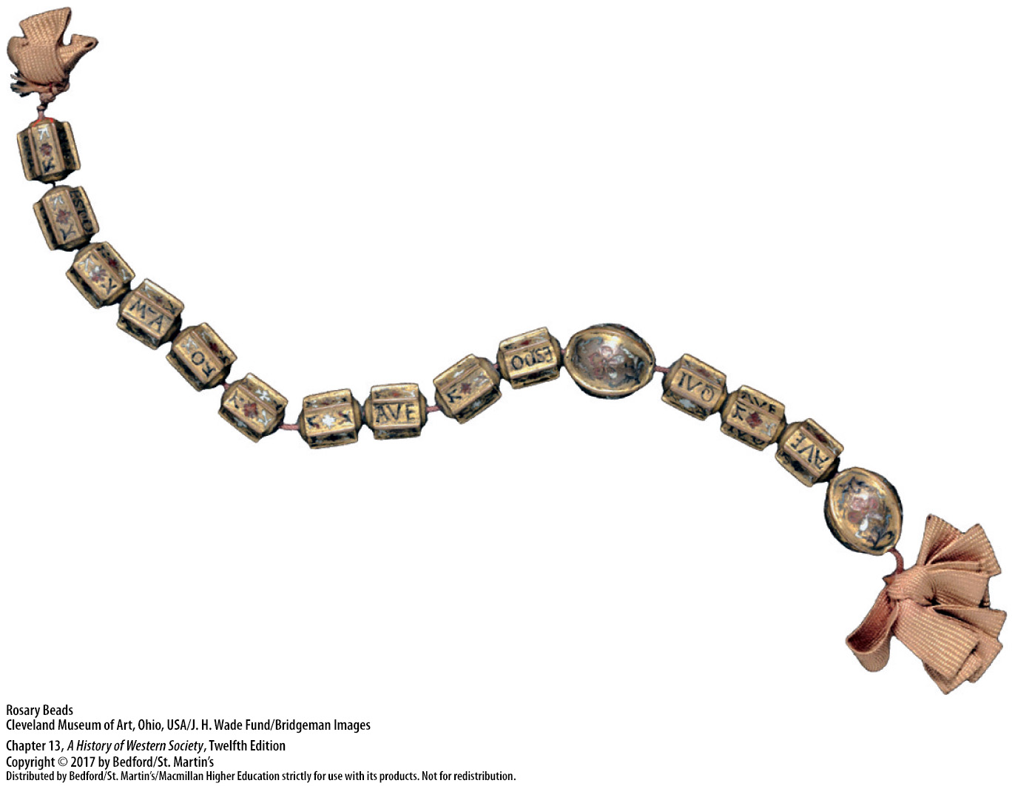

Slide 42
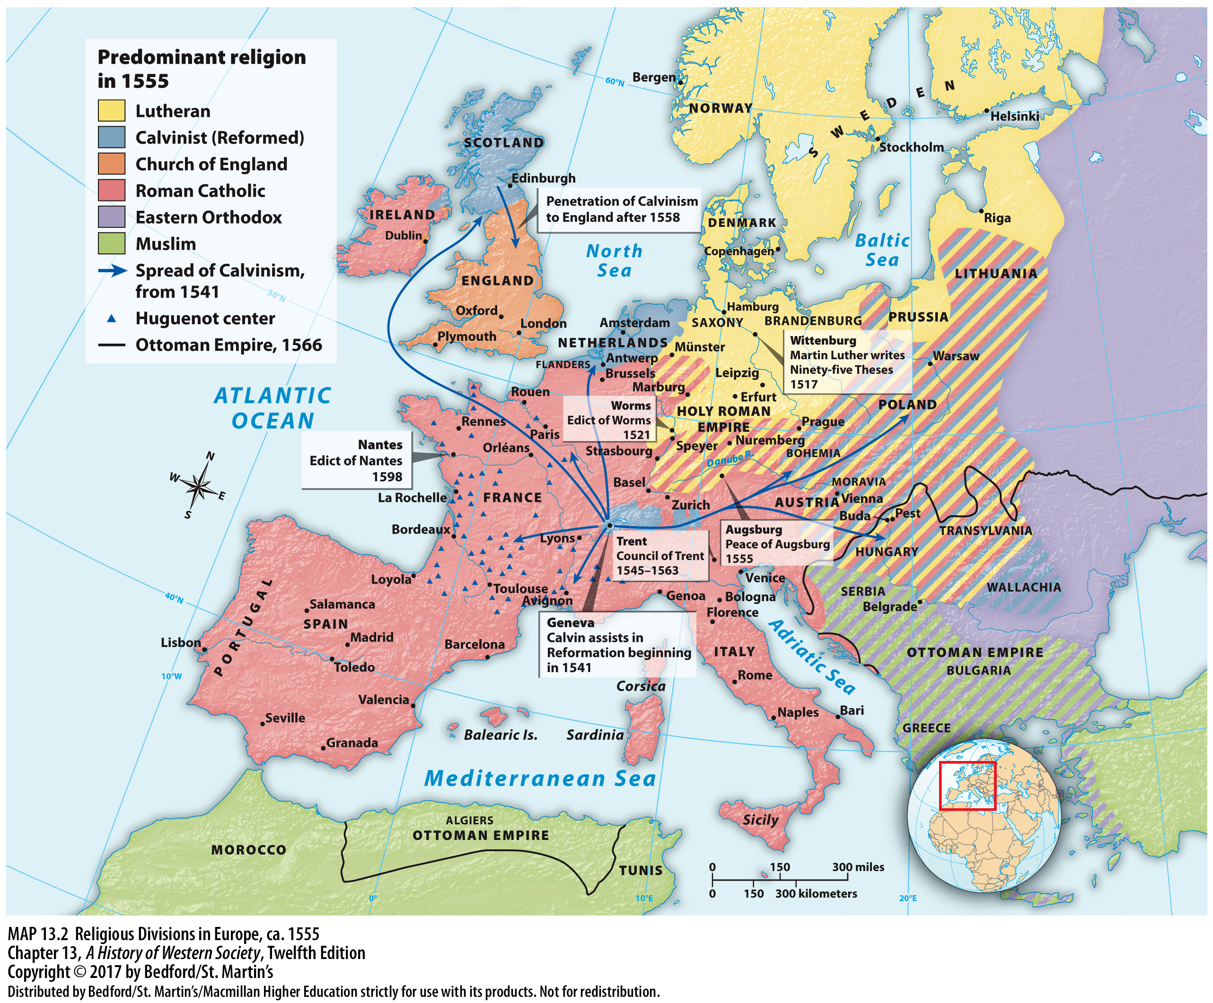

Slide 43
IV. The Catholic Reformation
New and Reformed Religious Orders
Teresa of Ávila (1515 – 1582)
The Ursuline order of nuns
The Society of Jesus (Jesuits)
Notes:
IV. The Catholic Reformation
B. New and Reformed Religious Orders
1. In Spain, Teresa of Ávila (1515–1582), inspired by mystical visions, founded new convents and reformed her Carmelite order to revive stricter standards of asceticism and poverty.
2. The Ursuline order of nuns, founded by Angela Merici (1474–1540), concentrated exclusively on teaching young girls, with the goal of re-Christianizing society by training future wives and mothers.
3. The Society of Jesus, or Jesuits, founded by Ignatius Loyola (1491–1556) played a powerful role in strengthening Catholicism in Europe and spreading the faith around the world.

Slide 44
IV. The Catholic Reformation
New and Reformed Religious Orders
Spiritual Exercises (1548)
Jesuits spread Christianity and vowed obedience to the pope
Adopted the humanist curricula and methods
Notes:
IV. The Catholic Reformation
B. New and Reformed Religious Orders
4. After being wounded in battle, Loyola spent a year in seclusion, prayer, and asceticism gaining insights that went into his great classic, Spiritual Exercises (1548), a training program of structured meditation designed to allow one to meld one’s will with God’s.
5. The Society of Jesus developed into a highly centralized, tightly knit organization that vowed special obedience to the pope. With flexibility and the willingness to respond to the needs of time and circumstance, the Jesuits achieved phenomenal success, carrying Christianity to India and Japan before 1550 and to Brazil, North America, and the Congo in the seventeenth century.
6. Jesuits adopted the humanist curricula and methods, educating the sons of the nobility as well as the poor, and also exerted great political influence in their role as confessors and spiritual directors to kings.

Slide 45
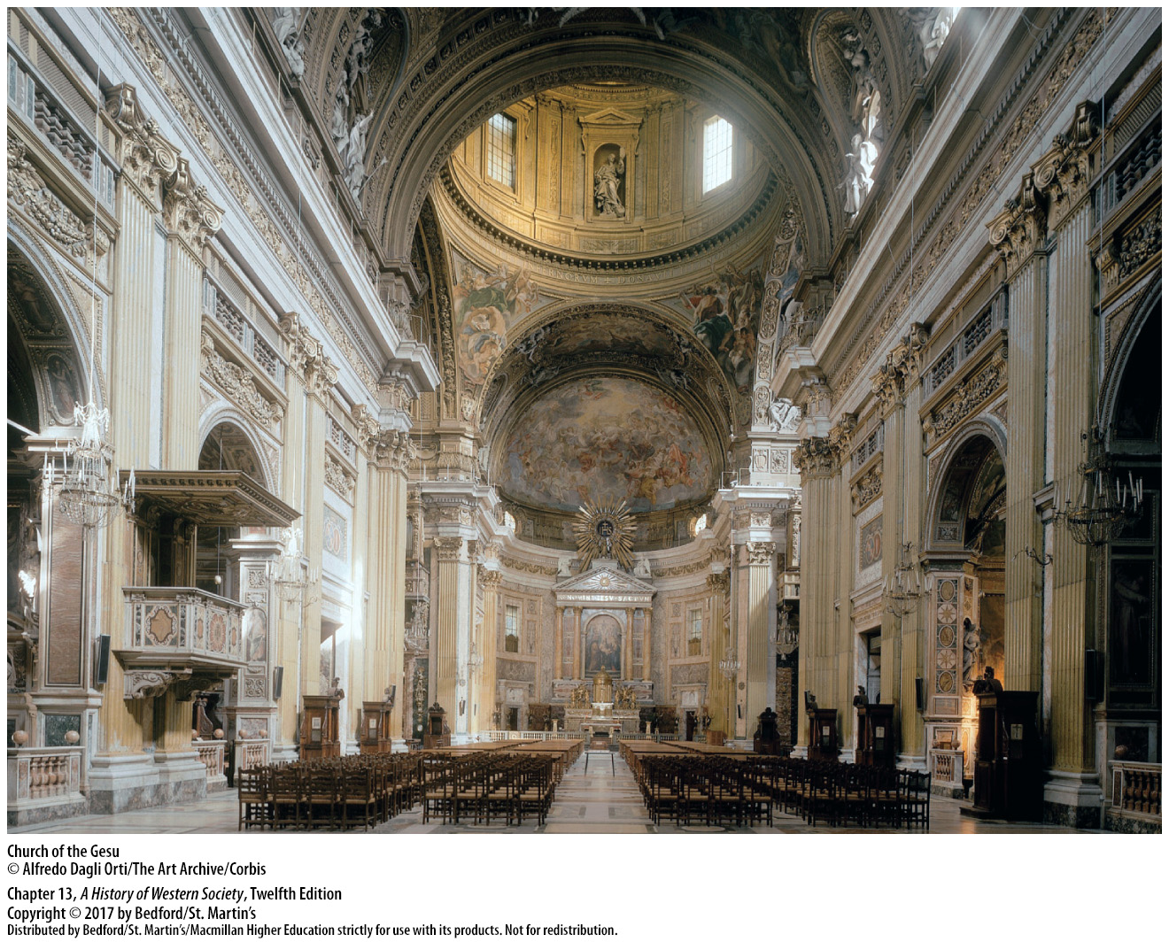

Slide 46
V. Religious Violence
French Religious Wars
The Treaty of Cateau-Cambrésis
The Concordat of Bologna
Calvinism
Huguenots
Catholic royalist lords vs. Calvinist antimonarchial lords
Notes:
V. Religious Violence
French Religious Wars
1. In 1559 France and Spain signed the Treaty of Cateau-Cambrésis, which ended the long conflict known as the Habsburg-Valois wars.
2. In a treaty with the papacy known as the Concordat of Bologna, King Francis I (r. 1515–1547) secured for the French crown the right to appoint all French bishops and abbots, ensuring a rich supplement of money and offices.
3. Calvinism drew converts from among reform-minded members of the Catholic clergy, industrious city dwellers, and artisan groups.
4. The number of French Calvinists (called Huguenots), most of whom lived in major cities, grew to perhaps one-tenth of the French population after the death of Henry II (r. 1547–1559).
5. Armed clashes between Catholic royalist lords and Calvinist antimonarchical lords, each believing that the others’ books, services, and ministers polluted the community, occurred in many parts of France, often incited by preachers or triggered by religious ceremonies.

Slide 47
V. Religious Violence
French Religious Wars
The Saint Bartholomew’s Day Massacre (1572)
Religious violence led to a civil war
Agriculture destroyed; commercialism declined
Politiques
Henry IV (r. 1589 – 1610)
The Edict of Nantes (1598)
Notes:
V. Religious Violence
French Religious Wars
6. The marriage ceremony of the king’s sister Margaret of Valois to the Protestant Henry of Navarre was intended to help reconcile Catholics and Huguenots, but it actually sparked the Saint Bartholomew’s Day Massacre on August 24, 1572, in which Huguenot wedding guests and other Protestants were killed.
7. Religious violence spread to the provinces, where thousands were killed by mobs, and led to a civil war that dragged on for fifteen years.
8. Agriculture in many areas was destroyed; commercial life declined severely; and starvation and death haunted the land.
9. A small group of moderates of both faiths, called politiques, believed that only the restoration of strong monarchy could reverse the trend toward collapse and favored accepting the Huguenots as an officially recognized group.
10. One of those politiques, Henry of Navarre, became Henry IV (r. 1589–1610) and converted to Catholicism.
11. In 1598 Henry IV issued the Edict of Nantes, which granted liberty of conscience and public worship to Huguenots in 150 fortified towns and prepared the way for French absolutism by helping to restore internal peace in France.

Slide 48
V. Religious Violence
The Netherlands Under Charles V
Appeal of Calvinism
Attempt to suppress Calvinism and raise taxes
The “Council of Blood”
Civil war between Catholics and Protestants
The Spanish Netherlands came under the control of the Spanish Habsburg forces
The Union of Utrecht (1581)
In 1609 Spain recognized the independence of the United Provinces
Notes:
V. Religious Violence
B. The Netherlands Under Charles V
1. Calvinism’s intellectual seriousness, moral gravity, and emphasis on any form of labor well done appealed to urban merchants, financiers, and artisans, but Calvinism also tended to encourage opposition to political authorities that were judged to be ungodly.
2. Spanish authorities attempted to suppress Calvinist worship and raised taxes in the 1560s, which caused rioting and the destruction of thirty Catholic churches in Antwerp.
3. Philip II, who assumed power over the Netherlands after the abdication of Charles V, sent twenty thousand Spanish troops under the duke of Alva, who opened his own tribunal, the “Council of Blood,” and executed fifteen hundred men in 1568.
4. Between 1568 and 1578, civil war raged in the Netherlands between Catholics and Protestants and between the seventeen provinces and Spain.
5. Eventually the ten southern provinces, the Spanish Netherlands (the future Belgium), came under the control of the Spanish Habsburg forces.
6. The seven northern provinces, led by Holland, formed the Union of Utrecht and in 1581 declared their independence from Spain; the north was Protestant, and the south remained Catholic.
7. Hostilities did not end until 1609 when Spain agreed to a truce that recognized the independence of the United Provinces.

Slide 49
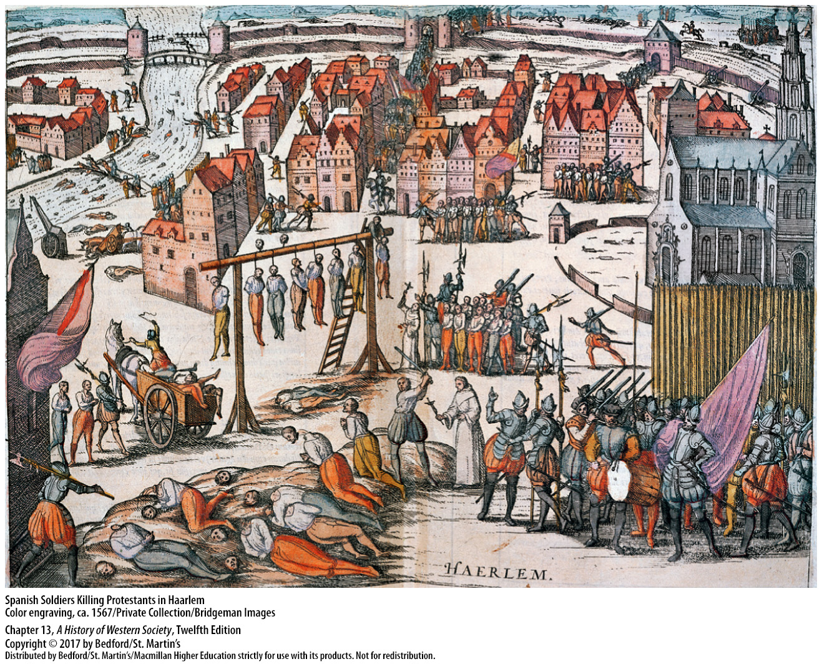

Slide 50
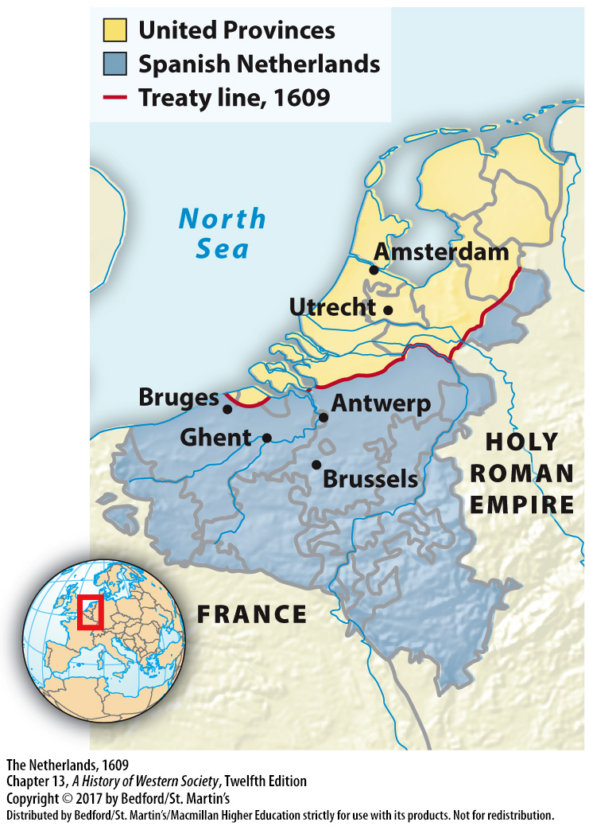

Slide 51
V. Religious Violence
The Great European Witch-Hunt
Height of witchcraft mania (1560 – 1600)
Witches were people used by the Devil
75 – 85% of executed “witches” were women
Misogynistic beliefs shaped witch-hunts
Notes:
V. Religious Violence
C. The Great European Witch-Hunt
1. Increasing persecution for witchcraft actually began before the Reformation in the 1480s, but it became especially common about 1560, and the mania continued until roughly 1660.
2. In the later Middle Ages, witches were no longer understood simply as people who used magical power to get what they wanted, but rather as people used by the Devil to do what he wanted. Witches were thought to engage in sexual orgies with the Devil, fly in the night to sabbats, and steal communion wafers and unbaptized babies for use in their rituals; some claimed that witches were organized in an international conspiracy to overthrow Christianity.
3. Scholars estimate that during the sixteenth and seventeenth centuries, somewhere between 100,000 and 200,000 people were officially tried for witchcraft and between 40,000 and 60,000 were executed; 75 to 85 percent of those tried and executed were women.
4. Ideas about women shaped the witch-hunts: misogyny and beliefs that women were weak and possessed a powerful sexual drive led many to believe that women would more likely give in to the Devil. In both classical and Christian traditions, women were associated with nature, disorder, and the body, all of which were linked with the demonic.

Slide 52
V. Religious Violence
The Great European Witch-Hunt
5. Inquisitorial legal procedure
6. Women prominent among accusers and witnesses
7. Charge, questioning, confession, execution
8. Witch panics
9. New ideas about science and reason
Notes:
V. Religious Violence
C. The Great European Witch-Hunt
5. Legal changes from an accusatorial legal procedure to an inquisitorial procedure in which legal authorities rather than individuals actually brought the charges made people much more willing to accuse others. Inquisitorial procedure involved intense questioning of the suspect, often with torture.
6. Women number prominently among accusers and witnesses, as well as among those accused, because the actions witches were accused of were generally part of women’s sphere; a woman who confronted other women who deviated from social norms secured her good standing.
7. Once a charge was made, the suspect was brought in for questioning, and confession was generally followed by execution. Although detailed records of witch trials survive, they cannot tell us whether the accused actually practiced witchcraft or whether they believed they were witches.
8. Larger witch-hunts, or witch panics, often occurred after some type of climatic disaster and were most common in the Holy Roman Empire, Switzerland, and parts of France, where small political units jealous of each other and divided by religion were governed by rulers who saw the persecution of witches as a way to demonstrate piety and concern for order.
9. New ideas about science and reason in the seventeenth century brought doubts about whether witches could make pacts with the Devil.

Slide 53
