Slide 1
A History of Western Society Twelfth Edition
McKay • Crowston • Wiesner-Hanks • Perry
CHAPTER 12
European Society in the Age of the Renaissance
1350–1550
Copyright © 2017 by Bedford/St. Martin’s
Distributed by Bedford/St. Martin's/Macmillan Higher Education strictly for use with its products; Not for redistribution.

Slide 2
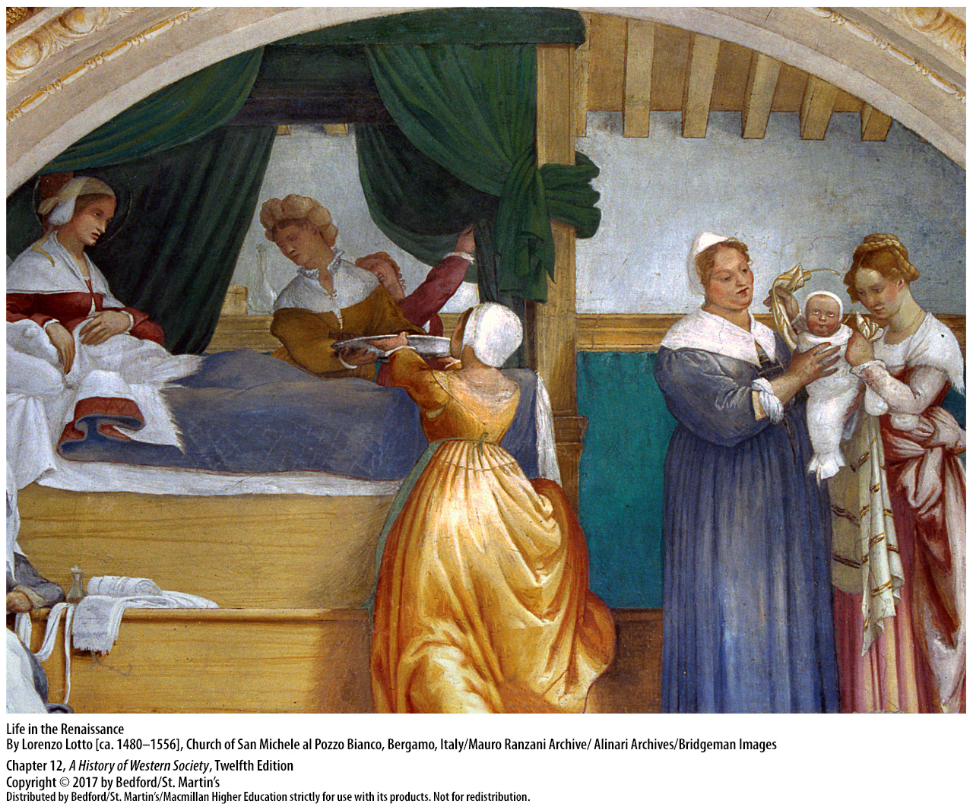

Slide 3
I. Wealth and Power in Renaissance Italy
Trade and Prosperity
The Renaissance
Advances in shipbuilding
Florence, a wealthy commercial leader
Wealth allowed people in thriving Italian cities greater material pleasures, and the leisure time to appreciate and patronize the arts
Opportunity to enjoy life
Notes:
Wealth and Power in Renaissance Italy
Trade and Prosperity
1. The Renaissance, a French word meaning “rebirth,” refers to the rebirth of the culture of classical antiquity that began in the fourteenth century in the city-states of northern Italy.
2. Important advances in shipbuilding enabled those cities’ ships to sail all year long at accelerated speeds and carry ever more merchandise.
3. Florence, another commercial leader situated on the Arno River in a favorable location on the main road northward from Rome that made it a commercial hub, had grown wealthy through international trade. Florentine merchants loaned and invested money, and they acquired control of papal banking toward the end of the thirteenth century.
4. Wealth allowed many people in Florence and other thriving Italian cities greater material pleasures, a more comfortable life, and the leisure time to appreciate and patronize the arts.
5. The rich, who commissioned public and private buildings and hired artists to decorate their homes and churches, came to see life more as an opportunity to be enjoyed than as a painful pilgrimage to the City of God.
(

Slide 4
I. Wealth and Power in Renaissance Italy
Communes and Republics of Northern Italy
Communes formed by merchant guilds
Merger of northern Italian nobility and the commercial elite; powerful oligarchy
Disenfranchisement of the popolo
Establishment of republican governments
Notes:
Wealth and Power in Renaissance Italy
B. Communes and Republics of Northern Italy
1. The northern Italian cities were communes, sworn associations of free men who began to seek political and economic independence from local nobles in the twelfth century. The merchant guilds that formed the communes built and maintained the city walls, regulated trade, collected taxes, and kept civil order.
2. Local nobles frequently moved into the cities, marrying the daughters of rich commercial families and starting their own businesses, often with money gained through their wives’ dowries. This merger of the northern Italian nobility and the commercial elite created a powerful oligarchy, yet rivalries among these families often made Italian communes politically unstable.
3. The common people (the popolo) were disenfranchised and heavily taxed, and they bitterly resented their exclusion from power.
4. Throughout most of the thirteenth century, in city after city, the popolo used armed force to take over the city governments and establish republican governments, in which political power theoretically resides in the people and is exercised by their chosen representatives.

Slide 5
I. Wealth and Power in Renaissance Italy
Communes and Republics of Northern Italy
5. Condottieri reestablished the merchant oligarchies
6. Cities in Italy became signori
7. Façade of communal government
8. Displays of wealth later copied by rules of nation-states
Notes:
Wealth and Power in Renaissance Italy
B. Communes and Republics of Northern Italy
7. Because the popolo could not establish civil order within their cities, merchant oligarchies reasserted their power and sometimes brought in powerful military leaders called condottieri to establish order.
8. Many cities in Italy became signori, in which one man ruled and handed down the right to rule to his son.
9. These oligarchic regimes maintained a façade of communal government, but the judicial, executive, and legislative functions of government were restricted to a small class of wealthy merchants.
10. The signori and merchant oligarchs of many cities transformed their households into courts and displayed their wealth and power by becoming patrons of the arts; they hired architects to build private palaces and public city halls, artists to fill them with paintings and sculptures, and musicians and composers to fill them with music. Rulers of nation-states later copied and adapted all these aspects of Italian courts.

Slide 6
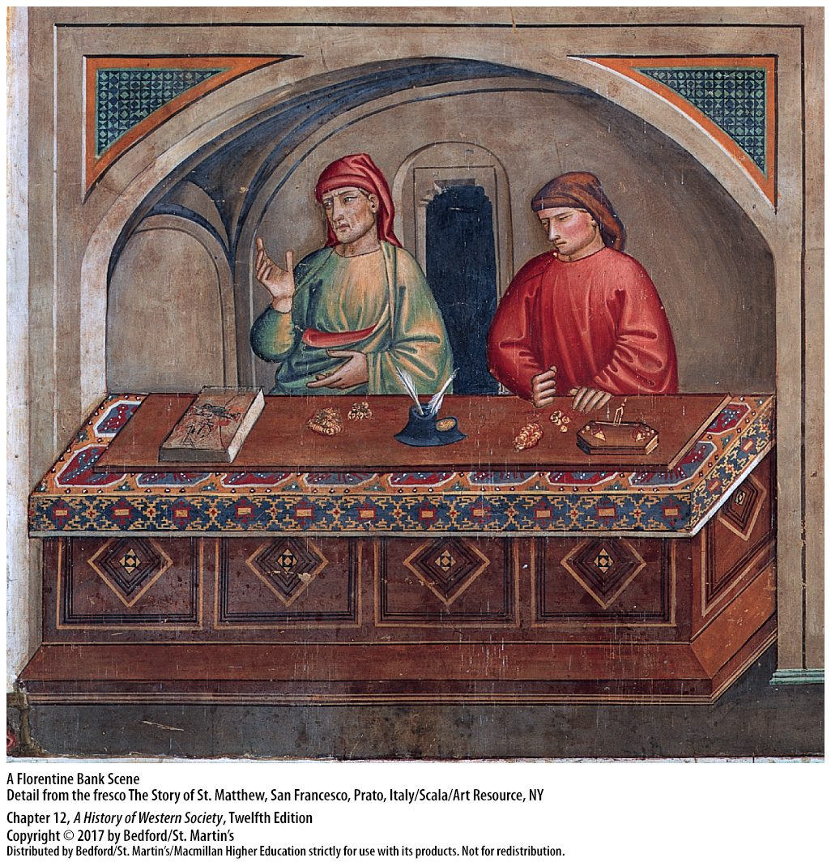

Slide 7
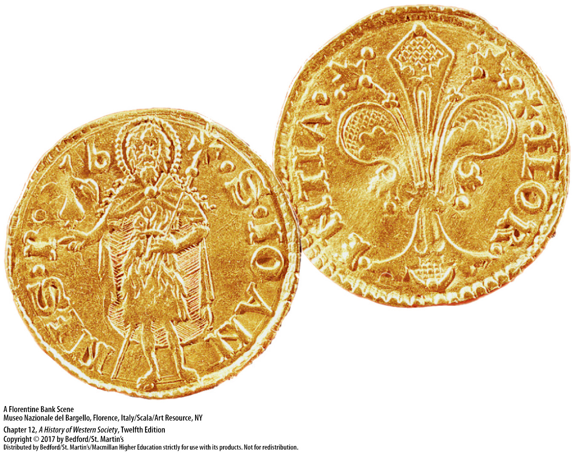

Slide 8
I. Wealth and Power in Renaissance Italy
City-States and the Balance of Power
Individual city-states
Balance of power between Italian states
King Charles VIII invaded Italy in 1494
The Habsburg-Valois wars
Continual warfare in Italy
Notes:
Wealth and Power in Renaissance Italy
C. City-States and the Balance of Power
1. Renaissance Italians had a passionate attachment to their individual city-states, which hindered the development of a single unified state.
2. Whenever one Italian state appeared to gain a predominant position within the peninsula, other states combined against it to establish a balance of power.
3. When Florence and Naples entered into an agreement to acquire Milanese territories at the end of the fifteenth century, Milan called on France for support, and the French king Charles VIII (r. 1483–1498) invaded Italy in 1494.
4. The French invasion inaugurated a new period in European power politics in which Italy became the focus of international ambitions and the battleground of foreign armies, particularly those of France and the Holy Roman Empire in a series of conflicts called the Habsburg-Valois wars.
5. The Italian cities suffered from continual warfare, especially in the sack of Rome in 1527 by emperor Charles V. The failure of the city-states to consolidate, or at least to establish a common foreign policy, led to centuries of subjection by outside invaders.

Slide 9
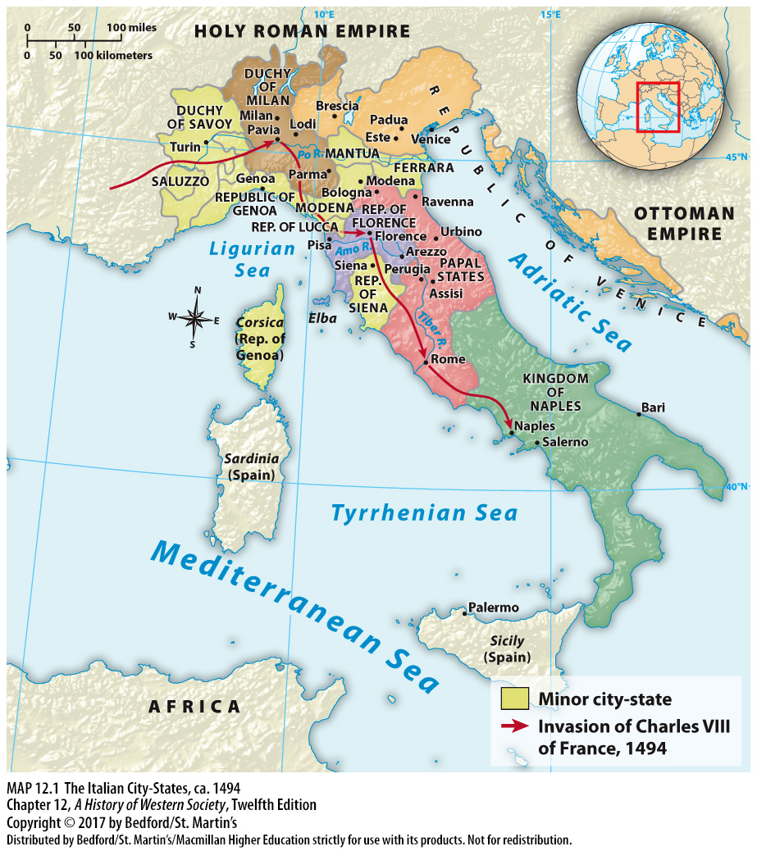

Slide 10
II. Intellectual Change
Humanism
Francesco Petrarch (1304-1374)
“liberal arts,” studia humanitates
Humanism
Cicero (106-43 B.C.E.)
Notes:
II. Intellectual Change
Humanism
1. The Florentine poet and scholar Francesco Petrarch (1304–1374) traveled Europe searching for classical Latin manuscripts because he felt the writers of ancient Rome had reached a level of perfection that had not since been duplicated; Petrarch believed that writers of his day should follow these ancient models and ignore the period between the fall of Rome, which he termed the “dark ages.”
2. He proposed a new kind of education in which young men would study the works of ancient Roman authors, using them as models of how to write clearly, argue effectively, and speak persuasively. The study of Latin classics became known as the studia humanitates, usually translated as the “liberal arts”; those who advocated it were known as humanists and their program as humanism.
3. Humanism, the main intellectual component of the Renaissance, contained an implicit philosophy: human nature and achievements were worthy of contemplation.
4. He admired the works of the Roman author and statesman Cicero (106–43 b.c.e.), including his use of language, literary style, and political ideas.

Slide 11
II. Intellectual Change
Humanism
Greek philosophy, ideas of Plato
Giovanni Pico della Mirandola (1463-1494)
Virtù
Notes:
II. Intellectual Change
Humanism
5. In the fifteenth century, Florentine humanists became increasingly interested in Greek philosophy, especially the ideas of Plato, whose emphasis on the spiritual and eternal over the material and transient—the Platonic ideal—fit well with Christian teachings about the immortality of the soul.
6. Giovanni Pico della Mirandola (1463–1494), Ficino’s most brilliant student, believed that both Christian and classical texts taught that the universe was a hierarchy of beings from God down through spiritual beings to material beings, with humanity as the crucial link possessing both material and spiritual natures.
7. Renaissance thinkers believed man’s divinely bestowed nature meant that there were no limits to individual achievement, especially for those with the admirable quality of virtù, the ability to shape the world around them according to their will.

Slide 12
II. Intellectual Change
Education
Humanists though education was for the public good
Humanist education became the basis for education well-to-do urban boys and men
Academies not open to women
Baldassare Castiglione’s The Courtier (1528)
Notes:
II. Intellectual Change
B. Education
1. Humanists taught that a life active in the world should be the aim of all educated individuals and that education was not only for private or religious purposes but also for the public good.
2. Humanist schools were established in other Italian cities, as well as in Germany, France, and England; humanist education became the basis for education for well-to-do urban boys and men.
3. Humanist academies were not open to women, but a few women who became educated in the classics through tutors or self-study argued that reason was not limited to men and that learning was compatible with virtue for women as well as men.
4. No book on education had broader influence than Baldassare Castiglione’s The Courtier (1528). According to Castiglione, the educated man should have a broad background in many academic subjects; his spiritual and physical as well as intellectual capabilities should be trained; and above all, he should speak and write eloquently.

Slide 13
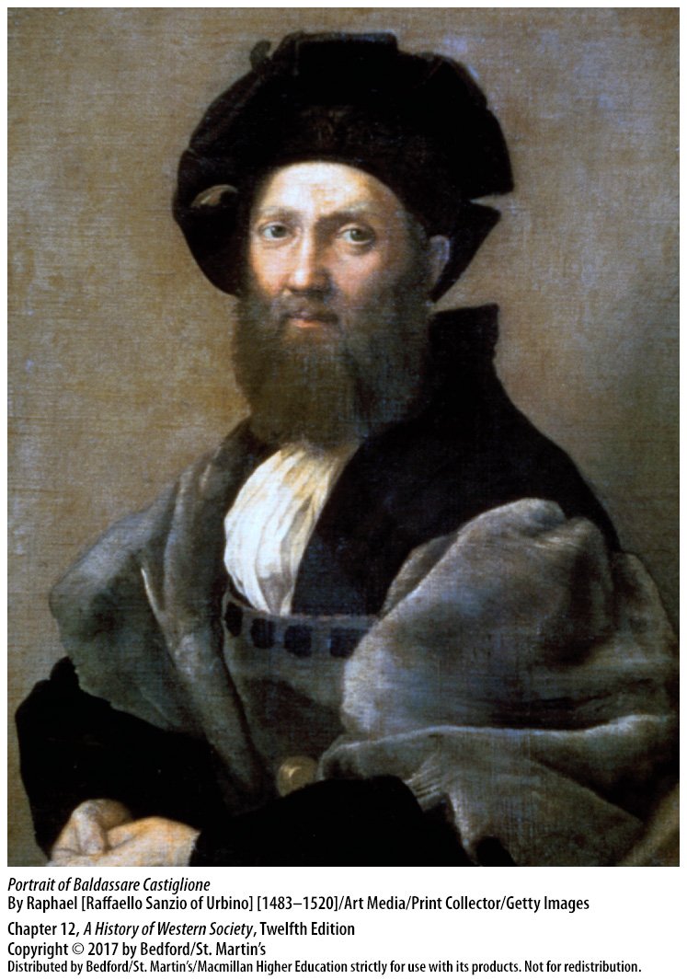

Slide 14
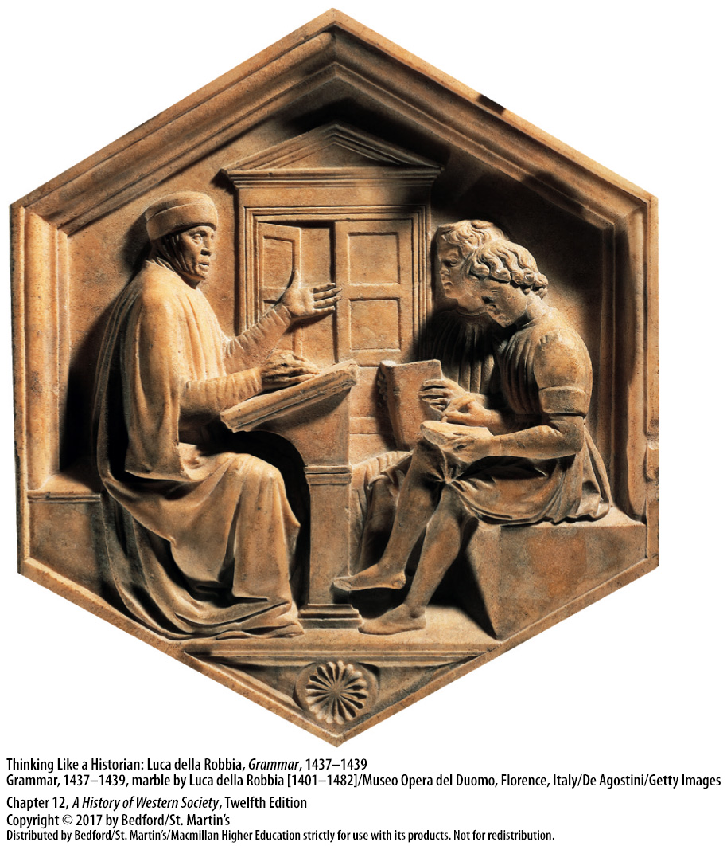

Slide 15
II. Intellectual Change
Political Thought
Some favored republicanism, some philoshopher-kings
“Civic humanism”
Niccolò Machiavelli (1469–1527), The Prince
Cesare Borgia (1475? – 1507)
A ruler’s moral code
Notes:
II. Intellectual Change
C. Political Thought
1. Some argued that republicanism was the best form of government, while others used Plato’s model of the philosopher-king to argue that rule by an enlightened individual might be best.
2. Both sides agreed, however, that educated men should be active in the political affairs of their city, a position historians have since termed “civic humanism.”
3. The most famous civic humanist, and ultimately the best-known political theorist of this era, was Niccolò Machiavelli (1469–1527). In The Prince (1513), Machiavelli uses the examples of classical and contemporary rulers to argue that the function of a ruler (or any government) is to preserve order and security by using any means necessary, but not by doing anything that would turn the populace against him.
4. Machiavelli’s primary contemporary example was Cesare Borgia (1475?–1507), who built up a state in central Italy by using new military equipment and tactics, hiring Leonardo da Vinci (1452–1519) as a military engineer, and murdering his political enemies.
5. In contrast to the medieval idea that governments should be judged on moral principles established by God, Machiavelli argued that governments should be judged by how well they provided security, order, and safety to their populace; he believed that a ruler’s moral code in maintaining these was not the same as a private individual’s.

Slide 16
II. Intellectual Change
Christian Humanism
Northern humanist wanted to reform the church
Best elements of classical and Christian cultures should be combined
Thomas More (1478-1535), Utopia (1516)
Desiderius Erasmus (1466? – 1536)
Notes:
II. Intellectual Change
D. Christian Humanism
1. Northern humanists shared the ideas of Ficino and Pico about the wisdom of ancient texts, but they viewed humanist learning as a way to bring about reform of the church and deepen people’s spiritual lives.
2. These Christian humanists thought that the best elements of classical and Christian cultures should be combined.
3. The English humanist Thomas More (1478–1535) wrote the controversial dialogue Utopia (1516), which describes a community on an island where all children receive a good education, and adults divide their days between manual labor or business pursuits and intellectual activities. More’s purposes in writing Utopia have been greatly debated: some view it as a revolutionary critique of More’s own hierarchical and violent society, some as a call for an even firmer hierarchy, and others as part of the humanist tradition of satire.
4.The fame of Dutch humanist Desiderius Erasmus (1466?–1536) rested largely on scholarly editions and translations, as well as popular works. Two fundamental themes run through Erasmus’s work: first, education in the Bible and the classics is the key to reform and moral and intellectual improvement; second, renewal should be based on “the philosophy of Christ,” an emphasis on inner spirituality and personal morality, rather than on scholastic theology or outward observances.

Slide 17
II. Intellectual Change
The Printed Word
Printing with movable metal type developed in Germany in the 1440s
Johann Gutenberg, metal stamps
Ready availability of paper
Increase in urban literacy and schooling expanded the reading market
Printing allowed for a group consciousness
Censorship by government and church officials
Notes:
II. Intellectual Change
E. The Printed Word
1. Printing with movable metal type developed in Germany in the 1440s as a combination of existing technologies.
2. Johann Gutenberg and other metal-smiths made metal stamps—later called type—for every letter of the alphabet, which could then be covered with ink and used to mark the letters onto a surface.
3. The ready availability of paper also enabled the printing revolution.
4. By the fifteenth century, the increase in urban literacy, the development of primary schools, and the opening of more universities had created an expanding market for reading materials of all types.
5. Printed materials allowed individuals to join causes and groups separated by geography and form a common identity, or group consciousness.
6. Officials prohibited certain books and authors and enforced this by confiscating books, arresting printers and booksellers, or destroying the presses of disobedient printers, although books printed secretly were smuggled all over Europe.

Slide 18
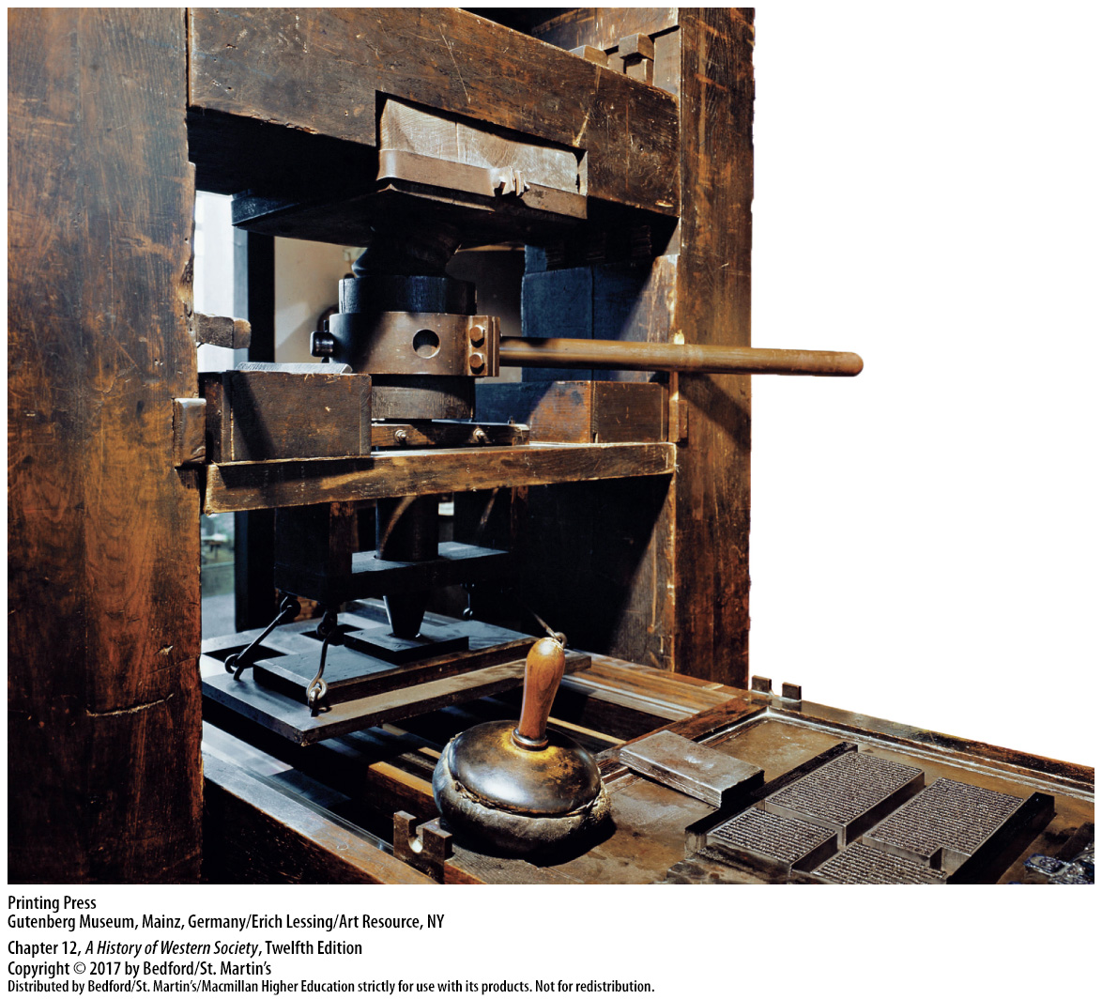

Slide 19
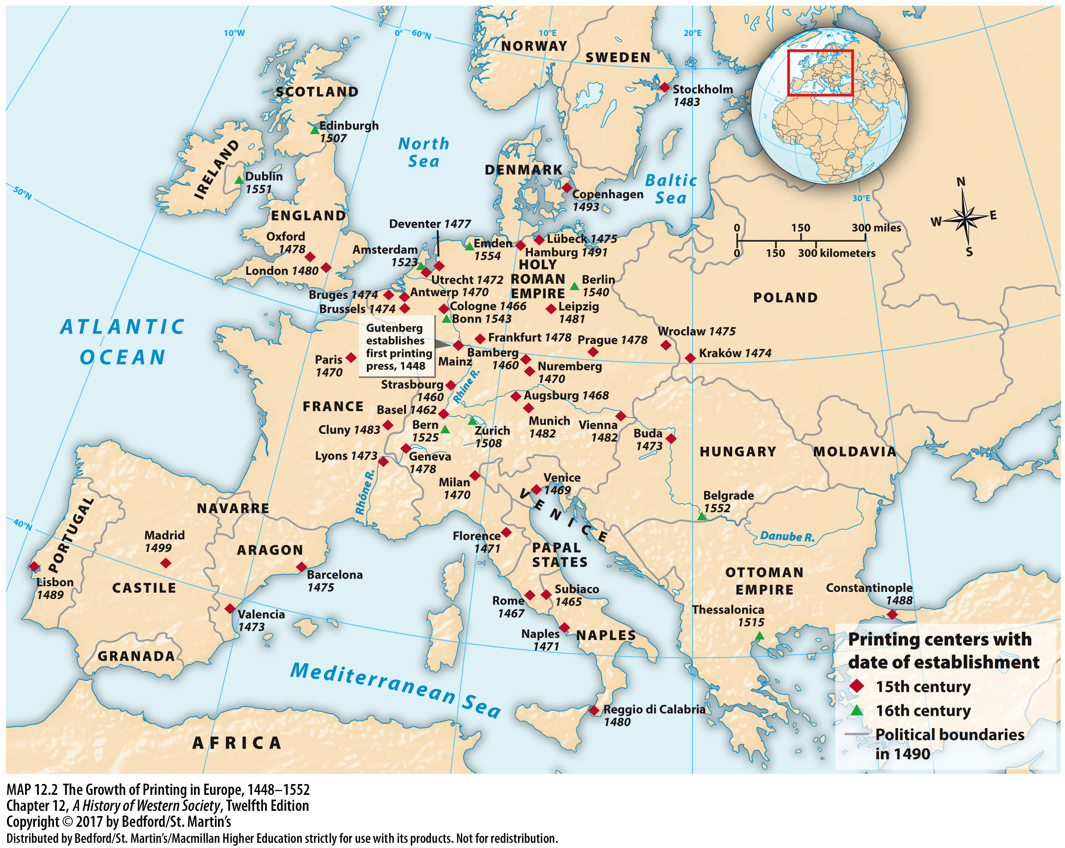

Slide 20
III. Art and the Artist
Patronage and Power
Commissioning art was a way to flaunt wealth
Patrons varied in their level of involvement
Pope Julius II commissioned Michelangelo to paint the Vatican’s Sistine Chapel (1508)
Art reveals patterns of consumption
Notes:
III. Art and the Artist
Patronage and Power
1. Powerful urban groups often flaunted their wealth by commissioning works of art in early Renaissance Italy. In the later fifteenth century, wealthy merchants, bankers, popes, and rulers, rather than corporate groups, sponsored works of art as a means of glorifying themselves and their families.
2. Patrons varied in their level of involvement as a work progressed; some simply ordered a specific subject or scene, while others closely oversaw the work of the artist or architect, making suggestions and demanding changes.
3. Pope Julius II (pontificate 1503–1513) commissioned the Florentine Michelangelo to paint the ceiling of the Vatican’s Sistine Chapel in 1508, visiting him frequently with suggestions and criticisms.
4. Art reveals changing patterns of consumption among the wealthy elite, with nobles spending less of their money on military gear as they adjusted to an urban culture.

Slide 21
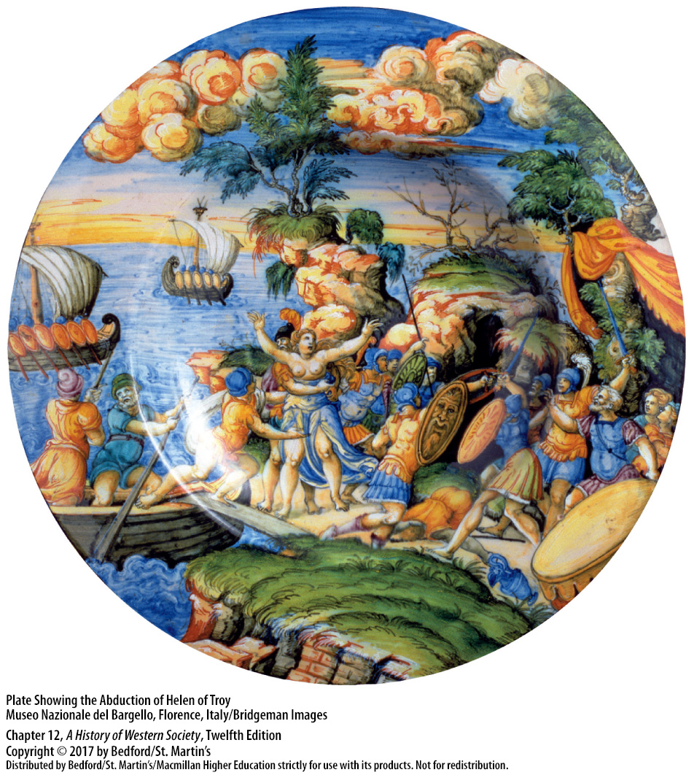

Slide 22
III. Art and the Artist
Changing Artistic Styles
The individual portrait
Giotto (1276 – 1337)
Piero della Francesca (1420 – 1492) and Andrea Mantegna (1430/31 – 1506)
Donatello (1386 – 1466)
Filippo Brunelleschi (1377 – 1446)
Notes:
III. Art and the Artist
B. Changing Artistic Styles
2. The individual portrait emerged as a distinct genre; Renaissance portraits showed human ideals, often portrayed in a more realistic style.
3. The Florentine painter Giotto (1276–1337) led the way in the use of realism, especially in his more natural treatment of the human body and face.
4. Piero della Francesca (1420–1492) and Andrea Mantegna (1430/31–1506) pioneered perspective in painting, the linear representation of distance and space on a flat surface.
5. The sculptor Donatello (1386–1466) revived the classical figure, with its balance and self-awareness.

Slide 23
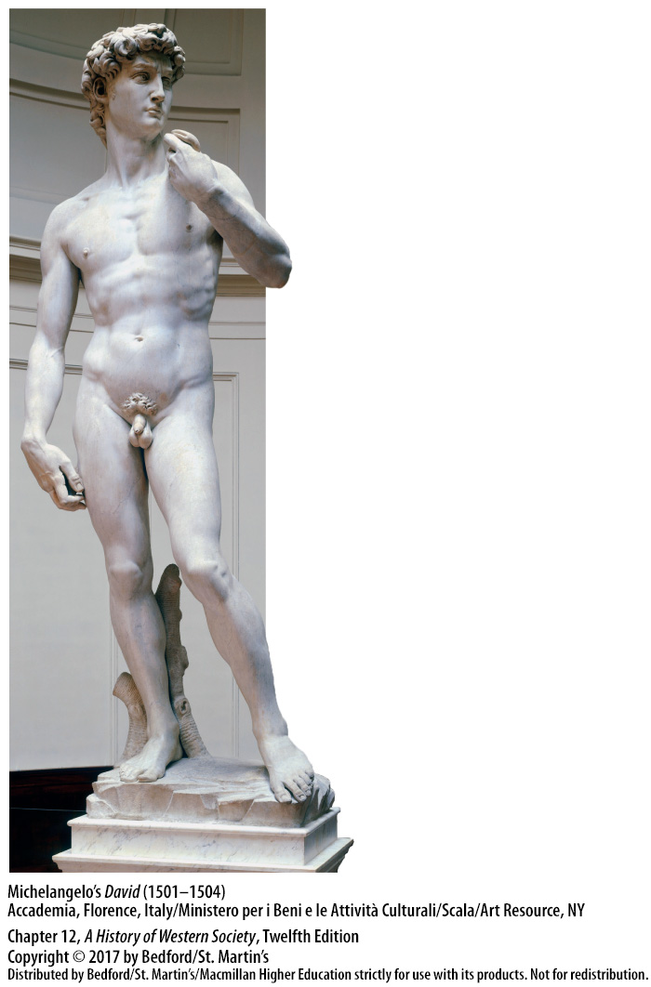

Slide 24
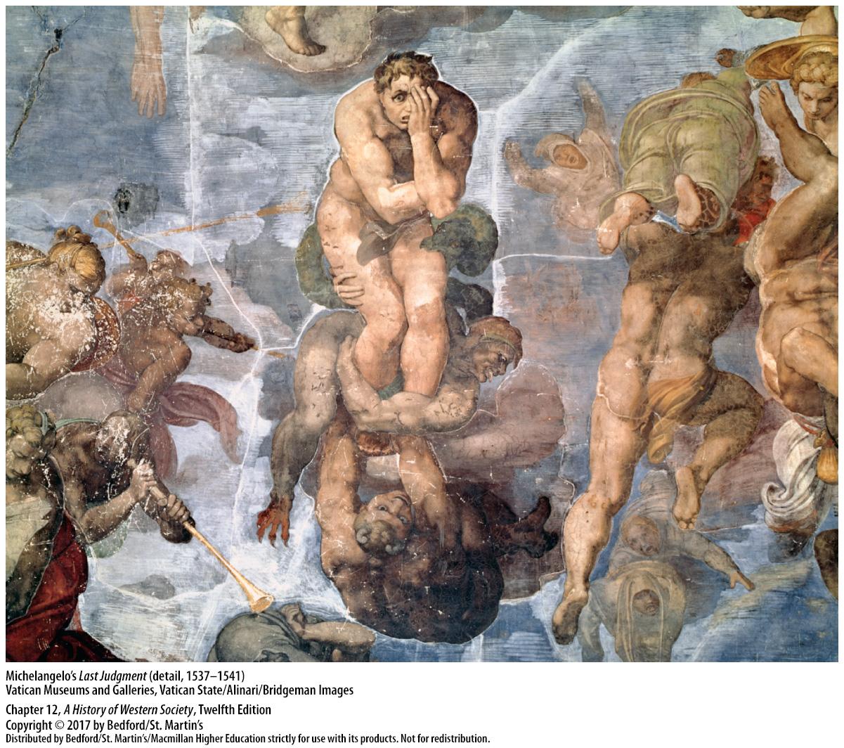

Slide 25
III. Art and the Artist
Changing Artistic Styles
8. Rogier van der Weden (1399/1400 – 1464) and Jan van Eyck (1366 – 1441)
9. Albrecht Dürer of Nuremberg
10. Center of art shifted from Florence to Rome
11. Raphael Sanzio (1483 – 1520)
12. Titian (1490 – 1576), “mannerism”
Notes:
III. Art and the Artist
B. Changing Artistic Styles
8. Flemish painters, notably Rogier van der Weyden (1399/1400–1464) and Jan van Eyck (1366–1441)—one of the first artists to use oil-based paints successfully—were considered the artistic equals of Italian painters.
9. Albrecht Dürer of Nuremberg rendered the human form and natural world in intricate detail and designed mechanical devices that could assist artists in solving the problems of perspective.
10. In the early sixteenth century, the center of the new art shifted from Florence to Rome, as Renaissance popes expended huge sums of money to beautify the city.
11. Raphael Sanzio (1483–1520) became the most sought after artist in Europe, overseeing a large workshop with many collaborators and writing treatises on his philosophy of art in which he emphasized the importance of imitating nature and developing an orderly sequence of design and proportion.
12. Titian (1490–1576) and other sixteenth-century painters developed an artistic style known as “mannerism” in which artists sometimes distorted figures, exaggerated musculature, and heightened color to express emotion and drama more intently.

Slide 26
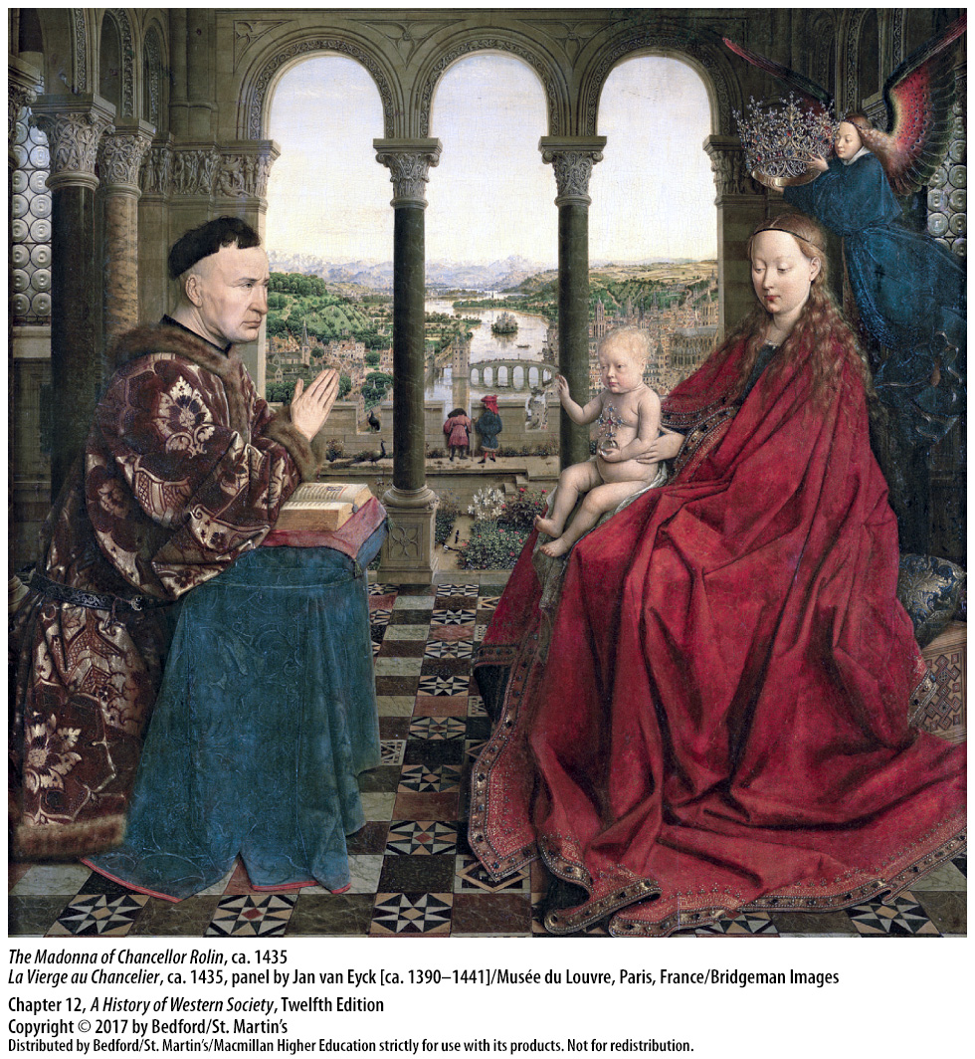

Slide 27
III. Art and the Artist
The Renaissance Artist
Artists “rare men of genius”
Expected to train with older artists
Beginners practiced through copying
Informal practice groups later turned into formal artistic “academies”
Gendered notion of artistic genius
Female painters restricted
Male-only artistic workshops
Notes:
III. Art and the Artist
C. The Renaissance Artist
1. Some patrons rewarded certain artists very well, and some artists gained public acclaim as “rare men of genius.”
2. Though they might be men of genius, artists still were expected to be well trained.
3. Beginning artists spent years mastering their craft by copying drawings and paintings; learning how to prepare paint and other materials; and, by the sixteenth century, reading books about design and composition.
4. Some informal groups of younger artists, who gathered in the evenings for drawing practice, turned into more formal artistic “academies” by the late sixteenth century.
5. The notion of artistic genius was gendered; all the most famous and most prolific Renaissance artists were male, and the types of art that women produced, such as textiles, needlework, and painting on porcelain, were deemed “minor” or “decorative” arts.
6. Several women became well-known painters, most of them daughters of painters or minor noblemen with ties to artistic circles or eldest daughters from families without sons, but they were not allowed to study the male nude, learn the technique of fresco, or join a group of male artists for informal practice.
7. Artistic workshops were male-only settings in which men of different ages came together for training and created bonds of friendship, influence, patronage, and sometimes intimacy.

Slide 28
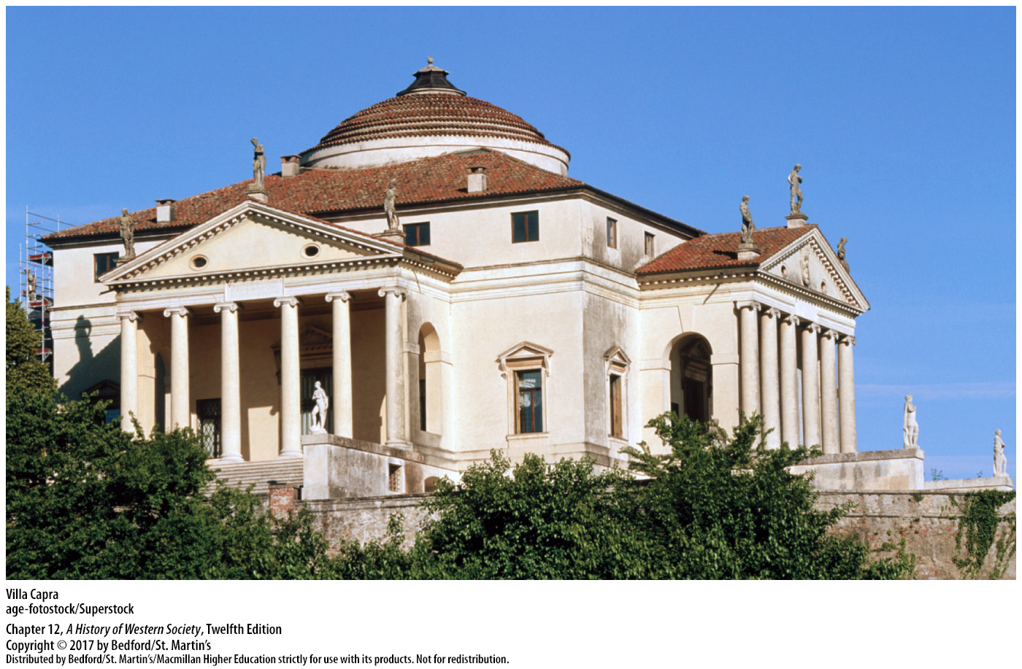

Slide 29
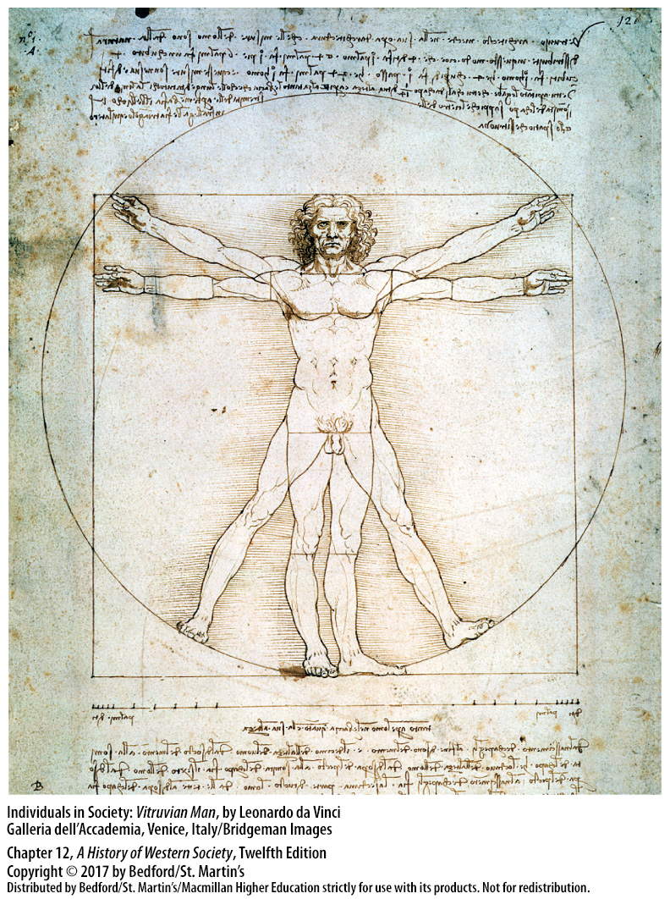

Slide 30
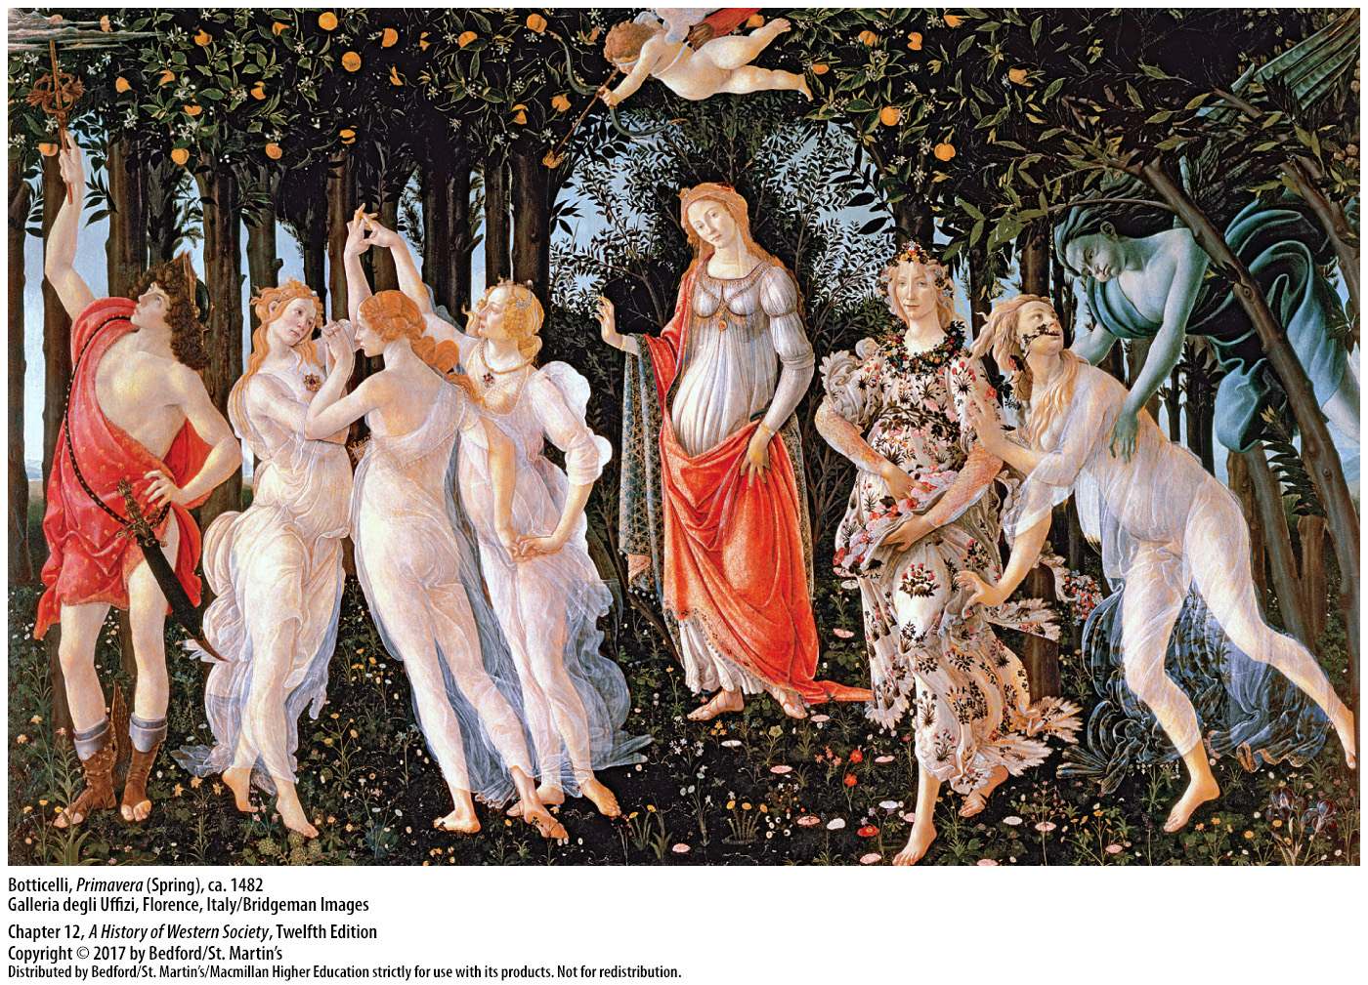

Slide 31
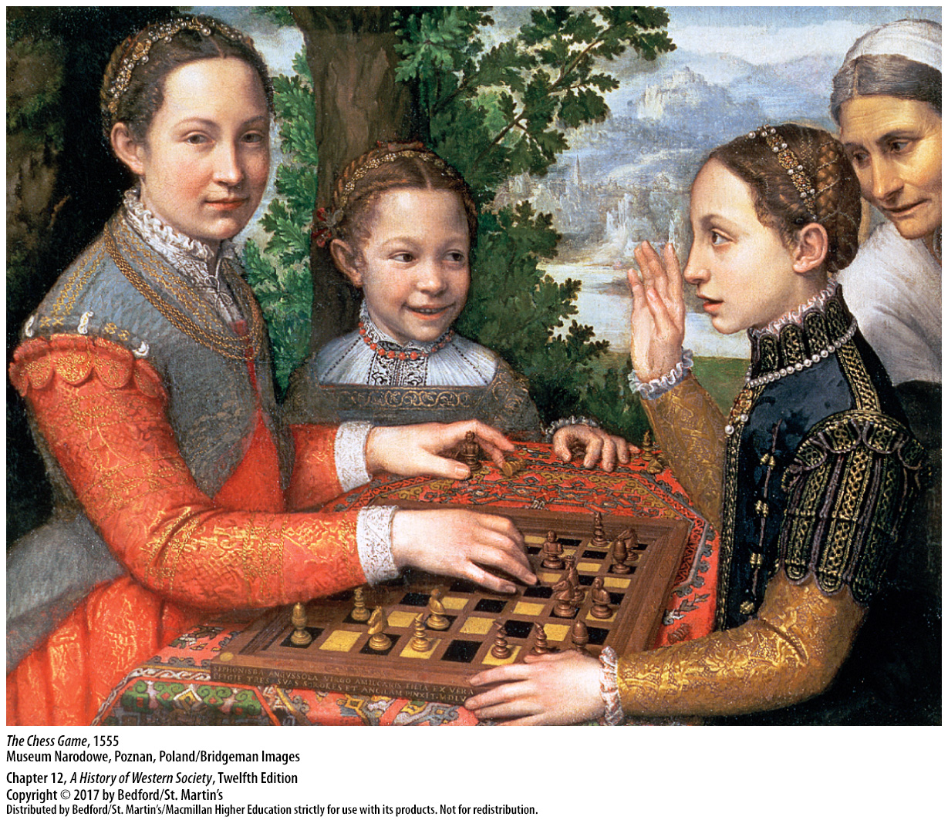

Slide 32
IV. Social Hierarchies
Race and Slavery
“Race,” “people,” and “nation” interchangeable
Merchants seized Africans to sell into slavery
Local authorities offered no protection
Portuguese sailors brought Africans to Mediterranean markets
Black servants sought after in northern Italy and other parts of Europe
Slave trade reinforced negative preconceptions about the inferiority of black Africans
Notes:
IV. Social Hierarchies
Race and Slavery
1. Renaissance people often used the words “race,” “people,” and “nation” interchangeably; they made distinctions based on skin color, but these distinctions were interwoven with other characteristics.
2. Unstable political conditions in many parts of Africa enabled enterprising merchants to seize people and sell them into slavery.
3. Local authorities afforded them no protection in a culture where tradition sanctioned the practice of slavery.
4. In the fifteenth century, Portuguese sailors began bringing Africans to markets in the Mediterranean, and by 1530 between four thousand and five thousand were sold to the Portuguese each year.
5. Although blacks were concentrated in the Iberian Peninsula, black servants were much sought after in northern Italy and other parts of Europe, in part because of a continuing interest in curiosities and the exotic. In Portugal, Spain, and Italy, slaves supplemented the labor force in virtually all occupations.
6. Most Europeans perceived Africa as a remote place, the home of strange people isolated by heresy and Islam from superior European civilization. The expanding slave trade only reinforced negative preconceptions about the inferiority of black Africans.

Slide 33
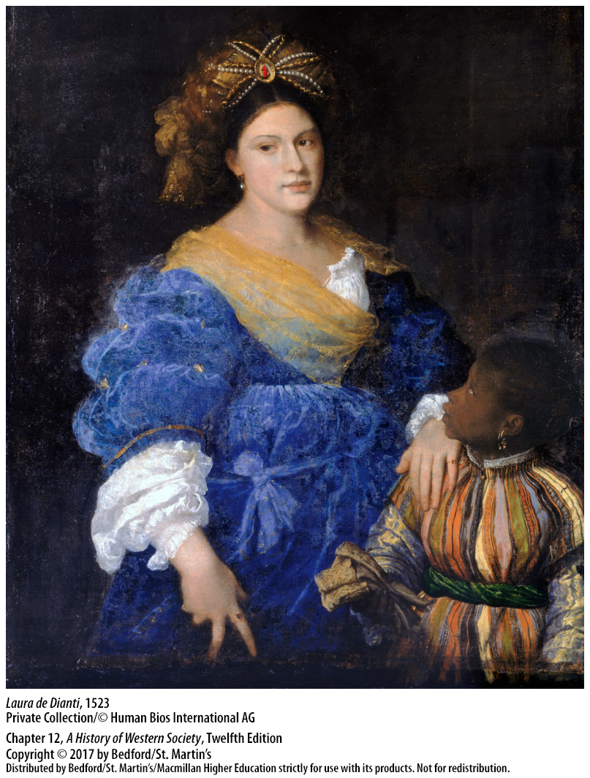

Slide 34
IV. Social Hierarchies
Wealth and the Nobility
Hierarchy of wealth
Poor nobles had higher status than wealthy commoners
Nobility integrated the new social elite of wealth
Social status also linked to honor in war and occupations
Sumptuary laws
Notes:
IV. Social Hierarchies
B. Wealth and the Nobility
1. The word “class” was not used in the Renaissance to describe social divisions, but by the thirteenth century, the idea of a hierarchy based on wealth was emerging, especially in cities. This hierarchy of wealth was more fluid than the older divisions into noble and commoner, allowing individuals and families to rise—and fall—within one generation.
2. The development of a hierarchy of wealth did not mean an end to the prominence of nobles, however, and even poorer nobles still had higher status than wealthy commoners.
3. The nobility maintained its status in most parts of Europe not by adhering to rigid boundaries, but by taking in and integrating the new social elite of wealth, often through marriage.
4. Along with being tied to hierarchies of wealth and family standing, social status also was linked to considerations of honor in warfare and occupations.
5. In cities, sumptuary laws reflected both wealth and honor.

Slide 35
IV. Social Hierarchies
Gender Roles
Querelle des femmes
Mysonigist critiques prompted authors to defend women
Christine de Pizan
Debate about female rulers
Notes:
IV. Social Hierarchies
C. Gender Roles
1. Toward the end of the fourteenth century, learned men (and a few women) began what was termed the querelle des femmes, a debate about women’s character and nature.
2. Misogynist critiques of women from both clerical and secular authors denounced females as devious, domineering, and demanding, which prompted several authors to compile lists of praiseworthy women.
3. Christine de Pizan was among those writers who were interested not only in defending women but also in exploring the reasons behind women’s secondary status, thus anticipating discussions about the “social construction of gender.”
5. Beginning in the sixteenth century, the debate about women also became one about female rulers and about whether gender or rank was the stronger determinant of character and social role. Despite a prevailing sentiment that women were not as fit to rule as men, there were no successful rebellions against female rulers simply because they were women, in part because female rulers emphasized qualities regarded as masculine.

Slide 36
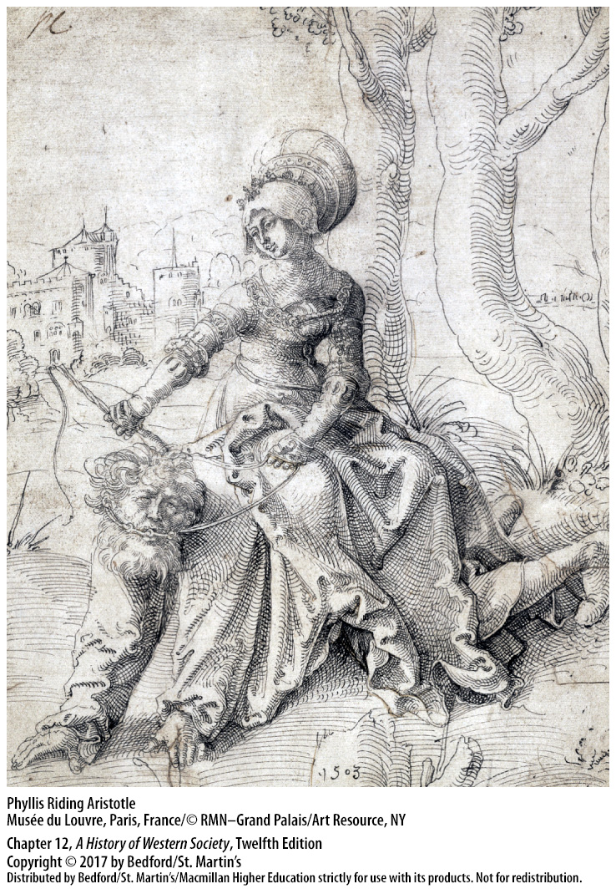

Slide 37
IV. Social Hierarchies
Gender Roles
“True” men were married heads of household
Women were “married or to be married”
Disorder in the gender hierarchy was linked with social upheaval and threatening
Gender hierarchy viewed as the most “natural” social hierarchy
Notes:
IV. Social Hierarchies
C. Gender Roles
8. The dominant notion of the “true” man was that of the married head of household; unmarried men whose social status and age would have normally conferred political power did not participate in politics to the same level.
9. Women also were understood as “married or to be married,” which meant that women’s work was not viewed as supporting a family—even if it did—and women who worked for wages earned about half to two-thirds of what men did, even for the same work.
10. Maintaining power relationships in which men were dominant and women subordinate symbolized the proper functioning of society, and disorder in the gender hierarchy was linked with social upheaval and viewed as threatening.
11. Of all the ways in which Renaissance society was hierarchically arranged—social rank, age, level of education, race, occupation—gender was regarded as the most “natural” and thus the most important to defend.

Slide 38
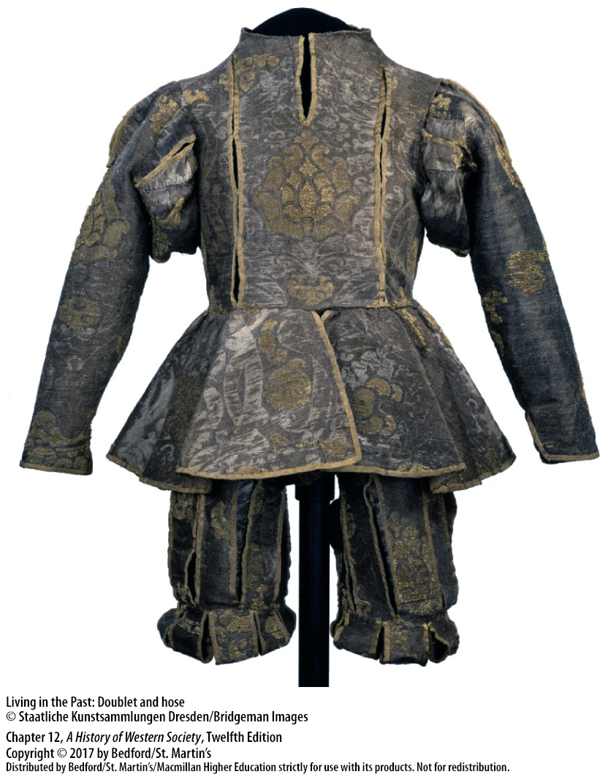

Slide 39
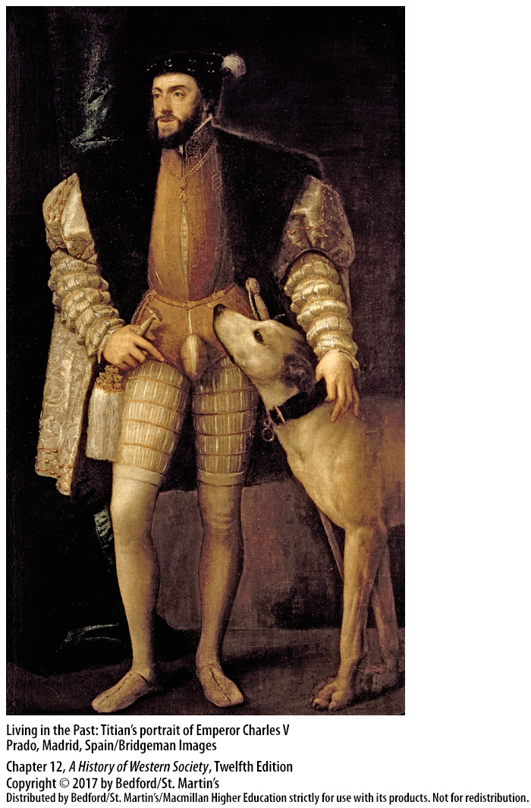

Slide 40
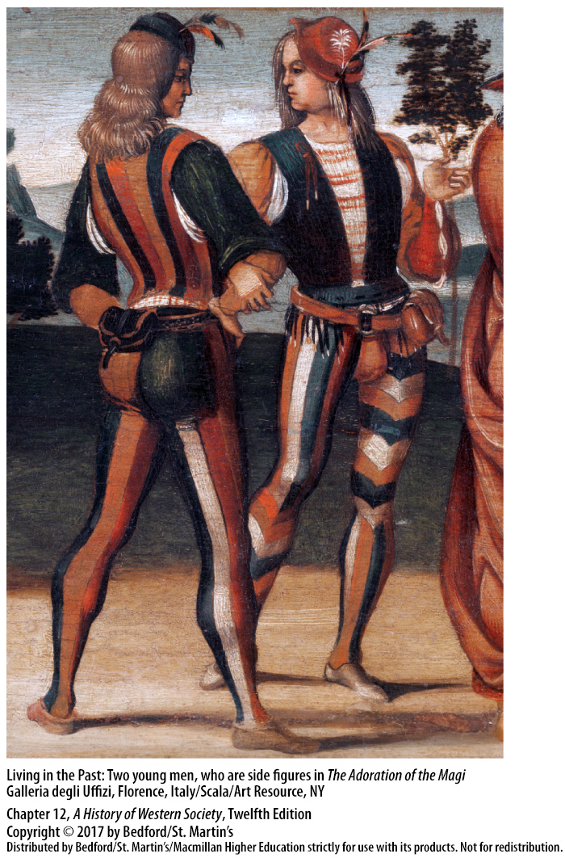

Slide 41
V. Politics and the State in Western Europe
France
Charles VIII (r. 1422 – 1461)
Expelled English, reorganized royal council, strengthened royal finances
Created the first permanent royal army
Louis XI (r. 1461 – 1483)
Marriage of Louis XII (r. 1498 – 1515) to Anne of Brittany further enlarged the state of France
The Concordat of Bologna in 1516
Notes:
V. Politics and the State in Western Europe
France
1. The Black Death and the Hundred Years’ War left France drastically depopulated, commercially ruined, and agriculturally weak, but Charles VII (r. 1422–1461) revived the monarchy and France.
2. By reconciling warring factions within France, expelling the English, reorganizing the royal council, and strengthening royal finances through taxes on certain products and land, Charles began France’s recovery.
3. Charles also created the first permanent royal army anywhere in Europe.
4. Louis XI (r. 1461–1483) used the army to control nobles’ militias and to conquer Burgundy, and he gained other territory through inheritance.
5. The marriage of Louis XII (r. 1498–1515) to Anne of Brittany further enlarged the state of France.
6. In the Concordat of Bologna in 1516, French king Francis I and Pope Leo X reached an agreement that allowed the French ruler to select bishops and abbots and, thus, control the policies of church officials.

Slide 42
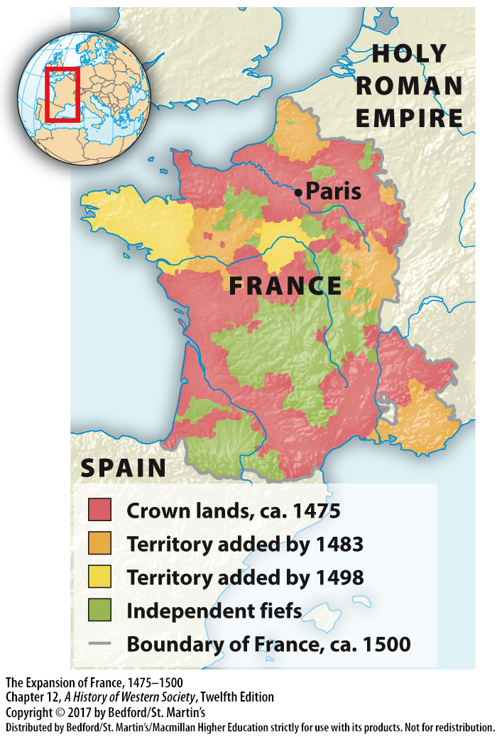

Slide 43
V. Politics and the State in Western Europe
England
Henry IV (r. 1399 – 1413)
Machiavellian methods
Foreign diplomacy
Henry VII’s royal council
The Court of Star Chamber
Henry VII died in 1509
Notes:
V. Politics and the State in Western Europe
B. England
1. The aristocracy dominated the government of Henry IV (r. 1399–1413) and indulged in disruptive violence at the local level.
2. Edward IV (r. 1461–1483), his brother Richard III (r. 1483–1485), and Henry VII (r. 1485–1509) used Machiavellian methods to reconstruct the monarchy, restore royal prestige, crush the power of the nobility, and establish order and law at the local level.
3. Edward IV and subsequently the Tudors, except Henry VIII, conducted foreign policy on the basis of diplomacy, avoiding expensive wars and thus undercutting Parliament’s influence.
4. Because Henry VII distrusted much of the nobility, he chose small landowners and urban residents trained in law to be members of his royal council, which governed at the national level.
5. The council dealt with real or potential aristocratic threats through a judicial offshoot, the Court of Star Chamber, which employed methods that ran counter to English common-law precedents but effectively reduced aristocratic troublemaking.
6. When Henry VII died in 1509, he left a country at peace both domestically and internationally, a substantially augmented treasury, an expanding wool trade, and a crown with its dignity and role much enhanced.

Slide 44
V. Politics and the State in Western Europe
Spain
Isabella of Castile and Ferdinand of Aragon
Entry into Granada; the end of the reconquista
Resentment of Jewish influence and wealth
Anti-Semitic progroms
Conversos, or New Christians
Inquisition established in 1478
Notes:
V. Politics and the State in Western Europe
C. Spain
1. The marriage of the dynamic and aggressive Isabella of Castile and the crafty and persistent Ferdinand of Aragon constituted a dynastic union of two royal houses, not the political union of two peoples.
2. The victorious entry of Ferdinand and Isabella into Granada on January 6, 1492, signaled the conclusion of the reconquista.
3. The majority of Spanish people viewed the Jews as potentially dangerous. Even though Jewish industry, intelligence, and money had supported royal power and financed many Christian businesses and ventures, a strong undercurrent of resentment of Jewish influence and wealth festered.
4. Anti-Semitic pogroms swept the towns of Spain in the fourteenth century, and perhaps 40 percent of the Jewish population was killed or forced to convert.
5. Those converted—conversos, or New Christians—were often well educated and held prominent positions in government, the church, medicine, law, and business. Aristocrats resented their financial dependence on conversos; the poor hated the converso tax collectors, and churchmen doubted the sincerity of their conversions.
6. In 1478 Queen Isabella and Ferdinand established their own Inquisition to “search out and punish converts from Judaism who had transgressed against Christianity by secretly adhering to Jewish beliefs and performing rites of the Jews.”

Slide 45
V. Politics and the State in Western Europe
Spain
7. Officials claimed that Jews could never be true Christians
8. “Purity of blood” laws
9. All practicing Jews expelled from Spain (1492)
10. Muslims in Granada were forcibly baptized and investigated by the Inquisition
11. Absolute religious orthodoxy and purity of blood
12. Portugal joined to the Spanish crown in 1580
Notes:
V. Politics and the State in Western Europe
C. Spain
7. Because most conversos identified as sincere Christians, officials of the Inquisition argued that a person’s status as a Jew was in their blood and was heritable, so Jews could never be true Christians.
8. “Purity of blood” laws made having pure Christian blood a requirement for noble status.
9. In 1492 Isabella and Ferdinand issued an edict expelling all practicing Jews from Spain.
10. Many Muslims in Granada were forcibly baptized and became another type of New Christian investigated by the Inquisition.
11. Absolute religious orthodoxy and purity of blood served as the theoretical foundation of the Spanish national state, while marital politics, as well as military victories and religious courts, upheld it.
12. Charles’s son Philip II joined Portugal to the Spanish crown in 1580, politically uniting the Iberian Peninsula.

Slide 46
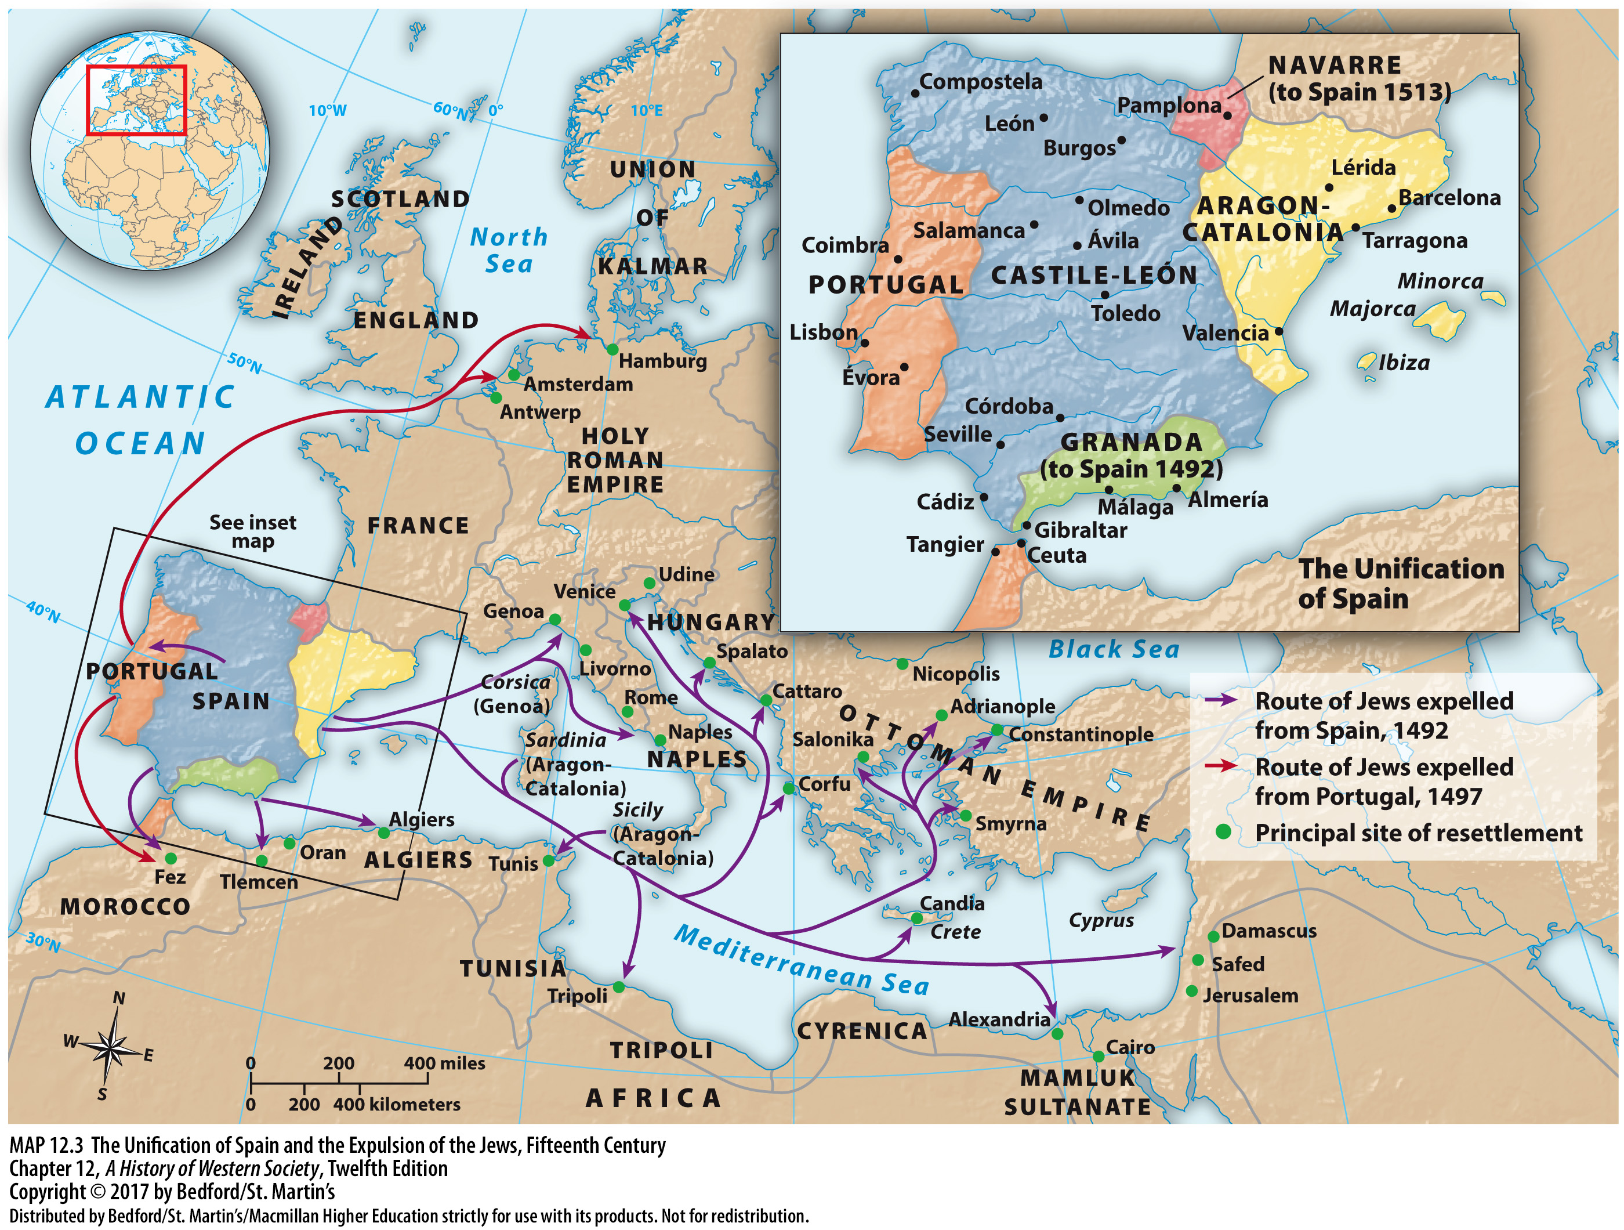

Slide 47
