Slide 1
A History of Western Society Twelfth Edition
McKay • Crowston • Wiesner-Hanks • Perry
CHAPTER 11
The Later Middle Ages
1300–1450
Copyright © 2017 by Bedford/St. Martin’s
Distributed by Bedford/St. Martin's/Macmillan Higher Education strictly for use with its products; Not for redistribution.

Slide 2
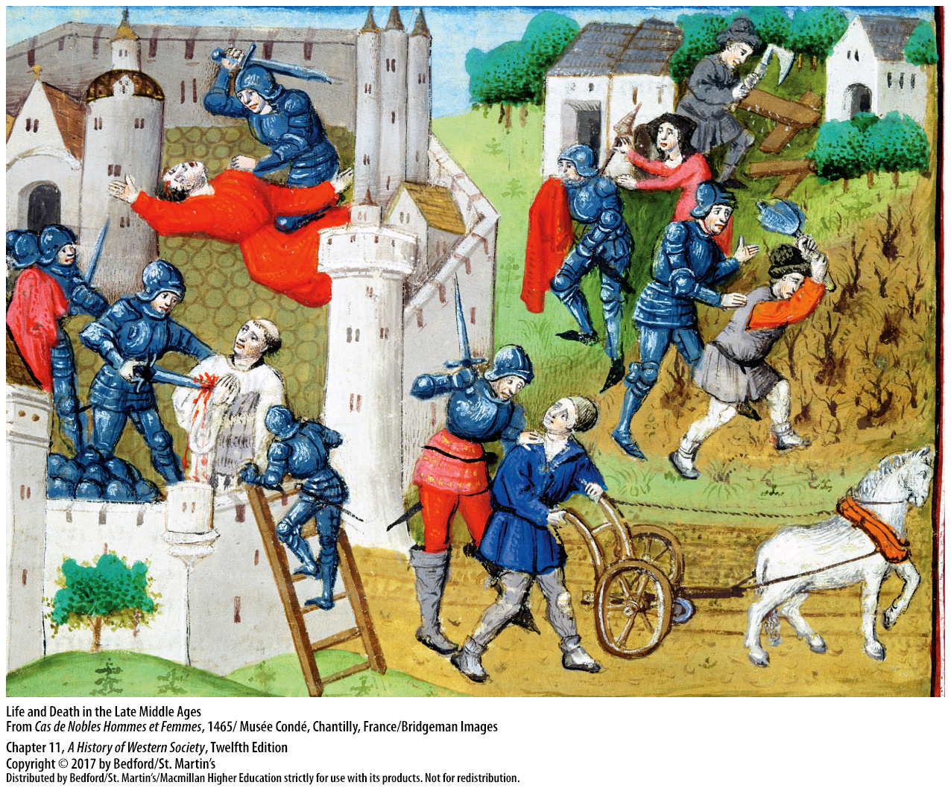

Slide 3
I. Prelude to Disaster
Climate Change and Famine
Little ice age
Storms, poor harvests, scarcity and starvation
Great Famine
Notes:
Prelude to Disaster
Climate Change and Famine
1. About 1300 the climate in Europe became colder and wetter, beginning a period that historical geographers refer to as a “little ice age.”
2. An unusual number of storms ruined wheat, oat, and hay crops, resulting in poor harvests that led to scarcity and starvation.
4. Almost all of northern Europe suffered a “Great Famine” in the years 1315 to 1322.

Slide 4
I. Prelude to Disaster
Climate Change and Famine
The cost of food rose sharply
Increased susceptibility to disease
Lower productivity, lower output, and higher grain prices
Notes:
Prelude to Disaster
Climate Change and Famine
5. Even in non-famine years, the cost of grain, livestock, and dairy products rose sharply, meaning fewer people could afford to buy food.
6. Reduced caloric intake meant increased susceptibility to disease, especially for infants, children, and the elderly.
7. Workers on reduced diets had less energy, which in turn meant lower productivity, lower output, and higher grain prices.

Slide 5
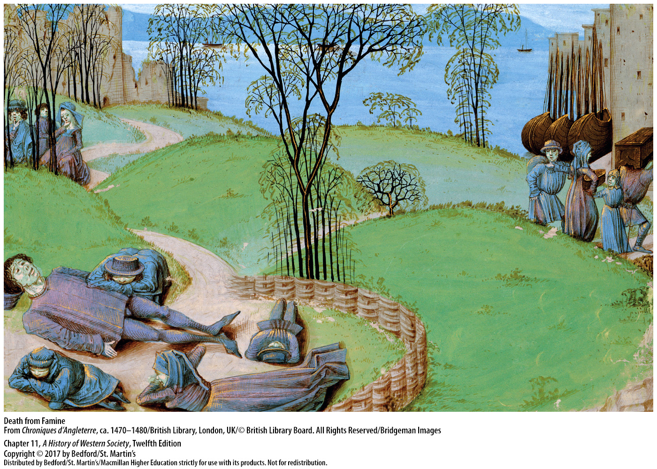

Slide 6
I. Prelude to Disaster
Social Consequences
Agrarian crisis
Population decline
Anger towards the rich, speculators, and the Jews
Rumors of a Jewish plot to kill Christians
Notes:
Prelude to Disaster
B. Social Consequences
1. The changing climate and resulting agrarian crisis of the fourteenth century led to the abandonment of homesteads and even entire villages as many people became vagabonds, wandering in search of food and work.
2. Overall, the population declined because of the deaths caused by famine and disease, though the postponement of marriages as young men and women sought work in the towns and the resulting decline in offspring also may have played a part.
3. As the subsistence crisis deepened, starving people focused their anger on the rich, speculators, and Jews, who were often targeted as creditors fleecing the poor through pawnbroking.
4. Rumors spread of a plot by Jews and their agents, the lepers, to kill Christians by poisoning wells, and many lepers and Jews were killed, beaten, or fined.

Slide 7
I. Prelude to Disaster
Social Consequences
Local disasters had international consequences for trade and commerce
Unemployment encouraged crime
Ineffective government responses
Notes:
Prelude to Disaster
B. Social Consequences
6. The international character of trade and commerce meant that a disaster in one country had serious implications elsewhere. For example, an infection attacked English sheep in 1318, resulting in a sharp decline in wool exports that put Flemish weavers out of work and thus hurt the businesses of Flemish, Hanseatic, and Italian merchants.
8. Unemployment encouraged people to turn to crime.
9. Government responses to these crises—condemning speculators, forbidding exports of grain, setting price controls, attempting to import grain—were ineffectual.

Slide 8
II. The Black Death
Pathology
Bacillus Yersinia pestis
Flees and rats spread the bacteria
In the 1890s doctors began to understand the cycle of infection
Some historians question whether the Black Death was actually the bubonic plague
Notes:
II. The Black Death
Pathology
1. Most historians and microbiologists identify the disease that spread in the fourteenth century as the bubonic plague, caused by the bacillus Yersinia pestis, a disease that normally afflicts rats.
2. Fleas living on the infected rats drink their blood and then pass the bacteria that cause the plague on to the next animal or human they bite.
3. Only in the 1890s, during another outbreak, did doctors and epidemiologists identify the bacillus as bubonic plague and come to understand the cycle of infection.
4. Because of differences between the nineteenth- and fourteenth-century outbreaks, some historians have questioned whether the Black Death was, in fact, the bubonic plague.

Slide 9
II. The Black Death
Pathology
Coughing, sneezing, flea bites
The bubo
Black spots or blotches
Death followed two or three days after coughing and spitting blood
Coughing also released pathogens into the air, infecting others who breathed them
Notes:
II. The Black Death
Pathology
6. The medieval plague was often transmitted directly from one person to another through coughing and sneezing as well as through flea bites.
7. The classic symptom of the bubonic plague was an agonizingly painful growth (the bubo) the size of a nut or an apple in the armpit, in the groin, or on the neck.
8. If the bubo was not lanced and drained, the next stage was the appearance of black spots or blotches caused by bleeding under the skin.
9. Finally, the victim began to cough violently and spit blood, indicating the presence of millions of bacilli in the bloodstream; death followed within two or three days.
10. The coughing also released pathogens into the air, infecting others who breathed them.

Slide 10
II. The Black Death
Spread of the Disease
From southwestern China in 1331 to ports of the Black Sea by the 1340s
Urban conditions ideal for spread of disease
Estimated one-third mortality rate in first wave
The plague came back intermittently in Europe until 1721, though never with the same strength
Streptomycin, discovered in 1947 by Selman Waksman
Notes:
II. The Black Death
B. Spread of the Disease
1. Plague symptoms were first described in 1331 in southwestern China; plague-infested rats accompanied Mongol armies and merchant caravans across central Asia in the 1330s and then boarded ships that carried the disease to the ports of the Black Sea by the 1340s.
2. Medieval urban conditions proved ideal for the spread of disease.
3. Mortality rates can be only educated guesses because population figures do not exist for most countries and cities in the pre-plague period, but the most widely accepted estimate is that one-third of the population of western Europe and the Mediterranean died in the first wave of infection.
4. Across Europe the Black Death recurred intermittently in the following centuries, though never with the same virulence because Europeans had built up some resistance. Improved standards of hygiene and quarantine measures also lessened the plague’s toll, but the plague continued to appear in Europe until 1721.
5. In 1947 the American microbiologist Selman Waksman discovered an effective treatment, streptomycin.

Slide 11
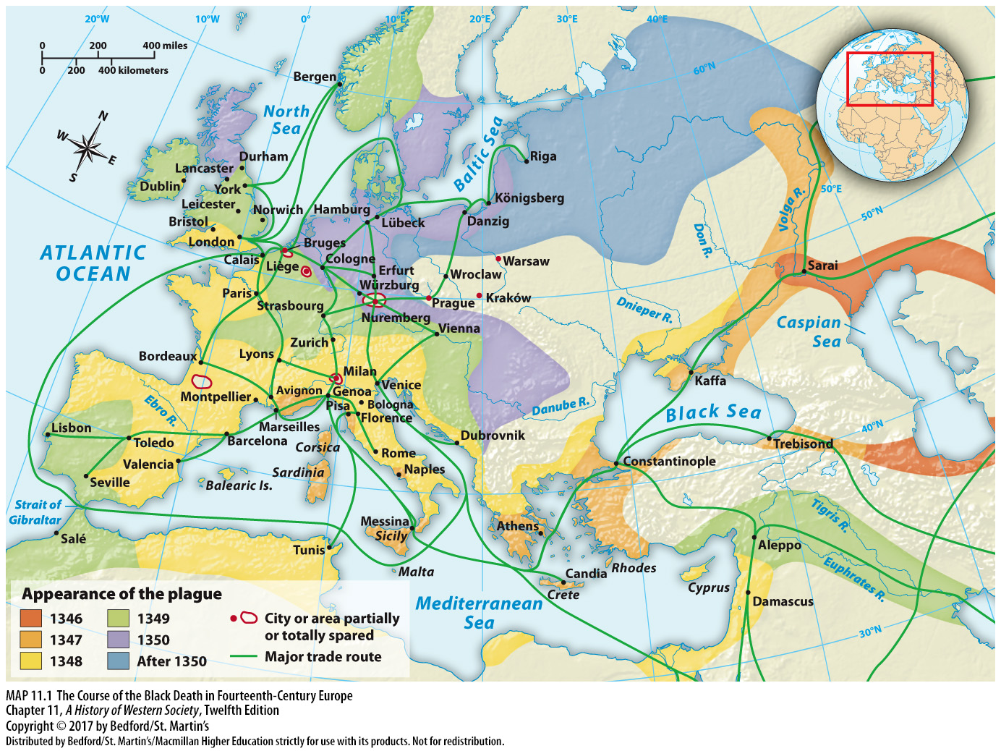

Slide 12
II. The Black Death
Care of the Sick
Physicians thought crowded cities had high death rates due to “corrupted air”
Treatment focused on ridding the air and body of these poisons to rebalance bodily fluids
Giovanni Boccaccio (1313-1375), The Decameron
Wealthier people fled to the countryside; some cities tried shutting their gates
Notes:
II. The Black Death
C. Care of the Sick
1. Fourteenth-century medical literature indicates that physicians tried many different things to prevent and treat the plague. They observed that crowded cities had high death rates, especially when the weather was warm and moist, but they thought in terms of “poisons” in the air or “corrupted air” that caused fluids in the body to become unbalanced.
2. Treatment focused on ridding the air and body of these poisons and rebalancing bodily fluids. People tried anything they thought might help: ringing church bells, firing cannons, taking medicines made from oozing plants, and creating cryptograms.
3. Descriptions of the course of the disease by Giovanni Boccaccio (1313–1375) in The Decameron reveal that many realized the disease passed from person to person.
4. To avoid contagion, wealthier people often fled cities for the countryside, though sometimes this simply spread the plague faster. Some cities tried shutting their gates to prevent infected people and animals from entering, which worked in a few places; others walled up houses in which there was plague in an attempt to isolate the sick.

Slide 13
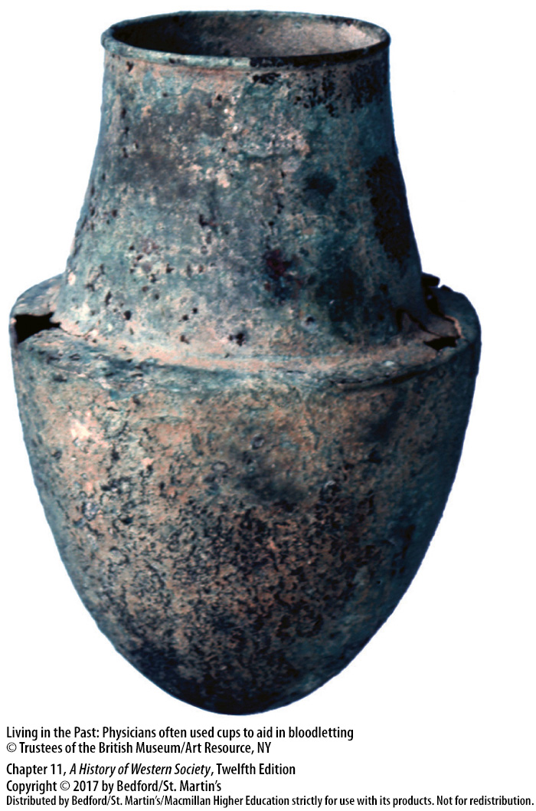

Slide 14
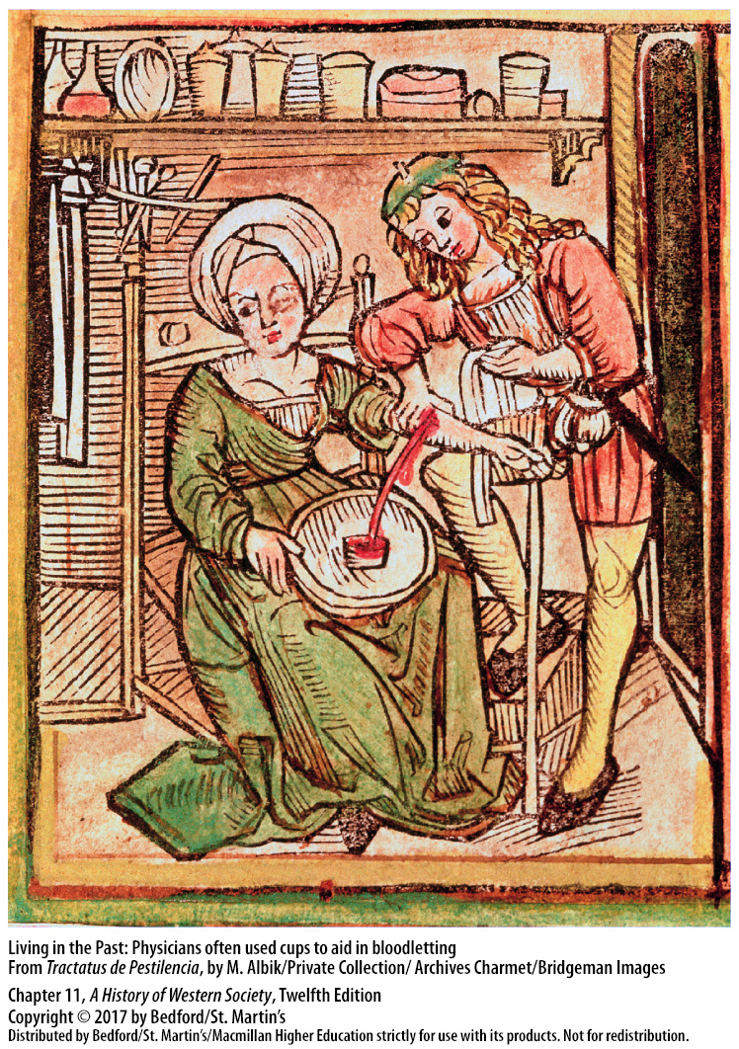

Slide 15
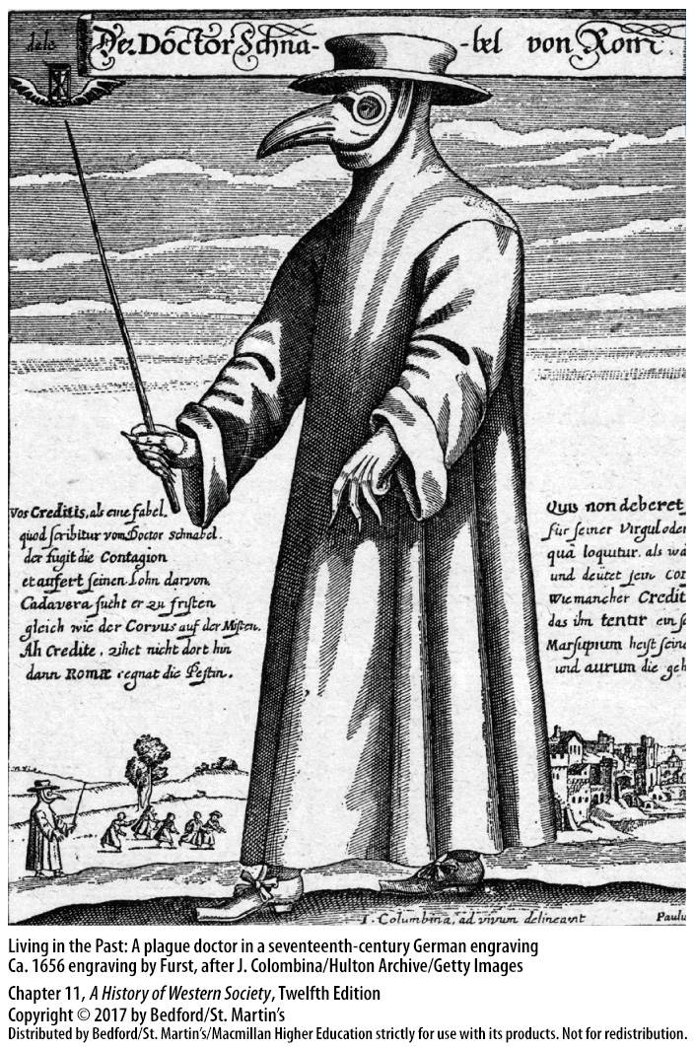

Slide 16
II. The Black Death
Economic, Religious, and Cultural Effects
Not as disastrous as traditionally thought
Less fertile land was abandoned, which promoted more specialized types of agriculture
Labor shortages led to workers demanding greater wages
Greater mobility for peasants and artisans
Notes:
II. The Black Death
D. Economic, Religious, and Cultural Effects
1. The traditional view that the plague had a disastrous effect has been greatly modified.
2. Evidence seems to indicate that population losses allowed less fertile land to be abandoned and promoted more specialized types of agriculture, which ultimately proved a better use of the land.
3. The Black Death brought on a European-wide inflation, but labor shortages meant that workers could demand better wages, and those who survived enjoyed a higher standard of living.
4. The greater demand for labor also meant greater mobility for peasants and artisans.

Slide 17
II. The Black Death
Economic, Religious, and Cultural Effects
Grief could lead to wild living or deep piety
The plague was seen as God’s punishment
Flagellants whipped themselves for penance
Scapegoats: Jews expelled and murdered due to a belief that they infected the drinking water
Notes:
II. The Black Death
D. Economic, Religious, and Cultural Effects
6. People’s sadness at the loss of their loved ones, especially their children, led some to seek release from the devastating affliction in wild living, but more became more deeply pious.
7. Rather than seeing the plague as a medical issue, people interpreted it as God’s punishment for their terrible sins and sought remedy through prayer, donations to churches, and efforts to live better lives.
8. Some Christians turned to the severest forms of asceticism and frenzied religious fervor, joining groups of flagellants, who whipped and scourged themselves as penance for their and society’s sins.
10. People also searched for scapegoats, and many came to believe that the Jews had infected the drinking water, which led to the expulsion and murder of thousands of Jews across Europe.

Slide 18
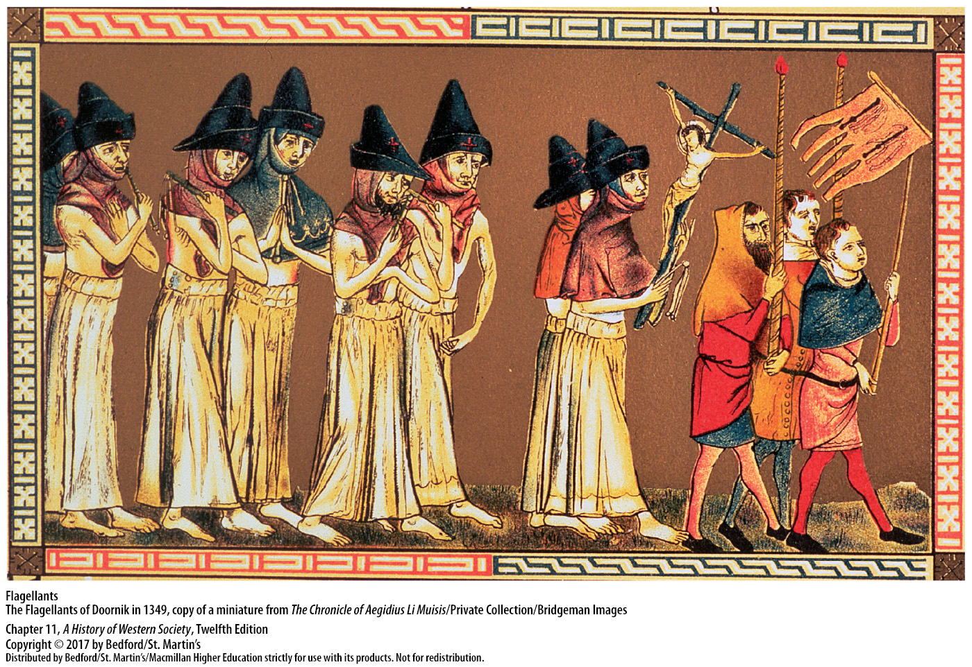

Slide 19
II. The Black Death
Economic, Religious, and Cultural Effects
Morbid concern with death in art and literature
The Dance of Death
Universities established due to shortage of priests and the decay of learning
More national and local institutions, which weakened international relations
Plague highlighted the central qualities of medieval society
Notes:
II. The Black Death
D. Economic, Religious, and Cultural Effects
11. The literature and art of the late Middle Ages reveal a terribly morbid concern with death.
12. A popular literary and artistic motif, the Dance of Death, depicted a dancing skeleton leading away living people.
13. New colleges and universities were founded whose charters specifically cited the shortage of priests and the decay of learning as reasons for their establishment.
14. These new institutions had more national and local constituencies, which weakened the international character of medieval culture.
15. As is often true with devastating events, the plague highlighted central qualities of medieval society: deep religious feeling, suspicion of those who were different, and a view of the world shaped largely by oral tradition, with a bit of classical knowledge mixed in among the educated elite.

Slide 20
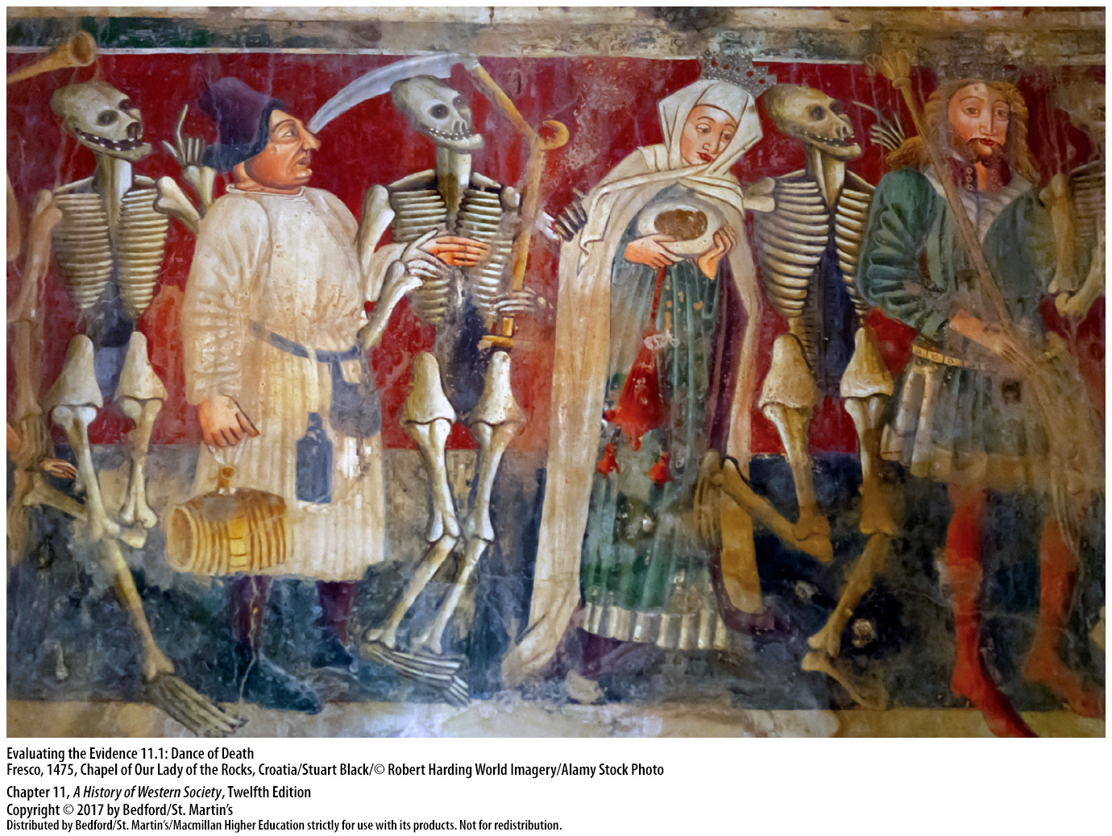

Slide 21
III. The Hundred Years’ War
Causes
Disagreements over land rights, the succession to the French throne, and economic conflicts
Both governments manipulated public opinion to support the war with royal propaganda
Opportunities for wealth and advancement for knights, criminals, and nobles
Notes:
III. The Hundred Years’ War
Causes
1. Causes of the Hundred Years’ War included disagreements over rights to land, a dispute over the succession to the French throne, and economic conflicts.
2. The governments of both England and France manipulated public opinion to support the war.
3. The war also presented opportunities for wealth and advancement: knights were promised regular wages, criminals were granted pardons, and great nobles were rewarded with estates; royal exhortations before battles repeatedly stressed that, if victorious, the troops might keep whatever they seized.

Slide 22
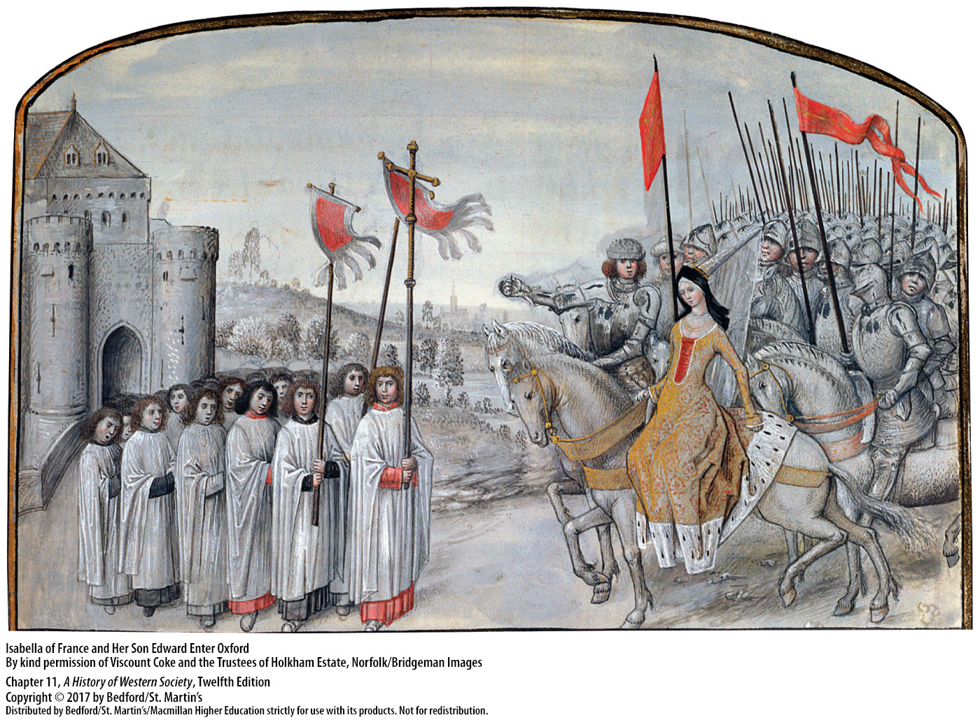

Slide 23
III. The Hundred Years’ War
English Successes
England highly successful in early stages with cannon and longbow
Brief peace before France recovered some territory
Henry V (r. 1413 – 1422)
By 1419 the English had advanced to the walls of Paris
Notes:
III. The Hundred Years’ War
B. English Successes
1. During the war’s early stages, England was highly successful. At Crécy in northern France in 1346, English longbowmen scored a great victory over French knights and crossbowmen. The English use of the cannon and longbow, which allowed for rapid reloading, unhorsed French horsemen and caused mass confusion and panic. Edward was not able to take all of France, but the English held Aquitaine and other provinces and allied themselves with many of France’s nobles.
2. After a brief peace, the French fought back and recovered some territory, and a treaty again halted hostilities as both sides concentrated on conflicts over power at home.
3. War began again in 1415 when an army led by the able English soldier-king Henry V (r. 1413–1422) invaded France and defeated a much larger French force at Agincourt, which Henry followed up with the reconquest of Normandy.
4. By 1419 the English had advanced to the walls of Paris.

Slide 24
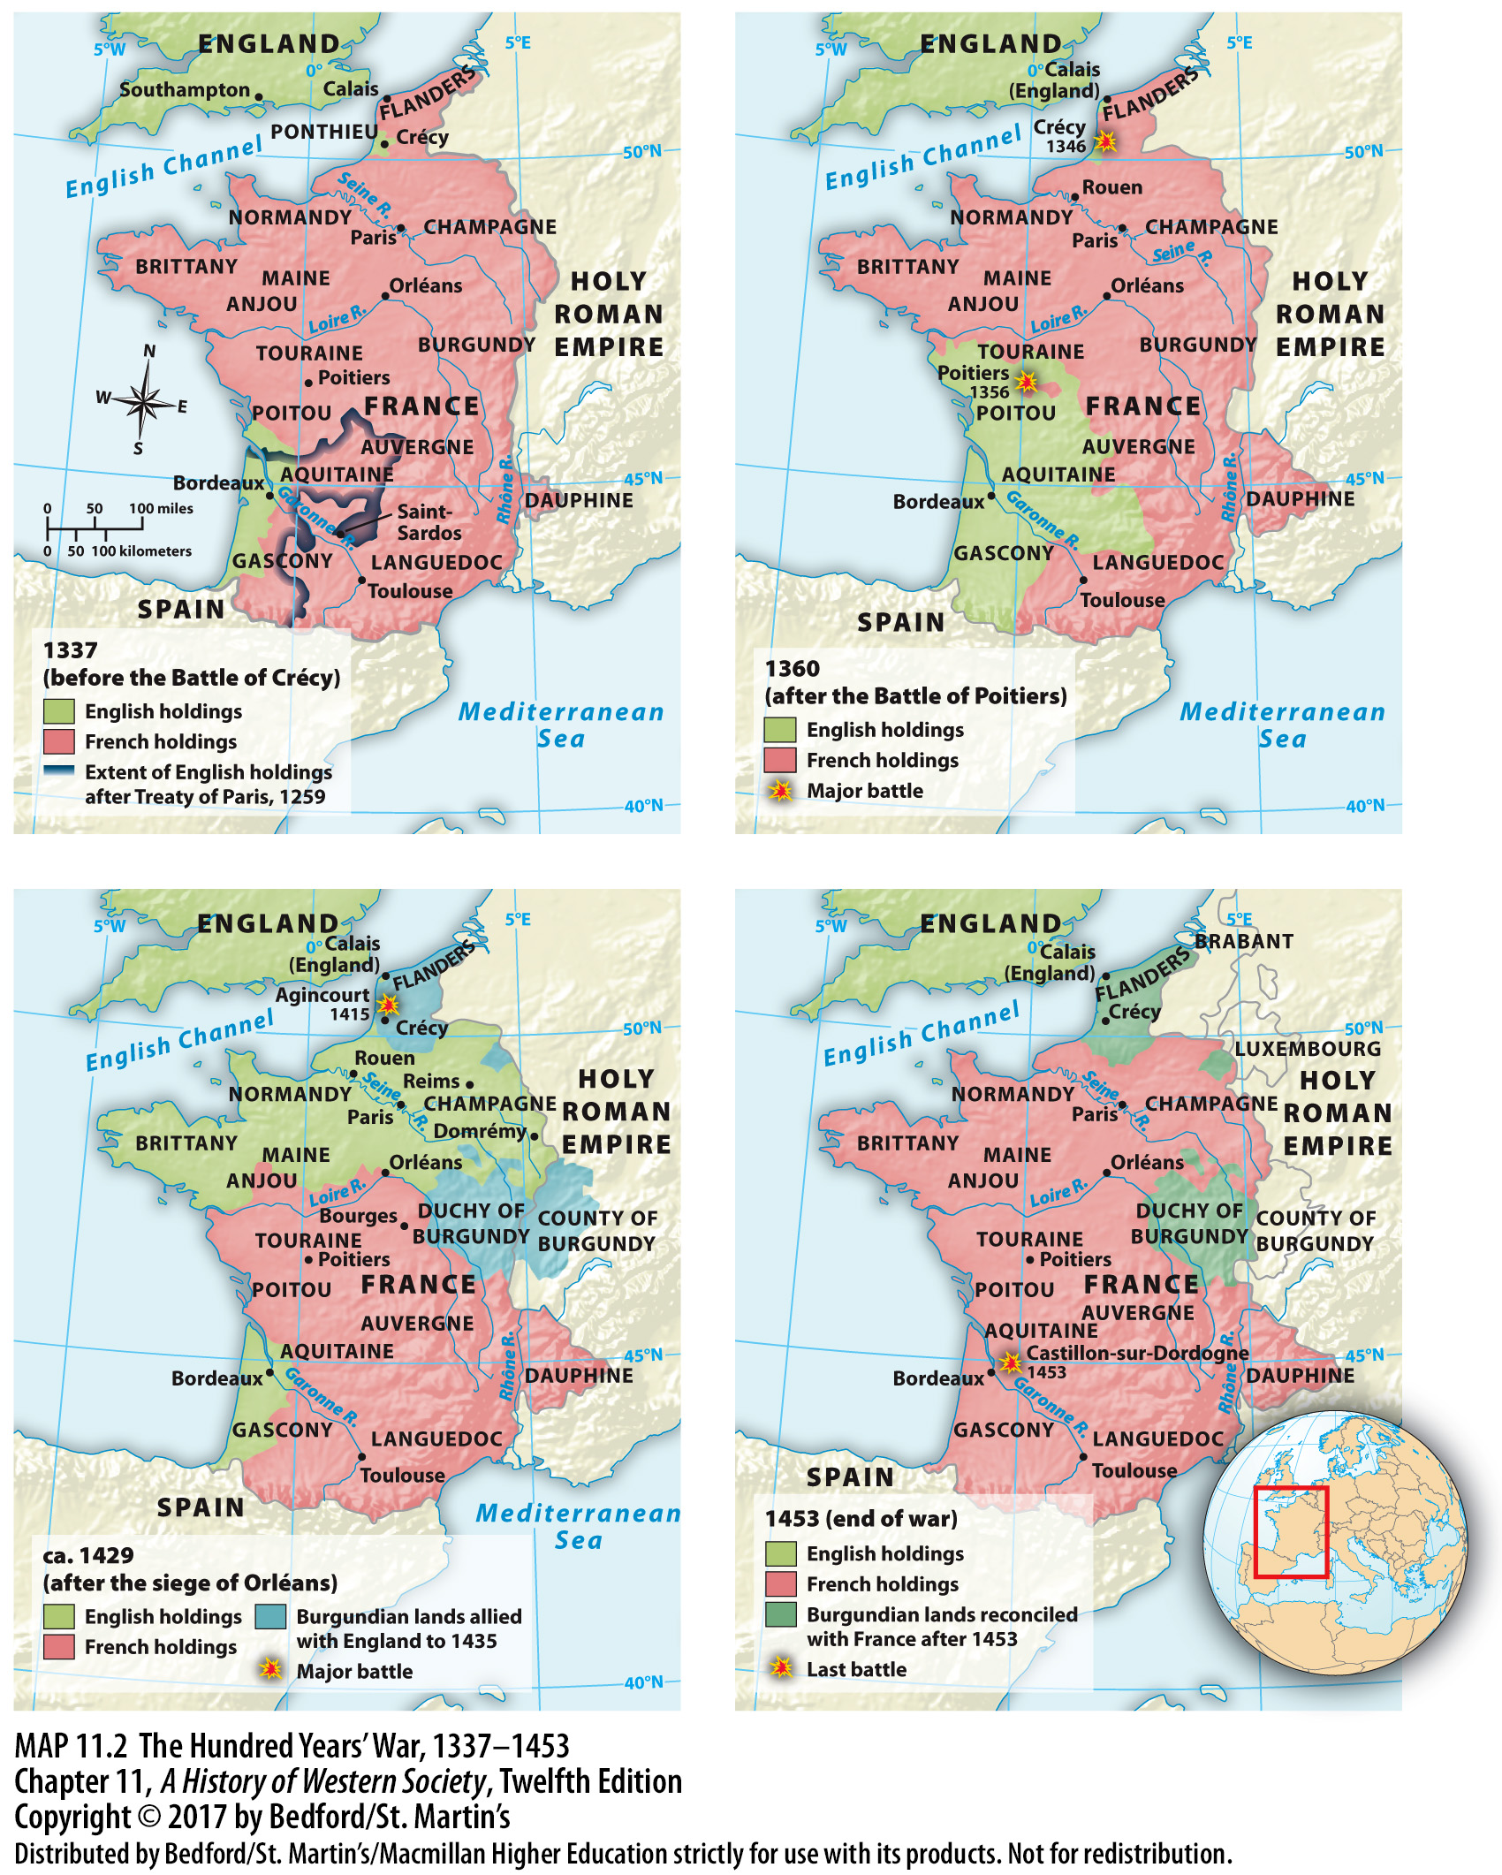

Slide 25
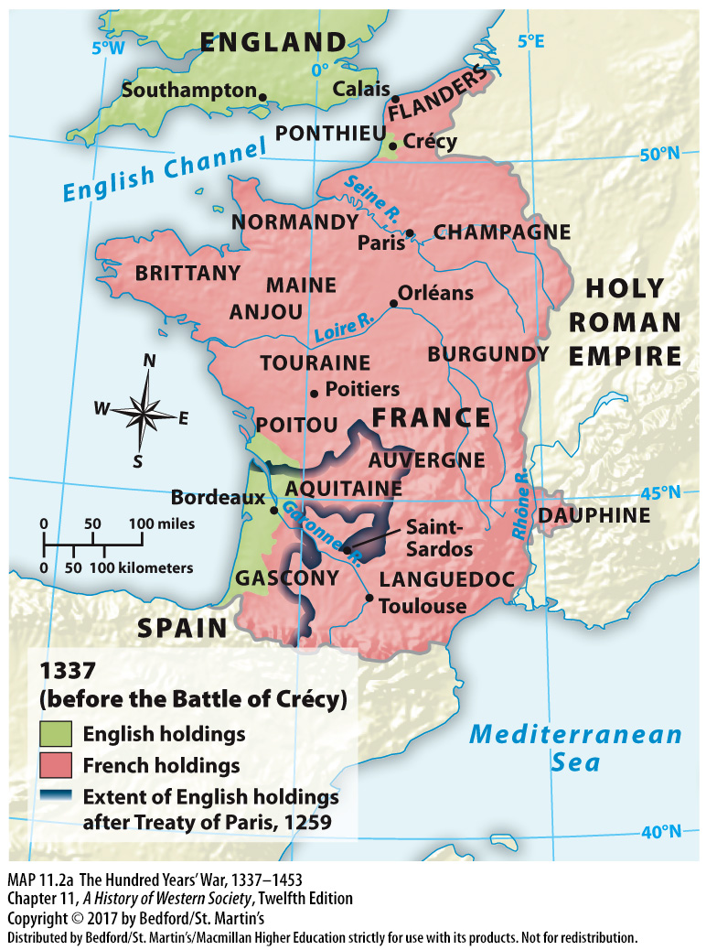

Slide 26
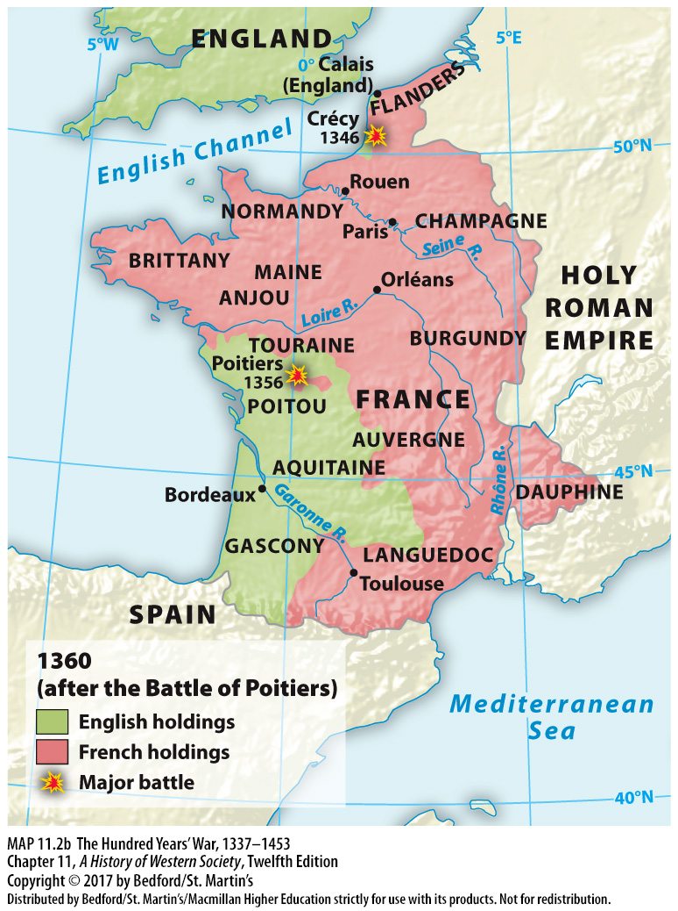

Slide 27
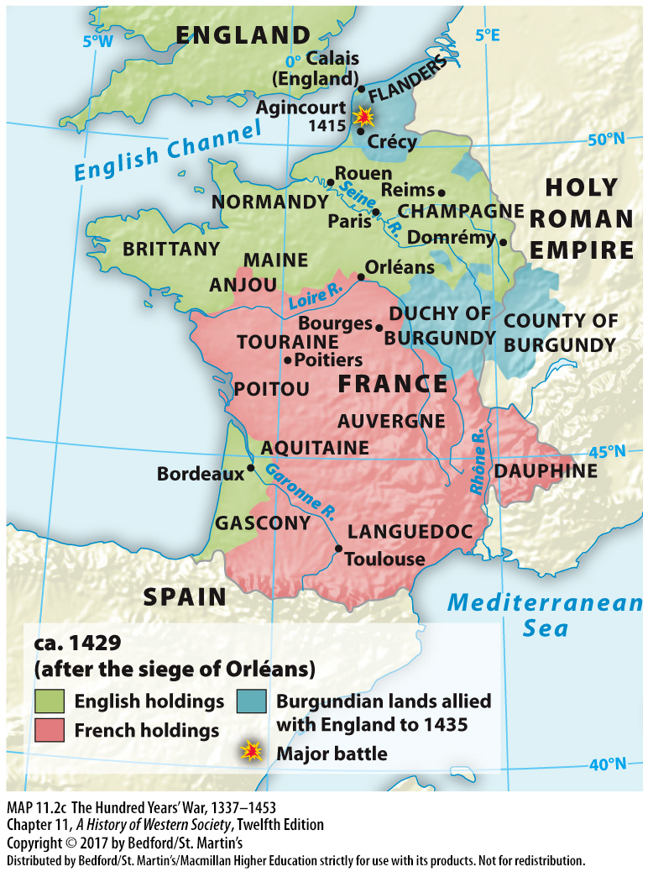

Slide 28
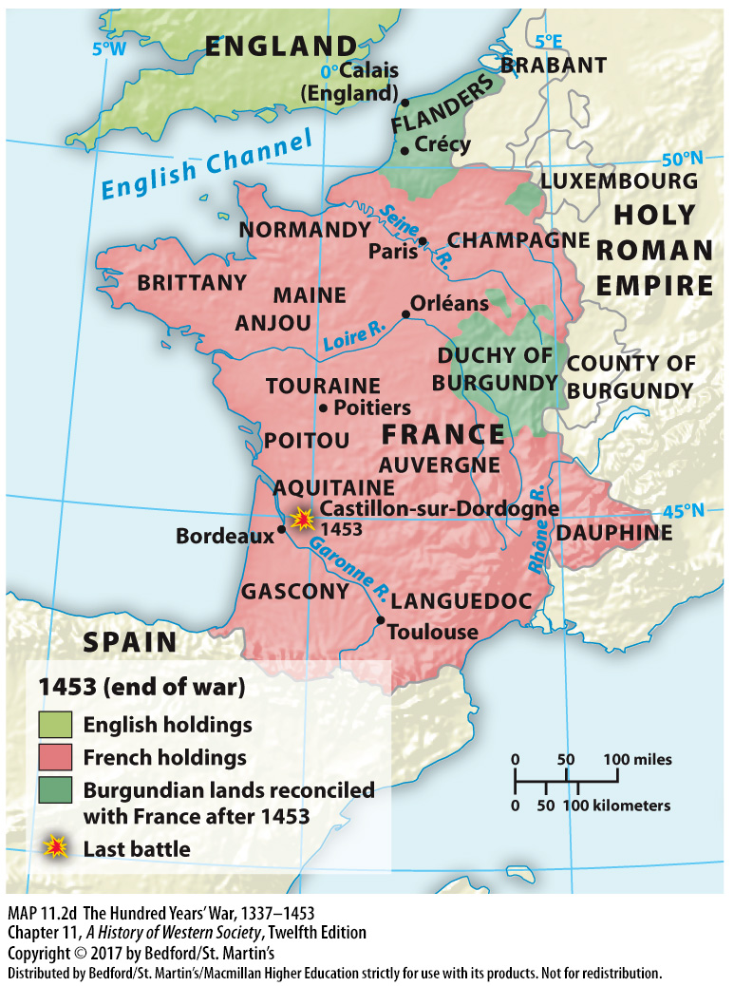

Slide 29
III. The Hundred Years’ War
Joan of Arc and France’s Victory
Joan “of Arc” (1412-1431)
“The Maid” sent by God
Co-commander of the army; string of victories
Charles VII crowned king at Reims in July 1429
The English charged her with heresy and burned her at the stake in Rouen in 1430
Notes:
III. The Hundred Years’ War
C. Joan of Arc and France’s Victory
1. The ultimate French success rests on the actions of a peasant girl, Joan “of Arc” (1412–1431), who came from a religious household in Champagne and whose visions and military leadership revived French fortunes and led to victory.
2. During adolescence Joan began to hear voices that told her the dauphin (the uncrowned King Charles VII) had to be crowned and the English expelled from France. Joan traveled secured Charles’s support to travel with the French army to Orléans dressed as a knight. There Joan dictated a letter to the English, ordering them to surrender to “The Maid,” as she called herself, sent by God.
3. The king made Joan co-commander of the entire army, and she led it to a string of military victories; other cities simply surrendered without a fight and returned their allegiance to France.
4. In July 1429, two months after the end of the siege of Orléans, Charles VII was crowned king at Reims.
5. In 1430 the Burgundians captured Joan; Charles refused to ransom her, and she was sold to the English, who charged her with heresy in a church court and burned her at the stake in Rouen.

Slide 30
III. The Hundred Years’ War
Joan of Arc and France’s Victory
6. The parliamentary grew opposed to the war
7. At the war’s end in 1453, English only kept Calais
8. Joan was declared a martyr in 1456 and became a political symbol of France
Notes:
III. The Hundred Years’ War
C. Joan of Arc and France’s Victory
6. As loss of life mounted and more money was spent, Parliamentary opposition mounted, fewer soldiers were sent, and more territory passed into French hands.
7. At the war’s end in 1453, only the town of Calais remained in English hands.
8. In 1456 Charles VII requested that the pope conduct a new trial of Joan; the pope cleared her of all charges and declared her a martyr. Pious and popular legends aside, Joan, a teenage girl who saved the French monarchy, became a political symbol of France.

Slide 31
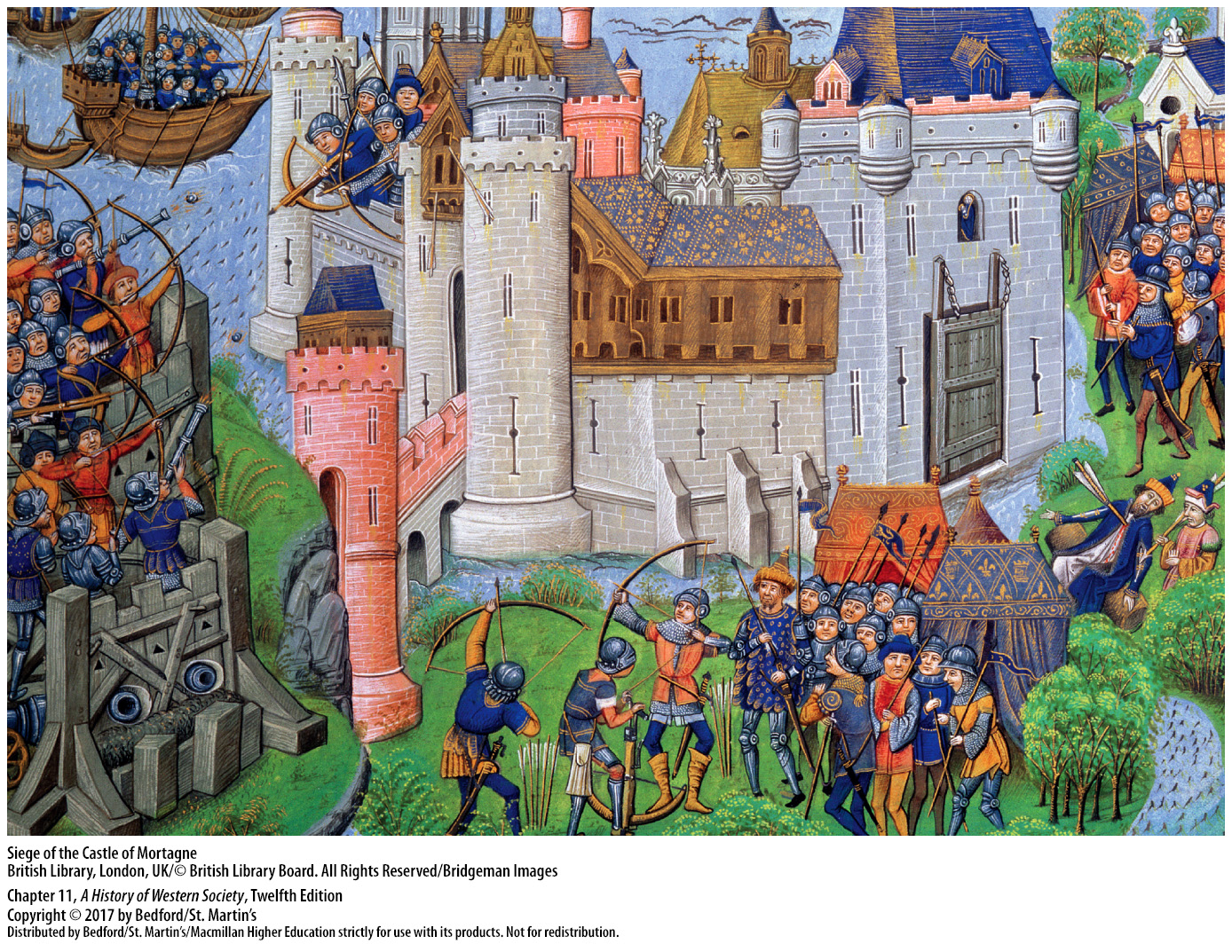

Slide 32
III. The Hundred Years’ War
Aftermath
French rural economy in shambles
England spent more than £5 million on the war
Social order disrupted in both countries
The cannon revolutionized warfare, and strengthened military power of national states
The cost of the war stimulated the development of the English Parliament
Notes:
III. The Hundred Years’ War
D. Aftermath
1. In France thousands of soldiers and civilians had been slaughtered and hundreds of thousands of acres of rich farmland were ruined, leaving the rural economy in shambles. The war disrupted trade and drastically reduced French participation in international commerce, and the heavy taxes that financed war aggravated peasant grievances.
2. England suffered an enormous financial loss after spending more than £5 million on the war effort. When the government raised taxes on the wool crop as a way to finance the war, it priced wool out of the export market.
3. In both England and France, the social order was disrupted as the knights who ordinarily served as sheriffs, coroners, jurymen, and justices of the peace were abroad.
4. The war stimulated technological experimentation, especially with artillery, and cannon revolutionized warfare, making the stone castle no longer impregnable. Because only central governments, not private nobles, could afford cannon, their use strengthened the military power of national states.
5. The long war and Edward III’s constant need for money to pay for it stimulated the development of the English Parliament, although representative assemblies declined in other countries after 1450.

Slide 33
III. The Hundred Years’ War
Aftermath
6. Parliamentary statute of 1341
7. No similar national representative assembly developed in France
8. Nationalism grew in both countries
Notes:
III. The Hundred Years’ War
D. Aftermath
6. The Commons—knights and wealthy urban residents—gradually realized that they held the country’s purse strings, and a parliamentary statute of 1341 required that most new taxes have parliamentary approval. When he signed the law, Edward III acknowledged Parliament’s power.
13. No similar national representative assembly developed in France, mostly because the regional and provincial assemblies, highly jealous of their independence, did not want a national assembly and because Charles VI found the idea distasteful.
14. In both countries, however, the war did promote the growth of nationalism—the feeling of unity and identity that binds together a people.

Slide 34
IV. Challenges to the Church
The Babylonian Captivity and Great Schism
King Philip pressured Pope Clement V to settle in Avignon permanently
The Babylonian Captivity (1309-1376)
Cut off church leadership from Rome
In 1377 Pope Gregory XI brought the papal court back to Rome, but died shortly after
Pope Urban VI intended to reform the church
Notes:
IV. Challenges to the Church
The Babylonian Captivity and Great Schism
1. With the death of Pope Boniface VIII and in an effort to control the church and its policies, King Philip the Fair of France pressured the new pope, Clement V, to settle permanently in Avignon in southeastern France.
2. The popes lived in Avignon from 1309 to 1376, a period in church history often called the Babylonian Captivity (referring to the seventy years the ancient Hebrews were held captive in Mesopotamian Babylon).
3. The Babylonian Captivity cut off church leadership from its historic roots and the source of its ancient authority, Rome, which badly damaged papal prestige.
4. In 1377 Pope Gregory XI brought the papal court back to Rome, but he died shortly after the return.
3. The next pope, Urban VI (pontificate 1378–1389), was a distinguished administrator and had excellent intentions for church reform, but he went about it in a tactless and bullheaded manner.
4. He attacked clerical luxury, denouncing by name and threatening with excommunication individual cardinals and bishops, who then slipped away from Rome and met at Anagni. The cardinals declared Urban’s election invalid because it had come about under threats from the Roman mob, and they excommunicated him and elected a new pope, Clement VII (pontificate 1378–1394).
9. The two popes—Urban at Rome and Clement VII at Avignon—began the Great Schism that divided Western Christendom until 1417.
10. The powers of Europe aligned themselves with Urban or Clement along strictly political lines: France, Aragon, Castile, Portugal, Scotland, and, later on, the Italian city-states supported the French pope, Clement; England and the German emperor, long-time enemies of France, recognized Urban.
11. The schism weakened the religious faith of many Christians and brought church leadership into serious disrepute.

Slide 35
IV. Challenges to the Church
The Babylonian Captivity and Great Schism
Urban VI excommunicated in 1378, replaced by Pope Clement VII
The Great Schism divided Western Christendom until 1417
Powers of Europe aligned themselves with Urban or Clement along political lines
Schism brought church leadership into disrepute
Notes:
IV. Challenges to the Church
The Babylonian Captivity and Great Schism
7. He attacked clerical luxury, denouncing by name and threatening with excommunication individual cardinals and bishops, who then slipped away from Rome and met at Anagni. The cardinals declared Urban’s election invalid because it had come about under threats from the Roman mob, and they excommunicated him and elected a new pope, Clement VII (pontificate 1378–1394).
9. The two popes—Urban at Rome and Clement VII at Avignon—began the Great Schism that divided Western Christendom until 1417.
10. The powers of Europe aligned themselves with Urban or Clement along strictly political lines: France, Aragon, Castile, Portugal, Scotland, and, later on, the Italian city-states supported the French pope, Clement; England and the German emperor, long-time enemies of France, recognized Urban.
11. The schism weakened the religious faith of many Christians and brought church leadership into serious disrepute.

Slide 36
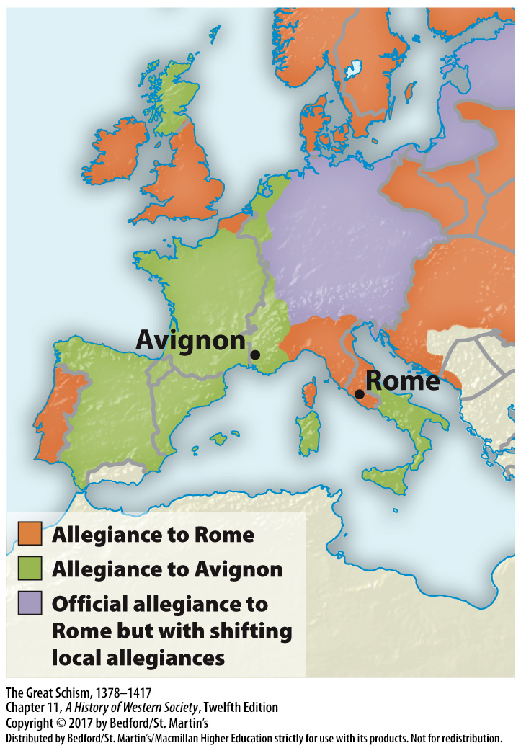

Slide 37
IV. Challenges to the Church
Critiques, Divisions, and Councils
William of Occam (1289? – 1347?)
Marsiglio of Padua (ca. 1275 – 1342)
Conciliarists believed church reform could come through period assemblies
John Wyclif (ca. 1330 – 1384)
Jan Hus (ca. 1372 – 1415)
Notes:
IV. Challenges to the Church
B. Critiques, Divisions, and Councils
1. William of Occam (1289?–1347?), a Franciscan friar and philosopher, saw the papal court at Avignon firsthand and argued vigorously against the papacy. Occam asserted that governments should have limited powers and be accountable to those they govern, and church and state should be separate.
2. The Italian lawyer and university official Marsiglio of Padua (ca. 1275–1342) agreed with Occam, claiming in his Defensor Pacis (The Defender of the Peace) that the state was the great unifying power in society and that the church should be subordinate to it.
3. These conciliarists believed that reform of the church could best be achieved through periodic assemblies, or councils, composed of clergy theologians and laypeople representing all Christian people.
4. The English scholar and theologian John Wyclif (ca. 1330–1384) went even further, arguing that Scripture alone should be the standard of Christian belief and practice and that papal claims of secular power had no foundation in the Scriptures. Wyclif wanted Christians to read the Bible for themselves and produced the first complete translation of the Bible into English.
5. A university theologian in Prague, Jan Hus (ca. 1372–1415), built on Wyclif’s ideas; Hus also denied papal authority, called for translations of the Bible into the local Czech language, and declared indulgences—papal offers of remission of penance—useless.

Slide 38
IV. Challenges to the Church
Critiques, Divisions, and Councils
Council at Pisa in 1409
Three objectives: End the schism, reform the church, and wipe out heresy
Jan Hus burned at the stake as a heretic (1415)
Deposed the Roman pope and the successor pope chosen at Pisa, electing a new pope
New Pope Martin V dissolved the council
Notes:
IV. Challenges to the Church
B. Critiques, Divisions, and Councils
6. In response to continued calls throughout Europe for a council to resolve the schism, the cardinals of Rome and Avignon summoned a council at Pisa in 1409, which failed to do anything except make matters worse by selecting a third pope.
7. Finally, a great council met at the imperial city of Constance (1414–1418) with three objectives: to end the schism, to reform the church, and to wipe out heresy.
8. The council moved first on the last point: despite being granted a safe-conduct to go to Constance by the emperor, Jan Hus was tried, condemned, and burned at the stake as a heretic in 1415.
9. The council also eventually healed the schism by deposing both the Roman pope and the successor pope chosen at Pisa, isolating the Avignon antipope, and calling a conclave that elected a new pope, Martin V (pontificate 1417–1431).
10. Martin proceeded to dissolve the council, and nothing was done about reform; the schism and conciliar movement had exposed the need for reform, however, laying the foundation for the great reform efforts of the sixteenth century.

Slide 39
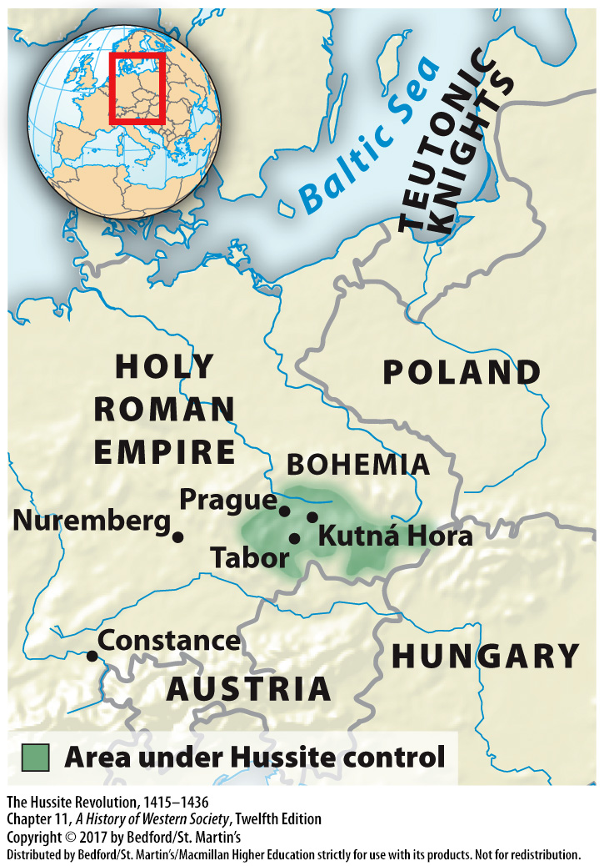

Slide 40
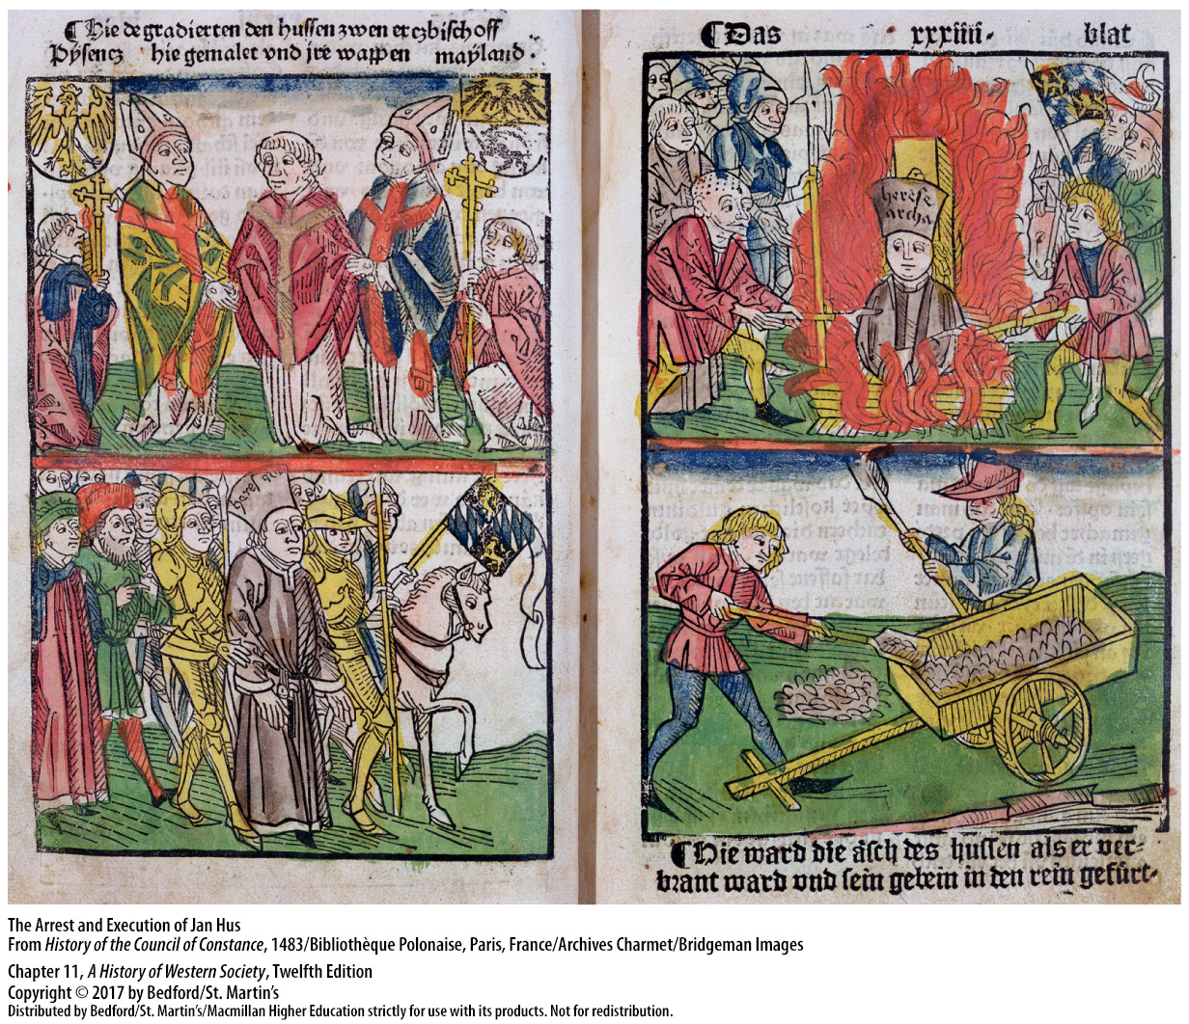

Slide 41
IV. Challenges to the Church
Lay Piety and Mysticism
Laypeople began to develop their own forms of piety
Lay Christians formed confraternities
Carried out devotional practices without a priest
Mostly men, some women’s confraternities formed
Brethren and Sisters of the Common Life
Thomas à Kempis, The Imitation of Christ
Only those who challenged the authority of the papacy were considered heretical
Notes:
IV. Challenges to the Church
C. Lay Piety and Mysticism
1. The failings of the Avignon papacy and the scandal of the Great Schism weakened the spiritual mystique of the clergy in the popular mind.
2. Lay Christian men and women often formed confraternities, voluntary lay groups organized by occupation, devotional preference, neighborhood, or charitable activity.
3. Some confraternities prayed for souls in purgatory, and others held dances, festivals, and collections to raise money for church repairs, supplies, and liturgical objects; all, however, often carried out their devotional practices without a priest.
4. Most confraternities were composed of men, but some women’s confraternities were formed, usually to oversee the production of vestments and altar cloths.
5. In Holland beginning in the late fourteenth century, a group of pious laypeople called the Brethren and Sisters of the Common Life lived in stark simplicity while daily carrying out the Gospel teaching of feeding the hungry, clothing the naked, and visiting the sick.
6. The Brethren’s goal of making religion a personal inner experience was best articulated by the Dutch monk Thomas à Kempis (1380?–1471) in The Imitation of Christ, which urged Christians to take Christ as their model, seek perfection in a simple way of life, and look to the Scriptures for guidance in living a spiritual life.
9. The confraternities and mystics were generally not considered heretical unless they began to challenge the authority of the papacy the way conciliarists such as Wyclif and Hus had. The movement of lay piety, however, altered many people’s perceptions of their own spiritual power.

Slide 42
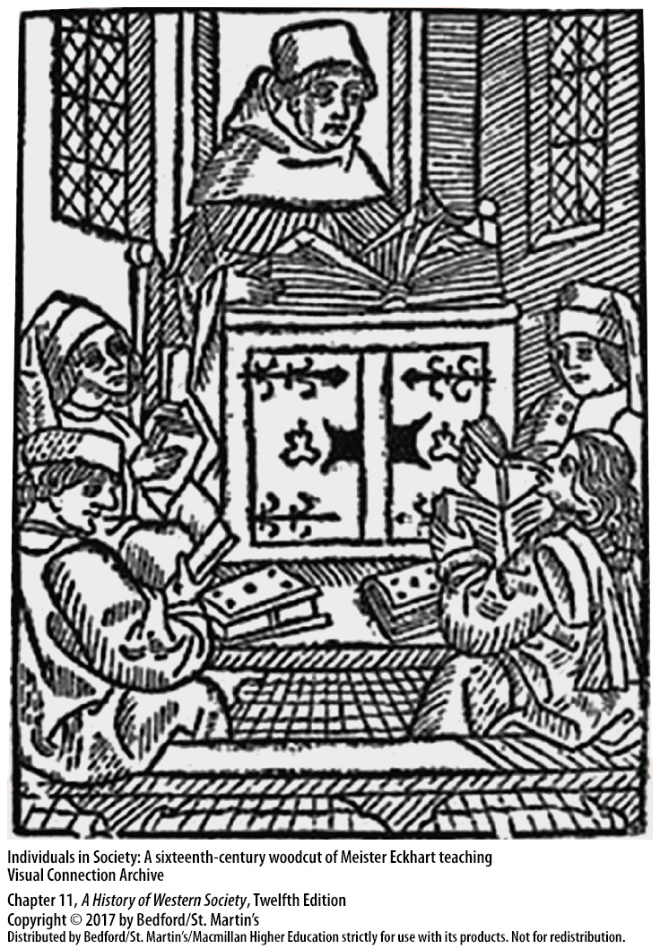

Slide 43
V. Social Unrest in a Changing Society
Peasant Revolts
Large-scale rebellion in Flanders (1320s)
The Jacquerie (1358)
The Statute of Laborers (1351)
The English Peasants’ Revolt
Richard II (r. 1377 – 1399)
Rural serfdom declined, disappearing in England by 1550
Notes:
V. Social Unrest in a Changing Society
Peasant Revolts
1. The difficult conditions of the fourteenth and fifteenth centuries spurred a wave of peasant revolts across Europe, the first of which was a large-scale rebellion in Flanders in the 1320s.
2. In 1358 the frustrations of French peasants over oppressive taxes, the criminal banditry of the countryside, losses on the battlefield, and their general misery exploded in a massive uprising called the Jacquerie, after a mythical agricultural laborer, Jacques Bonhomme (Good Fellow).
3. In England, when the Black Death drastically cut the labor supply, peasants demanded higher wages and fewer manorial obligations, to which their lords responded in 1351 with the Statute of Laborers, a law freezing wages and binding workers to their manors. The statute could not be enforced, and peasants’ economic grievances, along with the government’s lack of protection during the war, aristocratic violence, and agitation by the popular preacher John Ball, fueled a revolt.
4. In 1381, when the royal council reimposed a tax on all adult males, peasants revolted in a major uprising known as the English Peasants’ Revolt, involving thousands of people.
5. The boy-king Richard II (r. 1377–1399) met the leaders of the revolt, agreed to charters ensuring peasants’ freedom, tricked them with false promises, and then crushed the uprising with terrible ferocity.
6. The English Peasants’ Revolt did not bring social equality to England, but nobles were unsuccessful in their attempts to restore serfs’ labor obligations; thus, rural serfdom continued to decline, disappearing in England by 1550.

Slide 44
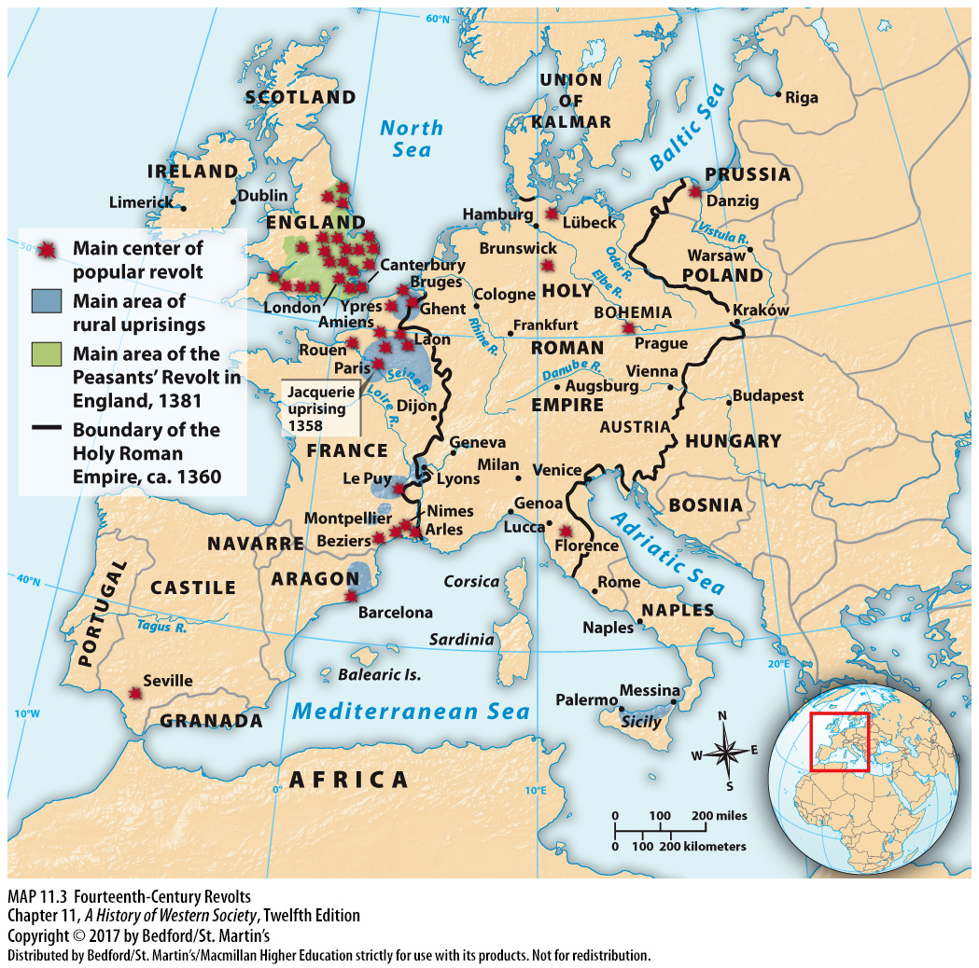

Slide 45
V. Social Unrest in a Changing Society
Urban Conflicts
New system made products on a larger scale
Shop masters earned enough so their families no longer had to work in the shop themselves
Decreased income and status for some artisans
Uprisings sparked over issues of honor
Skill and honor set journeymen apart
Guilds began to limit women’s participation
Notes:
V. Social Unrest in a Changing Society
B. Urban Conflicts
1. In the fourteenth century, a new system evolved to make products on a larger scale; in this system capitalist investors hired many households, with each household performing only one step of the process.
3. Some shop masters became so wealthy from the profits of their workers that they and their families no longer had to work in a shop themselves, though they still generally belonged to the craft guild.
4. While capitalism provided opportunities for some artisans to become investors and entrepreneurs, for many it led to a decrease in income and status.
5. Urban uprisings also were sparked by issues involving honor, such as employers’ requiring workers to do tasks they regarded as beneath them.
6. As their status and prospects declined, journeymen and poorer masters emphasized skill and honor as qualities that set them apart from less-skilled workers.
7. Guilds increasingly came to view the honor of their work as tied to an all-male workplace. In the fourteenth century, the amount of time that masters’ widows could operate a shop was limited, as was the number of daughters a master craftsman could employ, resulting in a decline in women’s participation in guilds.

Slide 46
V. Social Unrest in a Changing Society
Sex in the City
Later age of marriage for men and women
Steady market for prostitution
A social matter requiring public supervision
Brothels associated with achieving manhood
An urban phenomenon
Restrictions for brothel residents
Notes:
V. Social Unrest in a Changing Society
C. Sex in the City
1. Unlike in earlier time periods, a woman in late medieval northern and western Europe entered marriage as an adult in her twenties and took charge of running a household immediately, making her less dependent on her husband or mother-in-law.
2. Men of all social groups were older when they married; journeymen and apprentices often were explicitly prohibited from marrying, as were the students at universities.
3. Municipal authorities set up houses or districts either outside the city walls or away from respectable neighborhoods, as prostitution passed from being a private concern to a social matter requiring public supervision.
8. Young men associated visiting brothels with achieving manhood, though for the women themselves—many of whom had no choice—their activities were work.
4. Poor women—and men—also sold sex illegally, combining it with other sorts of part-time work such as laundering or sewing. Prostitution was an urban phenomenon because only populous towns had large numbers of unmarried young men, communities of transient merchants, and a culture accustomed to a cash exchange.
5. In the late fifteenth century, cities started to limit brothel residents’ freedom of movement and to require them to wear distinctive items; cities also began imposing harsher penalties on women who did not live in the designated house or section of town.

Slide 47
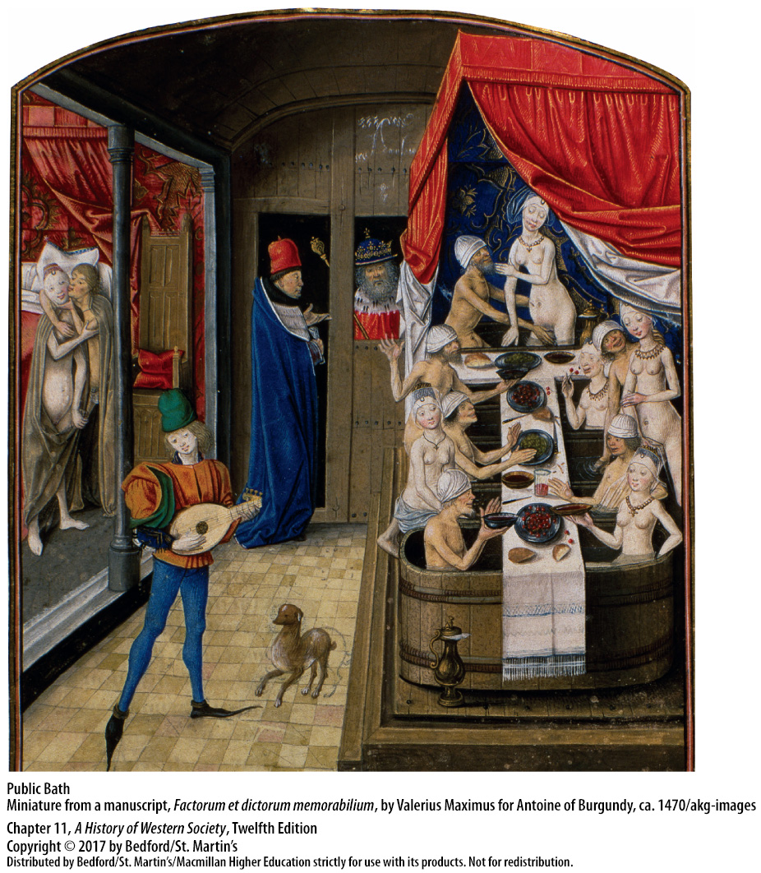

Slide 48
V. Social Unrest in a Changing Society
Sex in the City
7. Notions of female honor
8. Same-sex relations
9. The Office of the Night
10. Florentine social-sexual model
11. Sodomy not a marginal practice
12. Developed within all-male environments
13. Female same-sex relations often ignored by the authorities
Notes:
V. Social Unrest in a Changing Society
C. Sex in the City
7. Notions of female honor kept upper-class women secluded in their homes, but little effort was made to protect female servants or day laborers from seduction or rape.
8. Same-sex relations were another feature of medieval urban life, but they were of relatively little concern to church or state authorities until the late twelfth century when authorities began to define them as “crimes against nature” and made them a capital crime in most of Europe.
9. In Florence a special board of adult men, the Office of the Night, investigated about seventeen thousand men suspected of sodomy; most cases involved an adult man and an adolescent boy.
10. The Florentine social-sexual model identified the boy in the passive role as subordinate and dependent, while the dominant male was not considered to have compromised his masculinity.
11. A variety of accounts indicates that sodomy was not a marginal practice, which may explain why, despite harsh laws and special courts, actual executions for sodomy were rare.
12. Same-sex relations often developed within the context of all-male environments, such as the army or the craft shop, and were part of the collective male experience.
13. Same-sex relations involving women almost never came to the attention of legal authorities, although both female-female desire and male-male desire were expressed in songs, plays, and stories.

Slide 49
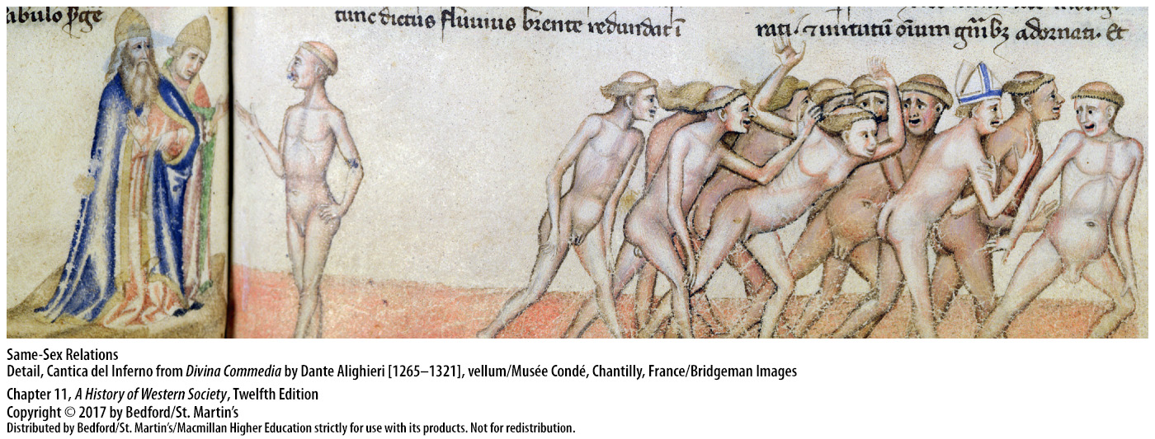

Slide 50
V. Social Unrest in a Changing Society
Fur-Collar Crime
Nobles’ incomes devalued with inflation
Noble bandits and “fur-collar crimes”
Corrupt landowners raised taxes and fees
Avoided punishment for their crimes
Legend of Robin Hood
Notes:
V. Social Unrest in a Changing Society
D. Fur-Collar Crime
1. Many were living on fixed incomes, which were devalued with inflation; because their chivalric code demanded lavish generosity and an aristocratic lifestyle, many turned to crime as a way of raising money.
2. Groups of noble bandits engaged in “fur-collar crimes,” roaming the English countryside and seizing wealthy travelers for ransom or demanding that peasants pay “protection money” to avoid having their hovels burned and their fields destroyed.
3. Corrupt landowners, including some churchmen, also pushed peasants to pay higher taxes and extra fees.
4. When accused of wrongdoing, fur-collar criminals intimidated witnesses, threatened jurors, and used their “pull” or cash to bribe judges.
5. The popularity of Robin Hood—a hero of folk legends that relate the adventures of the outlaw and his merry men as they avenge the common people against fur-collar criminals—symbolized the deep resentment of aristocratic corruption and abuse and represented the struggle against tyranny and oppression.

Slide 51
V. Social Unrest in a Changing Society
Ethnic Tensions and Restrictions
Migration and colonization
Legal dualism
Legal homogeneity and blood descent
Marriage laws: The Statue of Kilkenny (1366)
“Blood” differences to describe ethnic groups
Also religious, social, and racial differences
Notes:
V. Social Unrest in a Changing Society
E. Ethnic Tensions and Restrictions
1. Large numbers of people in the twelfth and thirteenth centuries migrated from one part of Europe to another in search of land, food, and work.
2. In the early periods of conquest and colonization, and in all regions with extensive migrations, a legal dualism existed: native peoples remained subject to their traditional laws, whereas newcomers brought and were subject to the laws of the countries from which they came.
3. The later Middle Ages witnessed a movement away from legal pluralism or dualism and toward legal homogeneity and an emphasis on blood descent.
4. Marriage laws were instituted that attempted to maintain ethnic purity by prohibiting intermarriage.
5. Late medieval chroniclers used words such as gens (race or clan) and natio (species, stock, or kind) to refer to different groups, and commentators increasingly described ethnic differences in terms of “blood.”
6. Religious beliefs also came to be conceptualized in terms of blood, with people regarded as having Jewish blood, Muslim blood, or Christian blood. Blood also came to be used as a way to talk about social differences, especially those of “noble blood” who were prohibited from marrying commoners in many parts of Europe.

Slide 52
V. Social Unrest in a Changing Society
Literacy and Vernacular Literature
Increasing use of the vernacular over Latin
Dante Alighieri’s Divine Comedy (1310 – 1320)
Scholastic philosophy; uniting faith and reason
Embodies the tensions of the age
Geoffrey Chaucer, Canterbury Tales (1387 – 1400)
Panorama of English social life
Notes:
V. Social Unrest in a Changing Society
F. Literacy and Vernacular Literature
1. A more positive effect of the development of ethnic identities was the increasing use of the vernacular rather than Latin. Two masterpieces of European culture, Dante Alighieri’s Divine Comedy (1310–1320) and Geoffrey Chaucer’s Canterbury Tales (1387–1400), illustrate a sophisticated use of the rhythms and rhymes of the vernacular.
3. The Divine Comedy is an epic poem of one hundred cantos (verses) that describes the realms of the next world: Hell, Purgatory, and Paradise. The Divine Comedy portrays contemporary and historical figures, comments on secular and ecclesiastical affairs, and draws on the Scholastic philosophy of uniting faith and reason.
4. This poem embodies the tensions of the age; profoundly Christian, it also contains criticisms of church authorities, and although it perpetuates the classical tradition, it is the first major work of literature in the Italian vernacular.
5. Chaucer’s Canterbury Tales is a collection of stories in lengthy rhymed narrative built around a pilgrimage made by thirty people of various social backgrounds to Saint Thomas Becket’s shrine at Canterbury.
6. The Canterbury Tales presents a rich panorama of English social life in the fourteenth century and, like the Divine Comedy, reflects the cultural tensions of the times; many of the pilgrims also are materialistic, sensual, and worldly.

Slide 53
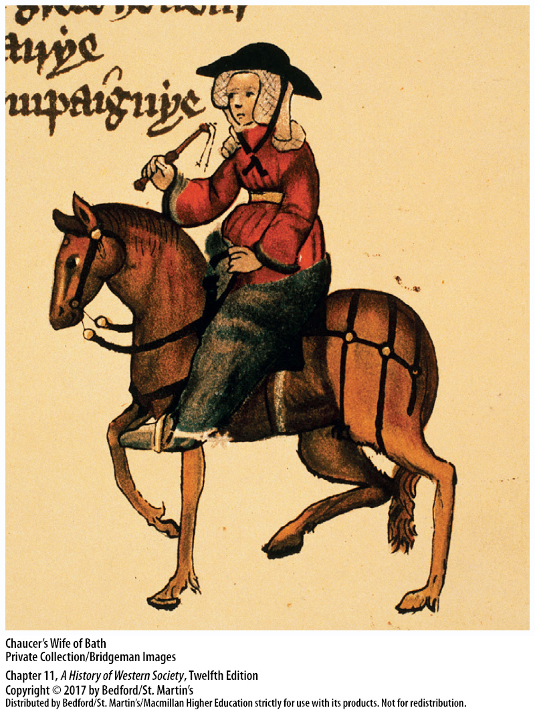

Slide 54
V. Social Unrest in a Changing Society
Literacy and Vernacular Literature
Increasing literacy of laypeople
Number of schools increased
Need to read administrative and financial records
Upper-class daughters sent to convent schools
Trade, commerce, and expanding government bureaucracies required more literate people
Notes:
V. Social Unrest in a Changing Society
F. Literacy and Vernacular Literature
5. A variety of evidence, including wills and inventories, attests to the increasing literacy of laypeople in the fourteenth century.
6. In England the number of schools in the diocese of York quadrupled between 1350 and 1500, with similar patterns seen in Flemish and German towns.
7. Laymen increasingly served as managers or stewards of estates and as clerks to guilds and town governments; such positions obviously required that they be able to keep administrative and financial records.
8. With growing frequency, the upper classes sent their daughters to convent schools, where they gained the rudiments of reading and sometimes writing.
9. Trade, commerce, and expanding government bureaucracies required an increasing number of literate people.

