Slide 1
The
Hundred
Years' War
(1347-1453)

Slide 2
Causes
of the
100 Years' War

Slide 3
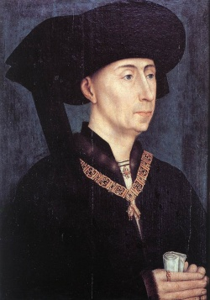
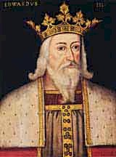
1. Controversy Over Succession
The French nobility selected Philip of Valois, a cousin of the last king through the male line.
He founded a new French dynasty that ruled through the 16c.
He was chosen in preference to King Edward III of England, whose mother was the daughter of the late king, Philip IV.
In 1340, Edward claimed the title “King of France.”

Slide 4
2. Fr. Land Belonging to Br. Kings
A longer standing issue was the status of lands within France that belonged to English kings.
Edward was actually a vassal of Philip’s, holding sizable French territories as fiefs from the king of France [it went back to the Norman conquest].

Slide 5
3. Conflict Over Flanders
The ‘dagger’ pointing at the ‘heart’ of England!
Wool industry.
Flanders wants its independence from French control.
Asks England for help.

Slide 6
4. A Struggle for National Identity
France was NOT a united country before the war began.
The French king only controlled about half of the country.

Slide 7
The
War
Itself

Slide 8
Military Characteristics
The War was a series of short raids and expeditions punctuated by a few major battles, marked off by truces or ineffective treaties.
The relative strengths of each country dictated the sporadic nature of the struggle.

Slide 9
French Advantages
Population of about 16,000,000.
Far richer and more populous than England.
At one point, the French fielded an army of over 50,000 → at most, Britain mustered only 32,000.

Slide 10
British Advantages
Weapons Technologies.
In almost every engagement, the English were outnumbered.
Britain’s most successful strategies:
Avoid pitched battles.
Engage in quick, profitable raids
Steal what you can.
Destroy everything else.
Capture enemy knights to hold for ransom.

Slide 11
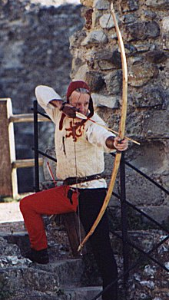
The Longbow as a Weapon
The use of the English defensive position was the use of the longbow.
Its arrows had more penetrating power than a bolt from a crossbow.
Could pierce an inch of wood or the armor of a knight at 200 yards!
A longbow could be fired more rapidly.
6 arrows per minute.

Slide 12
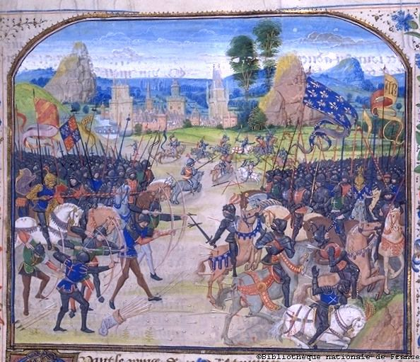
The British Longbow: The Battle of Poitiers, 1356

Slide 13
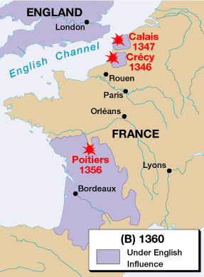
Early English Victories

Slide 14
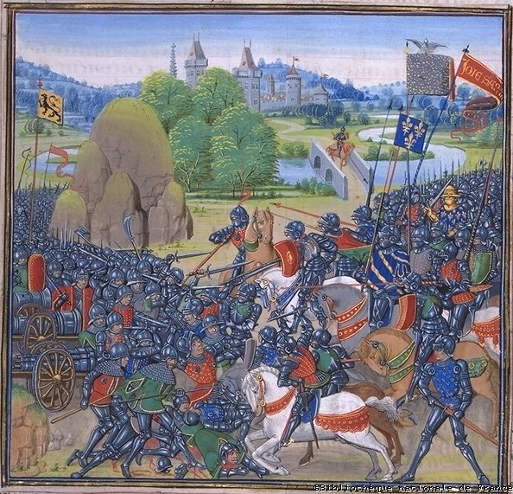
The Effective Use of the Cannon at Poitiers, 1356

Slide 15
French Confusion
The English captured the French king, John II [r.1350-1364].
France was now ruled by the Estates General
A representative council of townspeople and nobles.
Created in 1355.
Purpose → to secure funds for the war.
In theory, the French king could not levy taxes on his own!!

Slide 16
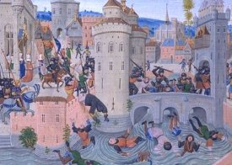
The Jacquerie, 1358
In the confusion and unrest following the French disaster at Poitiers, this rural movement began.
It was a response to the longstanding economic and political grievances in the countryside worsened by warfare.
The rebels were defeated by aristocratic armies.

Slide 17
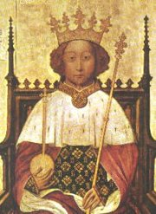
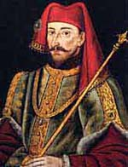
Trouble in England
Peasant Revolt in 1381 was put down by King Richard II [r. 1377-1399].
After charges of tyranny, Richard II was forced to abdicate in 1300.
Parliament elected Henry IV [r. 1399-1413], the first ruler from the House of Lancaster.
Henry avoided war taxes.
He was careful not to alienate the nobility.
Therefore, a truce was signed ending French and British hostilities [for the time being, at least].

Slide 18
King Henry V (r. 1412-1422)
Renewed his family’s claim to the French throne.
At Agincourt in 1415, the English, led by Henry himself, goaded a larger French army into attacking a fortified English position.
With the aid of the Dukes of Burgundy, Henry gained control over Normandy, Paris, and much of northern France!

Slide 19
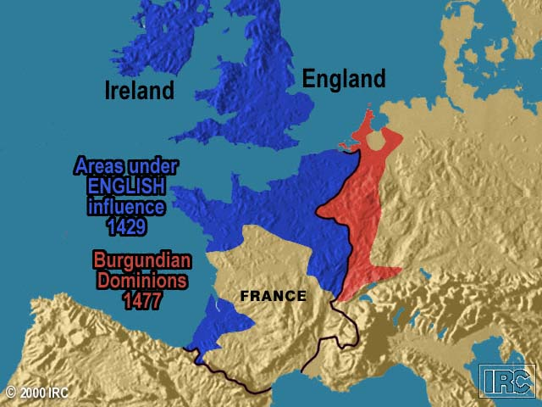
A Burgundian Presence

Slide 20
Treaty of Troyes (1420)
Charles VI’s son [the future Charles VII], was declared illegitimate and disinherited.
Henry V married Catherine, the daughter of Charles VI.
Henry was declared the legitimate heir to the French throne!
A final English victory seemed assured, but both Charles VI and Henry V died in 1422.
This left Henry’s infant son, Henry VI [r. 1422-1461], to inherit BOTH thrones.

Slide 21
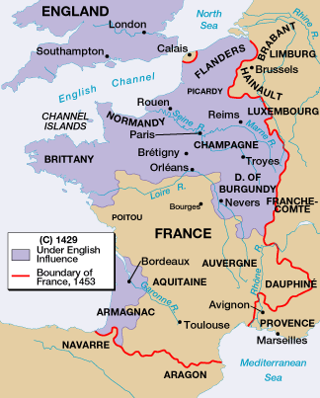
Height of English Dominance

Slide 22
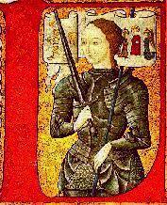
The French “Reconquest”
The two kings’ deaths ushered in the final stage of the 100 Years’ War [1422-1453].
Even though in 1428 the military and political power seemed firmly in British hands, the French reversed the situation.
In 1429, with the aid of the mysterious Joan of Arc, the French king, Charles VII, was able to raise the English siege of Orleans.
This began the reconquest of the north of France.

Slide 23
Joan of Arc (1412-1432)
The daughter of prosperous peasants from an area of Burgundy that had suffered under the English.
Like many medieval mystics, she reported regular visions of divine revelation.
Her “voices” told her to go to the king and assist him in driving out the English.
She dressed like a man and was Charles’ most charismatic and feared military leader!

Slide 24
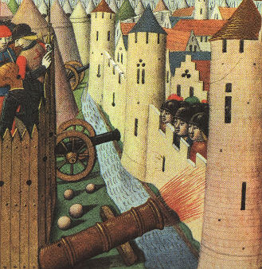
Cannons Used at Orleons

Slide 25
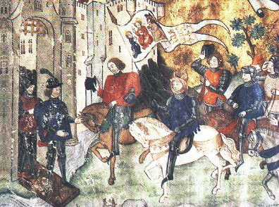
Joan Announces the Capture of Orleans to the King

Slide 26
Joan of Arc (1412-1432)
She brought inspiration and a sense of national identity and self-confidence.
With her aid, the king was crowned at Reims [ending the “disinheritance”].
She was captured during an attack on Paris and fell into English hands.
Because of her “unnatural dress” and claim to divine guidance, she was condemned and burned as a heretic in 1432.
She instantly became a symbol of French resistance.

Slide 27
Joan as a “Feminist” Symbol Today?

Slide 28
The End of the War
Despite Joan’s capture, the French advance continued.
By 1450 the English had lost all their major centers except Calais.
In 1453 the French armies captured an English-held fortress.
This was the last battle of the war.
There was not a treaty, only a cessation of hostilities.

Slide 29
France Becomes Unified!
France in 1453
France in 1337

